Slide 1
Trento PTC Fibre Beam Profile Measurement Comparisons with Film
Joe Bateman
University College London

Slide 2
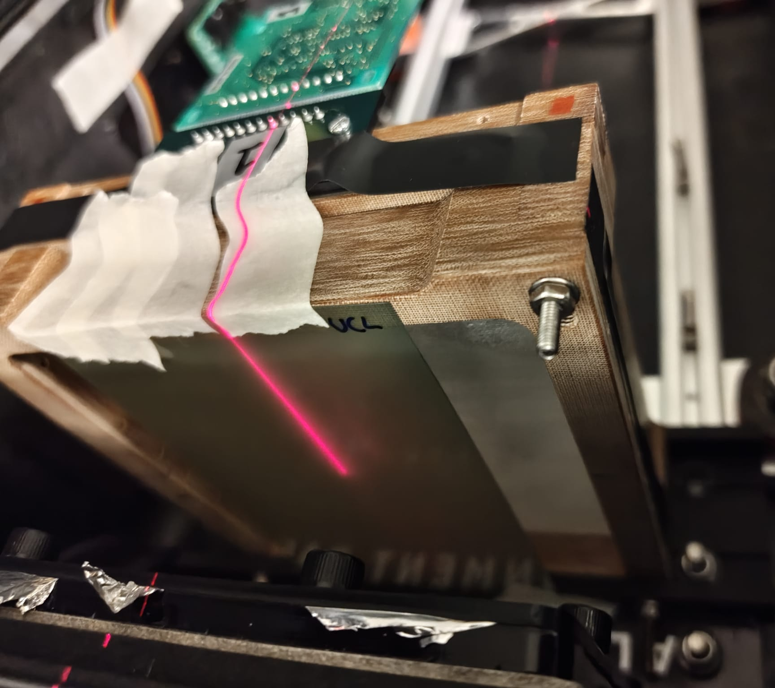
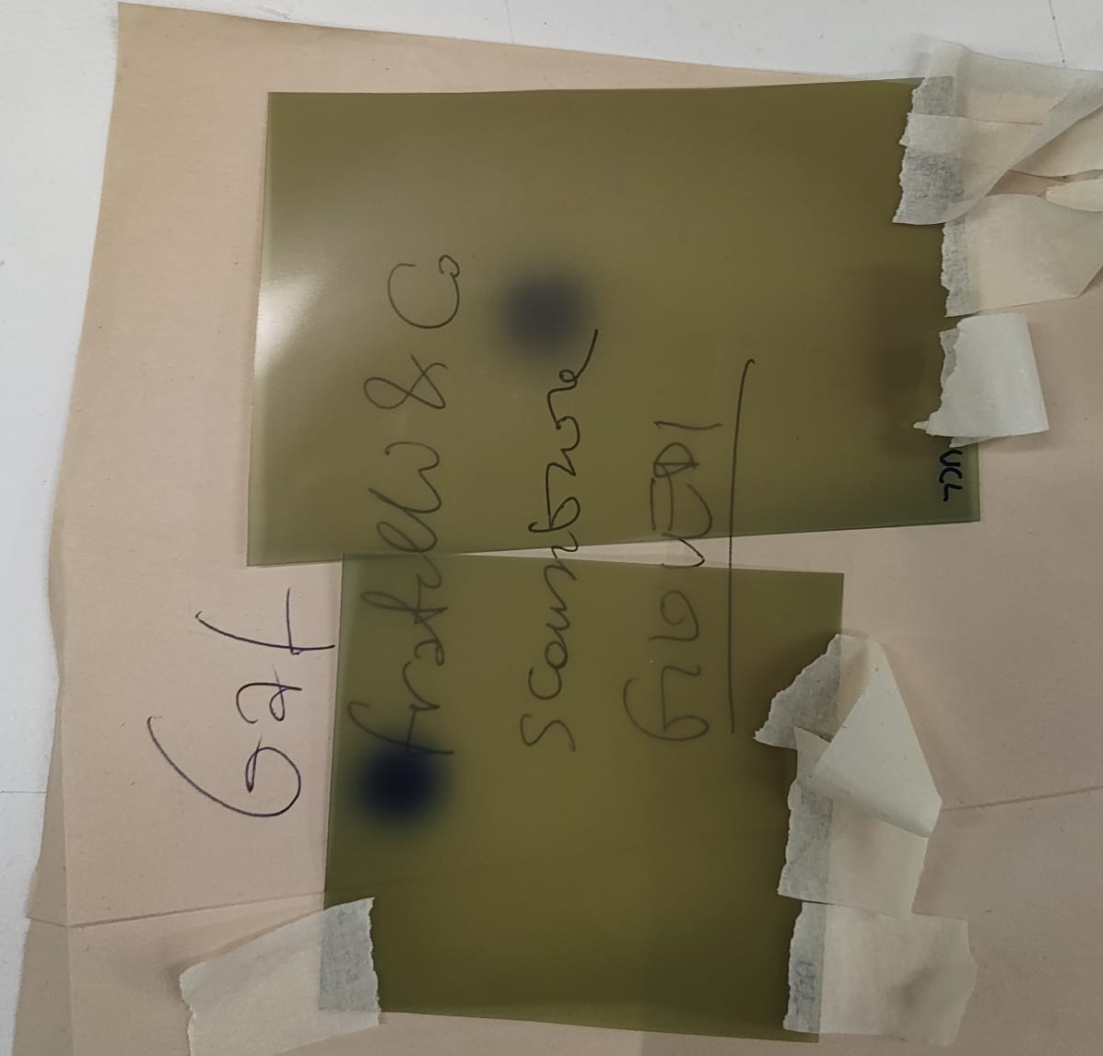
Overview and Setup
2 measurements performed at end of night 3 at Trento to compare beam size measured on radiochromic film to that by the fibre arrays (with the photodidoides in high gain mode).
Radiochromic film attached directly in front of first fibre array (Y array).
Measurements at 228 MeV and 148 MeV.

Slide 3
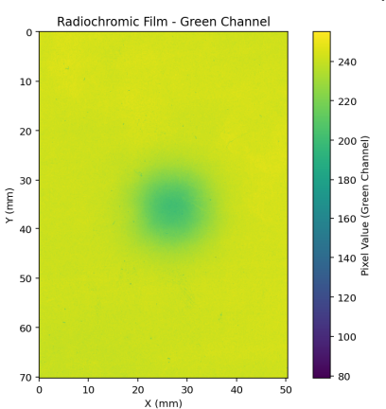
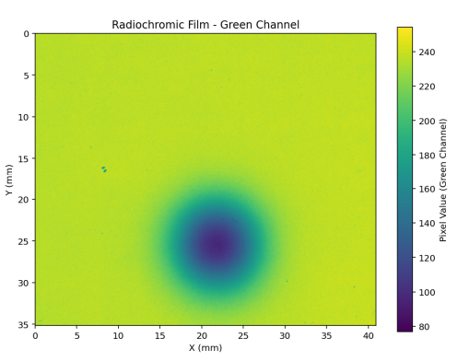
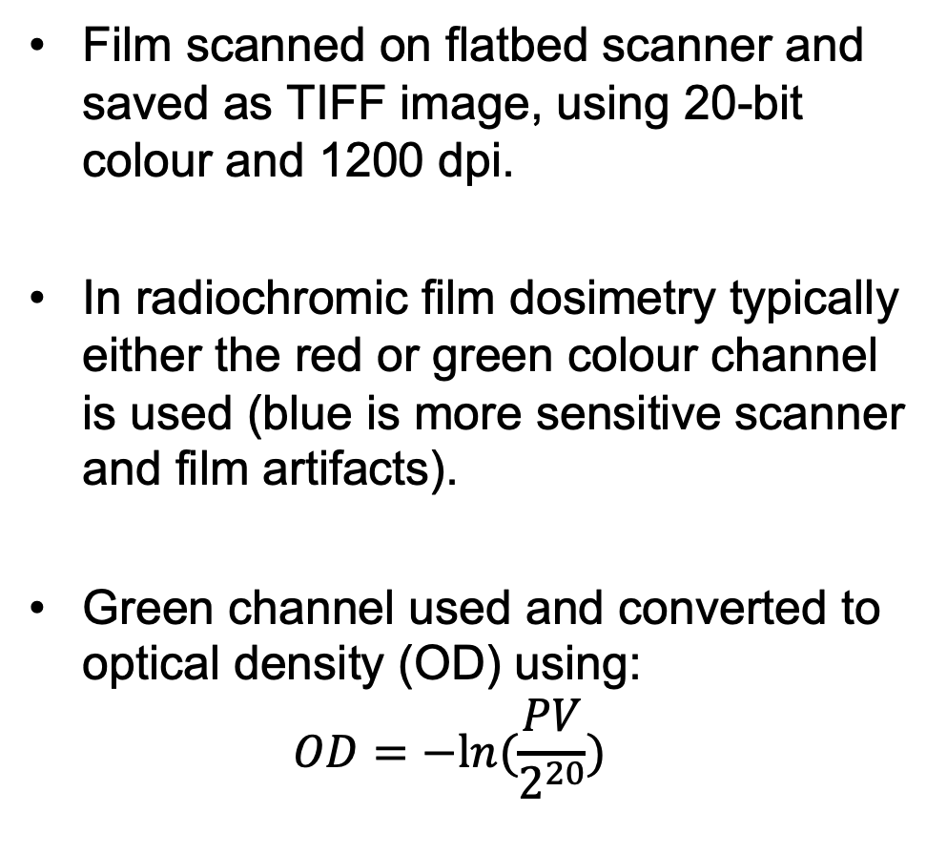
Radiochromic Film
Film scanned on flatbed scanner and saved as TIFF image, using 20-bit colour and 1200 dpi.
In radiochromic film dosimetry typically either the red or green colour channel is used (blue is more sensitive scanner and film artifacts).
Green channel used and converted to optical density (OD) using:
$OD=−ln(\frac{PV}{2^{20}})$
148 MeV
10 nA ion source current
10s acquisition
228 MeV
7 nA ion source current
5s acquisition

Slide 4
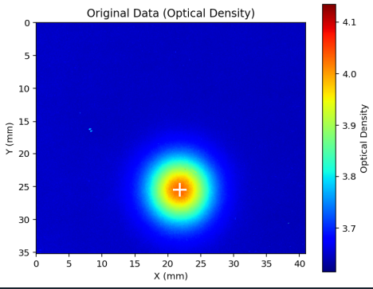
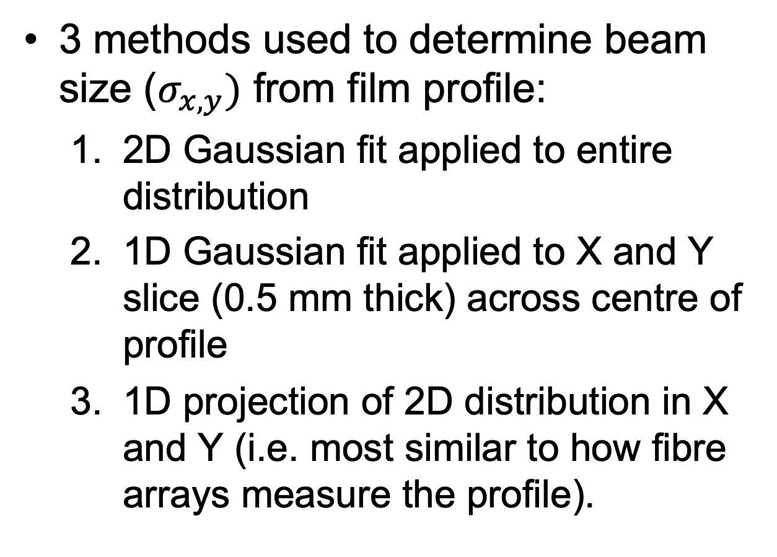
Gaussian Fitting
3 methods used to determine beam size ($σ_{x,y})$ from film profile:
  2D Gaussian fit applied to entire distribution
  1D Gaussian fit applied to X and Y slice (0.5 mm thick) across centre of profile
  1D projection of 2D distribution in X and Y (i.e. most similar to how fibre arrays measure the profile).

Slide 5
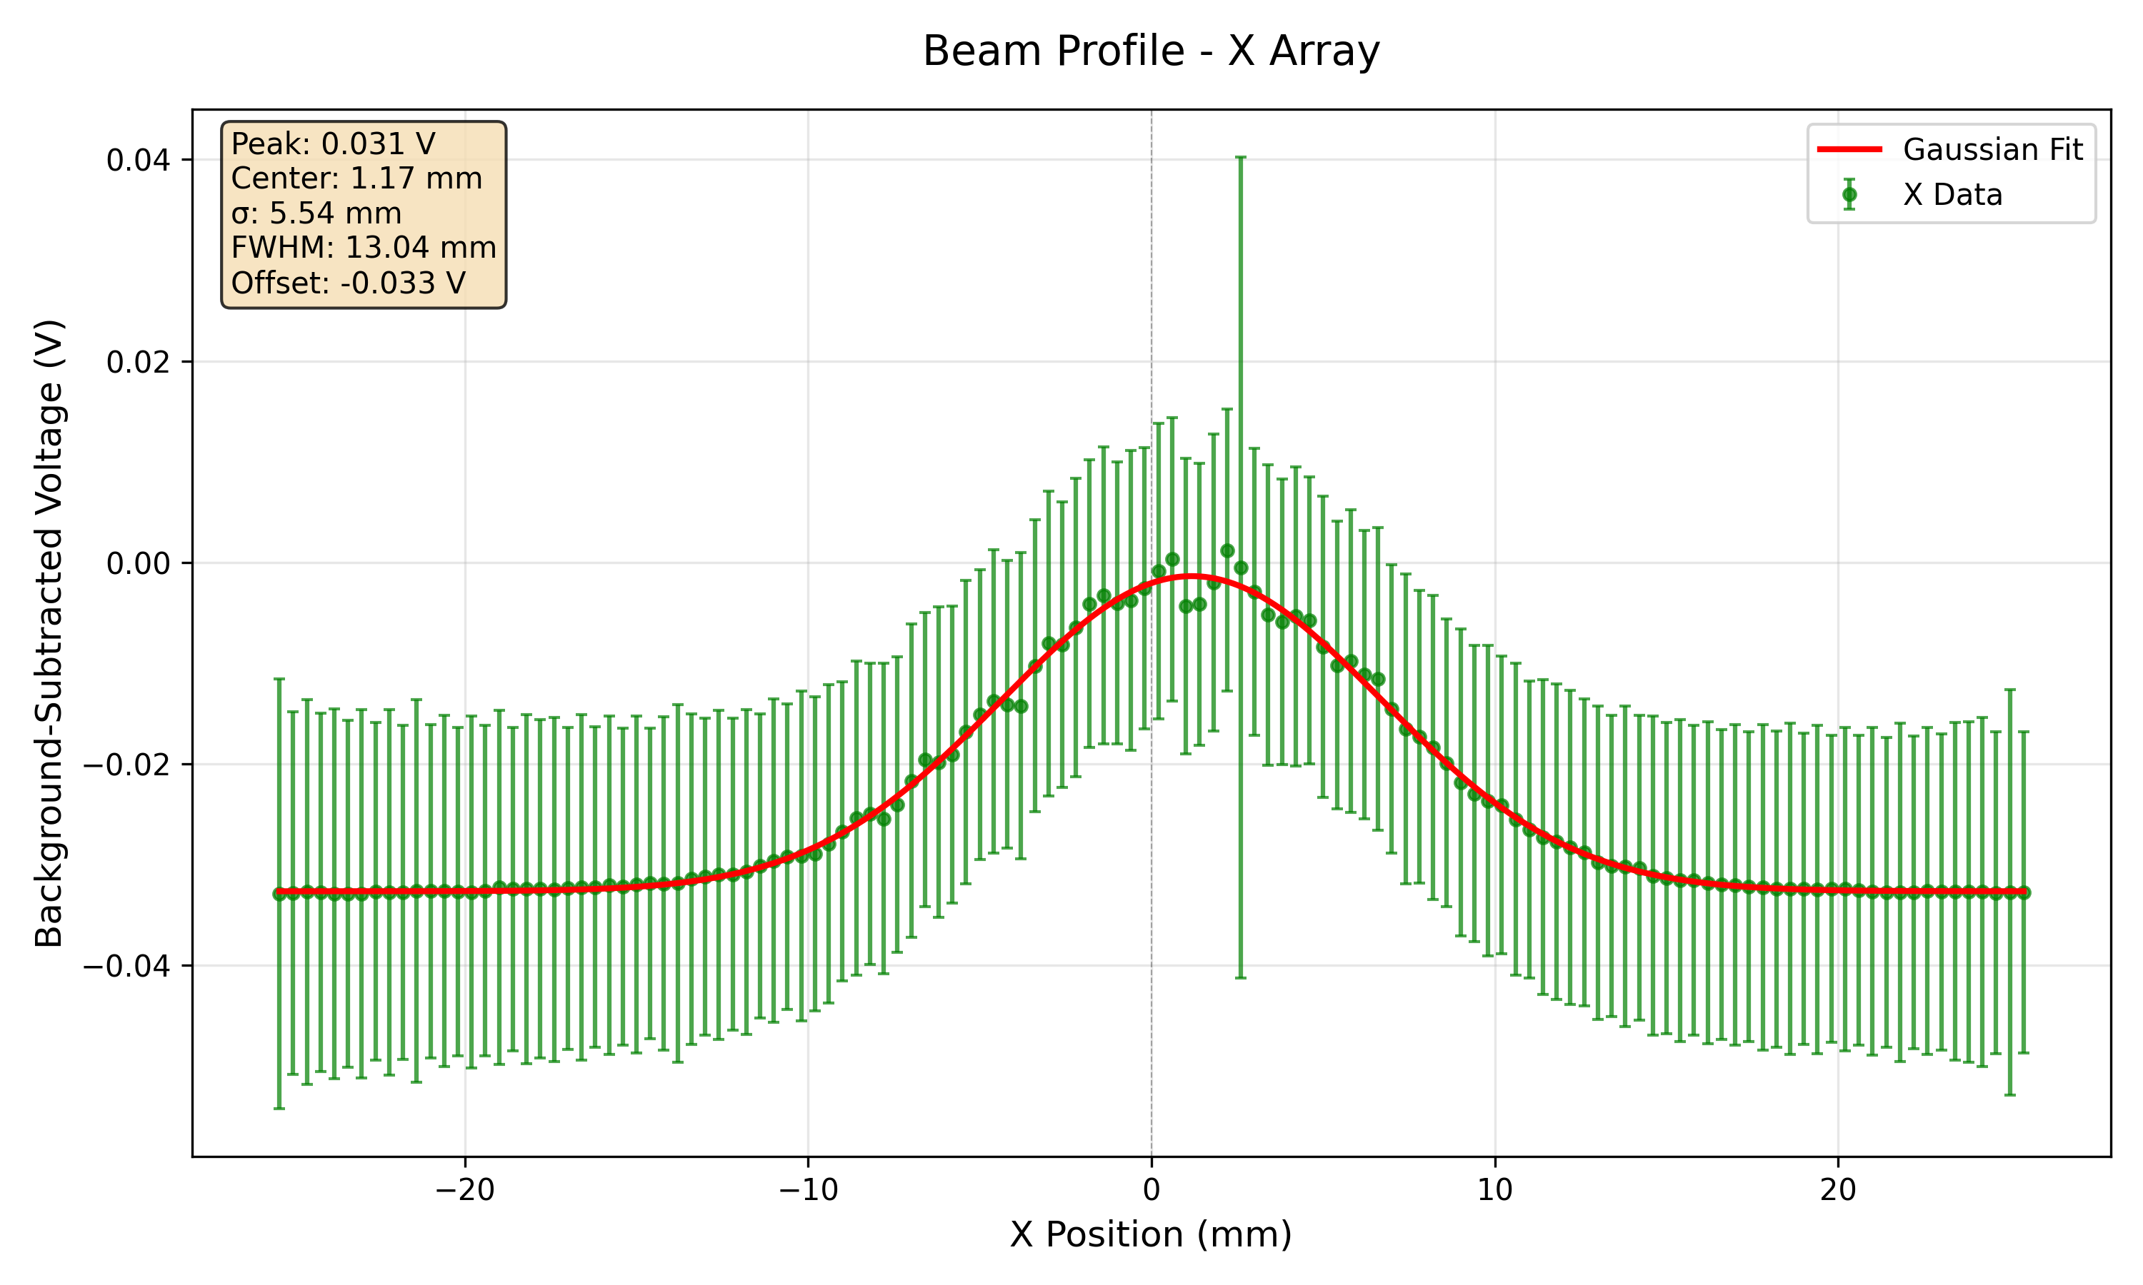
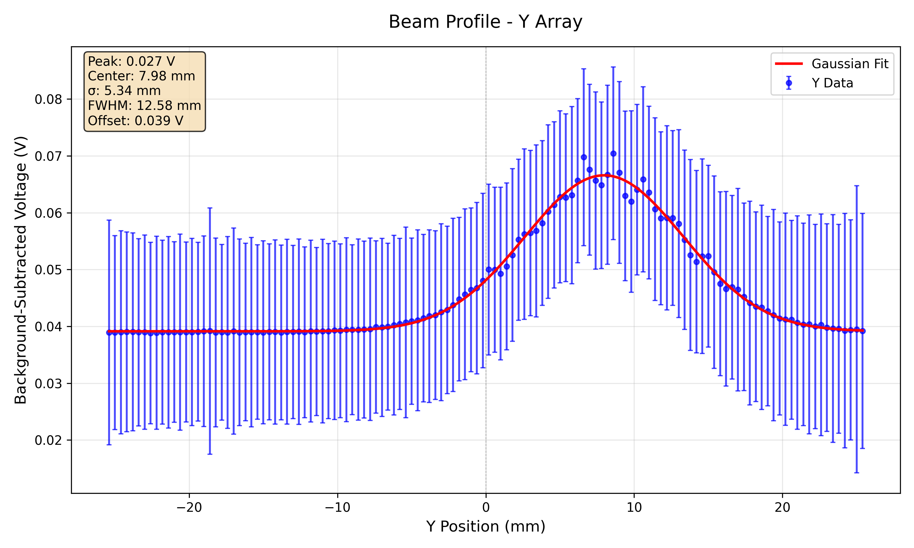
148 MeV 10 nA 10s – Fibre Array

Slide 6
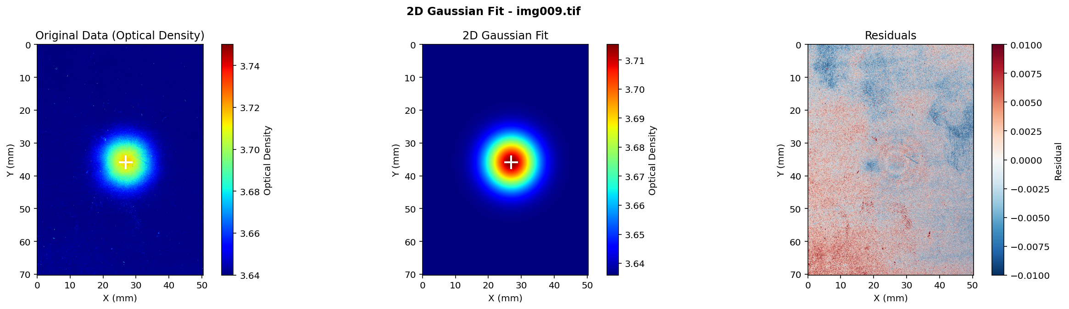
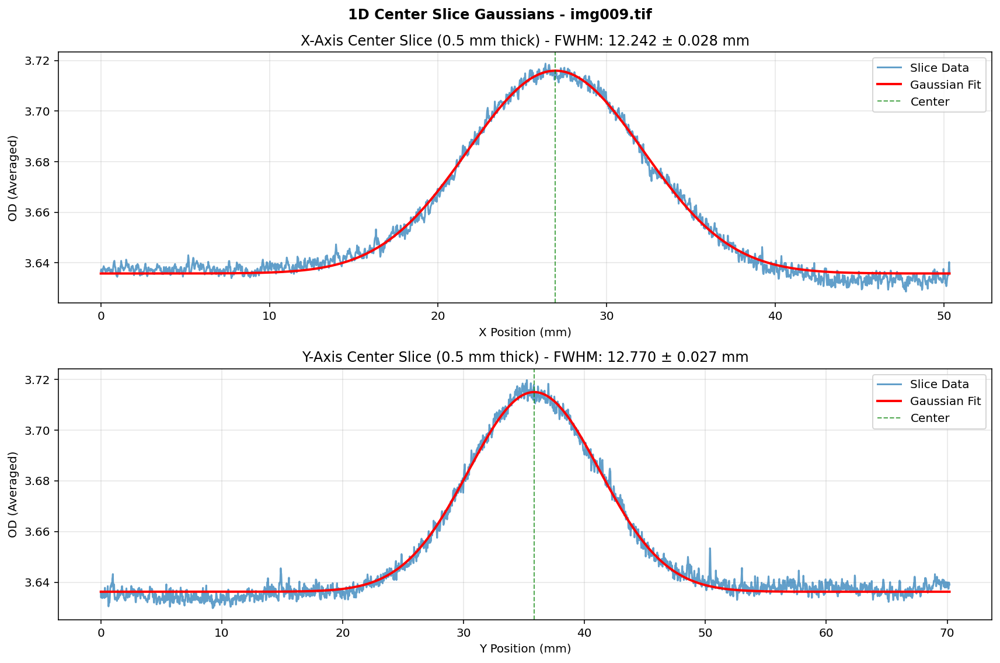
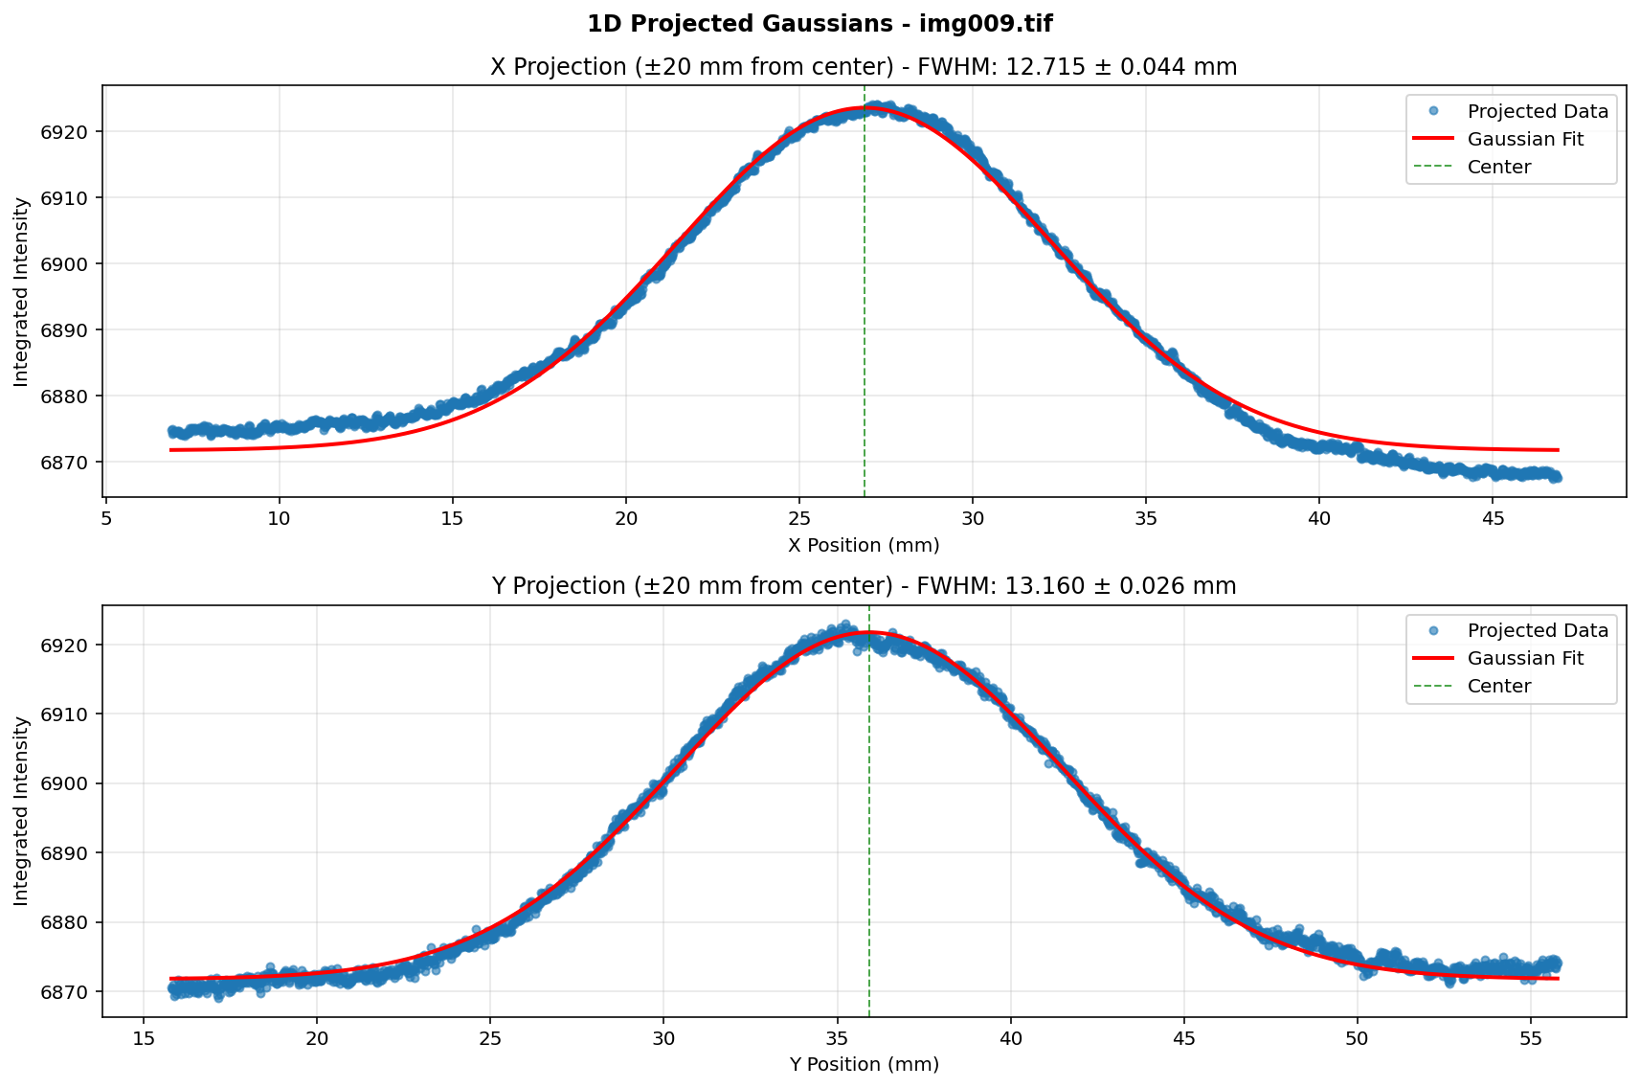
148 MeV 10 nA 10s – Film

Slide 7
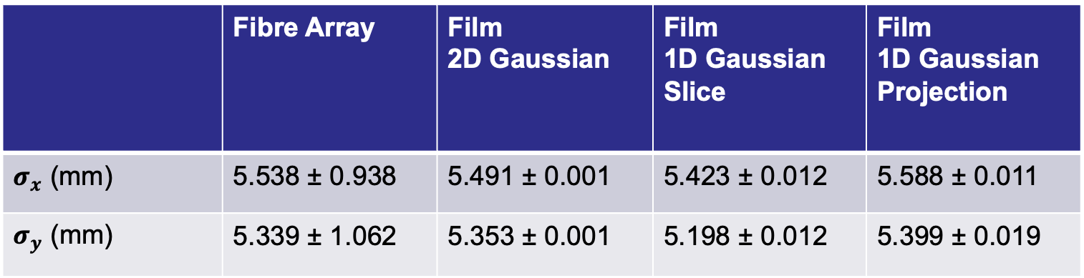
148 MeV Gaussian Fit Parameters
 | Fibre Array | Film 2D Gaussian | Film 1D Gaussian Slice | Film 1D Gaussian Projection
$σ_{x}$ (mm) | 5.538 ± 0.938 | 5.491 ± 0.001 | 5.423 ± 0.012 | 5.588 ± 0.011
$σ_{y}$ (mm) | 5.339 ± 1.062 | 5.353 ± 0.001 | 5.198 ± 0.012 | 5.399 ± 0.019

Slide 8
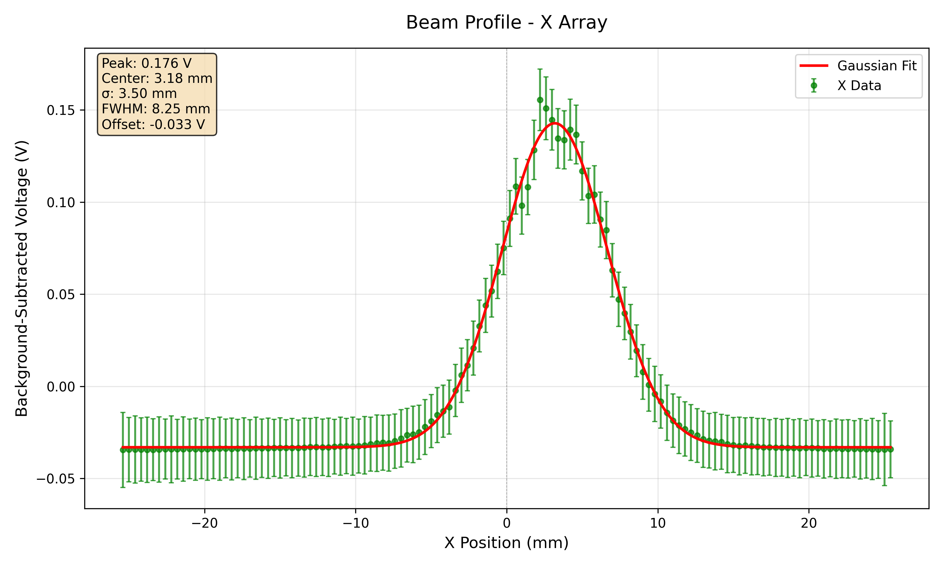
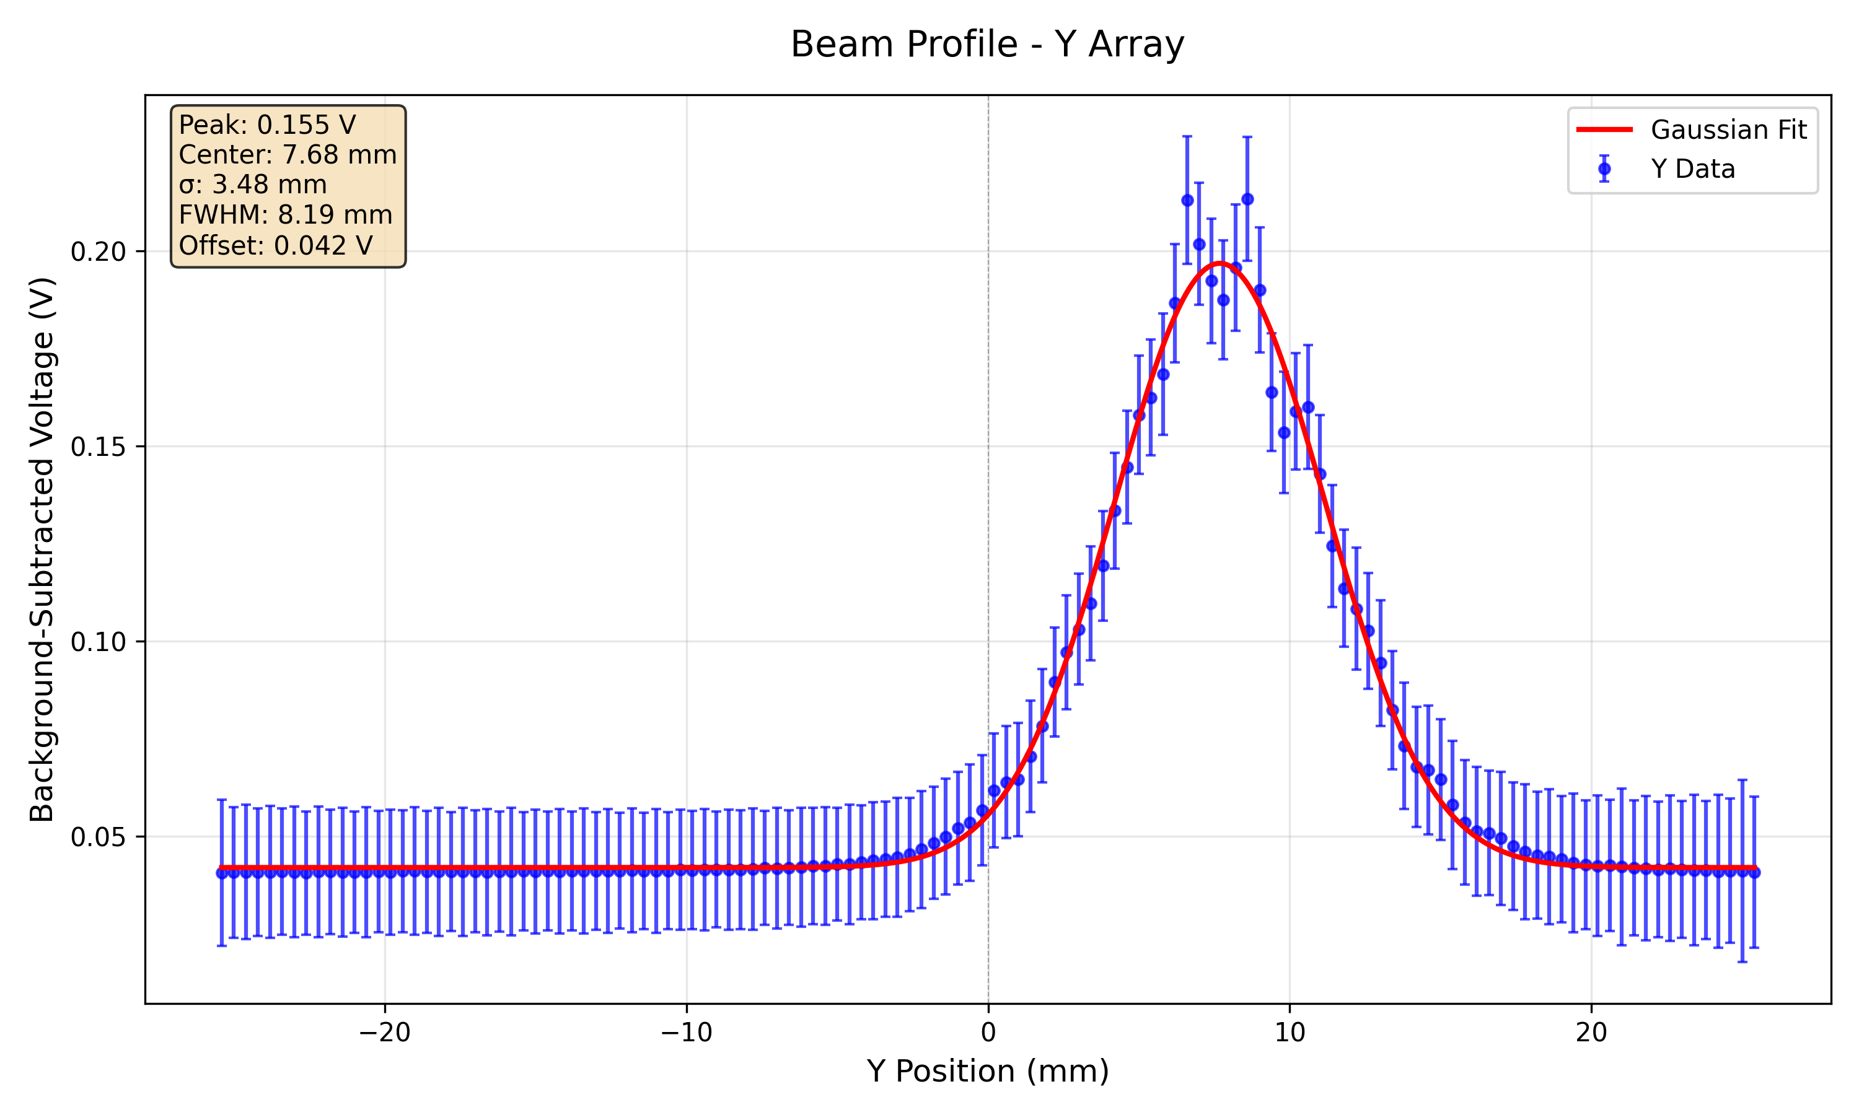
228 MeV 7nA 5s – Fibre Array

Slide 9
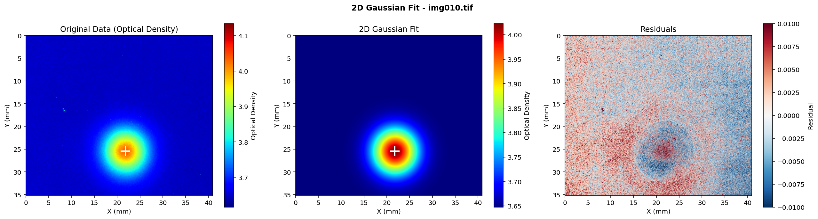
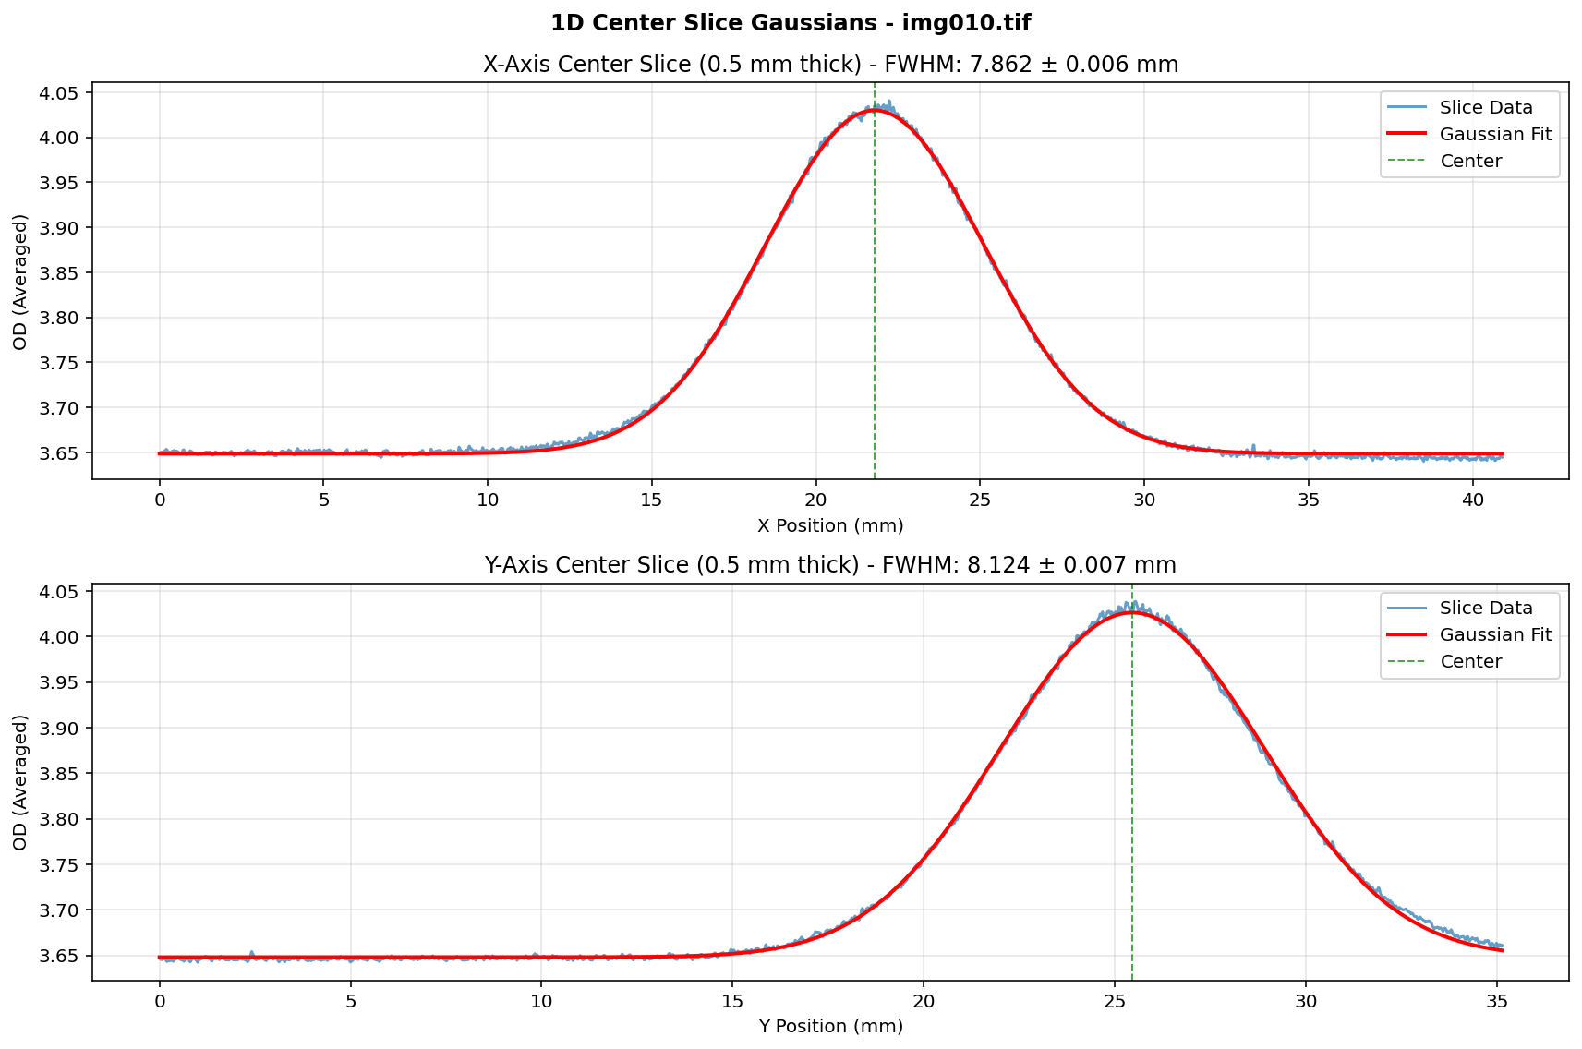
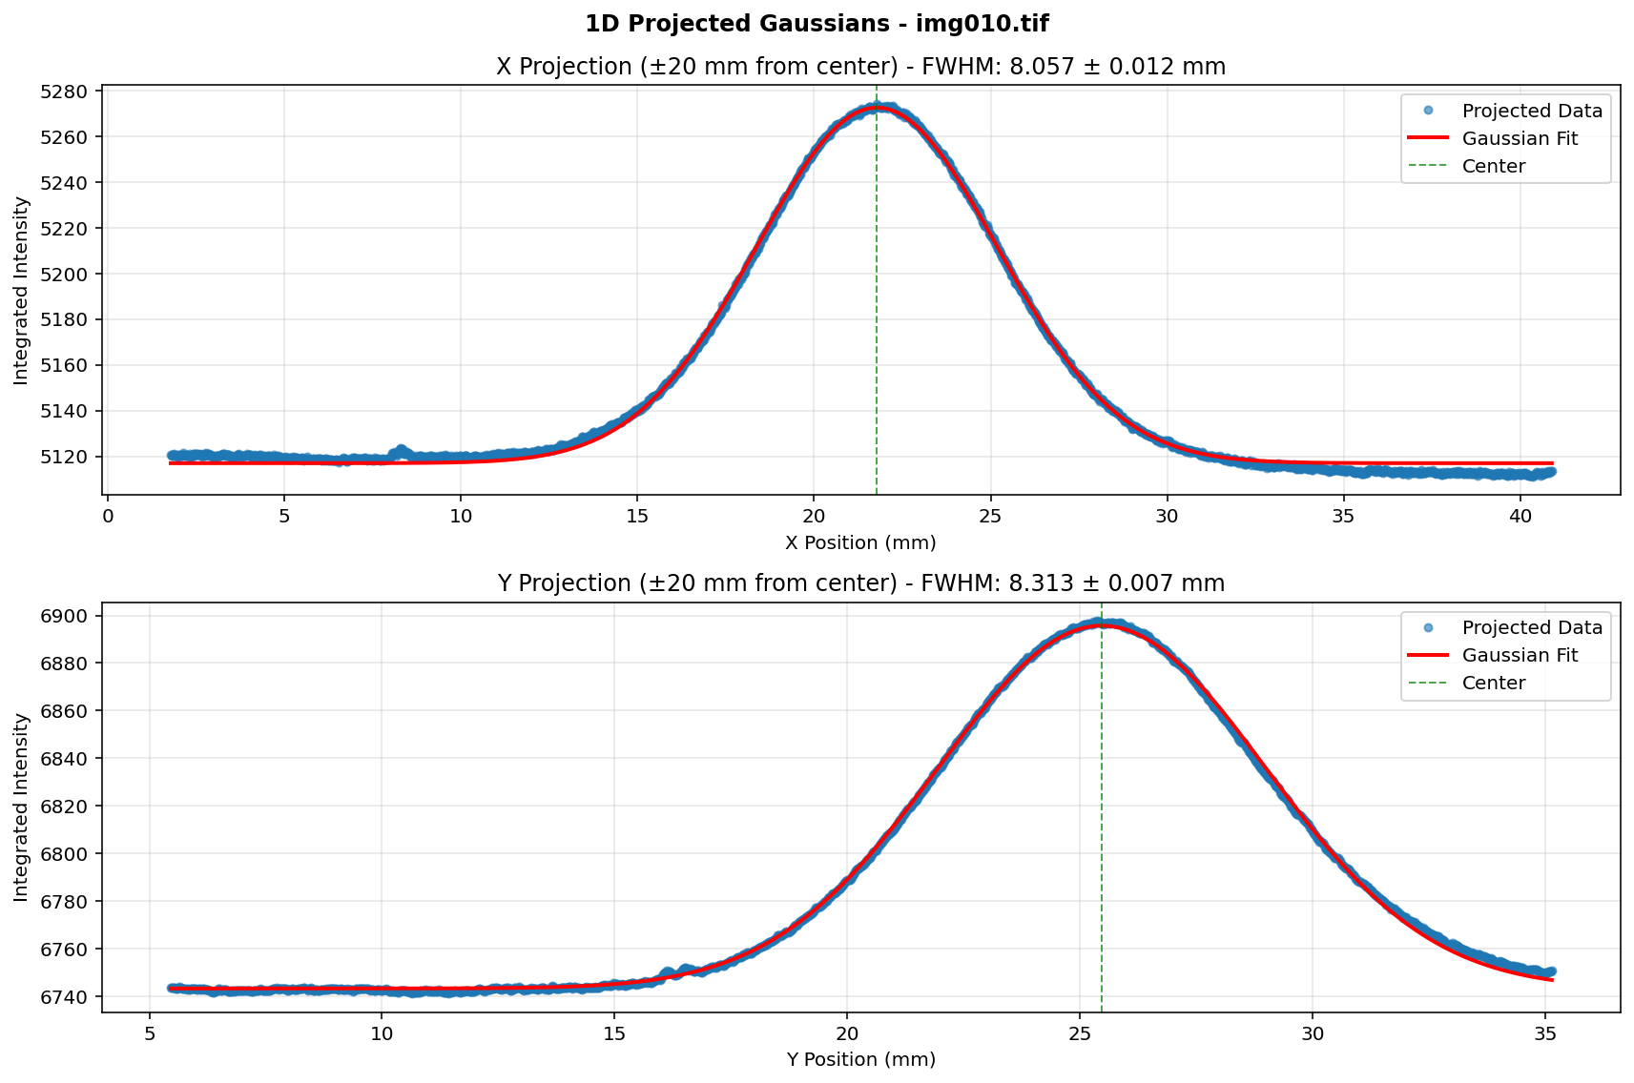
228 MeV 7nA 5s - Film

Slide 10
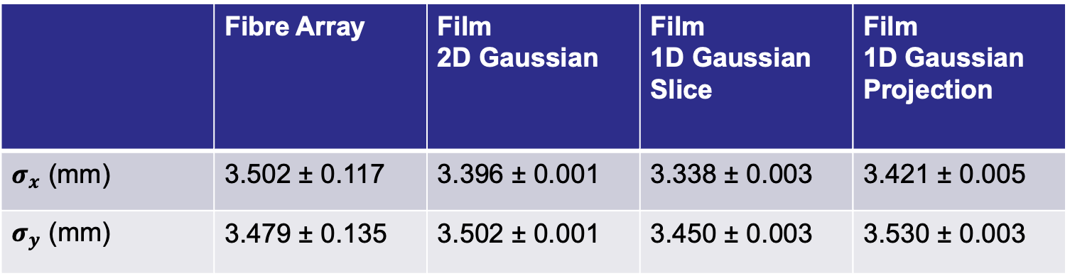
228 MeV Gaussian Fit Parameters
 | Fibre Array | Film 2D Gaussian | Film 1D Gaussian Slice | Film 1D Gaussian Projection
$σ_{x}$ (mm) | 3.502 ± 0.117 | 3.396 ± 0.001 | 3.338 ± 0.003 | 3.421 ± 0.005
$σ_{y}$ (mm) | 3.479 ± 0.135 | 3.502 ± 0.001 | 3.450 ± 0.003 | 3.530 ± 0.003

Slide 11
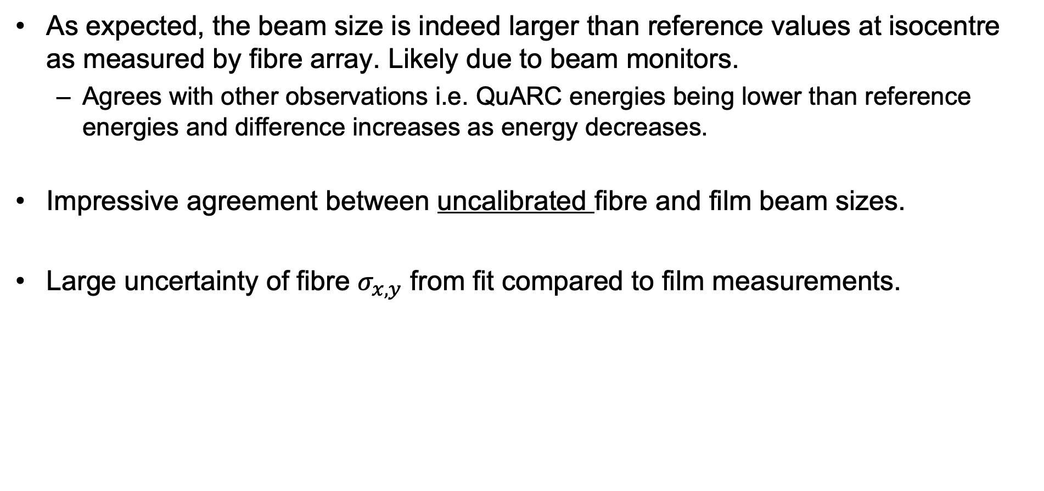
Observations and Summary
As expected, the beam size is indeed larger than reference values at isocentre as measured by fibre array. Likely due to beam monitors.
  Agrees with other observations i.e. QuARC energies being lower than reference energies and difference increases as energy decreases.
Impressive agreement between uncalibrated fibre and film beam sizes.
Large uncertainty of fibre $σ_{x,y}$ from fit compared to film measurements.

