Slide 1
PBT Meeting 19/8/25 SciFi array readout
Joe Bateman
University College London

Slide 2
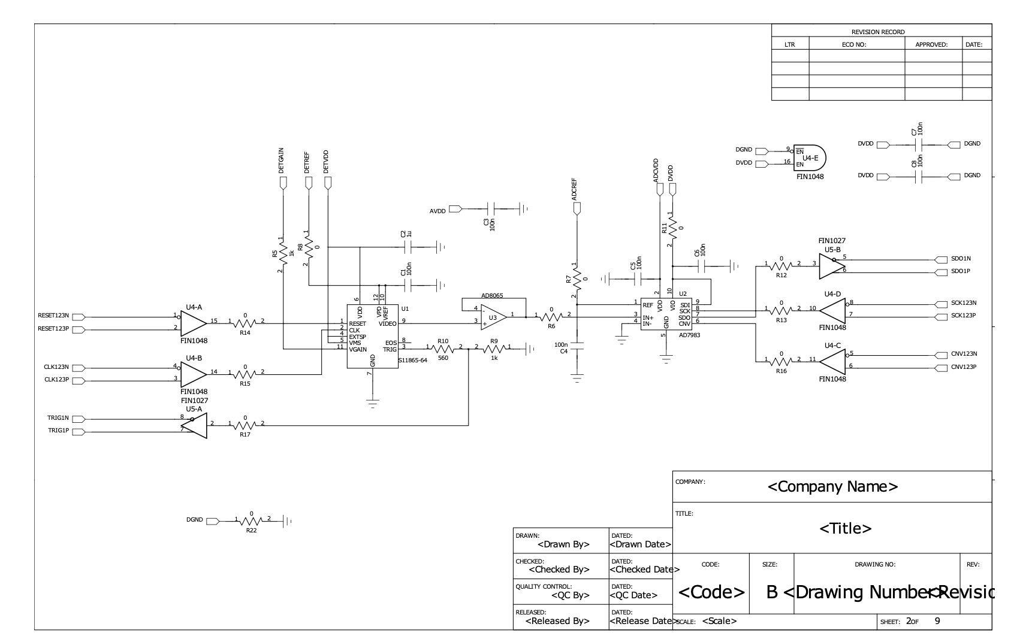
Heidelberg Signal Flow
Signal | Name | Direction | Quantity
Trigger Outputs | sensor_trig[0-4] | PD array -> FPGA | 5 diff. pairs
ADC Data | adc_sdo[0-4] | ADC -> FPGA | 5 diff. pairs
Sensor clock | sensor_clk[0] (arrays 1,2,3) sensor_clk[1] (arrays 4,5) | FPGA -> PD array | 2 diff. pairs
Sensor reset | sensor_reset[0] (arrays 1,2,3) sensor_reset[1] (arrays 4,5) | FPGA -> PD array | 2 diff. pairs
ADC Convert | adc_cnv[0] (arrays 1,2,3) adc_cnv[1] (arrays 4,5) | FPGA -> ADC | 2 diff. pairs
ADC Clock | adc_sck[0] (arrays 1,2,3) adc_sck[1] (arrays 4,5) | FPGA -> ADC | 2 diff. pairs
Gain Control | sensor_gainp sensor_gainn | FPGA -> ADC | 2 single ended

Slide 3
Additional HSMC Pin Assignments
link_tx[0-3]: 4 differential pairs for data transmission
link_rx[0-3]: 4 differential pairs for data reception
link_dir[0-3]: 4 differential pairs for link direction control

Slide 4
HSMC Pin Assignments Summary
By Function:
• ADC Data (Unique): 10 signals (5 differential pairs)
• ADC Control (Shared): 8 signals (4 differential pairs)
• Sensor Control: 20 signals
• Communication Links: 24 signals
• Total HSMC Utilisation: 62 signals

Slide 5
HSMC Pin Assignments Summary
By Direction:
• Inputs to MAX10: 30 signals (primarily data and triggers)
• Outputs from MAX10: 32 signals (primarily control and clocks)

Slide 6
Analogue Readout Wire Requirements
Analogue:
With Full Sharing: - Unique: 8 wires (2 trigger pairs, 2 data pairs) - Shared: 10 wires (clock, reset, CNV, SCK, gain) - Total: 18 wires
Without Sharing: Total: 26 wires

Slide 7
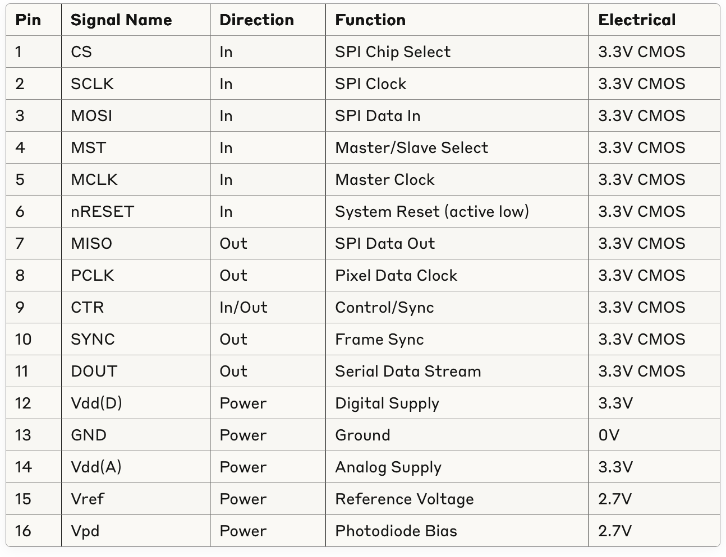
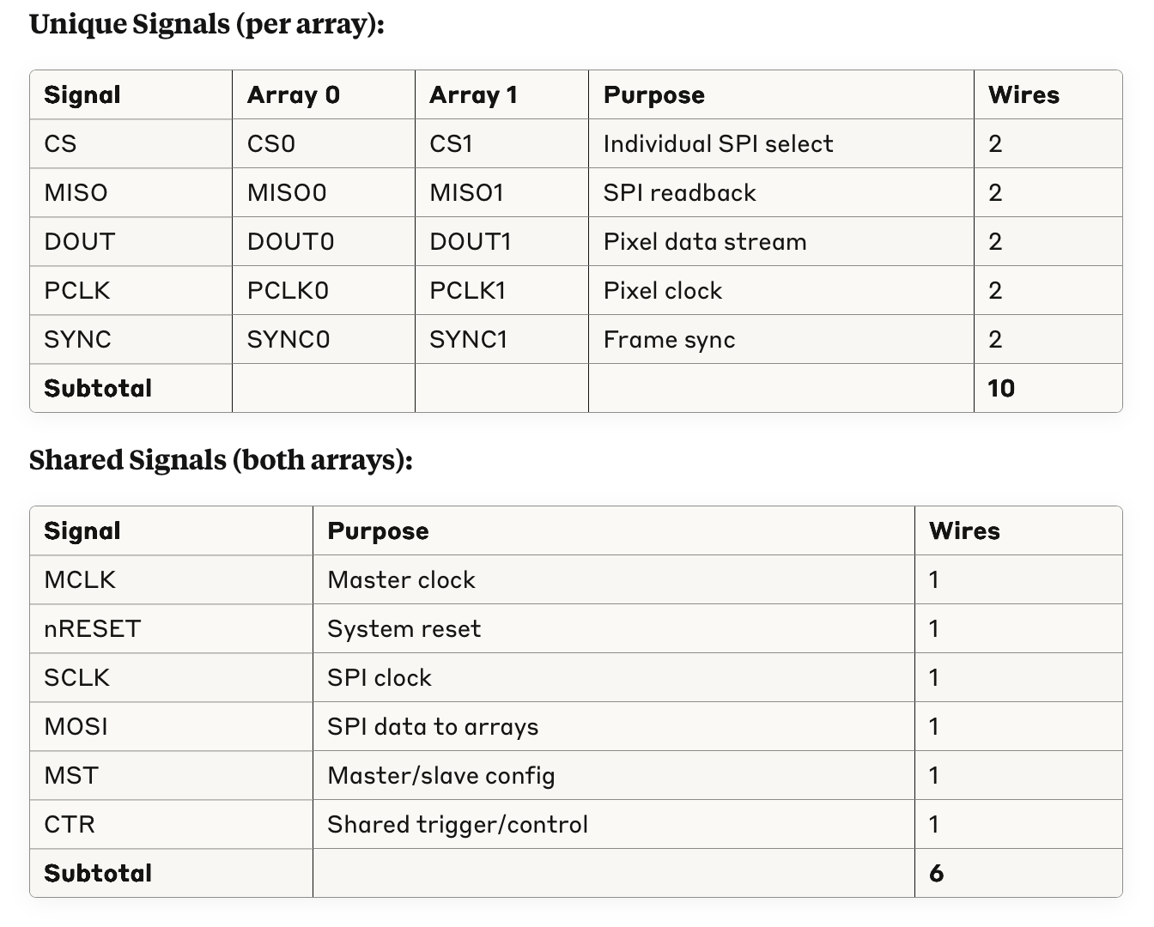
Digital Photodiode Readout Signals

Slide 8
Digital v Analogue Readout Wire Requirements
Analogue:
With Full Sharing: - Unique: 8 wires (2 trigger pairs, 2 data pairs) - Shared: 10 wires (clock, reset, CNV, SCK, gain) - Total: 18 wires
Without Sharing: Total: 26 wires
Digital:
Unique: 10 wires, Shared: 6 wires – Total: 16 wires

Slide 9
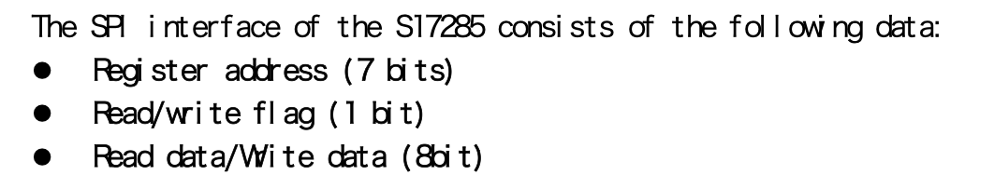
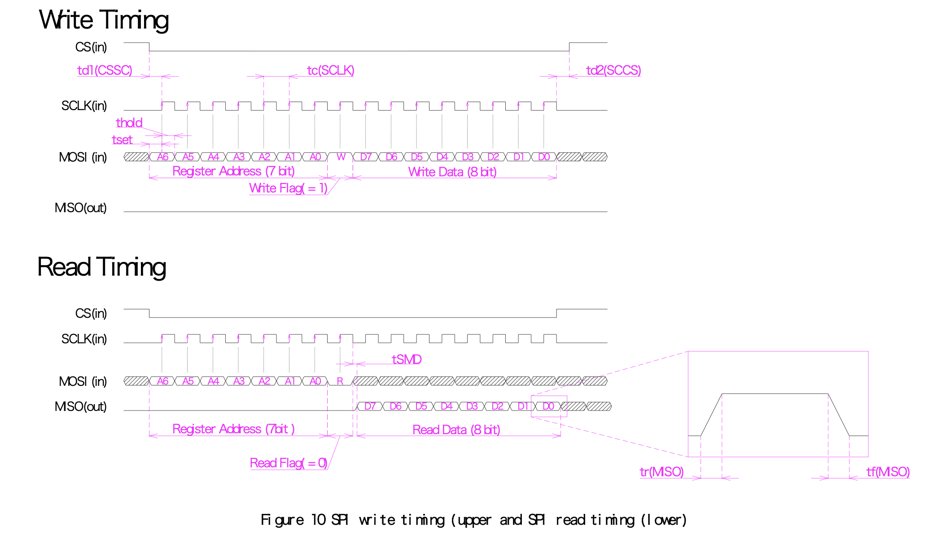
Dynamic Range Comparison
16-bit ADC converter in Heidelberg Design
S17285-128 PD arrays contain 14-bit ADC

Slide 10
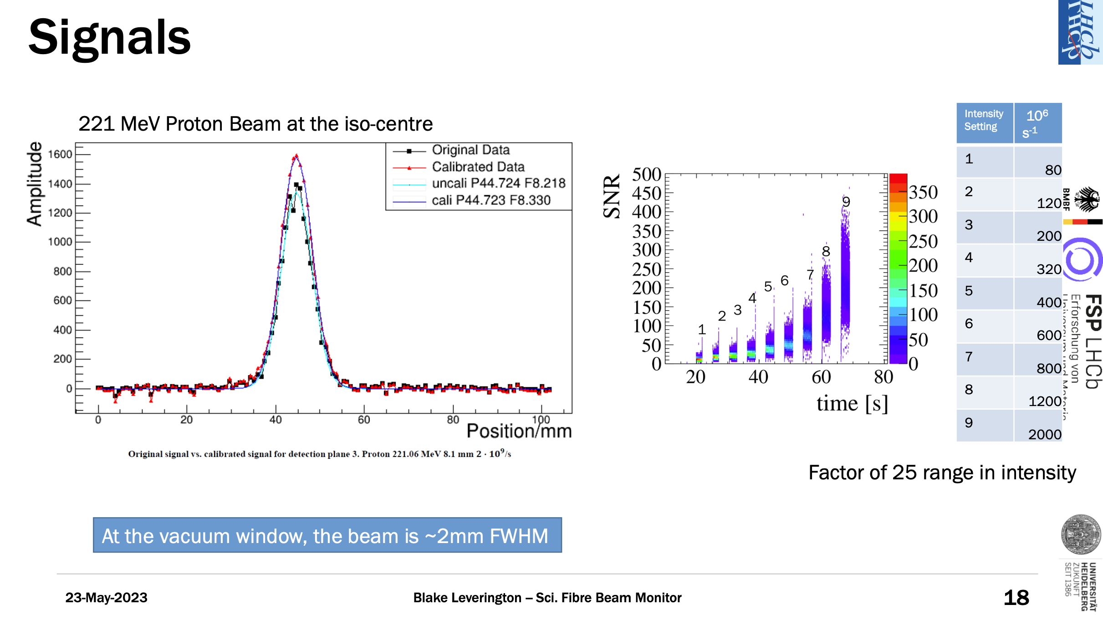
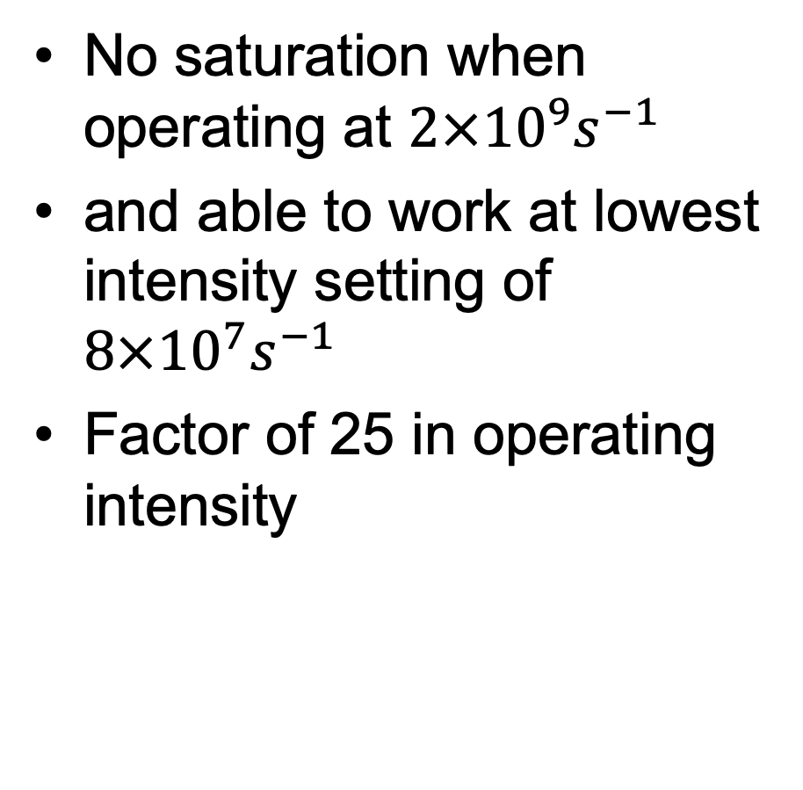
Heidelberg SciFi Operating Range
No saturation when operating at $2×{10}^{9}s^{−1}$
and able to work at lowest intensity setting of $8×{10}^{7}s^{−1}$
Factor of 25 in operating intensity

