Slide 1
PBT Meeting 08-10-2025
Joe Bateman
University College London

Slide 2
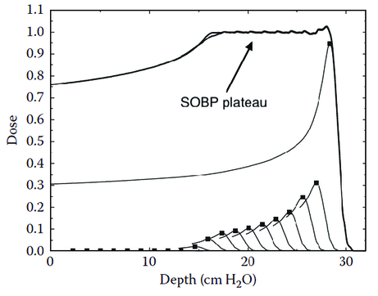
Proton Therapy QA
Protons can provide a more targeted and localised dose distribution.
However more susceptible to to range uncertainties etc.
Accurate and efficient QA is vital to maximise clinical benefit of PBT.

Slide 3
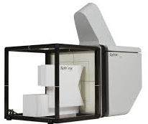
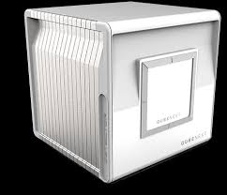
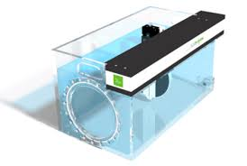
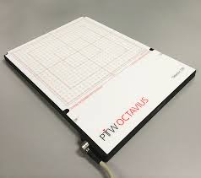
PBT QA
4 key quantities to verify in particle therapy beam QA:
Absolute dose
Beam range
Spot size
Spot position
In PBT every treatment plan requires some form of patient-specific QA
Either measurement based (time and resource consuming and ability to spot errors is limited)
Or log-file based (fast and efficient but not allowed by every vendor and requires more stringent verification of parameters)

Slide 4
QuADProBe
QuADProBe: Quality Assurance Detector for Proton Beam Therapy
Aims:
Develop a robust and affordable detector capable of providing:
All necessary beam measurements for PBS Machine QA: dose output, spot size, spot position and energy.
Real-time measurements of these parameters during a PSQA “dry-run”.

Slide 5
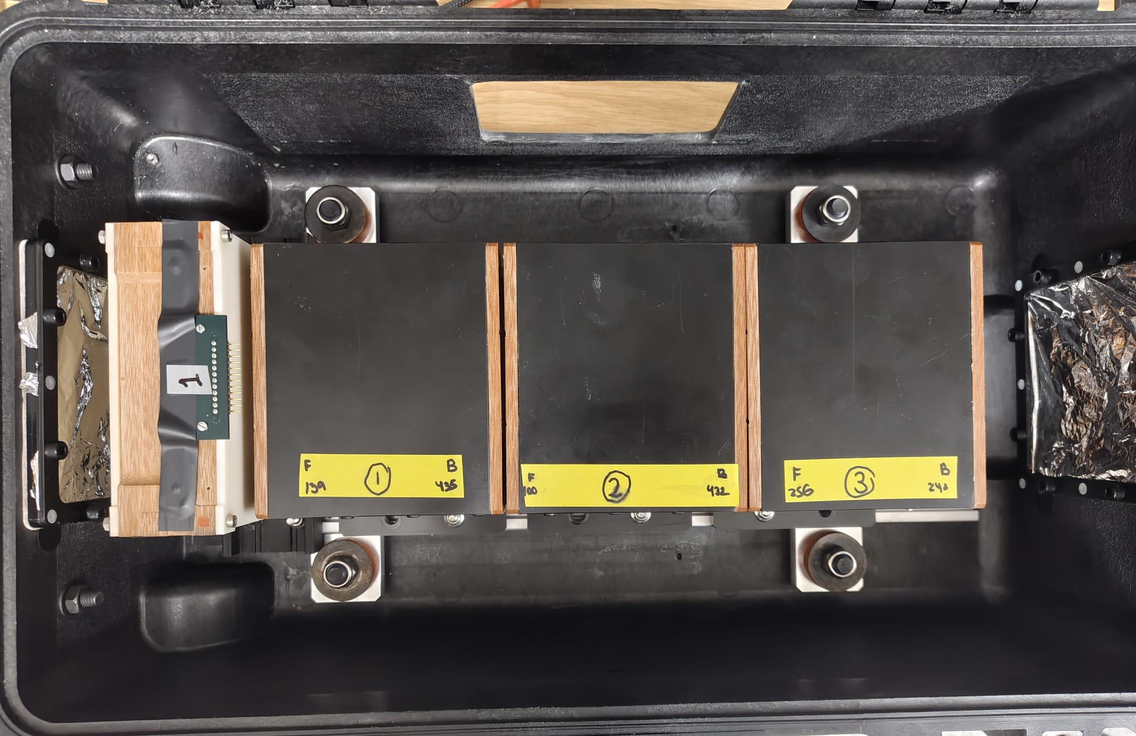
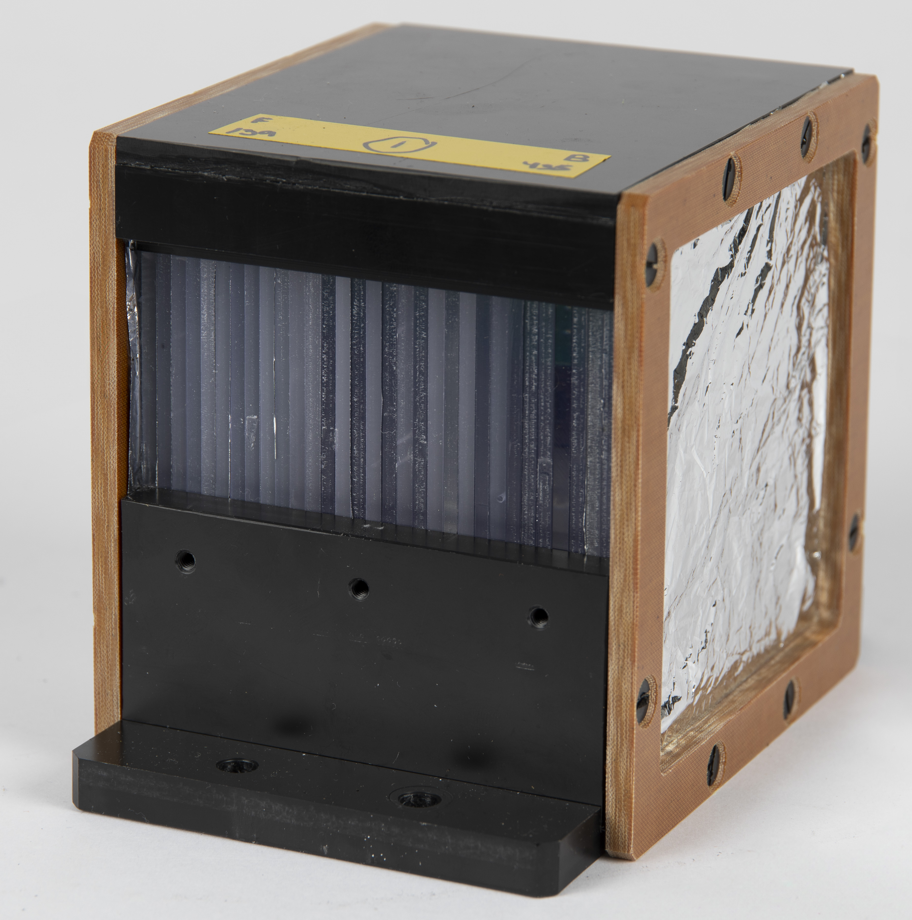
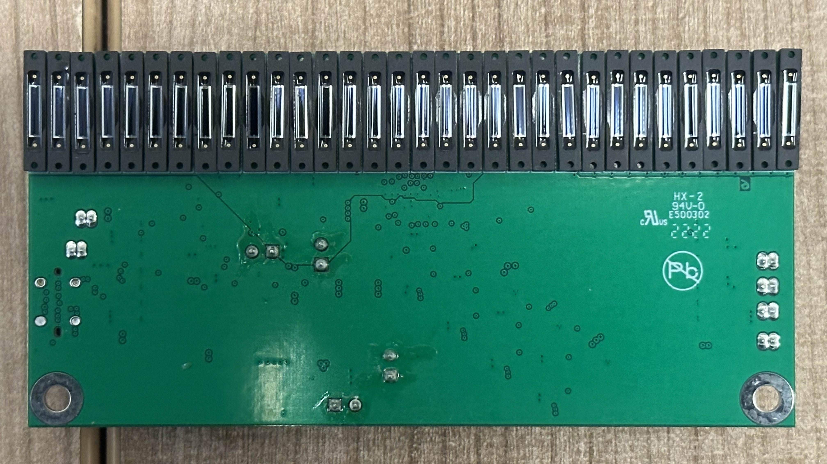
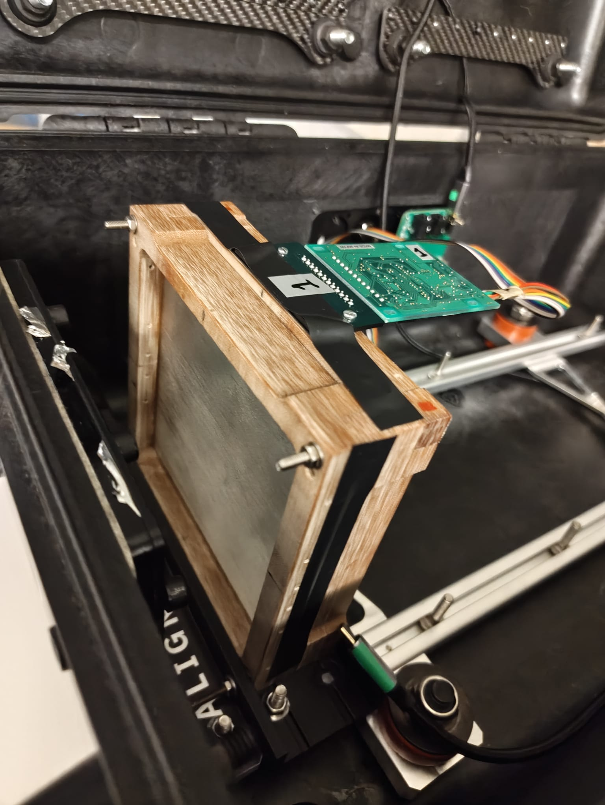
QuADProBe Current Status
QuARC
SciFi
Tracker

Slide 6
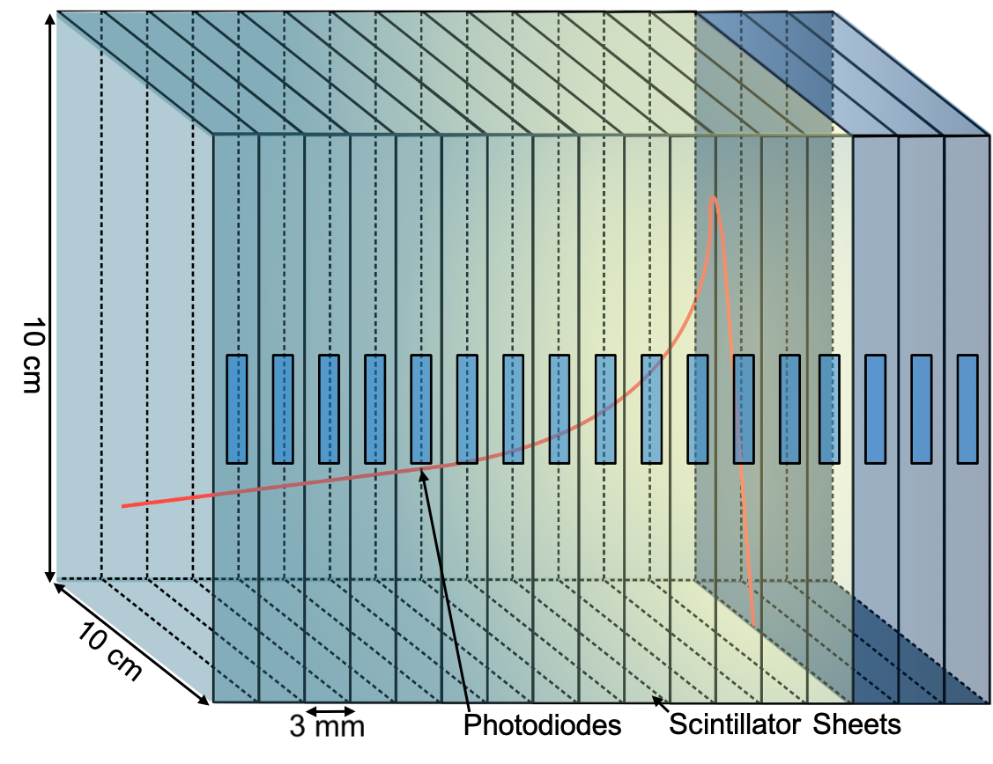
QuARC
The Quality Assurance Range Calorimeter (QuARC) constructed from plastic scintillator:
Protons intercepted by a series of optically-isolated polystyrene scintillator sheets.
Measure light output with photodiodes.
Light output of each sheet nonlinear to dose, but quenching described by Birks’ Law:
Fit data with analytical depth-light model.
Reconstruct Bragg depth-dose curve and measure proton range.
Photodiodes coupled to fast, modular electronics and an FPGA to read light levels at over 5 kHz.
FPGA connects to on-board PC (Raspberry Pi) via USB.
Connection to on-board PC via ethernet/WiFi.
Key benefits:
Plastic scintillator inexpensive and water-equivalent.
Range reconstructed with single beam delivery.
Easy detector setup and no optical artefacts.

Slide 7
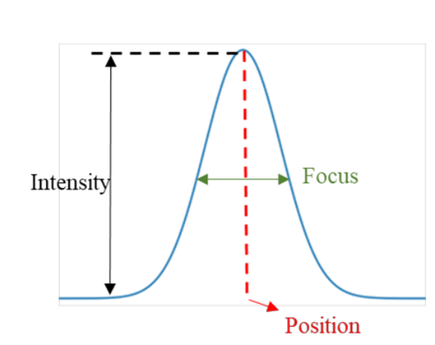
SciFi Profile Monitor
2 orthogonal 10 cm x 10 cm arrays made of BCF-60 plastic scintillating fibres by Saint-Gobain, 0.50 ± 0.13 mm diameter. Emission peak at 530 nm.
128-photodiodes array (Hamamatsu S13865), single and cascade operation. Image size: 51.2 x 0.6 mm, pixel pitch 0.4 mm
Hamamatsu C9118-02 CMOS driver circuit provides multiplexed data at up to 4 MHz
Analogic video output from the pixels array readout using NI USB-6366 Multifunction I/O
In low gain the dark output voltage is typ. 0.005 mV, max 0.1 mV
The saturation output voltage is min. 3 V typ 3.5 V
MCLK 1 MHz. Suggested min. reset time 10us and suggested min. integration time 17+4x128 clocks = 529 us.
FPGA high period of RESET clock (reset) = 50 us, low period (integration) 950 us

Slide 8
QuADProBe: My Working Areas
Detector Hardware
2nd SciFi prototype with digital readout photodiode arrays
DAQ, GUI, Postprocessing and Analysis
Trento fibre data analysis
Trento / UCLH / PPTC QuARC data analysis
GUI upgrades
Development of DAQ chain for next fibre readout electronics + 4 sided QuARC readout
Detector Simulation
Geant4 QuARC simulation
Geant4 QuADProBe Simulation
3D Dose Reconstruction
TOPAS simulation pipeline over plus1 + HEP batch farm
Alternatives for faster reconstruction
GPU-based MC codes e.g. FRED
AI based dose reconstruction: CNNs/PINNs for dose in water – 3D CNNs / Transformers for patient CT

Slide 9
Immediate term goals
Trento Beam Test Data Analysis
SciFi Measurements
Preliminary analysis
Continue code upgrades with Raffy
QuARC Measurements
Continue analysis with Sonia’s code as well as looking at beam position measurements
Make any necessary modifications
Paper preparation from PPTC/UCLH/Trento (& Geant4 simulations?)
Dual-sided QuARC readout
Correlation of position and size with SciFi

Slide 10
Immediate goals
GUI functionality and upgrades
Make sure to fully understand how GUI in its current form works
First test on debugging since currently only displays data for 6 boards but not for 7 or 8

Slide 11
Short/medium term goals
GUI functionality and upgrades
Make necessary upgrades i.e. improve responsiveness and replay function
Add fibre profile functionality

Slide 12
Short/medium term goals
Preparations for new readout electronics for SciFi
Gather as much info from Kirsty on signal requirements for S17285-128G photodiodes in order to assist for development of front end readout board
Initial board for testing of new photodiodes with USB104 -> possible beam test at HIT
Final board once decided whether to proceed with digital readout or analogue readout with full Kria integration.

Slide 13
Immediate term goals
Preparations for new readout electronics for SciFi
Gather as much info from Kirsty on signal requirements for S17285-128G photodiodes in order to assist for development of front end readout board
Make sure to understand signal requirements etc to level of Saads QuARC powerpoint
Download labview and prep NI for mocking up programme to test digital photodiodes

Slide 14
Short/medium term goals
Development of DAQ chain for next fibre readout electronics + QuARC
C++ code (or other if deemed more appropriate) for real-time readout and Gaussian fitting of fibre array profiles and display on GUI
Methods to reconstruct 2d profile and position using 2x 1D profiles
Development “Event Tagging” system to sync SciFi and QuARC “Events”

Slide 15
MC Simulations
Detector Geant4 Simulations
Further optimisations for QuARC simulation
Work with Raffy to add on fibre arrays
3D Dose reconstruction
TOPAS pipeline on plus1 and HEP batch farm working well
FRED on GPU cluster? Worth seeking access to Hypatia or any other UCL ARC GPU clusters or cloud-based GPU computing?
Other alternatives such as AI-based dose reconstruction – Matt from UCLH working on this for UCLH PBT PSQA

Slide 16
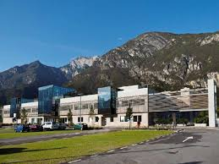
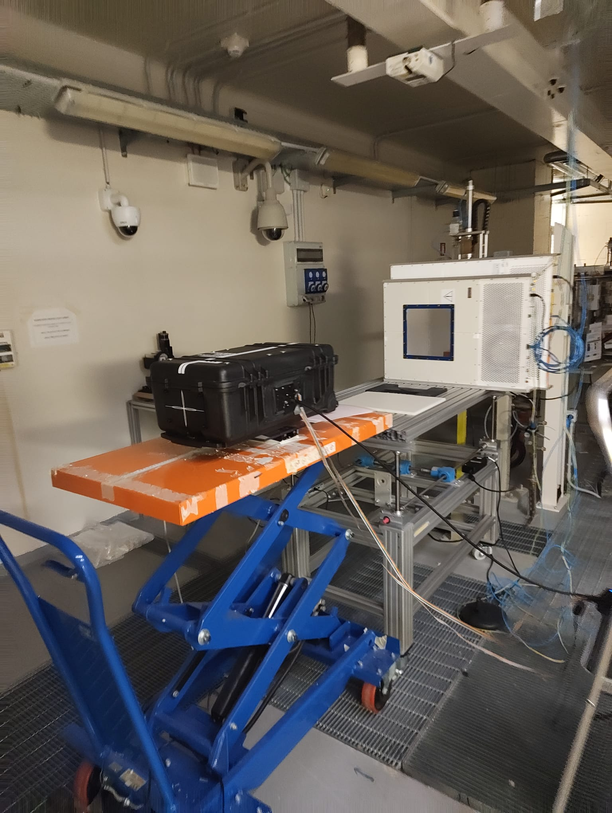
Trento Beam Test Summary and Prelim Results
3 nights of measurements in the research room at Trento PTC
Night 1: QuARC
Calibrations and Bragg Peak measurements scaling current up to FLASH (briefly).
Night 2: Combined QuARC + SciFi:
Dynamic range testing (fibres at low gain)
Beam position measurements
Night 3: SciFi Measurements
Dynamic range testing (fibres at low gain)
Different spot sizes (varying energy)

Slide 17
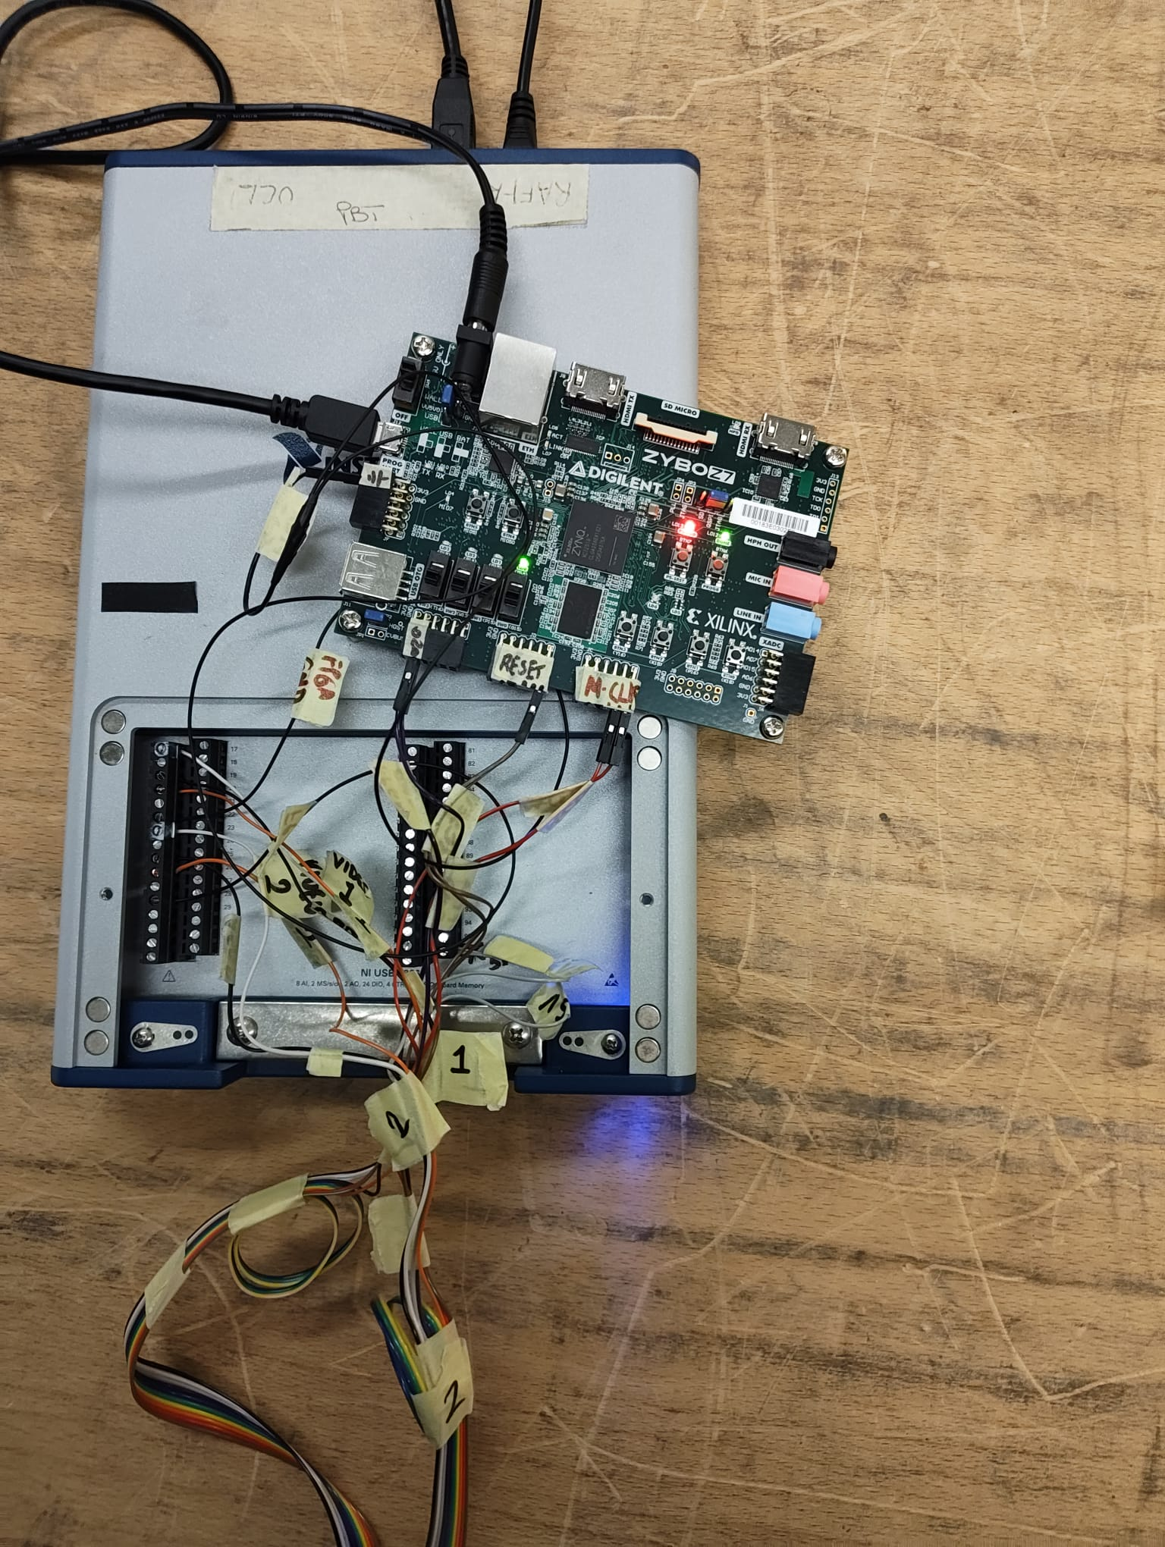
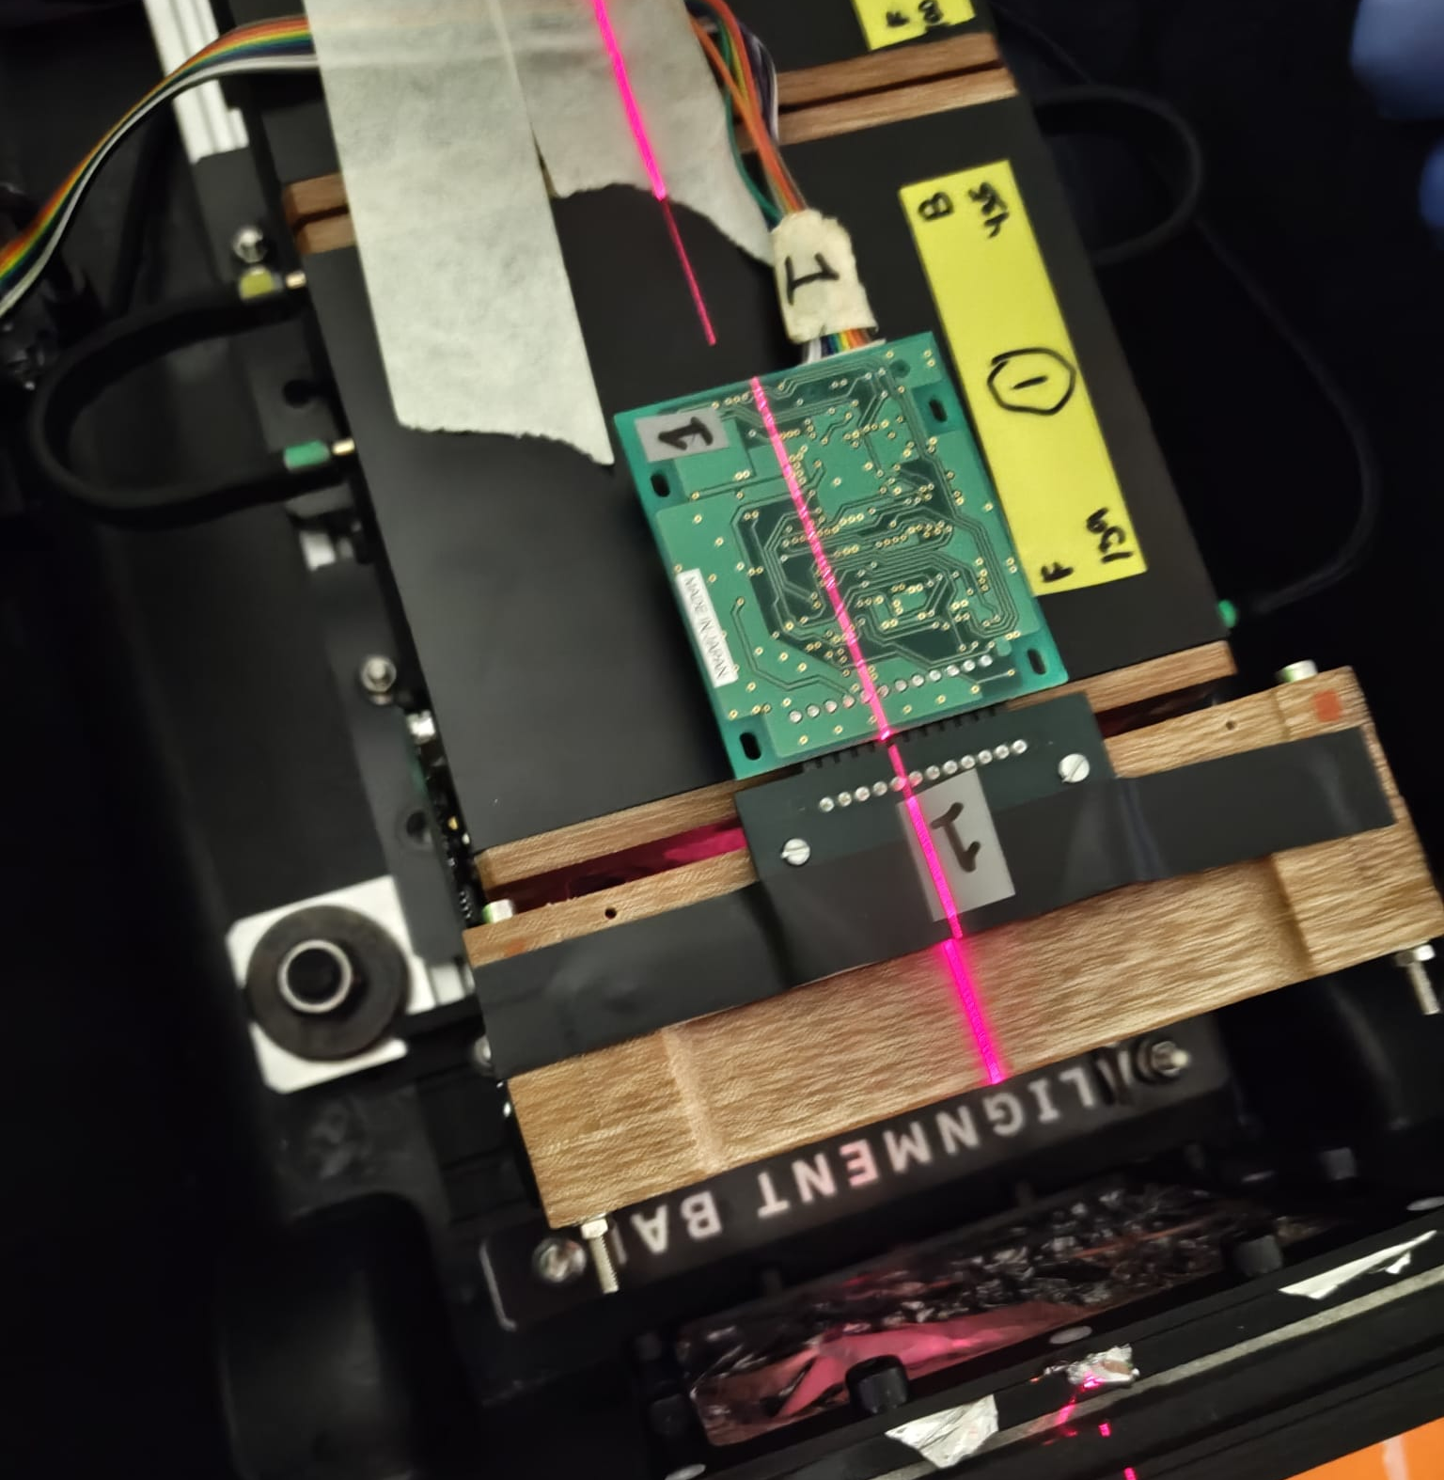
SciFi Measurements

Slide 18
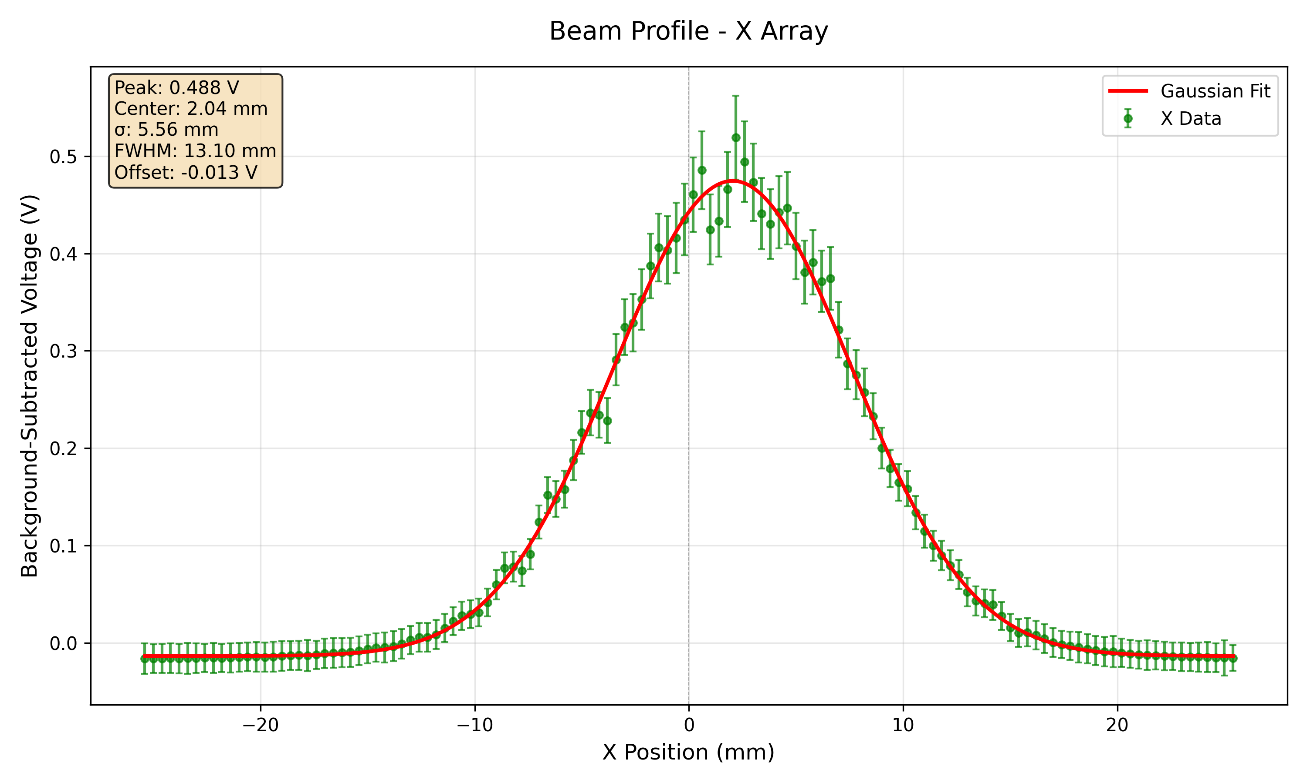
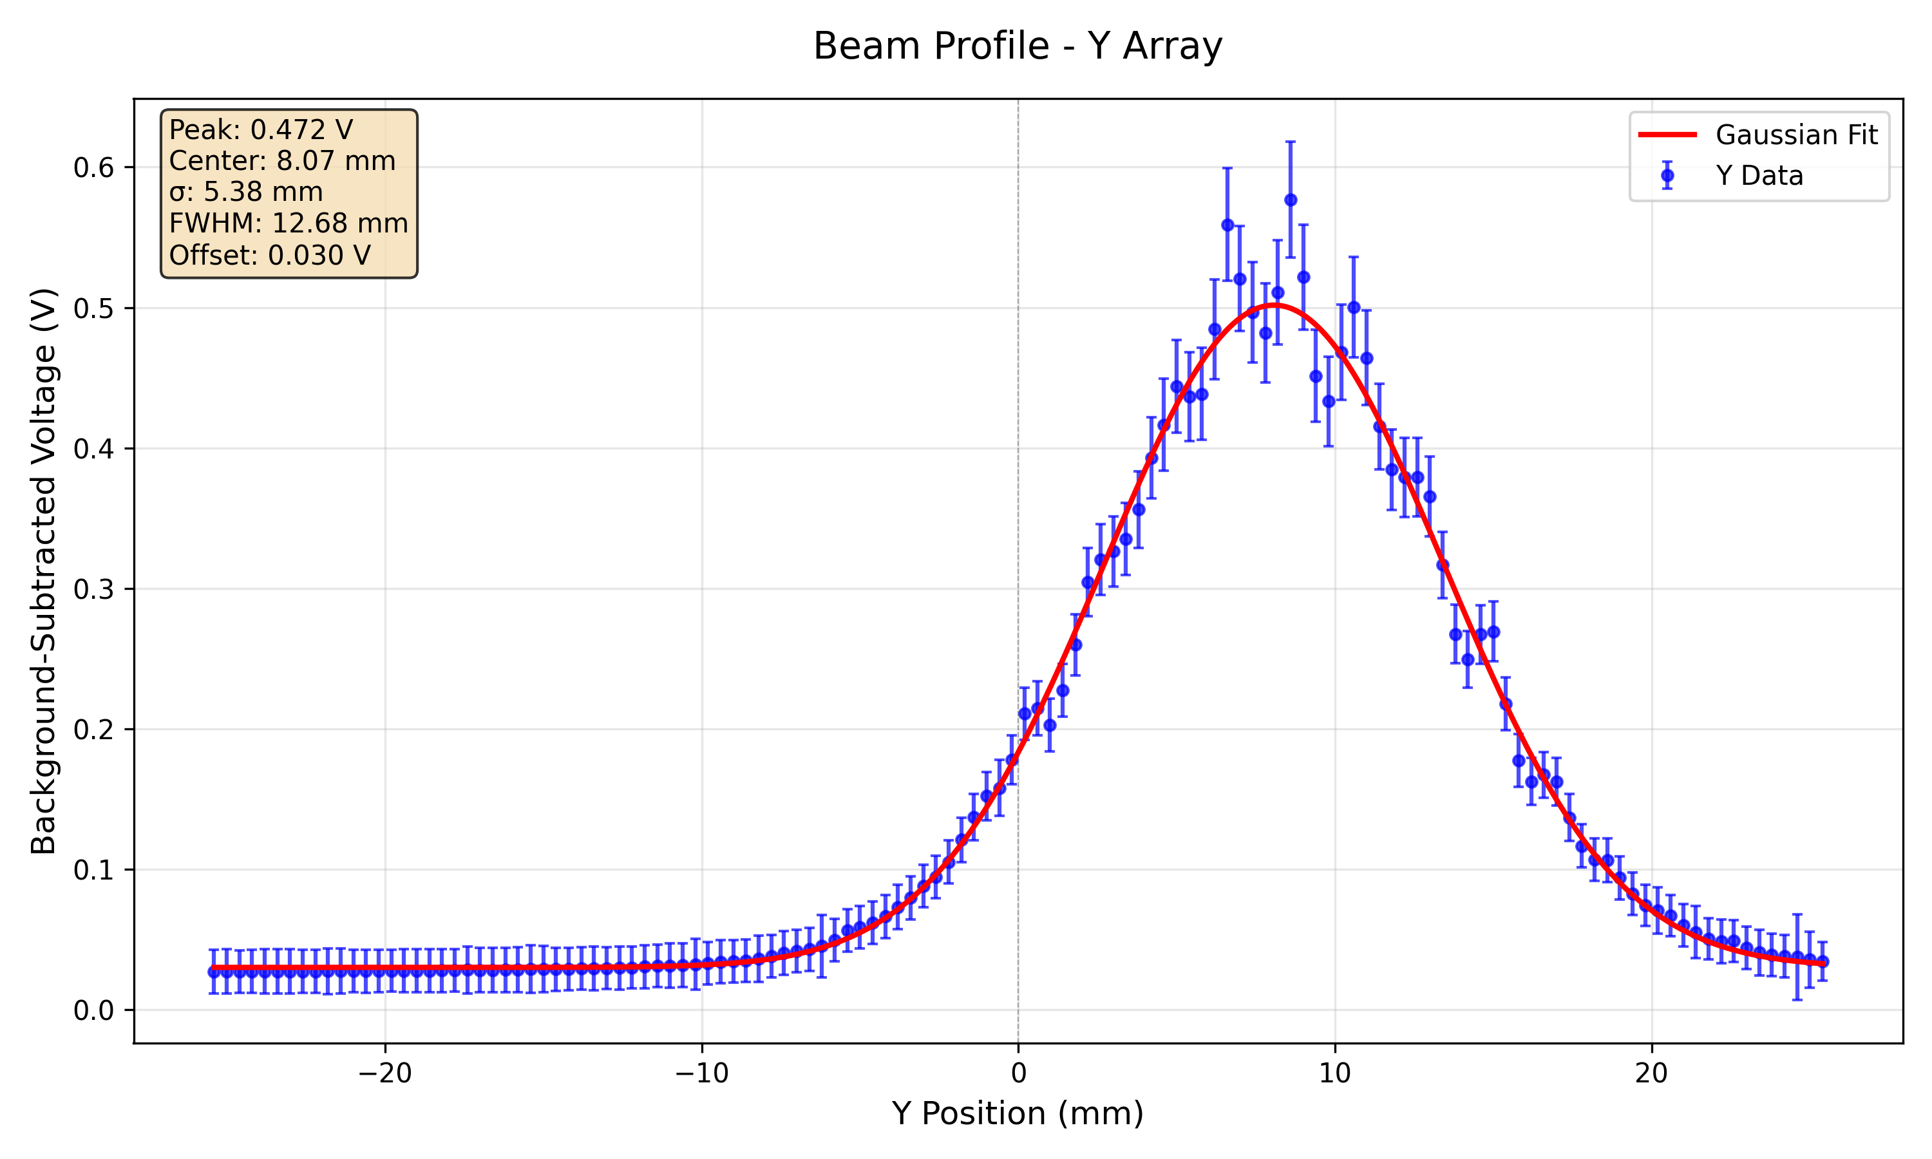
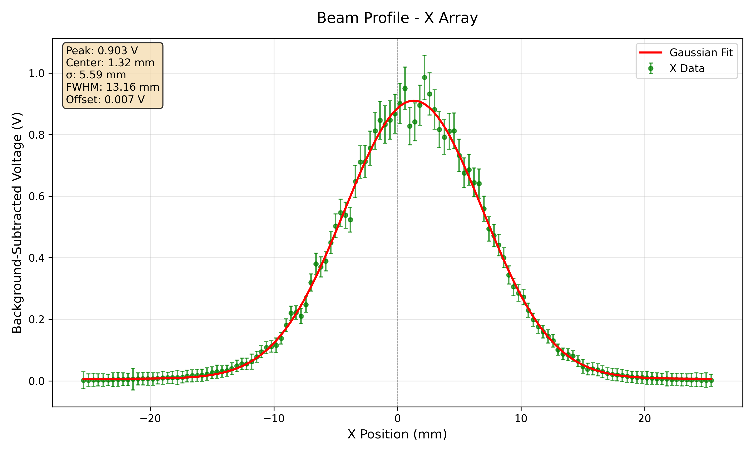
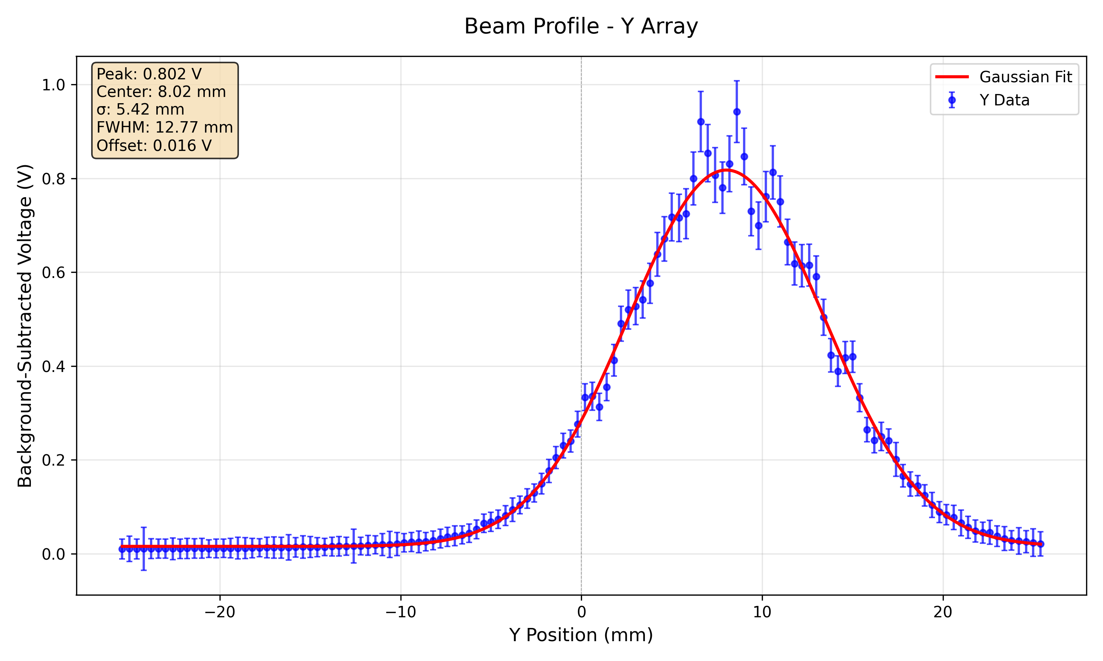
148 MeV 300 nA Profiles at Low Gain and High Gain
Low gain
High gain

Slide 19
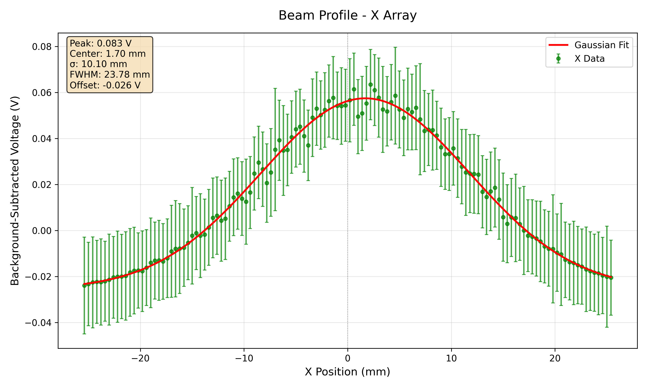
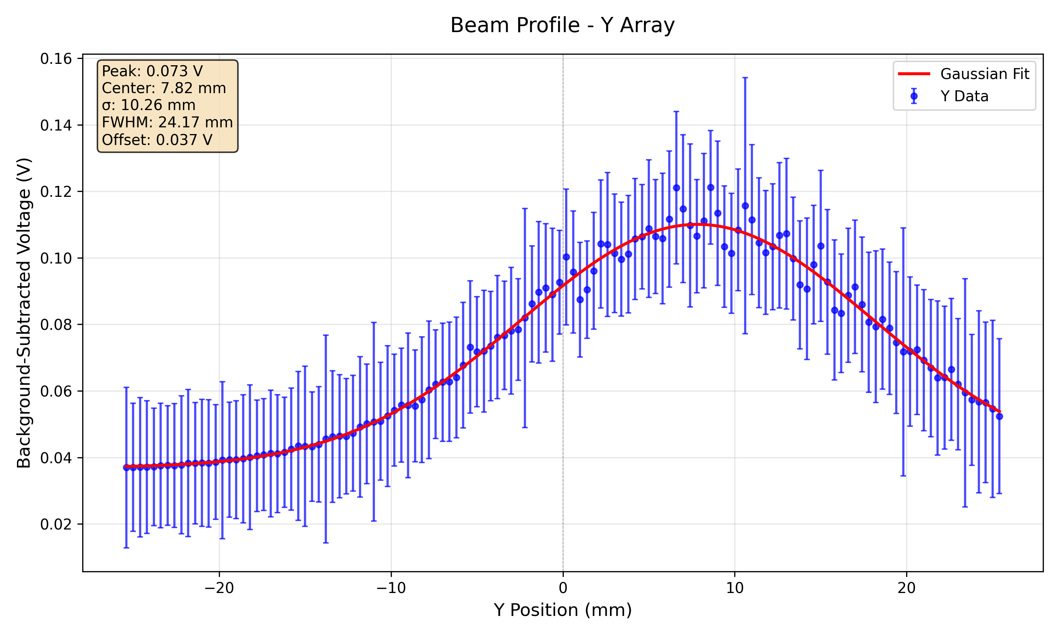
70 MeV 300 nA (max ion source current) High Gain

Slide 20
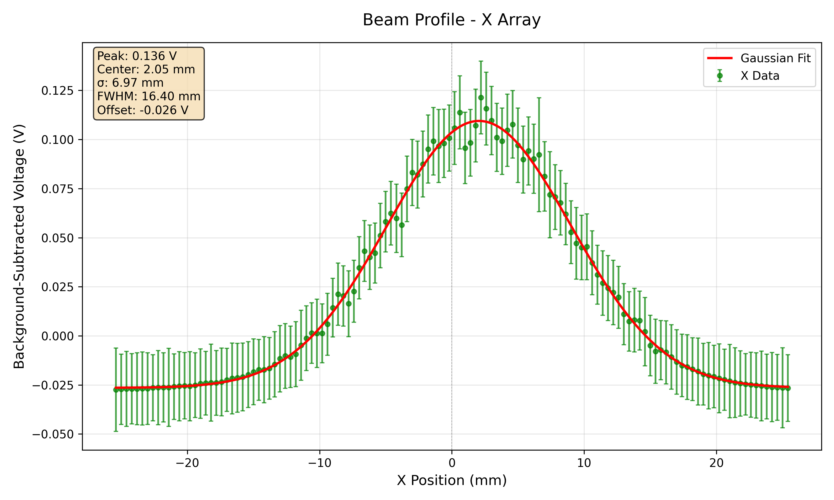
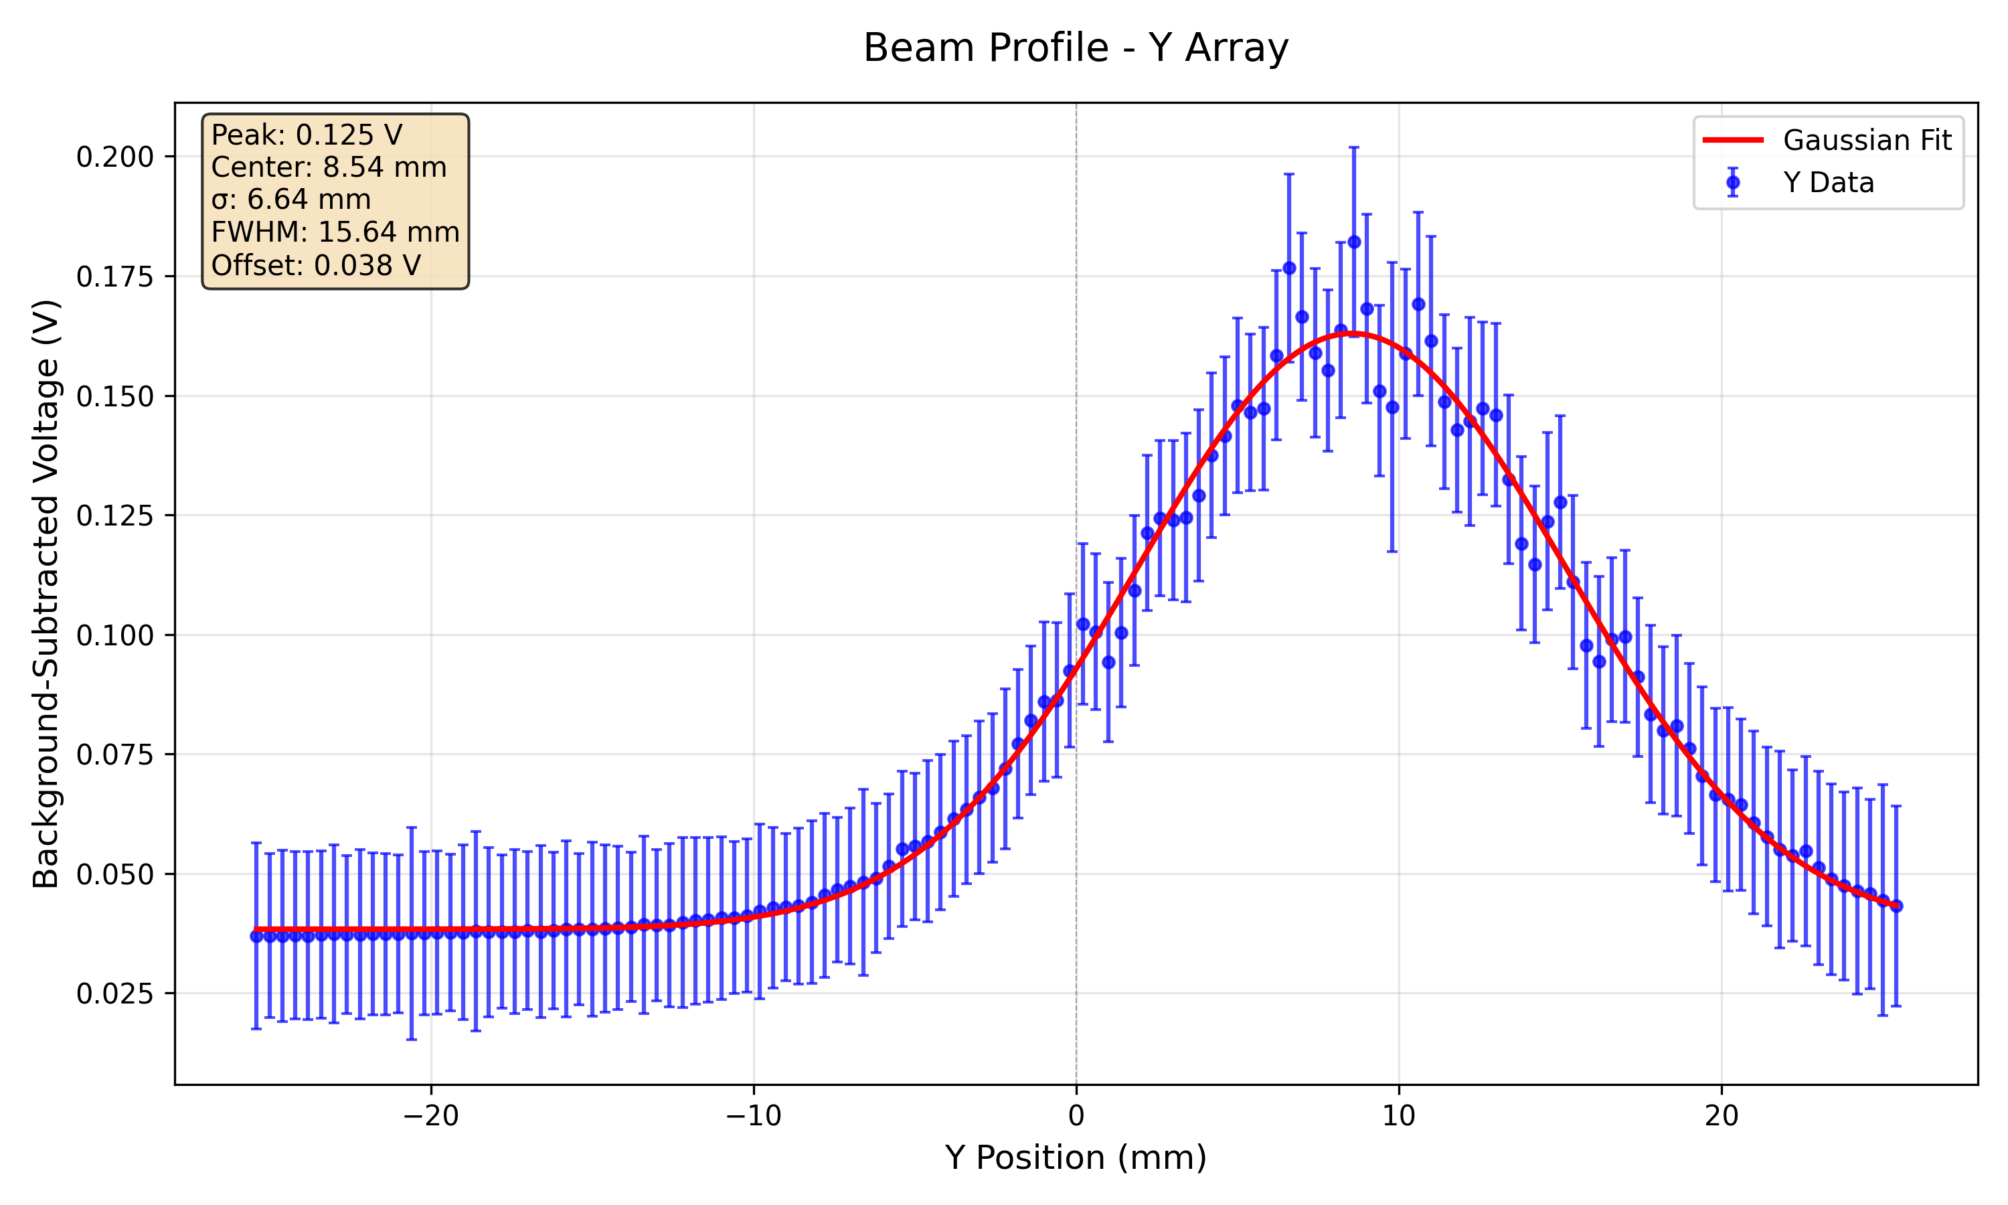
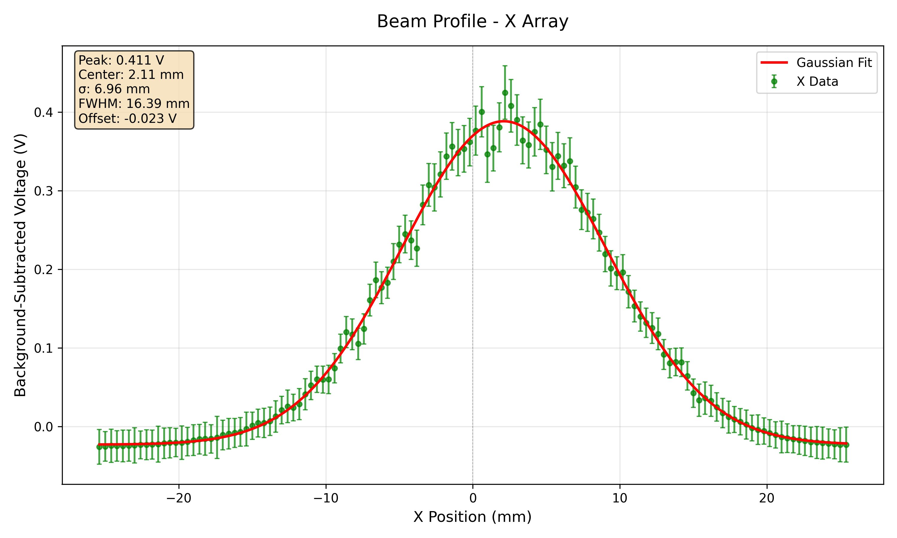
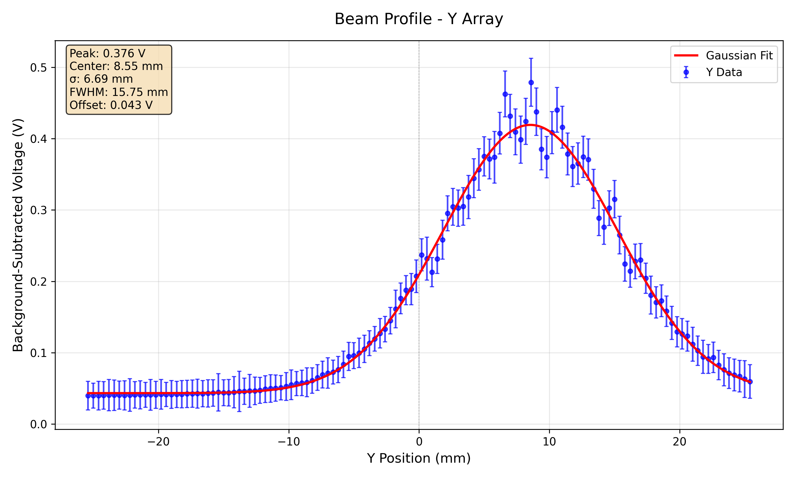
112 MeV High Gain
100 nA
300 nA

Slide 21
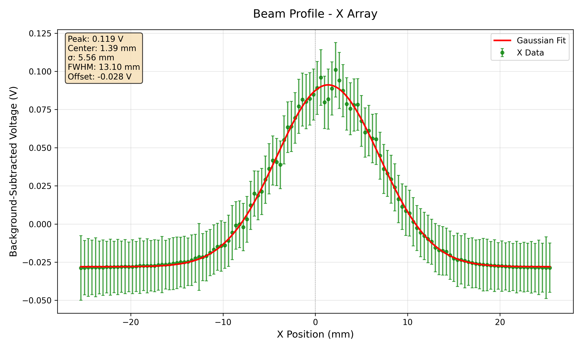
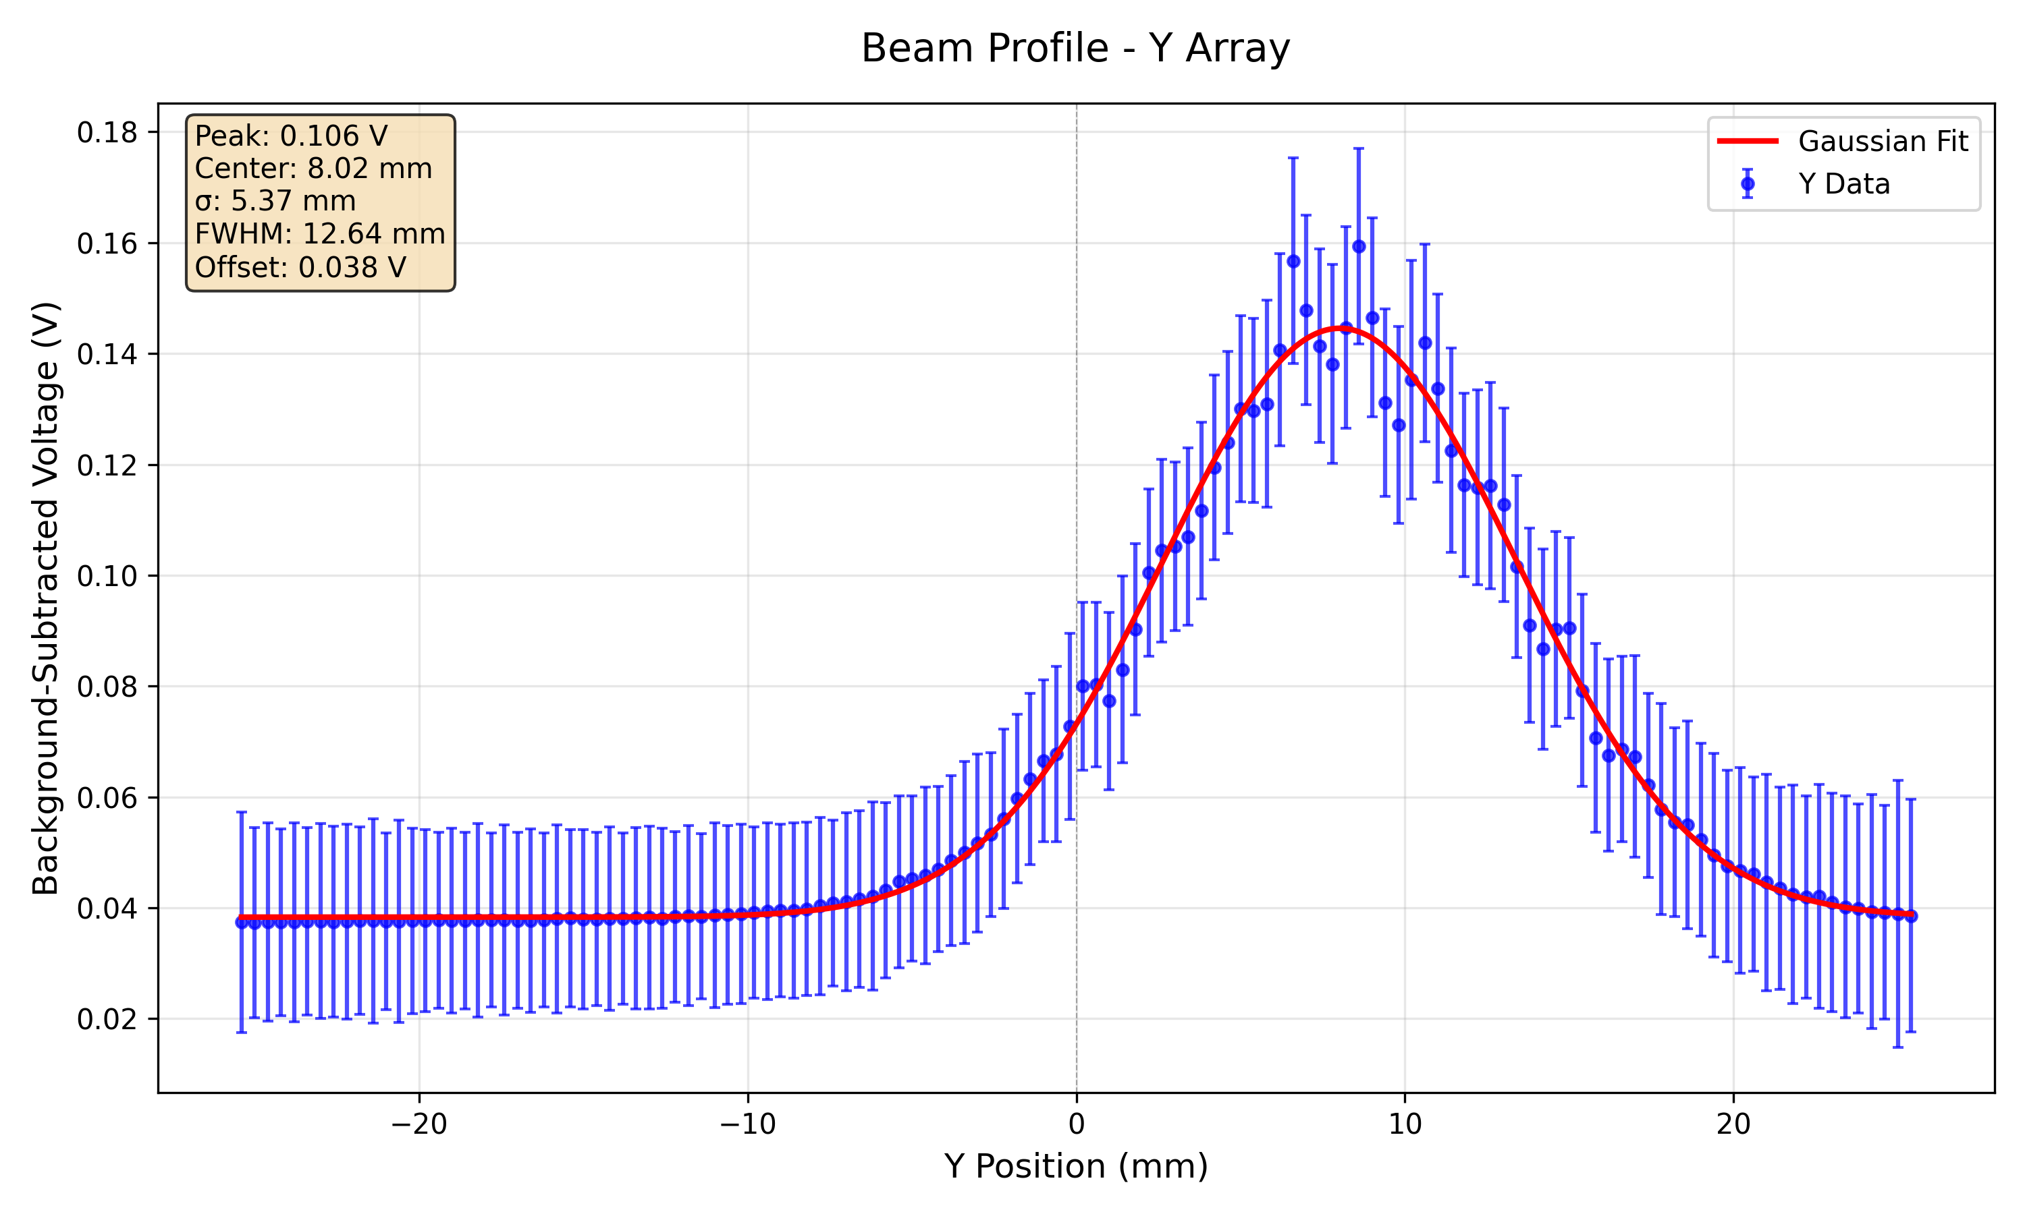
148 MeV 40 nA High Gain

Slide 22
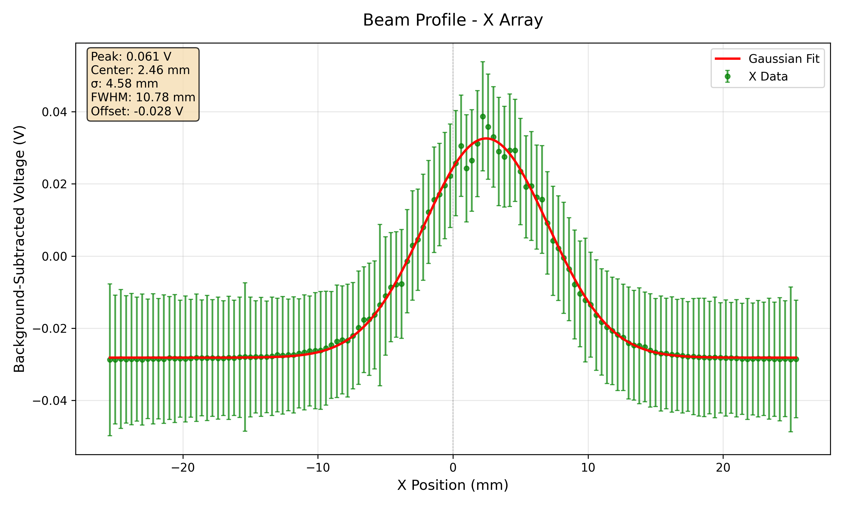
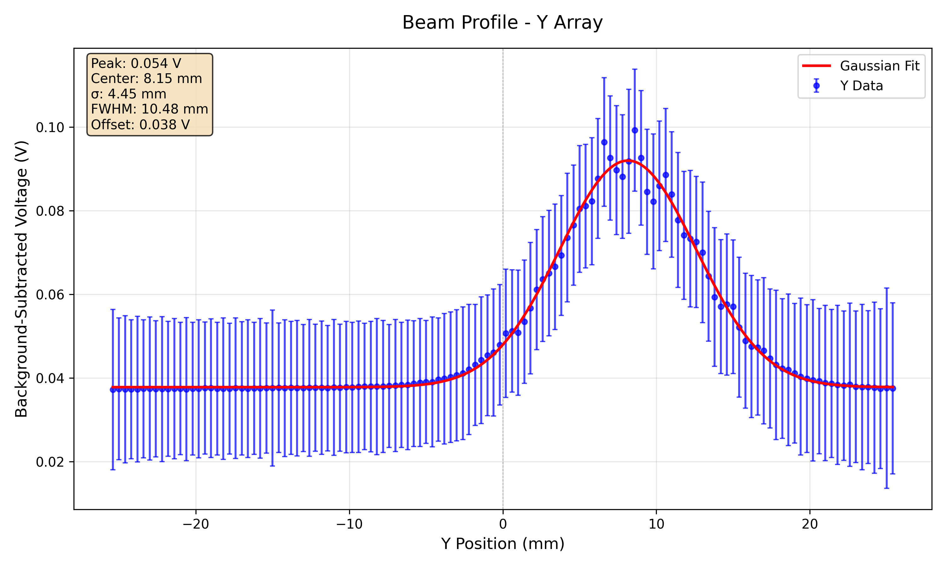
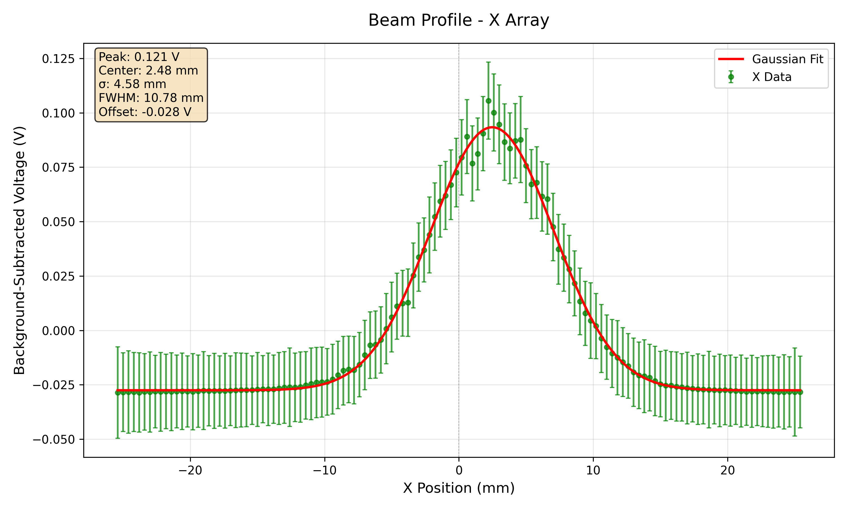
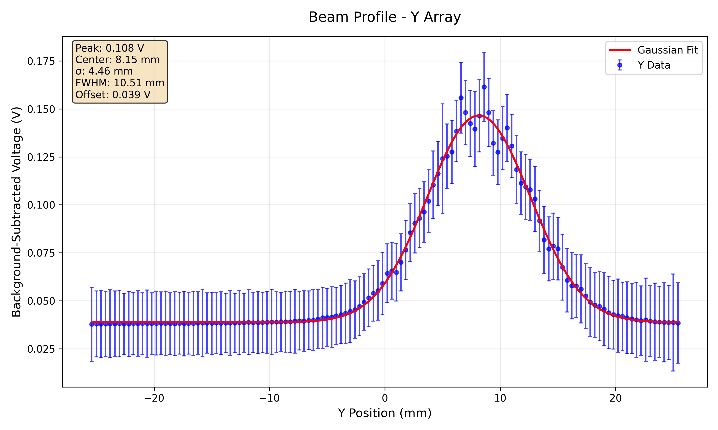
179 MeV High Gain
10 nA
20 nA

Slide 23
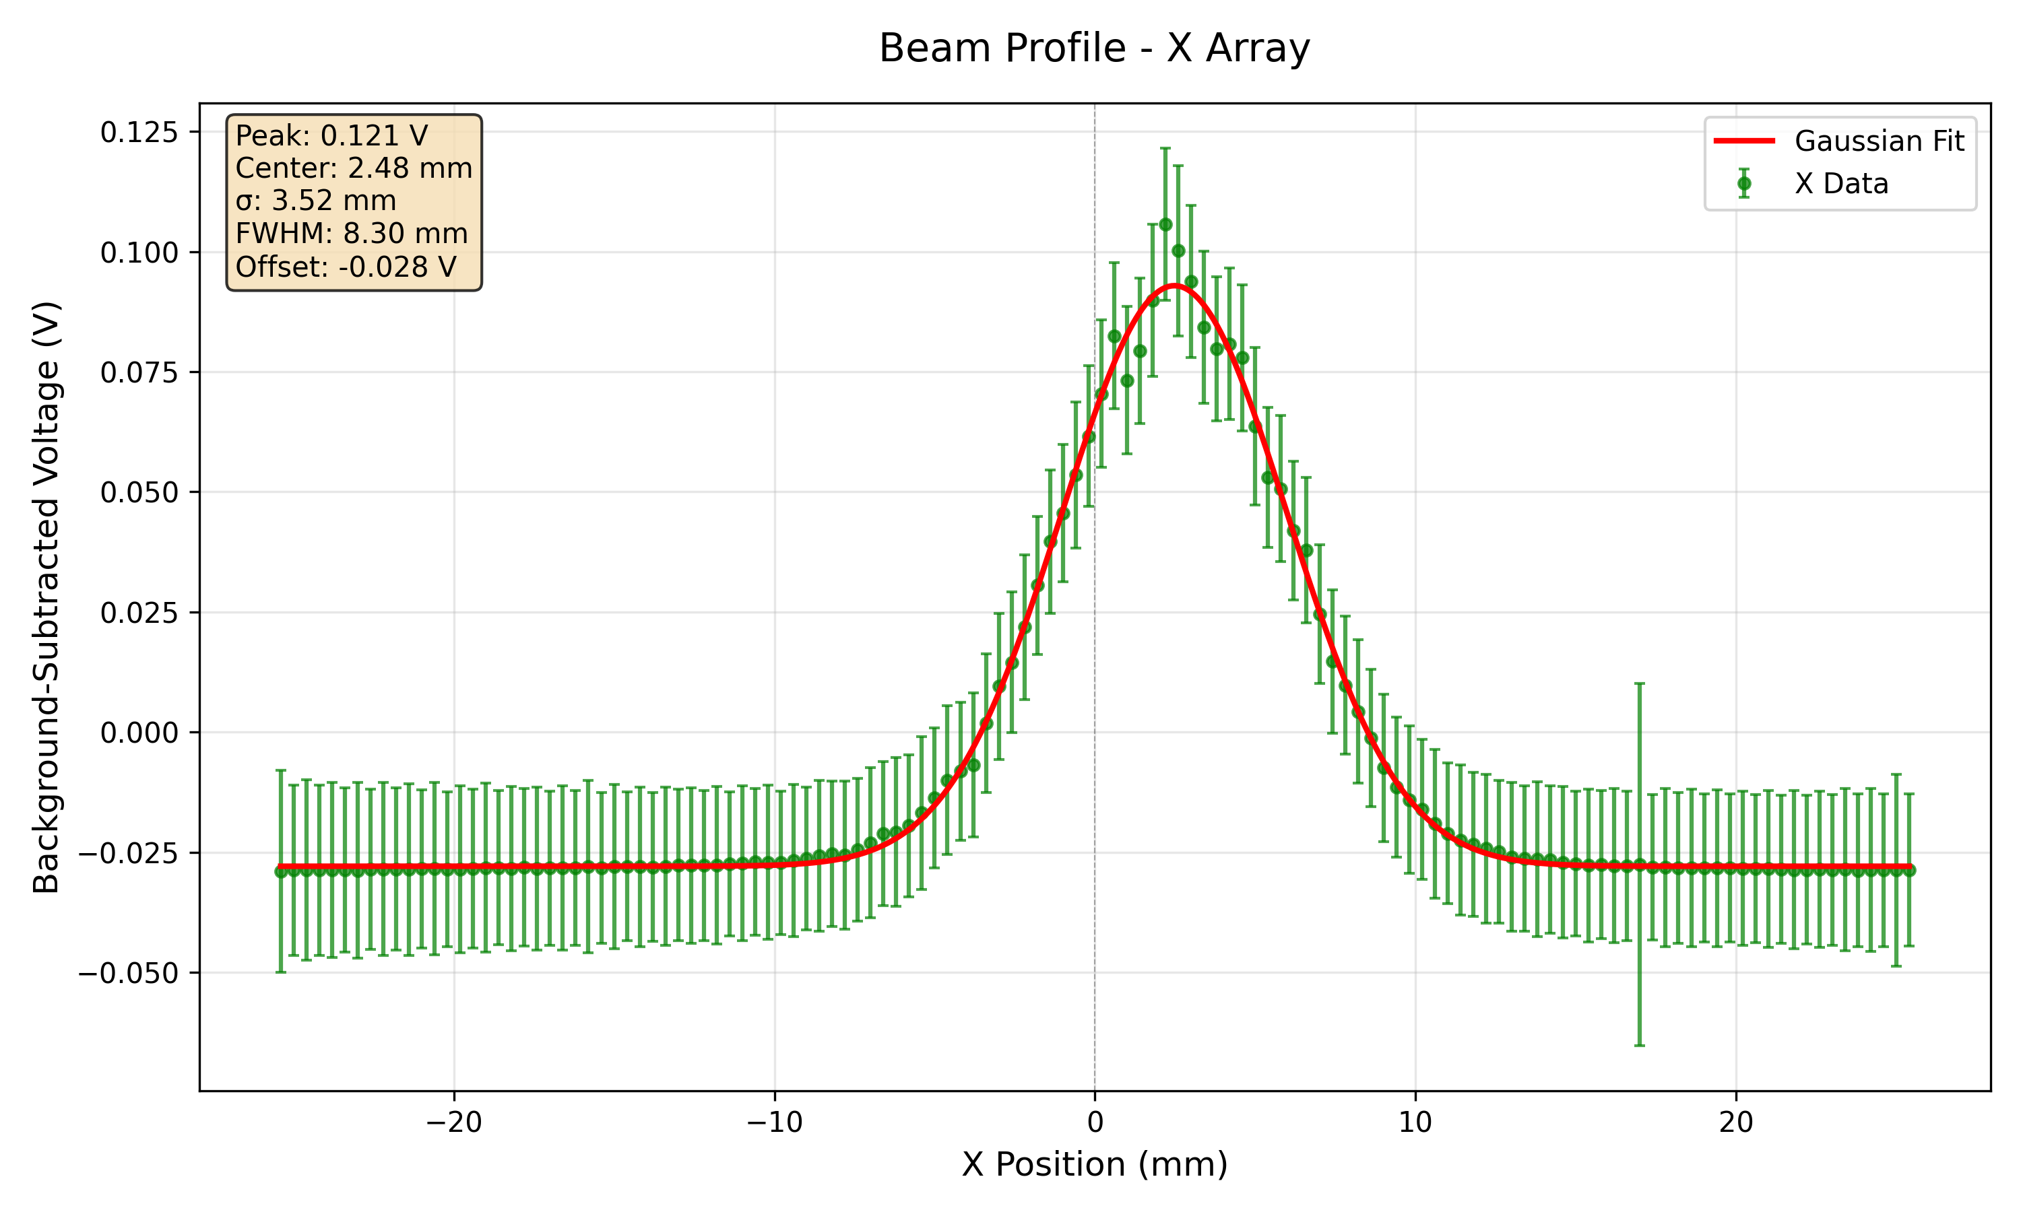
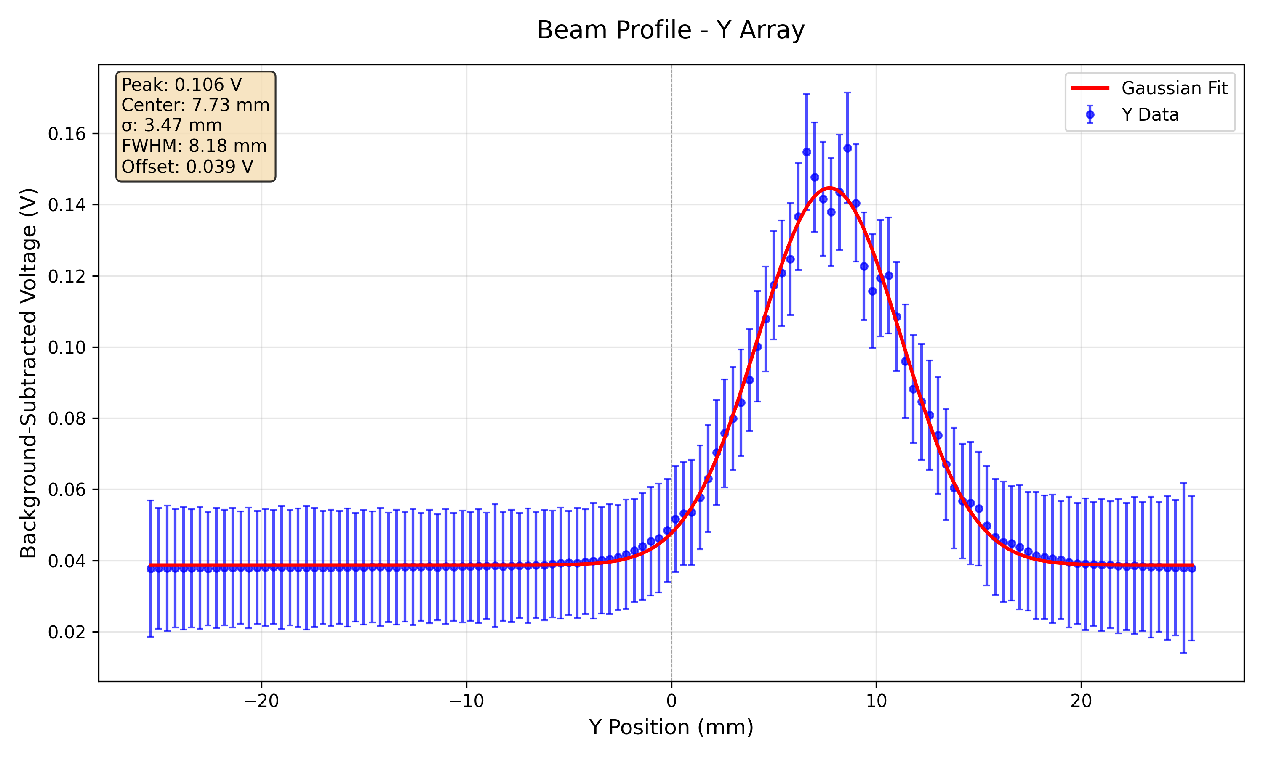
228 MeV 5 nA High Gain

Slide 24
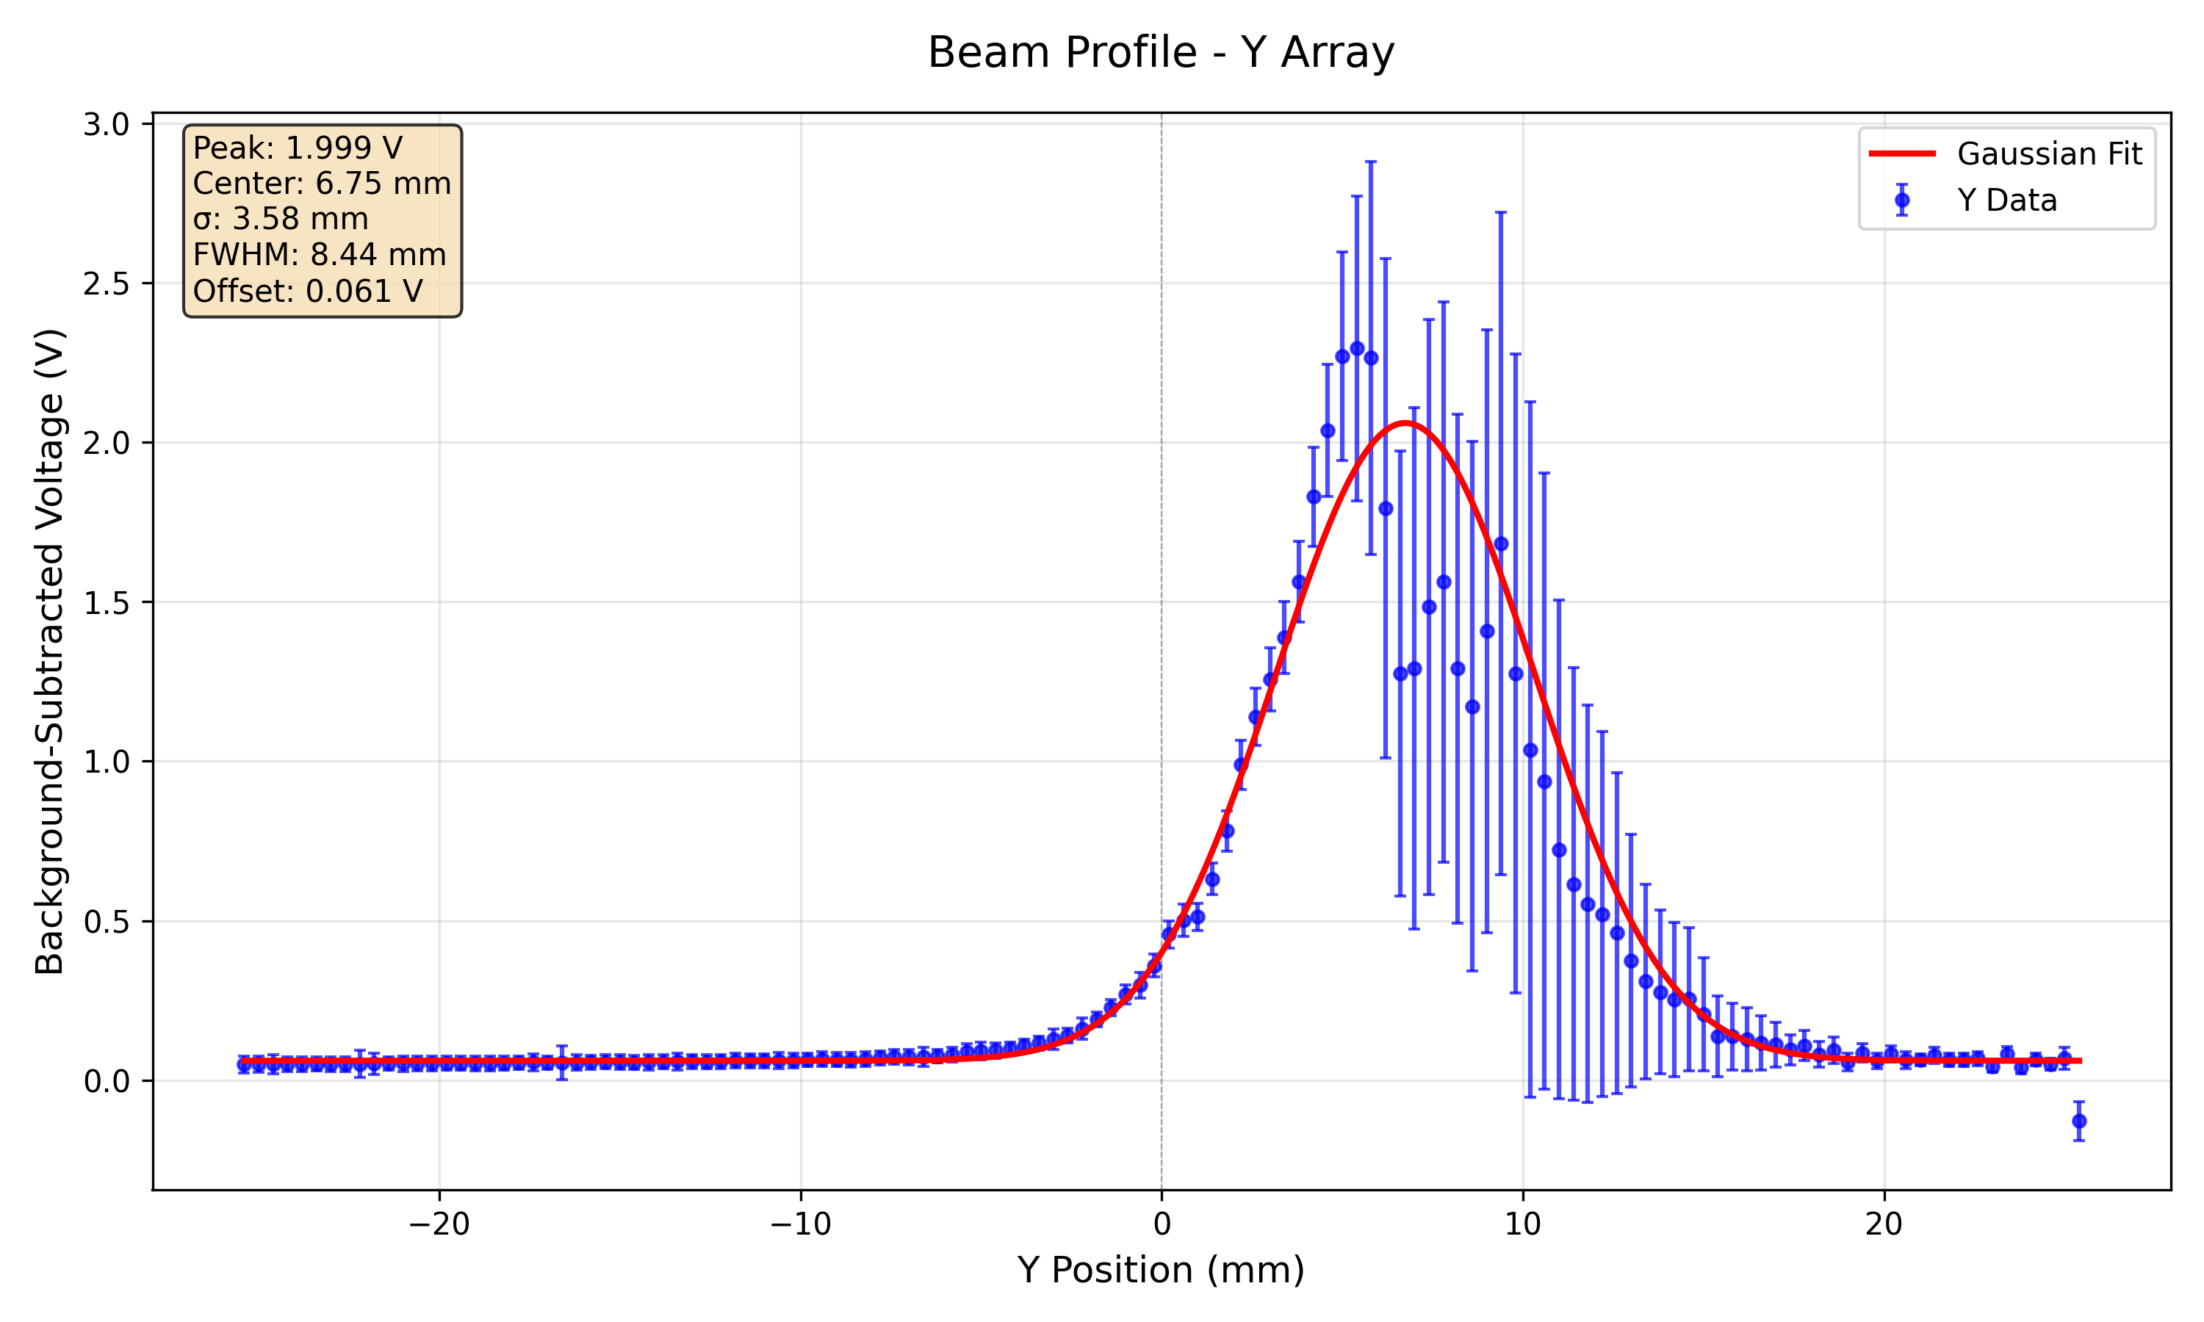
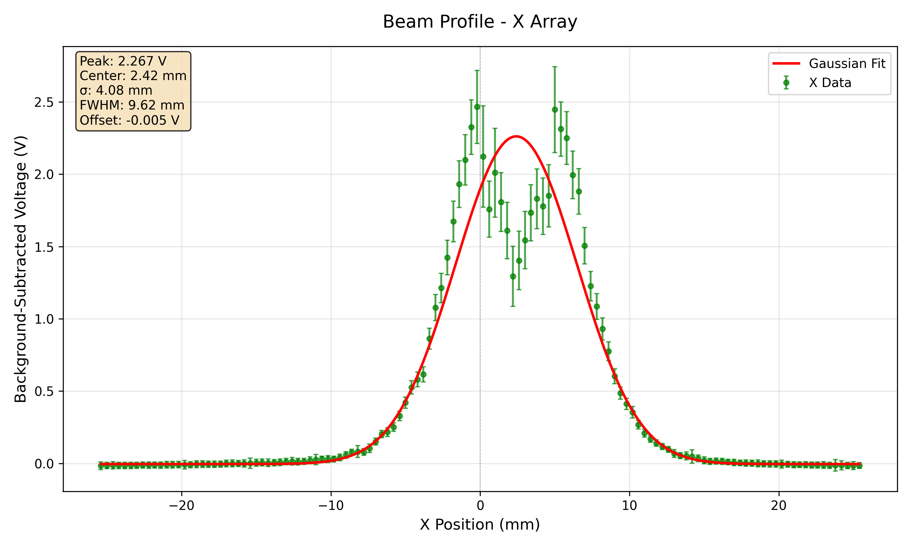
228 MeV 150 nA High Gain

Slide 25
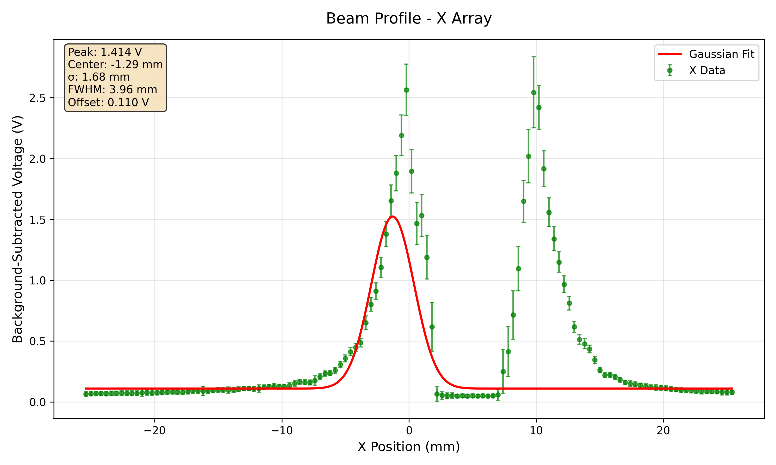
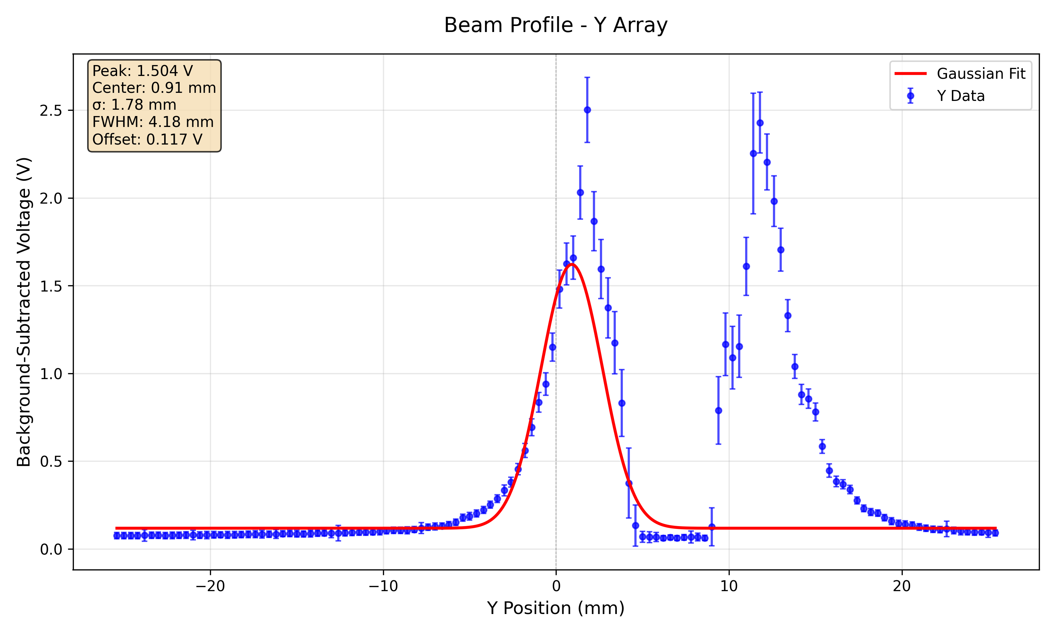
228 MeV 150 nA High Gain

Slide 26
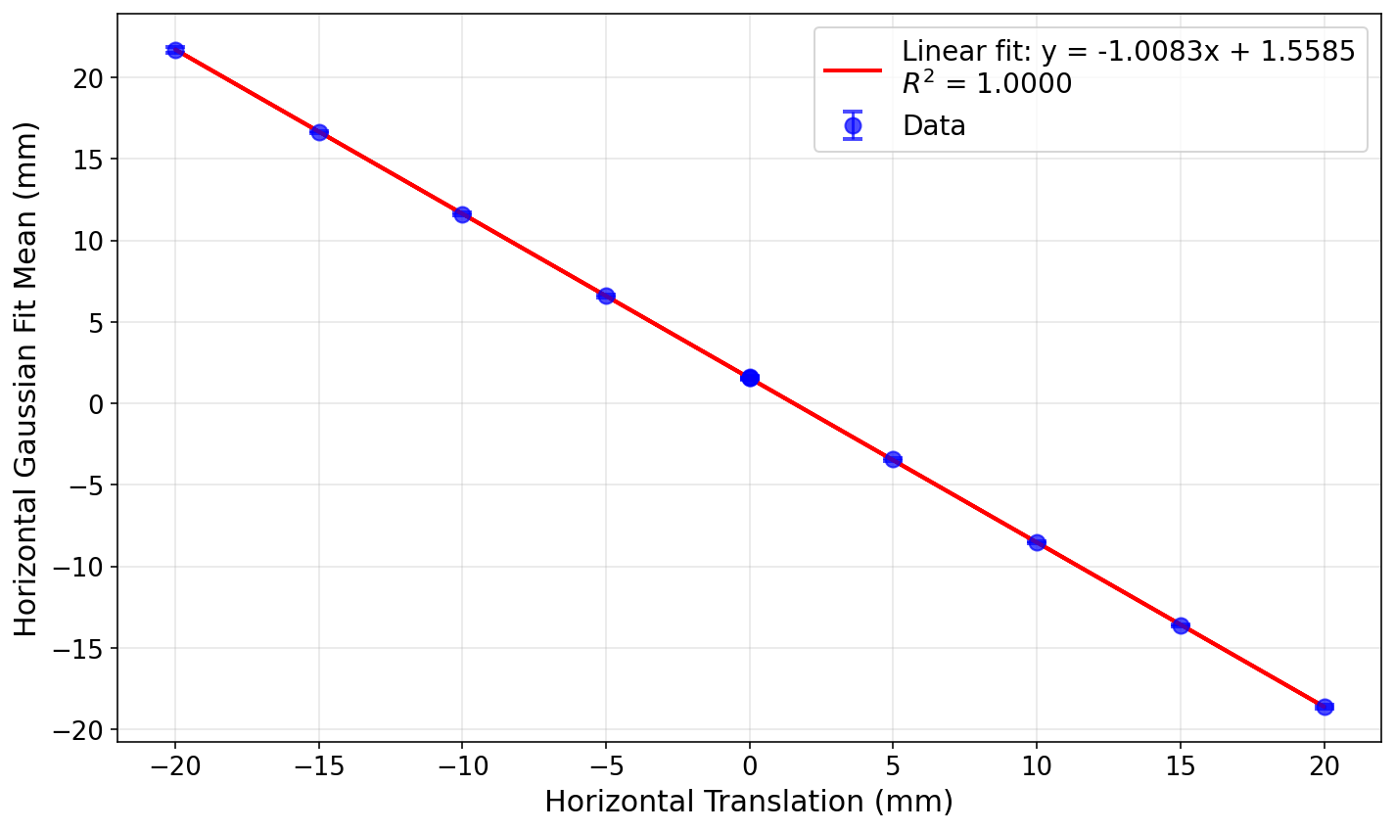
Position measurements using stage translation at 148 MeV 300 nA

Slide 27
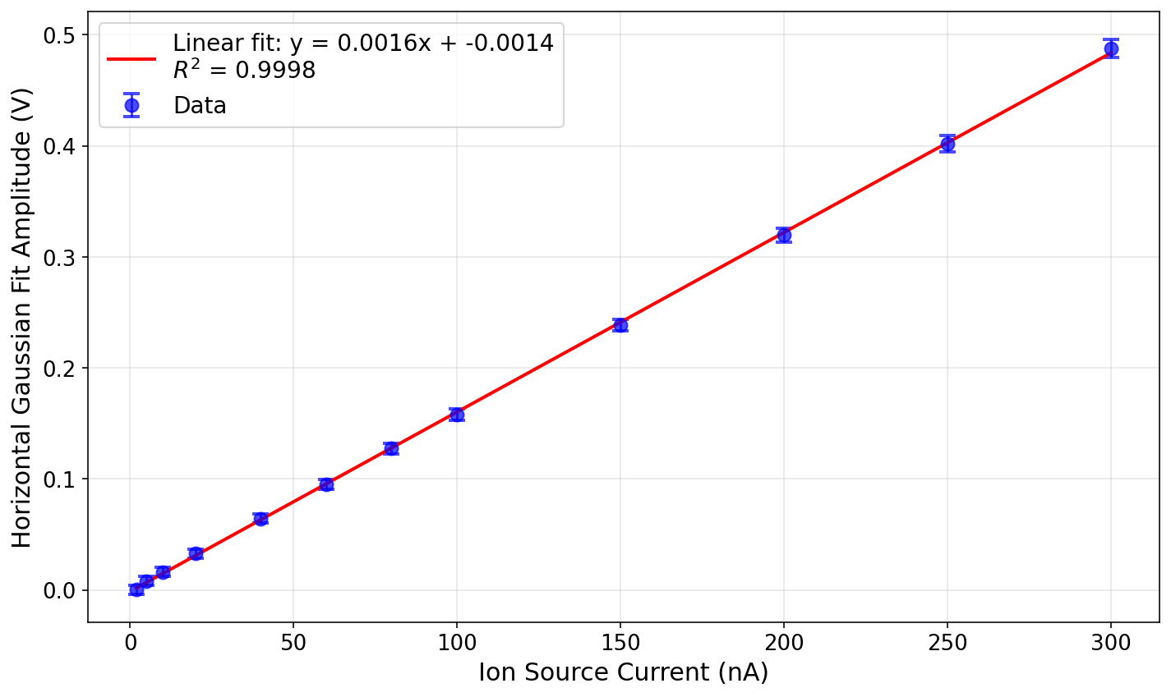
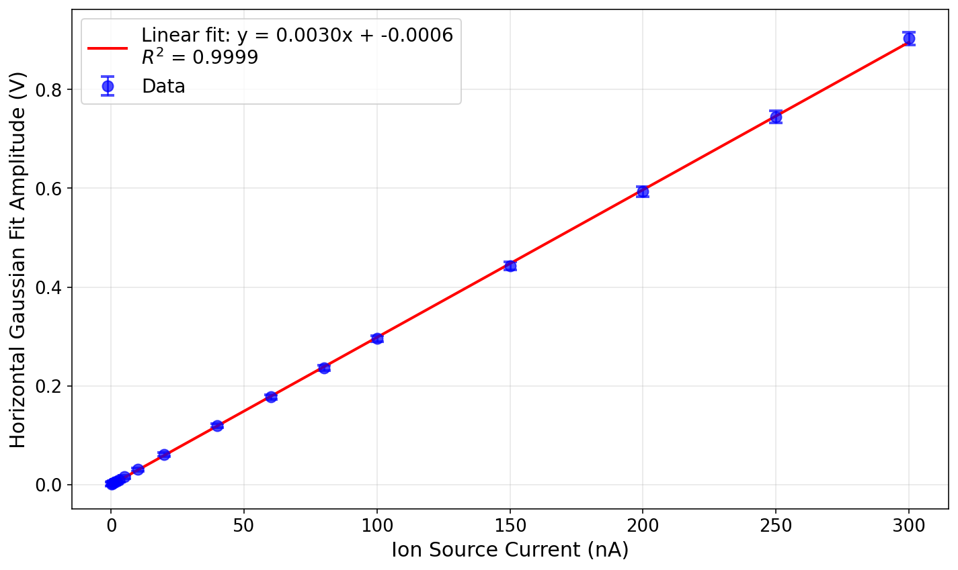
Response Linearity at 148 MeV (using Amplitude of Gaussian Fit on Horizontal Array)
Low gain
High gain

Slide 28
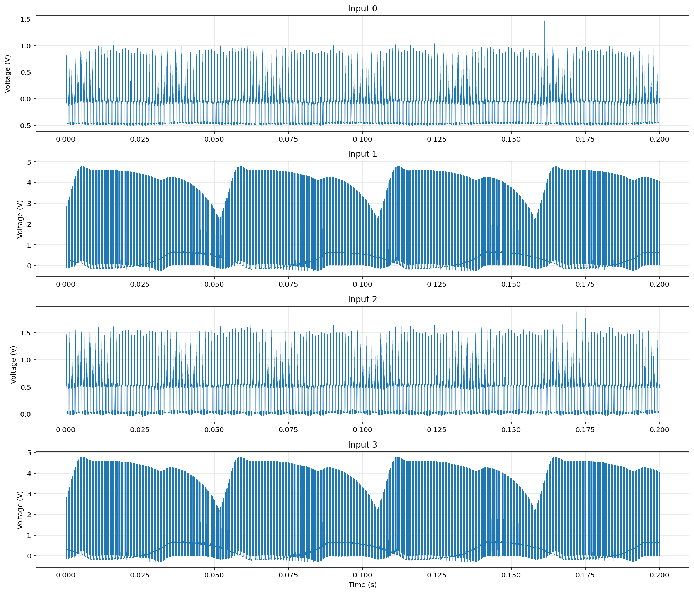
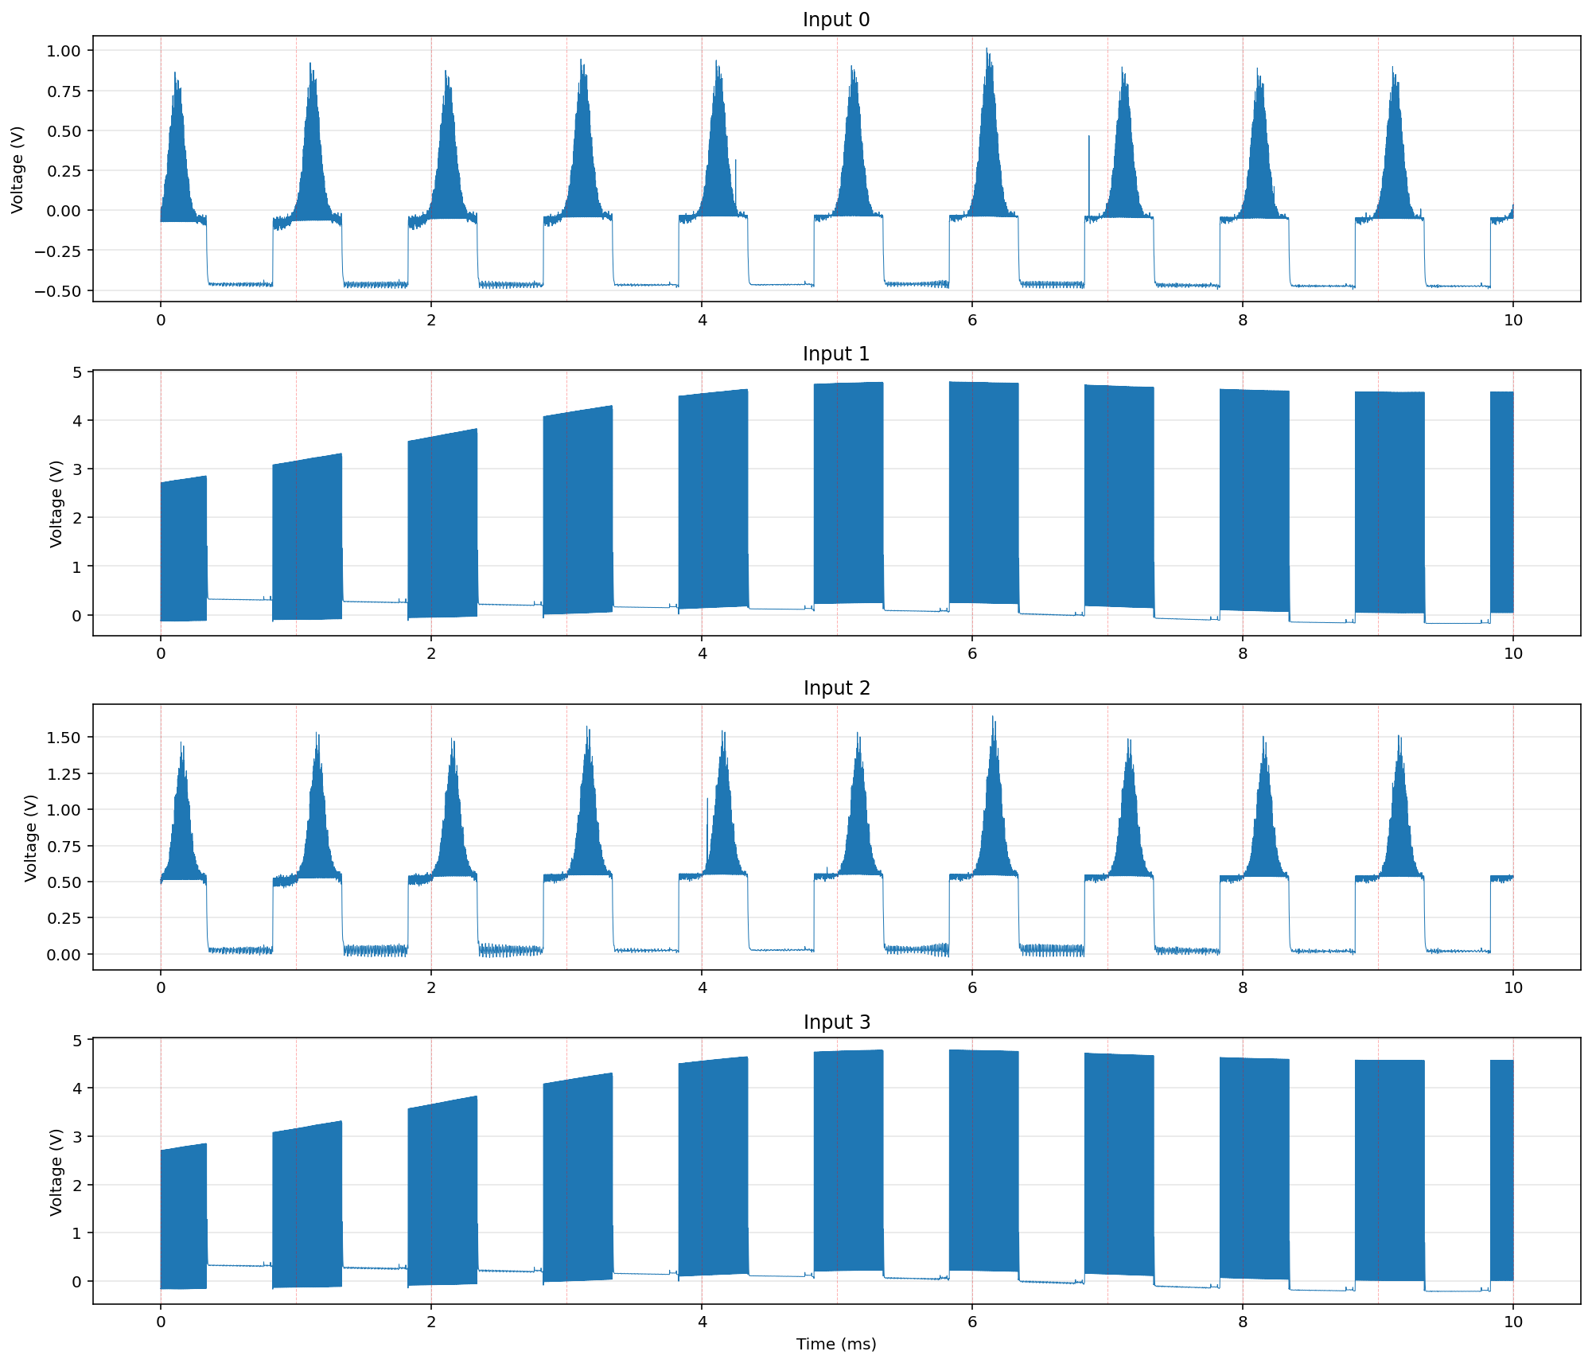
NI Output Traces
Video 1
Trigger 1
Video 2
Trigger 2

