Slide 1
UCL PBT Meeting
29-10-2025
Joe Bateman
University College London

Slide 2
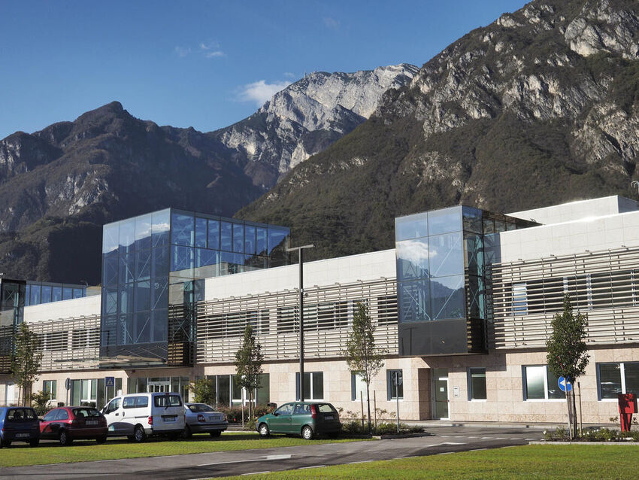
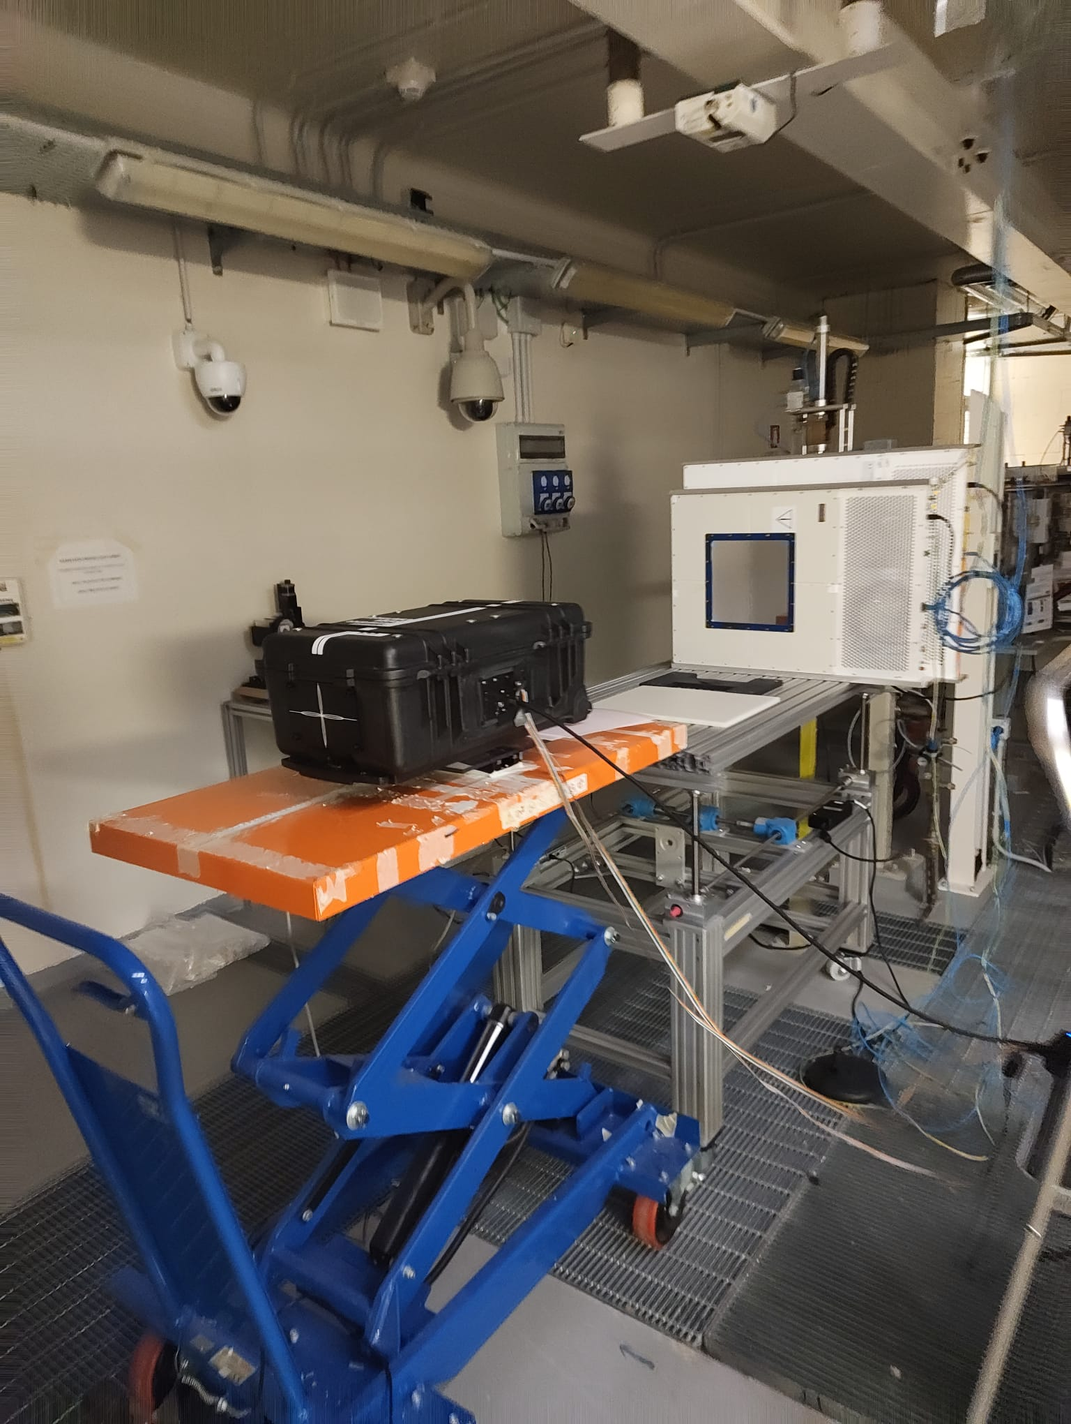
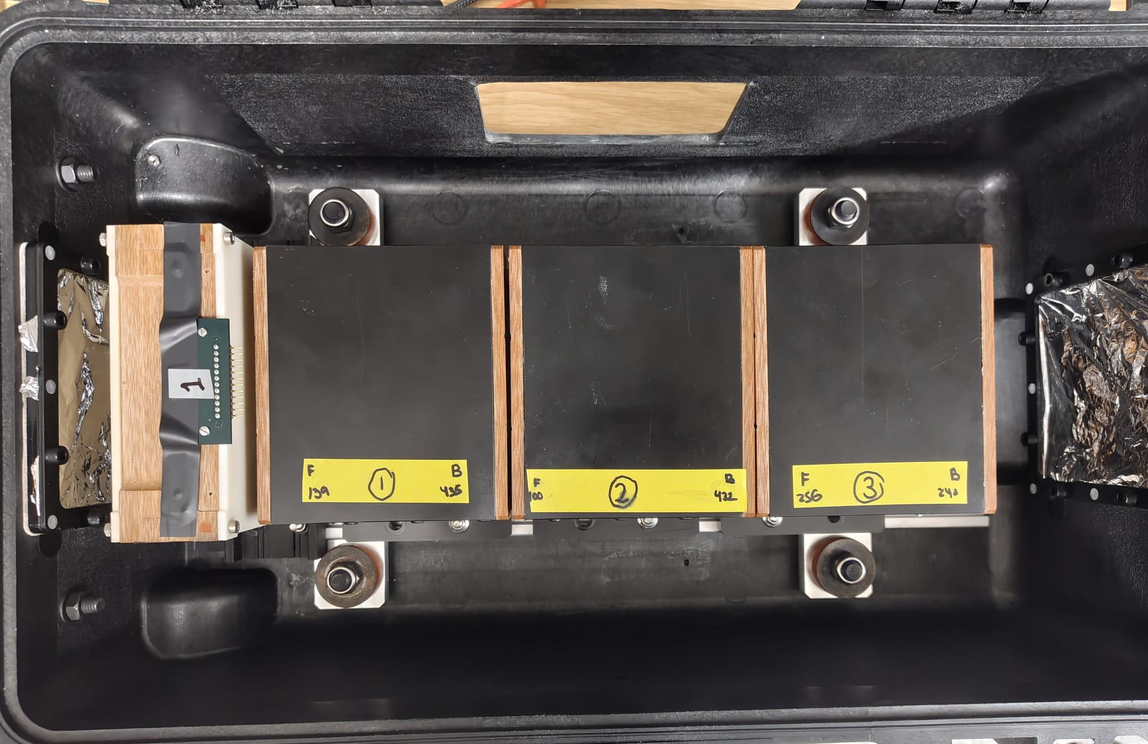
Trento Beam Test Summary
3 nights of measurements in the research room at Trento PTC
  Night 1: QuARC
    Calibrations and Bragg Peak measurements scaling current up to FLASH (briefly).
  Night 2: Combined QuARC + SciFi:
    Dynamic range testing (fibres at low gain)
    Beam position measurements
  Night 3: SciFi Measurements
    Dynamic range testing (fibres at high gain)
    Different spot sizes (varying energy)

Slide 3

Detector Calibration
$$coefficient\left[i\right]=\frac{ST_{back}\left[i\right]+ST_{front}[i]}{2}$$
245 MeV, back
245 MeV, front

Slide 4
Side A Shoot through comparisons
Module 1
Module 2
Module 3
PD Charge (pC)

Slide 5
Side B Shoot through comparisons
Module 1
Module 2
Module 3
PD Charge (pC)

Slide 6
Side A Calibrated
Module 1
Module 2
Module 3
Normalised PD Charge (a.u.)

Slide 7
Side B Calibrated
Module 1
Module 2
Module 3
Normalised PD Charge (a.u.)

Slide 8
Module 1
ST Front
ST Back

Slide 9
Module 1 High Current ST Front

Slide 10
Module 2
ST Front
ST Back

Slide 11
Module 3
ST Front
ST Back

Slide 12
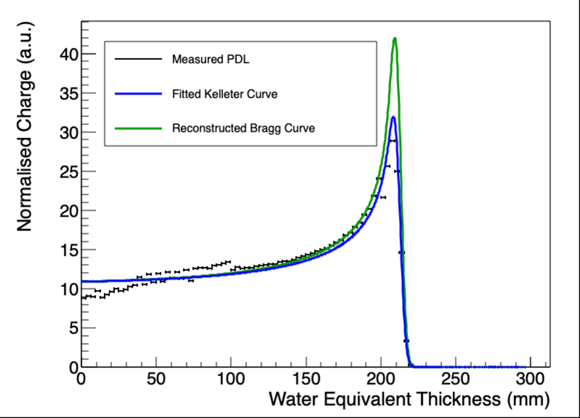
179 MeV 300 nA Side A
Fit restricted to +/- 5mm of peak
Fit over entire data set
E₀ = 178.68 MeV
kB = 0.10169
E₀ = 178.18 MeV
kB = 0.0995859

Slide 13
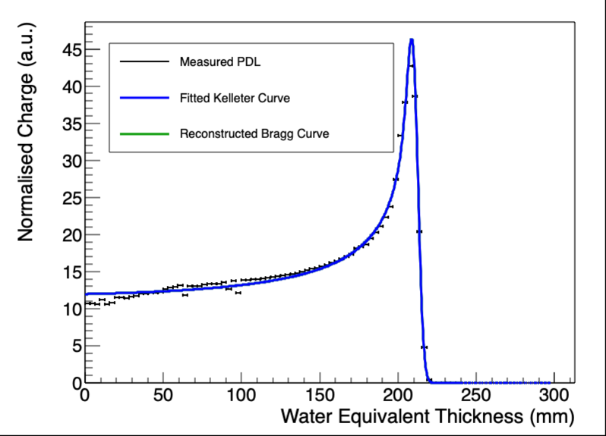
179 MeV 300 nA
Side A
Side B
E₀ = 178.18 MeV
kB = 0.0995859
E₀ = 177.9 MeV
kB = 1.87366e-05

Slide 14
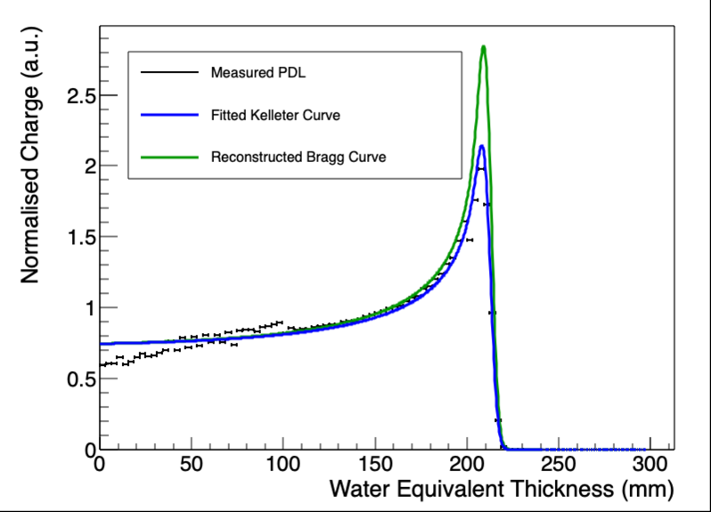
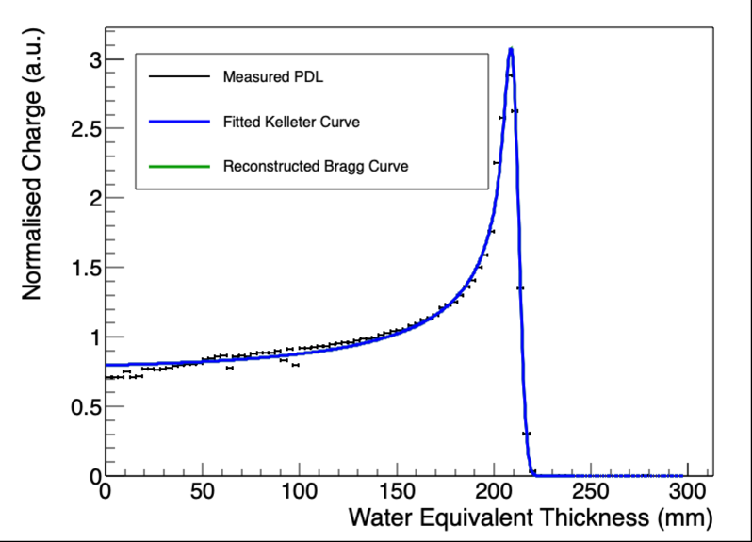
179 MeV 20 nA
Side B
Side A
kB = 0.105512
Sigma_0 = 3.11298
kB = 7.32185e-06
Sigma_0 = 3.03636

Slide 15
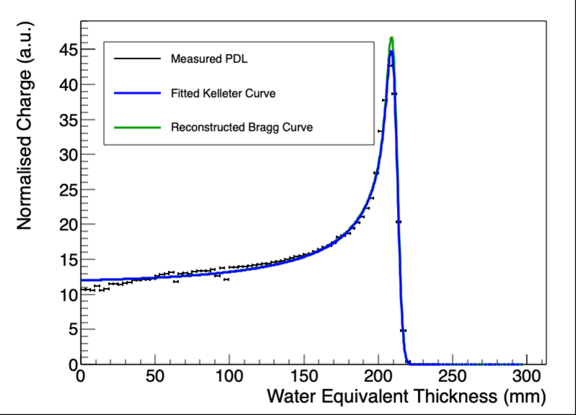
179 MeV 300 nA
Side A
Side B
E₀ = 179.98 MeV
kB = 0.01
(lower limit of restricted range: 0.01 – 0.15)
E₀ = 178.18 MeV
kB = 0.0995859

Slide 16
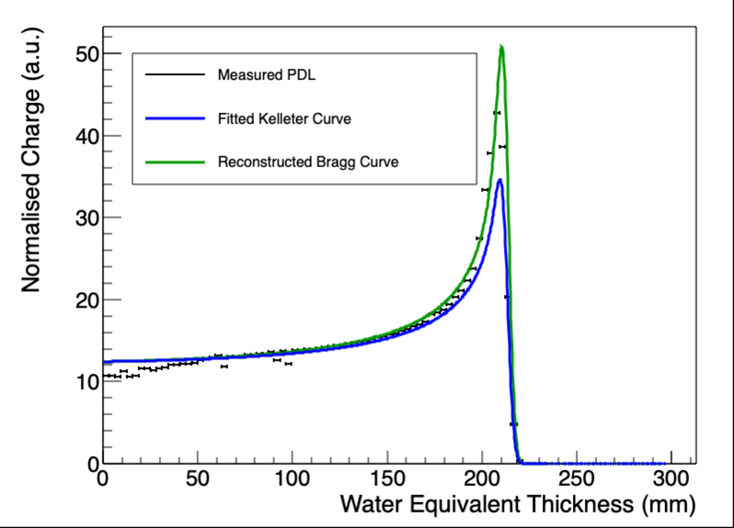
179 MeV 300 nA
Side A
E₀ = 178.59 MeV
kB = 0.15 (upper limit of restricted range: 0.05 – 0.15)
E₀ = 178.18 MeV
kB = 0.0995859

Slide 17
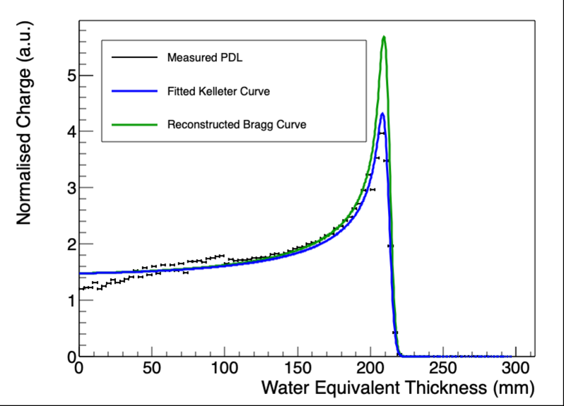

179 MeV 40 nA
Side A
Side B
E₀ = 178.18 MeV
kB = 0.10059
E₀ = 178.03 MeV
kB = 0.01 (lower limit of range)

Slide 18
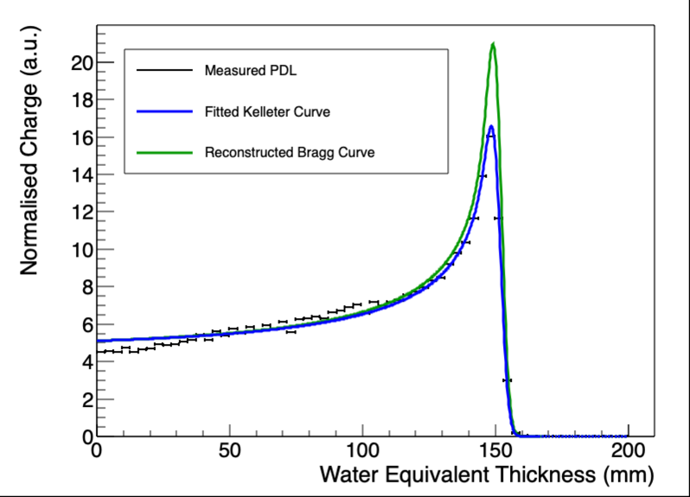
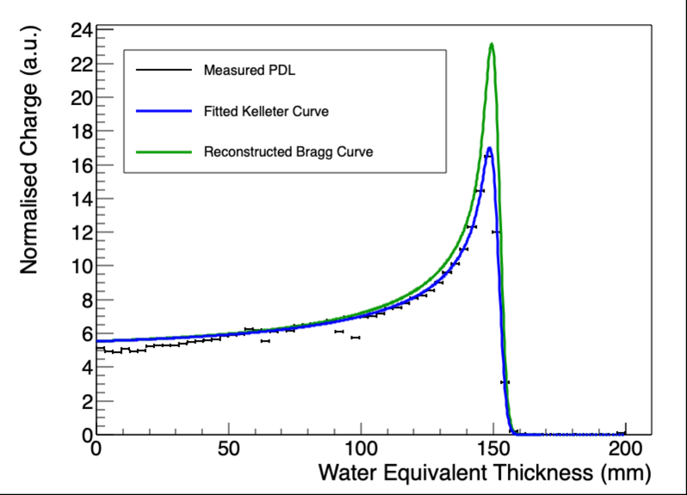
149 MeV Centered
A
B

Slide 19
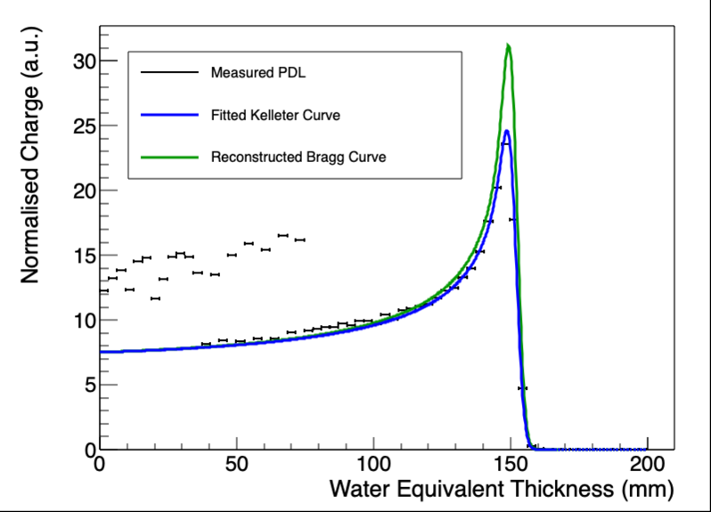
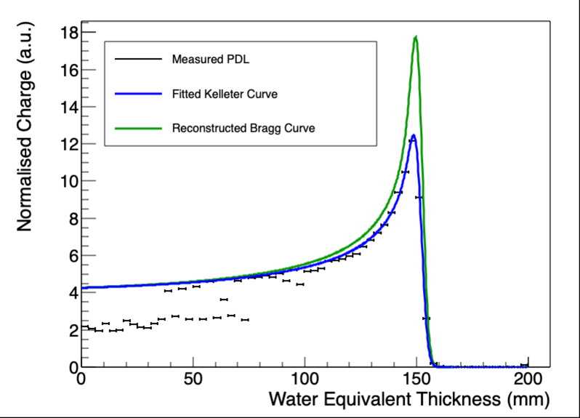
149 MeV Beam Spot 20 mm to right
A
B

Slide 20
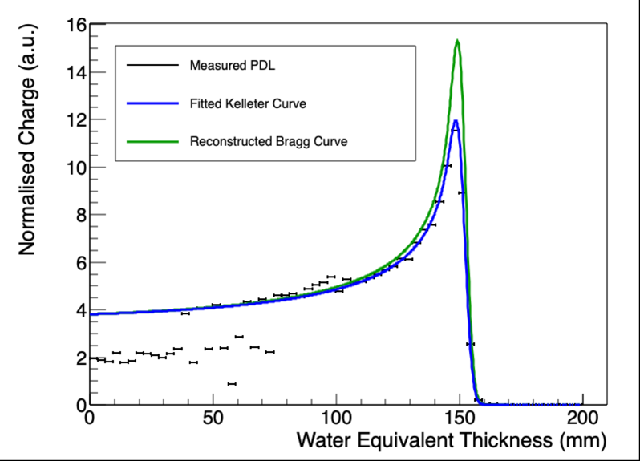

149 MeV Beam Spot 20 mm to left
A
B

Slide 21
Calibration Effect
Calibration disproportionally increases B-side signal around Bragg peak to make it look like a smaller kB.

Slide 22
Position Scan - reconstructed 148 MeV Bragg Curves
Beam 20mm to right
A: R₀ = 151.46 mm, E₀ = 146.9 MeV
B: R₀ = 151.73 mm, E₀ = 147.05 MeV
Avg: R₀ = 151.595 mm, E₀ = 146.975 MeV
Beam 20mm to left
A: R₀ = 151.47 mm, E₀ = 146.91 MeV
B: R₀ = 151.51 mm, E₀ = 146.93 MeV
Avg: R₀ = 151.49 mm, E₀ = 146.92 MeV
Beam in centre
A: R₀ = 151.29 mm, E₀ = 146.81 MeV
B: R₀ = 151.51 mm, E₀ = 146.93 MeV
Avg: R₀ = 151.4 mm, E₀ = 146.87 MeV

Slide 23
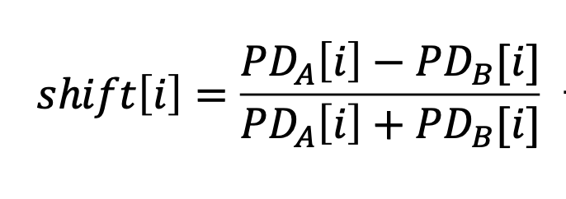

QuARC $Δ/Σ$ Measurements
Uncalibrated
Calibrated

Slide 24
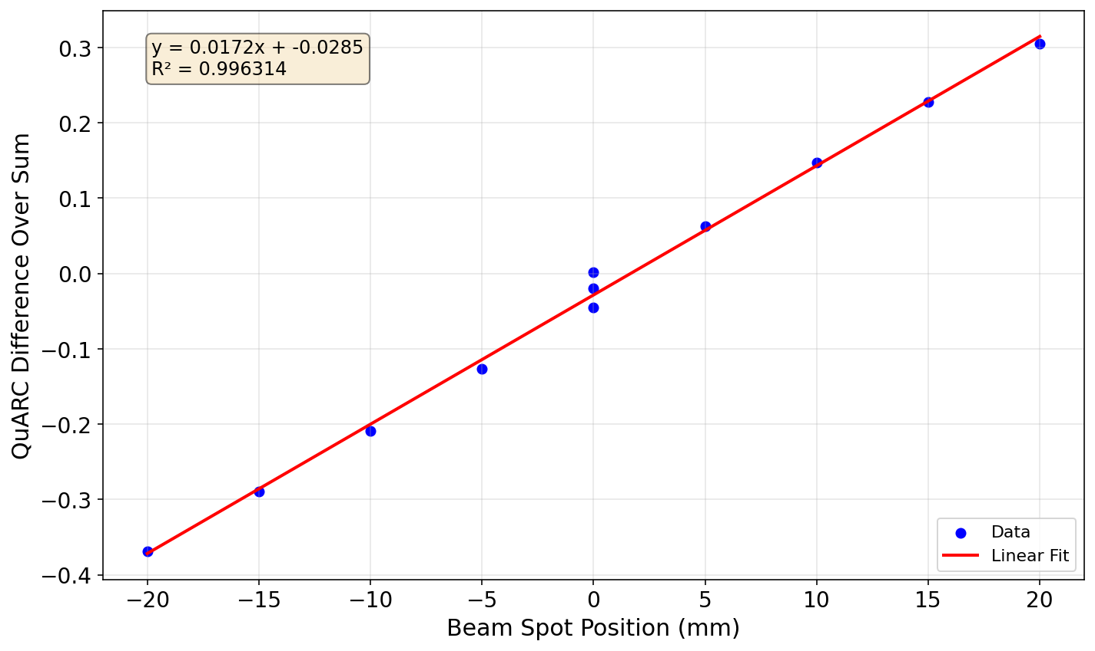
QuARC $Δ/Σ$ Measurements

Slide 25
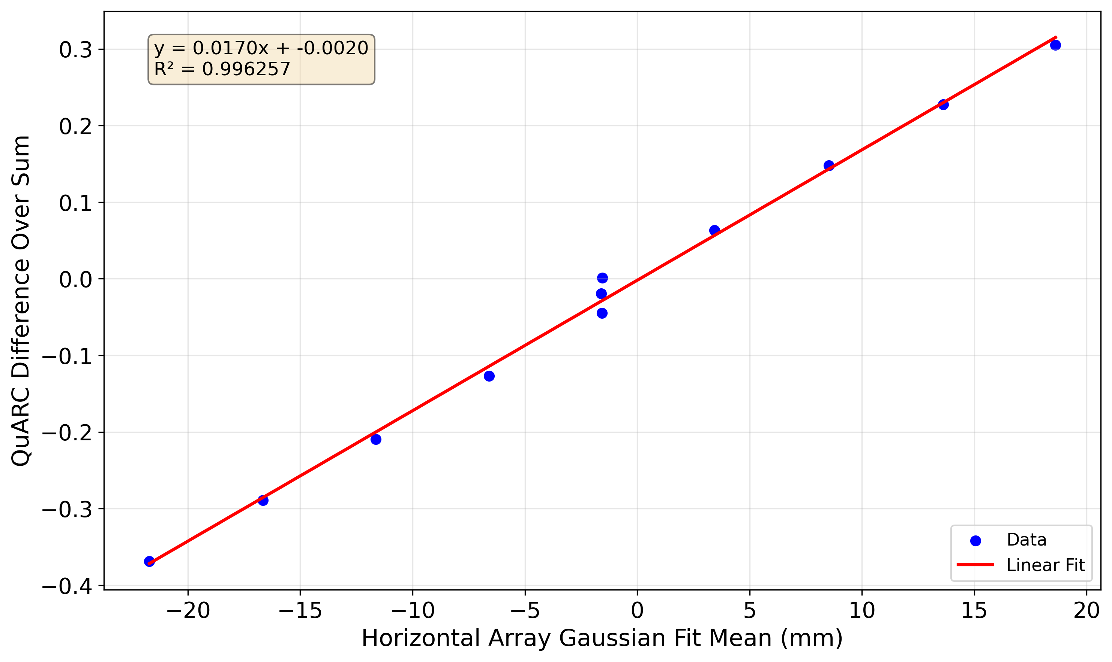

QuARC and Fibre Correlation
Uncentred
Centred
(fibre mean shifted by 1.60 mm)

Slide 26
QuARC and Fibre Correlation
Uncentred
Intercept is at -0.002 mm !!

Slide 27
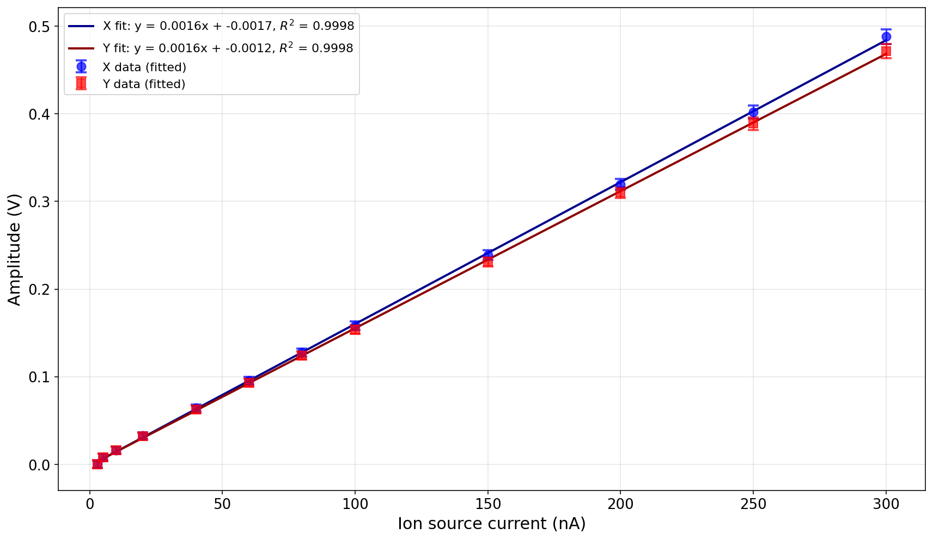
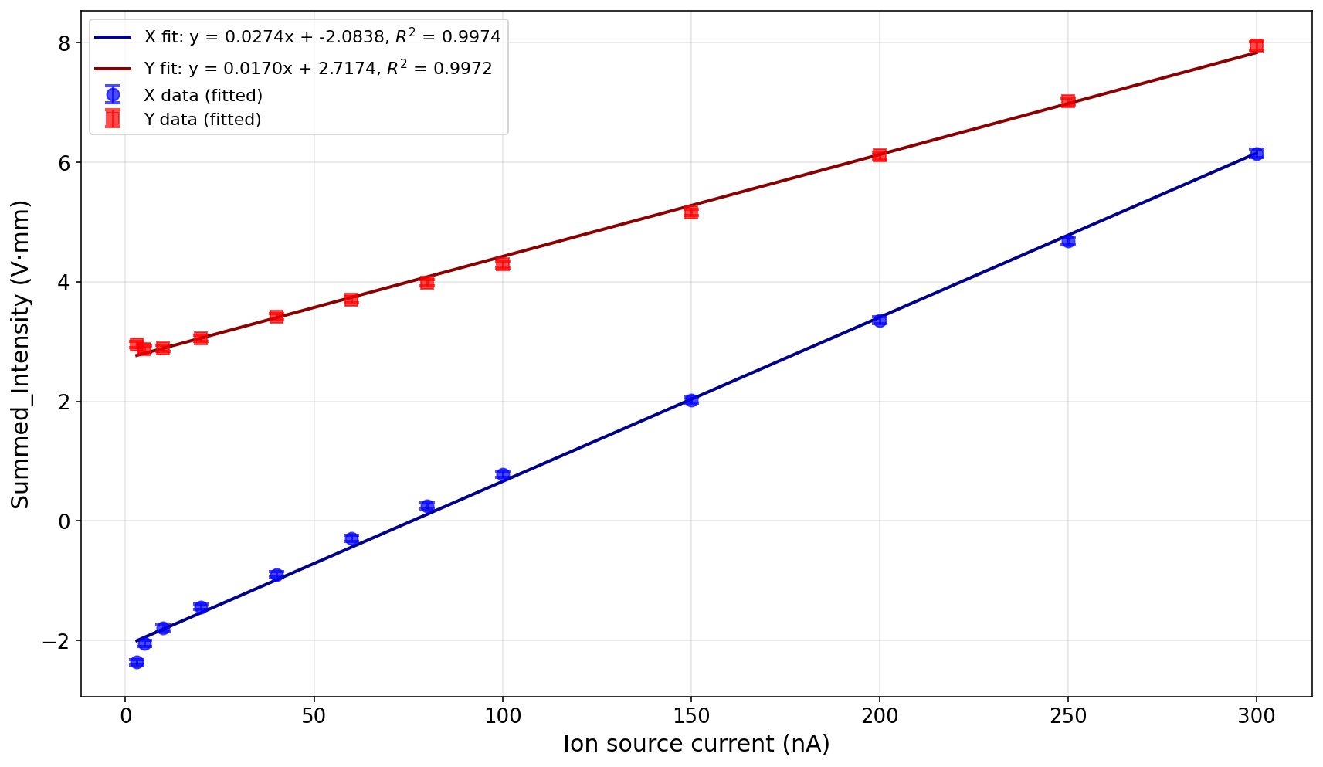
Fibre Linearity – 148 MeV Low Gain

Slide 28
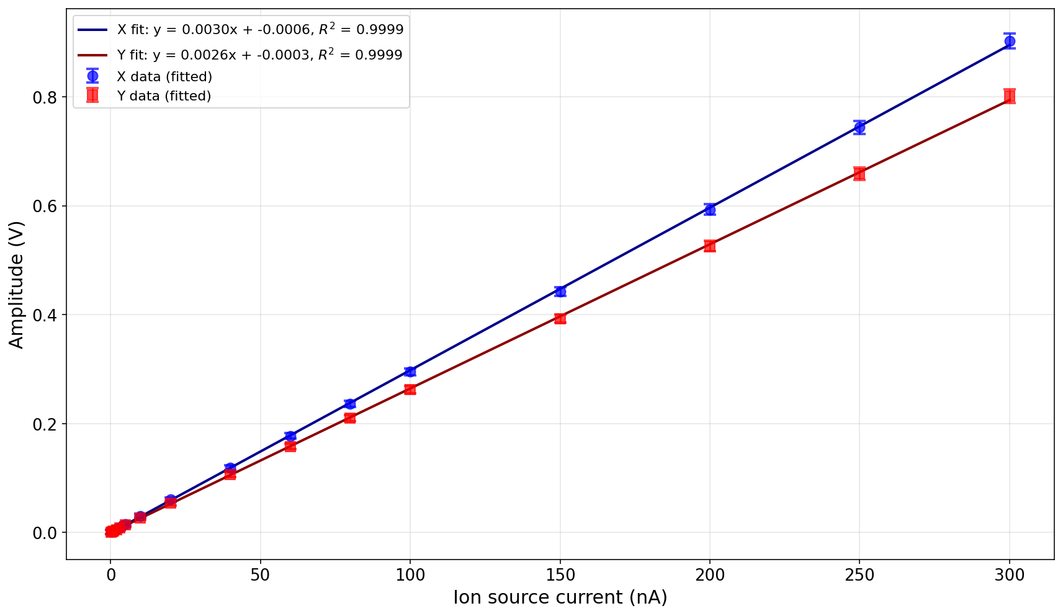
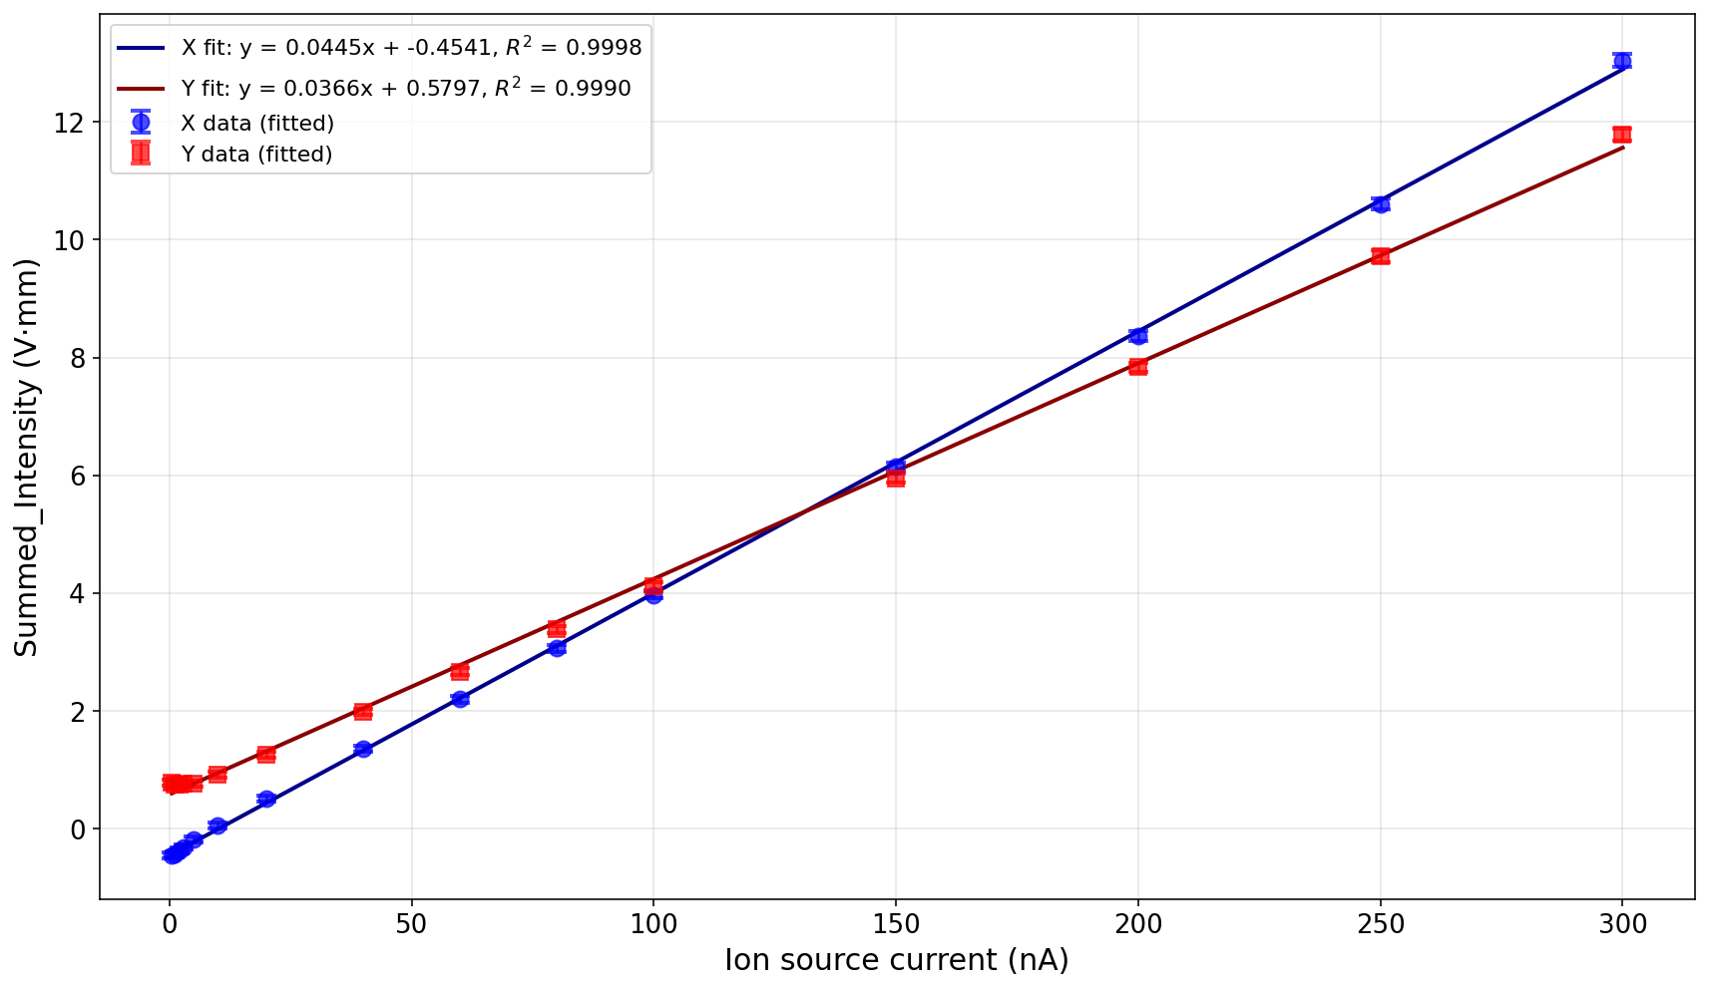
Fibre Linearity – 148 MeV High Gain

Slide 29
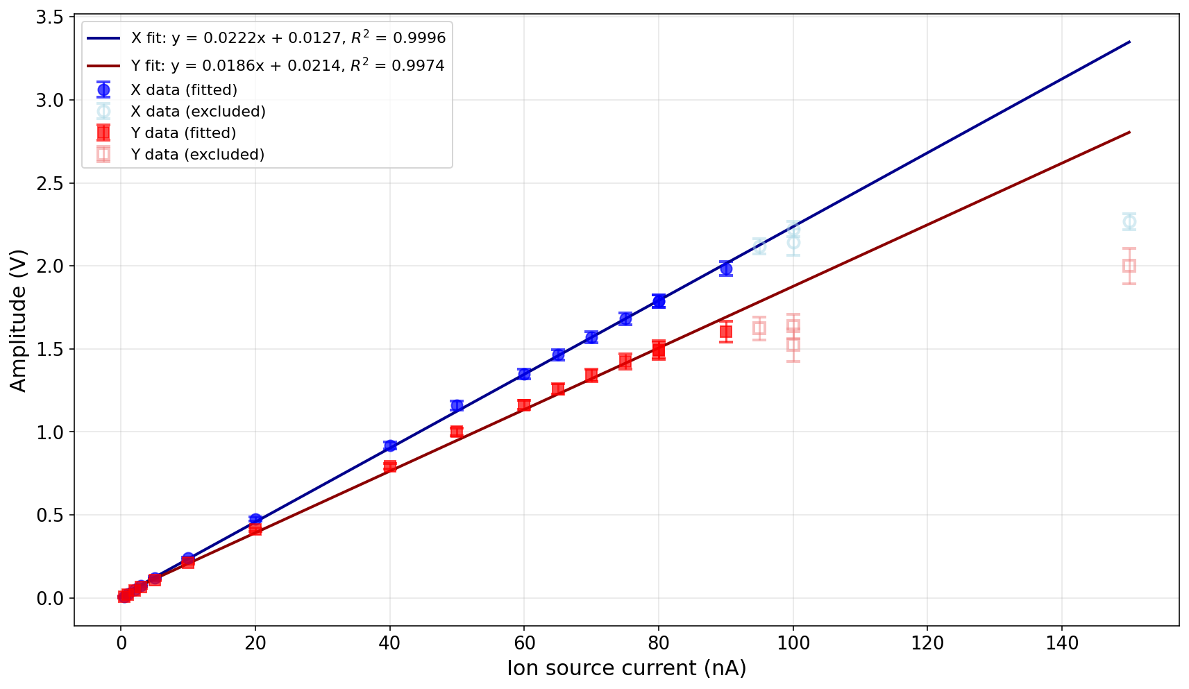
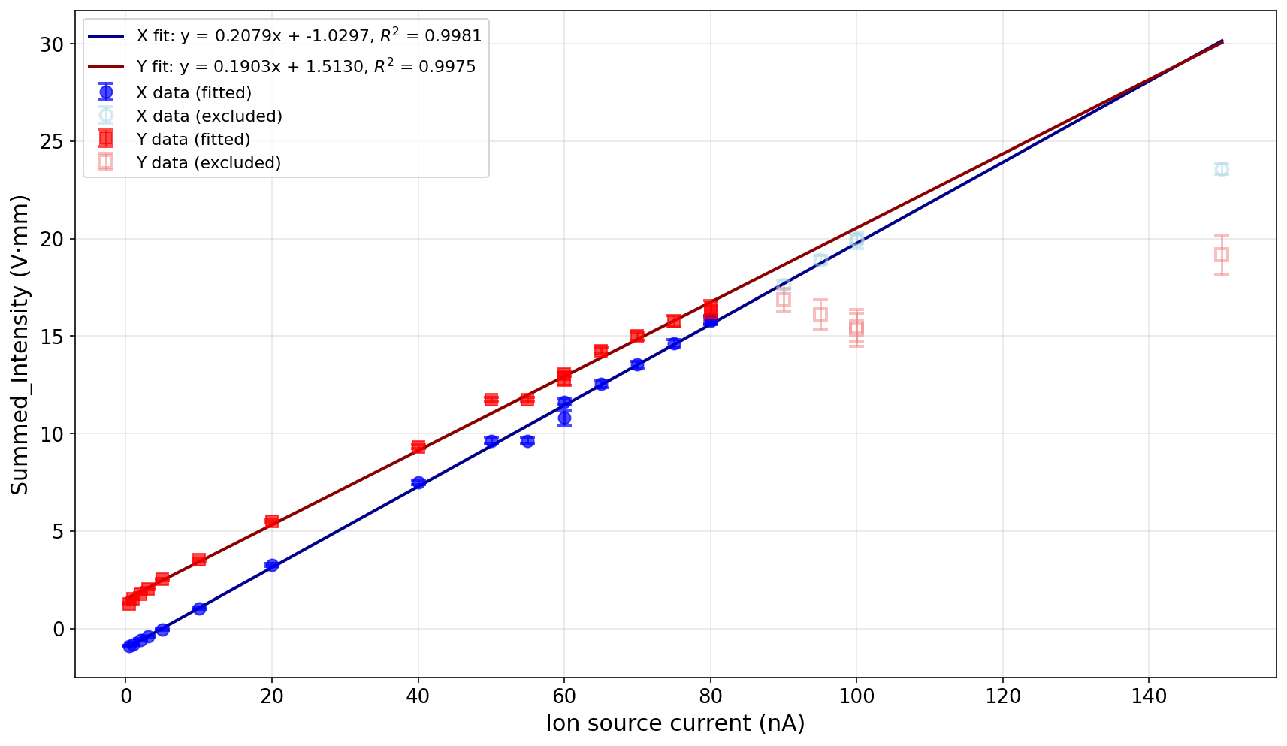
Fibre Linearity – 228 MeV High Gain

Slide 30
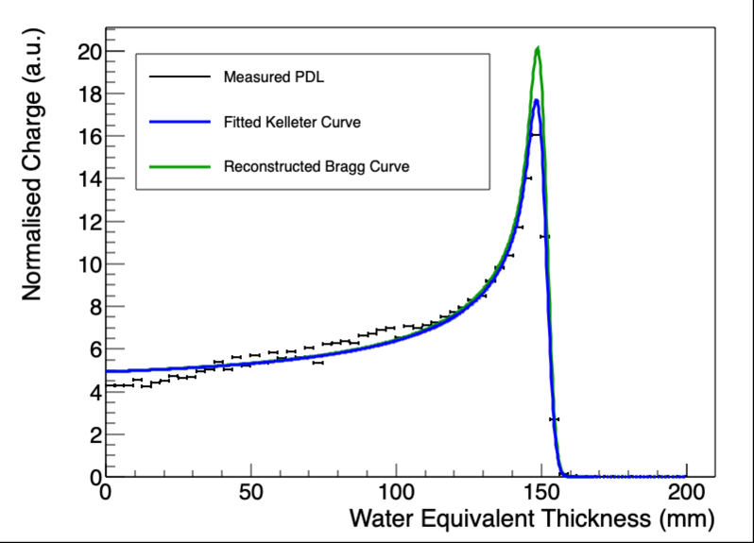
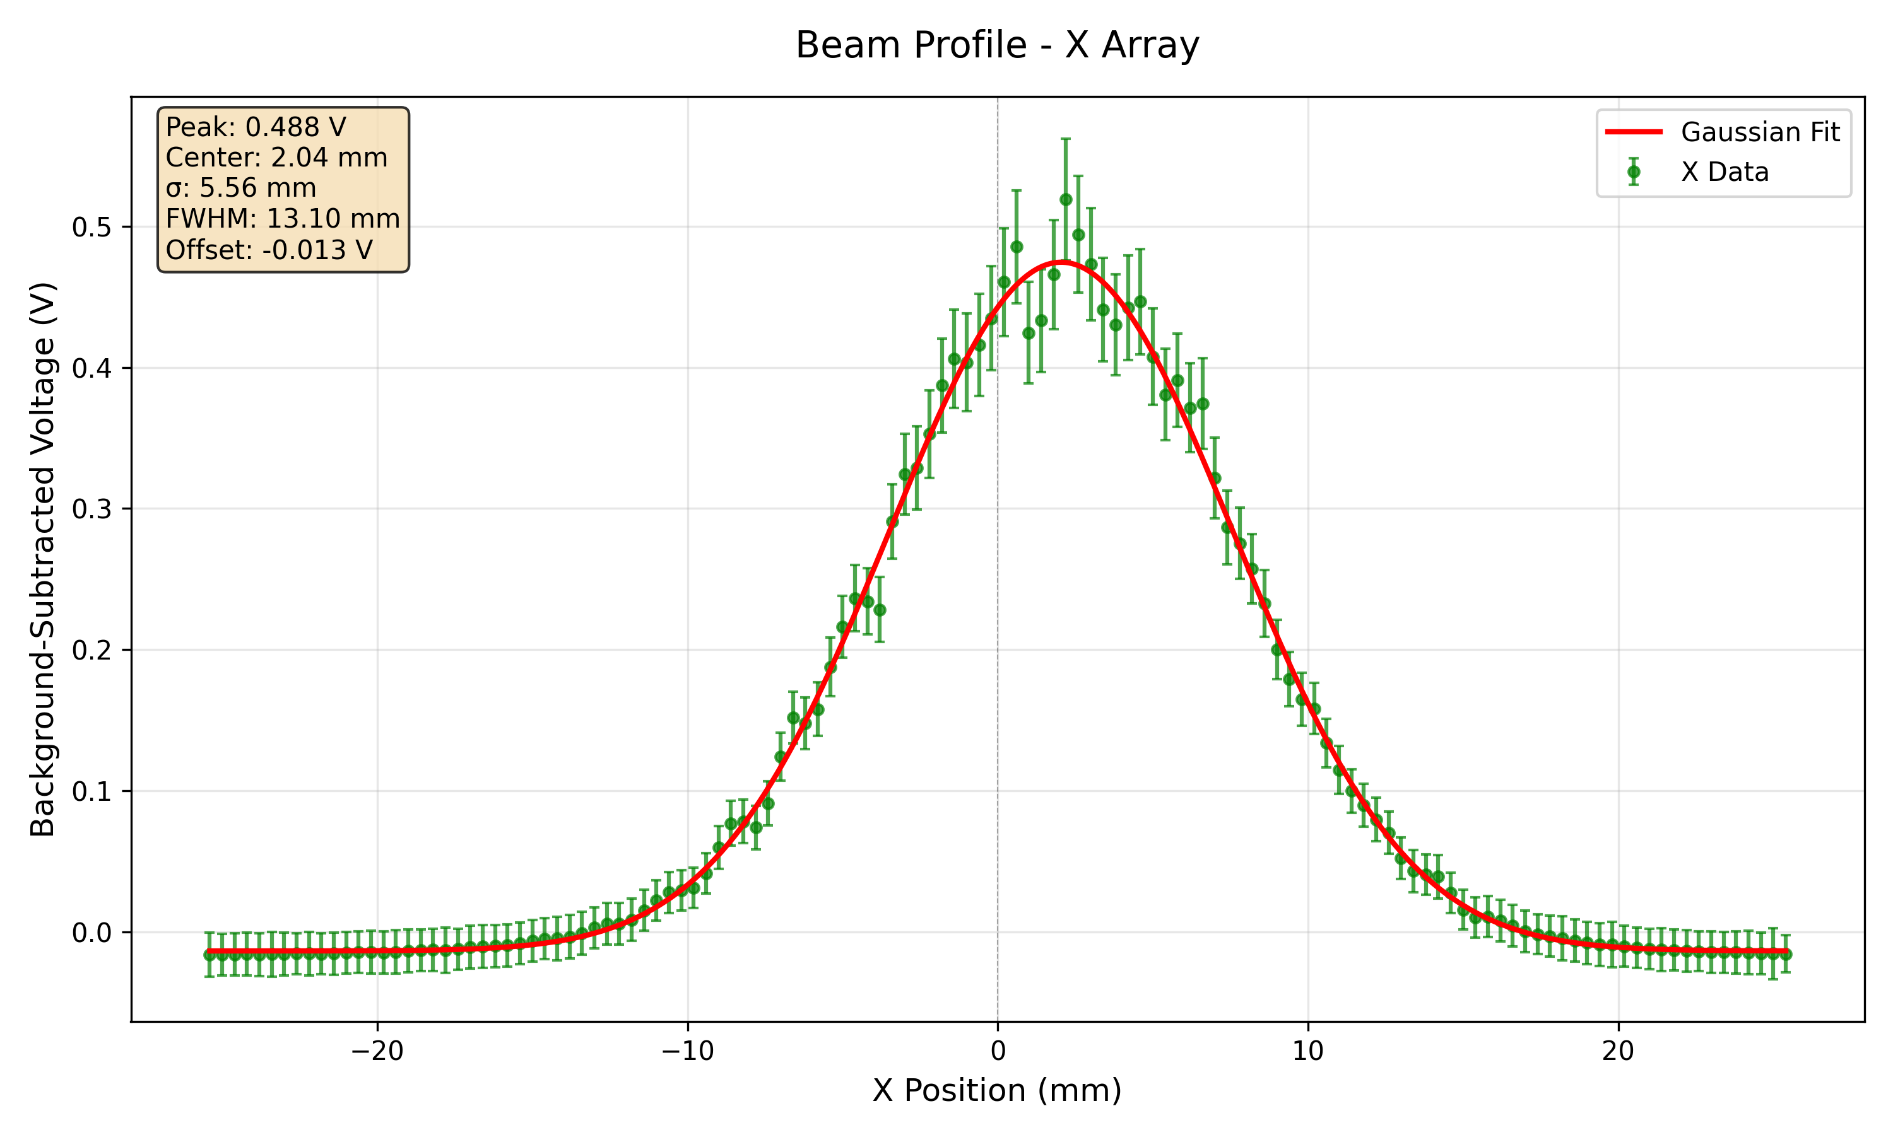
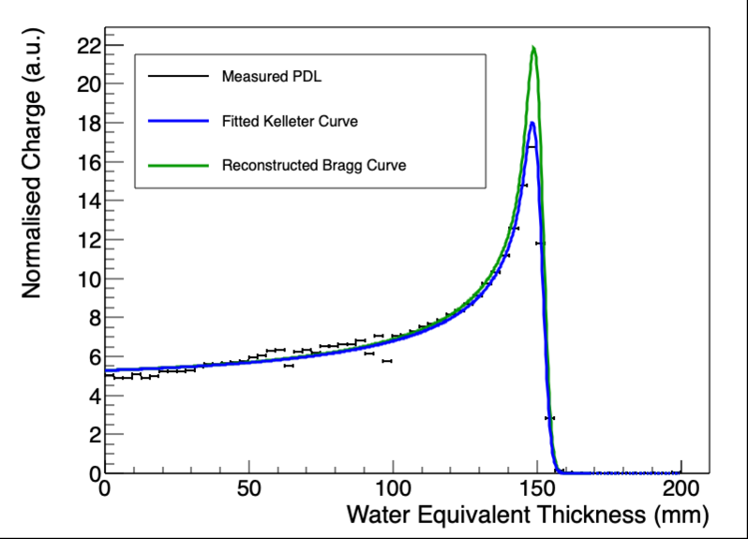
30/10 Run007 (300 nA 149 MeV)
A
B
Avg shift = -0.027795 -> 1.52 mm

Slide 31
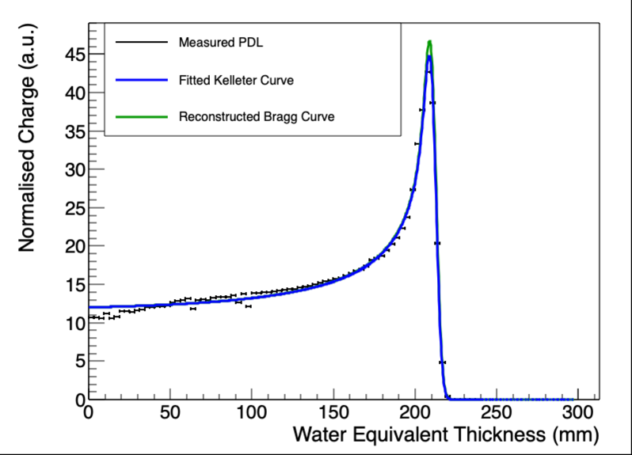
29/10 179 MeV 300 nA
A
B
Shift = -0.04924 - > 2.78mm

