Slide 1
UCL HEP PBT Meeting 26-11-2025
Joe Bateman
University College London

Slide 2
Analysis for paper
Dug into UCLH May 2025 beam test data to analyse single spot position SOBP and 5x5 box field for figures for paper.

Slide 3
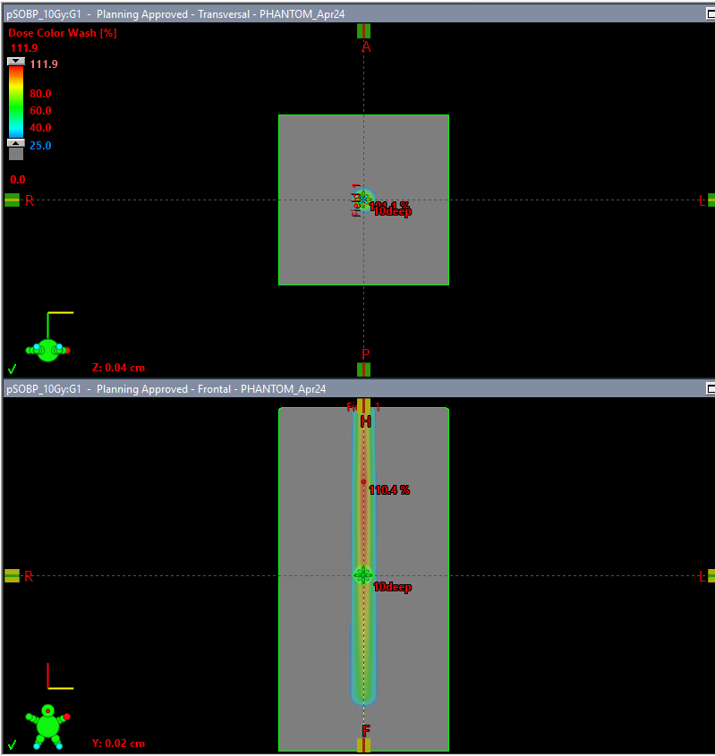
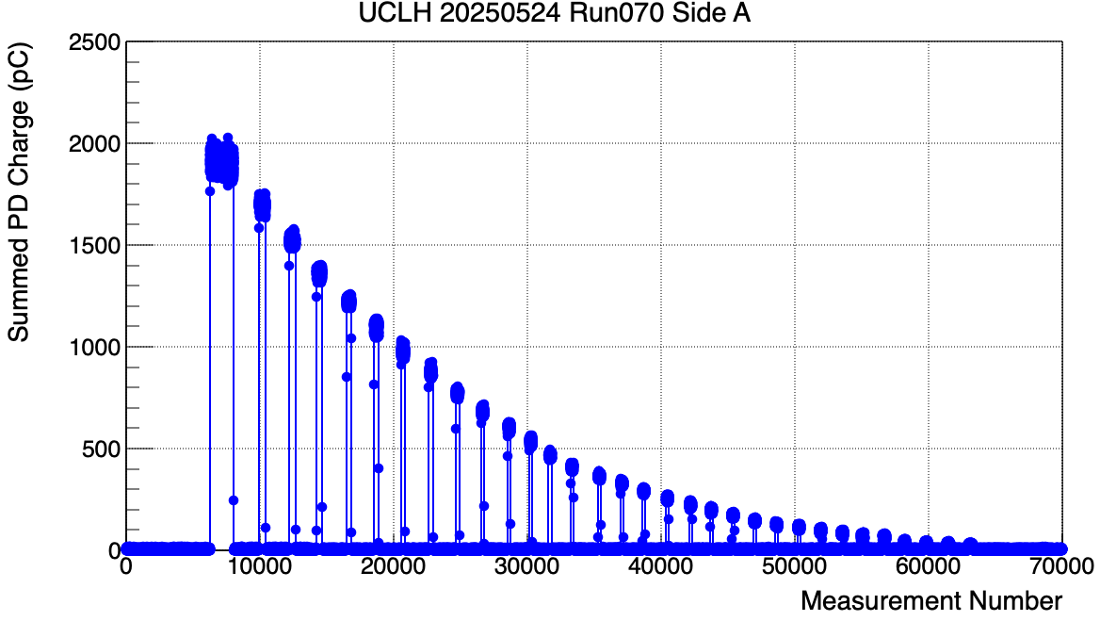
UCLH SOBP Reconstruction

Slide 4
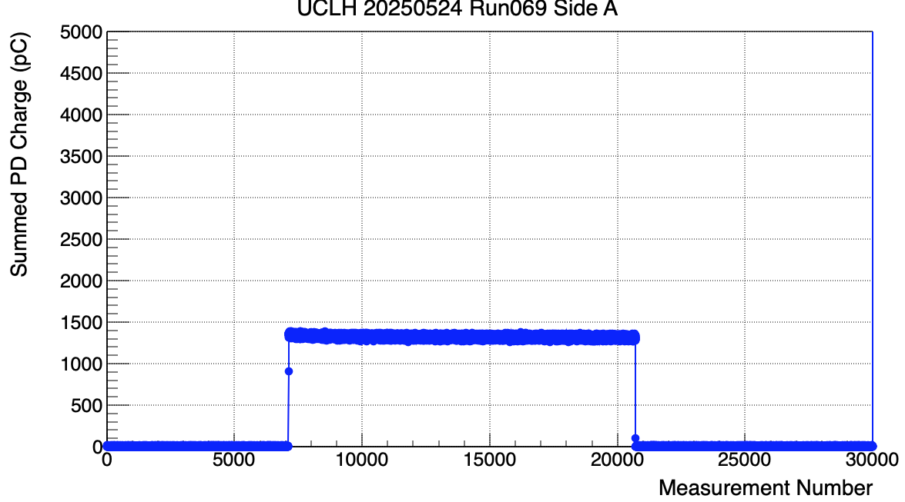
Pristine Bragg Peak Measurement

Slide 5
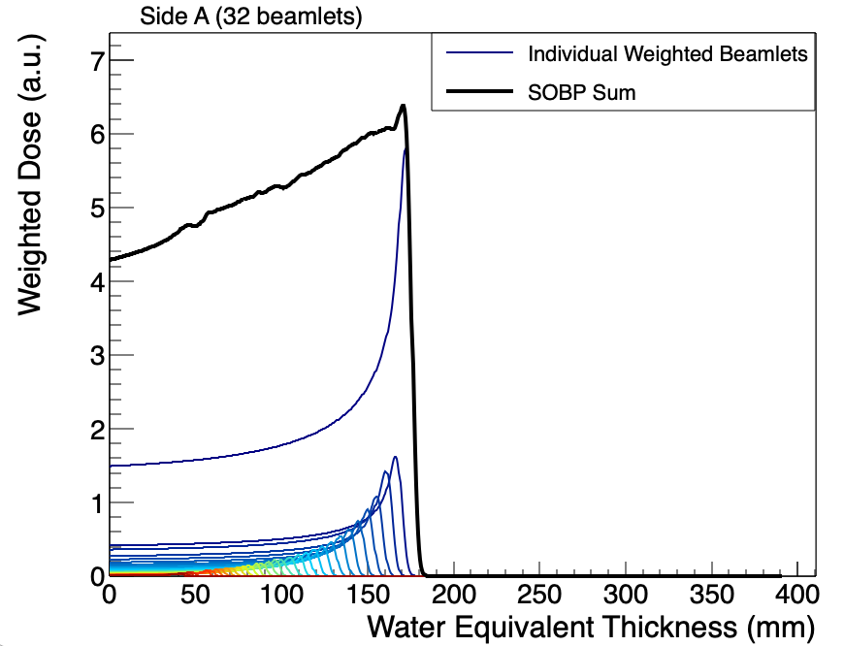
UCLH SOBP Reconstruction
Initial attempt weighting each BP (from averaged values across measurement) using total QuARC charge per beamlet

Slide 6
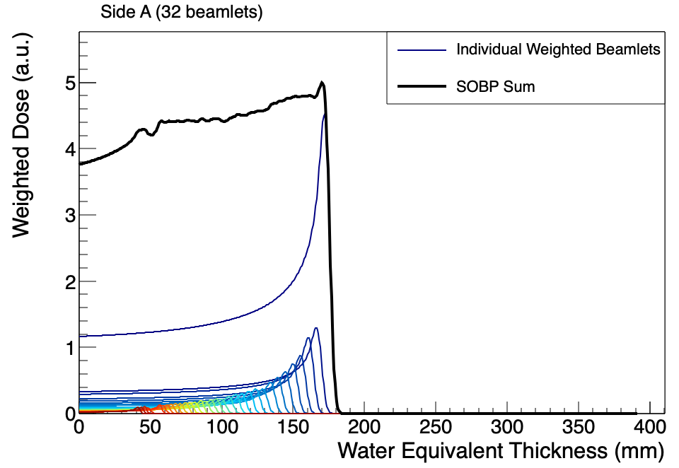
UCLH SOBP Reconstruction
SOBP Statistics
Plateau (90% level): 109.545 mm to 172.58 mm
Plateau width: 63.035 mm
Plateau mean : 4.68837 a.u.
Plateau std dev: 0.129093 a.u.
Flatness: 2.75347%

Slide 7
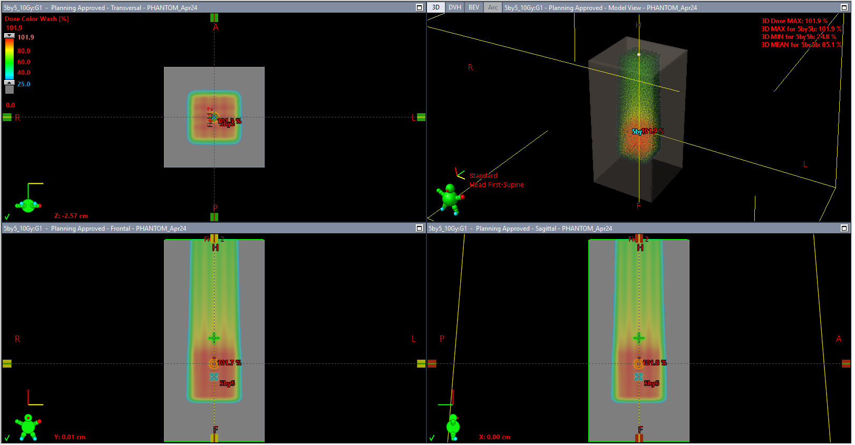
5x5x10 box field
-20 mm
0 mm
+20 mm
B
A

Slide 8
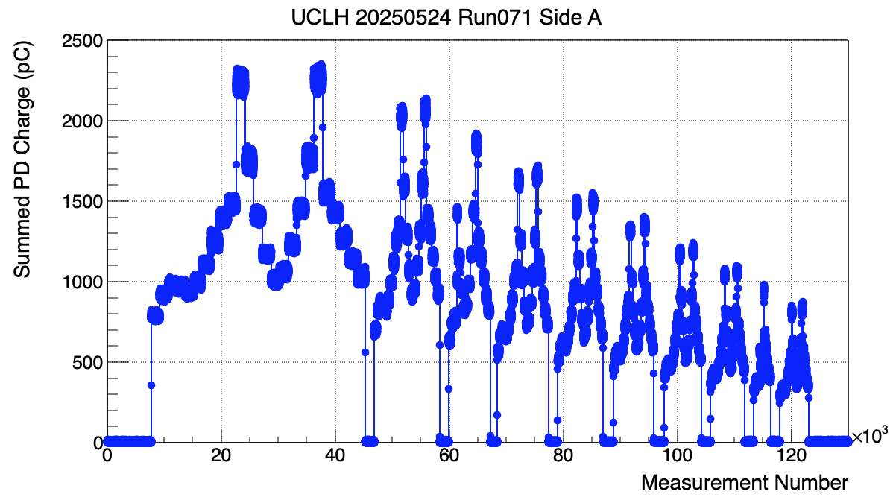
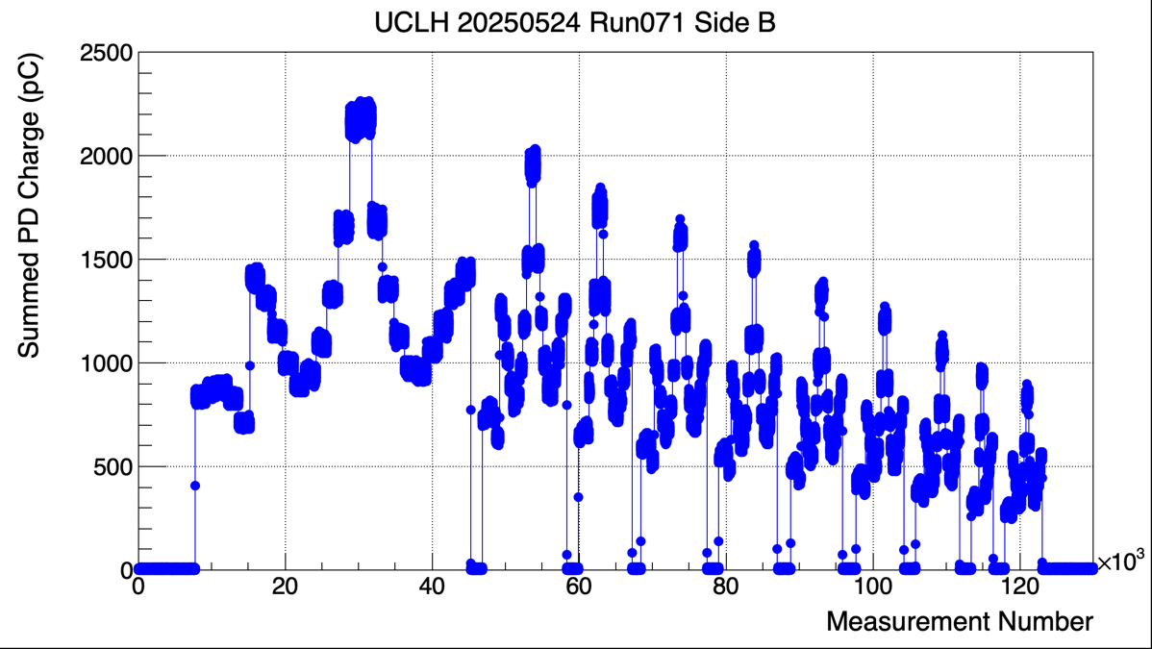
5x5x10 box field

Slide 9
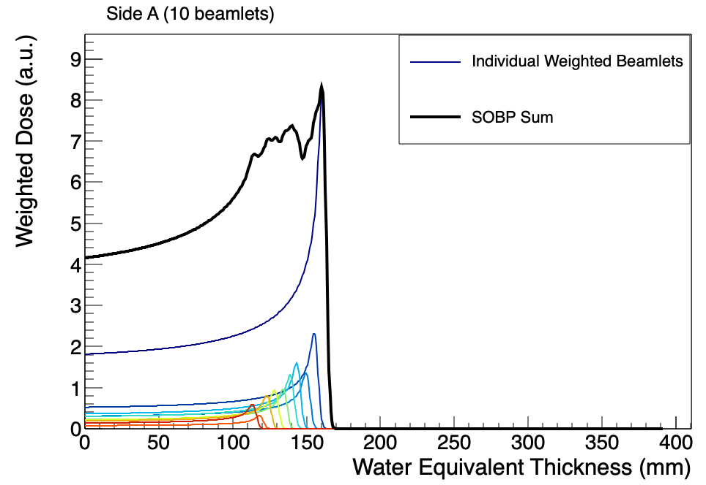
UCLH 5by5 box SOBP reconstruction

Slide 10
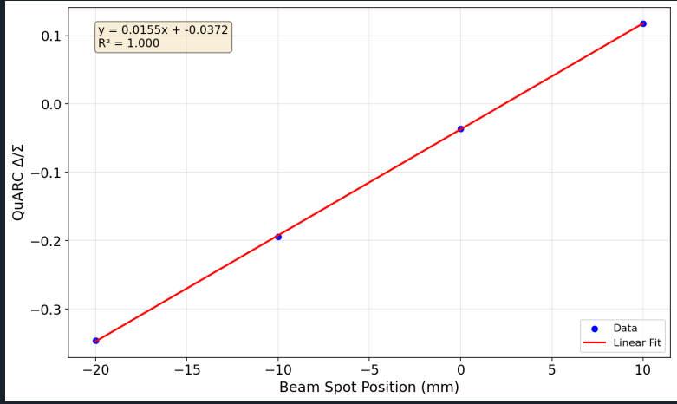
UCLH Couch Shifts
Couch shifted in 10 mm increments between -20 mm and 20 mm (although + 20 mm file overwritten)

Slide 11
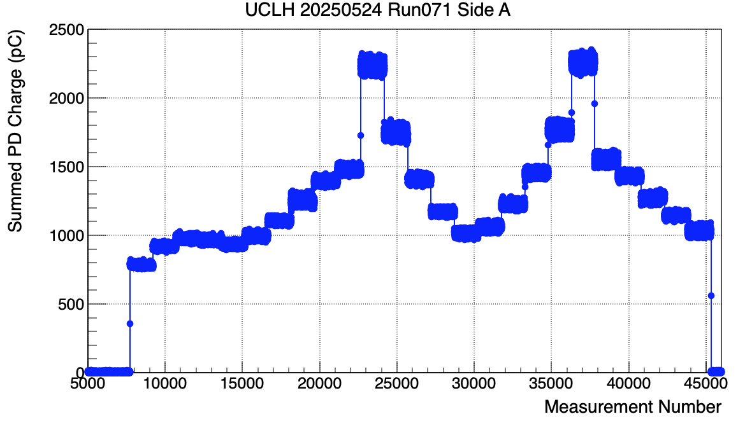
5x5x10 box field Layer 1 (153 MeV)
pb11
pb20
-20 mm
0 mm
+20 mm
B
A

Slide 12
UCLH 5x5x10 box field Layer 1 (153 MeV)
PB # | X Position (mm)
11 | 21.5734725
12 | 10.989817
13 | -0.0939031
14 | -11.01985
15 | -21.282869
16 | -20.01521
17 | -10.080626
18 | 0.11362465
19 | 10.5059938
20 | 20.9976154
-20 mm
0 mm
+20 mm
B
A
pb11
pb20

Slide 13
Other
Preparing slides for Nuvia on Prague, UCLH and Trento sheet response.
Downloaded community version of LabView on personal Mac to get to grips with LabView – will install full version Windows partition of dual-booted Intel MacBook

