Slide 1

Development of the QuADProBe:
A Comprehensive and Integrated Detector for Proton Therapy Machine QA and PSQA
Joseph J. Bateman
Sonia Escribano-Rodriguez, Febian, Raffaella Radogna, Simon Jolly
University College London
PPRIG 2025

Slide 2
QuADProBe
QuADProBe: Quality Assurance Detector for Proton Beam Therapy
Aims:
  Develop a robust and affordable detector capable of providing:
  All necessary beam measurements for PBS Machine QA: dose output, spot size, spot position and energy.
  Real-time measurements of these parameters during a PSQA “dry-run”.

Slide 3
The Future of PSQA
Phantom Measurement-based PSQA
Direct physical verification of dose delivery
Captures the entire delivery chain including beam transport system effects
Heavily time and resource consuming
Need to replan for water phantom/detector
Only measures certain points of dose distribution
Phantomless Log File-based PSQA
Fast and automated
Can analyse every fraction and compare 3D dose distributions in patient anatomy
Doesn’t directly measure dose
Relies on accuracy of machine log recording system
Doesn’t check file transfer and beam delivery
VS

Slide 4
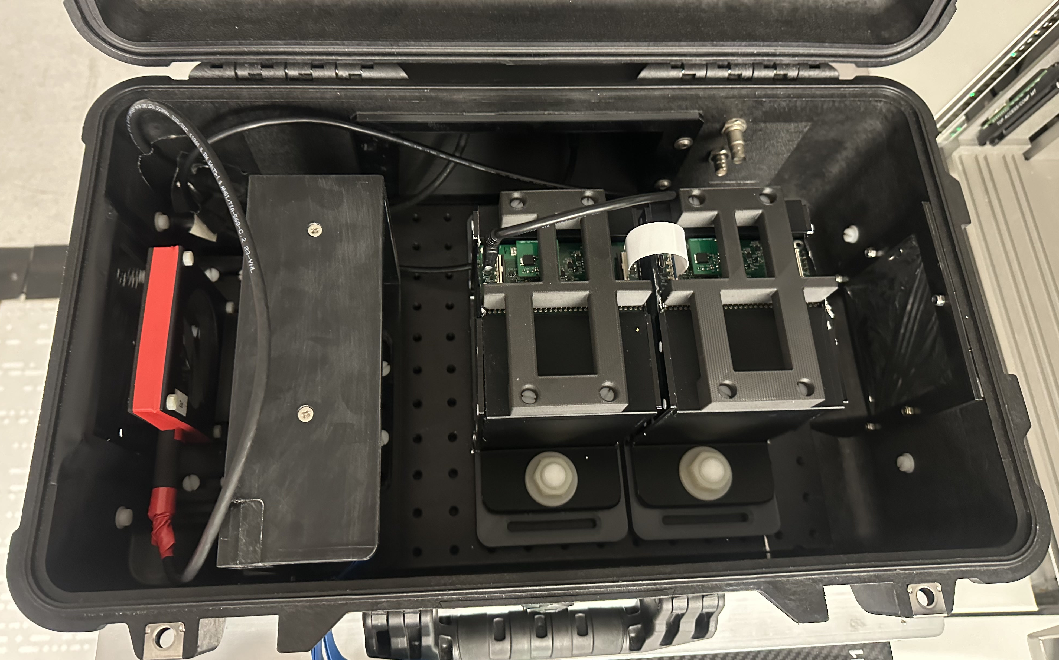
The QuADProBe
Absolute Dose: NPL Transmission Calorimeter (TC)
Water Equivalent Range: UCL QuARC Range Telescope
Protons
Spot Size + Position: LASSENA CMOS Pixel Sensor
Enclosure: Peli 1510 flight case with patch panel

Slide 5
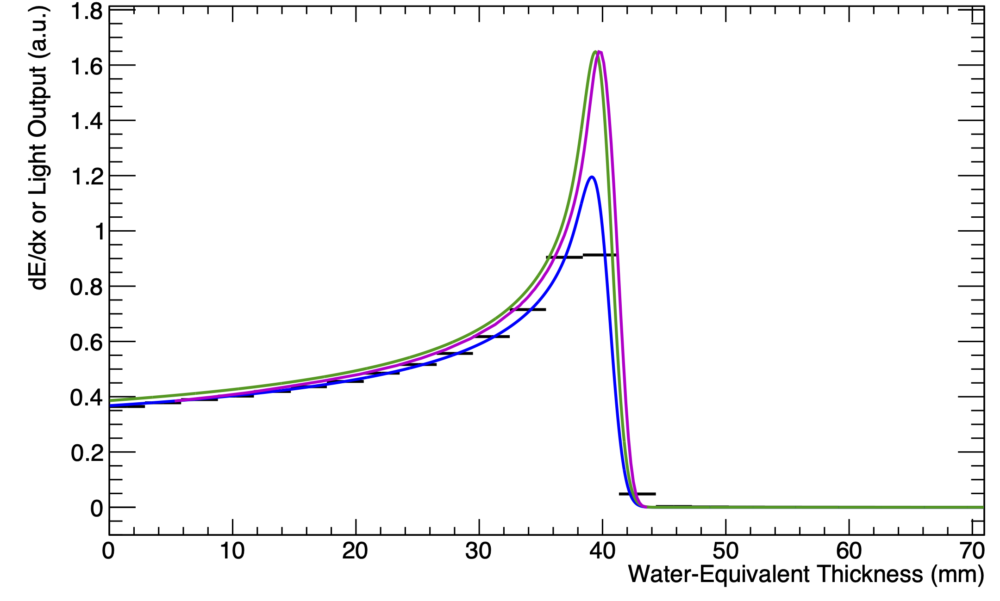
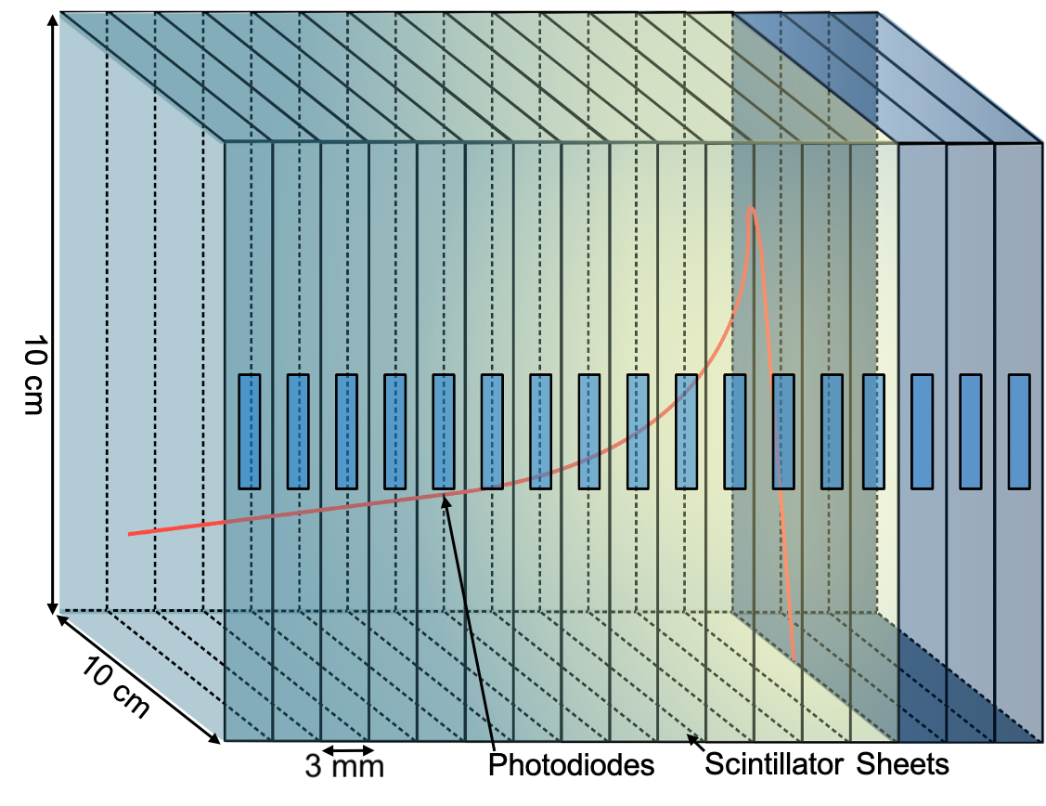
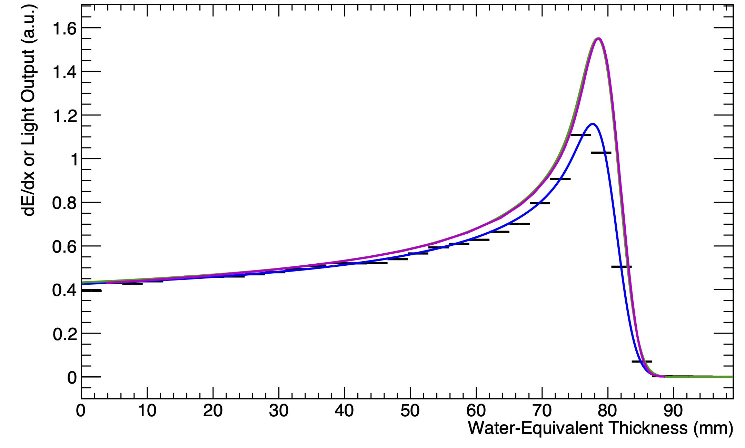
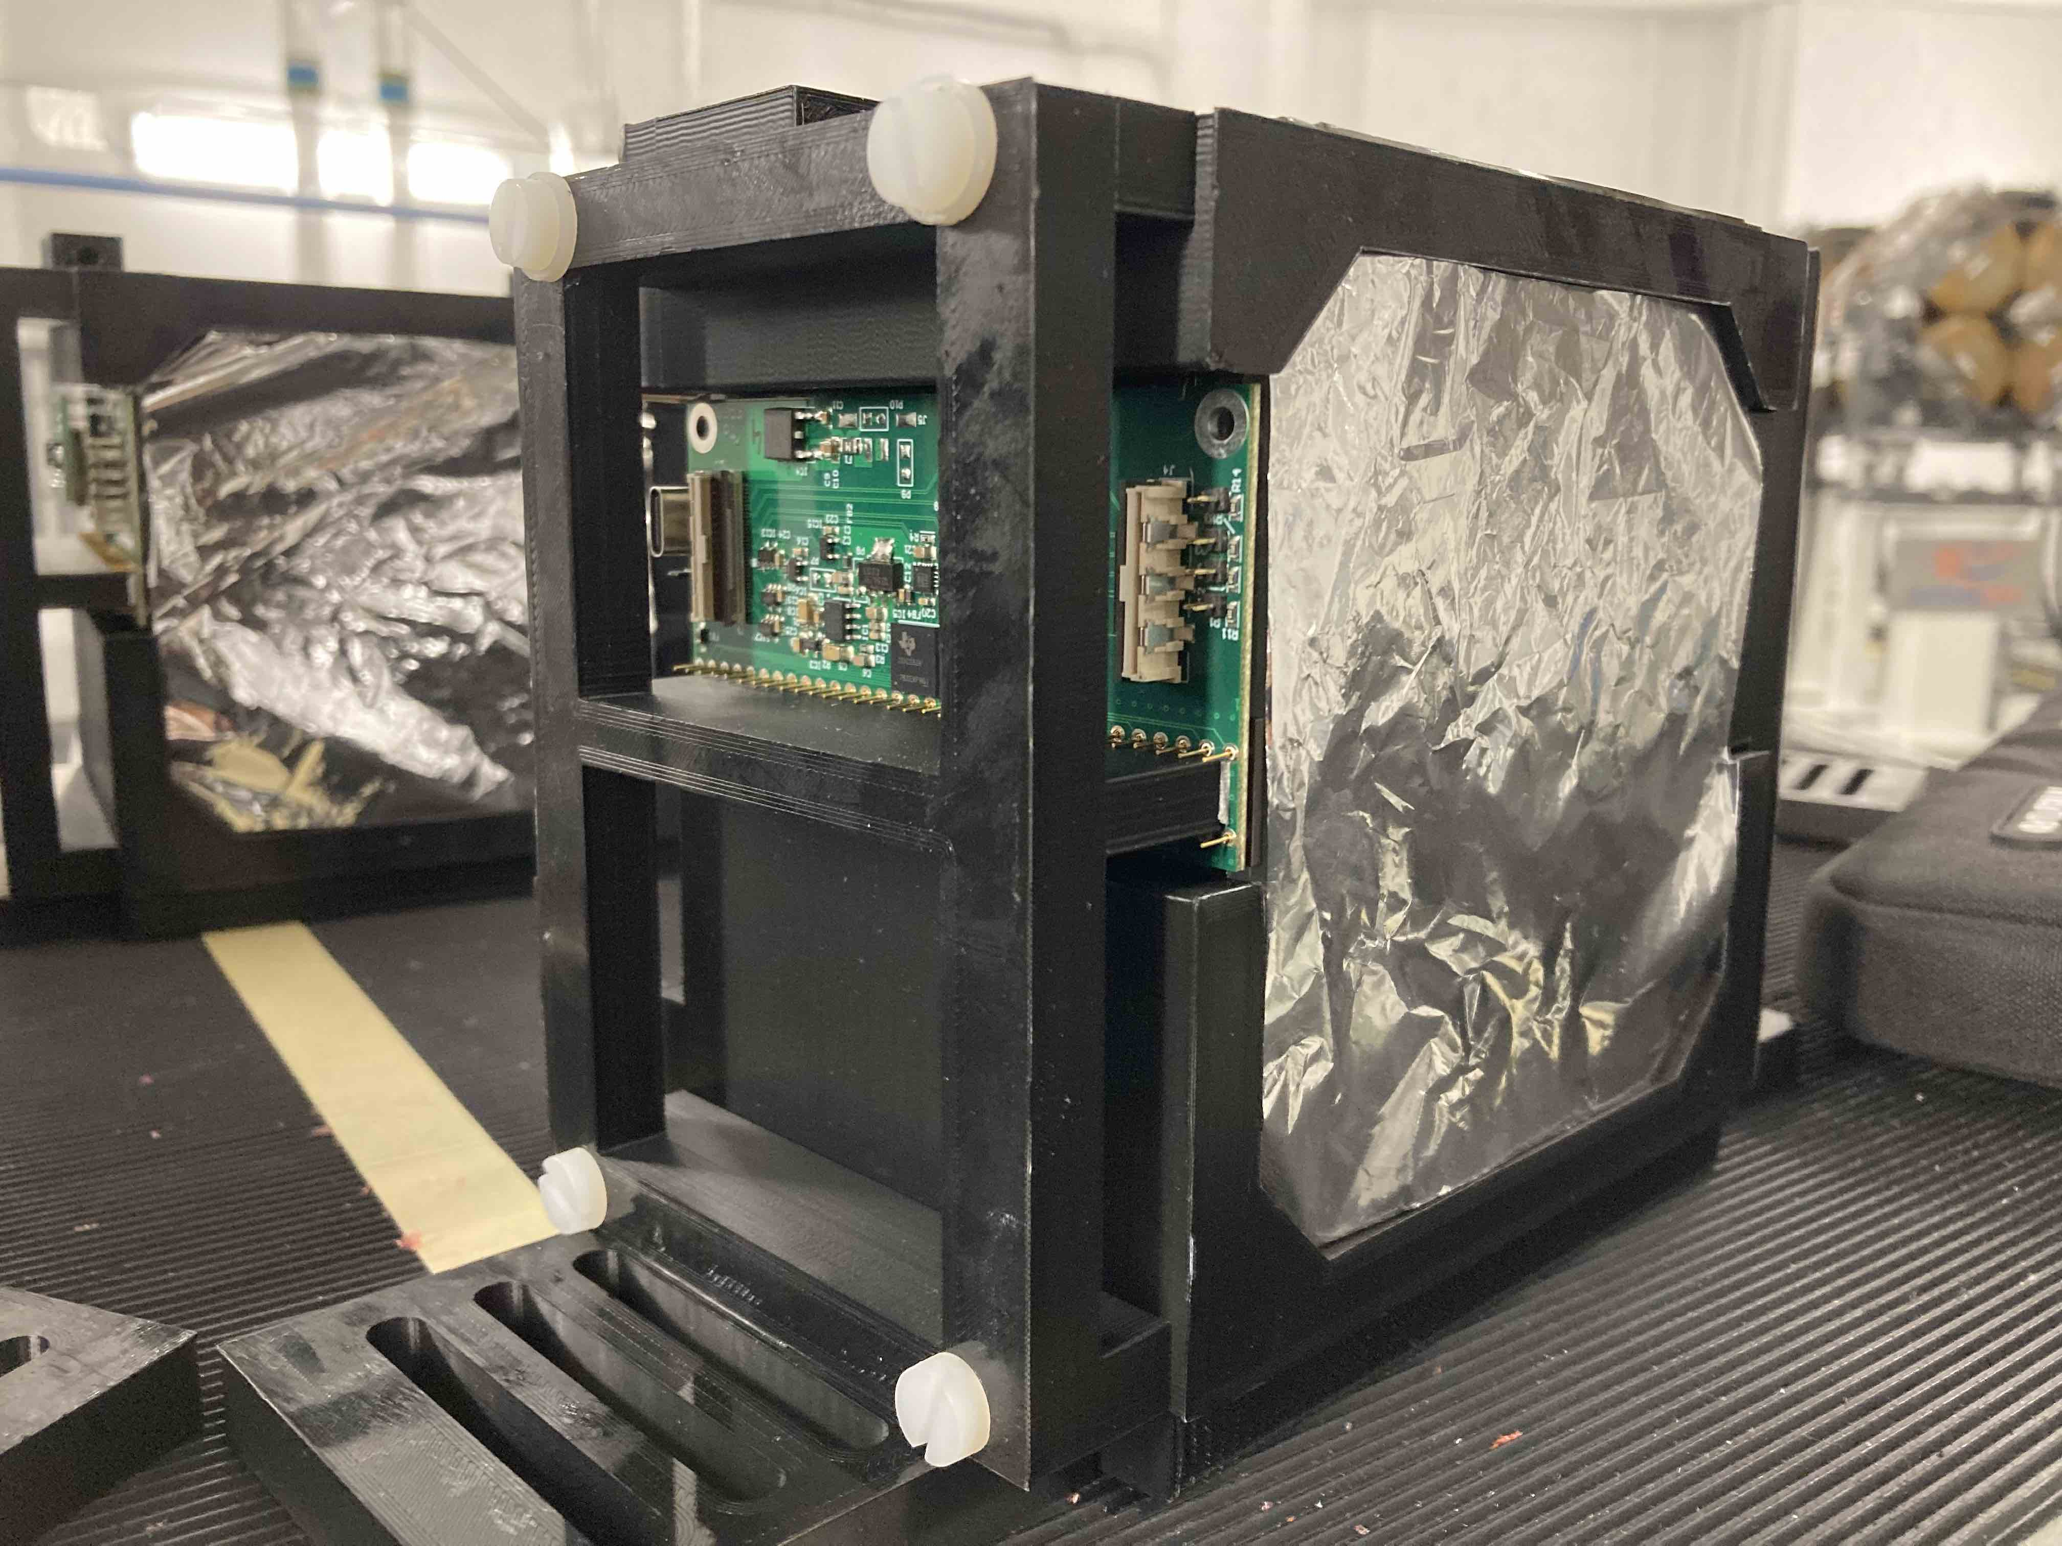
QuARC
The Quality Assurance Range Calorimeter (QuARC) constructed from plastic scintillator:
  Protons intercepted by a series of optically-isolated polystyrene scintillator sheets.
  Measure light output with photodiodes.
  Light output of each sheet nonlinear to dose, but quenching described by Birks’ Law:
    Fit data with analytical depth-light model.
    Reconstruct Bragg depth-dose curve and measure proton range.
  Photodiodes coupled to fast, modular electronics and an FPGA to read light levels at over 5 kHz.
  FPGA connects to on-board PC (Raspberry Pi) via USB.
  On-board DAQ runs web server: connect over network for full data viewing and control.
Sheet Average Light Output
Fitted Quenched Depth-Light Curve
Reconstructed Depth-Dose Curve
UCLH Reference Dose Curve
70 MeV
16/06/22
130 MeV
01/09/22
Slide information courtesy of Sonia Escribano-Rodriguez

Slide 6
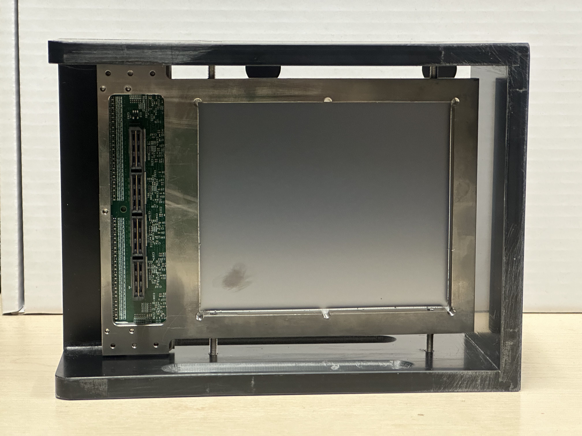
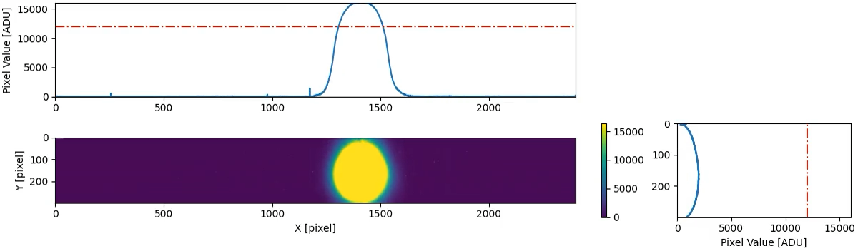


LASSENA CMOS Pixel Sensor
2D large format CMOS pixel sensor LASSENA:
  Developed at RAL (UK) X-ray imaging; marketed by Nordson
  2,400 x 2,800 pixels each 50x50 µm²
  12 x 14 cm² active area
  Readout along one side to allow tiling of sensors over a 24x(Nx12) cm² area
  Active thickness of 8 um silicon plus 700 um of support silicon.
  34 fps full frame readout via a rolling shutter (28 ms integration time).
NIMA 2022: 10.1016/j.nima.2022.166703
Jinst 2023: 10.1088/1748-0221/18/03/P03014
Slide information courtesy of Tony Price, Birmingham

Slide 7

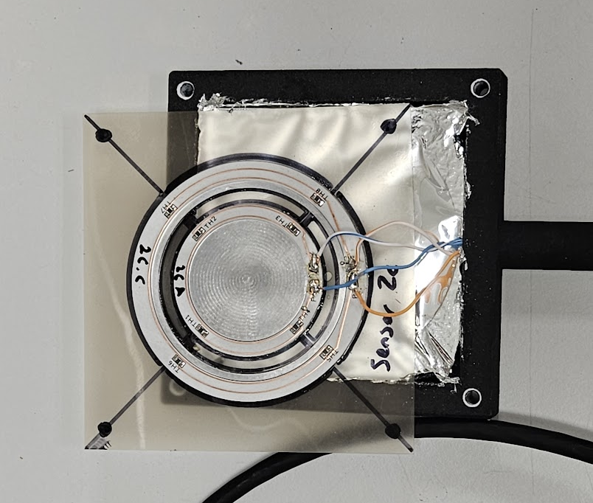
The NPL Transmission Calorimeter (TC)
A thin aluminium core with embedded thermistors
  45 mm diameter
  0.6 mm thickness, approximately 1.2 mm WET
  High performance 7 W/mK thermal conductivity dielectric PCB connecting thermistors
Twin core design:
  Primary core to measure radiation-induced temperature change
  Secondary core to compensate for ambient temperature fluctuations
Slide information courtesy of Sam Flynn, NPL

Slide 8
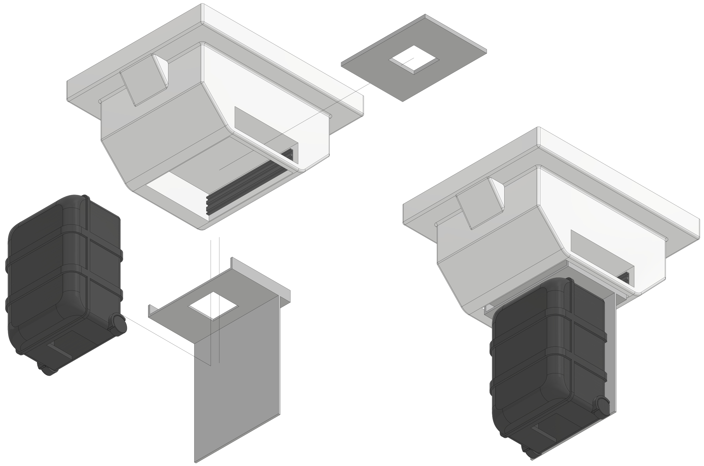
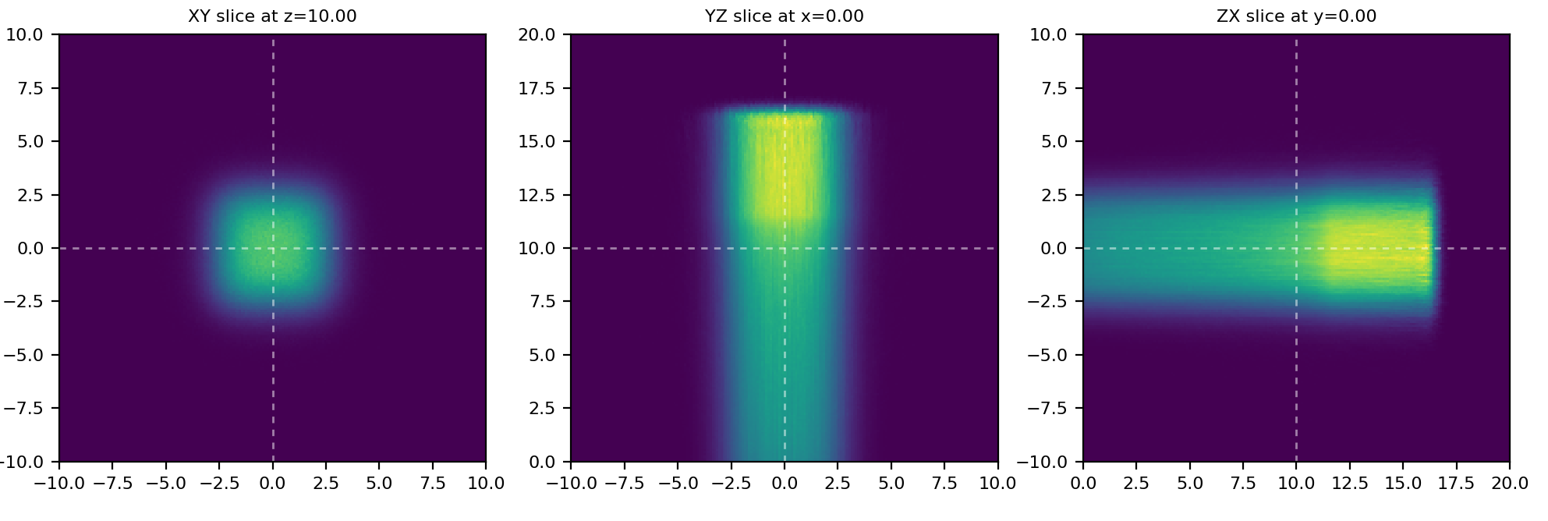
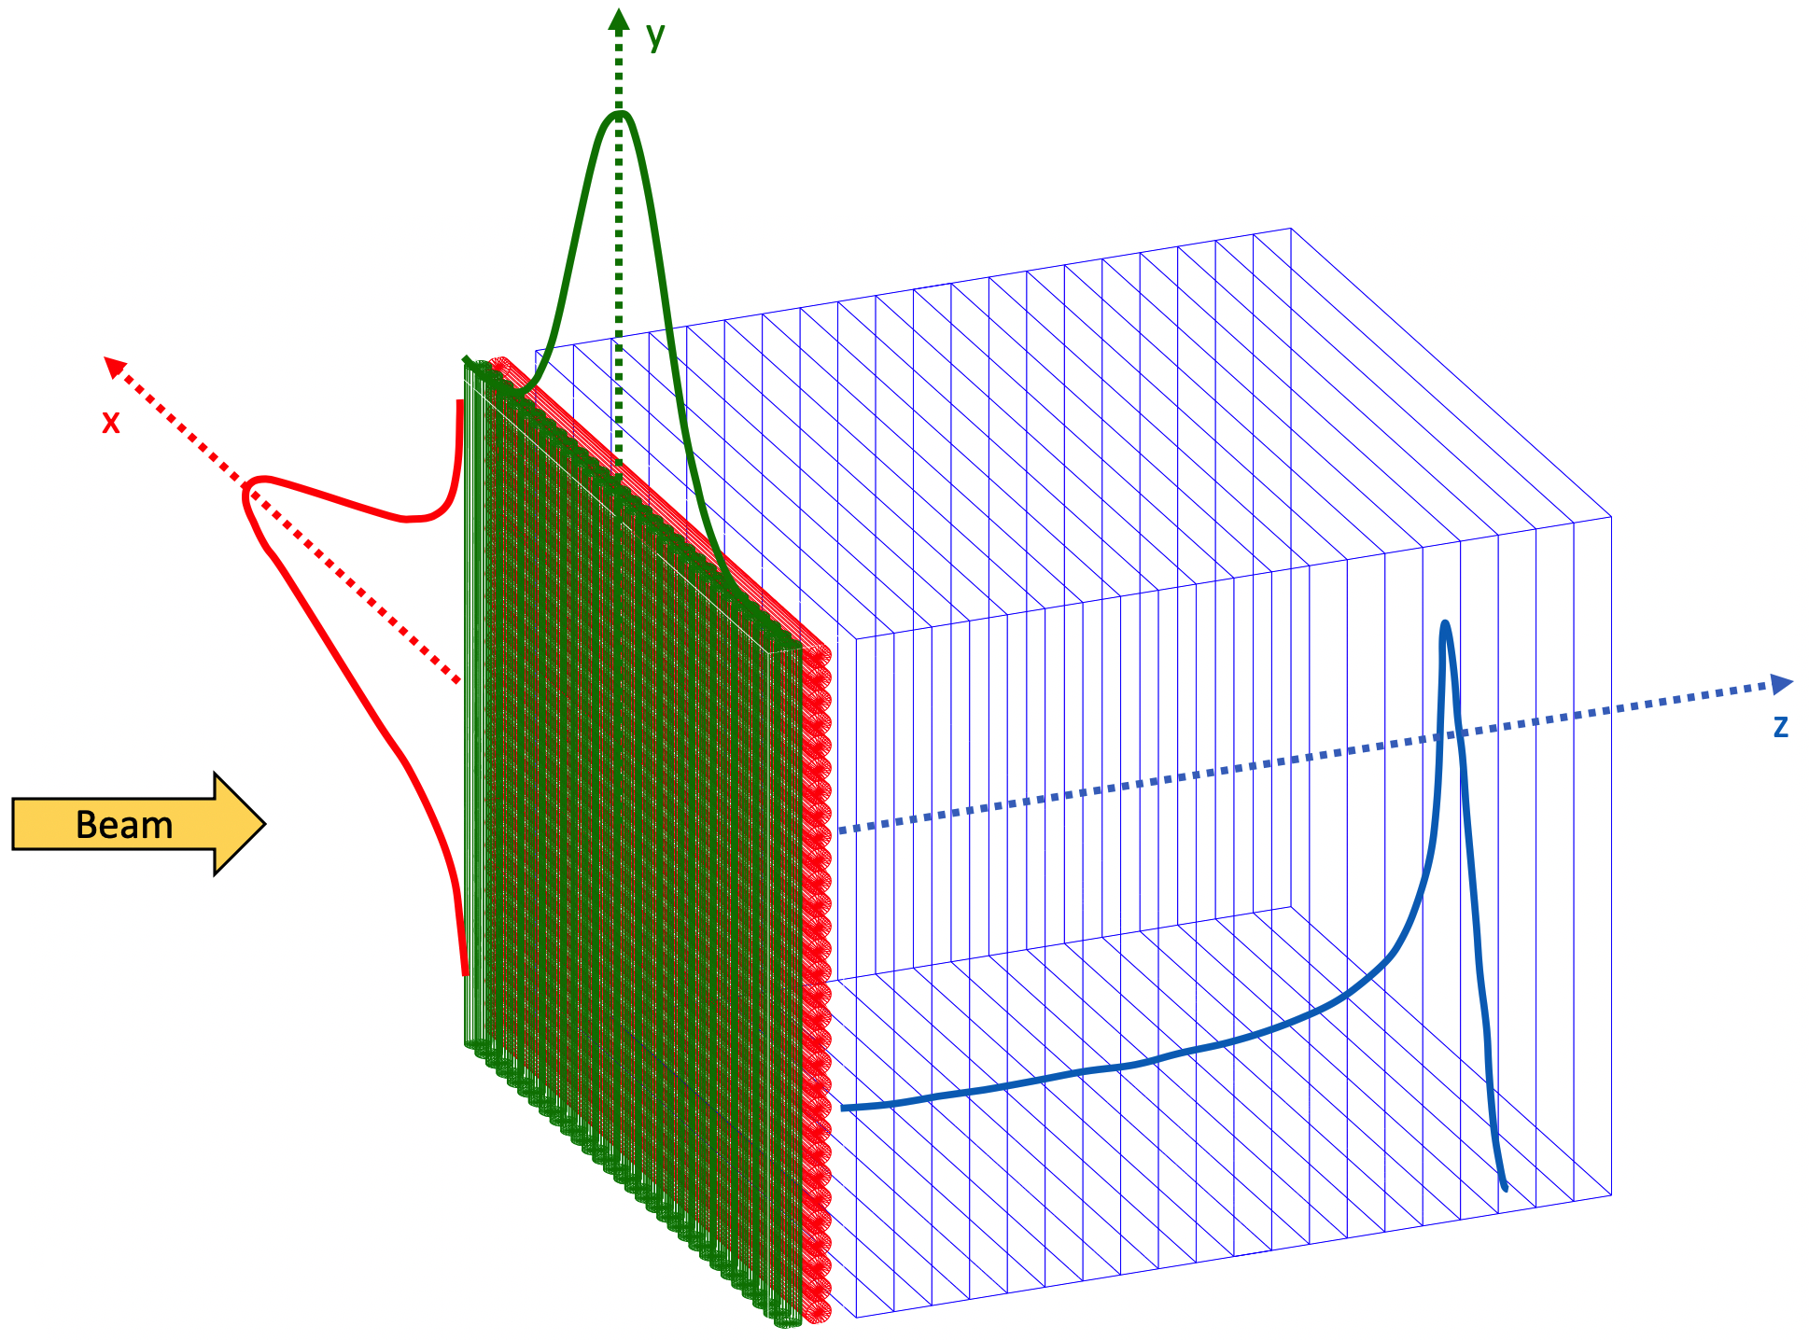
QuADProBe for PSQA Process
Mount QuADProBe to nozzle and run treatment plan
Measure: spot size, position, energy and dose for every pencil beam
Measurements used as input for MC simulation/IDC to reconstruct 3D dose distribution
Comparison of PSQA dose distribution to TPS

Slide 9

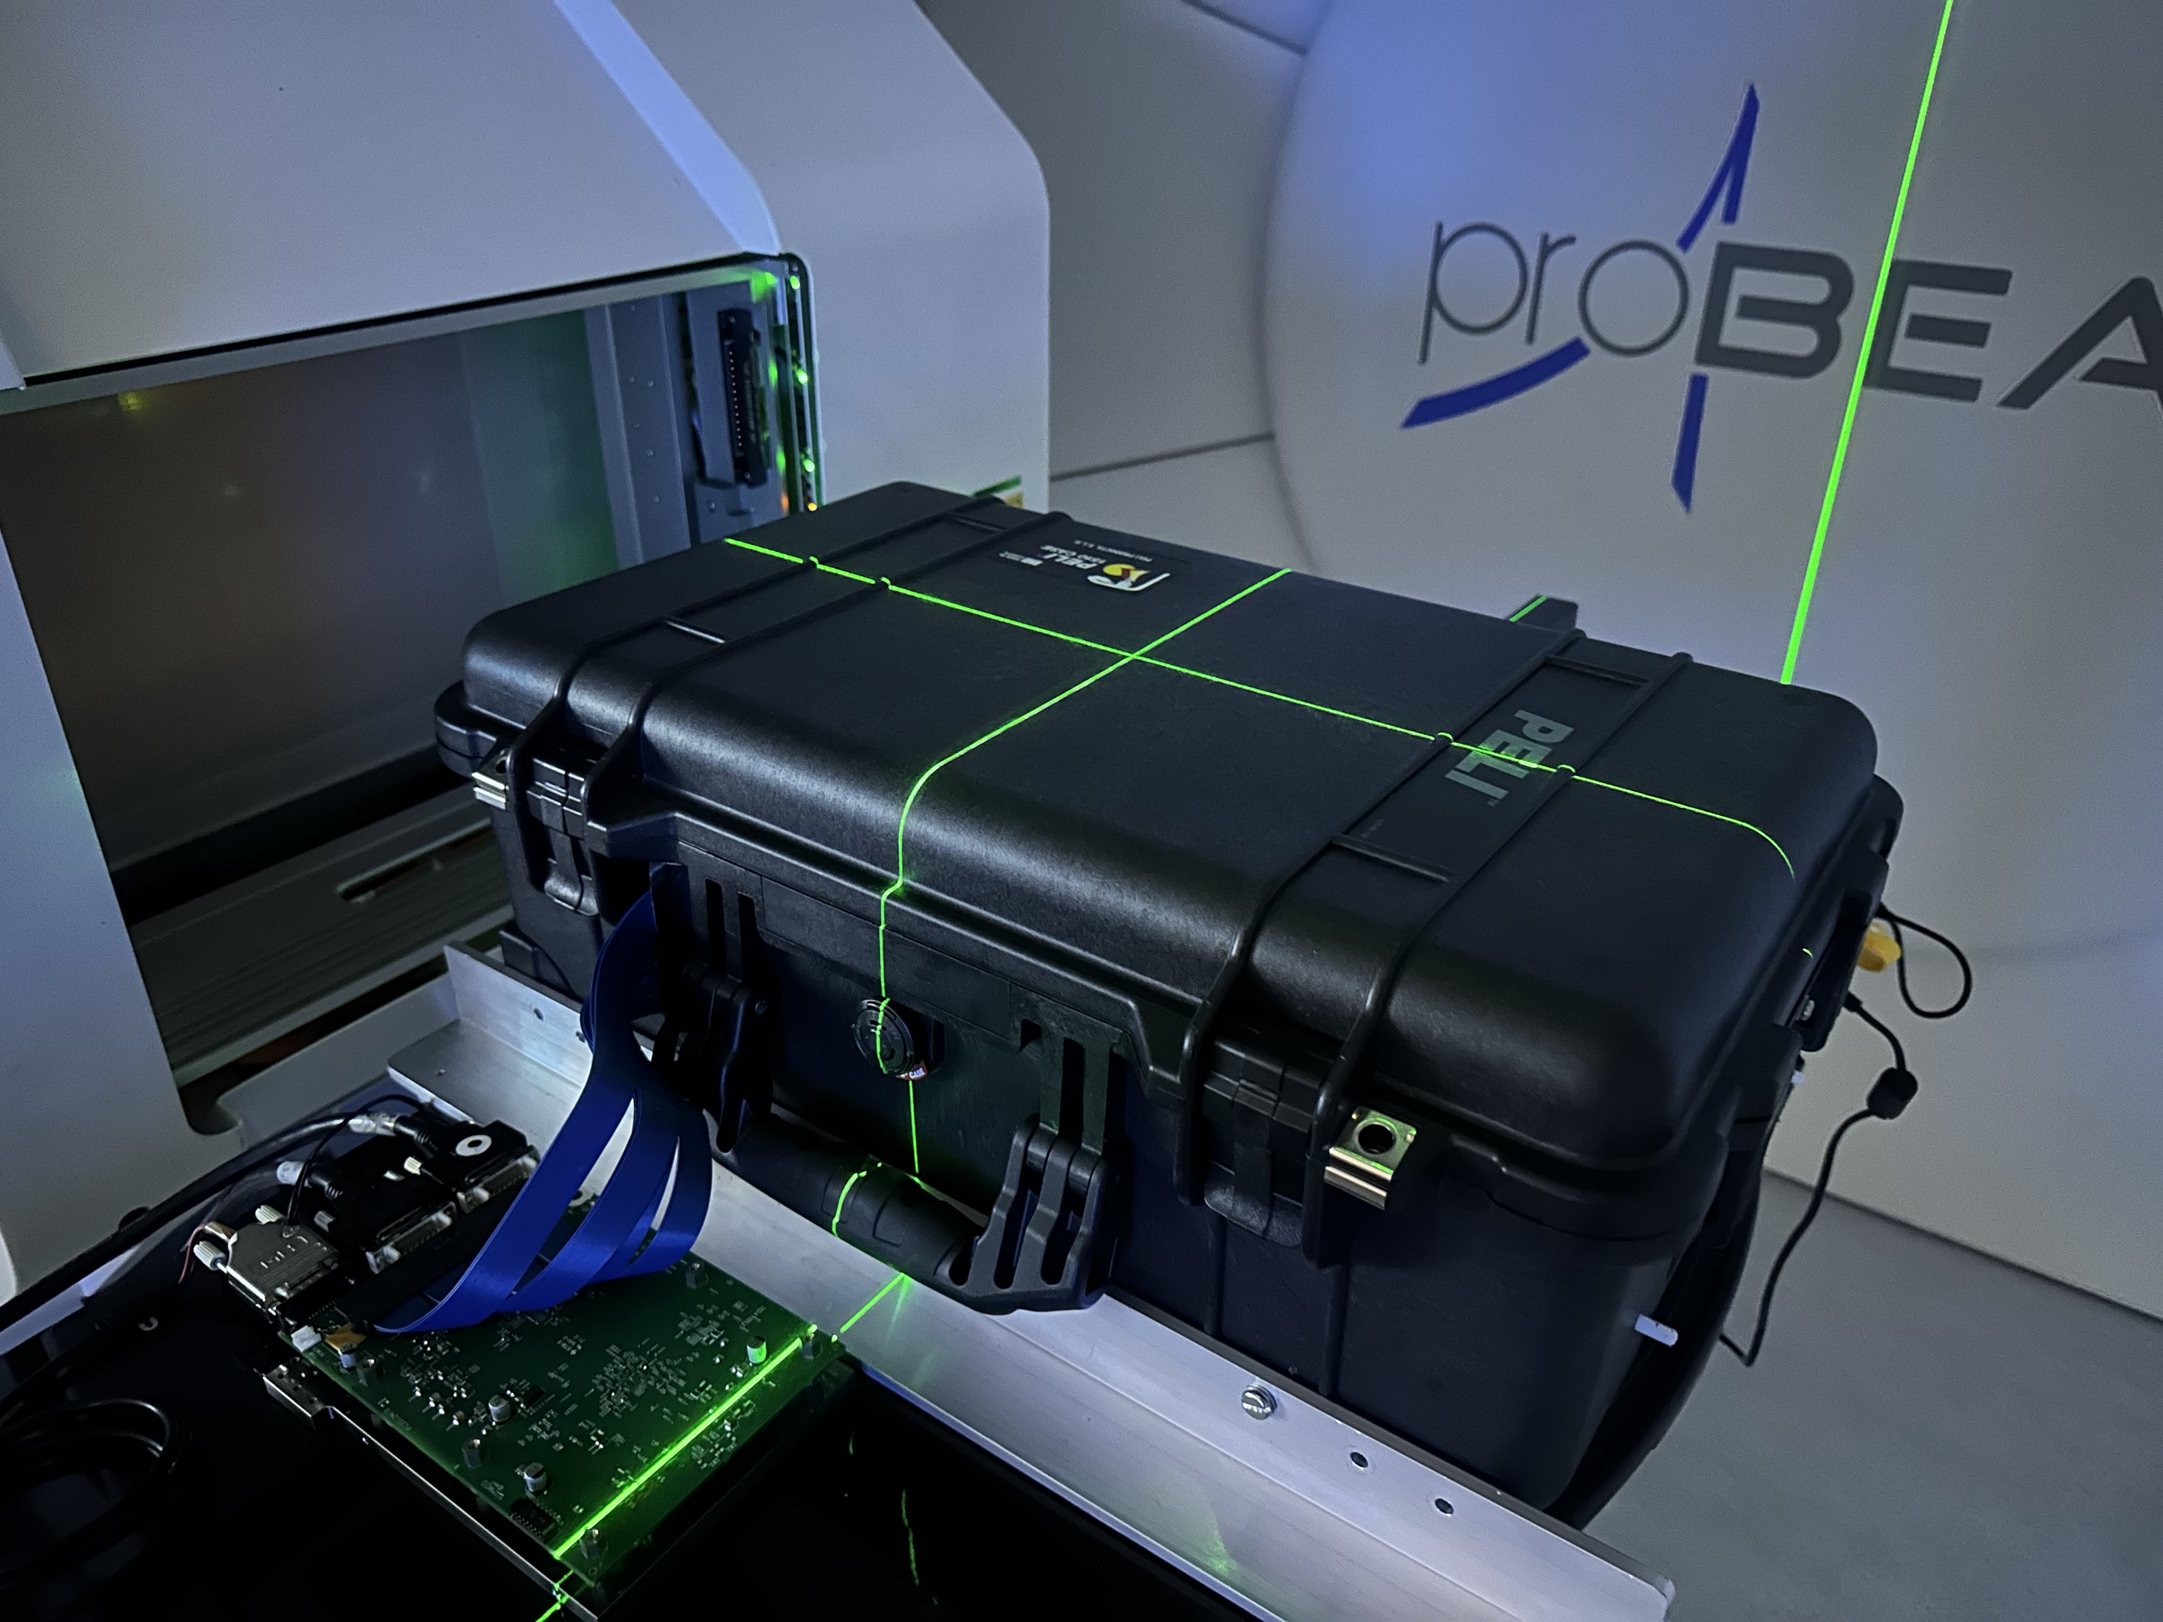
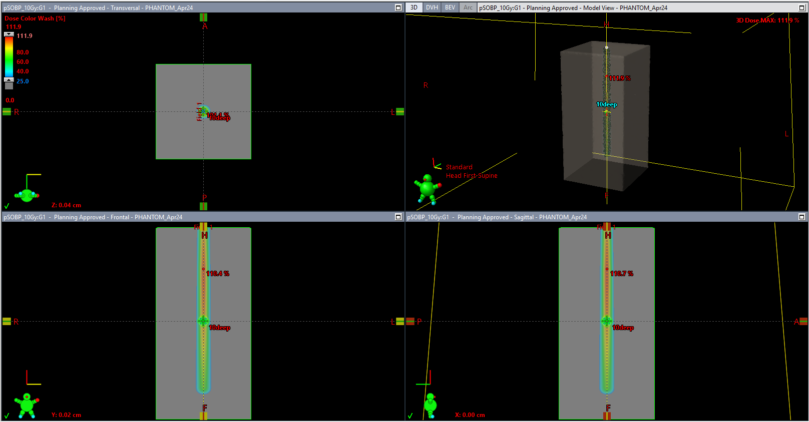
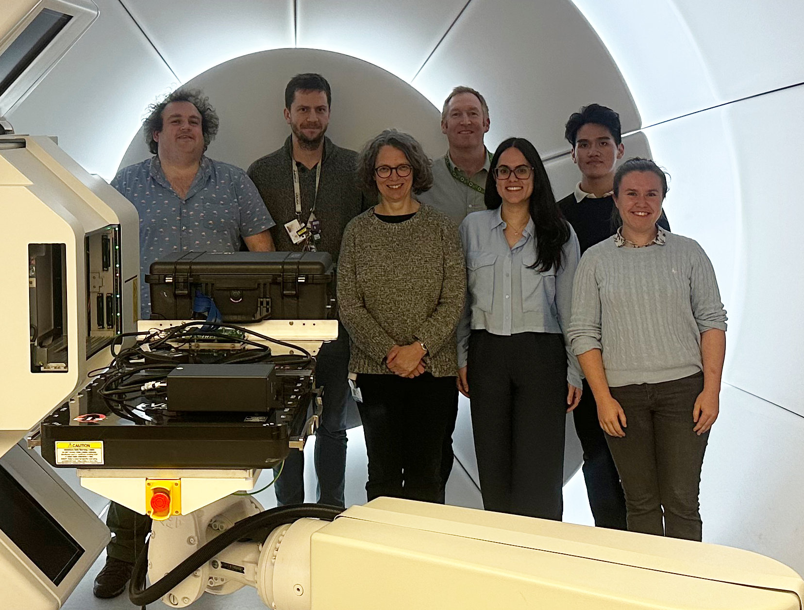
1st QuADProBe Beam Test @ UCLH
QuADProBe positioned on couch and QA plan delivered
Measure: spot size, position, energy and dose for every pencil beam
Measurements used as input for MC simulation/IDC to reconstruct 3D dose distribution
Comparison of PSQA dose distribution to TPS
Special thanks to:
Colin Baker
Alison Warry
Lee Harrison-Carey
Tony Price
Catherine Burne
Sam Flynn

Slide 10
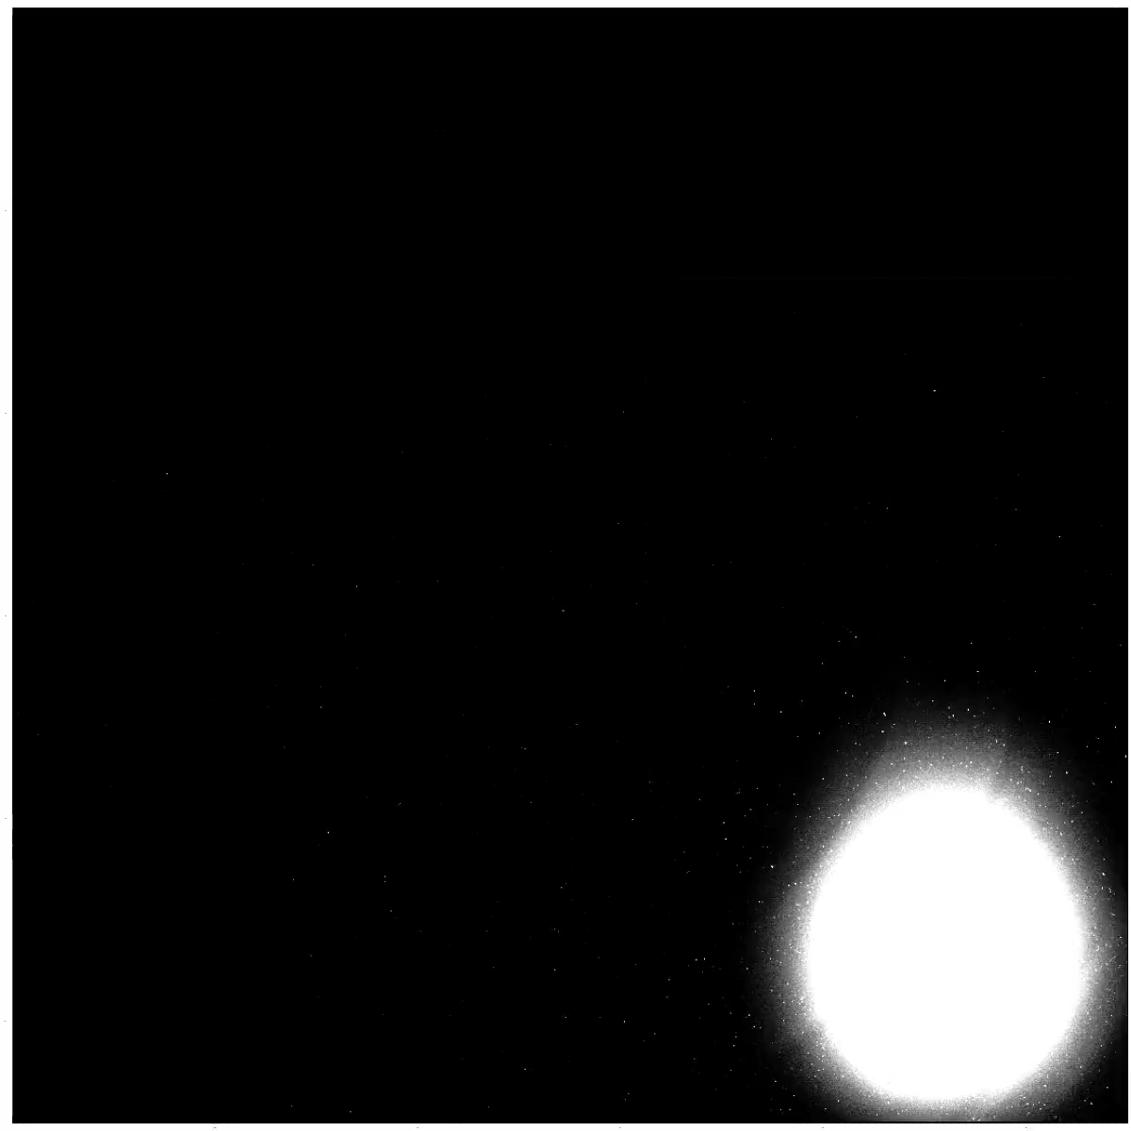
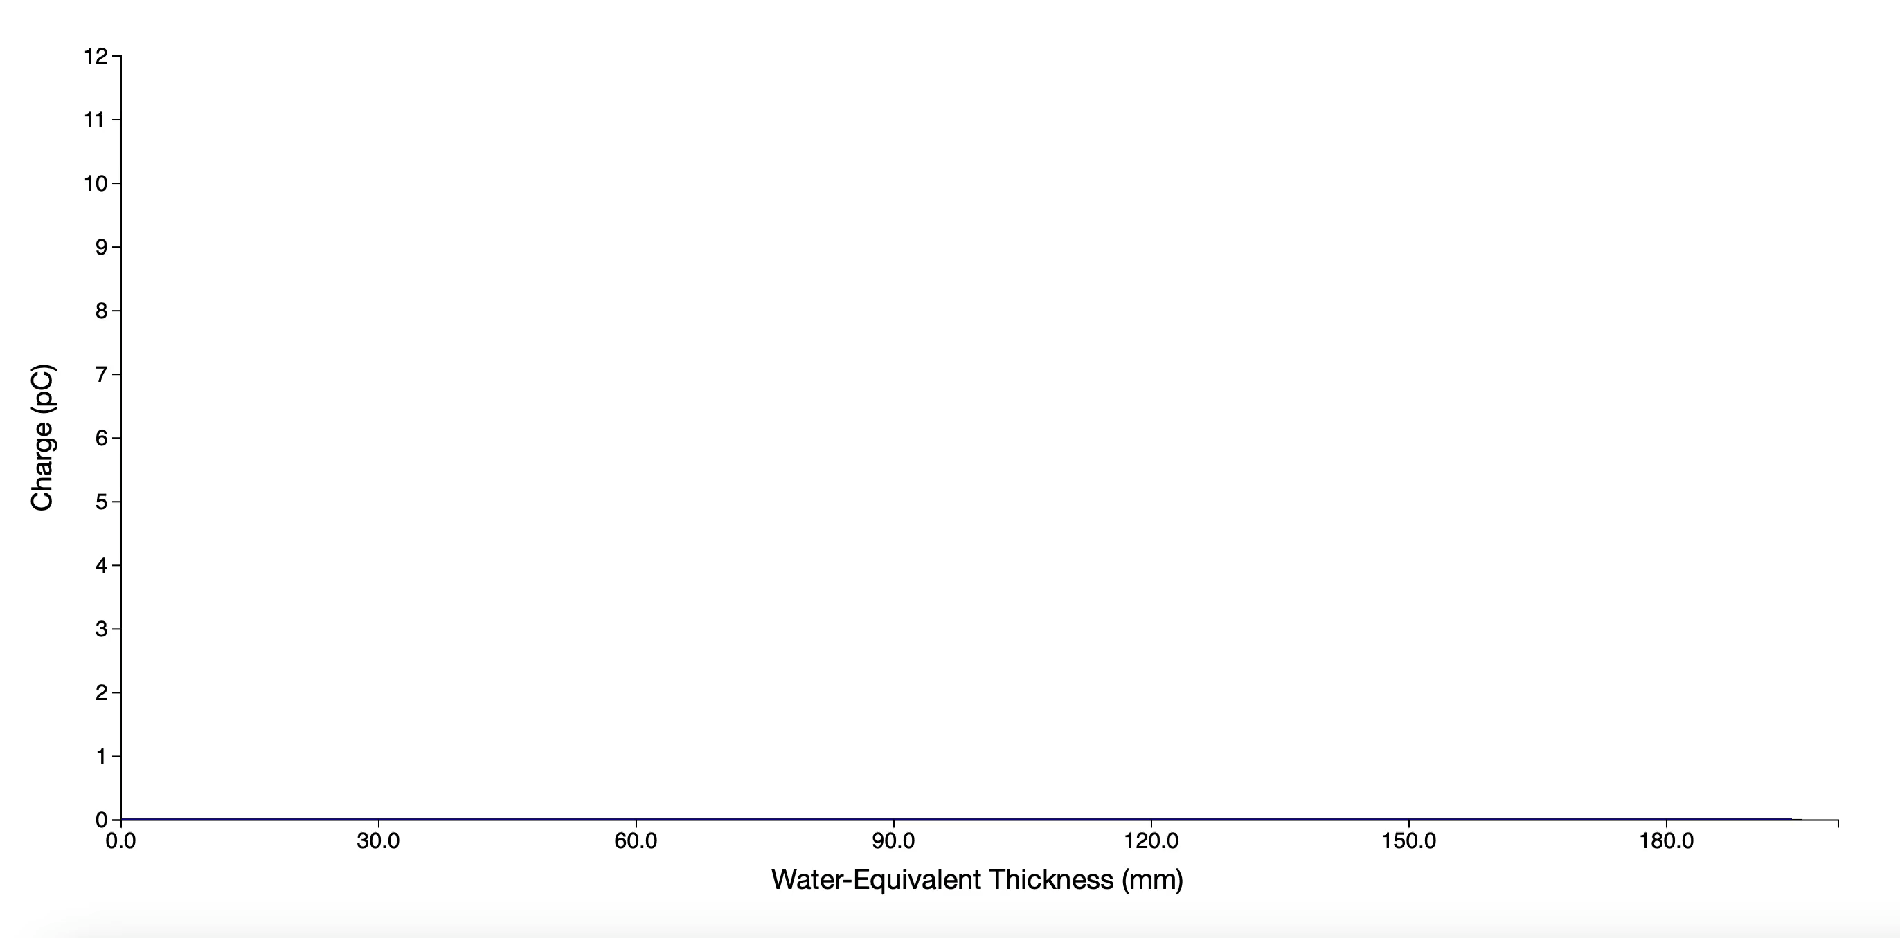
UCLH Beam Test Results
Pixel Sensor
QuARC

Slide 11


UCLH Spot Profile Comparison
Pixel Sensor
Gantry 1
Gantry 3

Slide 12
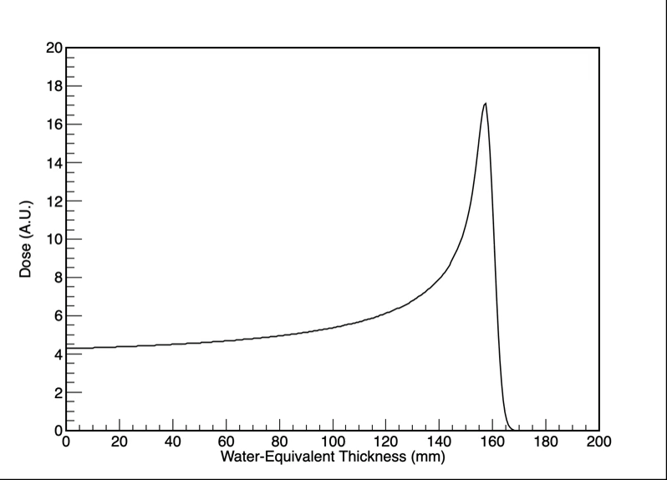
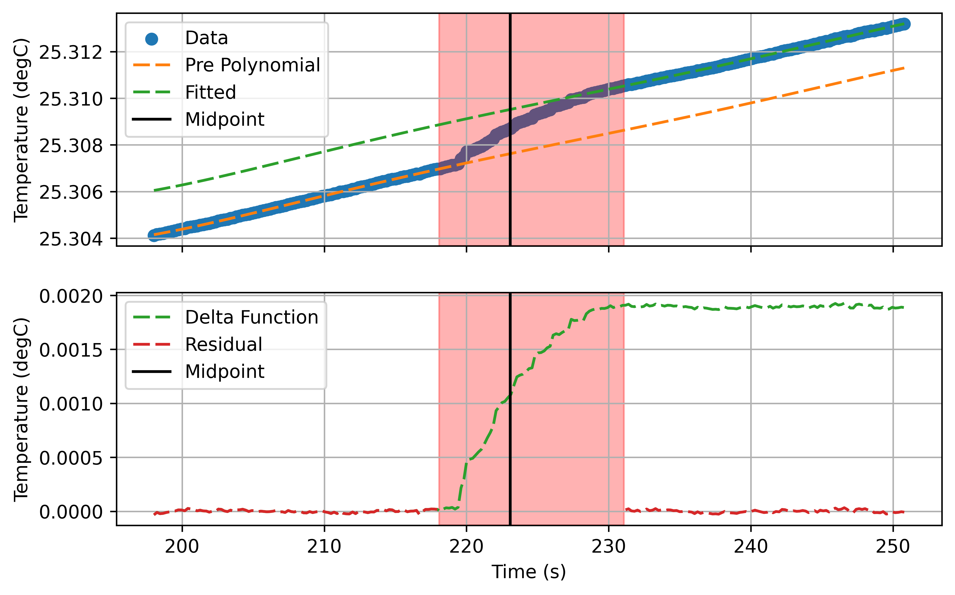
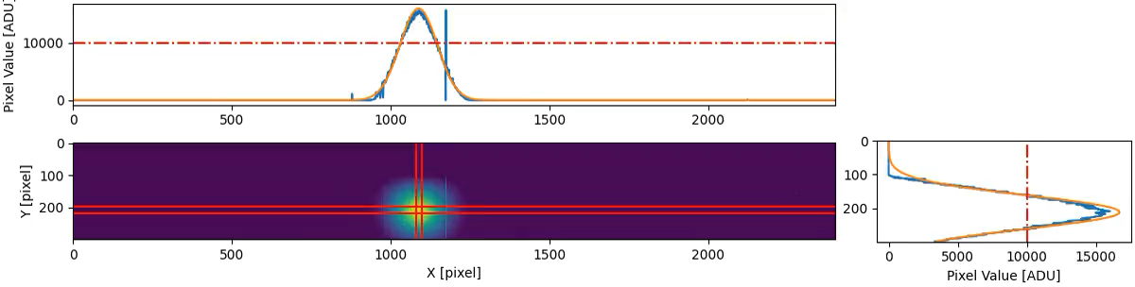
Combined Data Output

Slide 13
Full Analysis of 5 Gy SOBP
Comparison of of different beam input parameters to TOPAS simulation:
  Intensity: CMOS, Size/Pos.: CMOS, Energy: QuARC
  Intensity: QuARC, Size/Pos.: CMOS, Energy: QuARC
  Intensity: DICOM, Size/Pos.: CMOS, Energy: QuARC
  Intensity: DICOM, Size/Pos.: CMOS, Energy: DICOM
  Intensity: DICOM, Size/Pos.: DICOM, Energy: QuARC
  Intensity: DICOM, Size/Pos.: DICOM, Energy: DICOM
  Entirely QuADProBe parameters Part QuADProBe, part DICOM
  Entirely DICOM parameters

Slide 14
TC Dose Measurements
Linear response with dose in 3 x 3 x 3 cm³ cube
Measures 1.96 ± 0.04 mK for 10 Gy delivery
Performance evaluated at different dose rates and different energies
Slide information courtesy of Sam Flynn, NPL

Slide 15
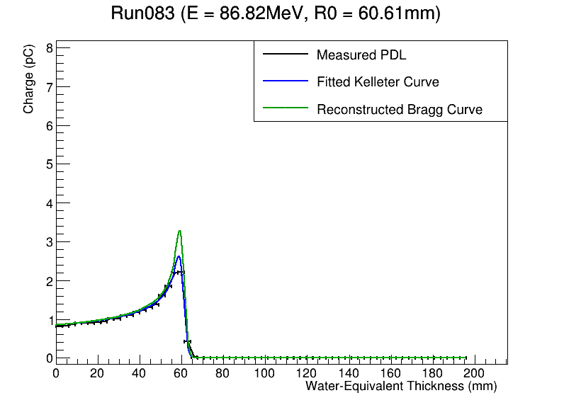
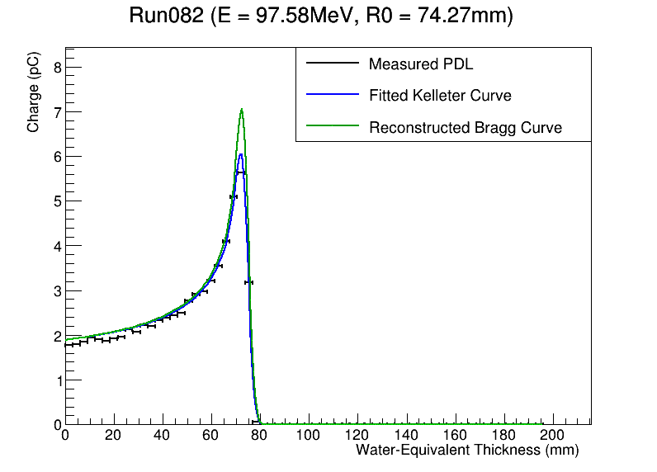
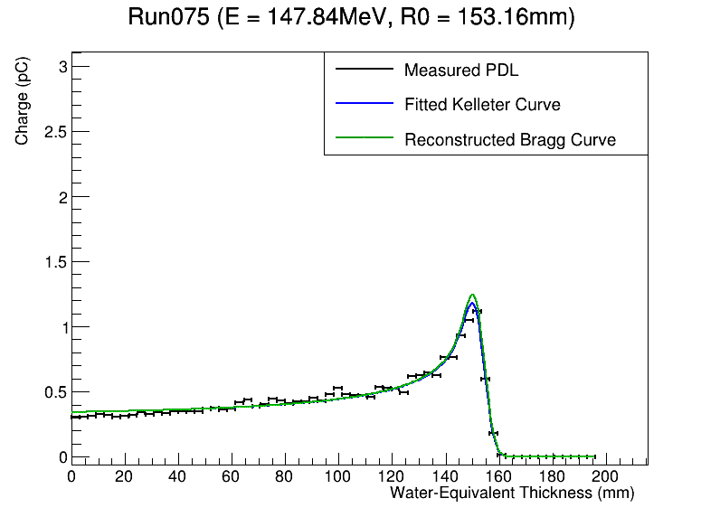
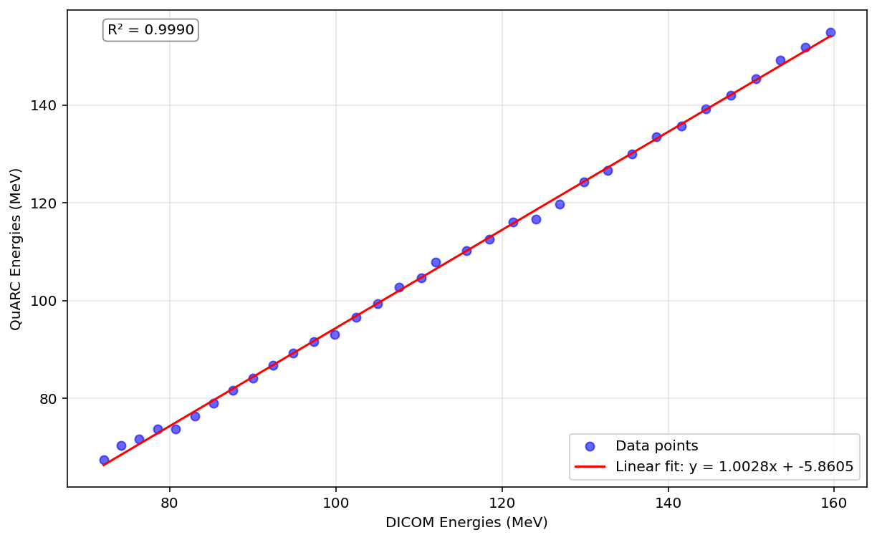
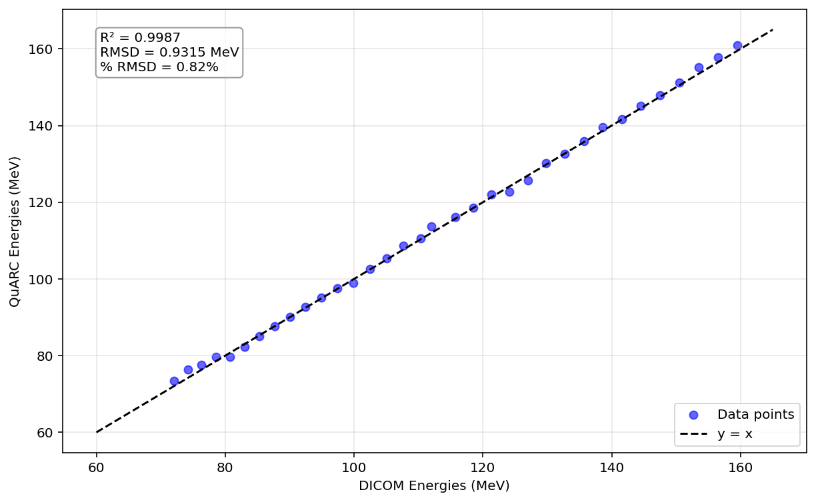
QuARC Energy Measurements
Uncorrected
Corrected

Slide 16
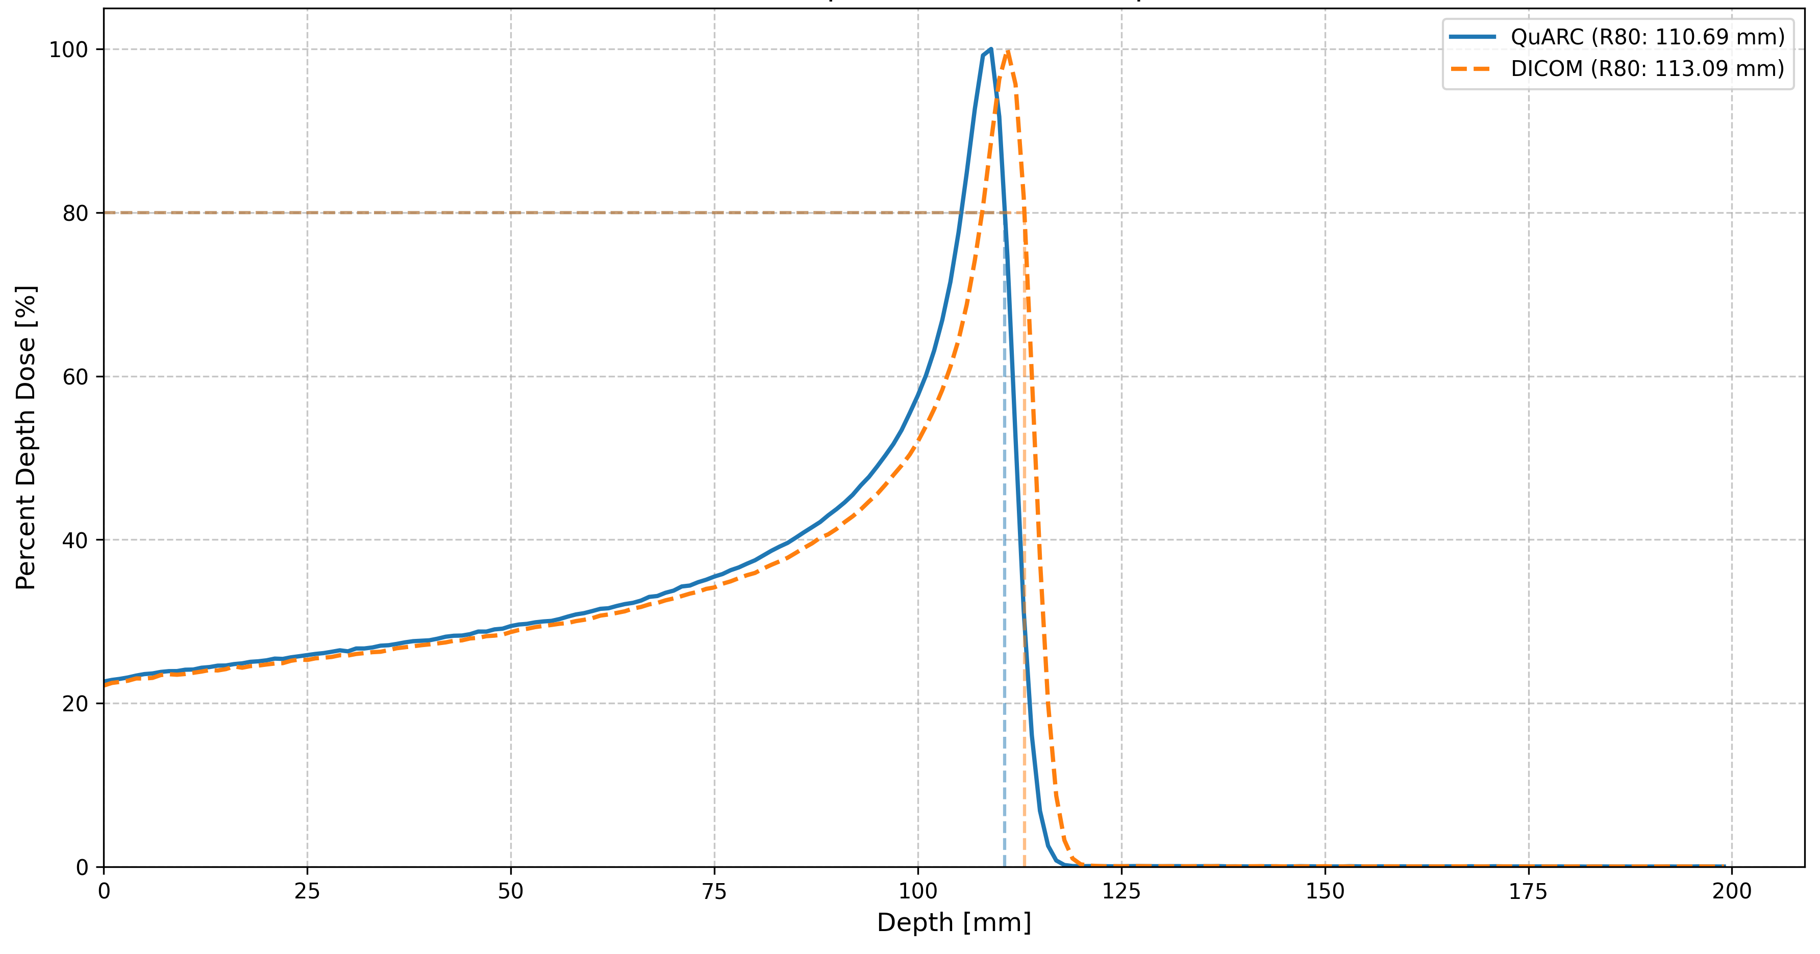
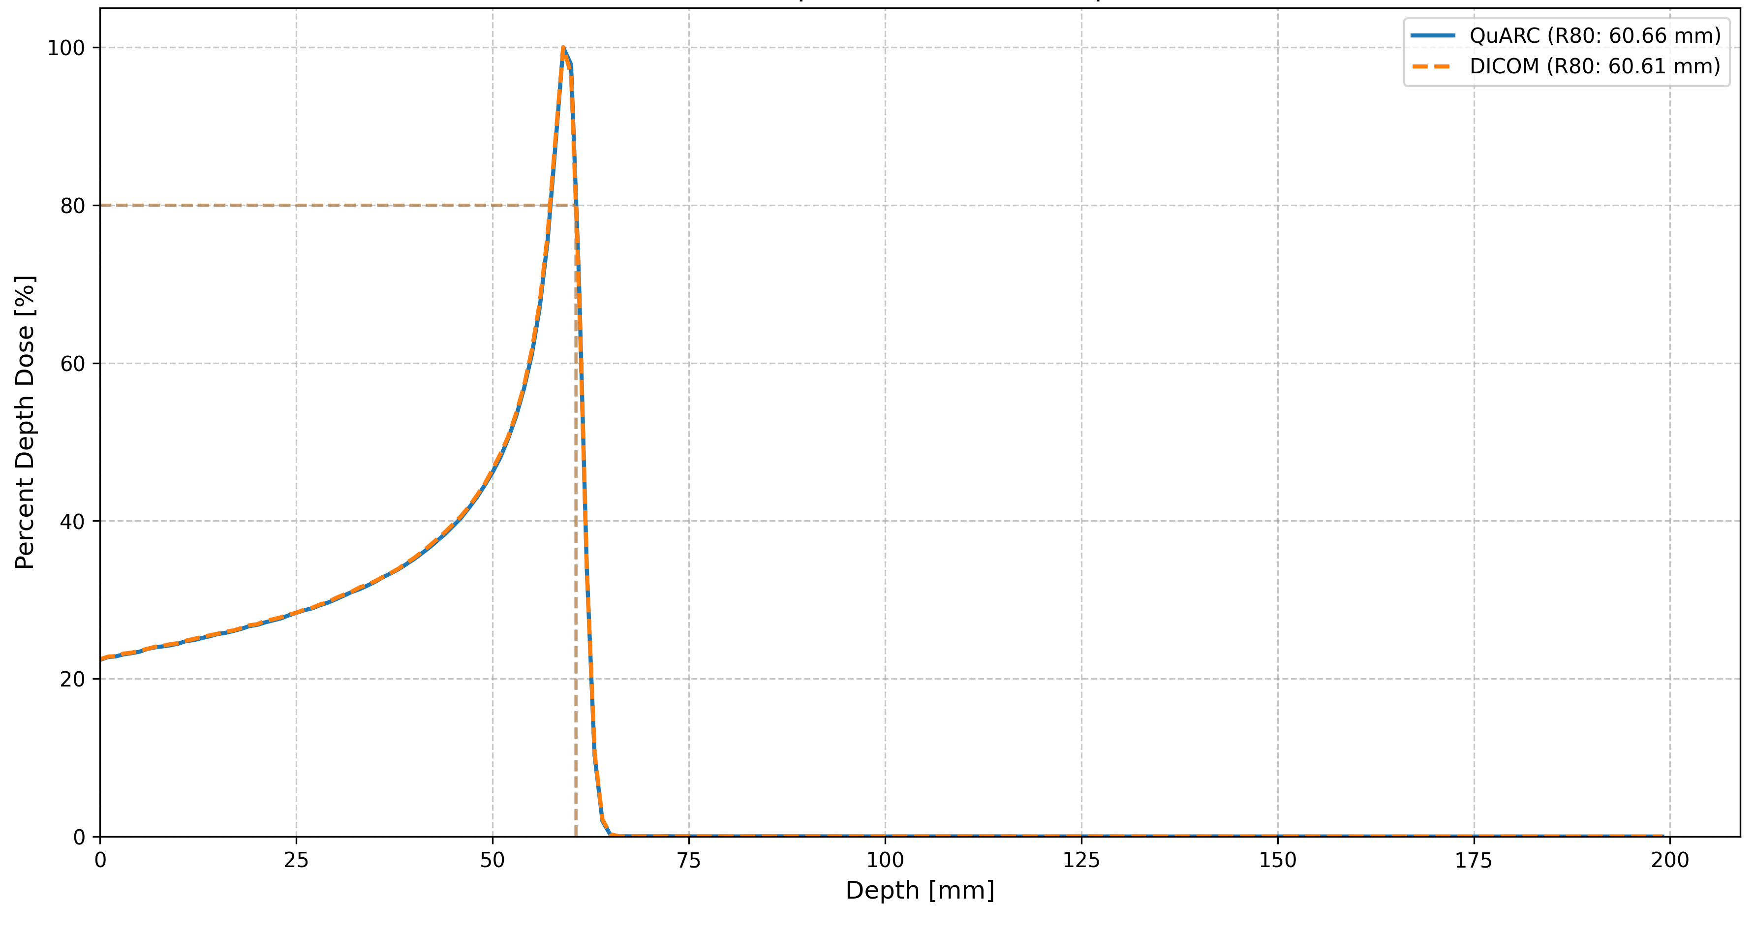
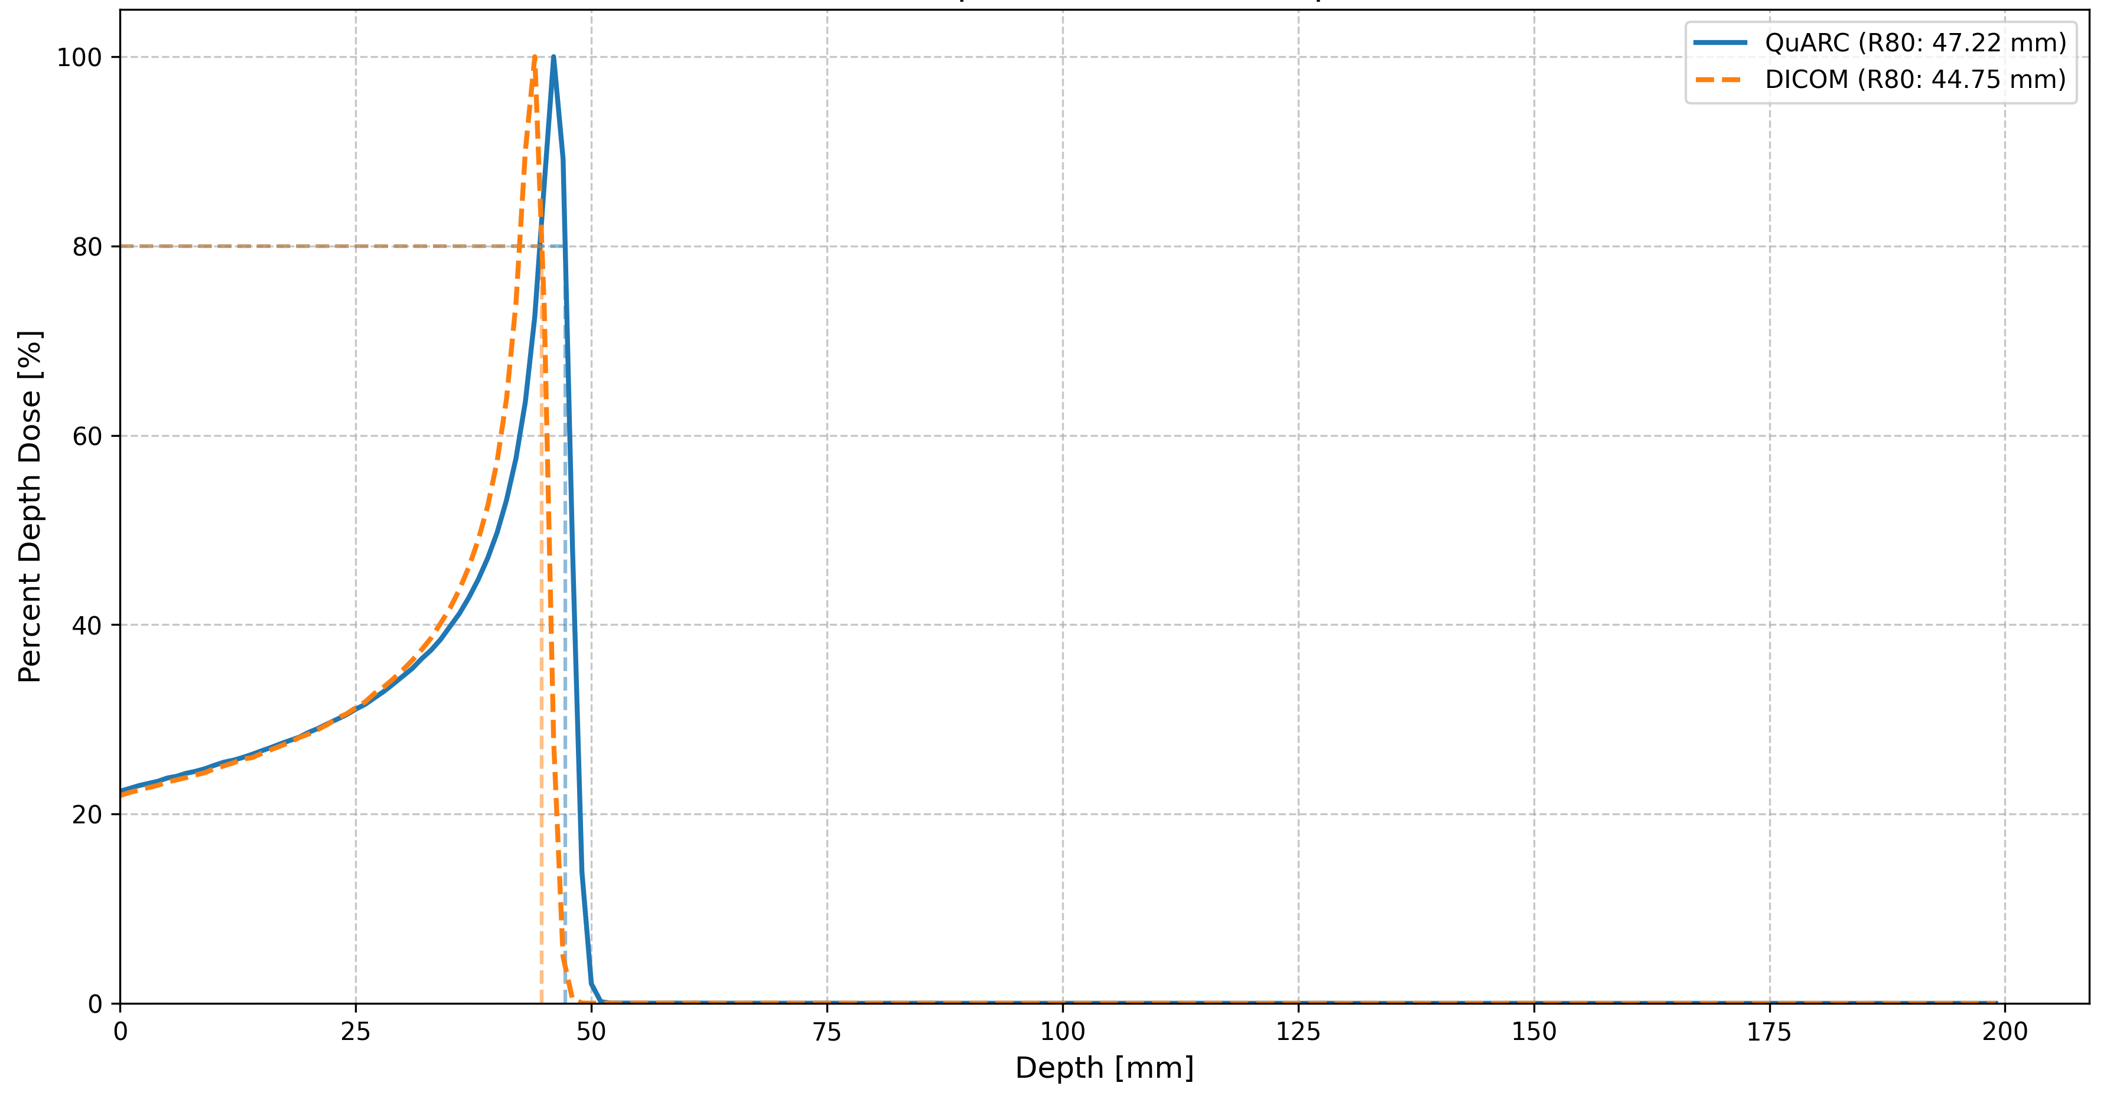
Individual Bragg Peak Comparisons
Largest deviations in each direction and closest agreement
QuARC: 122.7 MeV
DICOM: 124.1 MeV
QuARC: 118.57 MeV
DICOM: 118.50 MeV
QuARC: 76.3 MeV
DICOM: 74.2 MeV

Slide 17
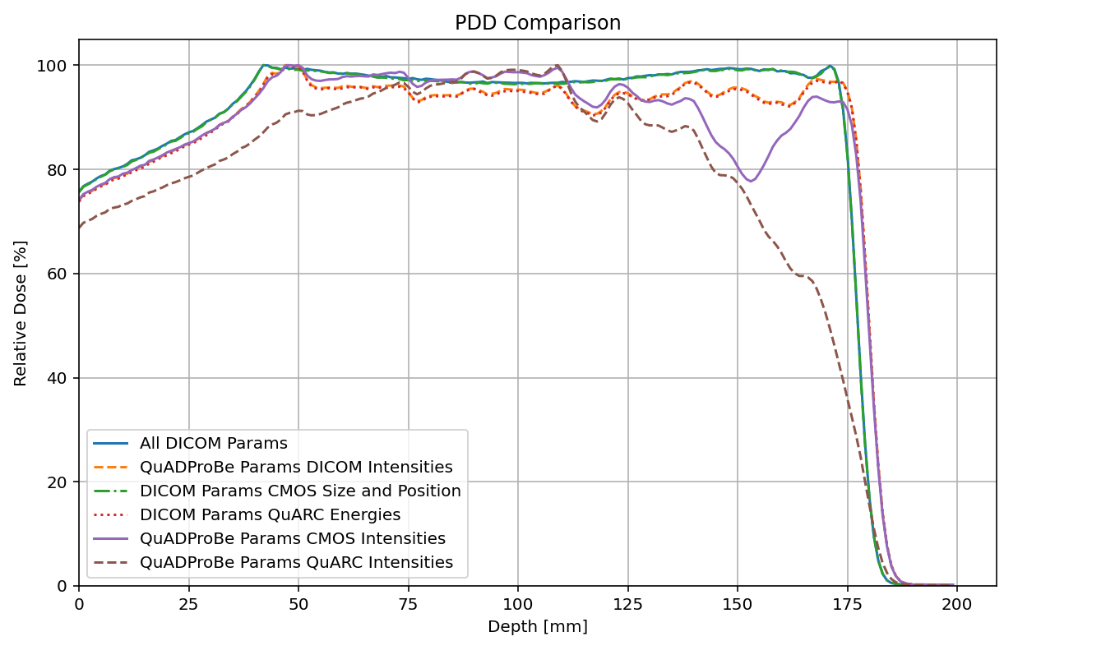
SOBP Comparison
Measurement | R80 (mm)
All DICOM | 175.23
QP Param, DICOM Intensity | 177.61
DICOM Param, CMOS Size/Pos | 175.20
DICOM Param QuARC Energy | 177.56
QP Param CMOS Intensity | 177.30
QP Param QuARC Intensity | 144.41

Slide 18
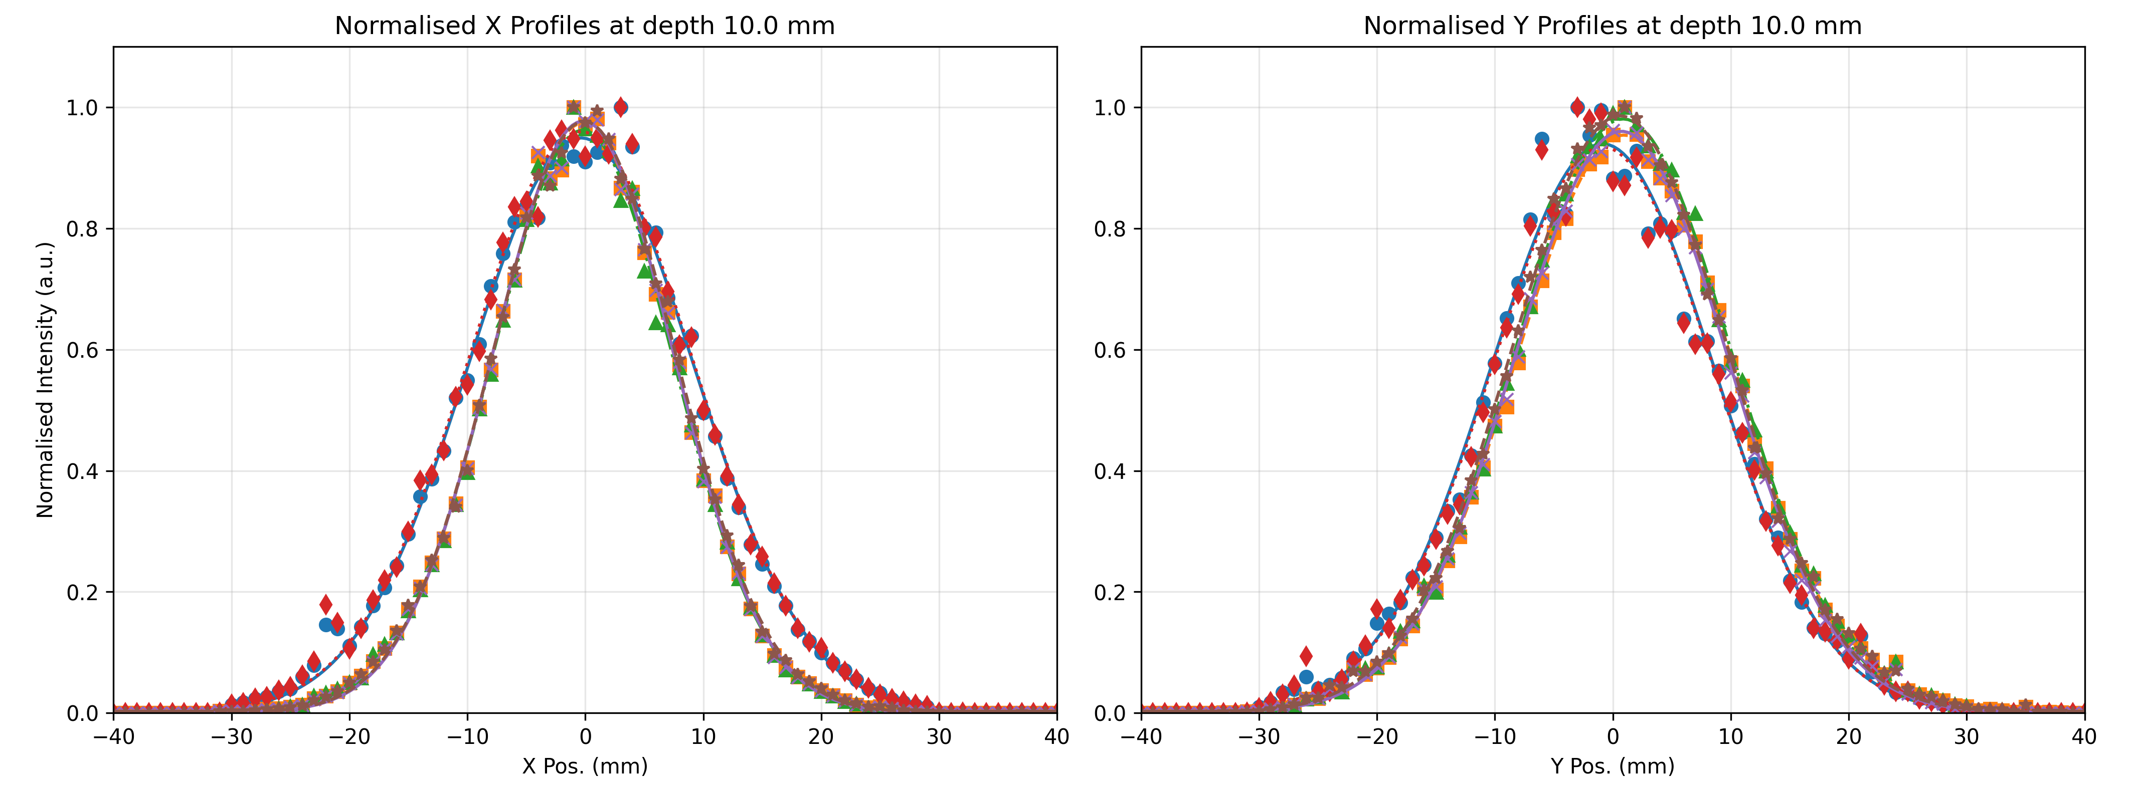
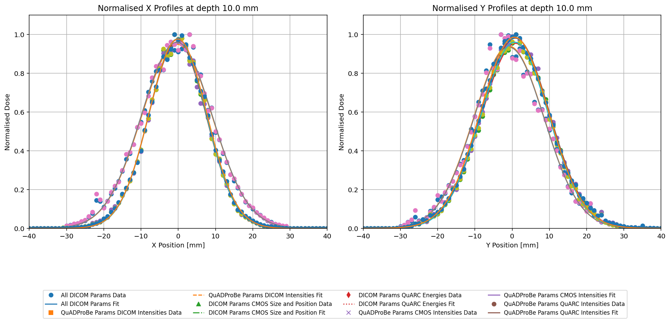
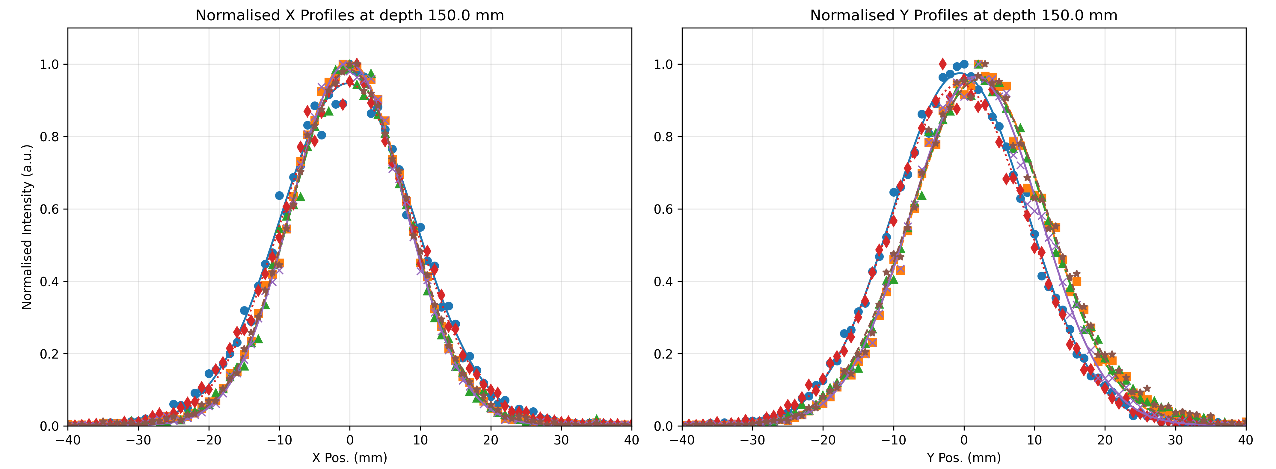
Beam Size Comparisons

Slide 19
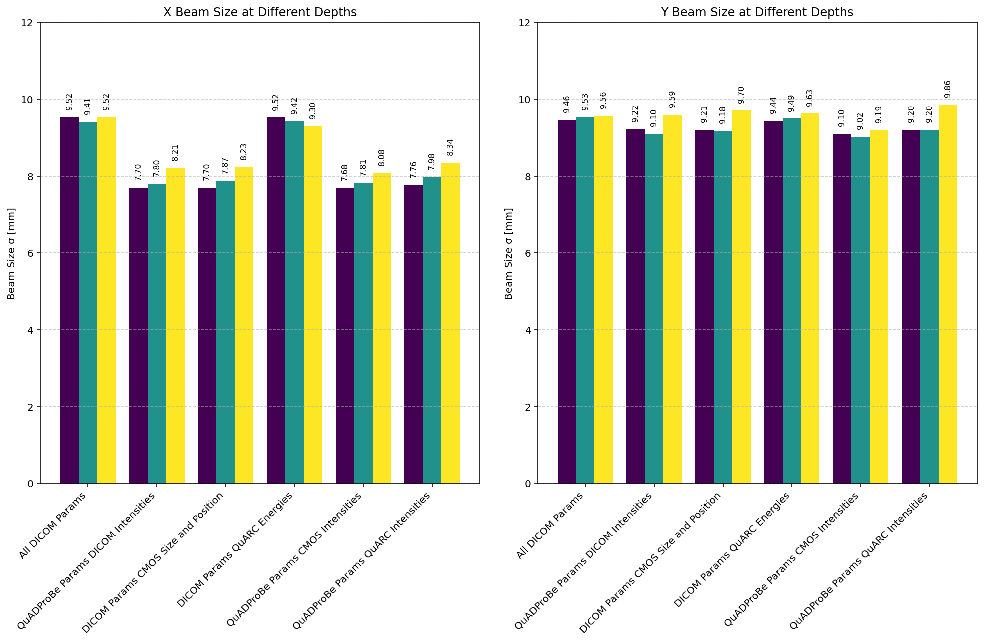

Beam Size Comparisons

Slide 20
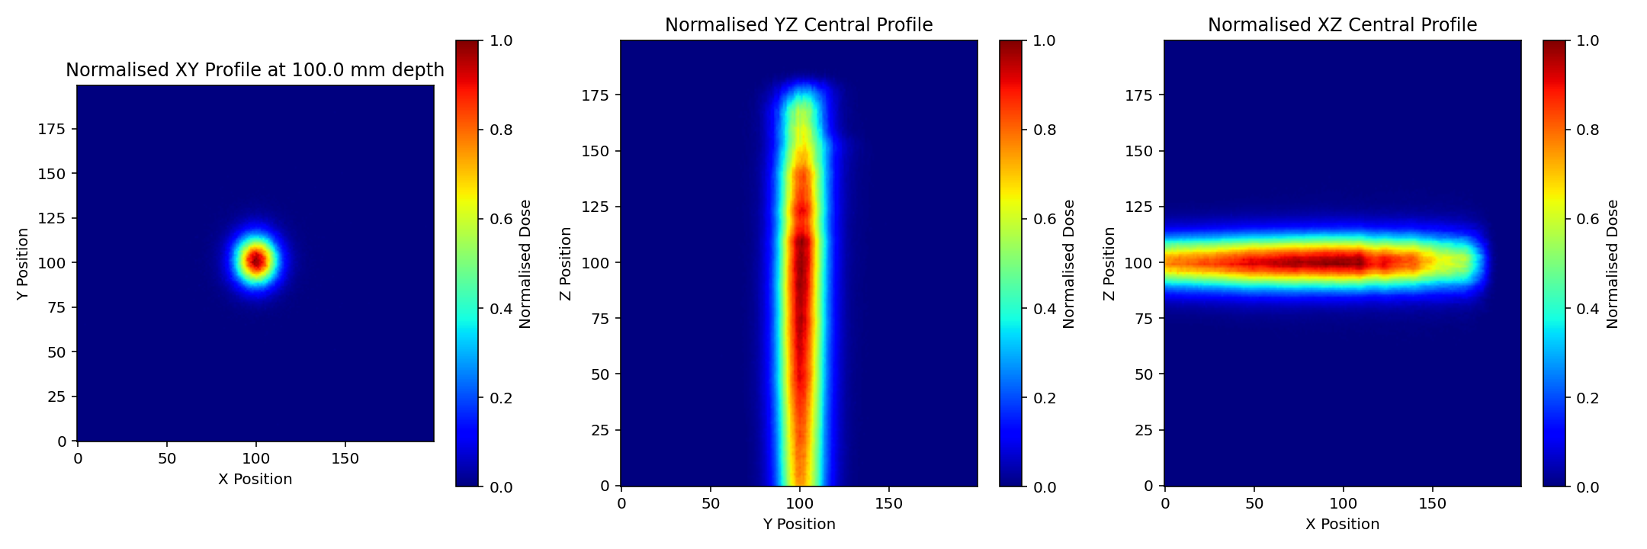
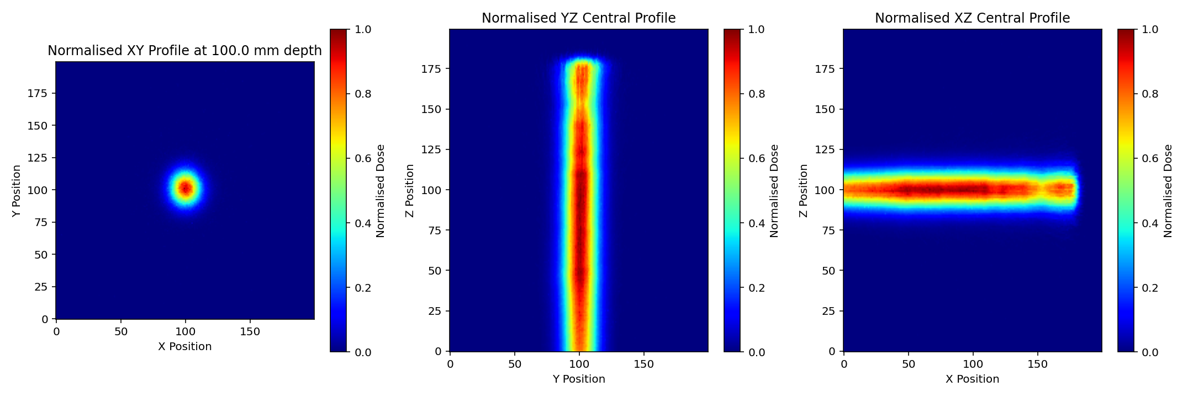
2D profiles
QuARC
Intensities
CMOS (2D)
Intensities

Slide 21
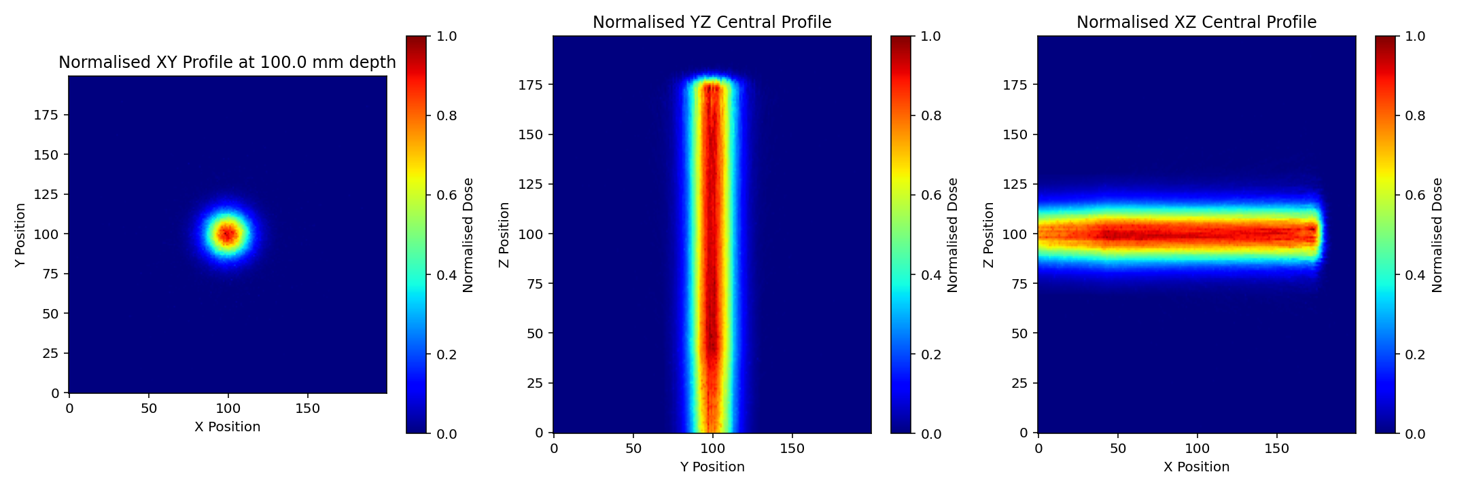

2D profiles
All
DICOM
QuADProBe
params
DICOM
intensity

Slide 22
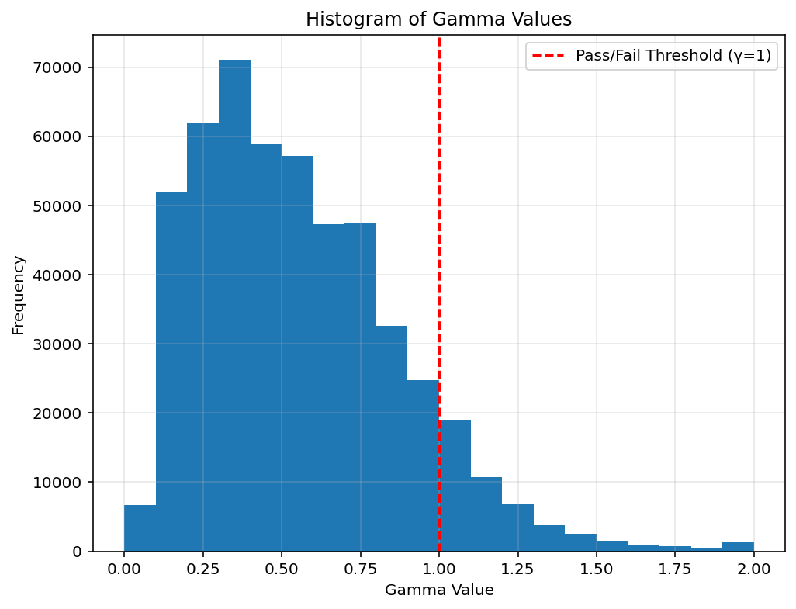
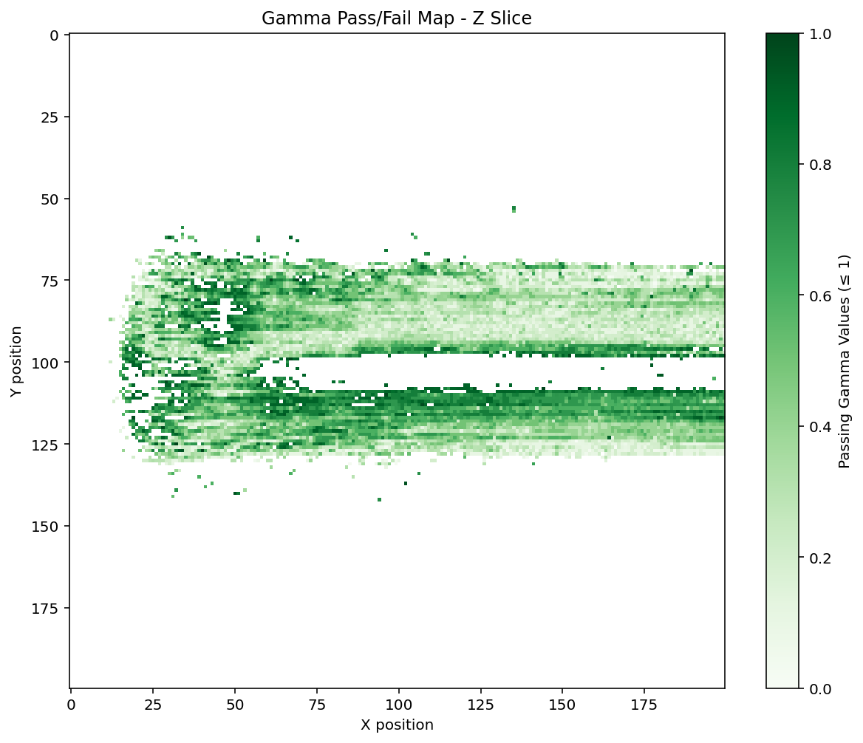
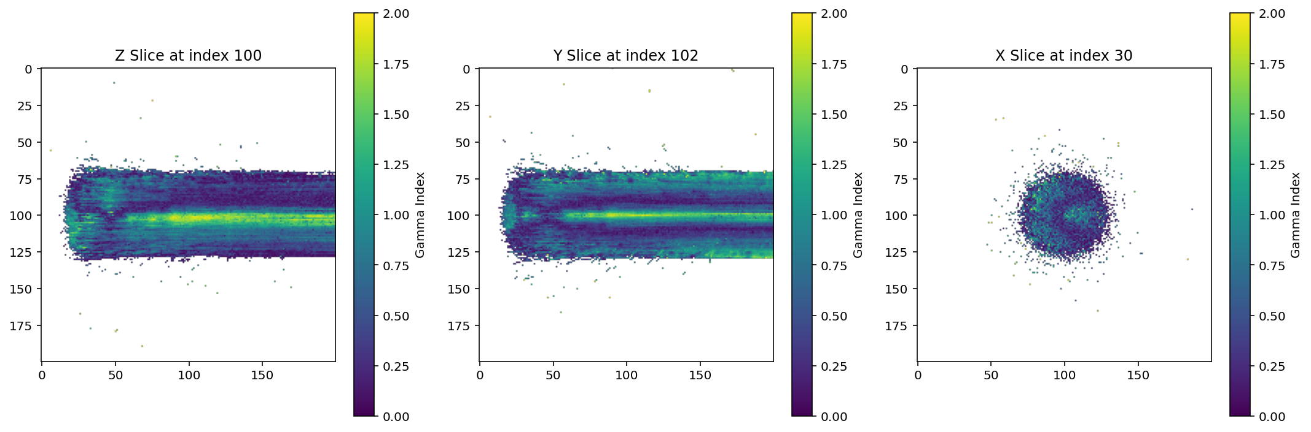
3D Distribution Comparisons
Gamma Index Comparisons
  Reference Dose Distribution: All DICOM Parameters
  Evaluated against: QuADProBe Params, CMOS (2D) Intensities
Gamma pass rate (3%/3mm): 90.58%

Slide 23
Next steps…
Proof of principle measurements for new method of PSQA demonstrated for QA fields. But improvements needed:
Currently in process of upgrading detector:
  QuARC:
    Improving electronics and scintillator sheets to resolve “noisy” channels.
    Dual-sided readout
  Scintillating Fibre Monitor for spot size and position readout
    Second prototype under construction
    Working with HIT who are developing similar device for beam monitoring
Also investigating fast MC simulations/independent dose calculations for reconstruction.

Slide 24
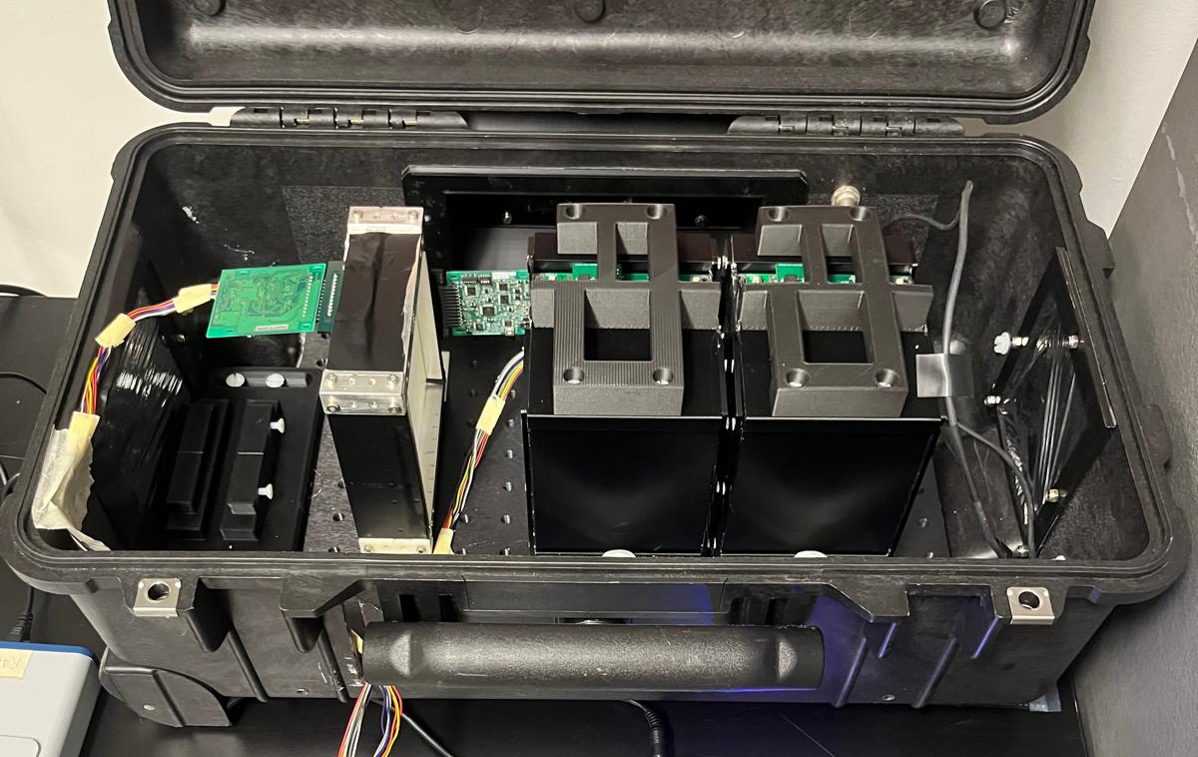
The Next Gen QuADProBe
Absolute Dose: NPL Transmission Calorimeter (TC)
Water Equivalent Range: UCL QuARC Range Telescope
Protons
Spot Size + Position: U. Bari & UCL Scintillating fibre array detector
Enclosure: Peli 1510 flight case with patch panel

Slide 25
Concluding Remarks
What do YOU (PBT medical physicists/RTTs) want most out of a PBT QA device?
  Nozzle mounting for 360º measurements or is a couch-based device preferred?
  Automation?
  Considerations for future of PBT QA i.e. combined approach rather than separate machine QA and PSQA measurements?

Slide 26



Acknowledgements
Simon Jolly Febian
Sonia Escribano-Rodriguez
Harry Barnett
Connor Godden
Matt Warren
Saad Shaikh Rafaella Radogna
Fern Pannell
Sam Flynn
Nigel Lee
Russell Thomas
Colin Baker
Alison Warry
Andrew Gosling
Lee Harrison-Carey
Andrew Poynter
Tony Price
Catherine Burne
Phil Allport

