Slide 1
QuARC 2025 Experiments:
Scintillator Sheet Response Comparisons
Joe Bateman, Sonia Escribano Rodriguez, Harry Barnett, Connor Godden, Matt Warren, Febian, Simon Jolly
University College London

Slide 2
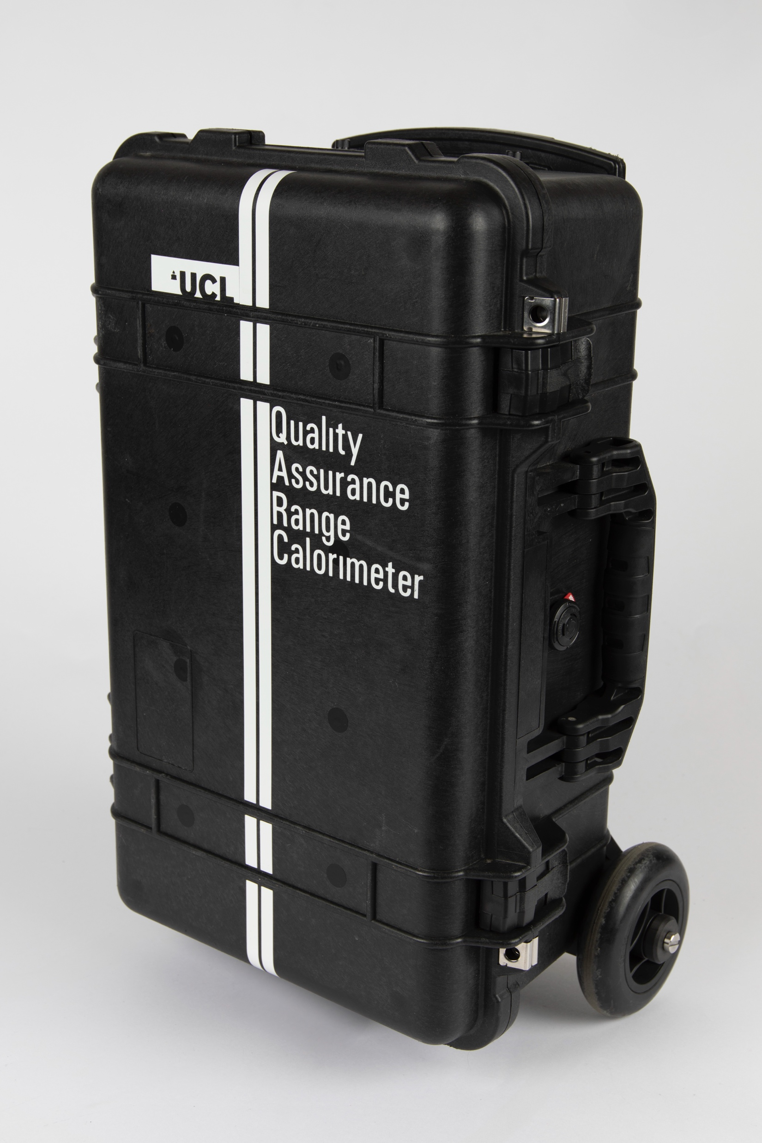
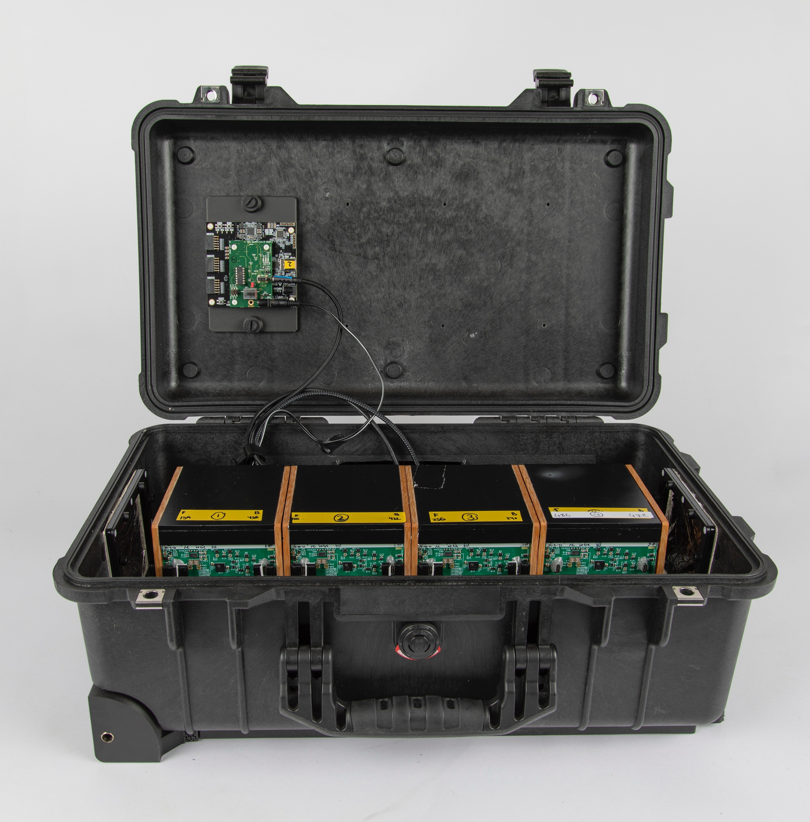
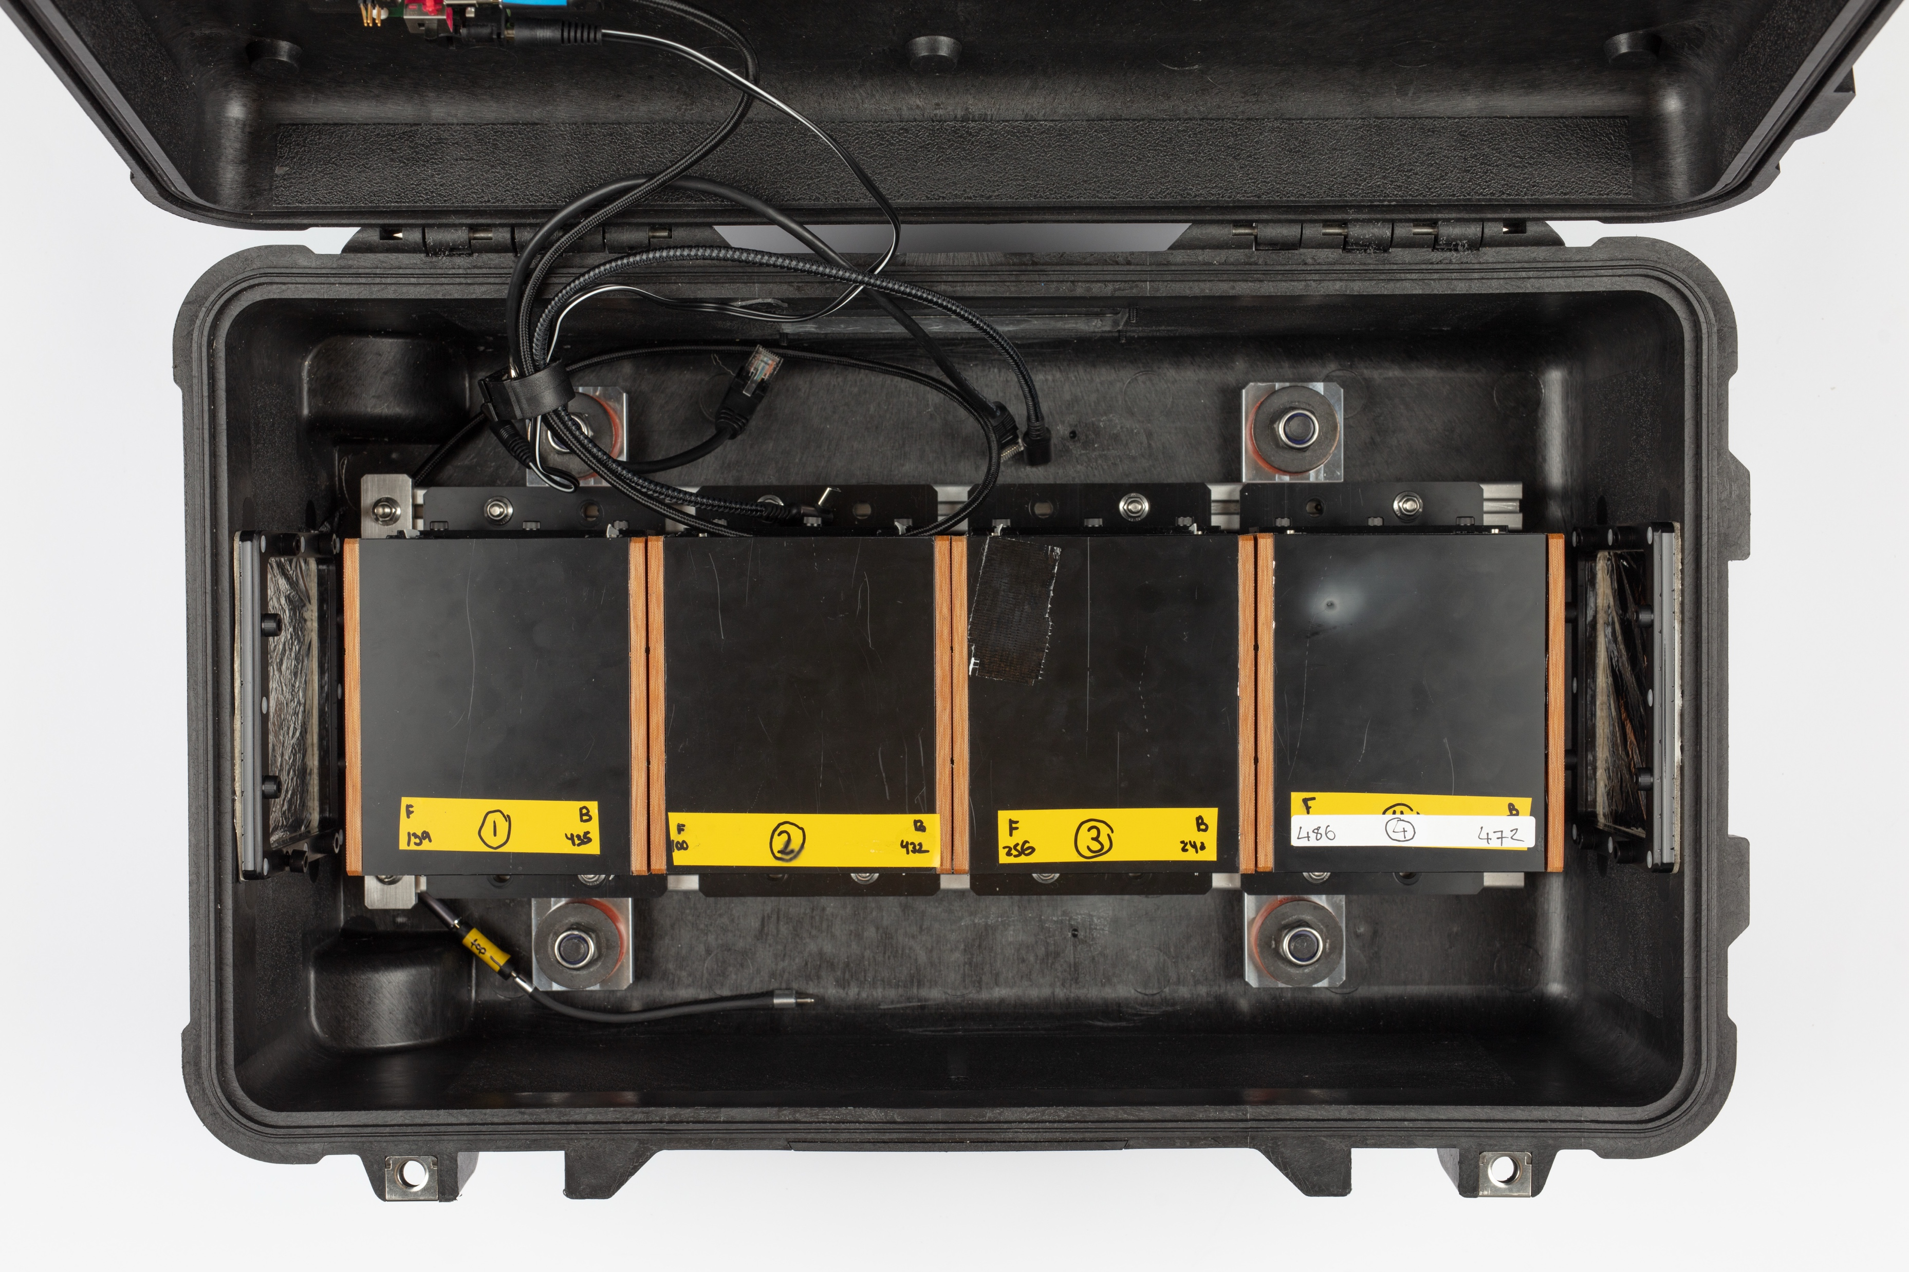
Overview
QuARC Detector Upgraded in 2025
  New scintillator sheets (modules contained mix of transparent machined sheets, translucent sheets and injection moulded transparent sheets)
  Updated electronics to reduce noise and have dual-sided readout of sheets.
3 beam tests in 2025
  Prague PTC in April 2025 (1 morning) – 4 modules
  UCLH in May 2025 (1 day) – 4 modules
  Trento Proton Therapy Centre (2 nights of QuARC measurements) – 3 modules

Slide 3
QuARC Module Assembly
Module 1:
  Front of module: mostly sanded translucent sheets
  Back of module: intertwined translucent sanded sheets, and machined polished sheets (combo of thick and thin)
Module 2 (best module):
  All machined polished sheets and those closets to 3mm (i.e. between 2.99mm and 3.01mm)

Slide 4
QuARC Module Assembly
Module 3:
  All sanded translucent sheets (all under 3mm: 2.96 – 2.99 mm thicknesses)
Module 4:
  Prague experiment:
    Front half – combination of injection moulded sheets and transparent polished sheets
    Back half: combination of injection moulded and translucent sanded sheets
    Irregularity of injection moulded sheets meant stack was too large for holder and difficult to assemble hence PD’s did not align well to sheets.
  UCLH experiment:
    Combination of sanded sheets and polished sheets (only a few near the front)

Slide 5
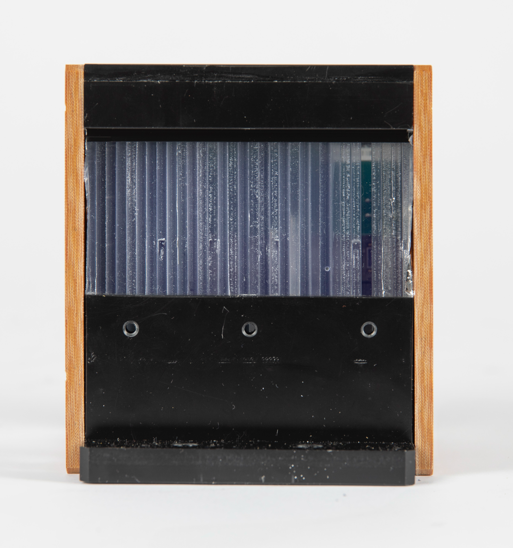
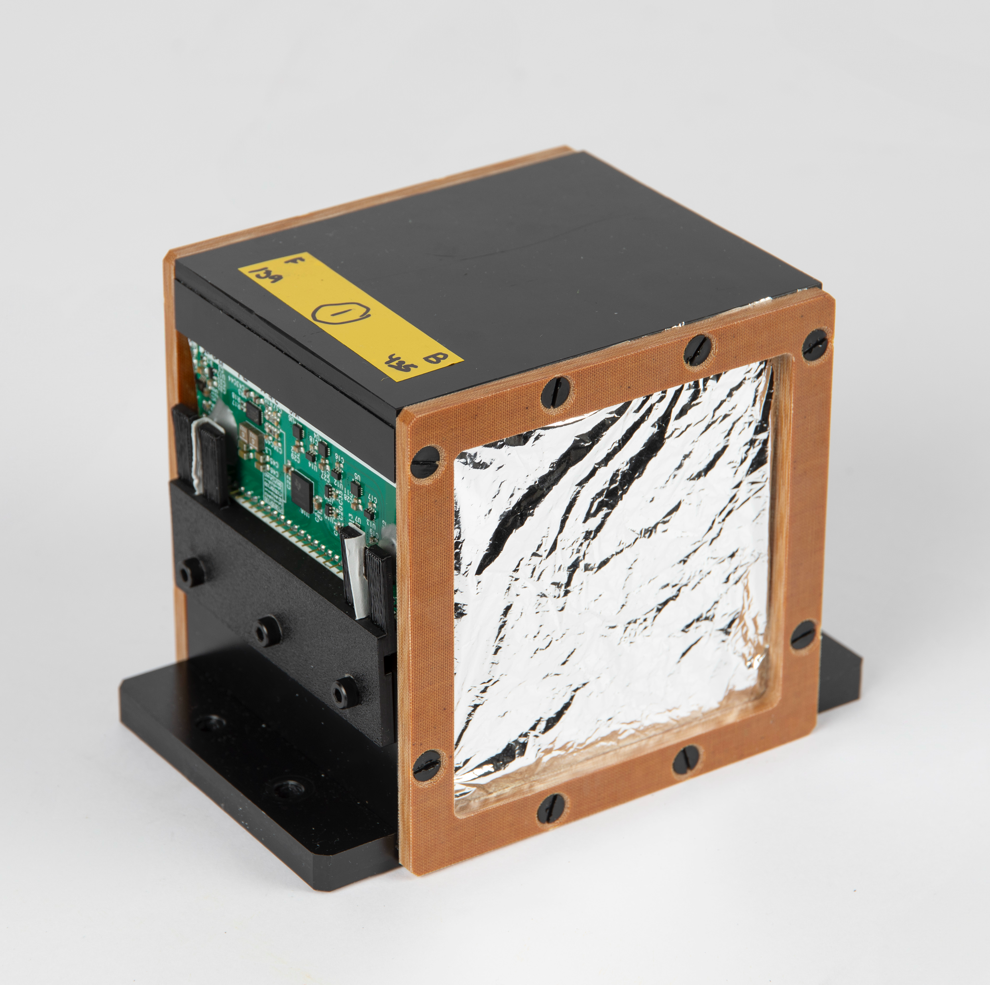
QuARC Module Side View

Slide 6
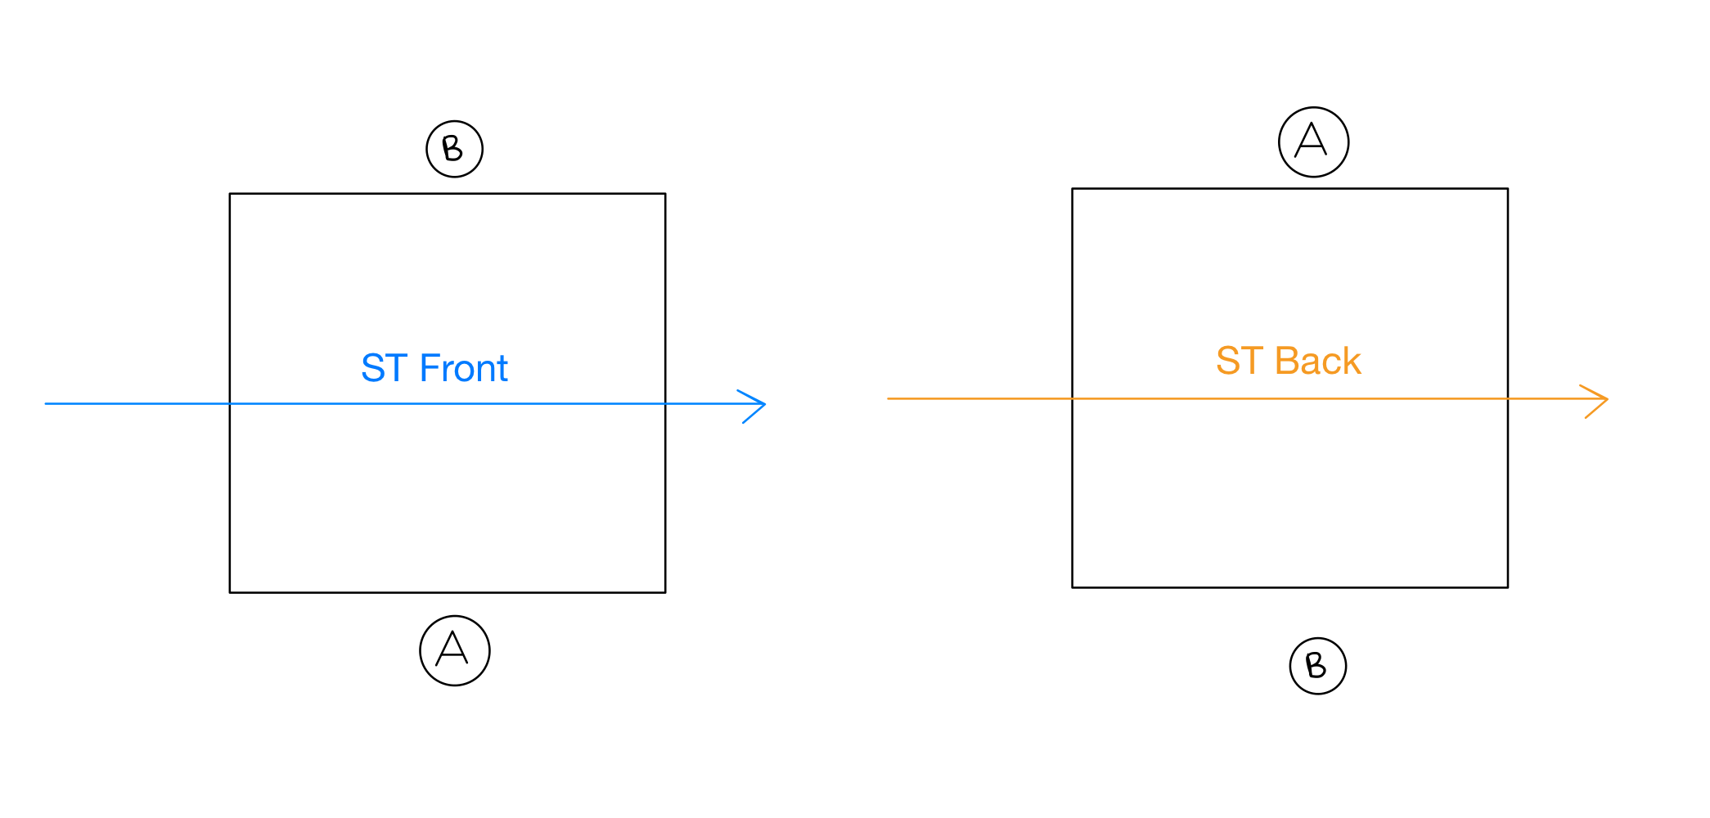
Detector Calibration
Gantry remains fixed so the beam direction is always the same. We rotate the modules to create ST Back.

Slide 7

Detector Calibration
$$coefficient\left[i\right]=\frac{ST_{back}\left[i\right]+ST_{front}[i]}{2}$$
245 MeV (Varian) or
228 MeV (IBA), back
245 MeV (Varian) or
228 MeV (IBA), front

Slide 8
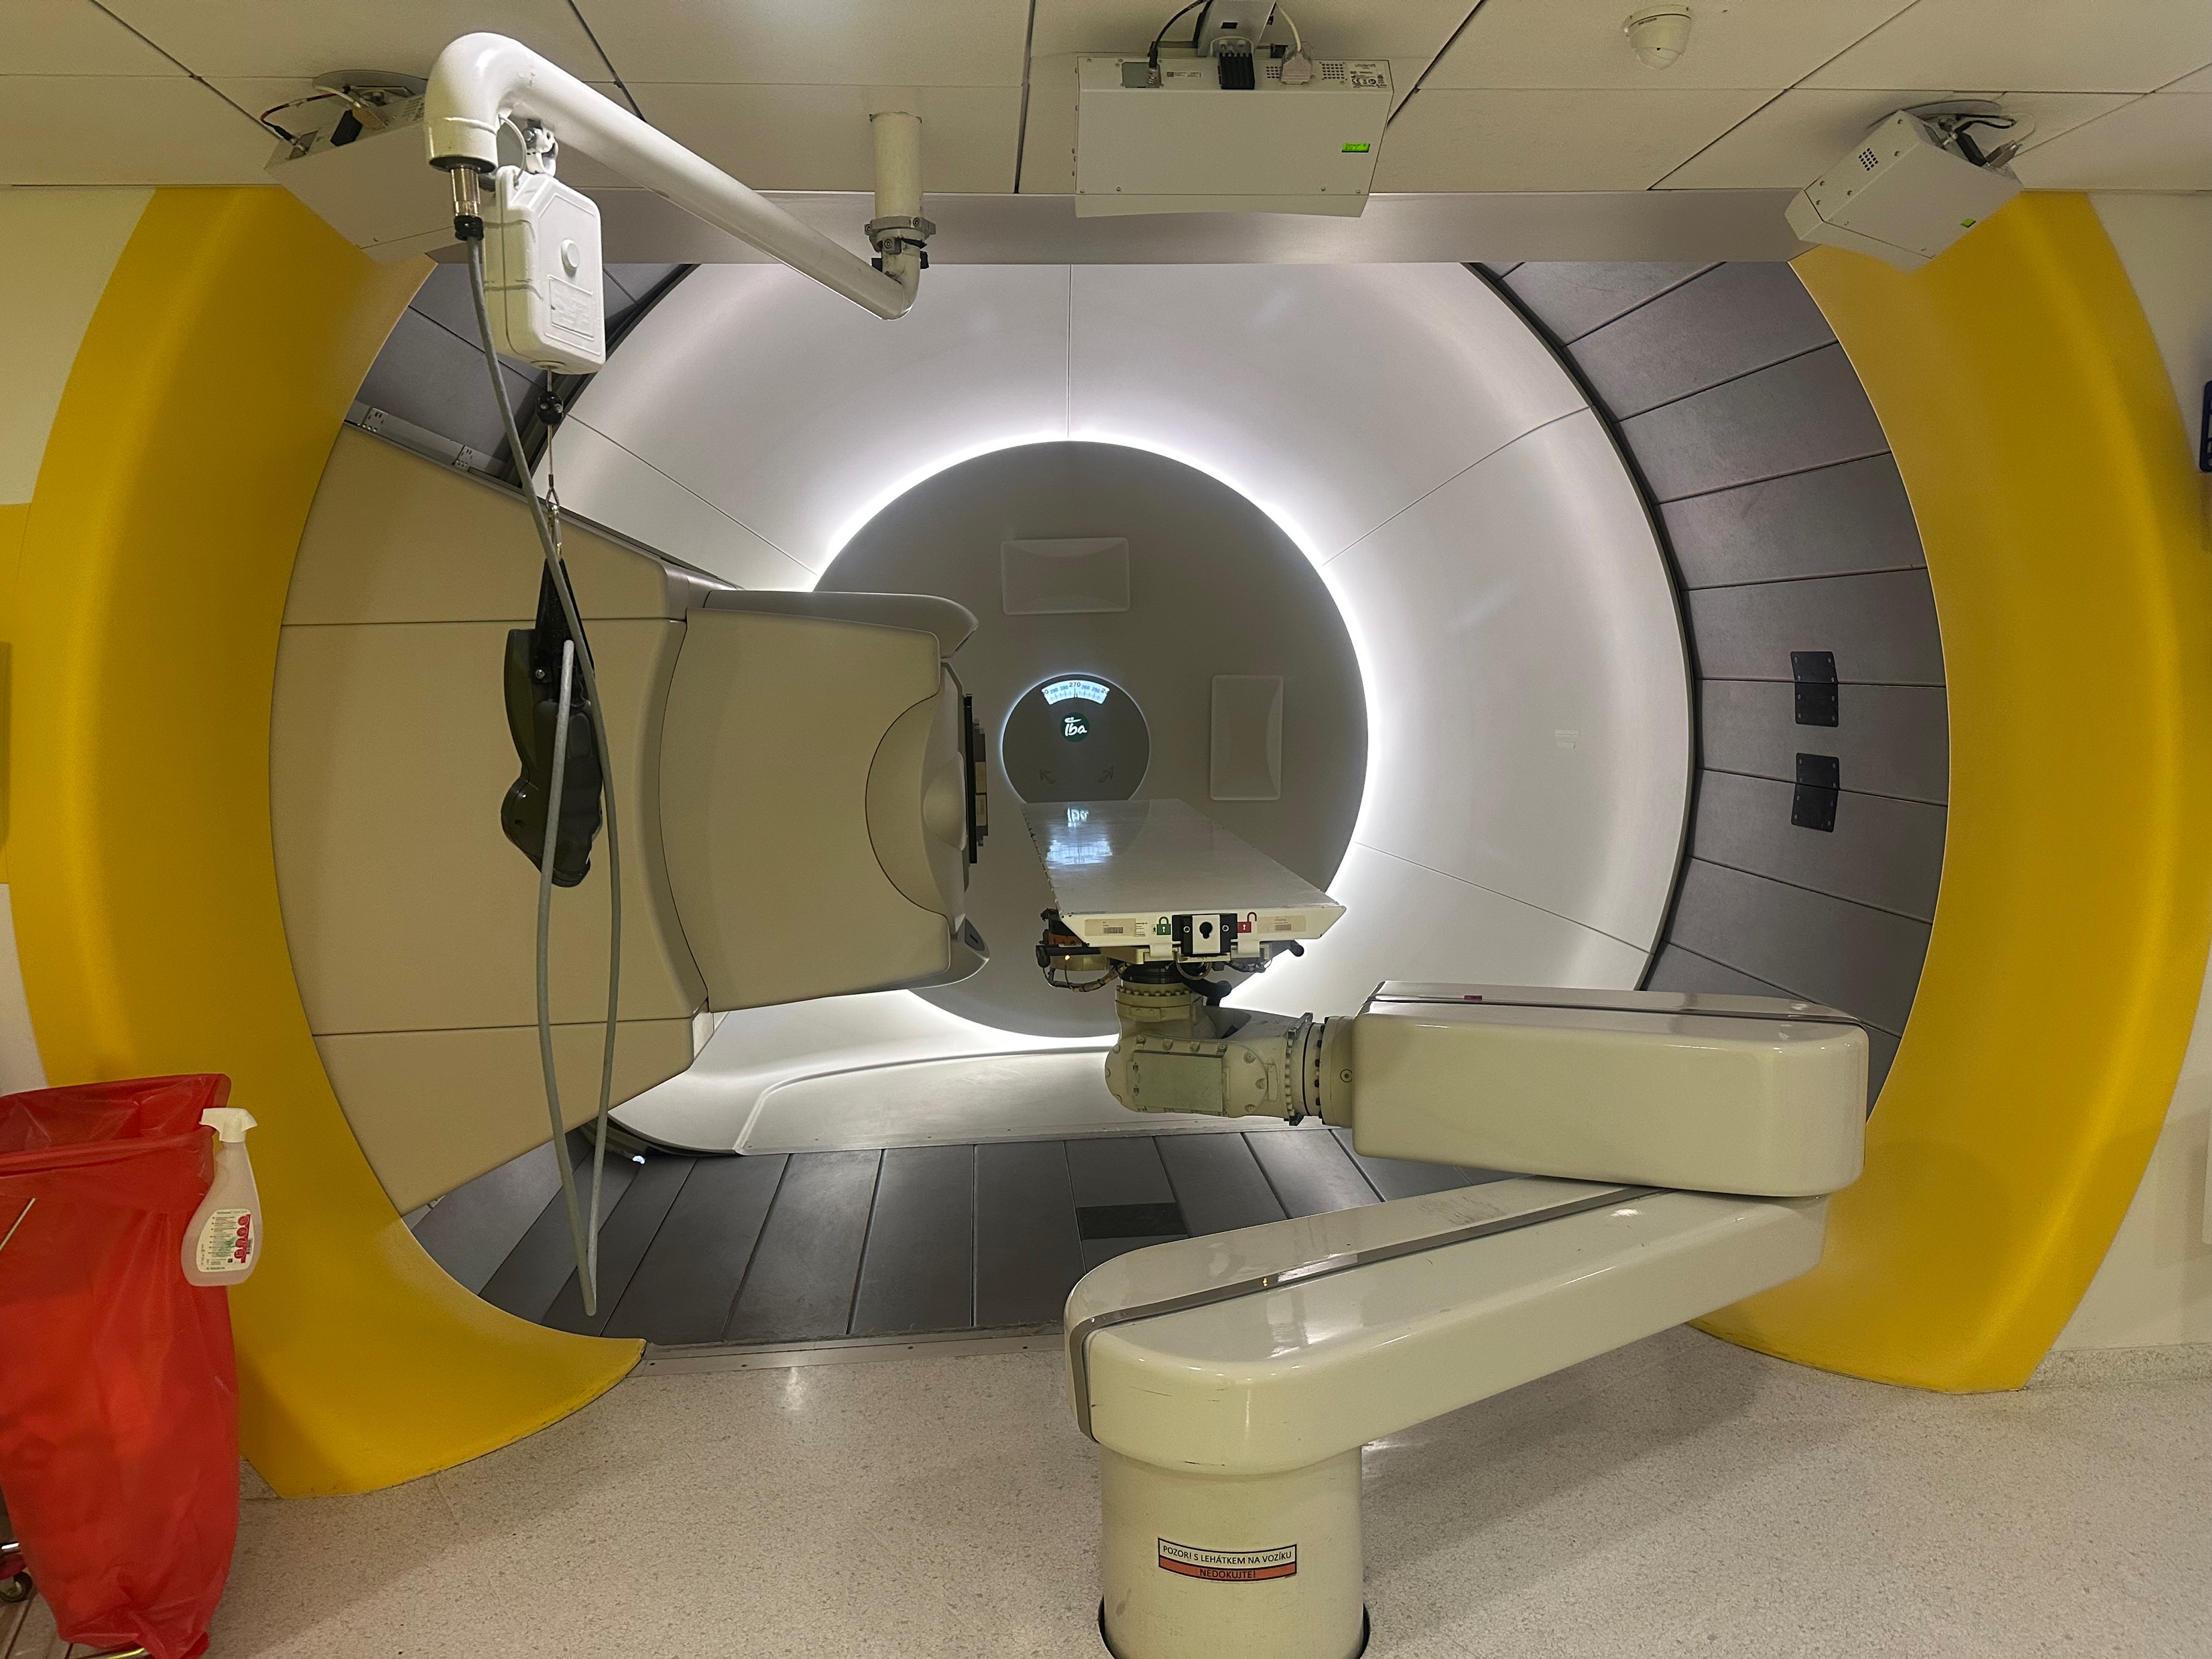
Prague PTC
IBA Machine so 228 MeV is max energy.
Two shoot through measurements performed per module (1 in each orientation).
Shoot-through irradiations performed at clinical current – 8 nA.
To note in next set of slides – A-side electronics more reliable – the less reliable PDs and boards were put on B-side

Slide 9
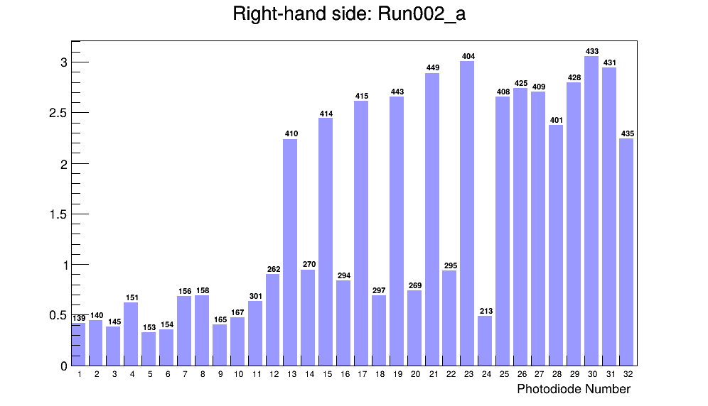
MODULE 1
Different scintillator sheets, so light output differs.
Much higher light output on machined polished sheets (number 400 onwards)
PD Charge

Slide 10
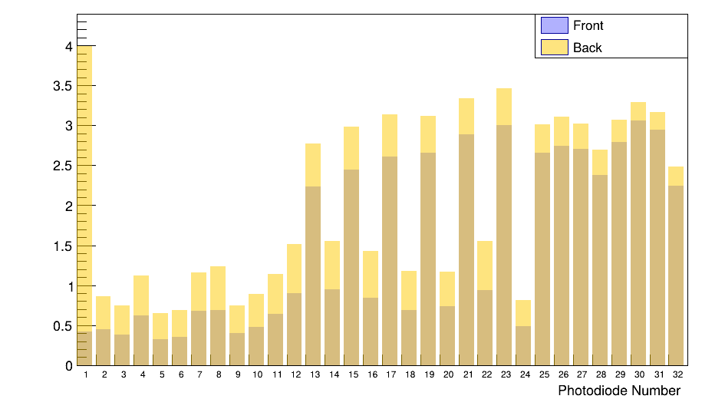
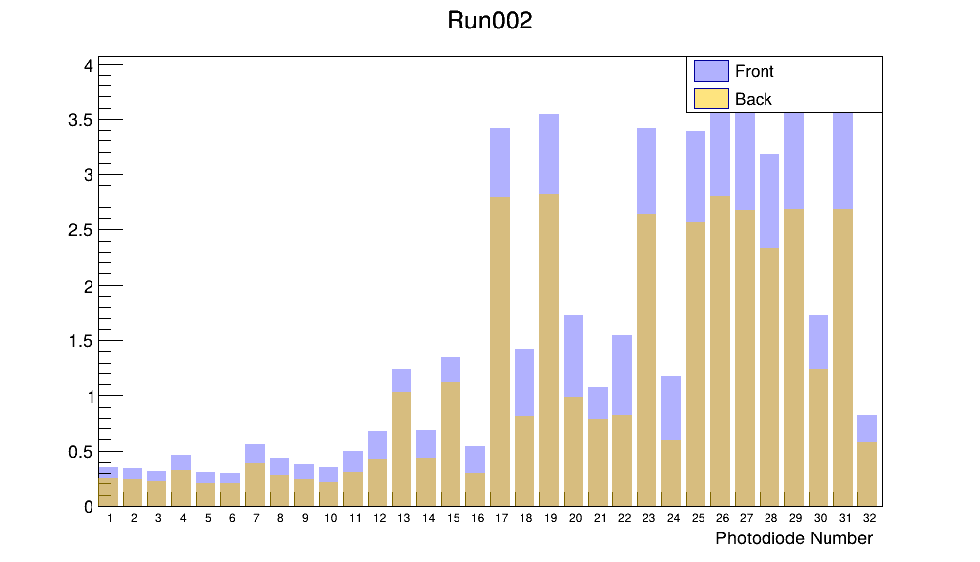
MODULE 1: compare STFront and STBack
A side (right) sees more light with STBack and B side (left) side sees more light with STFront -> Always more light when the board is placed on the left hand side of the beam.
A side
B side
Translucent sanded sheets
PD Charge
PD Charge
Transparent machined polished sheets

Slide 11
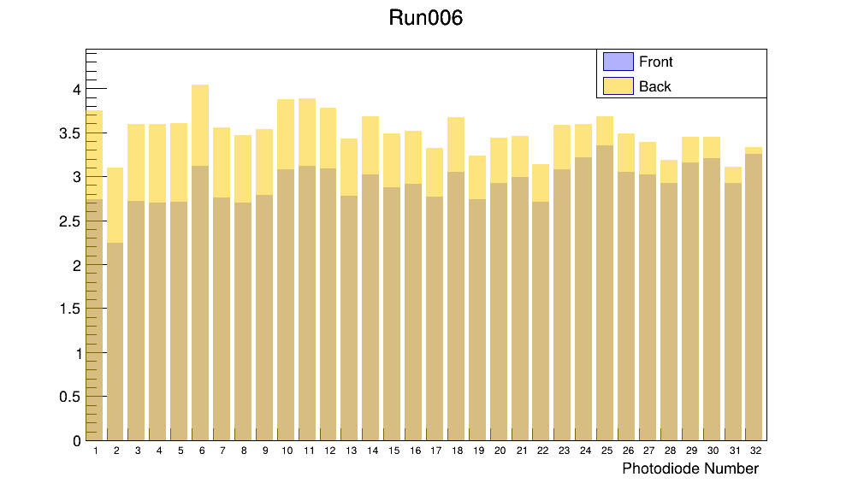
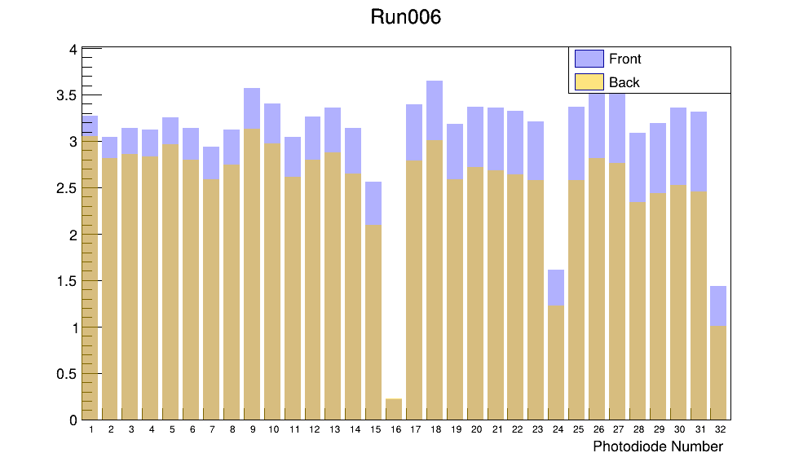
MODULE 2: compare STFront and STBack
A side (right) sees more light with STBack and B side (left) side sees more light with STFront again -> Always more light when the board is placed on the left hand side of the beam.
More uniform overall response due to all sheets being machined transparent sheets
A side
B side
PD Charge
PD Charge
Dodgy PD

Slide 12
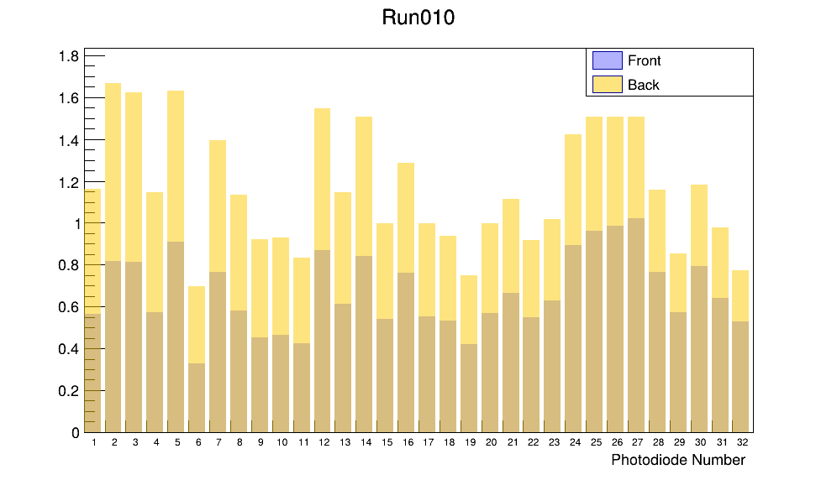
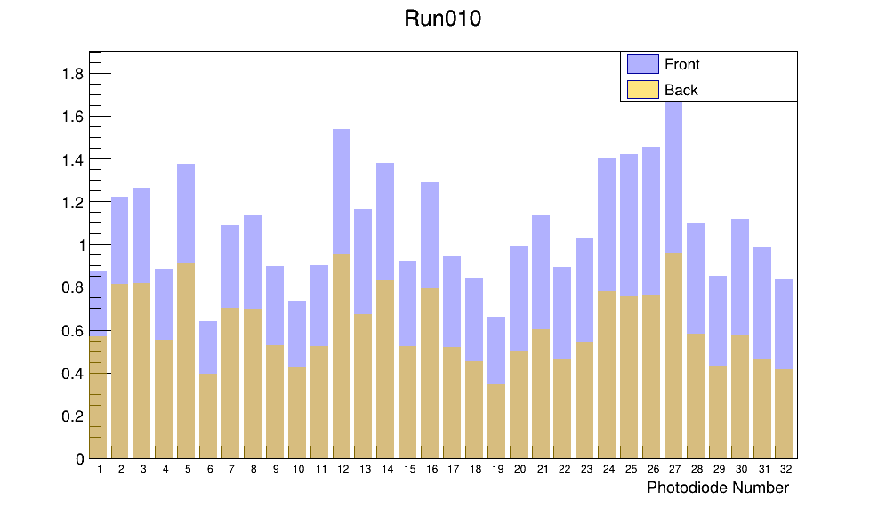
MODULE 3: compare STFront and STBack
Older sanded translucent sheets are showing much larger variation in response despite being all the same ‘type’ of sheet.
A side
B side
PD Charge
PD Charge

Slide 13
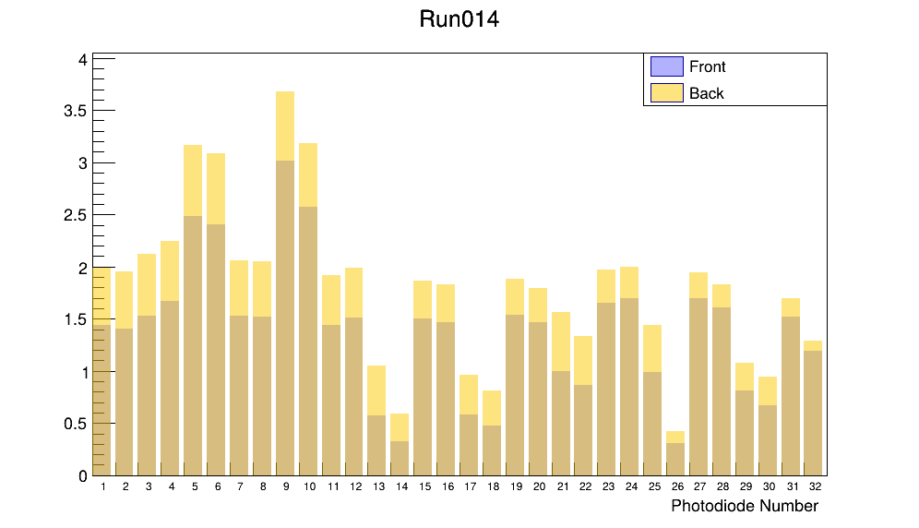
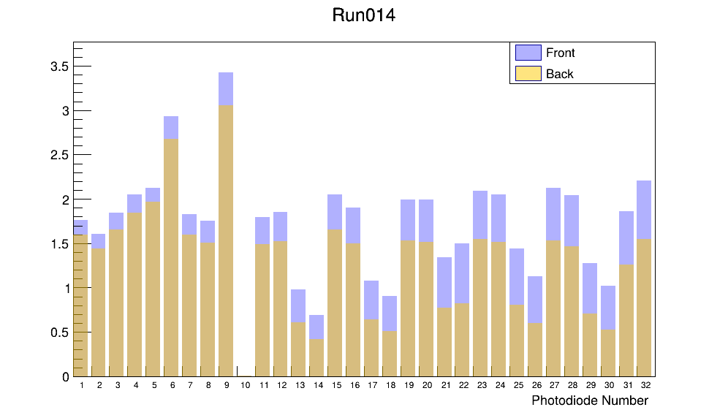
MODULE 4: compare STFront and STBack
Machined and polished sheets (MP) showed greatest light output
Injection moulded (IM) sheets showed better light output than sanded translucent sheets (S)
A side
B side
PD Charge
PD Charge
MP
MP
IM
IM
IM
IM
IM
IM
IM
IM
S
S
S
S

Slide 14
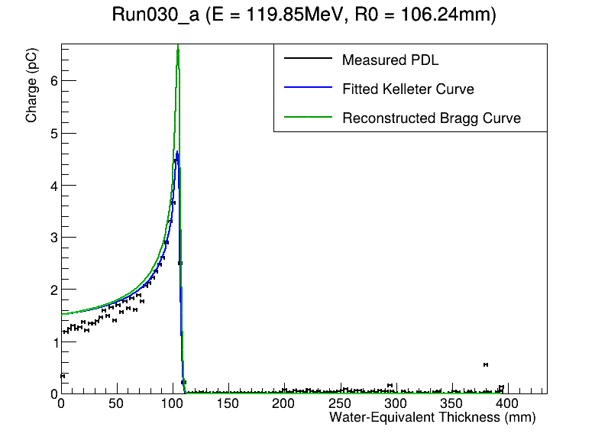
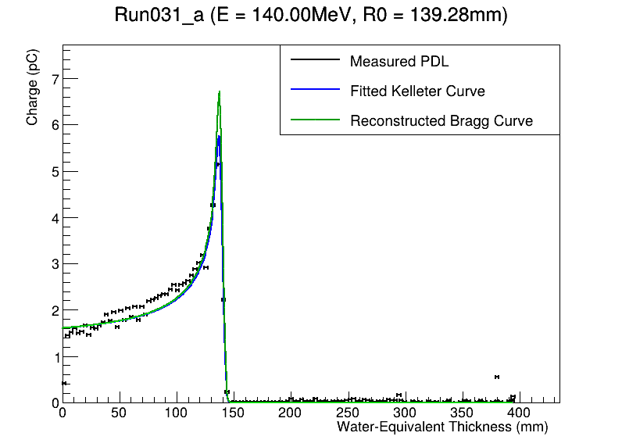
Bragg Peak results
120 MeV
140 MeV

Slide 15
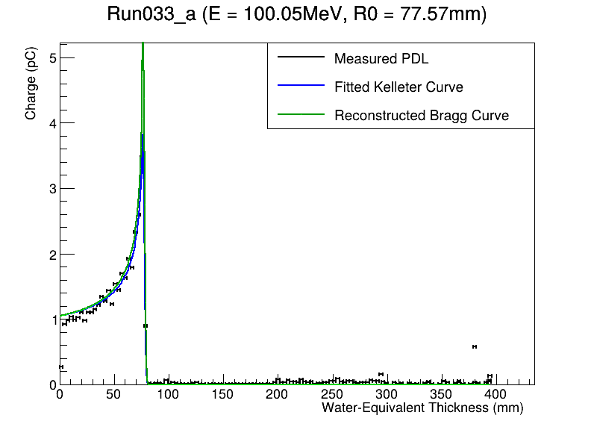
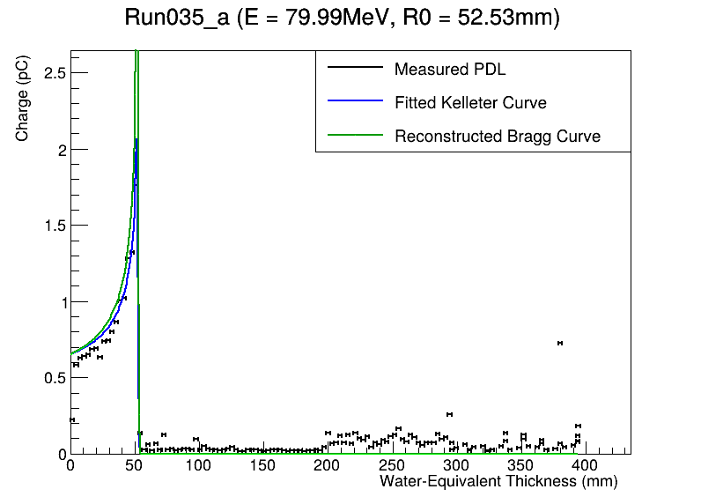
Bragg Peak results II

Slide 16
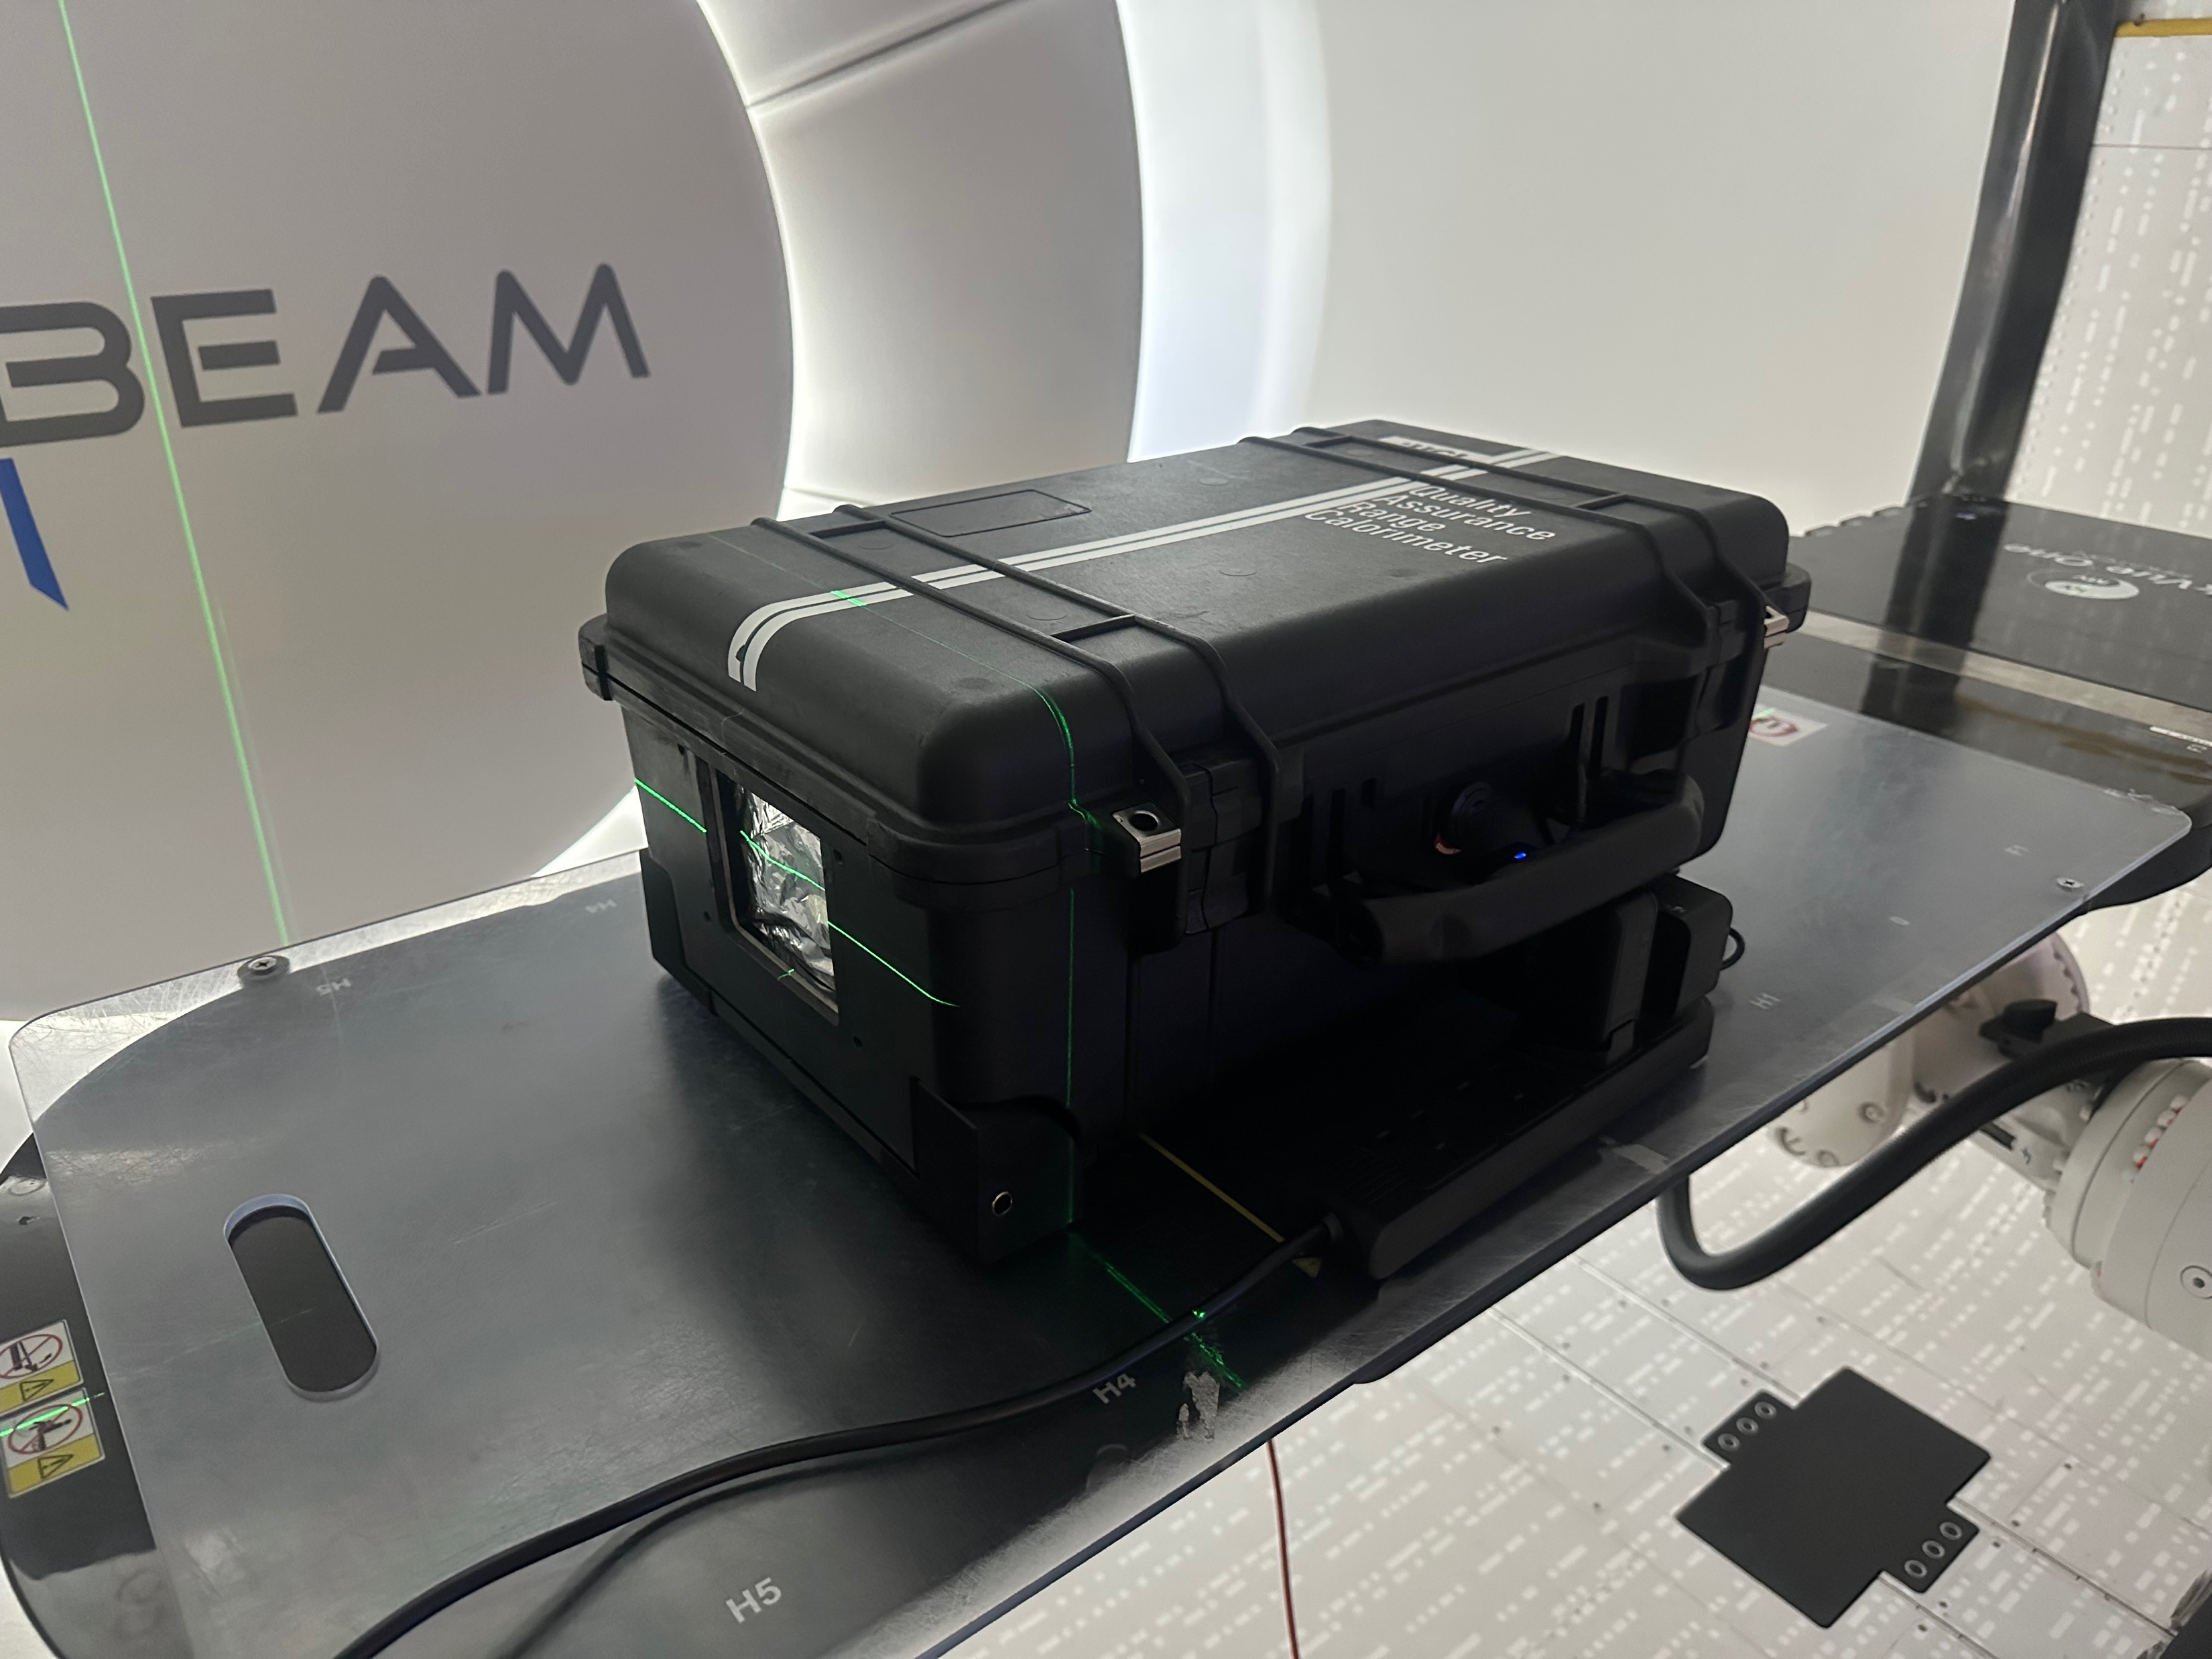
UCLH
Measurements with 4 modules (4th module different Prague measurements and consists of mostly sanded sheets and a couple polished sheets but no injection moulded).
2 shoot throughs per module (front and back) - approx 10,000 MU was sufficient for 30,000 measurements
Pristine Bragg peak measurements across entire clinical range (70 – 245 MeV) and SOBPs

Slide 17
Side A Shoot through comparisons
PD Charge (pC)
Module 1
Module 2
Module 3
Module 4

Slide 18
Side B Shoot through comparisons
PD Charge (pC)
Module 1
Module 2
Module 3
Module 4

Slide 19
Side A Calibrated
Normalised PD Charge (a.u.)
Module 1
Module 2
Module 3
Module 4

Slide 20
Side B Calibrated
Normalised PD Charge (a.u.)
Module 1
Module 2
Module 3
Module 4

Slide 21
75 MeV – BP in Mod 1
Side A
Side B
Range: 45.54 mm, Energy: 73.69 MeV
Range: 45.65 mm, Energy: 73.79 MeV

Slide 22
150 MeV – BP in Mod 2
Side A
Side B
Range: 156.59 mm, Energy: 149.73 MeV
Range: 156.82 mm, Energy: 149.86 MeV

Slide 23
180 MeV – BP in Mod 3
Side A
Side B
Range: 214.57 mm, Energy: 179.41 MeV
Range: 214.7 mm, Energy: 179.48 MeV

Slide 24
245 MeV – BP in Mod 4
Side A
Side B
Range: 360.17 mm, Energy: 241.54 MeV
Range: 361.29 mm, Energy: 241.97 MeV

Slide 25
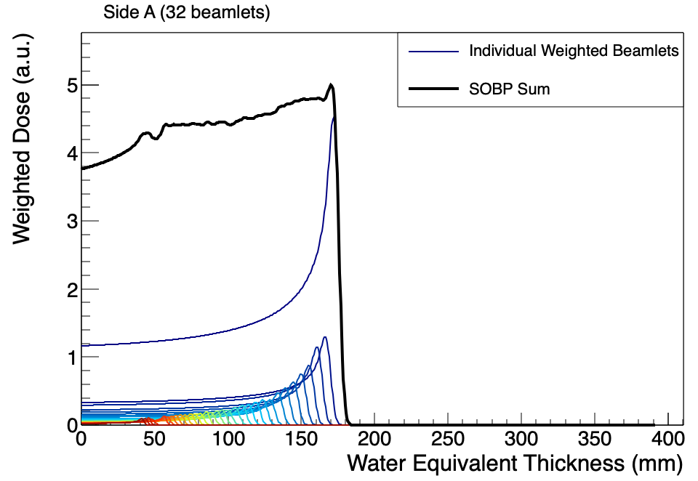
UCLH SOBP Reconstruction
SOBP Statistics
Plateau (90% level): 109.545 mm to 172.58 mm
Plateau width: 63.035 mm
Plateau mean : 4.68837 a.u.
Plateau std dev: 0.129093 a.u.
Flatness: 2.75347%

Slide 26
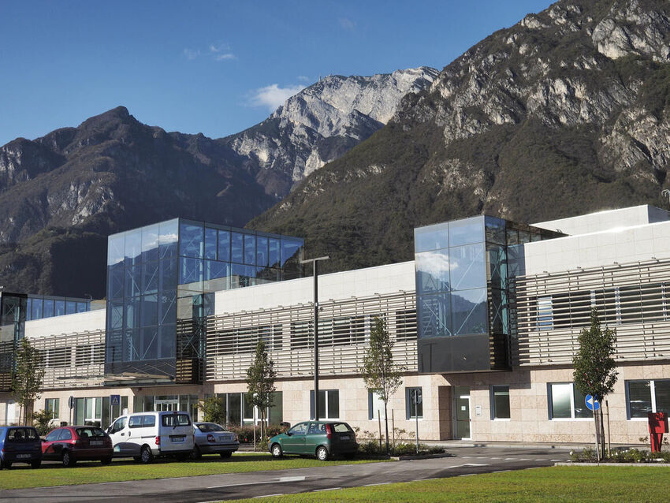
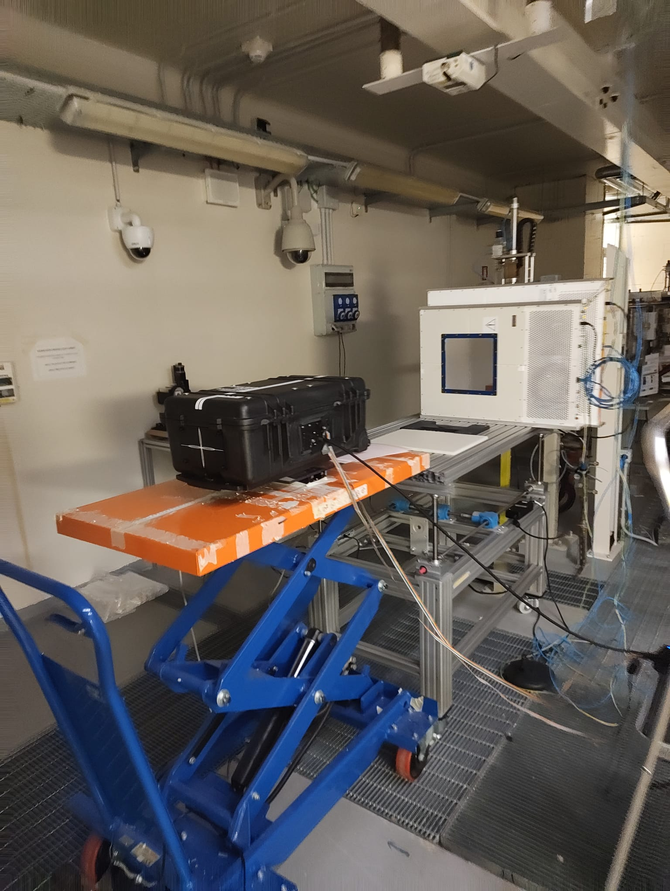
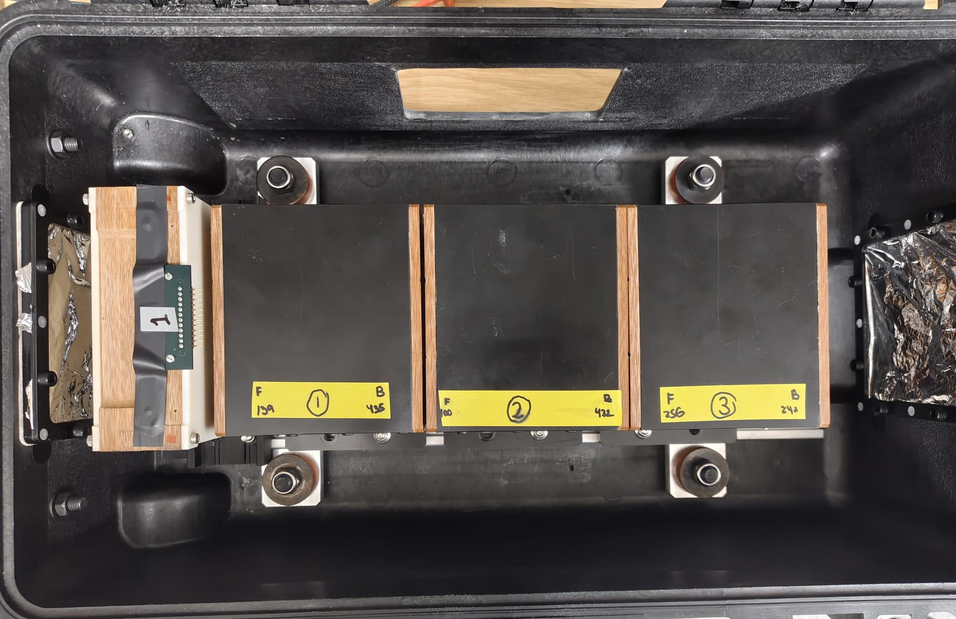
Trento Beam Test
3 nights of measurements in the research room at Trento PTC
  Night 1: QuARC
    Calibrations and Bragg Peak measurements scaling current up to FLASH (briefly).
  Night 2: Combined QuARC + SciFi:
    Dynamic range testing (fibres at low gain)
    Beam position measurements
  Night 3: SciFi Measurements
    Dynamic range testing (fibres at high gain)
    Different spot sizes (varying energy)

Slide 27
Trento
Measurements with 3 modules (to allow for fibre detector inside case).
2 shoot throughs for each module at 10 nA ion source current (~ 1.5 nA nozzle current).
Current scan performed on front shoot throughs of module 1 in both CONV and FLASH mode.
Response linearity current scan to measure linearity of detector response.
Beam position measurements to correlate QuARC dual-sided position measurement with fibre array position measurement by moving detector in 5mm increments horizontally.

Slide 28
Side A Shoot through comparisons
Module 1
Module 2
Module 3
PD Charge (pC)

Slide 29
Side B Shoot through comparisons
Module 1
Module 2
Module 3
PD Charge (pC)

Slide 30
Side A Calibrated
Module 1
Module 2
Module 3
Normalised PD Charge (a.u.)

Slide 31
Side B Calibrated
Module 1
Module 2
Module 3
Normalised PD Charge (a.u.)

Slide 32
Module 1: ST Front
Nozzle current:
~1 nA
Nozzle current:
~1nA
No log file data from Trento from these runs so nozzle current based on PBT wiki notes
Nozzle current:
~0.5 nA
Note that only polished sheets
appear to saturate

Slide 33
Module 1: ST Front
Nozzle current:
1.45 nA
Nozzle current:
25.81 nA
FSR 12.5 pC
FSR 350 pC

Slide 34
Module Front Shoot Throughs Comparison
Summed the charge from
Sanded sheets
Polished sheets
Evident from previous plots that the polished sheets have much higher light output, here it can be seen they have steeper response also.
Lack of accurate nozzle current data from Trento is reason for data at start looking odd.

Slide 35
Response Linearity
Response linearity of entire QuARC detector by summing the average PD values across the measurement time.
179 MeV
148 MeV

Slide 36
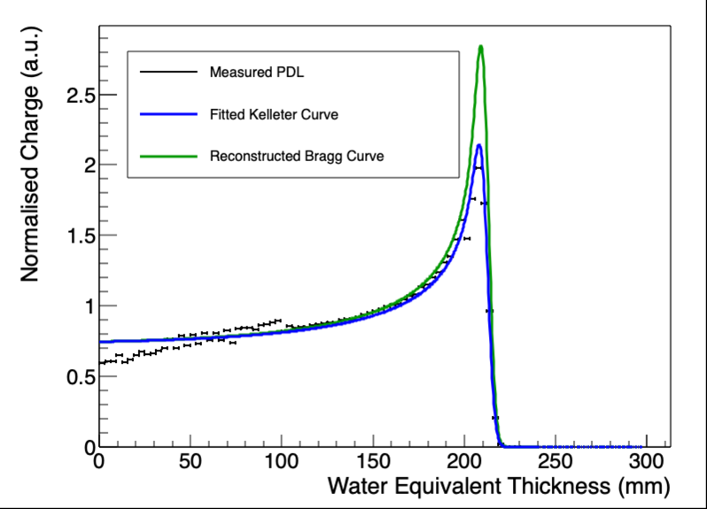
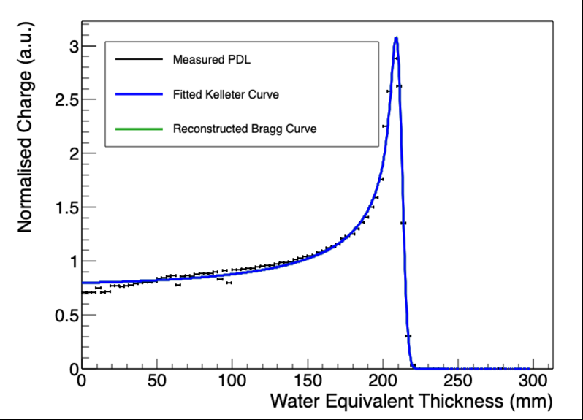
179 MeV 20 nA
Side B
Side A
kB = 0.105512
Sigma_0 = 3.11298
kB = 7.32185e-06
Sigma_0 = 3.03636

Slide 37
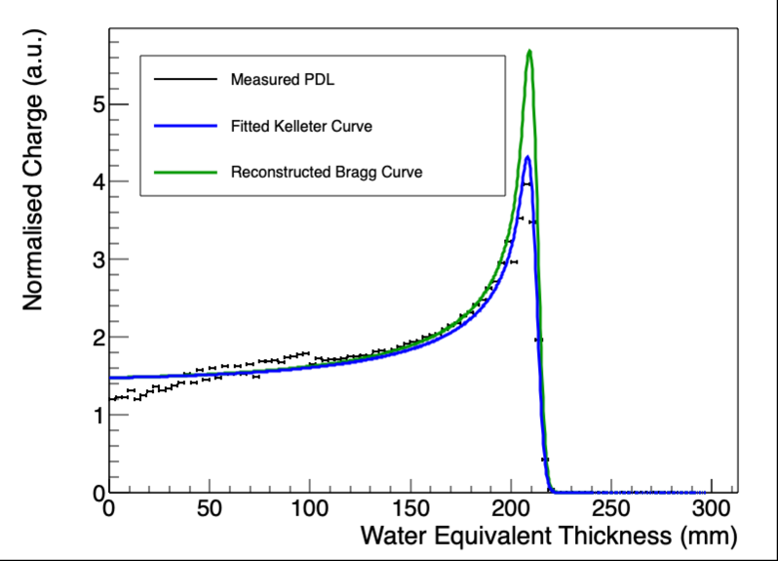

179 MeV 40 nA
Side A
Side B
E₀ = 178.18 MeV
kB = 0.10059
E₀ = 178.03 MeV
kB = 0.01

Slide 38
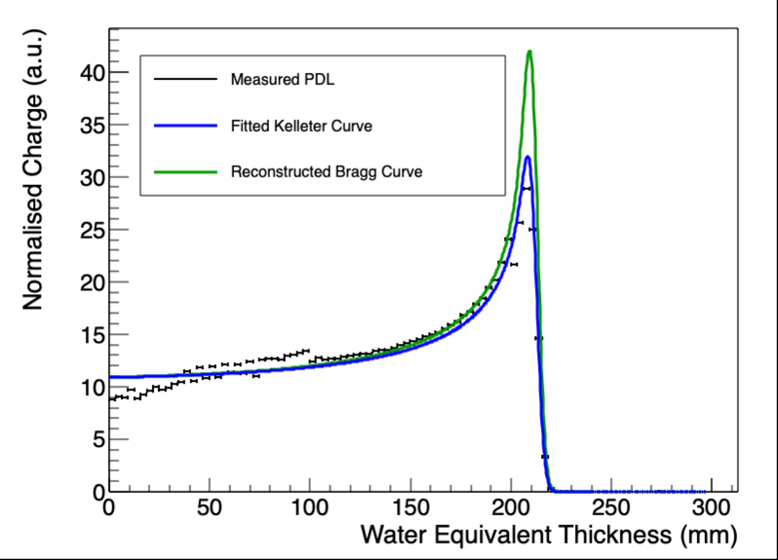
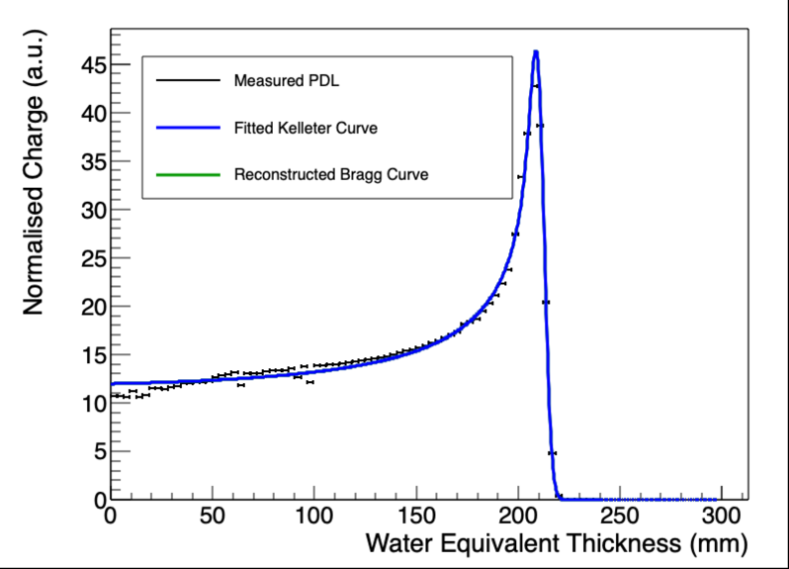
179 MeV 300 nA
Side A
Side B
E₀ = 178.18 MeV
kB = 0.0995859
E₀ = 177.9 MeV
kB = 1.87366e-05

Slide 39
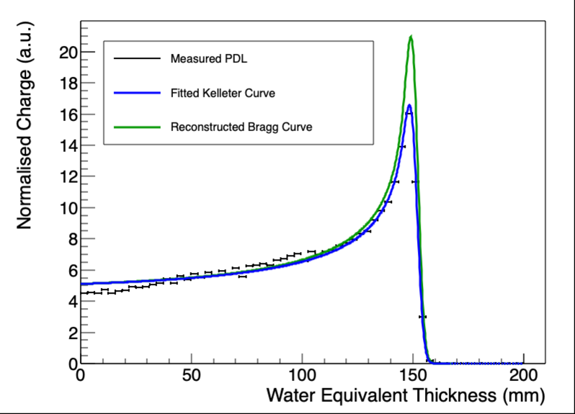
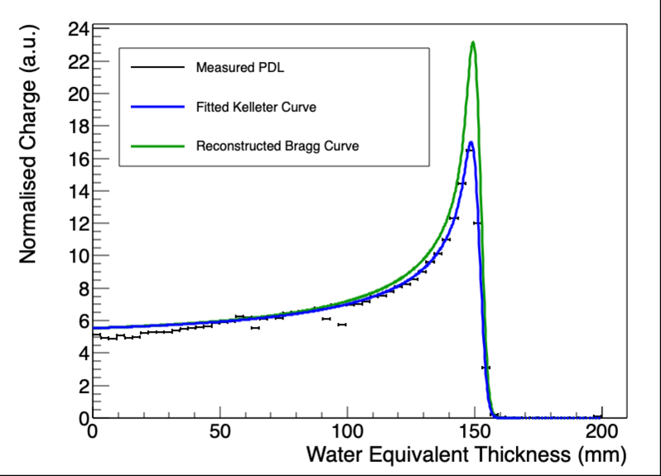
149 MeV Centered
A
B

Slide 40
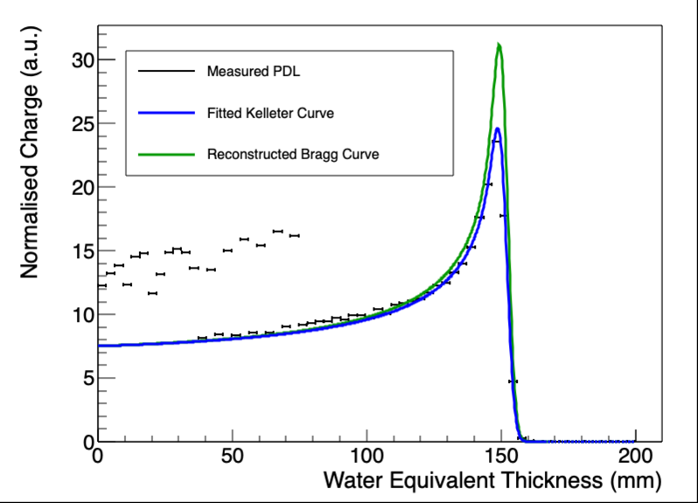
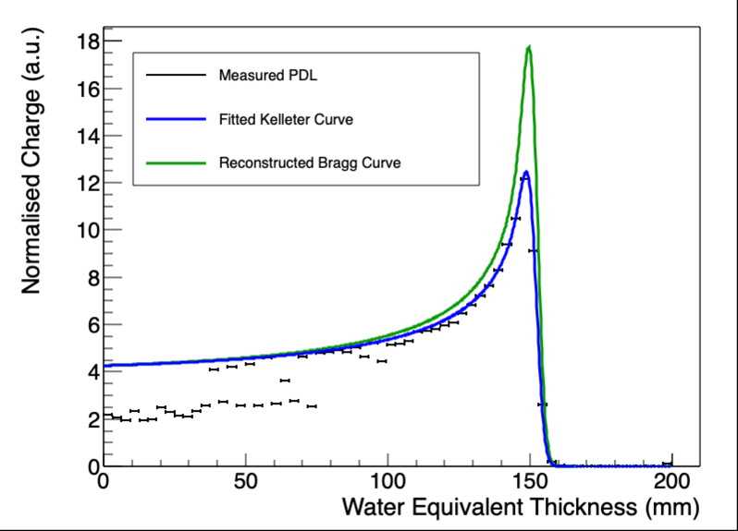
149 MeV Beam Spot 20 mm to right
A
B
Note how the sanded sheets in module 1 respond when the beam is scanned – due to large calibration factor being less reliable for these sheets

Slide 41
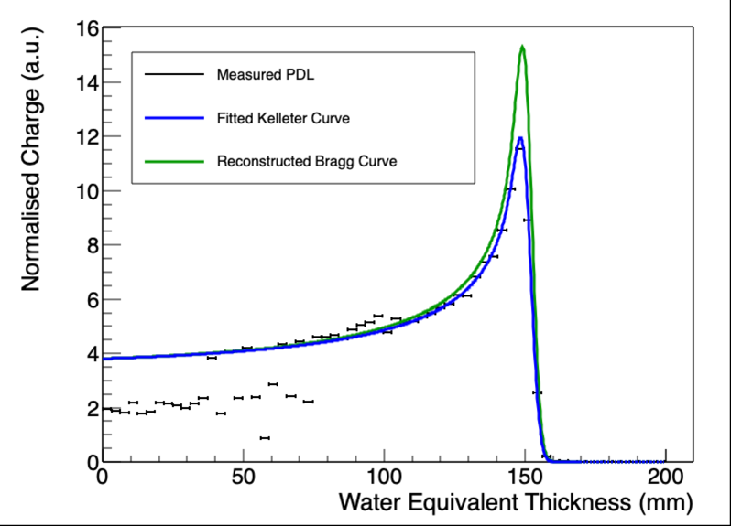

149 MeV Beam Spot 20 mm to left
A
B
Note how the sanded sheets in module 1 respond when the beam is scanned – due to large calibration factor being less reliable for these sheets

Slide 42
Calibration Effect
149 MeV
149 MeV
179 MeV
Calibration disproportionally increases B-side signal around Bragg peak to make it look like a smaller kB.
179 MeV

Slide 43
Calibration Effect
To summarise this effect:
Poor light output on module 3 sheets (sanded sheets) and slight misalignment of beam in calibration.
Hence large calibration factors on module 3 sheets with large uncertainties.
This leads to over exaggeration of peak on percentage depth light (PDL) curve and hence appears as lower kB when it isn’t.
Effect isn’t present when Bragg peak is in module 2 (where there are good sheets) – so isn’t explicitly a position effect.
Similar effect also causes sanded sheets in module 1 to fluctuate when beam position is being scanned.

Slide 44
Position Scan - reconstructed 148 MeV Bragg Curves
Beam 20mm to right
A: R₀ = 151.46 mm, E₀ = 146.9 MeV
B: R₀ = 151.73 mm, E₀ = 147.05 MeV
Avg: R₀ = 151.595 mm, E₀ = 146.975 MeV
Beam 20mm to left
A: R₀ = 151.47 mm, E₀ = 146.91 MeV
B: R₀ = 151.51 mm, E₀ = 146.93 MeV
Avg: R₀ = 151.49 mm, E₀ = 146.92 MeV
Beam in centre
A: R₀ = 151.29 mm, E₀ = 146.81 MeV
B: R₀ = 151.51 mm, E₀ = 146.93 MeV
Avg: R₀ = 151.4 mm, E₀ = 146.87 MeV
Consistent range reconstruction across entire range of beam spot positions.

Slide 45
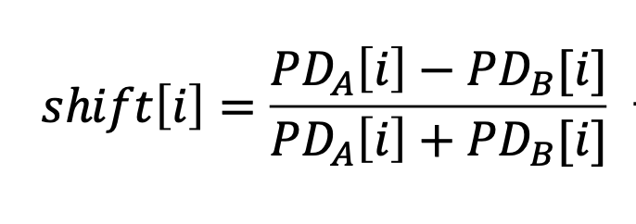
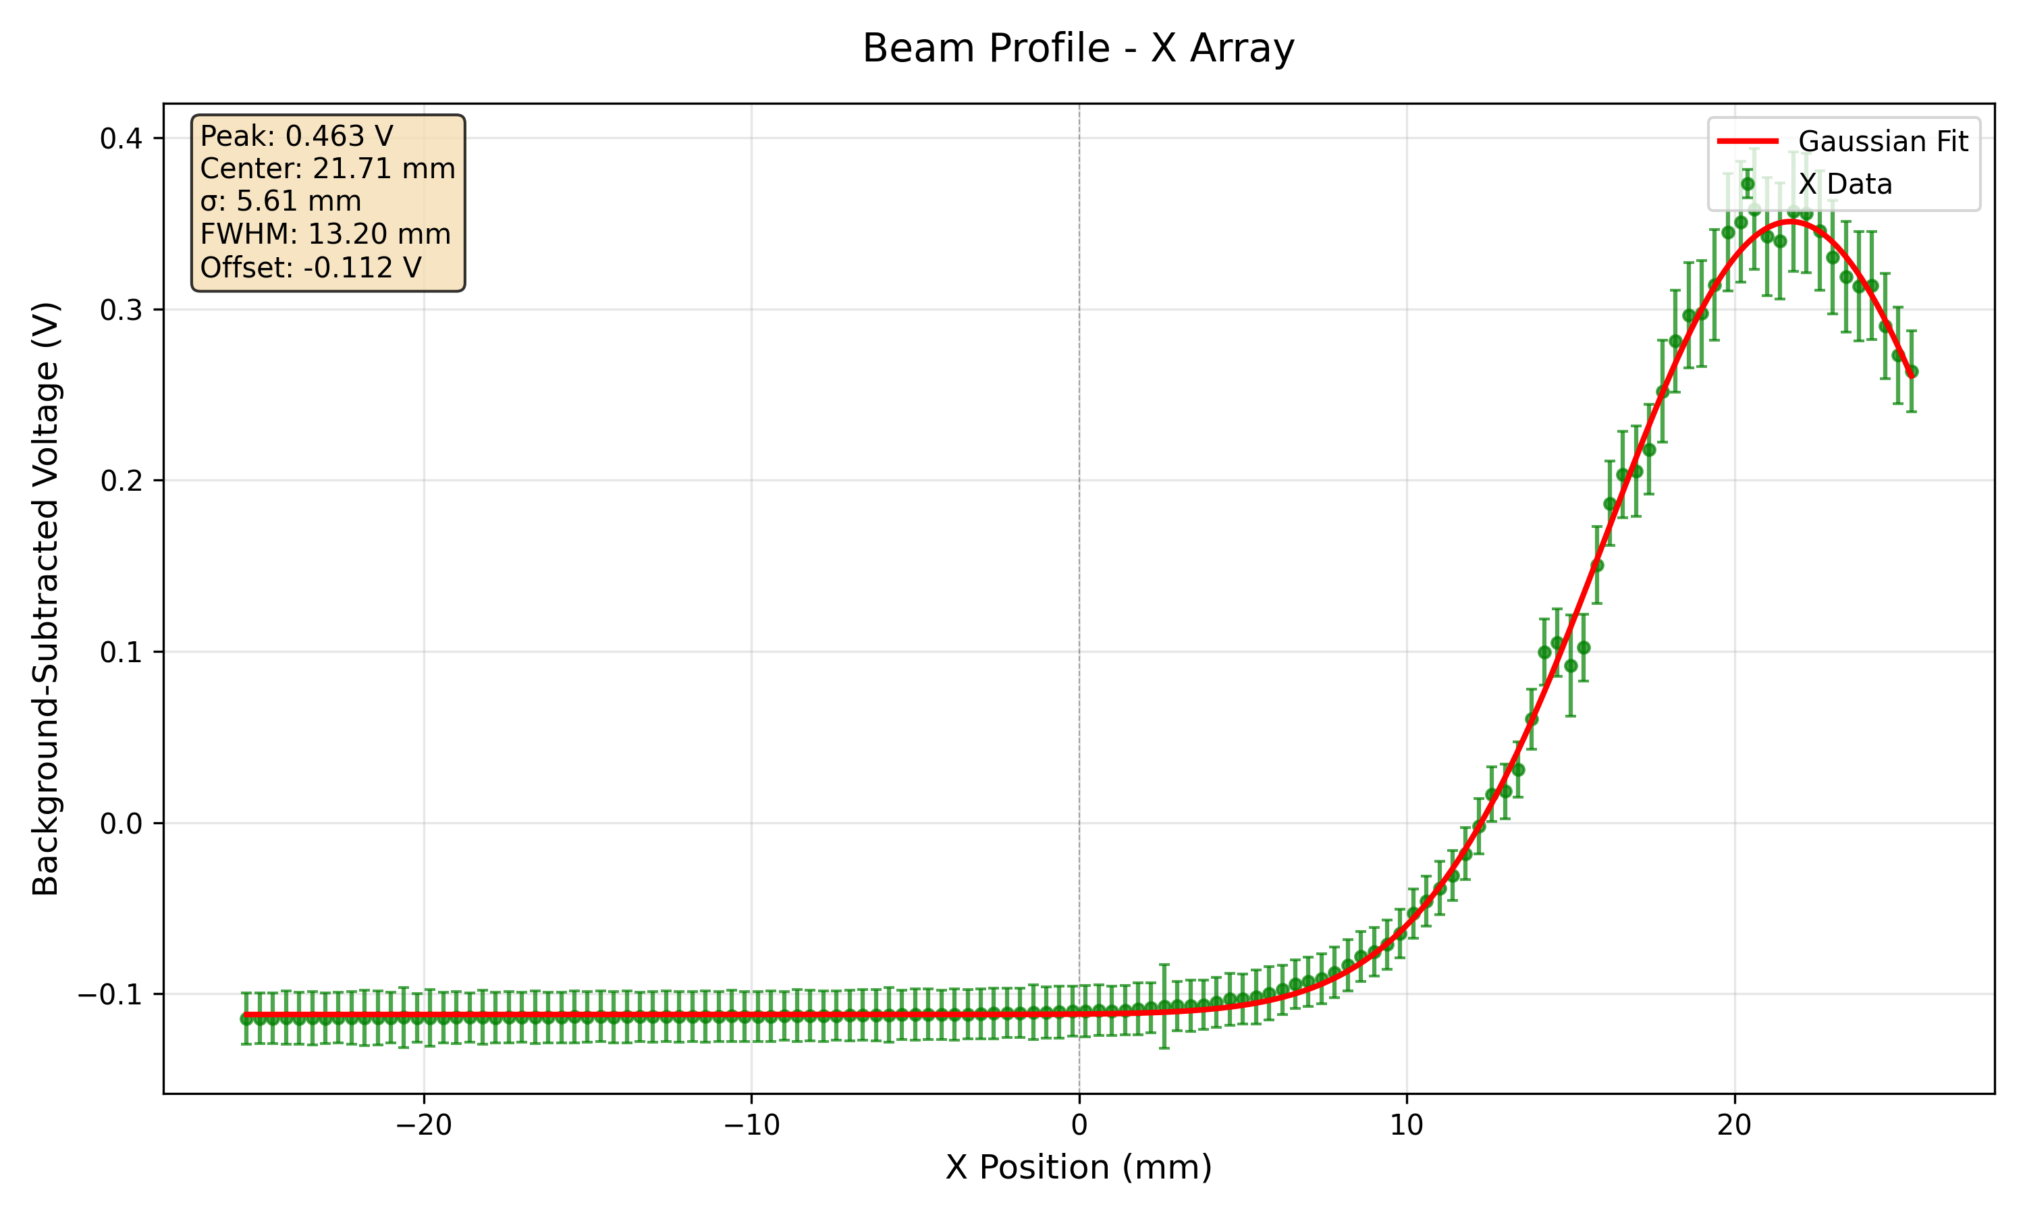
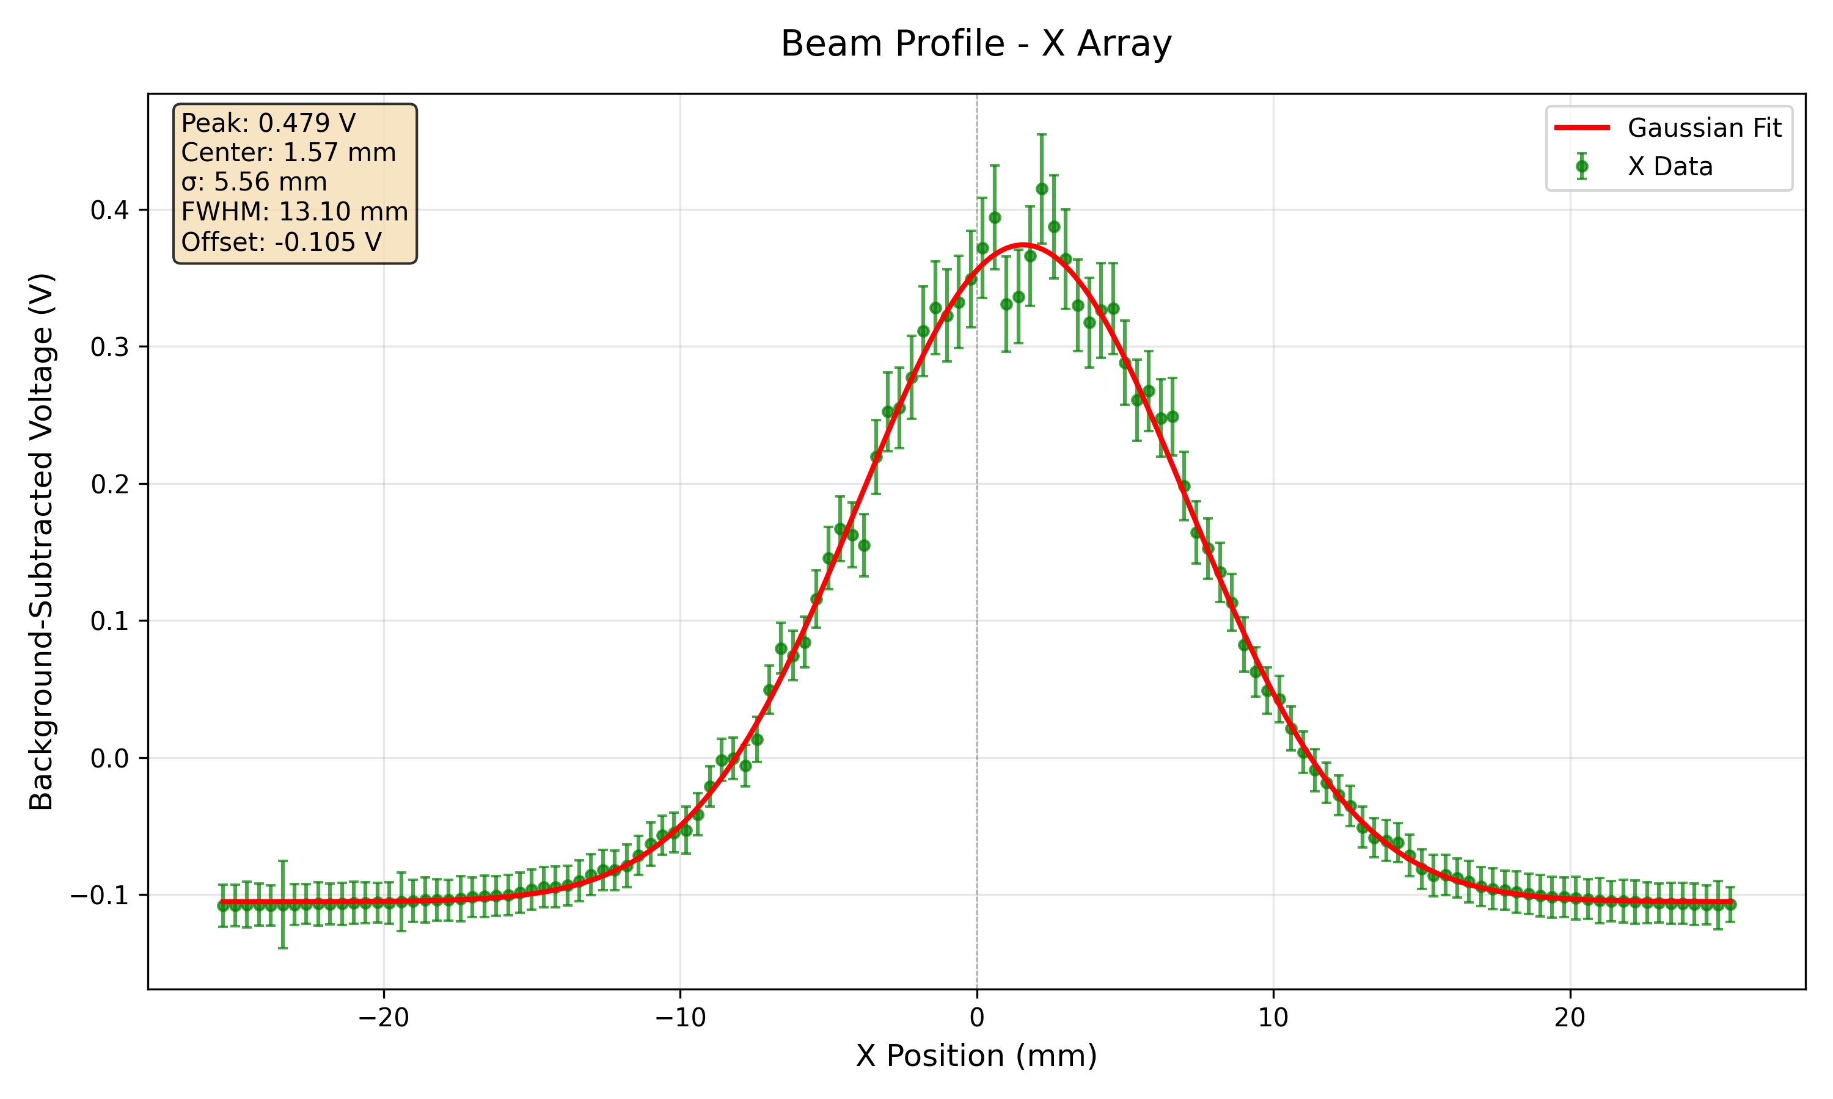
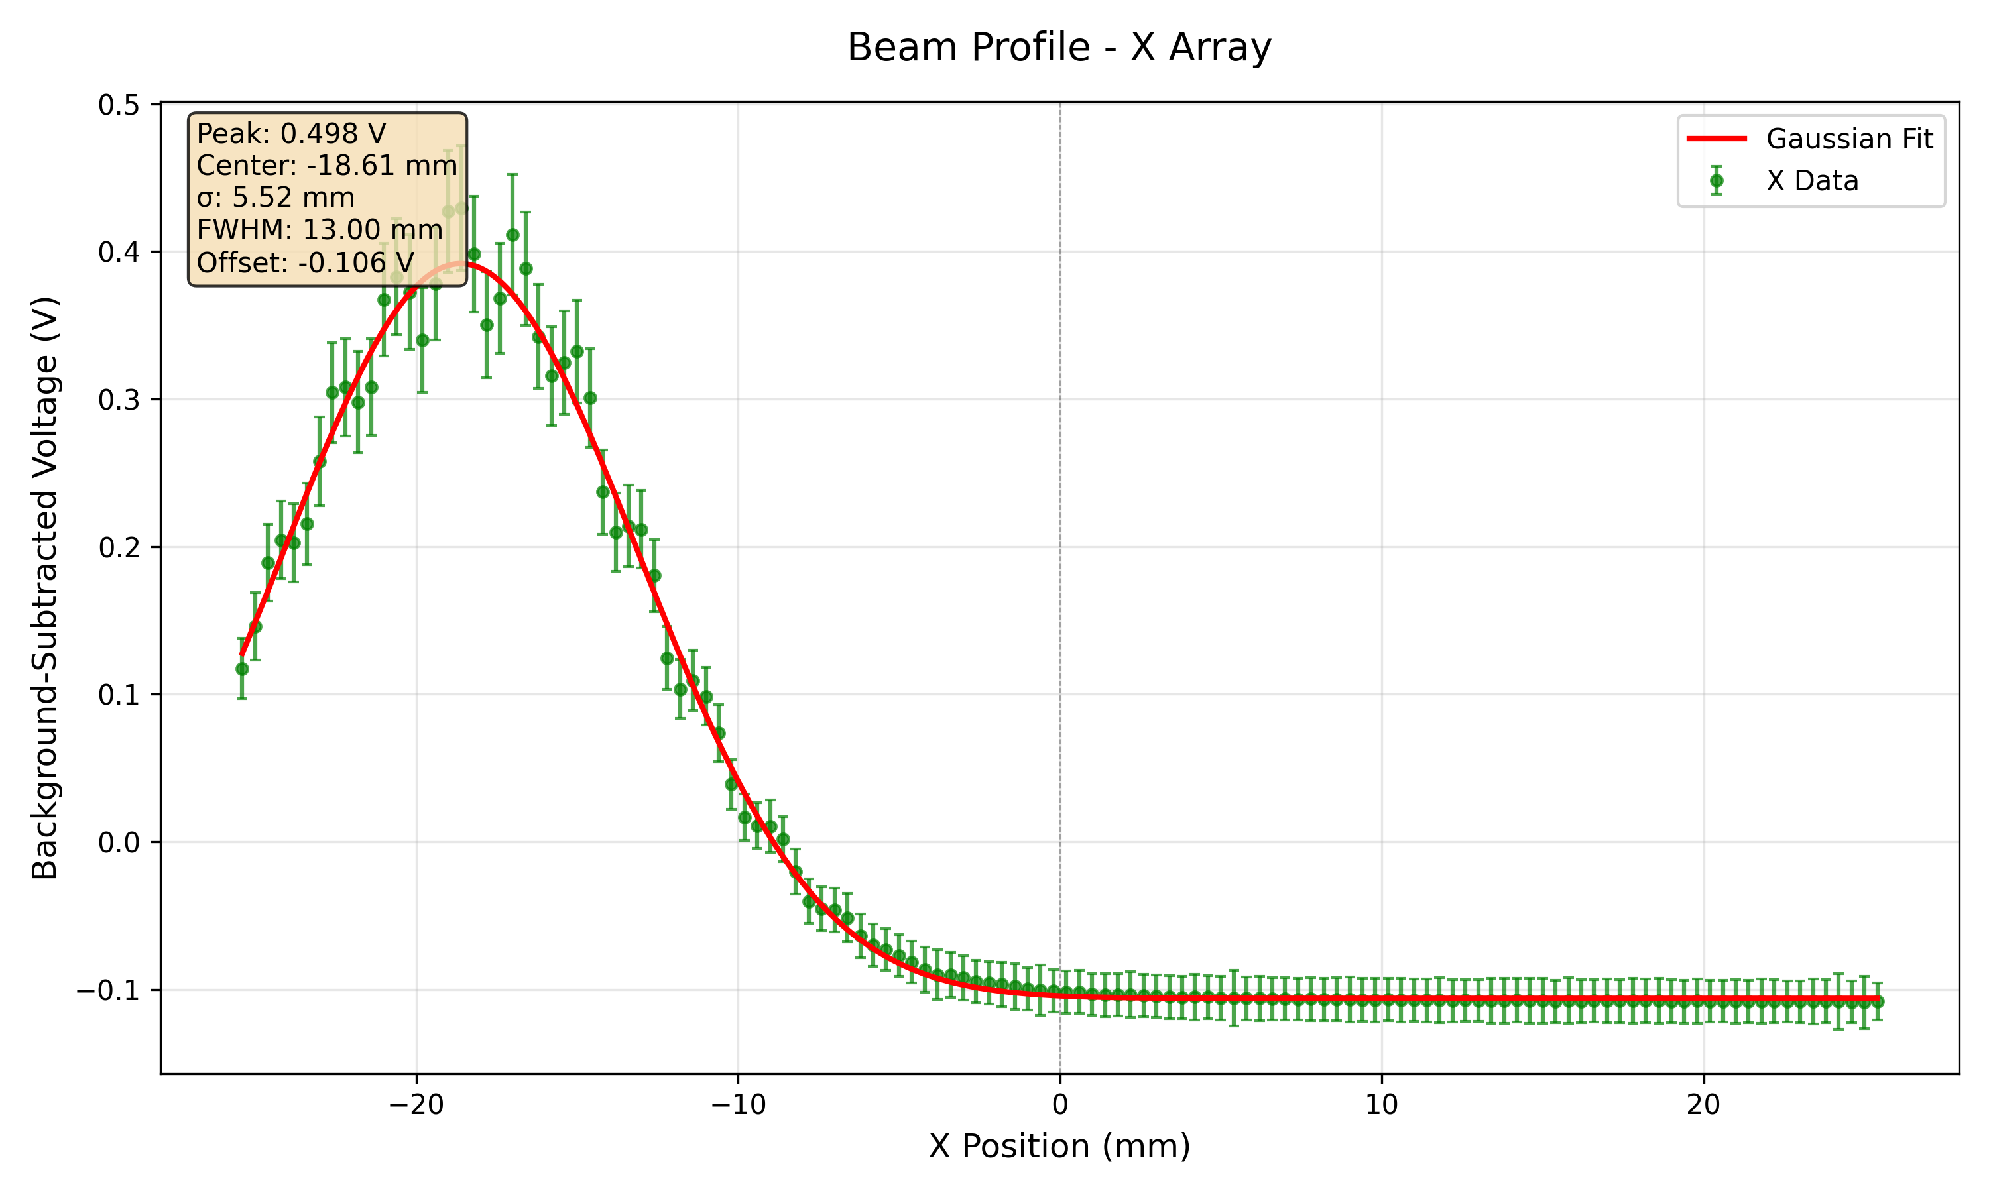

QuARC $Δ/Σ$ & Fibre $μ$Measurements
Calibrated

Slide 46
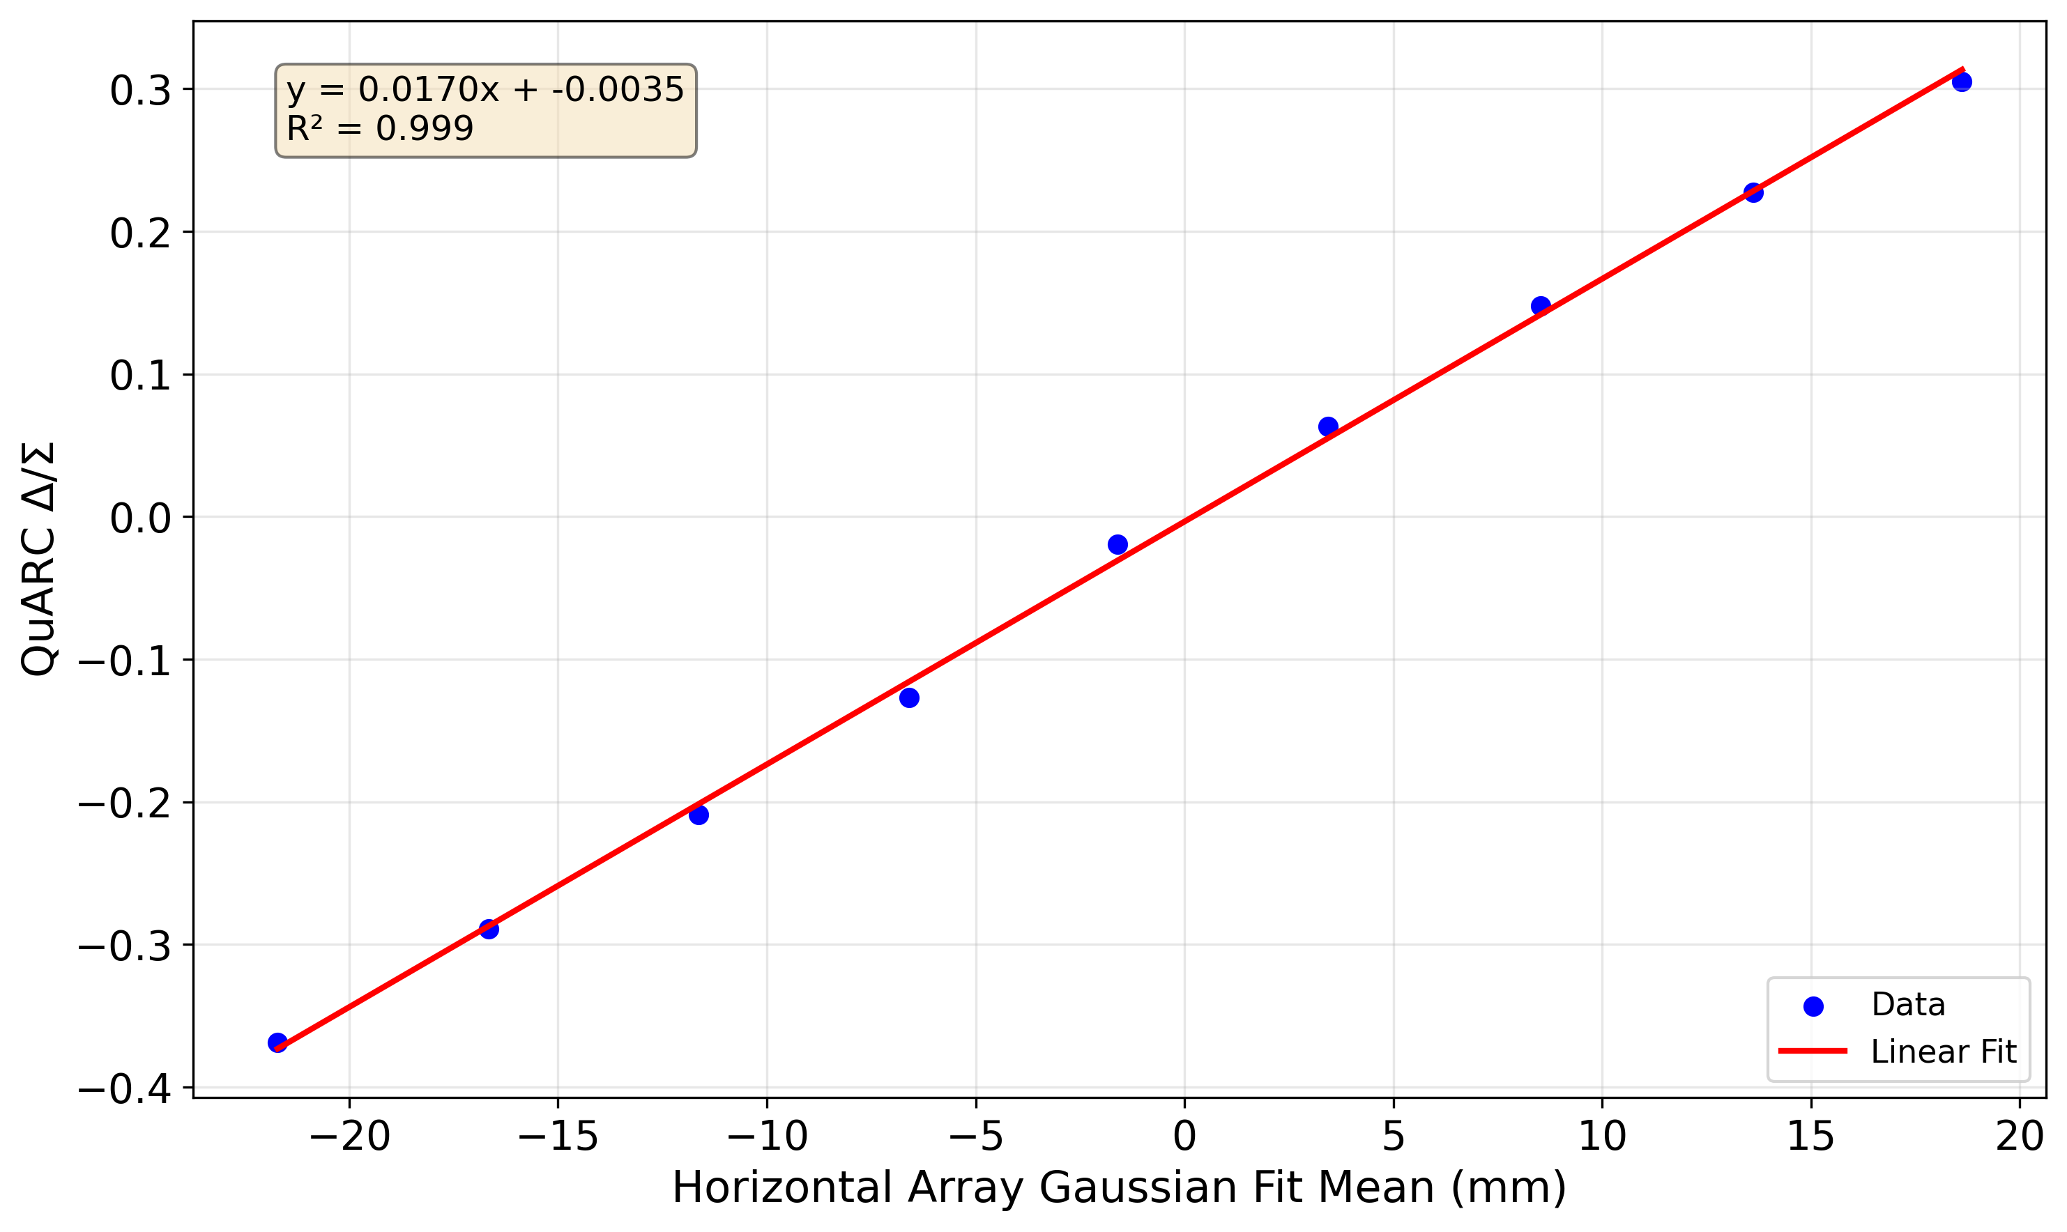
QuARC + Fibre Position Measurements

