Slide 1


UCL QuADProBe Detector Measurements at TIFPA 29/09/2025 – 01/10/2025
Joseph Bateman, Sonia Escribano Rodriguez, Simon Jolly
University College London
Raffaella Radogna, Annalisa Diggenaro
INFN, University of Bari

Slide 2
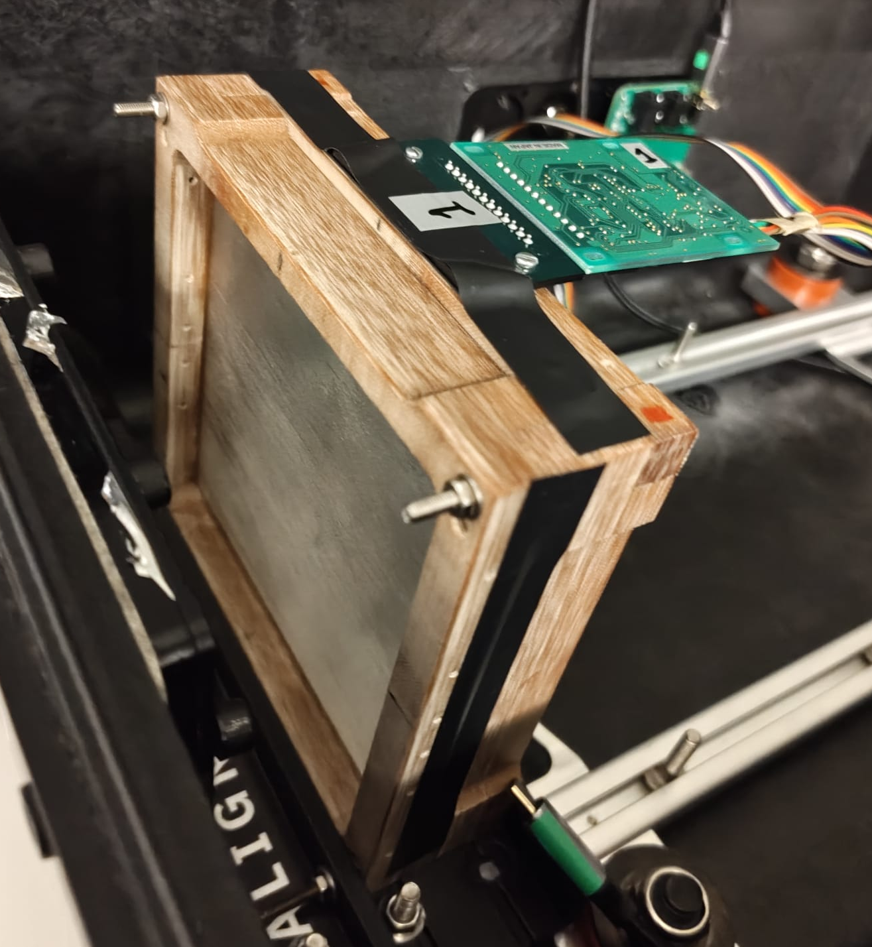
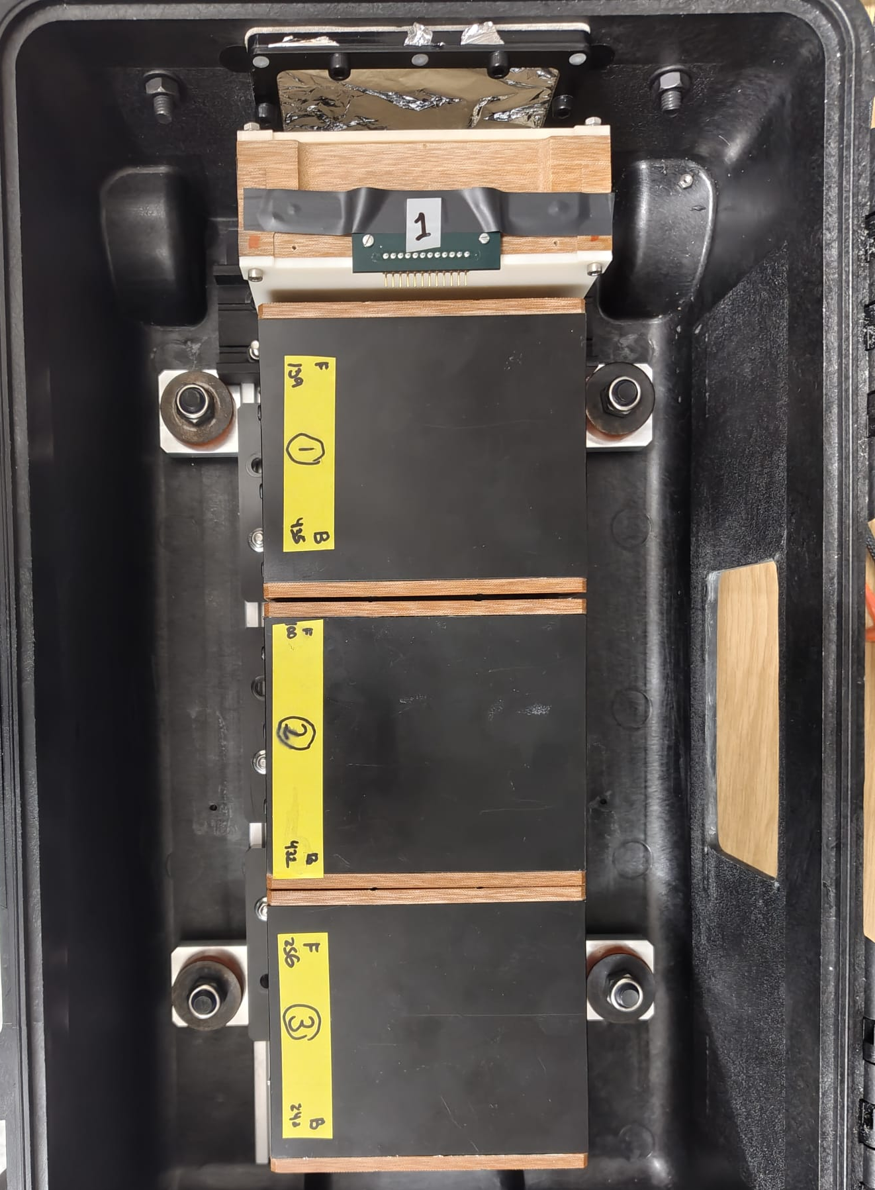
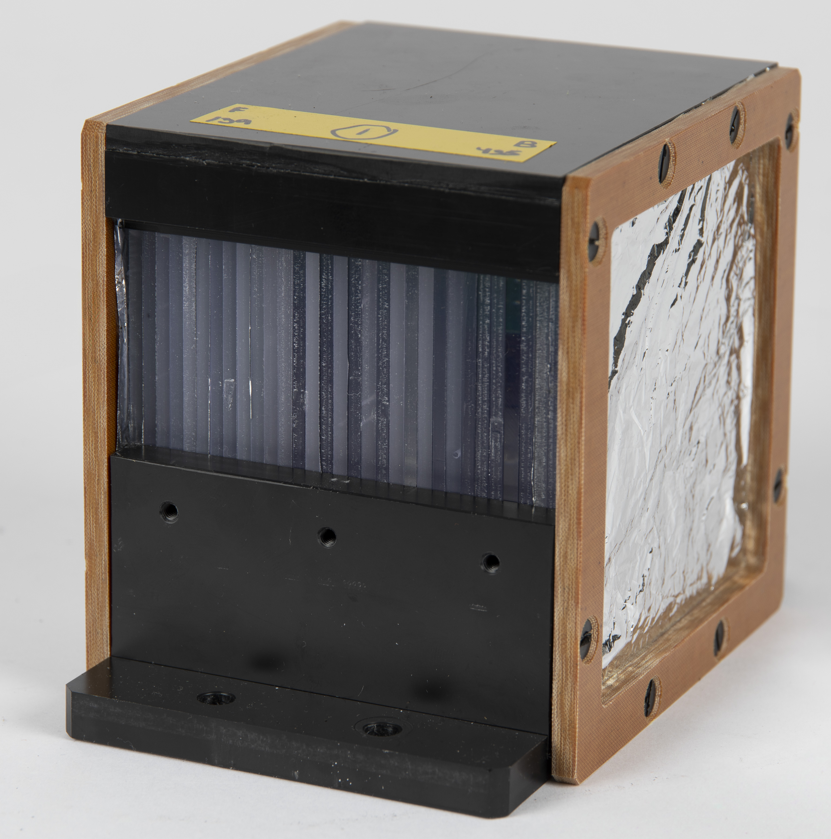
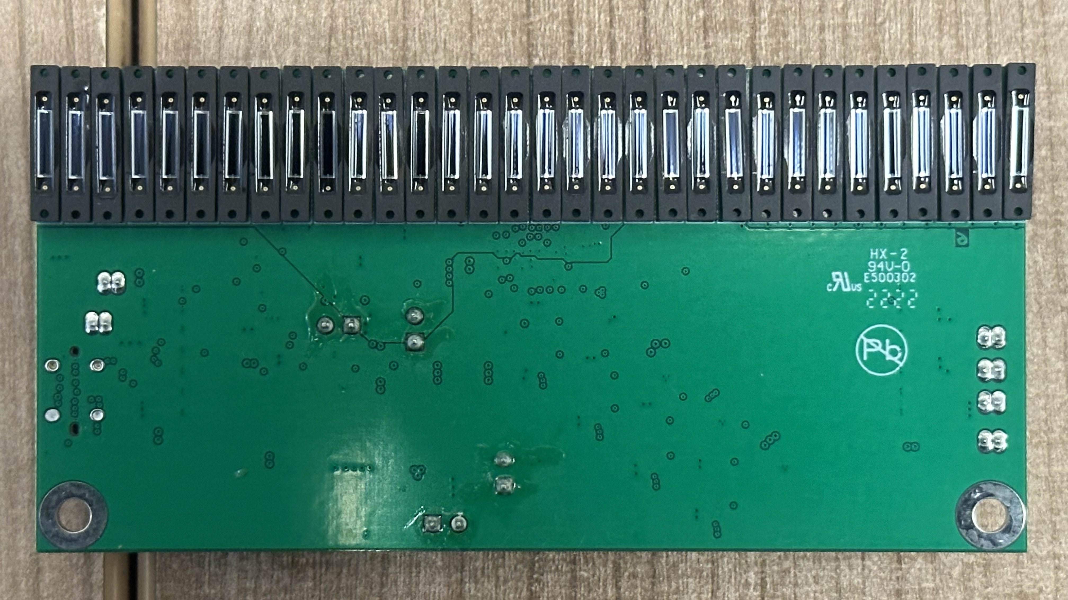
Quality Assurance Detector for Proton Beam Therapy (QuADProBe)
Scintillating Fibre (SciFi)
Profile Monitor
Quality Assurance
Range Calorimeter
(QuARC)

Slide 3
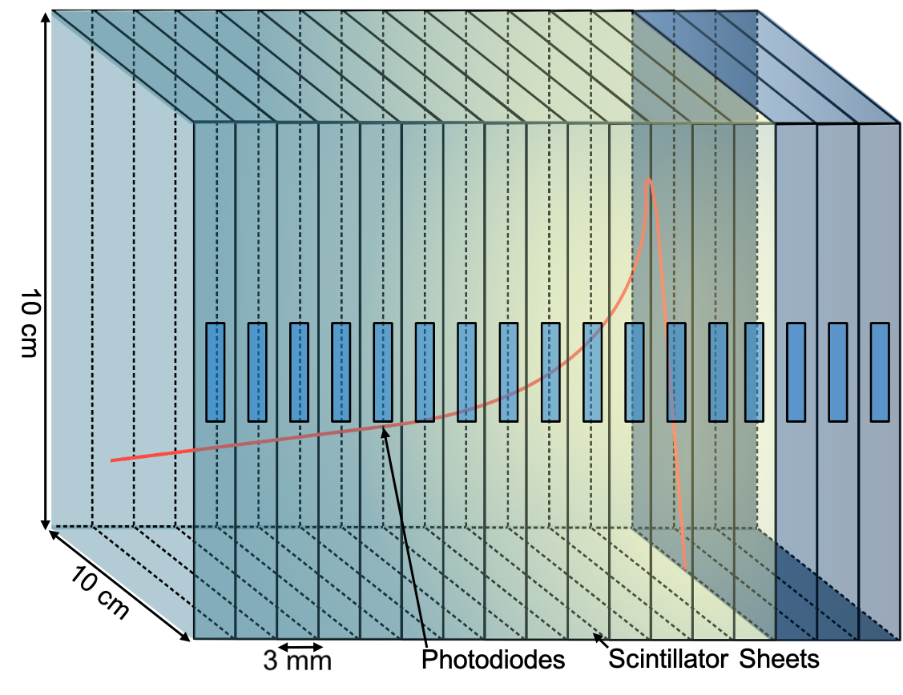
QuARC
The Quality Assurance Range Calorimeter (QuARC) constructed from plastic scintillator sheets:
Protons intercepted by a series of optically-isolated polystyrene scintillator sheets.
4 modules – 32 sheets per module.
Light output measured with photodiodes.
2 photodiodes coupled to each sheet.
Light output of each sheet nonlinear to dose, quenching described by Birks’ Law:
Data fitted with analytical depth-light model (Kelleter Fit).
Reconstruct Bragg depth-dose curve (Bortfeld Fit) and measure proton range.
Photodiodes coupled to fast, modular electronics and an FPGA to read light levels at over 5 kHz.
FPGA connects to on-board PC (Raspberry Pi) via USB.
Connection to on-board PC via ethernet/WiFi.

Slide 4
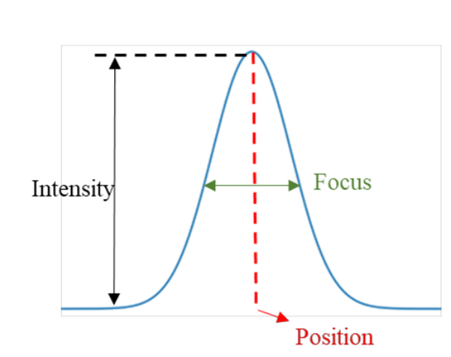
SciFi Profile Monitor
The Scintillating Fibre (SciFi) Array monitor constructed from two orthogonal arrays of plastic scintillating fibres:
10 cm x 10 cm arrays made of BCF-60 plastic scintillating fibres by Saint-Gobain, 0.50 ± 0.13 mm diameter. Emission peak at 530 nm.
128-photodiode array (Hamamatsu S13865), Image size: 51.2 x 0.6 mm, pixel pitch 0.4 mm
Hamamatsu C9118-02 CMOS driver circuit provides multiplexed data at up to 4 MHz
Analogic video output from the pixels array readout using NI USB-6366 Multifunction I/O
In low gain the dark output voltage is typ. 0.005 mV, max 0.1 mV
FPGA high period of RESET clock (reset) = 50 us, low period (integration) 950 us – overall 1 ms for measurement.

Slide 5
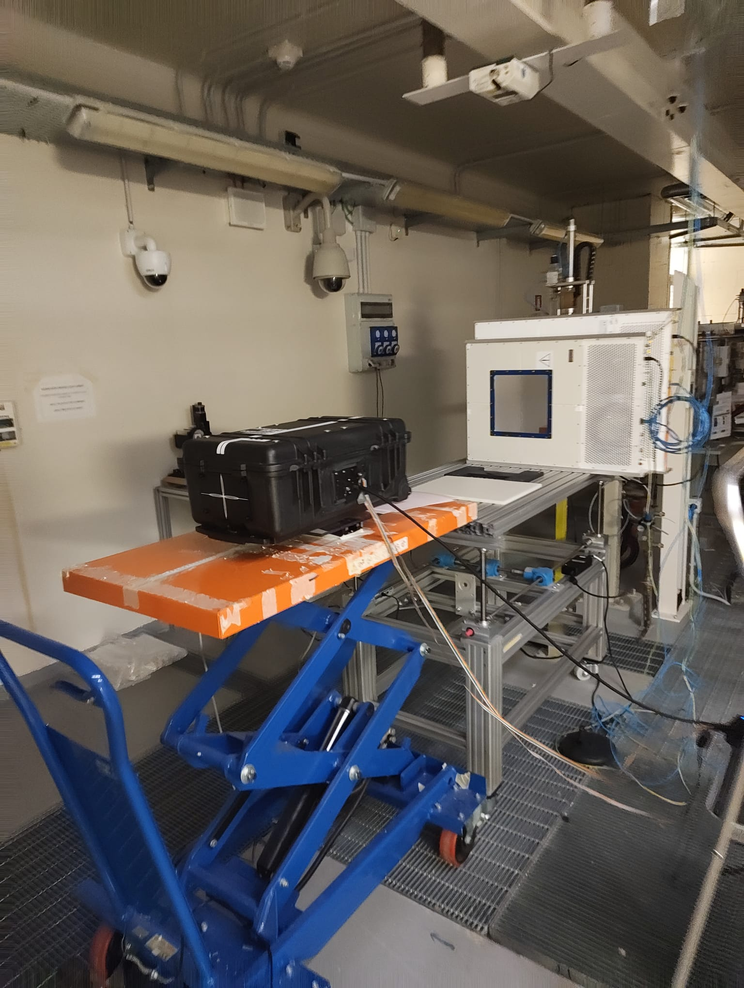
Experiment Overview
3 nights of measurements at TIFPA with detector installed on biology beam line to enable both FLASH and CONV:
Night 1: QuARC
Calibrations and Bragg Peak measurements
A couple FLASH measurements
Night 2: Combined QuARC + SciFi:
Dynamic range testing (fibres at low gain)
Beam position measurements
Night 3: SciFi Measurements
Dynamic range testing (fibres at low gain)
Different spot sizes (varying energy)
Detailed experiment itinerary can be found here: https://www.hep.ucl.ac.uk/pbt/wiki/Proton_Calorimetry/Experimental_Runs/2025/Trento_2025-09

Slide 6
Fibre Array Measurements
Fibre array measurements acquired over 10s period (1 kHz acquisition freq. = ~10,000 measurements).
Voltage for each photodiode pixel averaged and over all (~10,000) measurements then background subtracted and plotted against position.
Measurements involved:
Response linearity to ion source current and nozzle current (calculated from beam monitor data) by summing all photodiode values per run.
Beam size measurements at various energies and currents.
Beam position measurements (using horizontal translation stage to move the detector between -20 mm - +20 mm in 5 mm intervals).

Slide 7
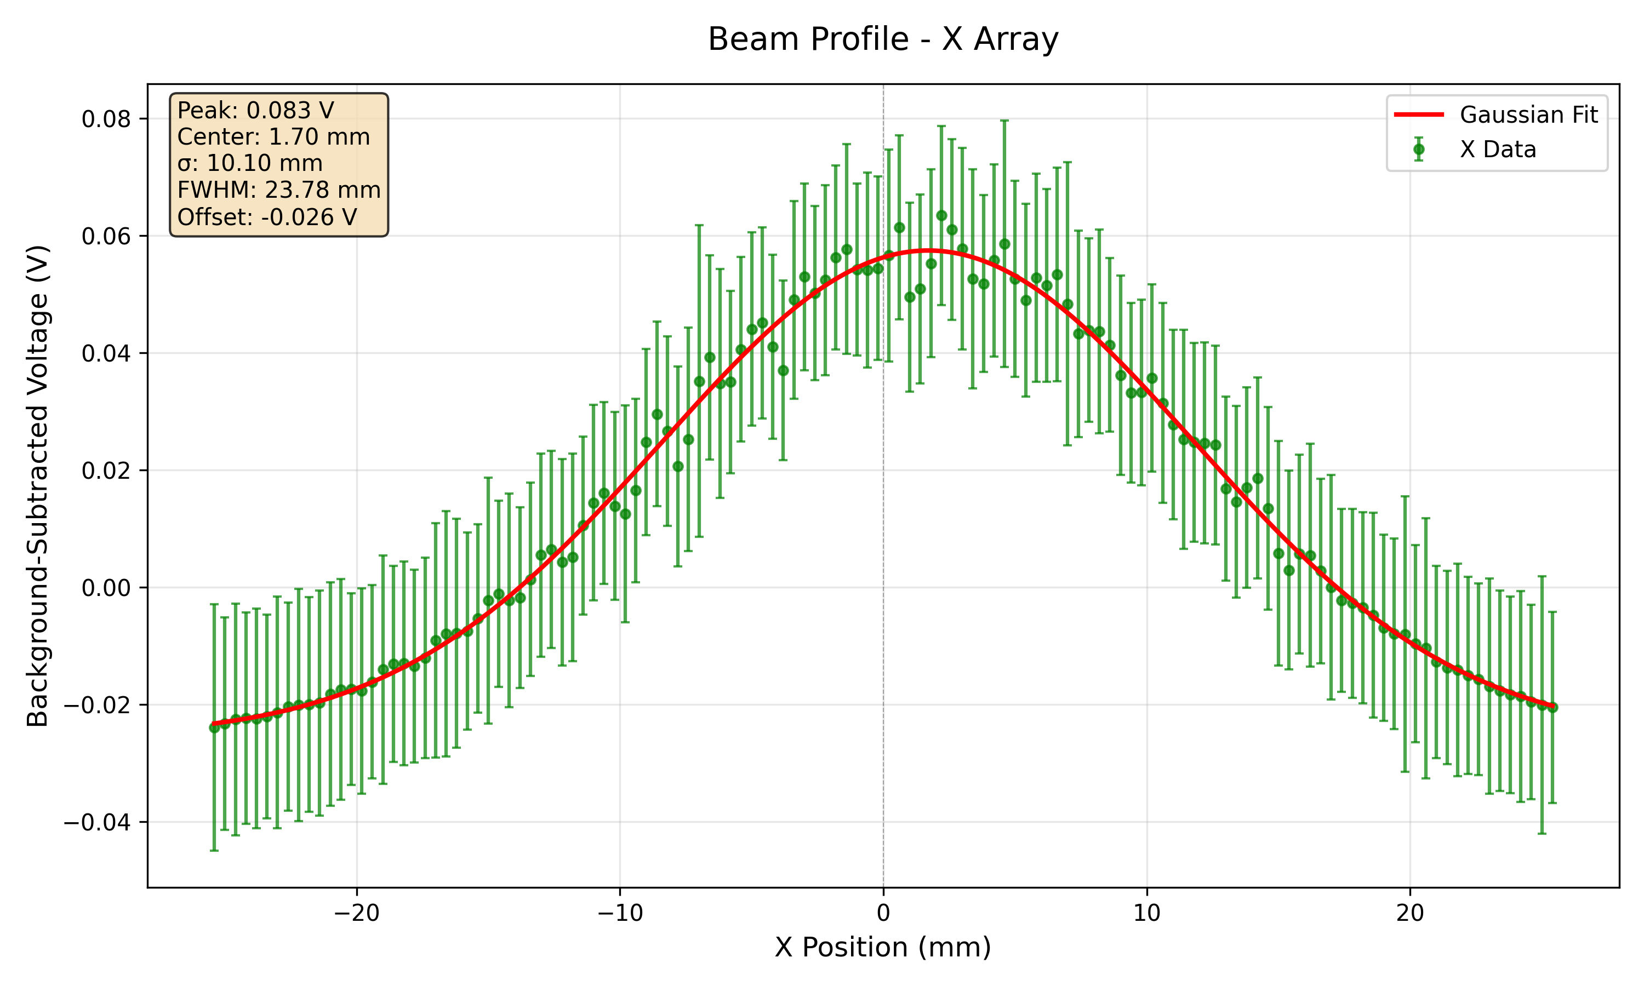
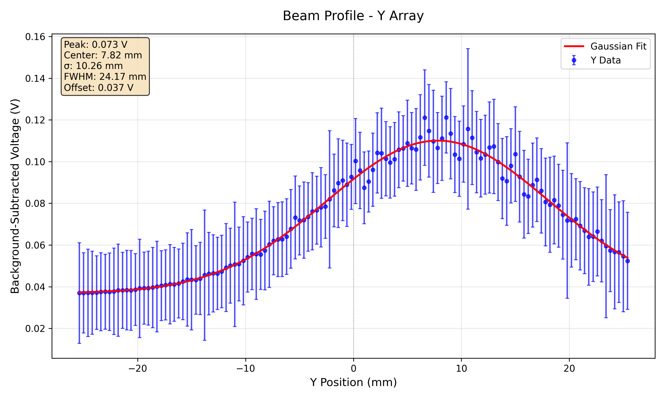
Fibre 70 MeV, 300 nA
Error bars represent the statistical fluctuation of the pixel value over the measurement run (~10,000 measurements per run).
Currently investigating the cause of the large fluctuations in the response of the photodiodes across each run which cause the large error bars.

Slide 8
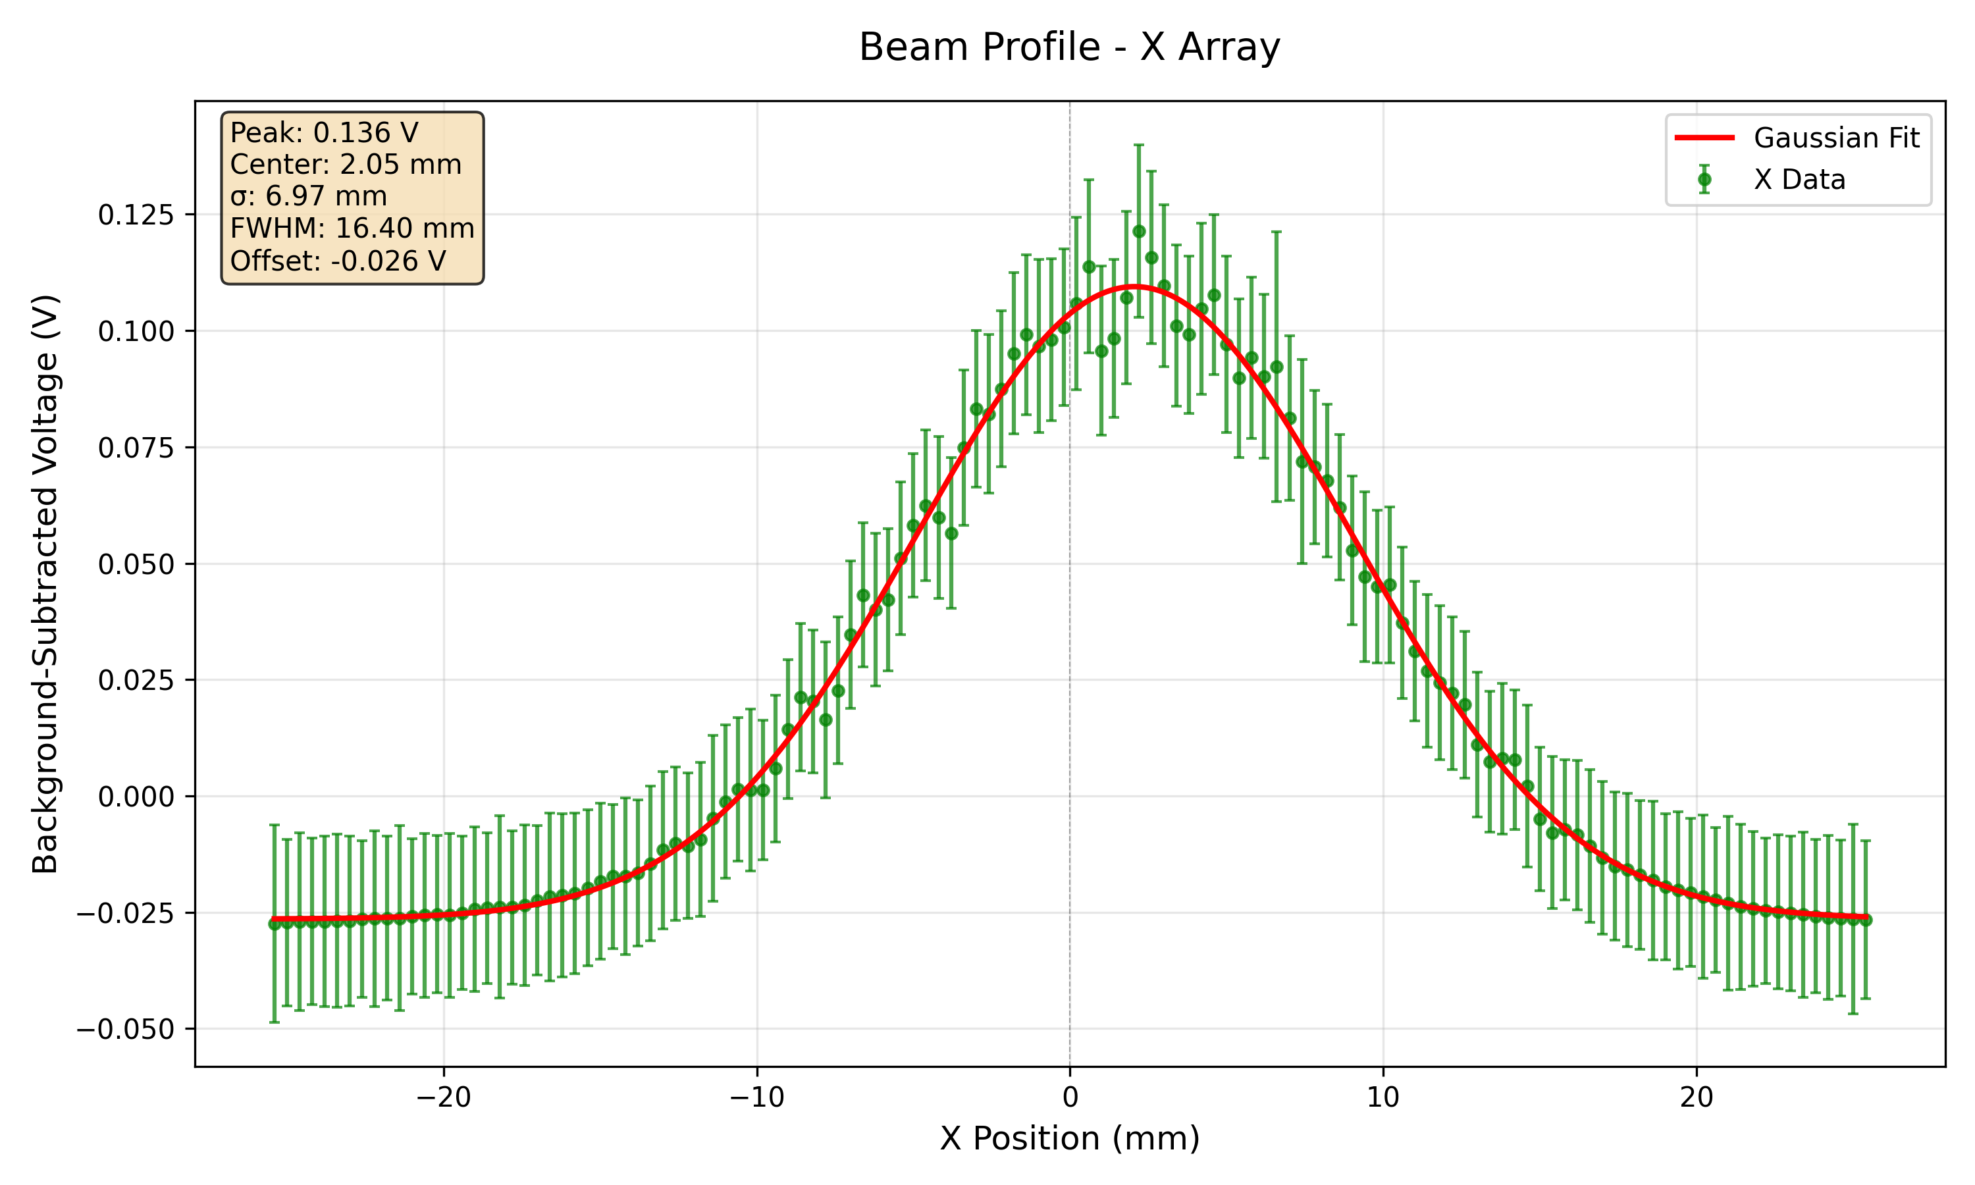
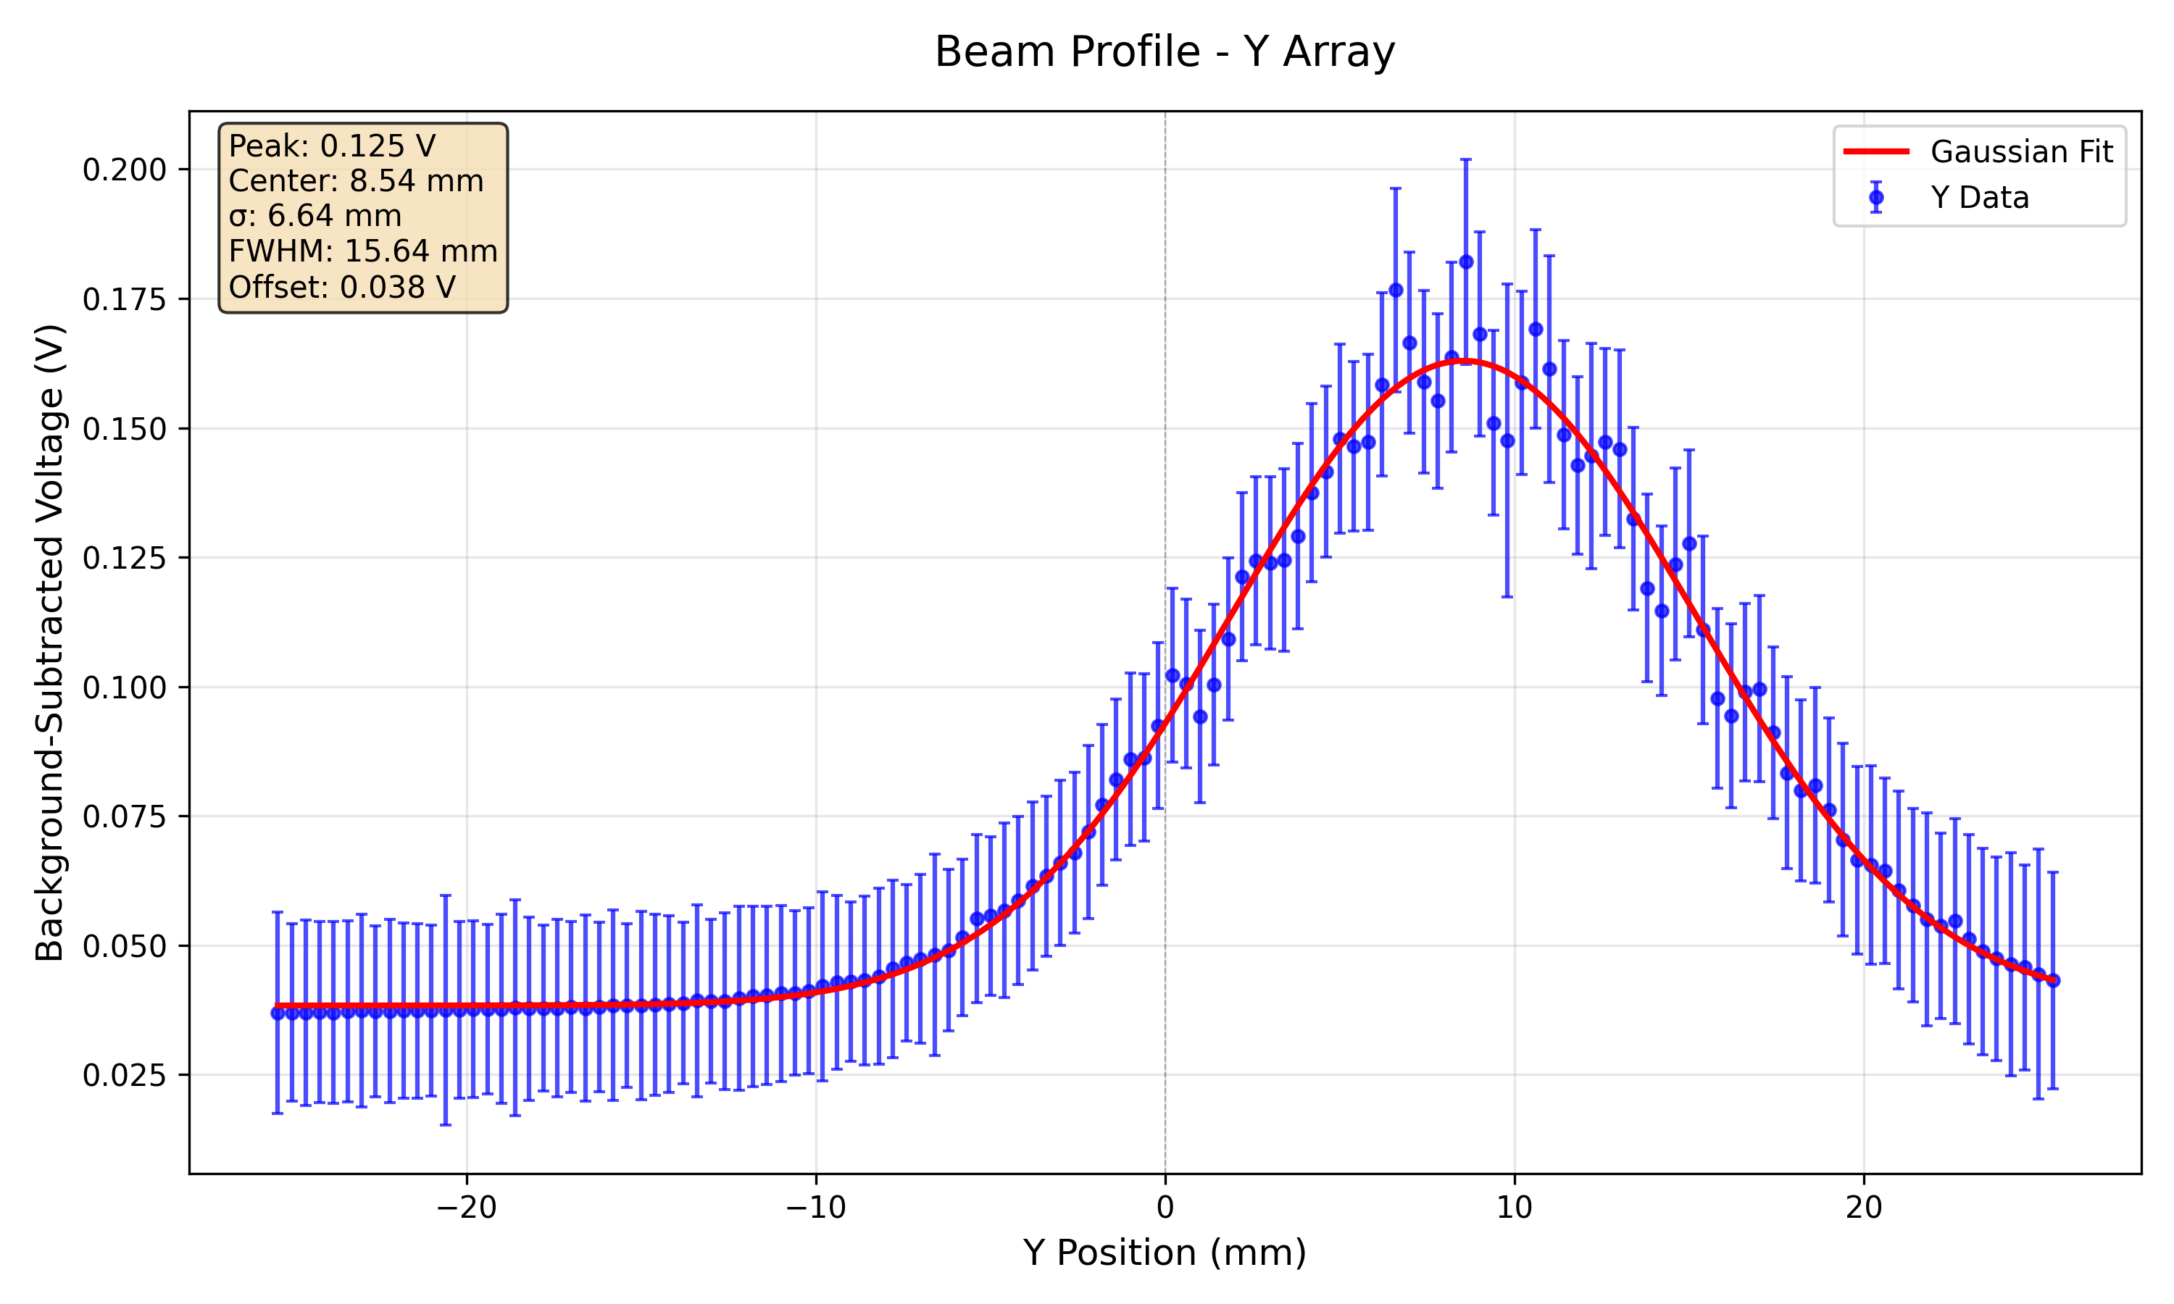
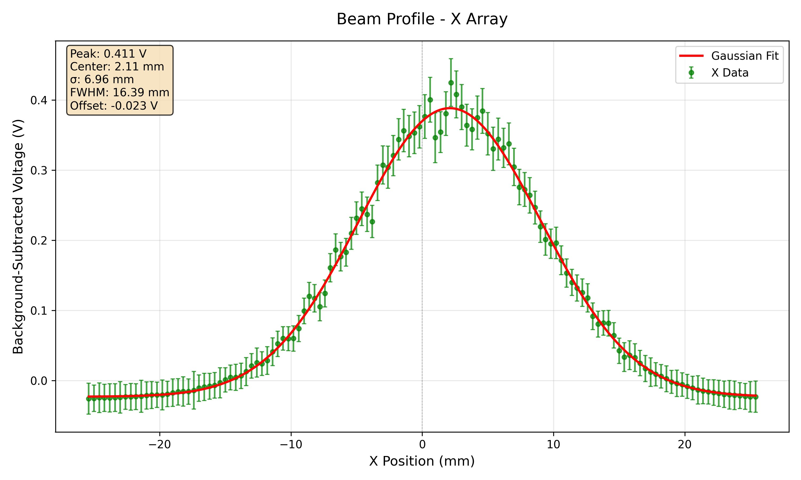
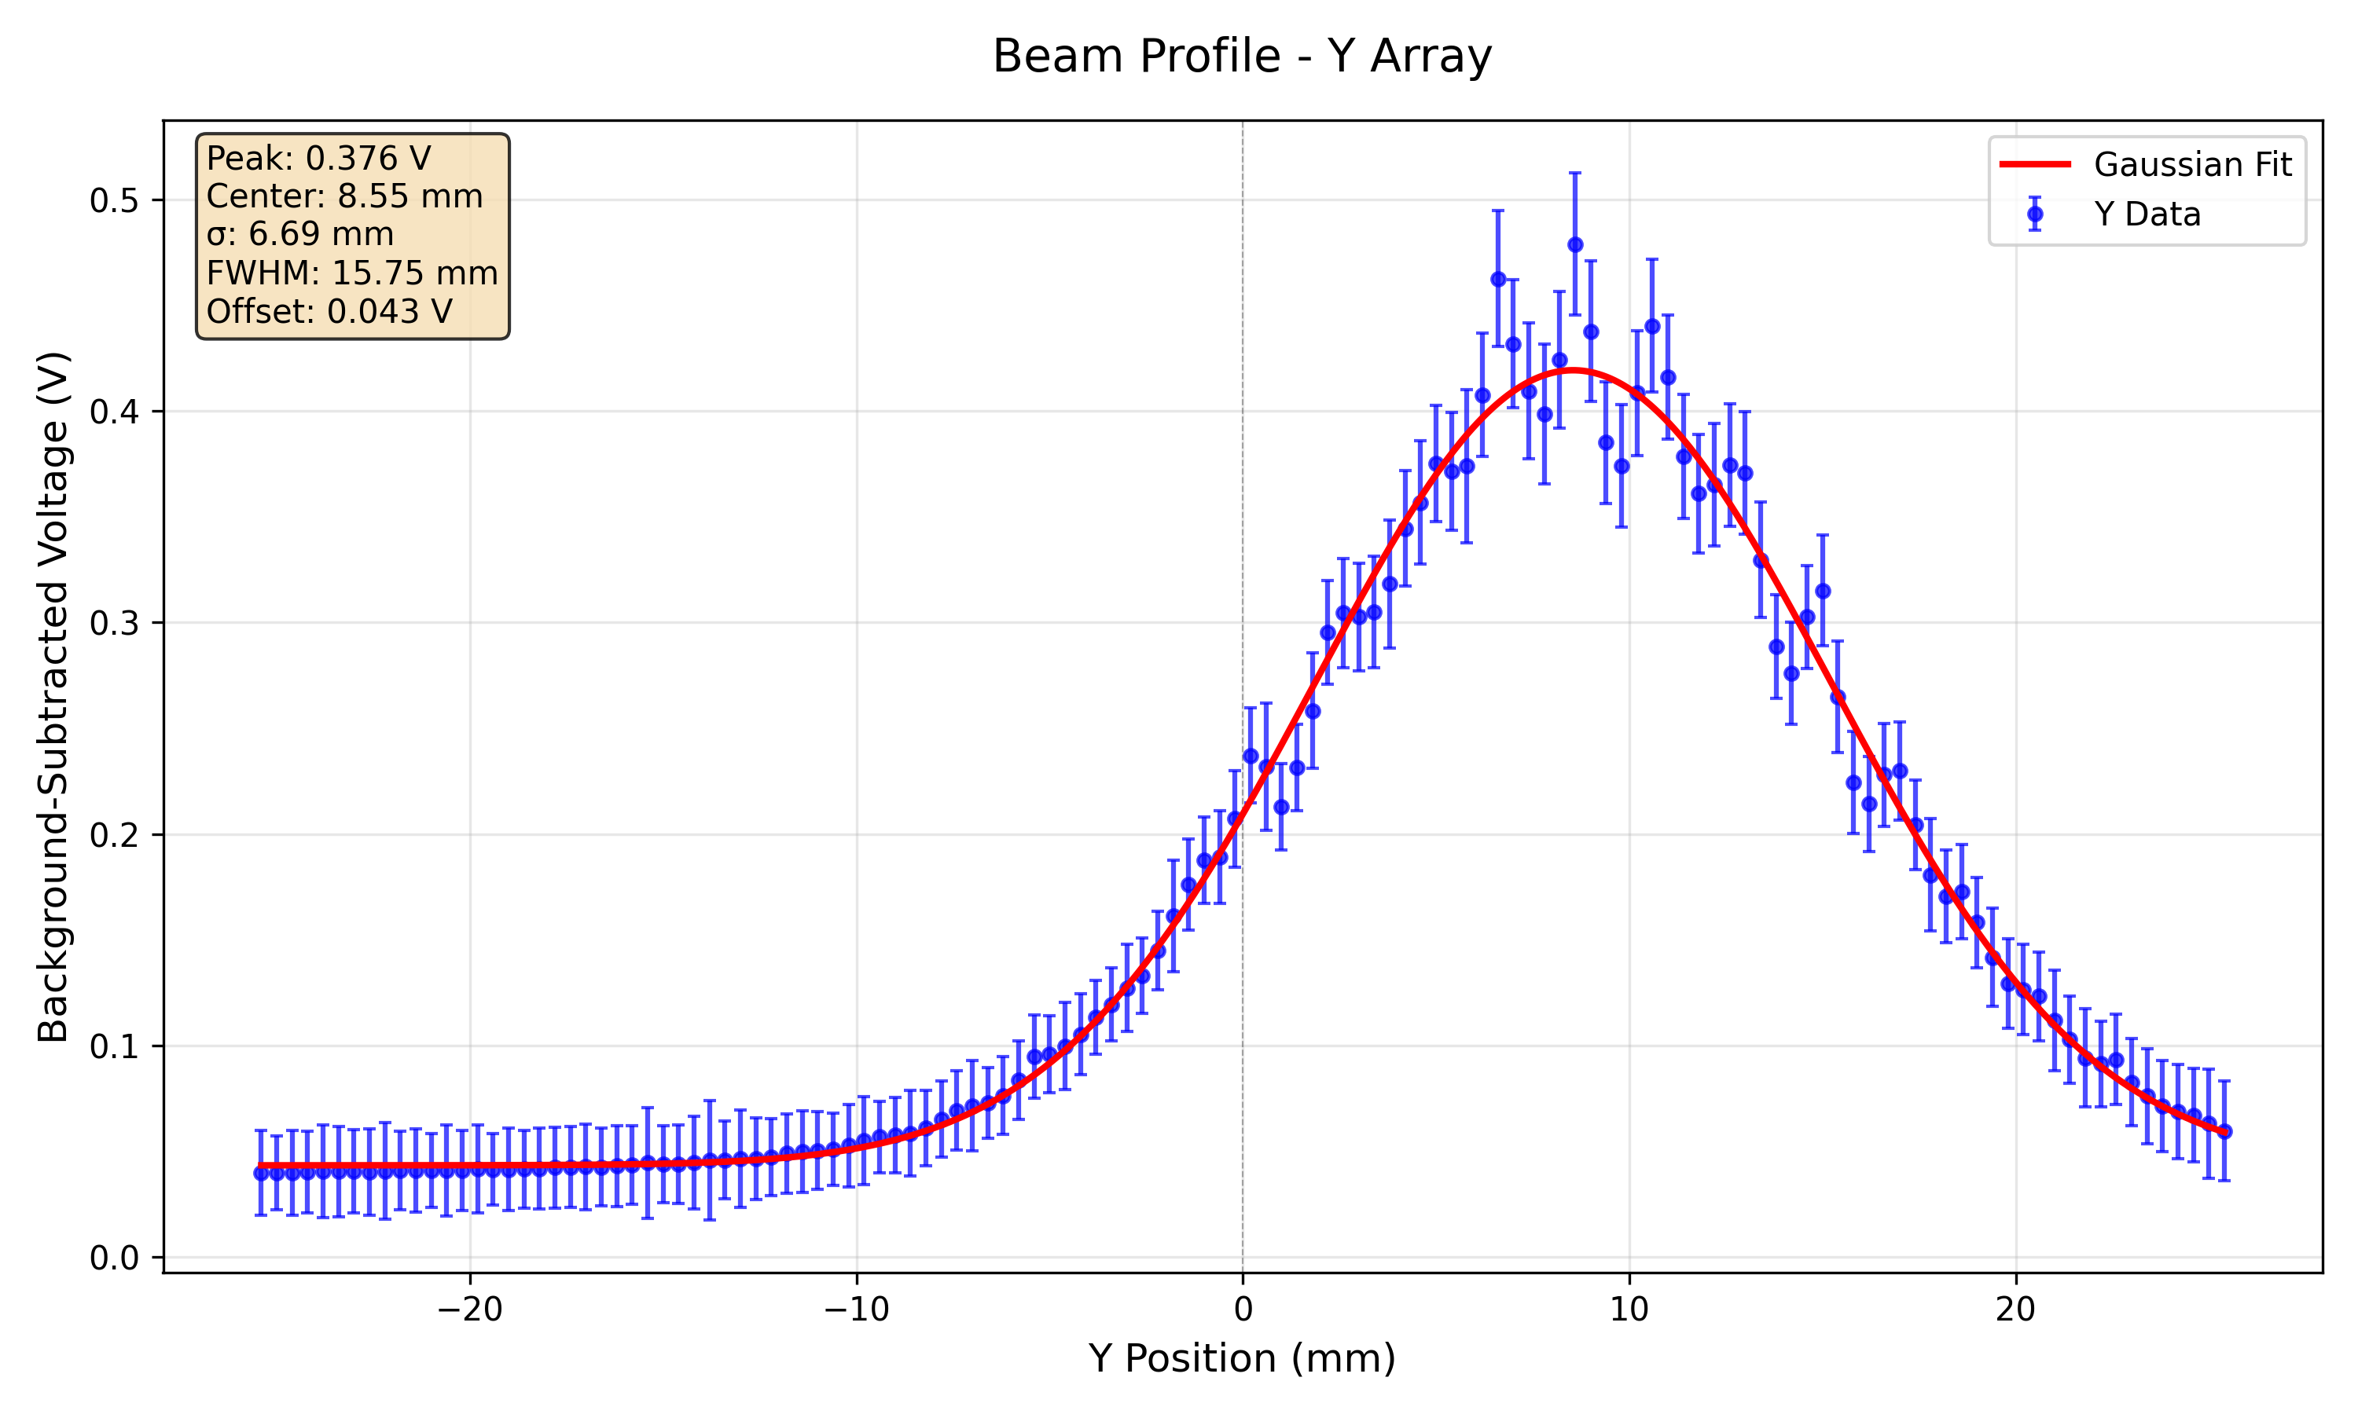
112 MeV
100 nA
300 nA

Slide 9
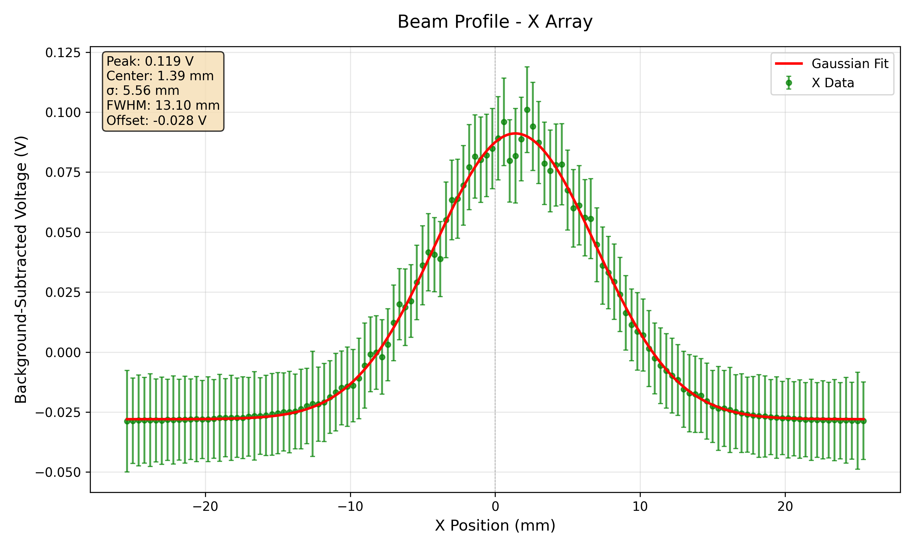
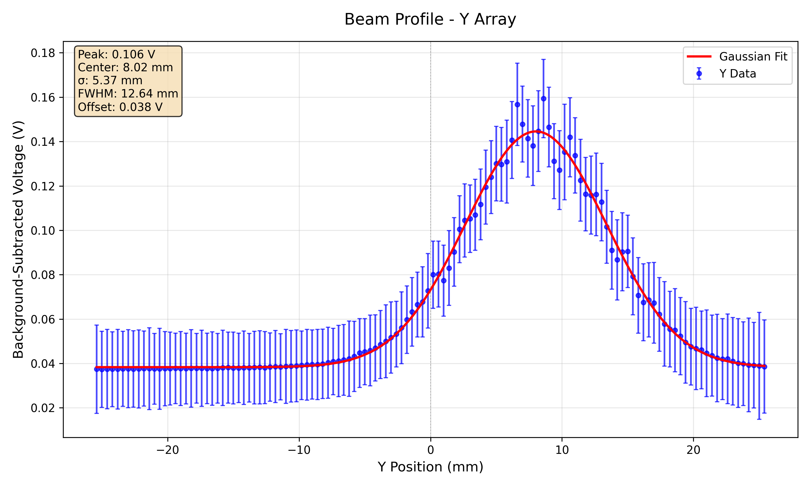
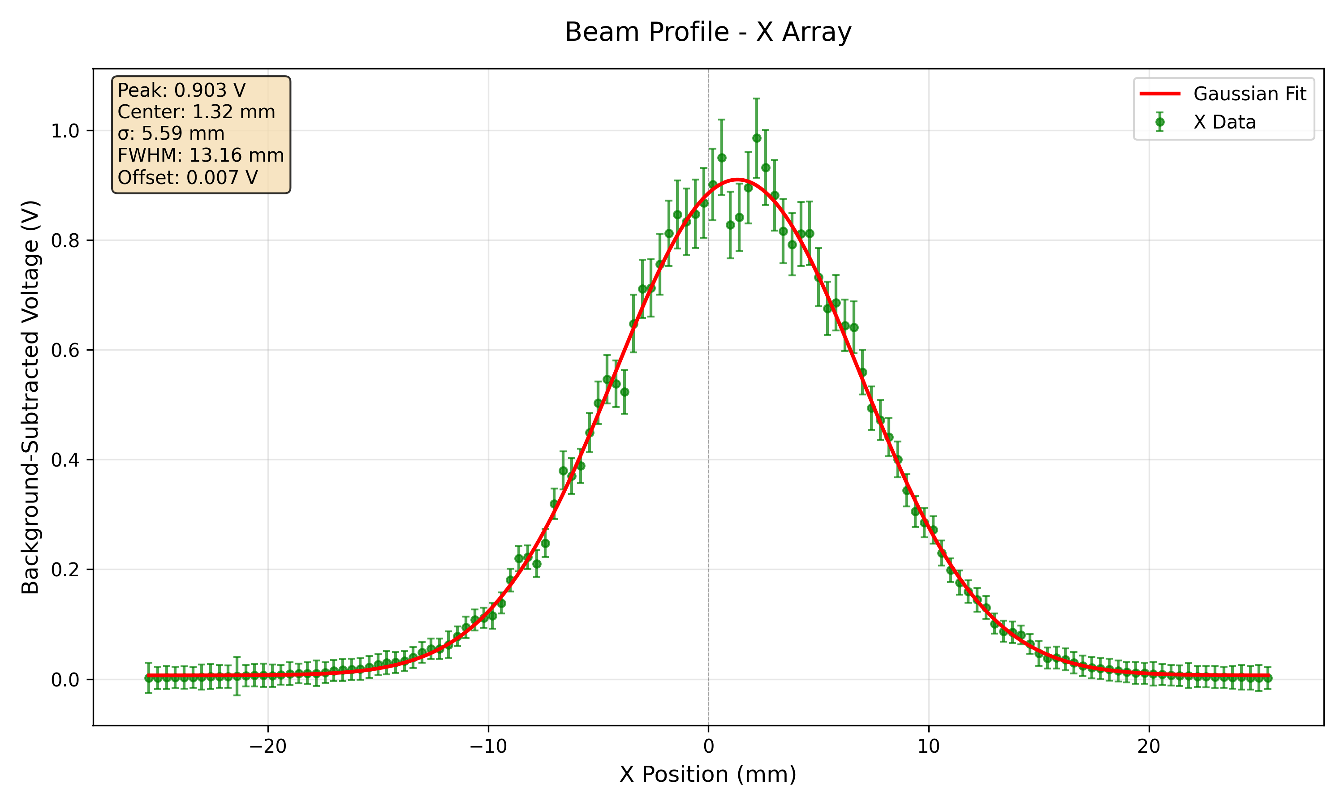
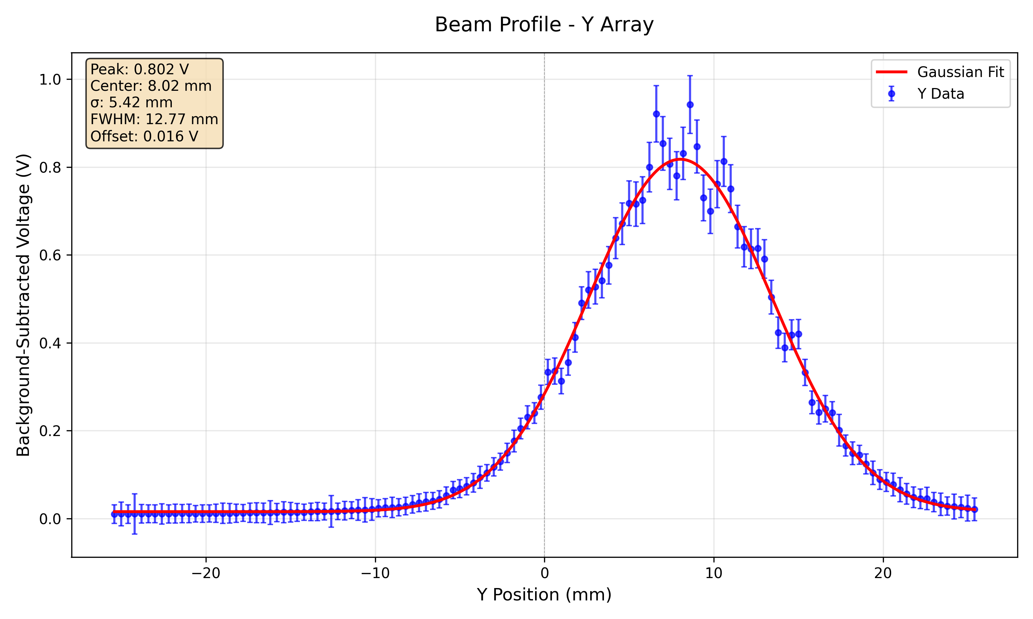
148 MeV
40 nA
300 nA

Slide 10
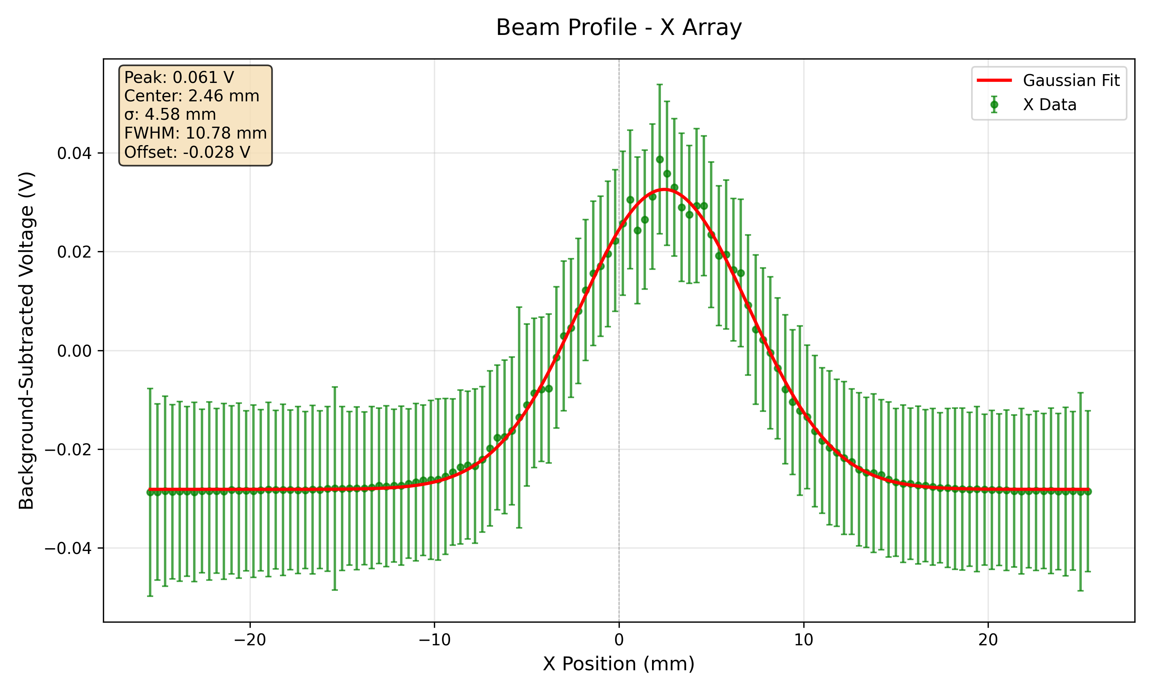
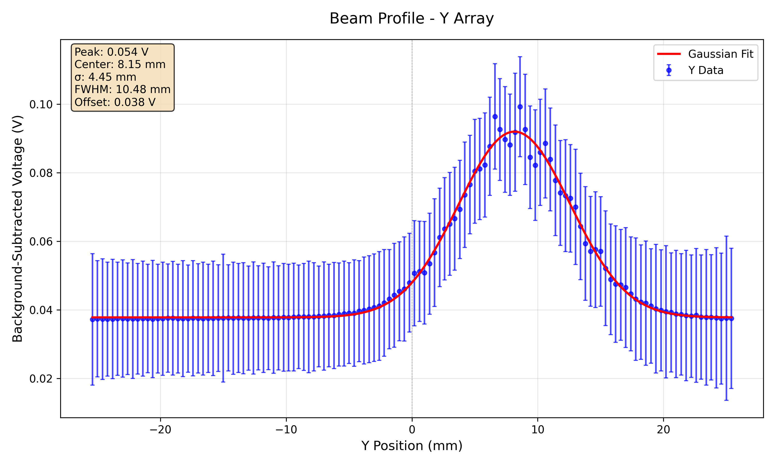
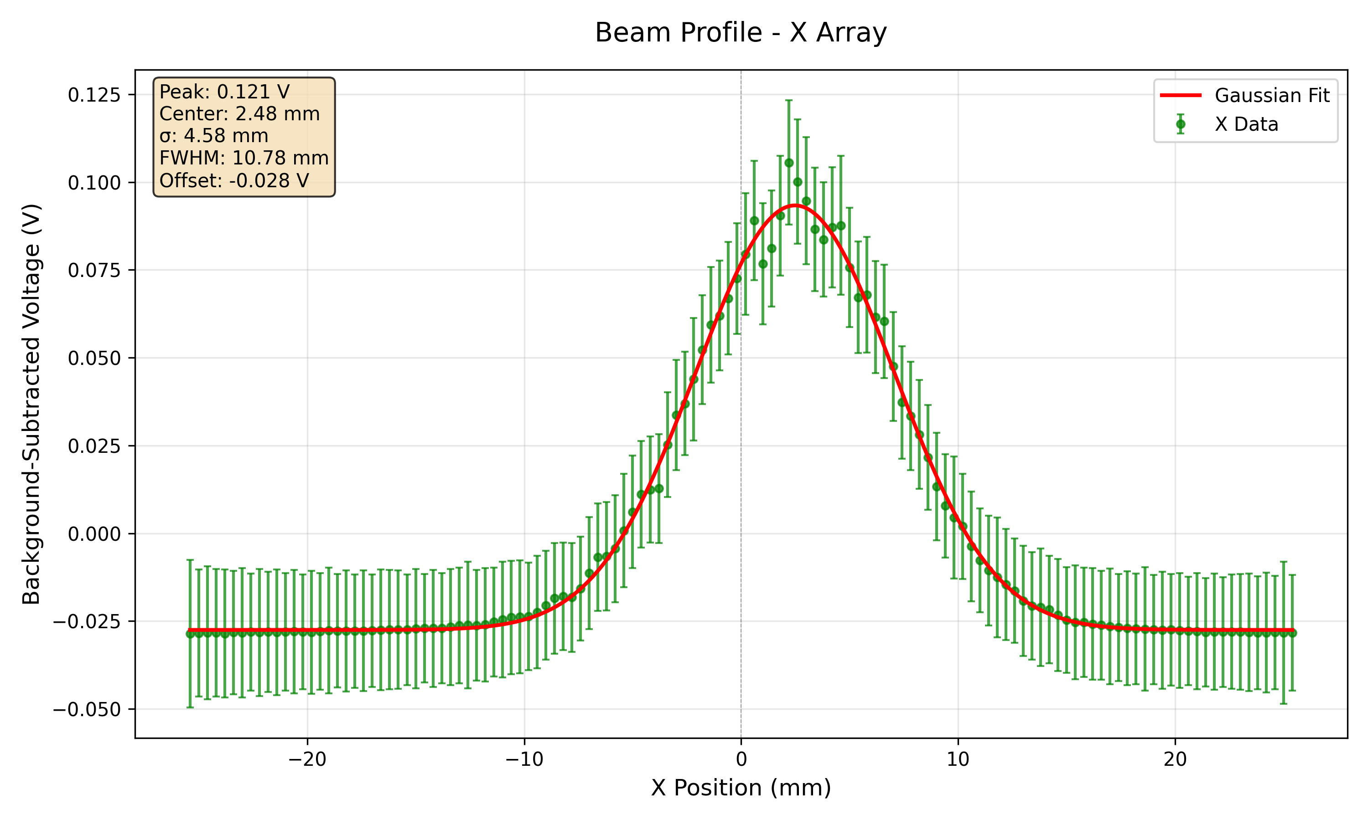
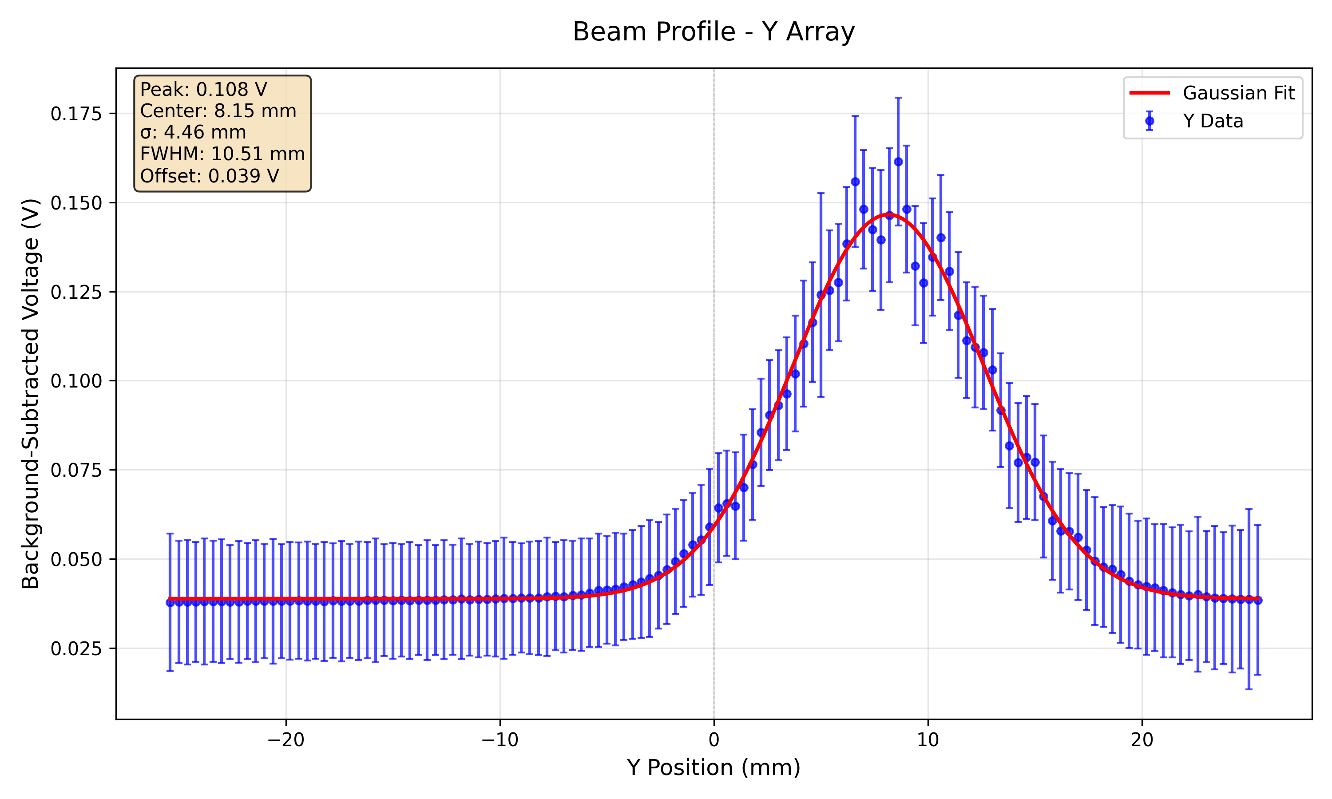
179 MeV
10 nA
20 nA

Slide 11
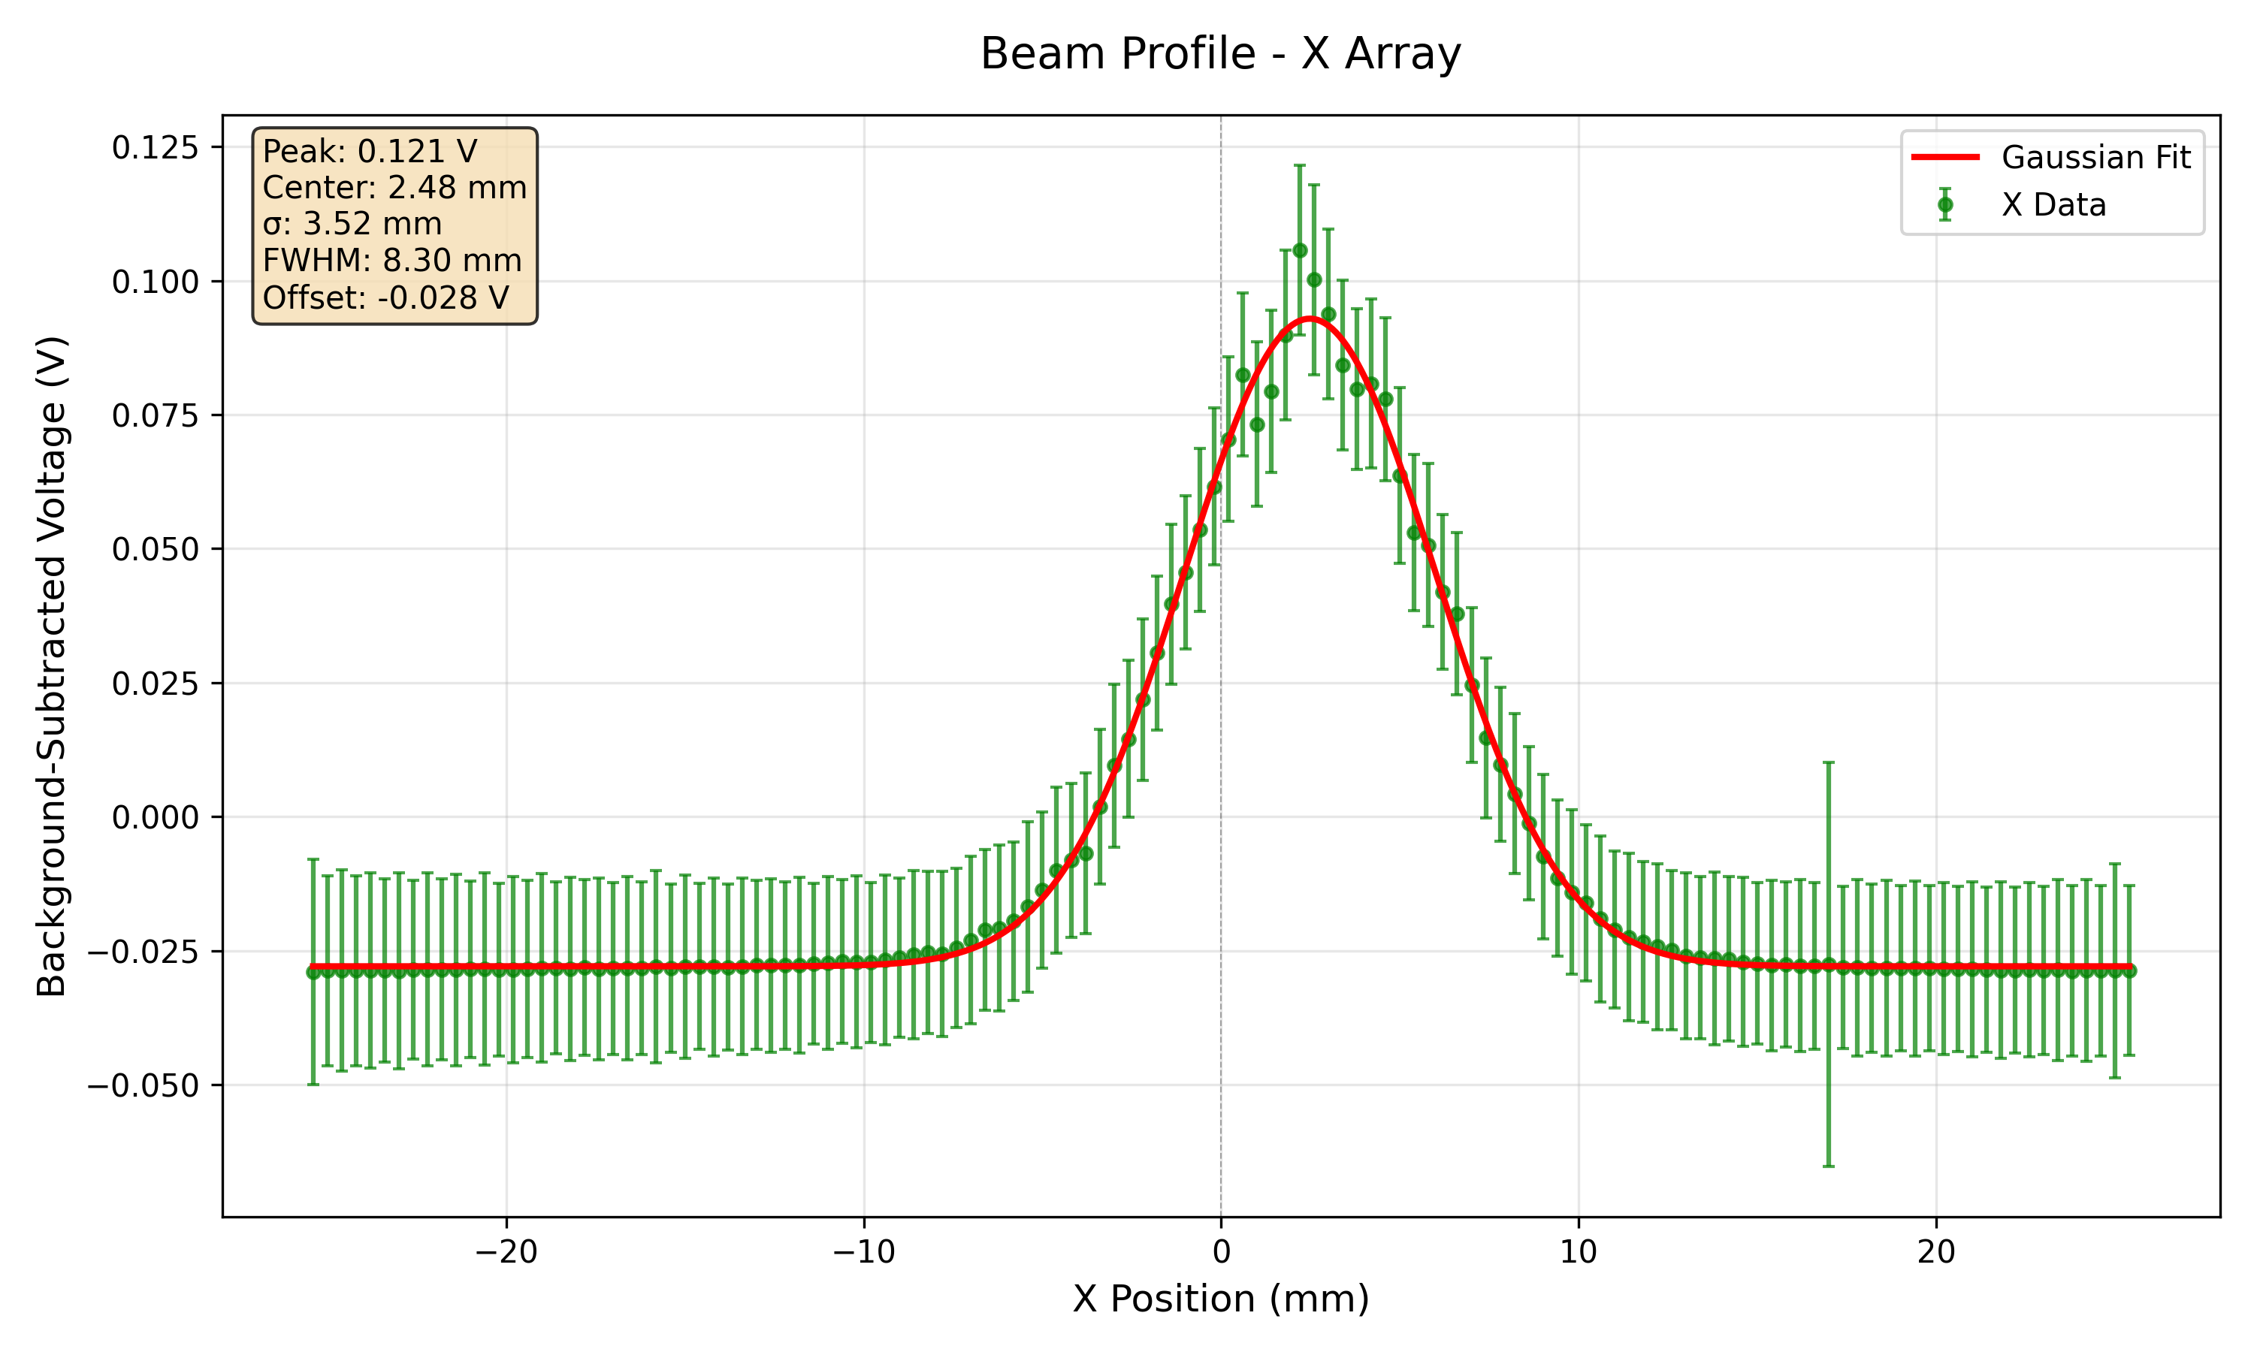
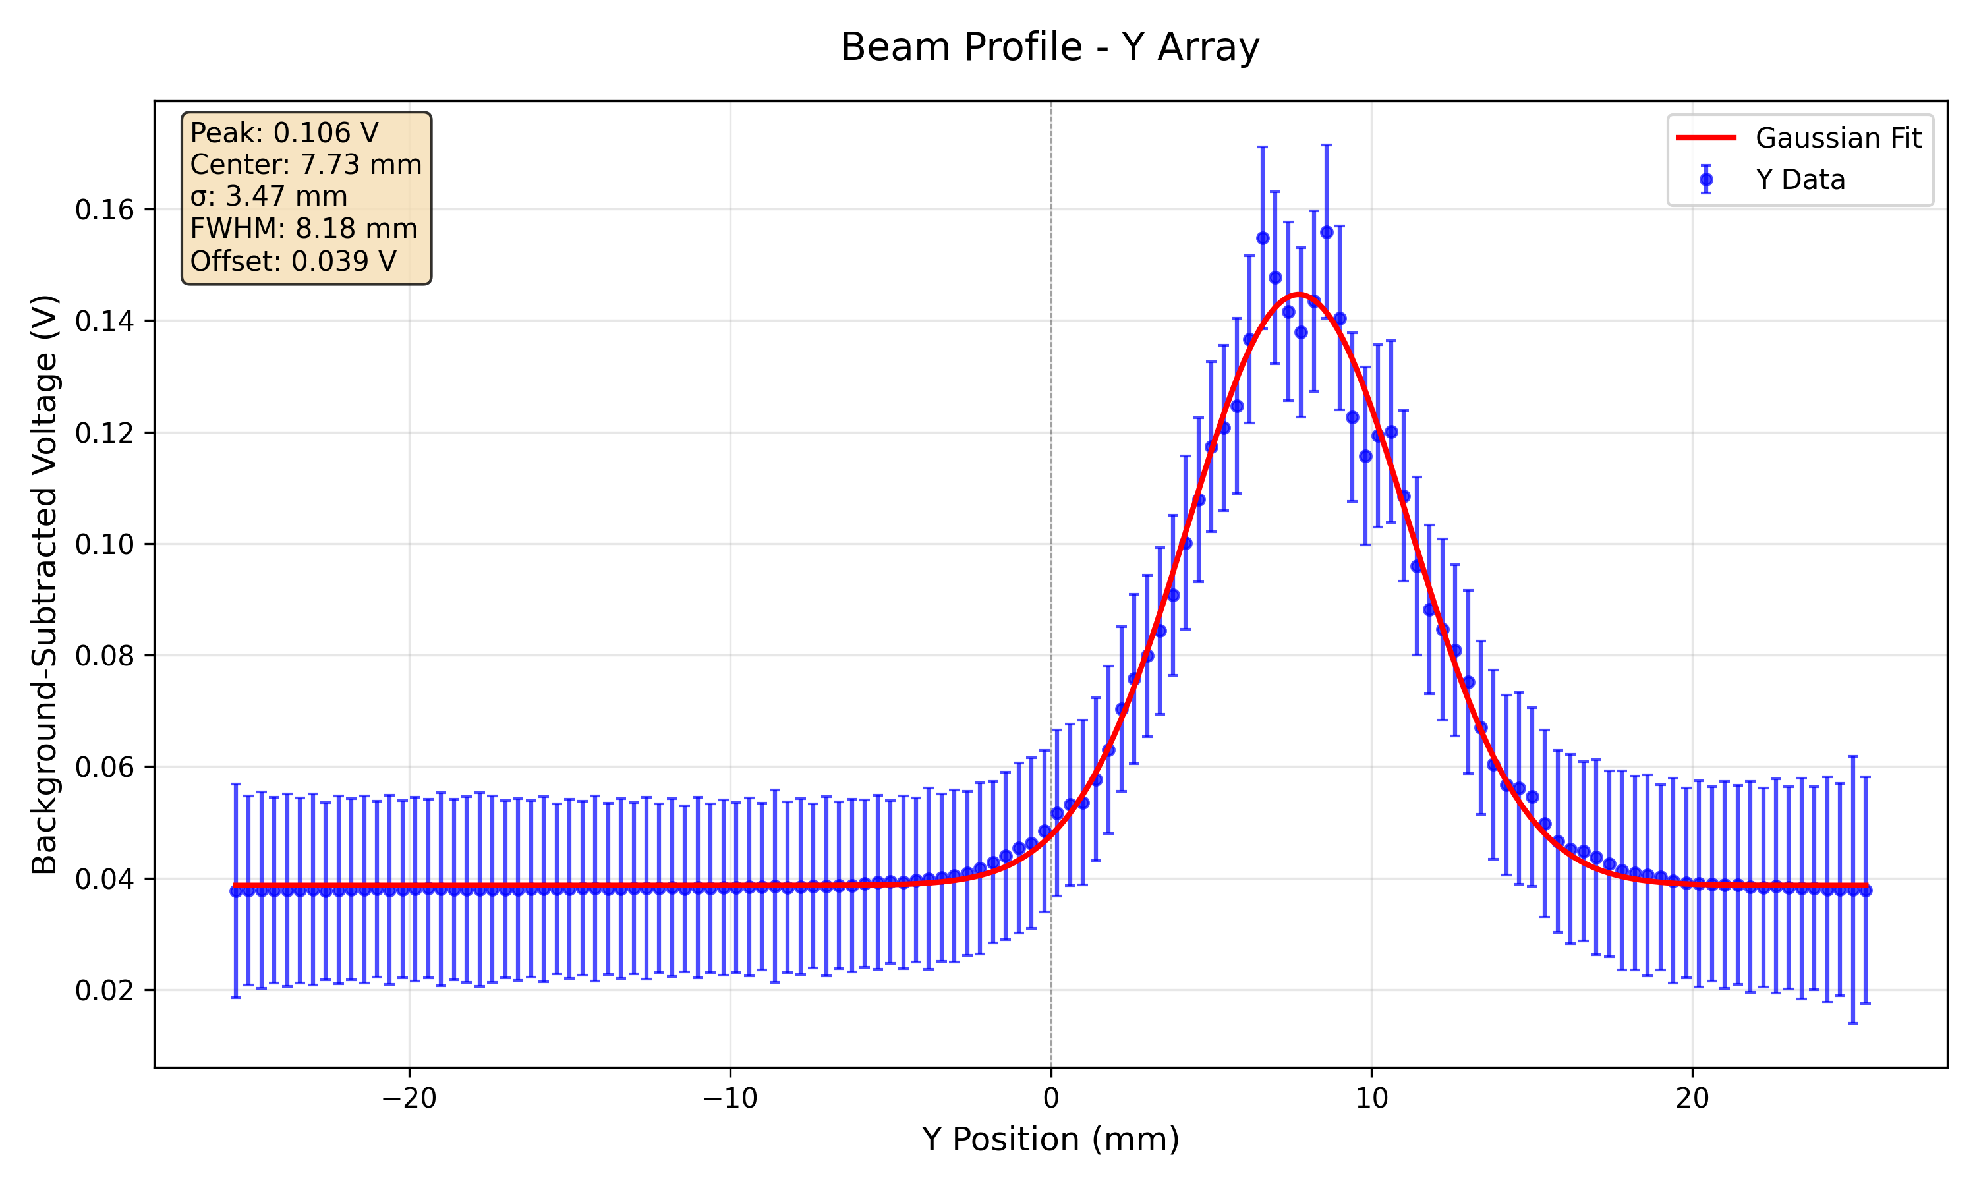
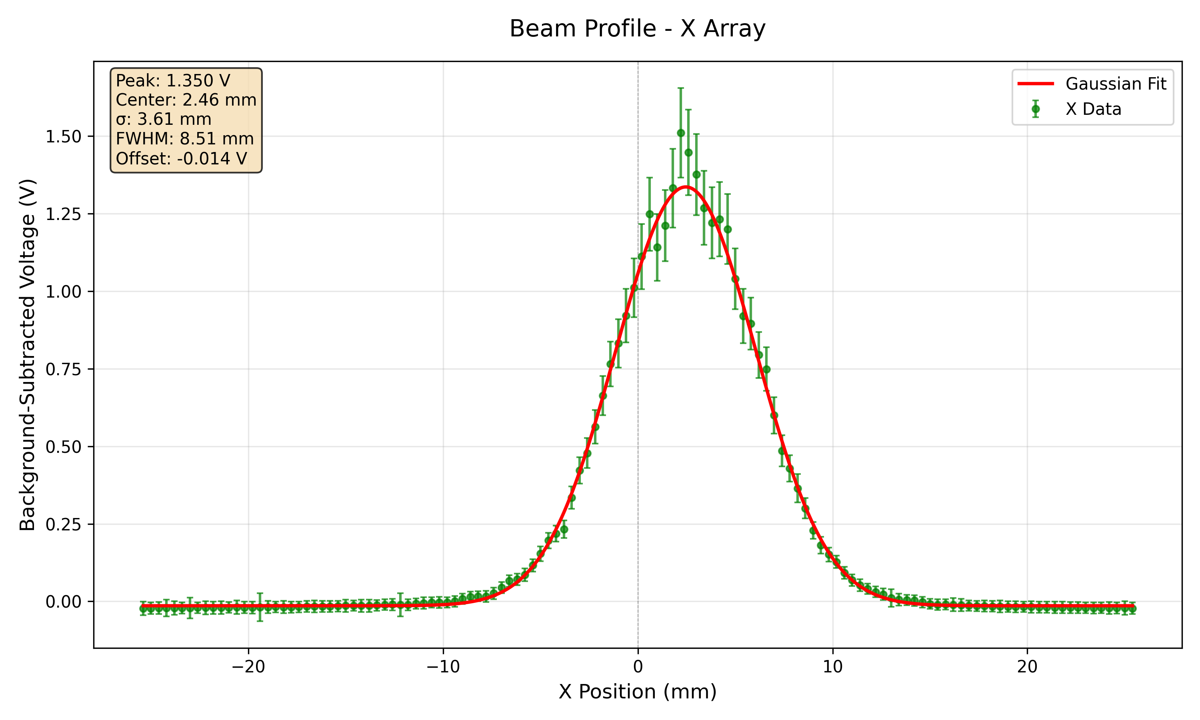
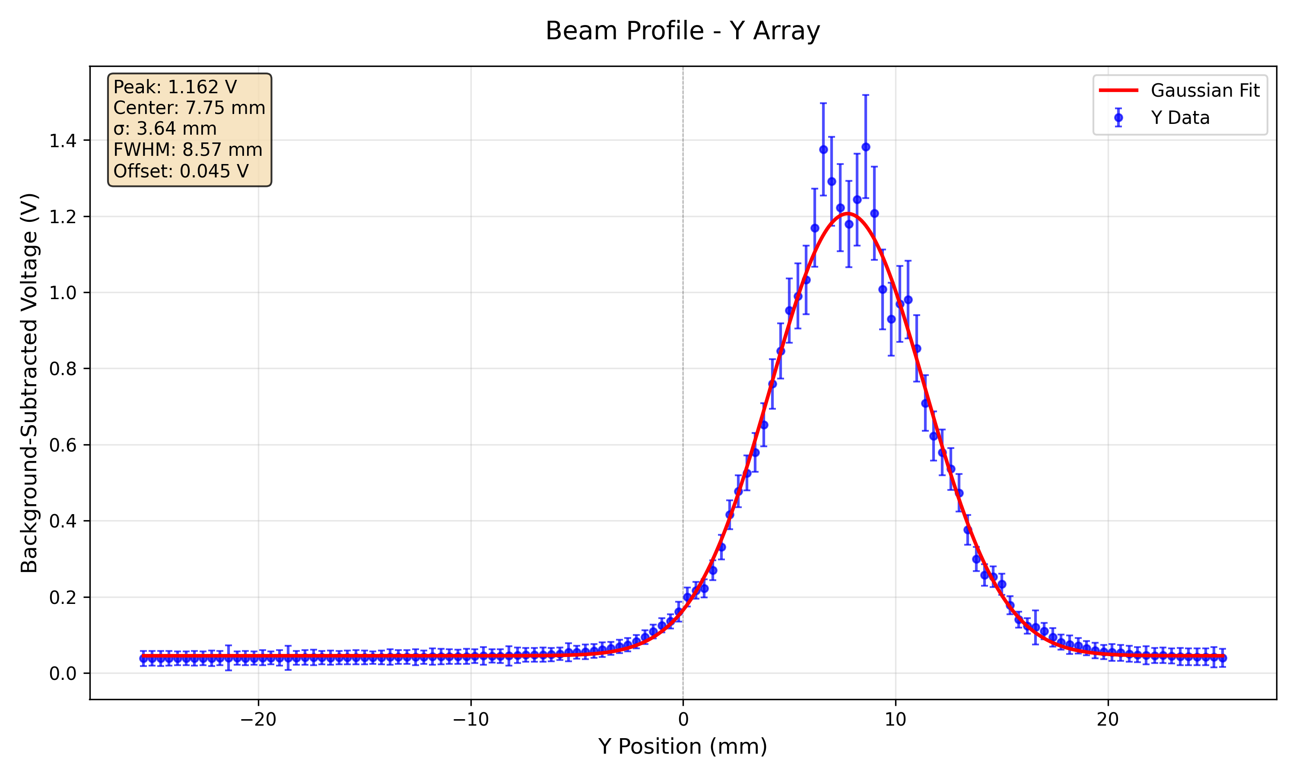
228 MeV
5 nA
80 nA

Slide 12
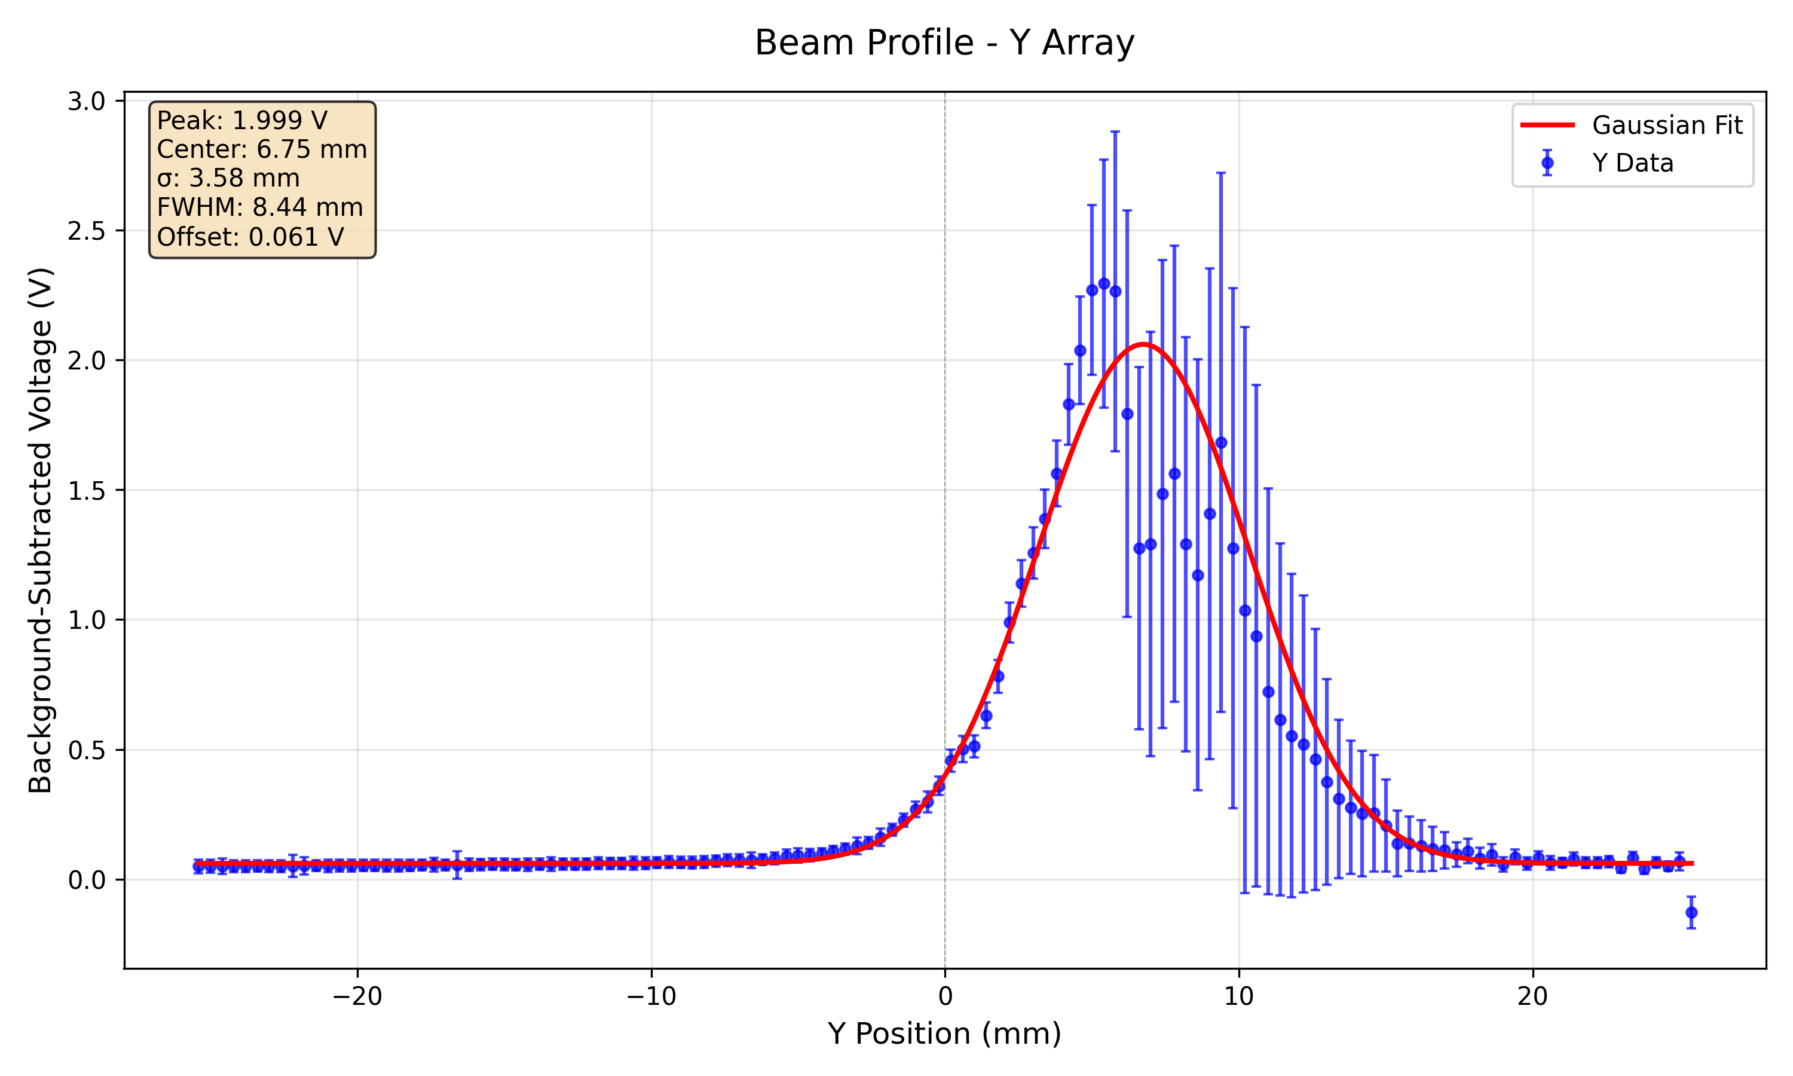
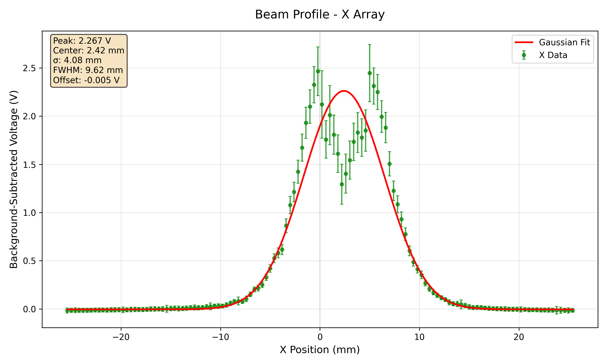
228 MeV 150 nA
Saturation becoming apparent at centre of X-profile.

Slide 13
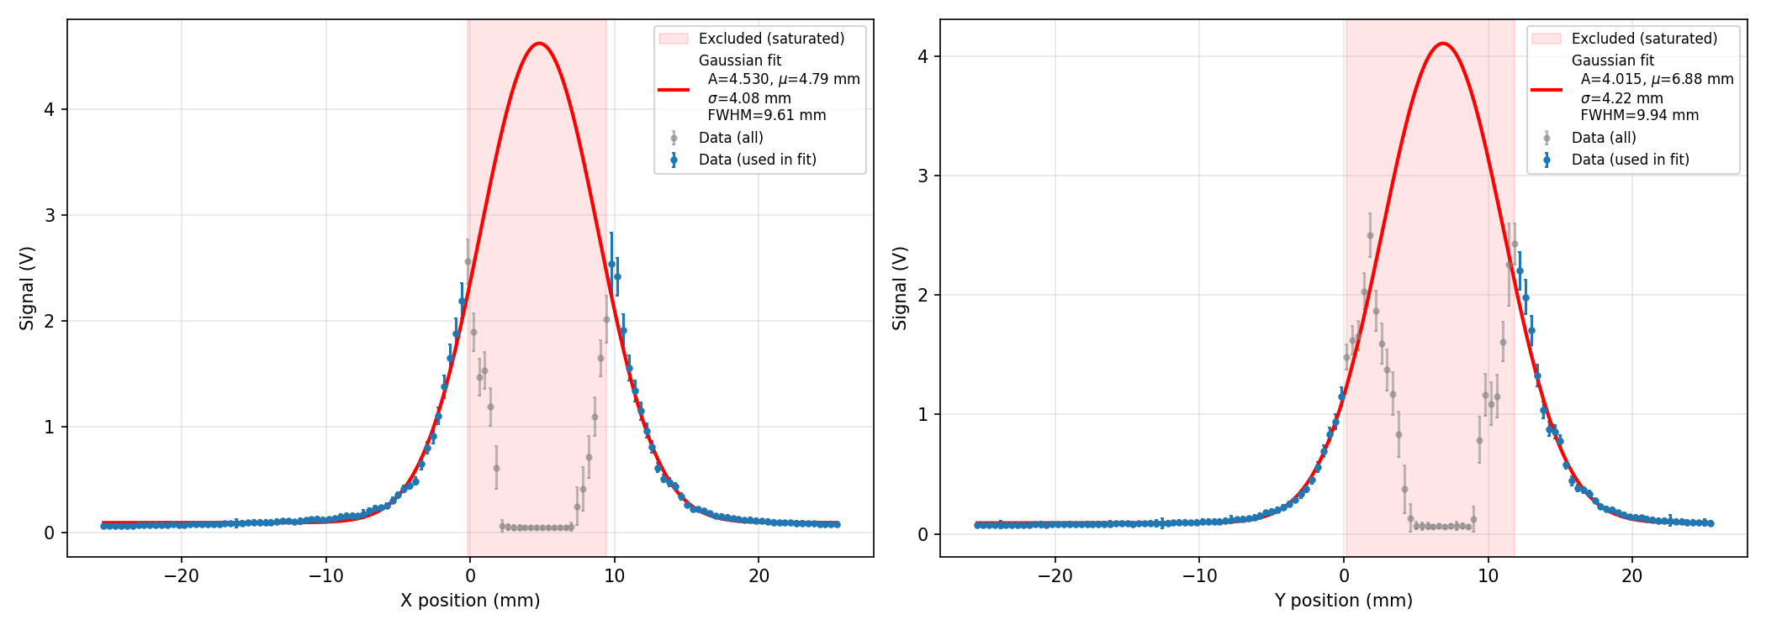
228 MeV 300 nA
Severe saturation at centre of both beam profiles. Still able to reconstruct Gaussian profile but $σ$ appears to be larger than the unsaturated profiles.
Beam is offset from previous profile measurements since these measurements were taken on a separate day and hence the detector was in a slightly different position.

Slide 14
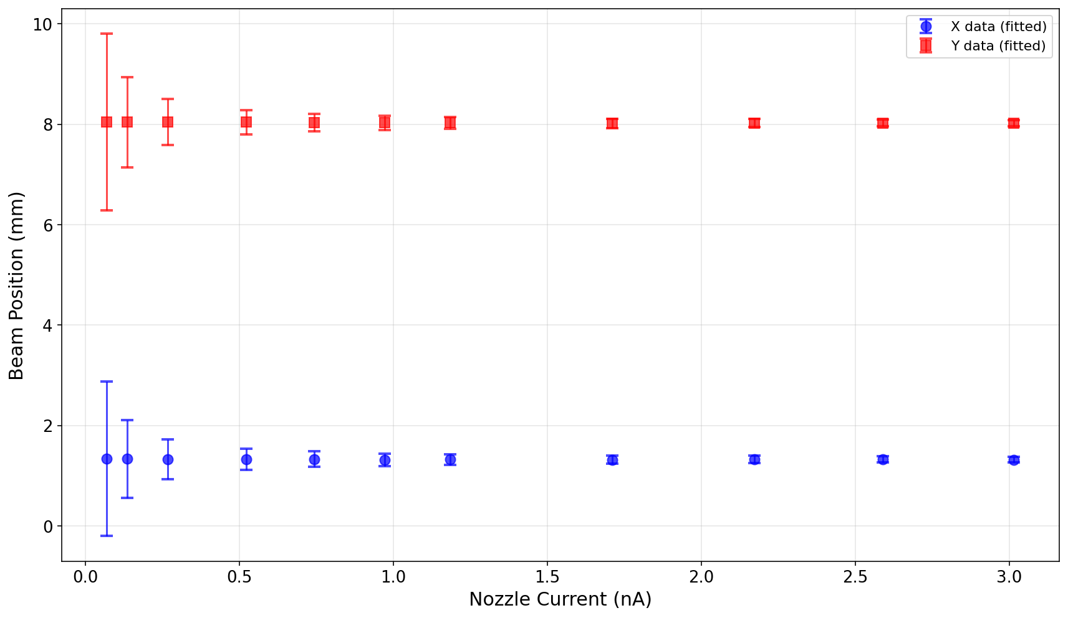
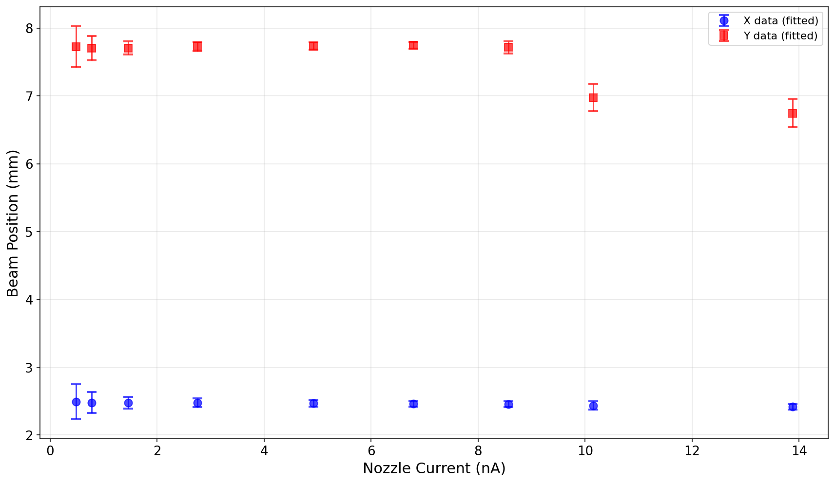
Beam Position Stability
Due to saturation in the profile measurement
148 MeV
228 MeV
Beam position determined from the mean ($μ_{x },μ_{y}$) of the Gaussian fit applied to the beam profile measurement. The error bars represent the uncertainty of the fit.

Slide 15
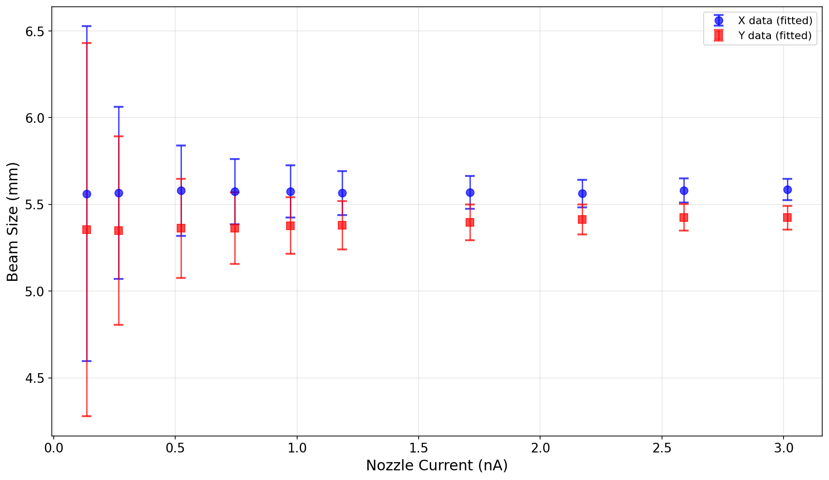
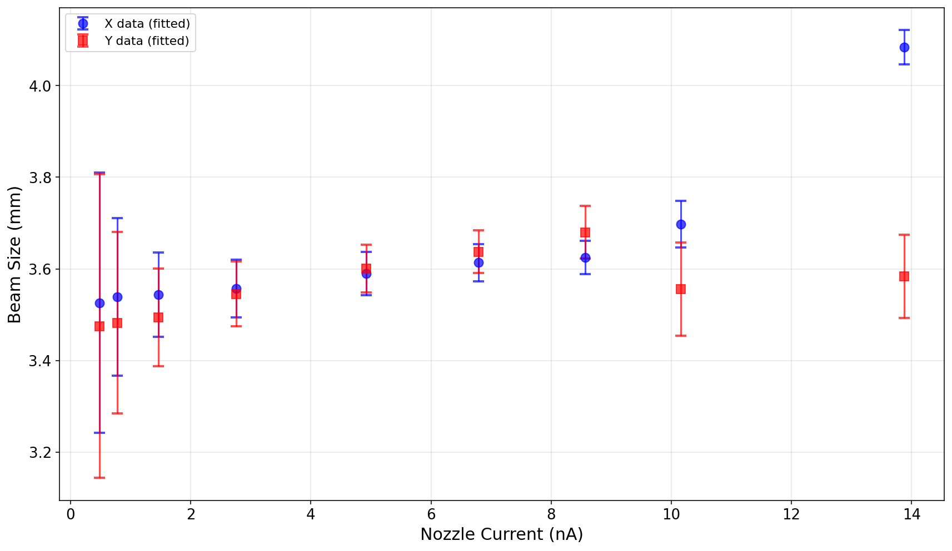
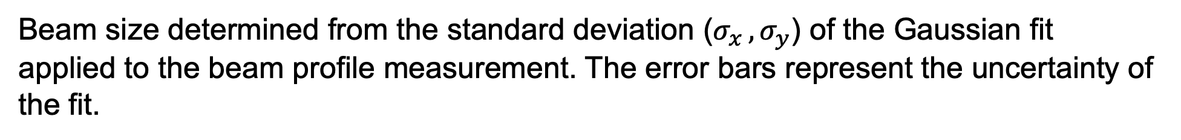
Beam Size Stability
Due to saturation in the profile measurement
148 MeV
228 MeV
Beam size determined from the standard deviation ($σ_{x },σ_{y}$) of the Gaussian fit applied to the beam profile measurement. The error bars represent the uncertainty of the fit.

Slide 16
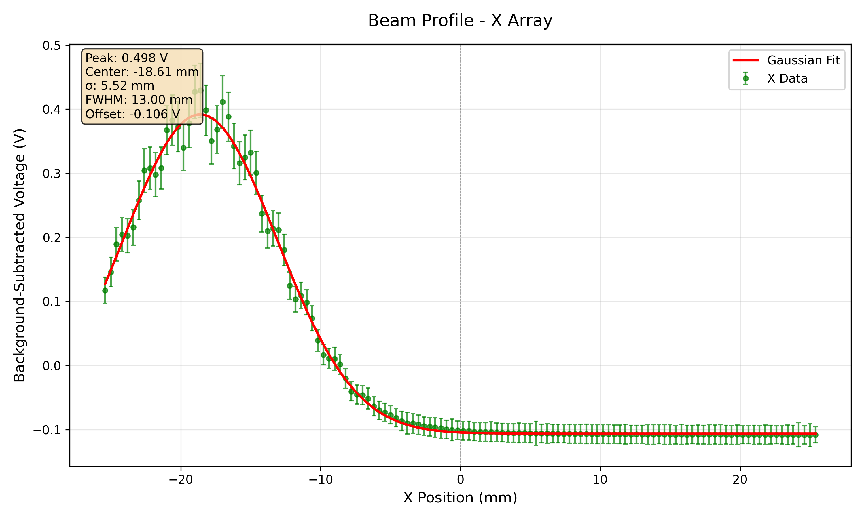
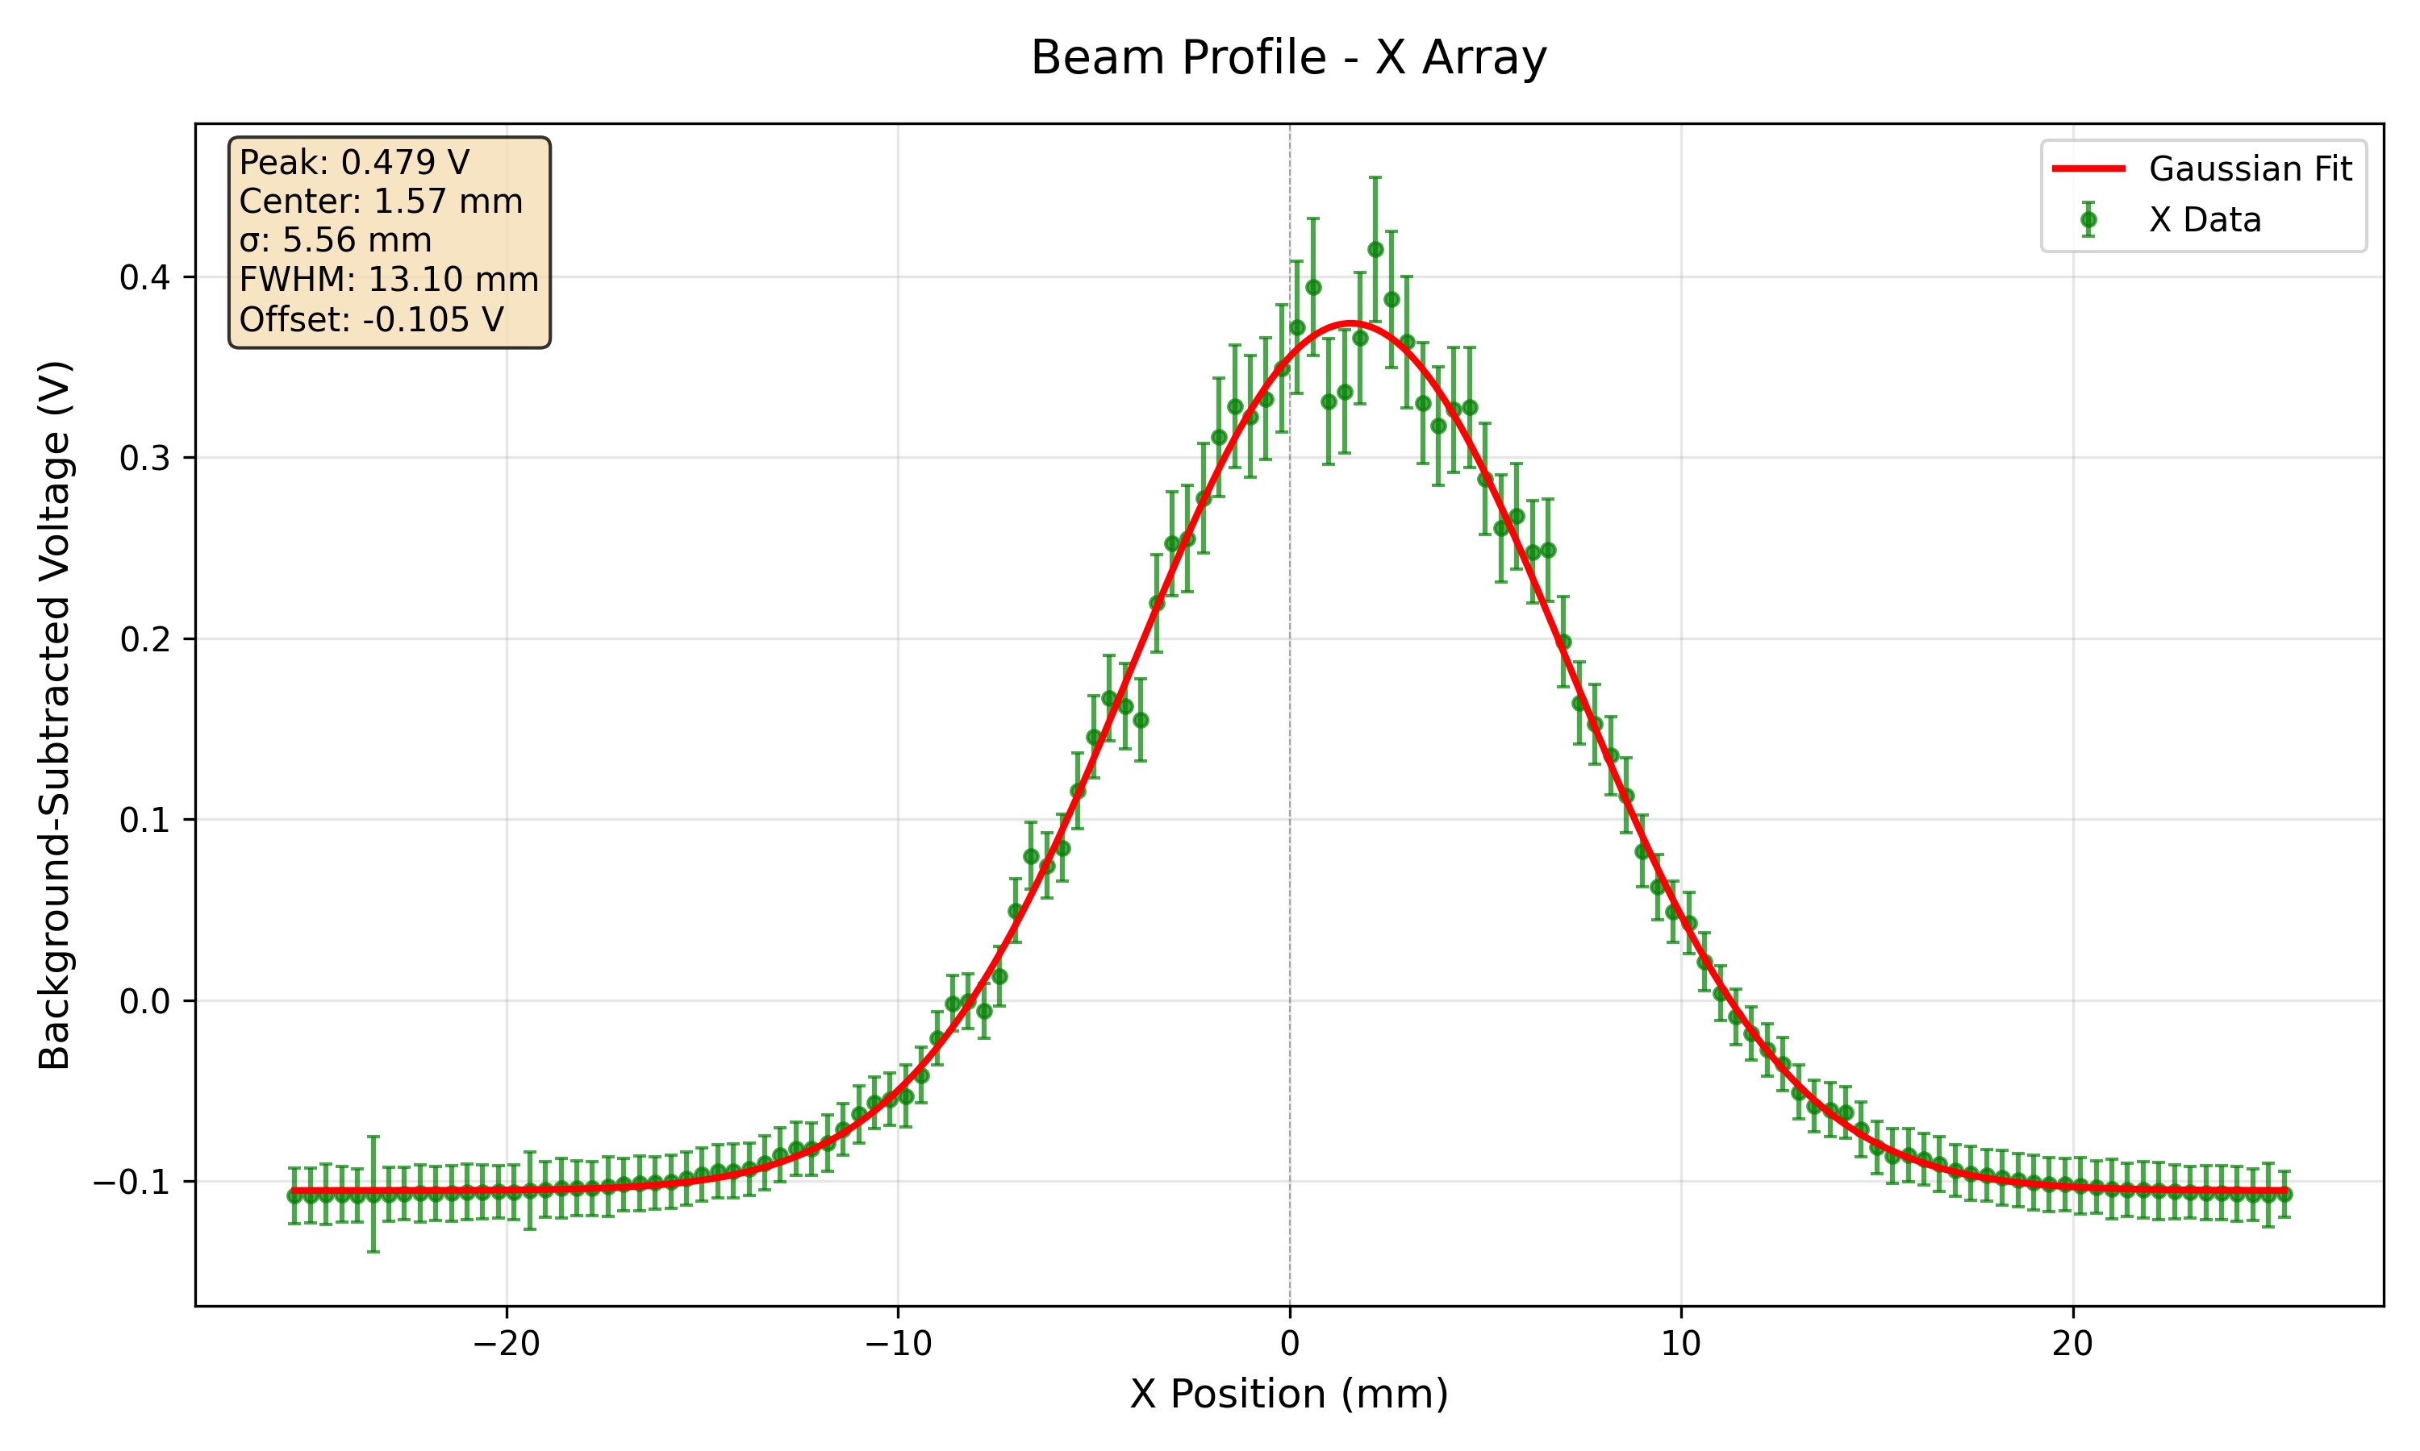
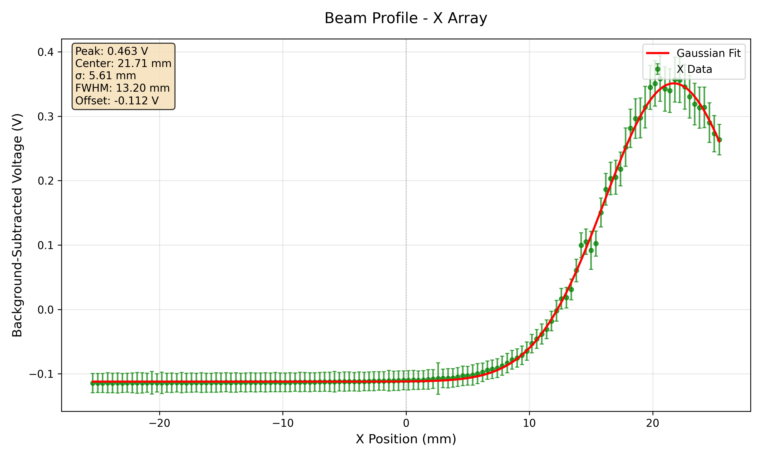
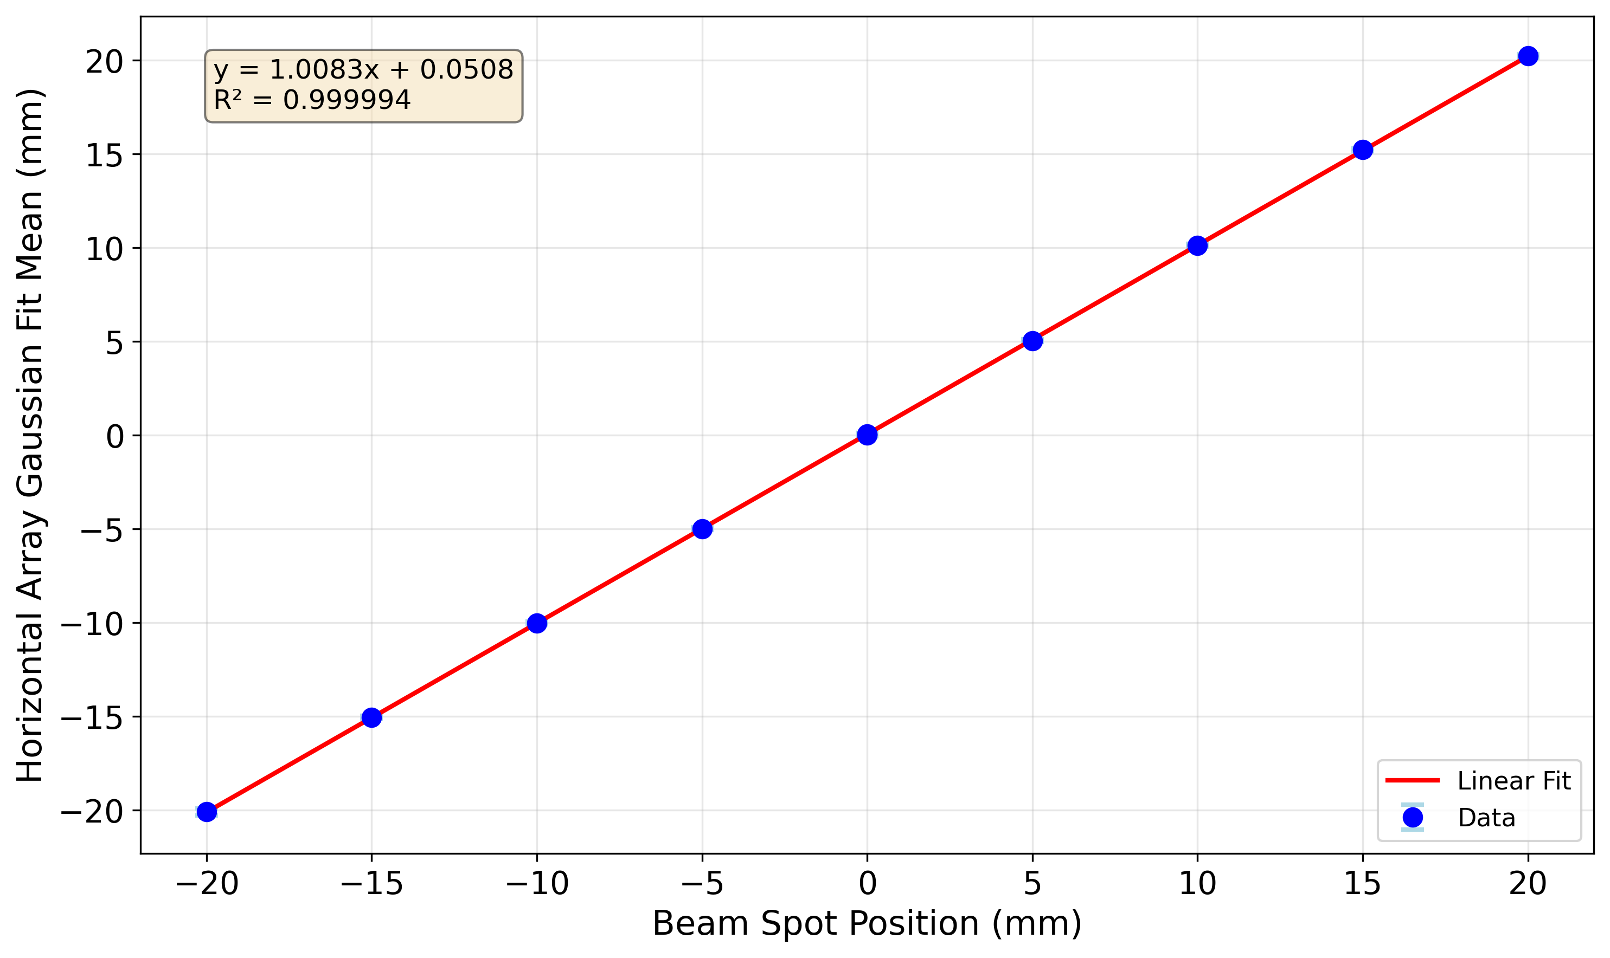
SciFi Position Response
Response of the Fibre Array at different horizontal positions using the translating stage between +/- 20 mm

Slide 17
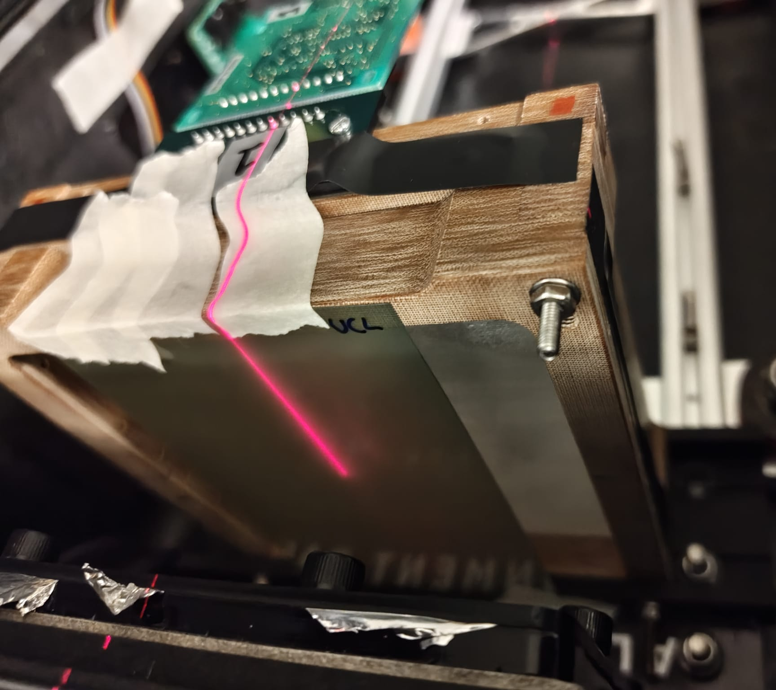
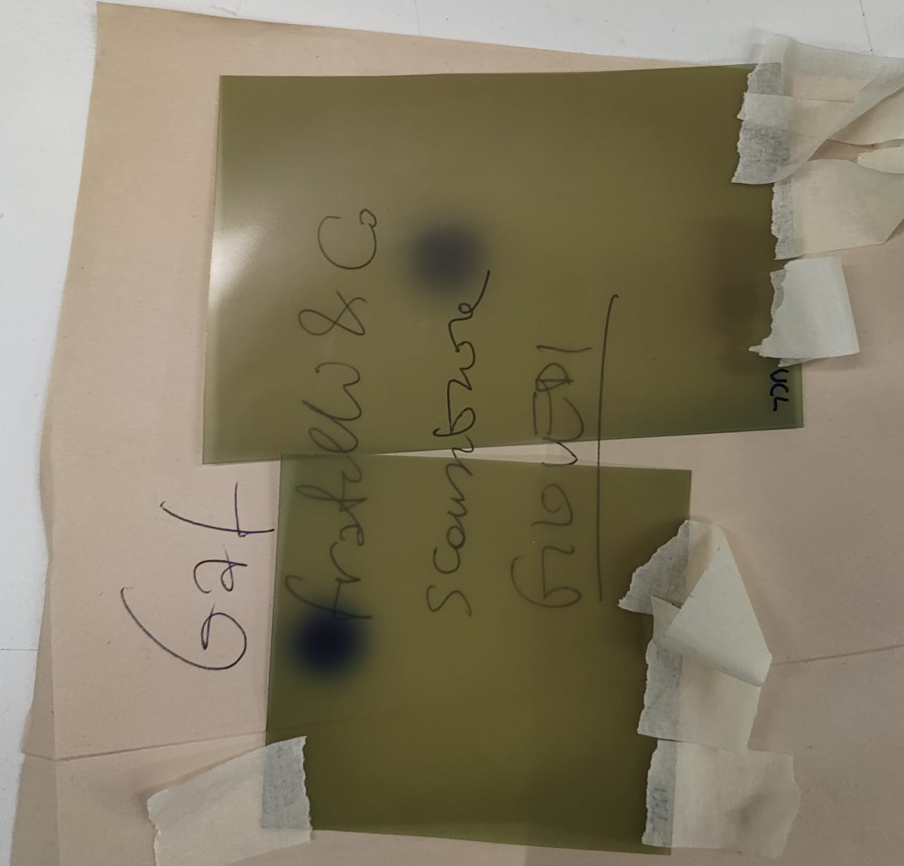
SciFi and Film Beam Profile Comparison
2 measurements performed at end of night 3 to compare beam size measured on radiochromic film to that by the fibre arrays, since the fibre array measurements were systematically larger than the reference beam sizes at isocentre.
Radiochromic film attached directly in front of first fibre array (Y array).
Measurements at 228 MeV and 148 MeV.

Slide 18
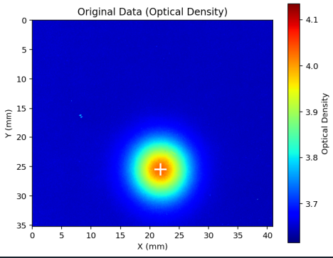
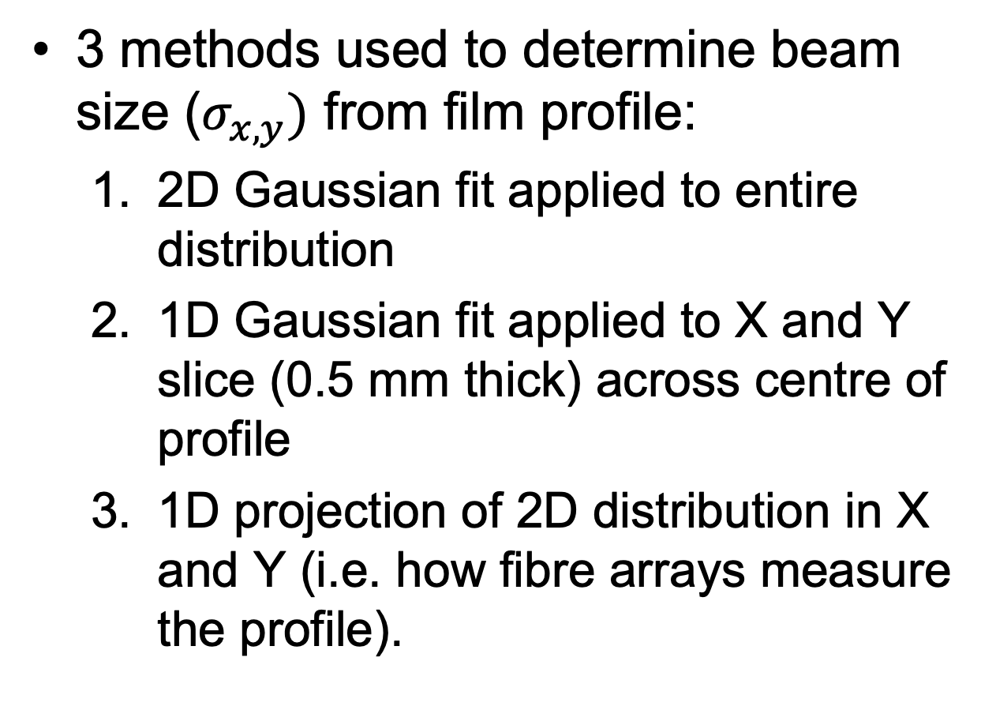
Gaussian Fitting
3 methods used to determine beam size ($σ_{x,y})$ from film profile:
2D Gaussian fit applied to entire distribution
1D Gaussian fit applied to X and Y slice (0.5 mm thick) across centre of profile
1D projection of 2D distribution in X and Y (i.e. how fibre arrays measure the profile).

Slide 19
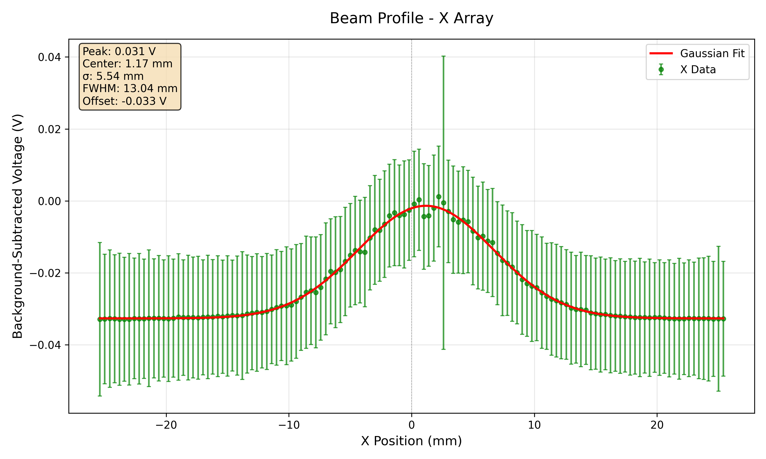
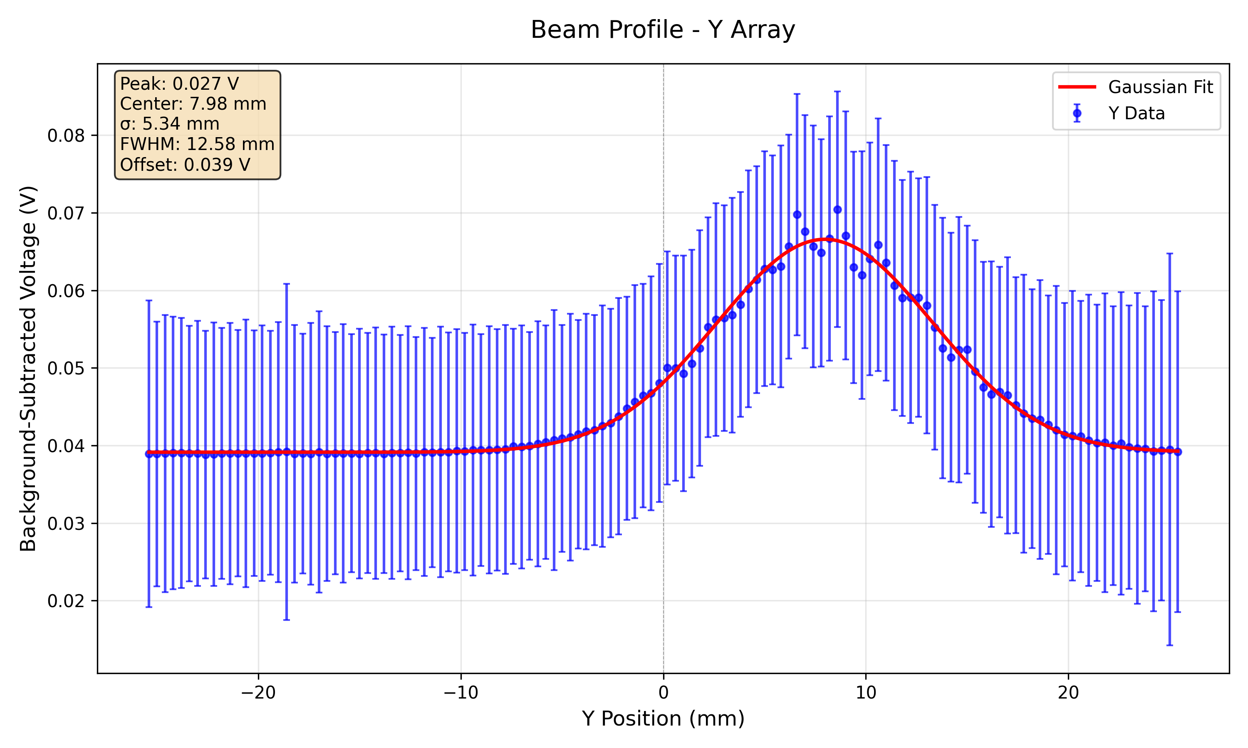
148 MeV 10 nA 10s – Fibre Array

Slide 20
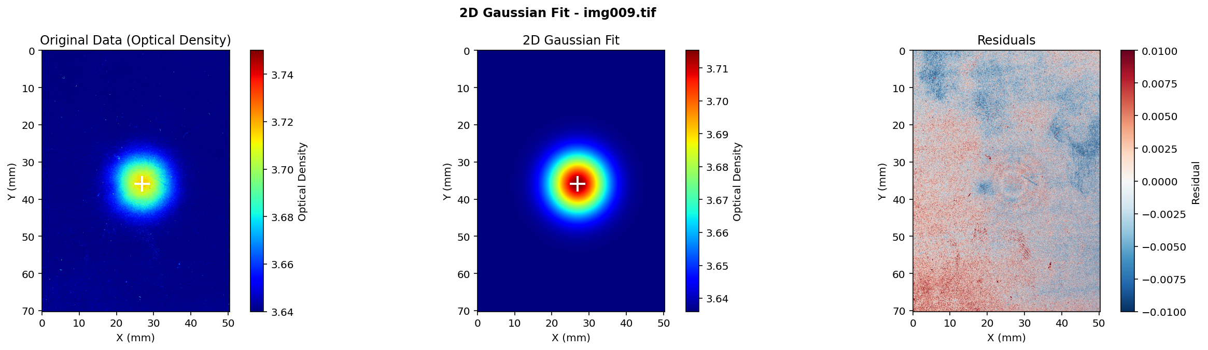
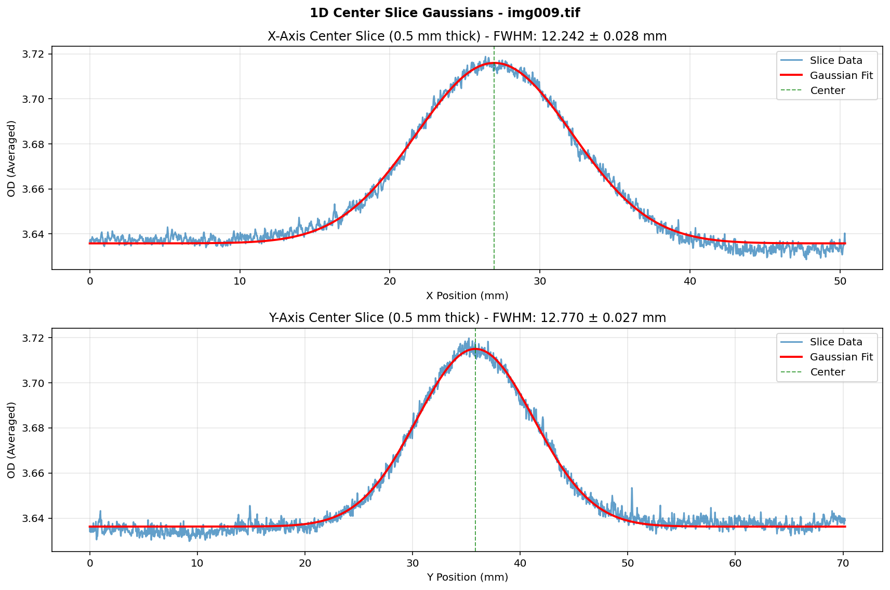
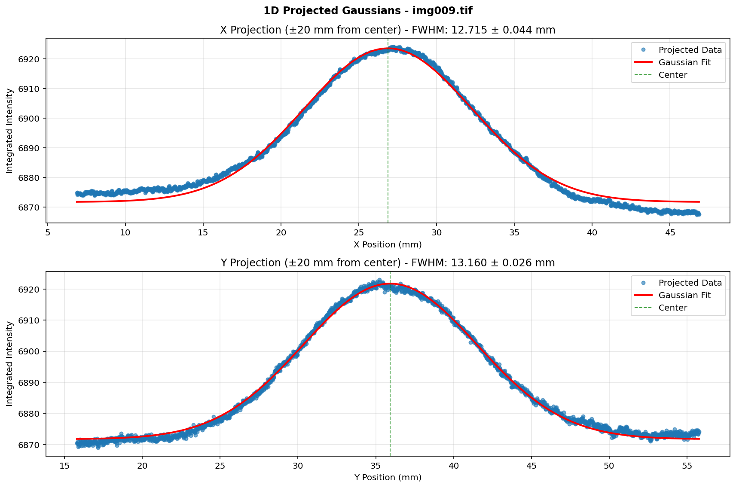
148 MeV 10 nA 10s – Film

Slide 21
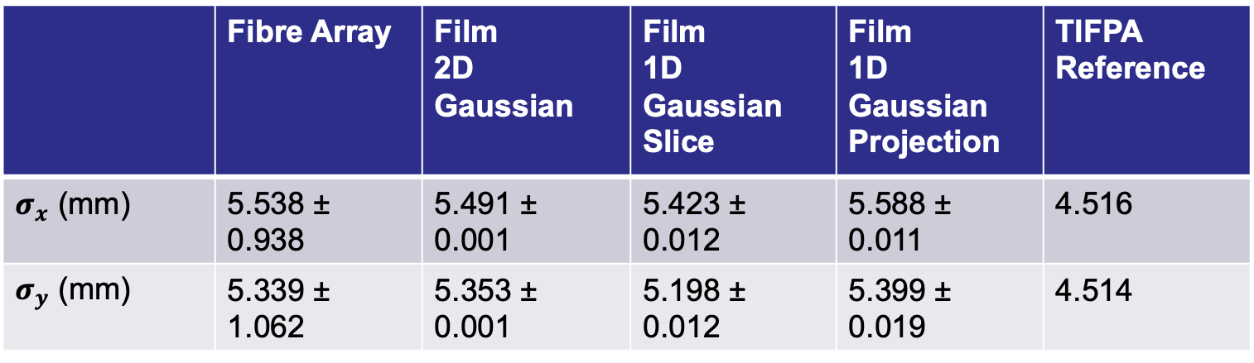
148 MeV Gaussian Fit Parameters
 | Fibre Array | Film 2D Gaussian | Film 1D Gaussian Slice | Film 1D Gaussian Projection | TIFPA Reference
$σ_{x}$ (mm) | 5.538 ± 0.938 | 5.491 ± 0.001 | 5.423 ± 0.012 | 5.588 ± 0.011 | 4.516
$σ_{y}$ (mm) | 5.339 ± 1.062 | 5.353 ± 0.001 | 5.198 ± 0.012 | 5.399 ± 0.019 | 4.514

Slide 22
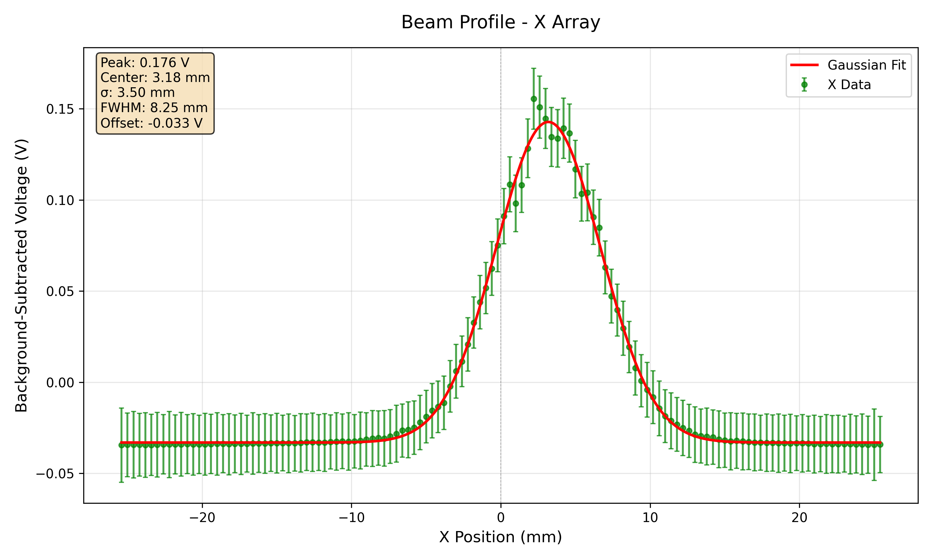
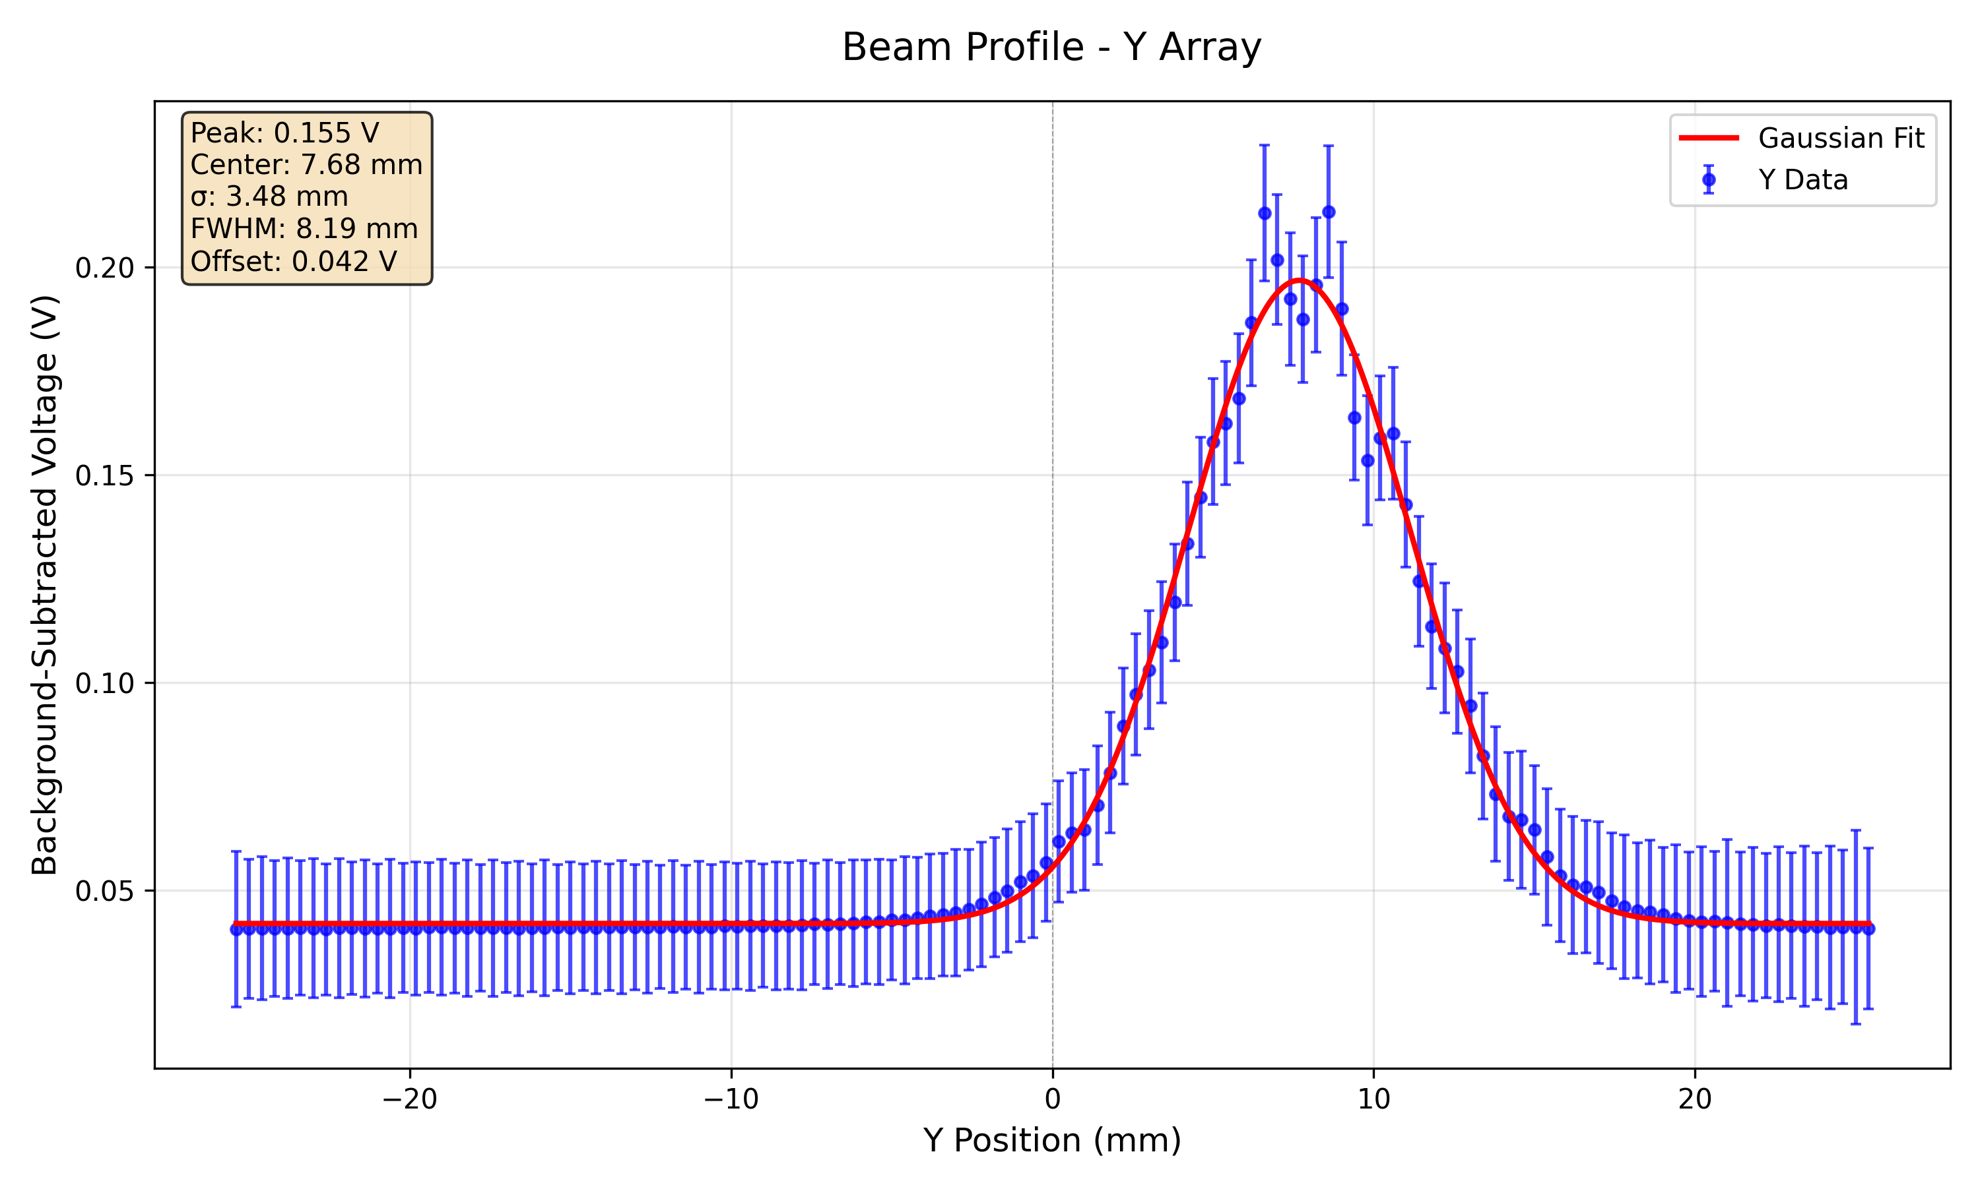
228 MeV 7nA 5s – Fibre Array

Slide 23
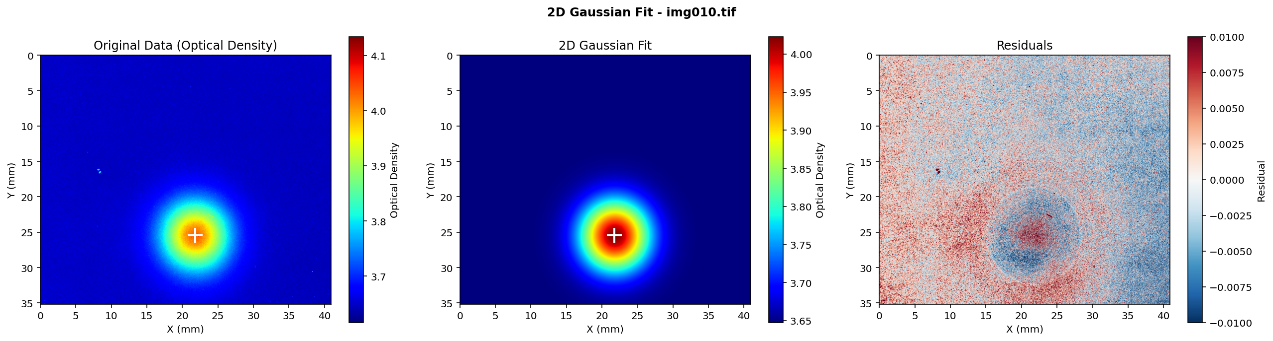


228 MeV 7nA 5s - Film

Slide 24

228 MeV Gaussian Fit Parameters
 | Fibre Array | Film 2D Gaussian | Film 1D Gaussian Slice | Film 1D Gaussian Projection | TIFPA Reference
$σ_{x}$ (mm) | 3.502 ± 0.117 | 3.396 ± 0.001 | 3.338 ± 0.003 | 3.421 ± 0.005 | 2.92
$σ_{y}$ (mm) | 3.479 ± 0.135 | 3.502 ± 0.001 | 3.450 ± 0.003 | 3.530 ± 0.003 | 2.9

Slide 25

SciFi and Film Beam Profile Comparison
Fibre array measurements of beam size ($σ$) in close agreement with that calculated from 1D Gaussian profile projection from film measurements.
However, both fibre array and film measurements for both energies (148 MeV & 228 MeV) are significantly larger than the TIFPA reference $σ$ values at isocentre.
Potentially due to scattering from beam monitor?

Slide 26
QuARC Detector Range Measurements
QuARC detector controlled entirely by web-based GUI.
Replay GUI to re-watch fitted measurements at 25 Hz: https://www.hep.ucl.ac.uk/pbt/QuARC-GUI/replay.html
170 𝜇s integration time for single module measurements and 220 𝜇s for full detector.
Measurements displayed in real-time on GUI at 25 Hz.
Each module individually calibrated using 228 MeV shoot-through beams from the front and back and averaging response.

Slide 27



QuARC Module Calibration
$$coefficient\left[i\right]=\frac{ST_{back}\left[i\right]+ST_{front}[i]}{2}$$
228 MeV, $ST_{back}$
228 MeV, $ST_{front}$

Slide 28
Module 1 Shoot-through Measurements
Nozzle current:
1.45 nA
Nozzle current:
25.81 nA
Full Scale Range 12.5 pC
FSR 350 pC
Performed numerous measurements at different dose rates on module 1 including some FLASH irradiations.
The attempted FLASH Irradiations of QuARC module 1 led to Raspberry Pi crashing and hence didn’t acquire data.

Slide 29
QuARC Detector Range Measurements
Kelleter fit (quenched Bragg curve) applied to percentage depth light curve (PDL) from the measured calibrated data – from this the Bortfeld curve can be reconstructed.
Relevant parameters (e.g. R90) extracted from reconstructed Bortfeld curve.

Slide 30
Range Measurements
70 MeV – 300 nA
70 MeV – 300 nA
112 MeV – 300 nA
Energy: 67.18 MeV
R90 (distal 90%): 38.52 mm
R80 (distal 80%): 38.72 mm
Delta R80 (distal - proximal): 1.98 mm
Peak-to-Plateau ratio: 4.25
Energy: 110.44 MeV
R90 (distal 90%): 91.57 mm
R80 (distal 80%): 92.13 mm
Delta R80 (distal - proximal): 4.59 mm
Peak-to-Plateau ratio: 3.95

Slide 31
Range Measurements
70 MeV – 300 nA
70 MeV – 300 nA
112 MeV – 300 nA
Kelleter curve and Bortfeld curve overlapping due to issues with calibration around Bragg Peak region for this range which overexaggerated measured signal around Bragg Peak – despite this still gives reasonable range measurements.
Energy: 67.18 MeV
R90 (distal 90%): 38.52 mm
R80 (distal 80%): 38.72 mm
Delta R80 (distal - proximal): 1.98 mm
Peak-to-Plateau ratio: 4.25
Energy: 110.44 MeV
R90 (distal 90%): 91.57 mm
R80 (distal 80%): 92.13 mm
Delta R80 (distal - proximal): 4.59 mm
Peak-to-Plateau ratio: 3.95

Slide 32
Range Measurements
148 MeV – 10 nA
148 MeV – 300 nA
Energy: 146.99 MeV
R90 (distal 90%): 150.94 mm
R80 (distal 80%): 151.58 mm
Delta R80 (distal - proximal): 5.31 mm
Peak-to-Plateau ratio: 4.12
Energy: 146.59 MeV
R90 (distal 90%): 150.21 mm
R80 (distal 80%): 150.87 mm
Delta R80 (distal - proximal): 5.49 mm
Peak-to-Plateau ratio: 4.06

Slide 33
Range Measurements
179 MeV – 15 nA
179 MeV – 300 nA
Energy: 178.09 MeV
R90 (distal 90%): 210.90 mm
R80 (distal 80%): 211.80 mm
Delta R80 (distal - proximal): 7.44197 mm
Peak-to-Plateau ratio: 3.73991
Energy: 178.18 MeV
R90 (distal 90%): 211.16 mm
R80 (distal 80%): 211.96 mm
Delta R80 (distal - proximal): 6.90203 mm
Peak-to-Plateau ratio: 3.85666

Slide 34

Range Measurement Correlation with Reference Ranges
Comparing the R90 values from the QuARC measurements (using the R90 of the reconstructed Bortfeld curve), to the reference effective R90 values at isocentre provided by TIFPA.

Slide 35

Horizontal Beam Position Scan
Detector moved horizontally using translating stage between -20 mm - +20 mm in 5 mm intervals.
QuARC measurements to investigate effect of horizontal beam position on Bragg Peak reconstruction and range measurement (by averaging the reconstructed Bortfeld curve measured on the a and b sides.
Dual-sided photodiode readout of scintillator sheets also allows for a ‘relative position’ measurement through calculating $∆/Σ$ of the each of the photodiode pairs per scintillator sheet:
$\frac{Δ}{Σ}[i]=\frac{{PD}_{a}\left[i\right]−{PD}_{b}\left[i\right]}{{PD}_{a}\left[i\right]+{PD}_{b}\left[i\right]}$
b
QuARC
Protons
1
2
3
a

Slide 36
Position Scan: 148 MeV Bragg Curves
Beam 20mm to left
A: R₀ = 151.47 mm, E₀ = 146.91 MeV
B: R₀ = 151.51 mm, E₀ = 146.93 MeV
Avg: R₀ = 151.49 mm, E₀ = 146.92 MeV
Beam in centre
A: R₀ = 151.29 mm, E₀ = 146.81 MeV
B: R₀ = 151.51 mm, E₀ = 146.93 MeV
Avg: R₀ = 151.4 mm, E₀ = 146.87 MeV
Beam 20mm to right
A: R₀ = 151.46 mm, E₀ = 146.90 MeV
B: R₀ = 151.73 mm, E₀ = 147.05 MeV
Avg: R₀ = 151.60 mm, E₀ = 146.96 MeV
Consistent range reconstruction across entire range of beam spot positions.

Slide 37


QuARC + Fibre Position Measurements
Possible to obtain relative horizontal position measurement from QuARC due to dual-sided photodiode read out.
Mean of $∆/Σ$ of the each of the photodiode pairs per scintillator sheet calculated for horizontal position scan and correlated with $μ$ calculated from horizontal fibre array.
Corresponds to an offset of 206 µm.

Slide 38
QuARC Response Linearity
Response linearity of entire QuARC detector by summing the average PD values across the measurement time to ion source current
179 MeV
148 MeV

Slide 39
QuARC Response Linearity
Response linearity of entire QuARC detector by summing the average PD values across the measurement time to nozzle current (calculated using beam monitor measured proton counts and times).
QuARC response appears to be less linear with nozzle current than with ion source current.
179 MeV
148 MeV

Slide 40


SciFi Response Linearity
Fibre array response to ion source current – demonstrates excellent linearity for entire current range for 148 MeV and in unsaturated region (up to ~80 – 100 nA) for 228 MeV. Error bars represent the mean fluctuation of the pixel value across each measurement.
148 MeV
228 MeV

Slide 41


SciFi Response Linearity
Fibre array response to nozzle current (calculated using beam monitor measured proton counts and times).
Fibre array response also appears to be less linear with nozzle current than with ion source current.
148 MeV
228 MeV

Slide 42
Conclusions
Fibre array beam size measurements agree with film measurements – but both are larger than reference beam size measurements.
Also investigating why there is large fluctuations across each run which cause the large error bars.
Fibre beam position measurements match horizontal stage translation and both fibre array and QuARC position measurements correlate well.
QuARC range measurements (R90) in close agreement with reference R90 values.
Both QuARC and fibre array showed excellent linearity with ion source current (R²>0.999) but less linear with nozzle current (measured by beam monitor).

