Slide 1
Therapeutic Proton Beam Profile Measurements with a Scintillating Fibre Array Detector
Joe Bateman, Simon Jolly - University College London
Raffaella Radogna - University of Bari
14/10/2025

Slide 2
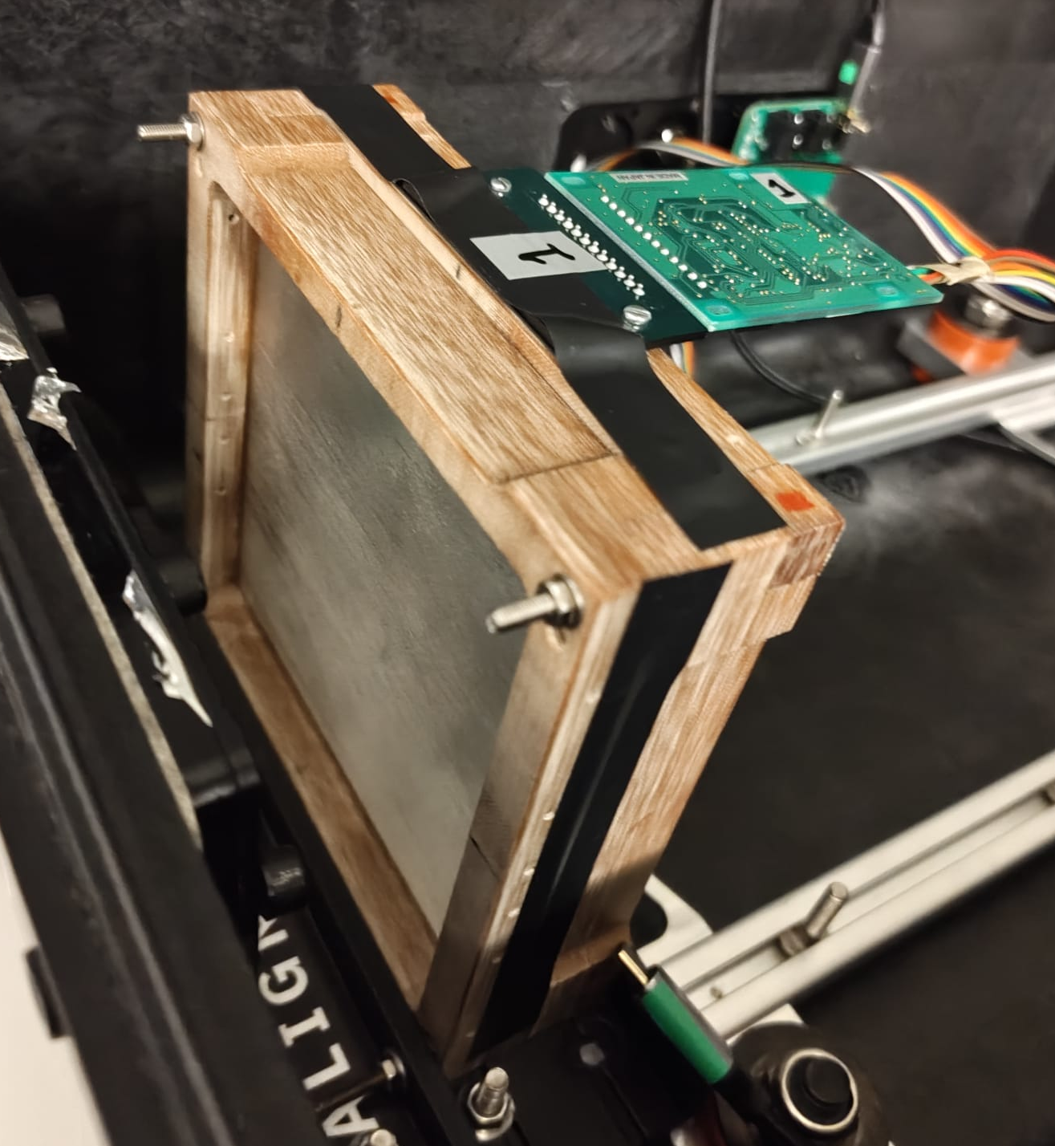
Fibre Array Detector Configuration
2 orthogonal 10 cm x 10 cm arrays made of BCF-60 plastic scintillating fibres by Saint-Gobain, 0.50 ± 0.13 mm diameter. Emission peak at 530 nm.
2x 128-channel photodiode array (Hamamatsu S11865-128) (1 per fibre array)
Single and cascade operation. Image size: 51.2 x 0.6 mm, pixel pitch 0.4 mm
Hamamatsu C9118-02 CMOS driver circuit provides multiplexed data at up to 4 MHz
Analogue video output from the pixels array readout using NI USB-6366 Multifunction I/O
In low gain the dark output voltage is typ. 0.005 mV, max 0.1 mV
The saturation output voltage is min. 3 V typ 3.5 V

Slide 3
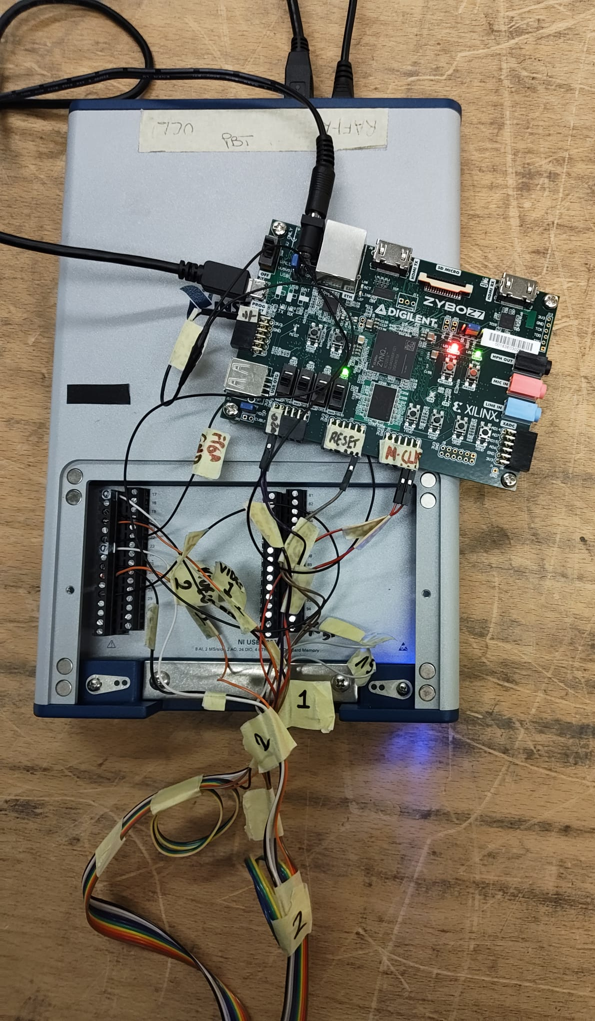
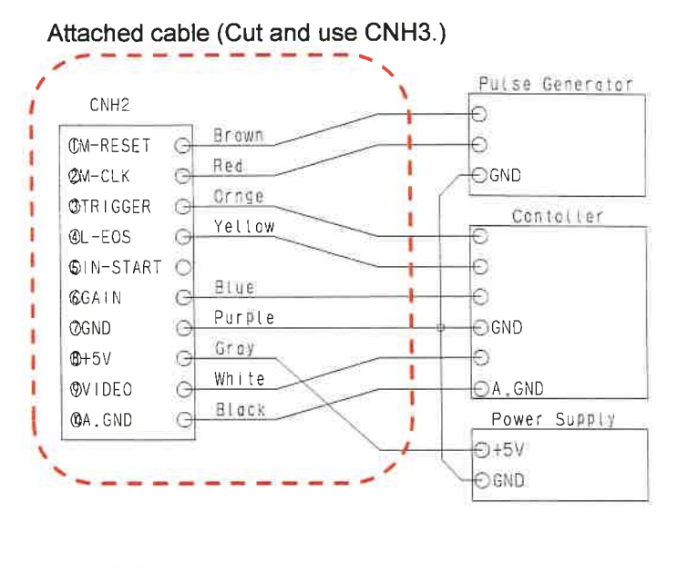
Fibre Array Readout Configuration
Analogue video output from the pixels array readout using NI USB-6366 Multifunction I/O
MCLK 1 MHz. Suggested min. reset time 10 μs and suggested min. integration time 17+ (4x128) clocks = 529 μs.
FPGA high period of RESET clock (reset) = 50 μs, low period (integration) = 950 μs.
VIDEO, Trigger and GND routed to NI board for analogue input.
MCLK – each board has individual clock from FPGA
RESET - shared clock from Zybo FPGA
NI USB-6366 Multifunction I/O connected to laptop inside experimental room (connected via remote desktop and ethernet to laptop in control room) and measurements obtained using analogue input on NI DAQ Express Software.
Measurements acquired at 1 kHz (from RESET).
Acquired measurements for 10s period – to get sufficient statistics.

Slide 4

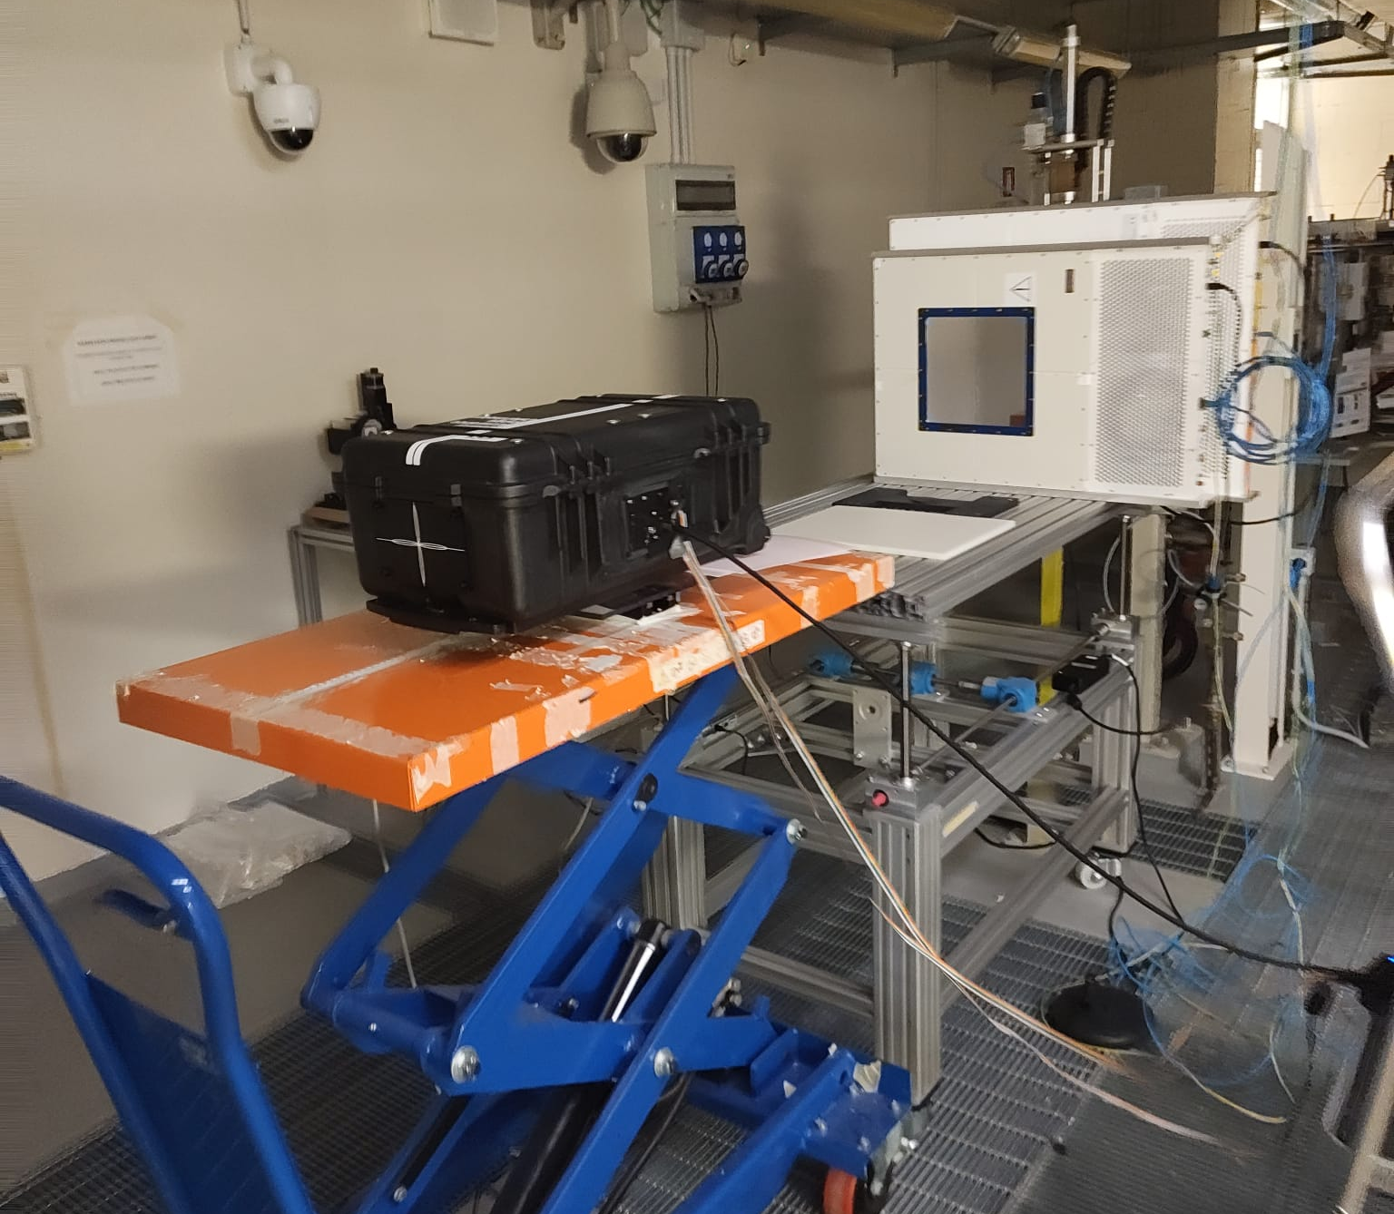
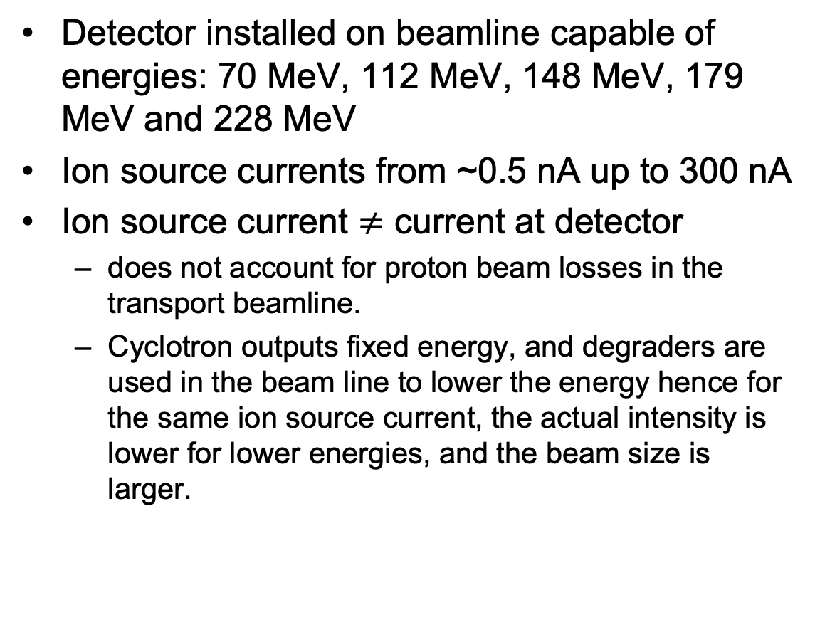
Trento Proton Therapy Centre Beam Test
Detector installed on beamline capable of energies: 70 MeV, 112 MeV, 148 MeV, 179 MeV and 228 MeV
Ion source currents from ~0.5 nA up to 300 nA
Ion source current $≠$ current at detector
does not account for proton beam losses in the transport beamline.
Cyclotron outputs fixed energy, and degraders are used in the beam line to lower the energy hence for the same ion source current, the actual intensity is lower for lower energies, and the beam size is larger.

Slide 5
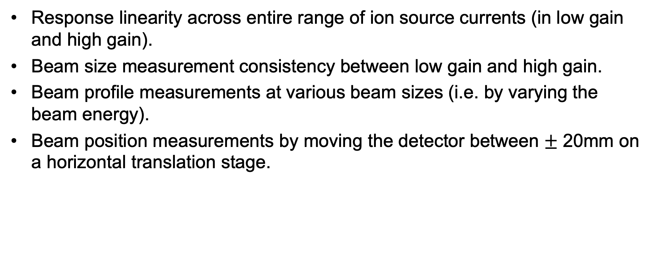
Experimental Measurements
Response linearity across entire range of ion source currents (in low gain and high gain).
Beam size measurement consistency between low gain and high gain.
Beam profile measurements at various beam sizes (i.e. by varying the beam energy).
Beam position measurements by moving the detector between $±$ 20mm on a horizontal translation stage.

Slide 6
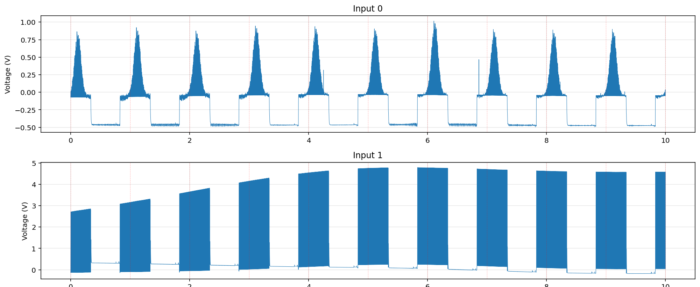
Data Analysis Process
Identify start of each 128-pixel readout cycle
Identify sustained high voltage (>3V) on trigger channel
Locate start of each 128-pixel readout sequence and verify trigger validity (127+ consecutive high samples)
Separate voltage readings for each pixel across all 10,000 acquisitions.
Calculate mean and standard deviation across entire acquisition period.
Background values obtained for each pixel from background runs.
Plot background subtracted mean against pixel channel
For now, position obtained by denoting centre of pixel array as 0 mm and utilising 0.4mm pixel pitch.
Gaussian fit applied to beam profile:
Amplitude for responsee linearity measurements
Mean (μ) for beam position
Sigma (σ) and full-width at half maximum (FWHM) for beam size
National Instruments Output
Video Output (channel 1)
Trigger (channel 1)

Slide 7
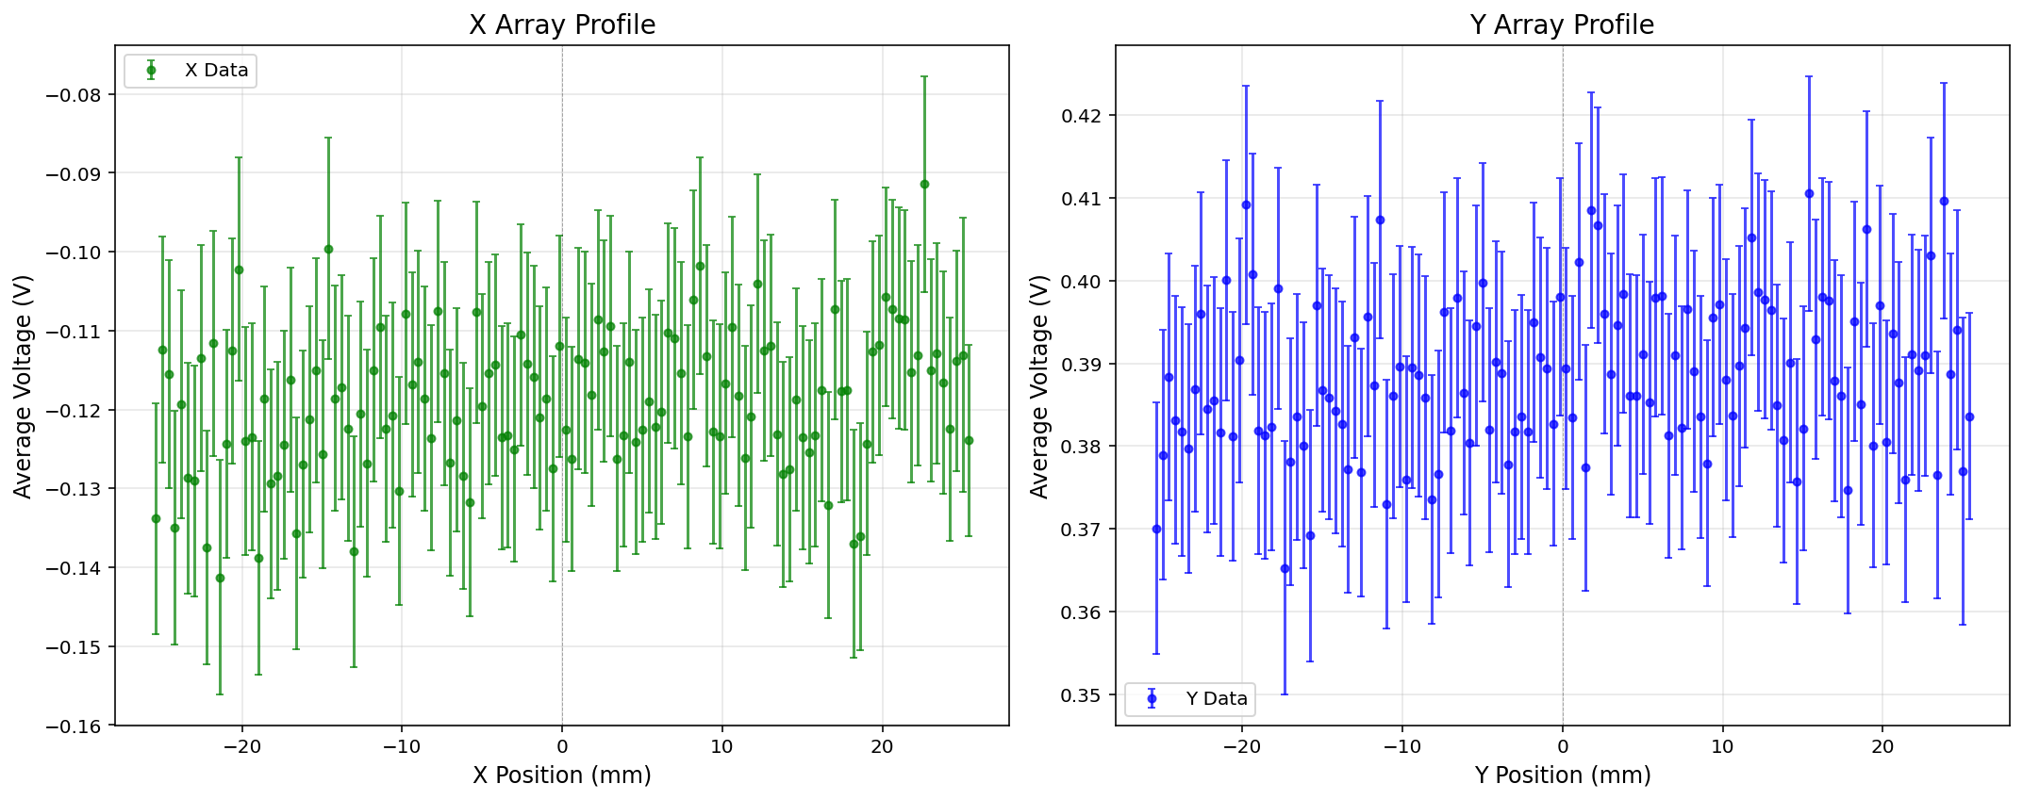
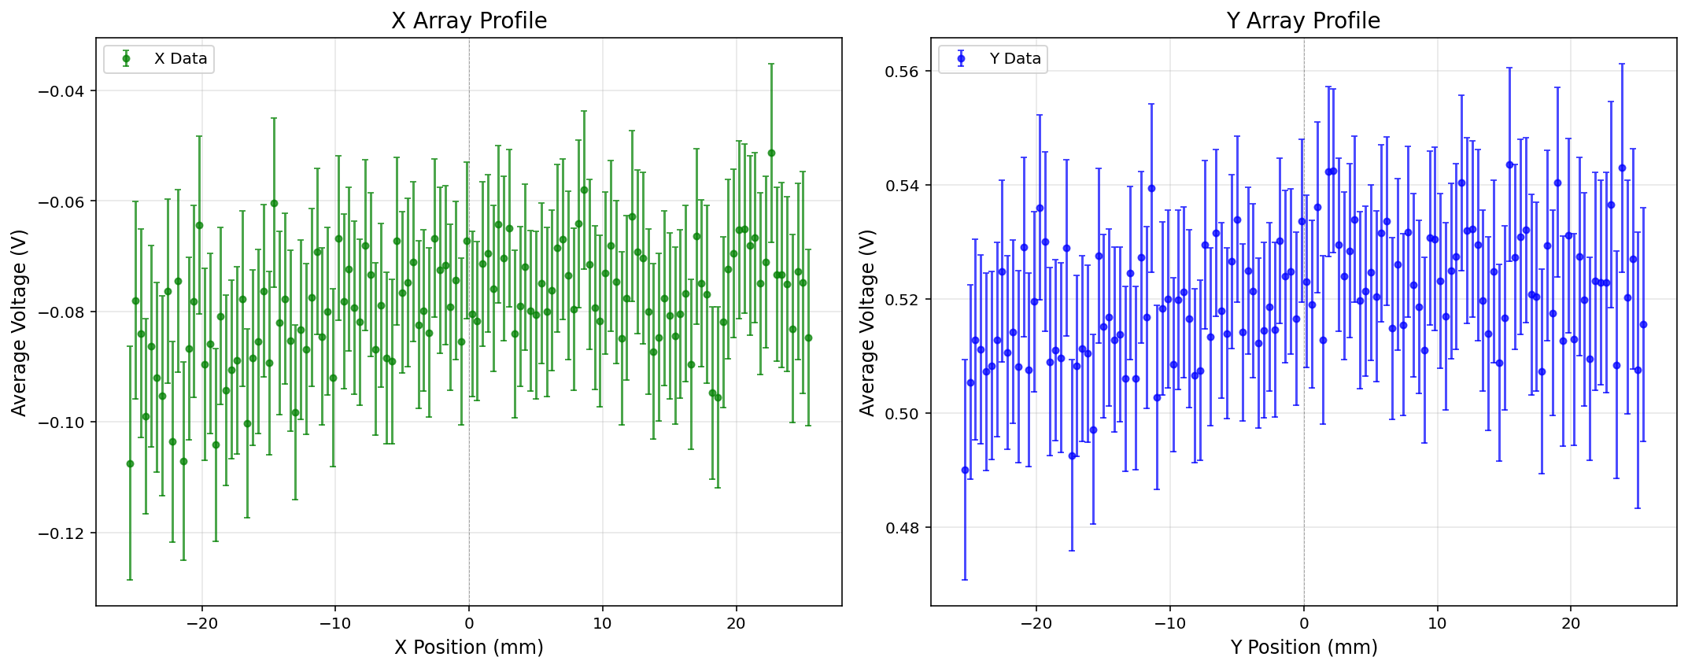
Background Measurements
Low gain
High gain

Slide 8
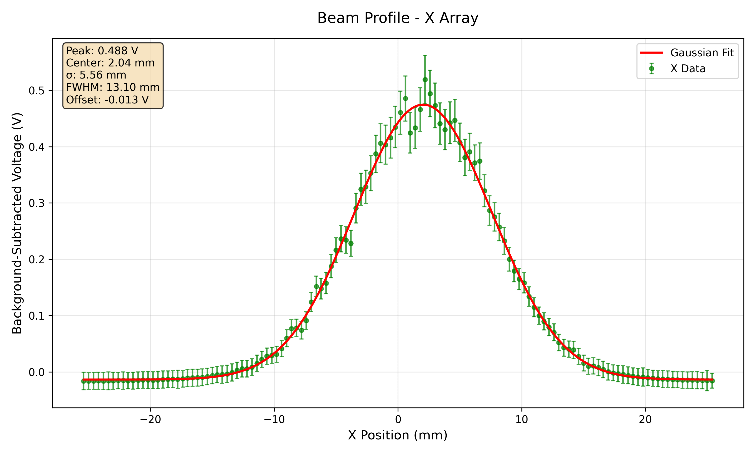
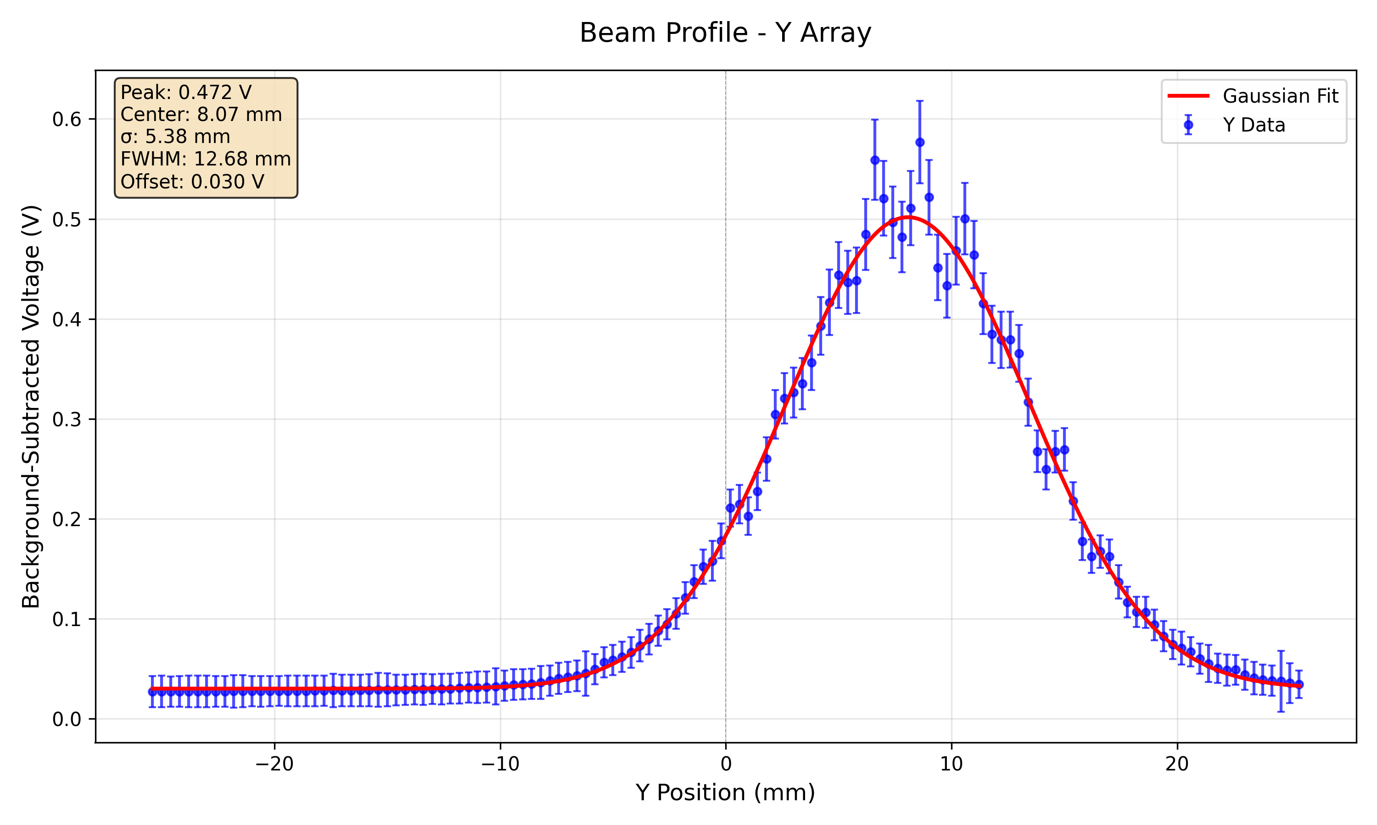
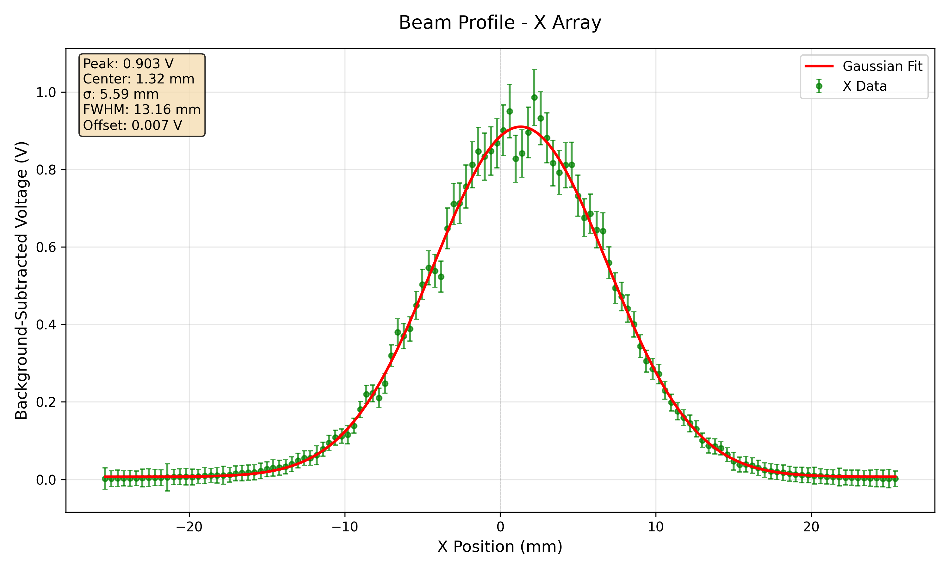
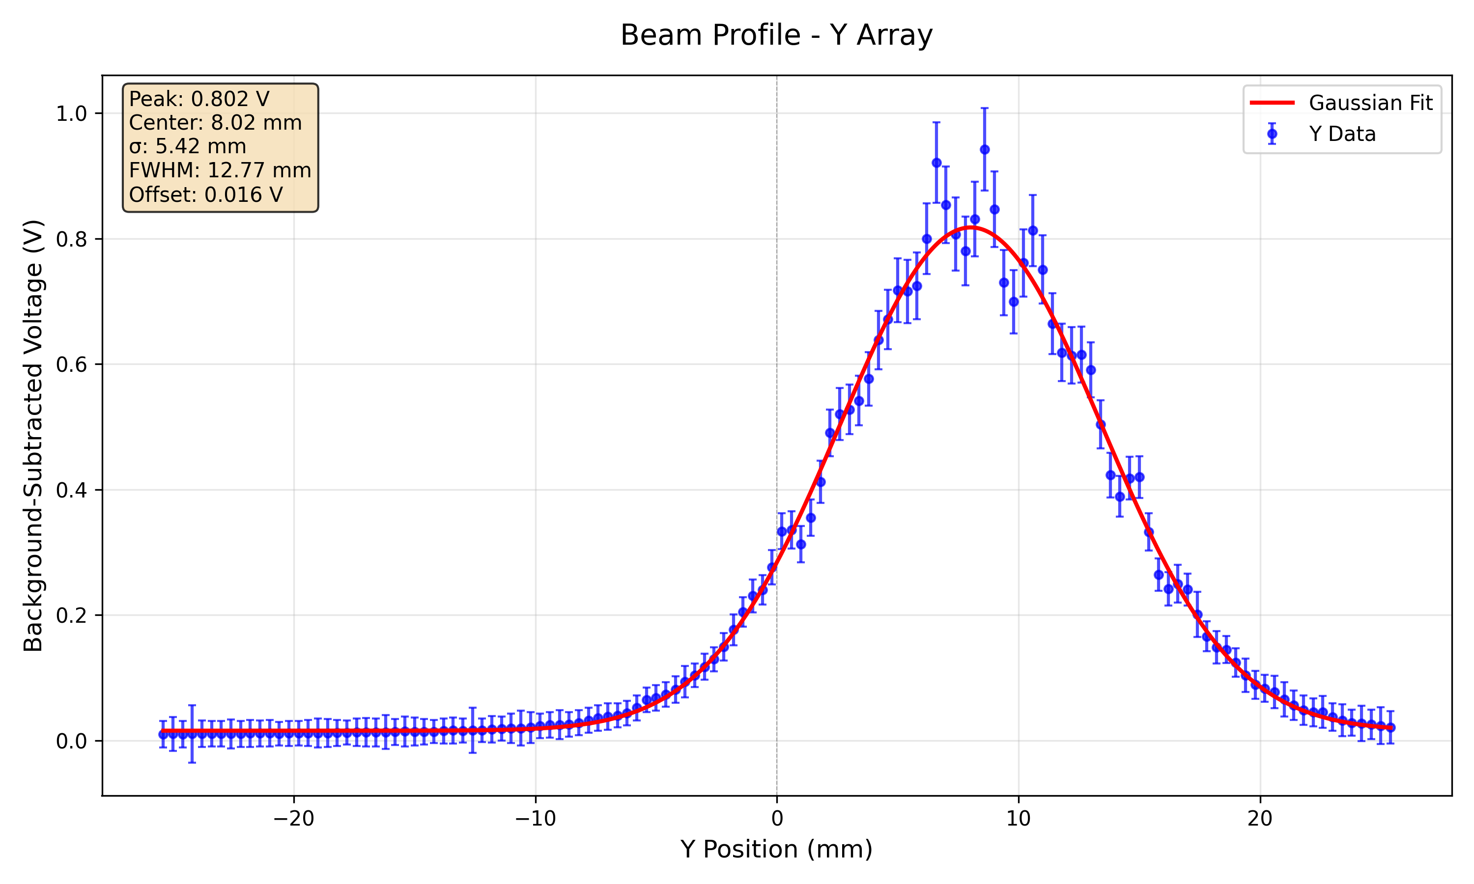
148 MeV Beam Energy 300 nA (max ion source current) Beam Profiles at Low Gain and High Gain
Low gain
High gain

Slide 9
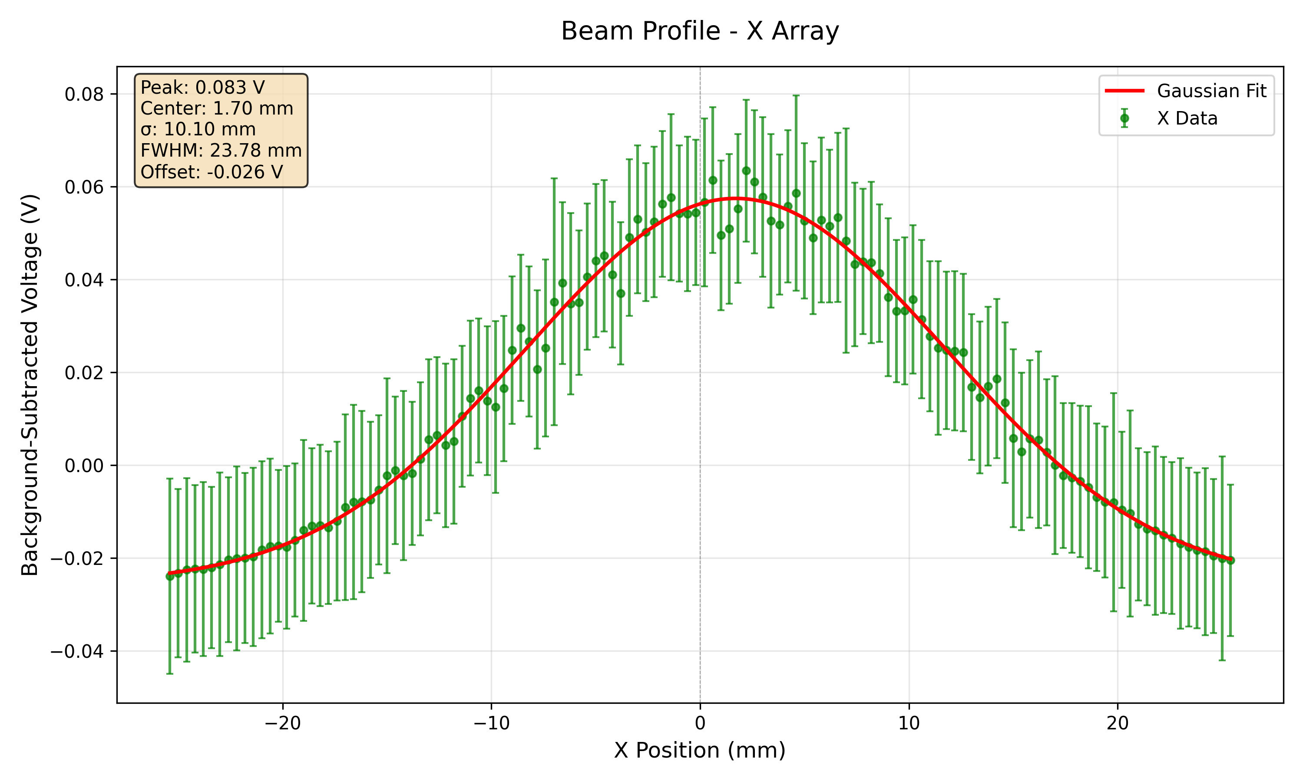
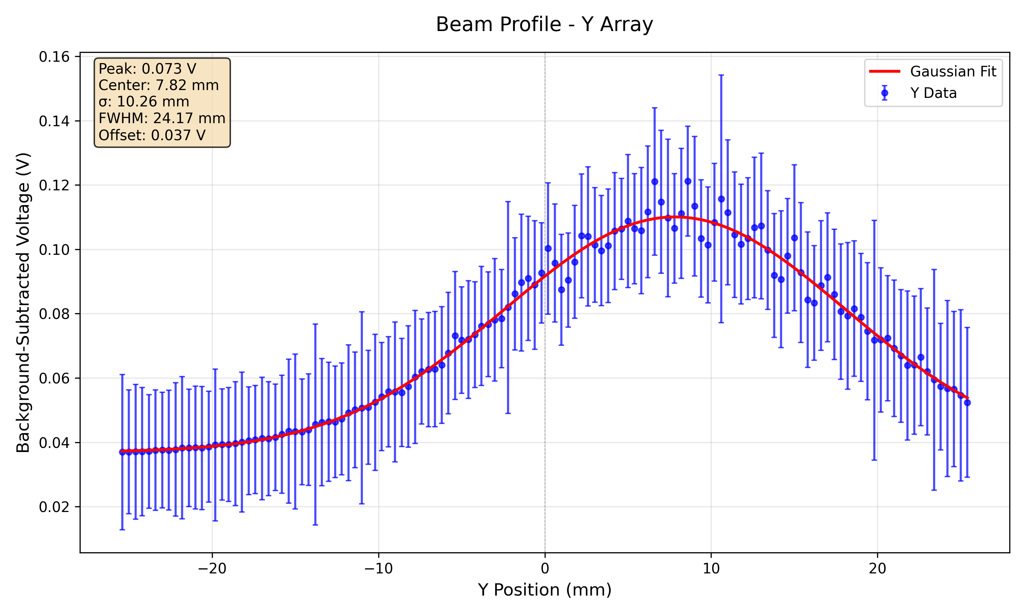
70 MeV Beam Energy 300 nA (max ion source current) High Gain

Slide 10
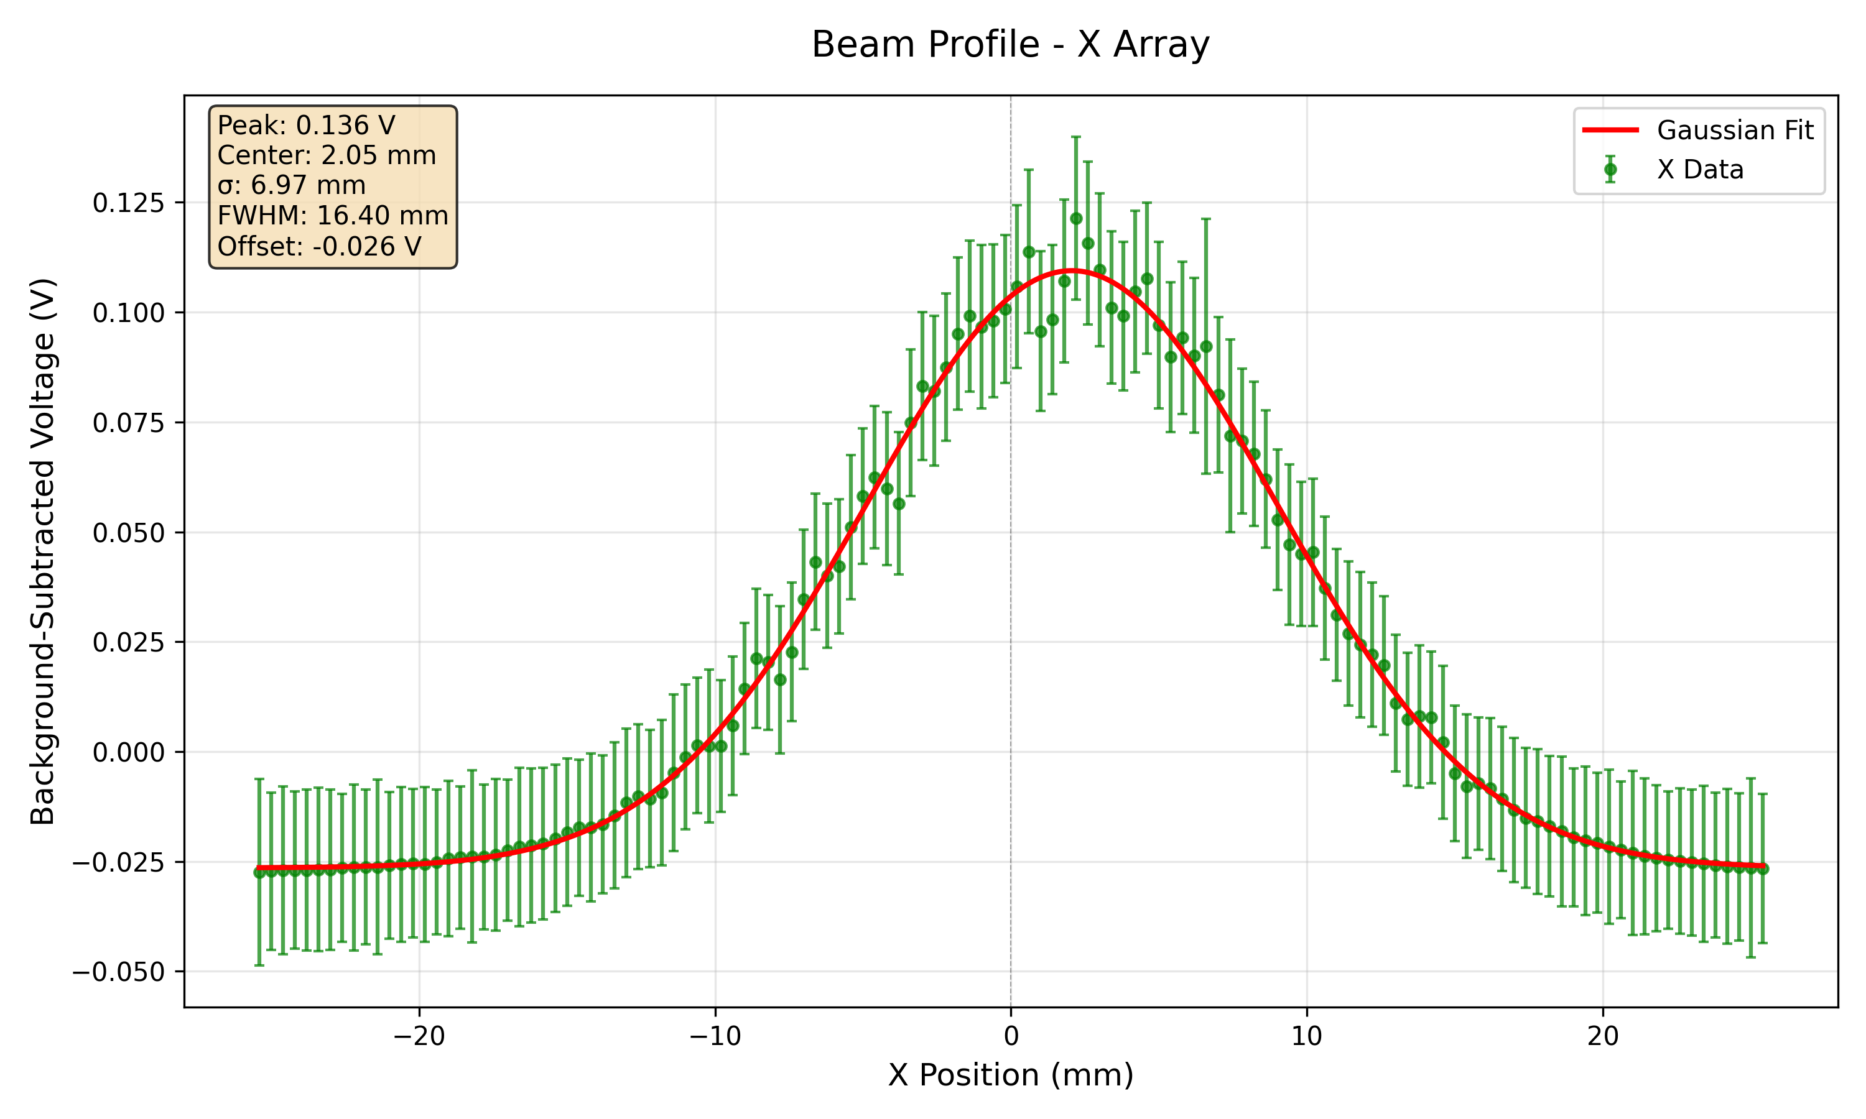
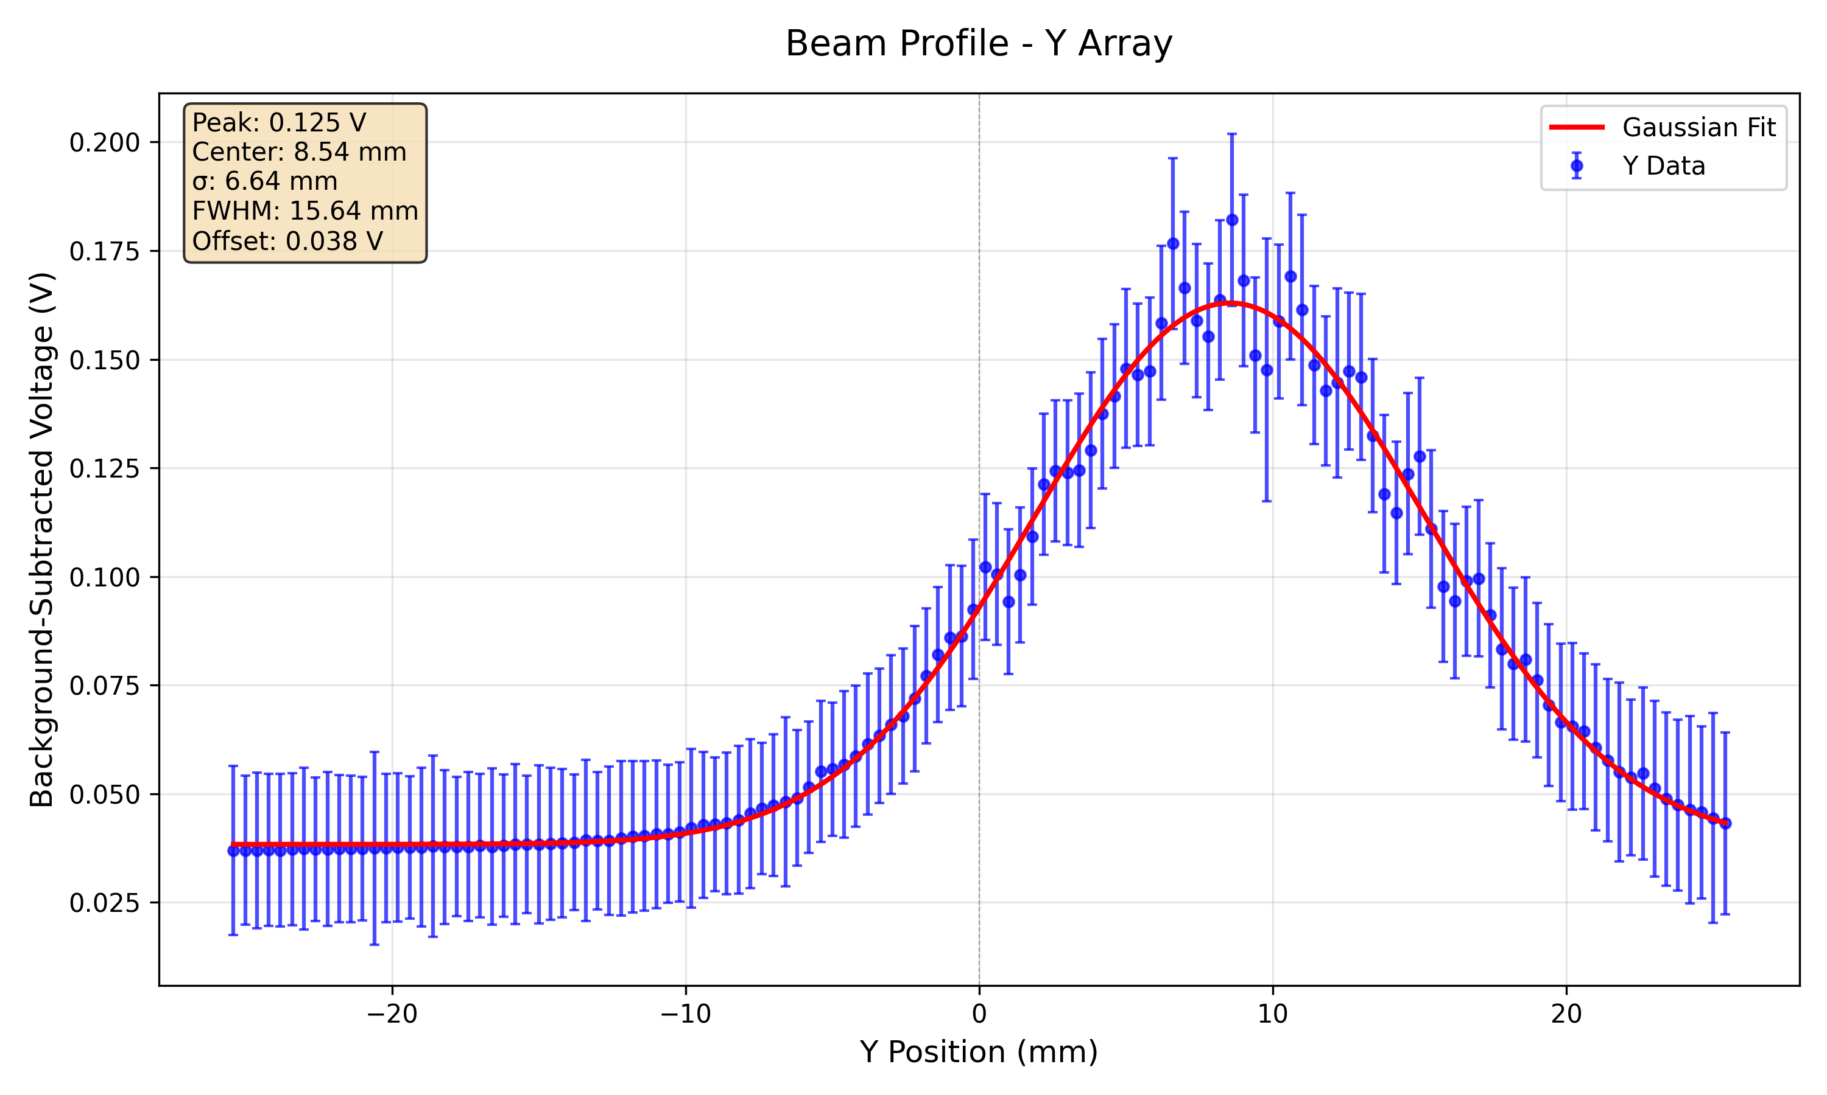
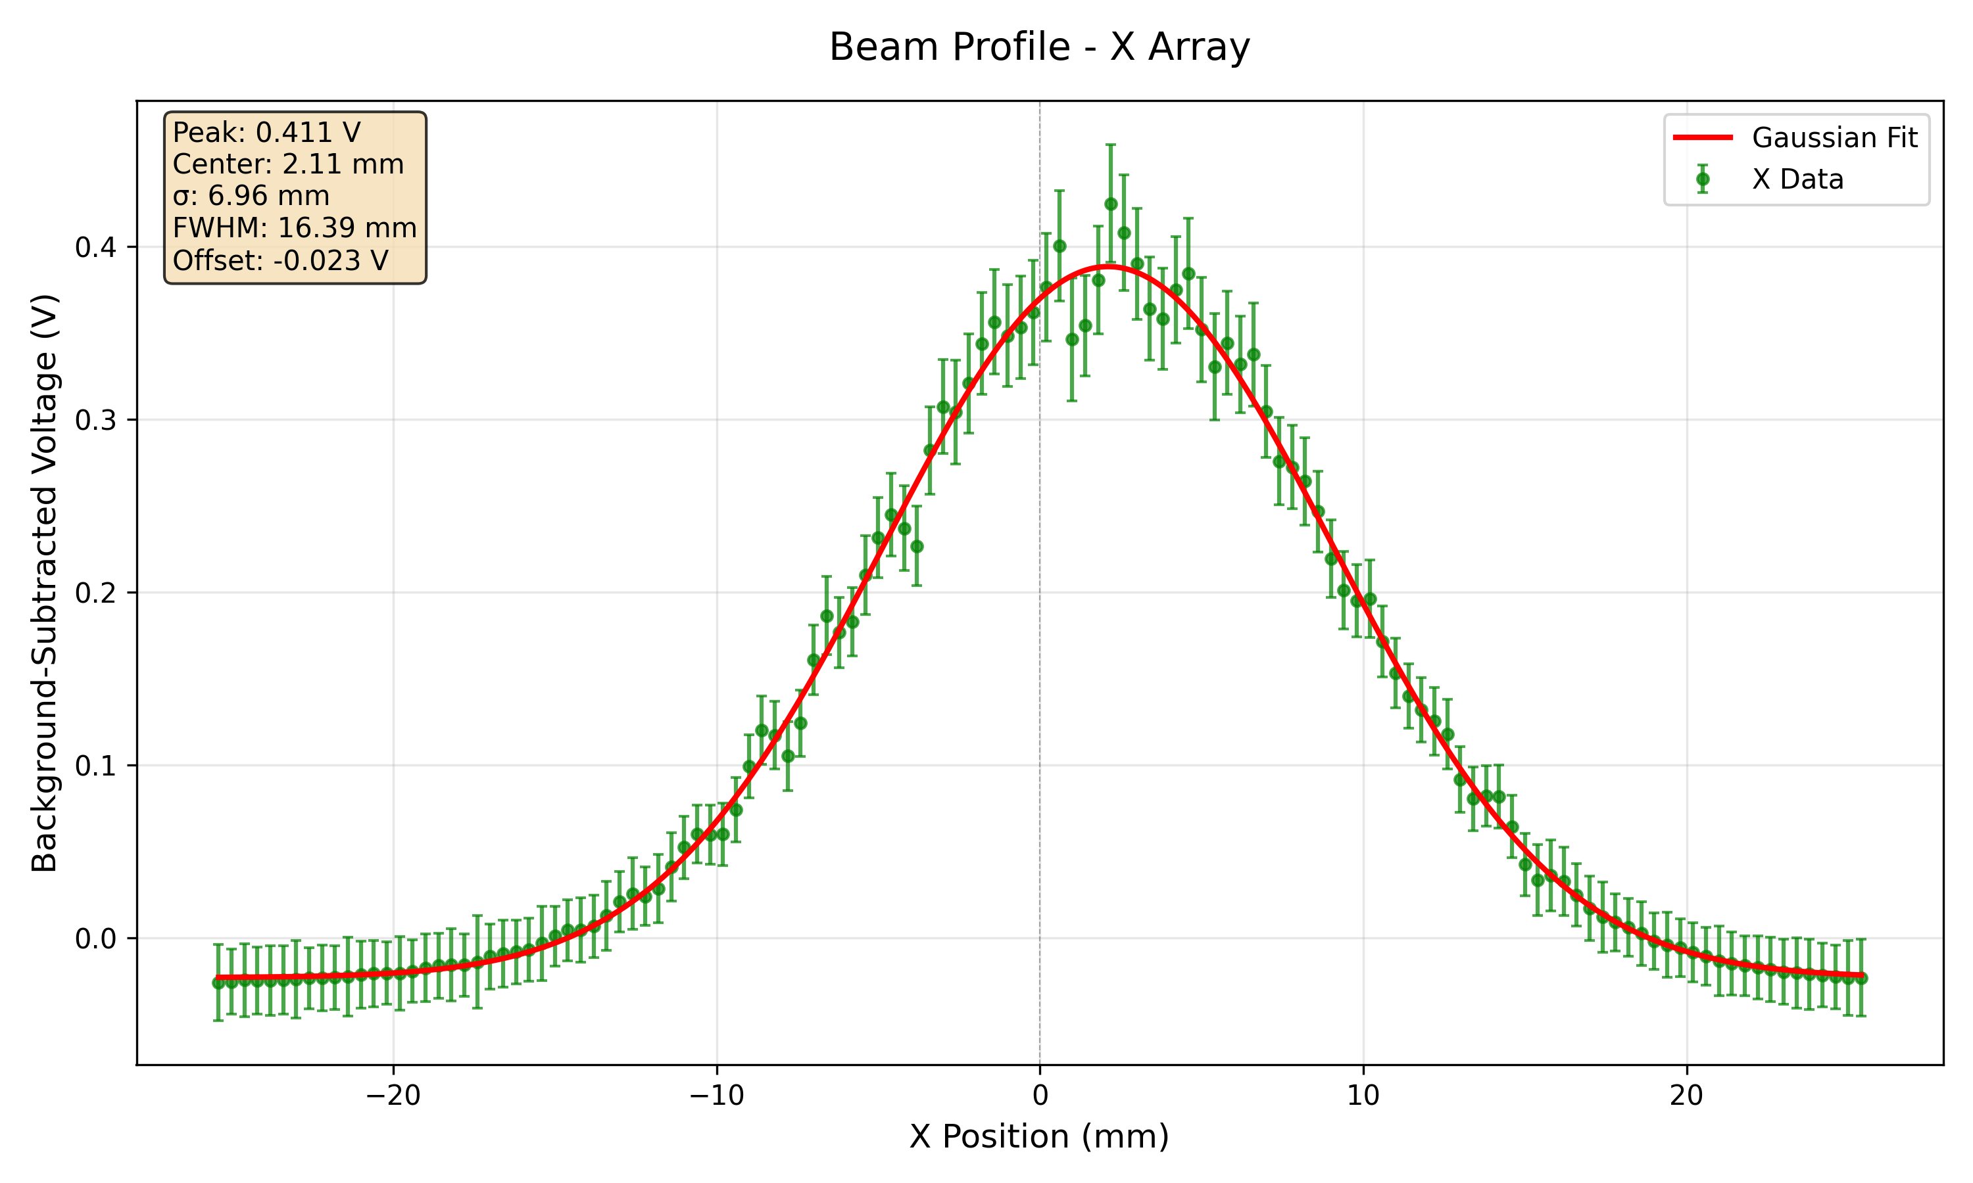
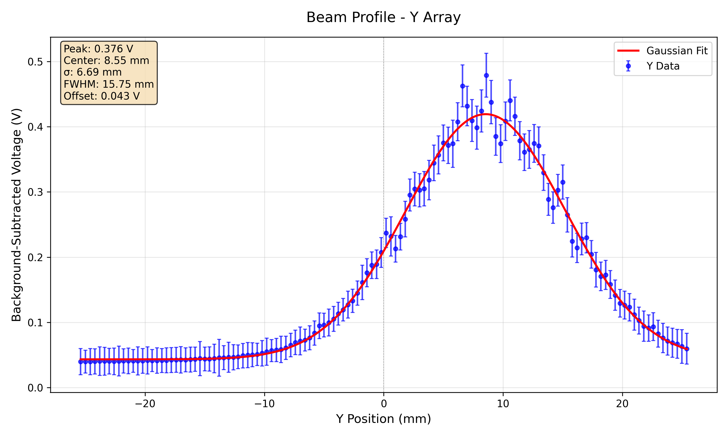
112 MeV High Gain
100 nA
300 nA

Slide 11
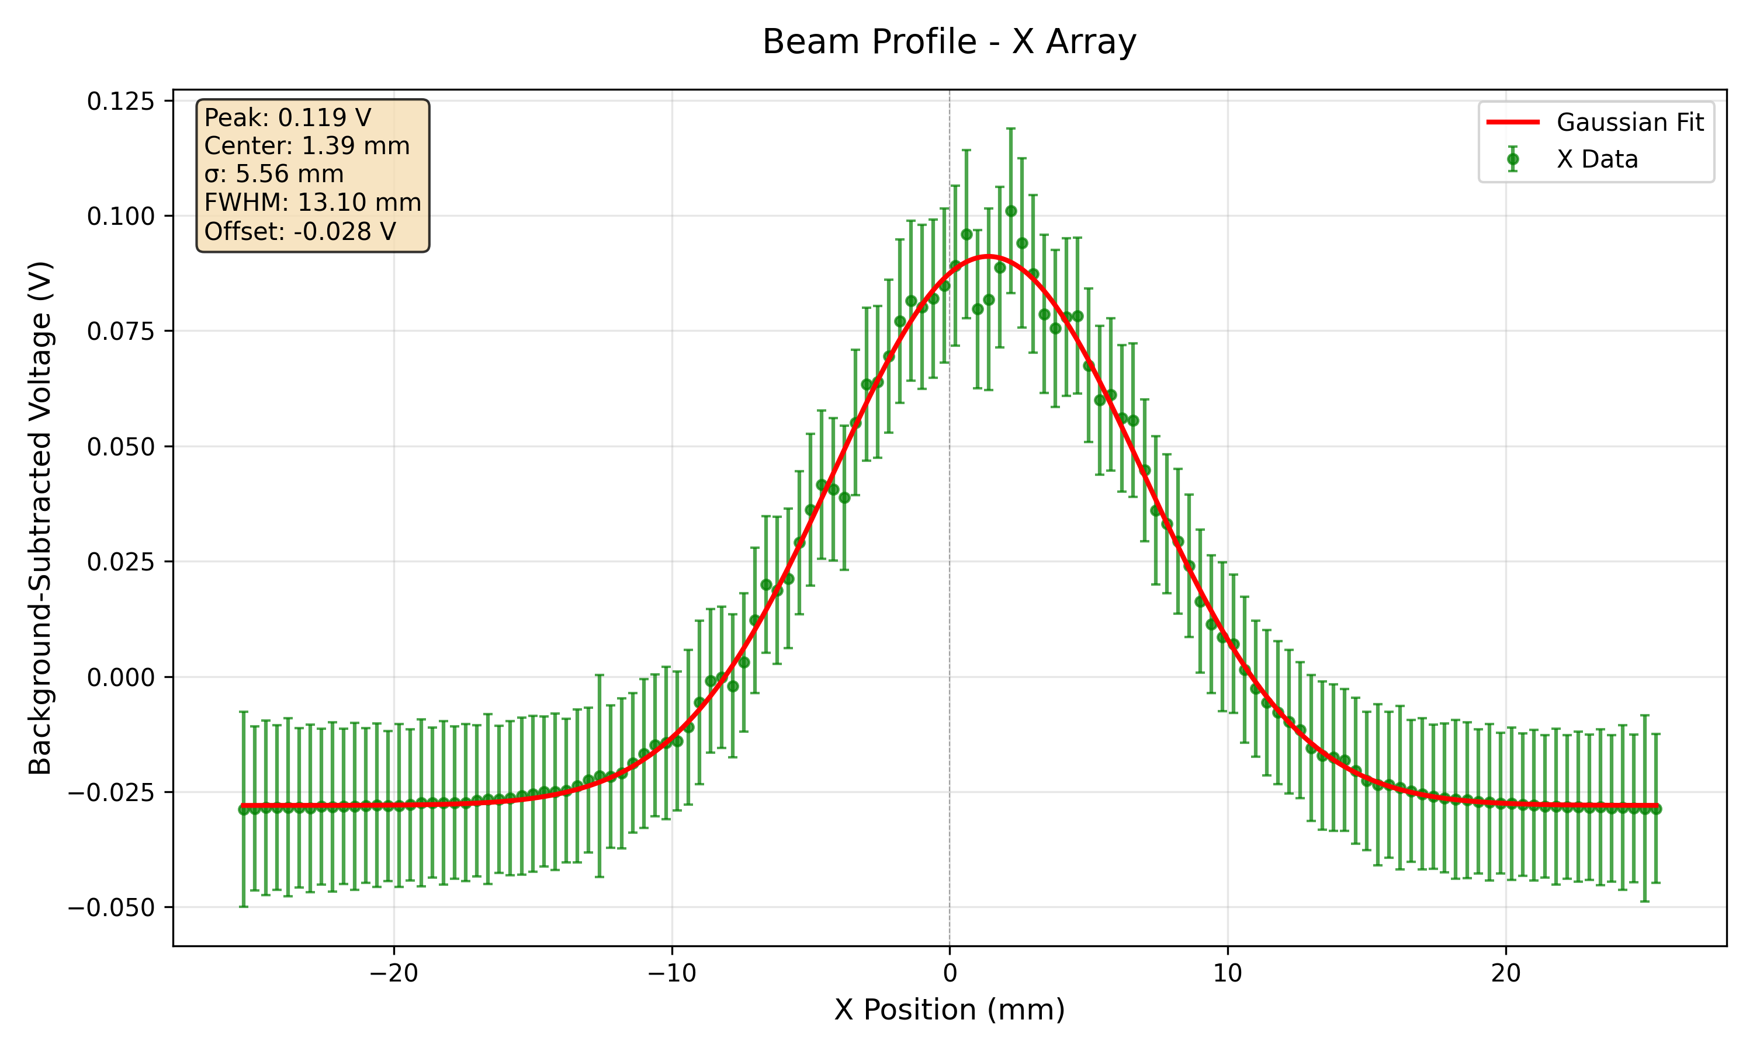
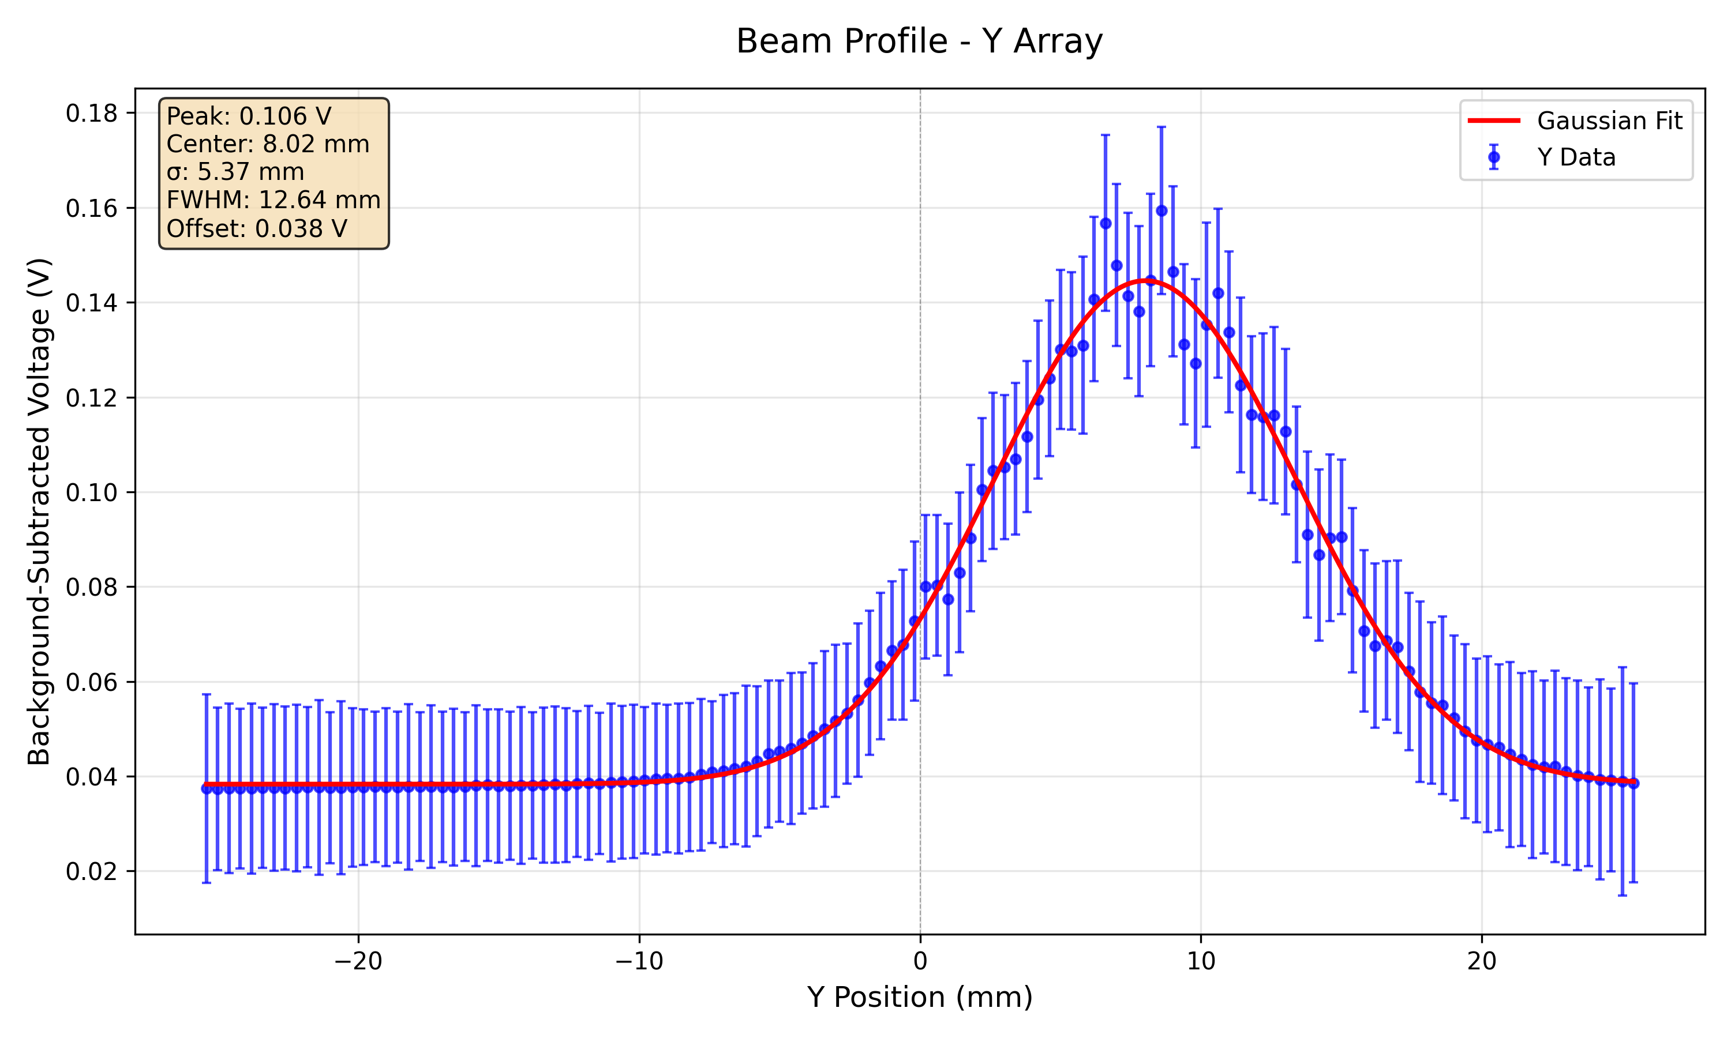
148 MeV 40 nA High Gain

Slide 12
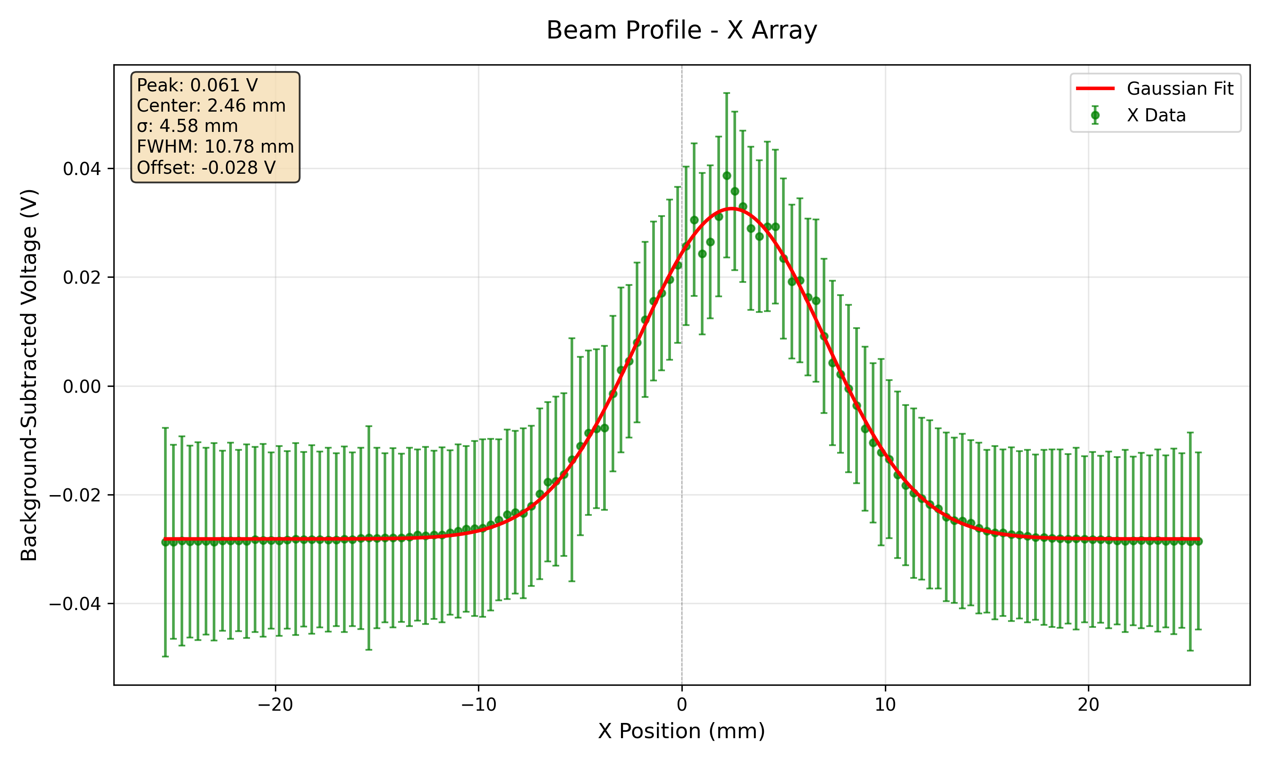
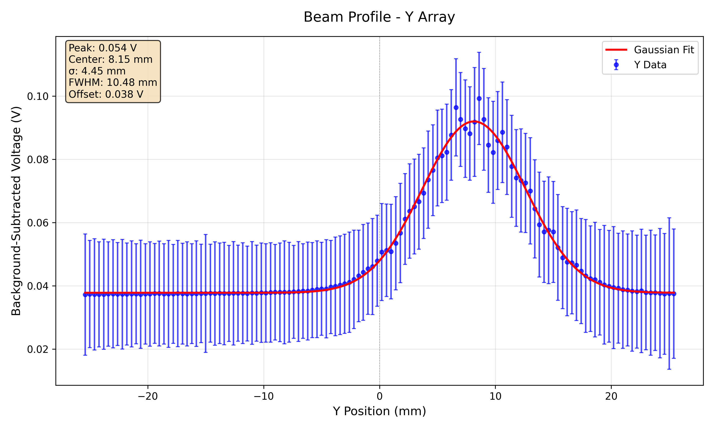
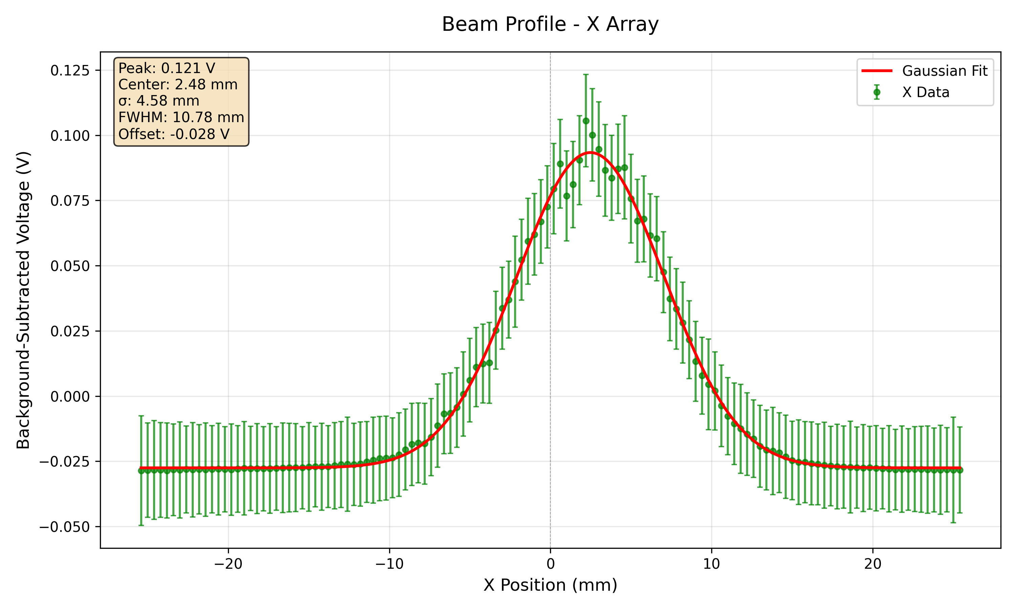
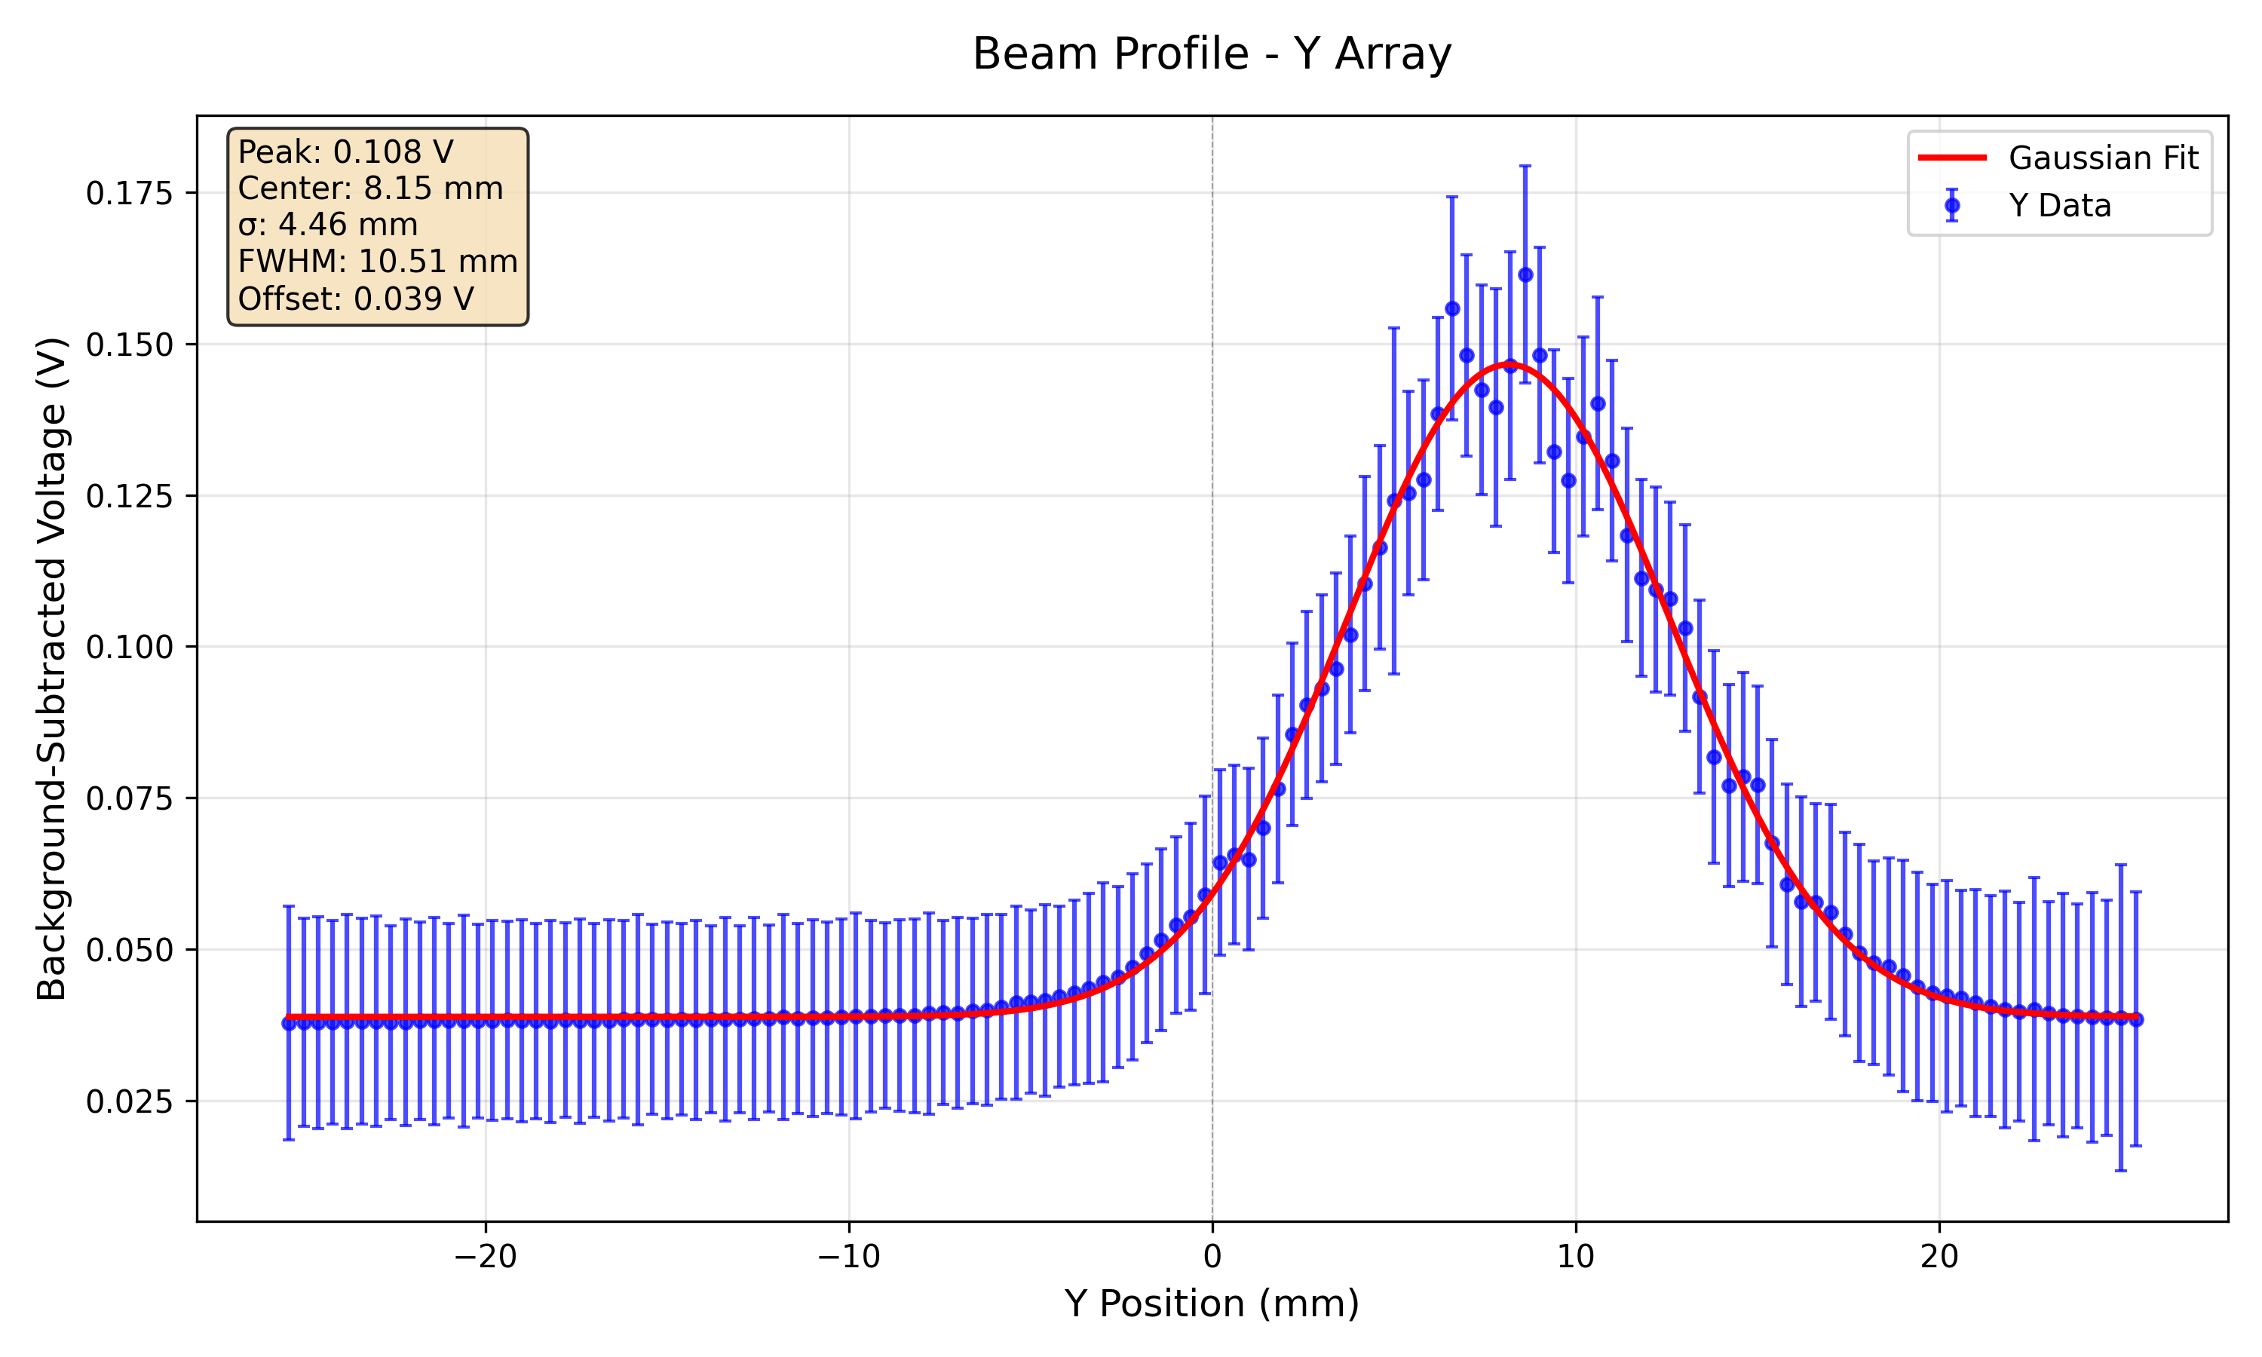
179 MeV High Gain
10 nA
20 nA

Slide 13
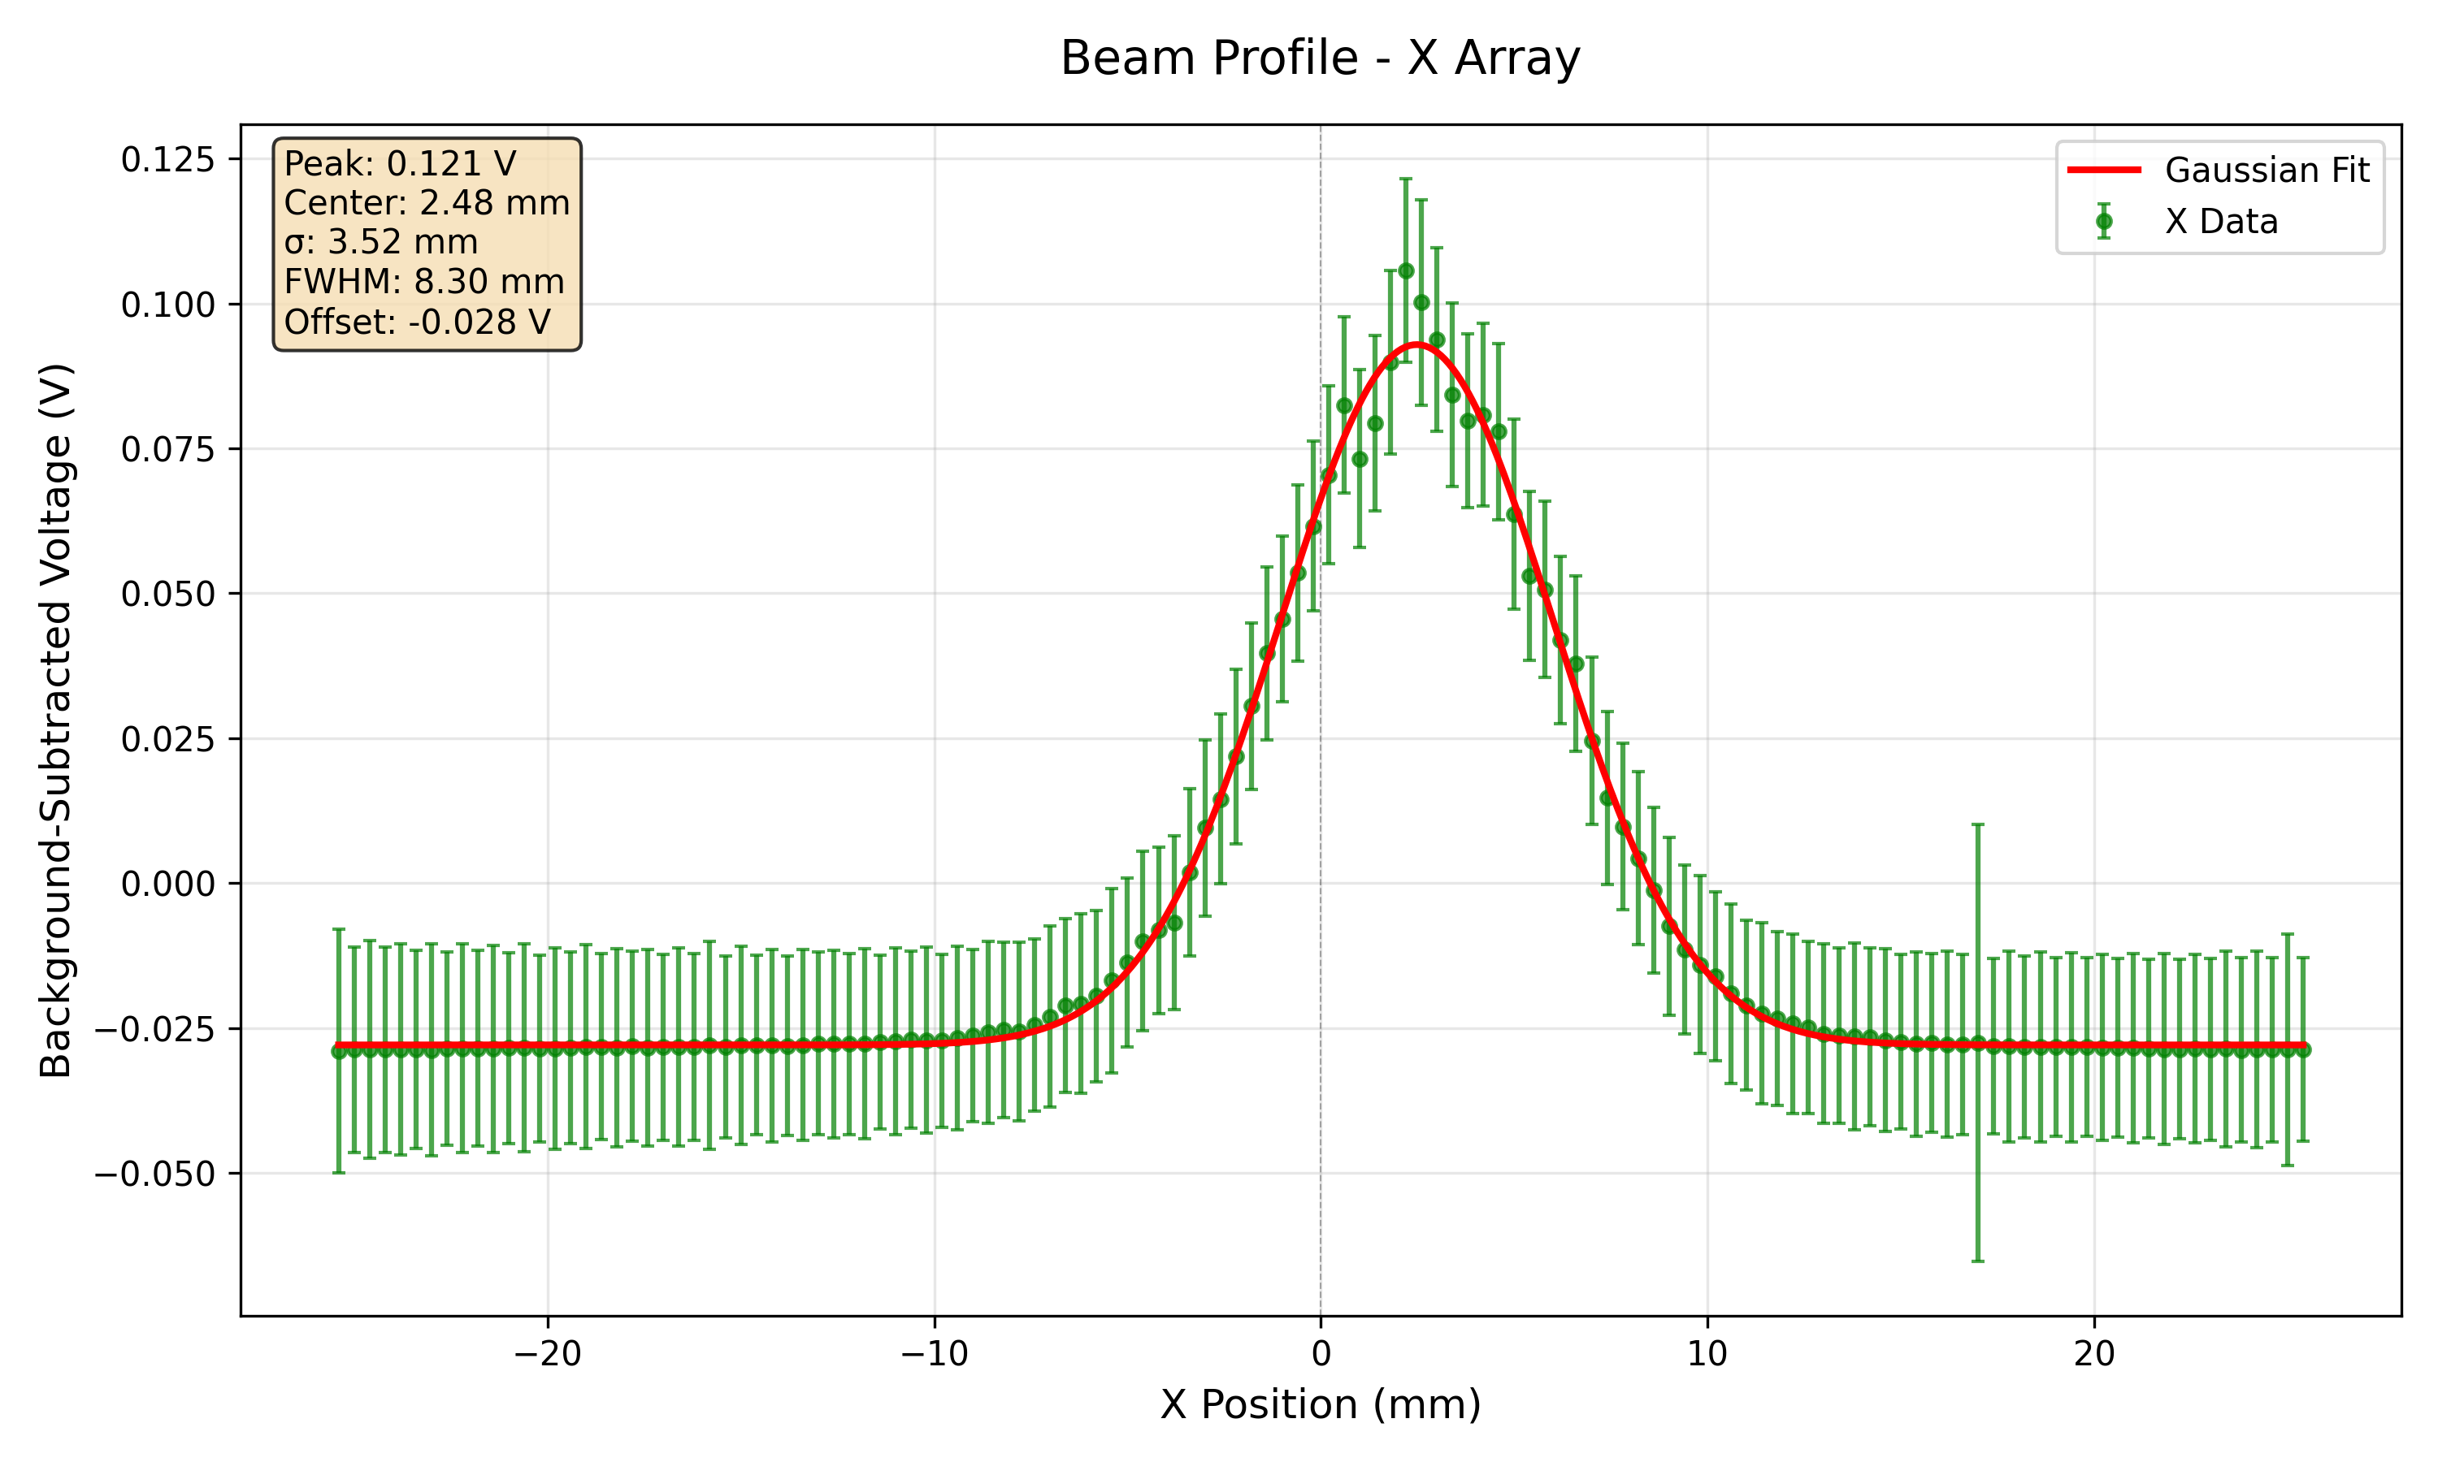
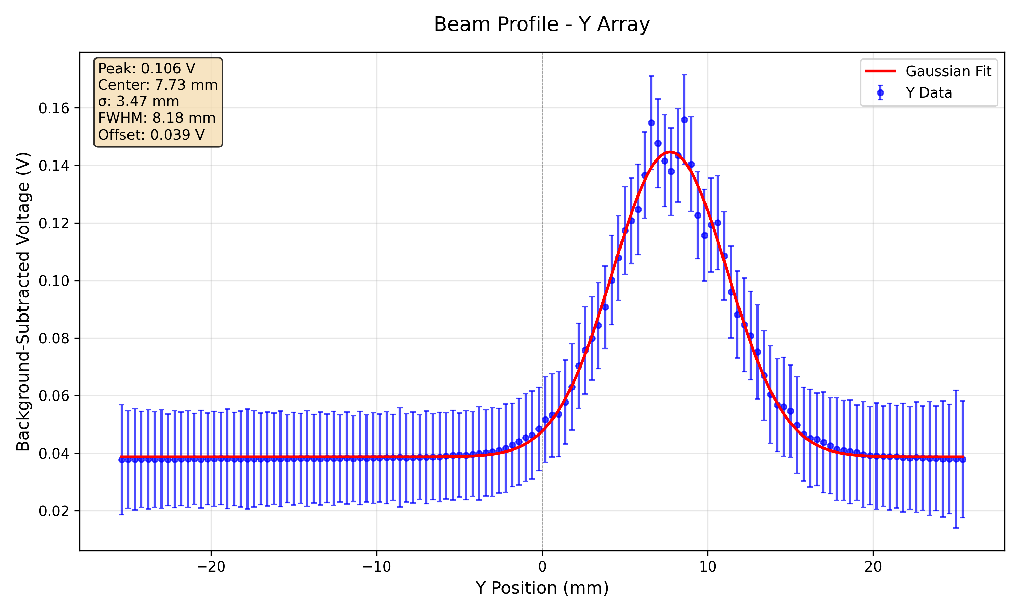
228 MeV 5 nA High Gain

Slide 14
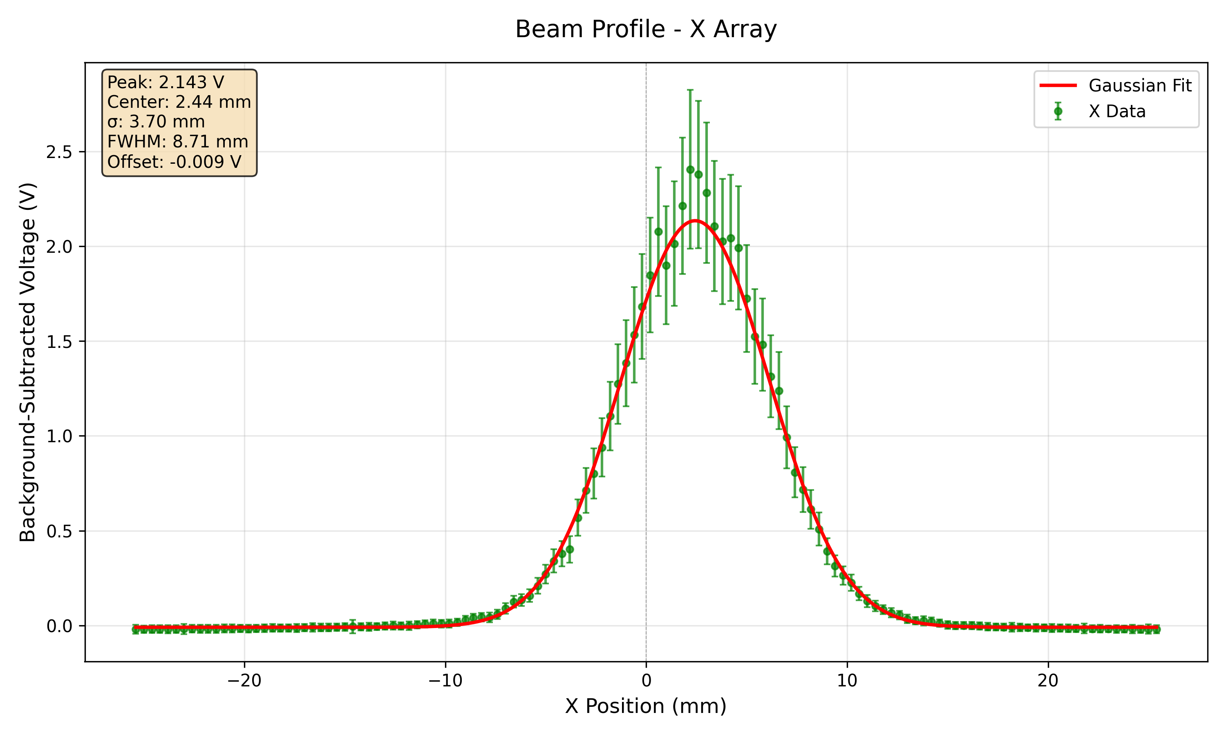
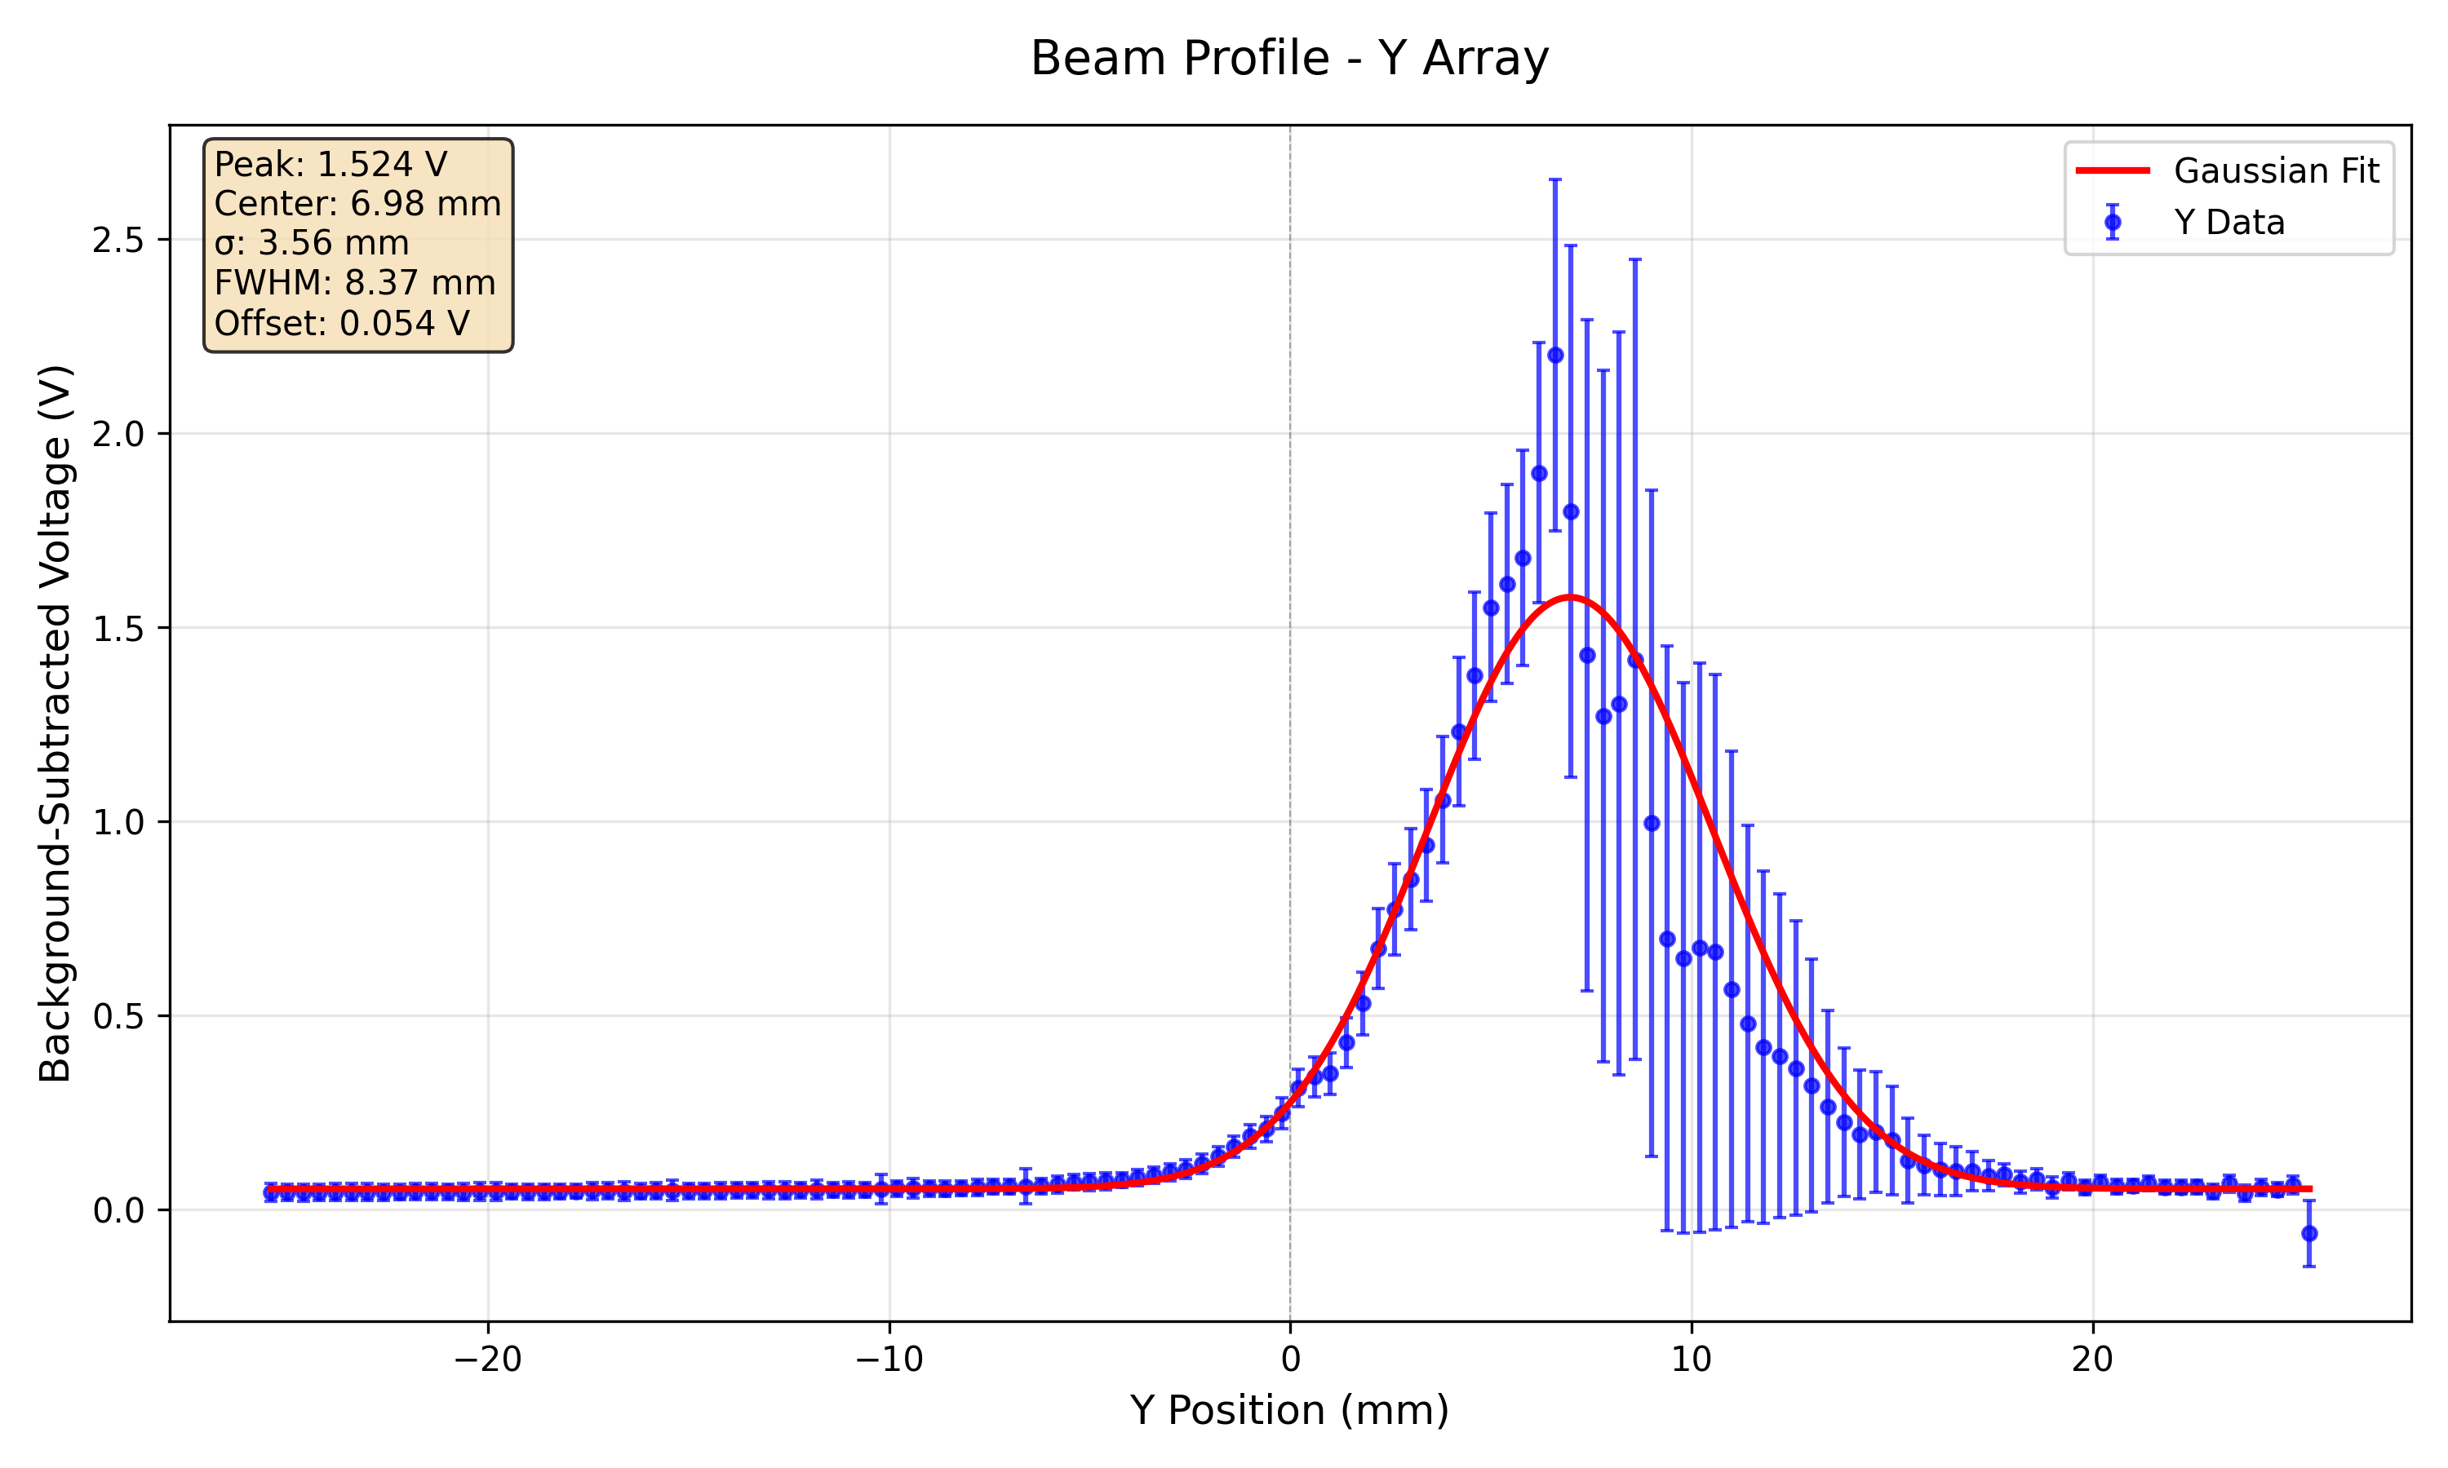
228 MeV 100 nA High Gain
Starting to see some saturation on some of the acquired pulses but not all – hence why error bars are quite large.

Slide 15
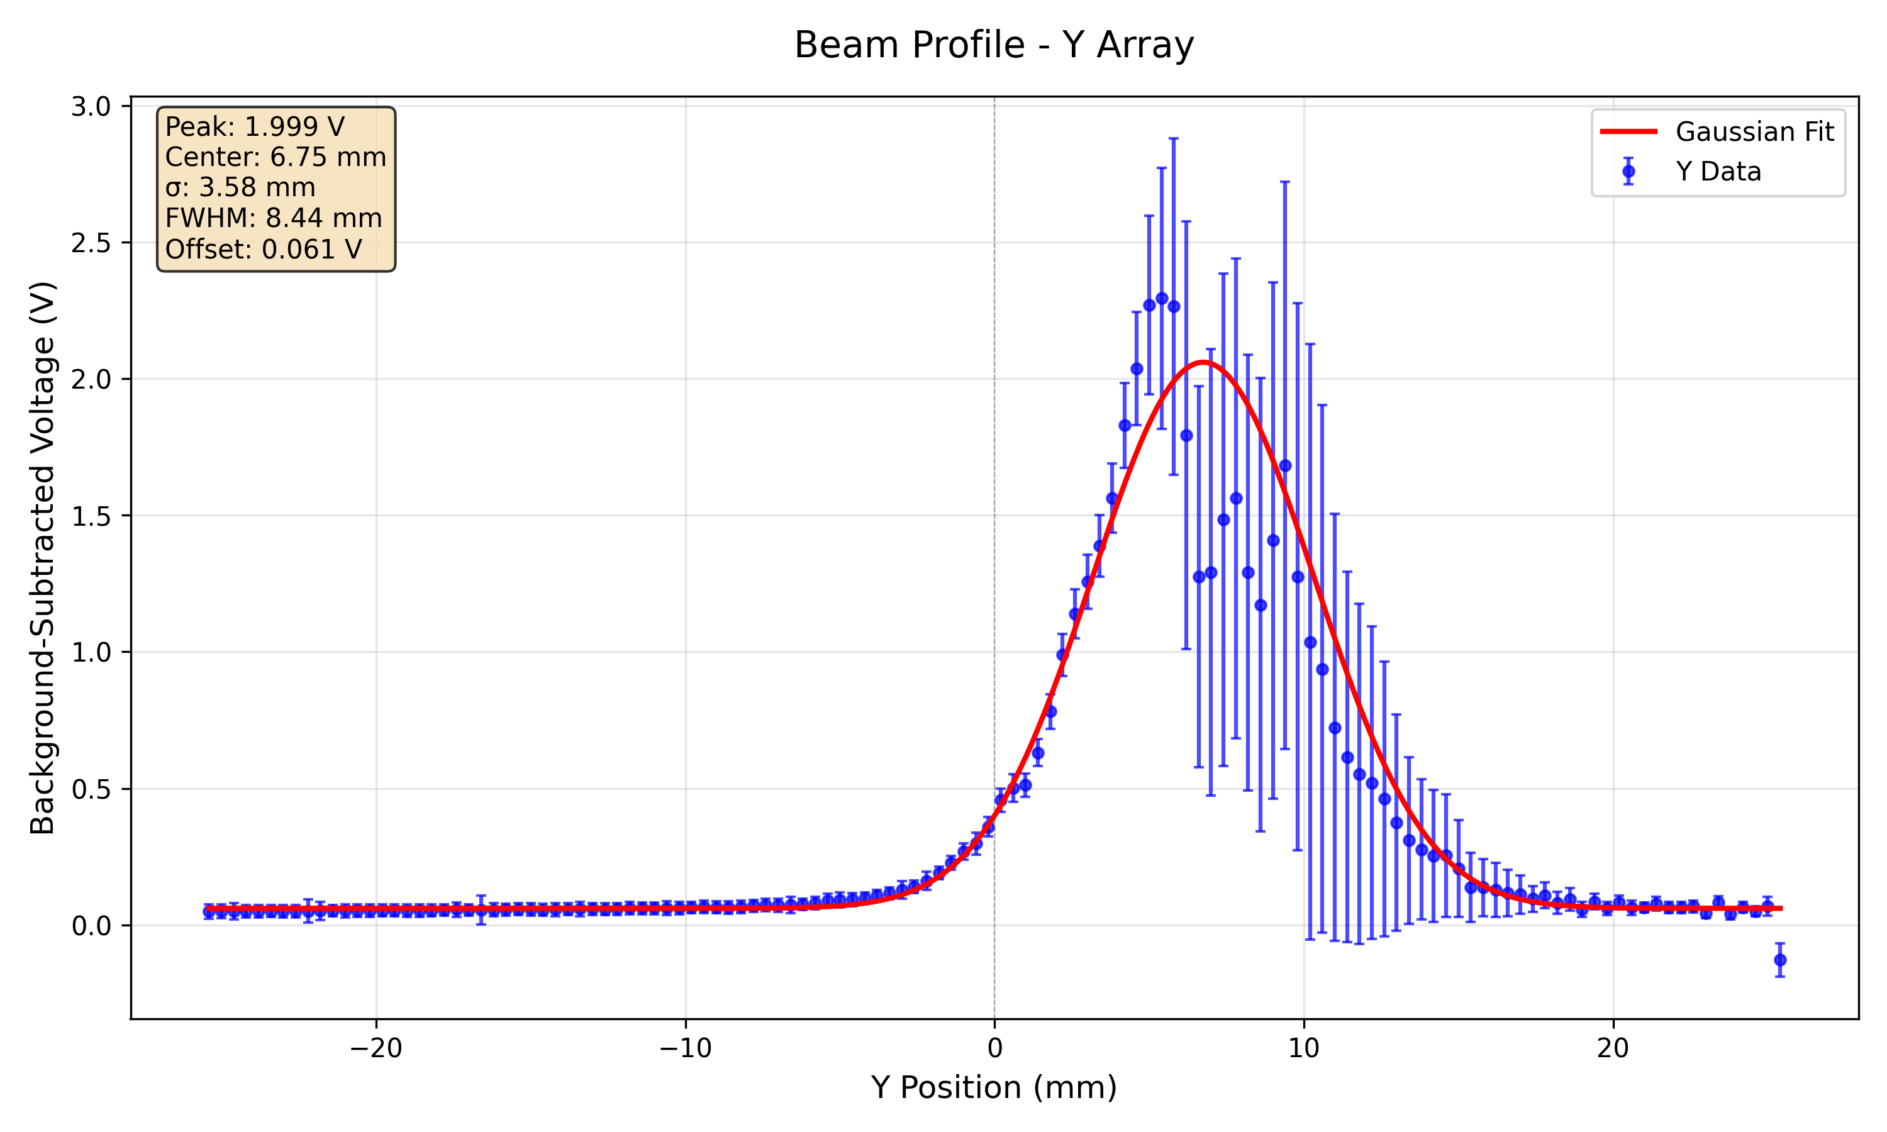
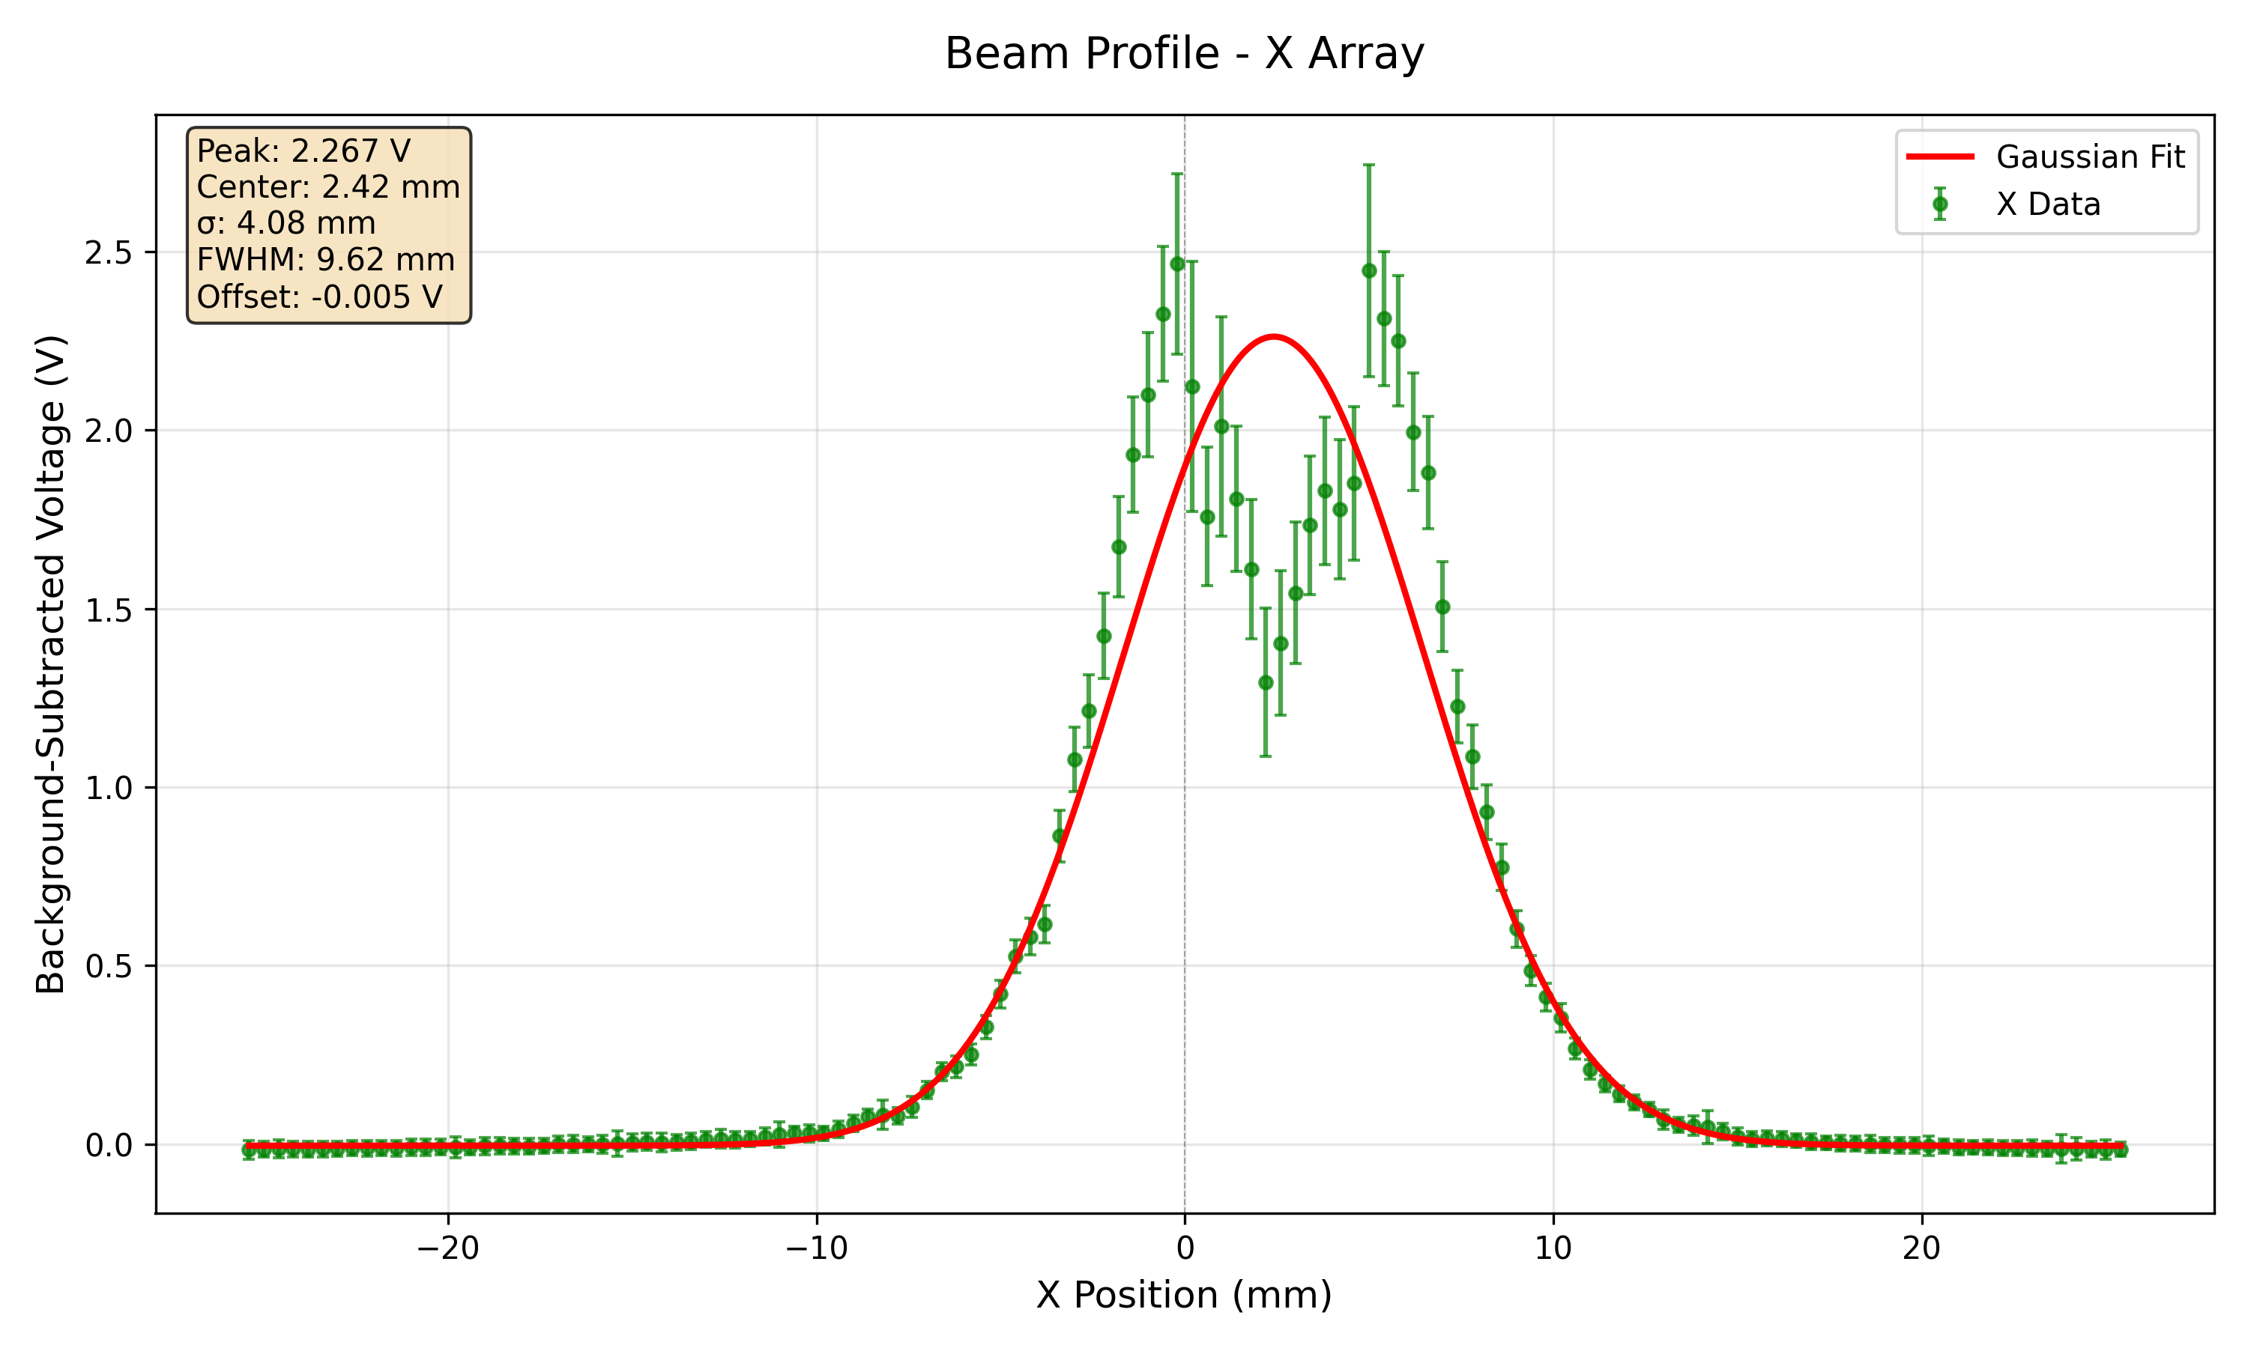
228 MeV 150 nA High Gain
Saturation becoming more apparent – particularly at centre of X-profile.

Slide 16
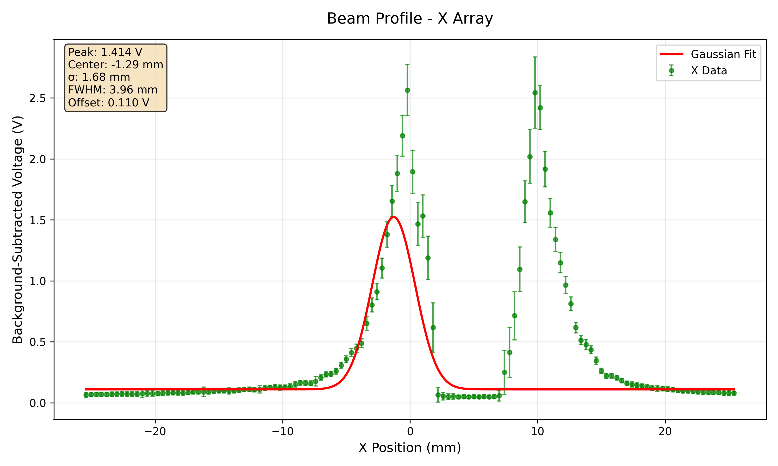
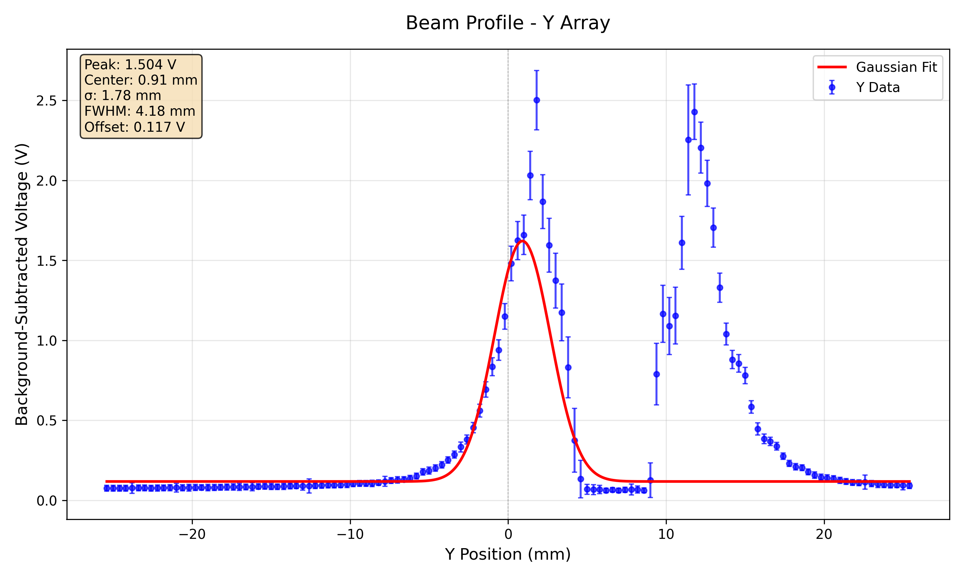
228 MeV 300 nA High Gain – Maximum Proton Current Output in CONV delivery mode.
Severe saturation at centre of both beam profiles.

Slide 17
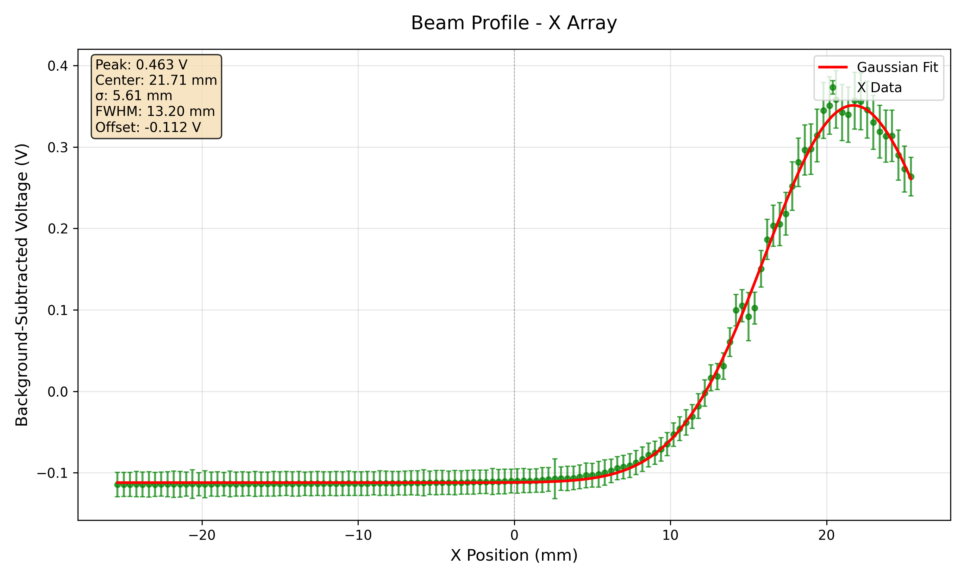
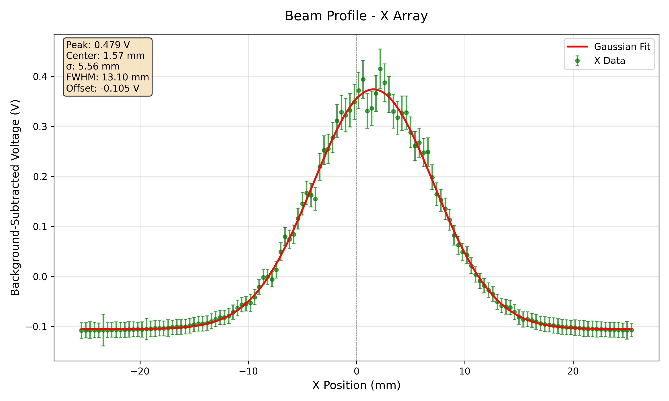
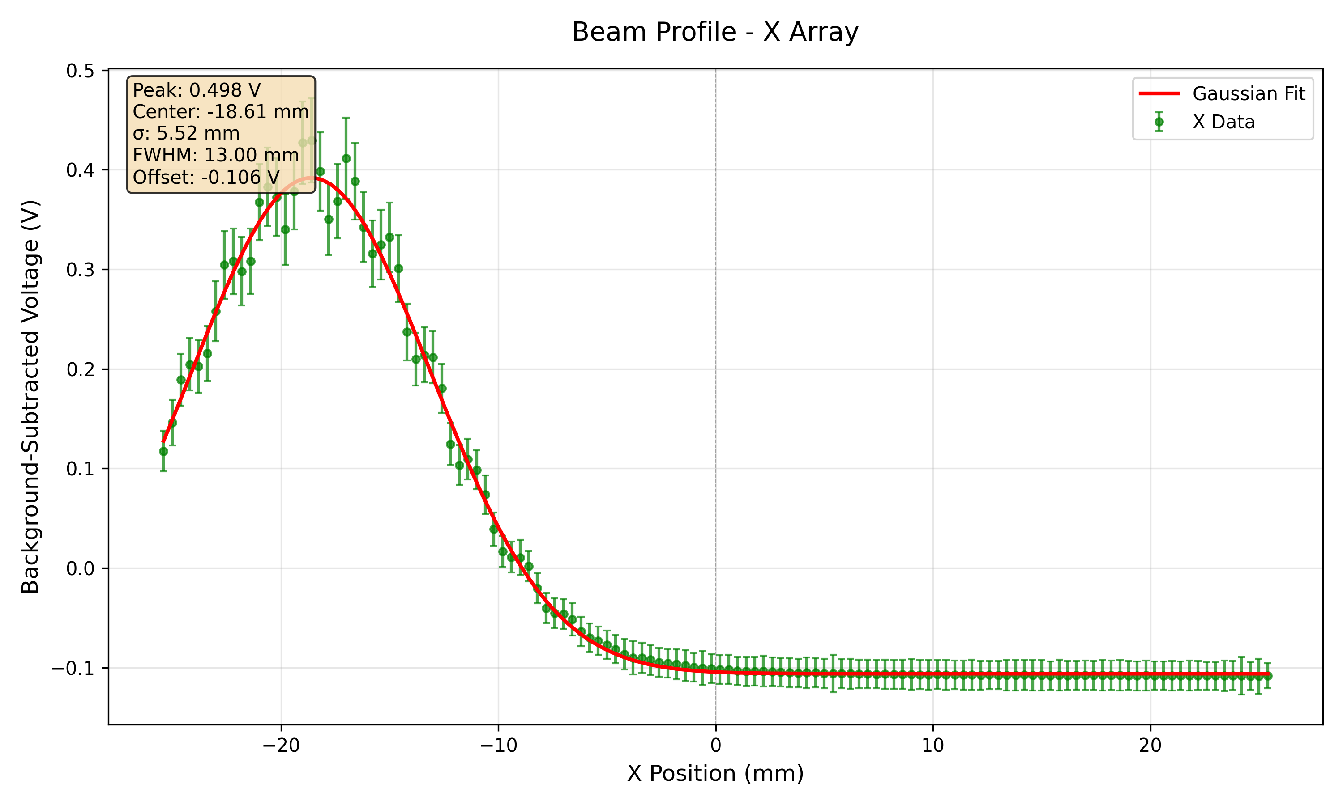
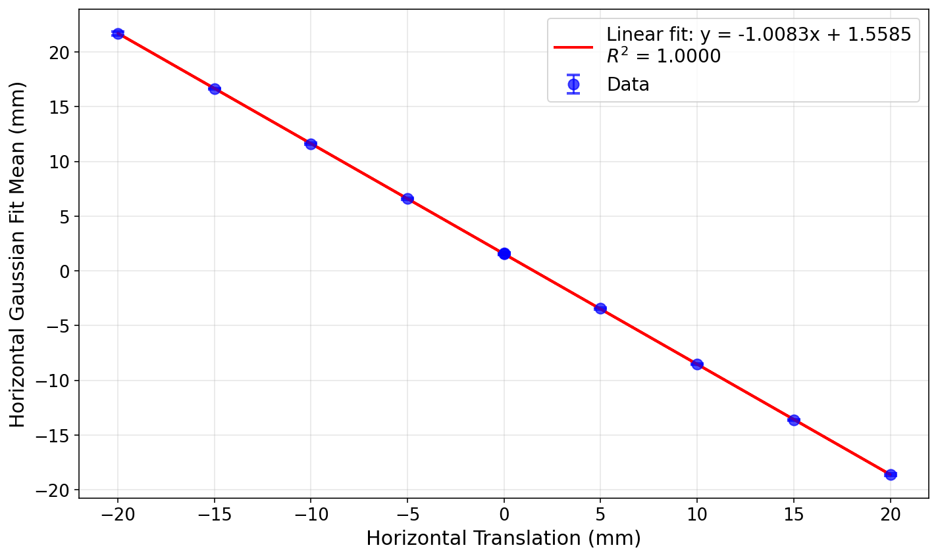
Position measurements using stage translation at 148 MeV beam energy 300 nA ion source current (low gain mode)

Slide 18
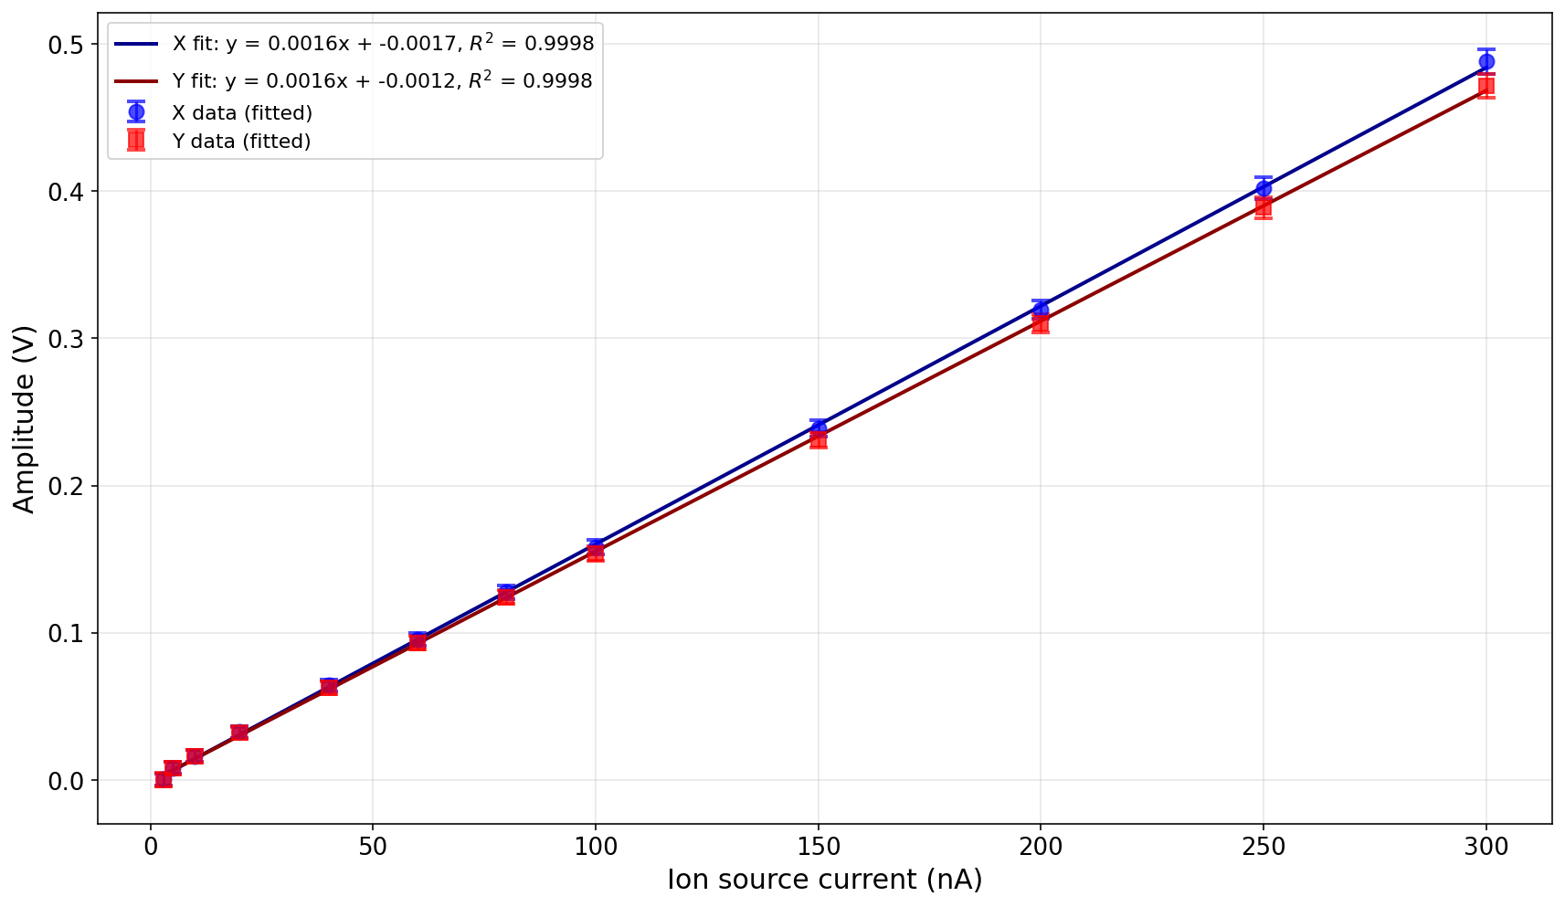
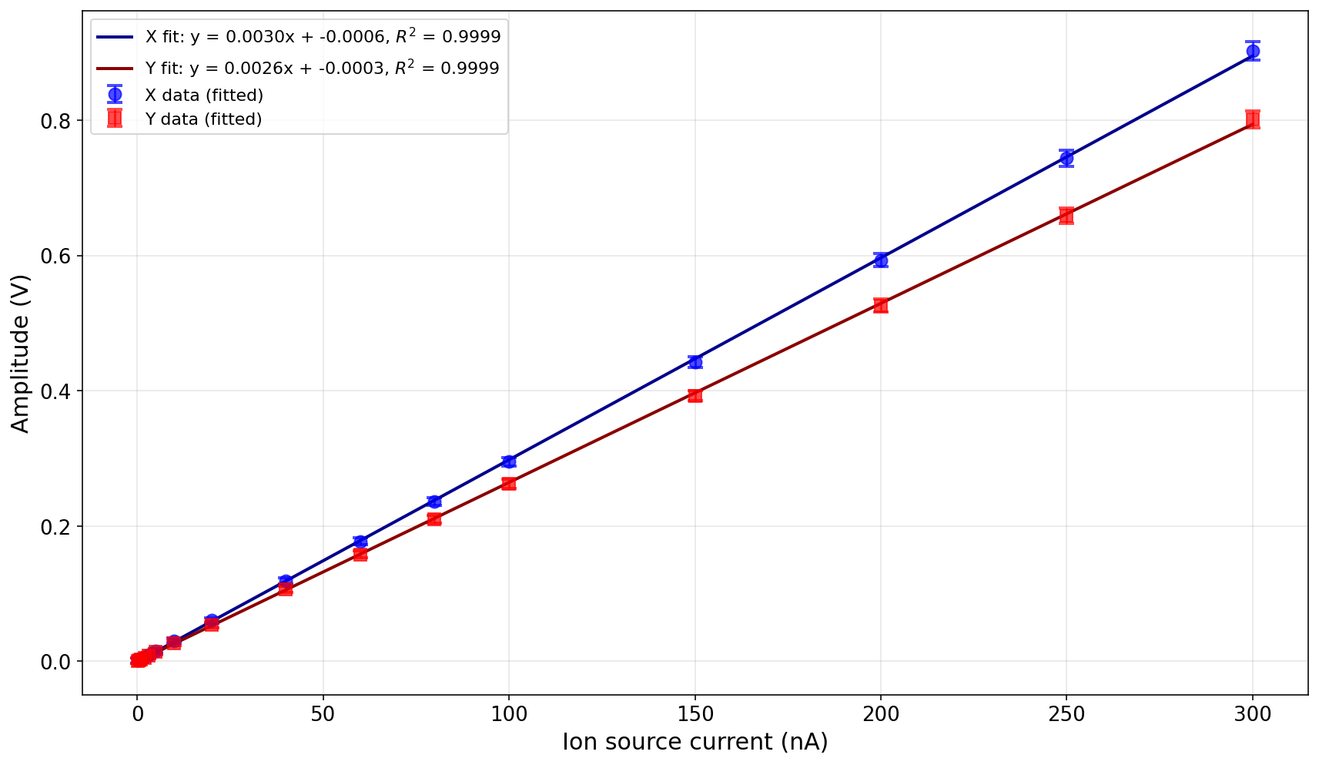
Response Linearity at 148 MeV Beam Energy (using Amplitude of Gaussian Fit)
Low gain
High gain

Slide 19
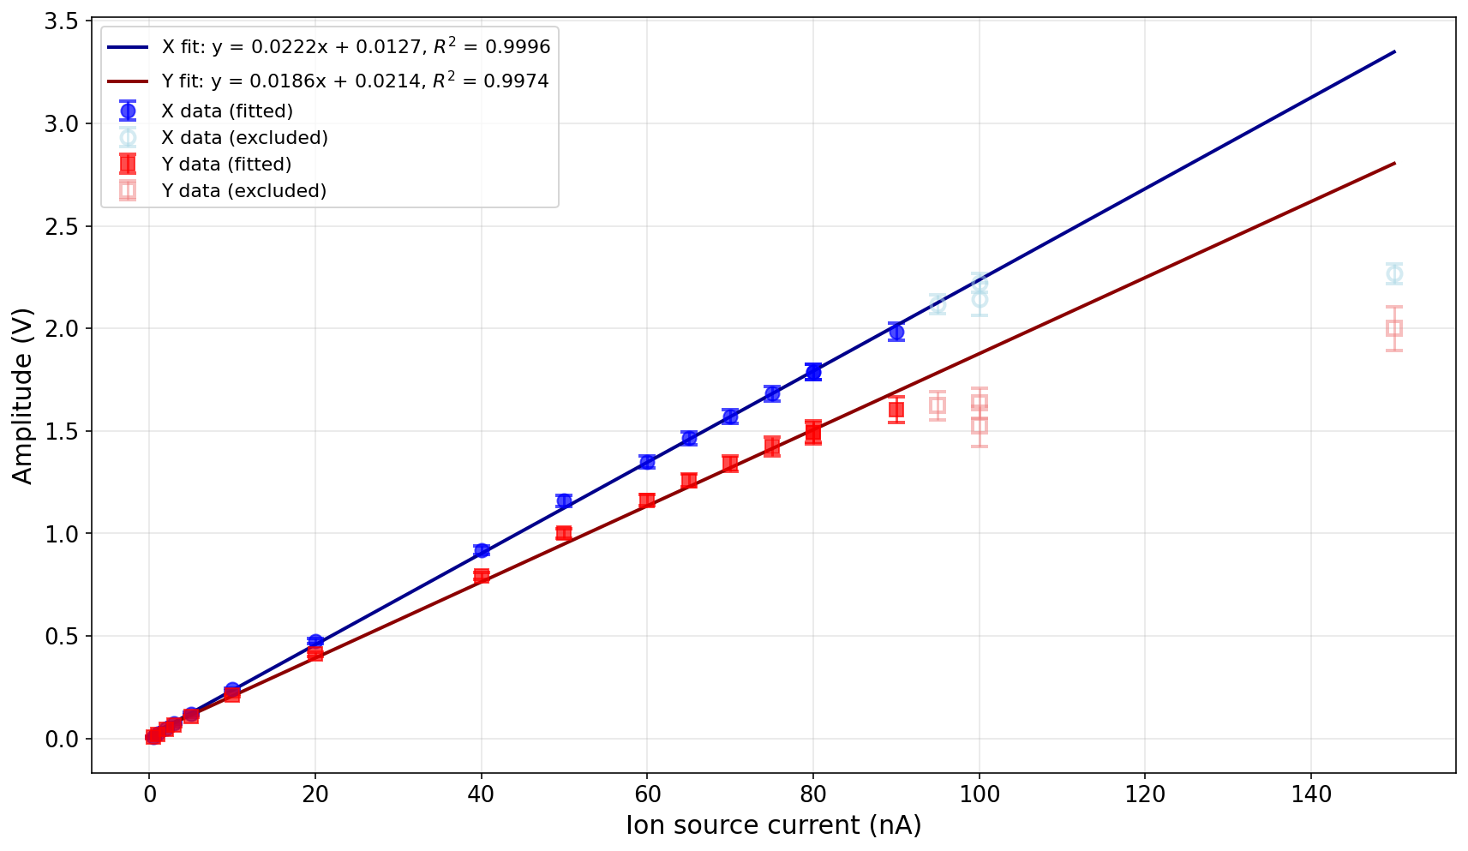
Response Linearity at 228 MeV Beam Energy (using Amplitude of Gaussian Fit)
Excluded points where saturation was observed from the linear fit.

Slide 20
Concluding Remarks
Initial measurements and analysis appear very promising.
Beam size and position measurements are consistent.
Beam sizes are systematically larger than reference sizes listed by Trento PTC but awaiting data for comparative measurement with film to check this.
Vertical beam position off-central due to mismatch in alignment of centre of detector – currently working on quantifying this offset.
Beam size measurement for same beam in low and high gain is consistent.
Linear response across entire range of currents for 148 MeV for both low and high gain modes.
Saturation observed in high gain at around 100 nA for 228 MeV.
Beam position measurement correlates excellently with horizontal stage translation position.

Slide 21
Looking Ahead
Whilst the current setup worked well with S11865-128 in the experimental setup – can benefit from digital readout for real-time data visualisation.
Currently we have to export acquisition from NI DAQ Express as .tdms file on DAQ laptop and transferred to personal laptop.
Eventually we want to synchronise readout with range detector (QuARC) and provide profile measurements on live GUI display.
Additionally, the larger gain range for the S17285 could benefit our low detection efficiency for low beam intensities and hopefully allow unsaturated measurements at the high energy and high current measurements.

