Slide 1
Trento Fibre Results for FRPT slides
Joe Bateman

Slide 2
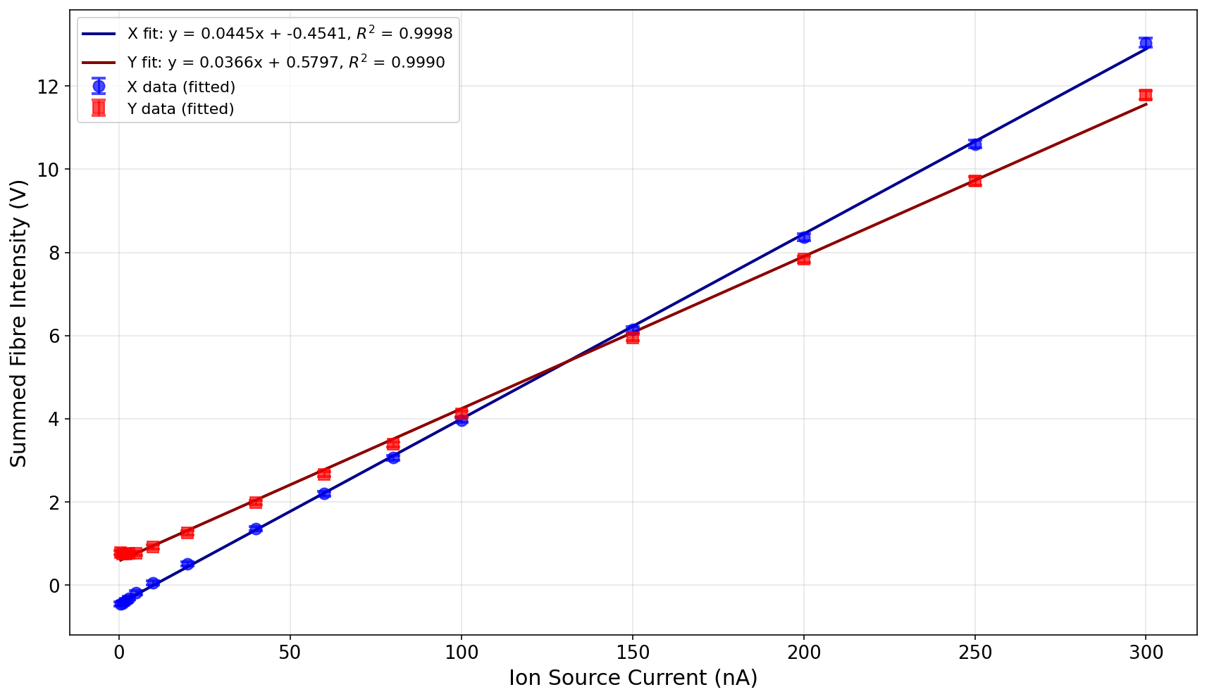
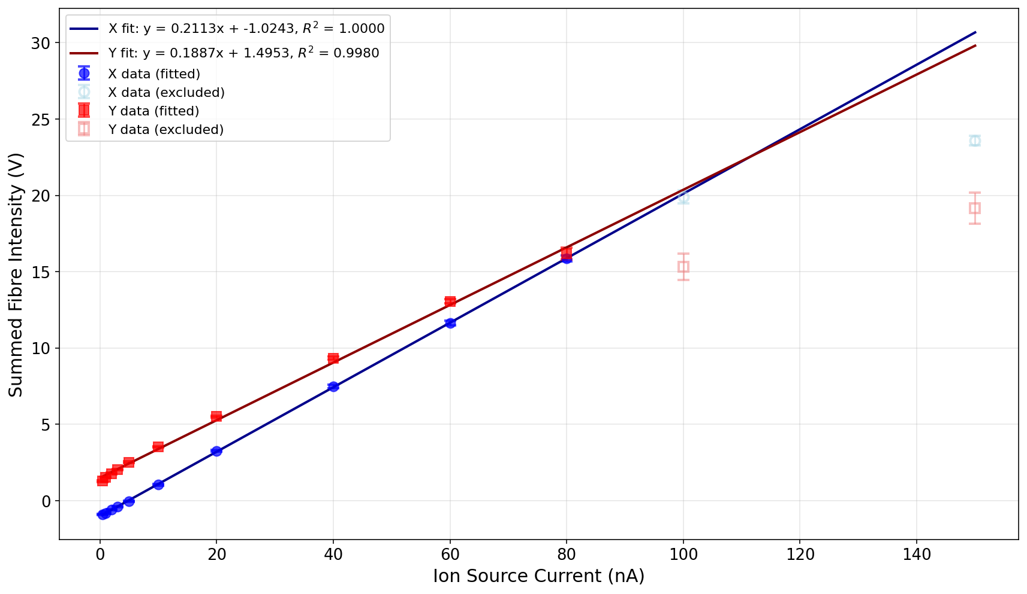
Response Linearity (to Ion source current)
148 MeV
228 Mev

Slide 3
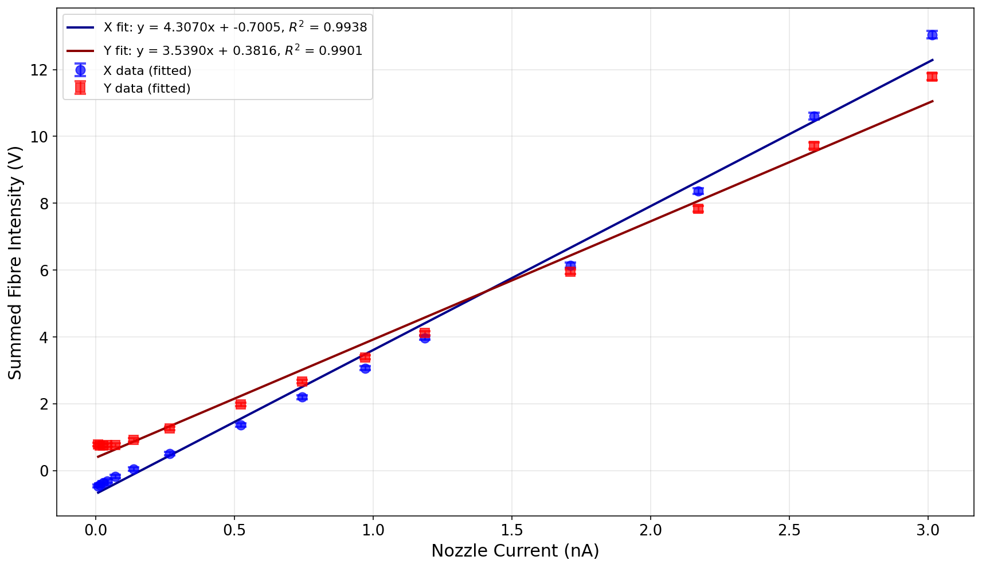
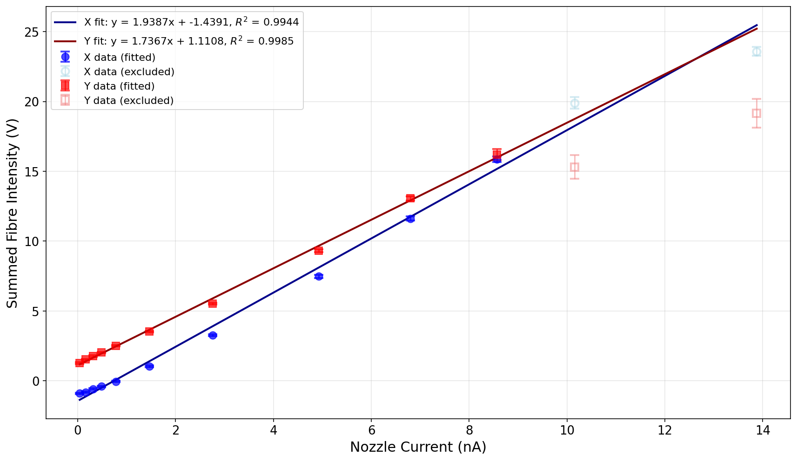
Response Linearity (to Nozzle current -from DE.TEC.TOR beam monitor)
148 MeV
228 Mev

Slide 4
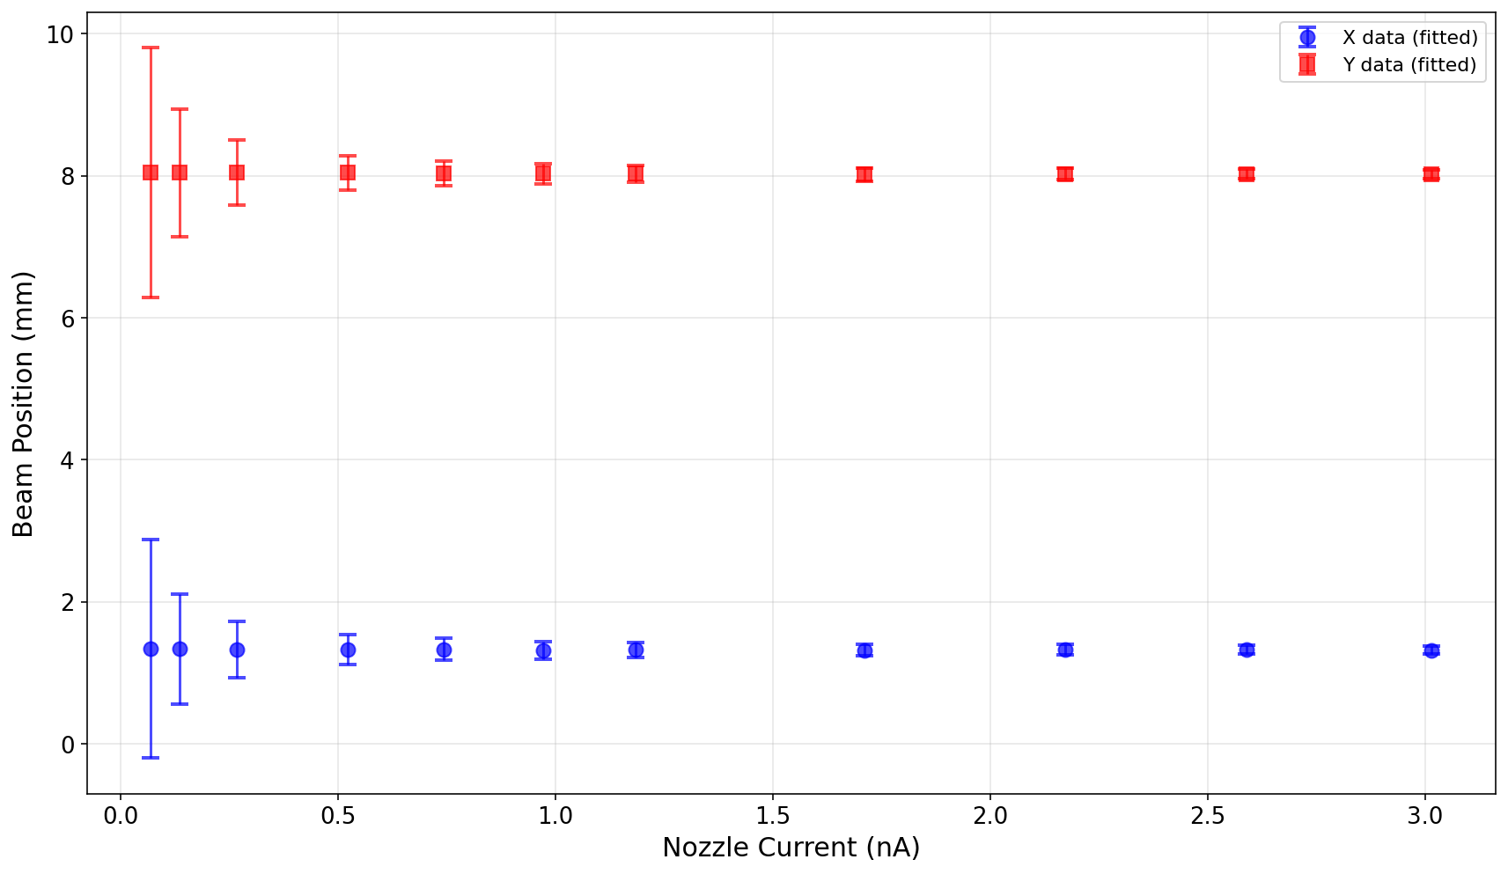
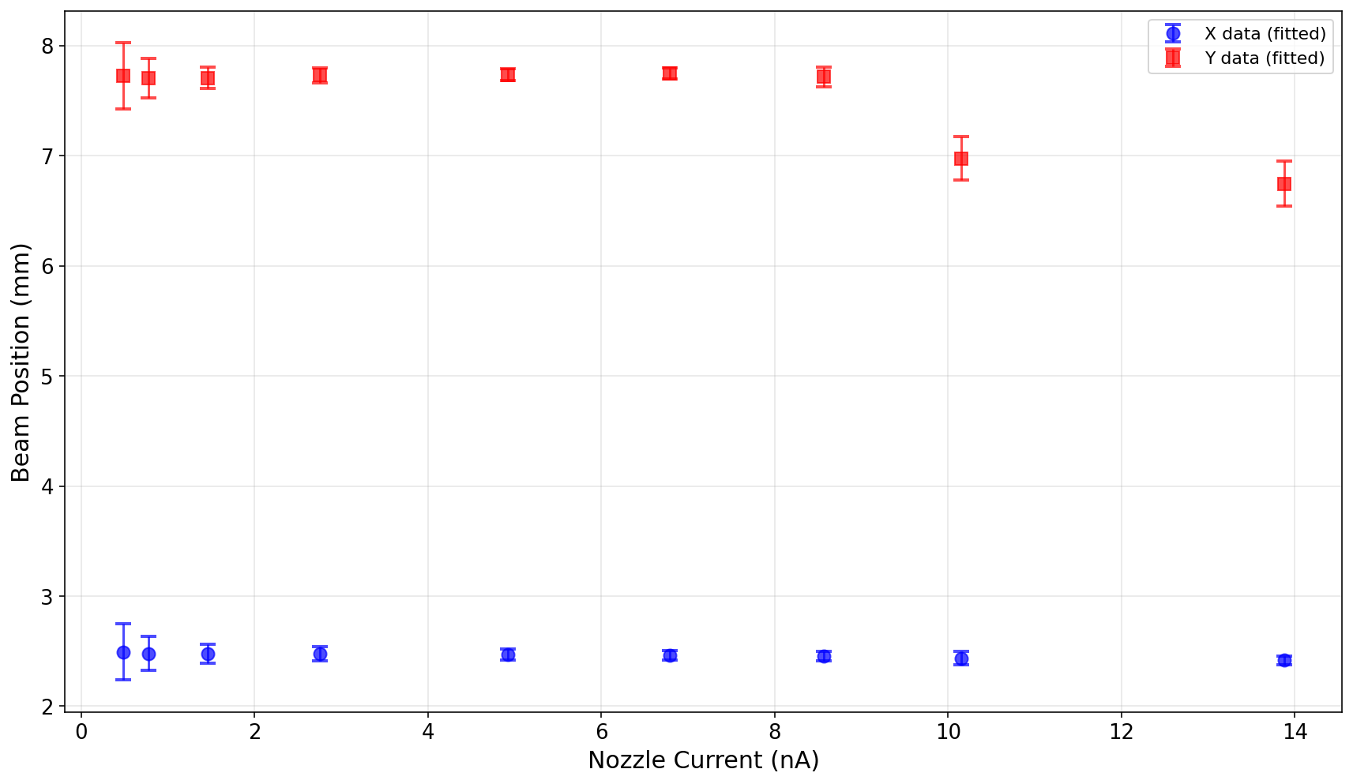
Beam Position Stability
148 MeV
228 Mev

Slide 5
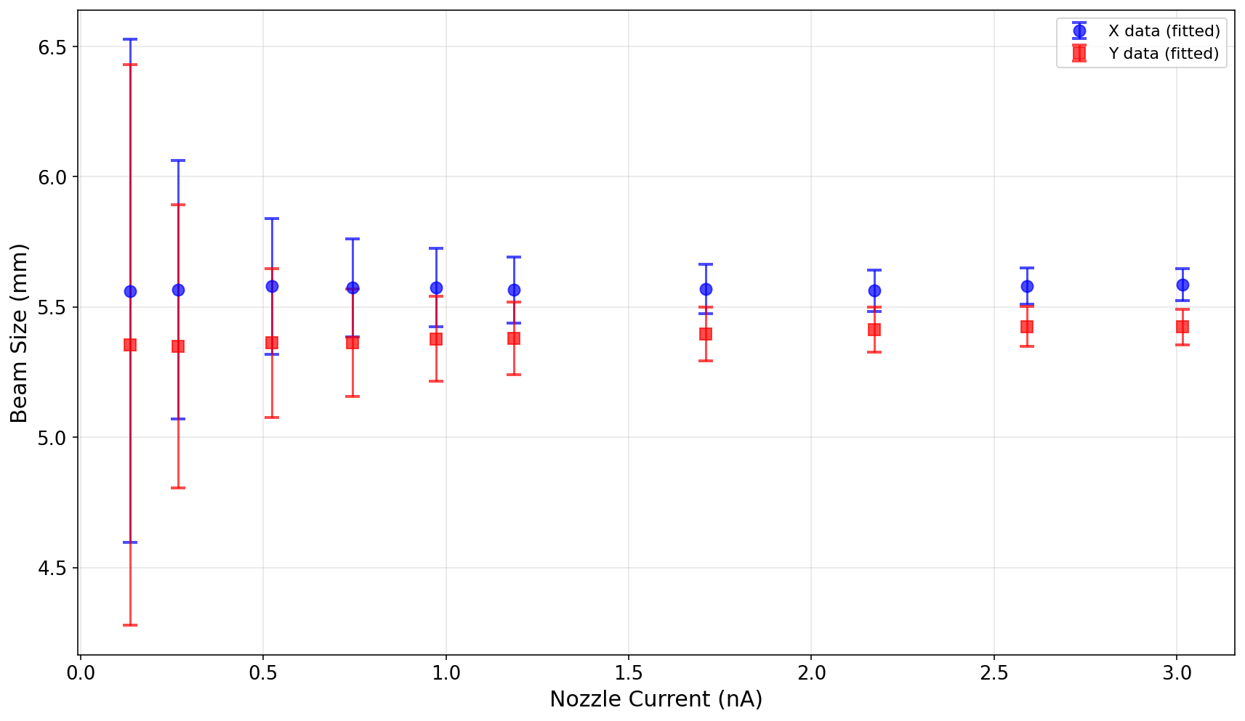
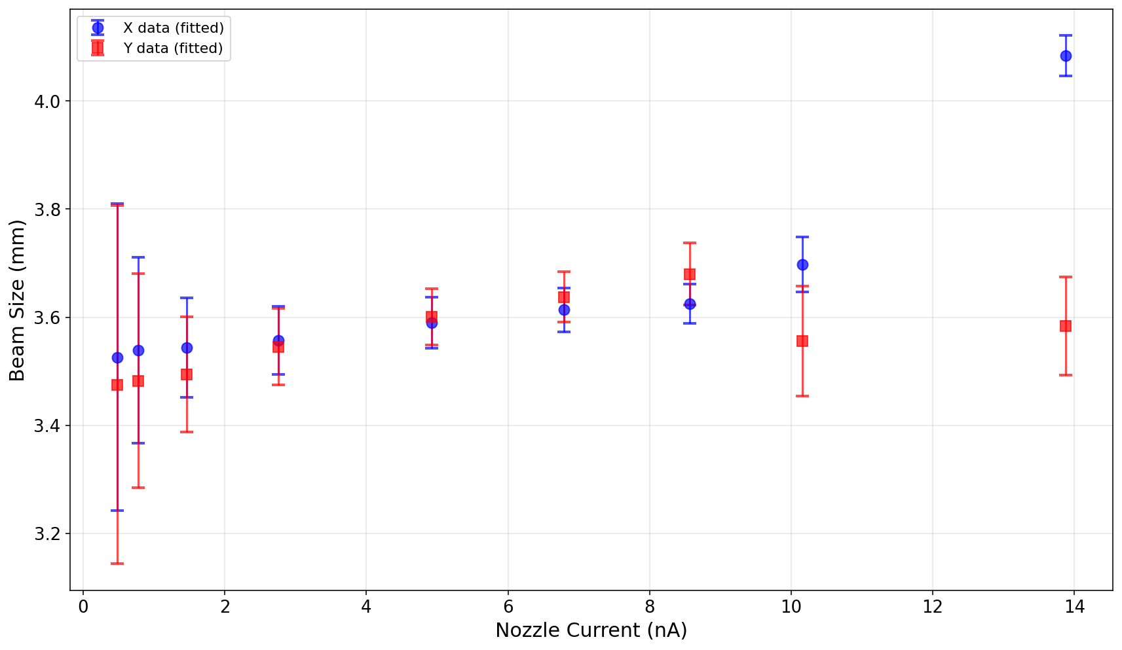
Beam Size Stability
148 MeV
228 Mev

