Slide 1
PPTC Analysis
05/06/2025

Slide 2
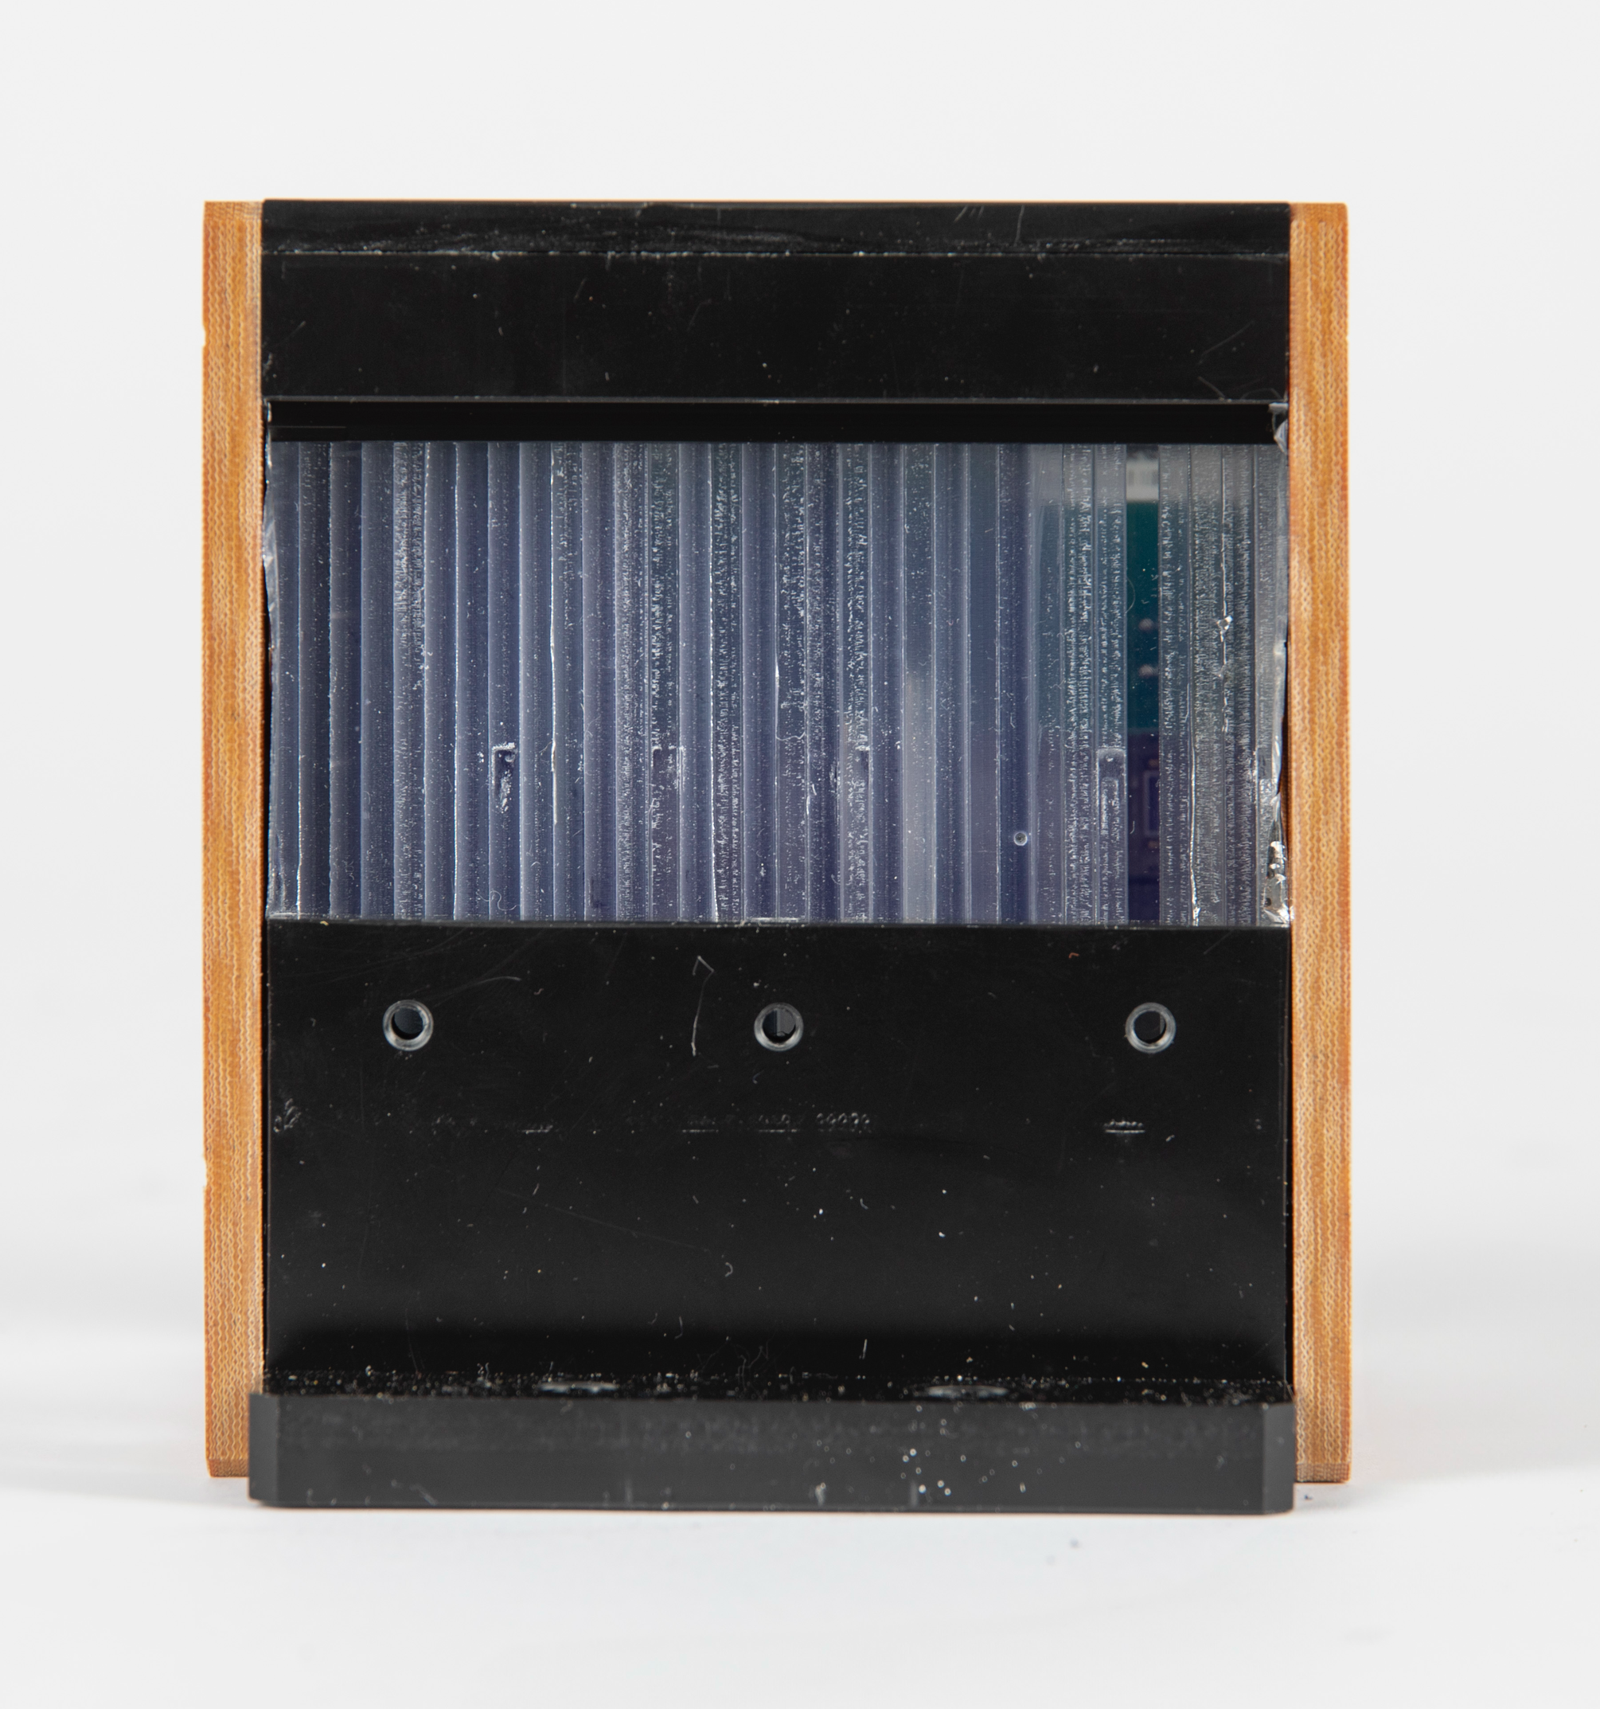
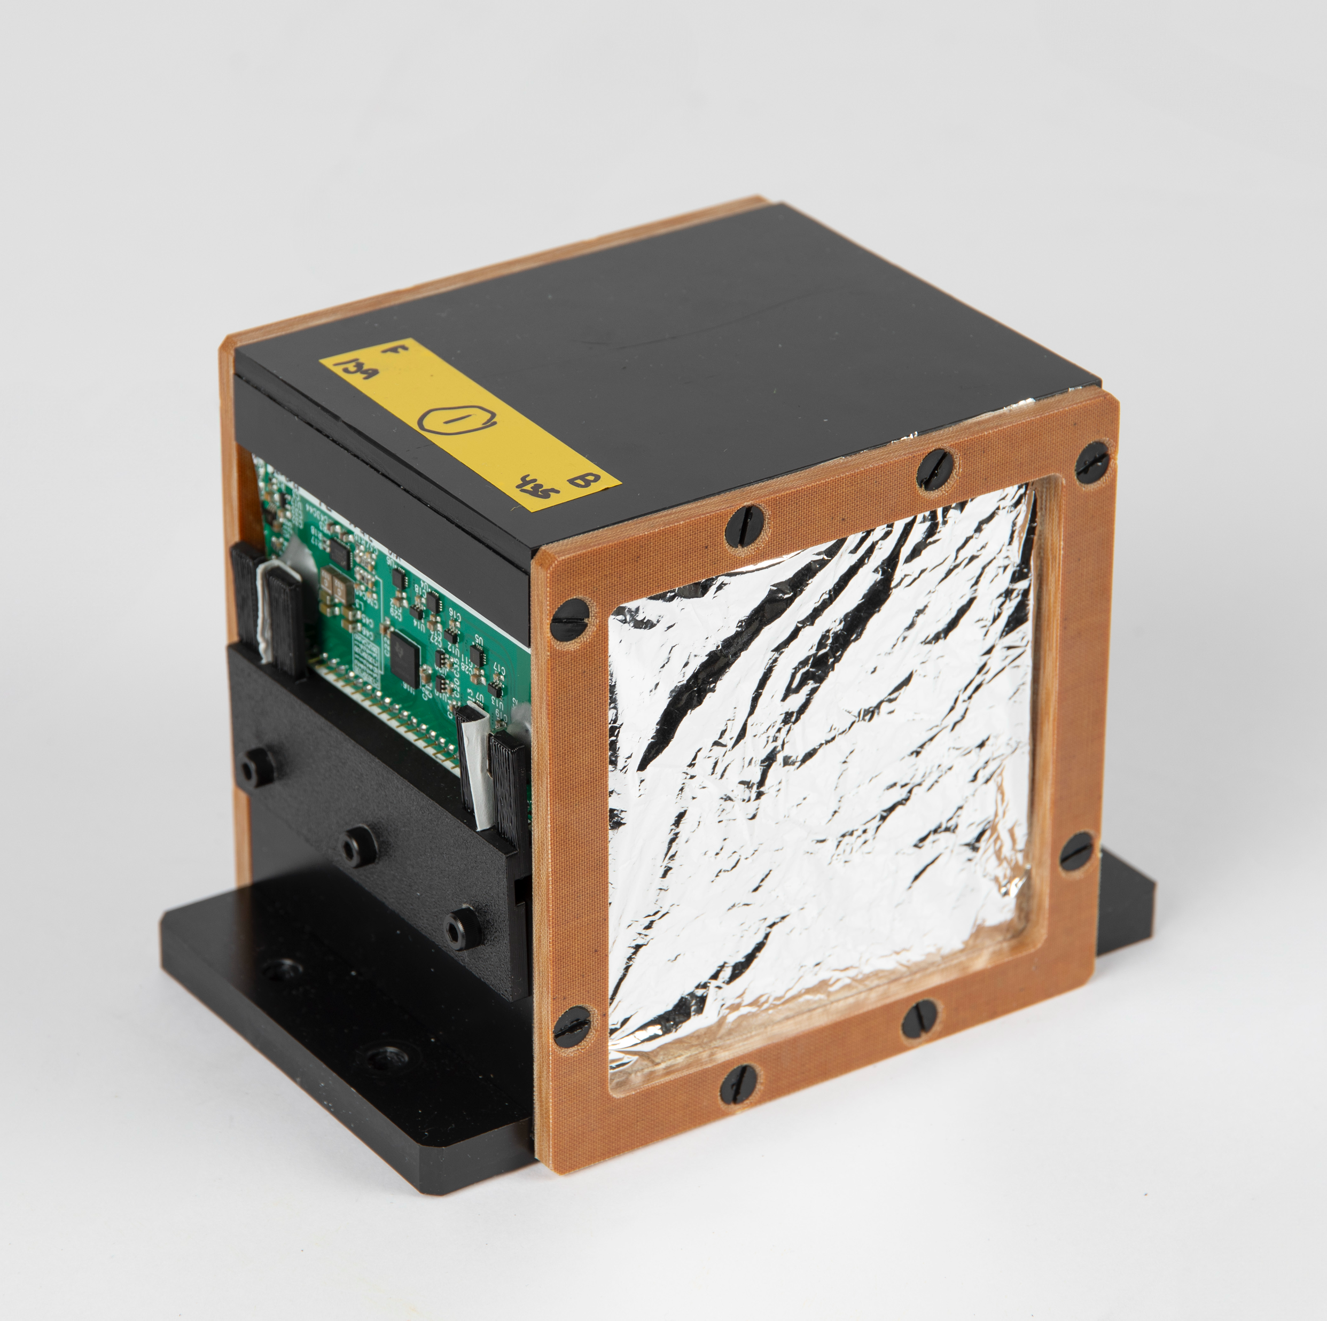
Shoot Through
ST Back and Front at 226 MeV, rotating stack

Slide 3
Shoot Through
ST Back and Front at 226 MeV, rotating stack

Slide 4
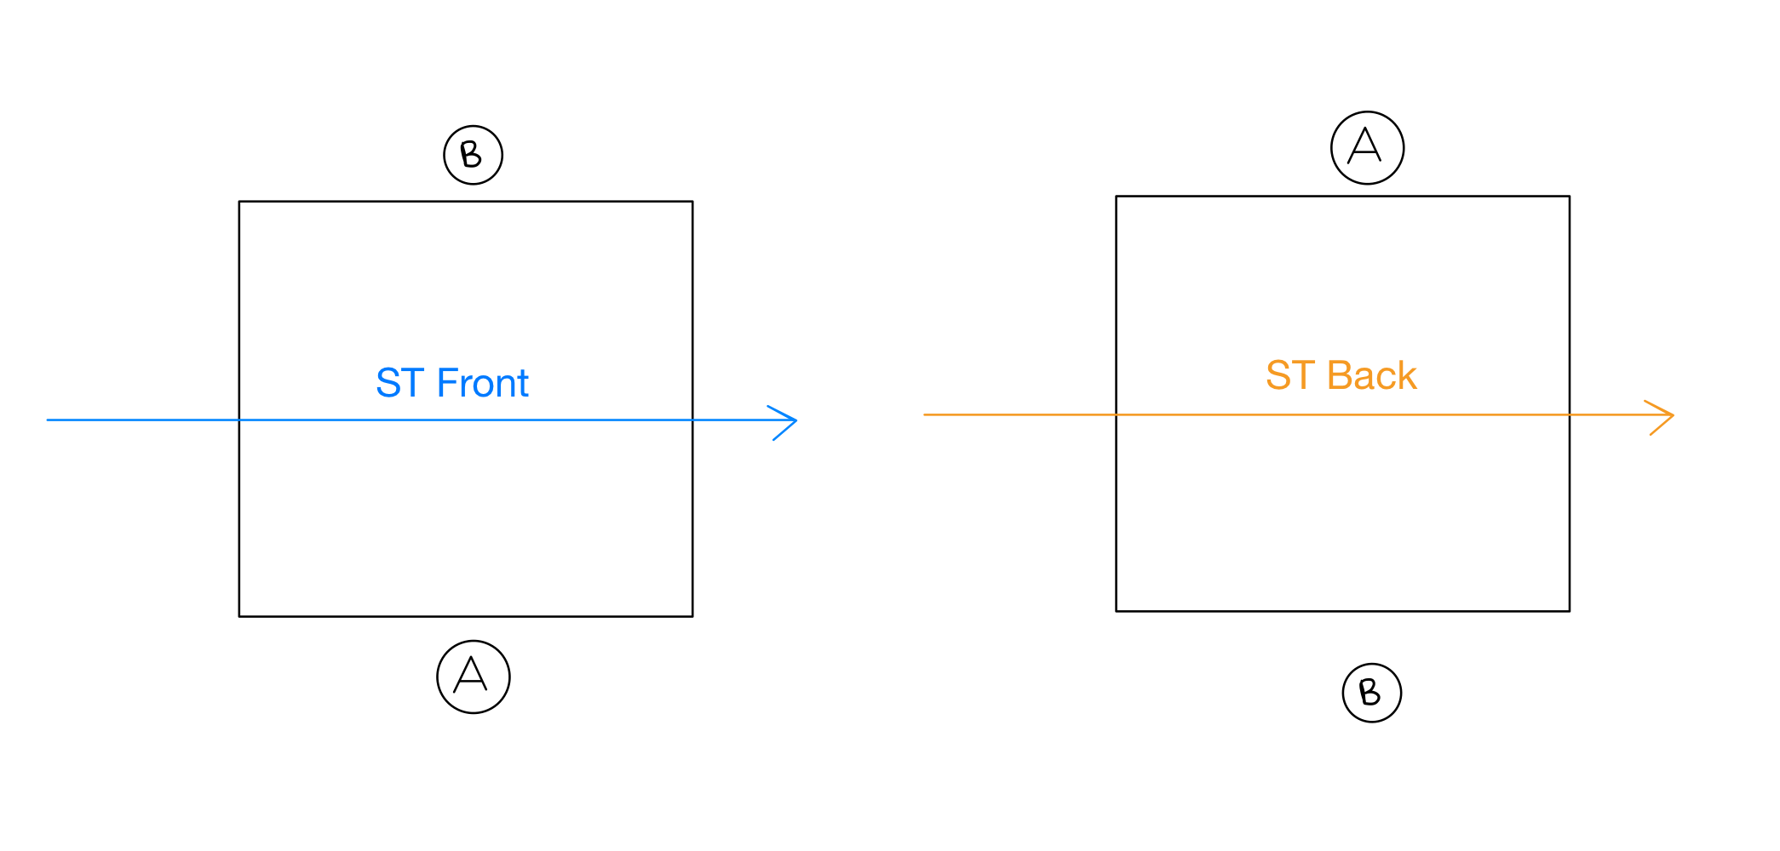
Gantry remains fixed so the beam direction is always the same. We rotate the modules to create ST Back.

Slide 5
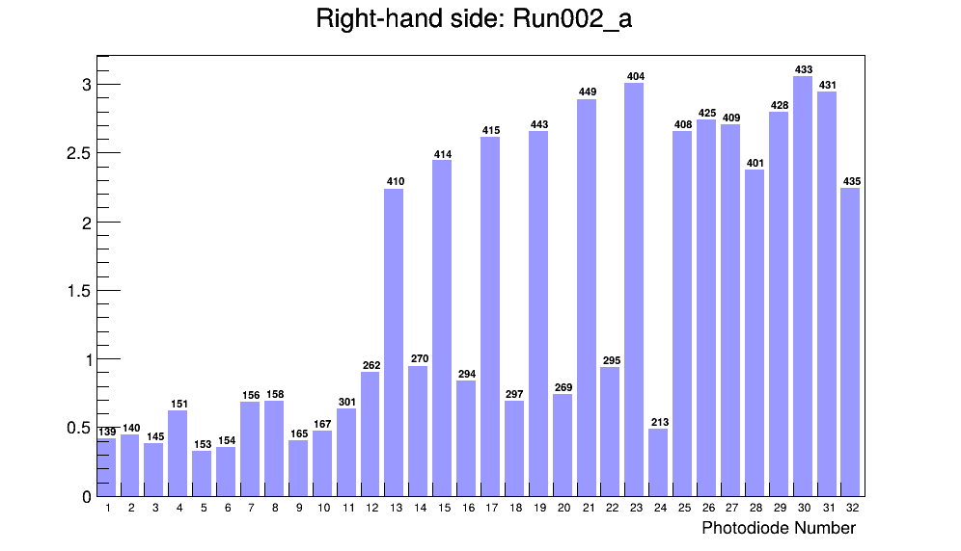
MODULE 1: Shoot Through
Different scintillator sheets, so light output differs. Much higher light output on new sheets (number 400 onwards)

Slide 6
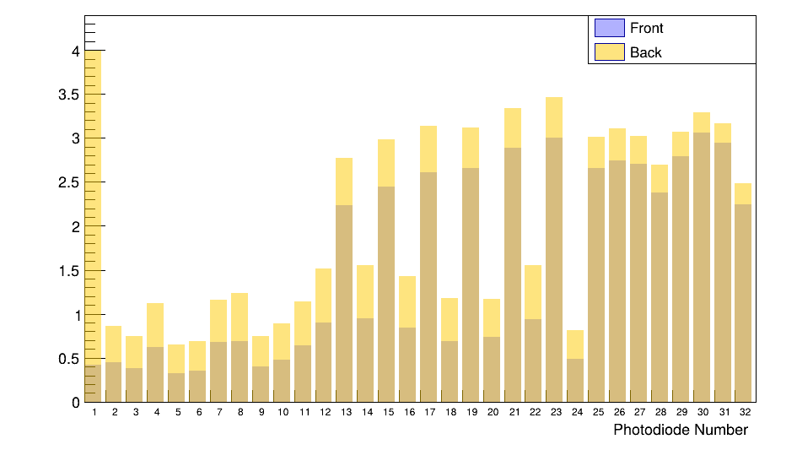
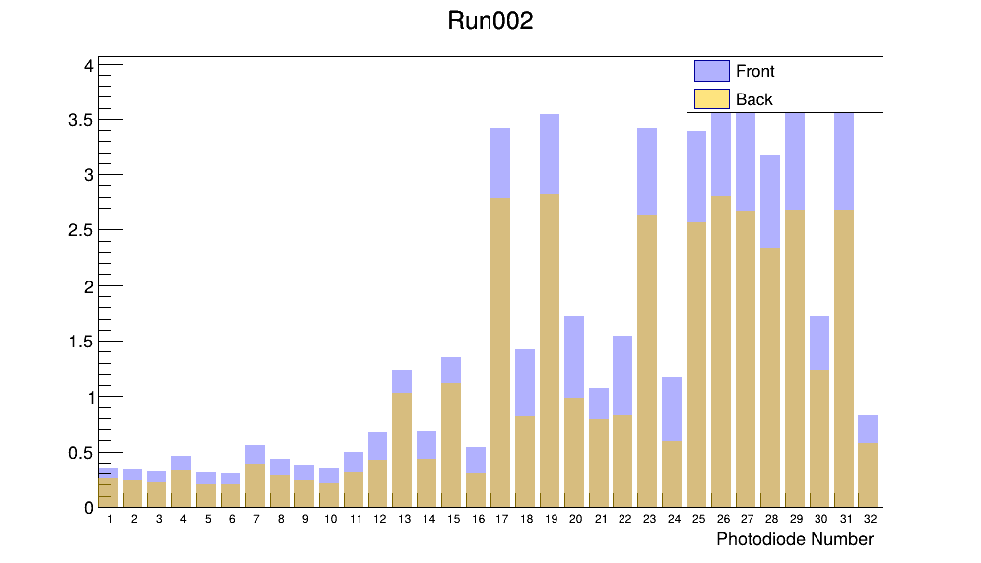
MODULE 1: compare STFront and STBack
A side (right) sees more light with STBack and B side (left) side sees more light with STFront -> Always more light when the board is placed on the left hand side of the beam.
A side
B side

Slide 7
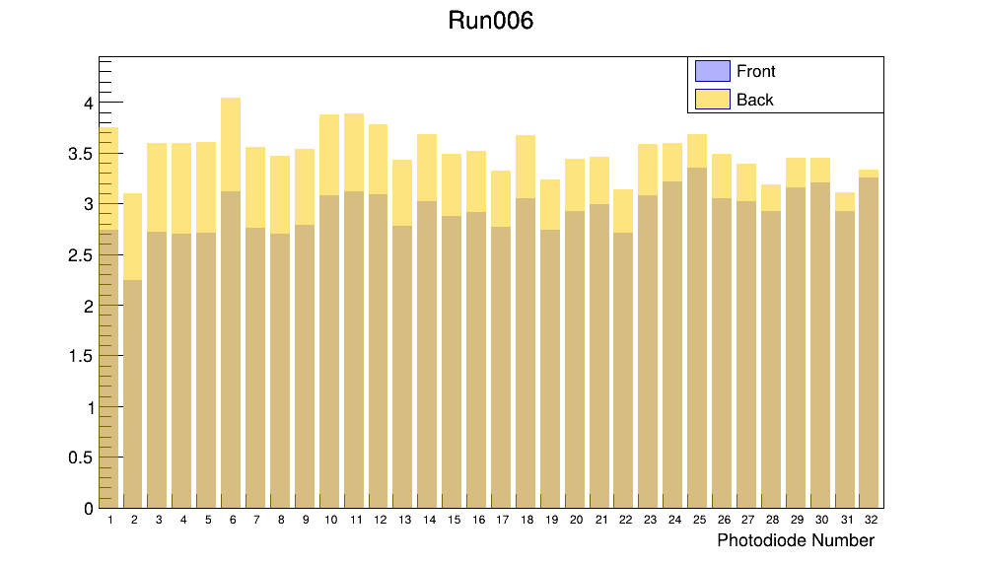
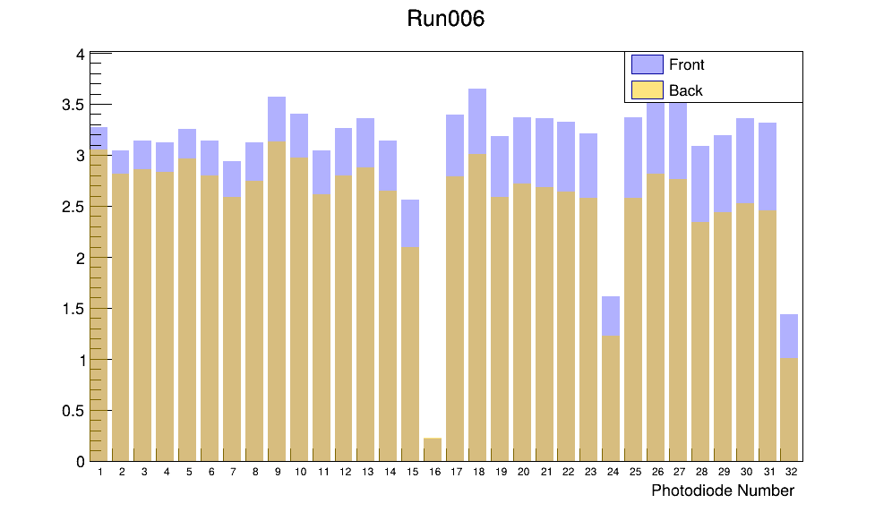
MODULE 2: compare STFront and STBack
A side (right) sees more light with STBack and B side (left) side sees more light with STFront again -> Always more light when the board is placed on the left hand side of the beam.
A side
B side

Slide 8
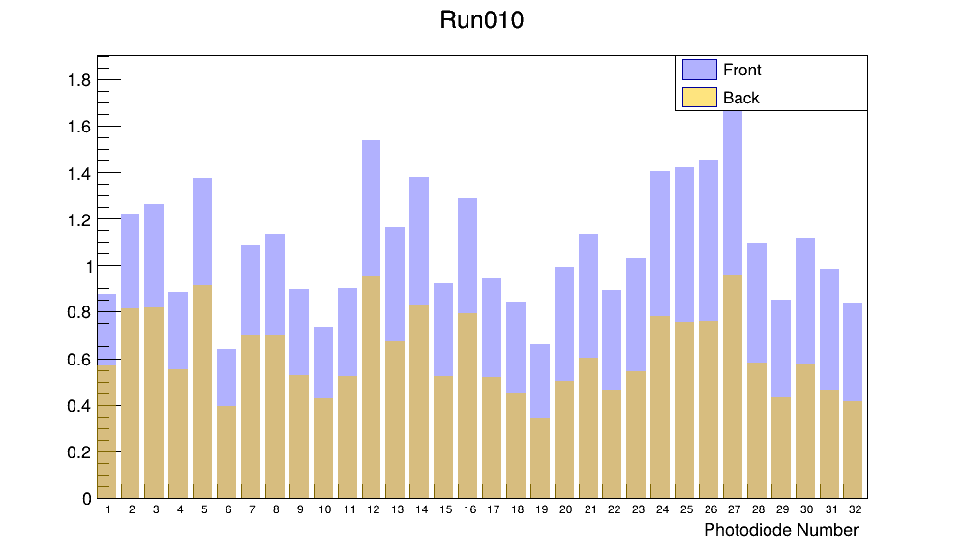
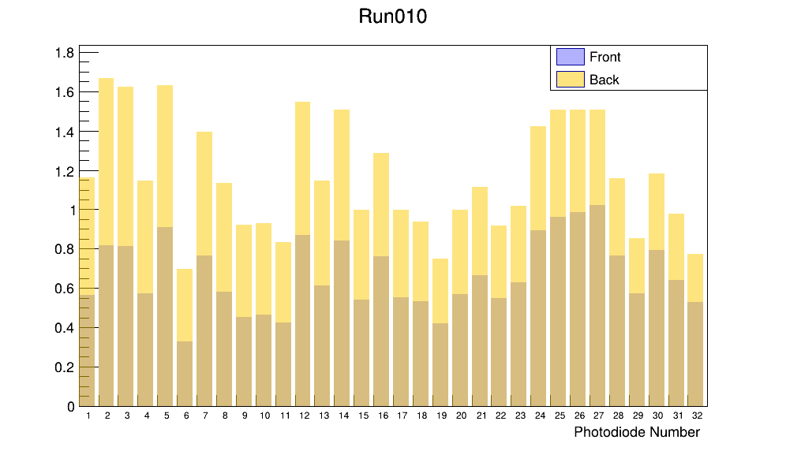
MODULE 3: compare STFront and STBack
A side
B side

Slide 9
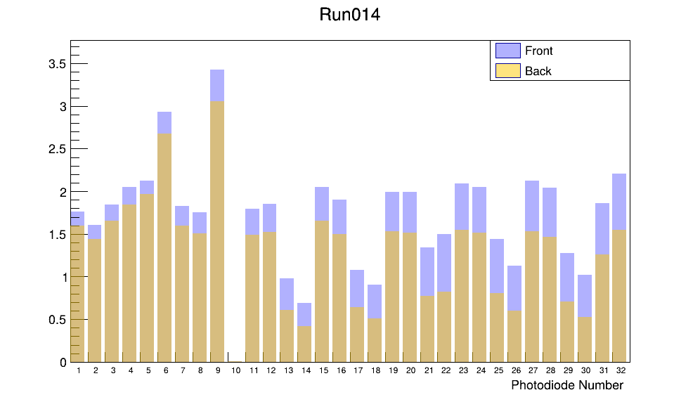
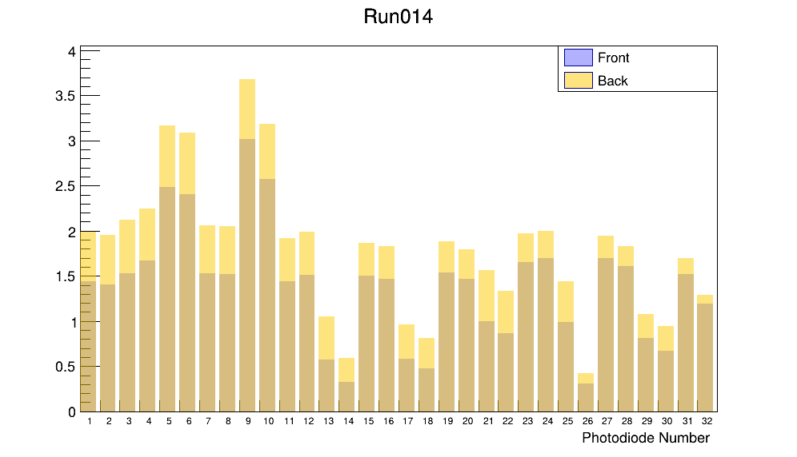
MODULE 4: compare STFront and STBack
A side (right) sees more light with STBack and B side (left) side sees more light with STFront -> Always more light when the board is placed on the left hand side of the beam.
B side
A side

Slide 10
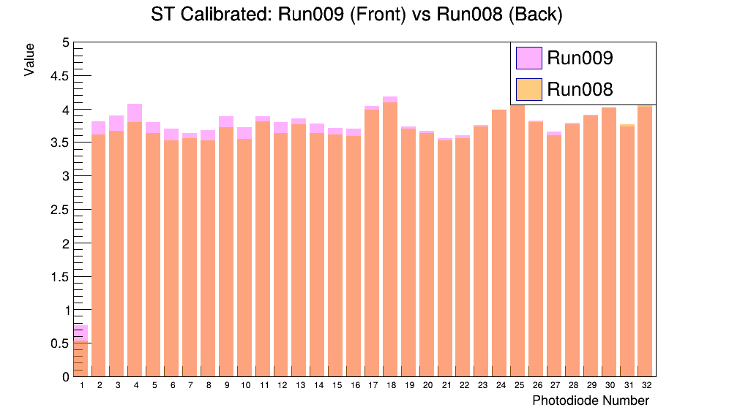
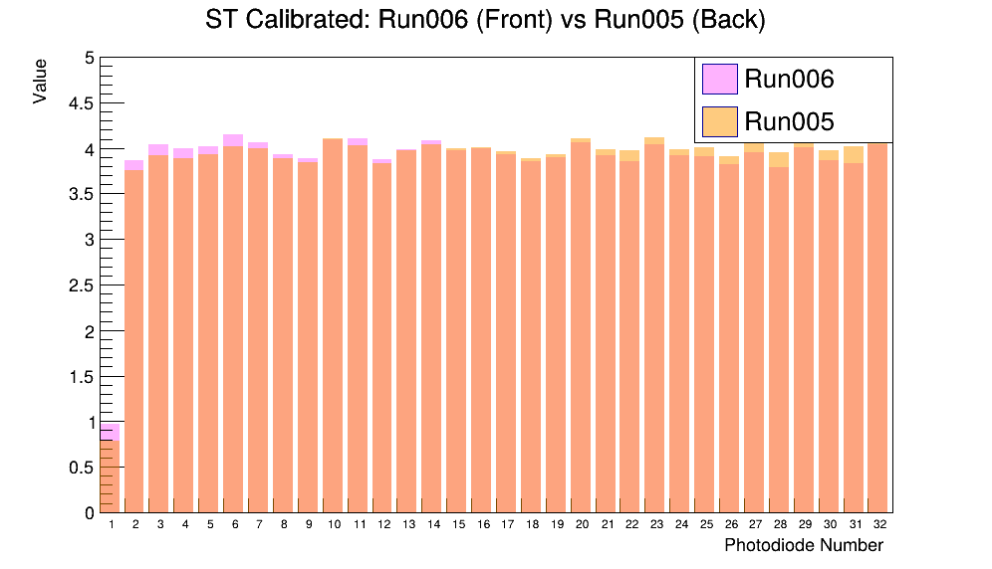
Previous experiments: UCLH 2024
One board per module, STFront and STBack pretty much identical.

Slide 11
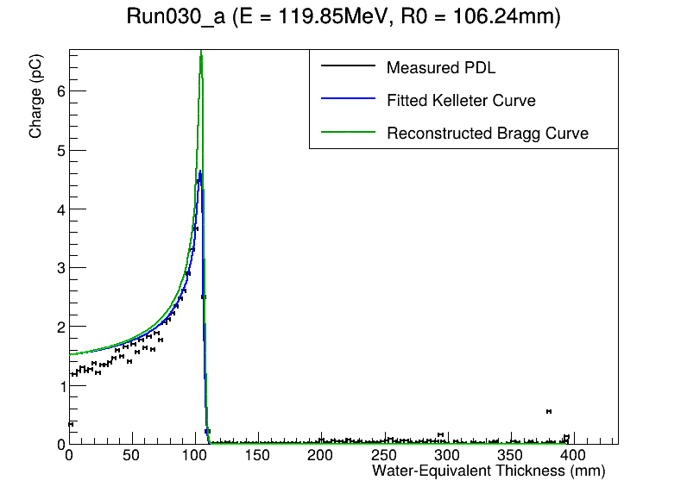
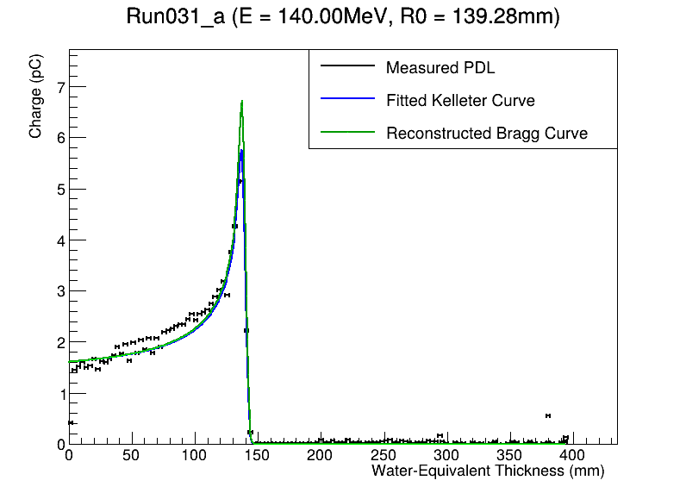
Bragg Peak results
120 MeV
140 MeV

Slide 12
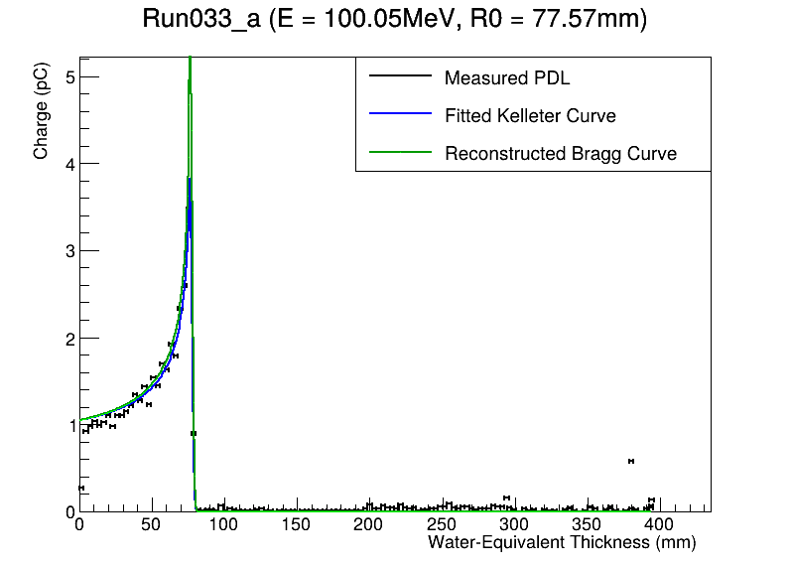
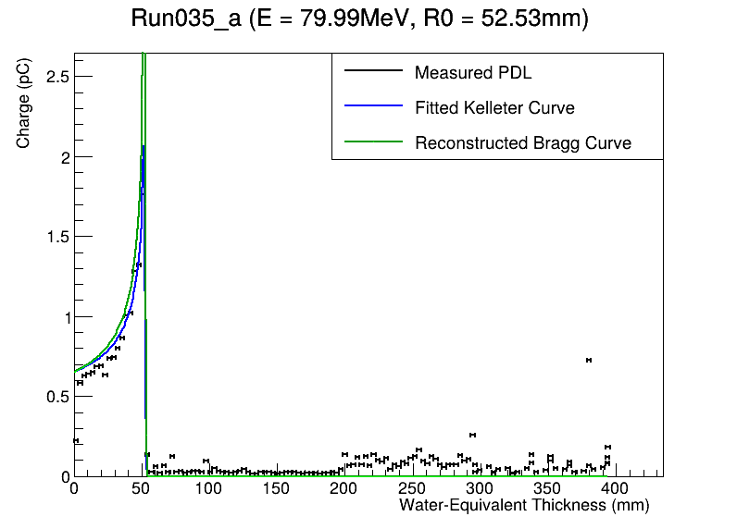
Bragg Peak results II

Slide 13
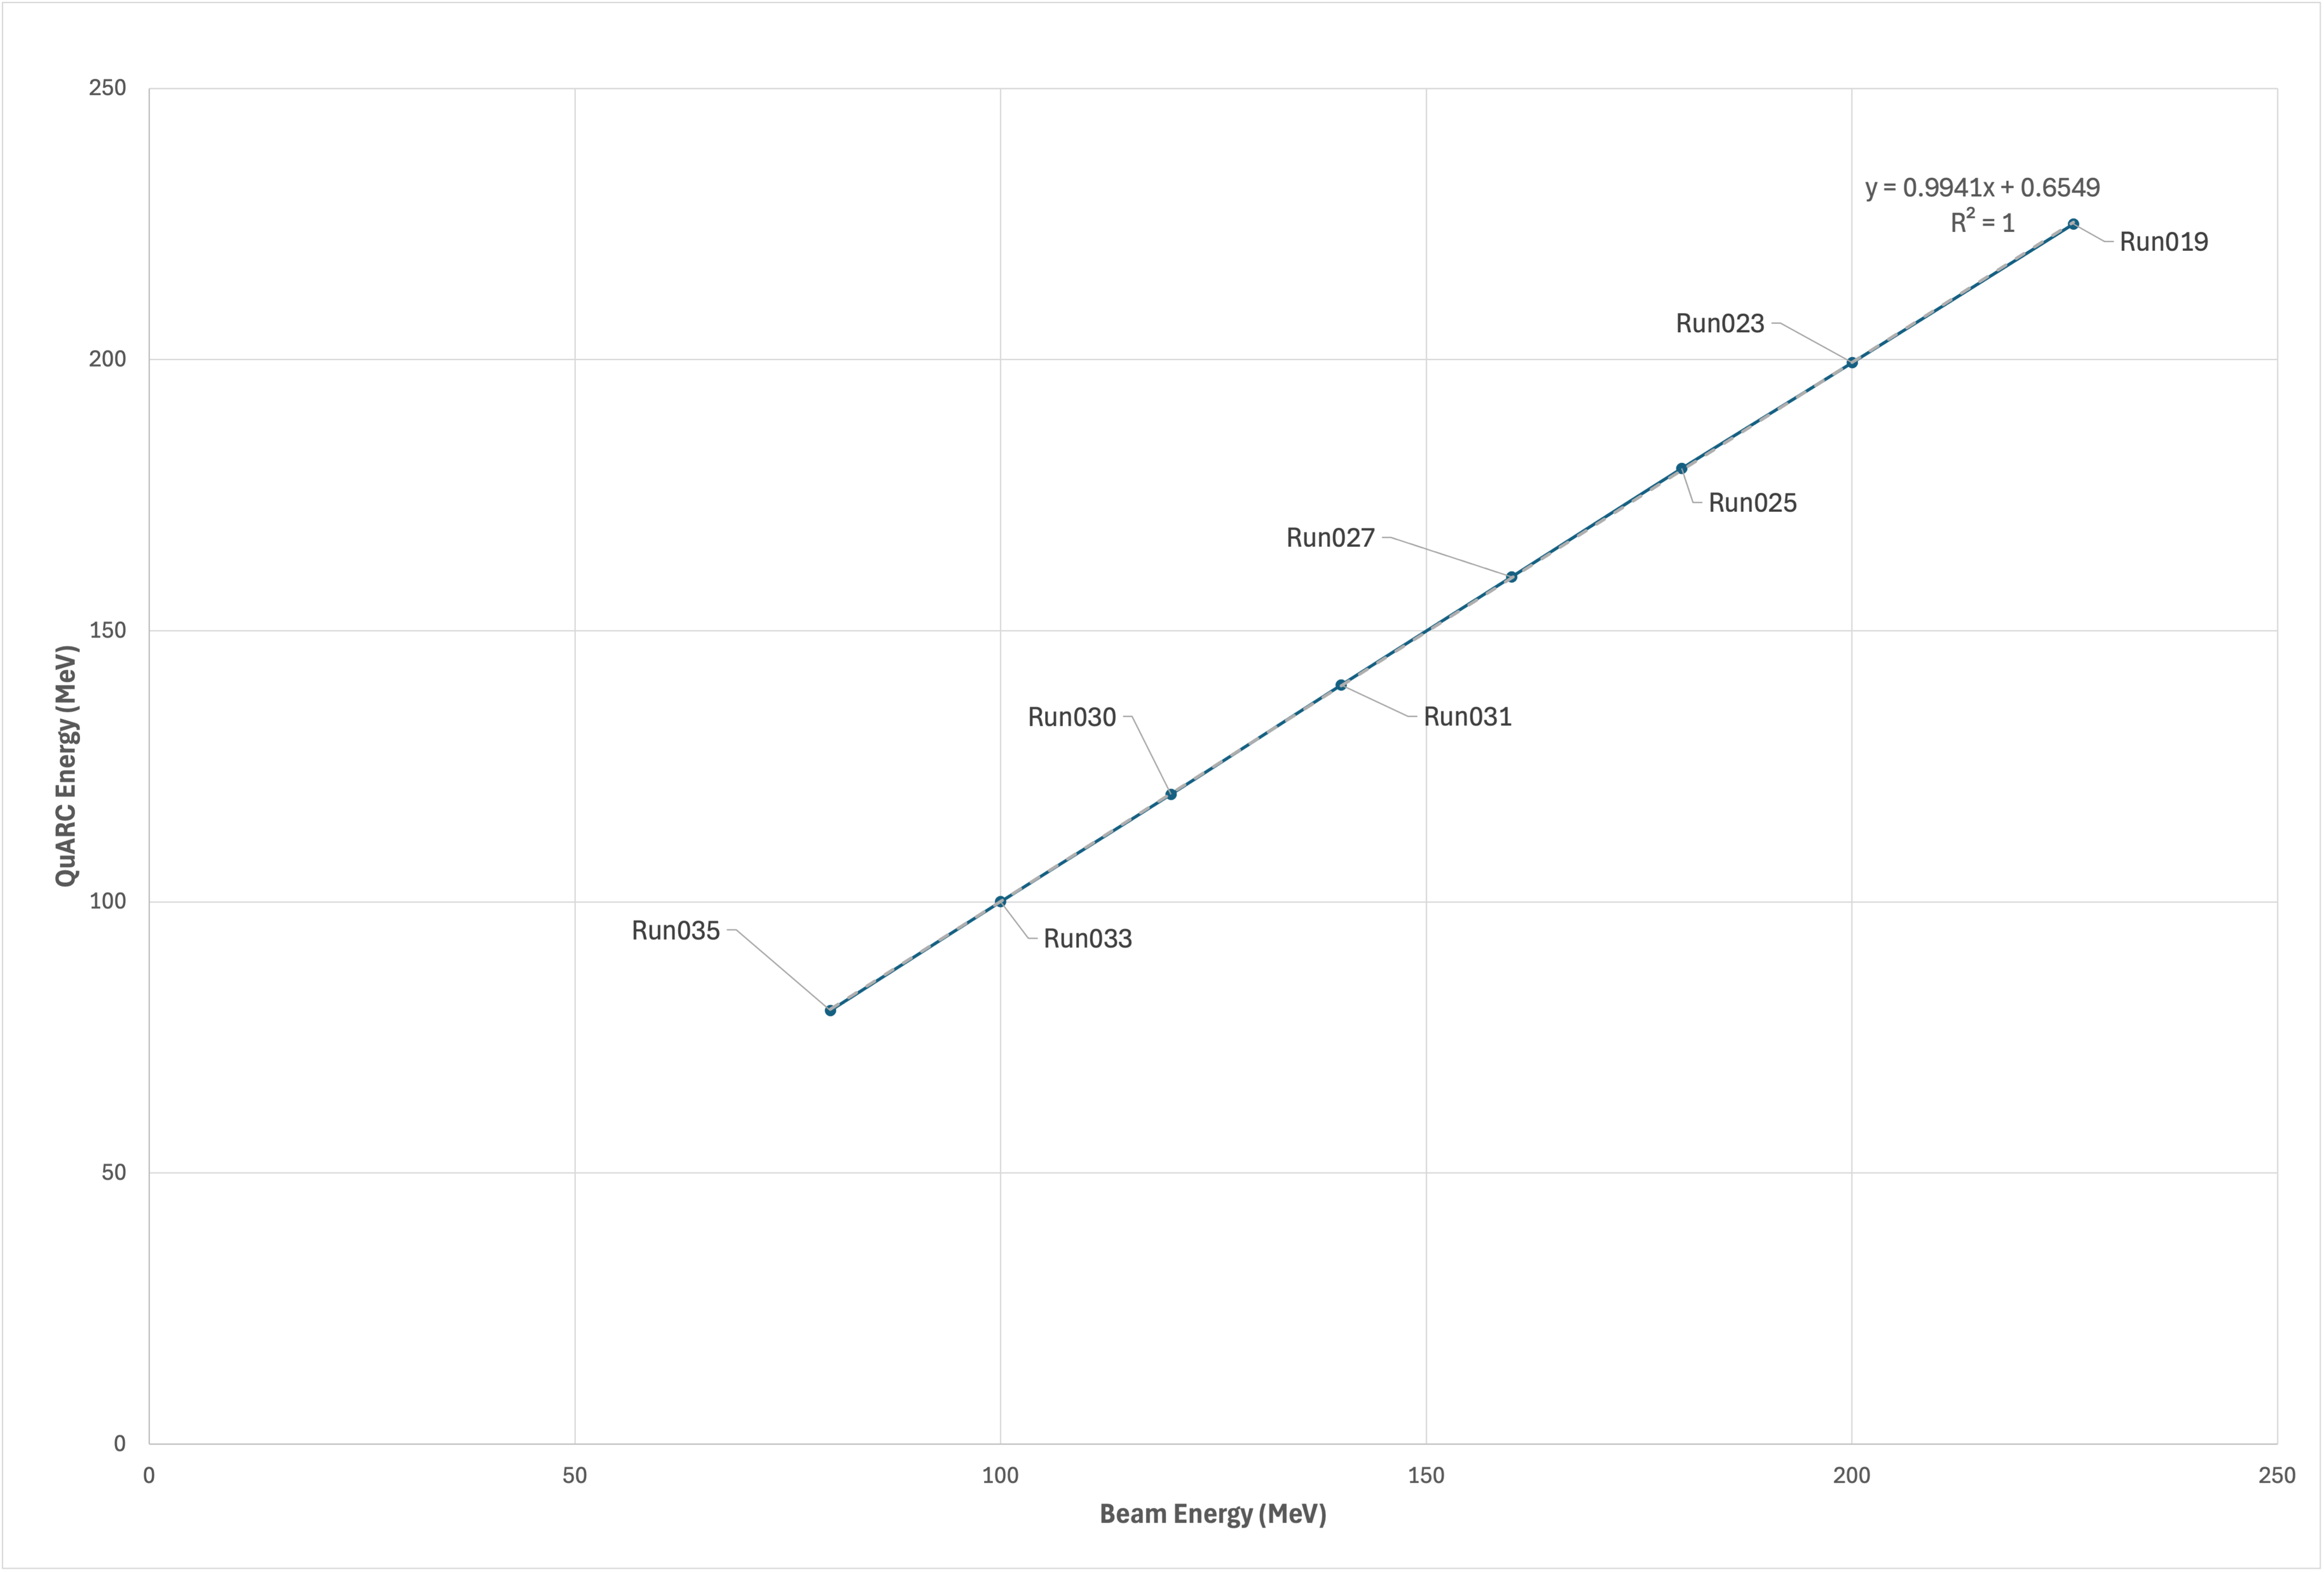
Considering all the energies with a fit:

Slide 14
Conclusions
A side (right) sees more light with STBack and B side (left) side sees more light with STFront. Always more light when the board is placed on the left hand side of the beam.
Experimental results show that beam is not perfectly aligned with the set up. Considering we used laser for reference, and double check our alignment we believe the reference lasers are not correct.
In a later experiment at UCLH we did not see this effect -> not detector related (data analysis pending)
Beam seems to be shifted towards the left with respect to the isocenter.
Good agreement between beam energies and QuARC energies.

