Slide 1
Raspberry Pi 5: Argon v3 cases
Sonia Escribano Rodriguez
26/02/2025

Slide 2
Install power button and fan control script
For the functioning pi, we need to configure the EEPROM and the argon control script. To do so, connect pi to internet and from the terminal do:
curl https://download.argon40.com/argon-eeprom.sh | bash
Reboot pi for it to take effect
curl https://download.argon40.com/argon1.sh | bash
Reboot pi again. Now we should see an argon icon on the desktop to configure fan speed and other elements (we keep the default values).

Slide 3
Copying OS + configuration
Considering that we have one fully functioning pi, with the power button and control script set up (explained on slides from 26/01/2024 + previous slide), we want to copy that OS + all the files to a new microSD card.
This can be done using the SD Card Copier that comes by default on the raspberry pi.

Slide 4
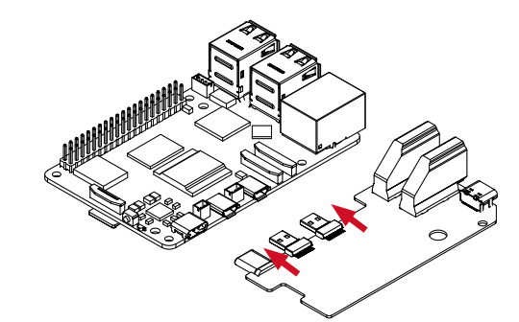
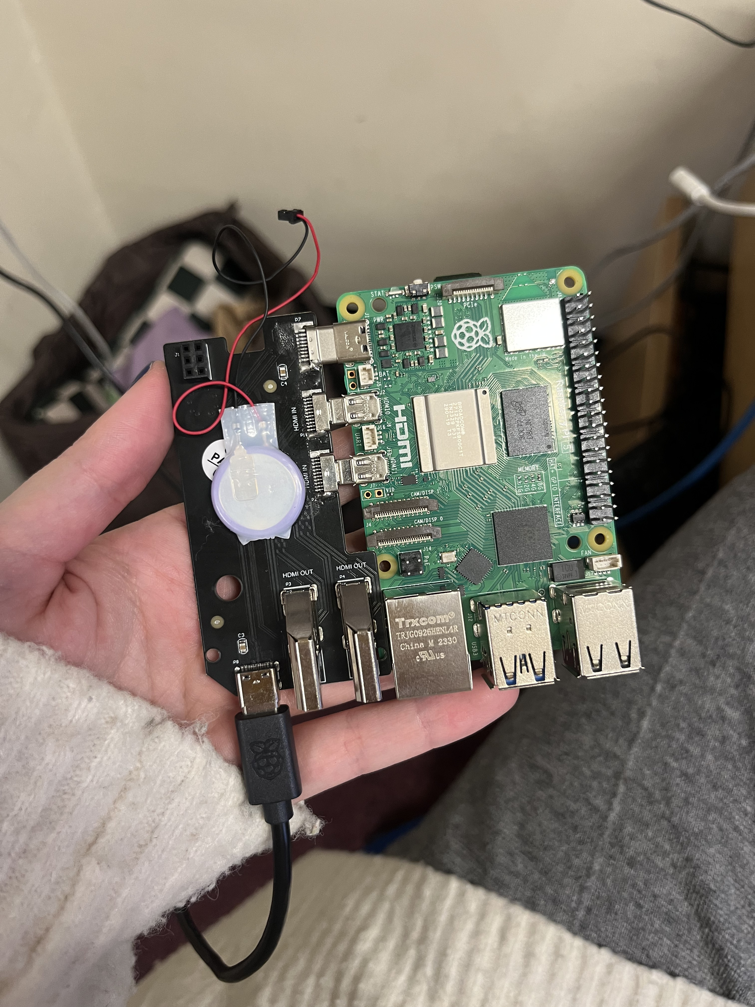
Assembly: boards
Connect HDMI-power board to the raspberry pi. One has to push in the board ALL the way, otherwise usb-C connection fails and board does not work. Stick RTC battery on top of the hdmi-power board.

Slide 5
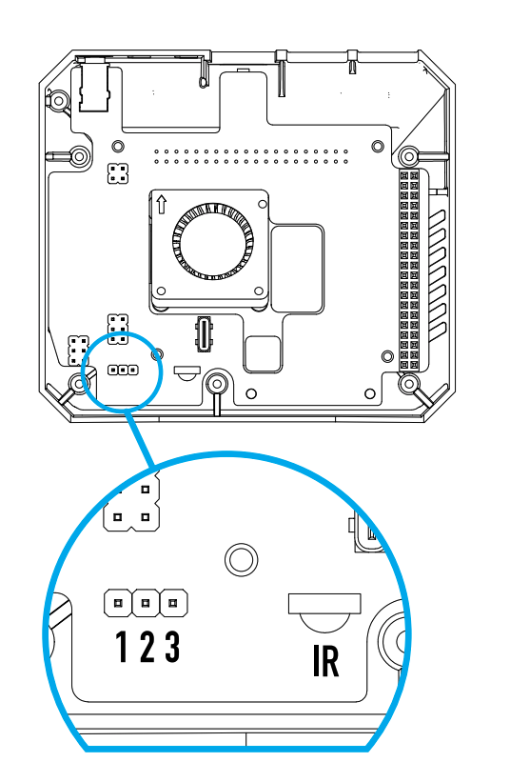
Assembly: power button
There are two possible configurations to turn the pi on:
Press on button to turn on: default option, place jumper over pins 1-2
Turn on as soon as power cable is connected: our chosen configuration, place jumper over pins 2-3
This needs to be done before placing and testing board on the enclosure!!!

Slide 6
Assembly: enclosure
Remove microSD from the pi.
Connect the set of two board to the top part of the argon case. This should be very smooth, if it isn’t is because the HDMI boards is not pushed all the way in the pi. Attention to this because the board will fit into the case, but due to the loose connection the device won’t work.
This is the moment for testing: check that pi5 and all ports of the enclosure are working correctly before doing anything else.

Slide 7
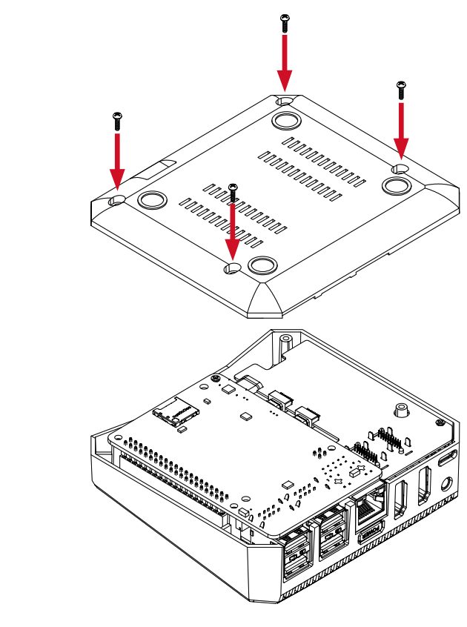
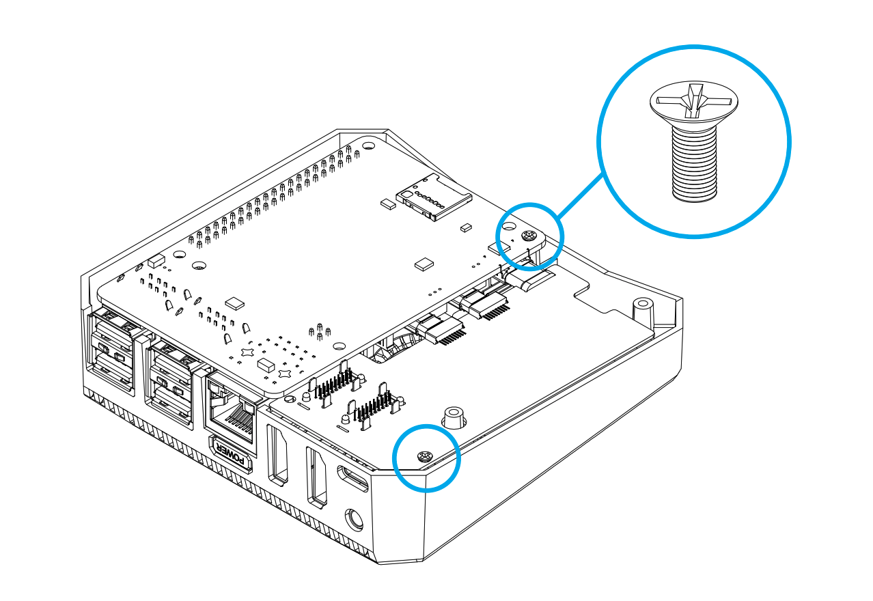
Assembly: secure
Once we have tested that everything works we can secure the boards to the top of the case with the flat screws and then the bottom with the round screws.

