Slide 1
WG3: Accelerator Parameters WG4: FLASH Beamlines
Prof. Simon Jolly
University College London

Slide 2
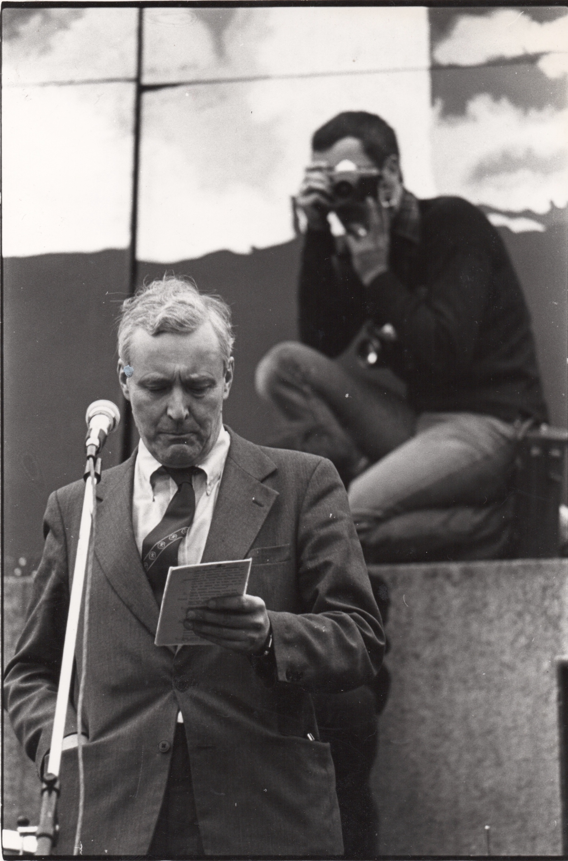
Martin Slavin (1941–2025)

Slide 3
Martin Slavin: Photography

Slide 4
Brotherly Advice
Always keep your words soft and sweet, just in case you have to eat them.
If you can’t be kind, at least have the decency to be vague.
It may be that your sole purpose in life is simply to serve as a warning to others.
We could learn a lot from crayons. Some are sharp, some are pretty and some are dull. Some have weird names and all are different colours, but they all have to live in the same box.

Slide 5
Sumitomo: Hong Kong Protons

Slide 6
Hat Tip To The Bloodhound Gang

Slide 7
WG3: Accelerator Parameters
Both Mariusz Sapinski and Simon Jolly stepping down.
Survey to send to particle therapy centres on accelerator parameters prepared, but there is no list of appropriate contacts.
Not clear this needs to be a Working Group: mainly a data collection task.
Calling our Early Career Researchers!
Build contacts list of key accelerator contact at each particle therapy centre (share with subcommittee).
Publish results on new PTCOG website (ptcog.online).

Slide 8
WG4: FLASH Beamlines
Presentations to the WG from Nicholas Gerrard (IBA) and Per Rugaard Poulsen (DPTC): thank you both!
IBA ConformalFLASH makes use of multiple incremental improvements:
Higher extracted current
Hedgehog filters.
Reduction in scanning speed.
200–500 ms delivery.
2–3 pulses per spot (ProteusOne).
More vendor presentations welcome!
UHDR ≠ FLASH: both valuable!
10.1016/
j.ijrobp.2024.04.071
Finding:
Smaller FLASH sparing factor for late damages than acute damages
Possible implications:
Great care needed in clinical translation of FLASH
Trials could consider sites that are currently limited by acute damages

