Slide 1
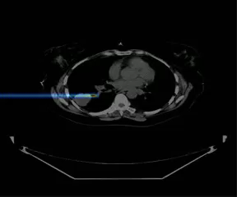
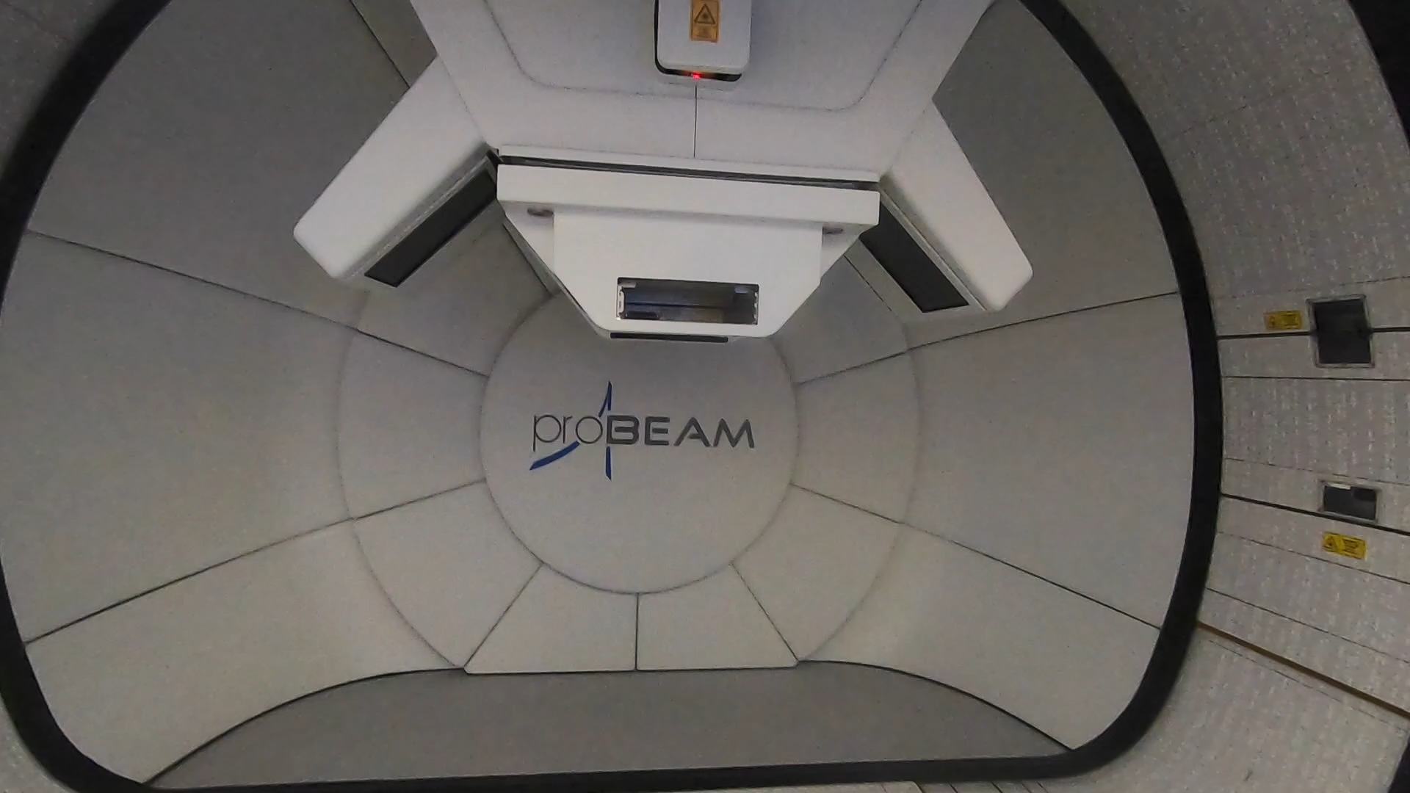
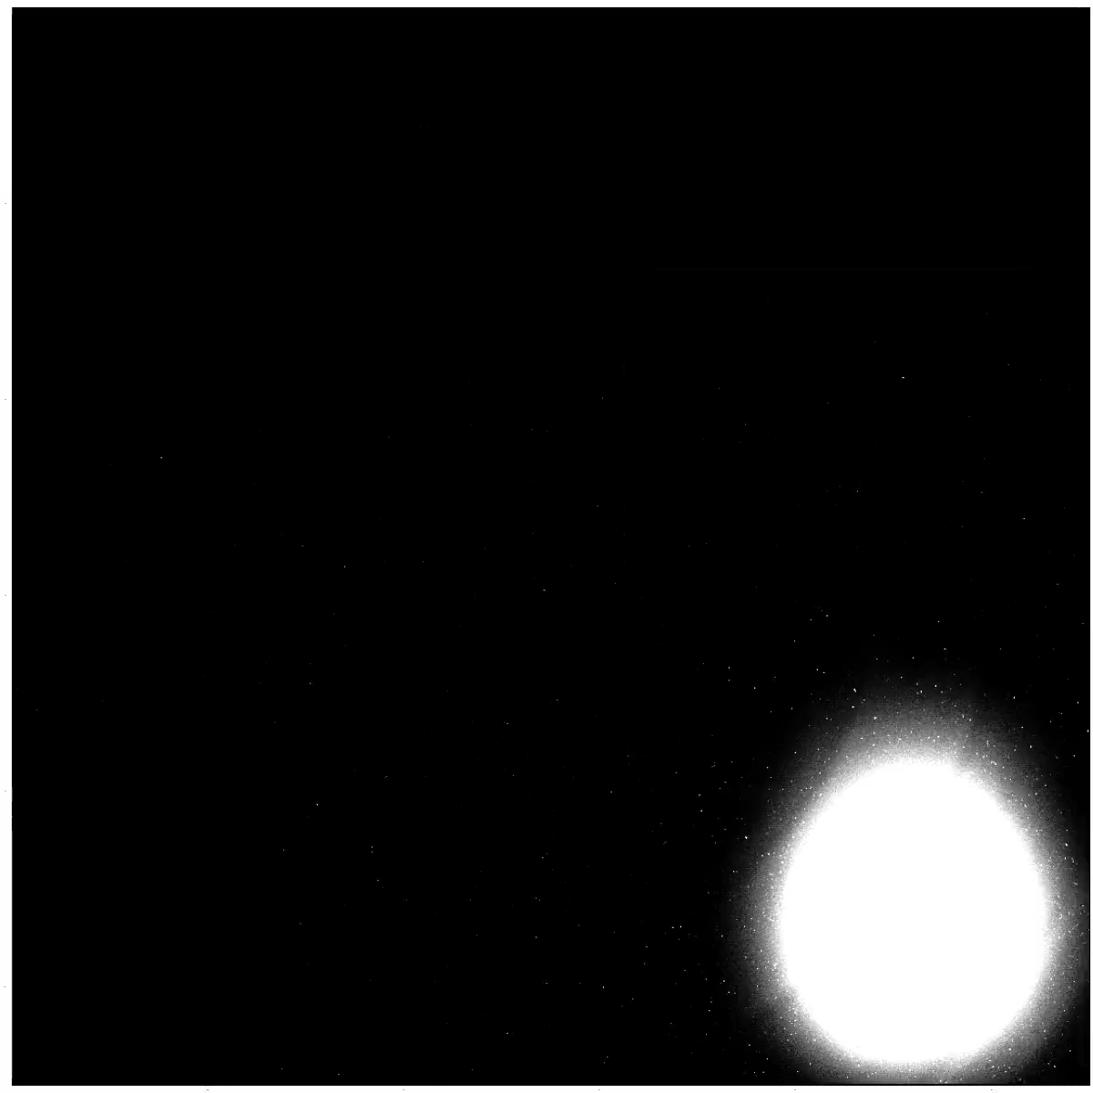
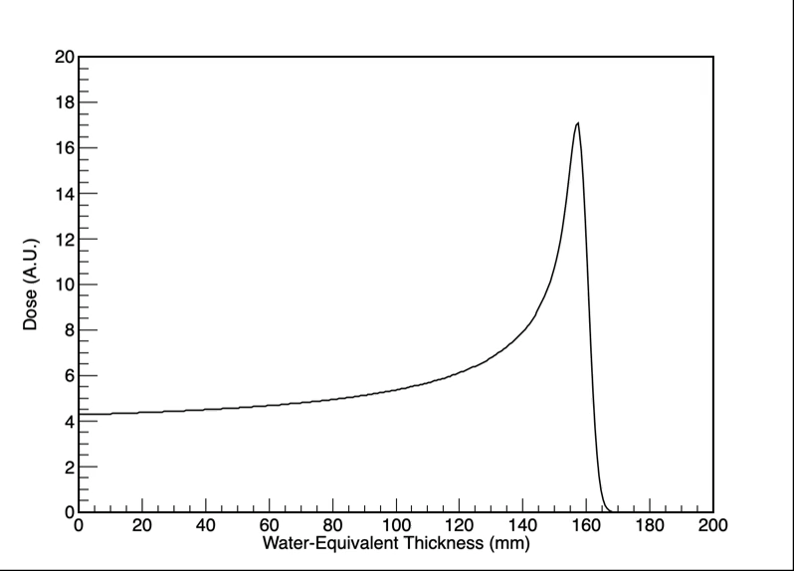
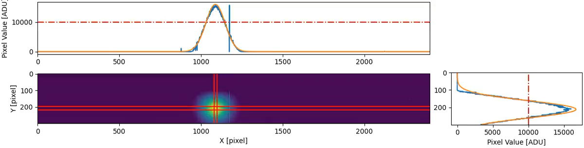
Proton Beam Therapy
70–250 MeV proton beams provide high precision radiotherapy.
The Quality Assurance Detector for Proton Beam Therapy (QuADProBe) will make realtime measurements of 3D dose to optimize treatment quality.
PhD Project:
  Integrate realtime dose monitoring from NPL Transmission Calorimeter.
  Develop front-end electronics and data acquisition system.
  Integrated GUI with range telescope (QuARC) and scintillating fibre profile monitor.
  Optimise fast spot scanning with Machine Learning.
  Install in a hospital…
Treating a lung tumour

