Slide 1
Proton Beam Therapy
Simon Jolly
Joe Bateman, Febian, Harry Barnett, Connor Godden, Matt Warren, Danial Saeed

Slide 2
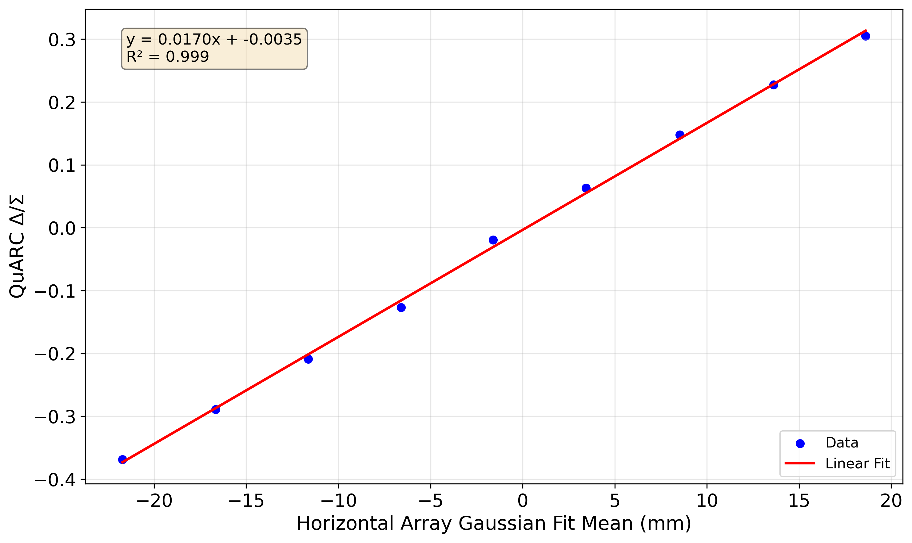
Living in a Flat Universe

Slide 3
Particle Dose Distribution
Unlike X-rays, charged particles stop!
Electrons, being lighter, scatter and spread out.
Protons deposit most dose at the end of their path: the Bragg Peak.

Slide 4
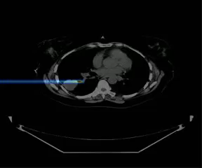
Pencil Beam Scanning

Slide 5
Beam Quality Assurance
We need to measure 4 key quantities in proton therapy beam QA:
Absolute dose:
Total number of protons/dose delivered per spot.
Overdosing results in healthy tissue toxicities.
Underdosing won’t eradicate primary tumour but still increases risk of secondaries.
Spot position:
Position of each spot relative to plan/treatment room isocentre.
Incorrect position means: inhomogeneities in dose to tumour and significantly more dose to healthy tissue.
Spot size:
Absolute RMS beam width in both transverse planes at isocentre.
Undersized spots cause cold spots in tumour dose.
Oversized spots cause hot spots in healthy tissue and less conformal dose.
Range:
Range in water (Water Equivalent Thickness/WET) for a given energy.
Range too short underdoses tumour.
Range too long deposits most damaging dose beyond tumour into healthy tissue.
Ideally measure all these quantities for all these quantites:
Spot size, range and dose for all positions AND gantry angles.

Slide 6
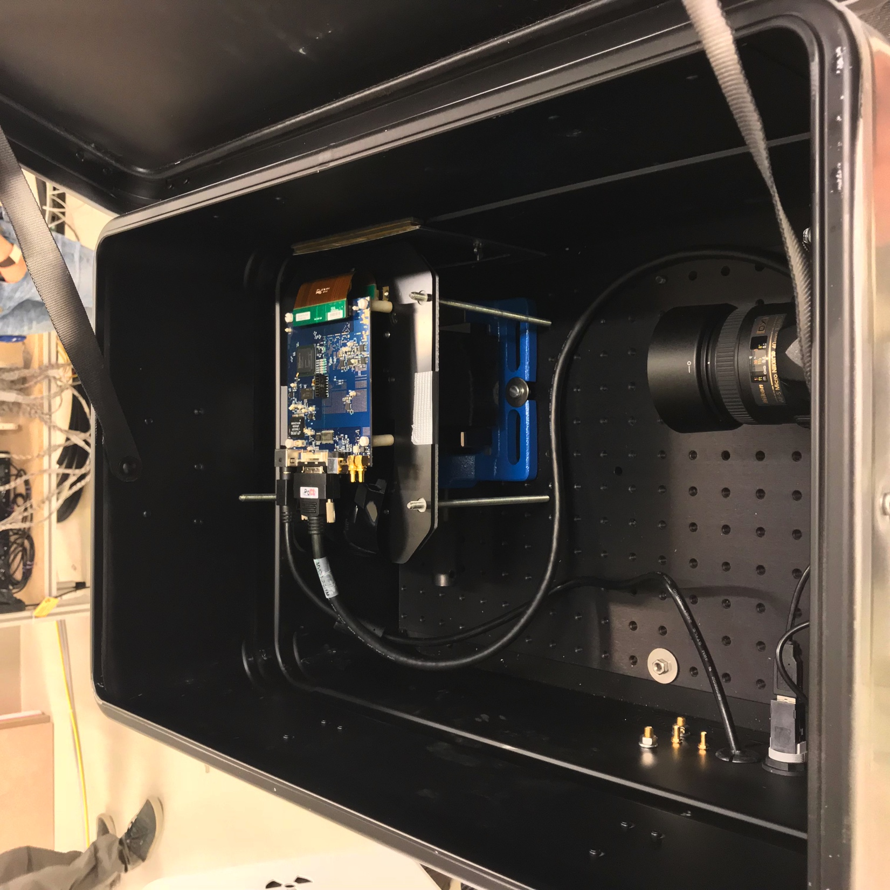
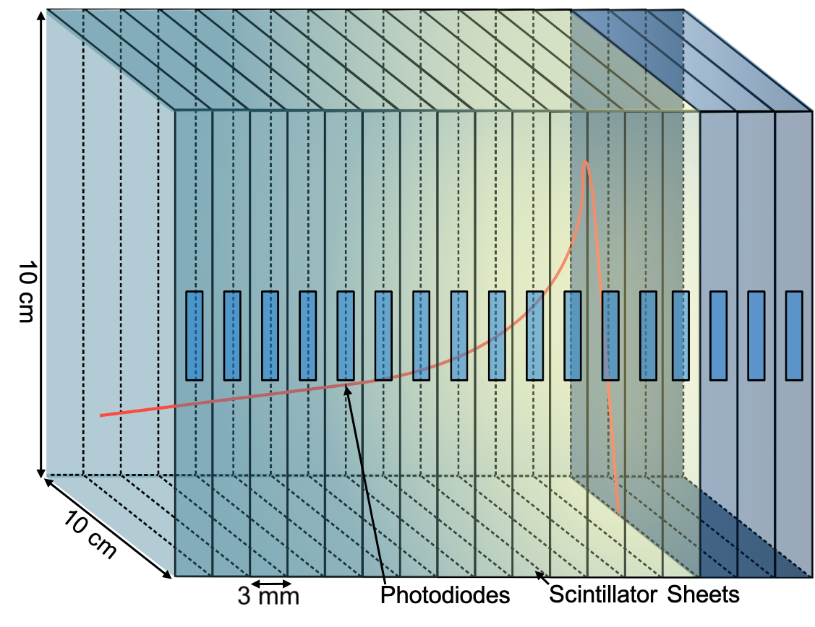
The Quality Assurance Range Calorimeter

Slide 7

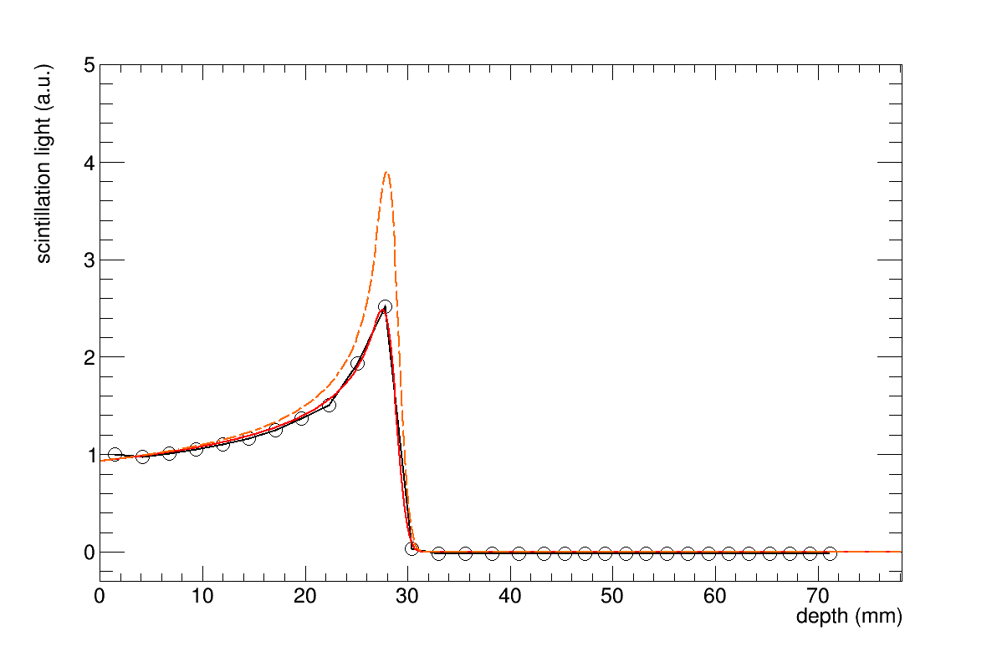
Range Quality Assurance v0.1

Slide 8
It Works

Slide 9
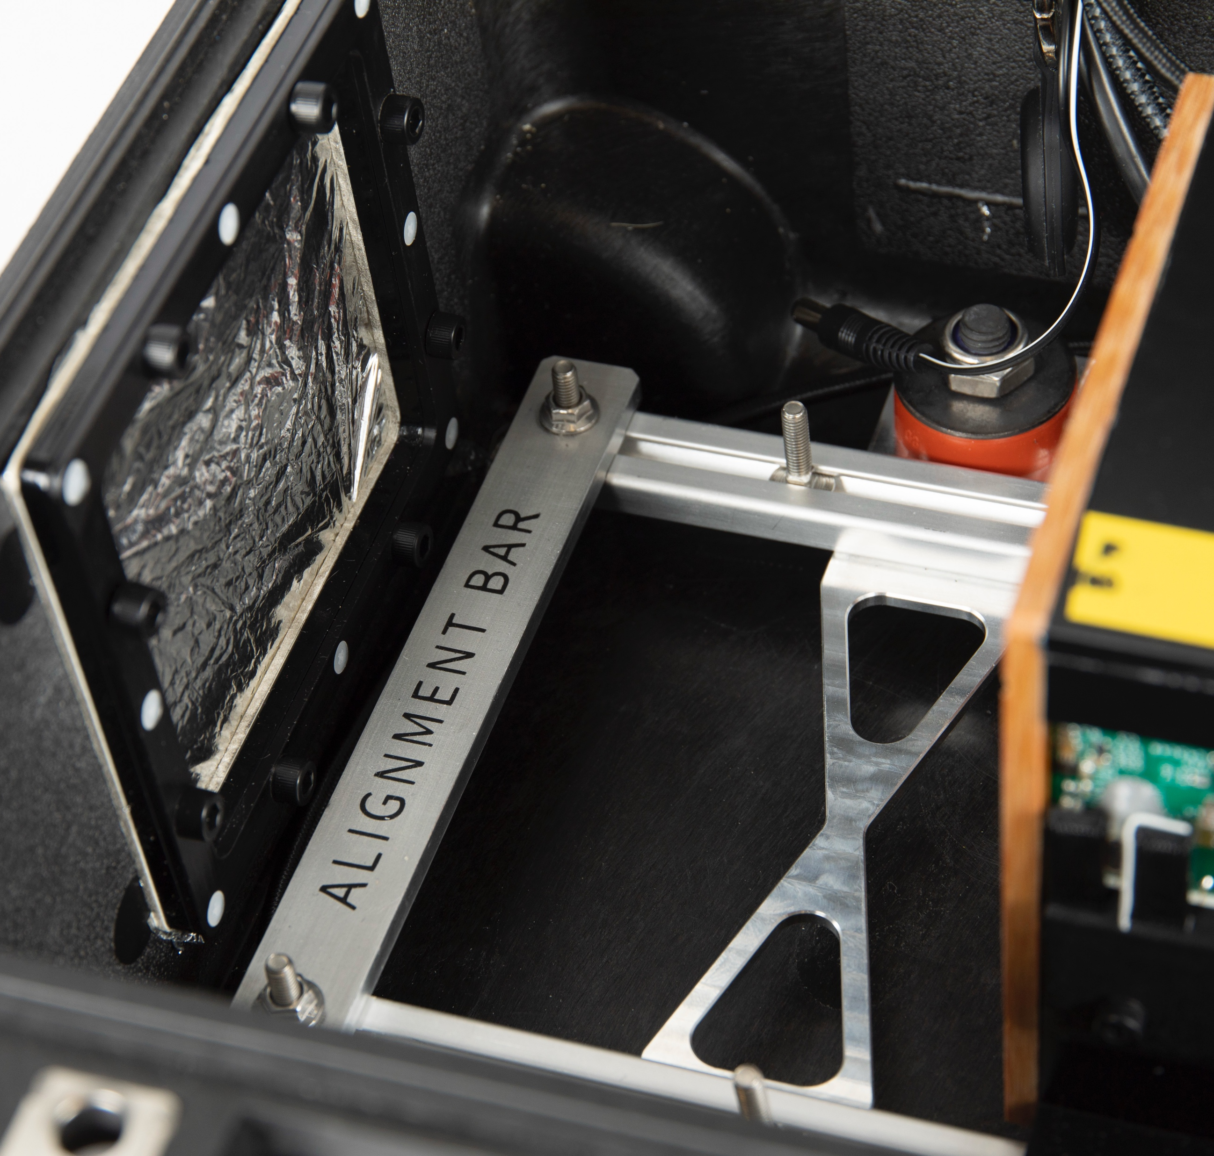
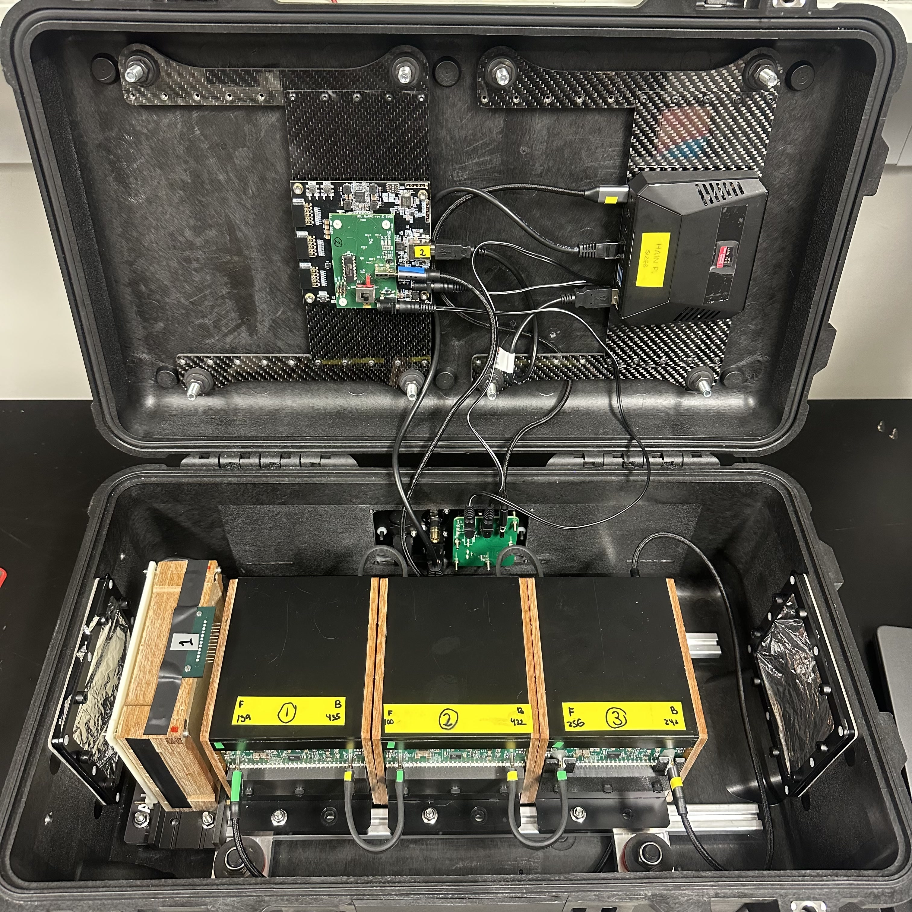
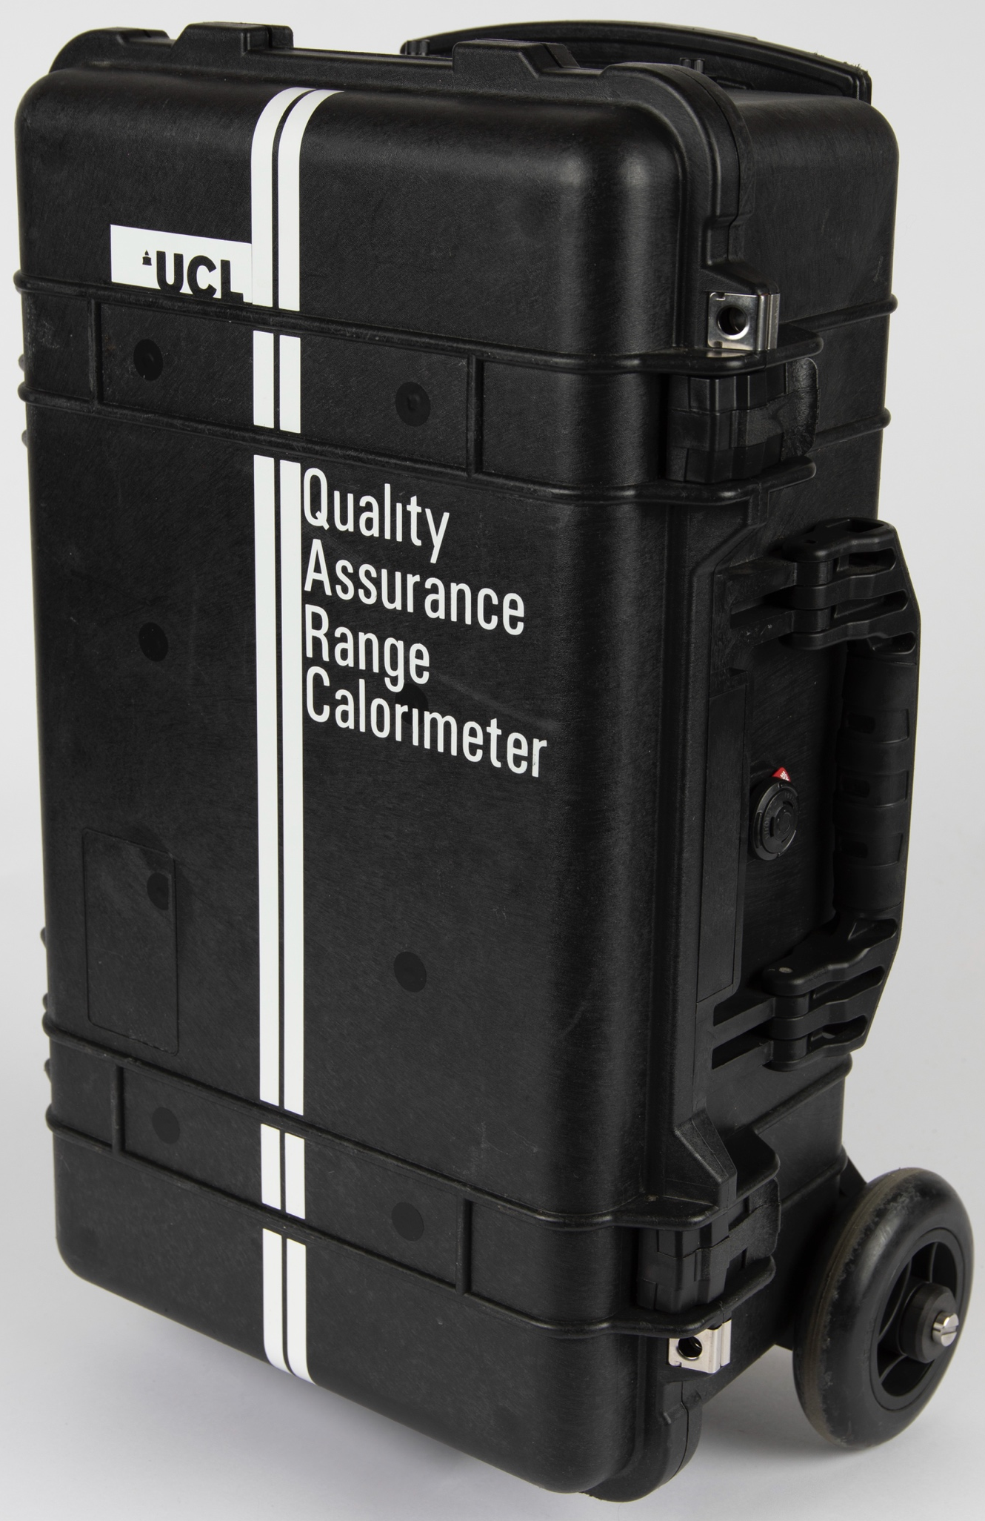
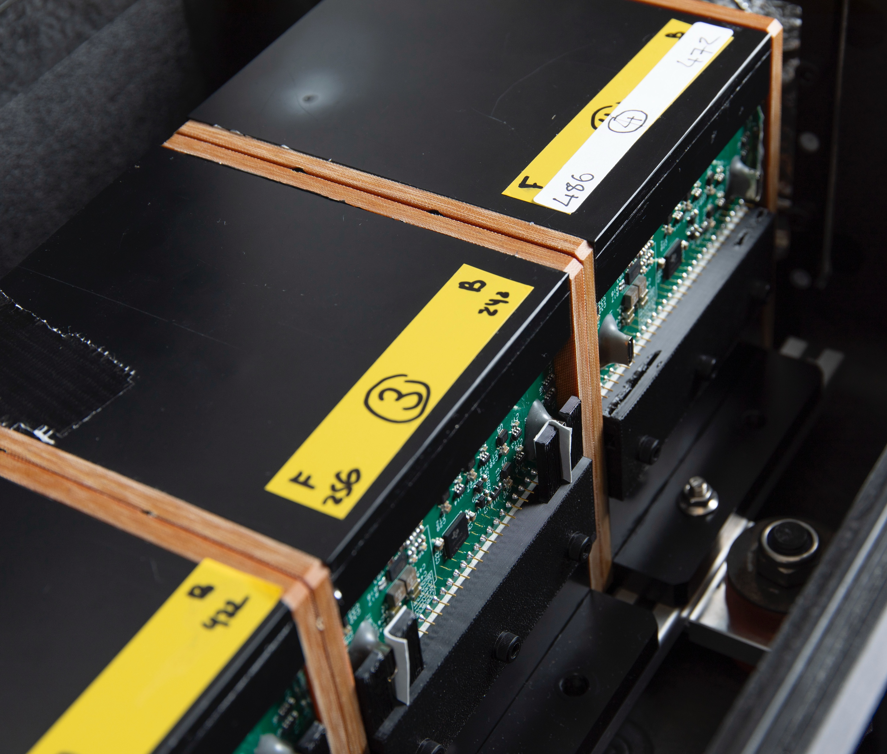
Quality Assurance Detector for Proton Beam Therapy
FPGA
Pi
SciFi
QuARC

Slide 10
QuADProBe Components
Quality Assurance Range Calorimeter (QuARC):
5 kHz measurements of water-equivalent range with plastic scintillator.
Scintillating Fibre profile monitor (SciFi):
10 kHz beam spot size and position measurements with 500 µm scintillating fibre.
USB104 FPGA:
Acquires data from front-end electronics over USB-C.
Raspberry Pi:
Reads data from FPGA over USB and runs web interface.

Slide 11
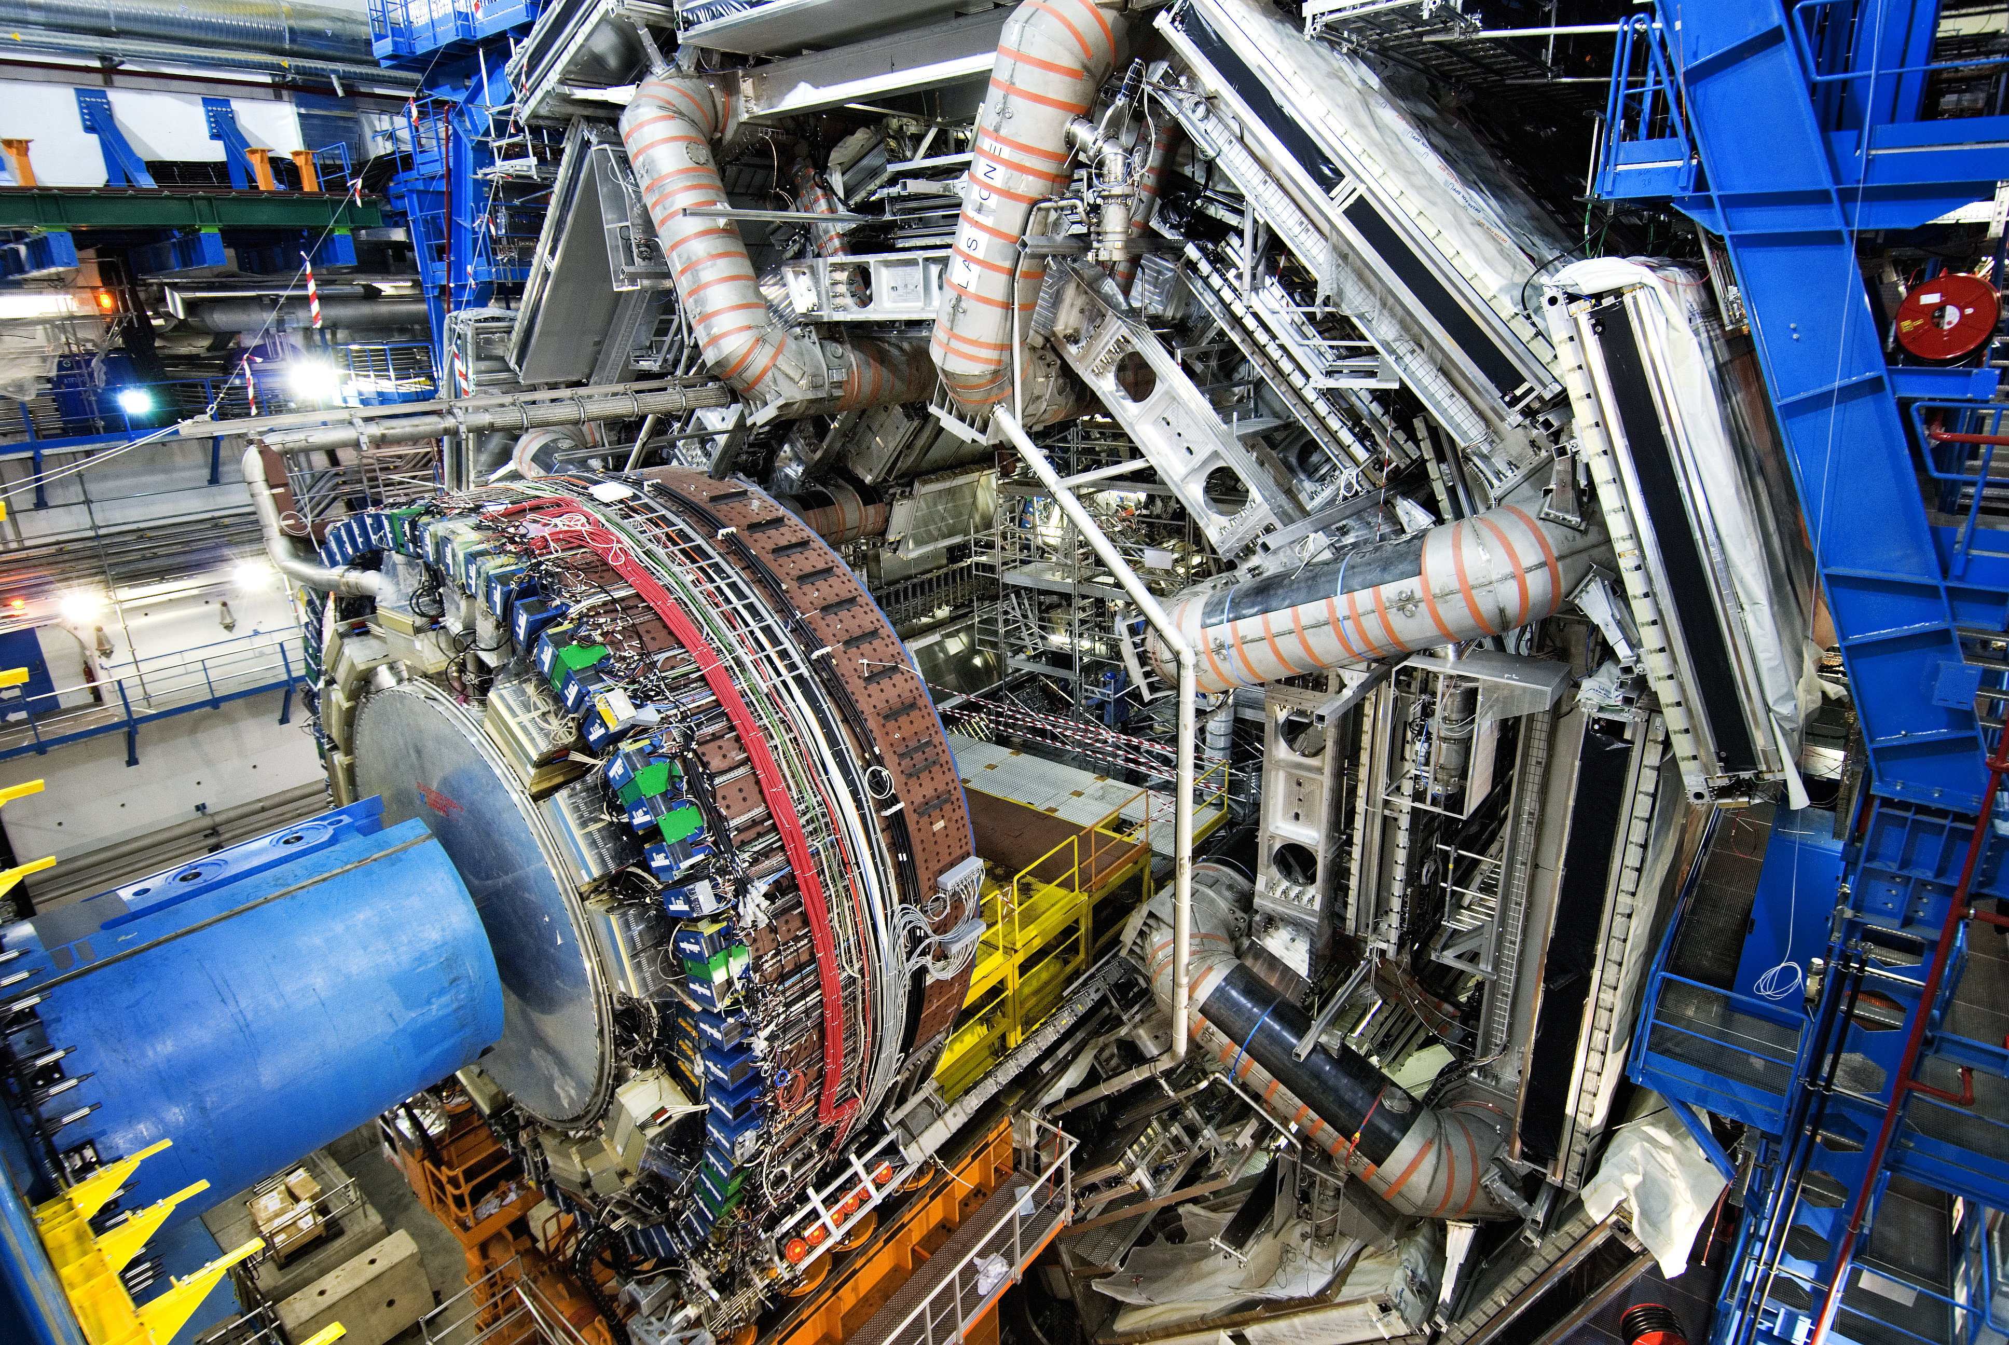
Size Doesn’t Matter (But It Really Does)

Slide 12
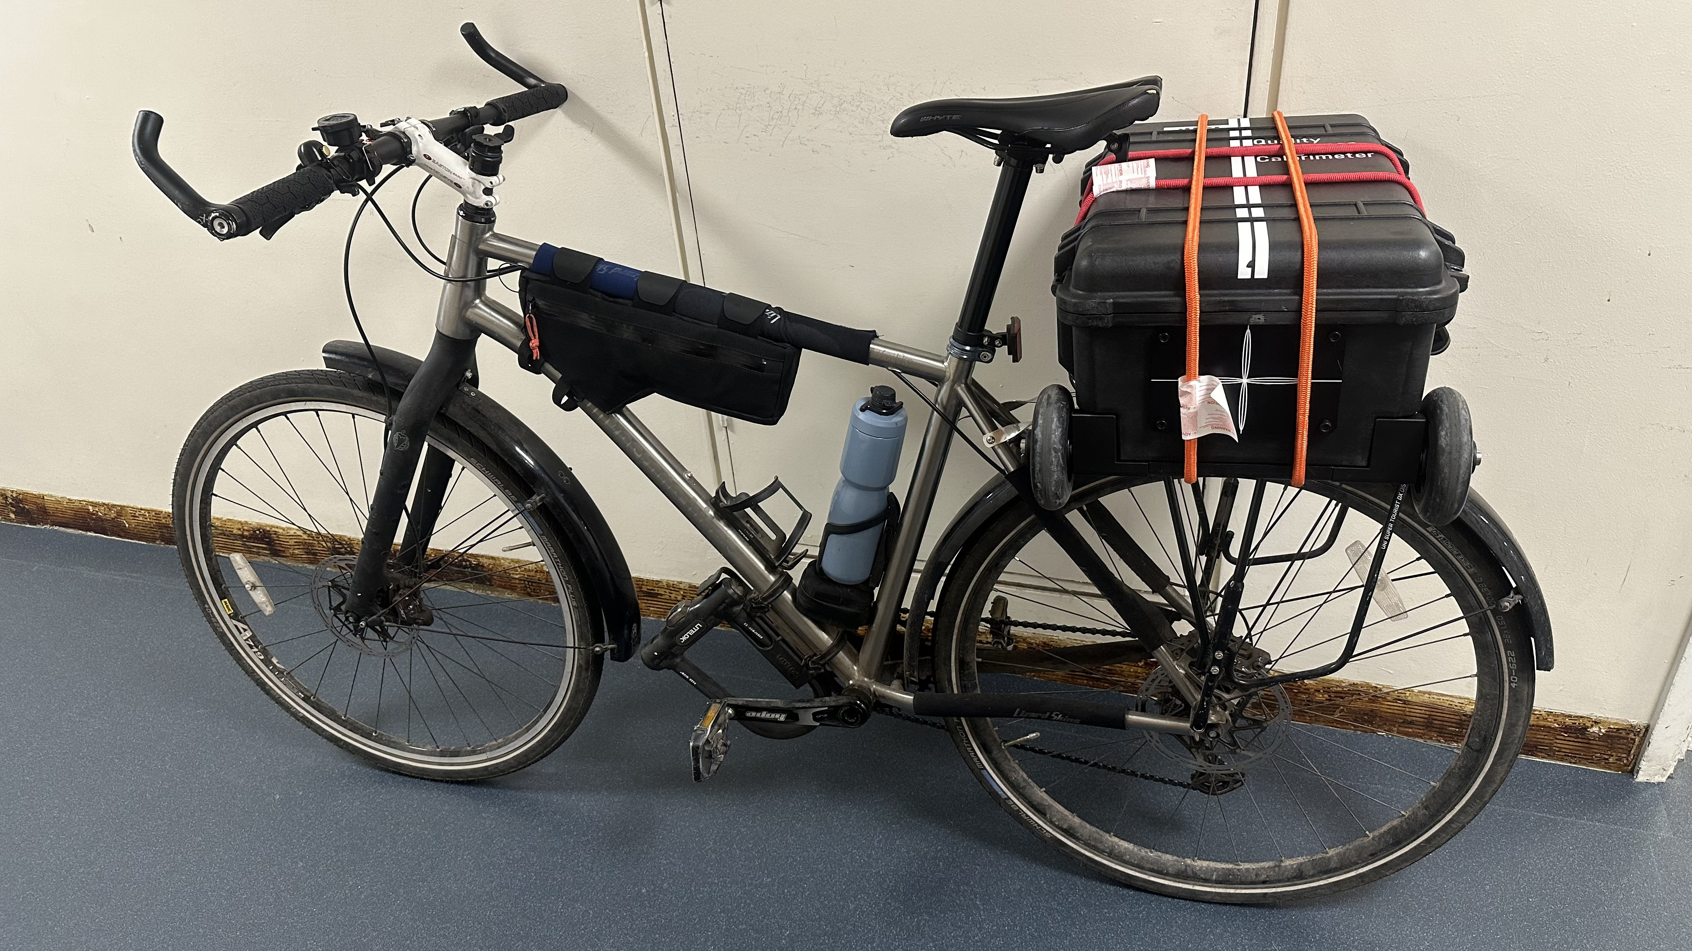
Size Doesn’t Matter (But It Really Does)

Slide 13
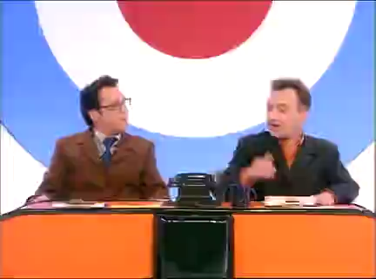
Scientific Parts

Slide 14
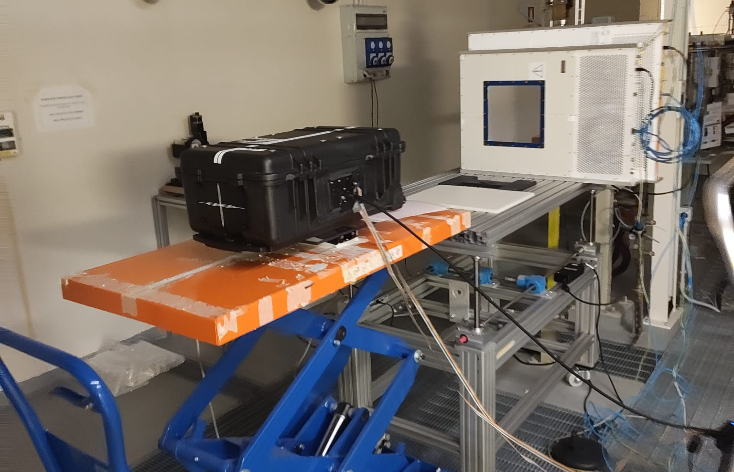
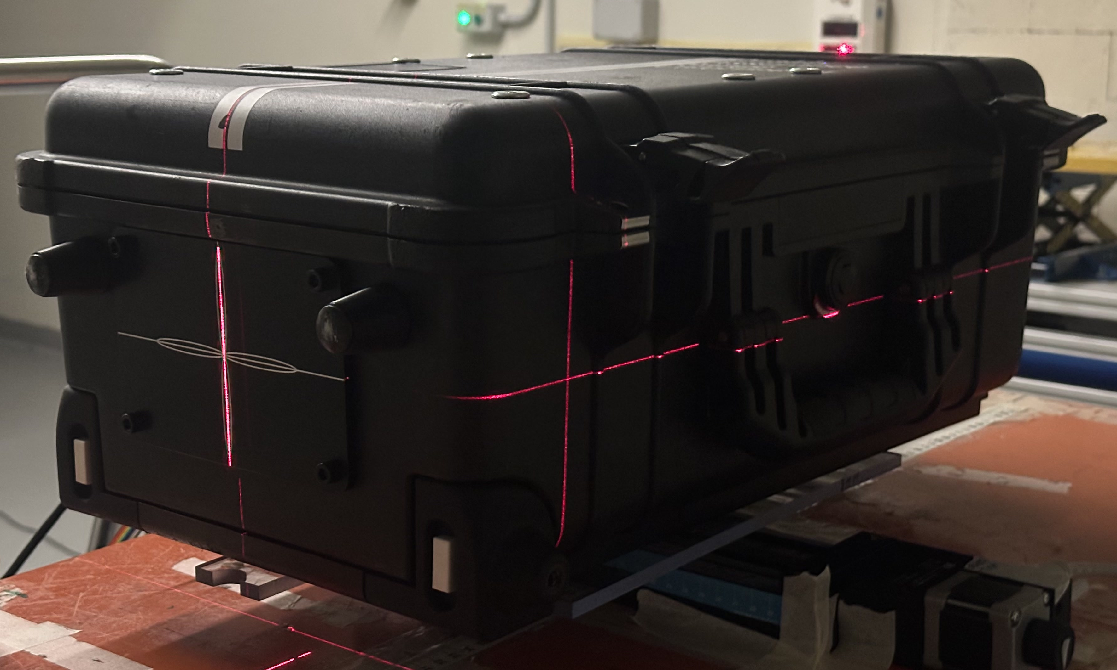
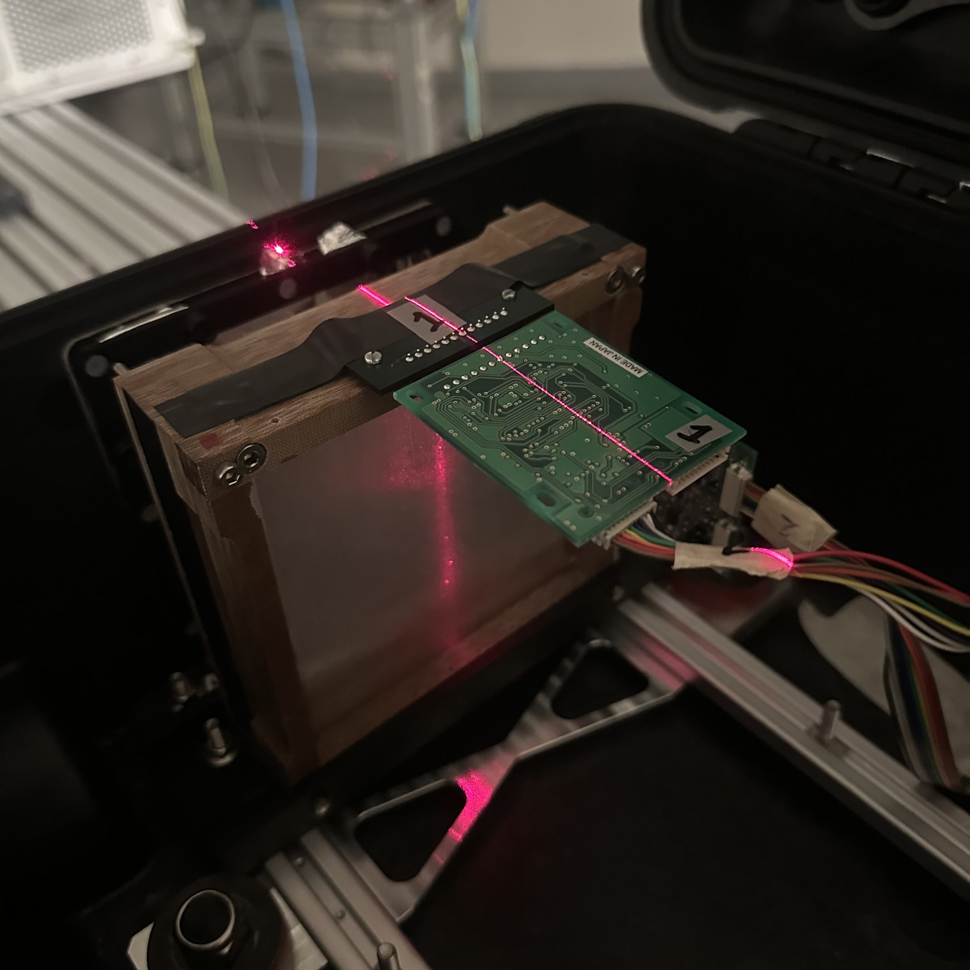
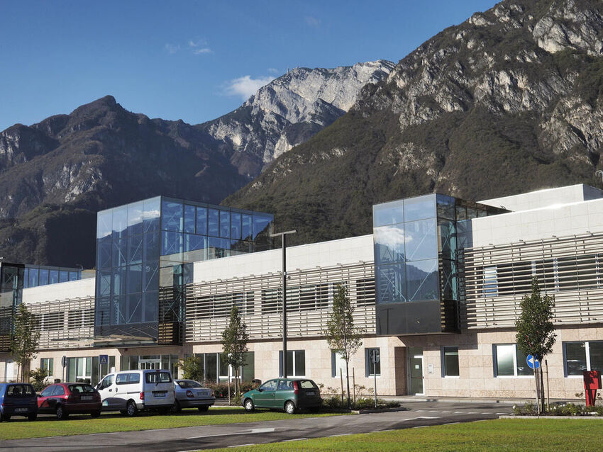
Trento Beam Test
3 nights in Trento PTC research room:
Night 1: QuARC Calibrations and Bragg Peak measurements scaling current up to FLASH (briefly).
Night 2: Combined QuARC + SciFi:
Dynamic range testing (fibres at low gain)
Beam position measurements
Night 3: SciFi Measurements
Dynamic range testing (fibres at high gain)
Different spot sizes (varying energy)

Slide 15
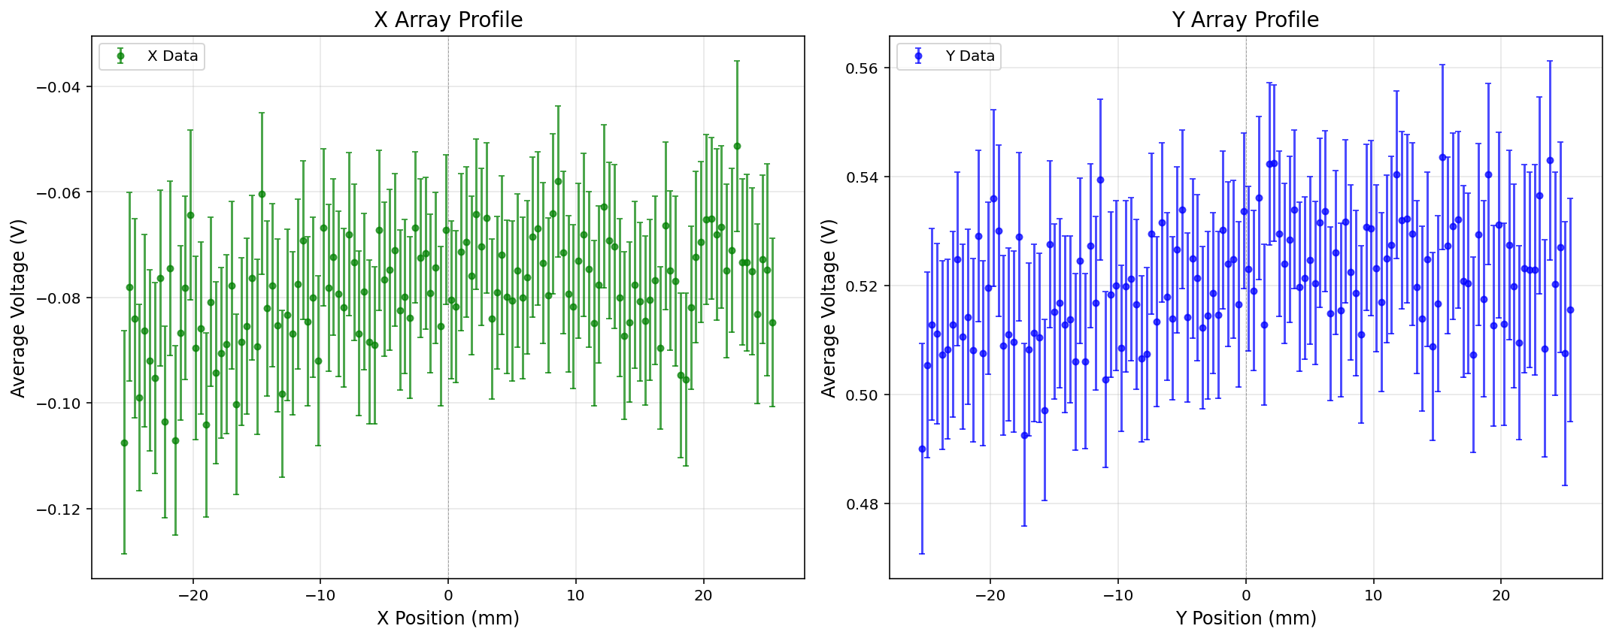
SciFi Response

Slide 16
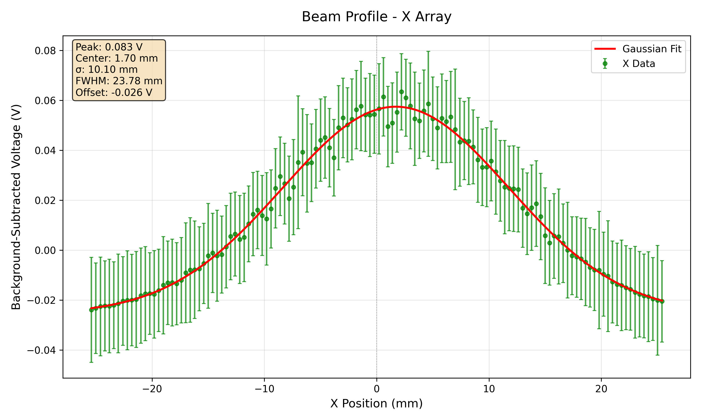
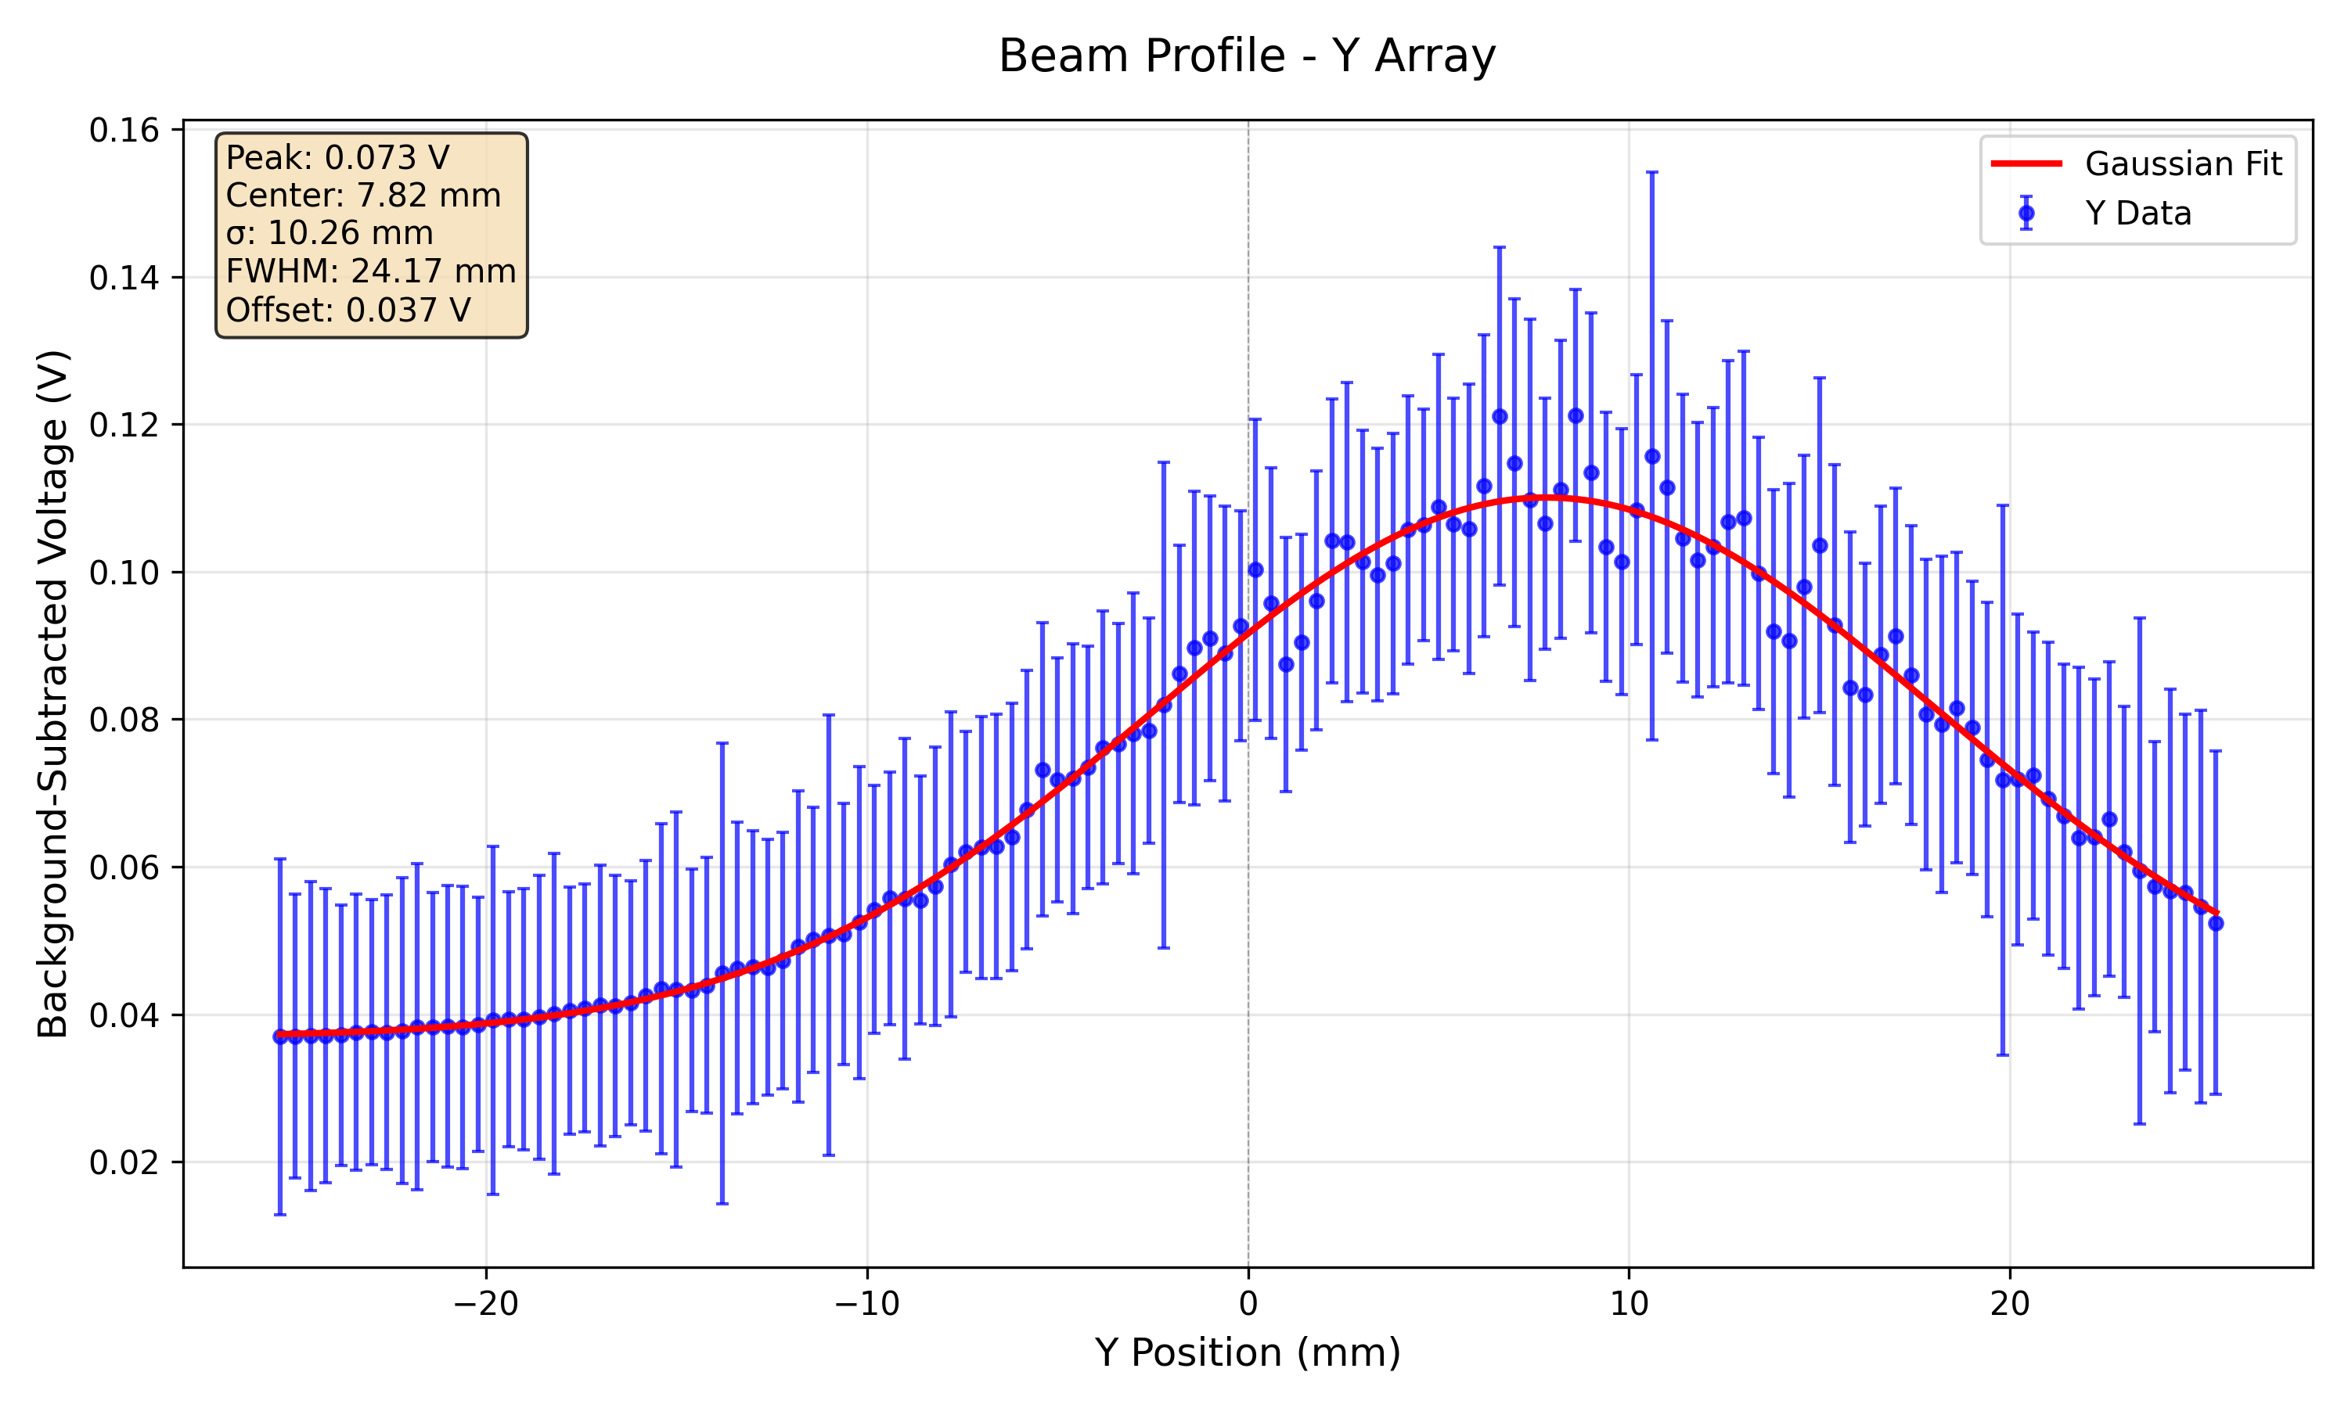
SciFi Response (70 MeV, 300 nA)

Slide 17
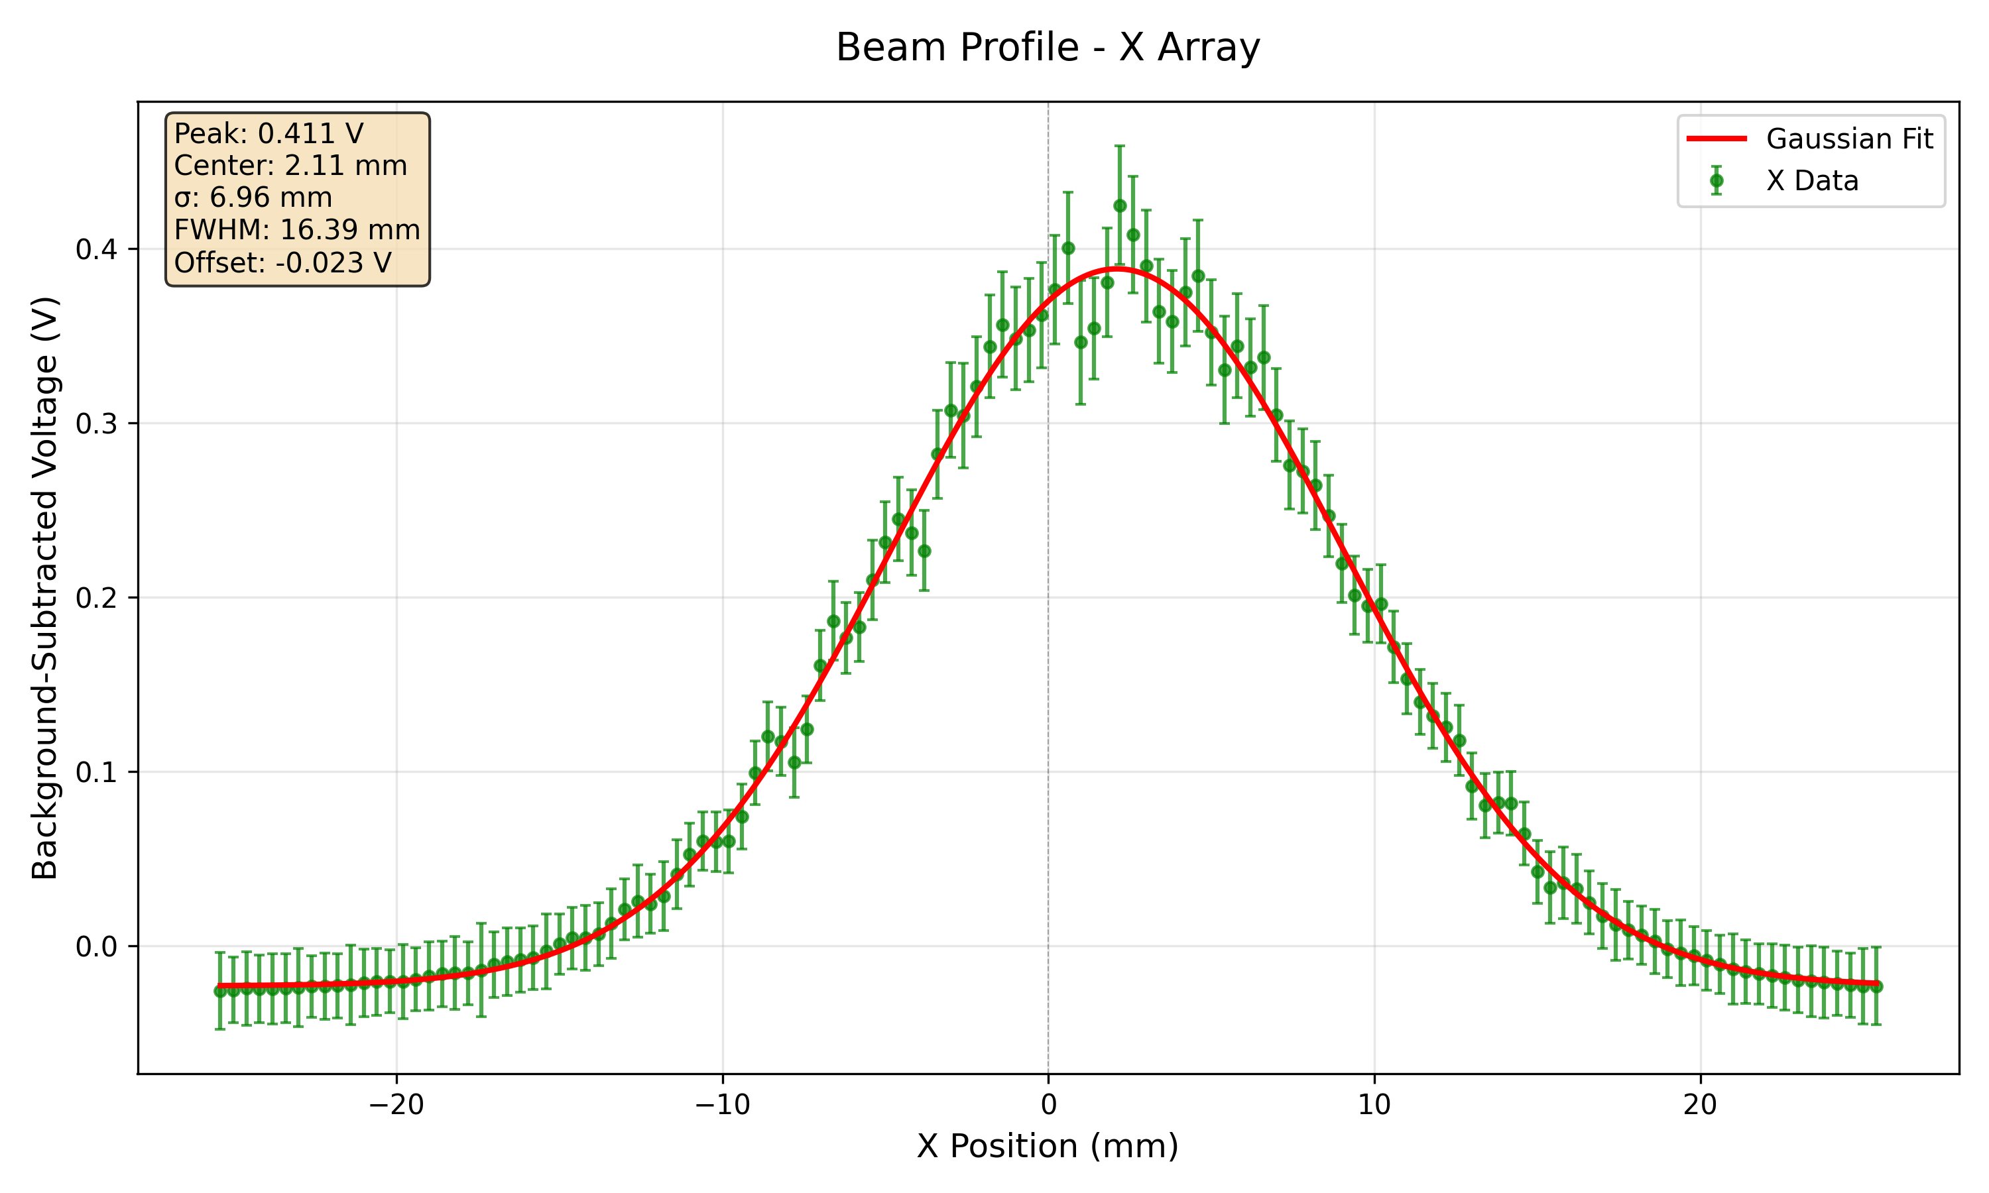
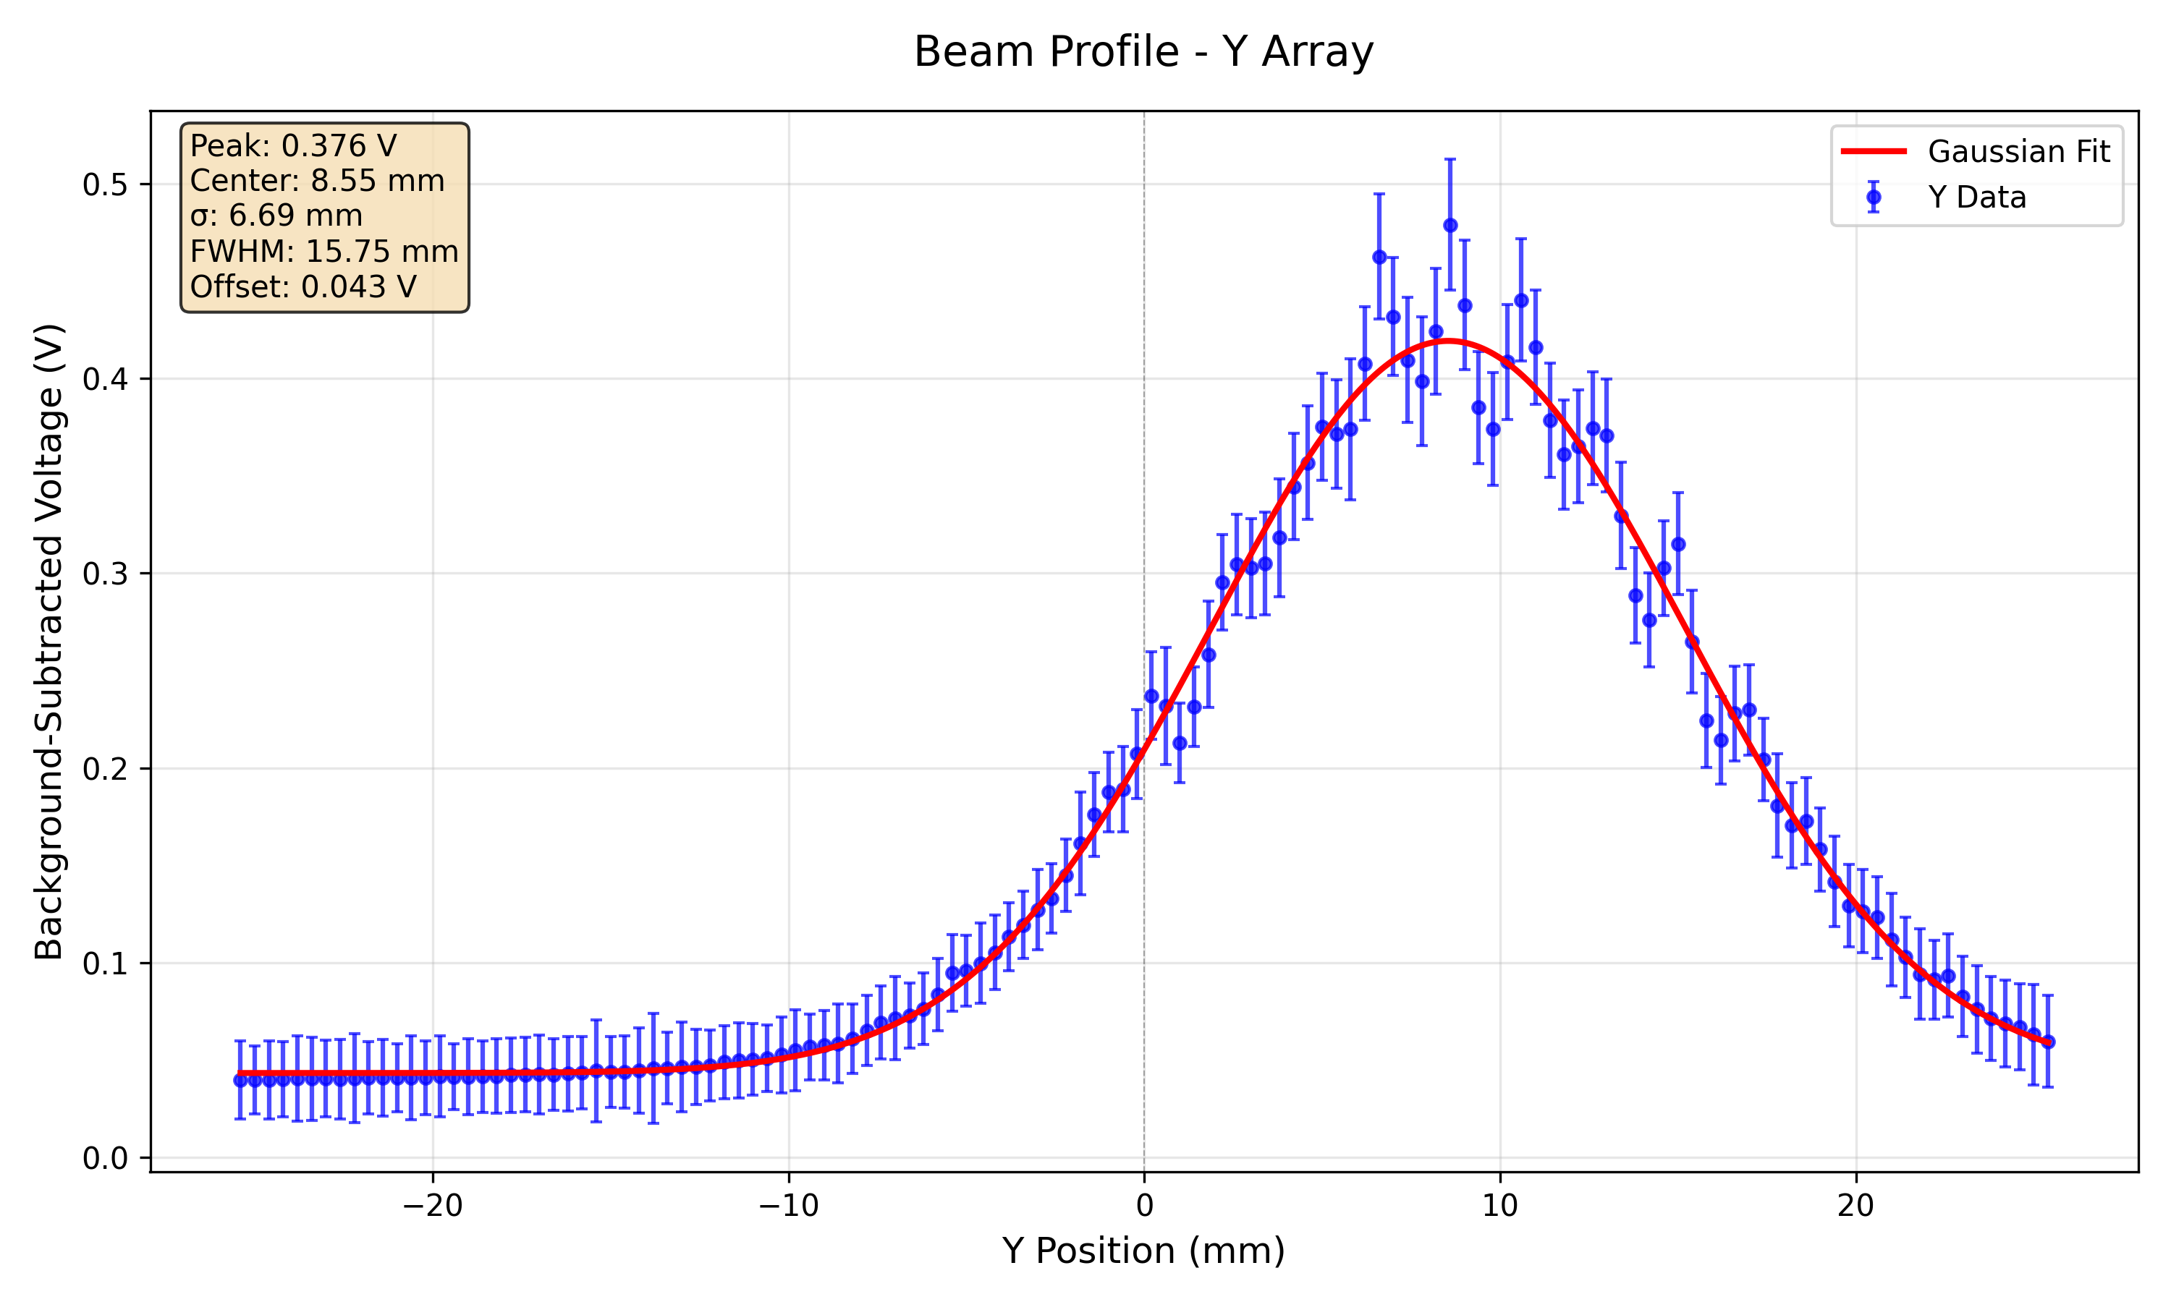
SciFi Response (112 MeV, 300 nA)

Slide 18
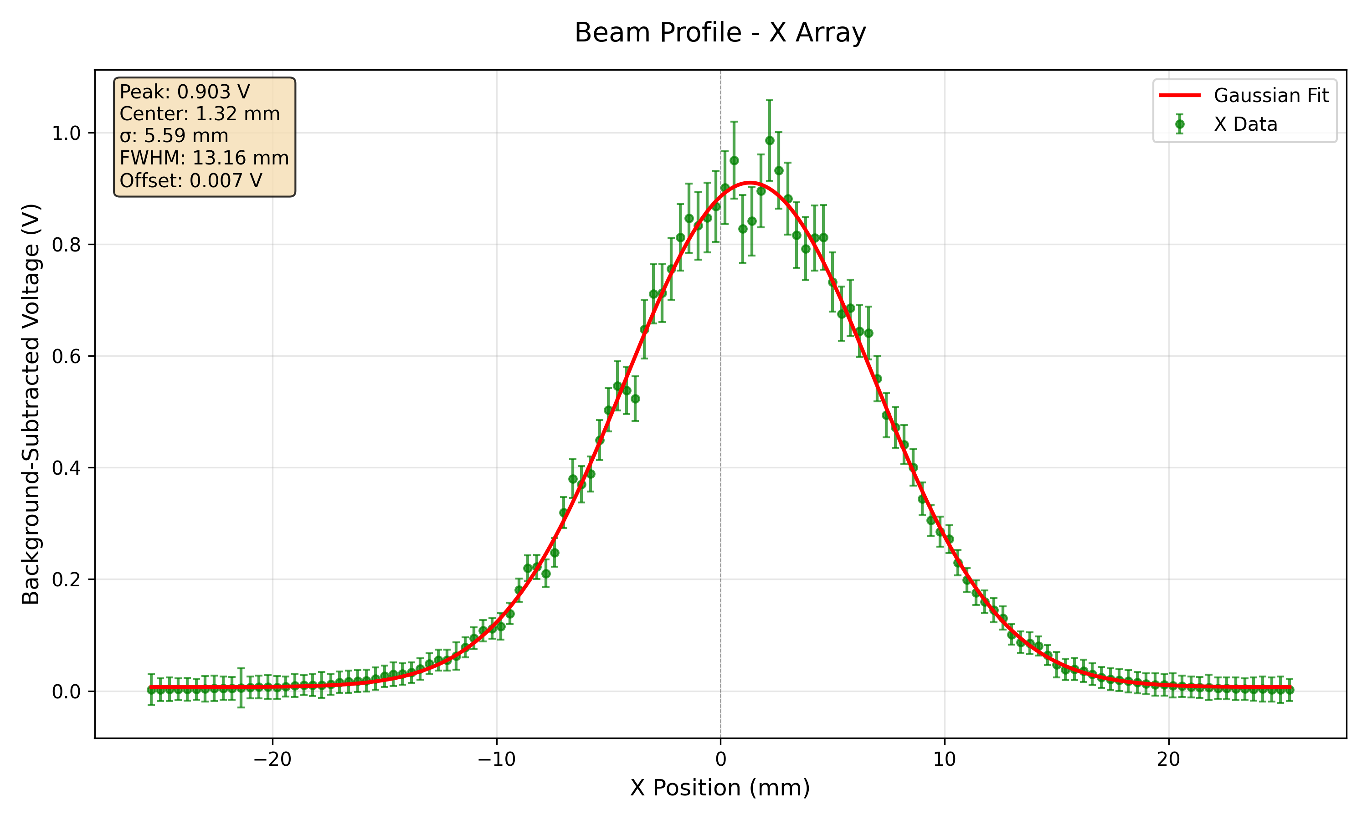
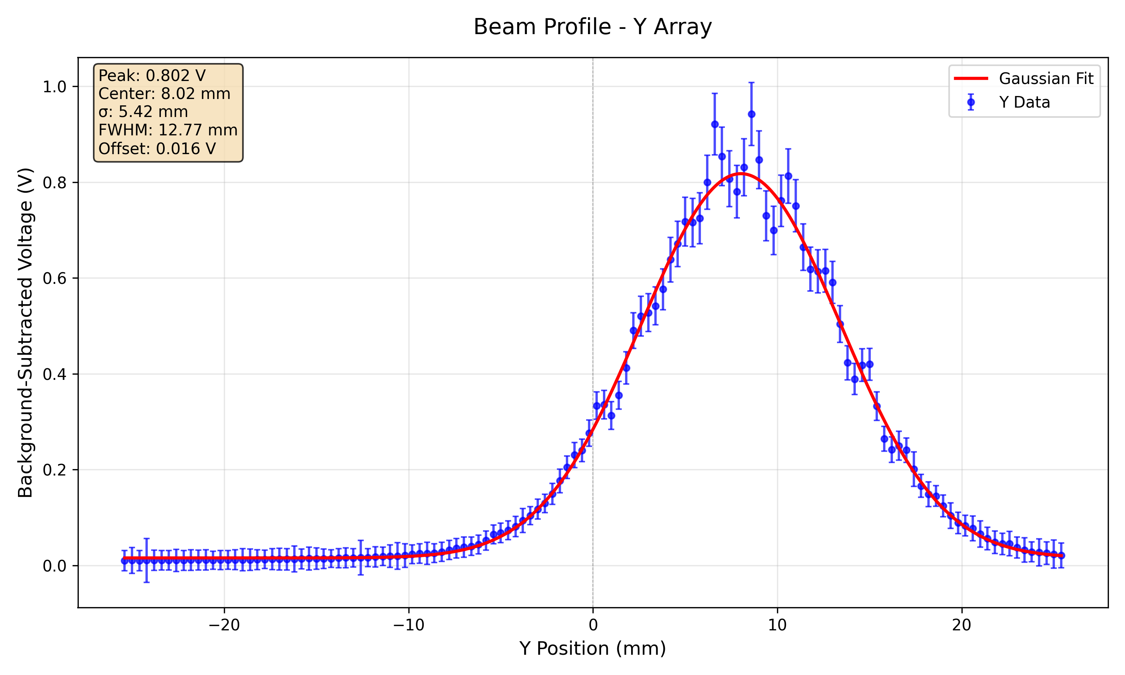
SciFi Response (148 MeV, 300 nA)

Slide 19
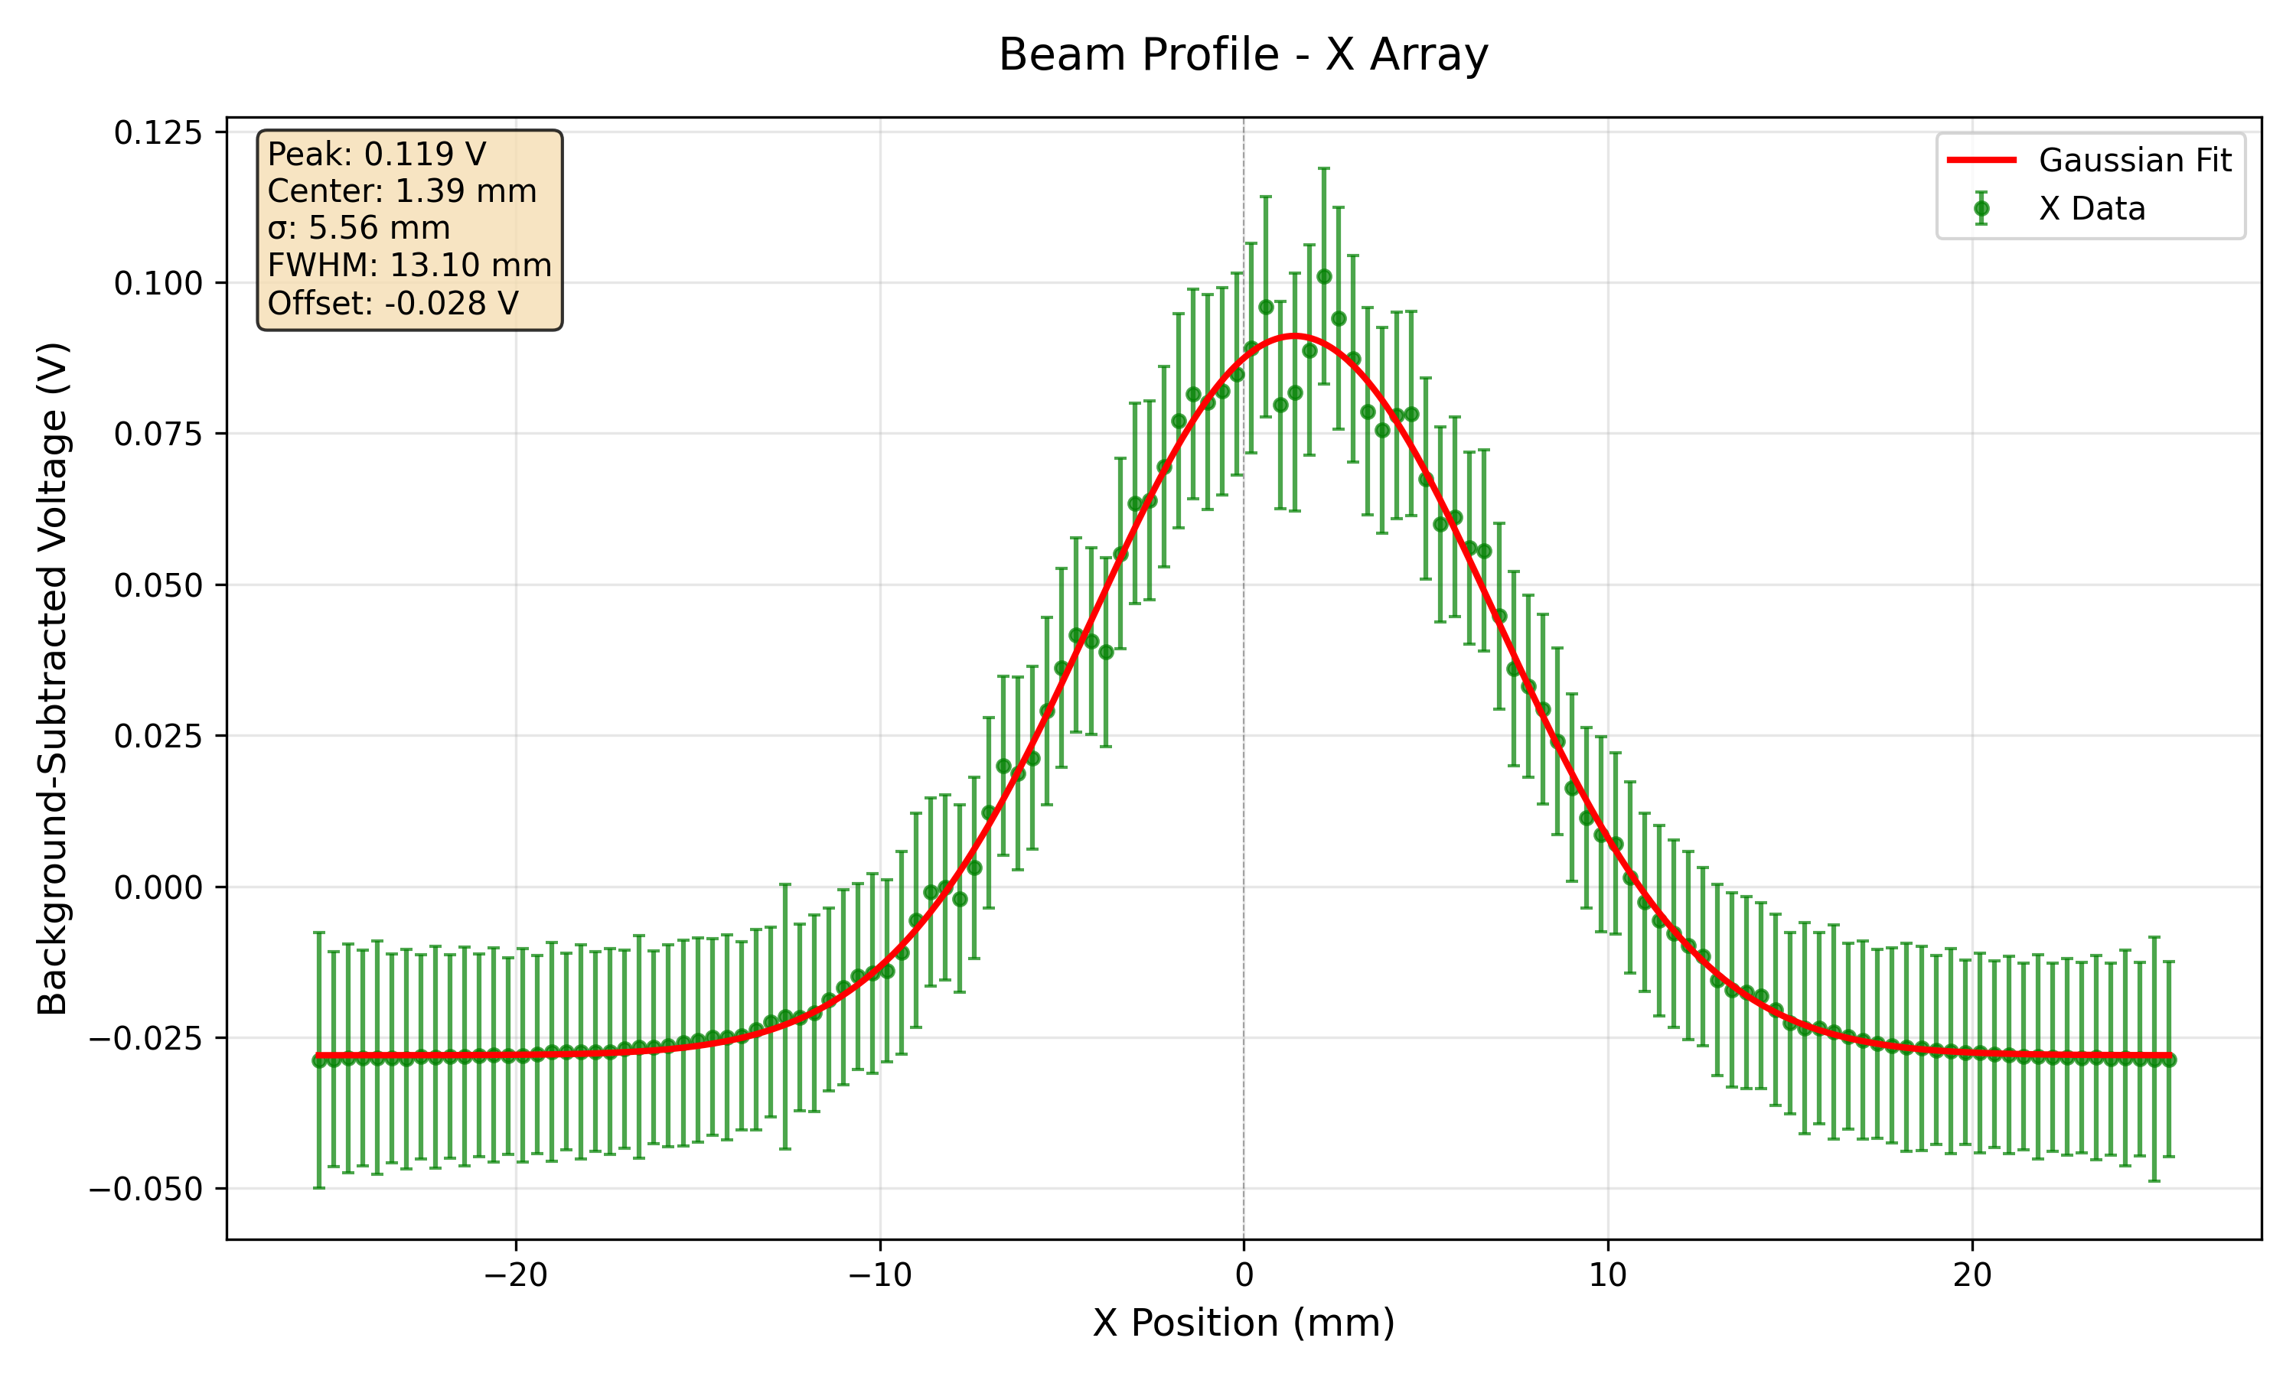
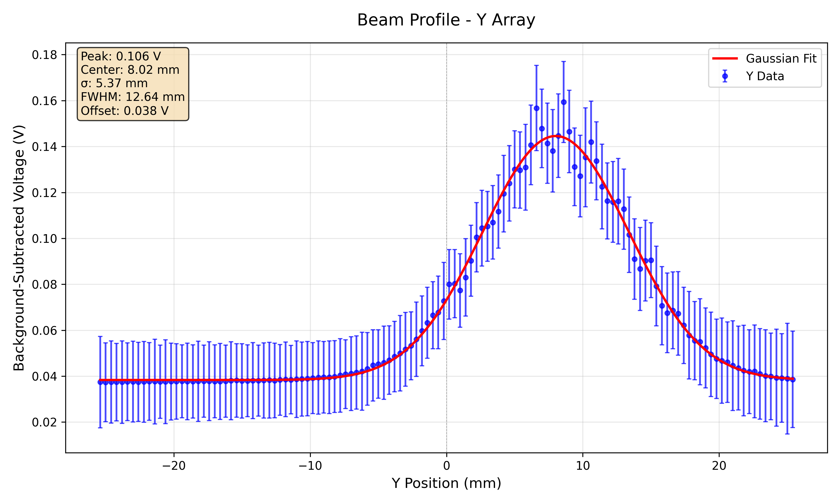
SciFi Response (148 MeV, 40 nA)

Slide 20
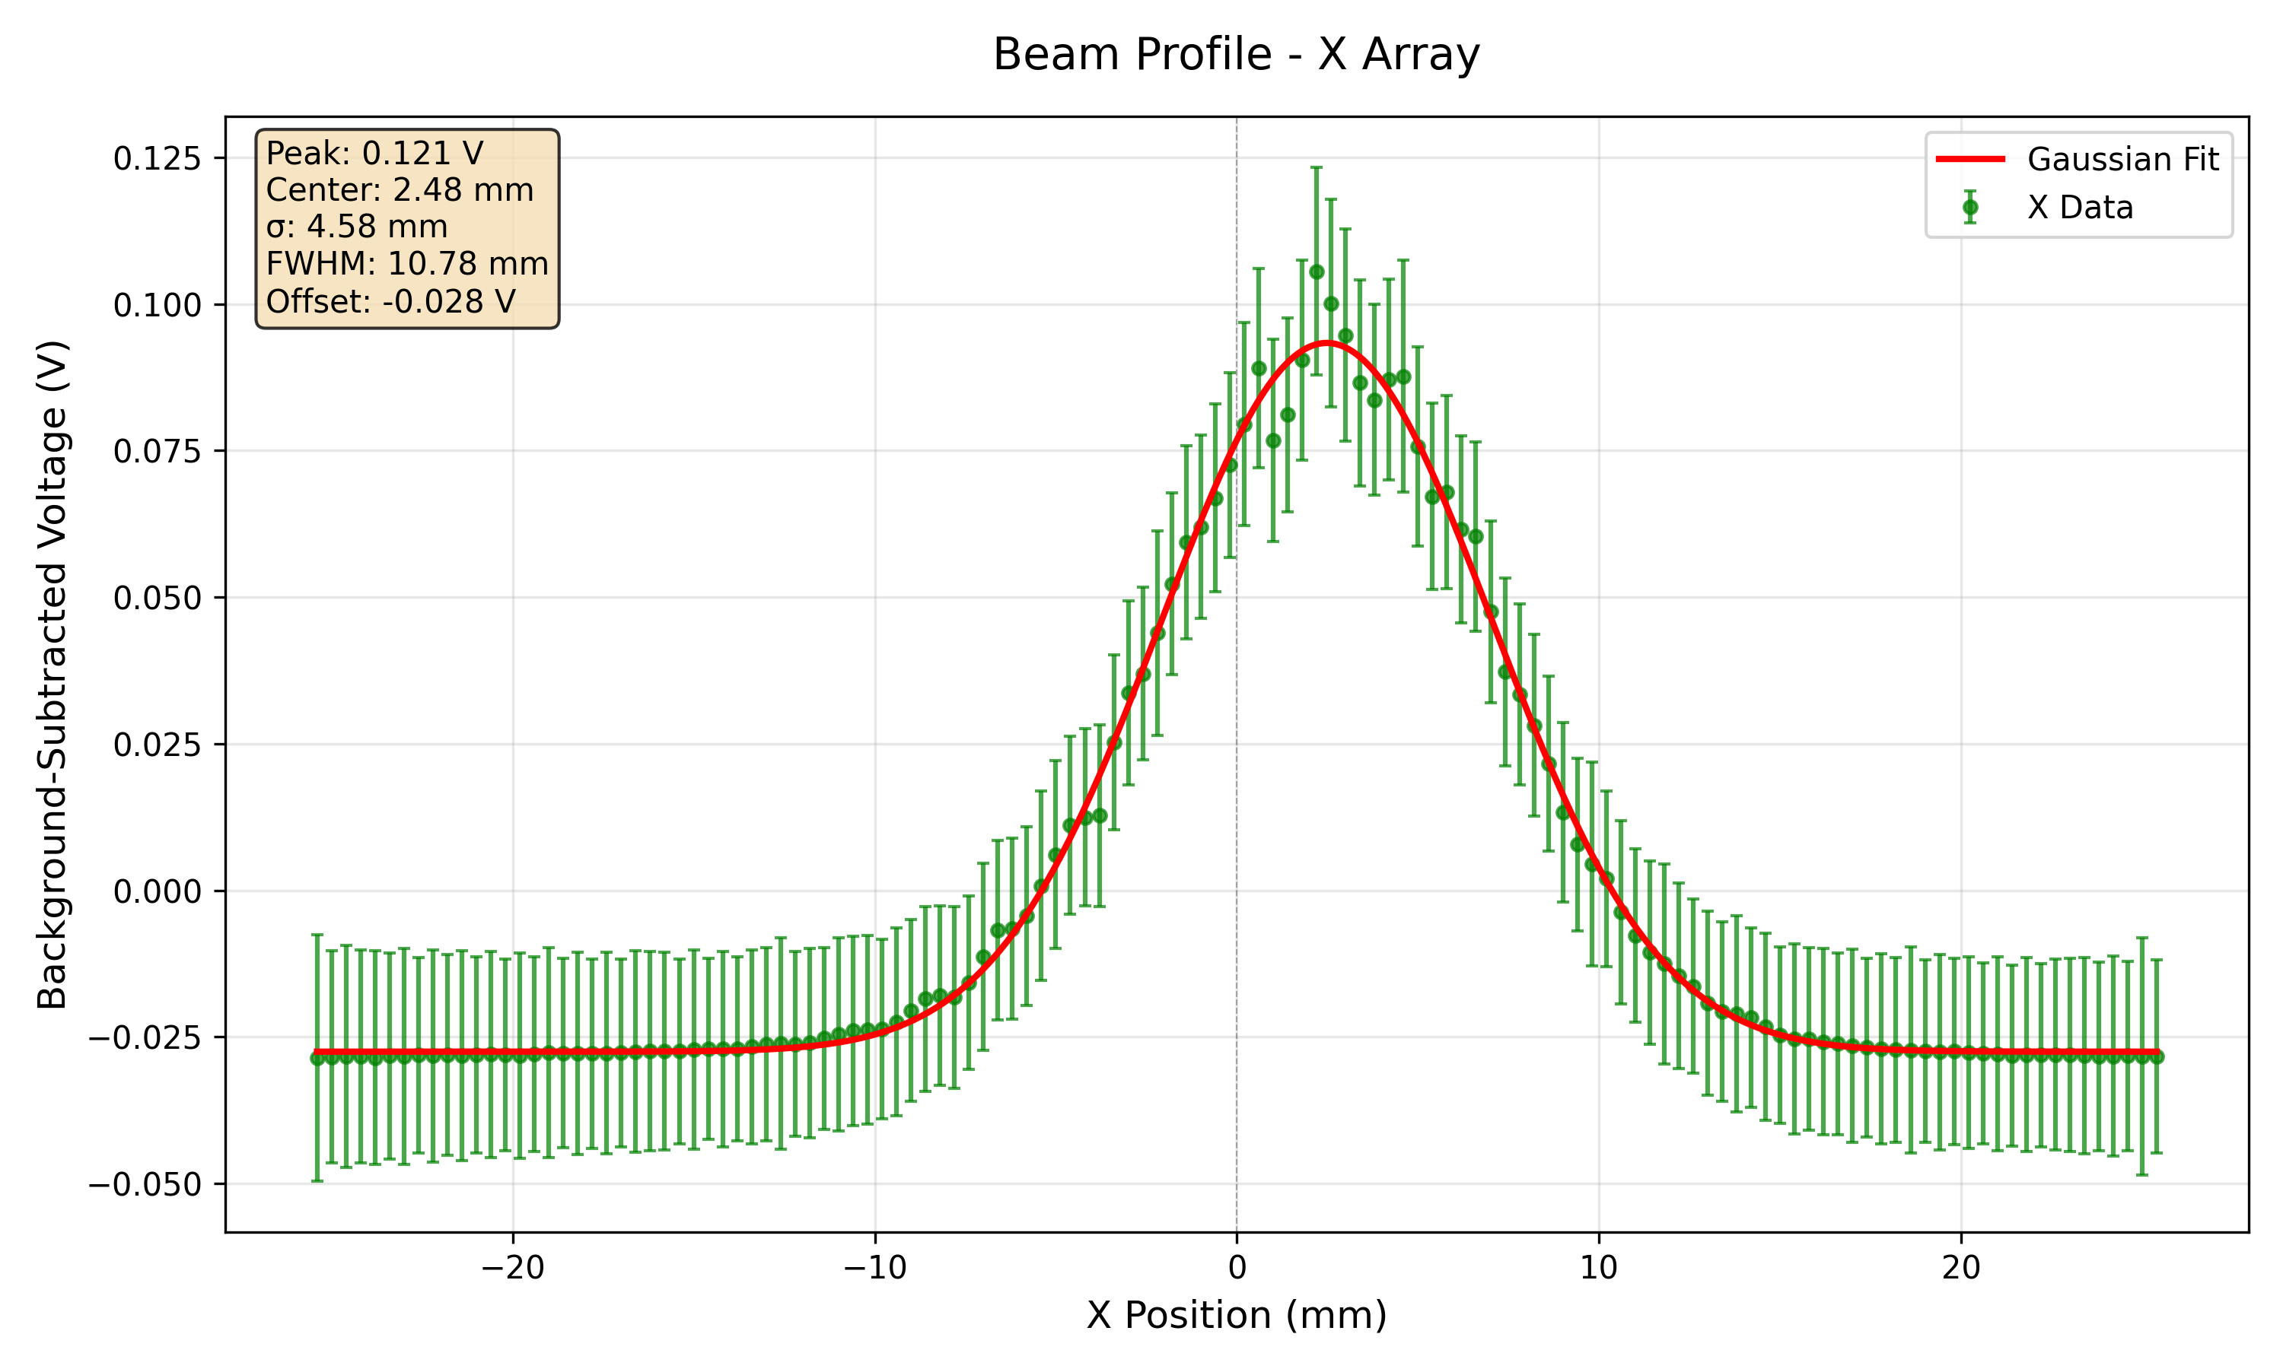
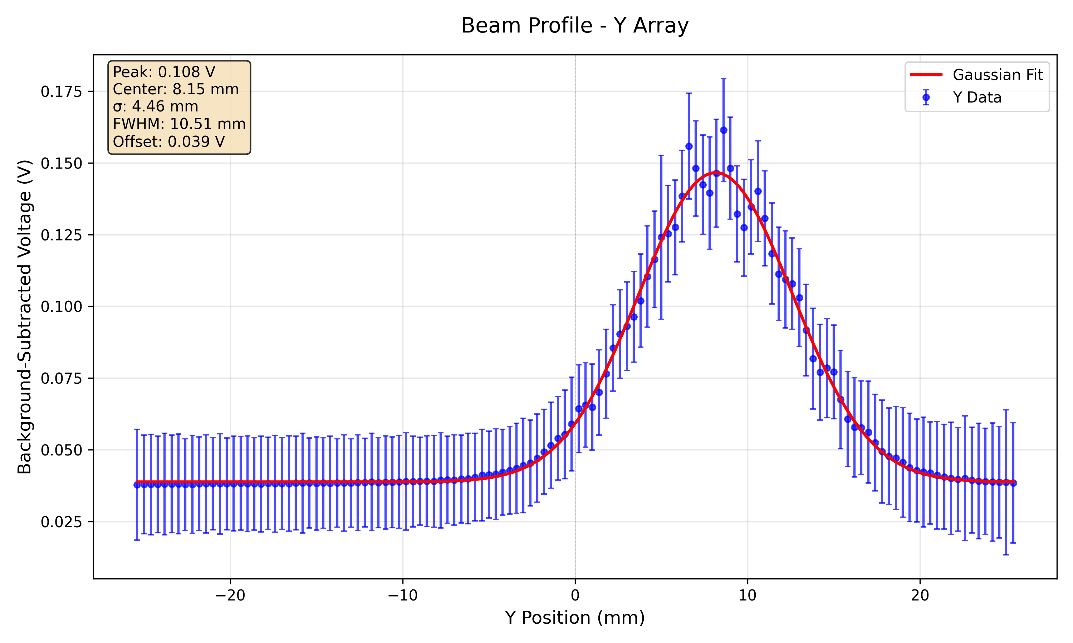
SciFi Response (179 MeV, 20 nA)

Slide 21
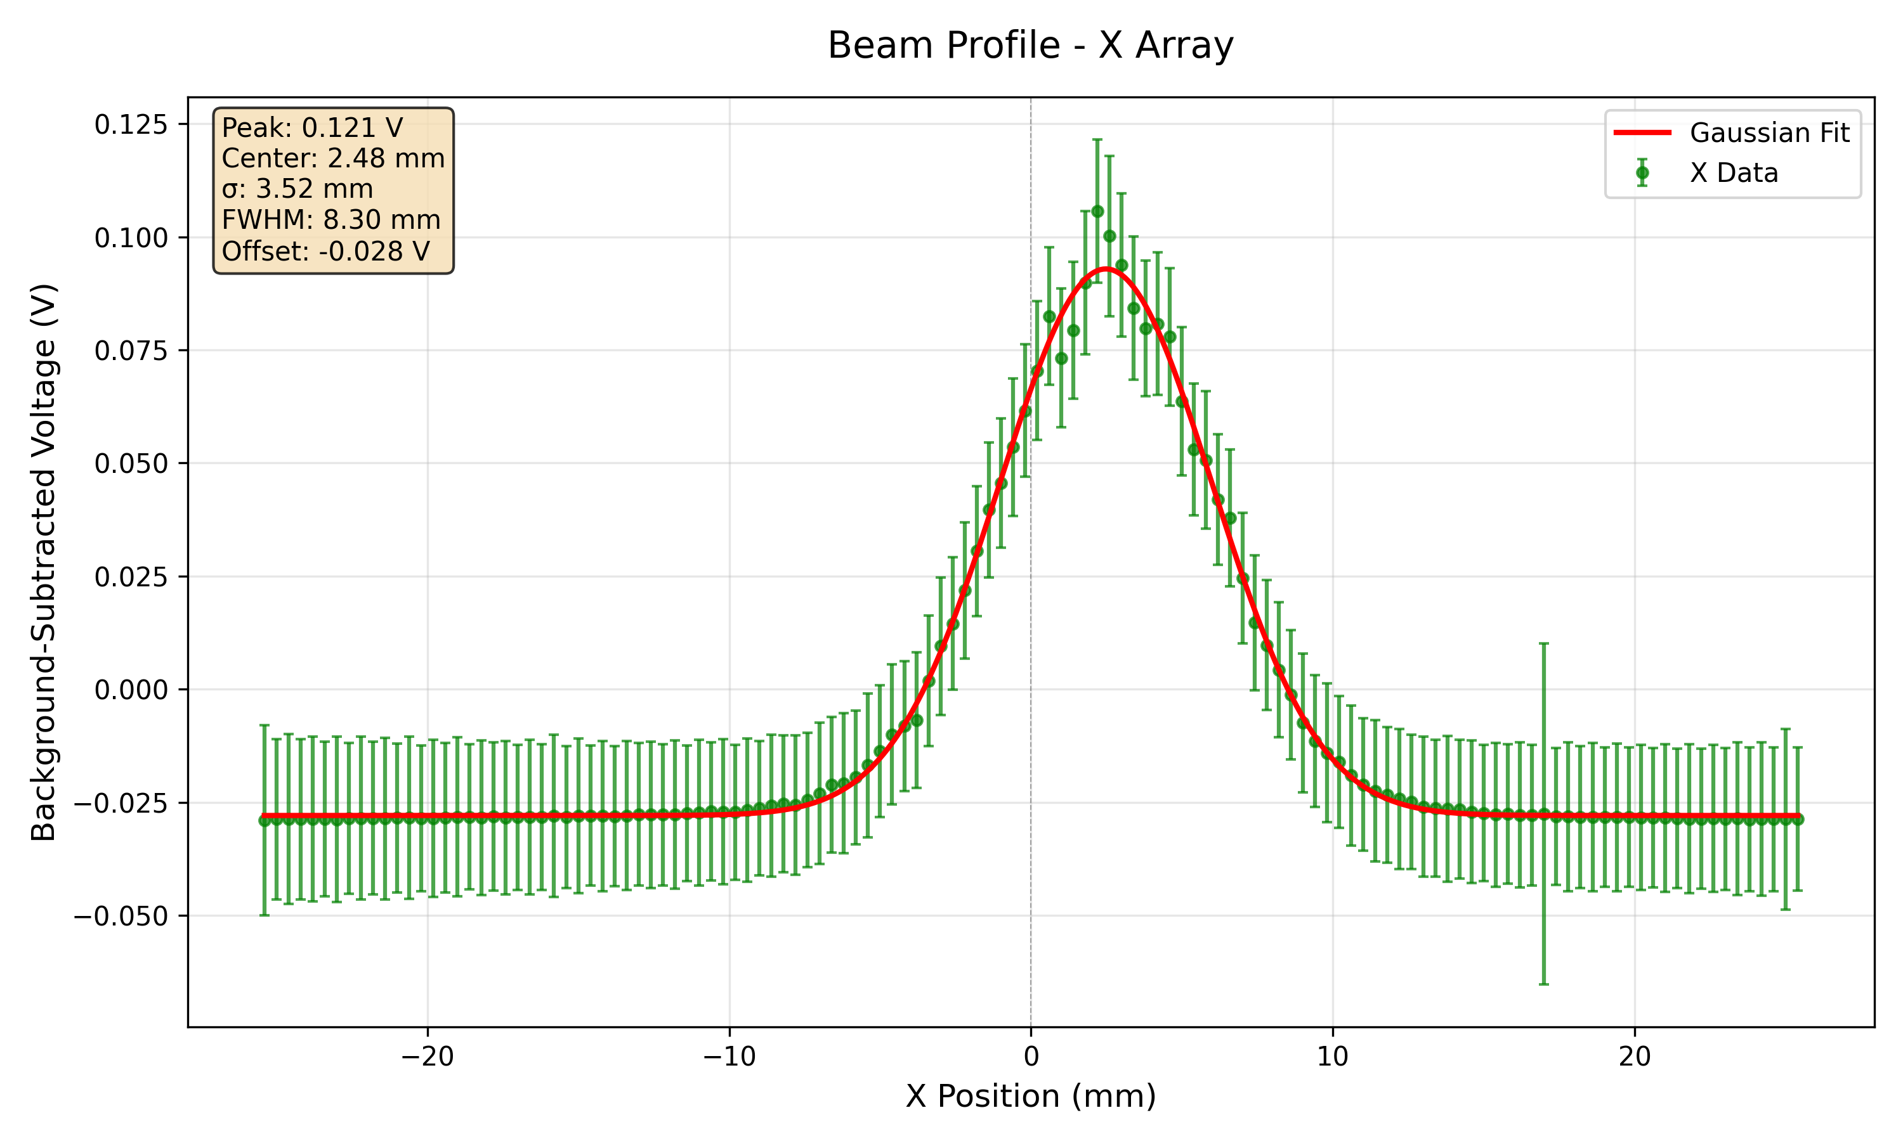
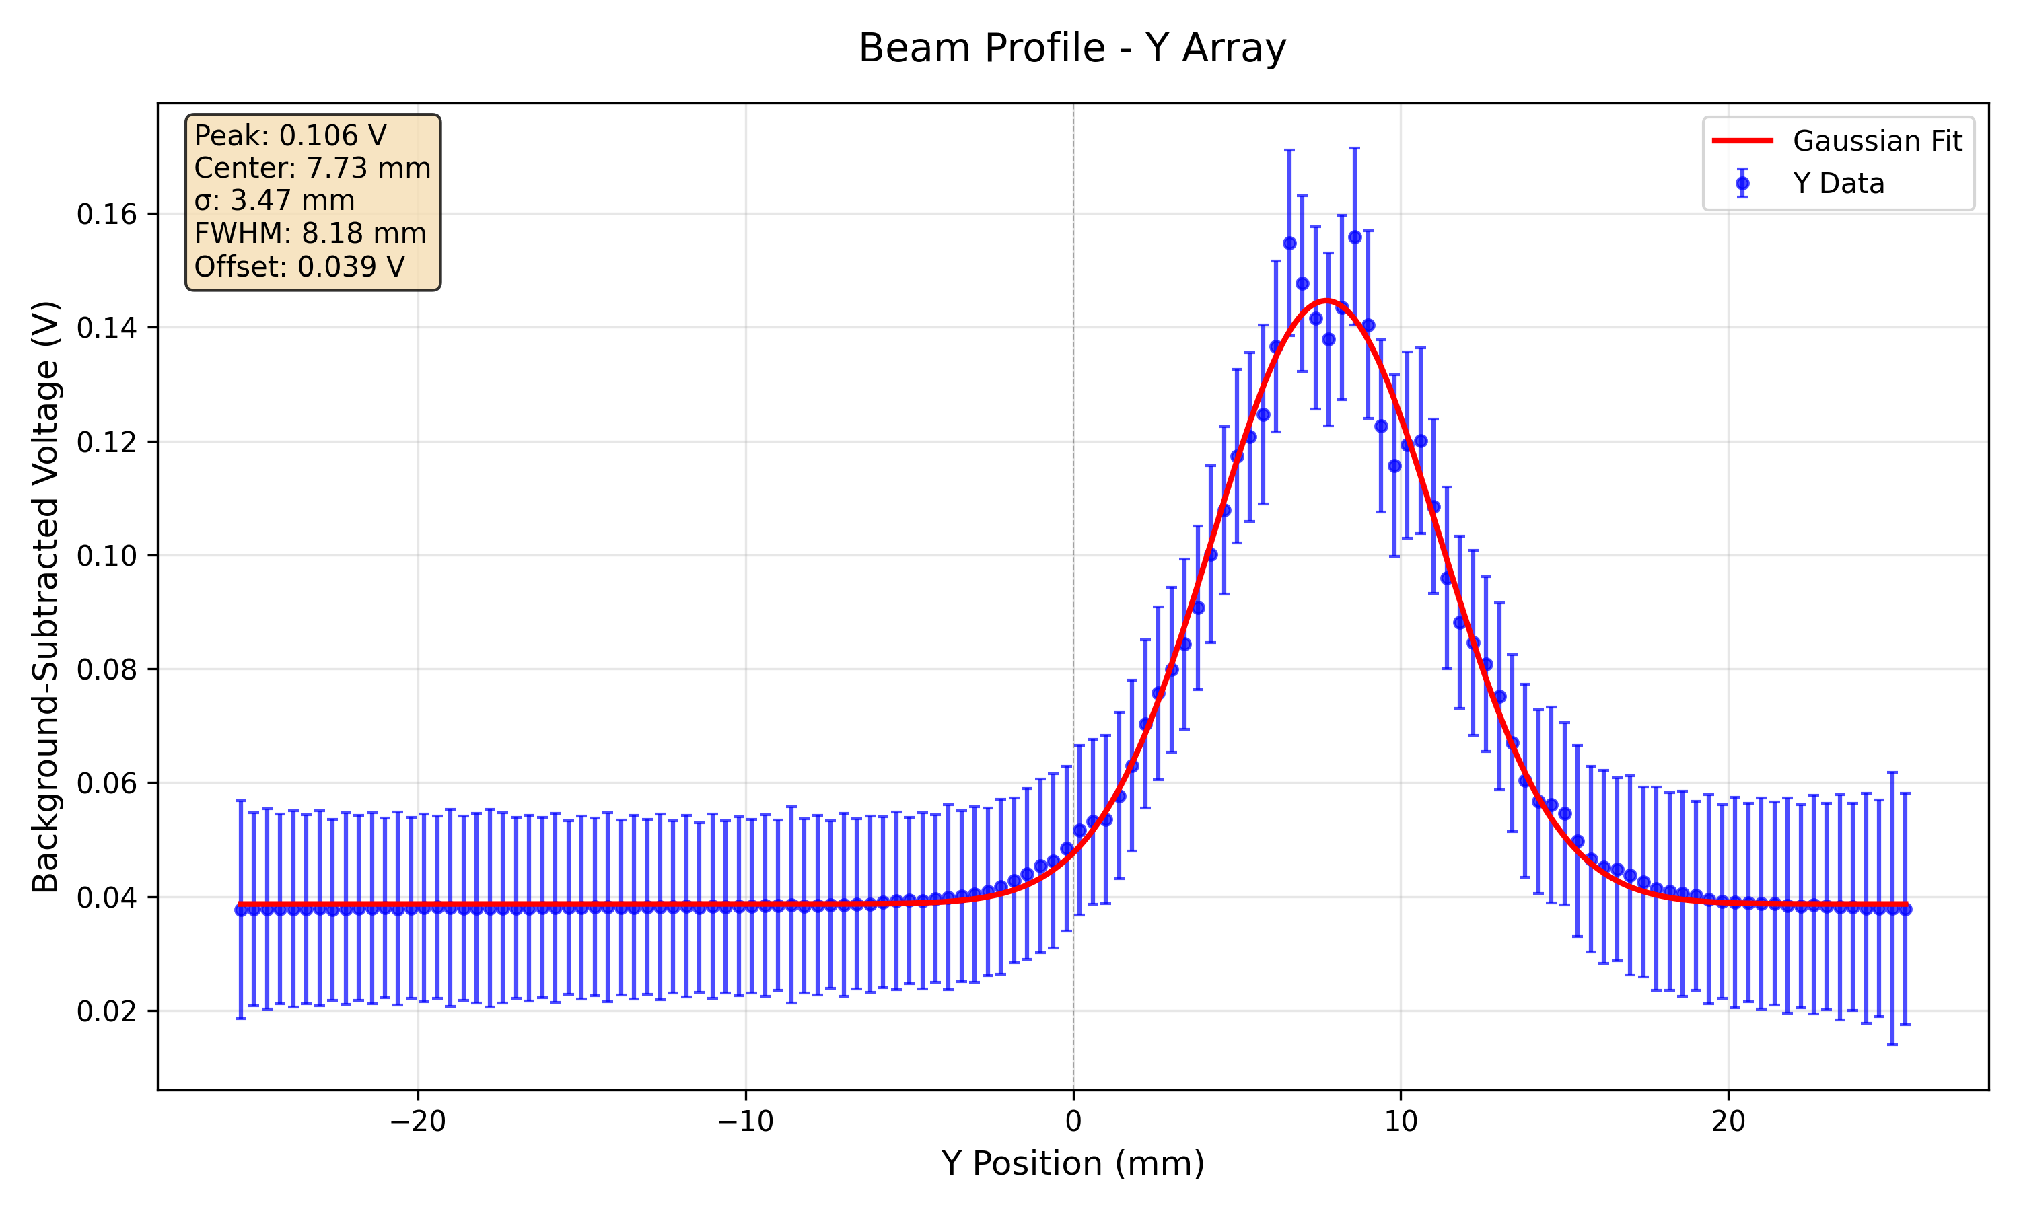
SciFi Response (228 MeV, 5 nA)

Slide 22
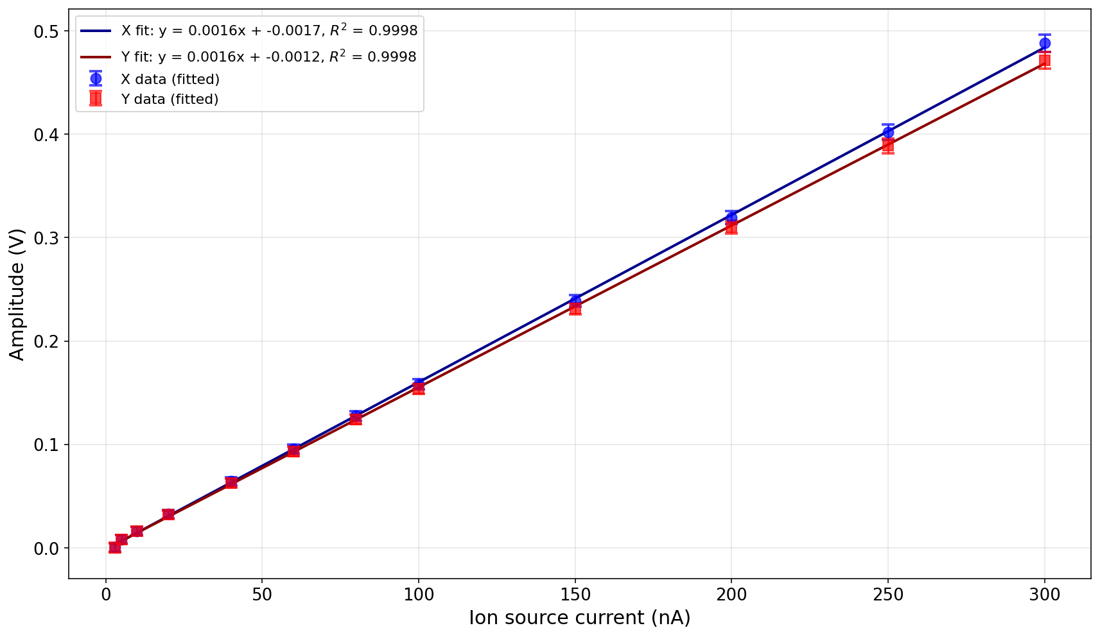
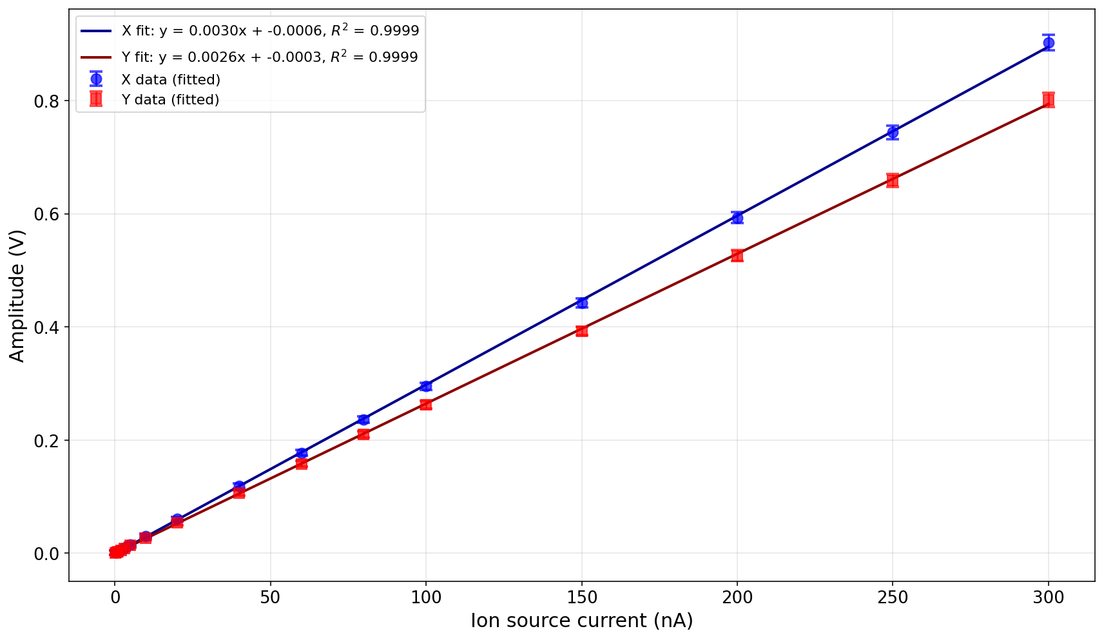
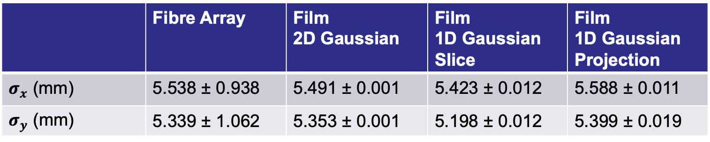
SciFi Response Linearity (148 MeV)
Low Gain
High Gain
 | Fibre Array | Film 2D Gaussian | Film 1D Gaussian Slice | Film 1D Gaussian Projection
$σ_{x}$ (mm) | 5.538 ± 0.938 | 5.491 ± 0.001 | 5.423 ± 0.012 | 5.588 ± 0.011
$σ_{y}$ (mm) | 5.339 ± 1.062 | 5.353 ± 0.001 | 5.198 ± 0.012 | 5.399 ± 0.019

Slide 23
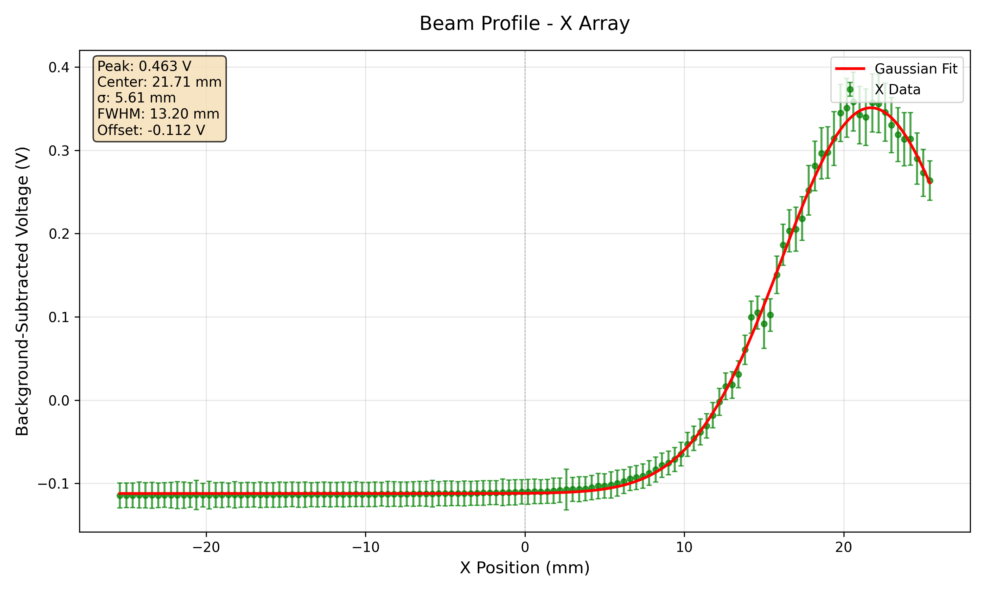
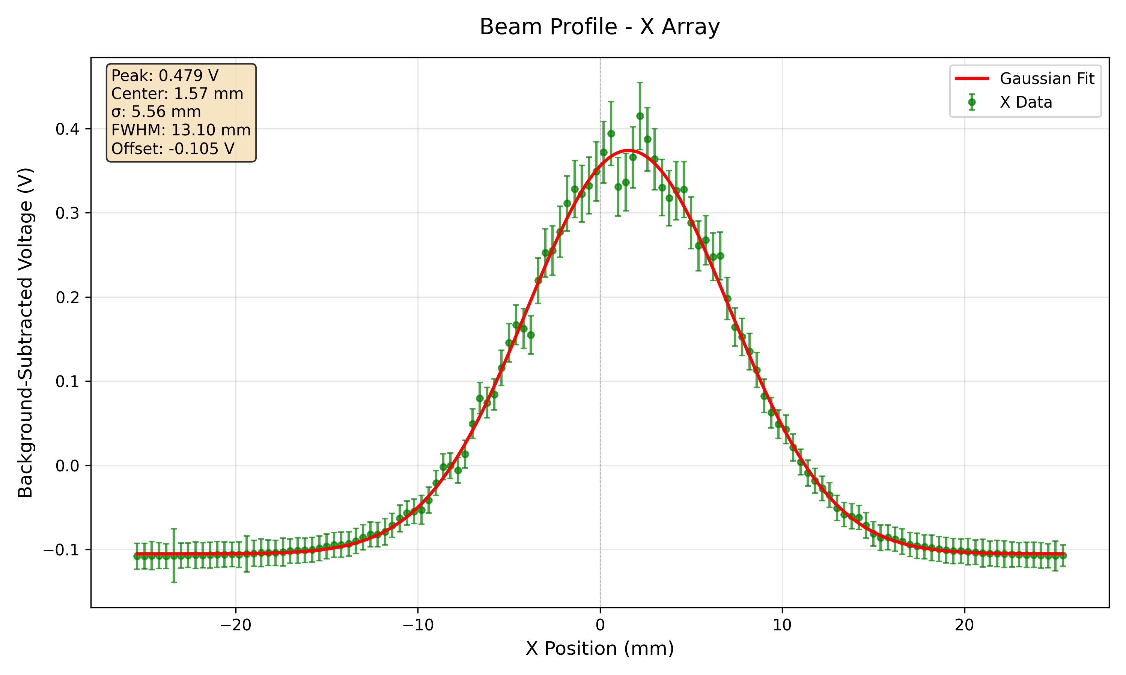
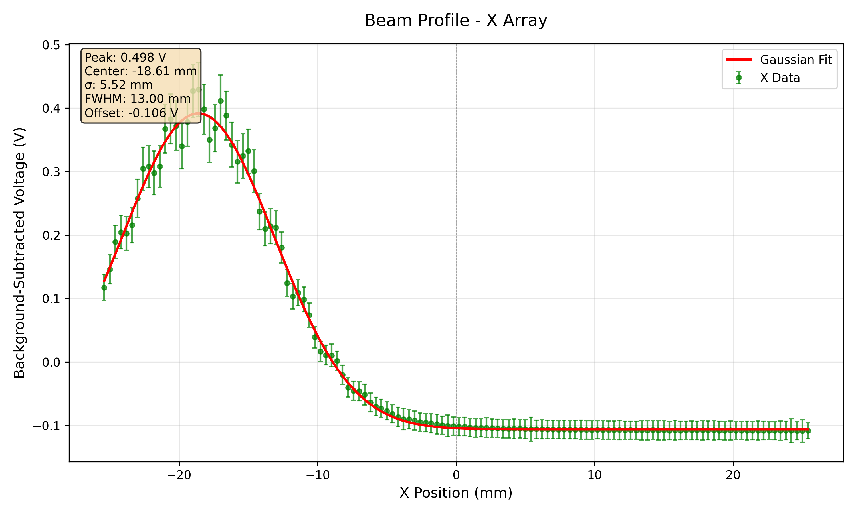
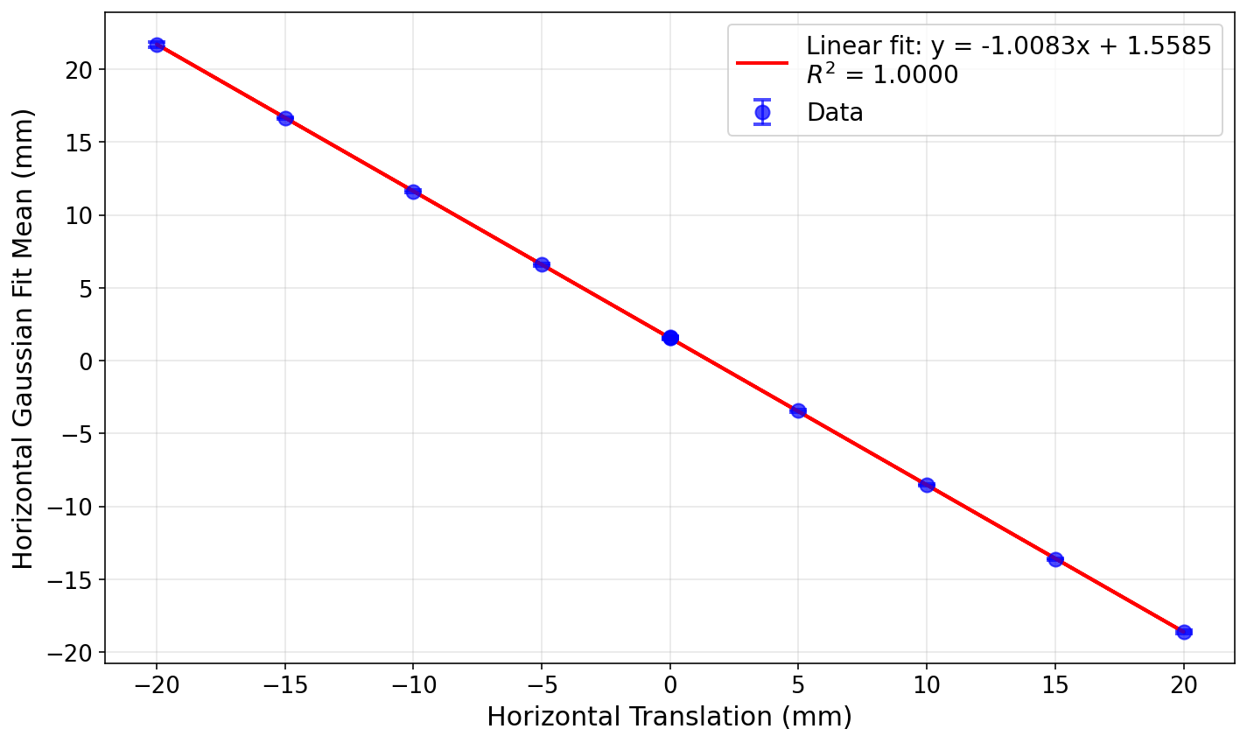
SciFi Position Response (+/-20 mm X)

Slide 24
88 MPH

Slide 25
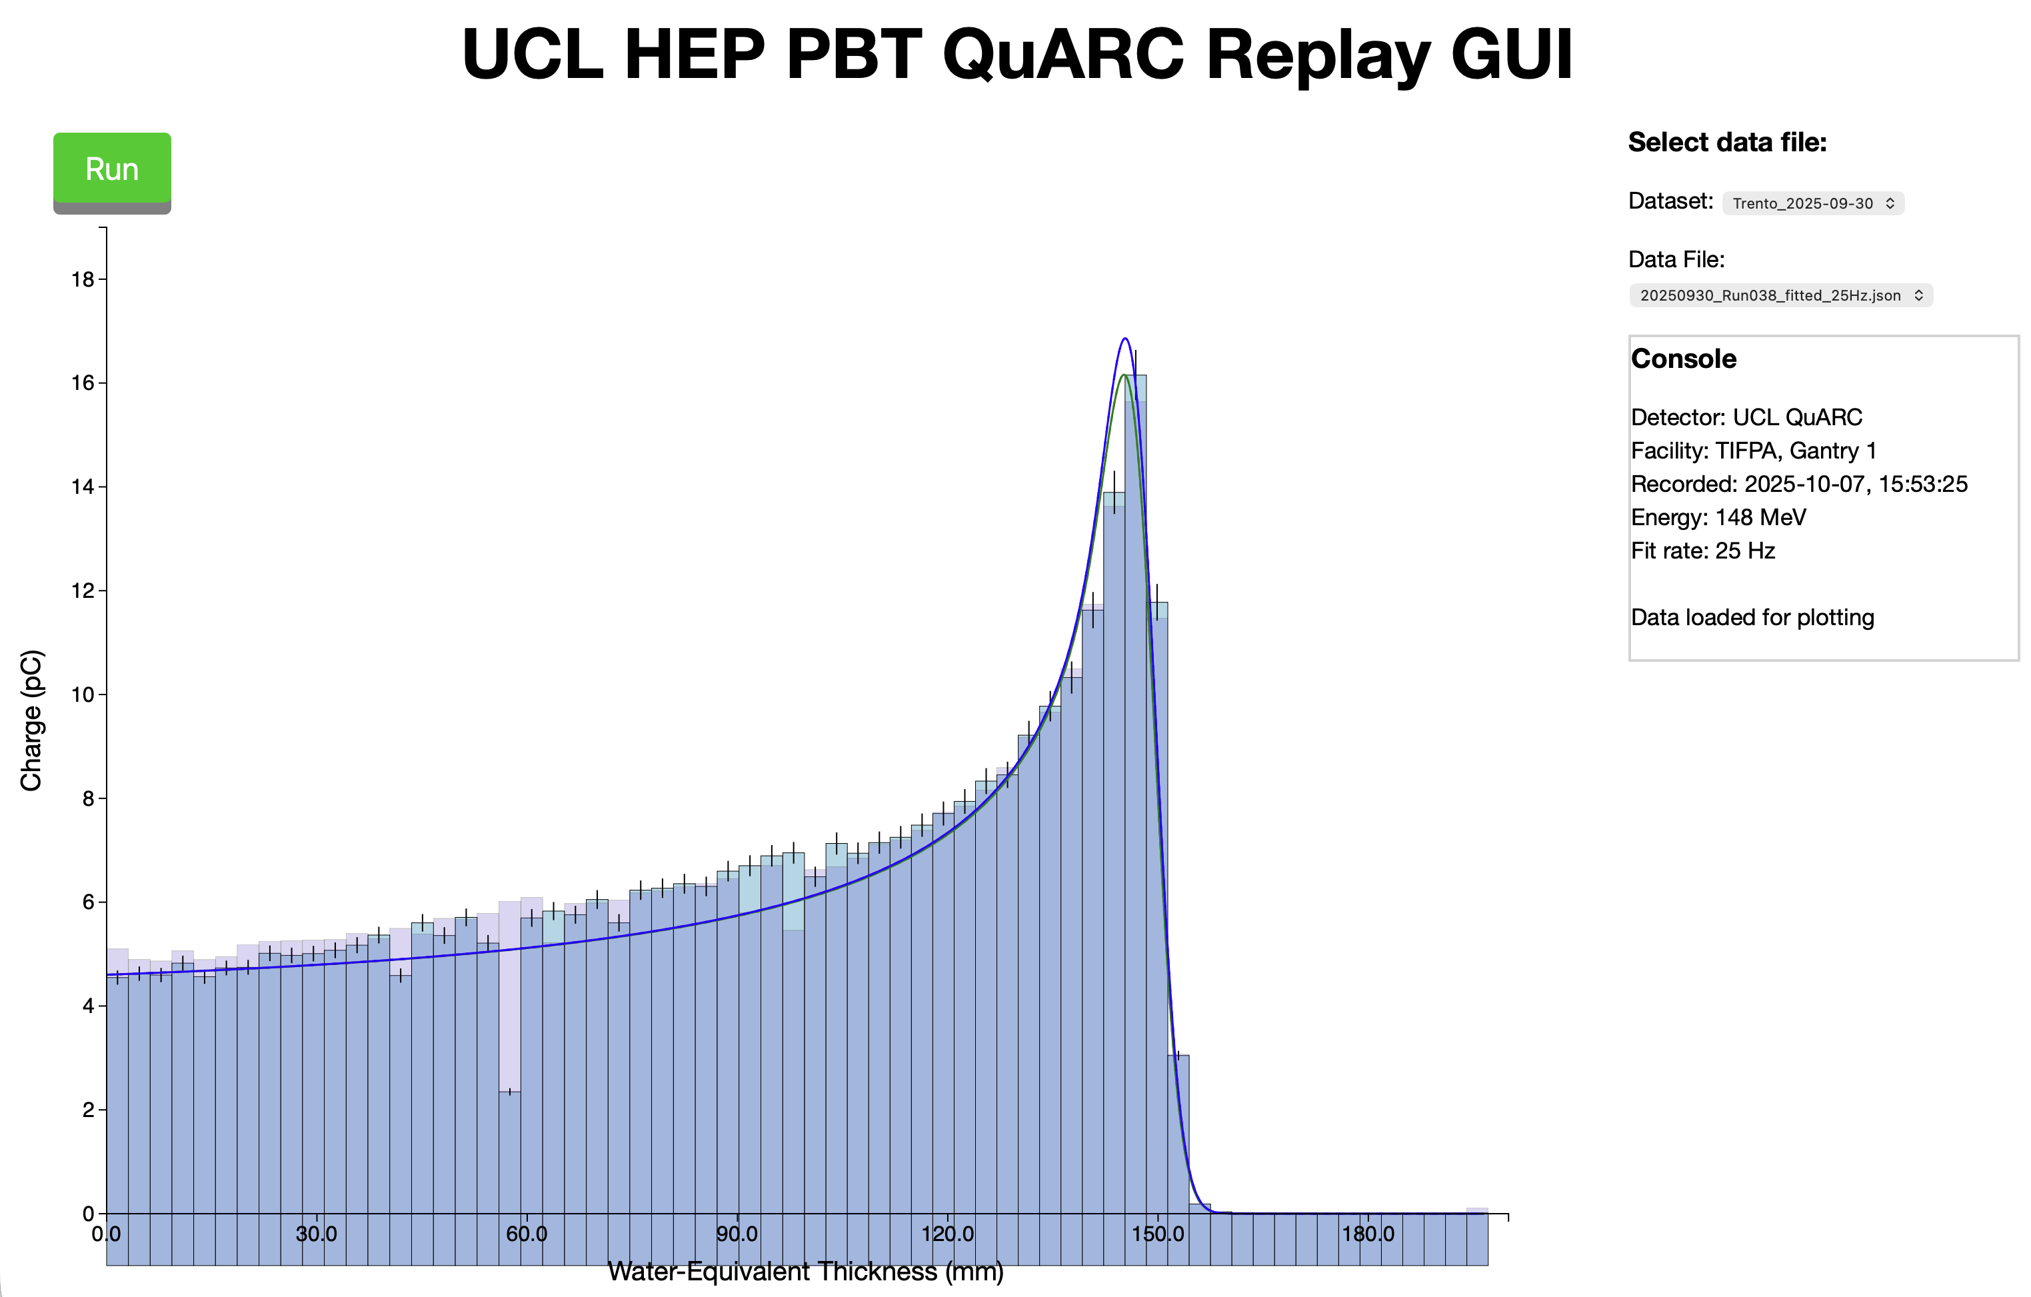
QuARC GUI
https://www.hep.ucl.ac.uk/ pbt/QuARC-GUI/ replay.html

Slide 26
Position Scan: 148 MeV Bragg Curves
Beam 20mm to right
A: R₀ = 151.46 mm, E₀ = 146.9 MeV
B: R₀ = 151.73 mm, E₀ = 147.05 MeV
Avg: R₀ = 151.595 mm, E₀ = 146.975 MeV
Beam 20mm to left
A: R₀ = 151.47 mm, E₀ = 146.91 MeV
B: R₀ = 151.51 mm, E₀ = 146.93 MeV
Avg: R₀ = 151.49 mm, E₀ = 146.92 MeV
Beam in centre
A: R₀ = 151.29 mm, E₀ = 146.81 MeV
B: R₀ = 151.51 mm, E₀ = 146.93 MeV
Avg: R₀ = 151.4 mm, E₀ = 146.87 MeV
Consistent range reconstruction across entire range of beam spot positions.

Slide 27
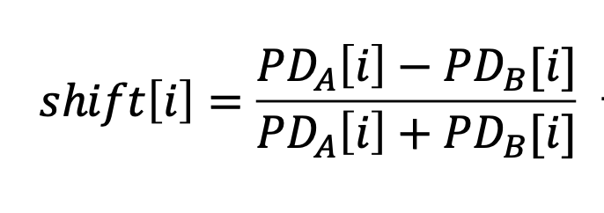

QuARC $Δ/Σ$ & Fibre $μ$Measurements
Calibrated

Slide 28
QuARC + Fibre Position Measurements

Slide 29



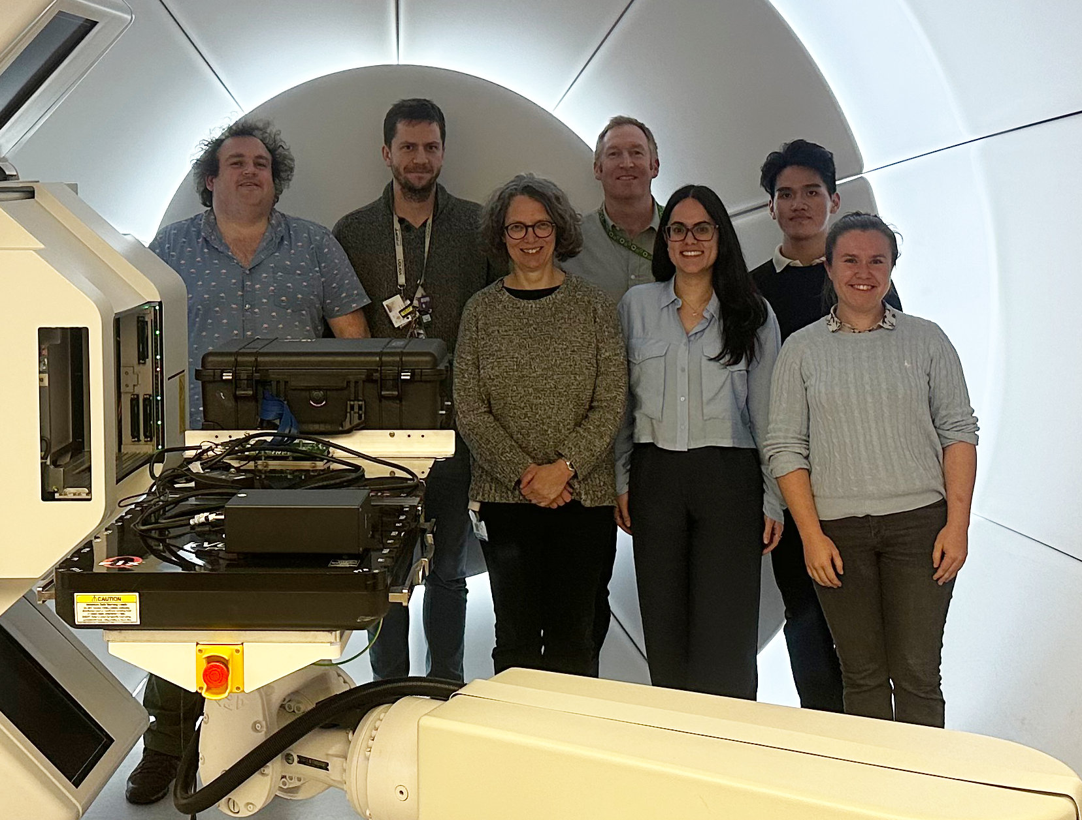
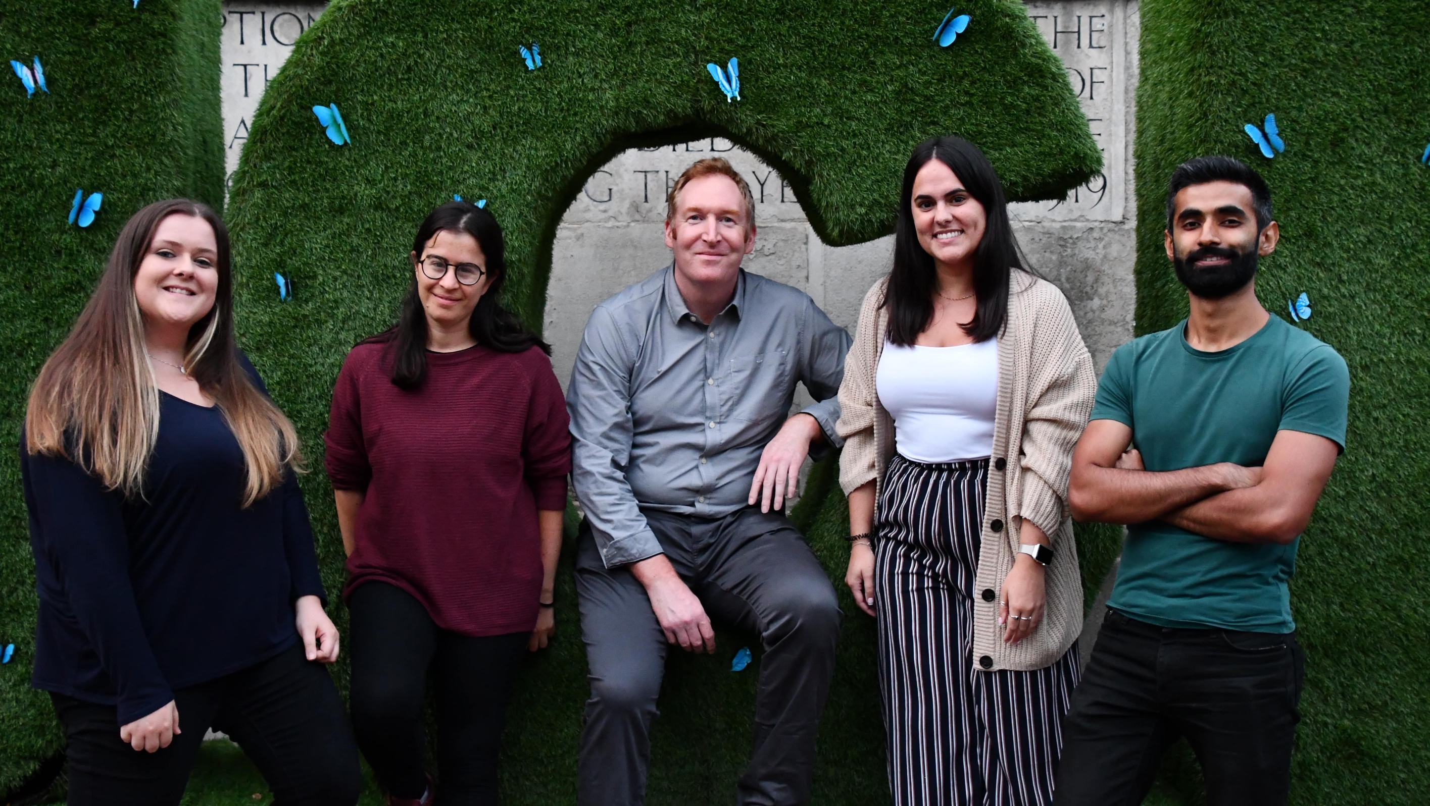




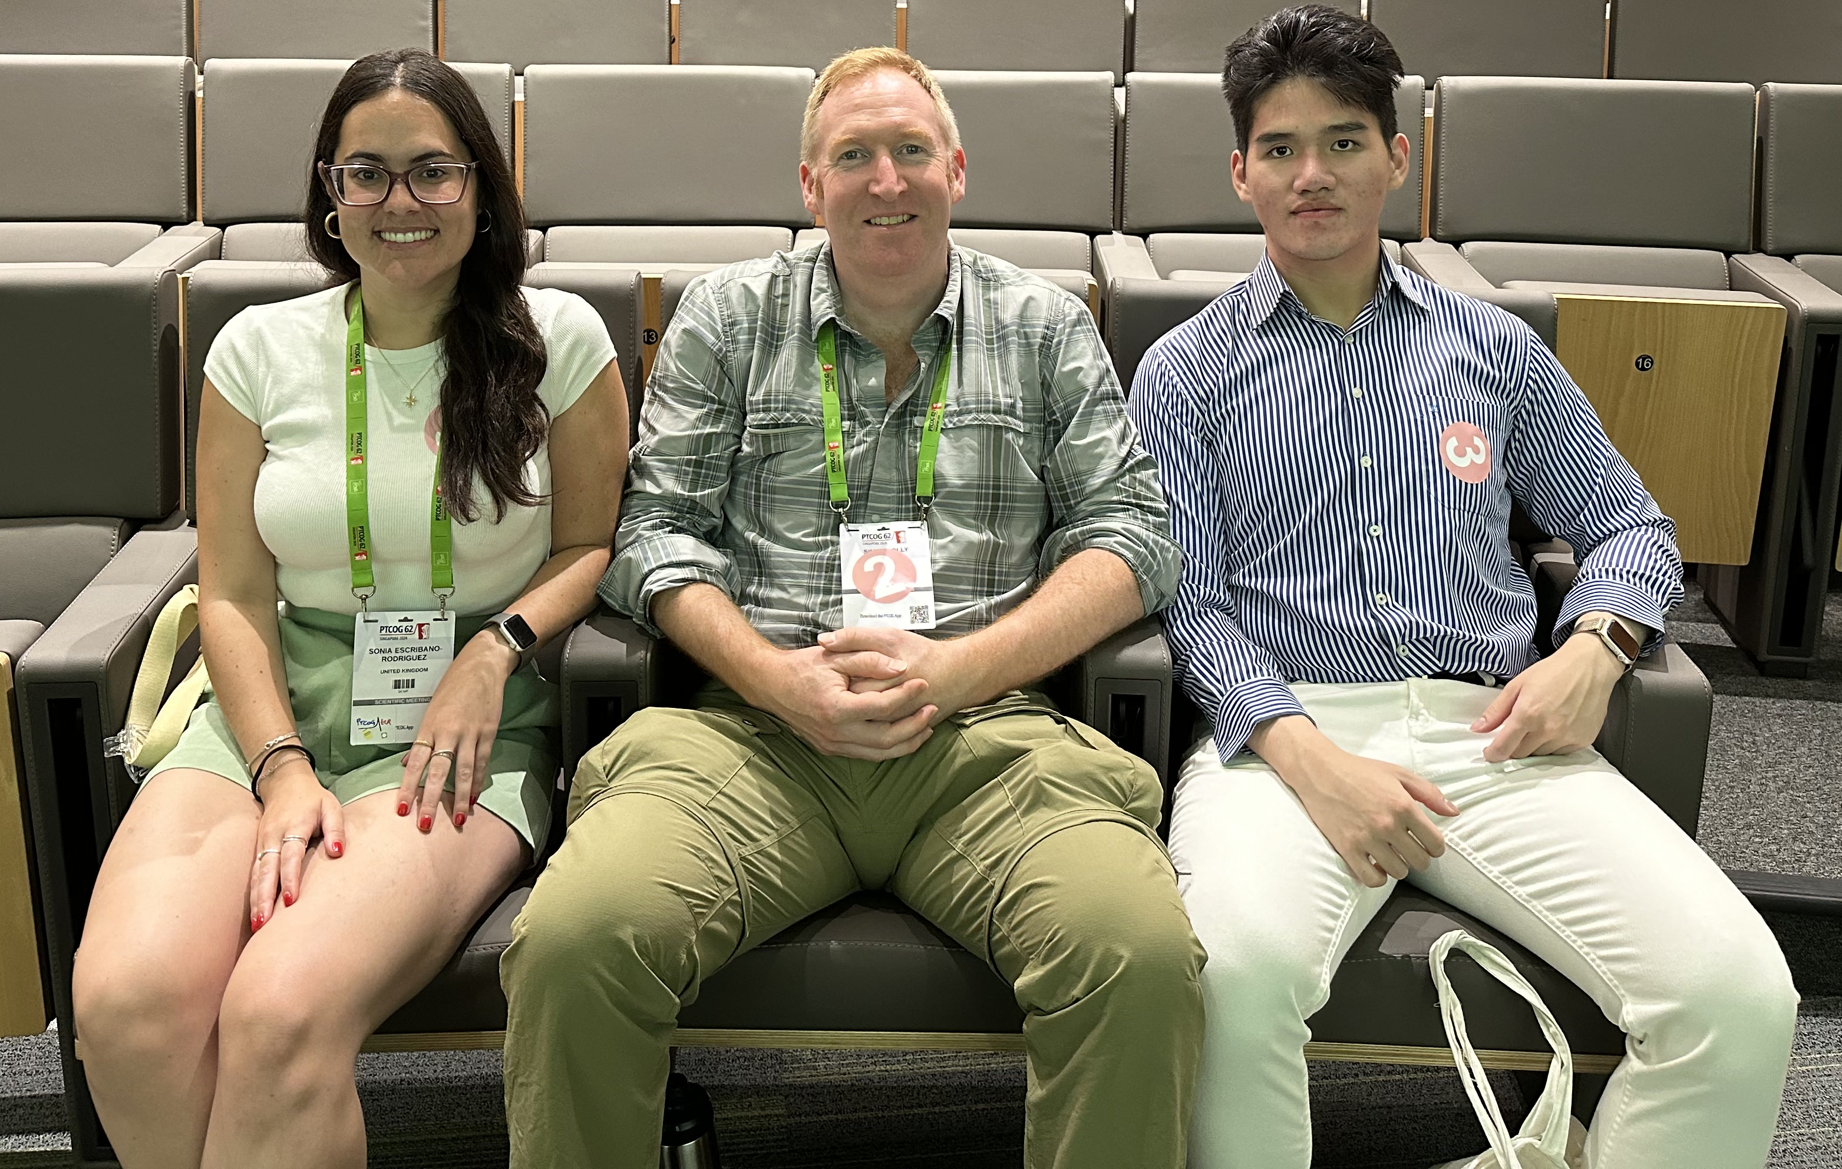
Acknowledgements
Simon Jolly Febian
Sonia Escribano Rodriguez
Connor Godden
Harry Barnett
Matt Warren
Joe Bateman
Saad Shaikh
Fern Pannell
Sam Flynn
Nigel Lee
Russell Thomas
Colin Baker
Alison Warry
Andrew Gosling
Lee Harrison-Carey
Andrew Poynter
Rafaella Radogna
Tony Price
Catherine Burne
Phil Allport

Slide 30
Happy Christmas

