Slide 1
QuADProBe Development Path
Simon Jolly
PBT Group Meeting
22/07/2025

Slide 2
Current Status
QuARC
  Successful beam tests with 2-sided readout using 8 boards, USB104 and Raspberry Pi 5.
  DAQ now entirely web-based.
  12 new DDC boards recently delivered from Oxford.
QuADProBe:
  Bari SciFi setup with basic NI-based DAQ tested.
  Heidelberg have developed SciFi profile monitor with FPGA readout for HIT.
  NPL Transmission Calorimeter in development.

Slide 3
QuARC Requirements
ALL beam tests show how vital matched sheets are! New sheets needed from Nuvia to be machined at UCL (Barnett).
DAQ limited by number of USB104 channels: more channels also needed for QuADProBe.
Shock absorption system needs lowering to align scintillator modules with central case axis; new version needed for lid.
Update to single 100W USB-C/DC power supply with internal distribution board (Hastings).
Gantry mounting hardware needed (IBA, Prague+Barnett).
Small changes to case (Barnett):
  Wheels mounts.
  Alignment plates.
Is Apache+D3 optimal for live web display? Python web server possible but static? To be investigated by MSci student (Saeed).
Move to 4 boards, photodiode arrays and 2.5 mm pitch…?

Slide 4
QuADProBe Requirements
Need scintillating fibre arrays: Bari/Heidelberg (Radogna/Bateman).
Current DAQ too limited: cannot adapt Heidelberg system in its entirety.
  Imperial Kria-based front end.
  Imperial to design Kria carrier (Rose).
Hamamatsu photodiode arrays best current option but analogue/digital versions not yet set:
  Analogue better dynamic range?
  Digital requires less front end electronics.
  Front-end interface board still needed (Hastings).
Arrays will need holder and mechanical structure (Barnett).
NPL Transmission Calorimeter to be integrated later: spare DAQ channels helpful!

Slide 5
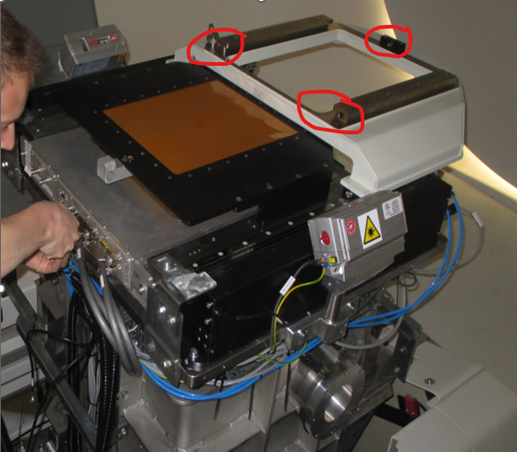
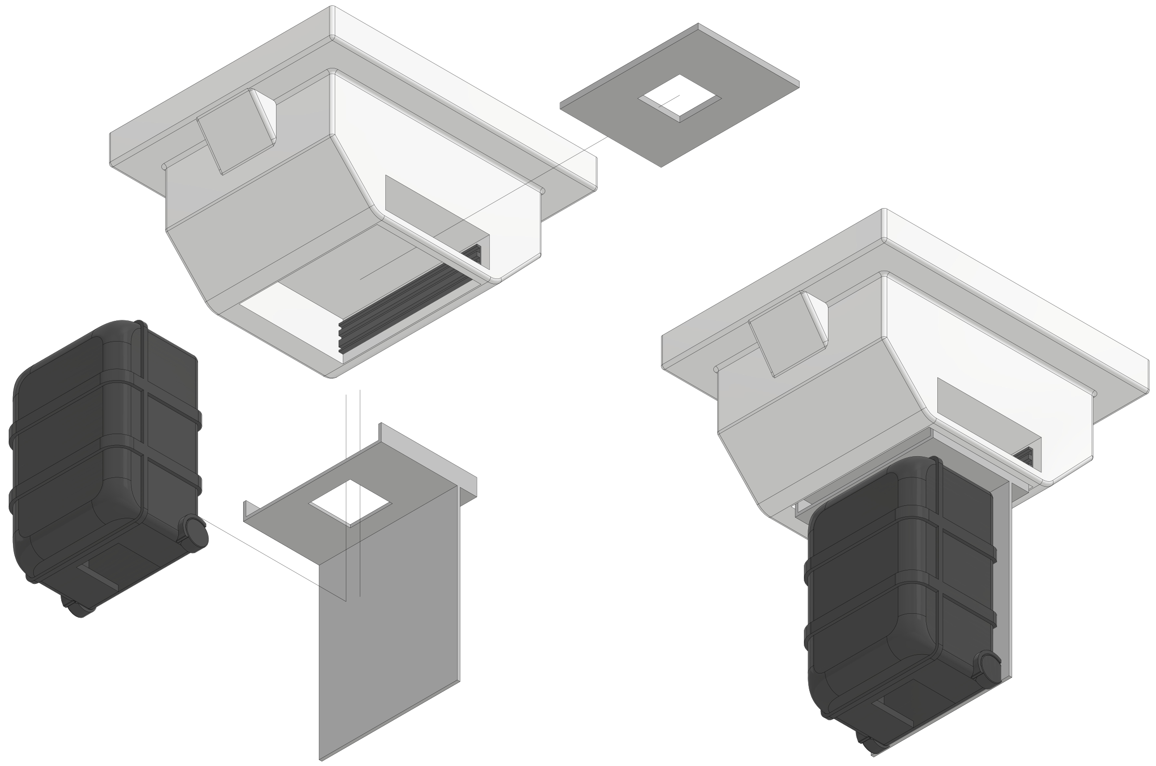
Nozzle Mount

Slide 6
Heidelberg Beam Monitor (Leverington)

Slide 7
Heidelberg Photodiode Arrays

Slide 8
Hamamatsu Photodiode Boards

Slide 9
Heidelberg ADC Board

Slide 10
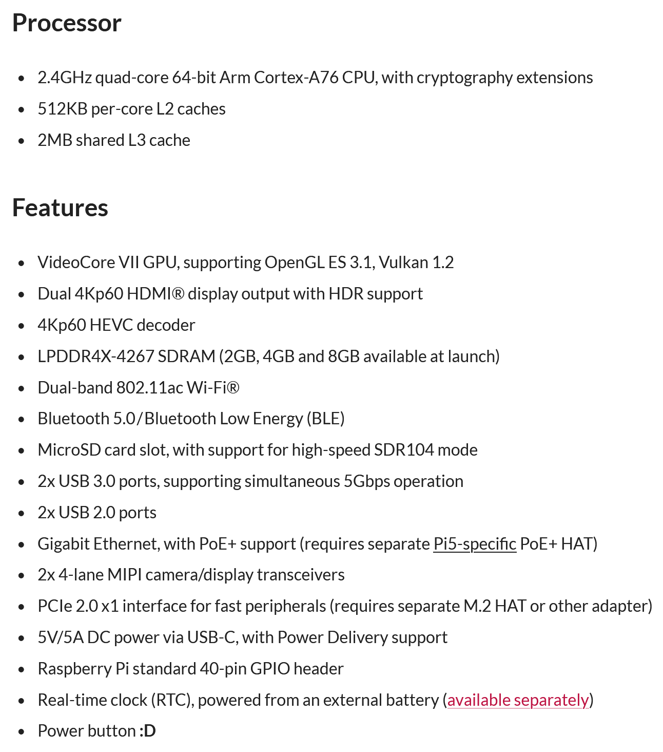
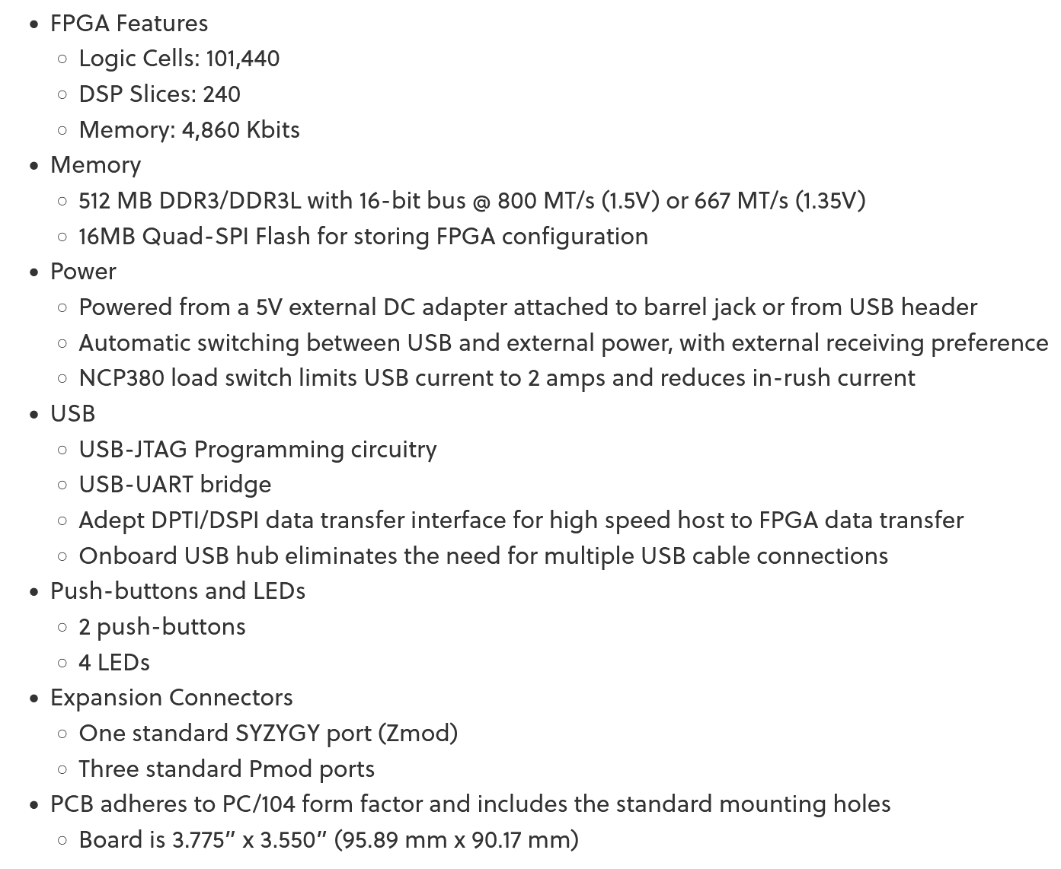
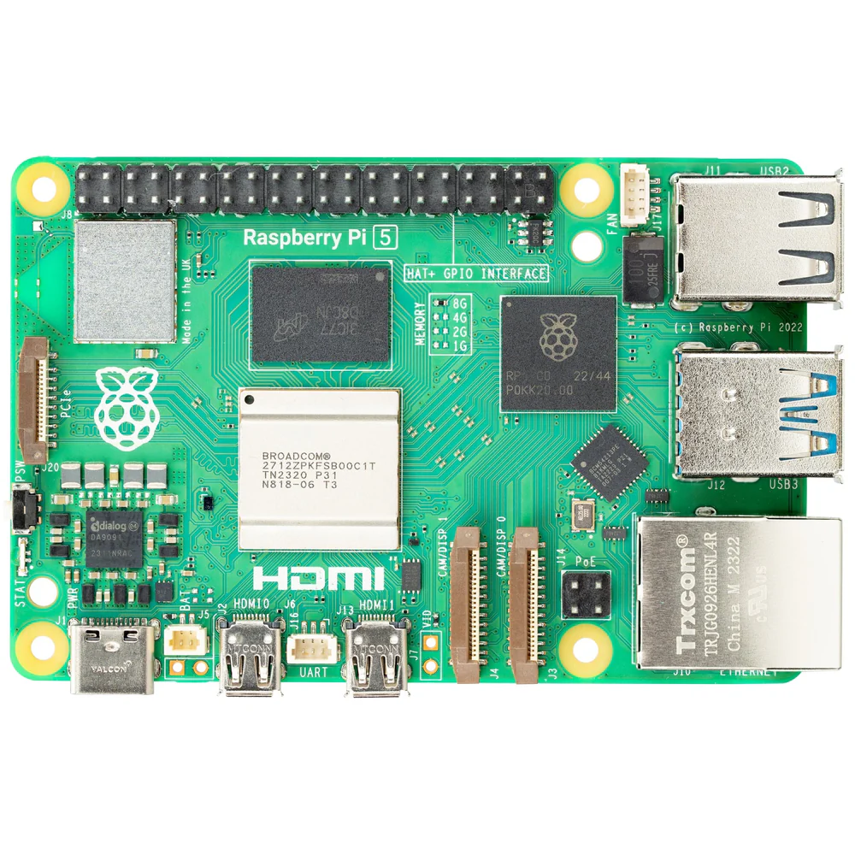
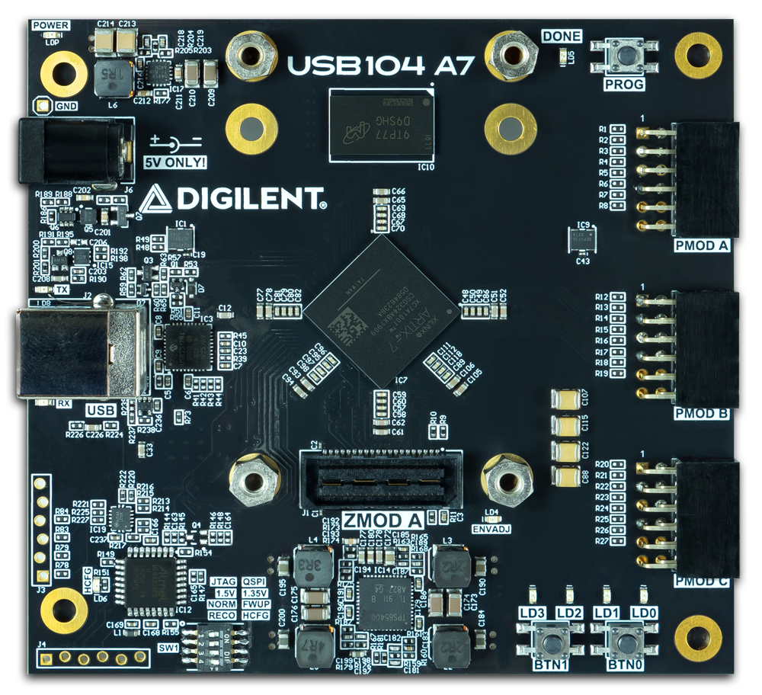
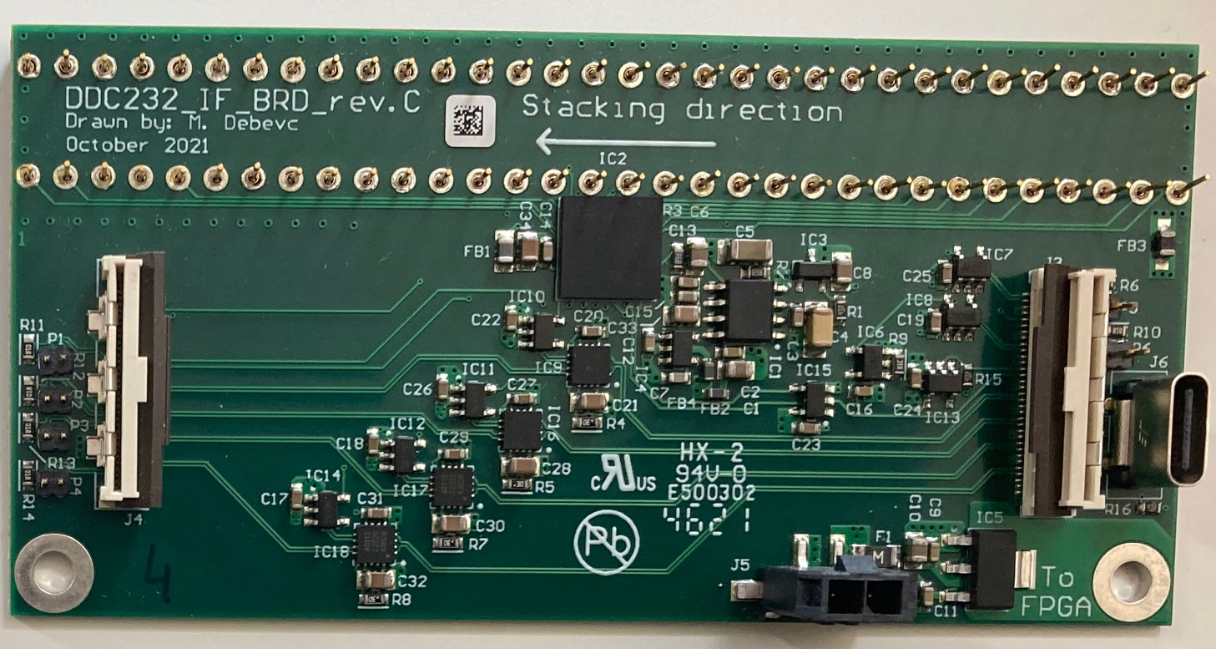
$350
£75
USB3
Z-mod to "usb-c" adapter
FPC
FPC

Slide 11
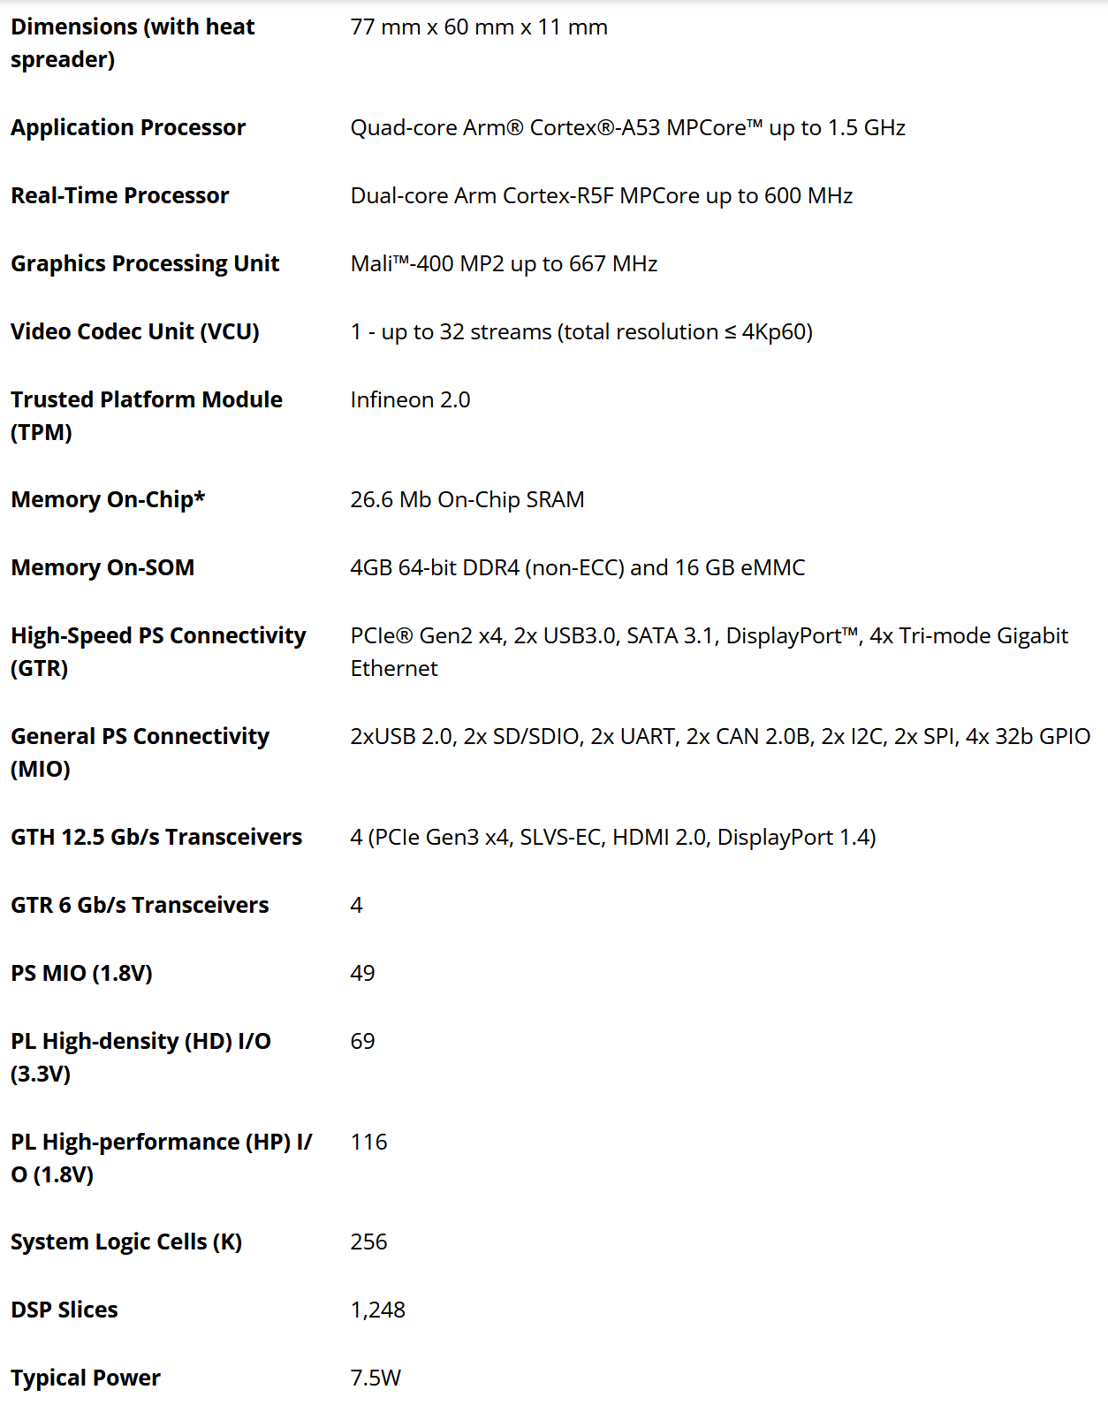
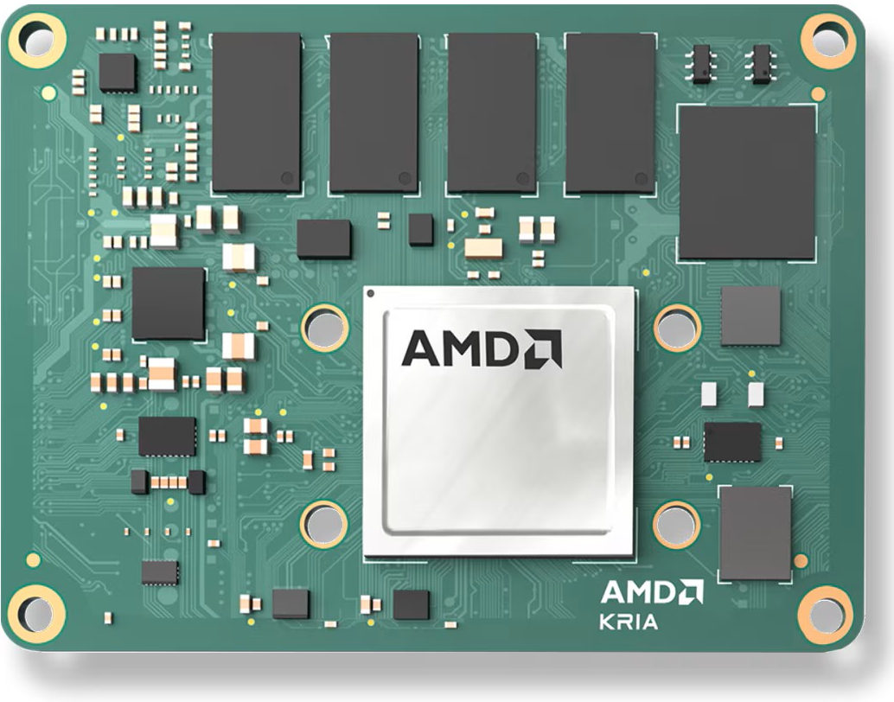
Custom Breakout Board
← ×0.6
$325
Single 12V supply in
GbE phy+RJ45
← ×5000
SATA M.2?
PCIe M.2?
c.f. Rpi5 +
USB401
"usb-c"
"usb-c"
"usb-c"
USB?
← ×2.5
← ×5

Slide 12
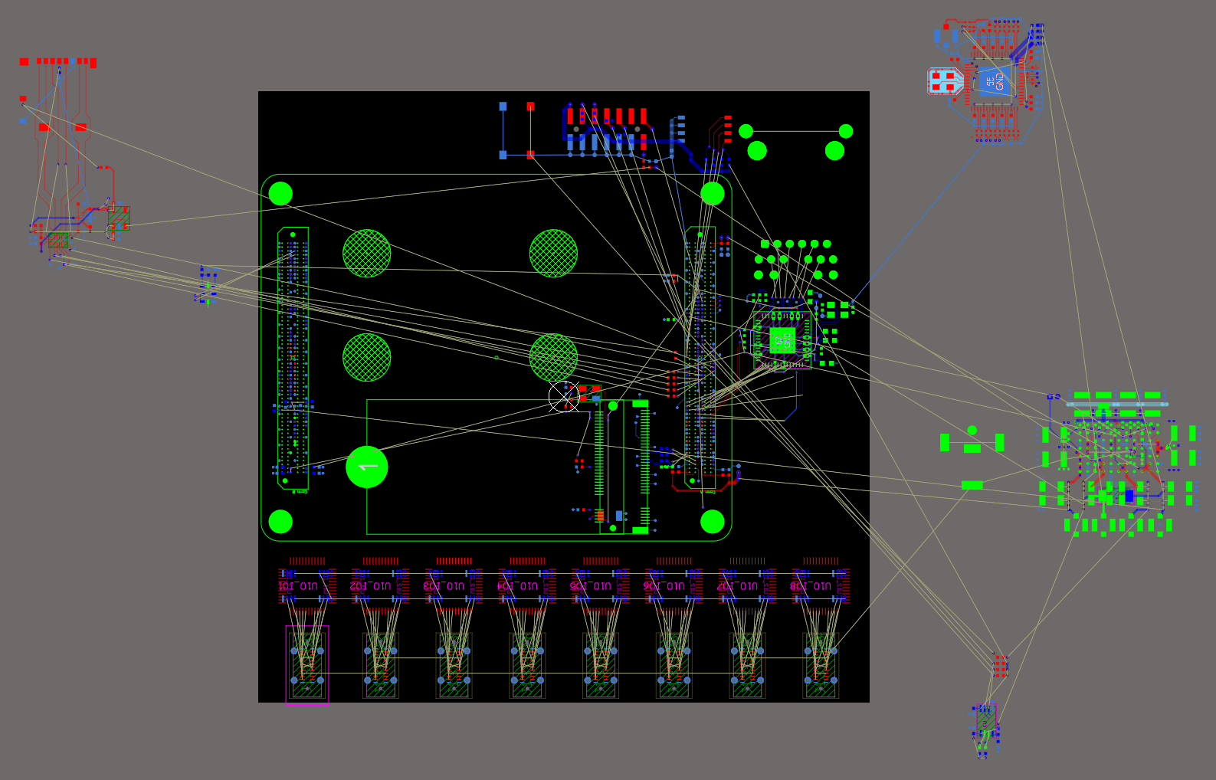
uSD card
GbE
First guesstimate of a board design from ripping up a Serenity s1.3 design
Kria
10cm
Power
Sata M.2
"usb-c"
10cm

Slide 13
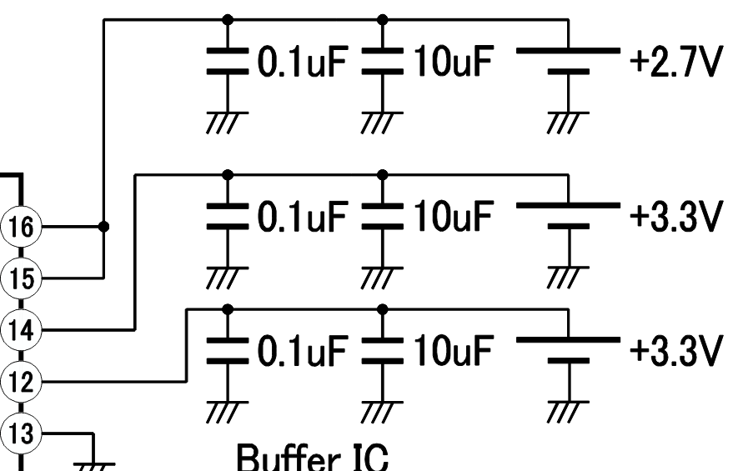
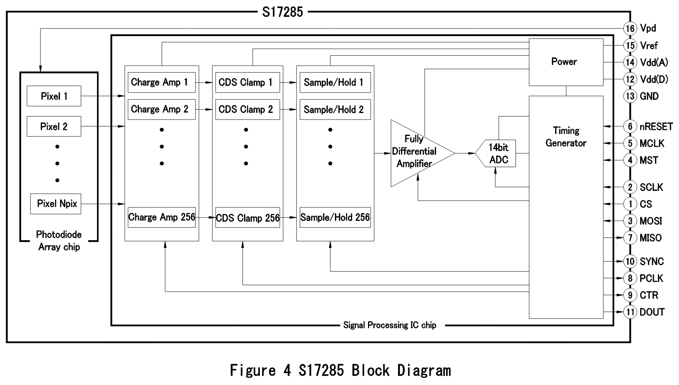
x1
x1?
x1?
x1
x4
x1
4xUSB-C for data
1 for control
x1
x4
x4
x4
x4
x4

Slide 14
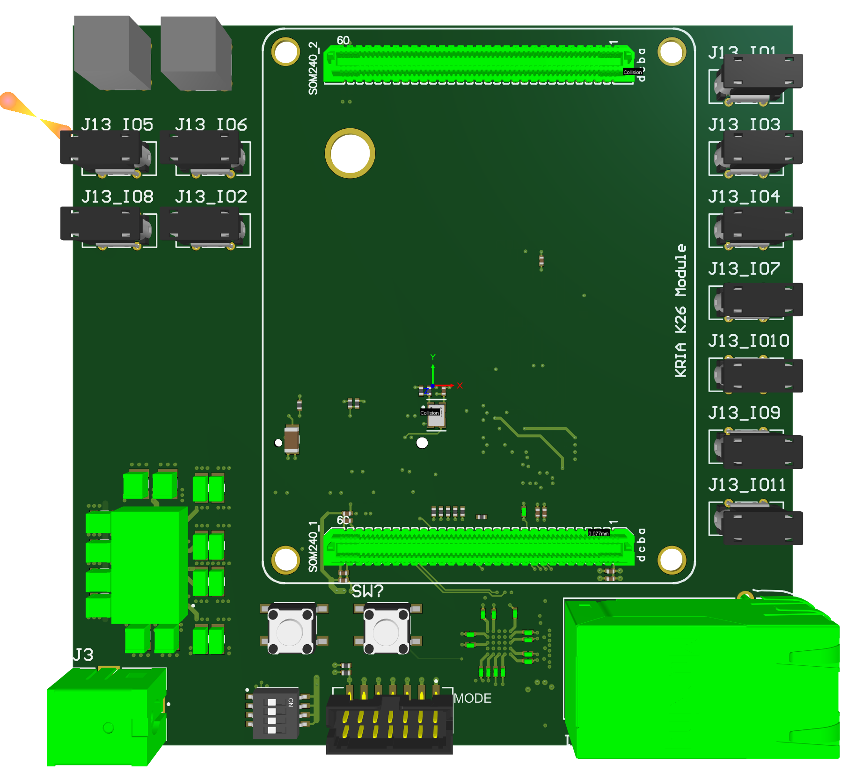
Kria Carrier Board Layout

Slide 15
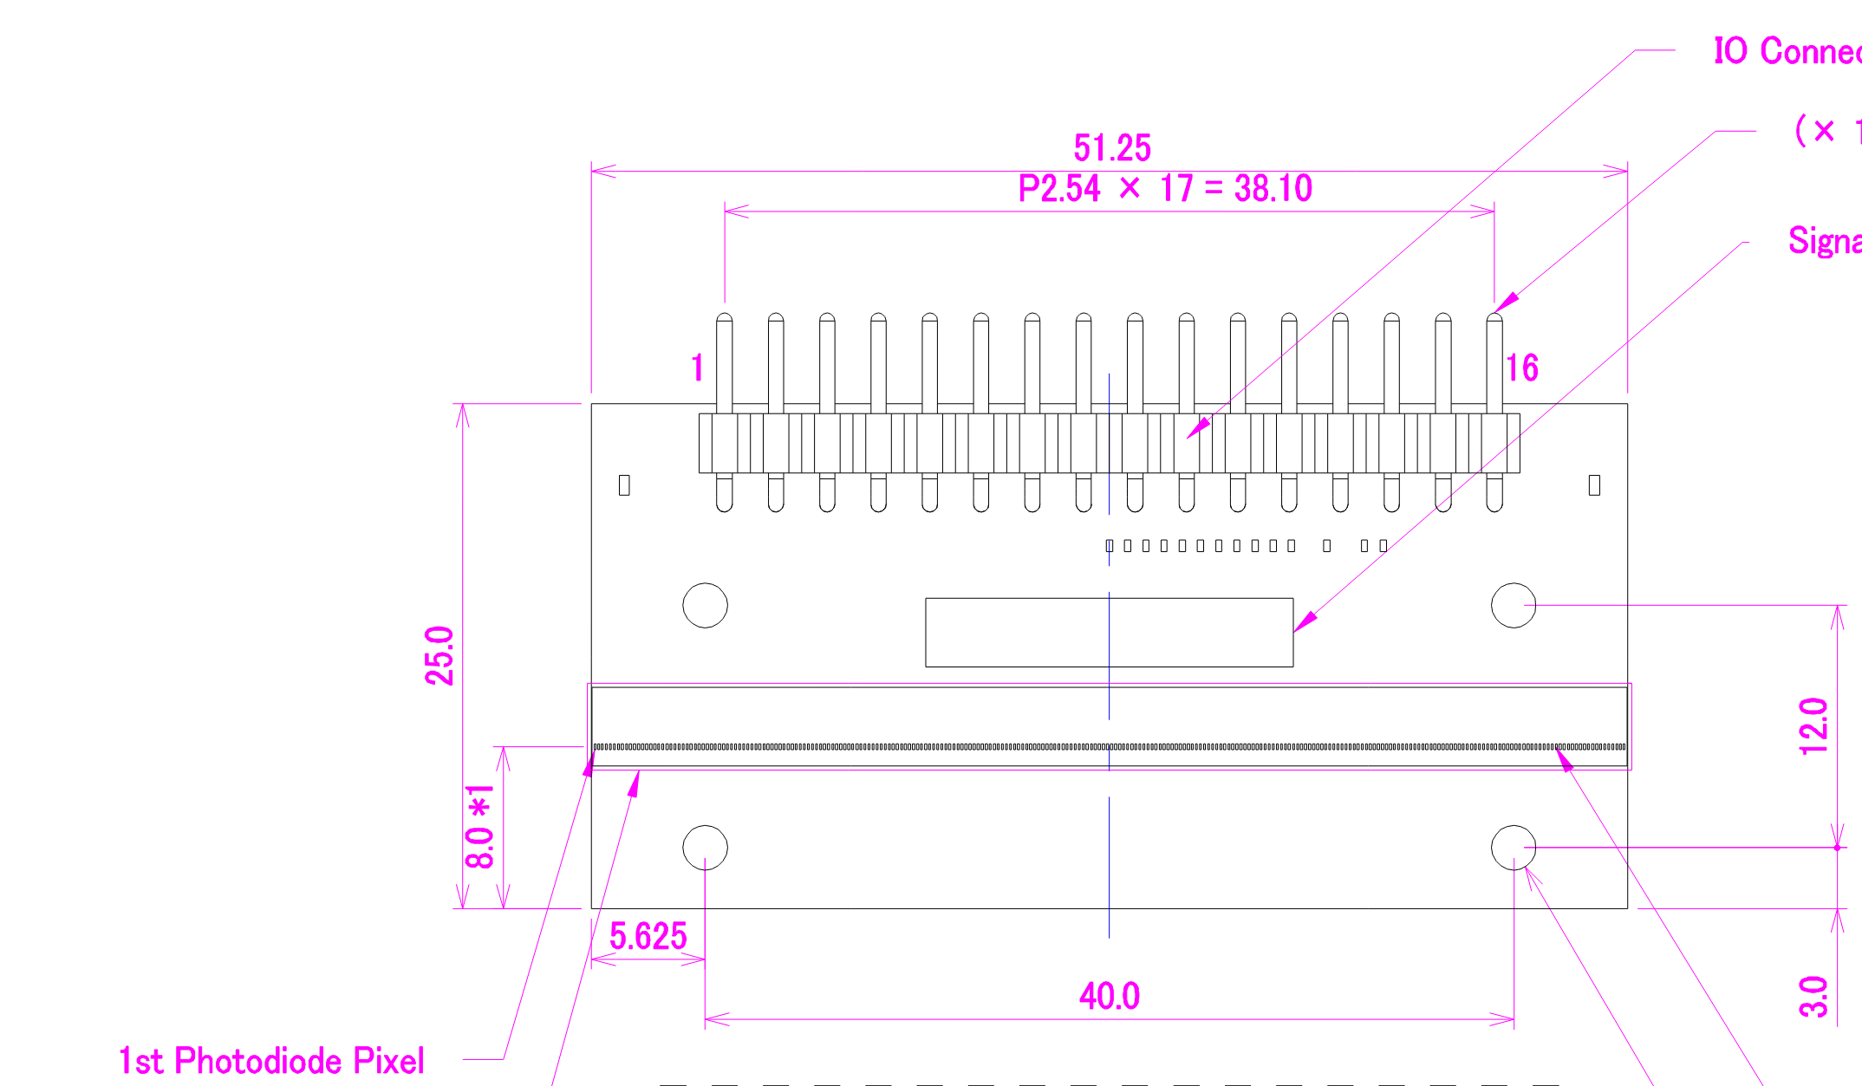
Kria SciFi Readout
Option 1
Option 2

Slide 16
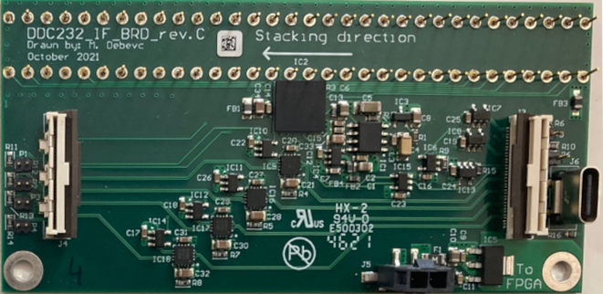
Kria QuARC Readout Option 1

Slide 17
Kria QuARC Readout Option 2

