Slide 1
Oxford QuARC Electronics Testing
Simon Jolly

Slide 2
Background
QuARC DAQ electronics needed upgrading from Cosylab system:
  USB104 more compact and can be bus powered compared to Nexys Video.
  ZMOD daughterboard needed in place of FMC with USB-C only.
  All DDC board connections should be USB-C.
Pete Hastings (Oxford) has already designed replacement ZMOD daughterboard:
  Matt Warren able to communicate with Rev.D DDC boards (with modifications…).
  New Oxford DDC boards just arrived with several design improvements.

Slide 3
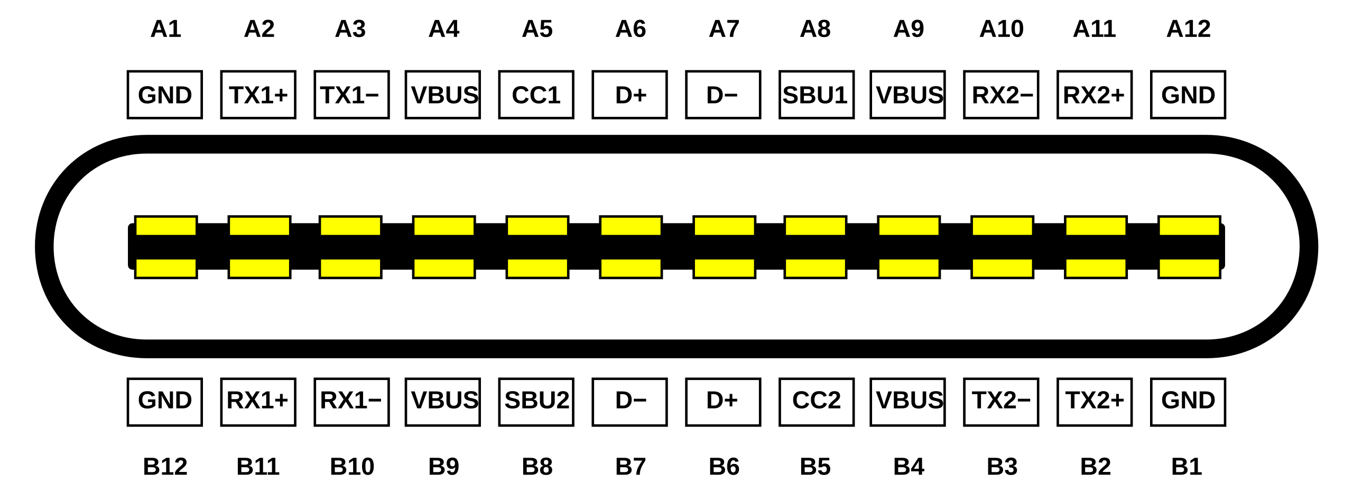
USB-C Cable Ideal Pin Connection
Input | Signals | Output | Signals
A1 | GND | A1 | GND
A2 | TX1+ | B11 | RX1+
A3 | TX1- | B10 | RX1-
A4 | VBUS | A4 | VBUS
A5 | CC1 | A5 | CC1
A6 | D+ | A6 | D+
A7 | D- | A7 | D-
A8 | SBU1 | B8 | SBU1
A9 | VBUS | A9 | VBUS
A10 | RX2- | B3 | TX2-
A11 | RX2+ | B2 | TX2+
A12 | GND | A12 | GND
B12 | GND | B12 | GND
B11 | RX1+ | A2 | TX1+
B10 | RX1- | A3 | TX1-
B9 | VBUS | B9 | VBUS
B8 | SBU2 | A8 | SBU2
B7 | D- | NC | NC
B6 | D+ | NC | NC
B5 | CC2 | NC | NC
B4 | VBUS | B4 | VBUS
B3 | TX2- | A10 | RX2-
B2 | TX2+ | A11 | RX2+
B1 | GND | B1 | GND
Input | A1 | A2 | A3 | A4 | A5 | A6 | A7 | A8 | A9 | A10 | A11 | A12 | B12 | B11 | B10 | B9 | B8 | B7 | B6 | B5 | B4 | B3 | B2 | B1
Signals | GND | TX1+ | TX1- | VBUS | CC1 | D+ | D- | SBU1 | VBUS | RX2- | RX2+ | GND | GND | RX1+ | RX1- | VBUS | SBU2 | D- | D+ | CC2 | VBUS | TX2- | TX2+ | GND
Output | A1 | B11 | B10 | A4 | A5 | A6 | A7 | B8 | A9 | B3 | B2 | A12 | B12 | A2 | A3 | B9 | A8 | NC | NC | NC | B4 | A10 | A11 | B1
Signals | GND | RX1+ | RX1- | VBUS | CC1 | D+ | D- | SBU1 | VBUS | TX2- | TX2+ | GND | GND | TX1+ | TX1- | VBUS | SBU2 | NC | NC | NC | VBUS | RX2- | RX2+ | GND

Slide 4
USB-C Connections: Cosylab Rev.D
FMC USB-C Connection
DDC Rev.D USB-C Connection

Slide 5
USB-C Connections: Rev.D + ZMOD v.1
ZMOD v.1 USB-C Connection
Cosylab DDC Rev.D USB-C

Slide 6
USB-C Connections: Oxford v.1
ZMOD v.1 USB-C Connection
Oxford DDC Rev.E USB-C

Slide 7
USB-C Connections: Oxford v.2 (Proposed)
ZMOD v.2 USB-C Connection
Oxford DDC Rev.E USB-C

Slide 8
USB-C Connections: Oxford DDC Rev.E
Oxford DDC Rev.E USB-C U/S
Oxford DDC Rev.E USB-C D/S

Slide 9
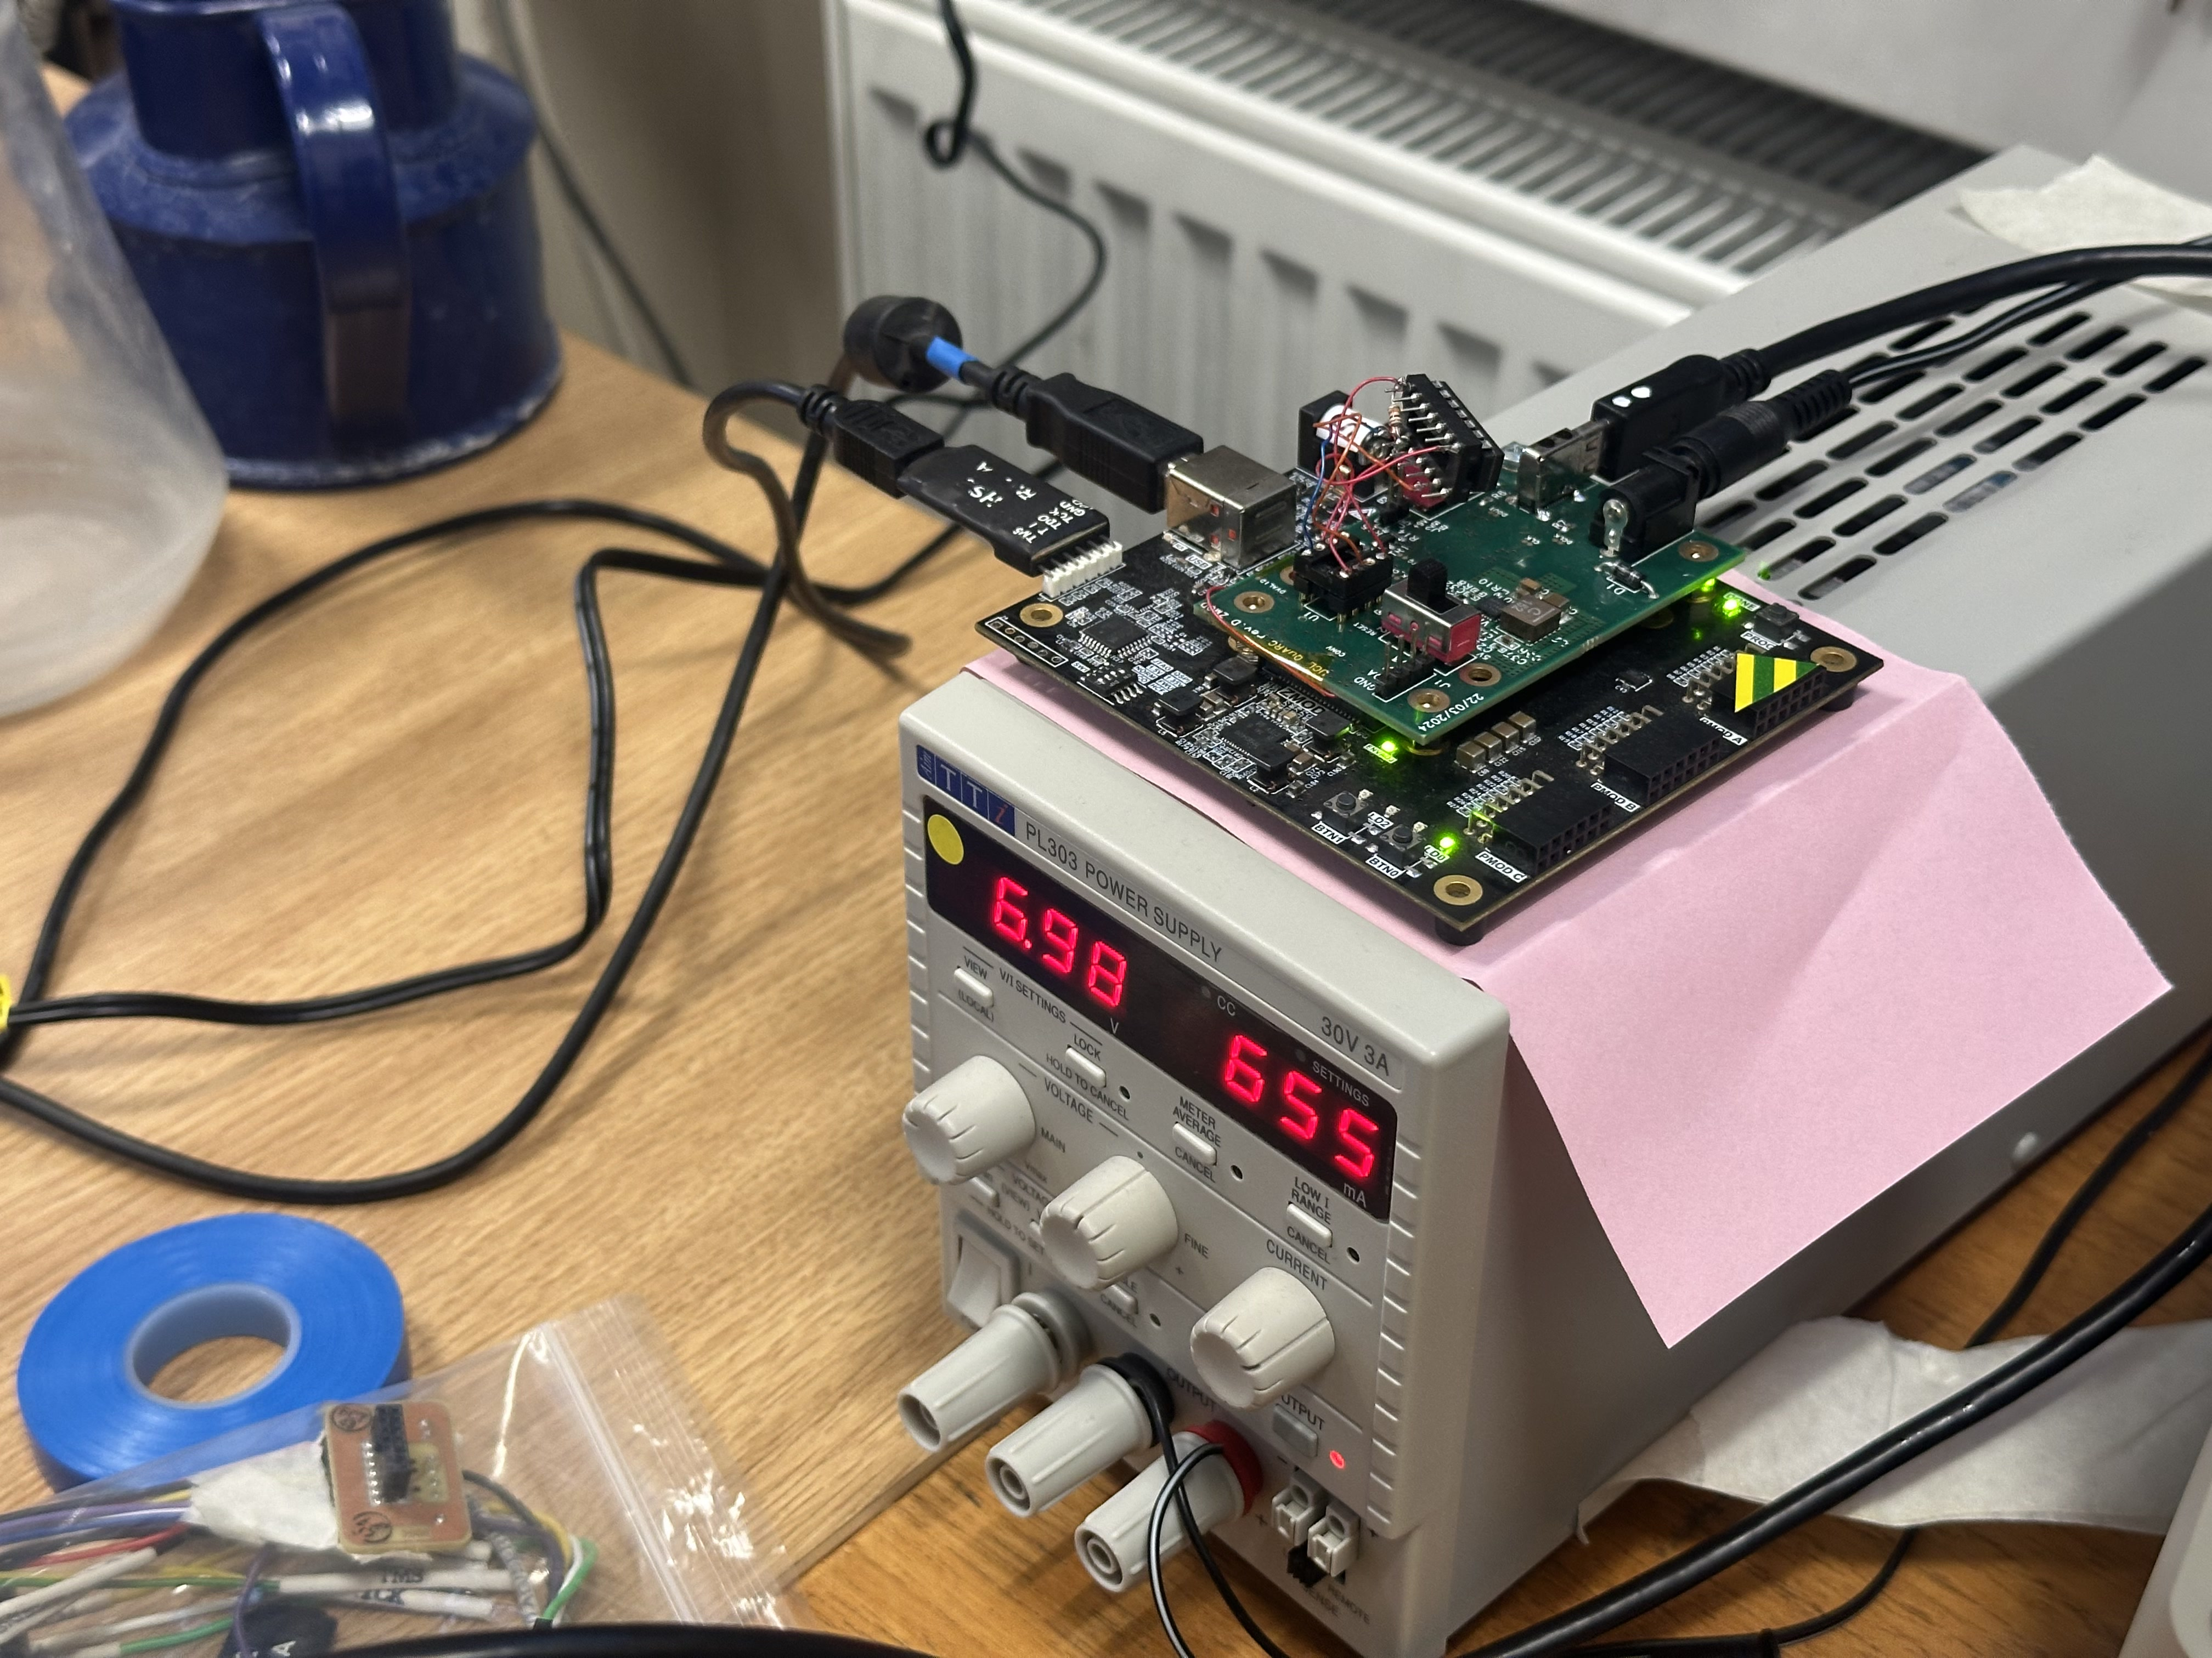
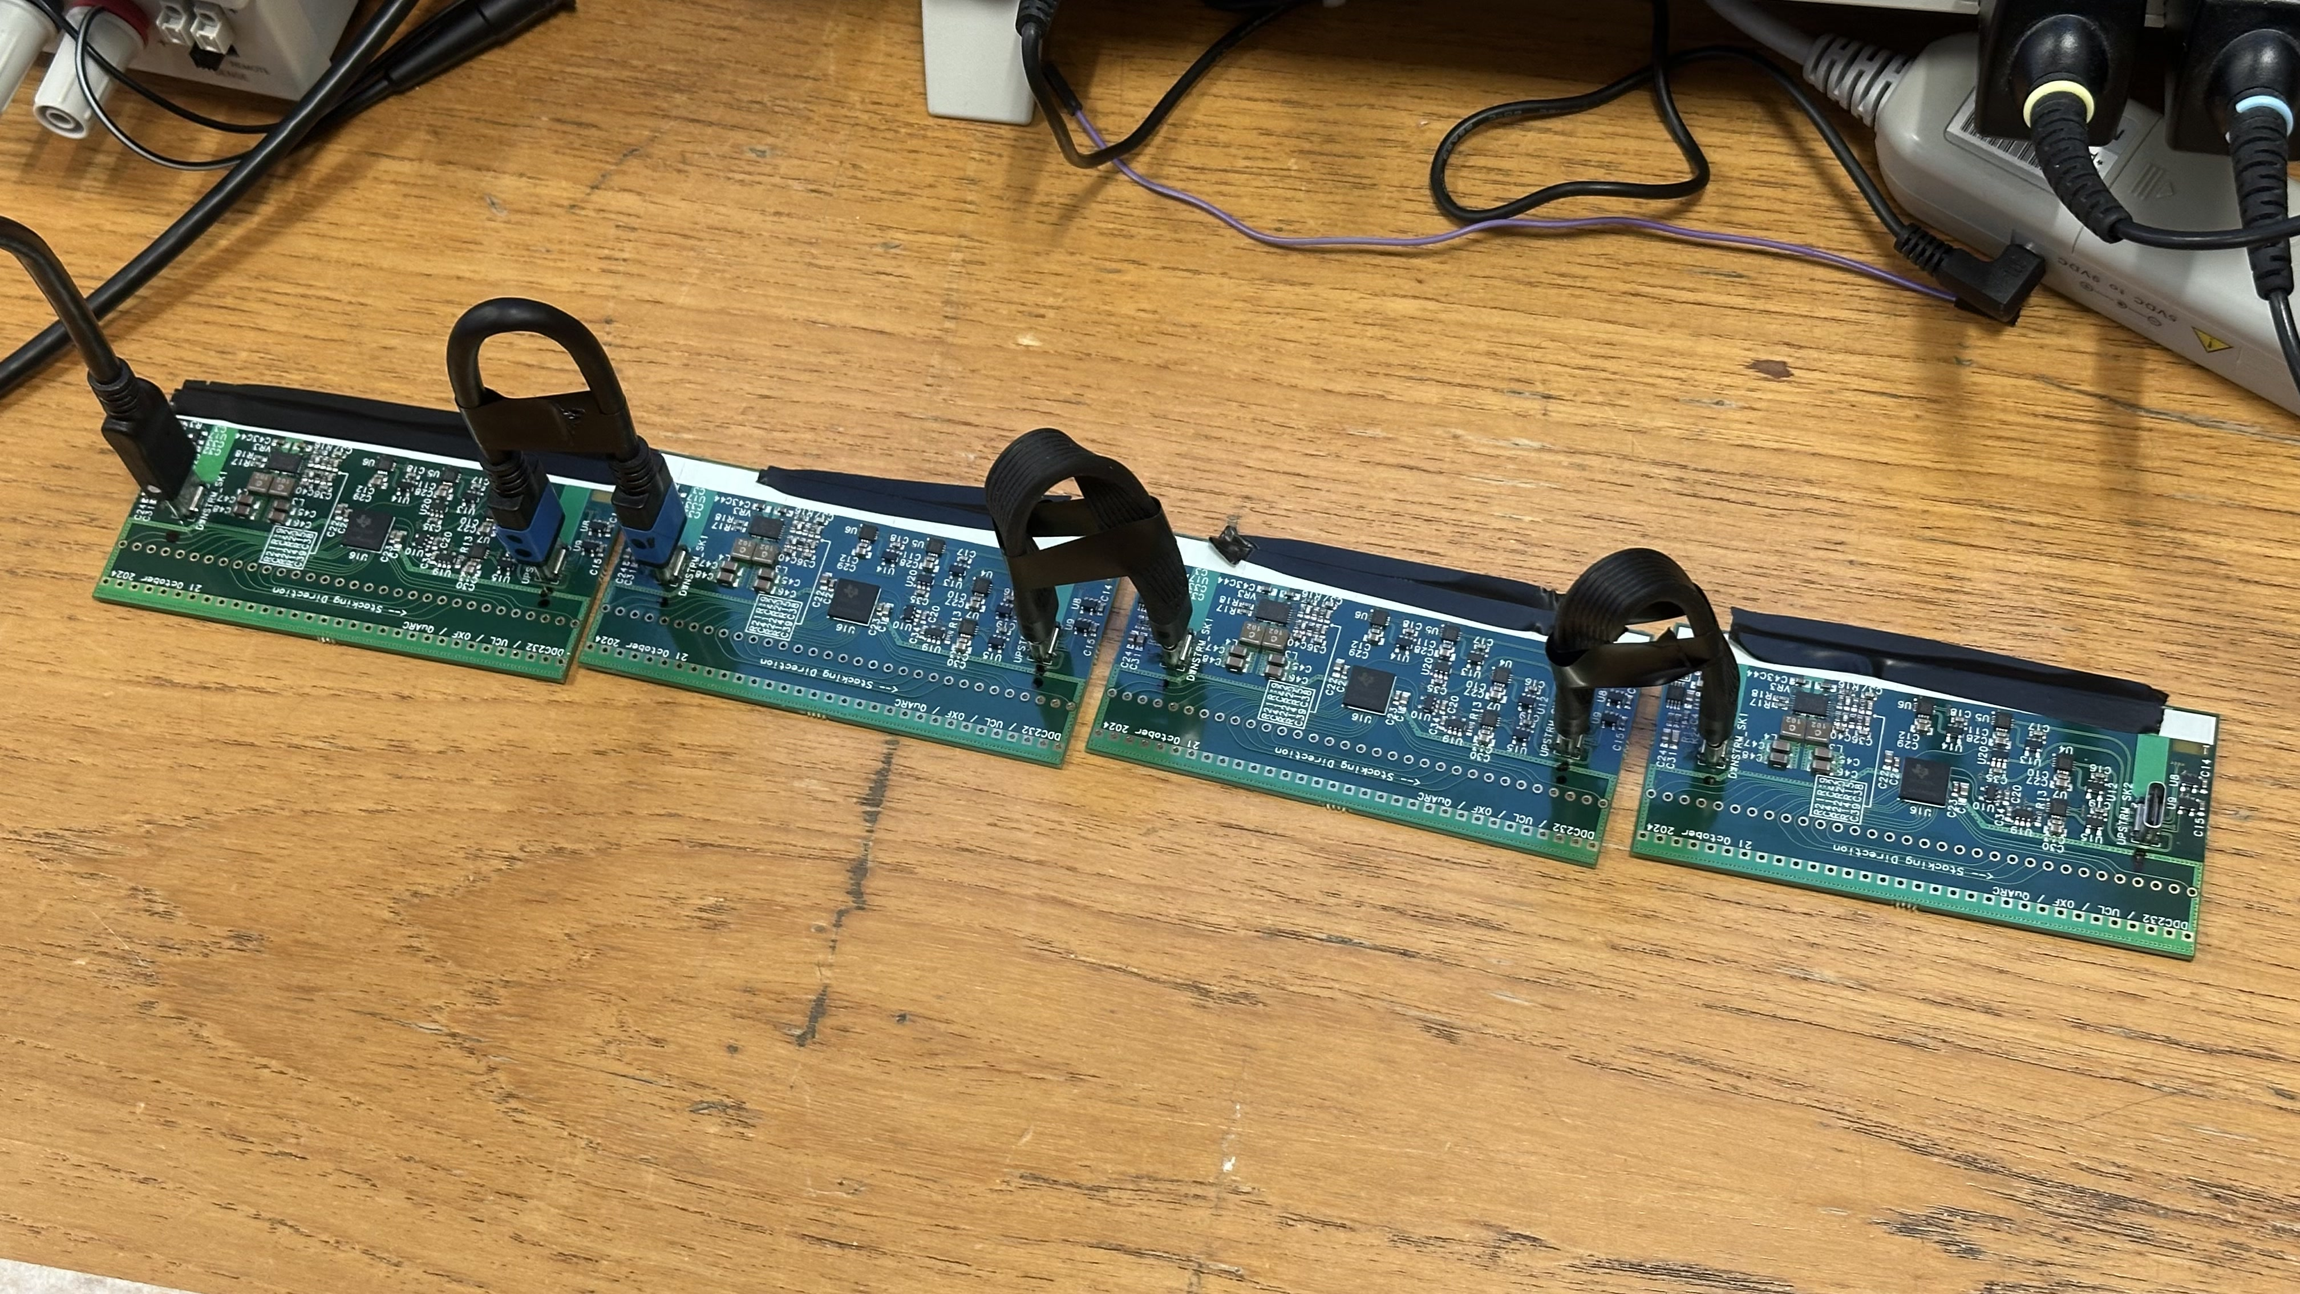
The Good News
It works!
After a few days buggering about with ZMOD signal assignments, we get the correct readback pattern:
  1801000000000000000000000000000000000000000000000000000000000030F066012480F69055
Can daisychain at least 4 boards! Readback pattern is identical for all boards.
Possible to see a response when one moves a finger over photodiode connections (more later…).

Slide 10

Channel Reponse: Note Low Noise!

Slide 11
Testing Results
Good News
Bad News
“Noise”/interference that we have seen previously has vanished.
Setup extremely stable and repeatable.
Daisy-chaining works exactly as intended: 1–4 boards tested.
Current draw low (at 7 V): will be able to drive single board from Raspberry Pi USB bus power only (600 mA/1.6 A).
“Upstream” USB-C socket on DDC board needs rotating 180 degrees: currently all USB-C board-to-board interconnects need 180 degree twist.
RESET passthrough on DDC does not come from Schmitt trigger: should be RESET_B.
We cannot fit photodiodes: DDC board is missing pin inserts.
Not clear whether USB-C cable/connector shielding is correctly grounded.
Some signals look messy (but everything still works…).
DDC Boards | Unconfigured | Running | Idle
1 | 169 mA | 182 mA | 170 mA
2 | 322 mA | 348 mA | 325 mA
3 | 479 mA | 519 mA | 484 mA
4 | 637 mA | 689 mA | 643 mA

Slide 12
DDC Board Upstream USB-C Socket
Current
Correct
Output, not input of U8

Slide 13
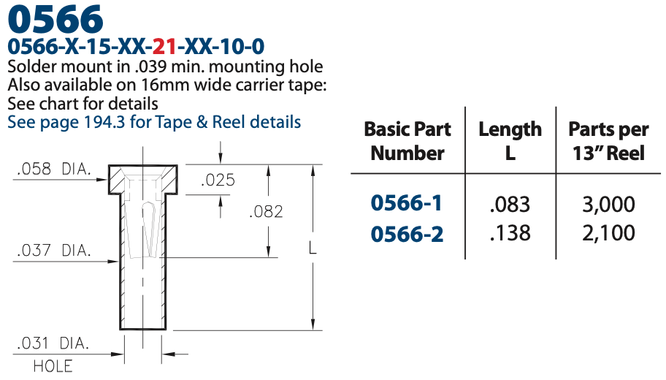
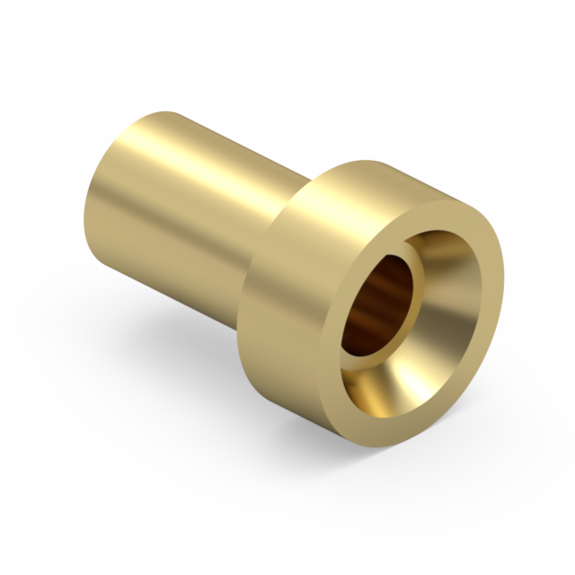
Photodiode Pin Inserts
DDC boards need pin receptacles soldered to board to take photodiode legs:
  Need to plug and remove.
  Adds small amount of elasticity.
Mill-Max:
  0566-1-15-15-21-27-10-0
  2 per diode.
  64 per board.
Available from Mouser, Digikey, Farnell.
Can they be retrofitted to existing boards?
https://www.mill-max.com/products/pin-receptacle/receptacle-with-no-tail/0566/0566-1-15-15-21-27-10-0

Slide 14
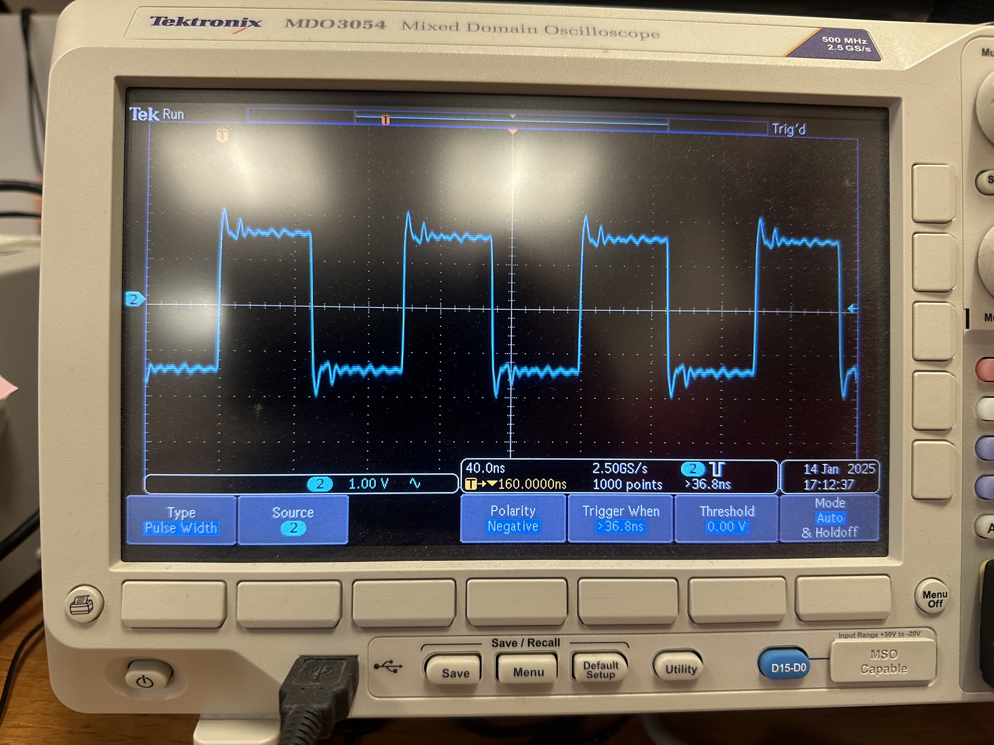
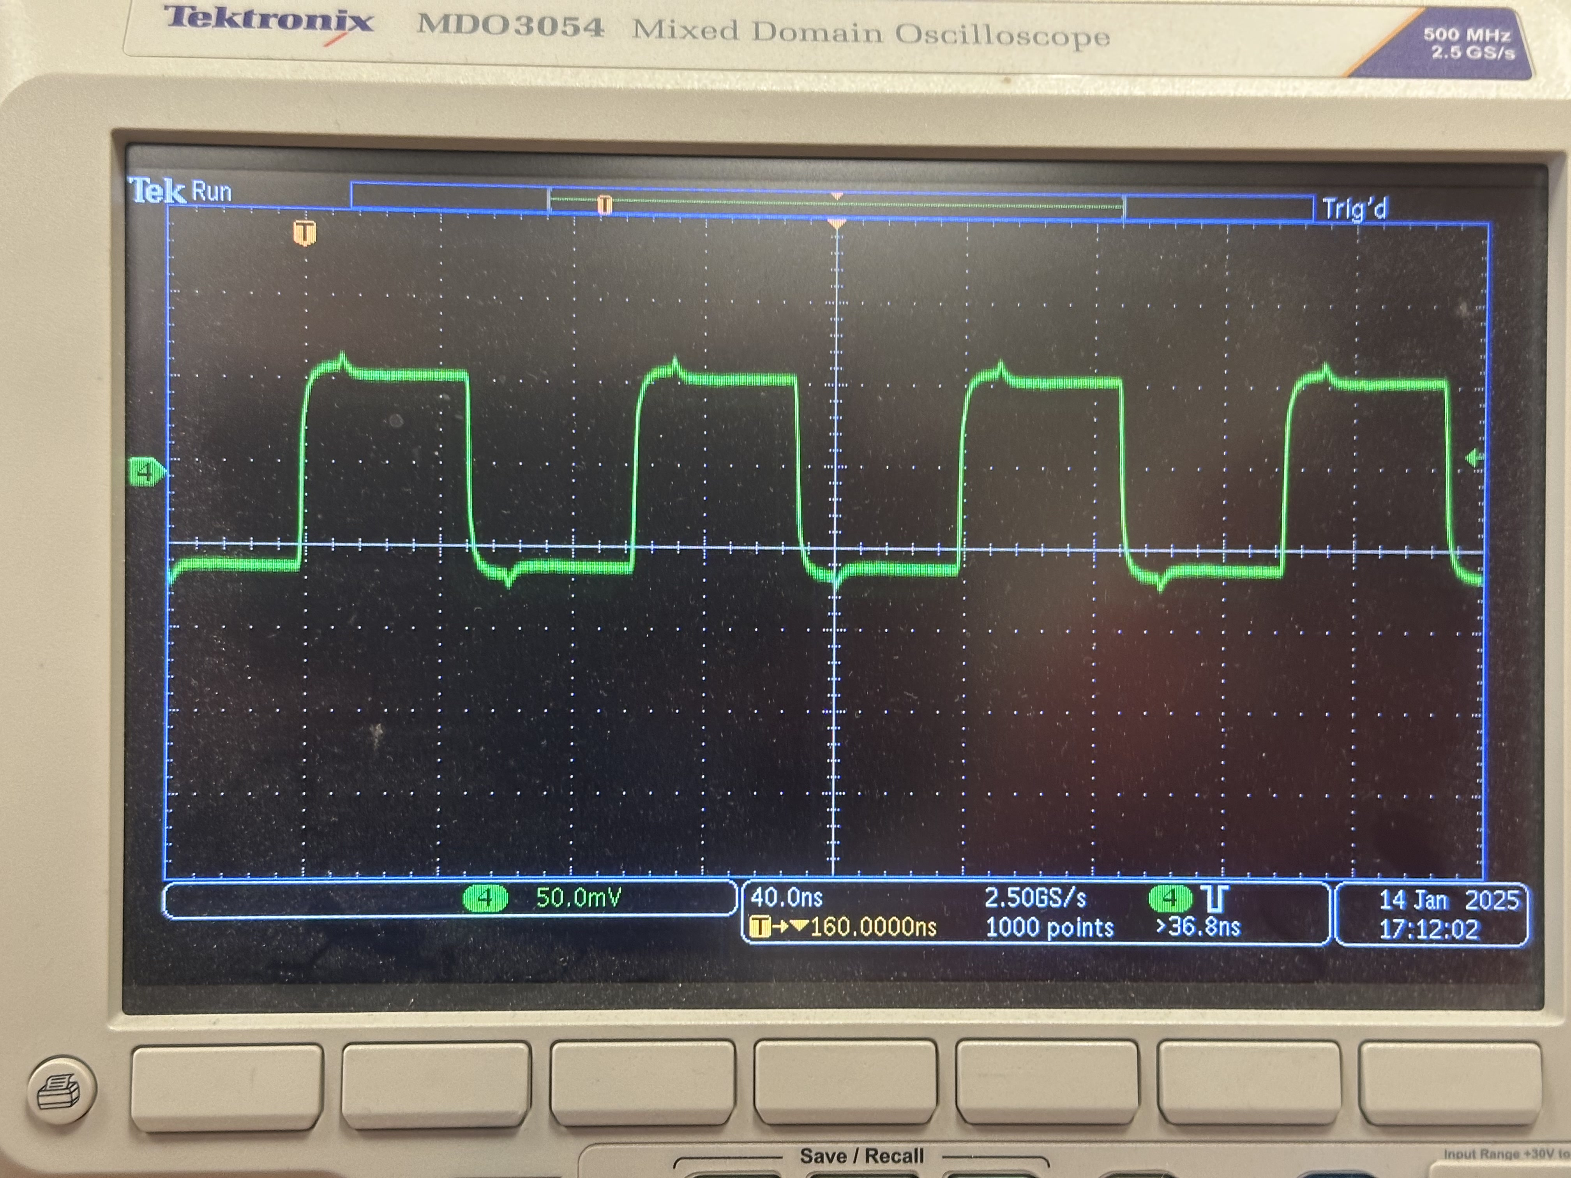
Signal Ringing
Some of the digital pulses on the board look…“interesting”…
Lots of ringing on rising and falling edges.
Single-ended RESET pulses become more distorted: perhaps due to non-buffering from Schmitt trigger?
Do USB-C signals need terminating on DDC board? Shouldn’t LVDS buffers etc. be enough?
May also be due to poor/incorrect termination on scope probe: ringing not seen with differential probe.
DAQ still seems to function perfectly despite this…

Slide 15
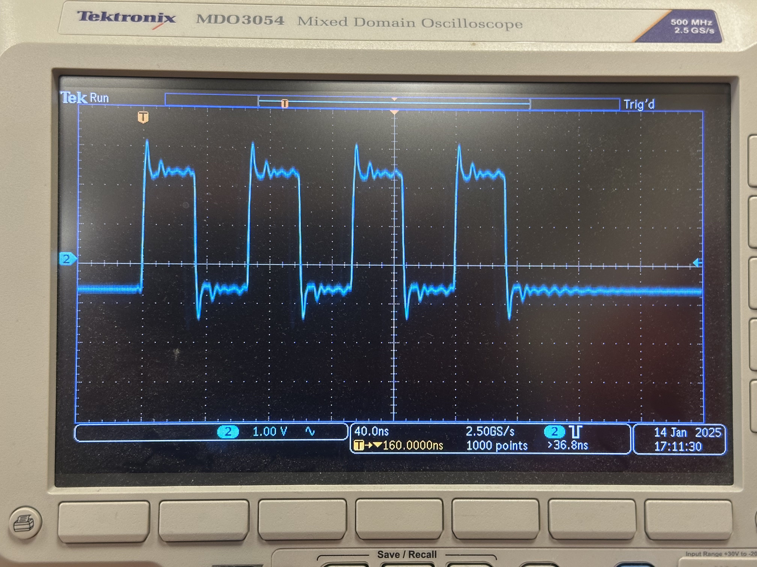
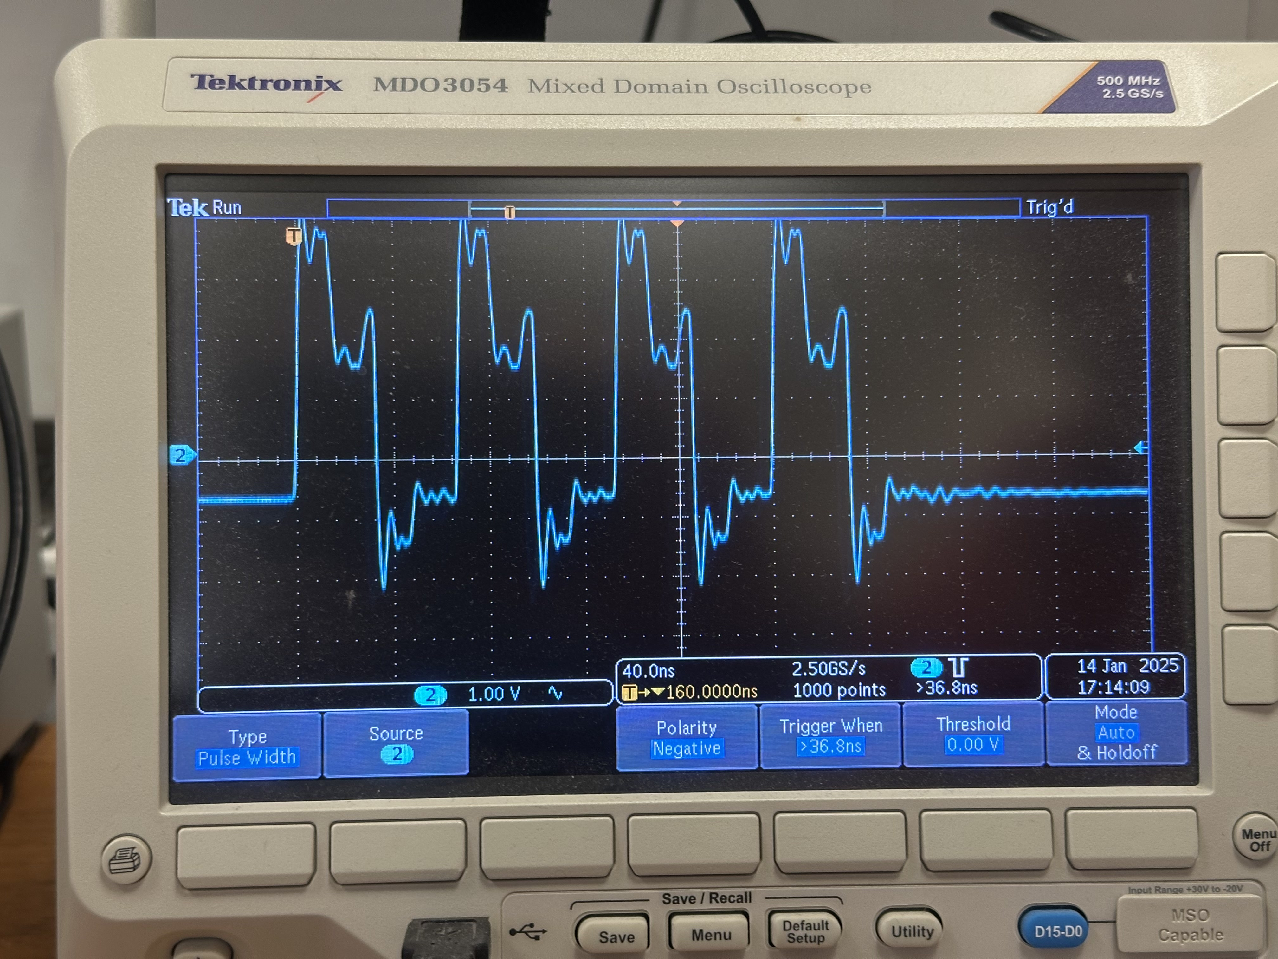
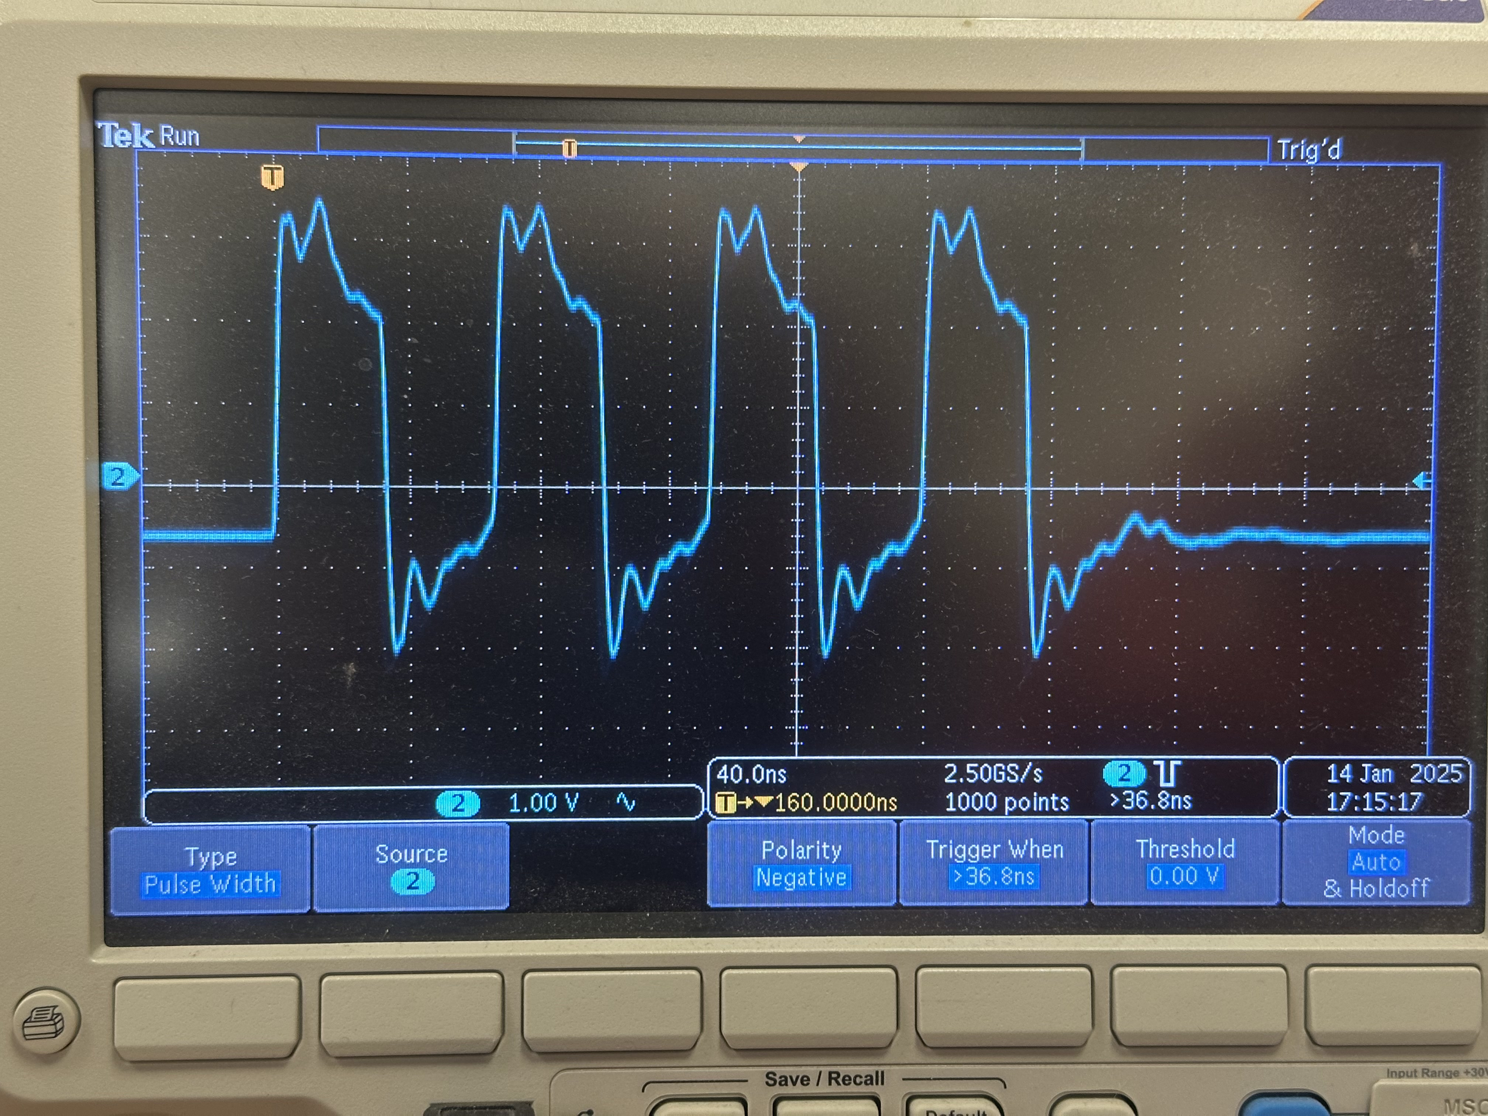
RESET Signal Ringing
CLK

Slide 16
Grounding/Shielding
I’m not sure this is an issue, but worth clarifying.
Where, if at all, is the USB-C shield supposed to be connected to ground?
  Currently connected on both sockets of DDC board but left open on ZMOD v.2 (R19, DNF).
  Not connected anywhere on Cosylab design: reason for noise…?
USB-C specs say:
  11. The receptacle shell shall be connected to the PCB ground plane.
  12. All VBUS pins shall be connected together in the USB Type-C plug.
  13. All Ground return pins shall be connected together in the USB Type-C plug.
So this implies that shield should be connected to ground at every socket.
Where is “chassis” on ZMOD?
Modify ZMOD with 0R at R19…?
https://www.usb.org/document-library/usb-type-cr-cable-and-connector-specification-release-24
ZMOD v.2 USB-C Connection

Slide 17
DDC Board Upstream USB-C Connector
DDC Rev.E USB-C U/S (Updated)
DDC Rev.E USB-C D/S

Slide 18
Conclusion
Design is sound for both ZMOD and DDC boards.
NO changes needed for ZMOD to work:
  Just check USB-C ground-shield connection. Fit R19?
DDC board design works but small mods needed:
  Add pin receptacles to take photodiodes.
  Rotate upstream USB-C socket (wiring) by 180 degrees so match downstream orientation.
  Pass Schmitt triggered RESET_B to upstream socket, not RESET.
Cause of ringing/distortion of square pulses? Is this an issue? DDC boards seem to work…

Slide 19


Follow The Monkey: Onwards…

