Slide 1
KriaDAQ _QuARC
7 Oct 2026

Slide 2
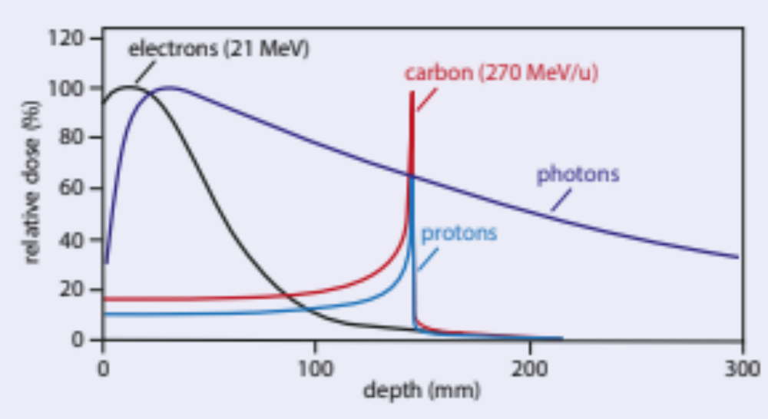
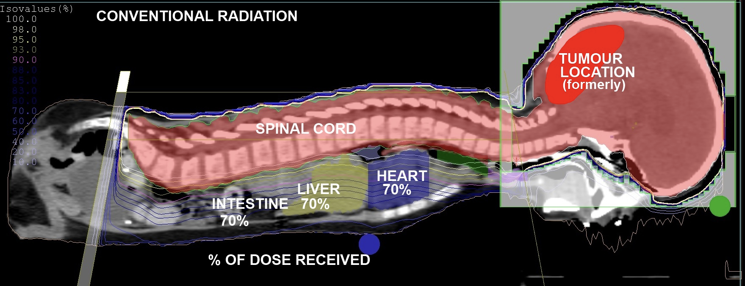
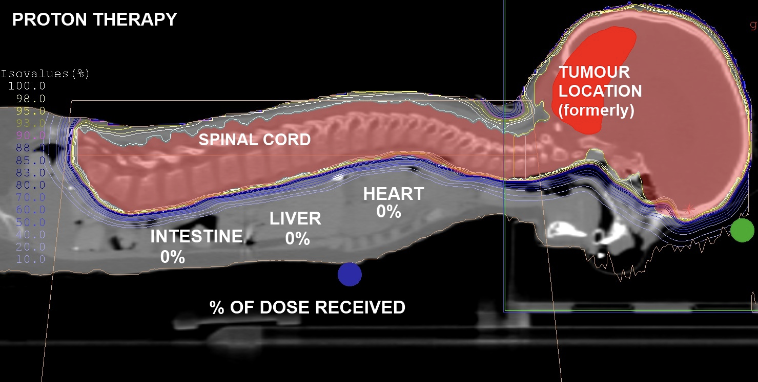
Background - PBT
Ionising radiation damages DNA of tumour cells, causing cell death.
PBT has a superior dose distribution as illustrated by Bragg curve.
Allows for more precise targeting of tumours, sparing surrounding healthy tissue and critical structures from unnecessary radiation.
Range uncertainties prevent taking full advantage of dose localisation benefits.
Clinic must perform daily beam Quality Assurance (QA).

Slide 3
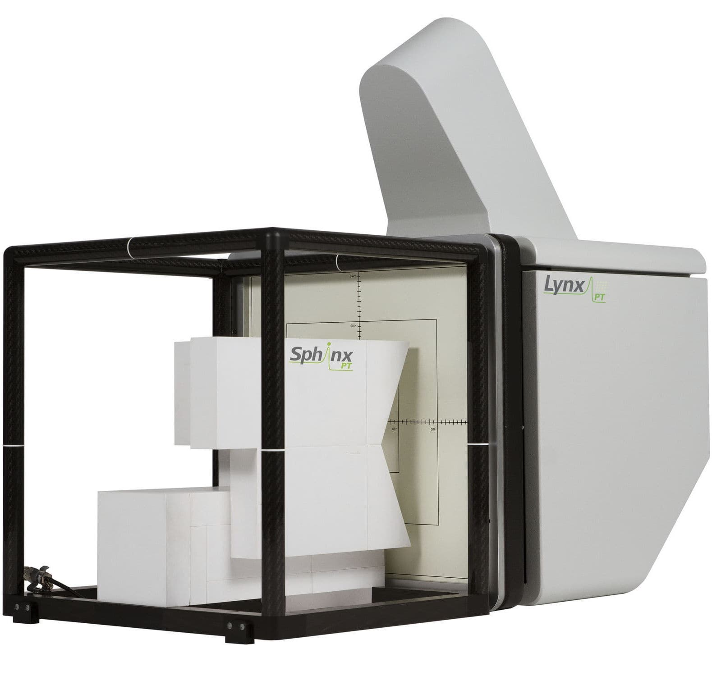
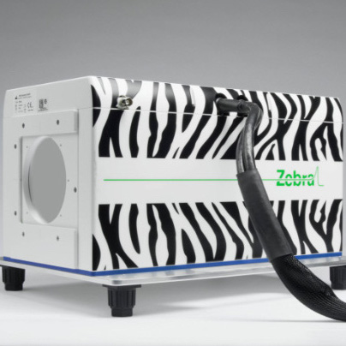
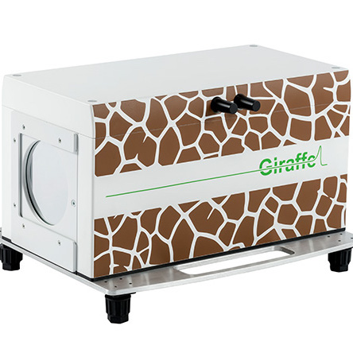
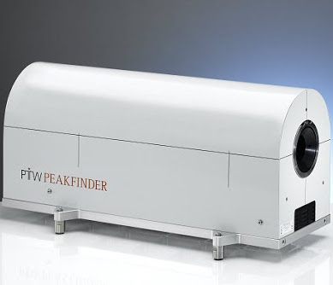
Background – daily QA
Daily QA requires measurement of beam range, spot position and spot size.
Range measured in water-equivalent material for a selection of beam energies.
  Water chosen as proxy for human tissue.
Typically measured using layers of ionisation chambers in a water tank, requiring repeated beam delivery.
Current methods often compromise between speed and accuracy.
Develop a detector to make fast, accurate measurements of proton range.
Reproduced Saad Slides

Slide 4
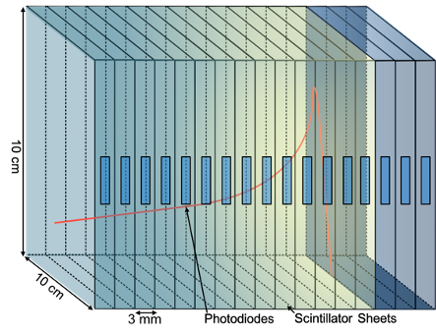
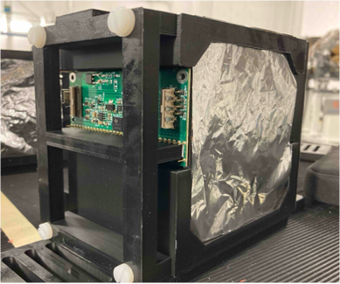
Quality assurance Range Calorimeter (QuARC)
QuARC is made of polystyrene scintillator sheets 3mm thick which optically isolated using mylar aluminium foil 6µm thick.
Scintillator sheet produces light when irradiated by charged particle.
Collecting each light output from each sheet obtaining depth-light curve to retrieve the proton range with a single beam delivery.
Advantage: fast response time, close resemblance to water equivalence depth, lightweight.

Slide 5
Last version
DAQ FPGA and Daughterboard: The DDC232 circuit boards are read-out using a DAQ FPGA (previously, Digilent USB104). As an interface between DDC232 board and DAQ FPGA, a daugtherboard is required. A custom Syzygy Zmod port daughterboard bridge USB104 FPGA with DDC232 board via USB-C. PC connectivity is established via USB 2.0 through an onboard FTDI FT2232H chip.
USB-C
Photodiode + DDC
FPGA
ZMOD DB
PC
QuARC Scintillator Modules
USB-C
USB-B to USB-A

Slide 6
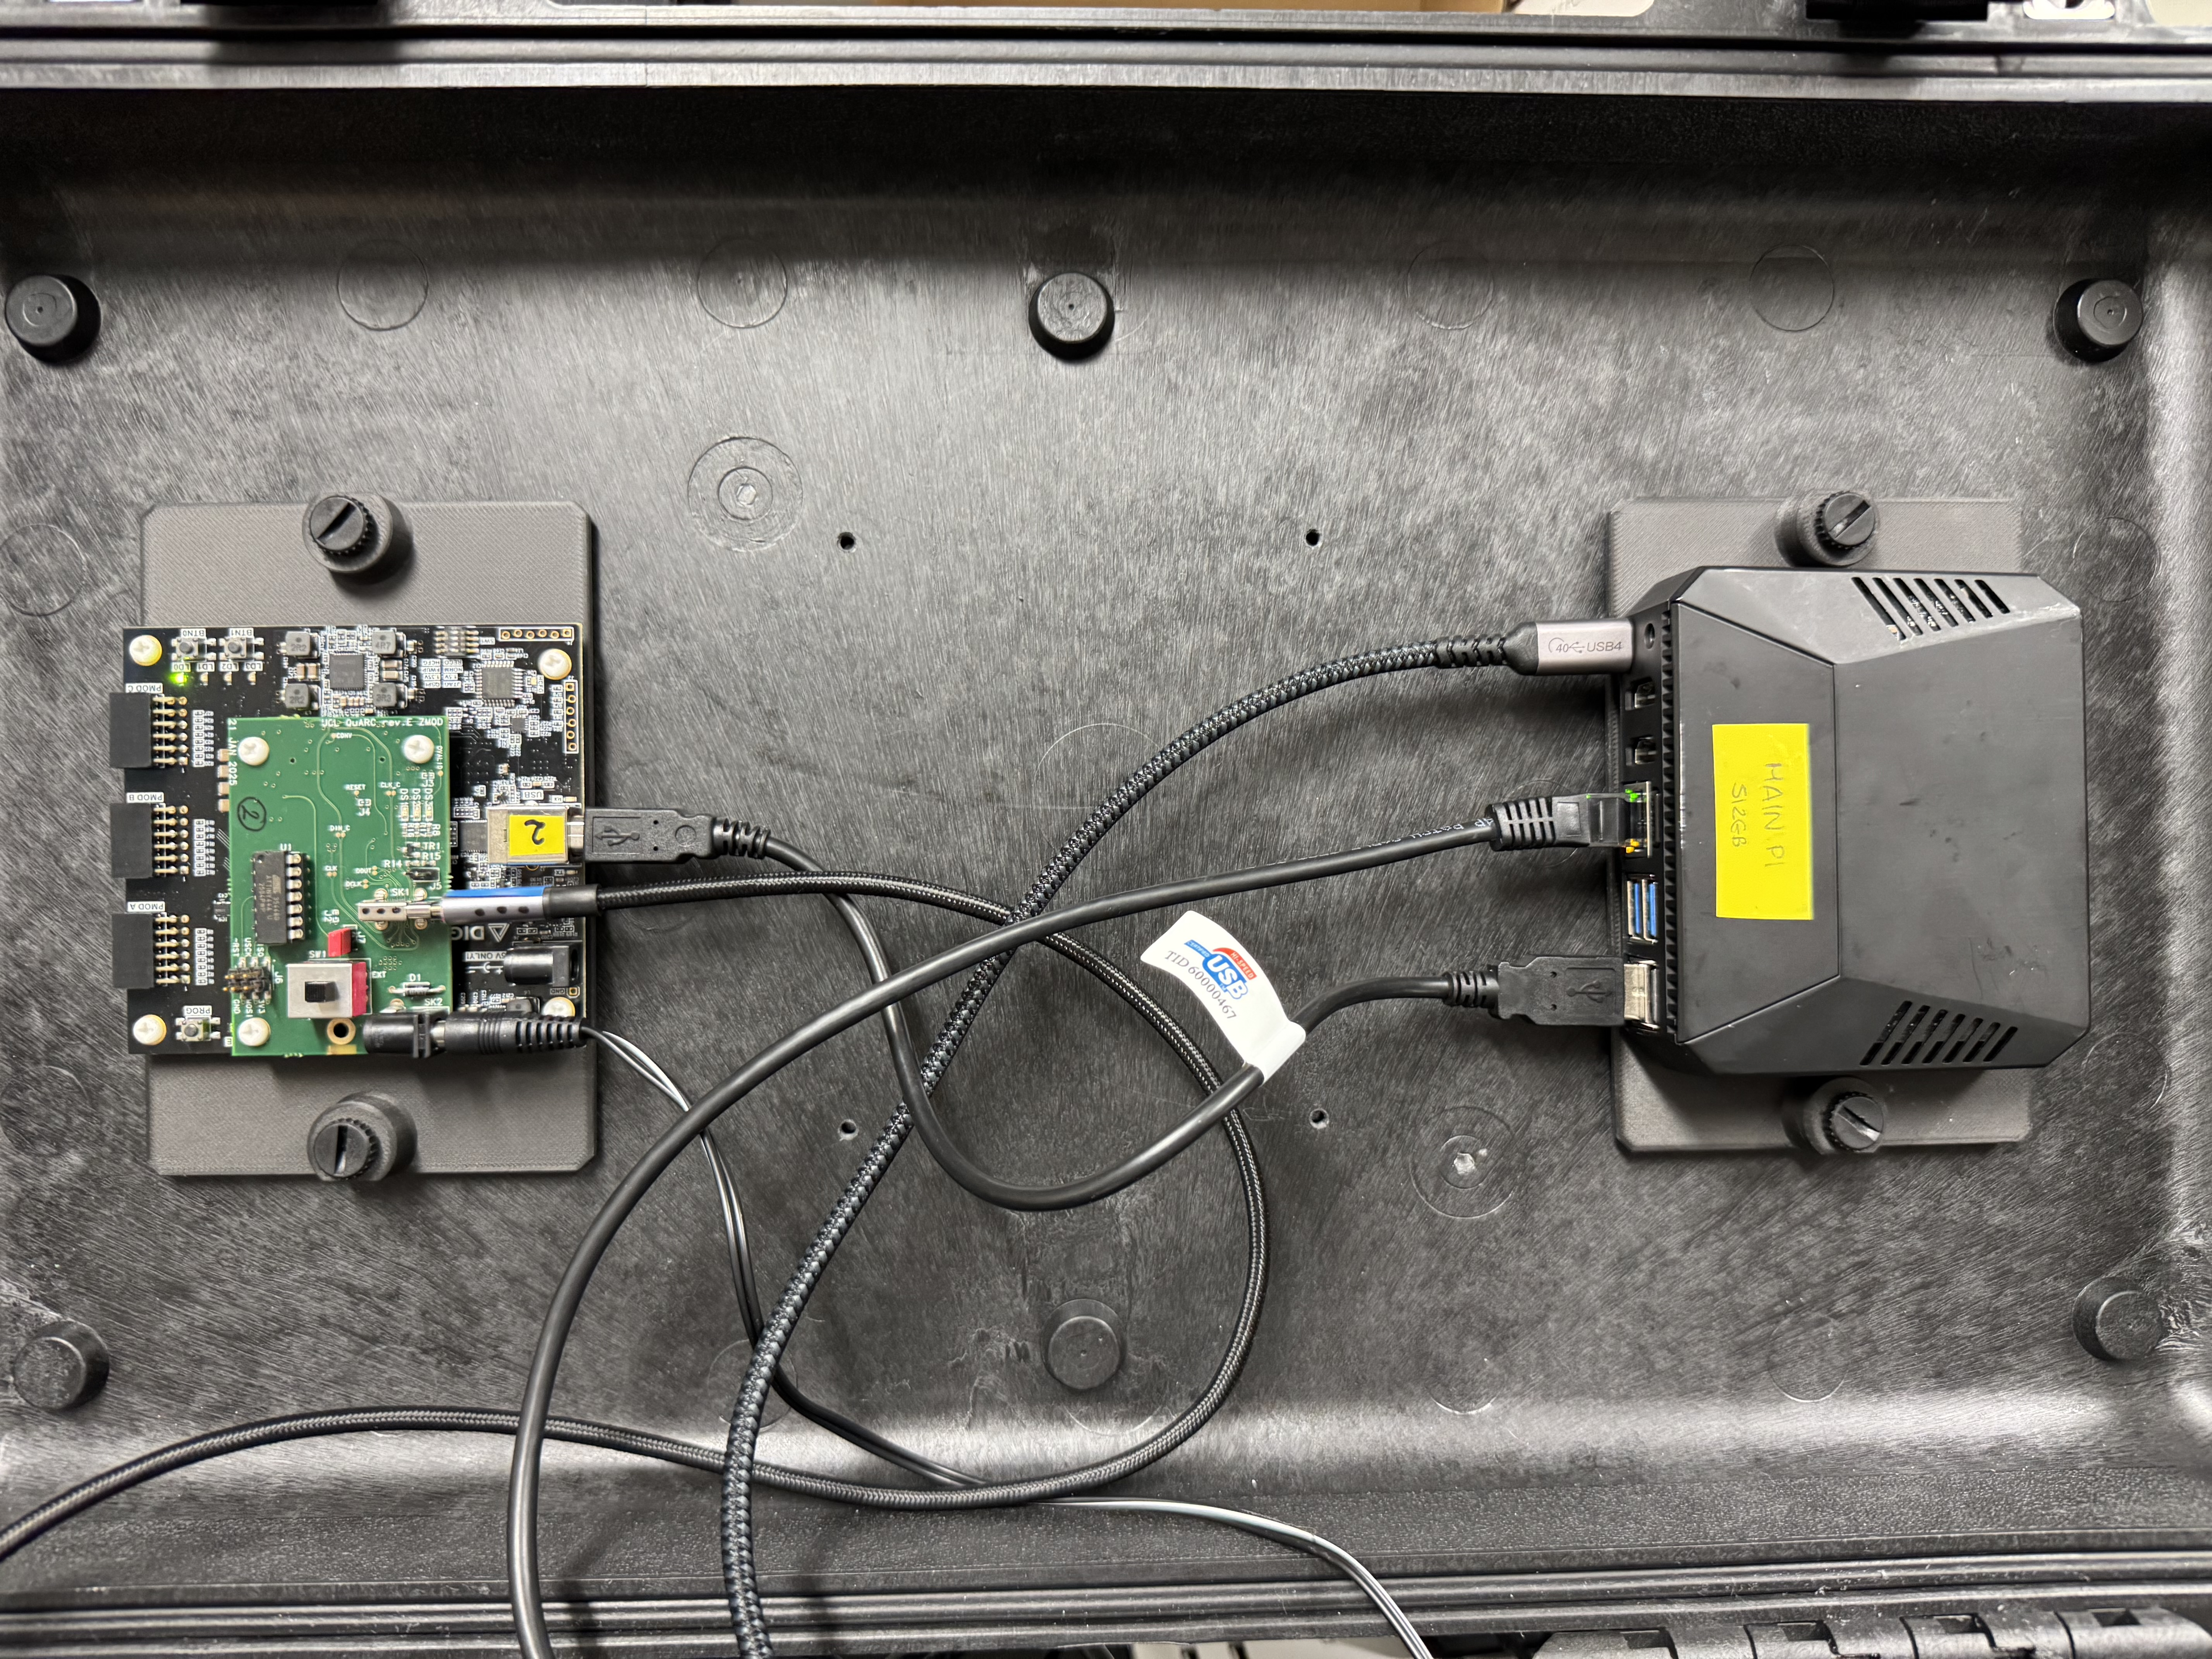
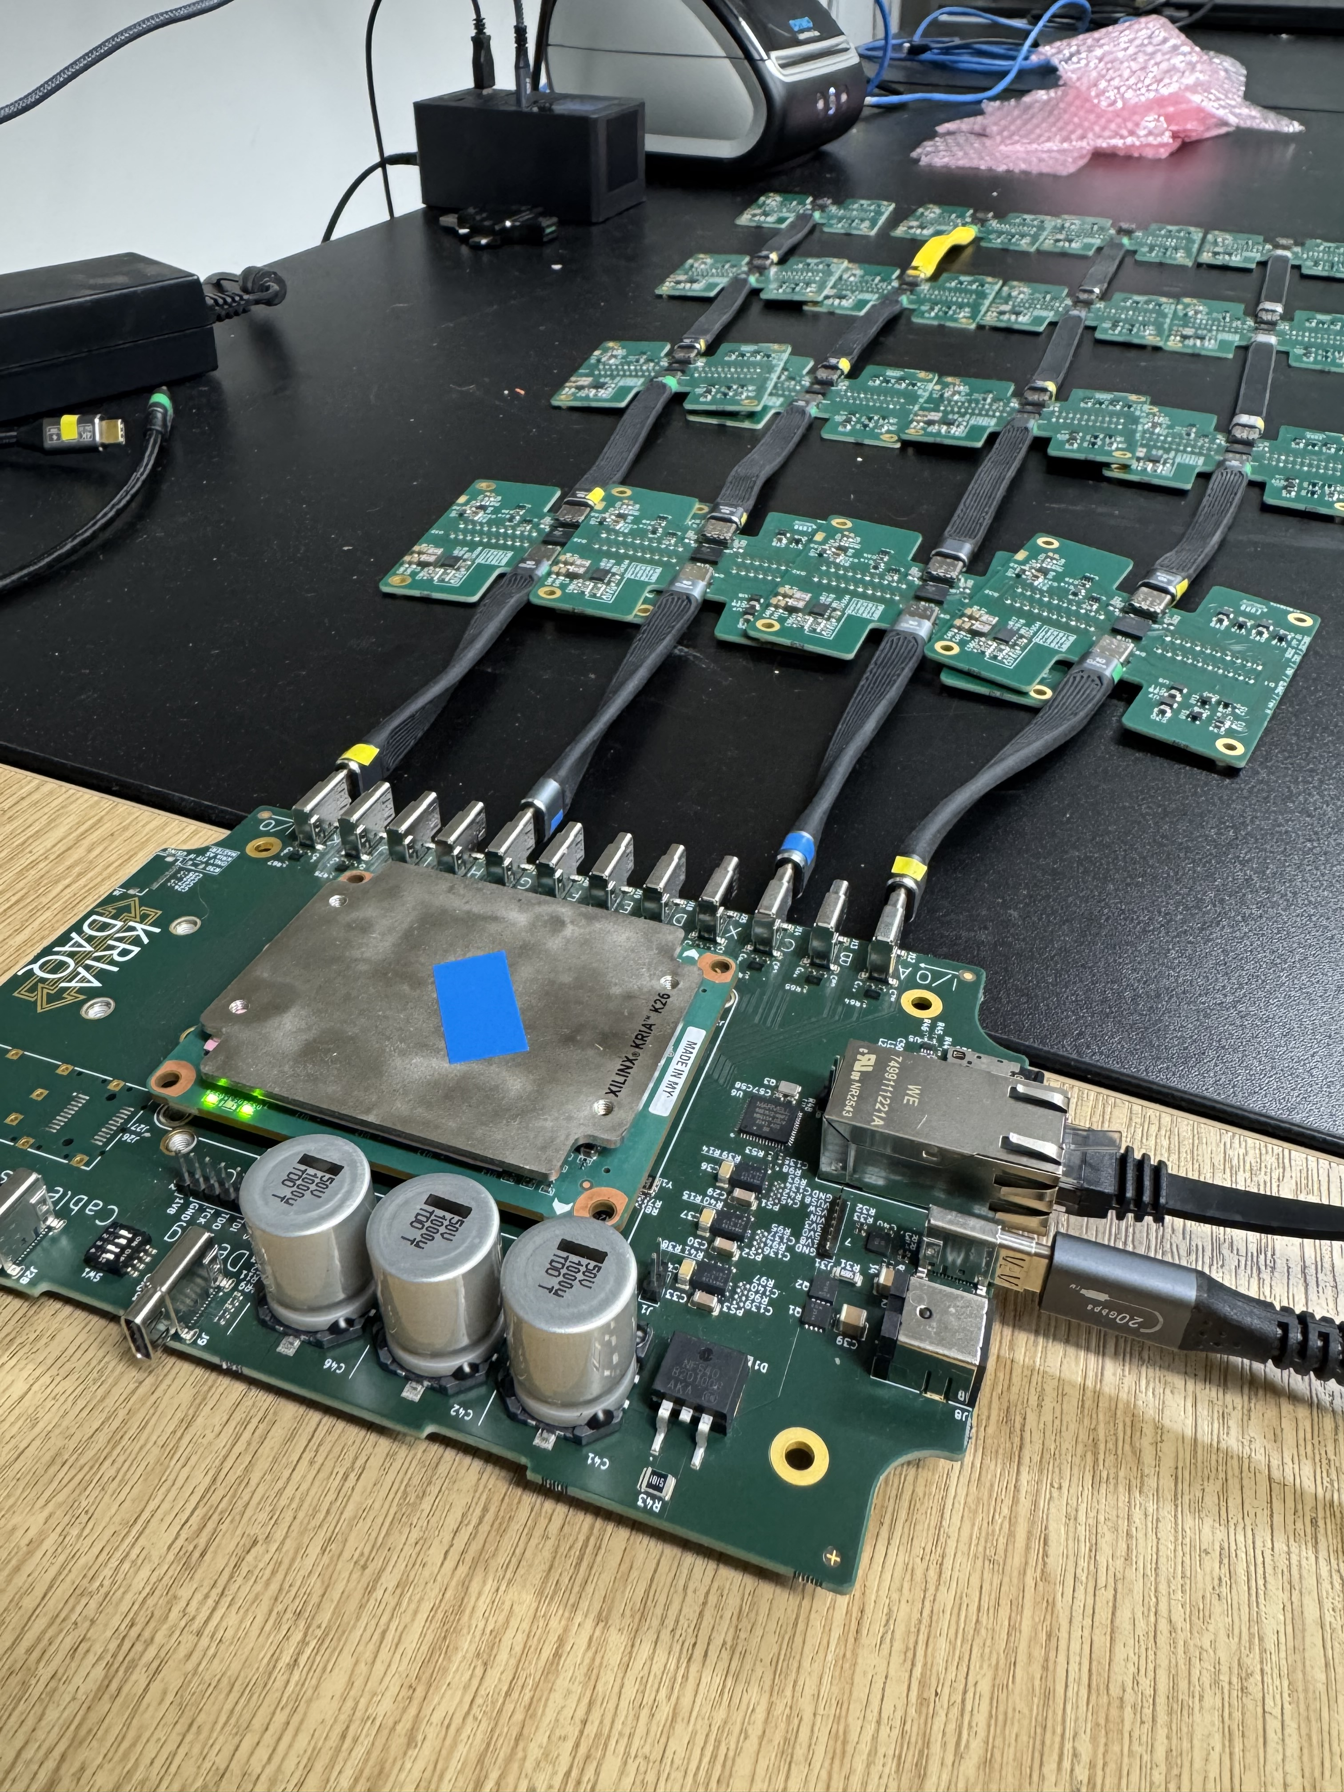
Transition to next gen
From 3 separate boards to a single board

Slide 7
K26 SOM overview
Programmable logic:
  256K system logic cells,
  144 block RAMs,
  64 UltraRAM blocks,
  1.2K DSP slices.
CPU: Dual-core Arm Cortex-R5F at 600 MHz. (eq. intel atom z500 (2005 era))
GPU: Arm Mali-400 MP2 at 667 MHz. (eq NVIDIA GeForce 6100)
Kit Dimension: 119 × 140 × 36 mm
On-chip memory: ~26.6 Mb SRAM (Caching Memory)
DDR Memory: 4 GB (4 x 512 Mb x 16 bit) [non-ECC]. (PC RAM)
Primary Boot Memory: 64MB QSPI (FPGA RAM)
Secondary Boot Memory: SDHC card (microsd card external)

Slide 8
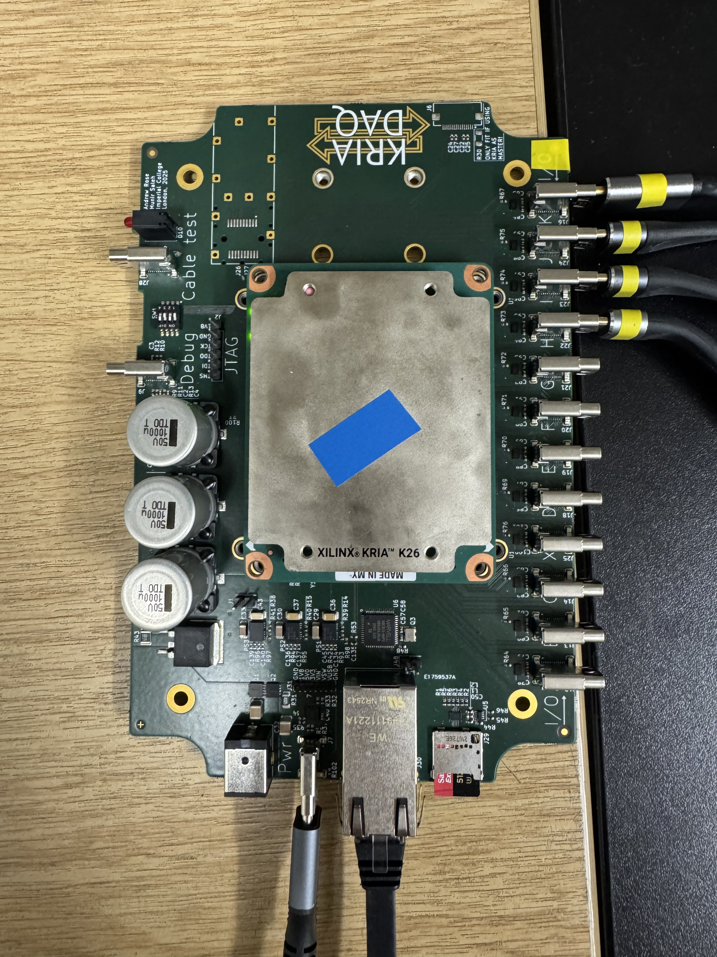
KriaDAQ – Custom carrier overview
12 USBC ports: A-K + X.
Each one of them has 5 differential pairs(CK,D0-D3), 4 single ended (S0-S3), 4 vbus pins, 4 ground pins.
Vbus can be enabled or disabled deliberately on requests.
20V input voltage recommended. 12V is the minimum requirements for running K26.
Switch for operational modes, 2 common modes for boot PS or pure FPGA. Boot PS required etched SD card whereas pure FPGA requires HS2 connector to interface the JTAG-UART.
Connection to the external devices from 1 available ethernet port.
Debugging board available with few LED indicators.

Slide 9
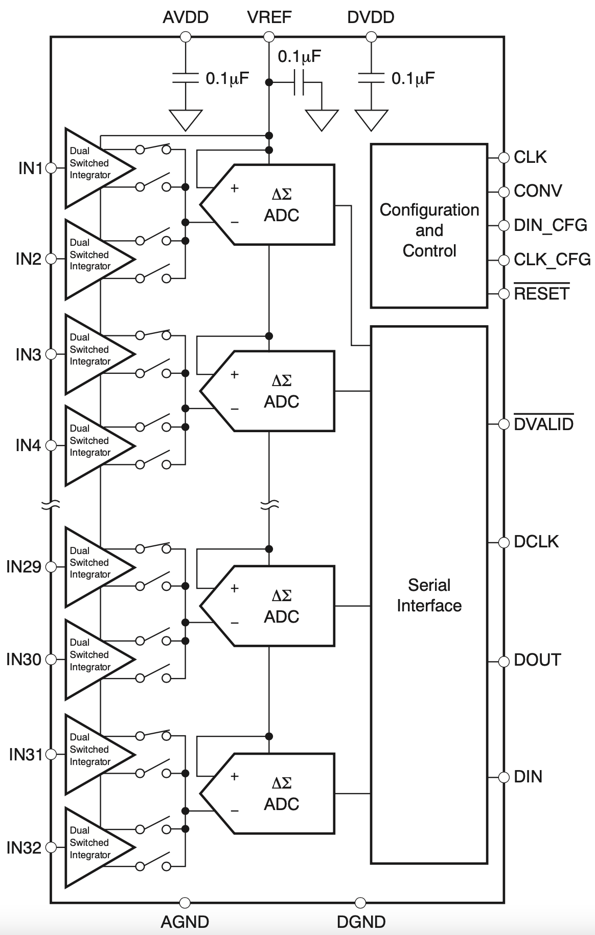
Communicate to DDC232 board
Py script from PS sends data to PL using AXI to start/stop/specify operation.
ADC configured: FPGA sends 12 bits to set dynamic range, precision etc.
ADC sends 640-bit read-back pattern – used to check everything is OK.
Integration begins: each 170μs cycle gives a photodiode measurement.
Measurement stored in FIFO on FPGA.
PL sends measurement to PS via AXI chip.
PC saves hexadecimal data and converts to charge (To do).
Py scripts to display data in real-time. (To do)

Slide 10
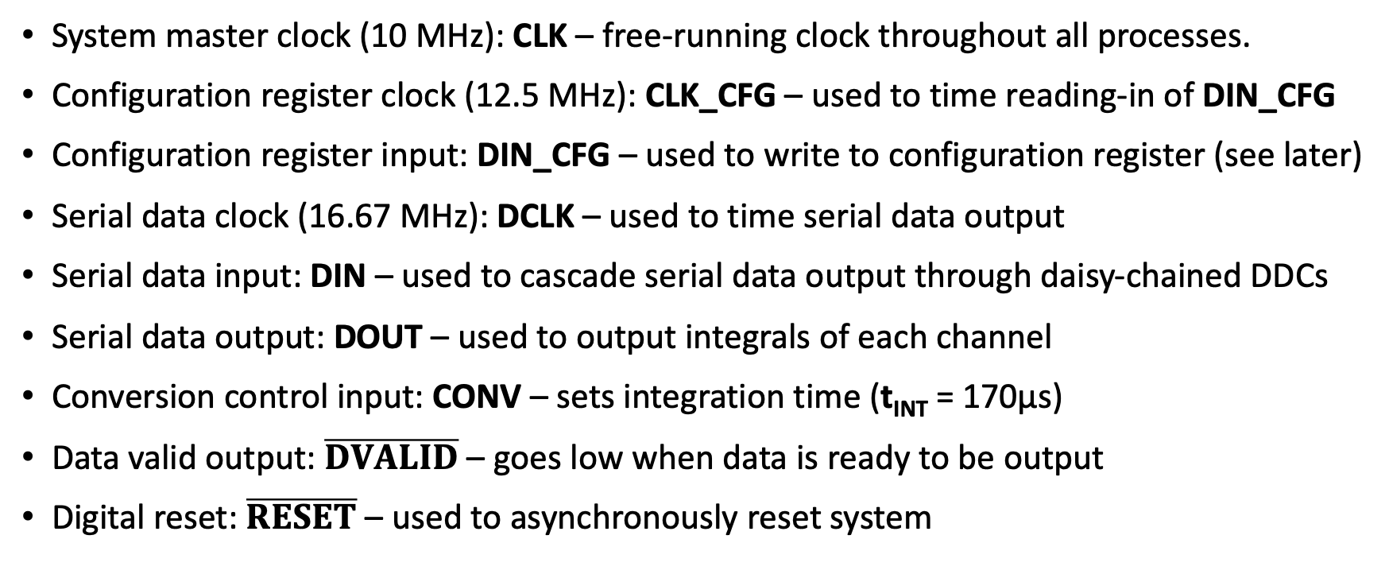
DDC232 IO Signals
System master clock (10 MHz): CLK – free-running clock throughout all processes.
Configuration register clock (12.5 MHz): CLK_CFG – used to time reading-in of DIN_CFG
Configuration register input: DIN_CFG – used to write to configuration register (see later)
Serial data clock (16.67 MHz): DCLK – used to time serial data output
Serial data input: DIN – used to cascade serial data output through daisy-chained DDCs
Serial data output: DOUT – used to output integrals of each channel
Conversion control input: CONV – sets integration time (t_{INT} = 170μs)
Data valid output: $\overline{DVALID}$ – goes low when data is ready to be output
Digital reset: $\overline{RESET}$ – used to asynchronously reset system

Slide 11
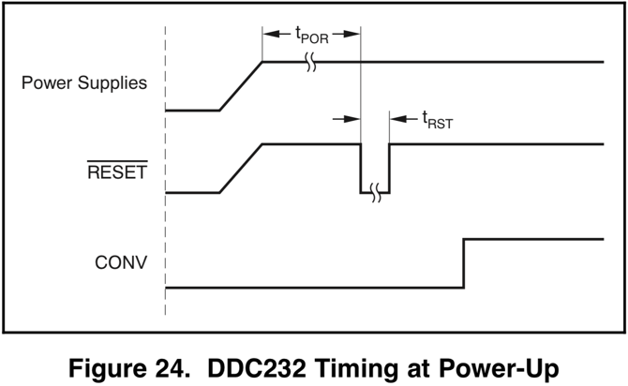
Powering Up
Before powering up, all digital and analog inputs must be held low until power supplies have stabilised. Master clock can then be supplied to CLK.
After time t_{POR} = 250ms, configuration can begin.
DDC232 requires 3.3V for digital signalling and 5V for analogue.

Slide 12
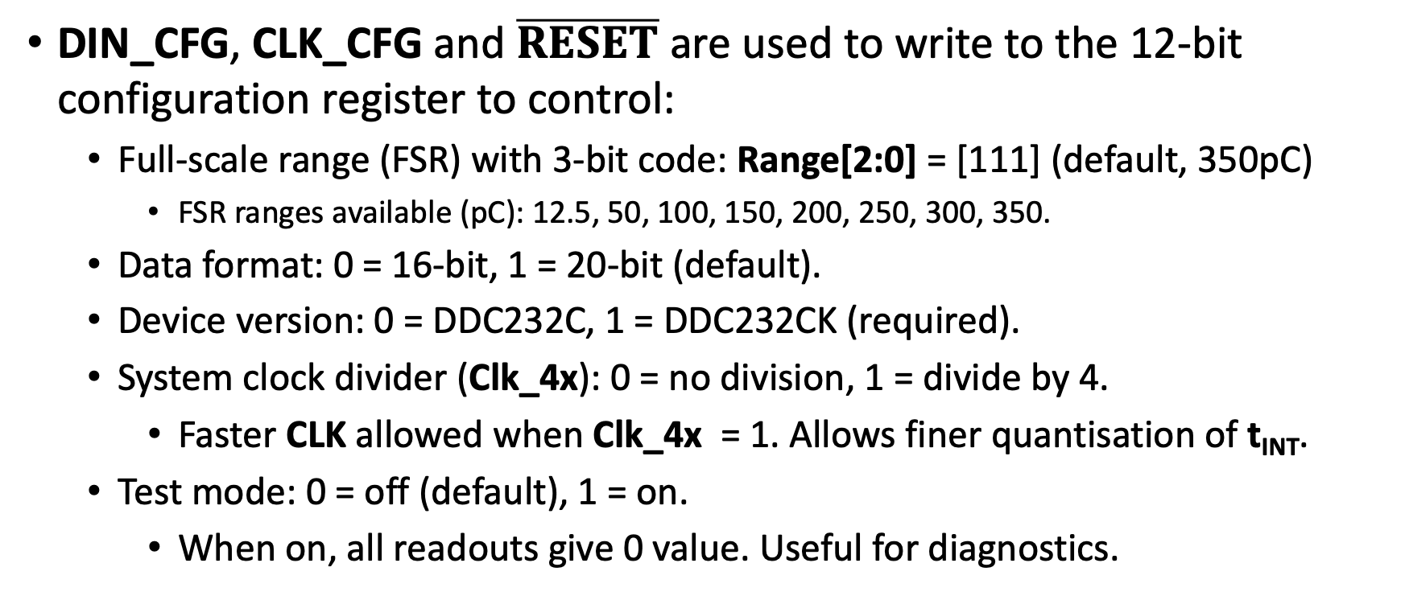
Configuration
DIN_CFG, CLK_CFG and $\overline{RESET}$ are used to write to the 12-bit configuration register to control:
  Full-scale range (FSR) with 3-bit code: Range[2:0] = [111] (default, 350pC)
    FSR ranges available (pC): 12.5, 50, 100, 150, 200, 250, 300, 350.
  Data format: 0 = 16-bit, 1 = 20-bit (default).
  Device version: 0 = DDC232C, 1 = DDC232CK (required).
  System clock divider (Clk_4x): 0 = no division, 1 = divide by 4.
    Faster CLK allowed when Clk_4x = 1. Allows finer quantisation of t_{INT}.
  Test mode: 0 = off (default), 1 = on.
    When on, all readouts give 0 value. Useful for diagnostics.

Slide 13
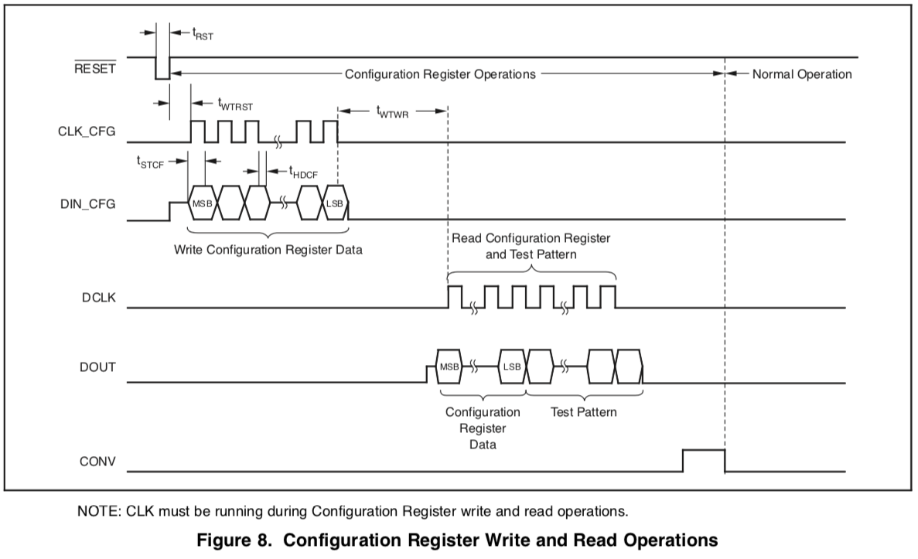

Slide 14
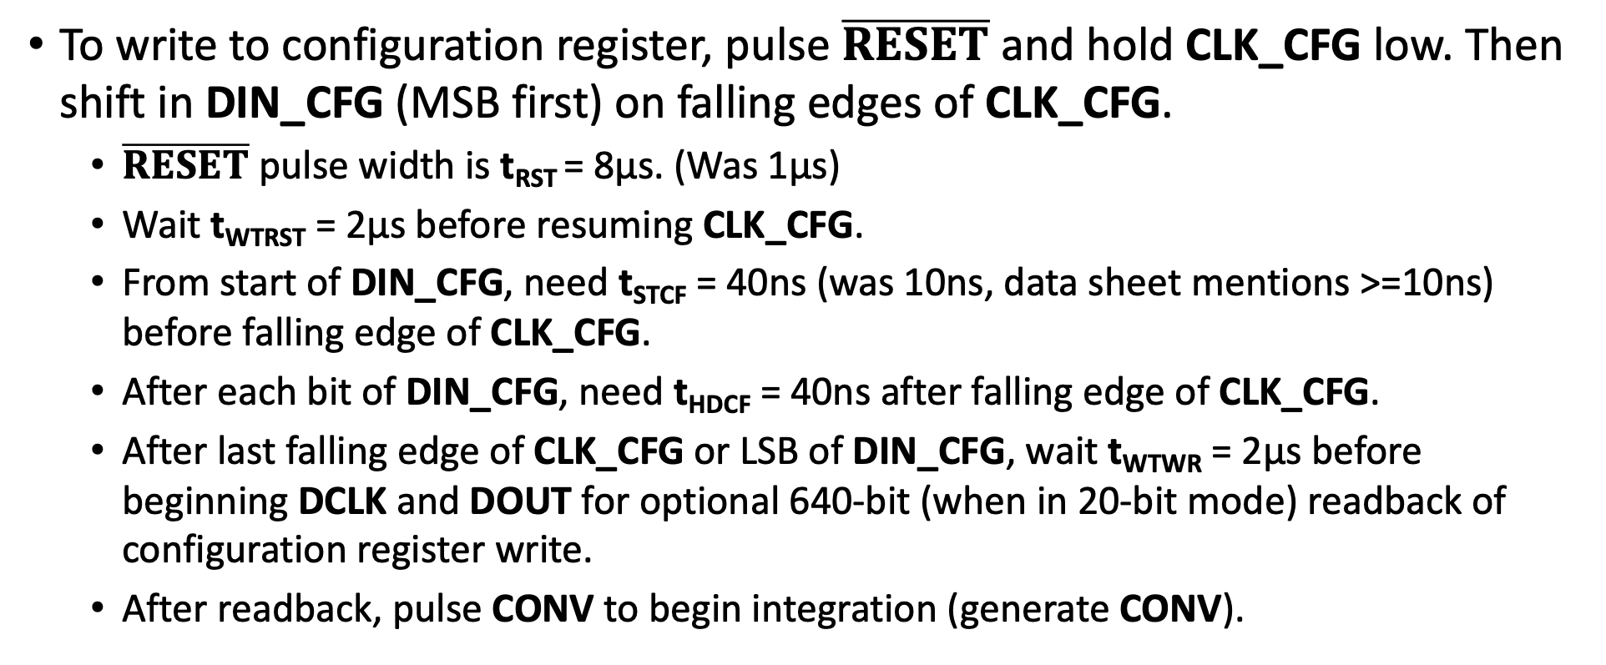
Configuration
To write to configuration register, pulse $\overline{RESET}$ and hold CLK_CFG low. Then shift in DIN_CFG (MSB first) on falling edges of CLK_CFG.
  $\overline{RESET}$ pulse width is t_{RST} = 8μs. (Was 1µs)
  Wait t­­_{WTRST} = 2μs before resuming CLK_CFG.
  From start of DIN_CFG, need t­­_{STCF} = 40ns (was 10ns, data sheet mentions >=10ns) before falling edge of CLK_CFG.
  After each bit of DIN_CFG, need t­­_{HDCF} = 40ns after falling edge of CLK_CFG.
  After last falling edge of CLK_CFG or LSB of DIN_CFG, wait t­­_{WTWR} = 2μs before beginning DCLK and DOUT for optional 640-bit (when in 20-bit mode) readback of configuration register write.
  After readback, pulse CONV to begin integration (generate CONV).

Slide 15
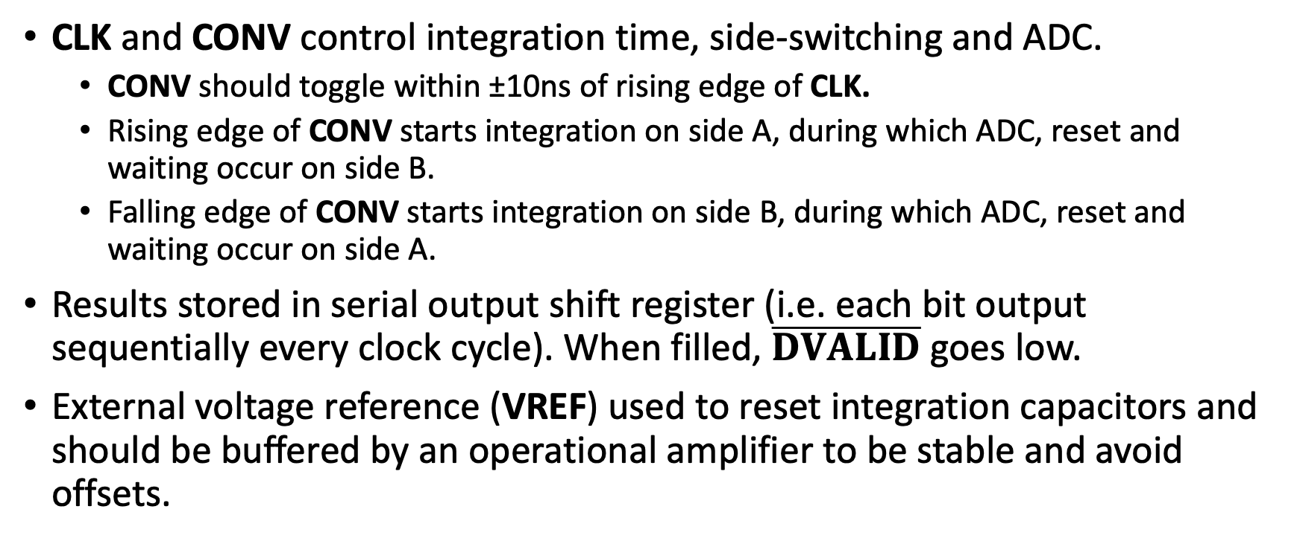
Integration
CLK and CONV control integration time, side-switching and ADC.
  CONV should toggle within ±10ns of rising edge of CLK.
  Rising edge of CONV starts integration on side A, during which ADC, reset and waiting occur on side B.
  Falling edge of CONV starts integration on side B, during which ADC, reset and waiting occur on side A.
Results stored in serial output shift register (i.e. each bit output sequentially every clock cycle). When filled, $\overline{DVALID}$ goes low.
External voltage reference (VREF) used to reset integration capacitors and should be buffered by an operational amplifier to be stable and avoid offsets.

Slide 16
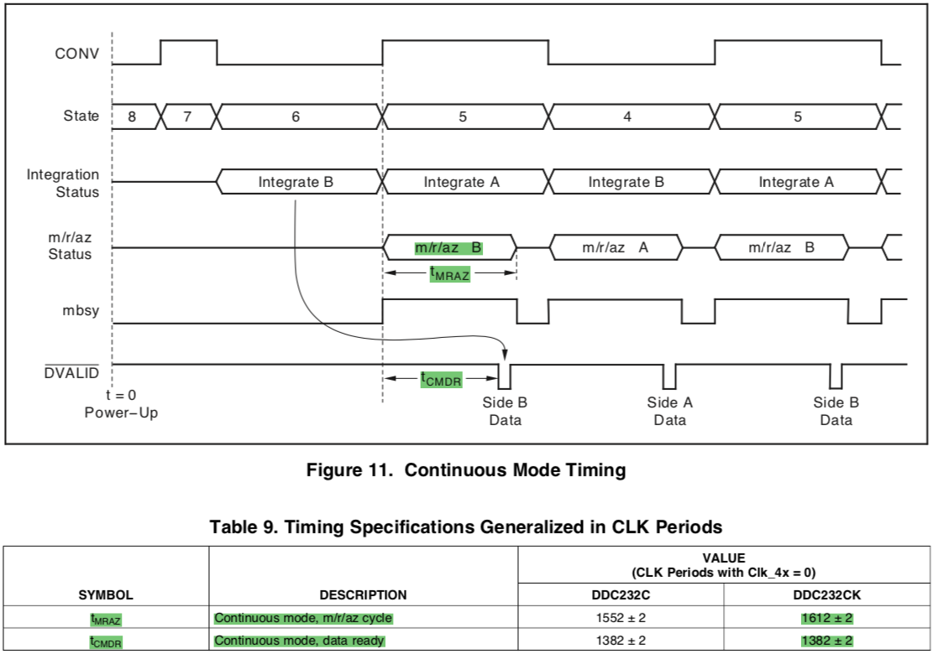

Slide 17
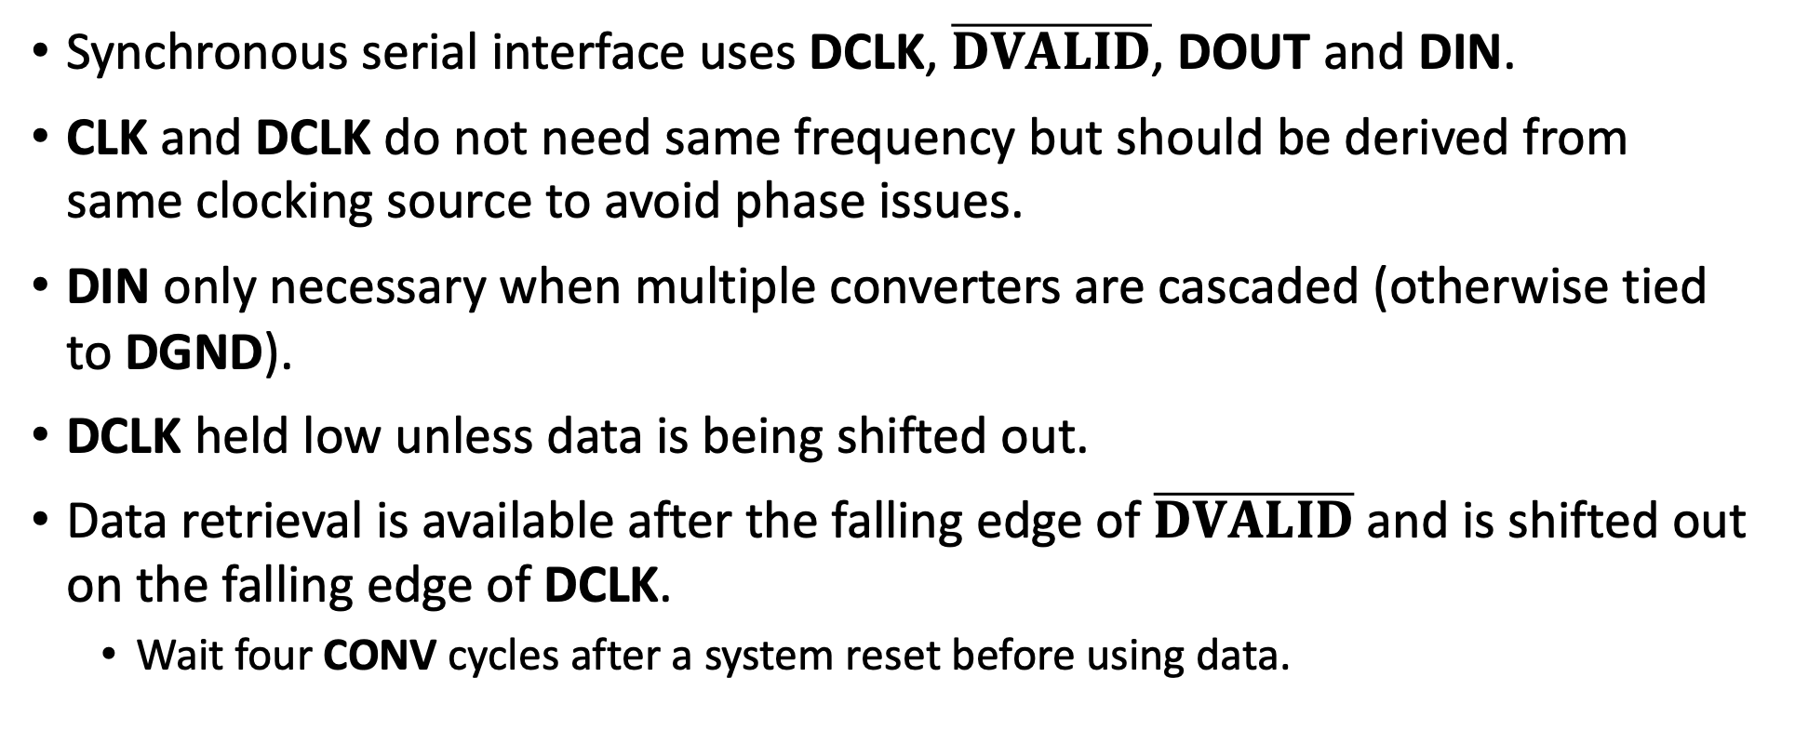
Integration
Synchronous serial interface uses DCLK, $\overline{DVALID}$, DOUT and DIN.
CLK and DCLK do not need same frequency but should be derived from same clocking source to avoid phase issues.
DIN only necessary when multiple converters are cascaded (otherwise tied to DGND).
DCLK held low unless data is being shifted out.
Data retrieval is available after the falling edge of $\overline{DVALID}$ and is shifted out on the falling edge of DCLK.
  Wait four CONV cycles after a system reset before using data.

Slide 18
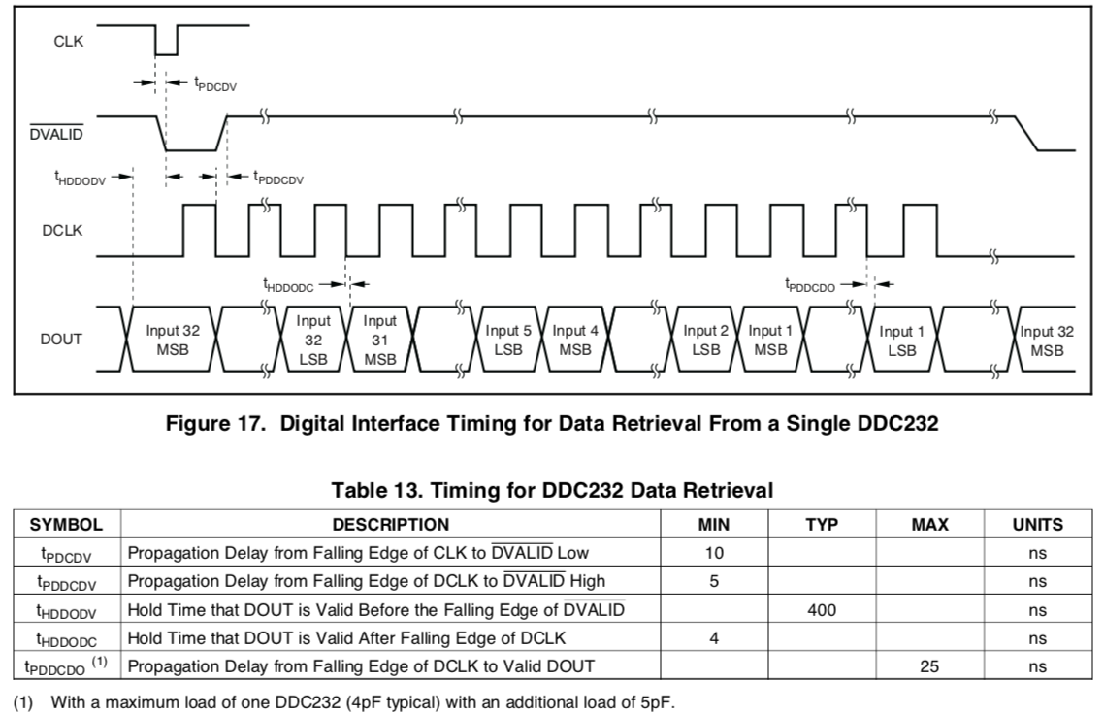
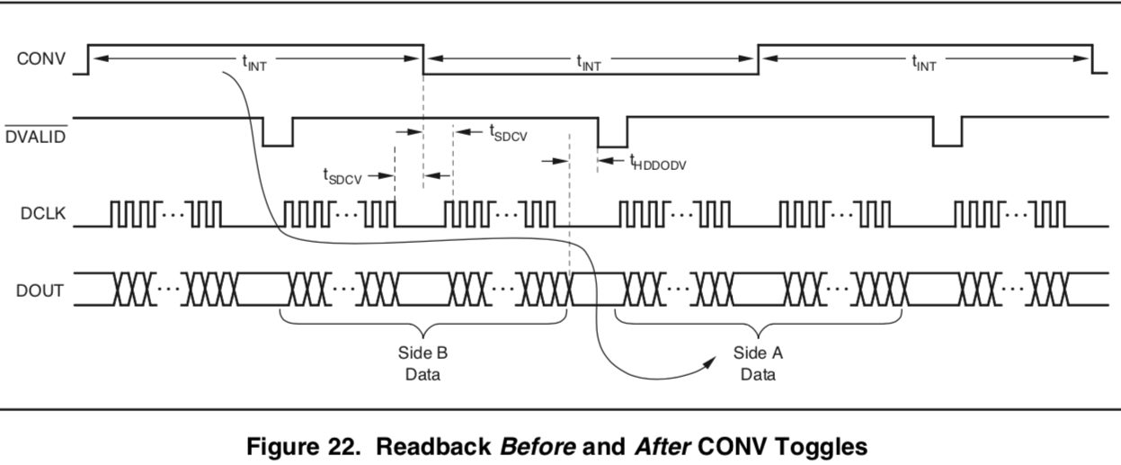
Timing

Slide 19
PS to communicate with PL
Python script using uHAL / IPbus links the PS (ArmCortex-A53, Linux) to the PL across the on-chip AXIbus — no USB cable, no FTDI, no external host.
At runtime the PS writes IPbus control registers toset integration time, full-scale range and boards/port.
  Port mask, frame count and test mode also specifiable; thescript reads the configuration back from the fabric.
During the run the PS drains each port’s FIFO in wholeframes, two IPbus packets per pass for all ports at once.
  Raw bytes memcpy’d from the uHAL buffer, not per-word ints.
Stores raw hex frames in one self-contained JSON perport, with the constants to convert codes to pC.
  Plus achieved rate, efficiency, peak FIFO fill and error flags.
Checks the configuration readback before the run, notafter — a failing port is dropped, the others continue.

Slide 20
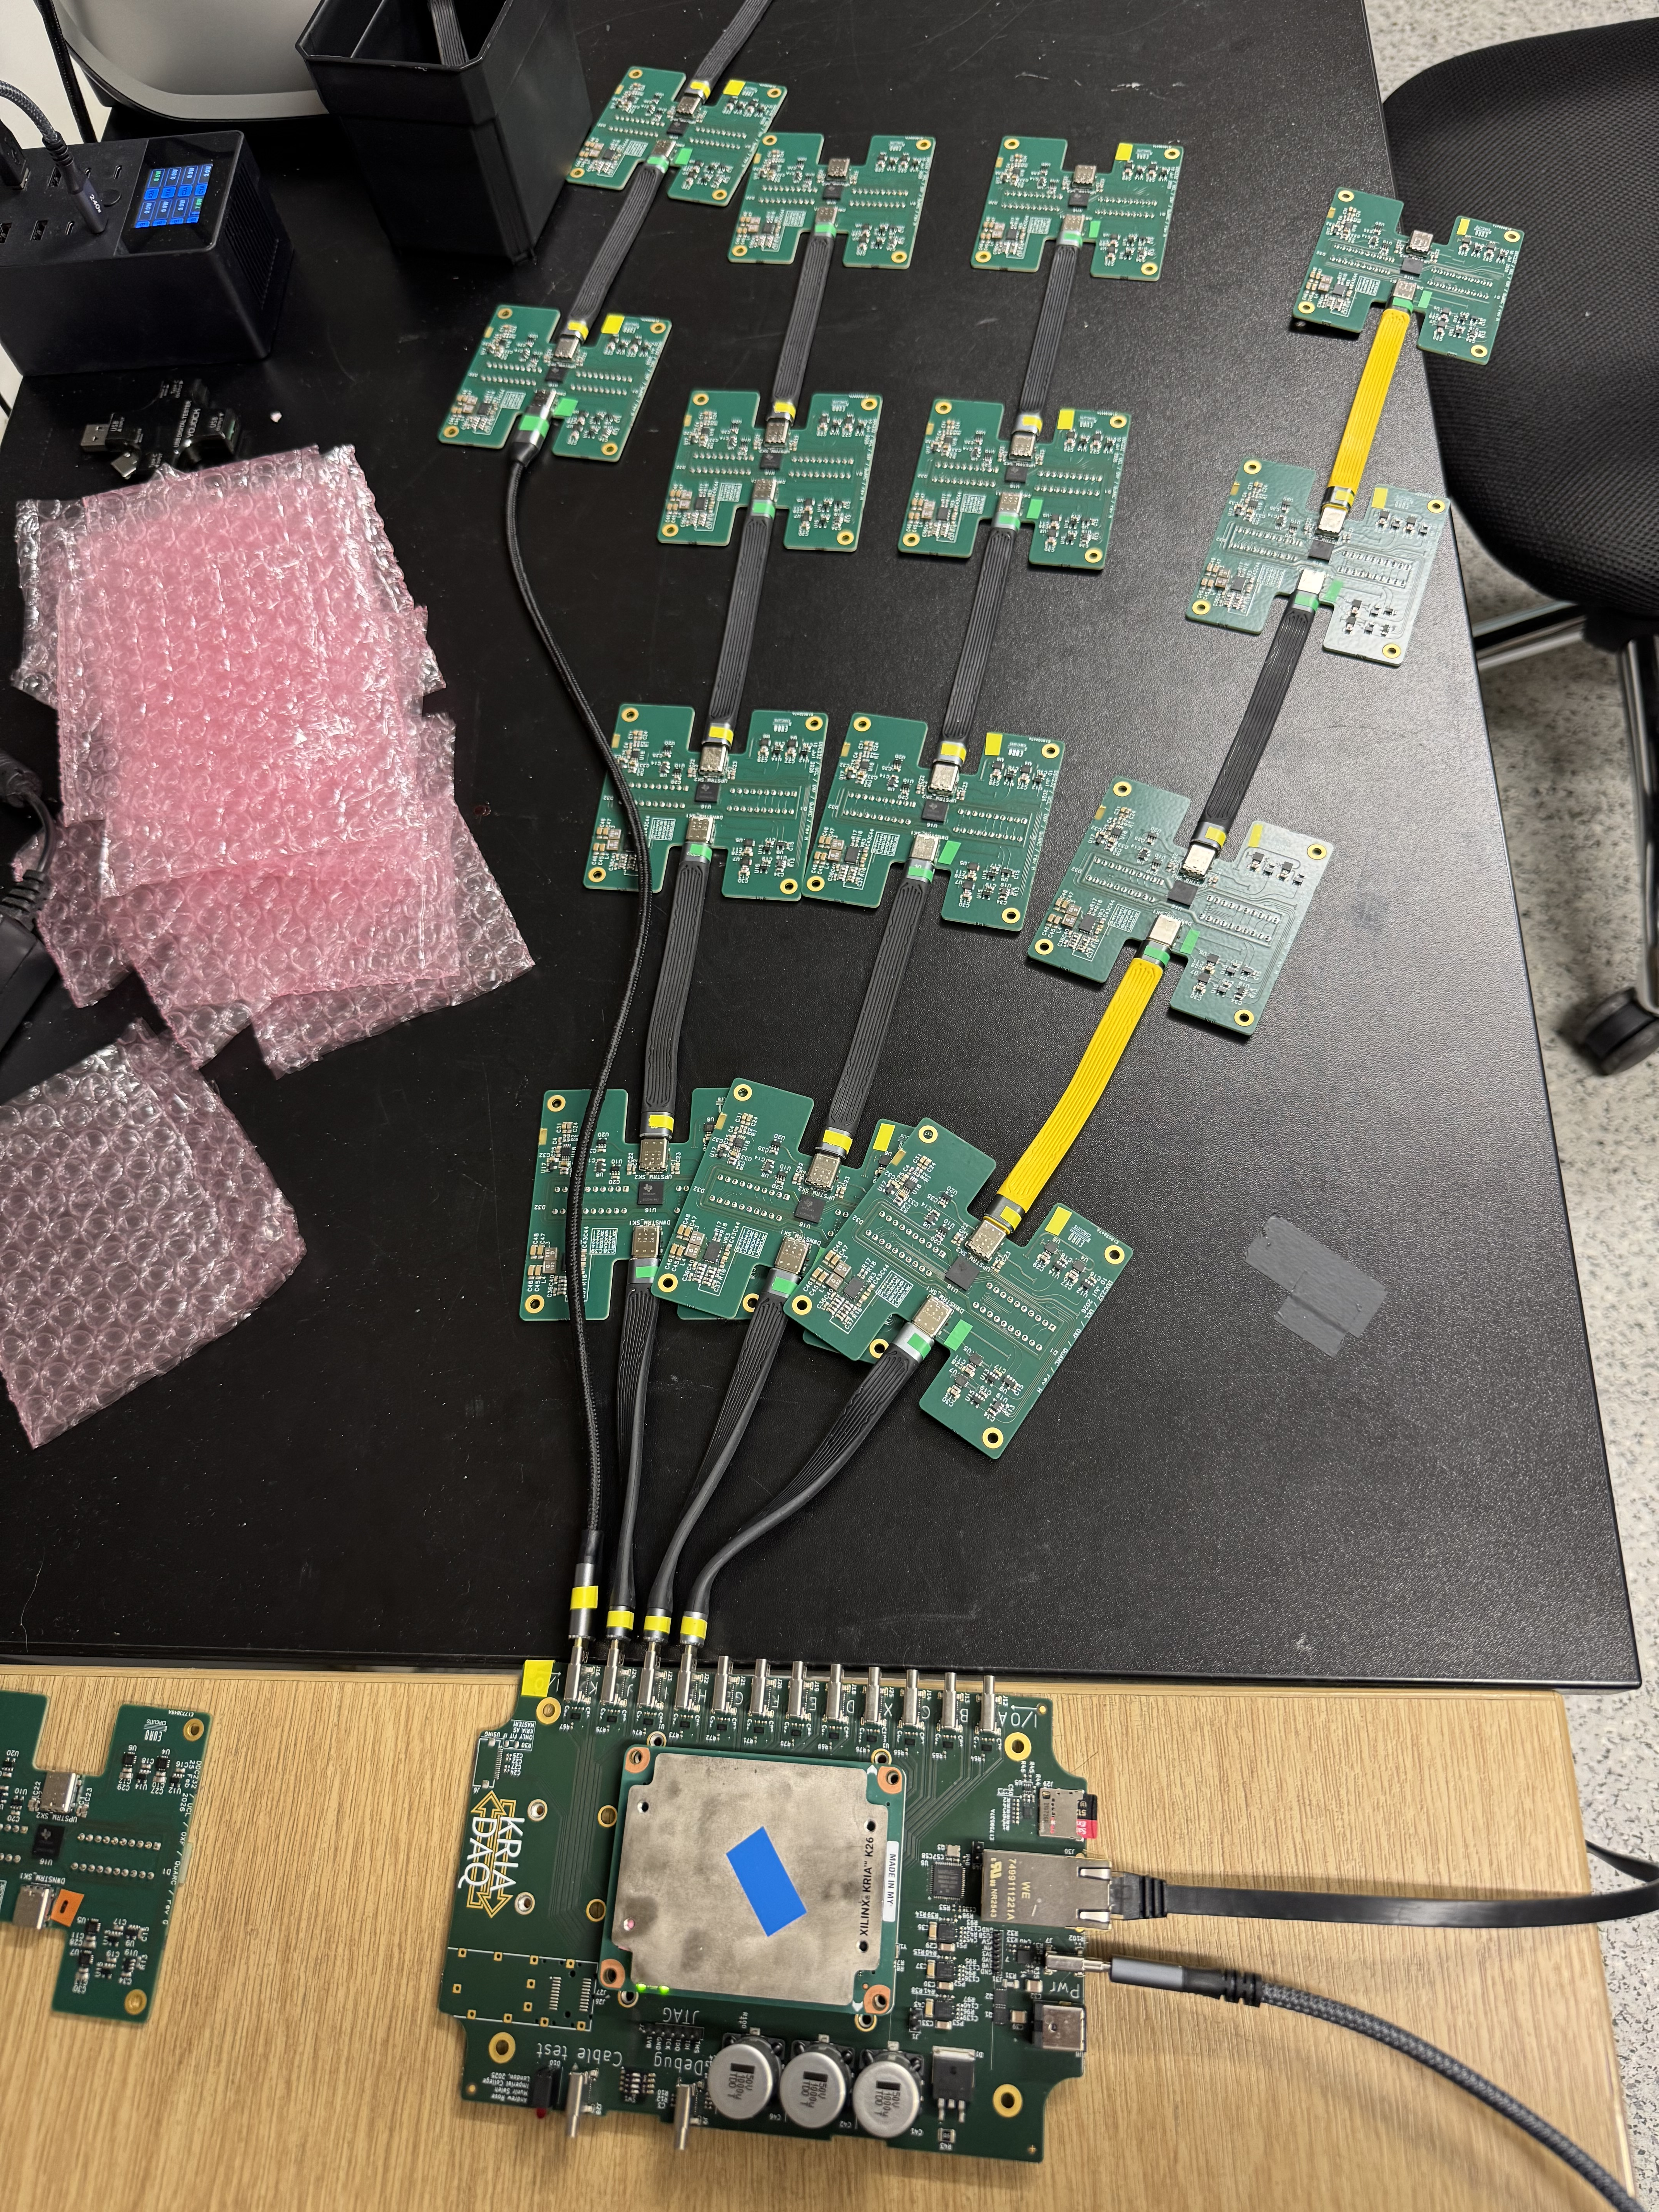
Throughput
One port is 32 channels × 20 bits × 4 boards = 2,560 bits = 320 bytes
DCLK was upgraded from 12.5MHz (80ns) to 16.67MHz(60ns) to accommodate 200 µs integration time:
2560 * 60 = 153.6 µs + 30µs (timing constraint) = 183µs.
Given the integ time is 200µs – 5Ksps. Throughput is 12.8Mbit/s or 1.6 MBps
For 4 ports, 6.4MBps
For 5 seconds: 32 MB total data
PS-PL AXI port communication, 64-bit @ 100 MHz : 6.40 Gbit/s = 800MBps
So our throughput here is under 1 percent of the maximum load of the communication can handle.

Slide 21
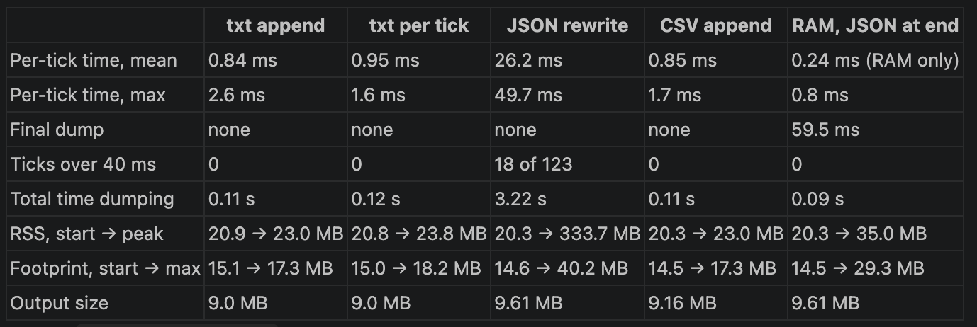
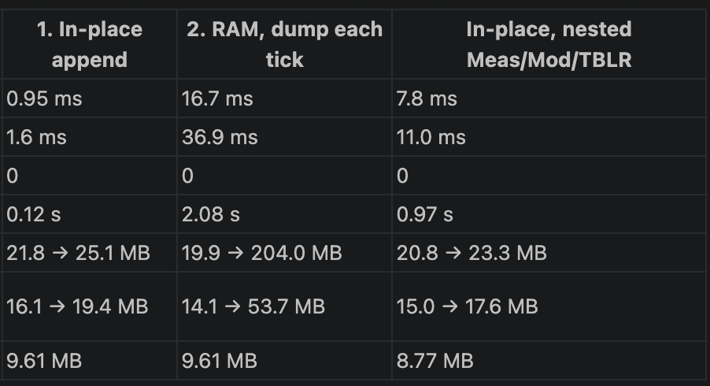
Memory and data structure: Memory and time benchmark
Load append dump
Keep open load
The memory it took: 20.9MB is the baseline python processing an running.
RSS is showing "how much RAM is this process touching", while footprint shows "how much memory would be released if this process were killed"

Slide 22
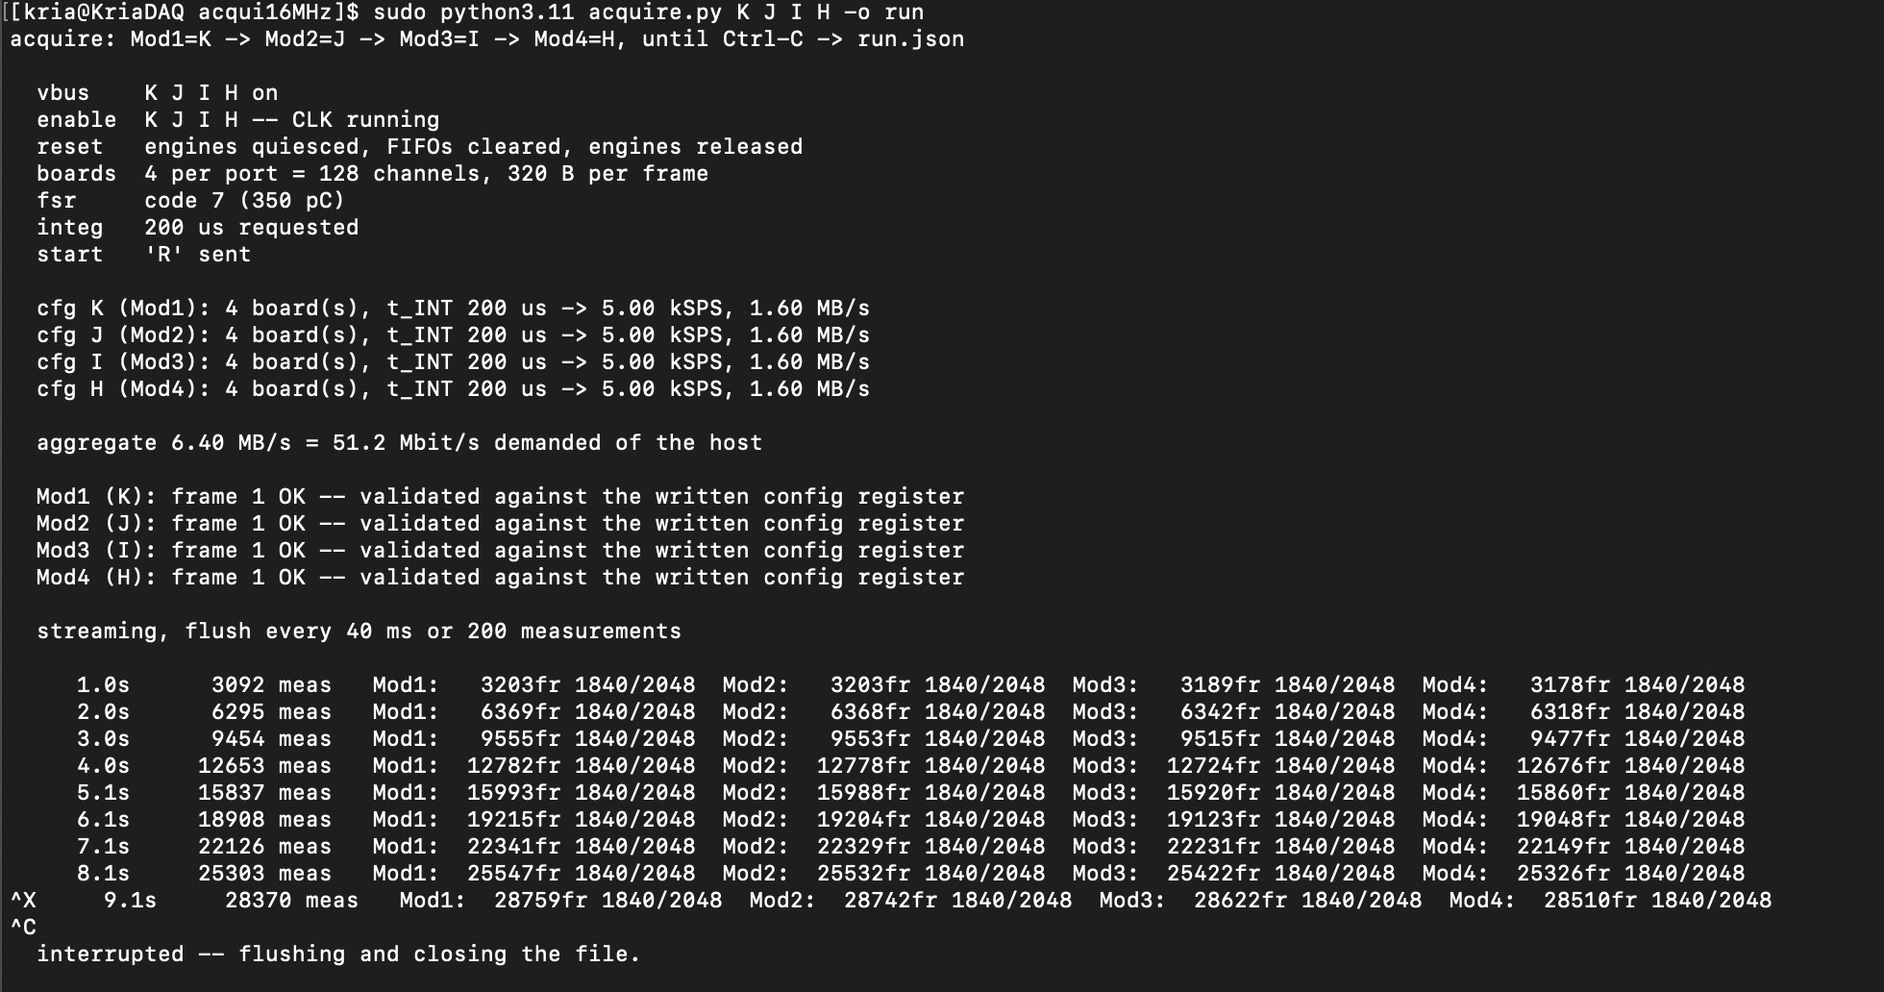
Good Job!
Run indefinetly.
4 boards
4 ports
Issue: cap at 3Ksps
Needs to investigate
Previous issue with CPU processing has been resolved by implementing direct conversion from memory rather than python word by word conversion

Slide 23
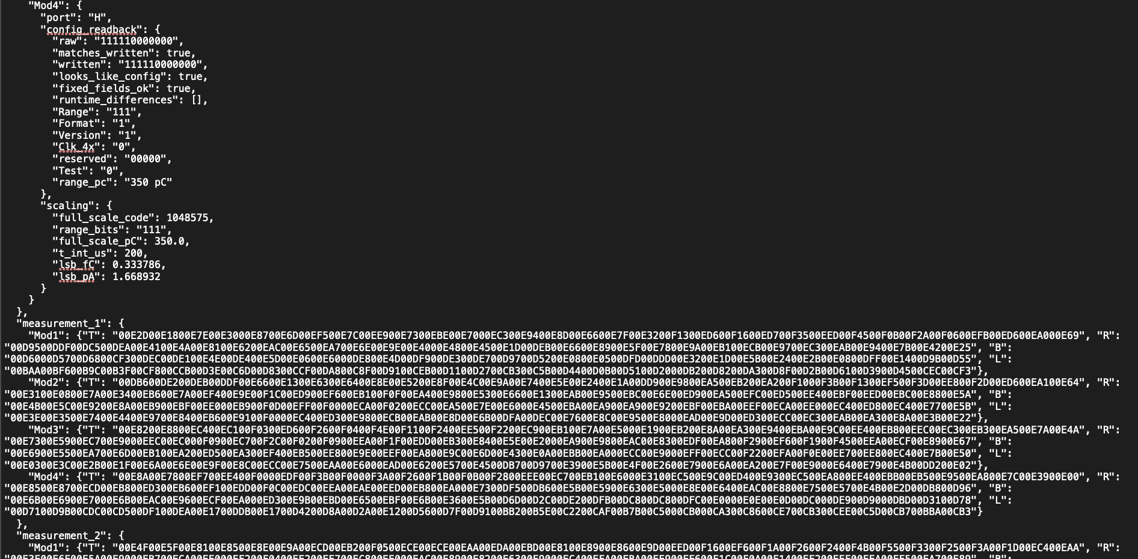
Data Structure as wanted

