Slide 1
QuARC v5 –
Mechanical Overview.
Harry Barnett, HEP Group
11/08/2026

Slide 2
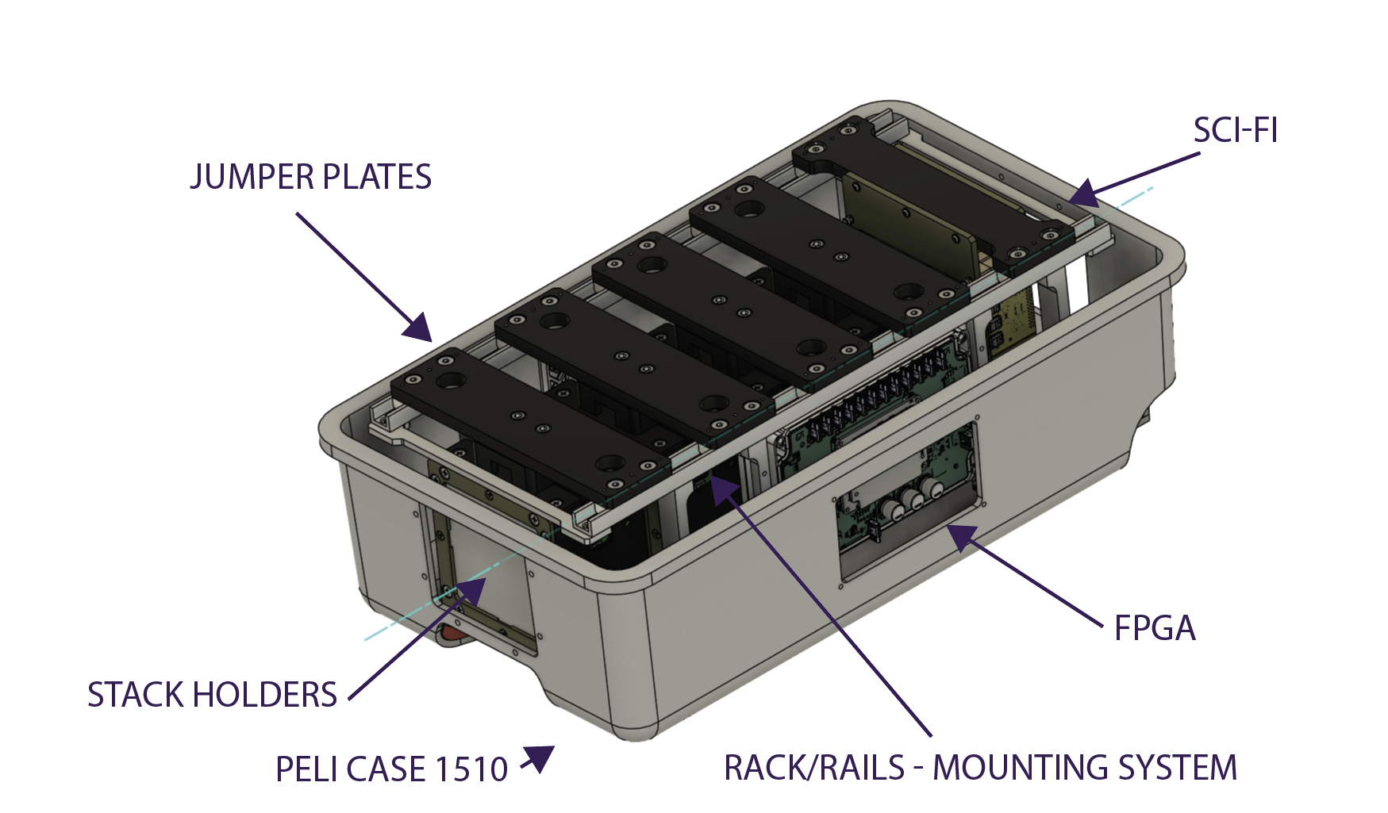
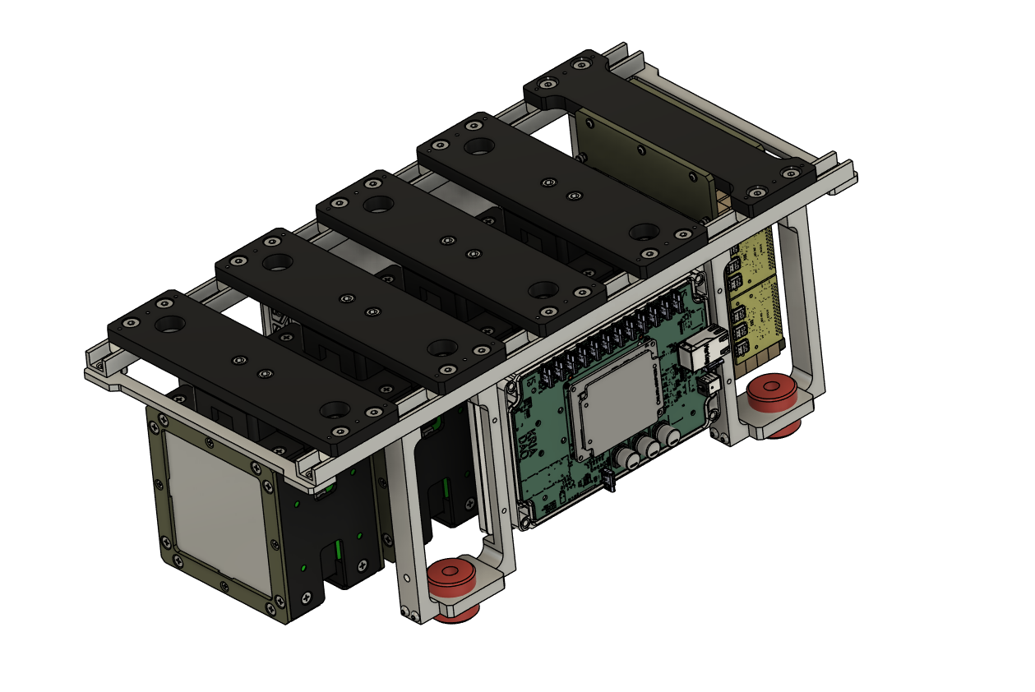
Overview
Entire rail system moved upwards into the box.
Designed for improved ease of access, ease of use, and overall accessibility.
New layout allows all electronics to be mounted directly onto the racks.
Electronics are shock-dampened and isolated from the outer box.
Increased protection against knocks, impacts, and rough handling.
Overall goal: a more accessible, robust, and durable system.

Slide 3
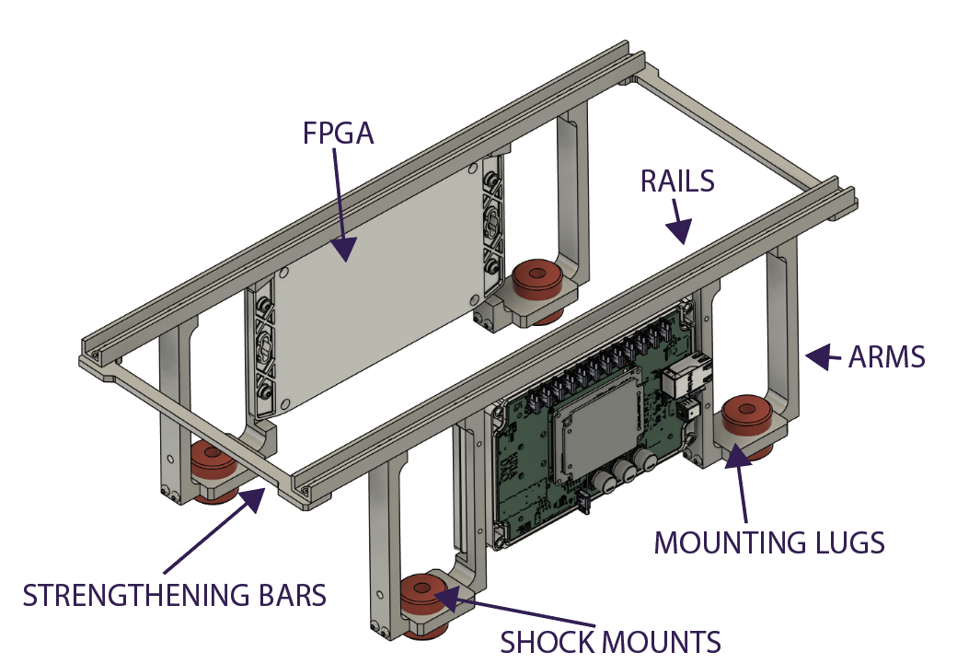
New Mounting System
FPGAs are mounted directly to the frame
A rail system has been retained, but aluminum extrusion has been replaced with a simpler U-shaped rail.
Aluminum extrusion is no longer required, reducing unnecessary complexity.
Strengthening bars connect the two rails, adding rigidity and helping keep them parallel.
Maintaining parallel alignment between the rails is important for the design.
All mounting lugs are the same.
All arms start from the same base design, with different machining processes applied depending on there location in the box
We are making a larger lever from the mount points this is a key change and will need to be considered carefully.
Simulations can be carried out to determine the force required to bend the arms, although this will require additional time.
This approach is similar to the previous design, and hopefully taking what worked well.

Slide 4
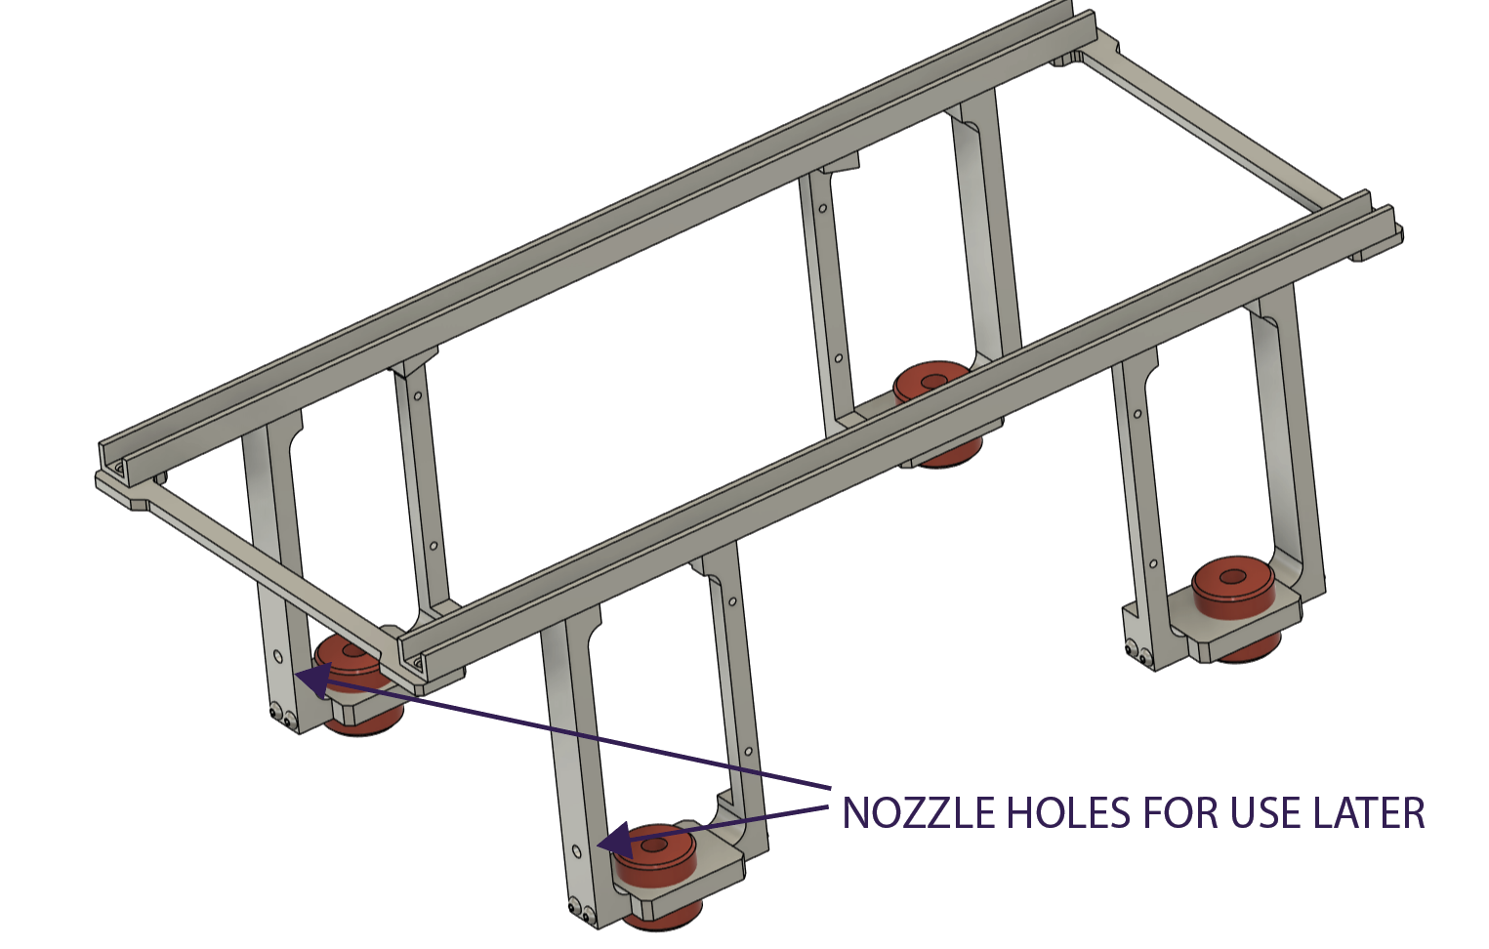
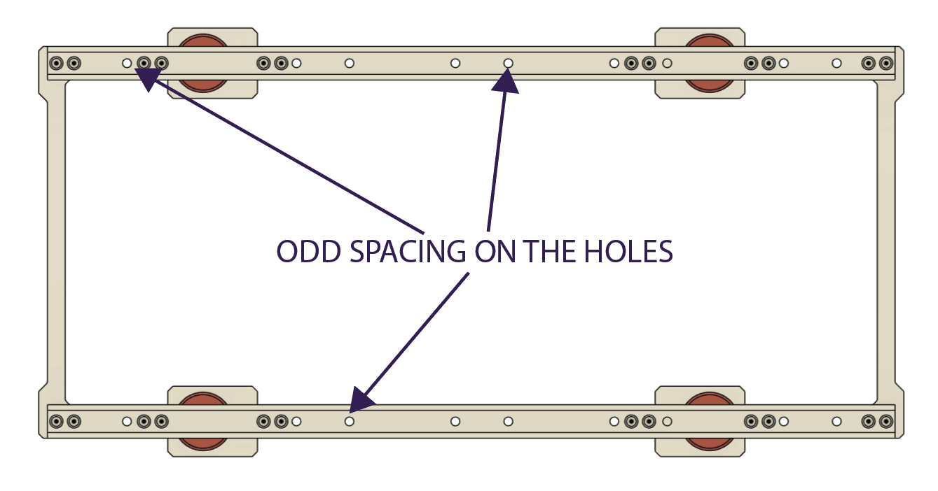
New Mounting System
The hole spacing along the rails is intentionally uneven.
This is because the bolt locations for travel differ from the “experiment” locations.
Experiment locations are flexible as the stack are held by gravity and friction. The travel location is fixed
Additional mounting holes have been included on the arms to allow a future nozzle-mounting component to be attached.
Mounting directly to the nozzle should make alignment easier and more consistent compared with the QUARC being positioned on the patient bed.

Slide 5
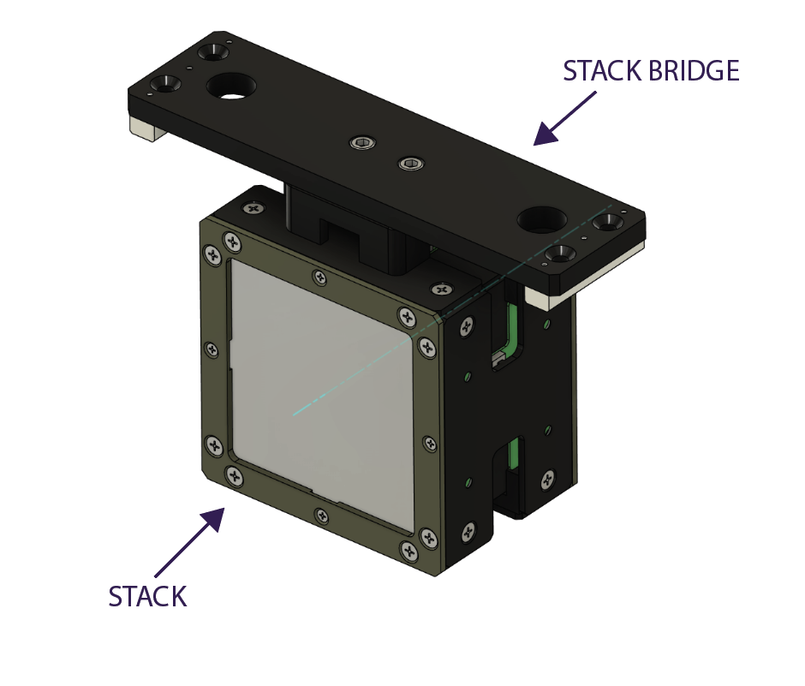
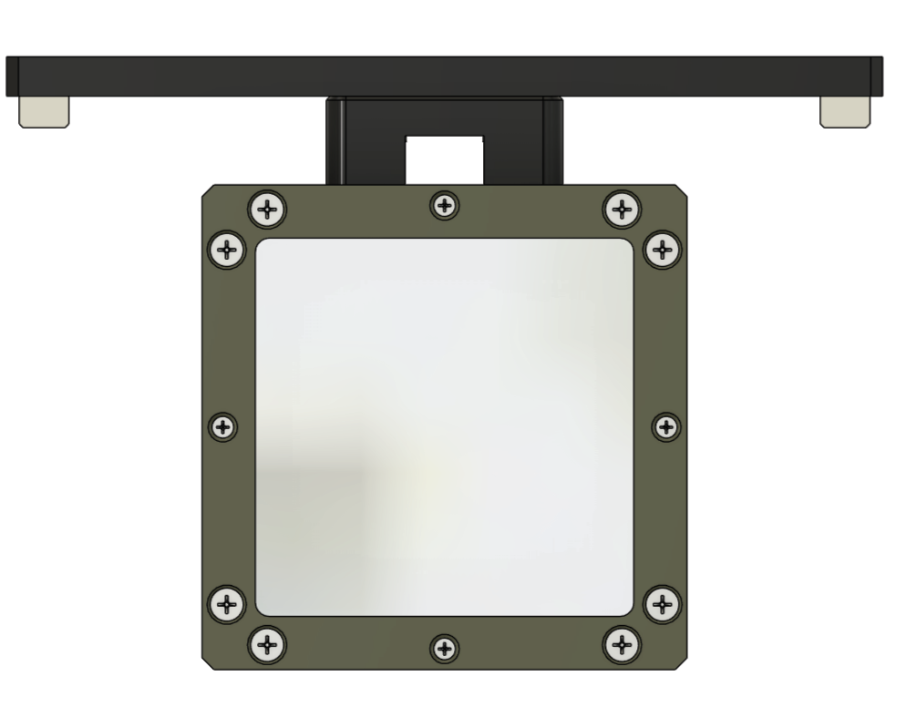
Stack Holders & Stack Bridge
The stack holders and mounting bridges connect the stacks to the main mounting system.
The stack bridge holds each stack on-axis and at the correct position for the beam to pass through the centre.
Through-holes connect the PCB clamp to jumper – hence we have a strong clamp between them.
These components are intended to remain permanently assembled; separating them would be a lengthy process.
One limitation of the current design is that rotating (if wanted) an individual stack would be difficult.
The two top mounting bolts provide a possible solution: separating the jumpers from the mounting plate
This would provide the ability for stack rotation but would increase the number of components required.

Slide 6
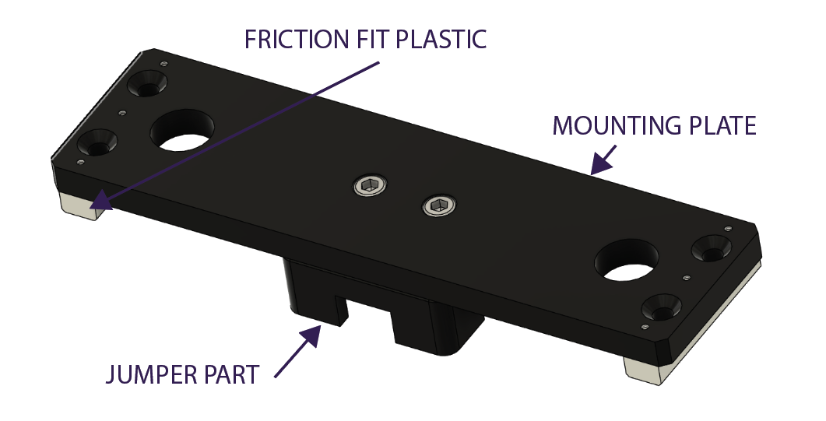
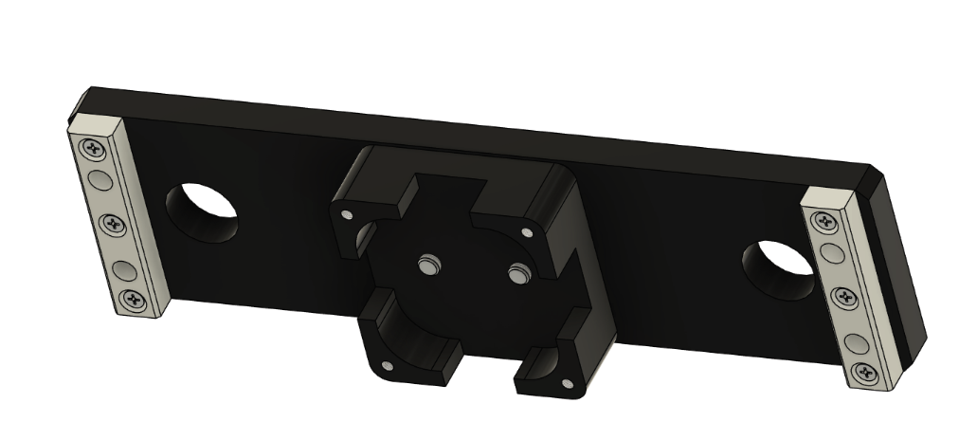
Stack Bridge
The stack bridge consists of three main elements: the mounting plate, the jumper, and the friction-fit pieces.
The jumper is the section that clamps directly to the stack.
The two end pieces friction-fit into the rails to locate and secure the assembly.
Originally, we considered adding a pressure or clamping mechanism to hold the bridge in place.
The current approach relies on gravity combined with a close friction fit between the components and rails.
This should provide sufficient stability while keeping the design simple.
If the friction-fit approach proves insufficient during testing, an additional retention or clamping method can be revisited.

Slide 7
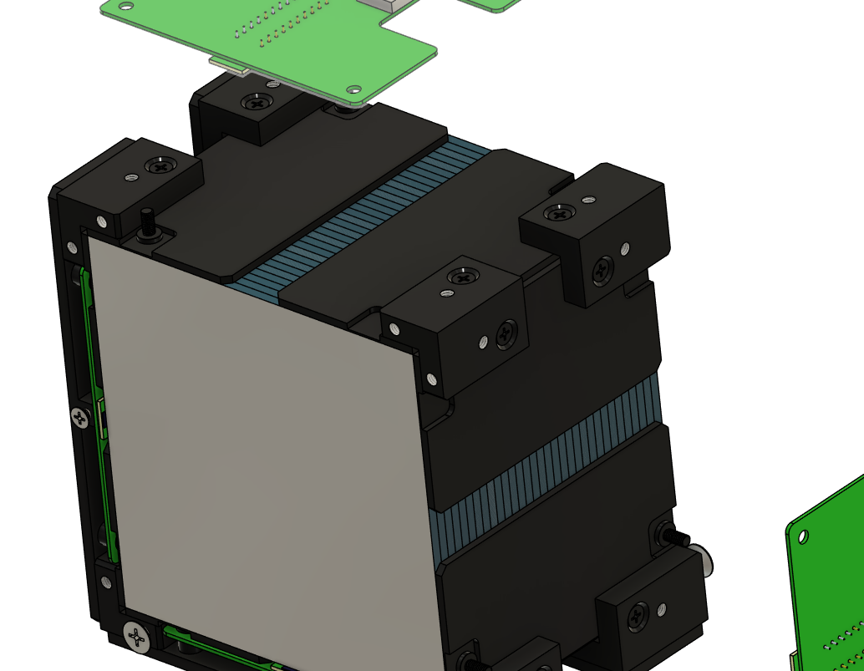
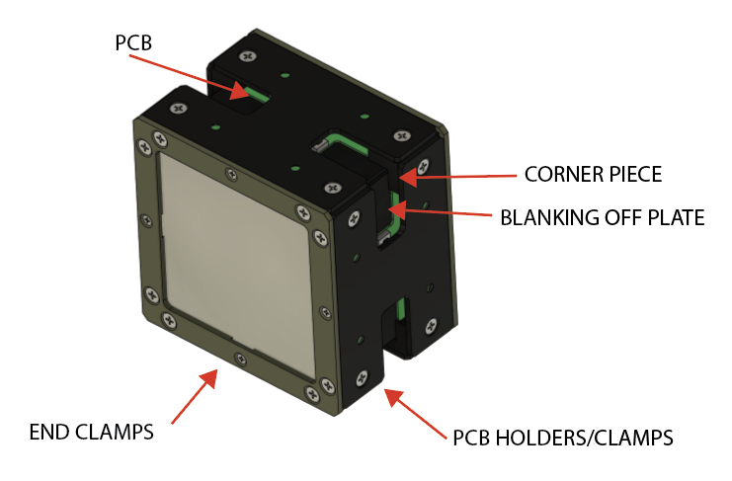
Stacks
The overall stack design has been established for some time, but this slide provides an overview of the main components.
The end clamps will be manufactured from Tufnol, providing the strength required while remaining a plastic component.
Most of the remaining stack components will be manufactured from Delrin.
The custom PCBs containing the photodiodes are held in position by the PCB clamps.
The exploded view shows how the corner pieces are split to provide clearance for the USB-C cable.
Blanking plates are attached to the corner pieces around the scintillator sheets.
These plates are designed to minimise light leakage and retain as much light as possible within the scintillator sheets.

Slide 8
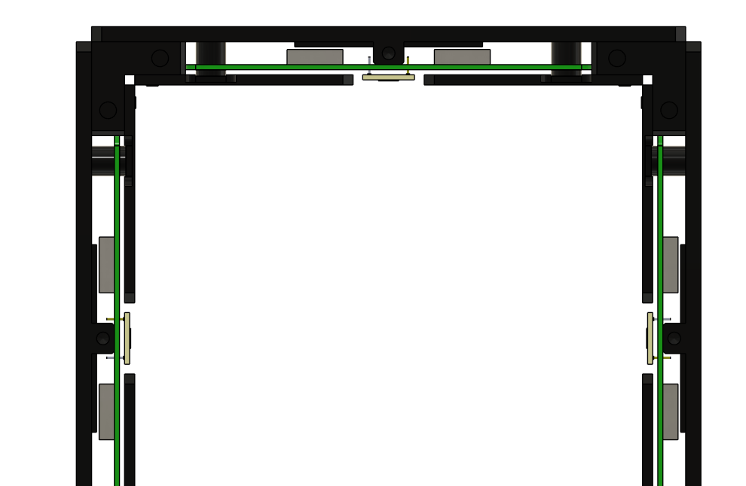
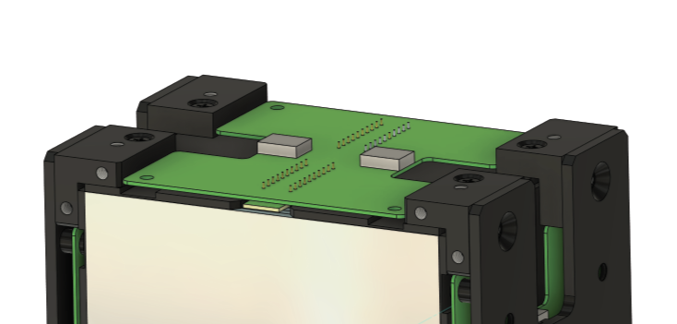
Stacks
This slide provides a general overview of how the stack components are assembled.
On the left, the corner piece is split to provide clearance and routing for the cables.
On the right, the PCB clamp includes features to limit movement around the USB-C ports
The PCB clamp also provides a pressure point behind the photodiode.
A small piece of compressible foam will sit between the photodiode PCB and the main PCB.
This should provide gentle, consistent pressure to hold the photodiode PCB neatly against the scintillator sheets.

Slide 9
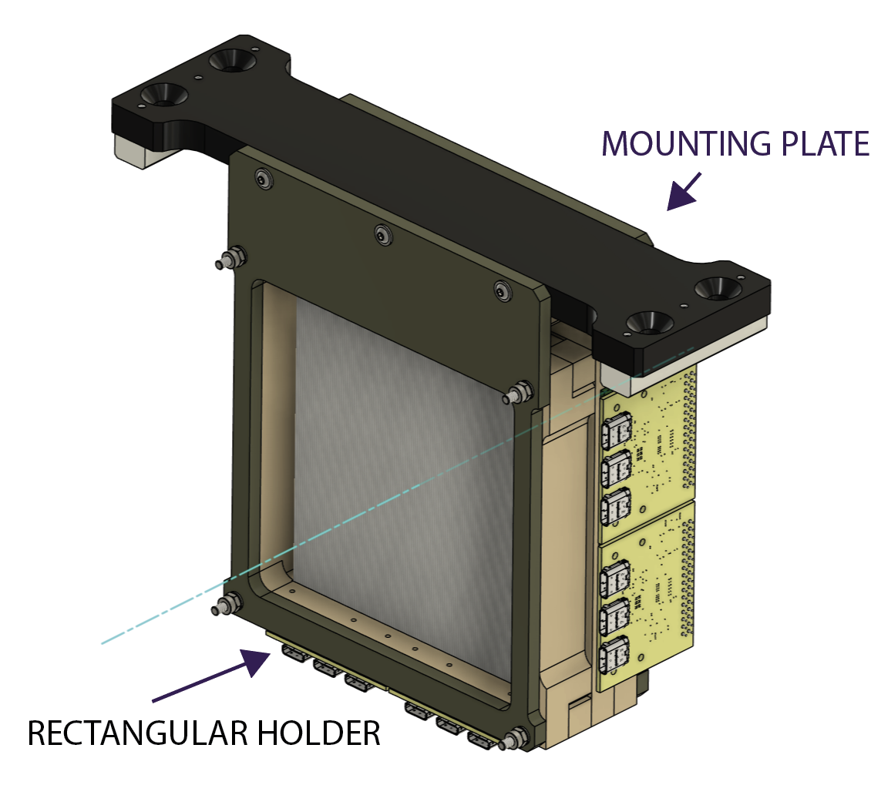
SciFi
The SciFi assembly itself remains largely unchanged; the main change is how it interfaces with the new mounting system.
The SciFi holder has its own individual mounting plate.
The rectangular holder frames will be manufactured from Tufnol, the same material used for the stack end clamps.
Tufnol provides the additional rigidity required, particularly as the assembly is supported at relatively few points.
Although the SciFi assembly is relatively lightweight, the holder should be as robust as possible.
The mounting plate follows a very similar design and mounting principle to the stack bridges.

