Slide 1
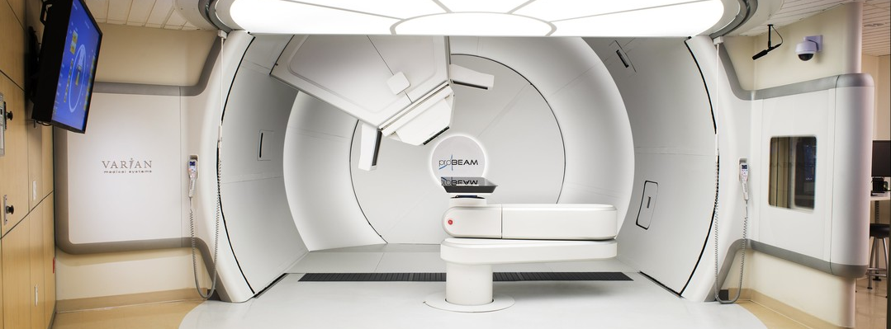
The UK Proton Beam Therapy Programme and Supporting Research
Simon Jolly
Notes:
Cover title slide using image at the bottom. The slide layout includes a main heading in the top left corner. UCL logo is positioned in the bottom right corner of the slide.

Slide 2
Abstract
Modern cancer treatment is largely a combination of 4 techniques: surgery, chemotherapy, radiotherapy and immunotherapy. Proton Beam Therapy (PBT) is a more targeted version to conventional radiotherapy, where protons in the 60-250 MeV energy range are used to maximise the destructive radiation dose to cancerous tumours whilst minimising the damage to healthy tissue. The advantage of PBT is that dose can be delivered more precisely than conventional radiotherapy due to the way protons lose energy: as a result of the Bragg Peak, most of the energy is deposited in the last few millimetres of the proton path. This has particular significance in the treatment of deep-lying tumours in the head, neck and central nervous system, particularly for children whose bodies are still developing and are particularly susceptible to long-term radiation damage.
In 2018, the NHS opened the first of two high energy PBT centres at The Christie in Manchester to complement the ocular facility at Clatterbridge that has been treating with protons since 1989; this was followed in 2021 by UCLH. The current status of the three clinical facilities will be presented, as well as the ongoing clinical trials to support improvements in patient outcomes and potential expansion of the current indications list. In addition, there will be an overview of some of the research and development in particle therapy accelerator technology.

Slide 3
Particle Dose Distribution
Bethe-Bloch:
E = energy
x = distance
me = electron mass
n = electron density
z = particle charge
β = particle velocity
e = electron charge
ϵ0 = vacuum permittivity
I = mean excitation potential
Unlike X-rays, charged particles stop!
Electrons, being lighter, scatter and spread out.
Protons deposit most dose at the end of their path: the Bragg Peak.

Slide 4
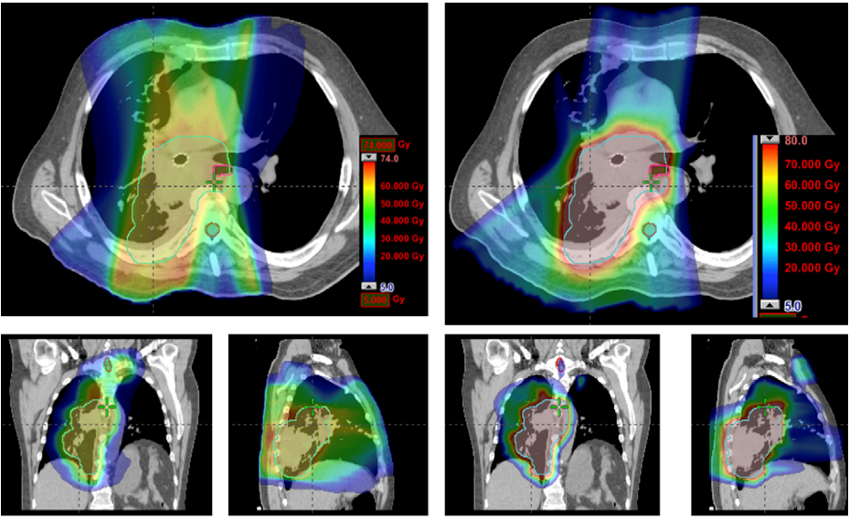
Non Small Cell Lung Cancer Doses
IMRT
PBT
Zhang X, Li Y, Pan X, et al.
Int J Radiat Oncol Biol Phys. (2010); 77 (2): 357–366
DOI: 10.1016/j.ijrobp.2009.04.028

Slide 5
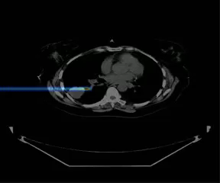
Pencil Beam Scanning

Slide 6
National Proton Beam Therapy Service Development Programme
 | Indication | Patients
Paediatric | Chordoma/ Chondrosacoma | 15
 | Rhabdomyosarcoma (Orbit) | 5
 | Rhabdomyosarcoma (Prameningeal and H&N) | 15
 | Rhabdomysarcoma (Pelvis) | 10
 | Osteosarcoma | 3
 | Ewings Sarcoma | 9
 | PPNET | 5
 | Paediatric Ependymoma | 25
 | Low Grade Glioma | 5
 | Optic Pathway Glioma | 12
 | Craniphayngioma | 15
 | Medulloblastoma (PNET) | 70
 | Hodgkins | 5
 | Retinoblastoma | 5
 | Meningioma | 3
 | Intracranial germinoma | 10
 | Nasopharynx (H&N) | 15
 | Difficult Cases (Esthe/Neuro/Liver) | 5
 | Very Young Age | 20
 | Total | 252
Adult | Choroidial Melanoma | 100
 | Ocular/Orbital | 25
 | Chordoma | 60
 | Chondrosarcoma | 30
 | Para-Spinal/Spinal Sarcoma | 120
 | Adult Sacral Chordoma | 60
 | Meningoma | 100
 | Acoustic Neuroma | 100
 | Craniospinal NOS (Pineal) | 10
 | Head & Neck & Paranasal Sinuses | 300
 | PNET (medulloblastoma intracranial) | 30
 | Difficult cases | 300
 | Total | 1,235
Grand Total |  | 1,487
https://www.gov.uk/government/publications/ national-proton-beam-therapy-service-development-programme
The strategic outline case and accompanying value for money addendum published in October 2012.
Provided suggested list of indications to fill maximum capacity of 2 centres (1,500 patients).
Notes:
Divider slide with an image on the left and one column text on the right. A headline is positioned at the top right and body text arranged beneath it. The UCL logo is positioned in the bottom-right corner. All elements are on dark purple background.

Slide 7
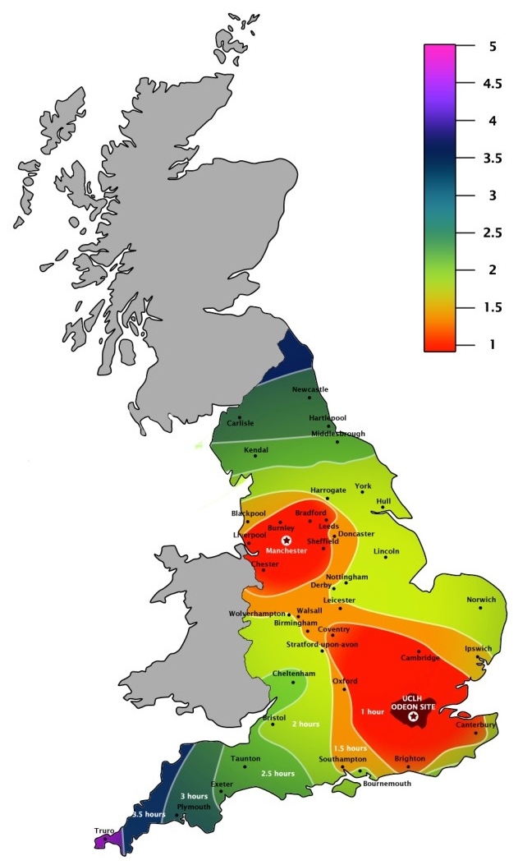
NHS PBT Patient Access
Two high energy facilities to complement 60 MeV Clatterbridge ocular facility:
  The Christie (Manchester)
  UCLH (London)
Sites partially chosen for geographic location.
National referral pathway:
  Patients referred by primary care teams to central panel.
  Those deemed appropriate for PBT passed to nearest centre.

Slide 8
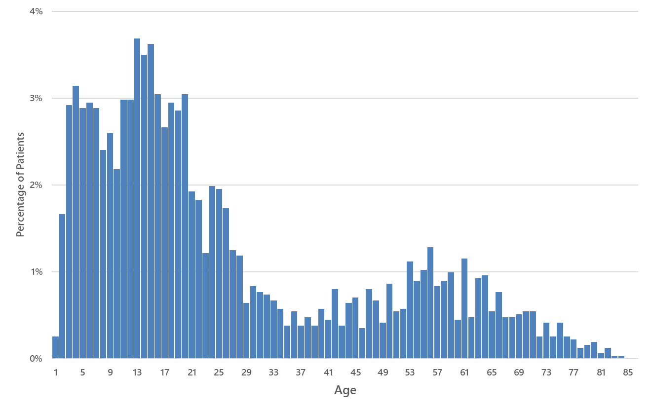
NHS PBT Clinical Service Status
The Christie opened late 2018.
UCLH followed early 2022.
Current status:
  ~12 hour treatment days.
  300 patients per year per centre.
Current case mix:
  ~40% CNS spine
  ~20% Sarcoma
  ~13% Head & Neck
Many trials in progress:
SIOP - Ependymoma II​
FaR-RMS​ - rhabdomyosarcoma
HR-MB​ - medulloblastoma
HRNBL2​ - neuroblastoma
INTER EWING1​ - ewings sarcoma
PARABLE (now closed to recruitment)​ - breast
APPROACH (recruitment for G3 LGG on hold / G2 open) - oligodendroglioma​
HIT-Meso​ - mesothelioma
PROTIEUS​ - oesophagus
PROTIS​ -sinonasal
Evaluative commissioning
SUPERMAN (neuroblastoma)
EMPHATIC (liver)
PRONTO (parotid)

Slide 9
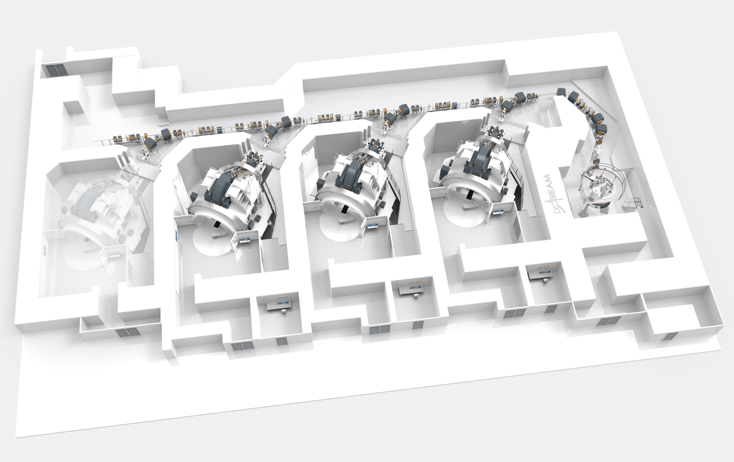
UCLH PBT Facility
Beamline Corridor
Courtesy of Jan Timmer, Varian Inc.
Cyclotron
Treatment Rooms

Slide 10
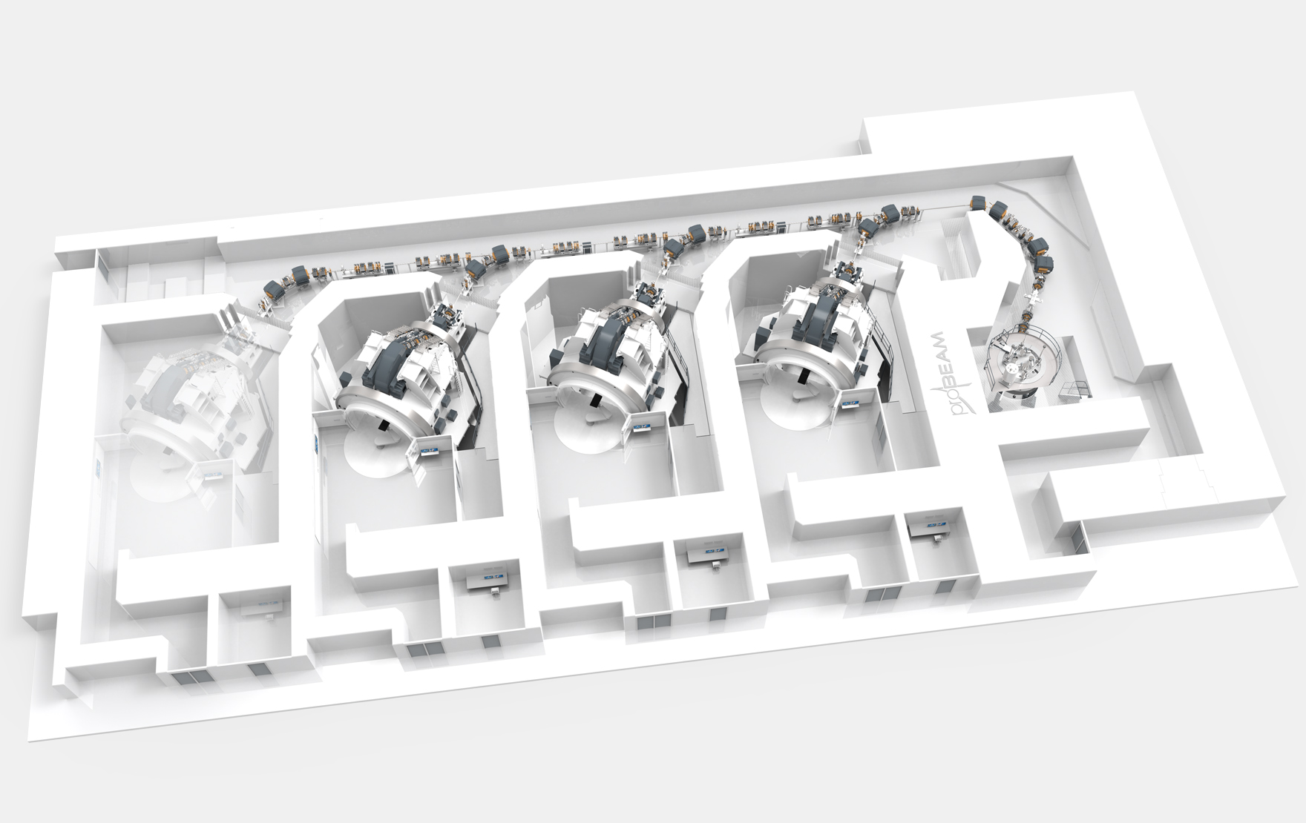
The Christie PBT Facility
Courtesy of Jan Timmer, Varian Inc.
Research Room
Beamline Corridor
Cyclotron
Treatment Rooms

Slide 11
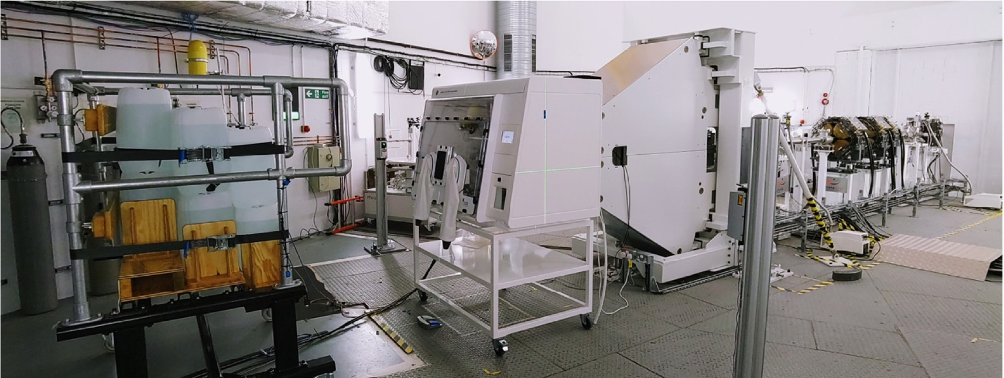
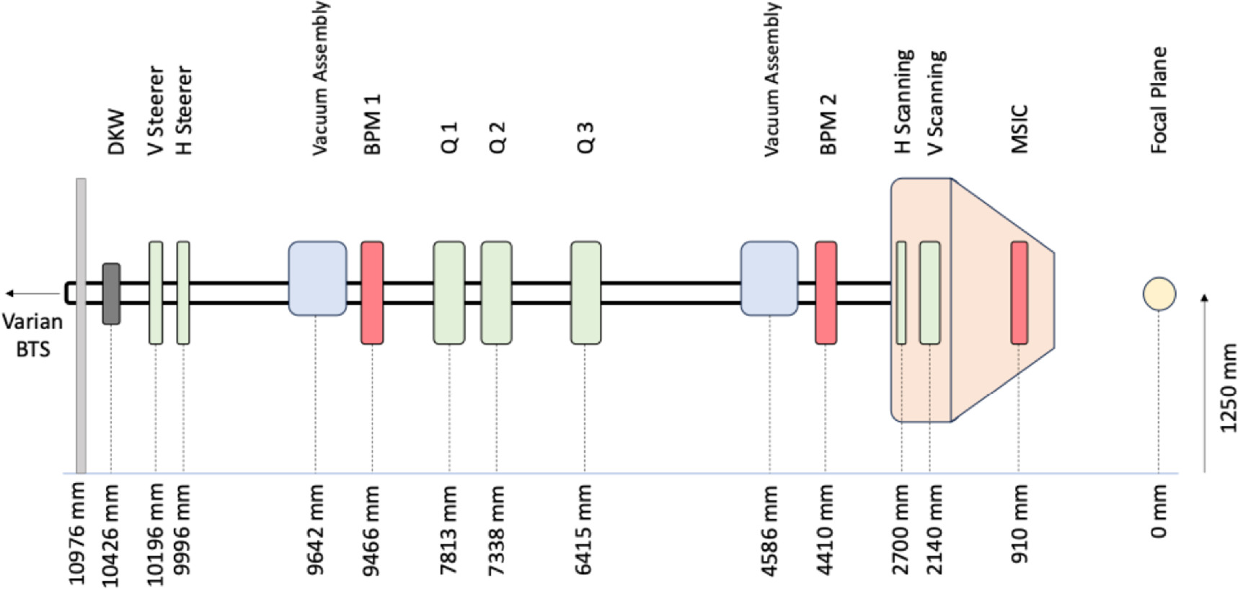
The Christie Research Room (M. Taylor)
The Christie 4th gantry vault equipped with research beamline:
  Air-gapped from clinical facility.
  Clinical nozzle.
Radiobiology end station; extending capability with second beamline.
Multiple physics projects:
  Range and dose verification
  Proton CT
  Proton-SFRT
  FLASH (Bragg peak and shoot through)
https://doi.org/10.1088/2057-1976/addbe8
Henthorn et al (2025)

Slide 12
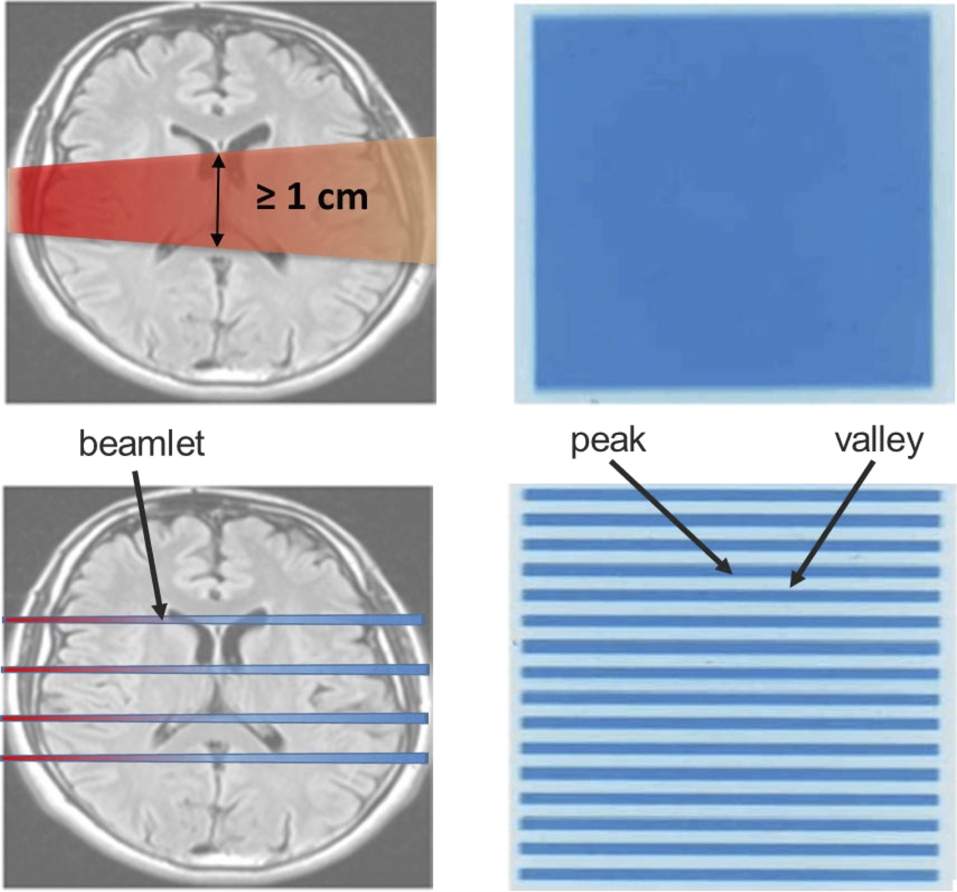
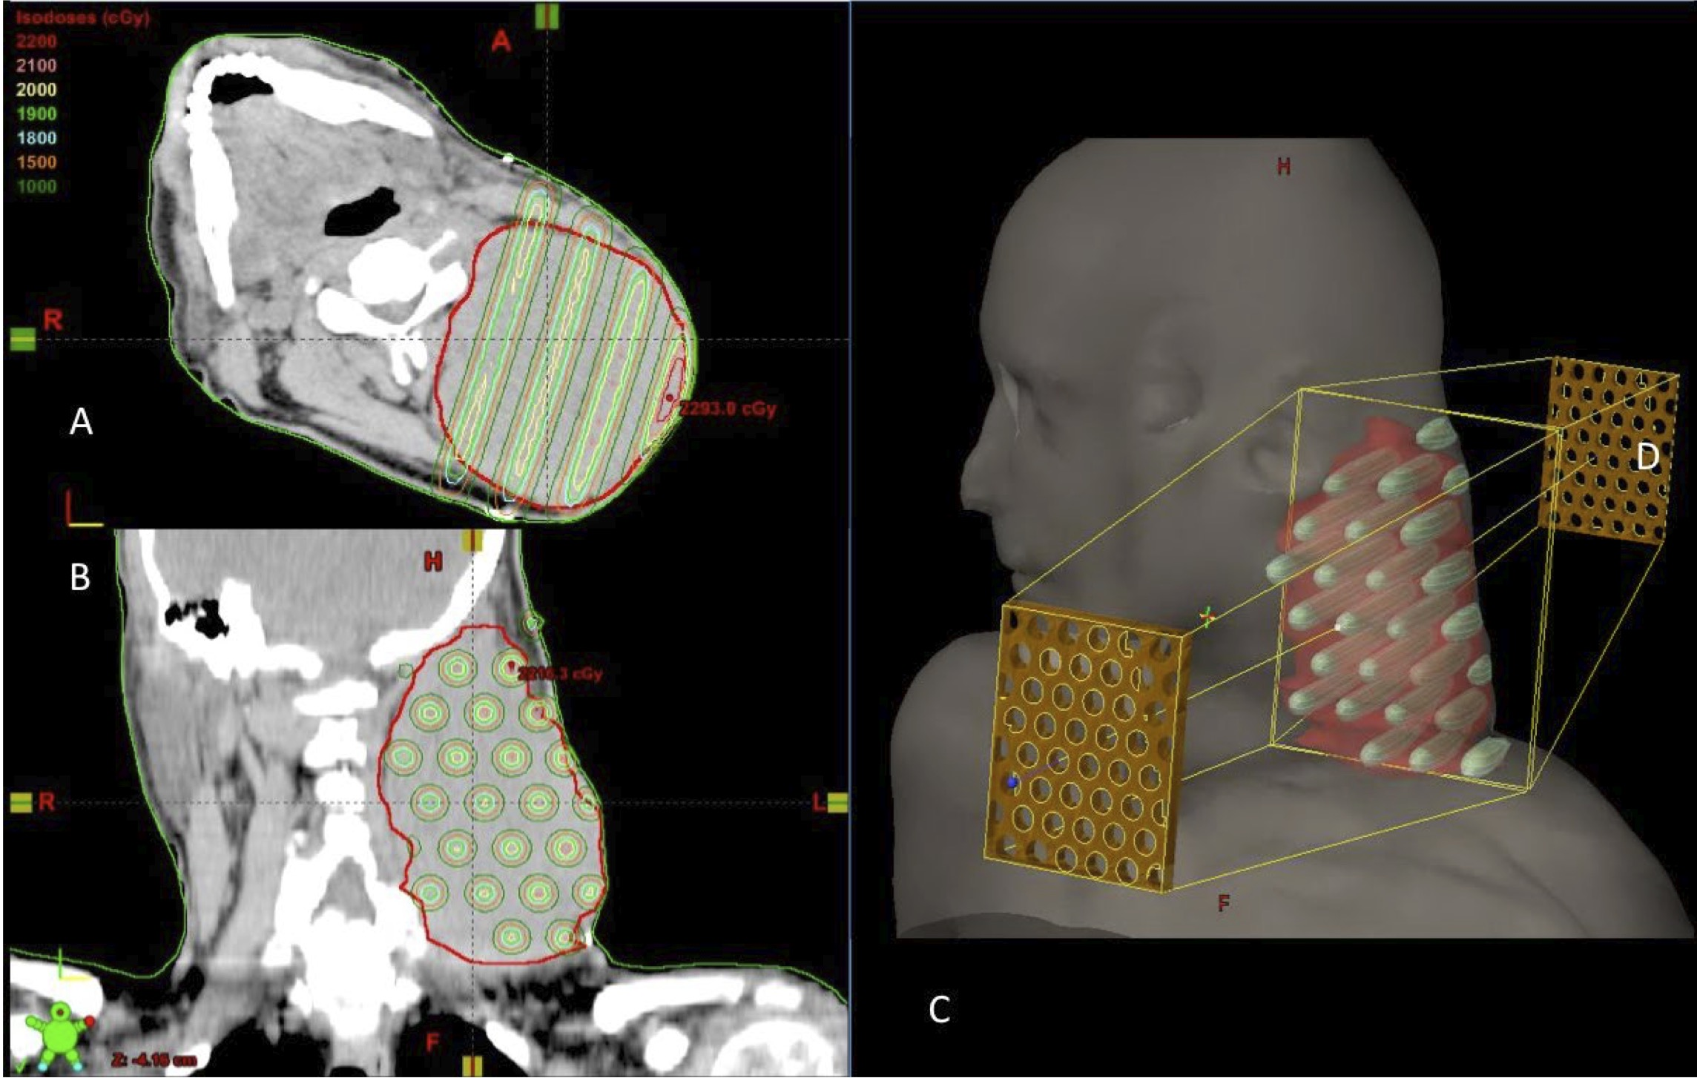
Spacially Fractioned Radiotherapy (SFRT)
Separate field into smaller beamlets
Maximium lateral heterogeneous dose distributions (peaks and valleys)
Increase of normal tissue tolerance.
A high peak-to-valley dose ratio (PVDR) combined with low valley doses improves normal tissue preservation.
Standard RT
SFRT
Mohiuddin et al (2022)
DOI: 10.7759/cureus.417

Slide 13
FLASH
“Therapeutic Window” is gap between:
  Tumour Control Probability (TCP)
  Normal Tissue Complication Probability (NTCP)
CONV delivery:
  2–8 Gy per fraction
  0.5–20 Gy/min
  ~30 s per field
FLASH delivery improves healthy tissue sparing:
  40 Gy/s.
  <200 ms per field.
Beam delivery is challenging!
Vozenin, Bourhis, Durante (2022)
DOI: 10.1038/s41571-022-00697-z
Jolly, Owen, Schippers, Welsch (2022)
DOI: 10.1016/j.ejmp.2020.08.005

Slide 14
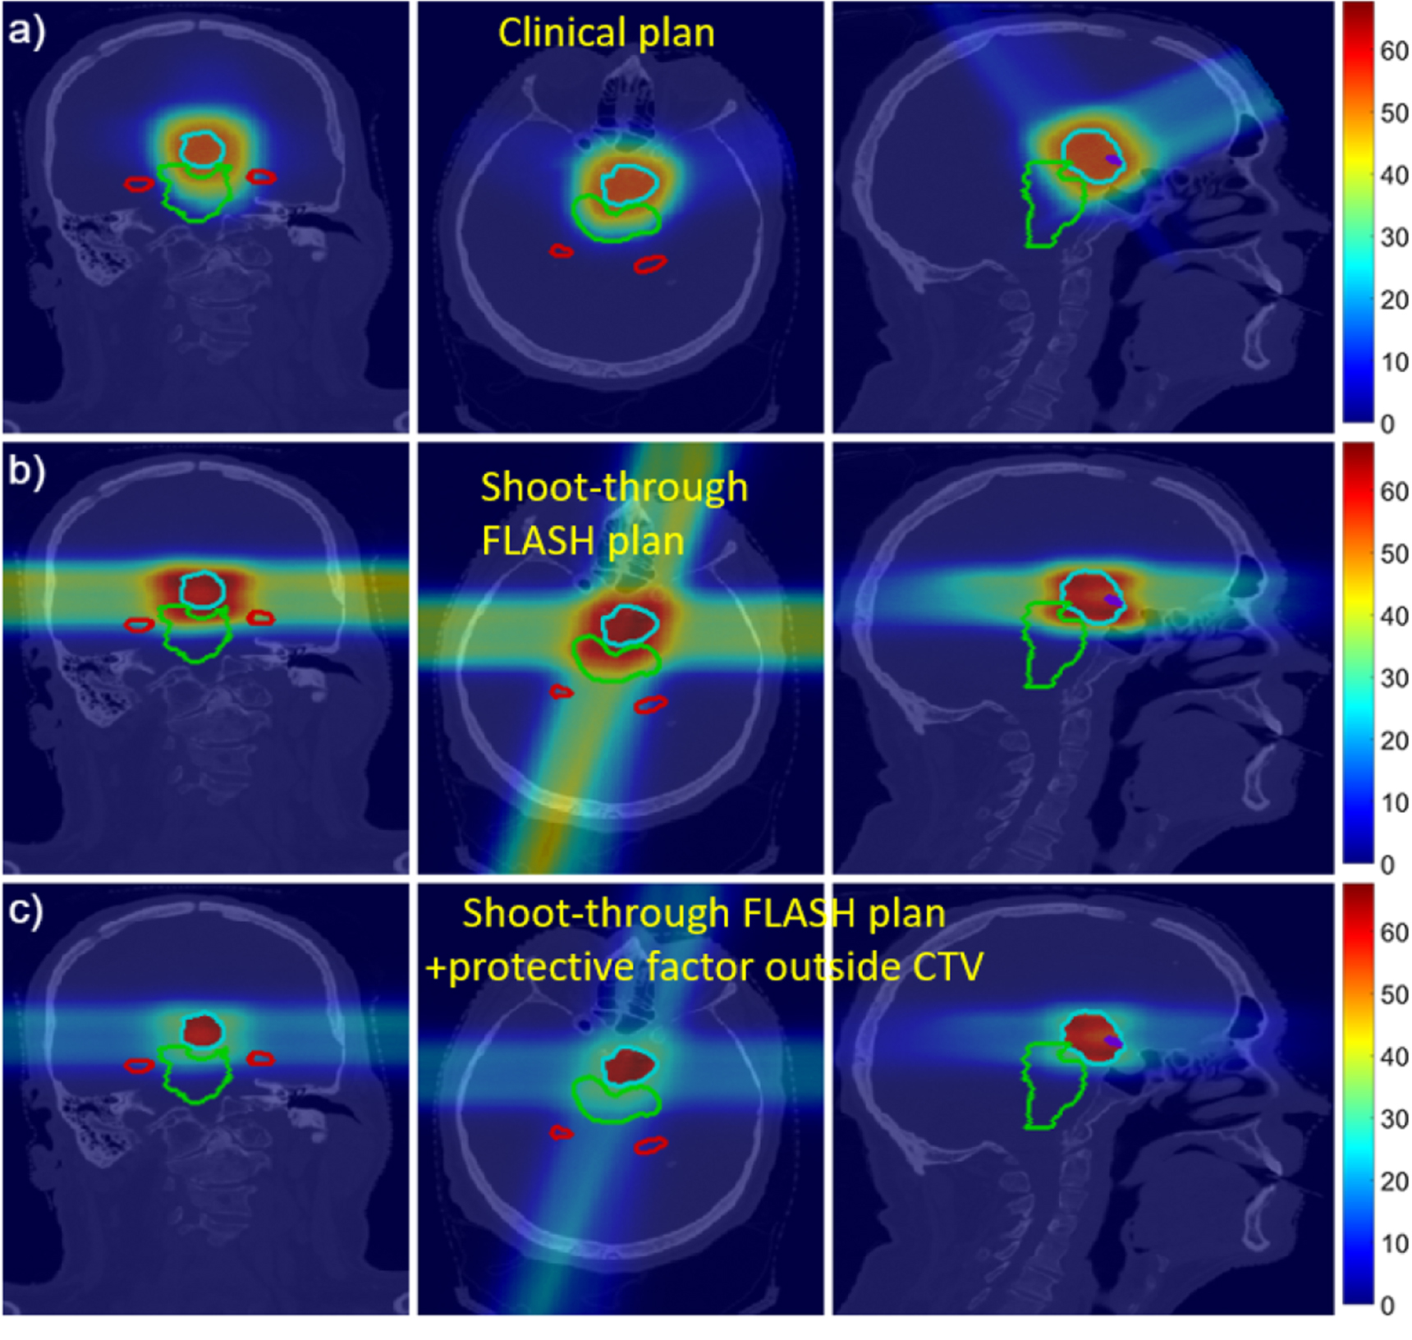
FLASH with Shoot-Through Protons (Varian)
Treating with highest energy protons (<250 MeV) avoids two issues:
  Energy layer switching time.
  Beam current reduction from degraders (Varian 600x reduction 250→70 MeV).
Improves lateral penumbra.
Similar to photon planning.
But…
  Relies on FLASH to minimise impact of dose to healthy tissue.
  No longer conformal.
Verhaegen, Wanders, Wolfs, Eekers (2021)
DOI: 10.1088/1361-6560/abe55a

Slide 15
Bragg Peak FLASH (IBA)
Courtesy of Nicolas Gerard, IBA
Pin ridge “hedgehog” patient specific filter enables conformal dose without modulating energy at the accelerator.

Slide 16

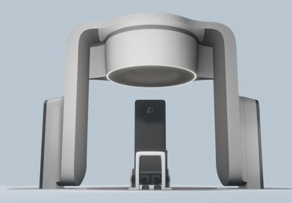
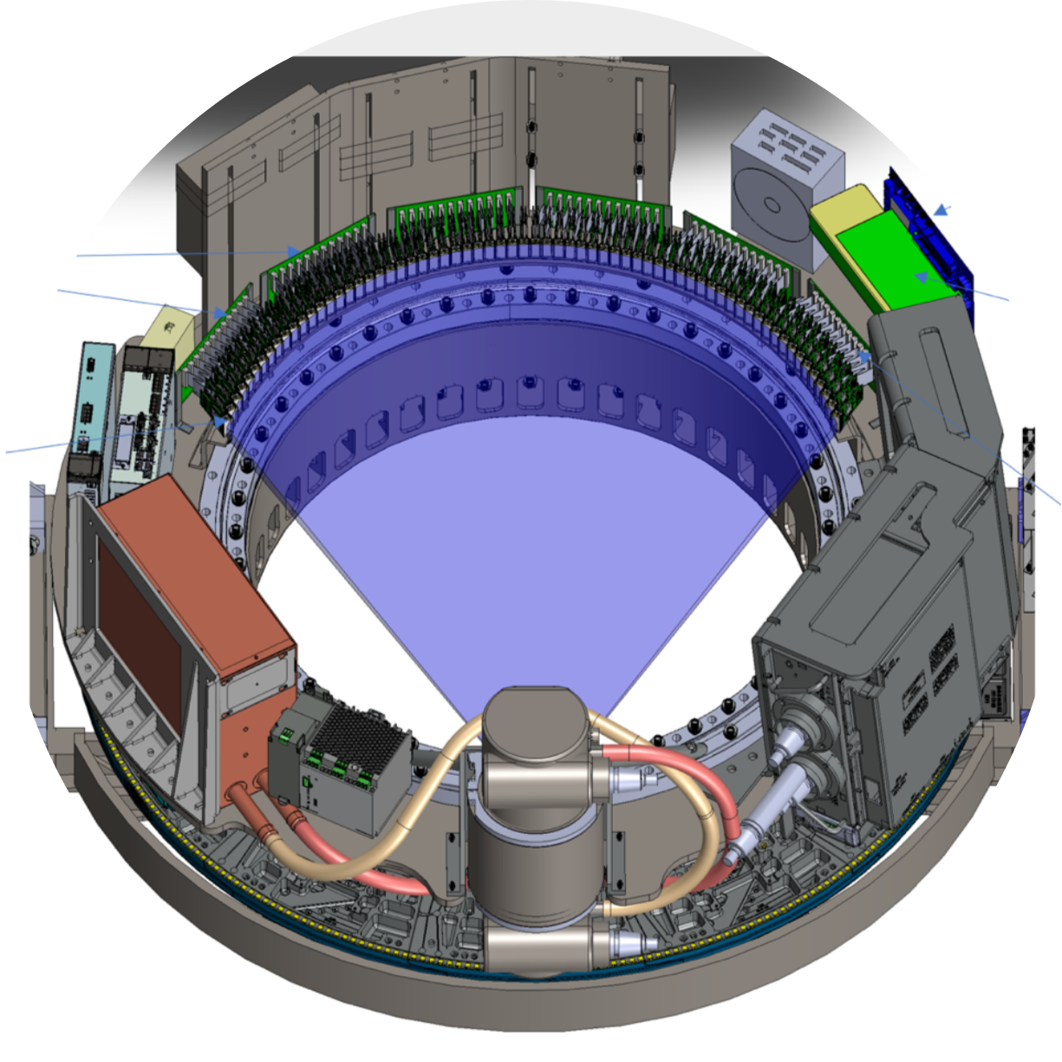
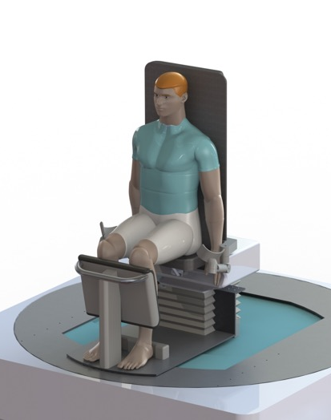
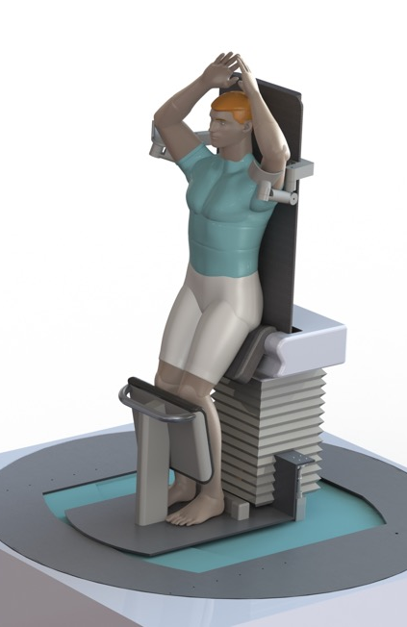
Upright Radiotherapy (Leo)
510K CLEARED IN SEPT 2024
510K CLEARED IN JULY 2025
UPRIGHT PATIENT POSITIONER
UPRIGHT AXIAL CT SCANNER
This system can be placed in front of any external radiation therapy beam.
Standardizing radiation therapy among Ext Beam RT modalities.
Seated Position
Perched Position
Courtesy of Niek Schreuder, Leo Cancer Care

Slide 17
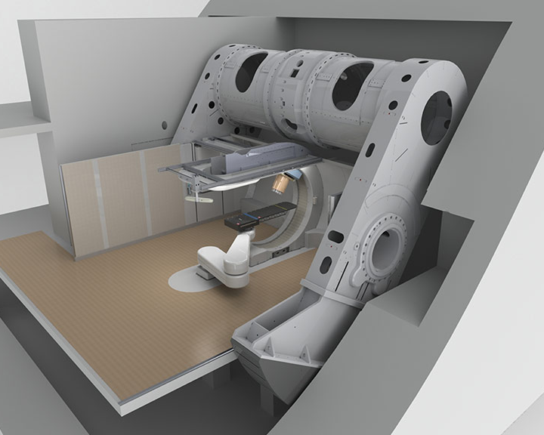
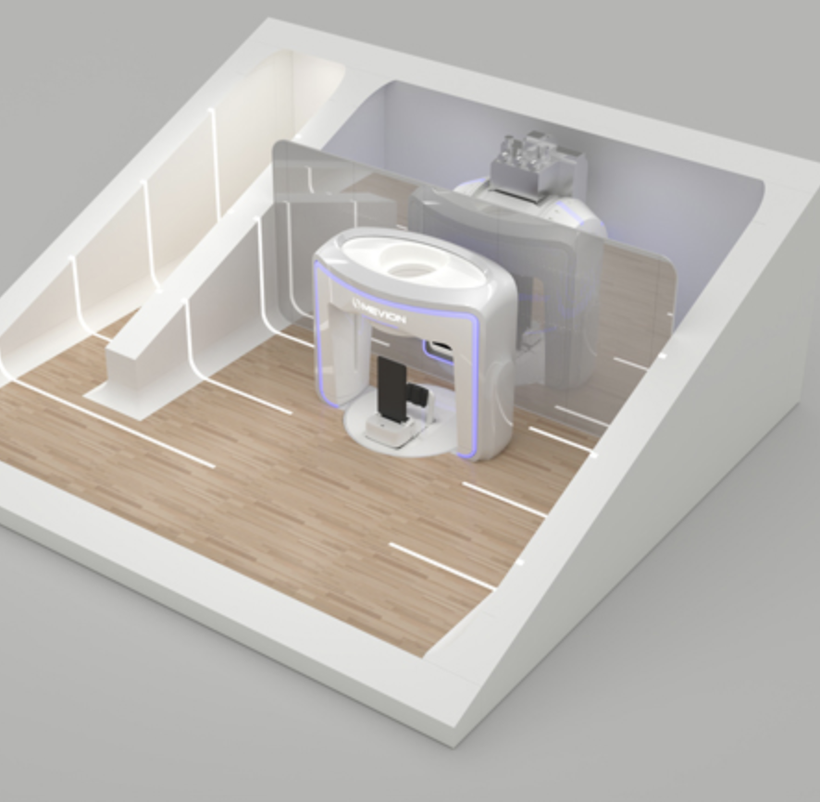
Compact Proton Therapy (Mevion S250-FIT)
Courtesy of Niek Schreuder, Leo Cancer Care

Slide 18
CNAO Accelerator Complex
IMRT
PBT
Courtesy of Marco Pullia
Energy range (MeV/u):
60–227 (250) (p) (30-320mm)
115–400 (C) (30-270mm)

Slide 19
CNAO Facility Expansion
IMRT
BNCT:
1 treatment room
1 experimental room
PBT

Slide 20
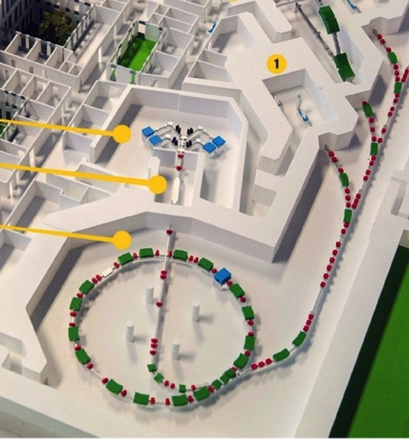
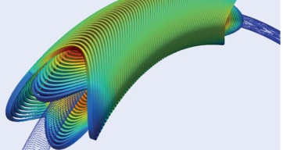
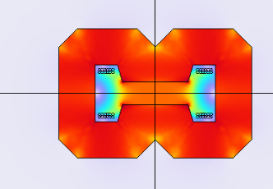
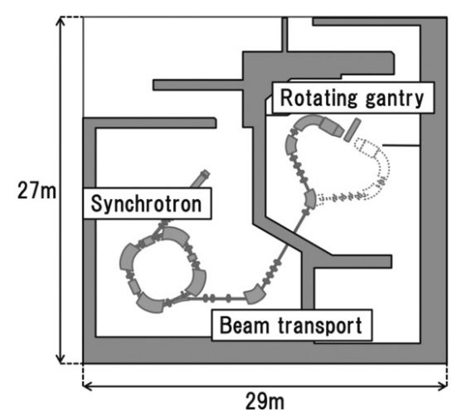
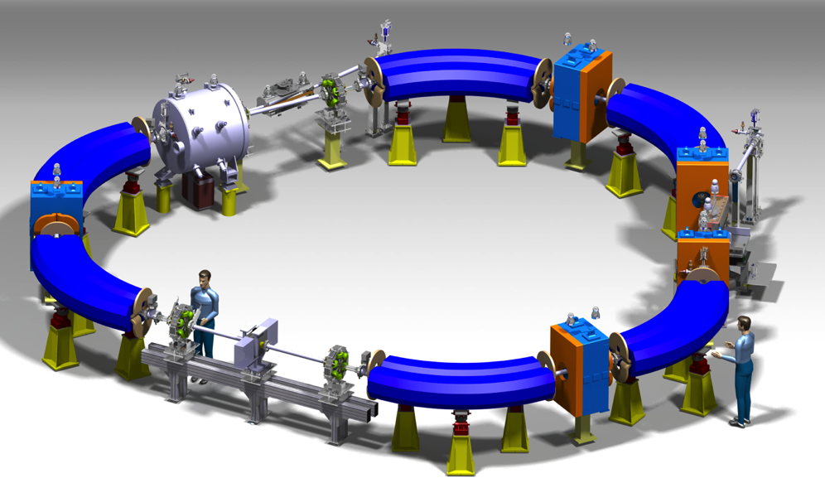
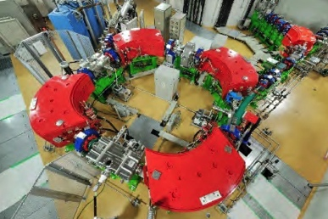
Compact medical synchrotrons
Courtesy of Elena Benedetto, Heli Huttunen
SC technology
HITACHI Synchrotron, ~6m
PIMMS (CNAO & MedAustron) ~25m
HIT (Heidelberg) ~ 20m diameter
NIMMS He-ions design, ~11m
Helium @ 220 MeV/u
(Bρ = 4.5 Tm)
Carbon @430 MeV/u
(Bρ = 6.6 Tm)
Protons @230 MeV
(Bρ = 2.42 Tm )

Slide 21
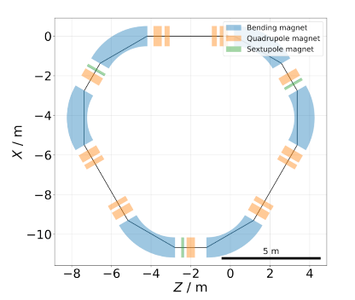
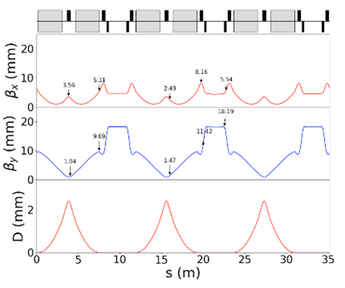
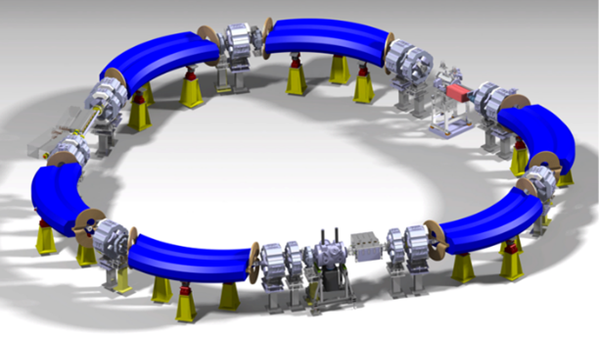
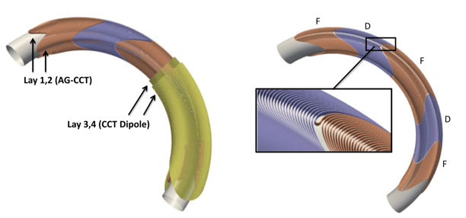
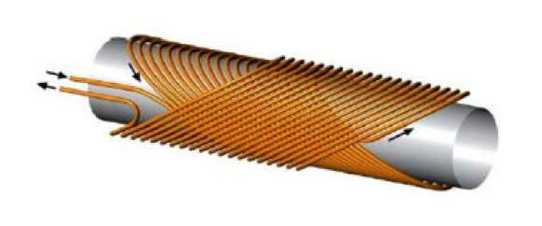
Helium & Light Ion Compact Synchrotron (HeLICS)
Courtesy of Elena Benedetto, Heli Huttunen

Slide 22
Large Momentum Acceptance Beamlines
Courtesy of Suzie Sheehy, Adam Steinberg, Jacinta Yap
Achromatic bending with constant-field superconducting dipoles, with matching quadrupoles that vary with energy.

Slide 23
Static Field Gantries: FFAG/TURBO/GaToroid
Courtesy of Suzie Sheehy, Adam Steinberg, Jacinta Yap

Slide 24
Conclusions
Exciting time to be in particle therapy!
FLASH not realised clinically, but developments in delivery speed valuable.
SFRT continues to grow, with small but increasing clinical validation.
Compact/upright facilities make ion therapy more feasible.
Immuno-radiotherapy is the future! Radiation stimulates immune response to eradicate cancer: potentially systemic (abscopal).
Dose conformality may not be the only metric…

