Slide 1
Detector Development for Proton Beam Therapy
The Jolly Shrewdness

Slide 2
Particle Dose Distribution
Unlike X-rays, charged particles stop!
Electrons, being lighter, scatter and spread out.
Protons deposit most dose at the end of their path: the Bragg Peak.
Bethe-Bloch:
E = energy
x = distance
me = electron mass
n = electron density
z = particle charge
β = particle velocity
e = electron charge
ϵ0 = vacuum permittivity
I = mean excitation potential

Slide 3
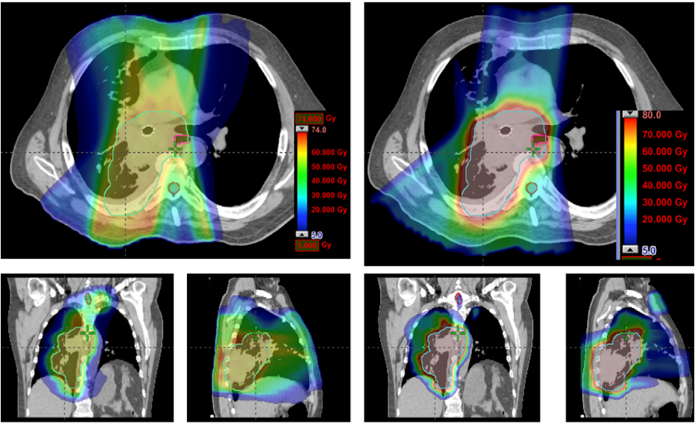
Non Small Cell Lung Cancer Doses
IMRT
PBT
Zhang X, Li Y, Pan X, et al.
Int J Radiat Oncol Biol Phys. (2010); 77 (2): 357–366
DOI: 10.1016/j.ijrobp.2009.04.028

Slide 4
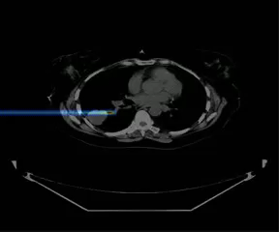
Pencil Beam Scanning

Slide 5
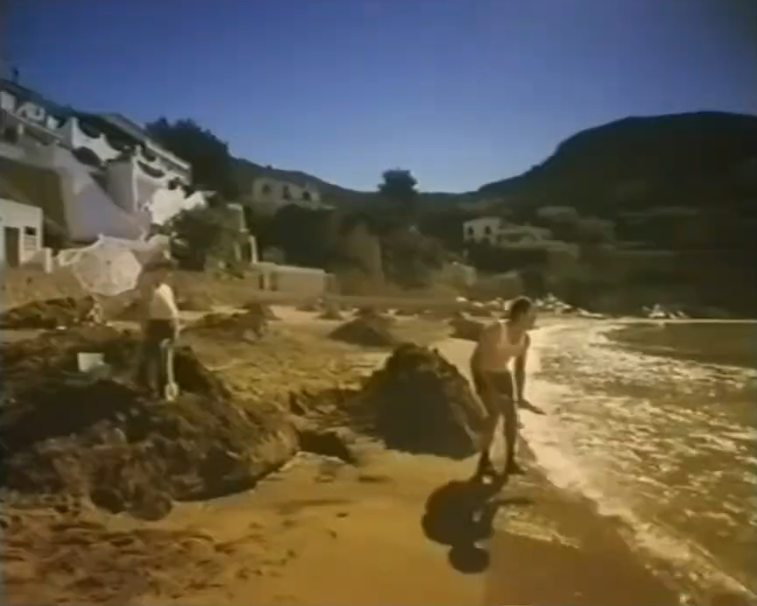
PBT ≠ HEP…
Particle Detectors ≠ Accelerator Diagnostics:
  Particle physics detectors are for precision measurements of single particles.
  Accelerator diagnostics measure up to 10¹⁹ particles simultaneously.
Particle therapy sits somewhere in the middle:
  10¹¹ protons/s is typical treatment intensity.
  Too many for particle-by-particle.
  Too few for standard accelerator diagnostics.

Slide 6
Beam Quality Assurance
We need to measure 4 key quantities in proton therapy beam QA:
  Absolute dose:
    Total number of protons/dose delivered per spot.
    Overdosing results in healthy tissue toxicities.
    Underdosing won’t eradicate primary tumour but still increases risk of secondaries.
  Spot position:
    Position of each spot relative to plan/treatment room isocentre.
    Incorrect position means: inhomogeneities in dose to tumour and significantly more dose to healthy tissue.
  Spot size:
    Absolute RMS beam width in both transverse planes at isocentre.
    Undersized spots cause cold spots in tumour dose.
    Oversized spots cause hot spots in healthy tissue and less conformal dose.
  Range:
    Range in water (Water Equivalent Thickness/WET) for a given energy.
    Range too short underdoses tumour.
    Range too long deposits most damaging dose beyond tumour into healthy tissue.
Ideally measure all these quantities for all these quantites:
  Spot size, range and dose for all positions AND gantry angles.

Slide 7
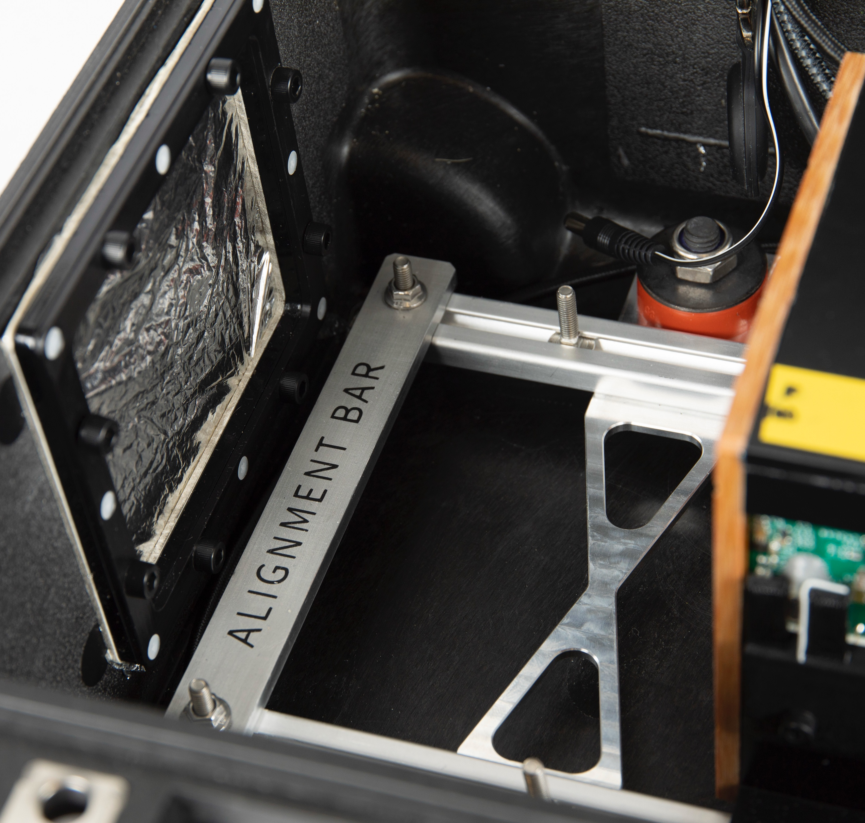
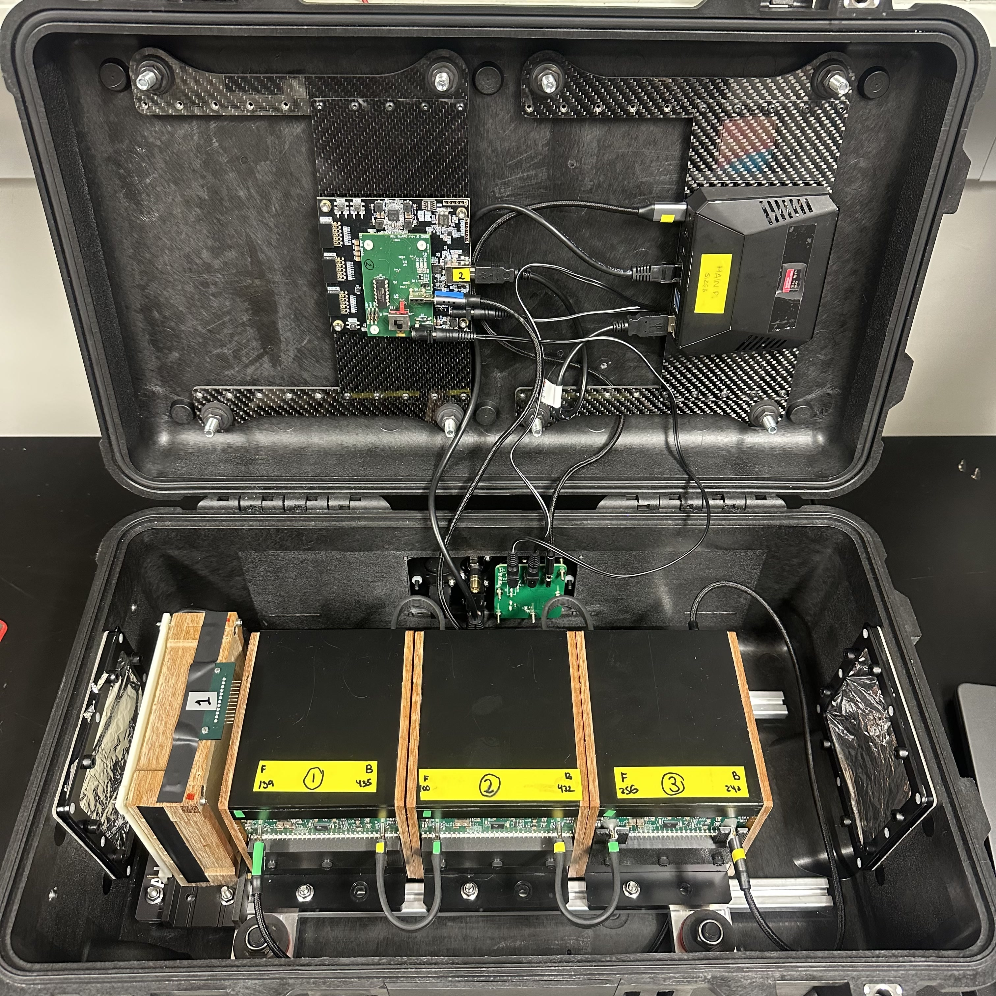
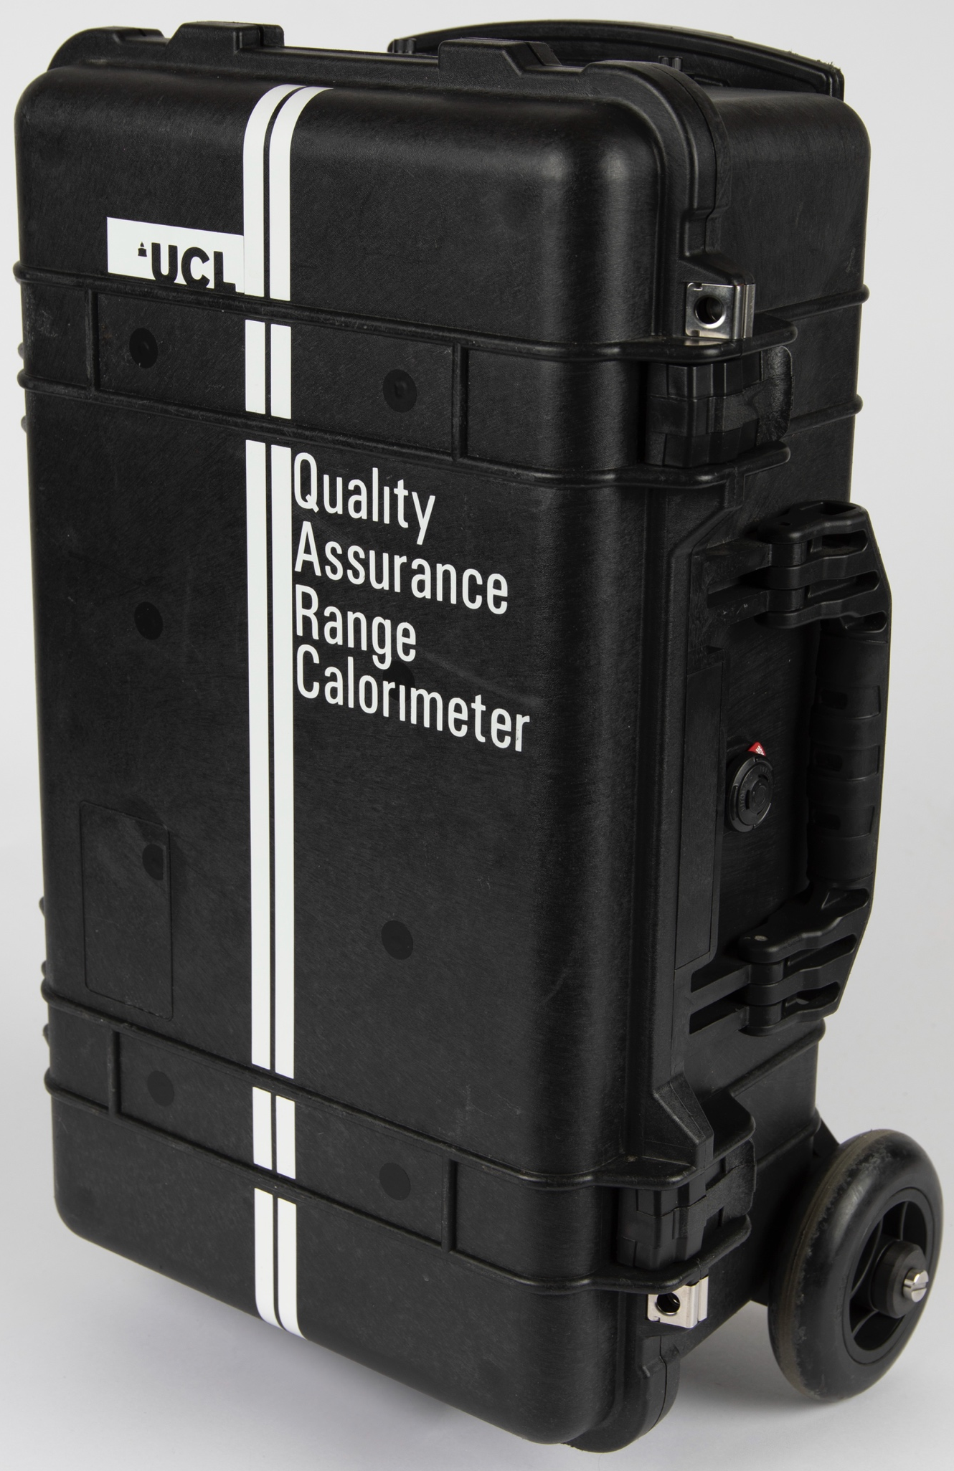
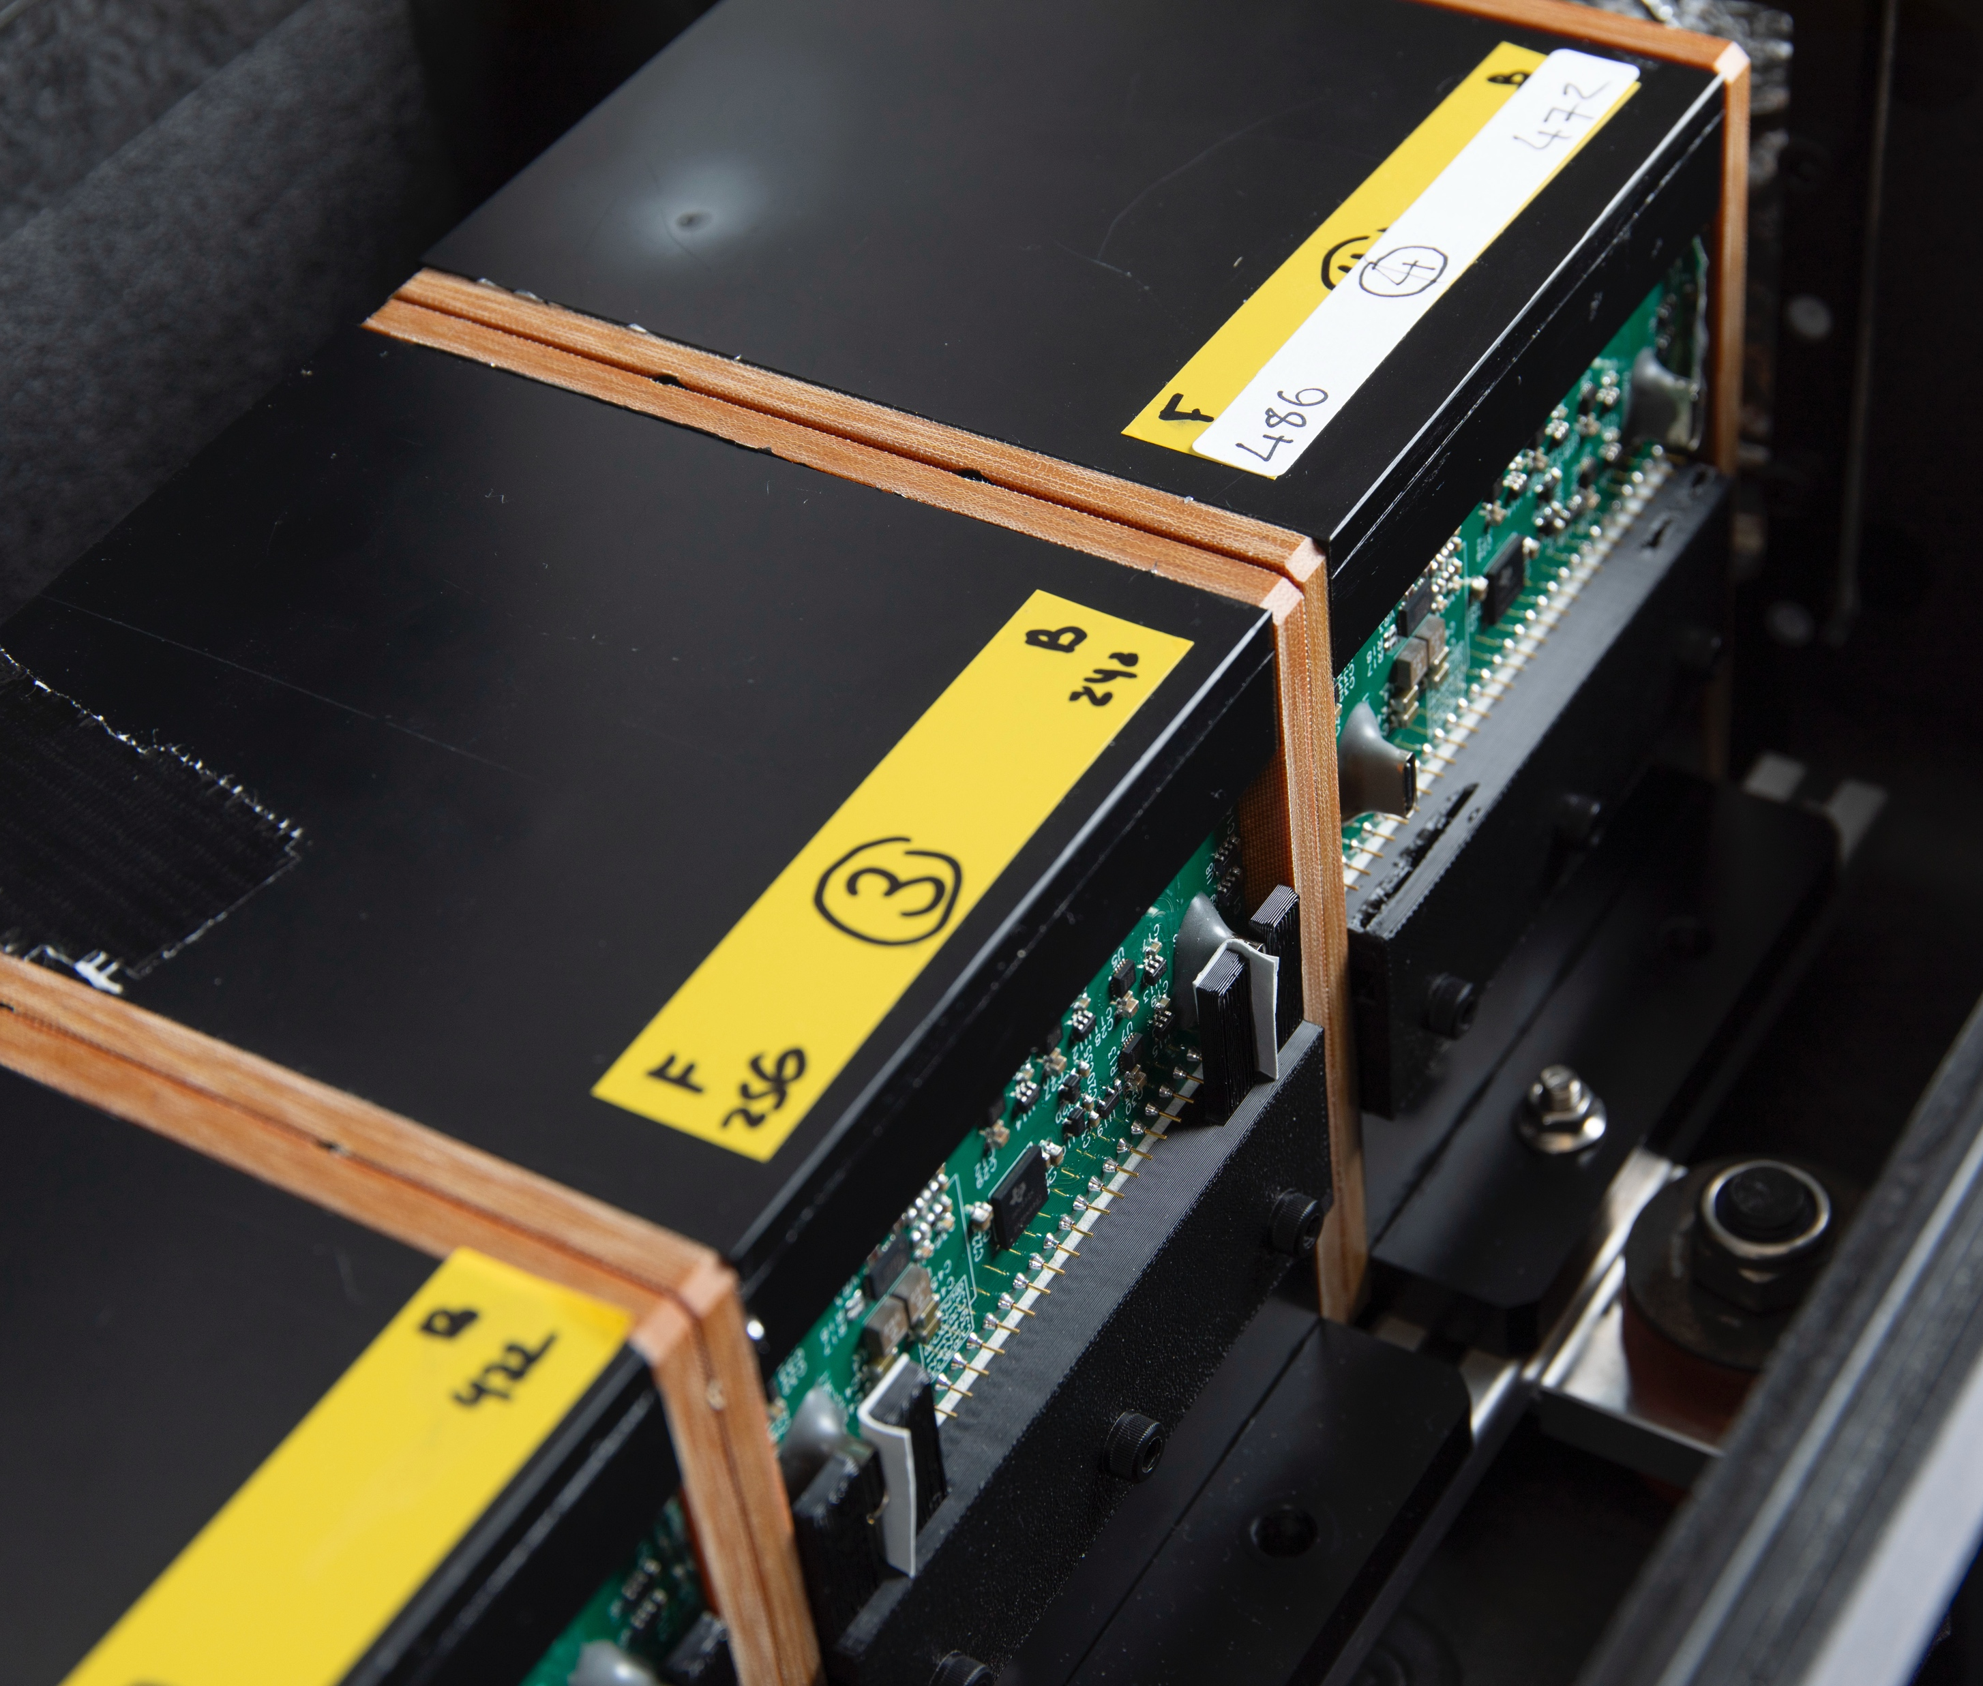
Quality Assurance Detector for Proton Beam Therapy
FPGA
Pi
SciFi
QuARC

Slide 8
QuADProBe: Design Considerations
Robustness:
  Regular clinical use means detector will be dropped, bashed, used as a stool, stored in dusty cupboards…
  Built-in shock absorption; no external components.
Transport:
  We need to transport it to/from various international centres; it will need to be moved between treatment rooms.
  Built into standard Peli flight case sized for carry-on luggage.
Ease of setup:
  Time is limited, so setup must be simple.
  Detector self contained; only 2 cables (power, network); alignment markings on case to align to in-room lasers/CT.
Ease of use:
  Needs to be controlled from multiple devices/OS.
  All DAQ hardware and software on board detector; controlled through web browser (PC/tablet/phone); no software installation needed.

Slide 9
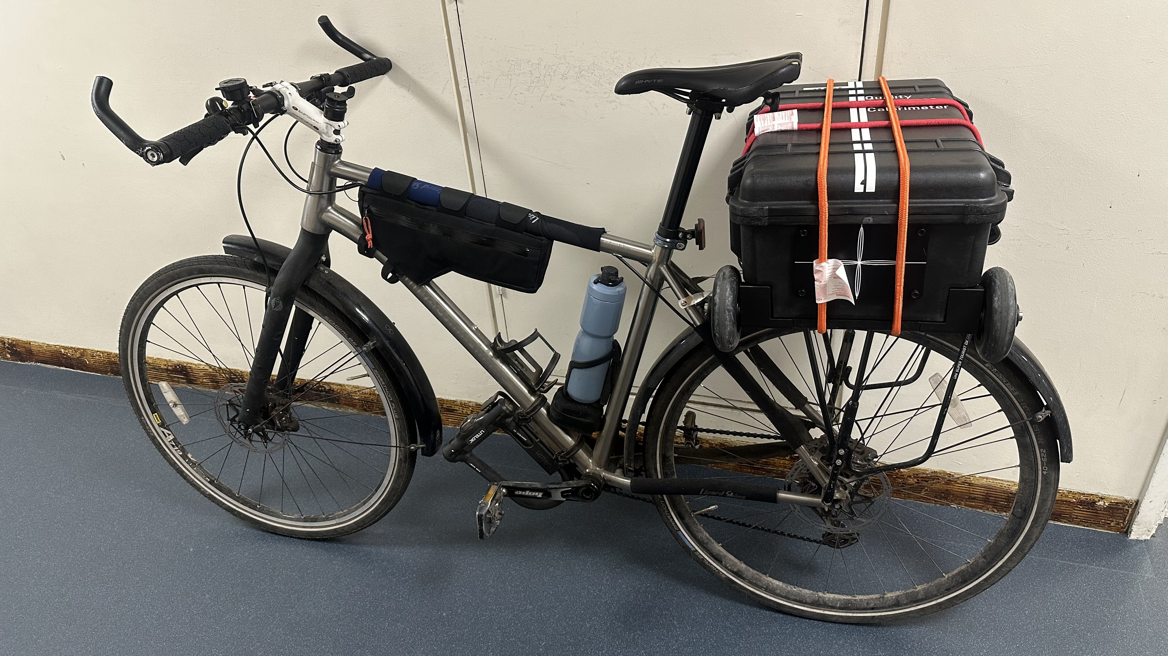
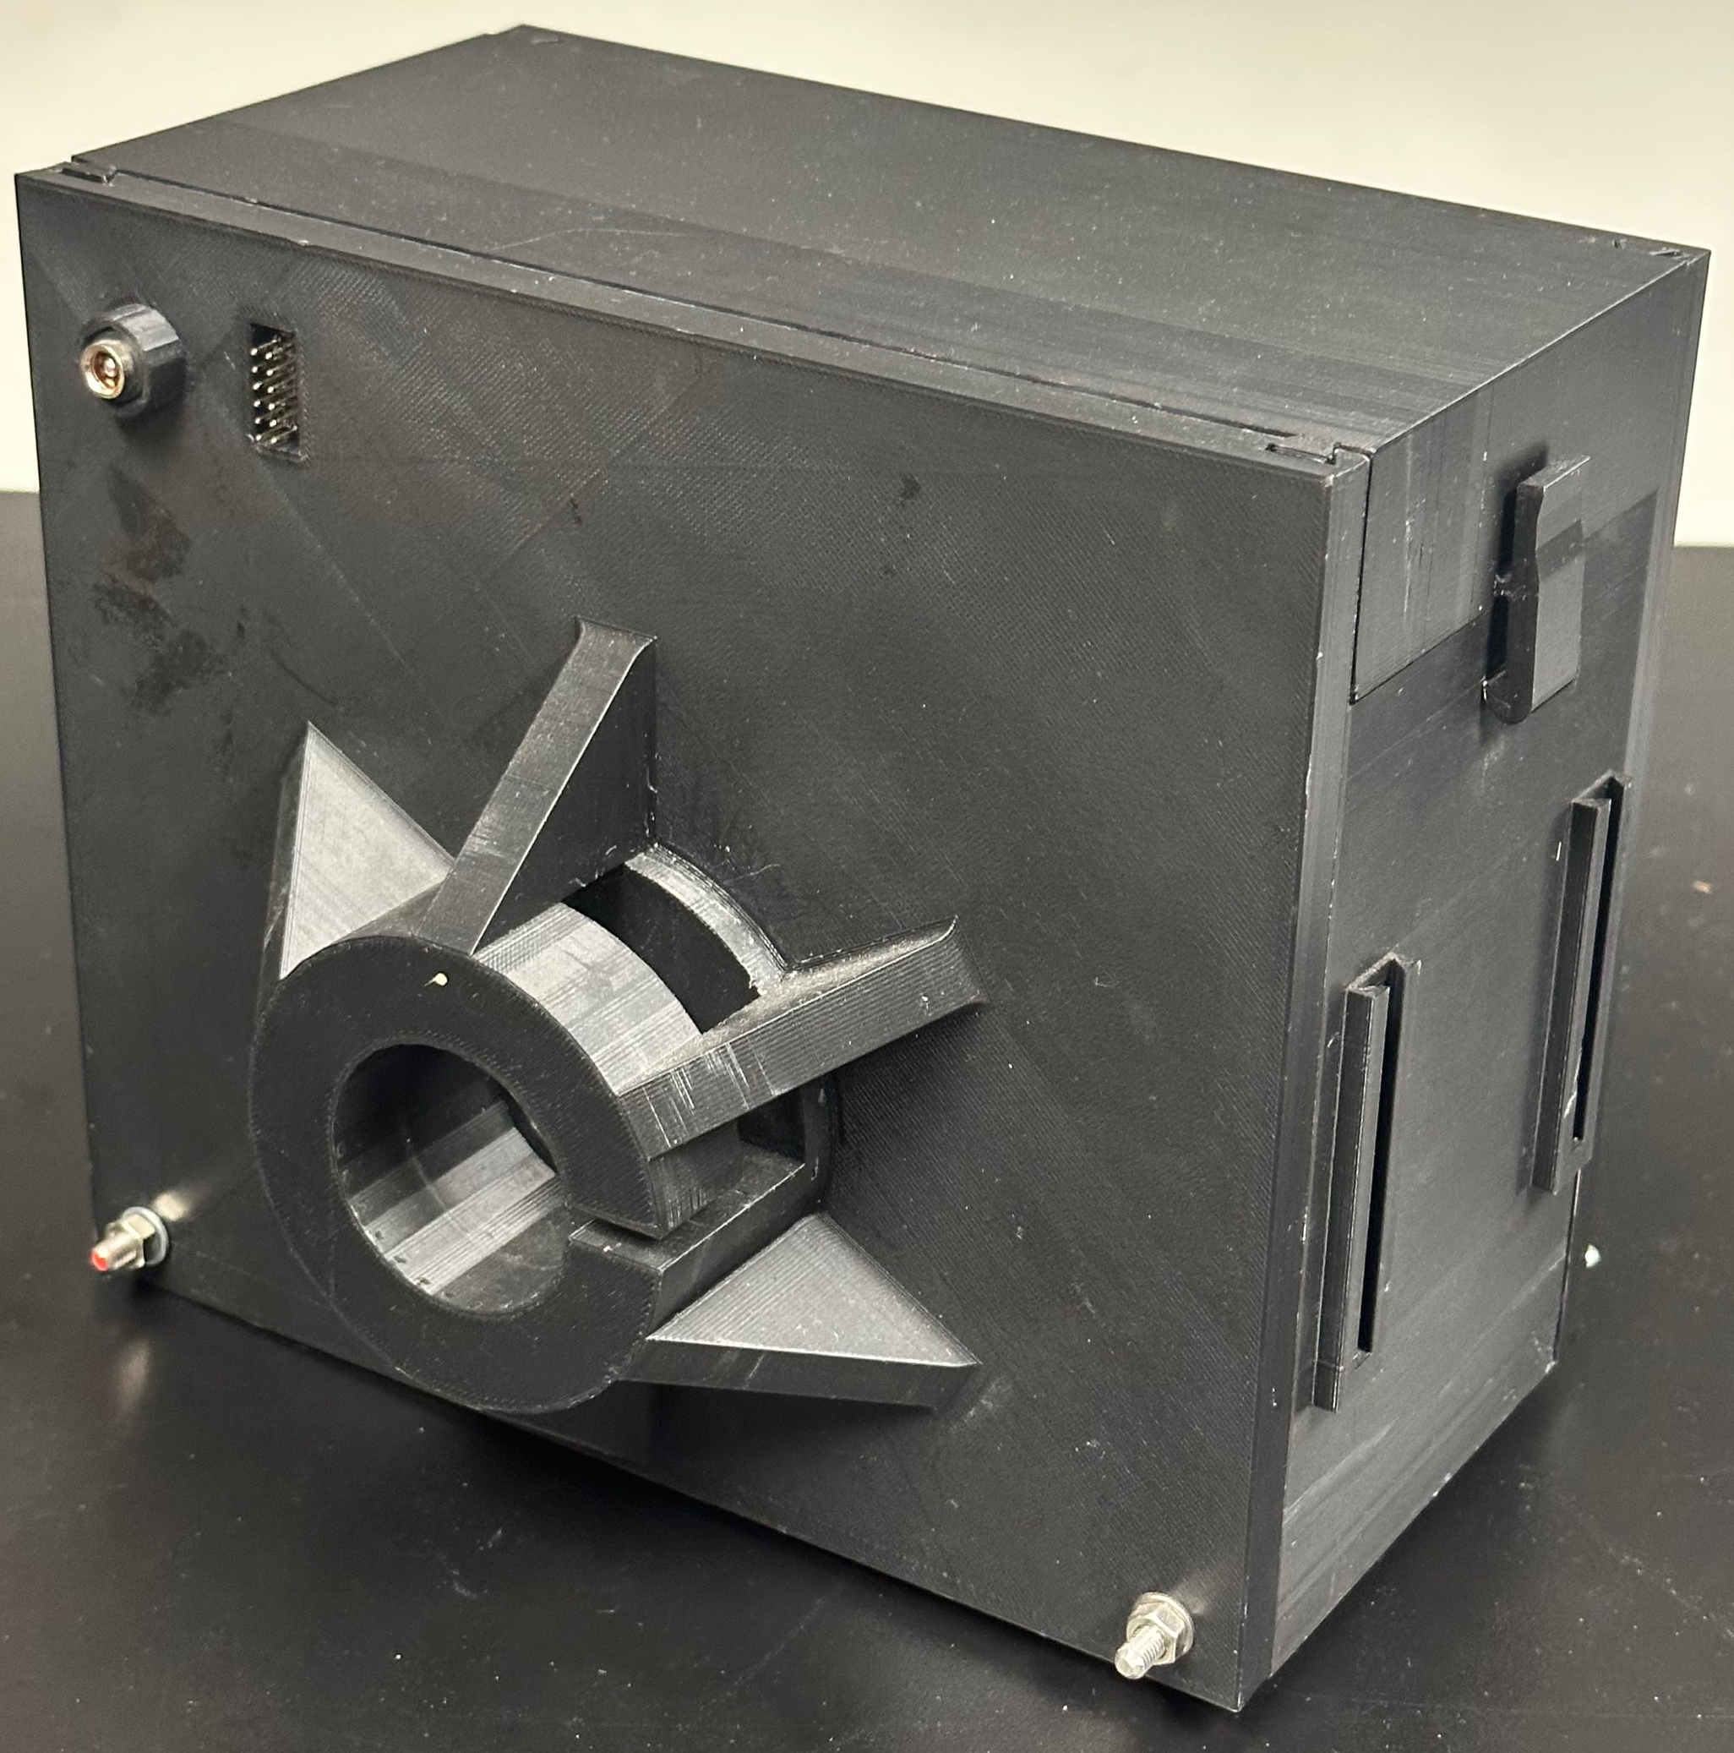
Size Doesn’t Matter (But It Really Does)

Slide 10
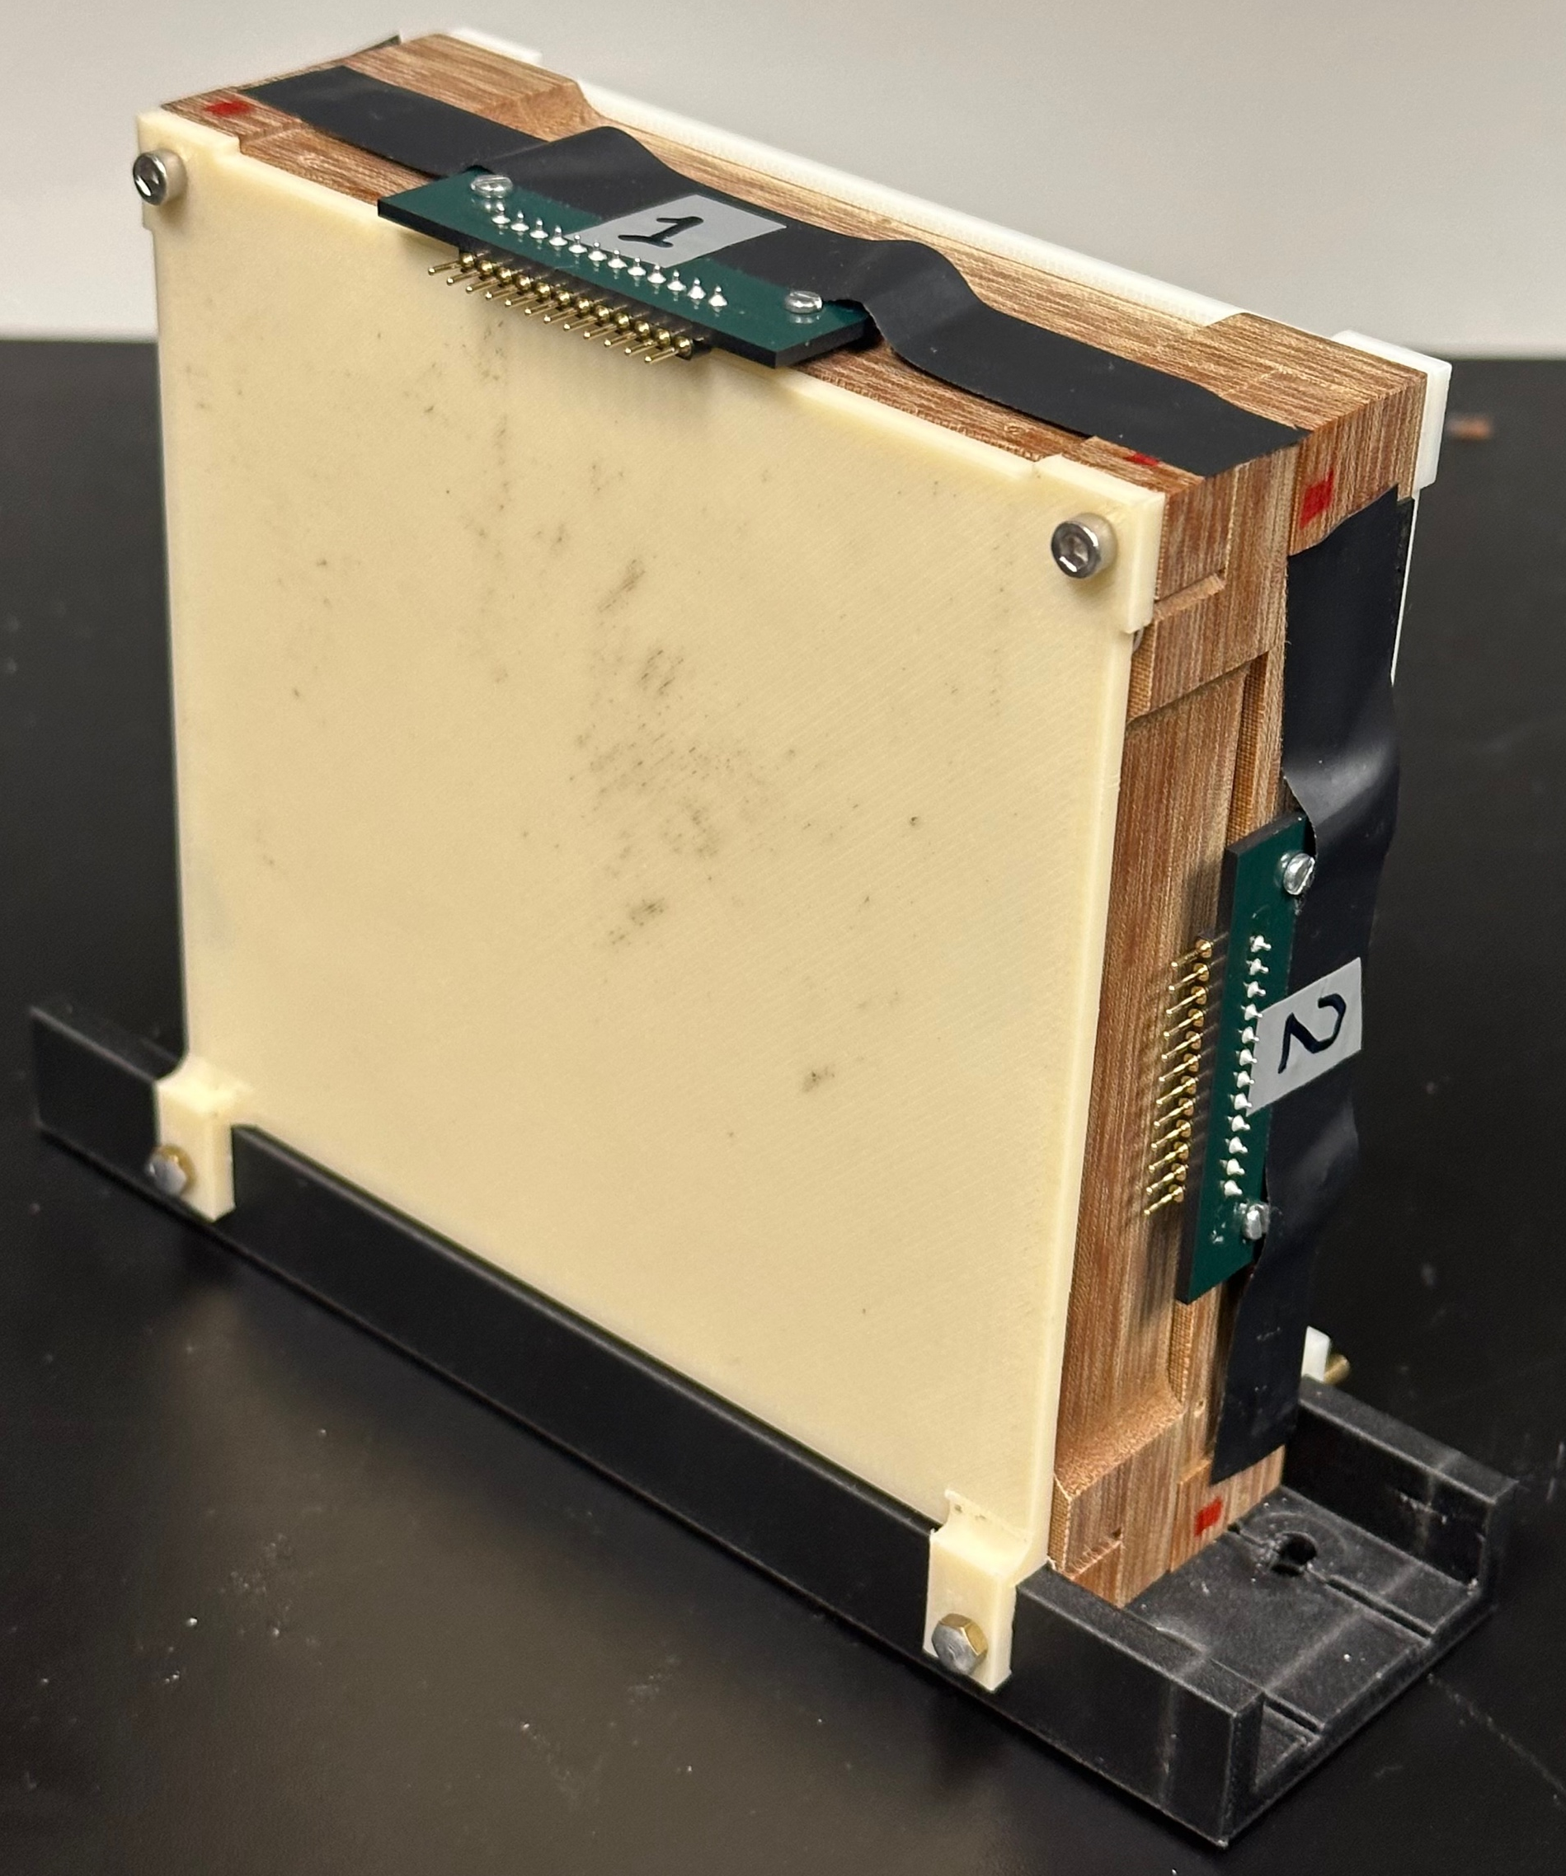
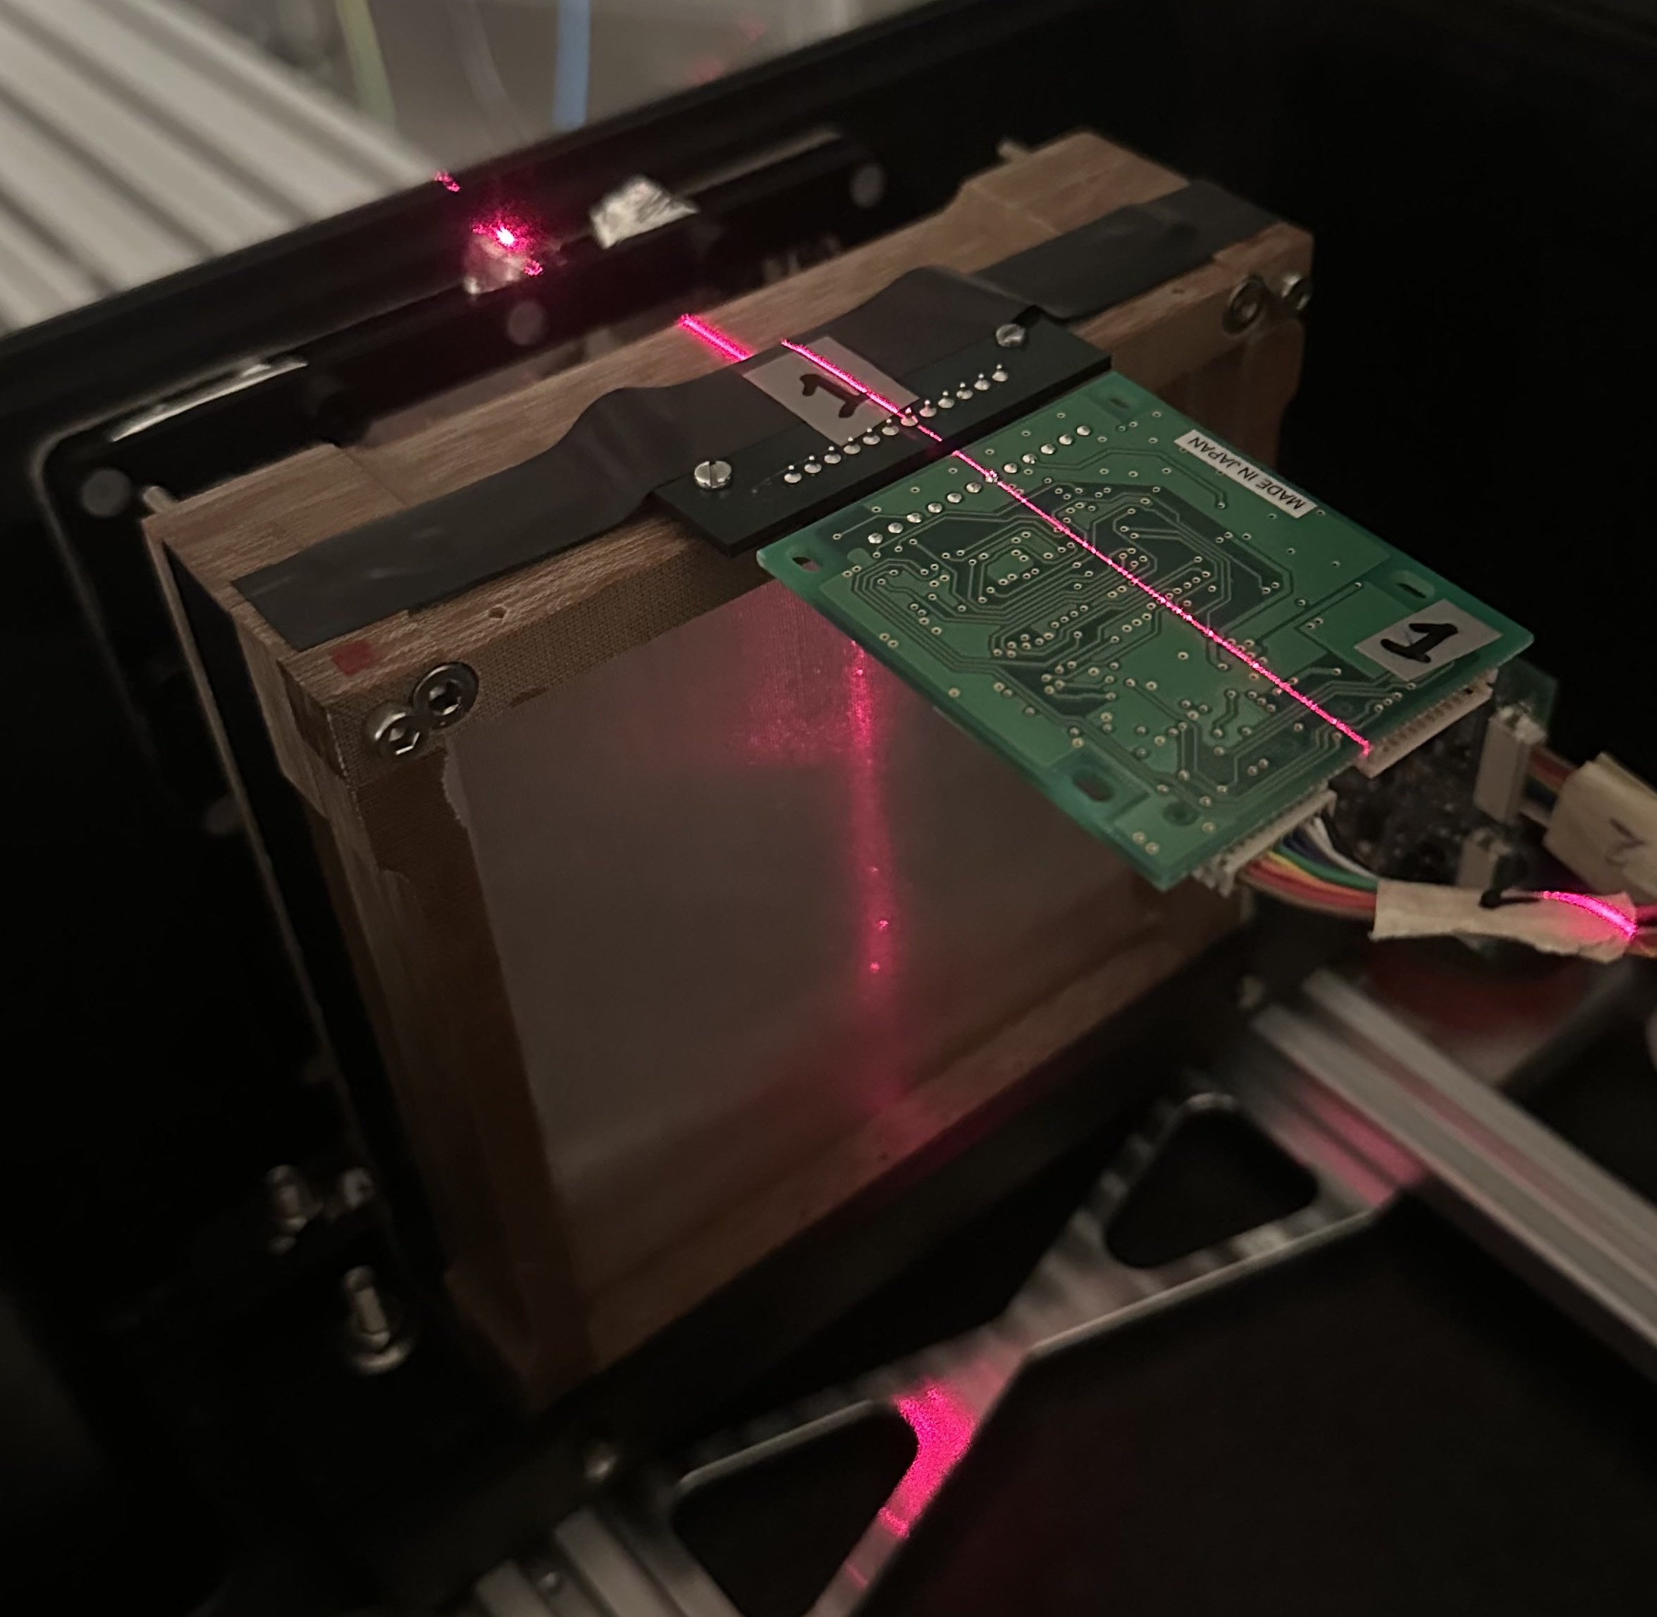
Scintillating Fibre Beam Profile Monitor
Orthogonal arrays of 500 µm scintillating fibres.
Independently measure X and Y spot position and profile.
Based on design from Blake Leverington’s LHCb group at Heidelberg:
  Installed at Heidelberg Ion Therapy centre.
Hamamatsu S17285 prototype 128-element photodiode arrays with 400 µm pitch.

Slide 11
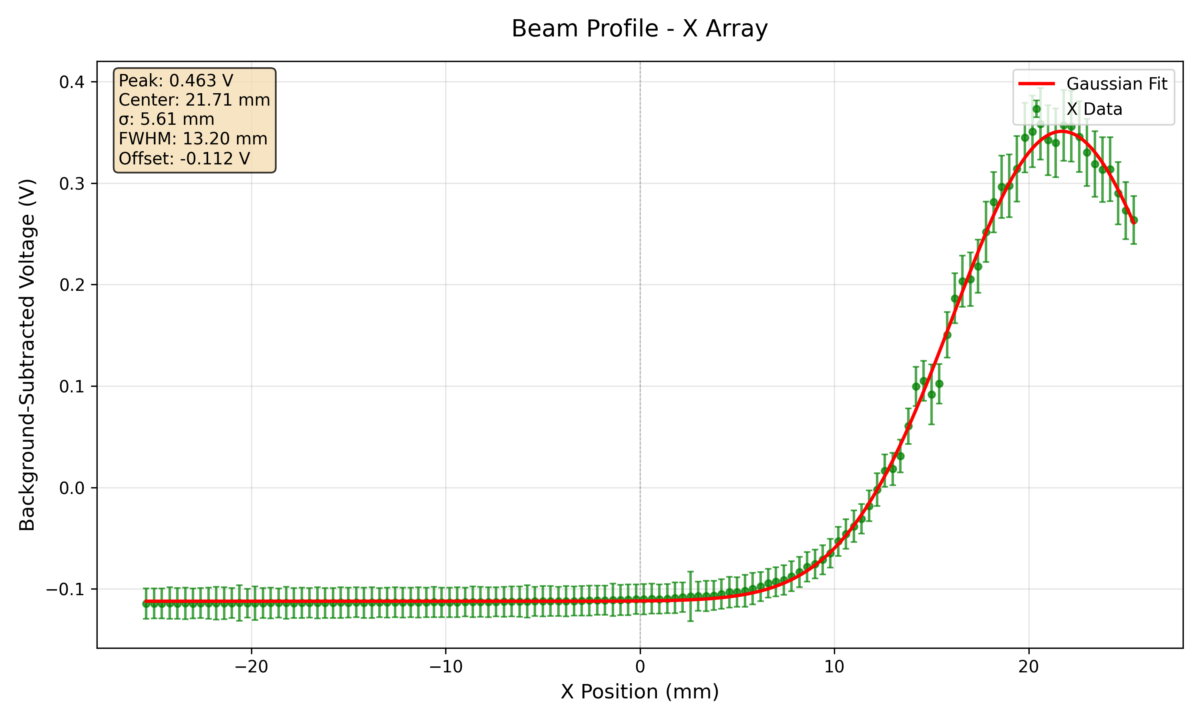
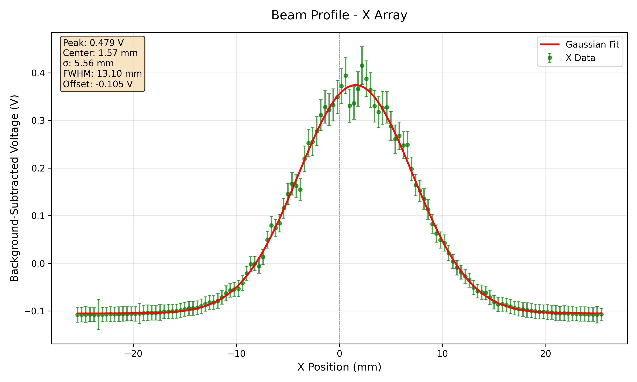
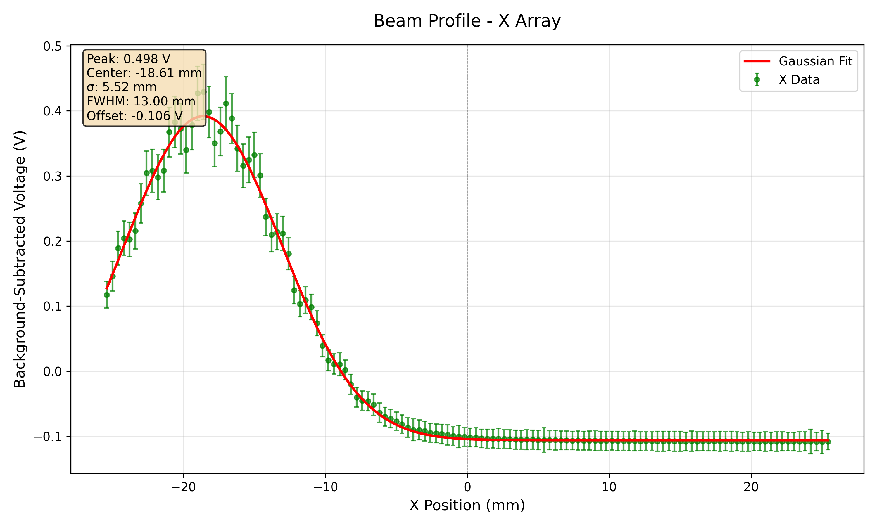
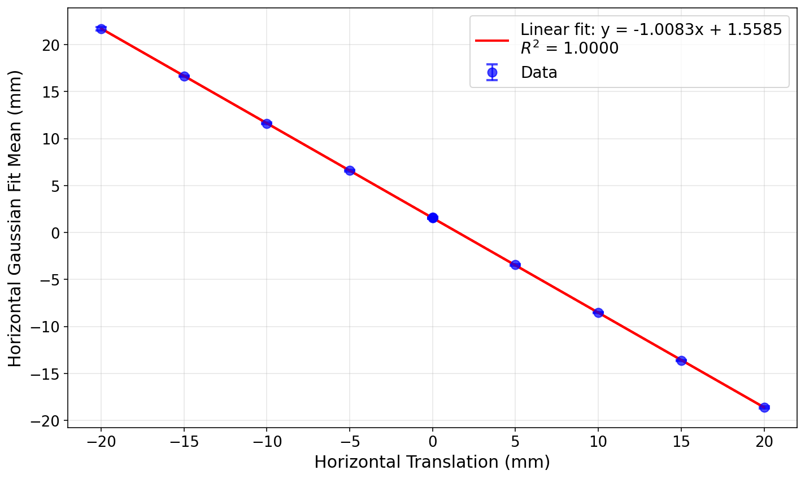
SciFi Position Response (+/-20 mm X)

Slide 12
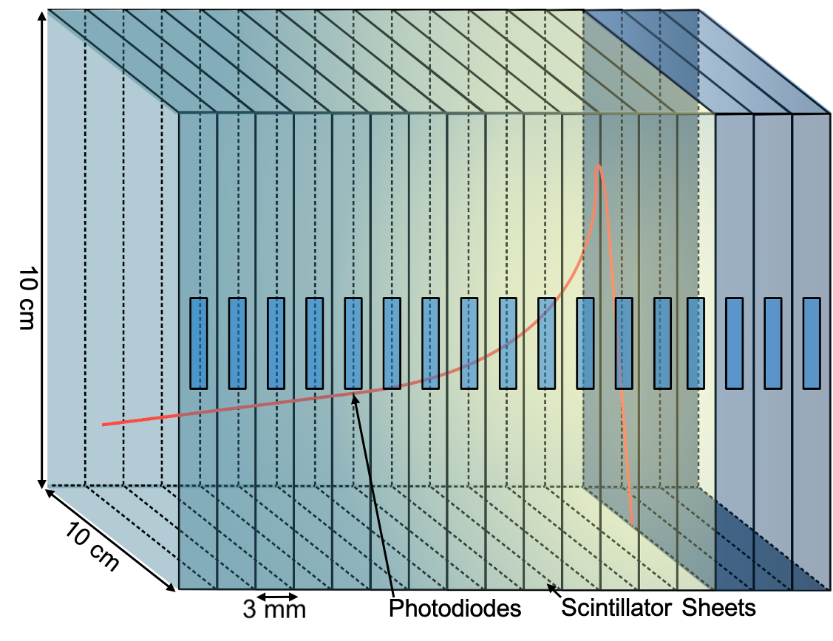
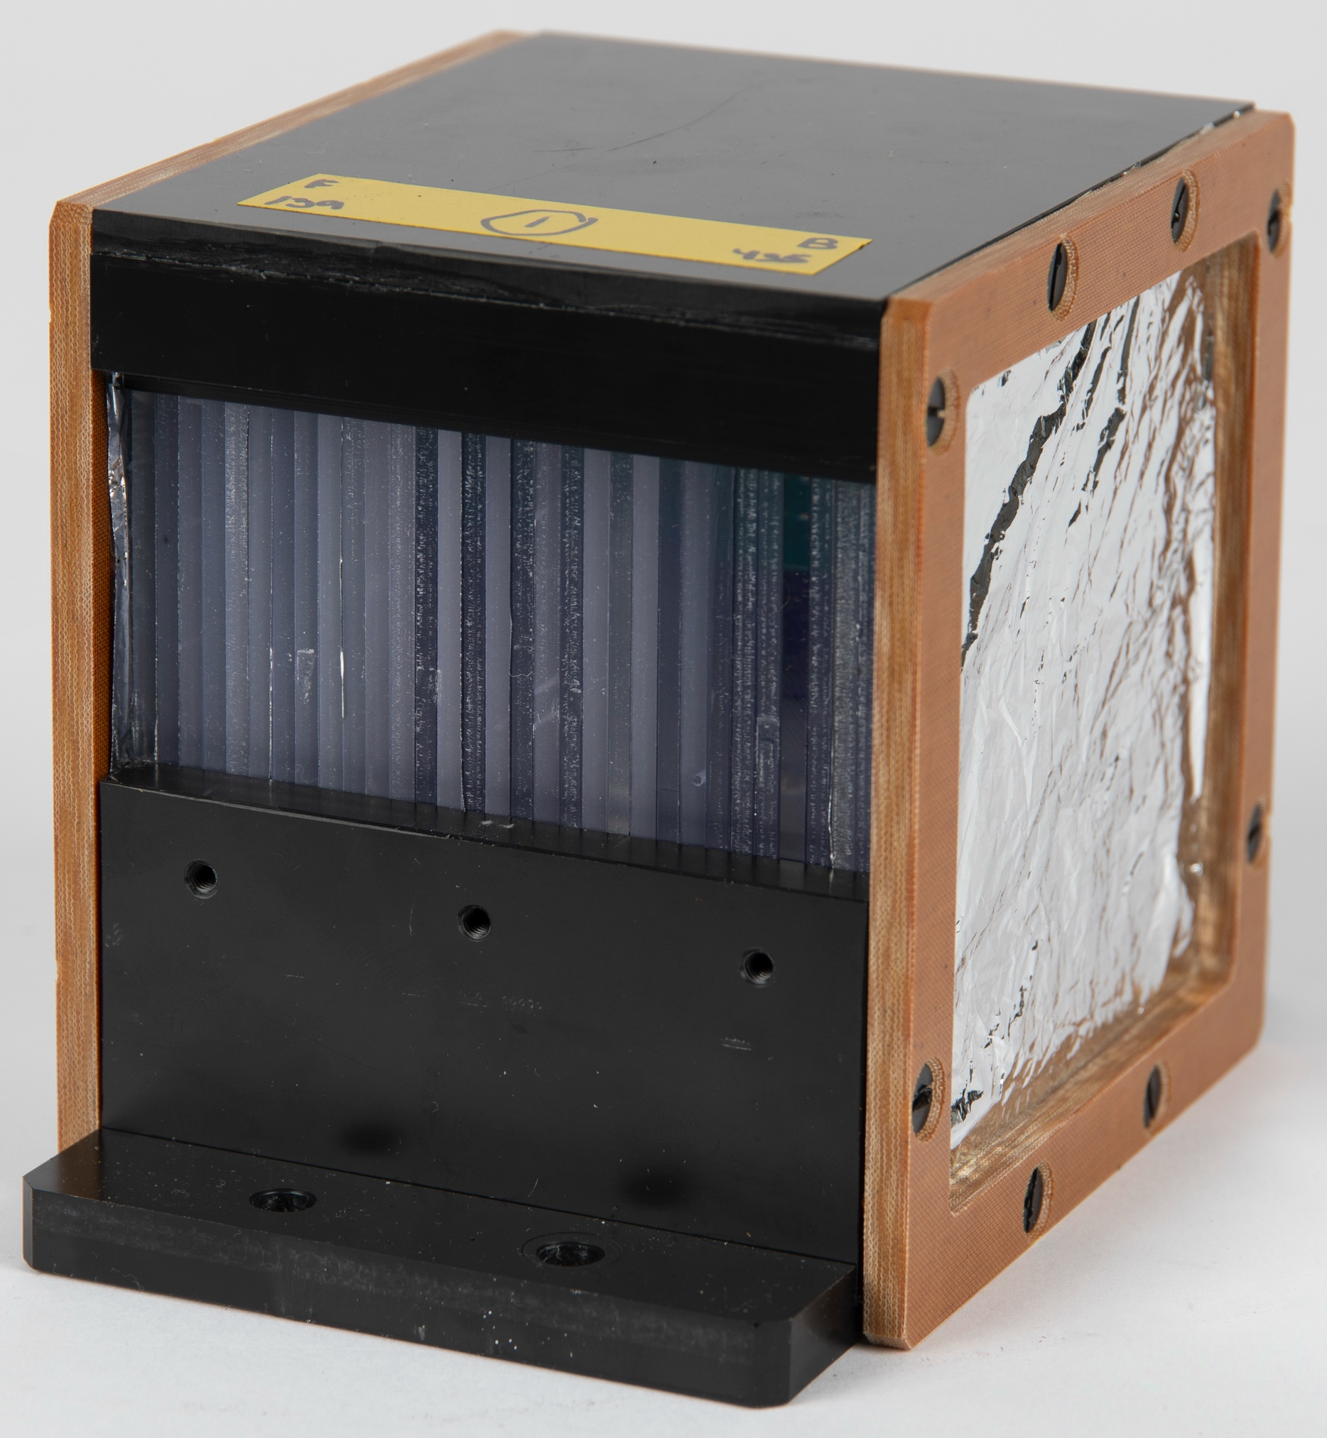
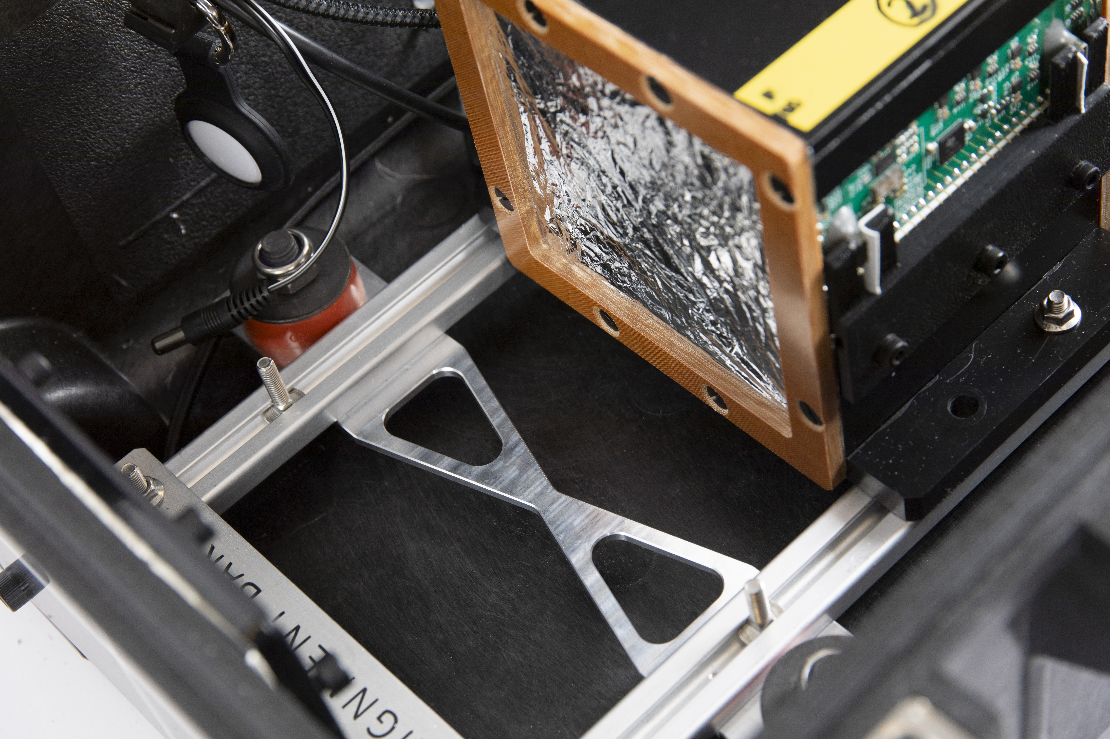
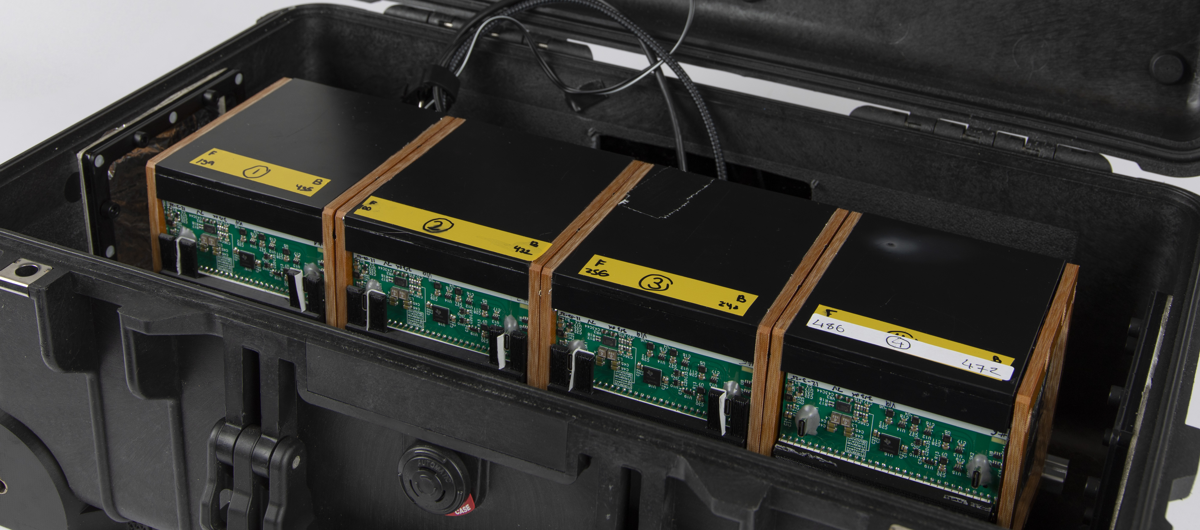
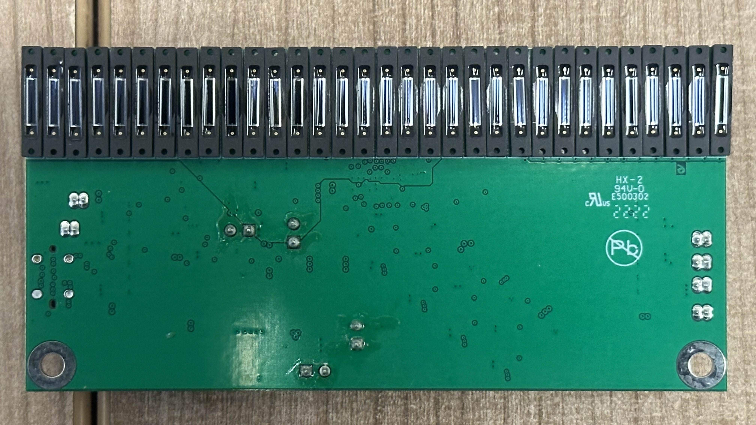
The Quality Assurance Range Calorimeter

Slide 13
UCLH Bragg Peak Comparison
A+B side averaged Bortfeld and UCLH reference curves

Slide 14
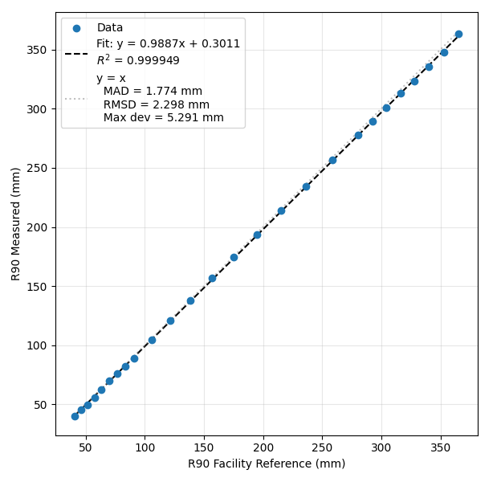
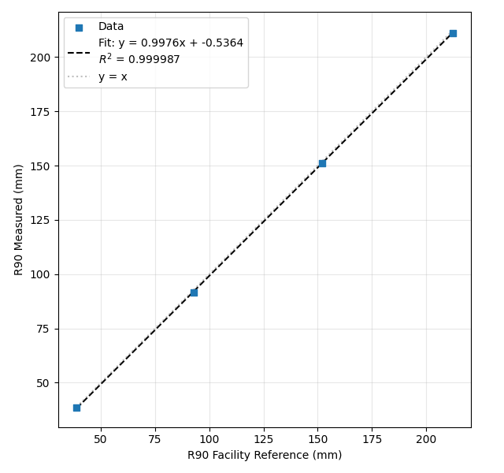
QuARC Range Measurements
UCLH
TIFPA

Slide 15
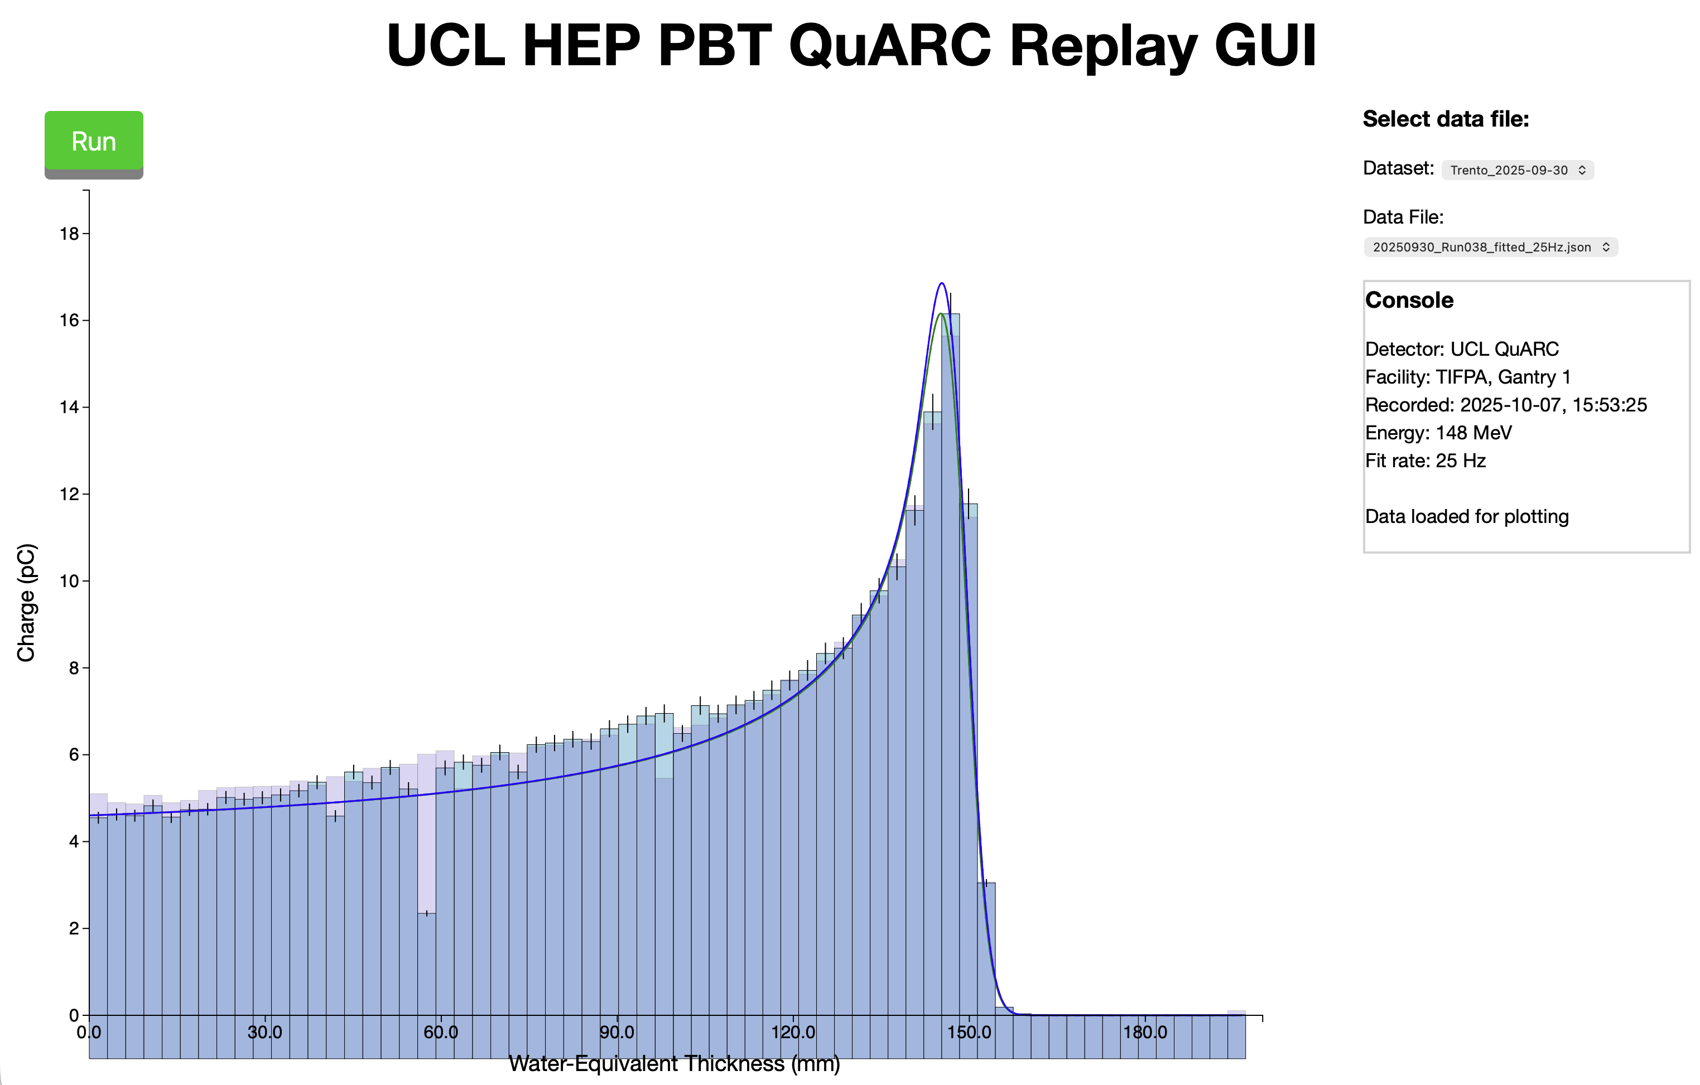
QuARC GUI
https://www.hep.ucl.ac.uk/ pbt/QuARC-GUI/ replay.html

Slide 16
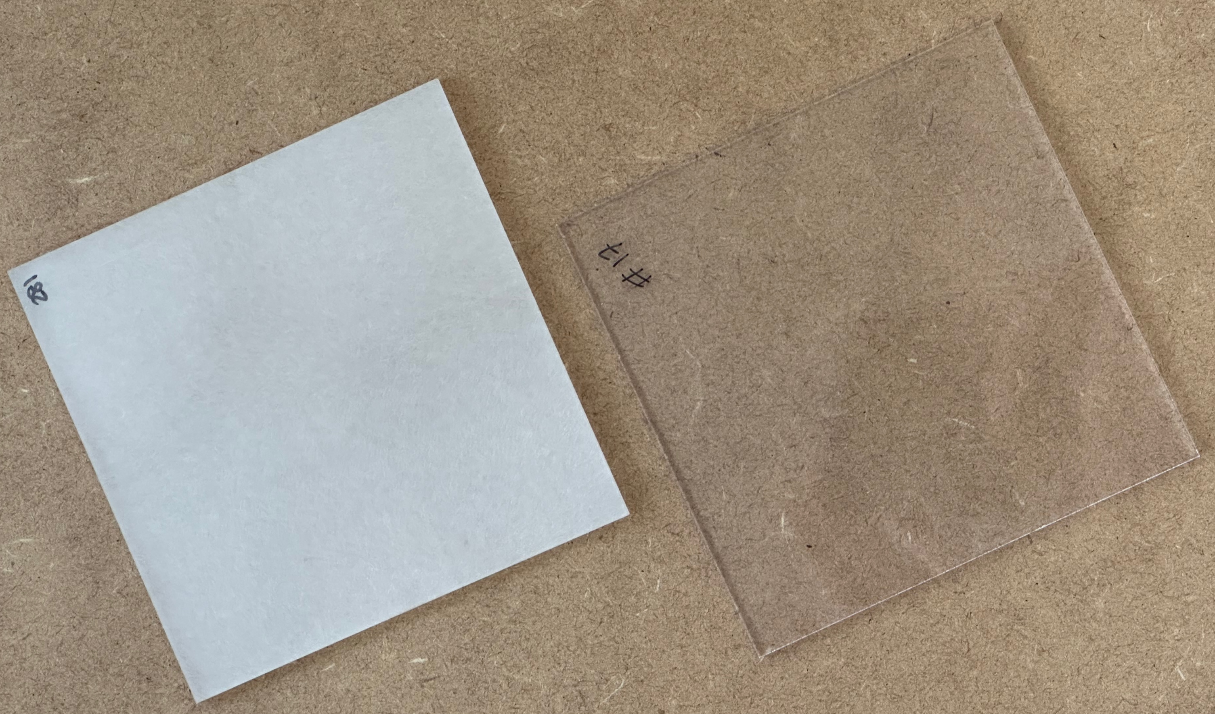
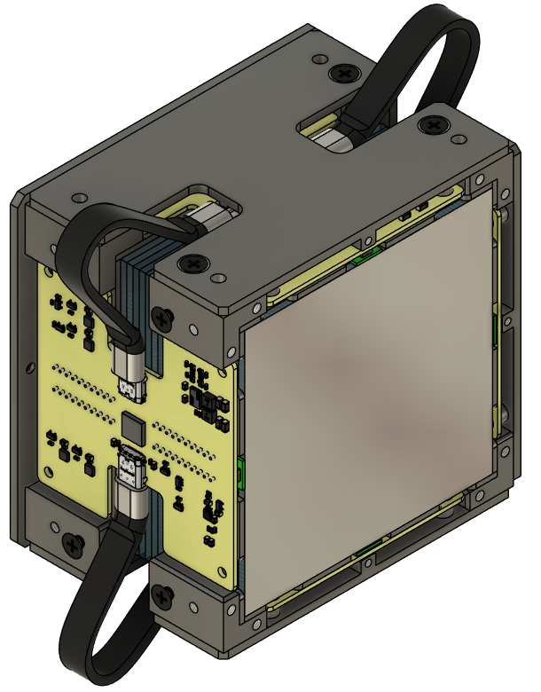
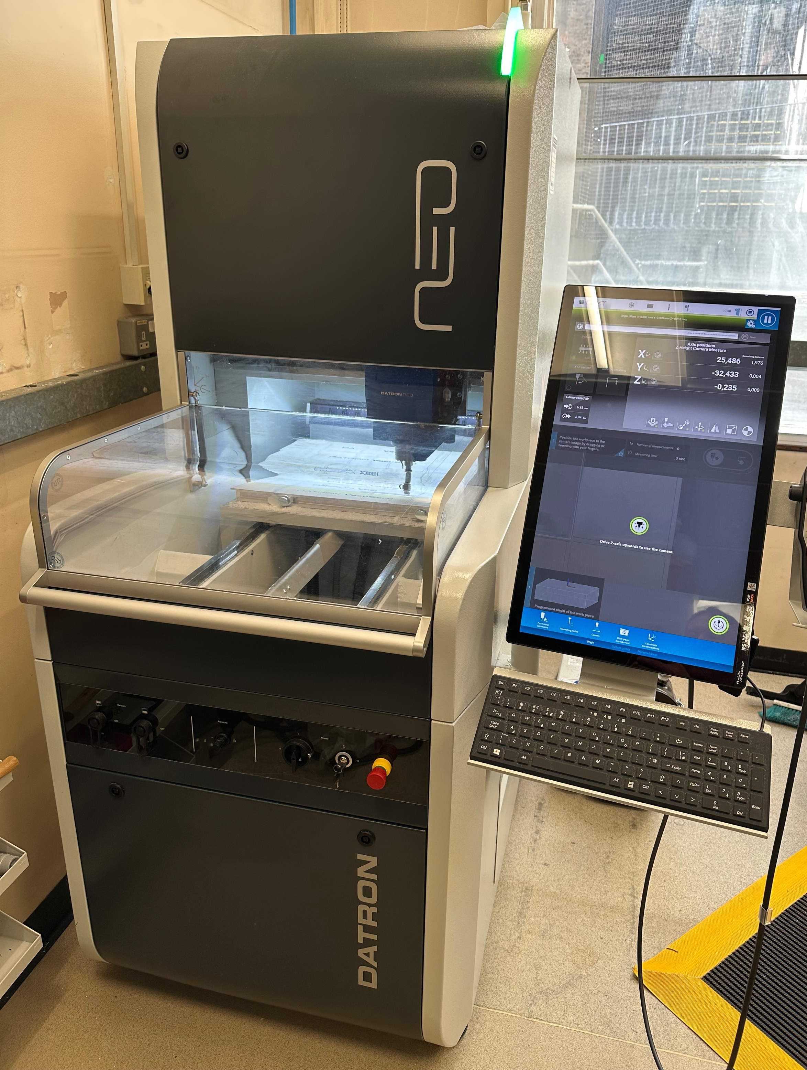
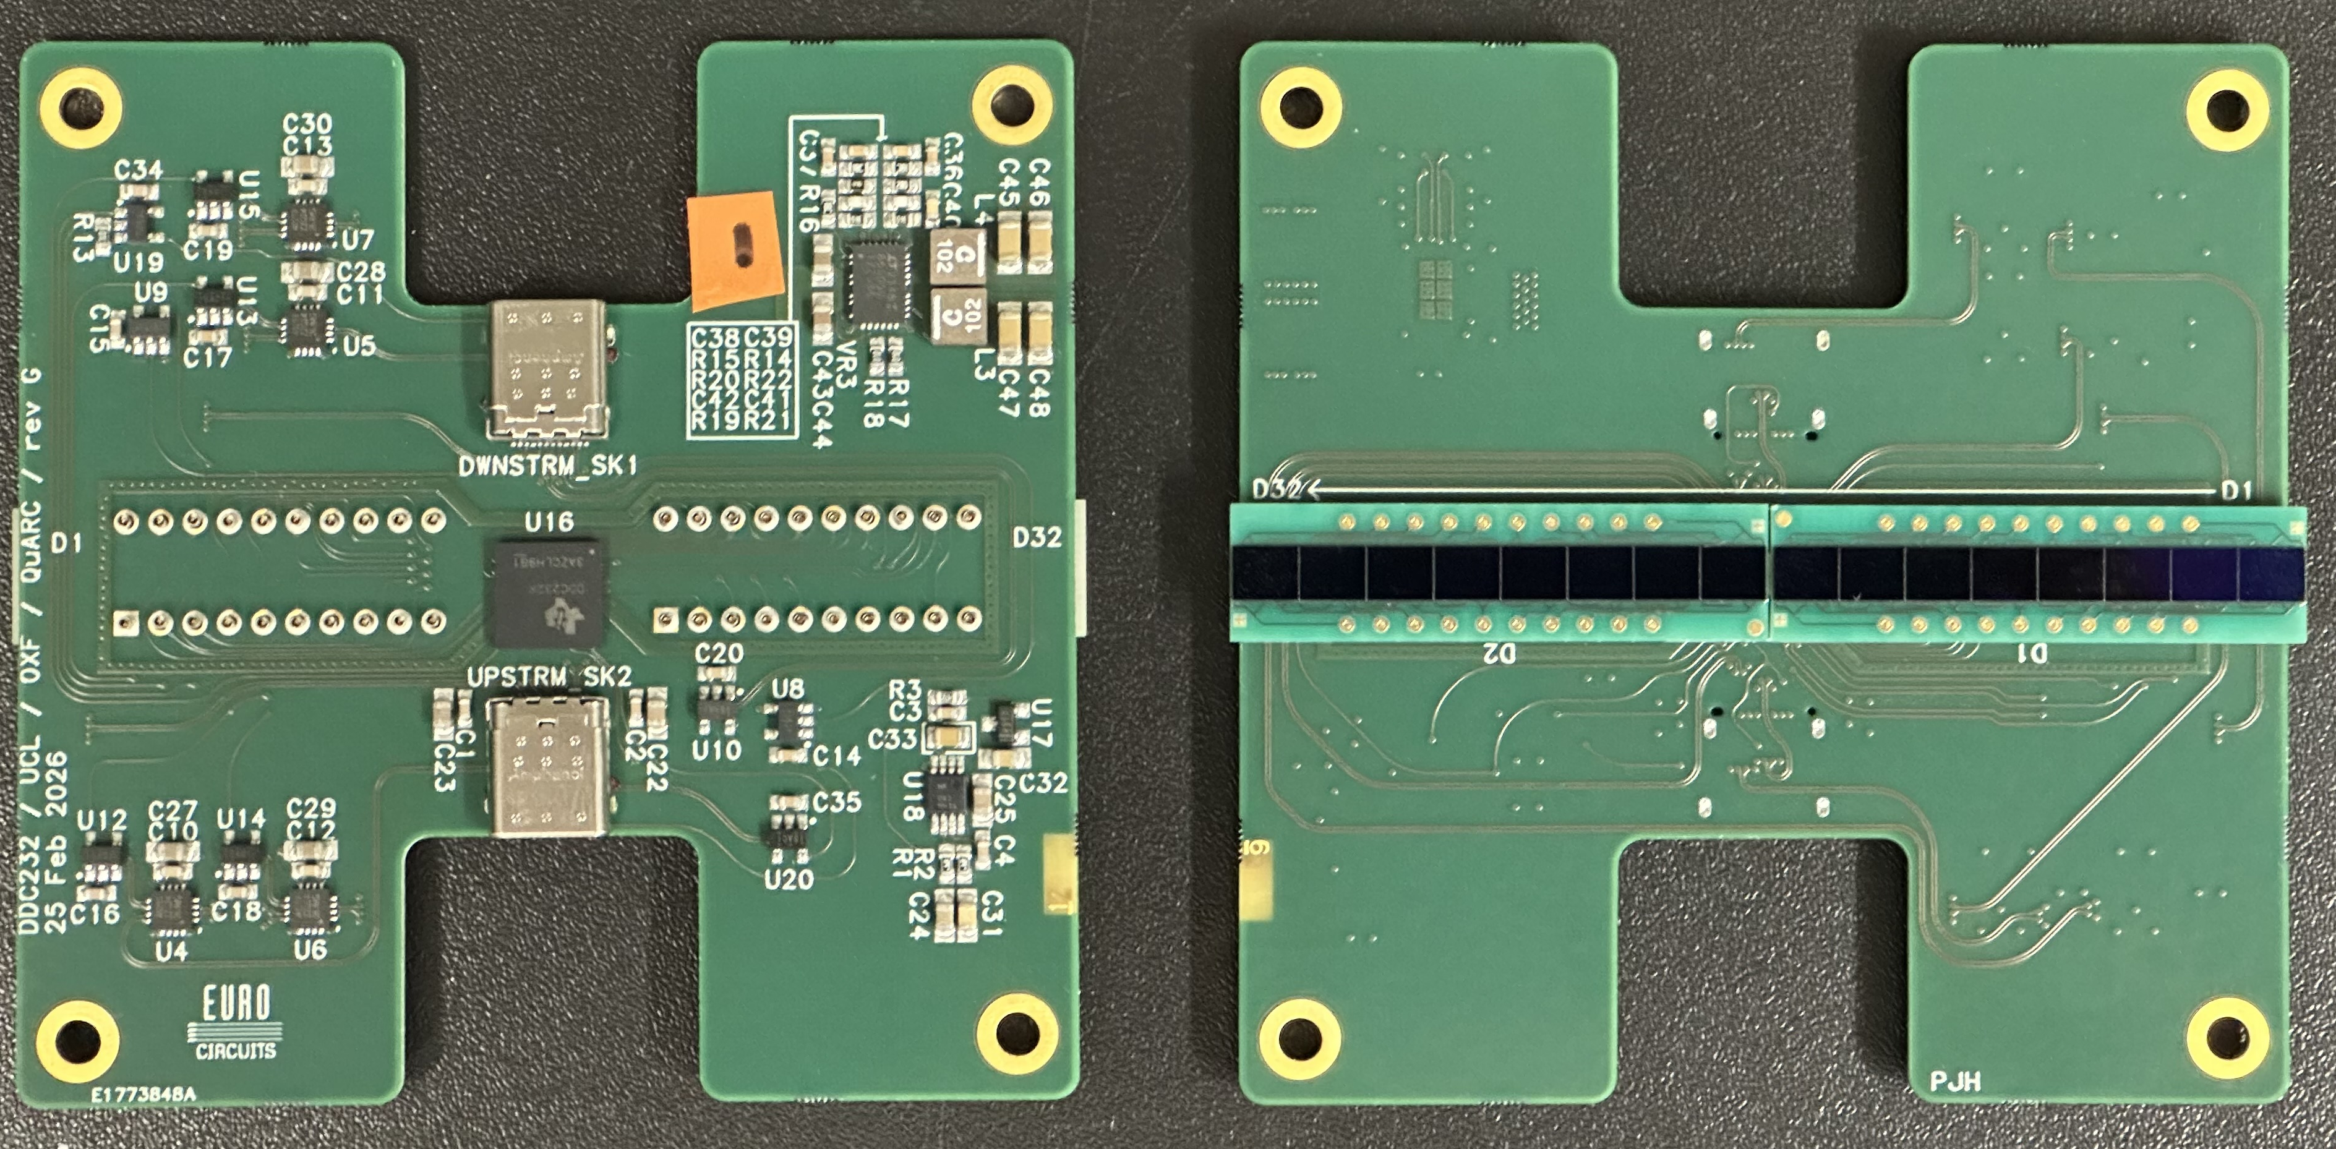
QuARC Upgrades

Slide 17
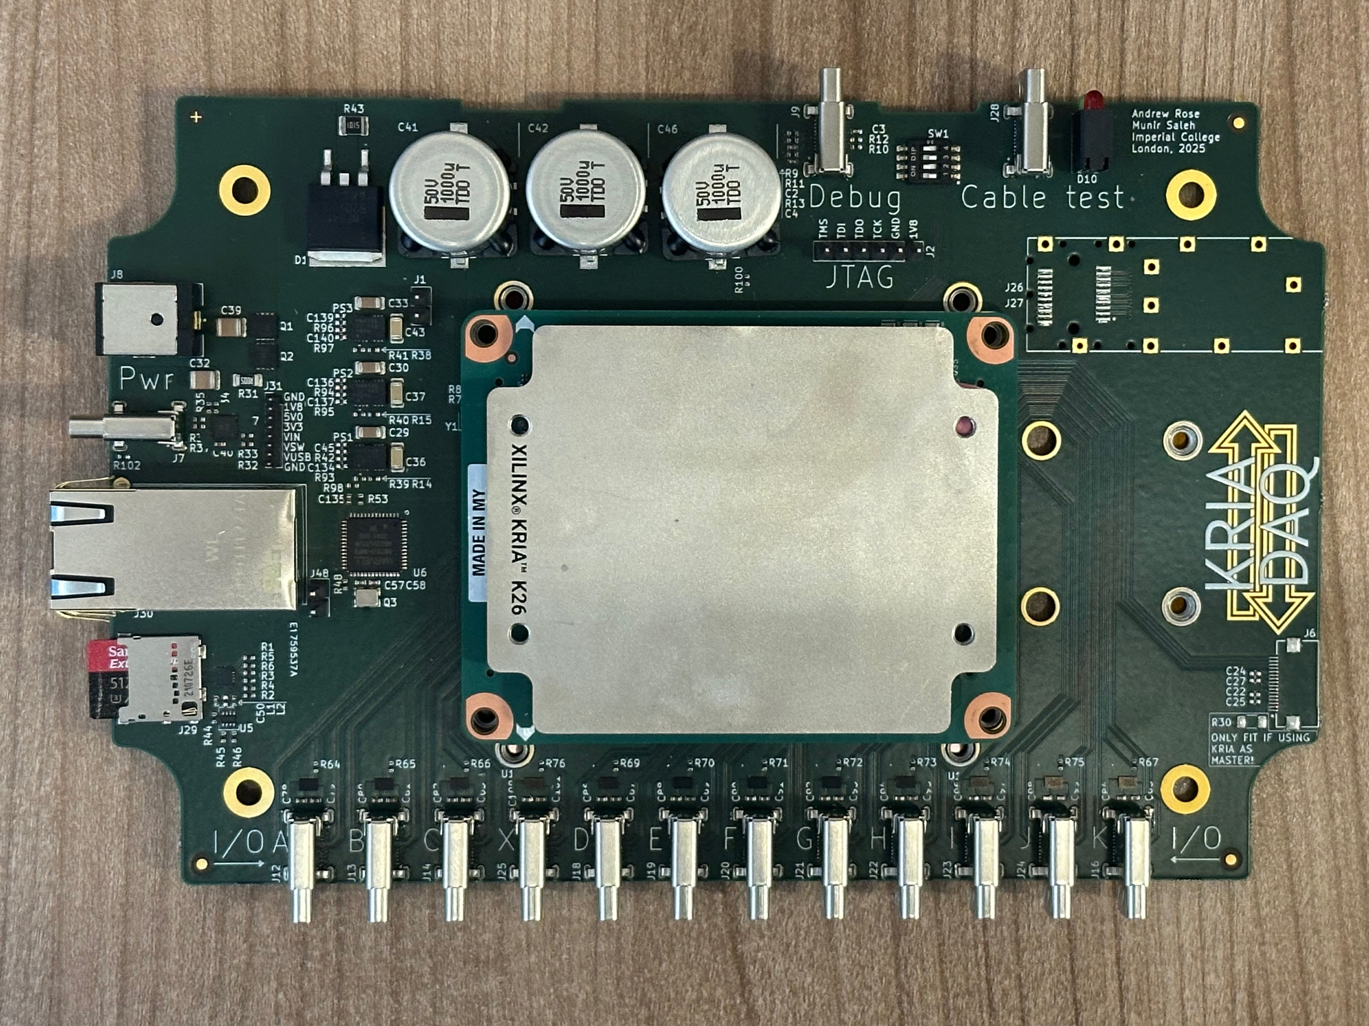
Data Acquisition
We are upgrading from our Raspberry Pi’s!
AMD/Xilinx Kria K26 provides both CPU and FPGA on single System-on-Module.
13-channel USB-C I/O for QuARC+SciFi.
20V USB-C PD power; on-board ethernet, µSD, m.2.
On-board web server.
All DAQ/power distribution.

Slide 18




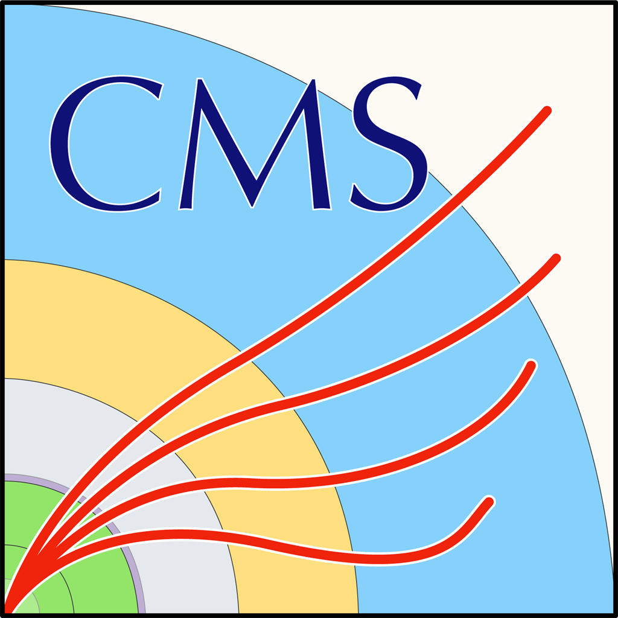
HEP → QuADProbe

Slide 19
Acknowledgements
UCL
Richard Amos
Derek Attree
Harry Barnett
Anastasia Basharina Freshville
Joe Bateman
Sonia Escribano Rodriguez
Febian
Connor Godden
Matthieu Hentz
Laurent Kelleter
Andreas Korn
Erdem Motuk
Fern Pannell
Gary Royle
Ruben Saakyan
Danial Saeed
Saad Shaikh
Matt Warren
Dave Waters
UCLH
Andy Poynter
Colin Baker
Alison Warry
Andrew Gosling
Lee Harrison-Carey
Bari
Raffaella Radogna
Birmingham
Tony Price
Clatterbridge
Andrzej Kacparek
Linda Mortimer
GSI
Lenny Volz
Heidelberg
Julian Horn
Blake Leverington
Imperial
Andy Rose
Duncan Parker
Munir Saleh
Liverpool
Carsten Welsch
Manchester
Hywel Owen
Mike Taylor
Oxford
Pete Hastings
RAL
David Sankey

Slide 20
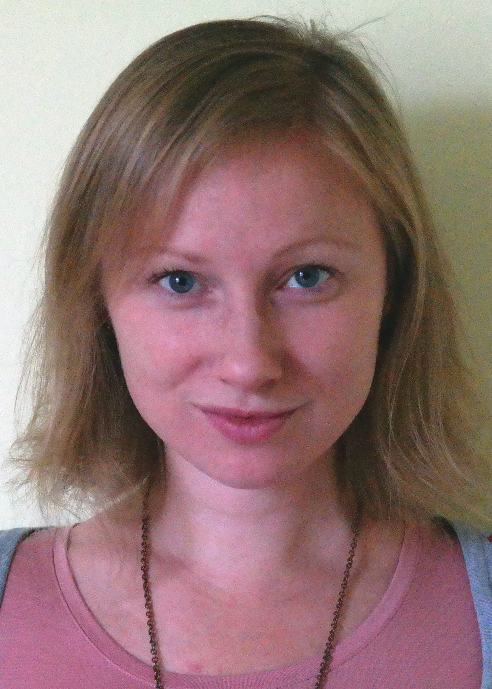
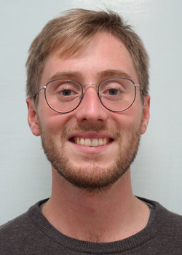
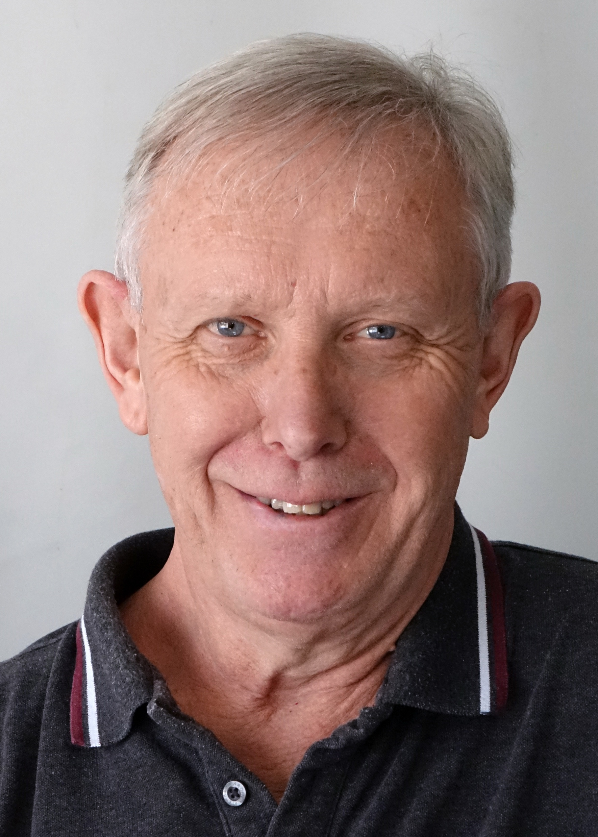
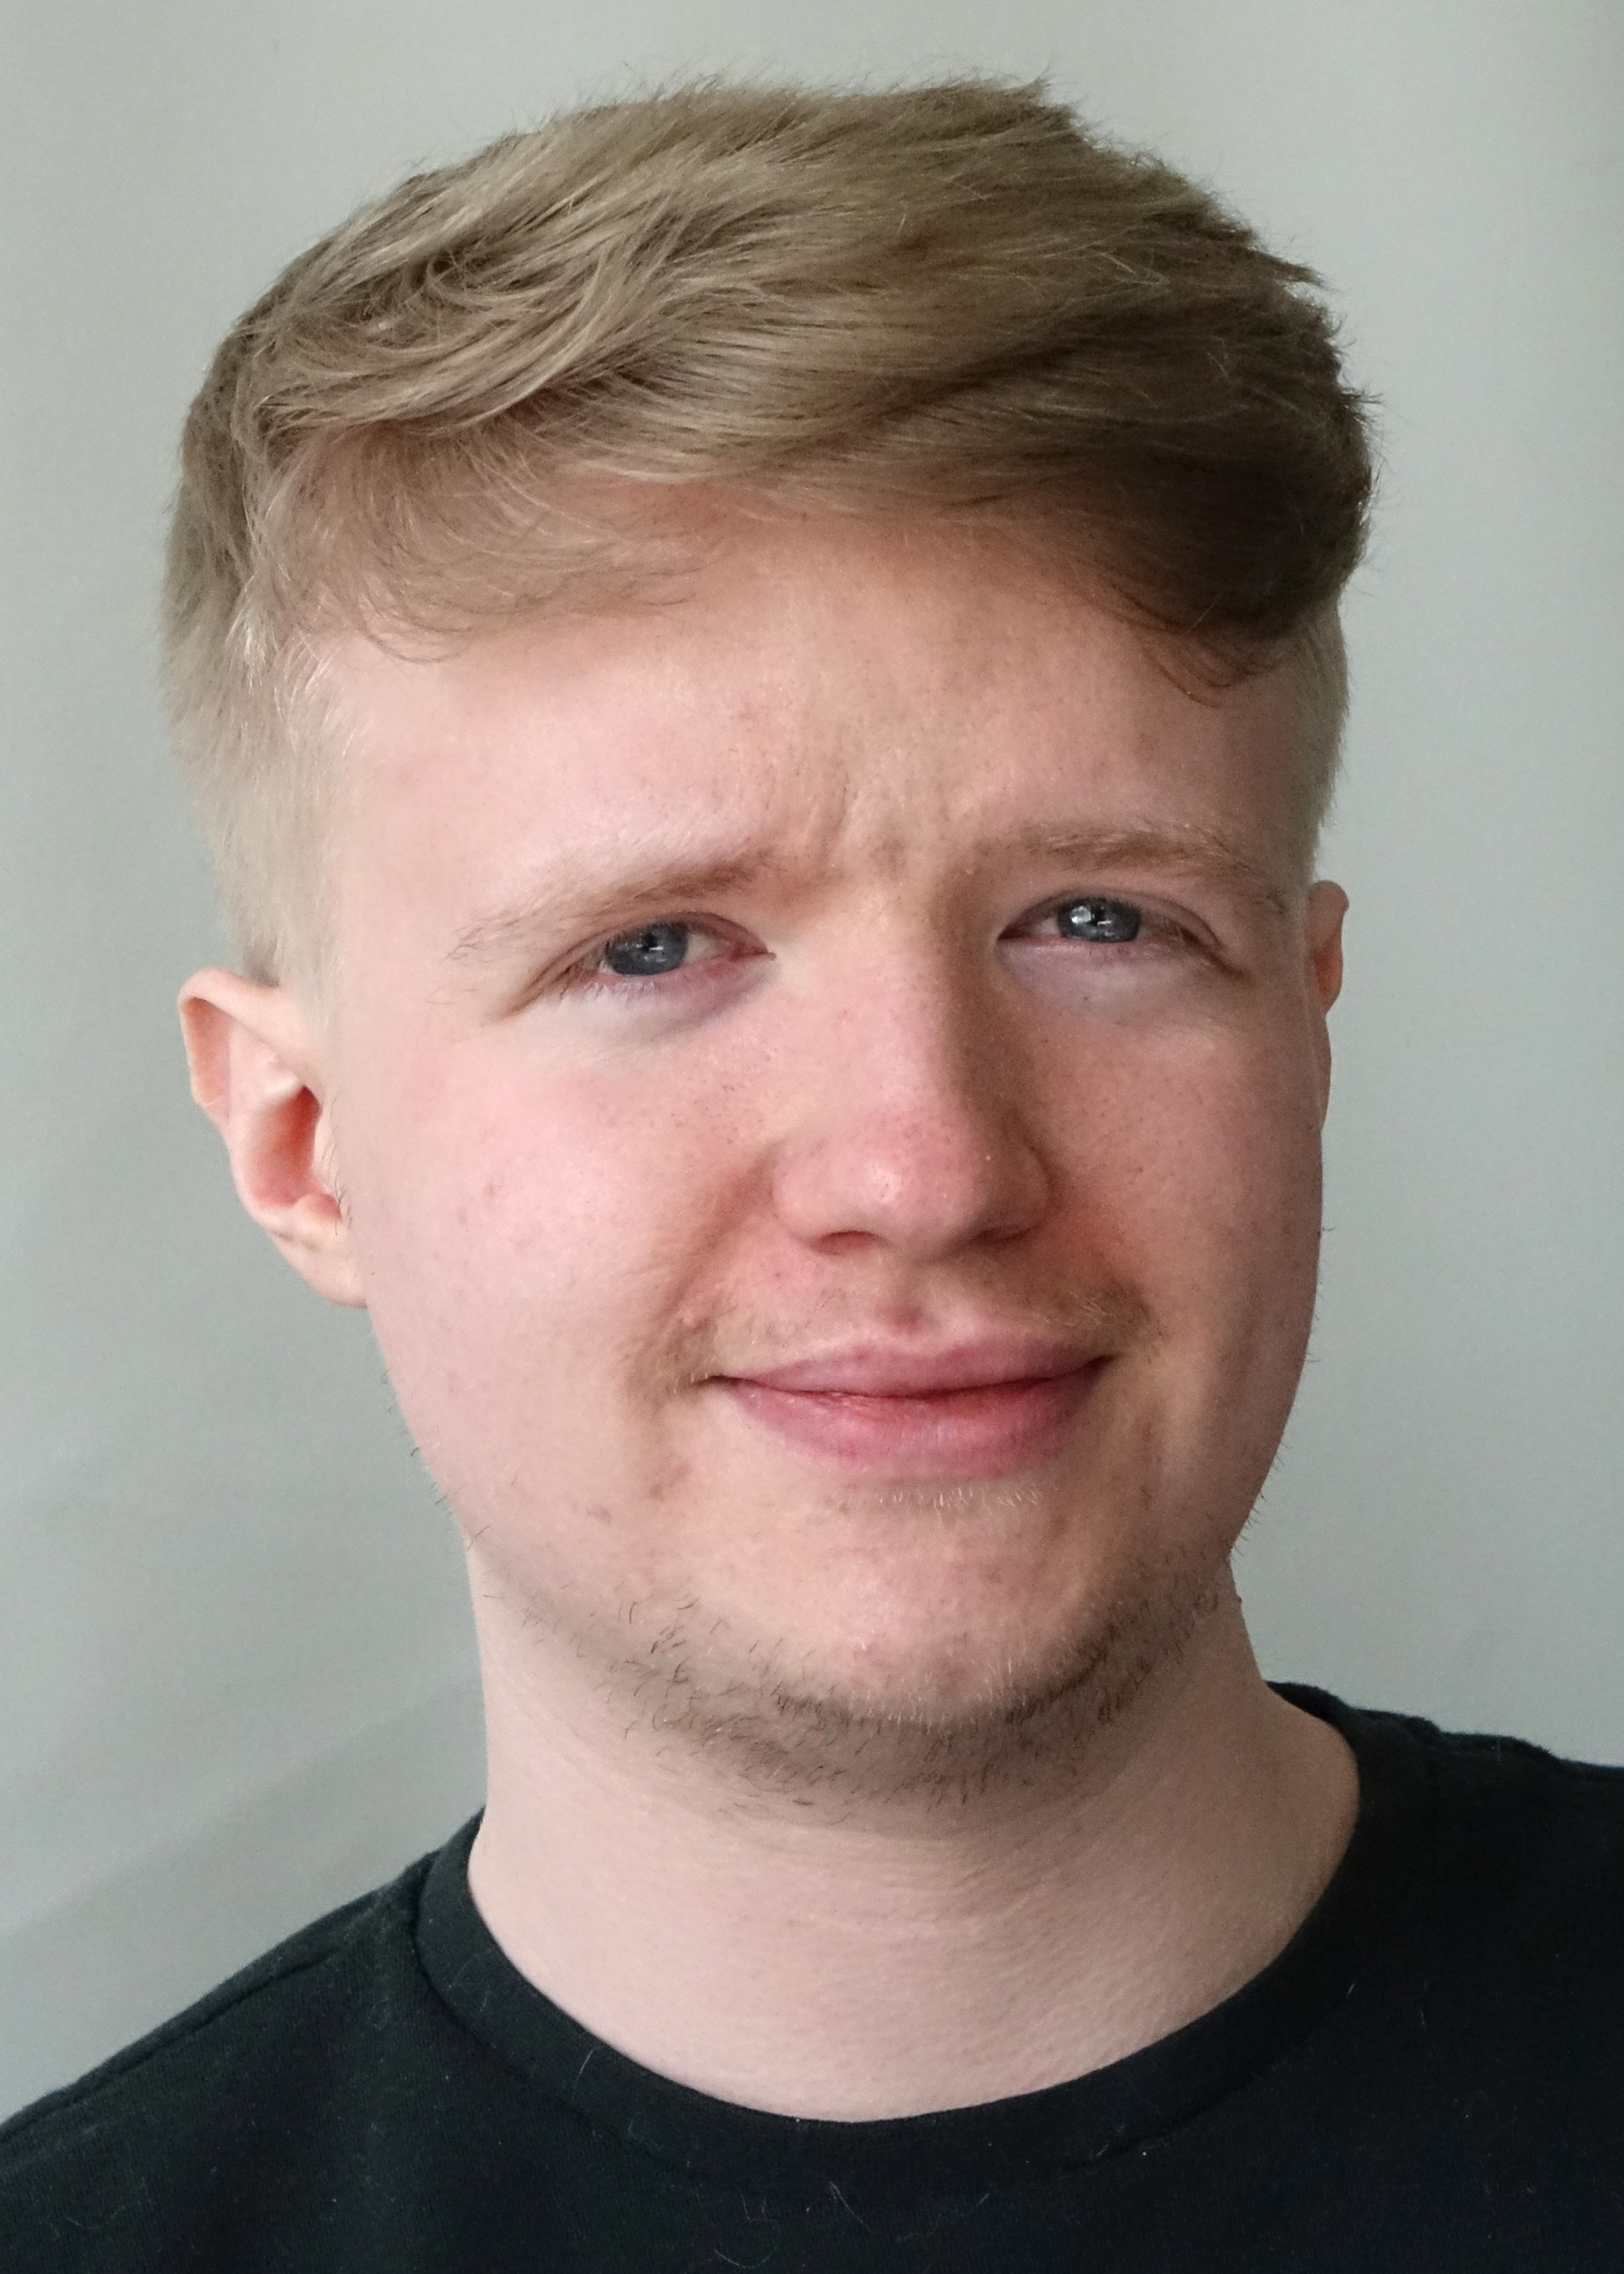
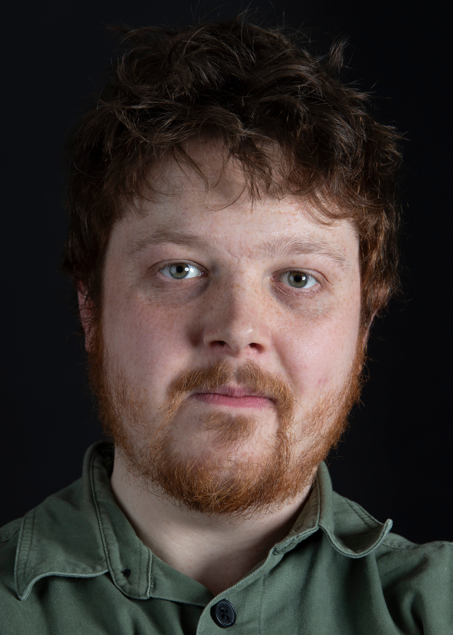
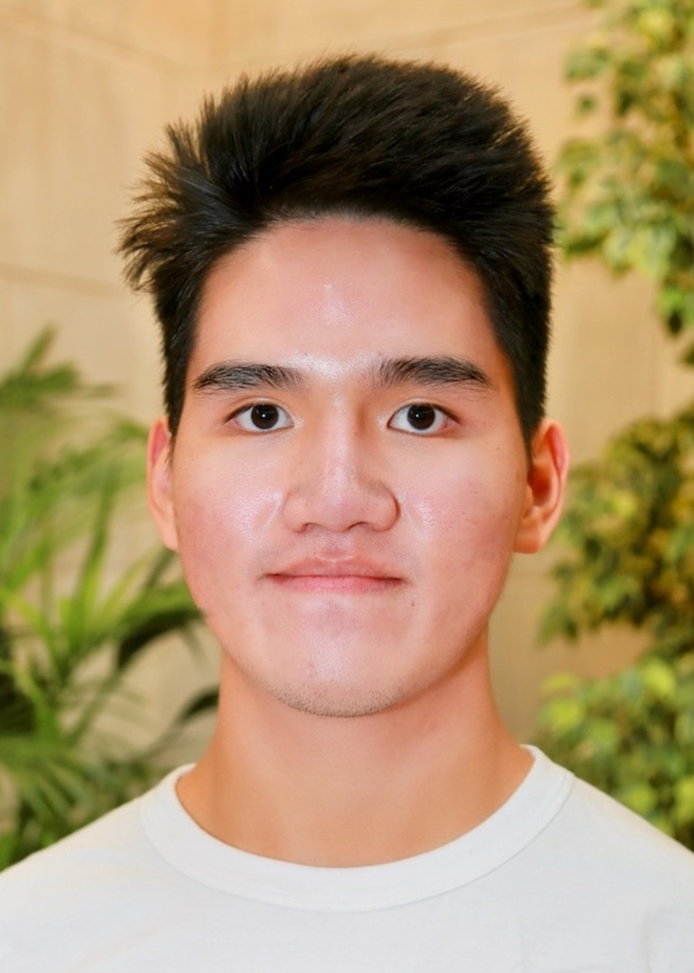
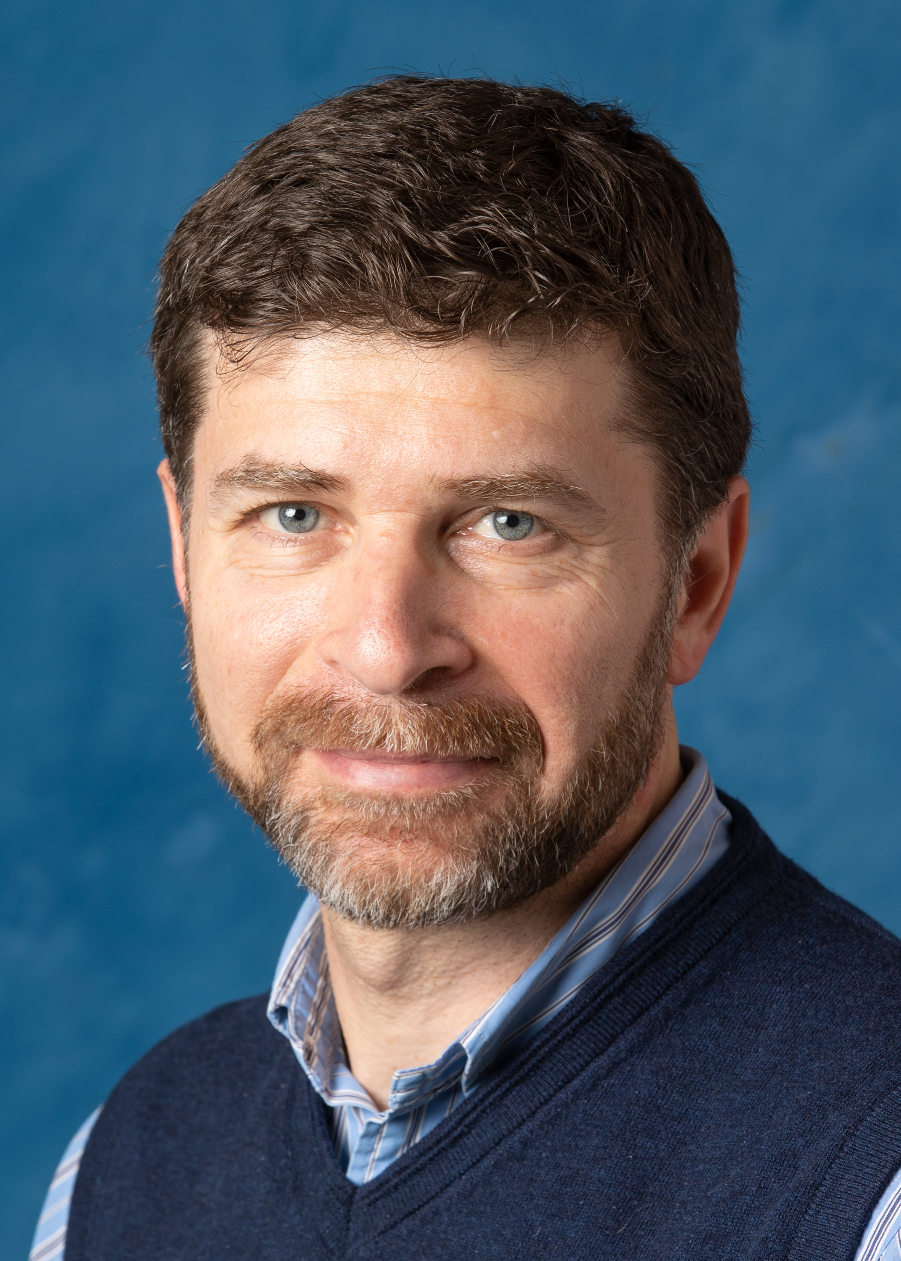
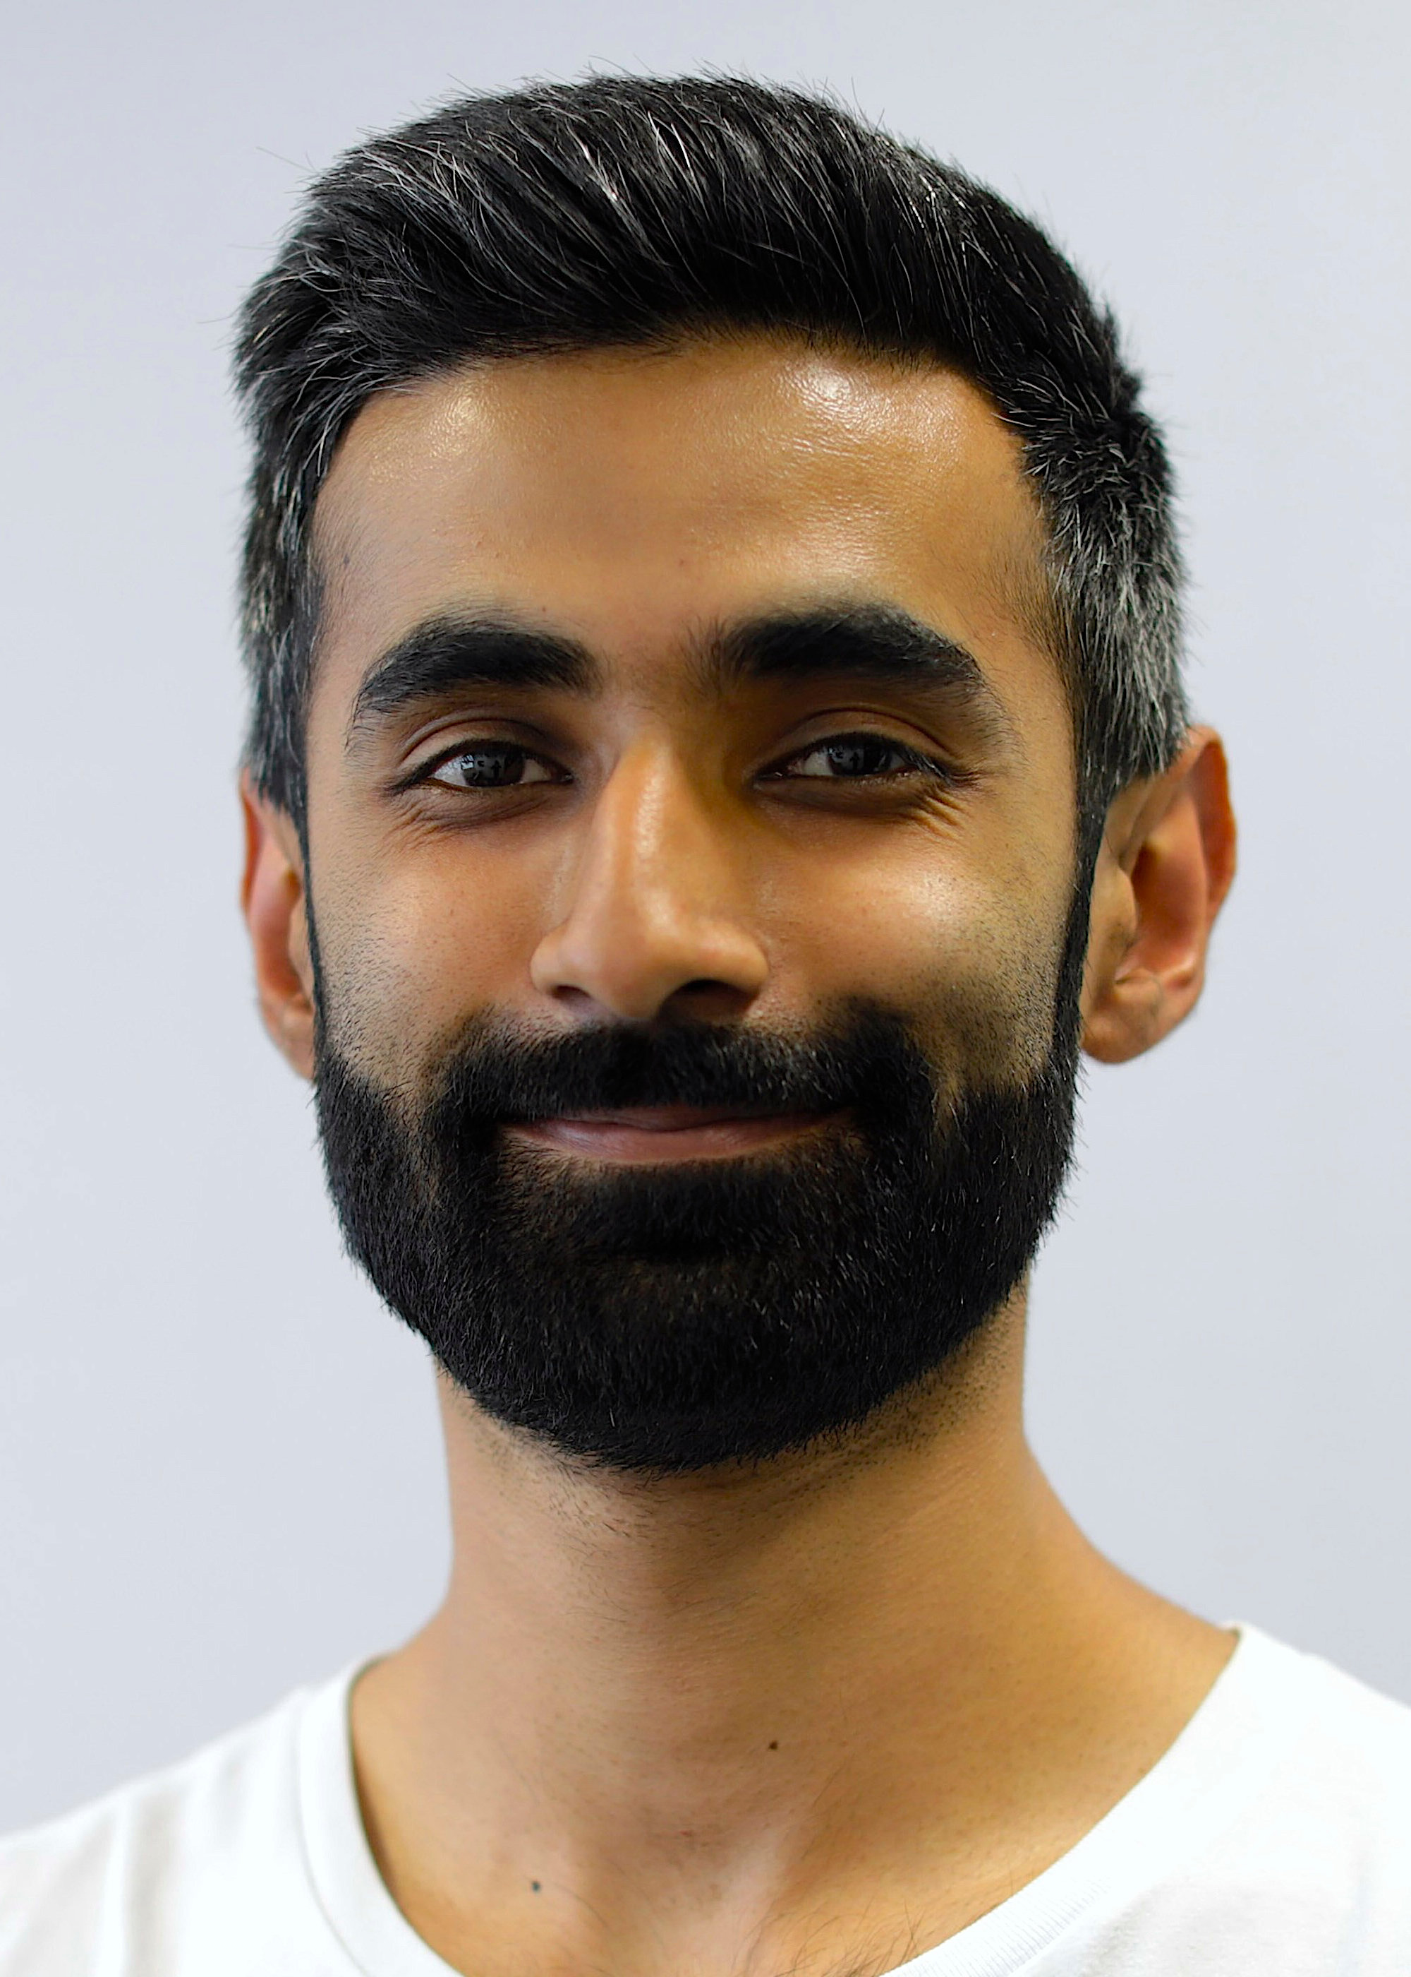
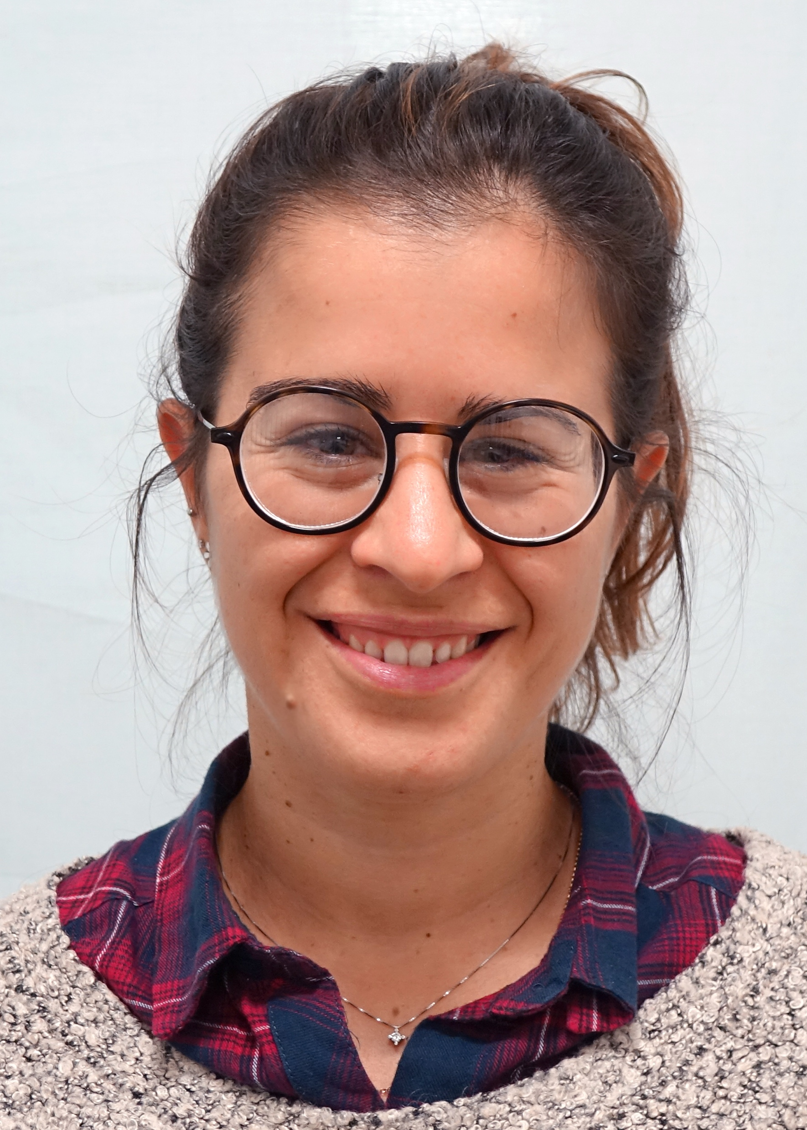
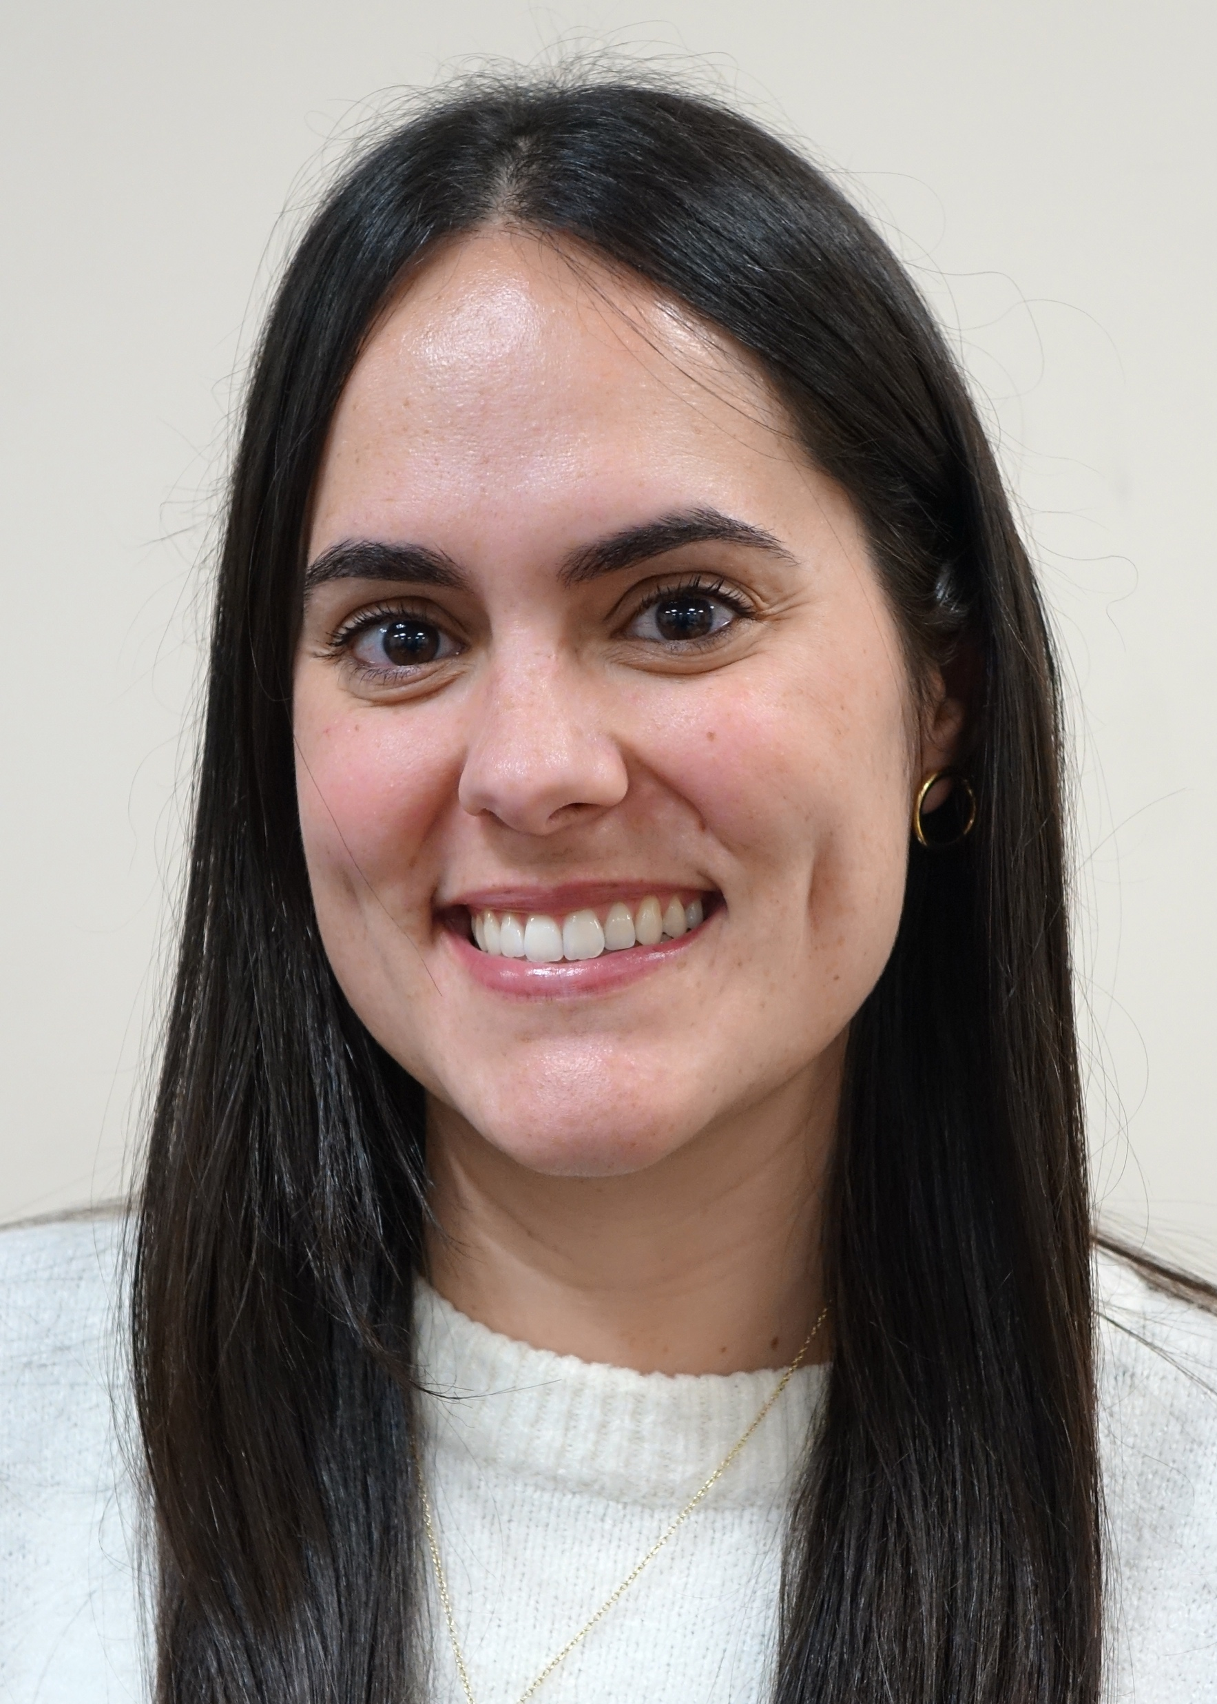
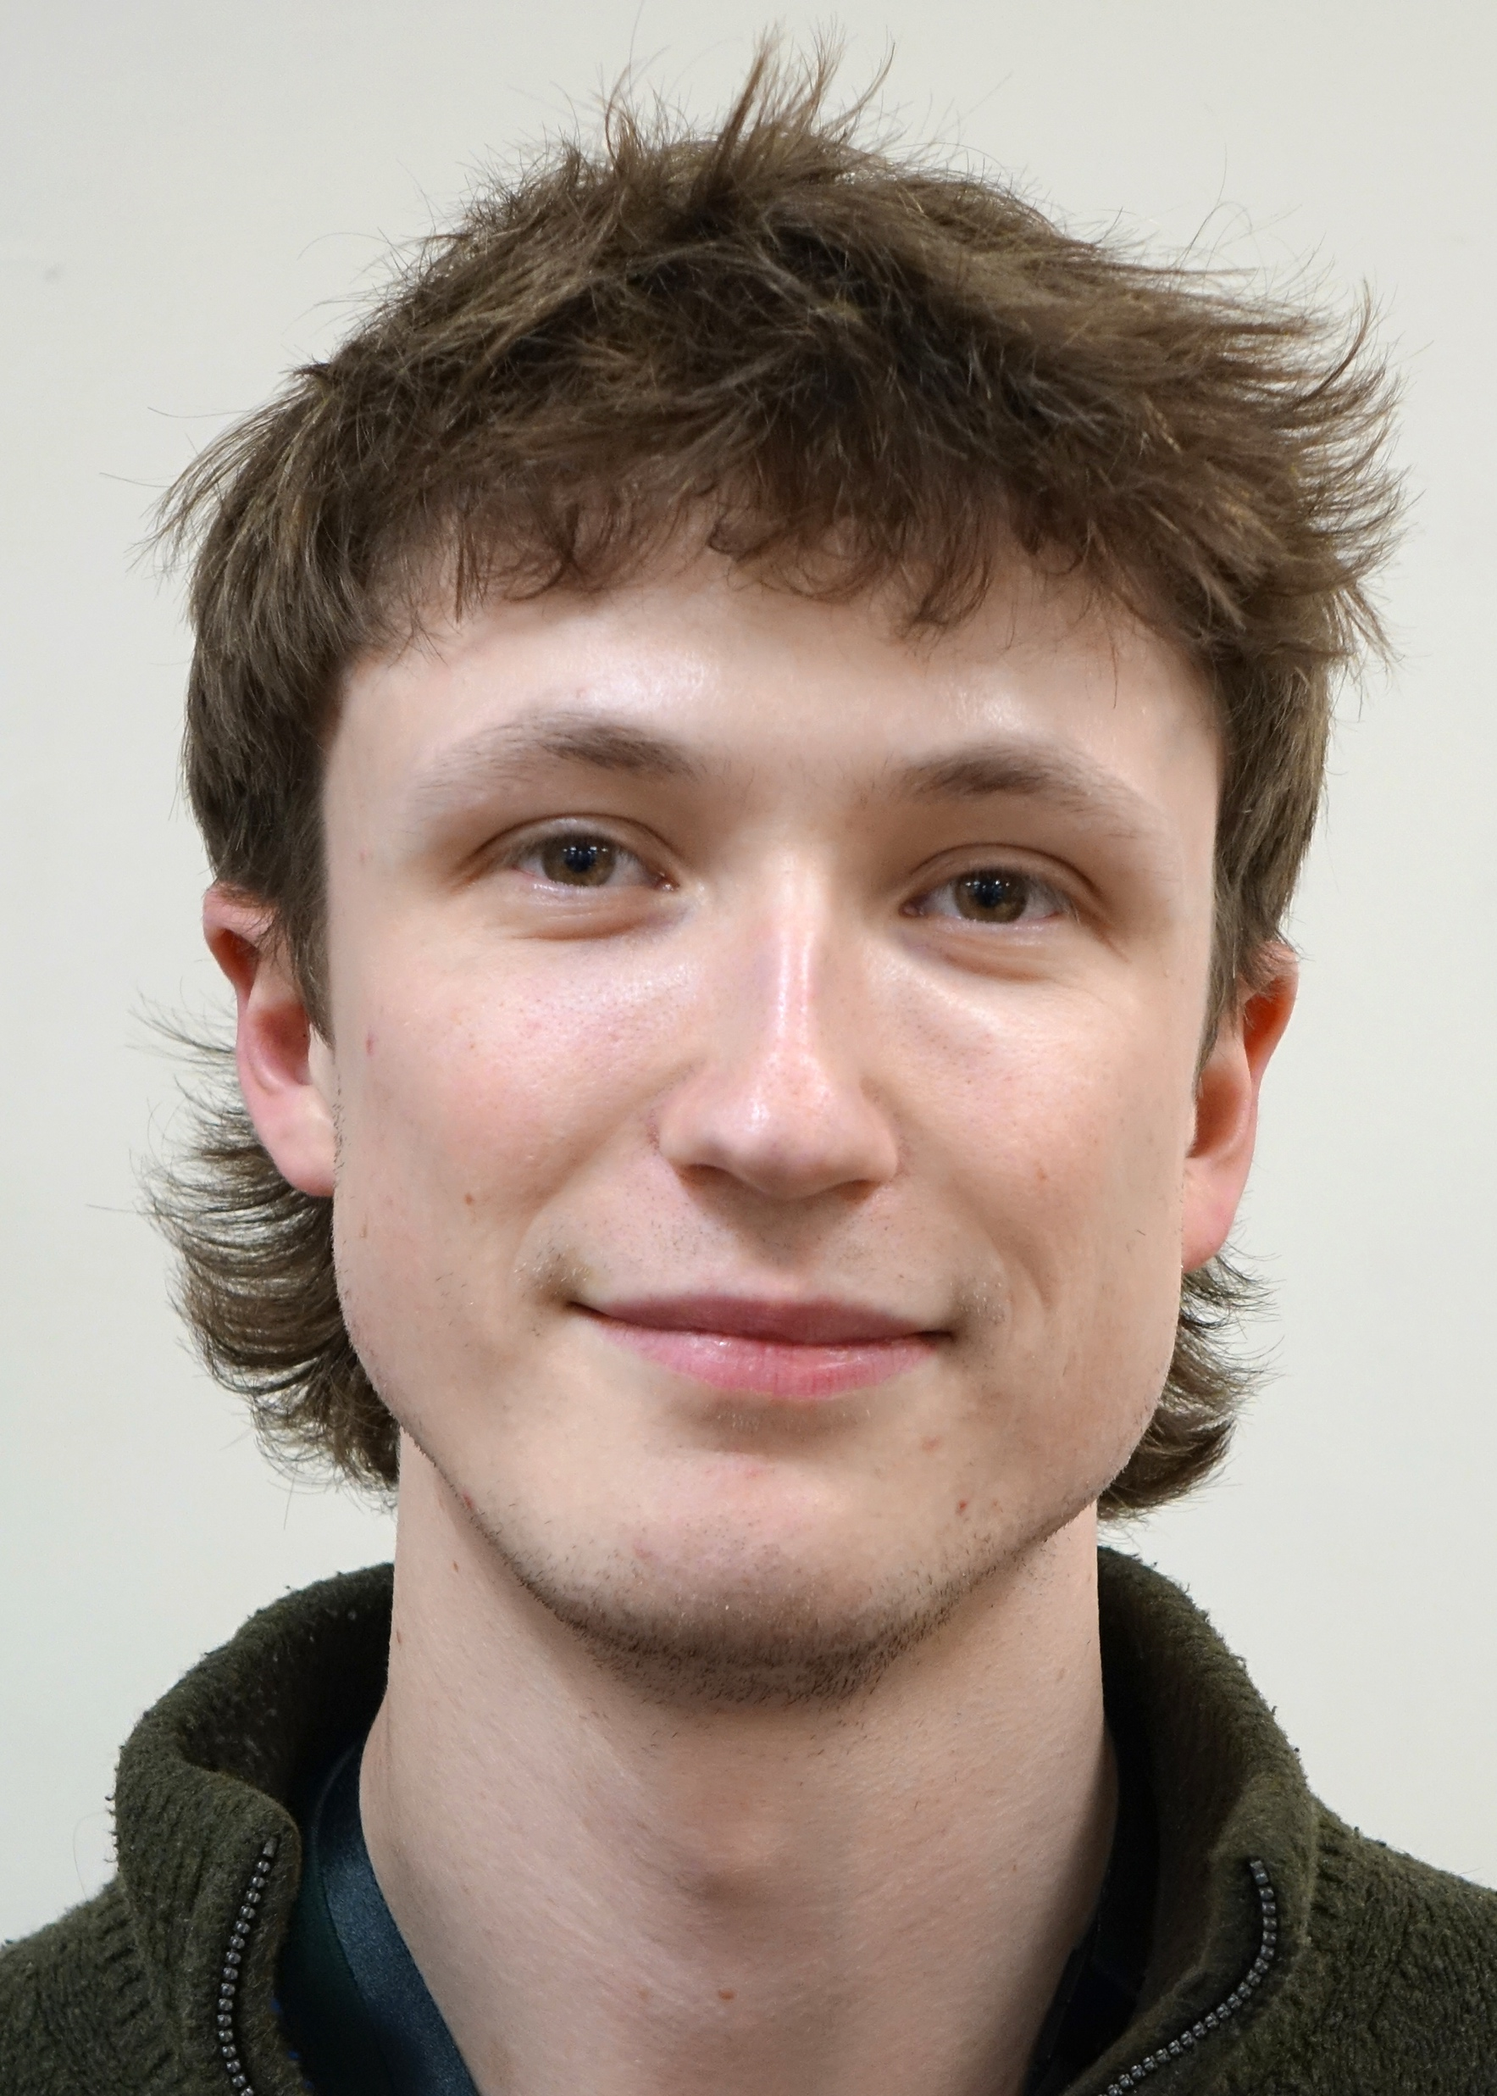
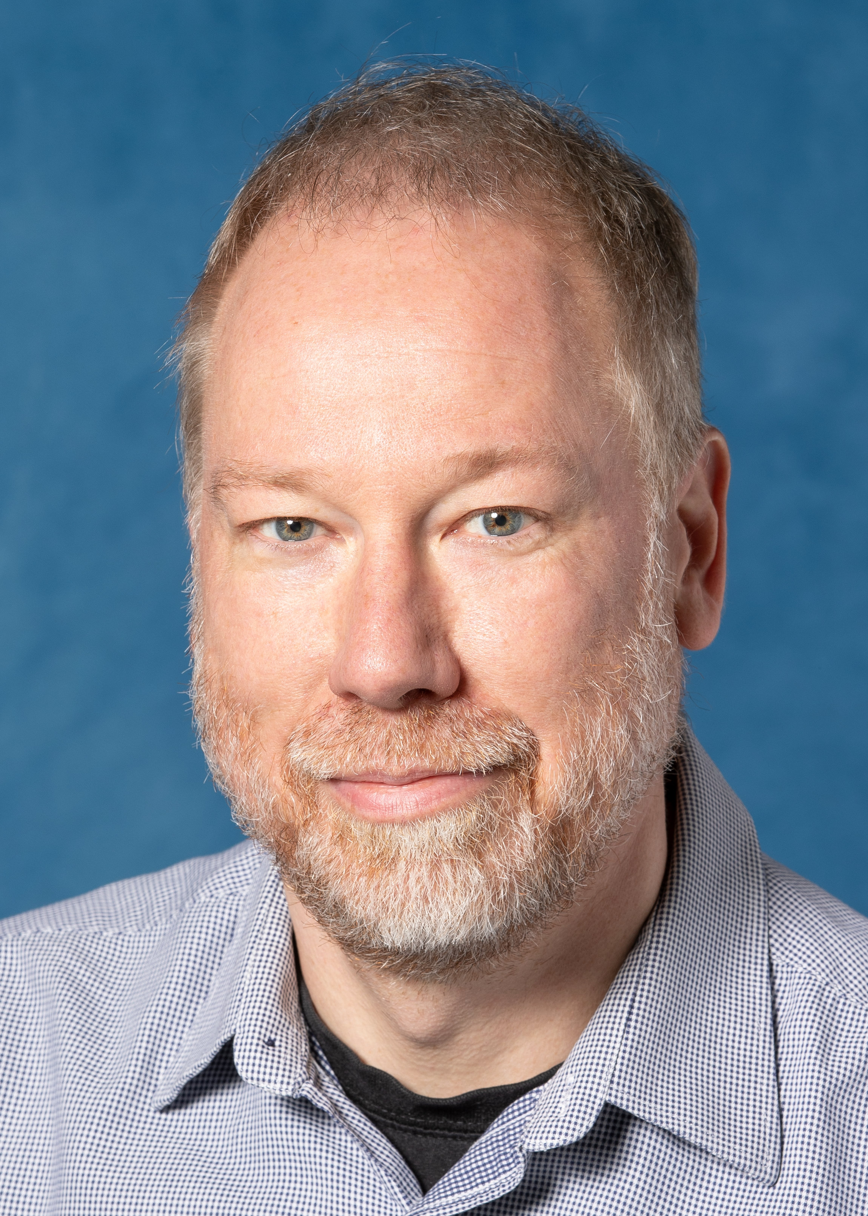
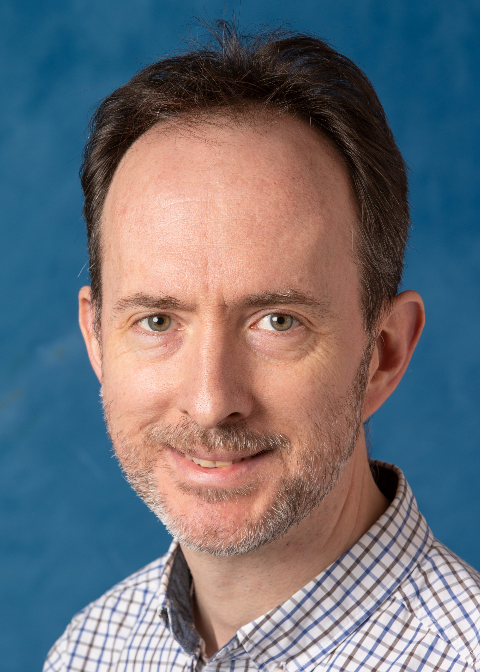
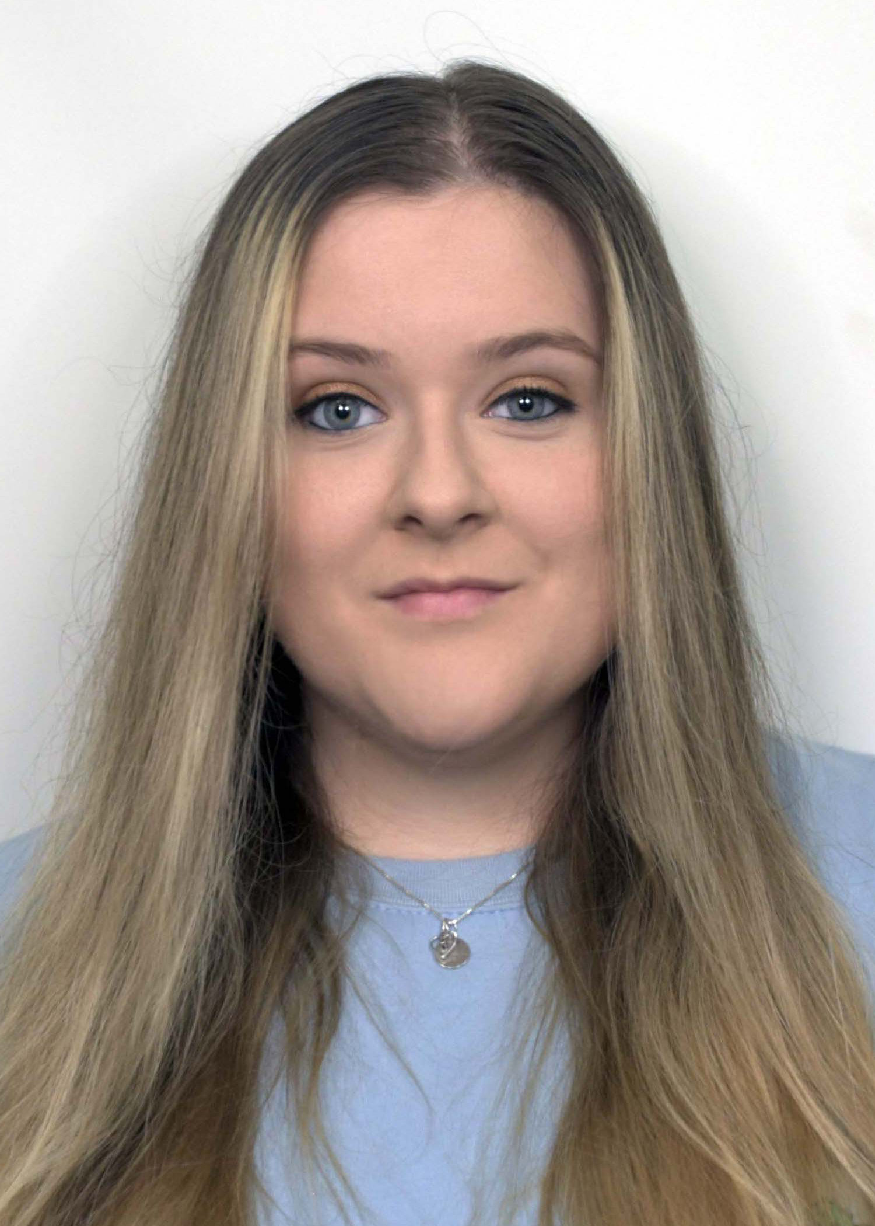
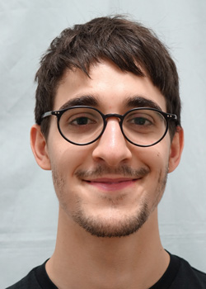
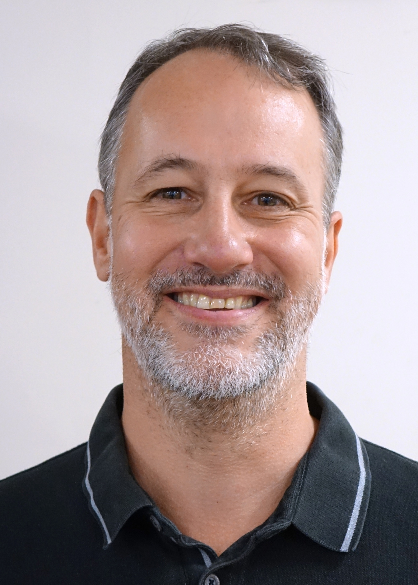
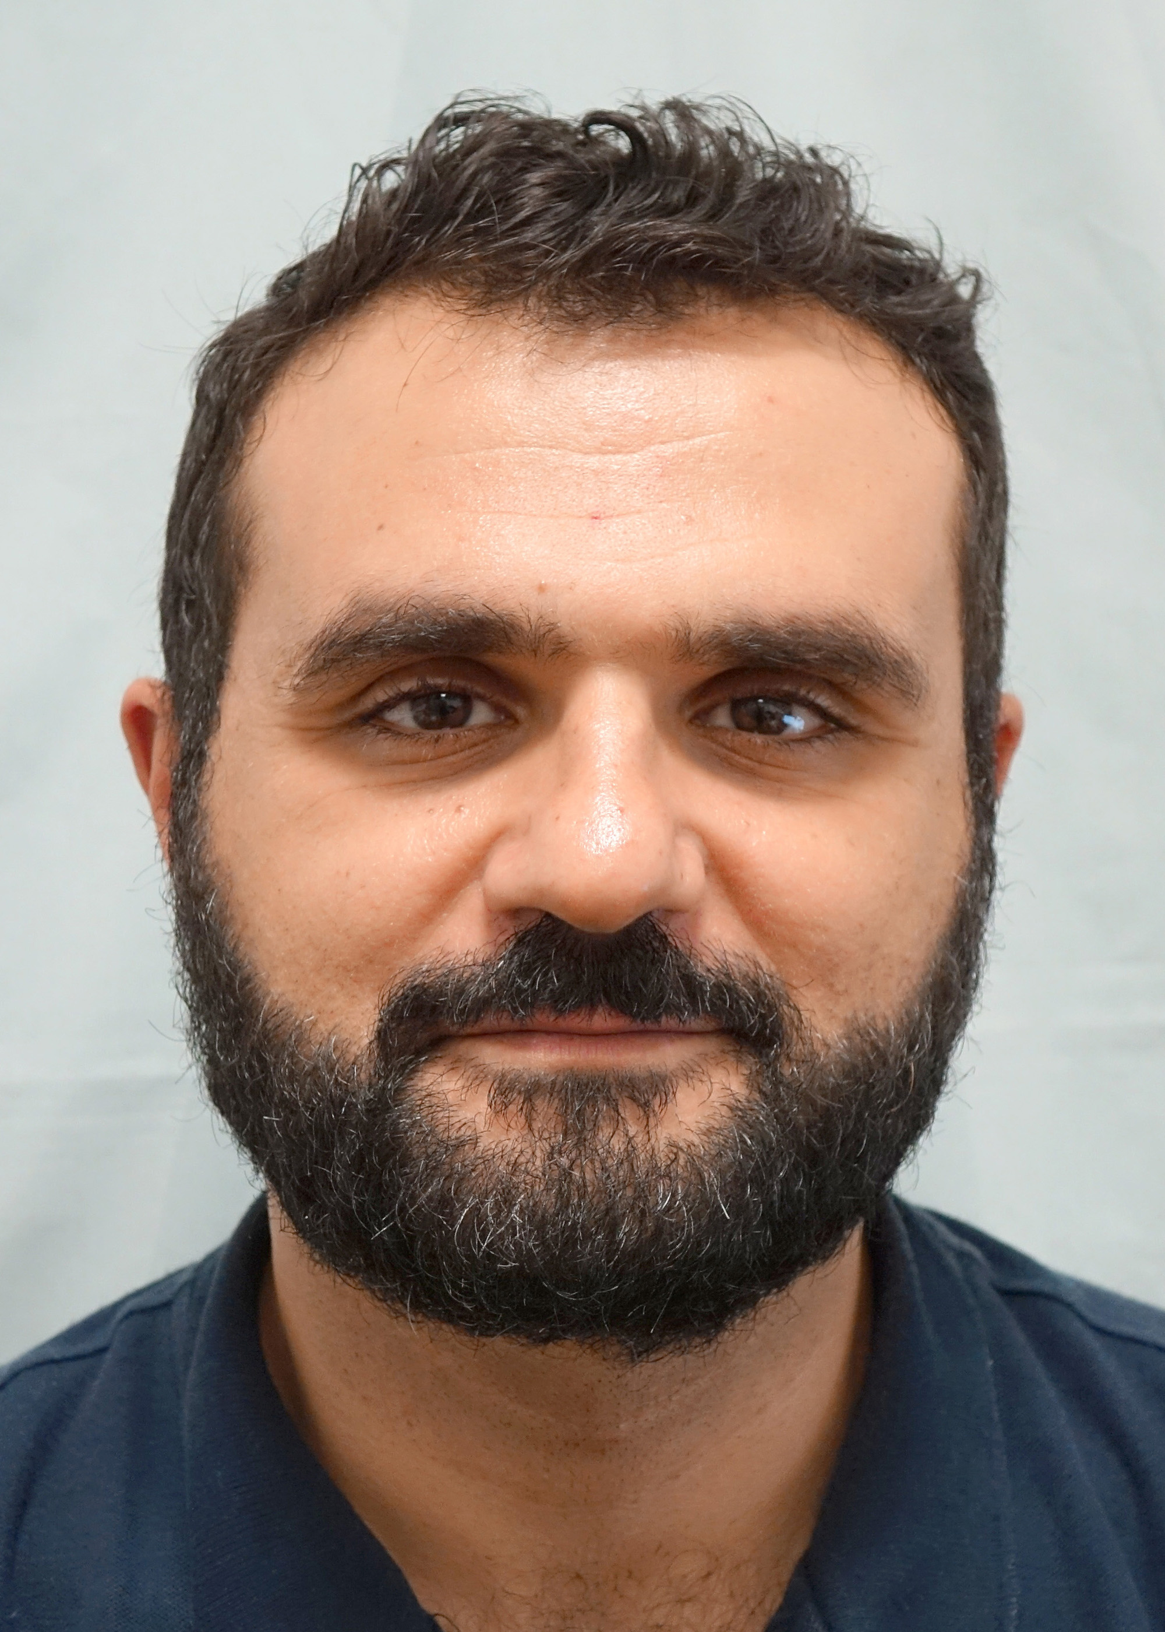

HEP PBT: Thank You!

