Slide 1
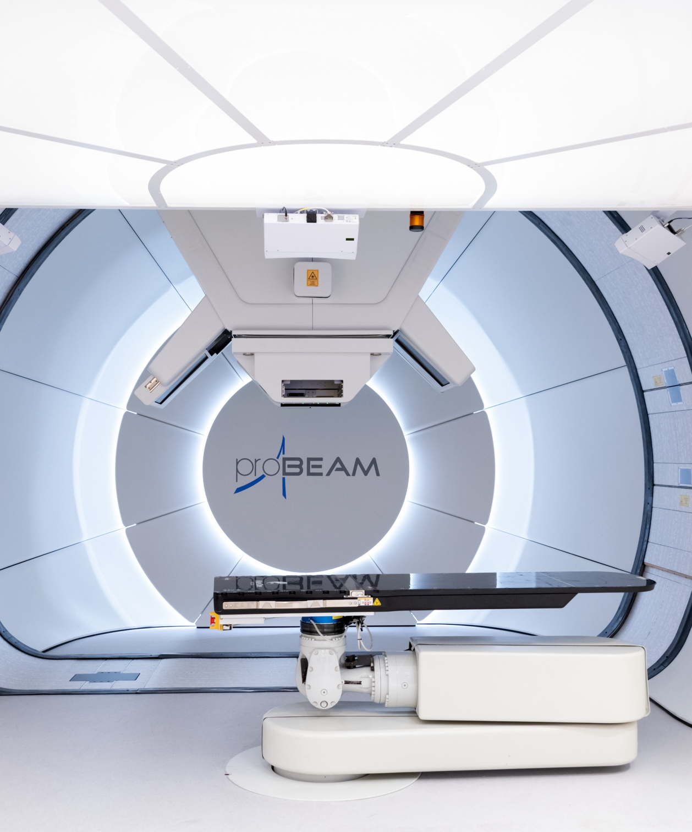
Proton Beam Therapy
Proton Beam Therapy uses accelerated proton beams for high precision radiotherapy.
Superior dose delivery to X-rays.

Slide 2
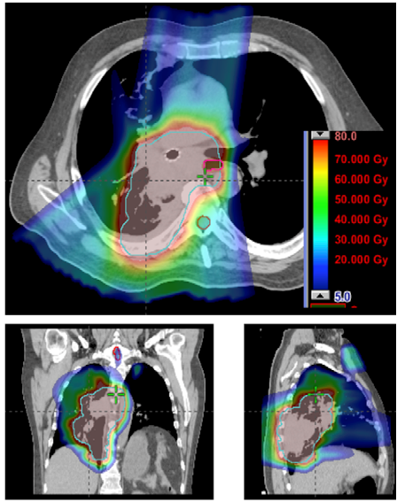
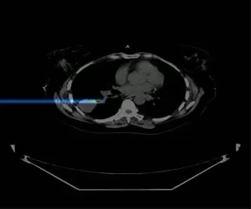
Pencil Beam Scanning

Slide 3
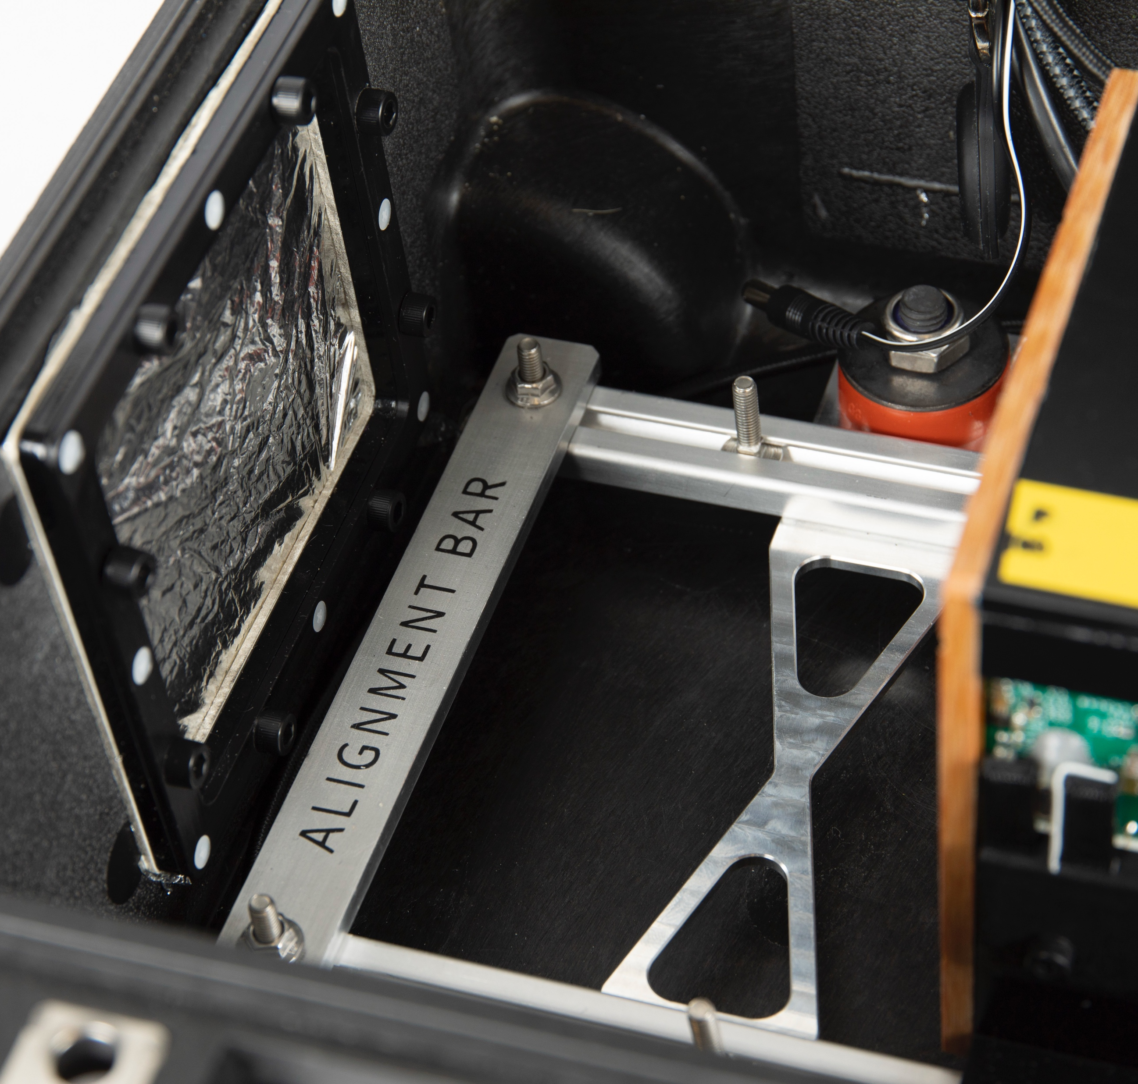
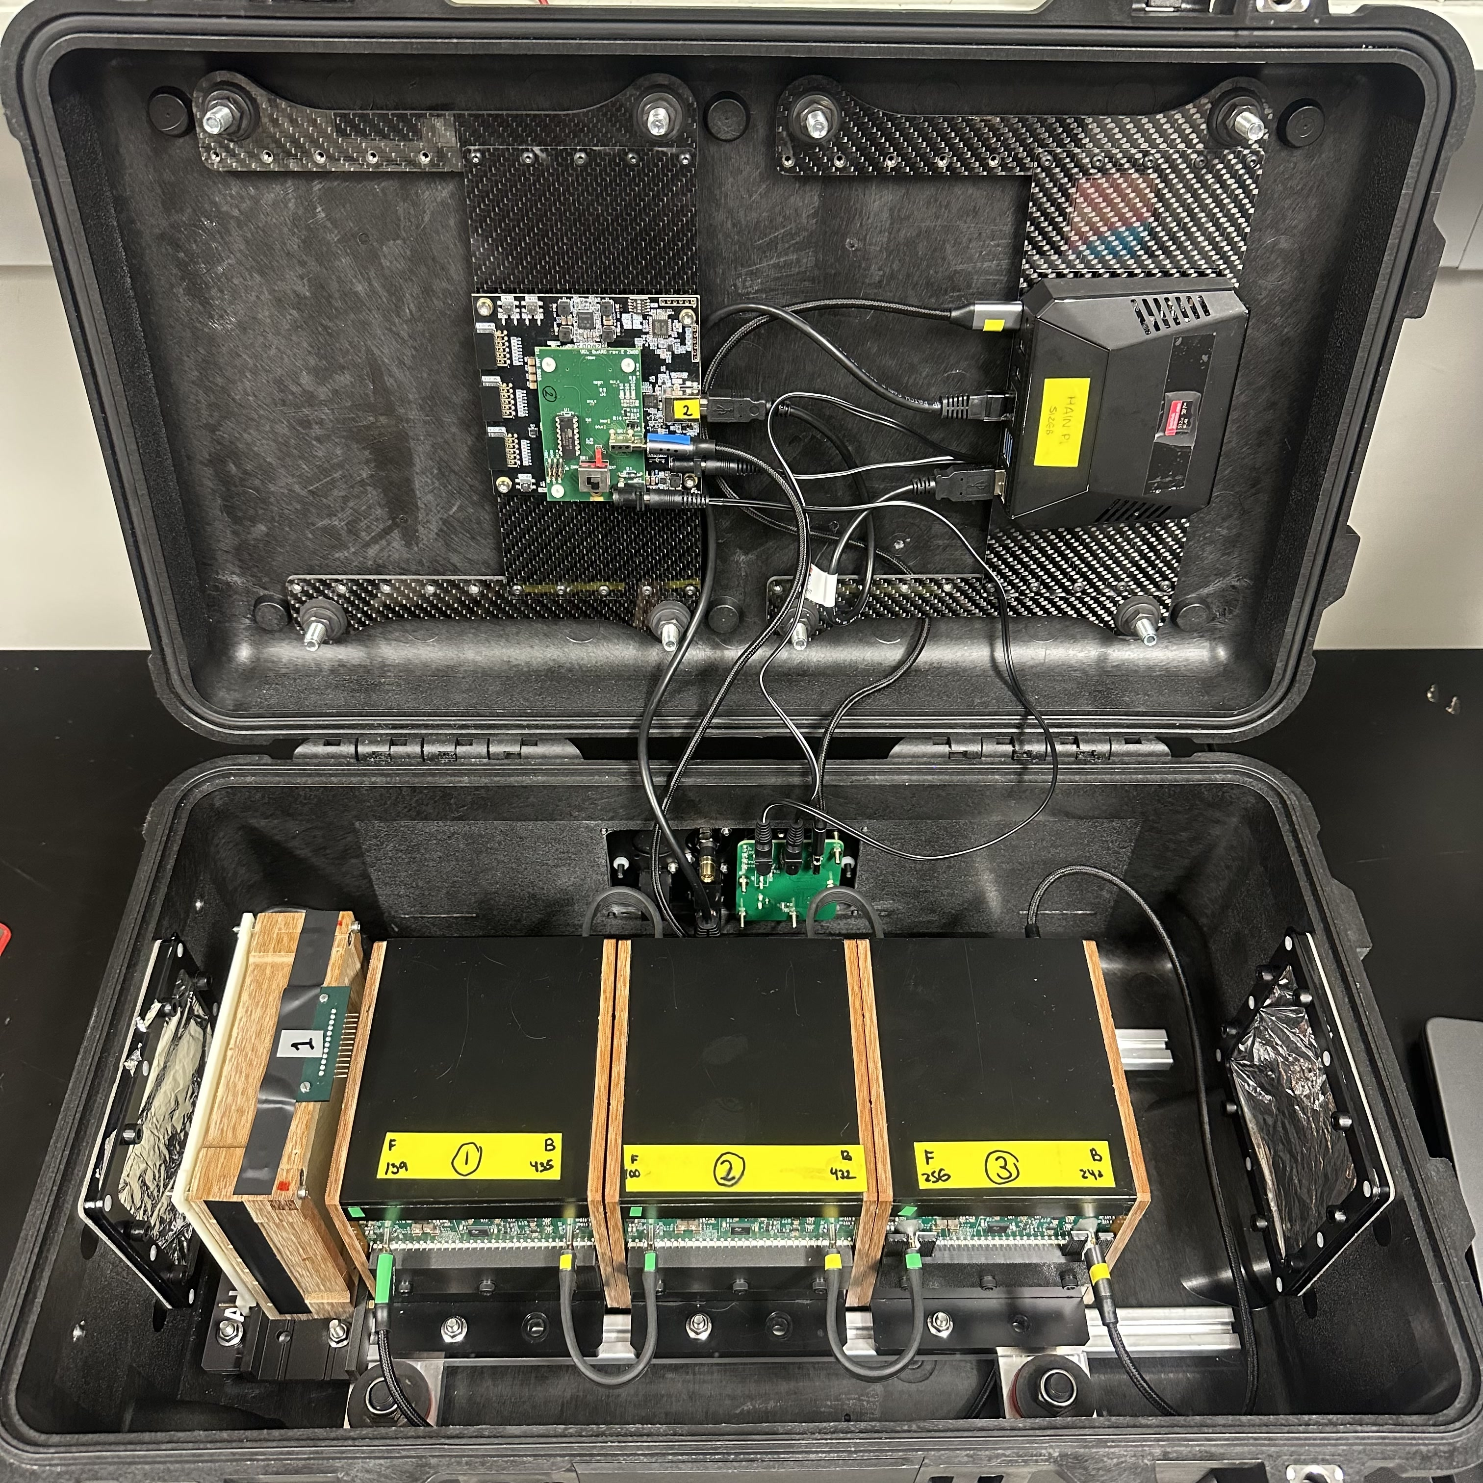
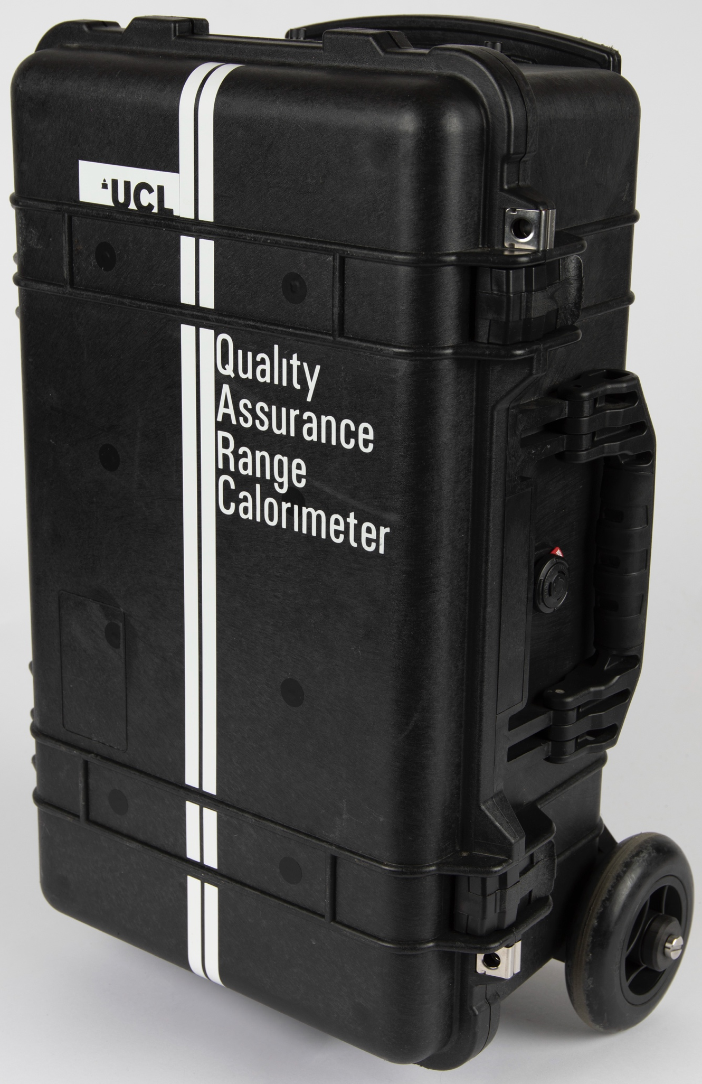
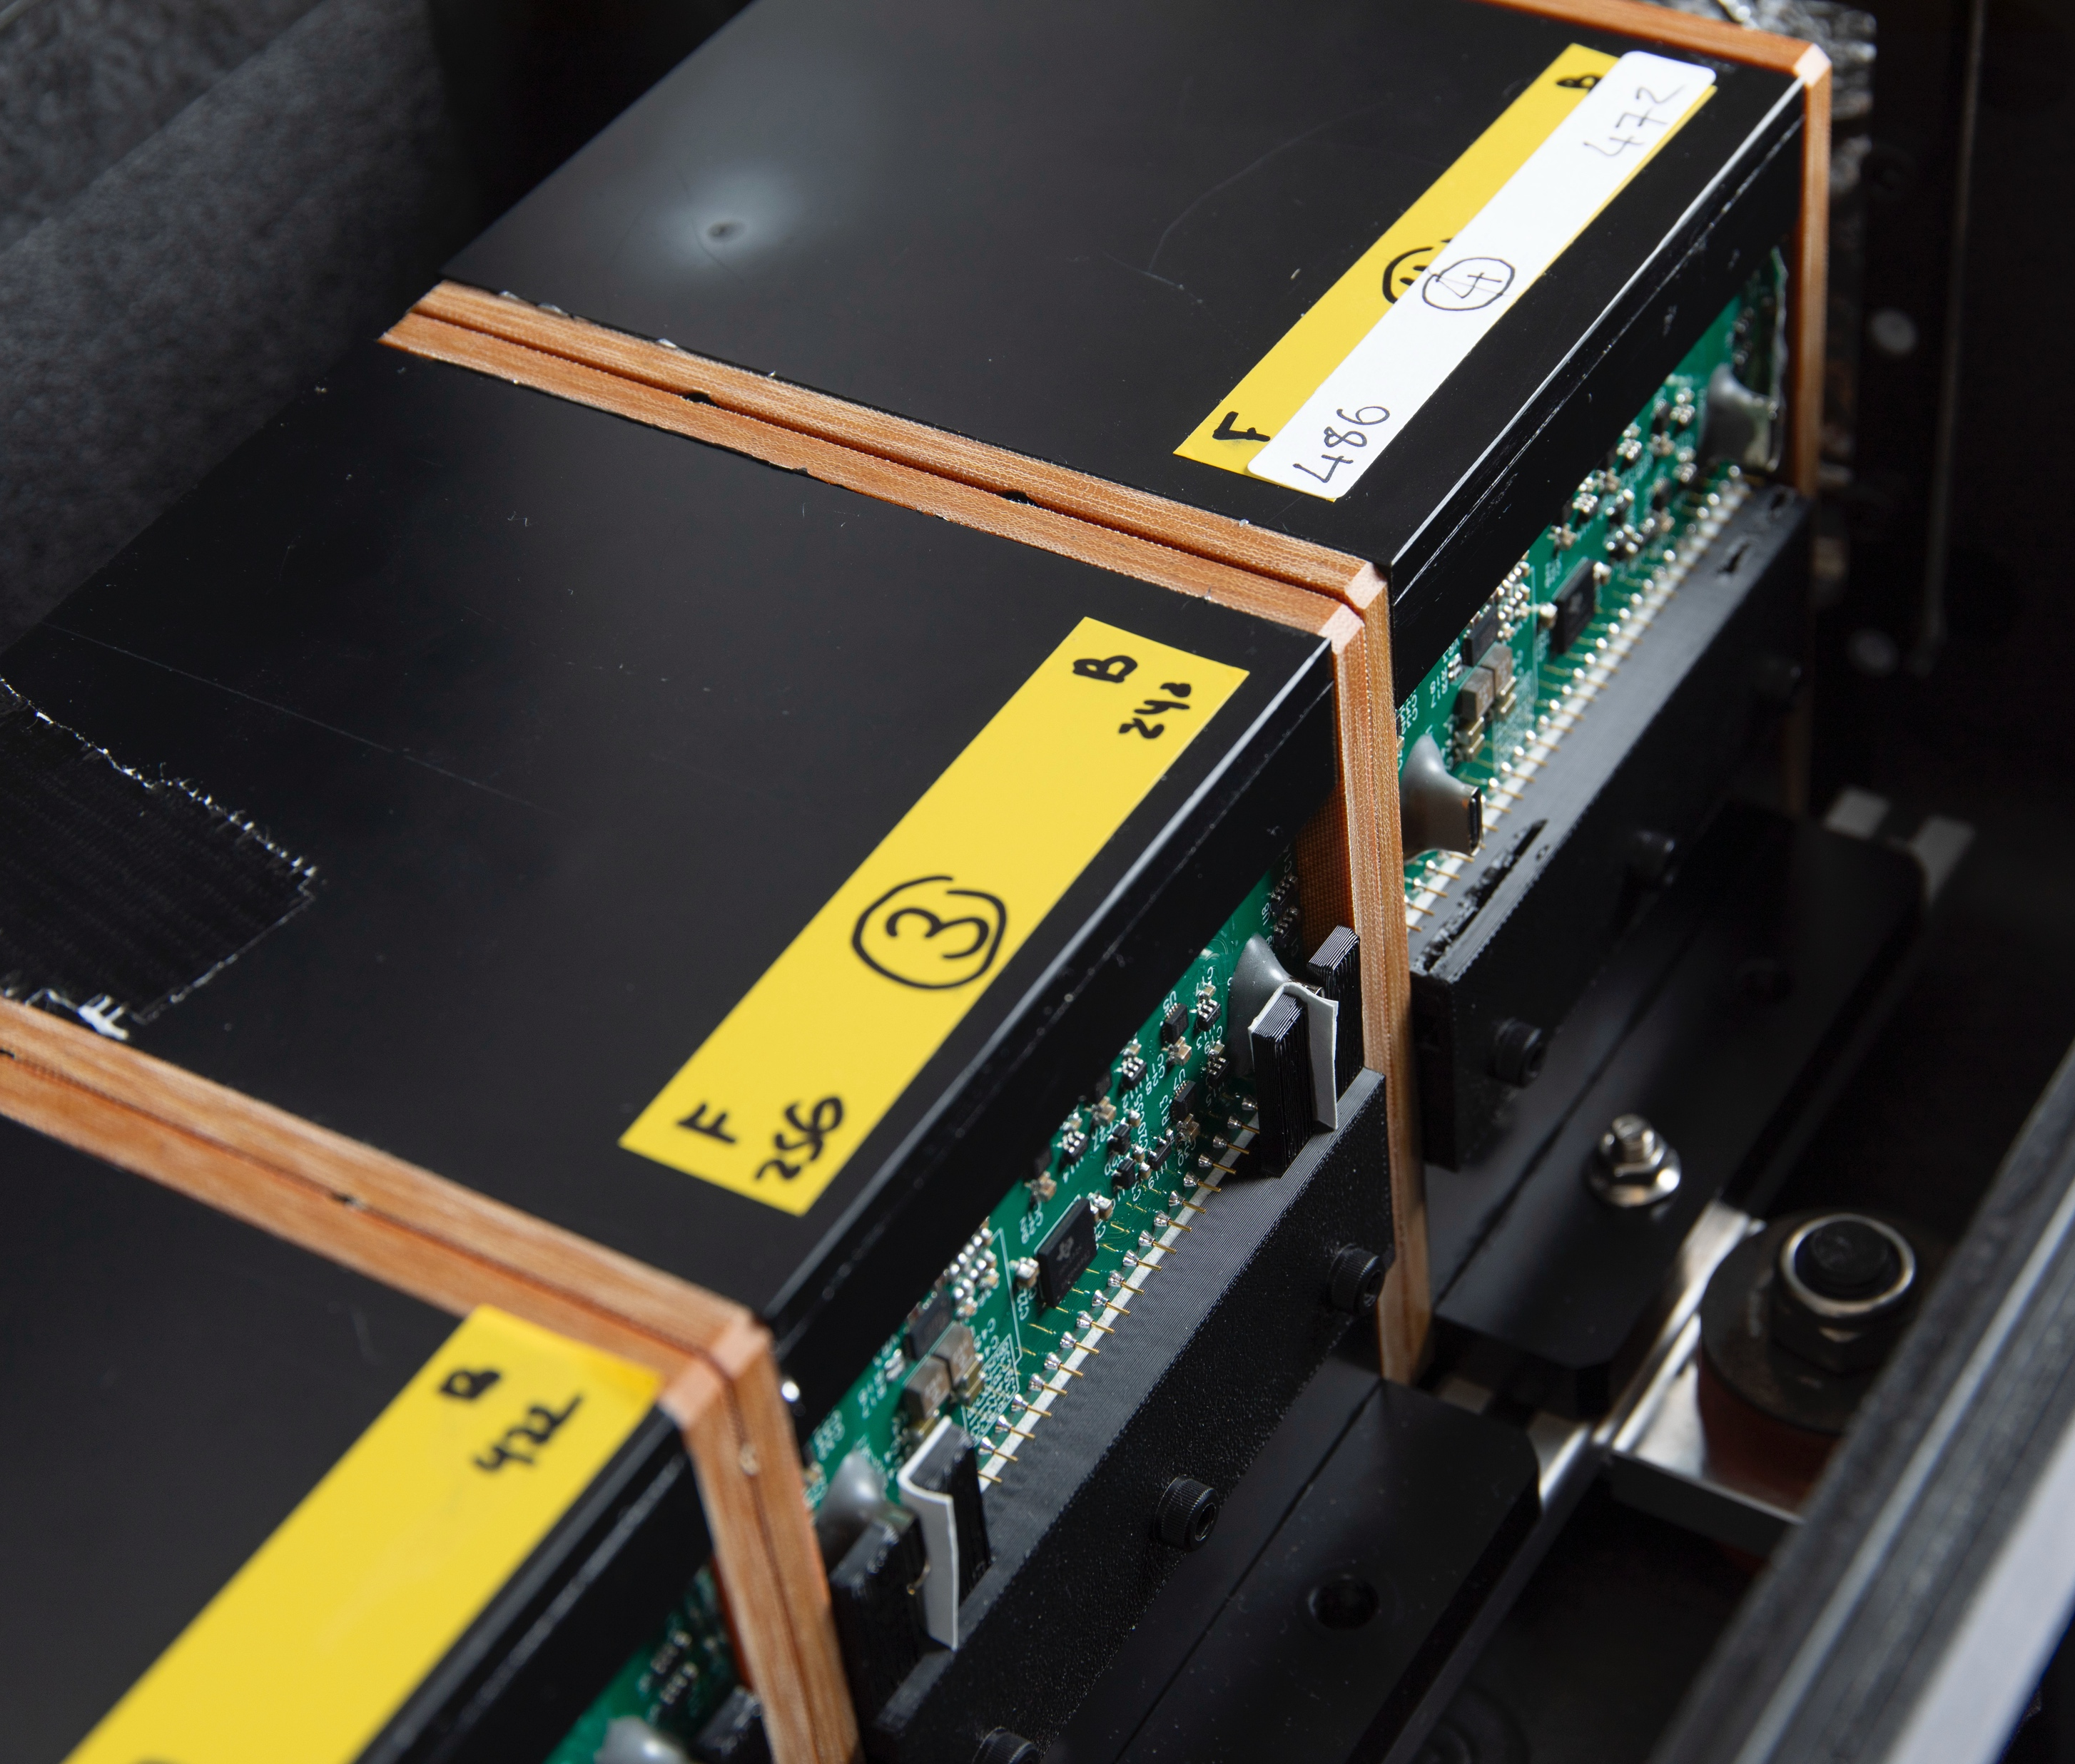
Quality Assurance Detector for Proton Beam Therapy
FPGA
Pi
SciFi
QuARC

Slide 4
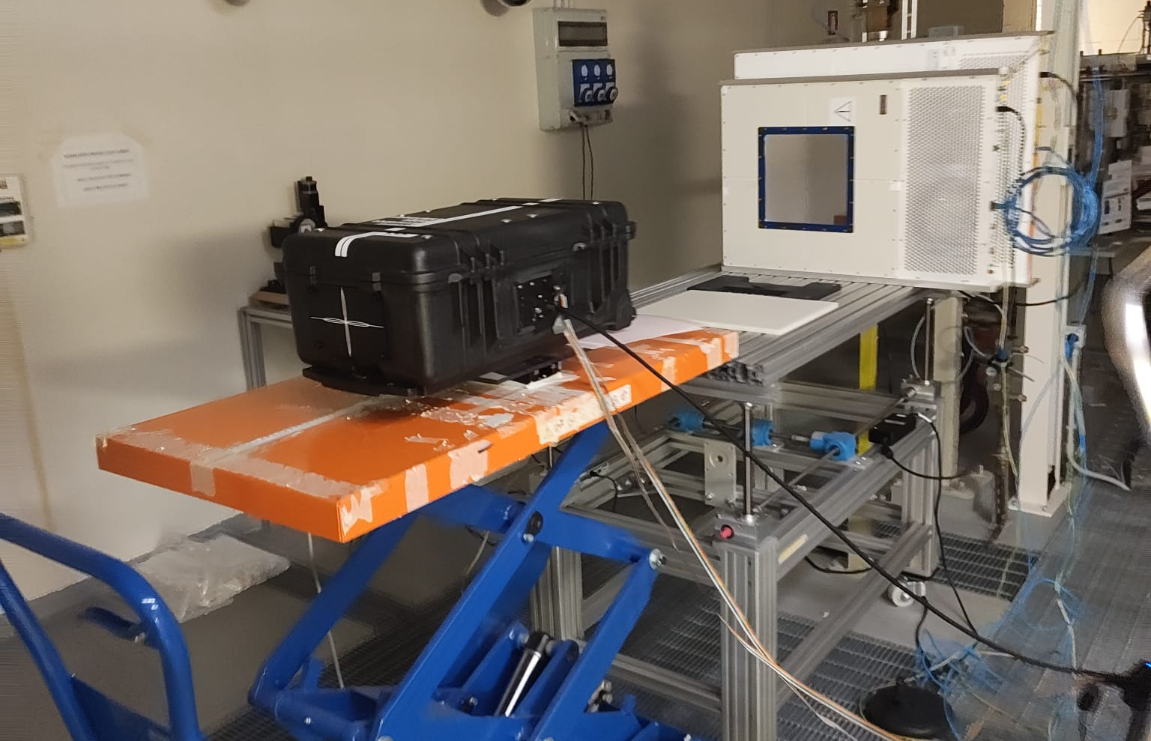
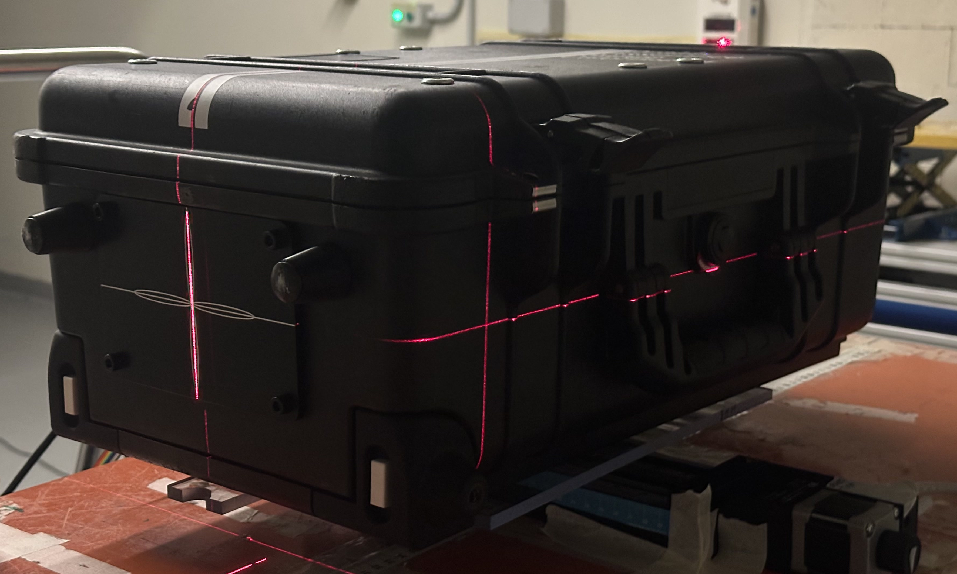
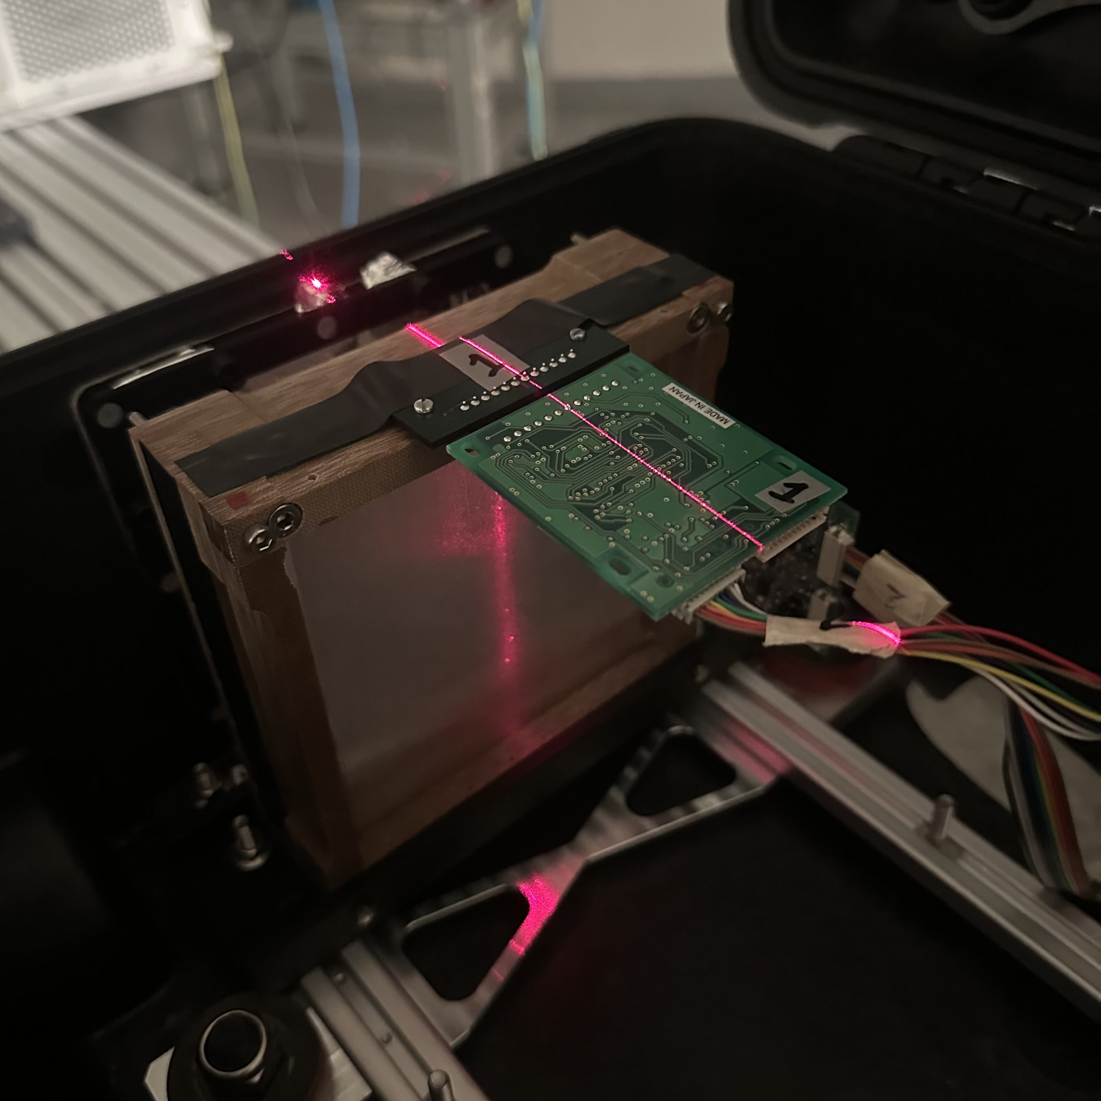
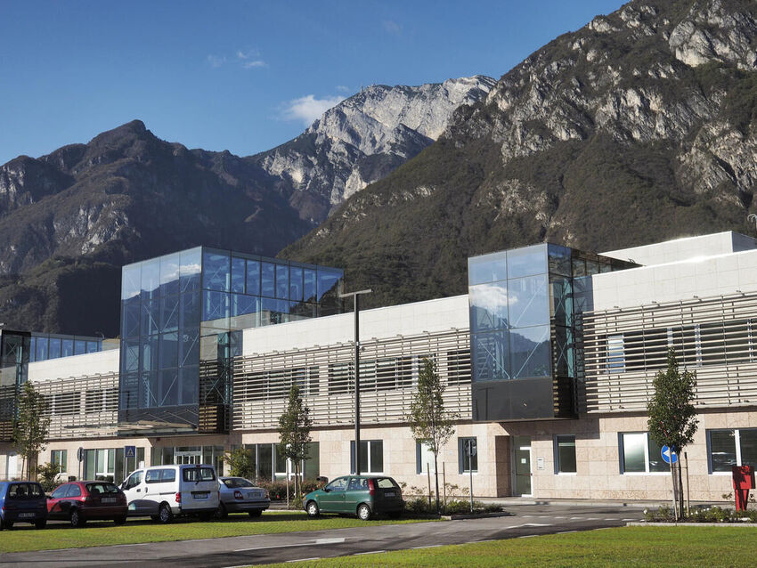
PhD in PBT
Detector development, data analysis and clinical measurements for improved cancer treatment.
Develop front-end electronics and data acquisition system.
Integrated GUI with range telescope (QuARC) and scintillating fibre profile monitor.
Optimise fast spot scanning with Machine Learning.
Integrate realtime dose monitoring.
Install in a hospital…

Slide 5
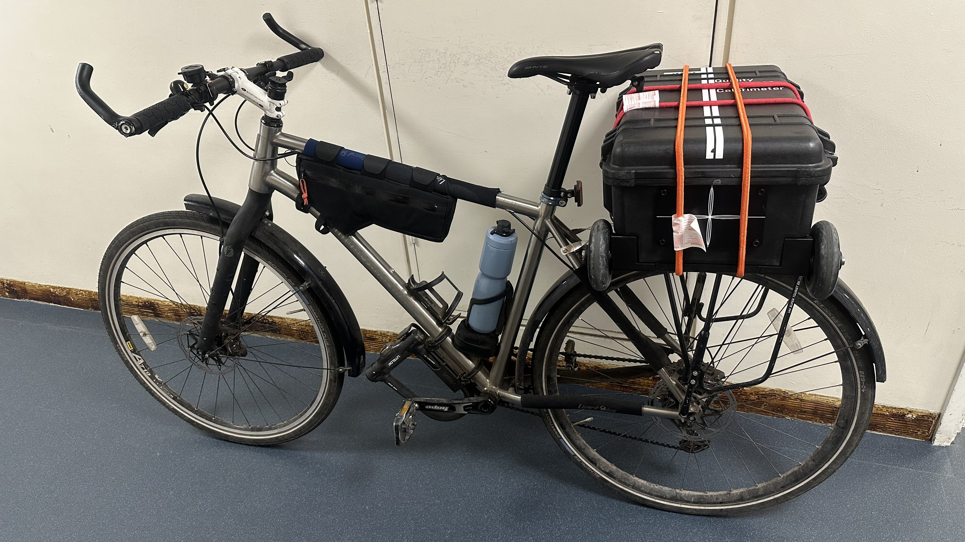
Size Doesn’t Matter (But It Really Does)

