Slide 1
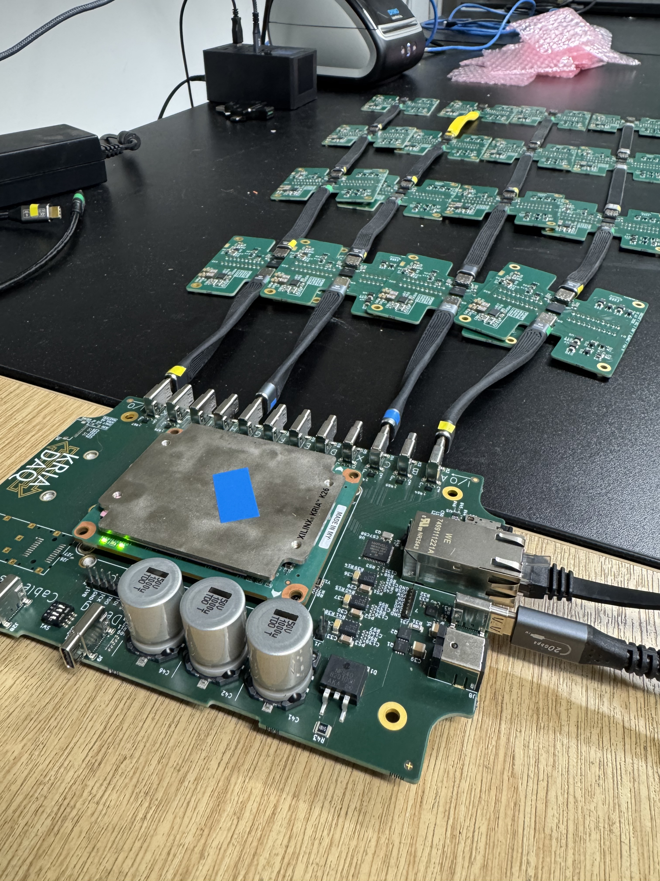
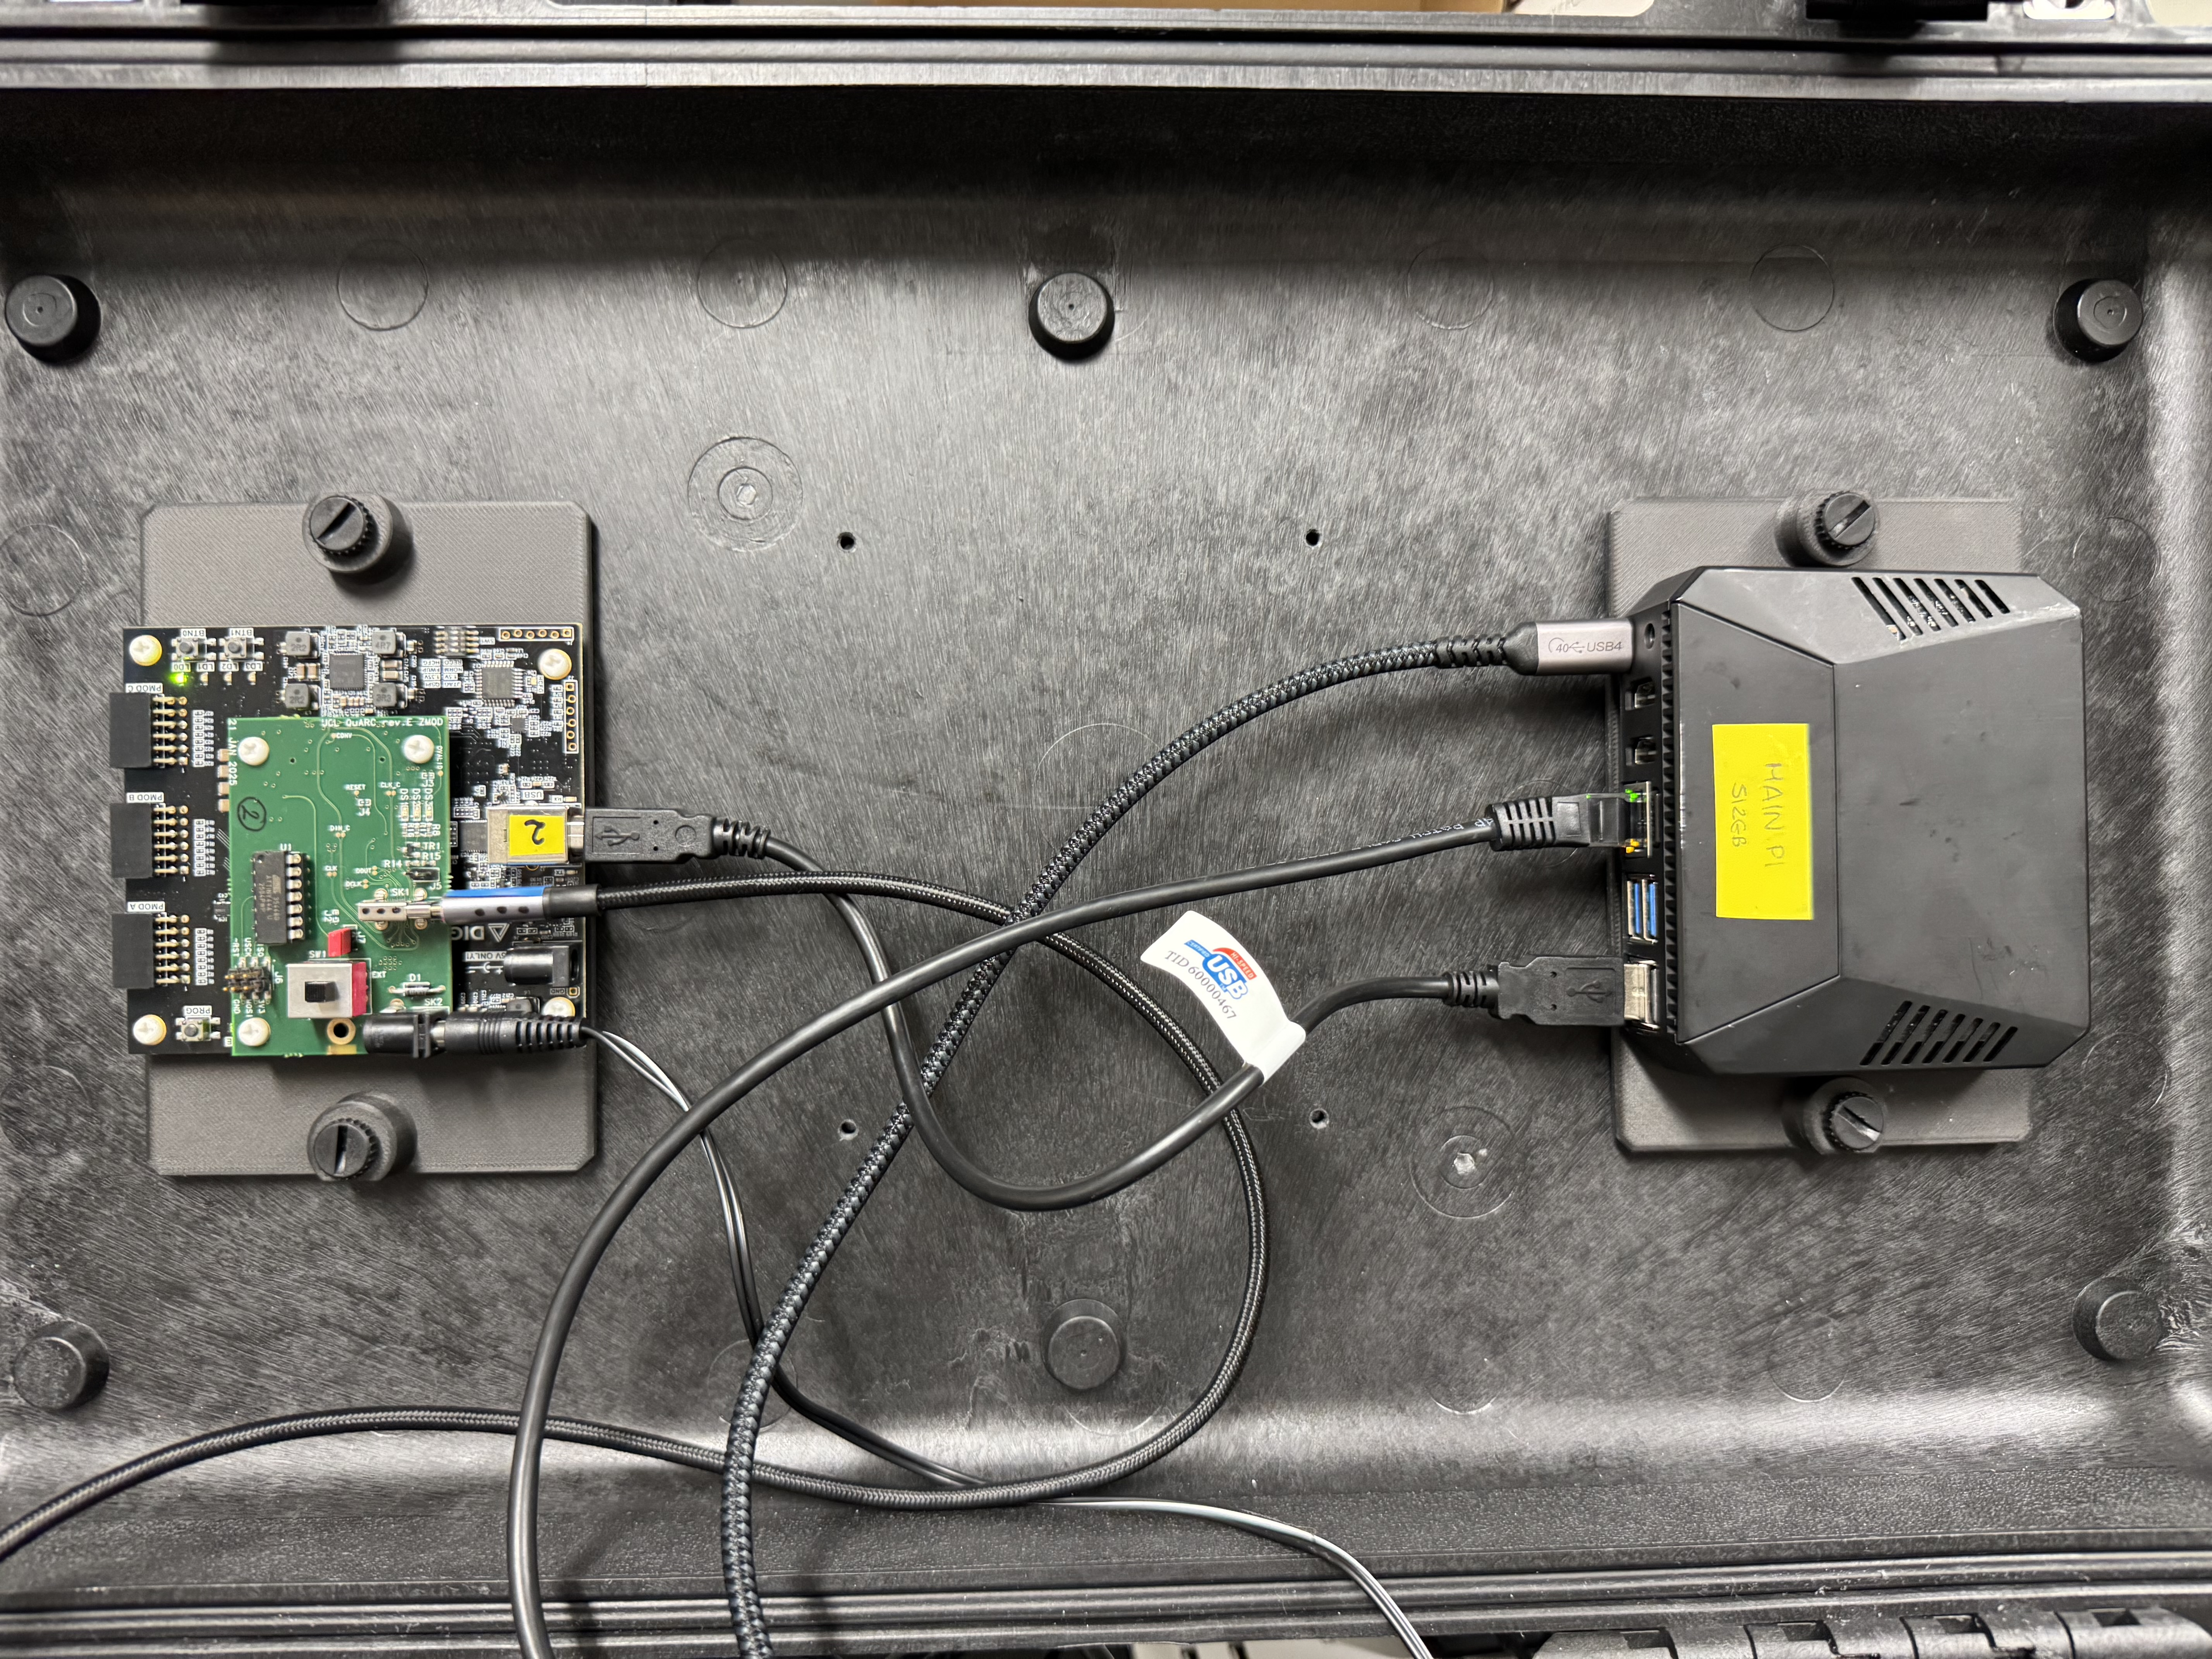
PBT: Battle of the SoM
PBT Quality Assurance Detector for Proton Beam Therapy (QuADProBe) measures proton beam range and spot position for QA.
FPGA-based DAQ has done through several iterations:
  Nexys Video+FMC board+laptop.
  Raspberry Pi+USB104+USB-C daughterboard
  Kria SoM+KriaDAQ carrier board
From 3 separate boards to a single board

Slide 2
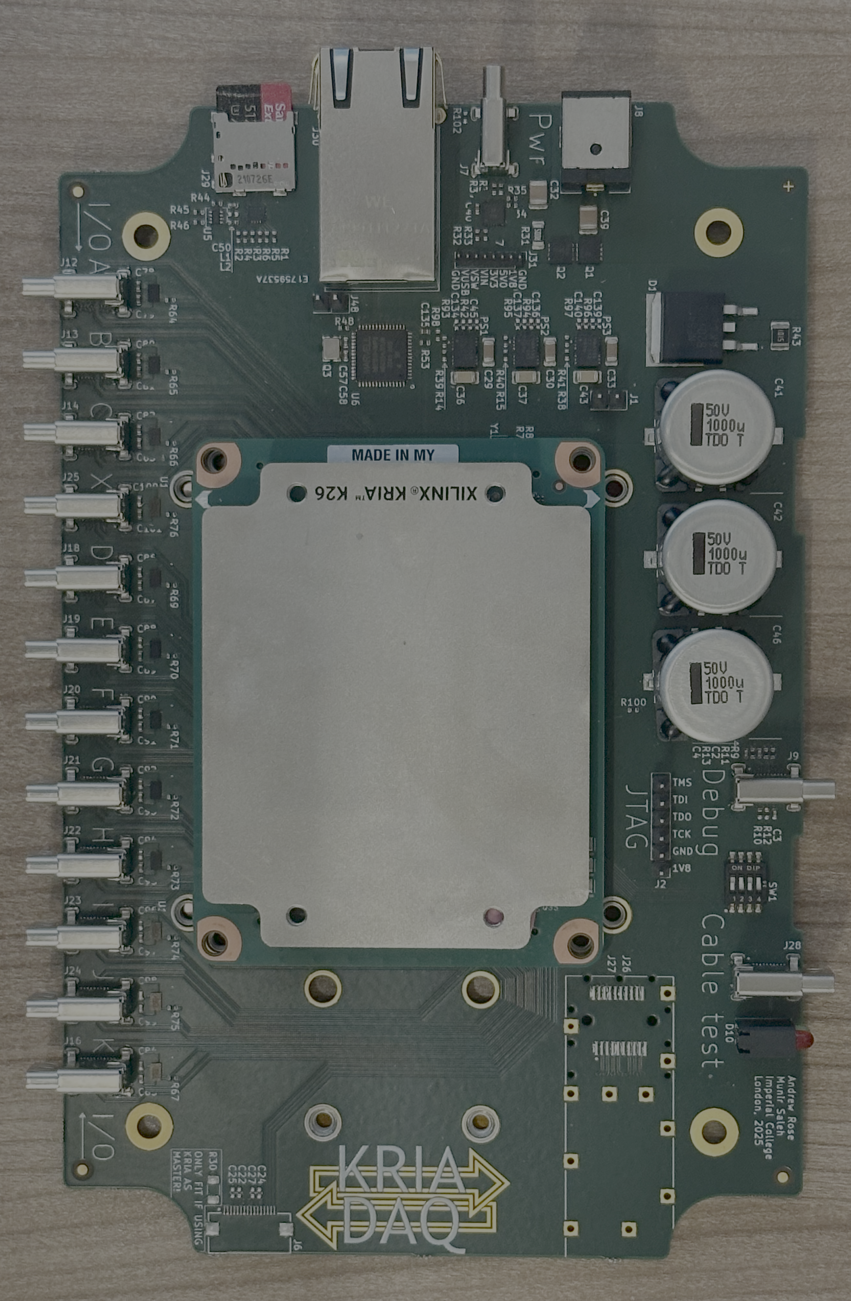
KriaDAQ: Imperial+UCL+Oxford
5x more powerful FPGA peripherals on top of fully optimized usage for our use case compare to the previous iterations with USB104.
K26 SOM provides ARM CPU and FPGA PL on the same chip improving compactness, flexibility and mobility on the software side as well as reducing complexity in setup.
Allows much greater number of DAQ channels and more FPGA processing.
Integrates hardware, software and firmware from SuperNEMO, LHCb, CMS and ATLAS.
Moving on from single sided DDC per module to 2 sided last year, we are now moving on to all 4-sided DDC232 board couple to each side of the module allows us to measure spot position 3D.
KriaDAQ carrier board has 12 ports allowing integration of Quality Assurance Range Calorimeter (QuARC) with scintillating fibre beam beam profile monitor (SciFi).
More powerful DSP will potentially allows more mathematical operations to be done in FPGA including Calibration process and potentially fitting.

