Slide 1
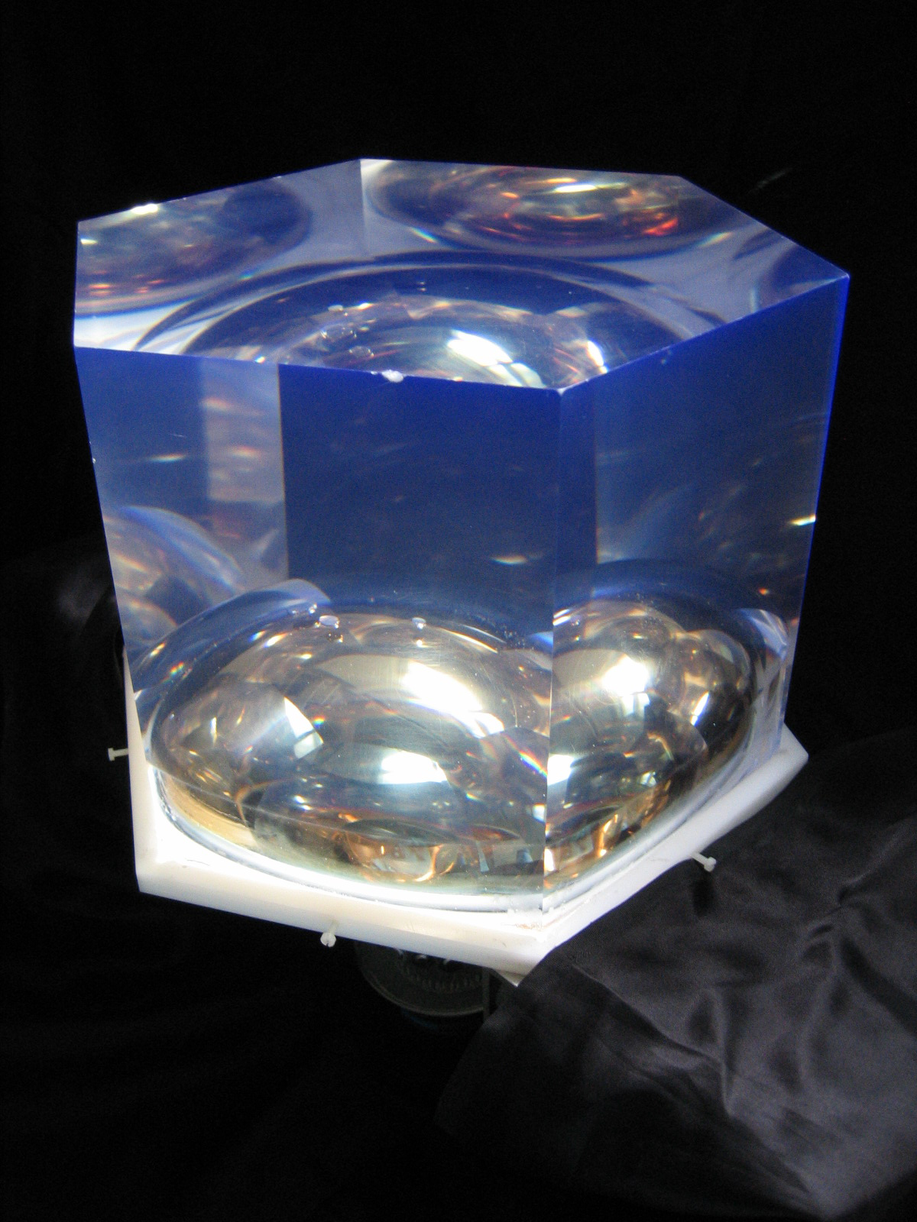
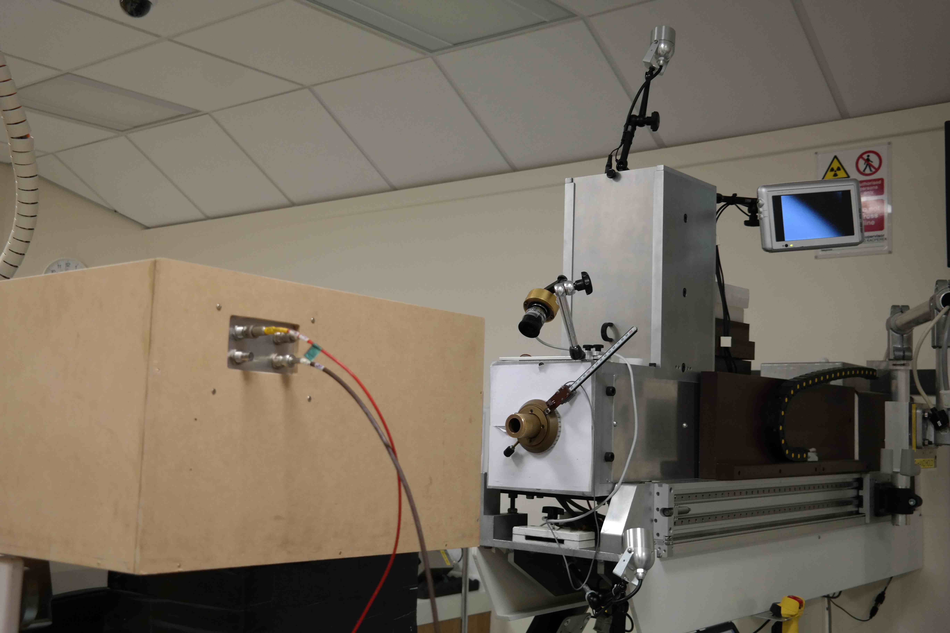
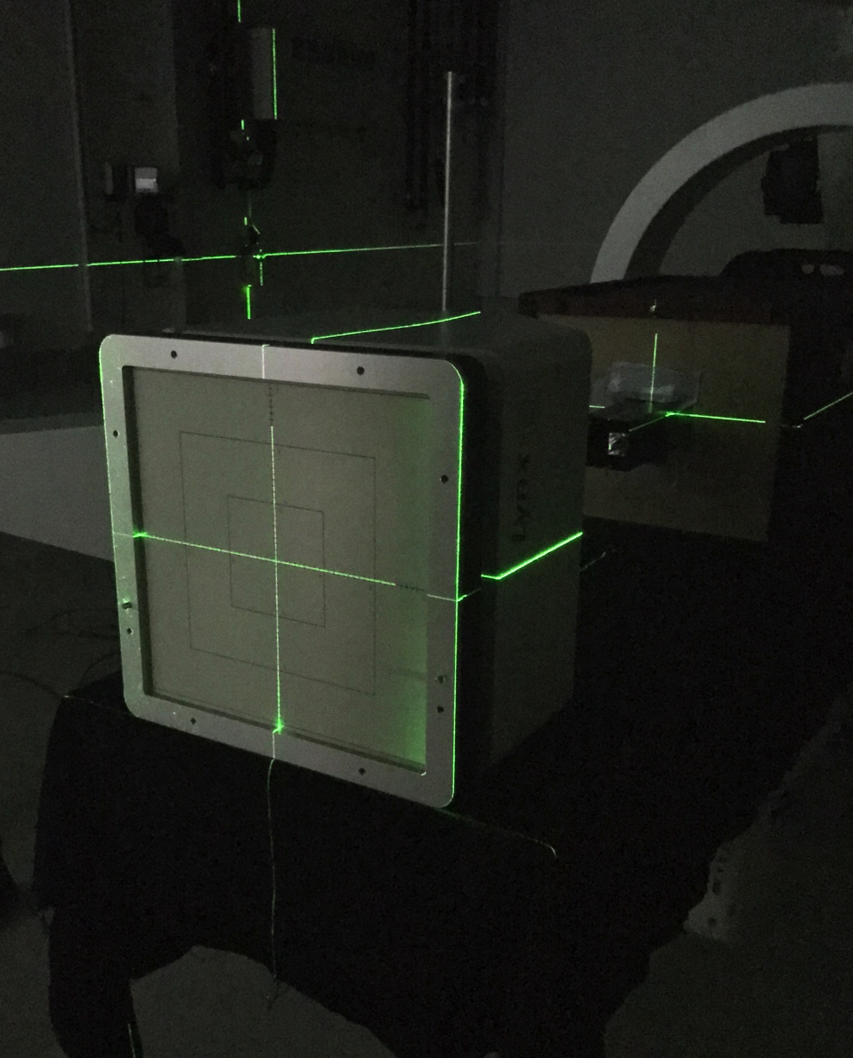
From SuperNEMO to Proton Therapy: Adapting SuperNEMO Calorimeter Technology for Proton Therapy QA
Anastasia Basharina-Freshville
(University College London)
Notes:
We’ve had a few seminars on PT. This one is different - based on actual *data* from working PT facility using technology developed at UCL for particle physics experiment.

Slide 2
Cancer Treatment
Cancer is treated with 3 different modalities:
  Surgery
  Chemotherapy
  Radiotherapy
Each has advantages and disadvantages
Surgery is the most successful
If you can’t remove it with surgery, radiotherapy is the next best option
Also cost effective
Notes:
There are three different modalities to treat cancer: surgery, chemo and radiotherapy.
Surgery is the most successful, but cannot be used in all cases. Where it can’t be, radiotherapy then becomes the most successful and is also cost effective, costing around 1/10th of chemo.

Slide 3
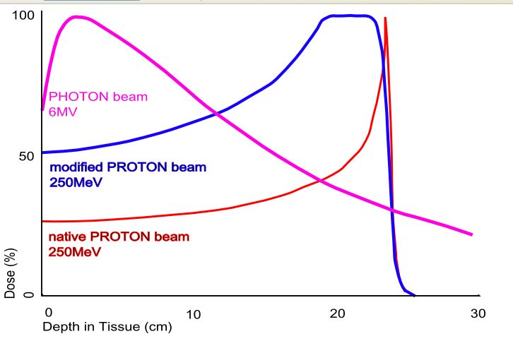
Why Proton Therapy?
More precise form of radiotherapy
  Precise tuning of the delivered dose to the patient through careful selection of proton beam energy
  Due to energy loss profile of protons
  And much smaller beam spot sizes
Important for areas where we particularly want to avoid large doses of radiation to healthy tissue:
  Head and neck
  Central nervous system
  In children
http://samhs.org.au/Virtual%20Museum/xrays/Braggs-peak-rxth/braggpeakrxth.htm
Notes:
Protons have:
A low entrance dose
A high Bragg peak region dose
No exit dose

Slide 4
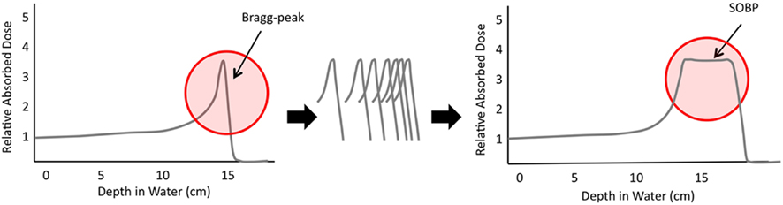
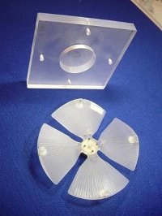
Why Proton Therapy?
Front. Oncol., 06 September 2011 | doi: 10.3389/fonc.2011.00024
Range shifter and modulator used for a Spread Out Bragg Peak
Alters beam energy to provide a uniform dose over the depth of the tumor
http://www.clatterbridgecc.nhs.uk/professionals/physicsdepartment/cyclotron/
Notes:
SOBP = Spread out Bragg Peak. Alignment of many Bragg peaks allows creation of the SOBP, allowing deposition of radiation in a specific location (and a larger tumor than using one Bragg peak).

Slide 5
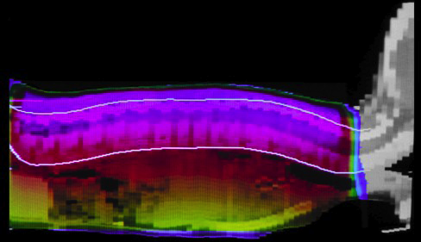
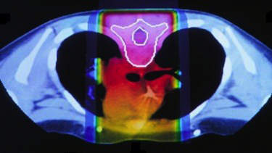
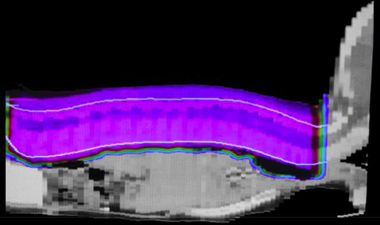
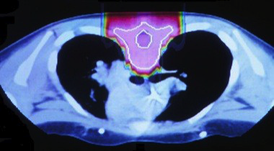
Photons vs Protons: Medulloblastoma
Conventional radiation (photons)
Proton therapy
http://www.seattlecca.org/diseases/proton-therapy-head-neck-cancers.cfm
Notes:
Pediatric brain tumour

Slide 6
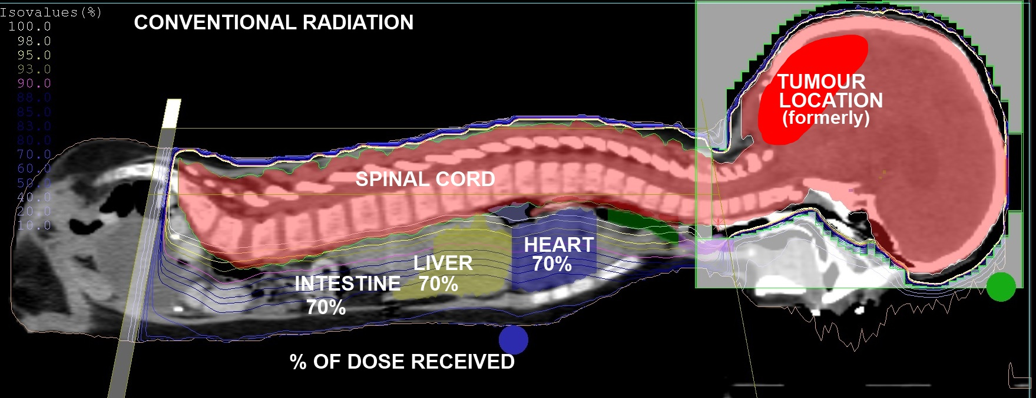
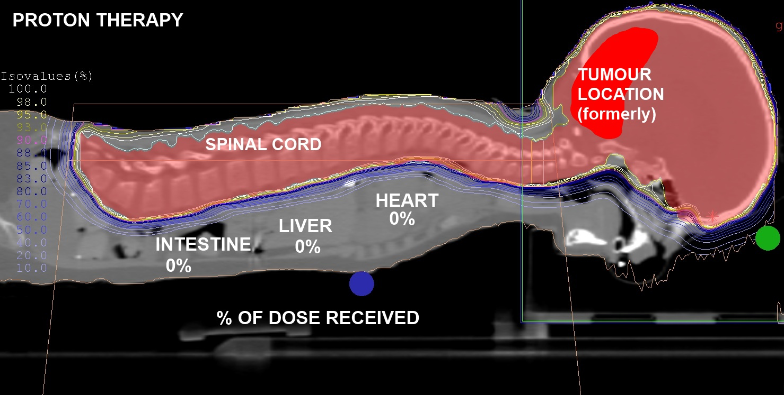
Photons vs Protons: Medulloblastoma
IMRT
PBT

Slide 7
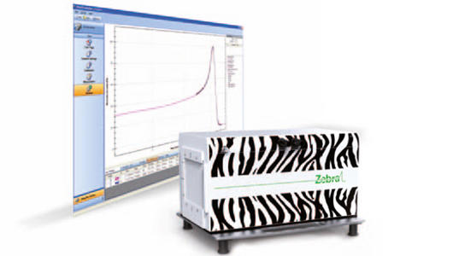
Proton Therapy Challenges (1)
Quality Assurance (QA):
  A number of QA checks are necessary for safe PT treatment:
    Daily, weekly and monthly
  Daily checks carried out before treatment:
    Verifying that the range is correct for a given energy takes most time
  Two methods currently used:
    A single dose monitor to look at 3-5 different
    beam ranges/energies, >1 hour daily
    “Zebra”: a multi-layer ionisation chamber,
    <1 minute to acquire data
    BUT: expensive, bukly and long setup times
http://www.iba-dosimetry.com/complete-solutions/radiotherapy/particle-therapy-dosimetry/zebra-with-omnipro-incline
Notes:
Range (used in medical physics)/energy (used by us) verification is of utmost importance to make sure the patient gets the correct dose.
This is carried out daily and takes ~1 hour in the morning. It is done with a single dose monitor, looking at 3-5 different beam energies/ranges (there is not enough time to map out the Bragg peak).
Unless the “Zebra” system is used, which is a multi-layer ionisation chamber, which takes less than a minute to run, but costs £250,000 and is bulky.

Slide 8
Proton Therapy Challenges (2)
  Proton imaging
  Requires an increase in imaging resolution compared to X-ray based systems due to localisation of proton dose delivery
  Currently use a conversion factor to convert from X-Ray to proton therapy treatment plans → imprecision and range uncertainty
  Currently, the patient is imaged away from the treatment – any movement of the patient’s anatomy introduces further imprecision
Notes:
X-ray CT images do not provide information on the proton-specific absorption characteristics of tissue surrounding the treatment volume, therefore an algorithm must be used for conversion, introducing uncertainty into something that has to be extremely precise to work well and not cause damage
The patient is imaged away from the treatment – therefore any movement in anatomy (even breathing) introduces further uncertainty

Slide 9
Proposed Solutions
Calorimetry approach for:
  Measuring range for QA:
    measure energy and convert to range using a single scintillator + PMT
    measure range directly using a segmented scintillator with a readout on every slice
    Both methods aim to reduce QA times to 2-3 minutes, are affordable and can have short setup times
Proton imaging:
  Image with > 300 MeV proton beam, which will emerge from the body without significant energy deposition
  Tomography approach:
    A series of tracking layers upstream and downstream of the patient
    Accurate calorimeter for energy measurements
    Target energy resolution: ~1% σ for 300 MeV imaging protons
Notes:
Emphasise that we have two different ways of doing QA:
Single scintillator + PMT: measure energy and convert to range (so energy is a way of looking at the range)
Sandwiched design with individual readout per slice: measure range directly
Note: To measure the track of particle for pCT you need the particle 4-momentum. So px, py and pz come from the tracker and the energy (4th component) comes from the calorimeter.

Slide 10
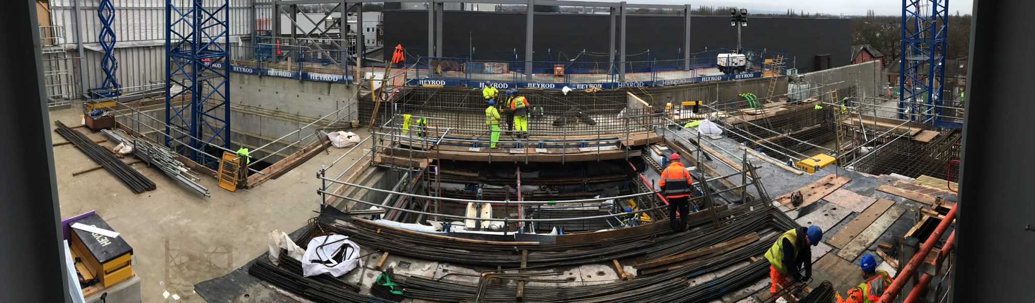
Proton Therapy in the UK
One currently operational proton therapy centre:
  Clatterbridge Cancer Centre: treatment of ocular melanomas with 60 MeV proton beam
Two new high energy centres currently under construction:
  The Christie (Manchester)
  UCLH (London)
£250 million joint project - the largest single project the NHS has ever attempted!
The Christie will open in August 2018 and UCLH a couple of years later.

Slide 11
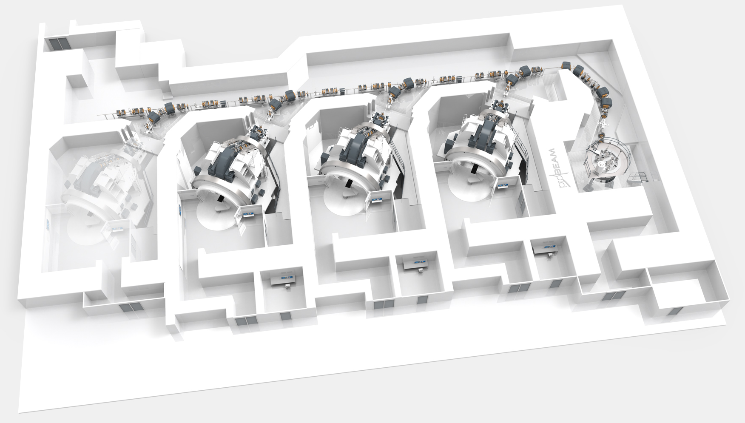
UCLH Proton Therapy Centre
Accelerator
Gantries
Treatment Room
Use a particle accelerator (cyclotron) to get a 250 MeV proton beam
Delivered to the patient through a gantry, which has to be big enough to deliver the beam from any angle: must be 3 stories tall!
Three gantries
Construction in progress (summer 2015)
First patient treatment: 2020
Can we work on some of the challenges before then?
Notes:
Remember: do NOT mention research room!

Slide 12

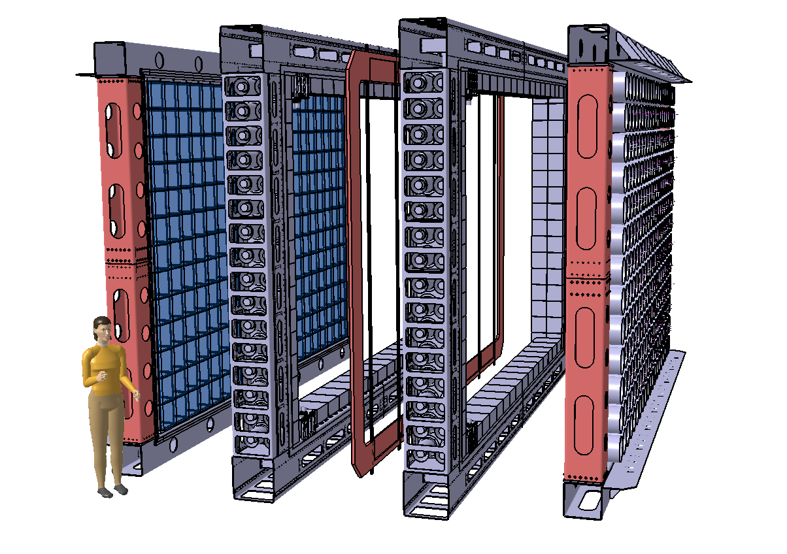
SuperNEMO
Neutrinoless double beta decay detector using NEMO3’s tracker-calorimeter technique
Target sensitivity: T_{½} > 10²⁶ years → <m_{ν}> <0.04 – 0.1 eV
Modular detector with a planar geometry
1 module (of 20) consists of:
Source foil:
- 5 kg (total of 100 kg) of 40 mg/cm² (4 x 2.7 m²)
- ⁸²Se (high Q_{ββ}, long T_{1/2}^{2vββ}, proven enrichment technology): starting baseline
- ¹⁵⁰Nd and ⁴⁸Ca being considered depending on enrichment possibilities
Tracker: ~2000 drift cells in Geiger mode
→ particle identification (for background suppression)
Calorimeter: ~550 scintillator blocks + PMTs
→ energy and time of flight measurements of particles
Passive shielding surrounding each module
4 m
6 m
2 m (assembled, ~0.5 m between source and calorimeter)
Notes:
82Se is the starting baseline design, but as the source is not the detector (as you have in other neutrinoless double beta decay experiments) there is a possibility of using other sources.
SN status: all of the detector components are now underground, it is undergoing commissioning and first physics run will start this year.

Slide 13
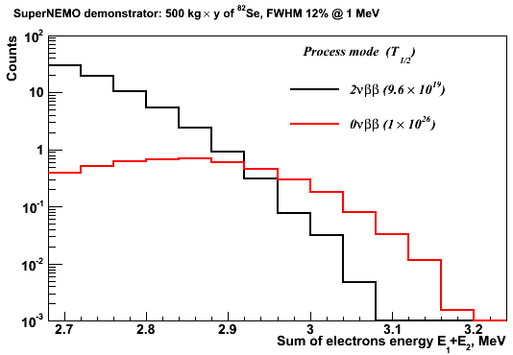
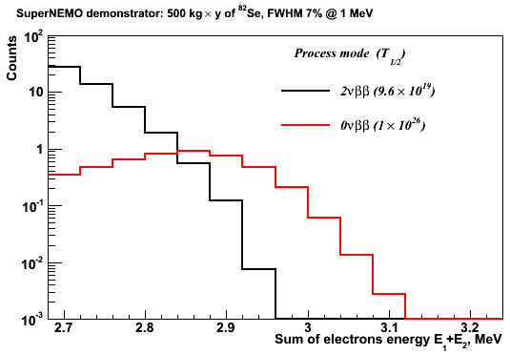
From NEMO3 to SuperNEMO
Energy resolution is one of the main challenges (factor of 2 improvement):
SuperNEMO scintillator has to be organic plastic scintillator
(high light yield, low electron back-scattering, high radiopurity, fast timing)
→ Can 3% σ at 1 MeV be reached for organic solid plastic scintillator?
First step in SuperNEMO R&D: secured STFC funding for energy resolution R&D
NEMO3:
SuperNEMO:
Notes:
From NEMO3 to SuperNEMO: light output improved by a factor of 4
Not liquid scintillator: because of difficulty of mechanical design and energy loss of electrons in the entrance window of the liquid scintillator container, also the resolution wasn’t better than with a solid scintillator

Slide 14


Energy Resolution
σ sigma of distribution
E mean of distribution
N_{pe} number of photo-electrons
N_{ph}/E_{e.} number of photons per unit energy
ε^{light} light collection efficiency
QE^{PMT} quantum efficiency of the photo-cathode
ε^{PMT} PMT collection efficiency
Three experimental objectives:
scintillator light output
Physically translates to:
Scintillator: material, surface treatment, geometry
Reflector: material, reflectivity coefficient, specular/diffusive
Optical coupling quality: material, geometry, light guides
Photomultiplier Tubes (PMTs): quantum efficiency (QE), collection efficiency, gain of the first dynode
Combined in an “optical module”:
scintillator wrapped in reflective material coupled to a PMT

Slide 15
SuperNEMO Calorimeter Test Bench
Excite scintillator with a monochromatic electron source (approximates the delta function) → any smearing of distribution is due to detector properties
UCL:
²⁰⁷Bi source: 976 keV and 482 keV K-shell conversion electrons
Fit: deconvolution of X-rays, γs, L-shell and M-shell conversion electrons
Bordeaux:
⁹⁰Sr spectrometer: ⁹⁰Sr beam passed through a magnetic field to select monochromatic electrons of known energy
Fit: Gaussian

Slide 16
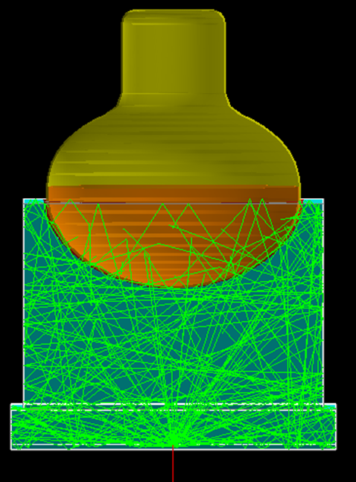
SuperNEMO Calorimeter R&D: Simulations
Full calorimeter simulations:
  GENBB event generator
  Physics simulations with GEANT4 (optical photon transport in scintillator detectors)
The model accounts for wavelength dependence of optical properties, all of which have been experimentally measured, of the:
  scintillators (self absorption and re-emission)
  reflective wrappings
  photomultipliers (QE)
  optical coupling materials
  refractive index of optical materials
For further details see: “Spectral modeling of scintillator for the NEMO-3 and SuperNEMO detectors” https://doi.org/10.1016/j.nima.2010.09.027

Slide 17


SuperNEMO Calorimeter R&D: Scintillators
Block shape studies:
Material: polystyrene (PST) vs. polyvinyl toluene (PVT)
Close collaboration with manufacturers (JINR Dubna, ISM Kharkiv, NUVIA, ELJEN) for contents of:
  PPO scintillating agent
  POPOP wavelength shifter
Surface finishing: polished vs. depolished
  All surfaces depolished (machine finish), with the face with the hemispherical cutout polished
C256: cubic 256² x 190 mm²
H276: hexagonal 276 mm diameter
with 12 mm minimum depth
C308: cubic 308² x 190mm²
T308: cubic 308² x 190mm² with tapered sides
Notes:
PVT: higher light yield and longer light attenuation length, but it’s more brittle than PST and therefore harder to machine and handle
Note: Numbers in table are relative changes, to single out particular parameters (R&D done in lots of different order)

Slide 18
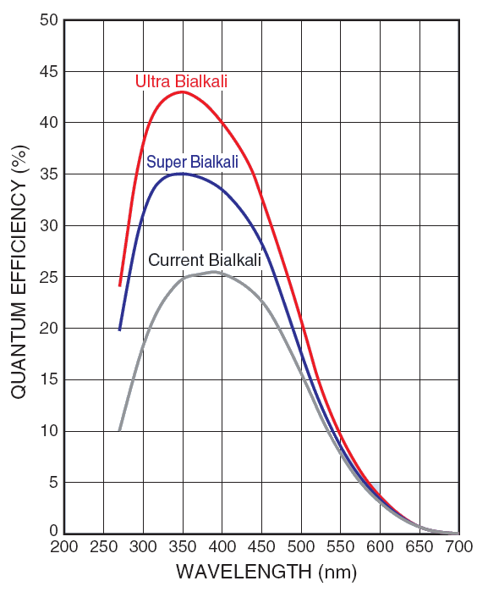
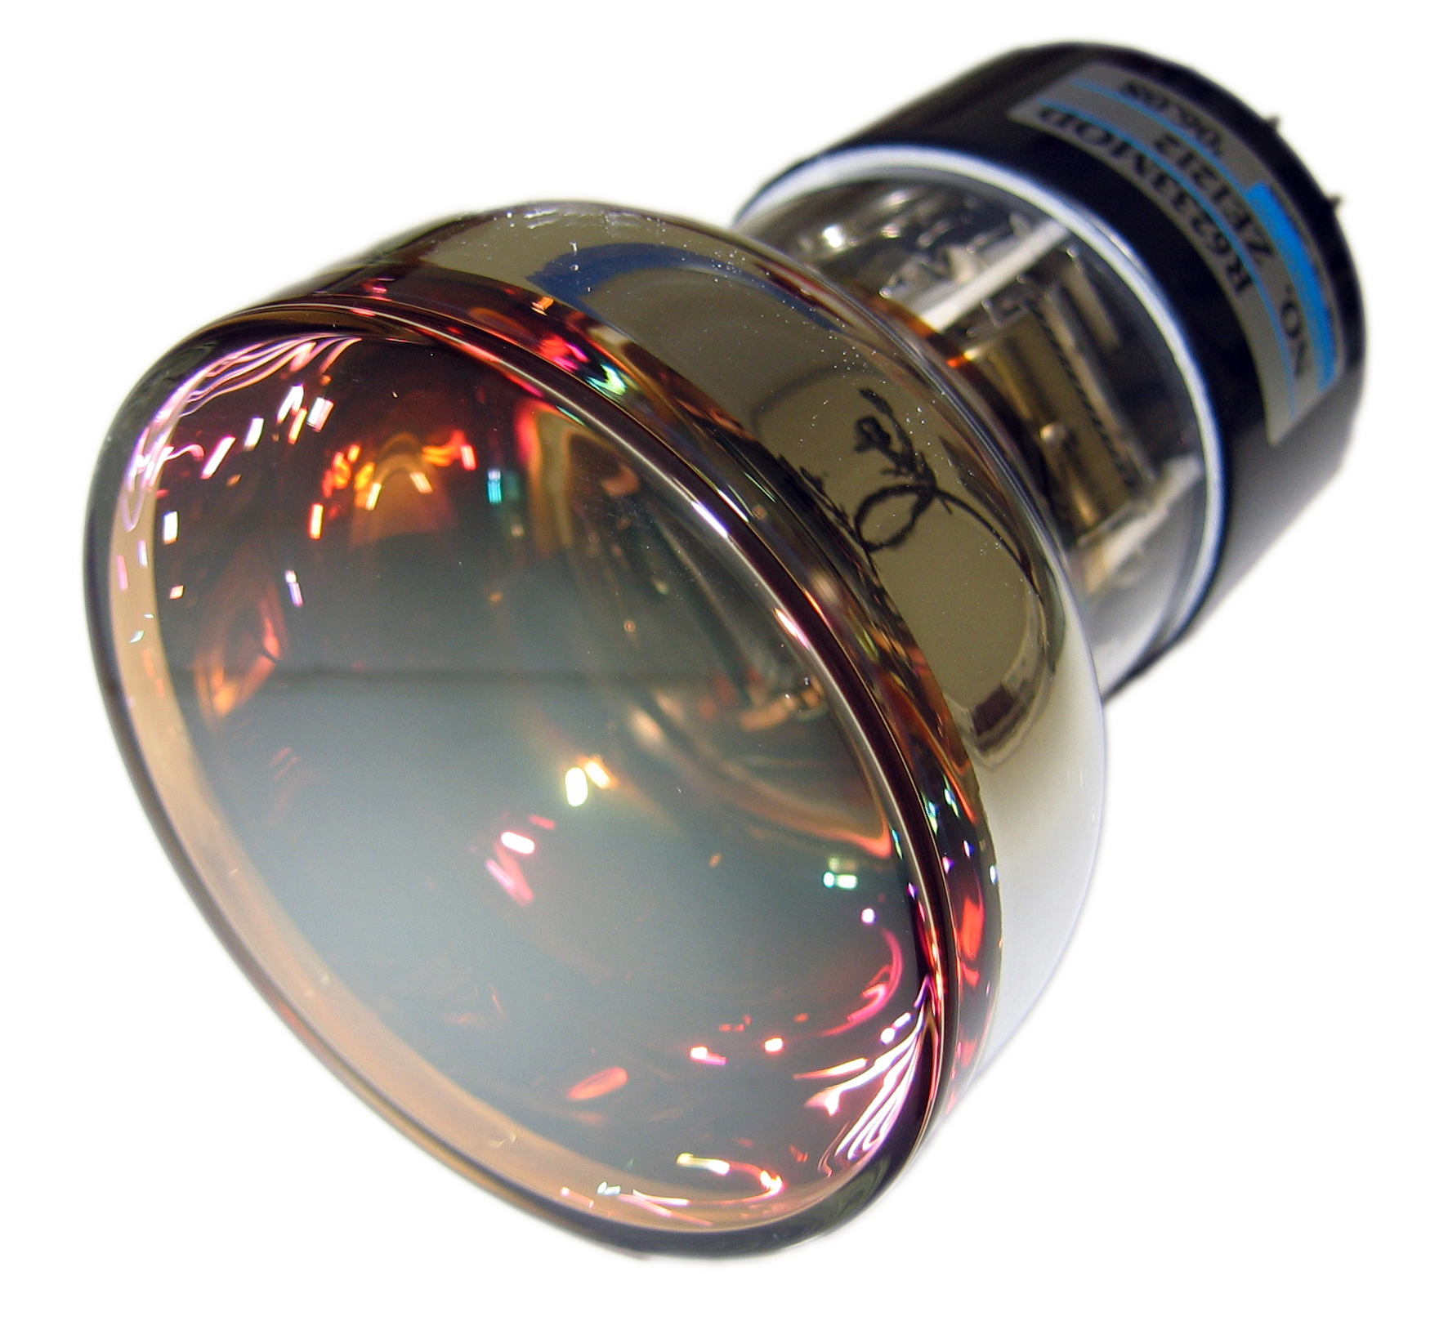
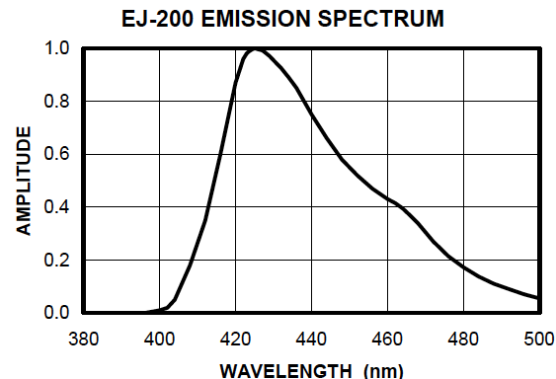
SuperNEMO Calorimeter R&D: PMTs
Photocathode QE:
Collection efficiency (close collaboration with Hamamatsu on 8” R5912-MOD tube):
  Number of dynode stages reduced from 10 to 8
  Voltage divider optimisation
  Improved from <70% to ~80%
Hamamatsu QE Profile:
Bi-alkali alloy development for photocathode material has achieved QE > 40%
Selection of PMT to optimise QE to the emission spectra of the scintillator
Notes:
Voltage divider optimisation:
Increase HV between the cathode and the first dynode (by 2)
Increase HV between the first and second dynodes (by 1.5)

Slide 19
SuperNEMO Calorimeter R&D: PMTs
Photocathode uniformity:
  Close collaboration with Hamamatsu to improve photocathode uniformity across the entire surface of the R5912-MOD PMT
Timing:
  Reducing the number of dynode stages improves the timing of the PMT by reducing the time transition spread (TTS)
Gain and Linearity (a big achievement!):
  Reducing the number of dynode stages and optimising the voltage divider decreases the gain: ~1 x 10⁵
  → Good linearity (< 2% for very high light levels – 50 mA peak current) whilst good gain of the 1st dynode and therefore high collection efficiency
Notes:
Gain: one of the highlights
Mention that other experiments are also considering them now
Incremental improvement of the PMT and scintillator and their matching to each other

Slide 20
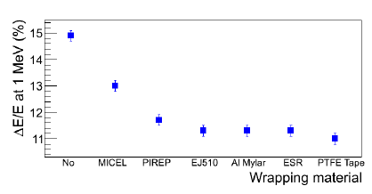
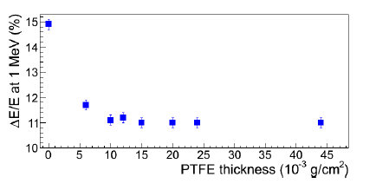
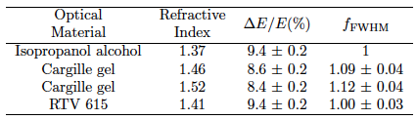
SuperNEMO Calorimeter R&D: Reflective Material & Coupling
Reflective material:
  High reflectivity, radiopure, low Z and low density (to reduce backscattering)
Optical coupling:
  Good optical coupling between scintillator and PMT essential for uniform and complete light collection
  Direct coupling of PMT to hemispherical cutout in scintillator gave the biggest impact in energy resolution improvement.
PST C308
PST C308
Notes:
For now we are planning to use RTV 615 – good radiopurity and viscosity. But work is still ongoing to find something with a closer matching refractive index.
Scintillator refractive index: 1.58
PMT refractive index: 1.47

Slide 21
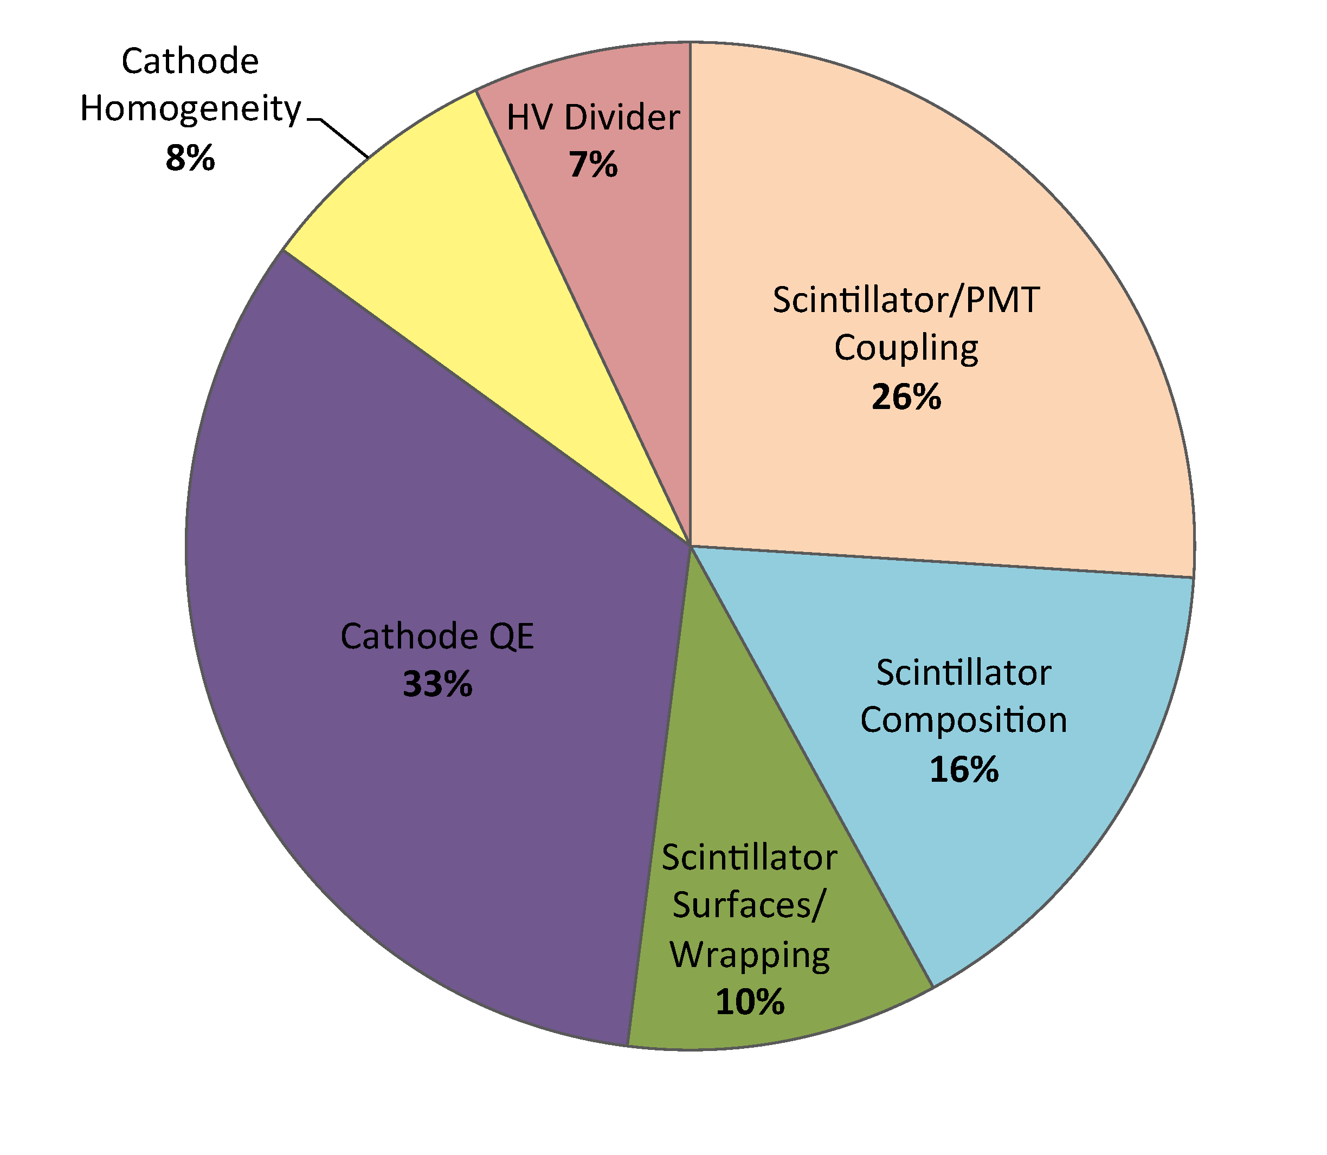
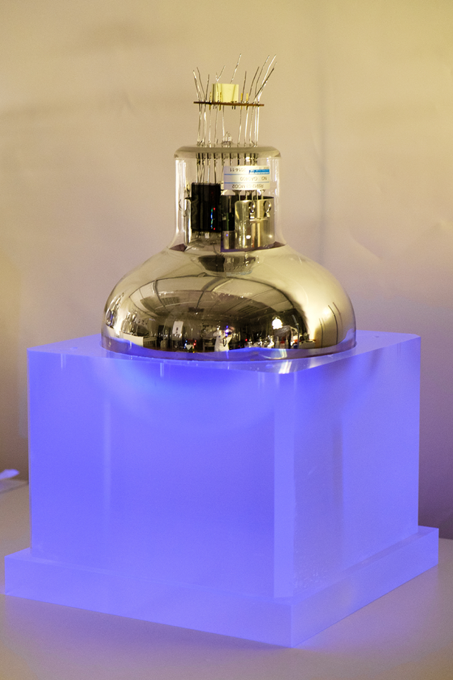
SuperNEMO Calorimeter R&D: Summary
For further details, see:
“Calorimeter development for the SuperNEMO double beta decay experiment”
https://doi.org/10.1016/j.nima.2017.06.044

Slide 22
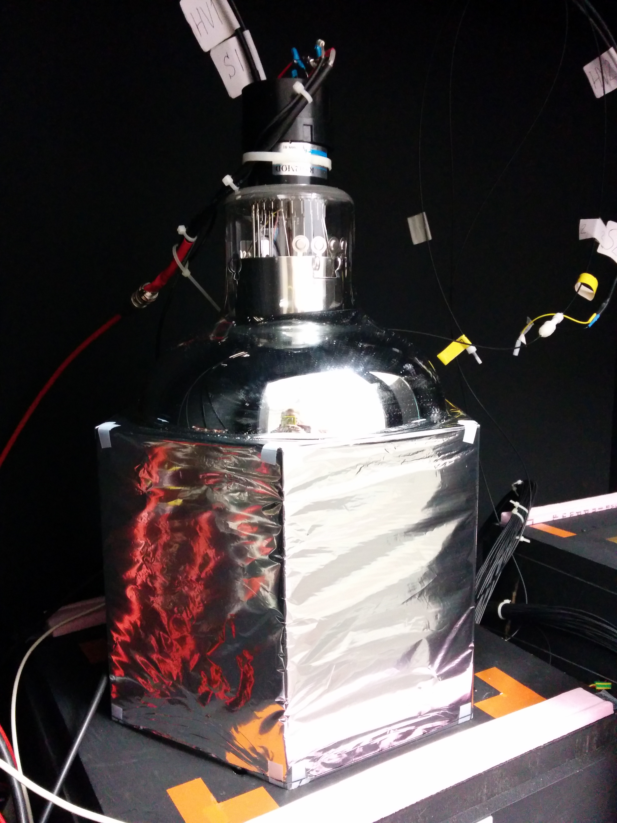
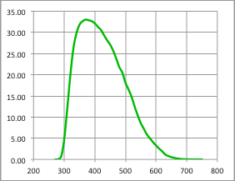
Optimised SuperNEMO Optical Module Design
EJ-200 hexagonal PVT block:
276 mm diameter
193 mm deep, minimum thickness between PMT and scintillator: 100 mm
R5912-MOD Hamamatsu 8” PMT:
Maximum quoted QE: 33%
32% QE at 400 nm
QE (%)
Wrapping:
Sides: 75 μm of PTFE (Teflon) ribbon
Sides and entrance face: 12 μm of Mylar
Wavelength (nm)
Notes:
Note: Since then a couple more improvements (now at 7.2%)

Slide 23
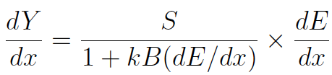
Back to Proton Therapy…
With this fantastic energy resolution of 3.2% σ at 1 MeV can we apply the SuperNEMO optical module technology to proton therapy beam monitoring and proton imaging?
Challenges: from SuperNEMO (electrons) to a proton beam
Very high intensity of events at a proton beam (~10 GHz):
  Random number of protons per bucket from beam, we require 1 proton per bucket
  Pile up!
Scintillator quenching for protons:
  For a plastic scintillator, the scintillator response is nonlinear with the amount of energy deposited in it
  Amount of deviation → “quenching”
  Characterised by Birk’s law:
  Becomes important for large dE/dx and ionisaion density → important for protons, which have a large dE/dx when they slow down
Energy range:
  SuperNEMO optimised for electrons from 0.5 – 4 MeV for double beta decay
  For proton therapy we require ~O(100 MeV)
dY/dx light yield per unit path length
dE/dx energy lost by particle per unit path length
kB relates density of ionisation to energy loss
= 0.207 mm/MeV
S absolute scintillation efficiency
Notes:
A proton beam delivers a random number of protons per bucket, this will worsen the energy resolution measured. We require 1 proton per bucket for a good detector response.

Slide 24
Step 1: GEANT4 Simulations
A 60 MeV proton beam simulated, positioned 30 cm before the entrance face of the scintillator block
  Proton beam has been run through the Clatterbrdige beamline
Scintillator geometry and composition fully described
Quenching of scintillation light in plastic scintillator for protons
Energy deposited smeared according to Poissonian fluctuations in the number of generated photo-electrons
The number of photo-electrons per MeV taken from test bench data (SuperNEMO calorimeter R&D): 982 photo-electrons per MeV
(for an energy resolution of 3.2% σ at 1MeV)
Notes:
Physics list for simulations presented here: User-defined (with EMLIvermore Physics)
Now we use: QGSP_BIC_HP for hadrons and EMLivermore Physics for electromagnetic processes (with an input of 8.5% FWHM, as measured). The new resolution result is 1.53% (very simiar to the 1.48% presented here)

Slide 25
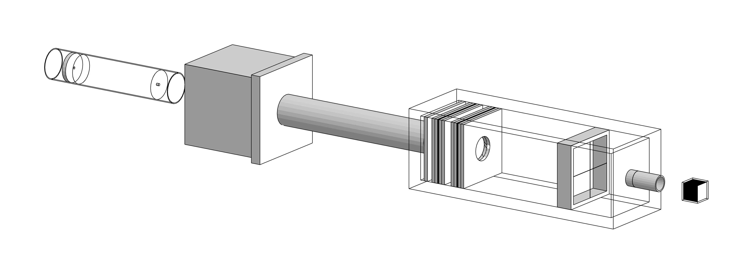
Step 1: GEANT4 Simulations
resulting proton beam
protons
after passing through beamline
Energy deposited in scintillator after beam passes through detector

Slide 26
Step 1: GEANT4 Simulations
Input:
982 p.e. at 1 MeV extrapolated
to 39.2 MeV
Uncertainty on range: 0.3 mm → 1%
Our target!
Use 0.64 % σ as proxy
Quenching from simulations:
  Simulated mean: 39.2 MeV
  Quenching: 35% for 60 MeV protons
Energy resolution from simulations:
  σ: 0.252, μ: 39.21
  σ/E: 0.64 % σ
Notes:
GEANT now implements a solution for quenching when the user provides Birk’s constant for the material.
For a 30cm range we want 0.3 – 0.5 mm accuracy, which is 1%, as simulations show. This is our goal. We actually measure energy resolution, which is 0.63 % sigma, which corresponds to an uncertainty of 1% on range.

Slide 27
Step 1: GEANT4 Simulations
60 MeV protons range out at 30 mm in the scintillator
Notes:
Energy deposition vs. depth of scintillator block, with Bragg Peak clearly seen

Slide 28
Step 1: GEANT4 Simulations
Proton Stopping Distance
Simulations of SuperNEMO scintillator vs Water Equivalent
  Pencil beam simulations
  The SuperNEMO scintillator is water equivalent for stopping distance and spread
    One to one conversion for water phantoms used in medical physics
    An advantage for direct range verification using the “segmented” design
Proton Beam Energy, MeV | Mean stopping distance, SCINT (mm) | Mean stopping distance, WATER (mm) | σ stopping distance, SCINT (mm) | σ stopping distance, WATER (mm)
60 | 30.21 | 30.54 | 0.33 | 0.33
200 | 255.4 | 257.1 | 2.48 | 2.44
300 | 505.9 | 509.9 | 4.64 | 4.78
Notes:
Our detector = water, so this is a big advantage for direct range verification using the segmented design.
Usually you would need a conversion or to use a passive water phantom, but with our design we can do it simultaneously.

Slide 29
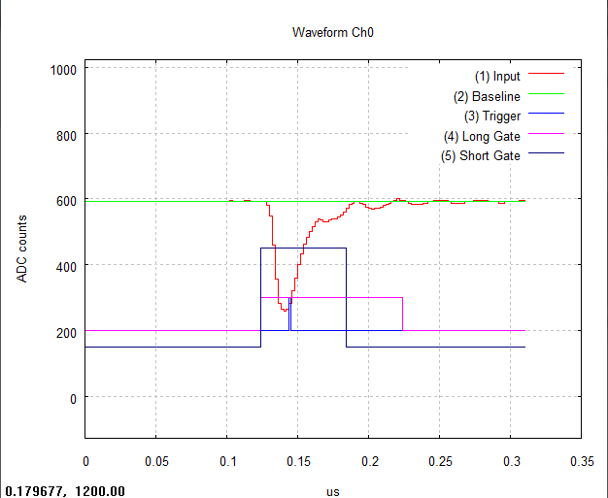
Step 2: Equipment Setup
CAEN DT5751 Digitiser:
Dual-gate signal integration
→ Pulse shape analysis
→ Neutron/gamma discrimination

Slide 30
Step 3: ²⁰⁷Bi Test at UCL
Optical module resurrected after some years: re-measure energy resolution!
  New test bench at UCL: a thin scintillator introduced into set up, which triggers DAQ only when an electron passes through it
  → Gammas removed, fit simplified to triple Gaussian of 976 keV and 482 keV peaks
²⁰⁷Bi Spectrum at 1400V
976 keV conversion electron peak
482 keV conversion electron peak
After:
correction for energy lost in thin scintillator
conversion to MeV
σ/E: 3.6 ± 0.2 % σ at 1 MeV
  σ: 148
  μ: 3460
Notes:
A lot of handling, therefore a little bit of aging, but still within the errors

Slide 31
Step 4: Clatterbridge Cancer Centre
Only currently operational proton beam treatment centre in the UK
Home to the Douglas Cyclotron → produces 60 MeV proton beam for the treatment of ocular melanomas (penetration of 60 MeV protons: 30.5 mm in water)
Double scattering beam technique:
Beam accelerated to single energy
Beam passes through range-shifter wheel that modulates the proton beam energy to reach front/back of target volume
Scatterer enlarges beam to cover whole volume
Collimator shapes outer edge of beam to target area
Notes:
The Clatterbrdige beam is smaller than the target, therefore you need a scatter to enlarge the beam.

Slide 32
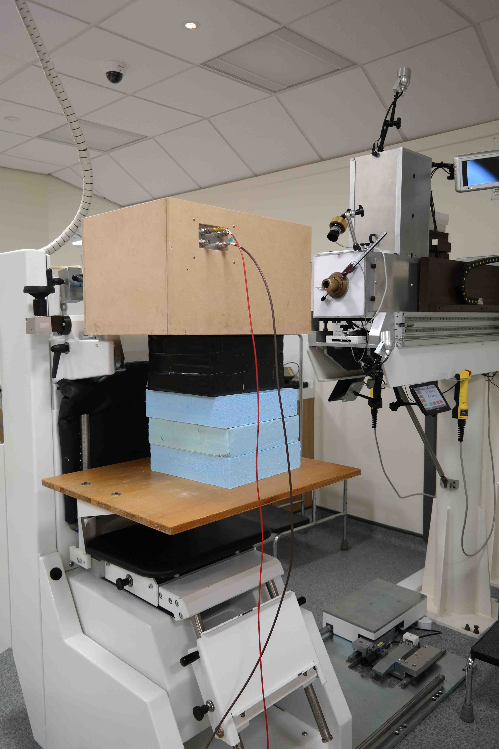
Step 4: Clatterbridge Cancer Centre
Eight full days in total of proton beam access granted to UCL from 2013 - 2016

Slide 33
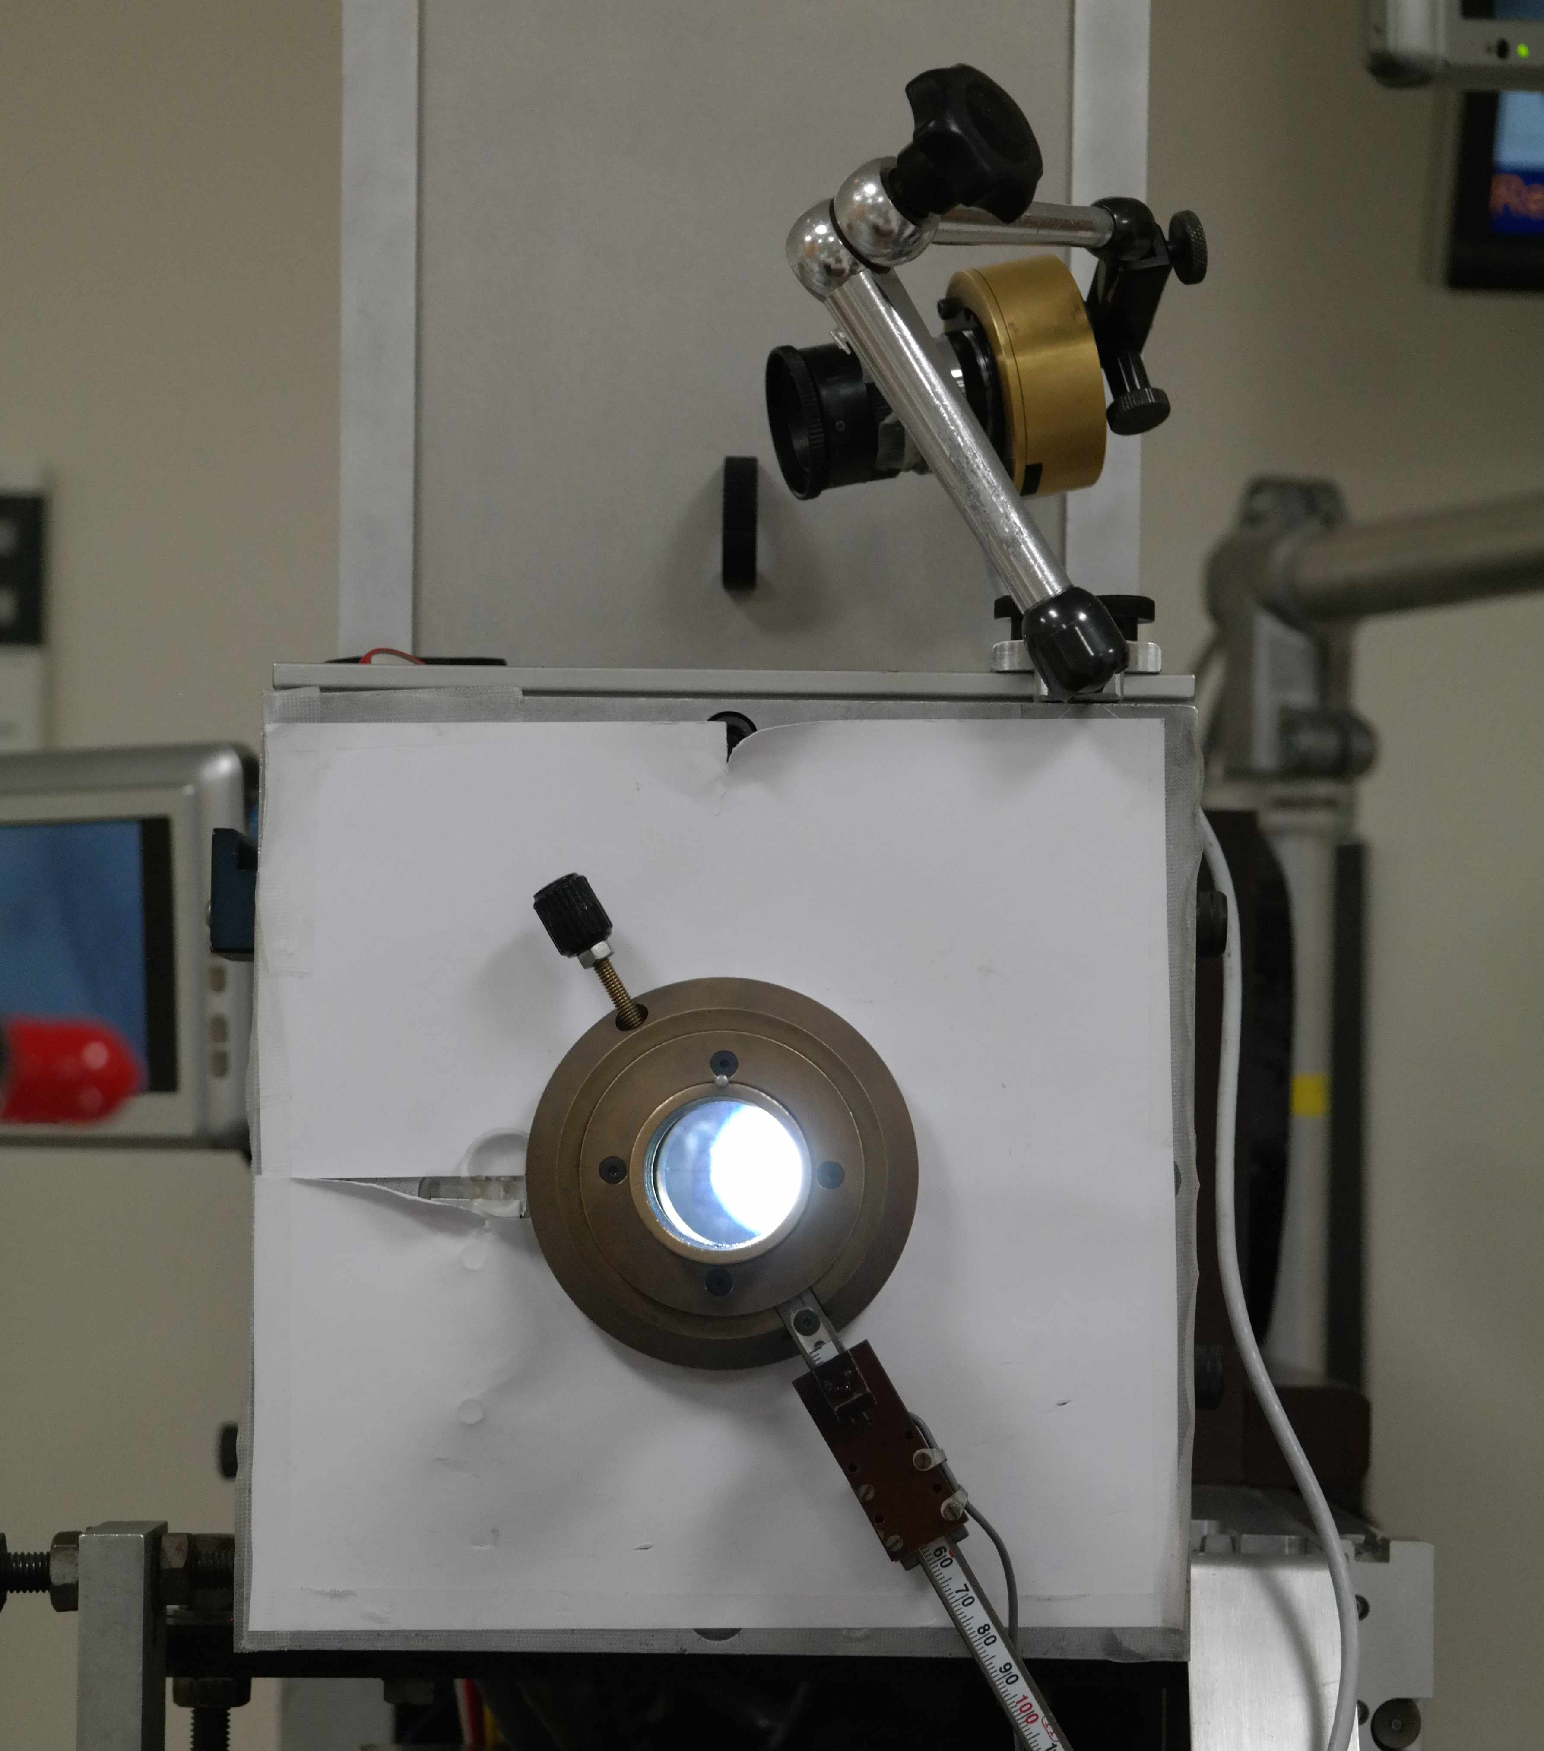
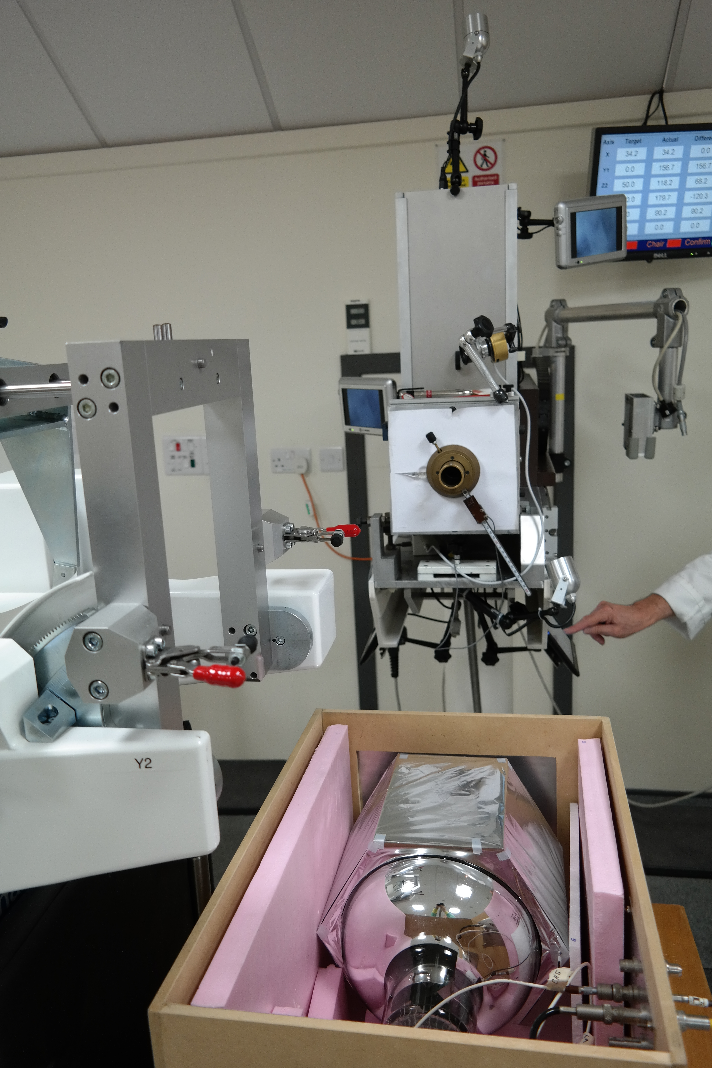
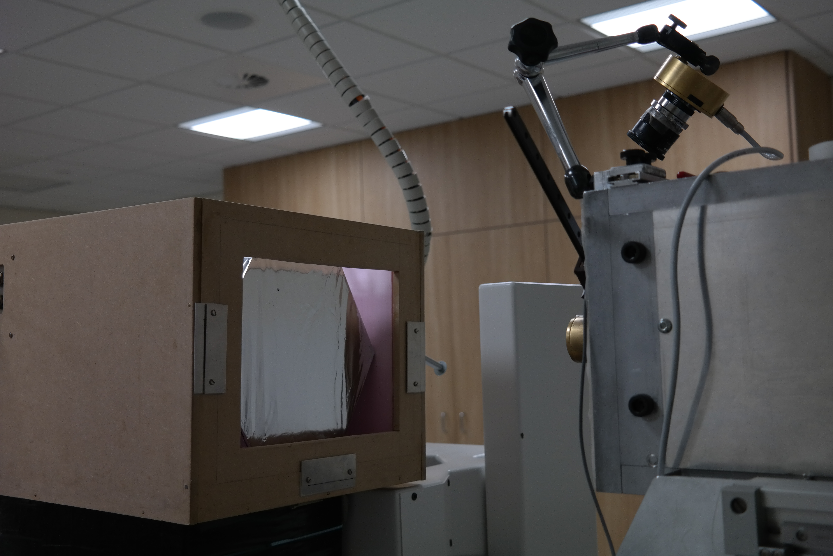
Step 4: Clatterbridge Cancer Centre

Slide 34
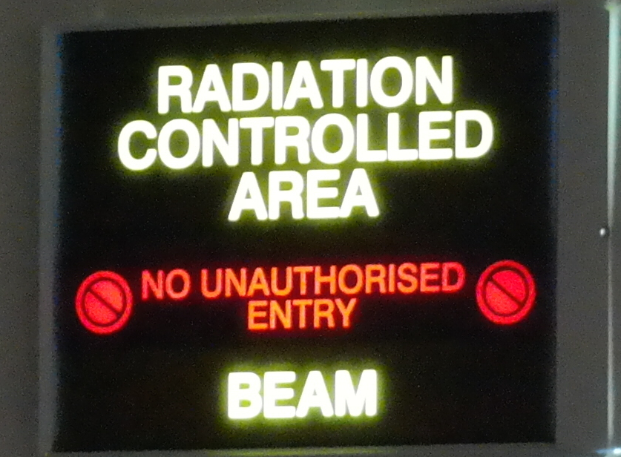
Step 4: Clatterbridge Cancer Centre

Slide 35
Step 4: Clatterbridge Cancer Centre
The proton rate from the beam was carefully controlled by
  Inserting brass collimators with varying diameters
  (0.5 mm – 10 mm) into the beam nozzle
  (~30 cm upstream of the optical module)
  Adjustment of the ion source gas supply
  Adjustment of the cyclotron RF phase
Resulting distribution:
Notes:
For our runs: no discharge current on the gas source bottle, protons are mostly produced by multiple scattering

Slide 36
Step 4: Clatterbridge Cancer Centre
Fitting function:
Convolution of Gaussian and Landau
+ 2nd Degree Polynomial
→ σ/E: 0.74 ± 0.11 % σ (for ~40 MeV due to quenching!)
at 70 kHz
Compared to 0.64 % σ
from simulations
Notes:
Mirror Landau Tail:
Landau tail from fluctuations of energy loss of charged particle by ionisation traversing a thin layer of material (The beam interacting with anything before the scintillator - the Mylar wrapped around the scintillator entrance face, air etc.)
Mirror Landau: due to some energy being lost in the Mylar (energy lost in the foil moves the distribution to lower energies)
Gaussian and Landau convolution: Fluctuation of energy loss from delta-electrons, happens at BEGINNING of event (therefore mirror). Delta-electrons are produced when a freed electron after ionisation has enough energy to cause further ionisation. These delta-electrons have a huge range of energy, therefore you see a very long Landau tail. The ones that escape without further interaction are seen as missing energy. Note: This also happens inside of the detector, but since we see all of the interactions in there all of the energies are summed up and this evens out by the time we look at the total energy deposit.
Pol2: generic shape to fit background

Slide 37
Step 4: Clatterbridge Cancer Centre
MC
DATA
Our simulations accurately represent our data!

Slide 38
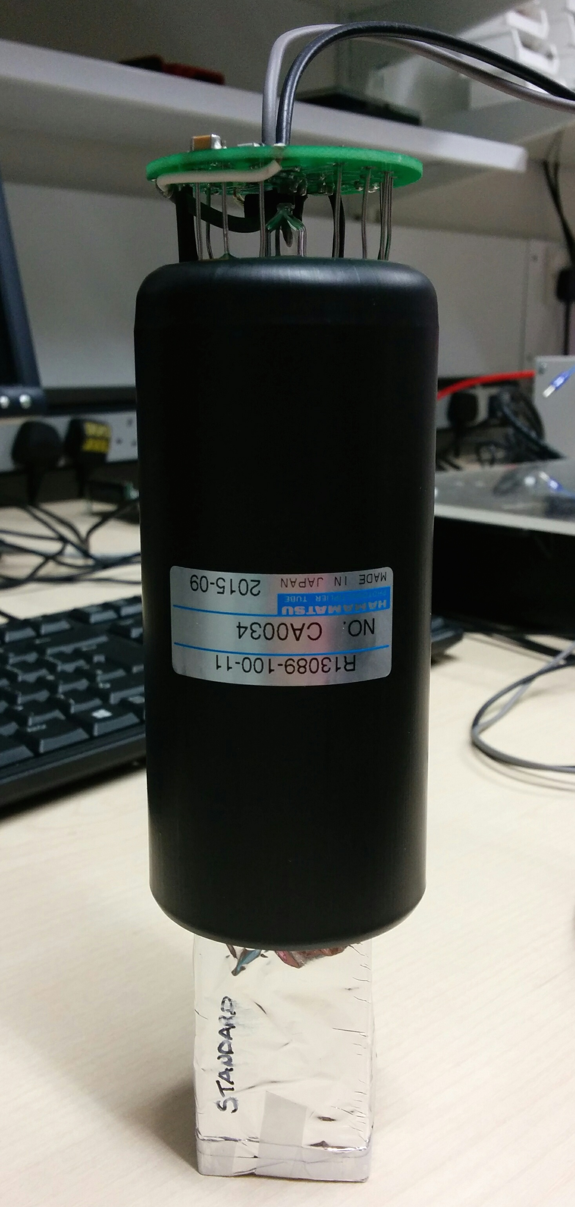
Step 5: Make the Technology Smaller & Faster
We have already achieved the target energy resolution: 0.7 % σ
But, at rates > 250 kHz we start to see pile up
The next step is to do this for very high rates of 1 – 10 MHz with a compact design:
  Reduce the size of the PMT and the scintillator to improve timing and make the design nozzle-mountable
  -VE HV PMT base to remove decoupling capacitor (not fast enough discharge)
2” Hamamatsu R13089-100-11 PMT with negative HV active divider base
  3 cm x 3 cm x 5 cm cuboid ENVINET/NUVIA PS scintillator
  Coupled with BC-630 Saint Gobain silicone optical gel
Wrapped in 75 μm of PTFE (Teflon) ribbon on the sides and 12 μm of Mylar on the sides and entrance face
Treatment Nozzle
Notes:
For our runs: no discharge current on the gas source bottle, protons are mostly produced by multiple scattering

Slide 39
Step 5: Make the Technology Smaller & Faster
→ σ/E: 0.97 ± 0.11 % σ (for ~40 MeV due to quenching!)
at 25 kHz
We are still at our < 1 % σ target!
Notes:
Energy resolution here could be worse due to the scintillator being PS instead of PVT – consistent with 207Bi test bench measurements.
For our runs: no discharge current on the gas source bottle, protons are mostly produced by multiple scattering

Slide 40
Energy Dependence on Resolution
Energy of protons incident on scintillator varied by placing absorbers (PMMA plates and calibration wheel) of known thickness ~1.8 m upstream of the optical module
dependence!
Notes:
Comment regarding poor fit, answer:
The “badness” of the fit is dominated by low energy points. These are not as well measured/fitted because of the beam going through a large amount of PMMA and hence causing a lot of scattering etc./making the beam fuzzy.

Slide 41
Linearity: -900 V
We want to run the PMT at higher voltages (can run at up to 1500V) as this will increase the PMT’s collection efficiency and will improve the energy resolution
BUT we have a LOT of light (tens of thousands of photo-electrons) so we need to make sure we are not saturating the PMT
  Look at linearity
For - 900V:
Deviation from linearity < 2%!
Notes:
Note: systematic errors under investigation (if asked)

Slide 42
Beam Uniformity Measurements
0.5 mm Ø collimator
Uniform 8 mm away from the centre
16 mm away from the centre is 1mm away from the beam edge
  Currently trying to understand these edge effects
Okay to use collimators to reduce rates!
Notes:
For now we can conclude that the beam is uniform and that reducing rates using a collimator whilst keeping nominal beam operating conditions is a valid method to get the beam down to measurable rates.
So – although single module isn’t the front runner this shows that we could potentially use collimators (with a one off measurement to start with) at pbt facilities and hence use the single module for QA

Slide 43
Radiation Damage Assessment
Total estimated radiation dose received by 2” OM: 0.25 Gy
No noticeable difference in resulting energy resolution so far.
Date | HV Supply | DAQ | σ/E (%)
27/07/16 | Portable | UCL | 3.16 ± 0.03
28/07/16 | UCL | UCL | 3.14 ± 0.03
Clatterbridge Test Beam: 02-03/08/16
04/08/16 | UCL | UCL | 3.08 ± 0.03
Notes:
The plots imply a change in gain (but not in energy resolution, as numbers show). This could be due to the PMT being switched off, packaged up, unpackaged etc. – gain CAN change.
²⁰⁷Bi tests carried out at -1700 V:
before test beam: 27-29/07/2016
after test beam: 04/08/2016

Slide 44
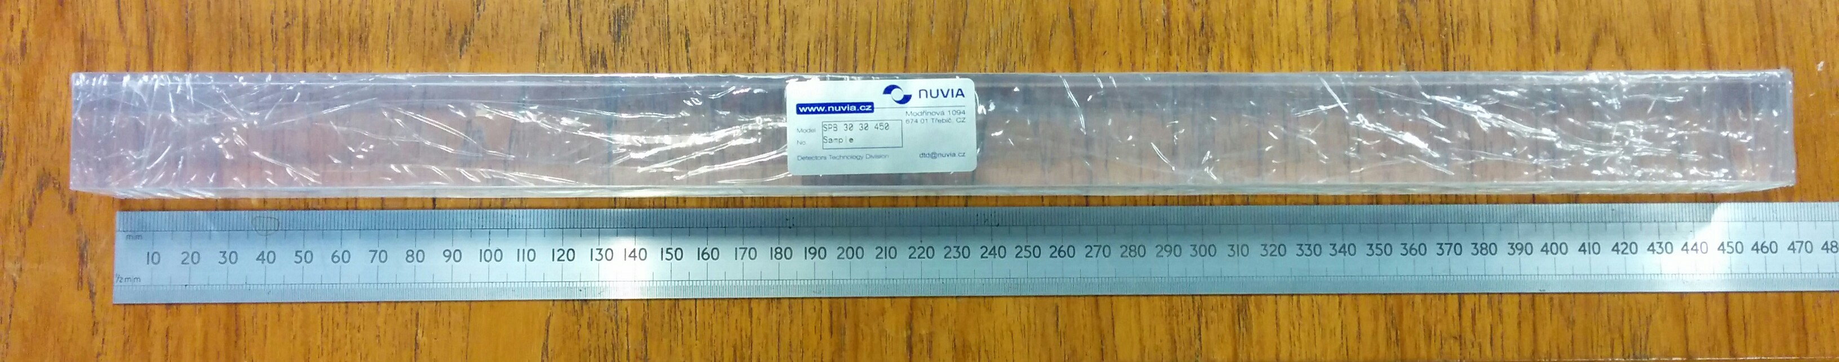
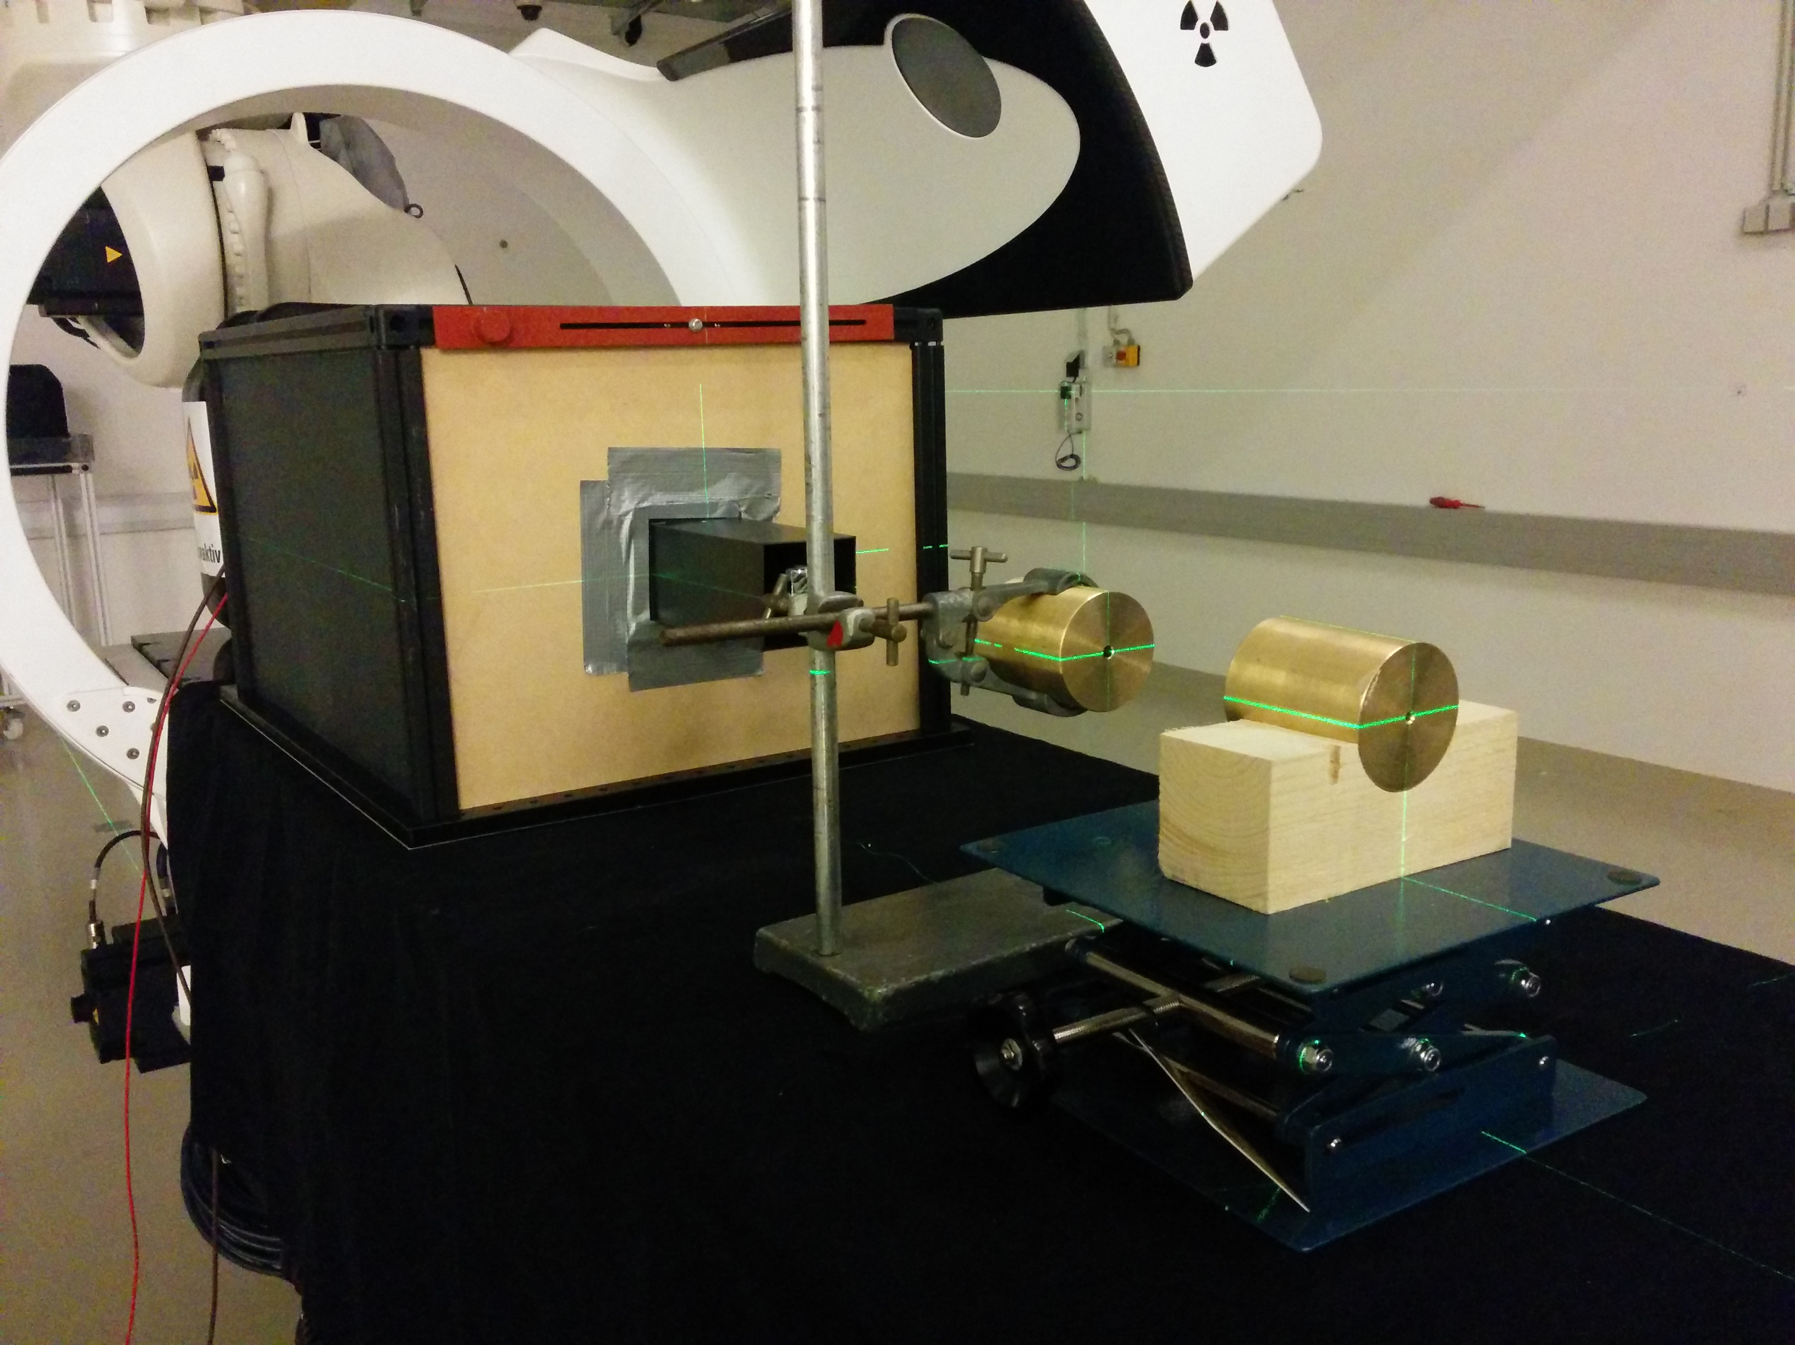
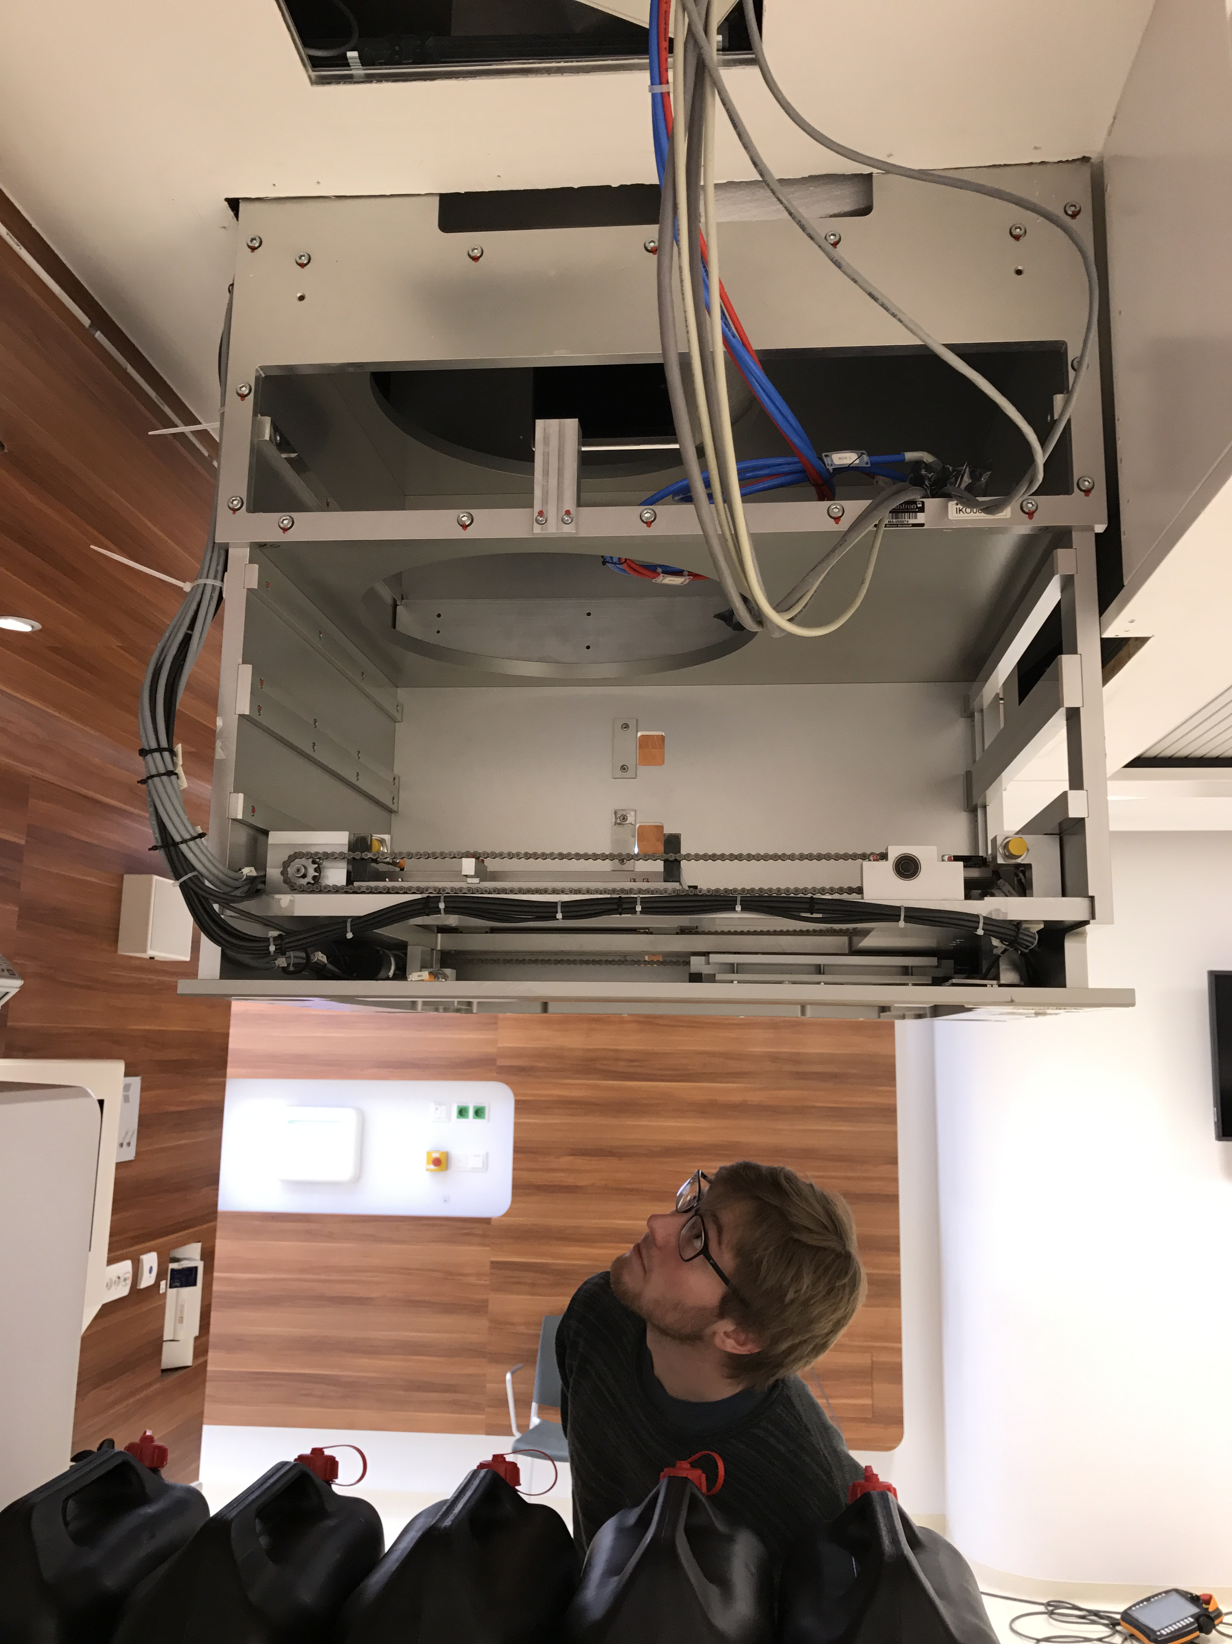
Step 6: 250 MeV Beam at medAustron
First external collaborators to use research room at the medAustron proton beam therapy centre in Austria!
Two nights of tests:
  Scintillator length increased to 45 cm to contain 250 MeV beam
  62 – 252 MeV beam
  Rate adjusted down with chopper magnet
    1 kHz–1 MHz
  Custom collimators to reduce intensity and beam size

Slide 45
Step 6: 250 MeV Beam at medAustron
Still seeing excellent energy resolution up to 252 MeV!
Best resolution 0.2% σ
But also still seeing rate issues:
  PMT current limit from too much light!
  Detector not fast enough for 10¹⁰ p/s clinical rate
In close collaboration with Hamamatsu to develop a new kind of light detector:
  High QE (photocathode) of PMT
  Lower gain of 10³
  Low noise
  Currently experimenting with bases

Slide 46
Summary for Single Module Measurements
An optical module inspired by the SuperNEMO experiment has measured the 60 MeV proton beam at Clatterbridge with an energy resolution of:
And a 250 MeV proton beam at medAustron with an energy resolution of 0.2 % σ
A great result for protonCT
But this single module isn’t fast enough to handle clinical proton rates and therefore is not currently suitable for QA range verification
Ongoing work to improve timing in collaboration with Hamamatsu
Goal to reach 10 MHz
→ Design a segmented calorimeter to be used as a range telescope!
0.97 ± 0.11 % σ
(for 40 MeV “visible” energy)
This has reached the target energy resolution of
< 1 % σ

Slide 47
Segmented Calorimeter: Range Telescope
Clinical facilities operate at much higher rates of ~ 10⁹ – 10¹⁰ protons/sec
We need to reach these rates for a feasible QA system
R&D for a new multi-layer scintillator design to verify the range directly:
  Segment block into slices and read out light from entire spill (not single proton) from each slice individually
  Map out the Bragg Peak
  No need for energy-range conversion, measure range directly
  Our plastic scintillator is water equivalent!
  Minimum slice width will depend on manufacture: aiming for < 3 mm
  Use simple, stable light detection: photodiodes/pixel sensors
Protons
Notes:
Water equivalent PS =

Slide 48
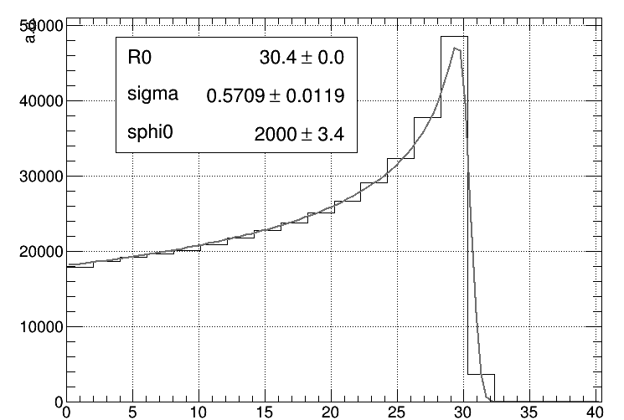
Segmented Calorimeter: Range Telescope
Current R&D:
  Collaboration with NUVIA in Czech Republic to manufacture 2 – 3 mm scintillator sheets. Challenging due to uniformity!
  Testing and researching best detector to couple scintillator sheets to
  Simulations to characterise light quenching to reconstruct Bragg curve carried out by Laurent
    Quenching included in Bortfeld formula
    Fit to light output
Dose deposited
Light emitted
60 MeV protons
Notes:
Laurent built preliminary model in GEANT4, using 2mm scintillator slices with mylar wrapping.
Included quenching in Borfeld formula.
Need to characterise light quenching to reconstruct Bragg curve

Slide 49
Segmented Calorimeter: First Tests
Fist tests carried out using the Birmingham cyclotron:
  28 MeV proton beam,
  range of protons ~ 6 mm
  Clinical rates
  2 sheets of 3 mm and 4 mm NUVIA scintillator used to
  PRaVDA Priapus MAPS pixel sensor (10 cm x 5 cm)
MC
MC
protons

Slide 50
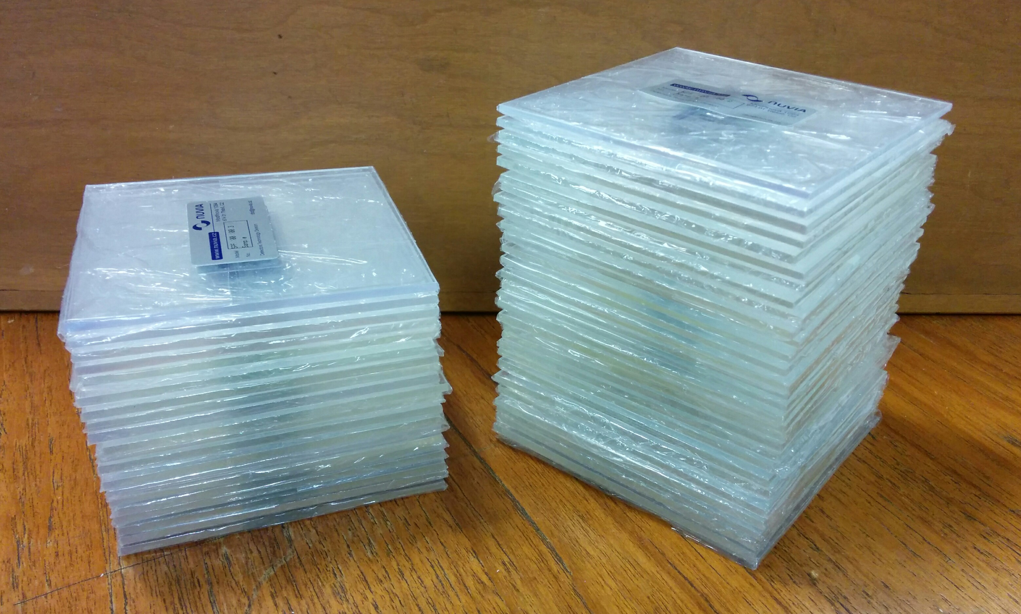
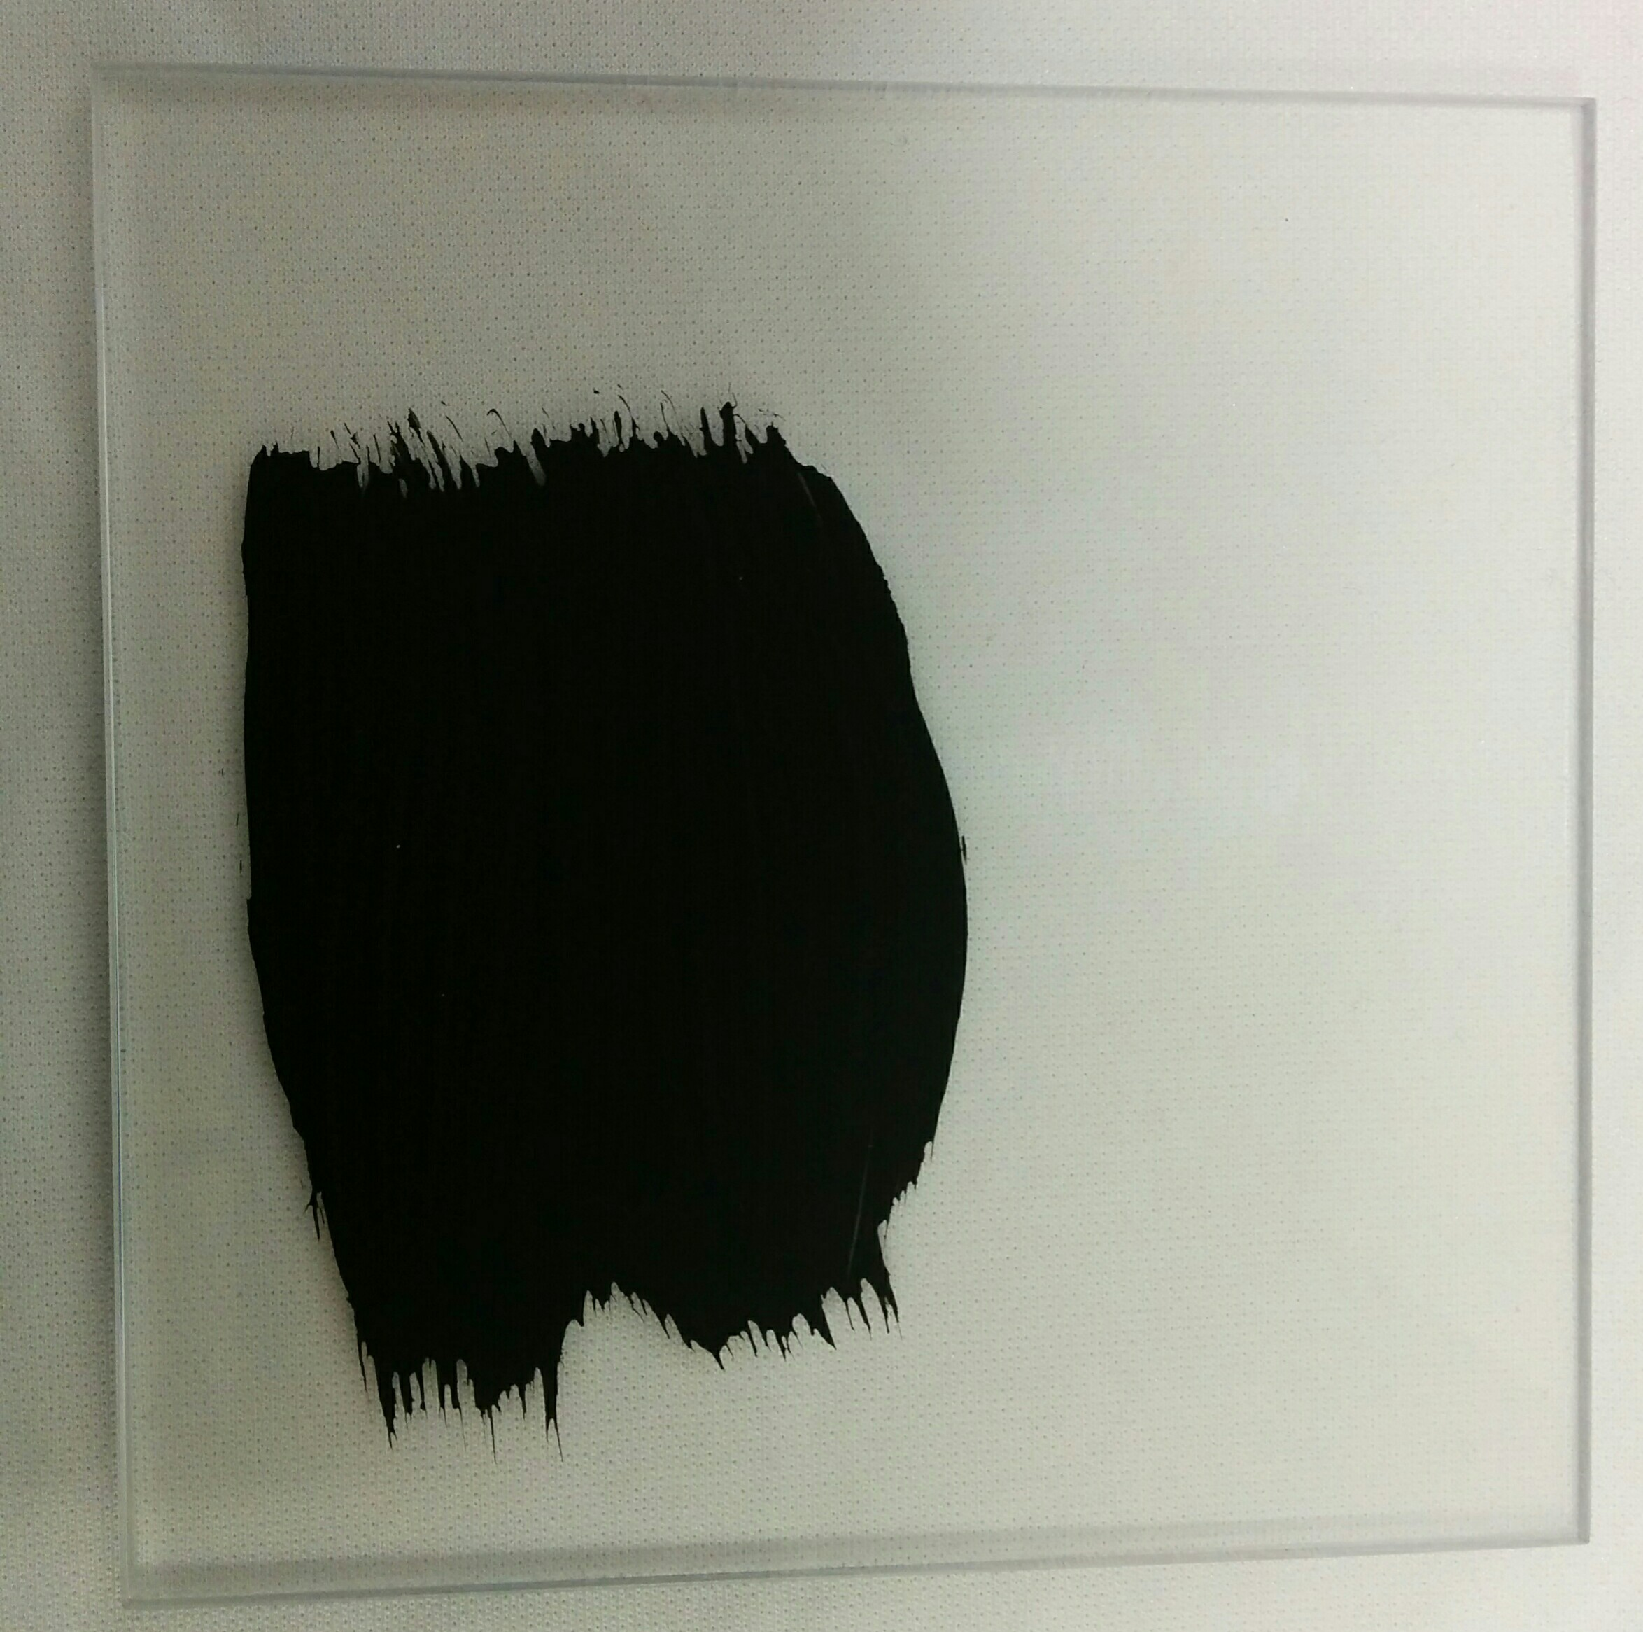
Current Work & Future Plans
Construct 60 MeV prototype using:
  20 x 3 mm and 30 x 2 mm scintillator sheets obtained from NUVIA
  Tests ongoing to determine the best method to isolate sheets from each other and reduce light output (we have too much light!)
  Clinical beamline tests lined up for the near future:
    Birmingham, Clatterbridge and medAustron
  Look at overall performance, radiation hardness and quenching at high rates

Slide 51
Acknowledgements
UCL participation in this work:
Simon Jolly, Ruben Saakyan, Derek Attree,
Anastasia Basharina-Freshville, Laurent Kelleter, Matthieu Hentz
A HUGE thank you to Andrzej Kacperek and the fantastic team at Clatterbridge, the medAustron team and the Birmingham team for all of their expertise and help!

Slide 52
Back Up Slides

Slide 53
First Test Beam Details
The proton rate from the beam was carefully controlled by:
  Inserting brass collimators with varying diameters (0.5 mm – 10 mm) into the beam nozzle (~30 cm upstream of the optical module)
  Adjustment of the ion source gas supply
  Adjustment of the discharge current
  Adjustment of the cyclotron RF phase
Over the four days of test beam the dependence of measurements on the following parameters was studied:
  Collimator diameter size (0.5 mm – 10 mm)
  Beam settings
  Operating voltage of the PMT (800 V, 900 V)
    Increasing HV increases collection efficiency of the PMT and therefore
    achieves a better energy resolution
    Note: standard operating HV for this PMT is 1500V, but due to such
    high light levels ( 100,000 photons → 30,000 photo-electrons) reduce HV
  Integrating window of acquisition on the CAEN digitiser
  (50 ns, 100 ns, 200 ns): sensitive to pile up effects
Notes:
For our runs: no discharge current on the gas source bottle, protons are mostly produced by multiple scattering

Slide 54
8” PMT + Hexagonal Scintilator: 0.67 ± 0.11 % σ

Slide 55
8” PMT + Hexagonal Scintilator: 0.67 ± 0.11 % σ

Slide 56
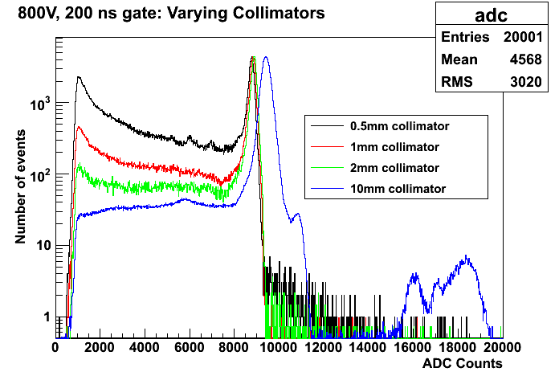
Pile Up: Varying Collimators
Protons scattering off the collimator increases with diameter decrease
To avoid pile up:
Optimal collimator: 2mm diameter
Keep integrating window small to only collect 1st proton pulse
More than 1 proton per bucket for larger diameter collimators, causing peak to widen

Slide 57
Considering Measuring Parameters
PMT HV (V) | Acquisition window (ns) | Collimator diameter (mm) | Energy resolution, % FWHM
800 | 50 | 2 | 1.6 ± 0.18
800 | 100 | 2 | 1.58 ± 0.27
800 | 200 | 2 | 2.11 ± 0.42
900 | 50 | 2 | 1.1 ± 0.13
900 | 100 | 2 | 0.97 ± 0.16
900 | 200 | 2 | 1.27 ± 0.19
800 | 200 | 3 | 2.32 ± 0.43
800 | 200 | 4 | 2.16 ± 0.41
Reducing the acquisition gate from 200ns to 100ns shows considerable improvement (ensures we only look at 1 proton).
But we don’t win anything with a 50ns gate.
At 900 V:
Improved energy resolution but are we linear at 900 V?
(See later)
Further confirmation that 2mm diameter collimator is optimal for reducing intensity
Our optimal parameters for measurements are:
PMT HV: 800 V
Acquisition window: 100 ns
Collimator diameter: 2 mm

Slide 58
Energy Dependence on Resolution
Energy of protons incident on scintillator varied by placing absorbers (PMMA plates) of known thickness ~1.8 m upstream of the optical module
dependence!
Notes:
Evidence (from such a good chi^2), that the errors are overestimated for the 200ns gate. This could be because of the pile up we see with the 200ns gate, which is not included in the model of the fit.

Slide 59
Intrinsic Energy Resolution of Optical Module
How much of the measured energy resolution is due to the proton beam and how much is due to the “intrinsic” energy resolution of the detector?
From MC (1.48%) we already know that most of the energy resolution measured with the proton beam (1.58 ± 0.27) is from the intrinsic resolution of detector:
  Use MC and data to put a limit on the energy spread of the 60 MeV Clatterbridge beam:
Also tests carried out at UCL:
  Pulse PMT with a 400nm LED at an amplitude and width that will give a peak at the same ADC counts as the proton beam spectra
  Fit the acquired spectra with a Gaussian and extract energy resolution
  Proton energy spread: 0.65 ± 0.66 % FWHM
  or limit on spread: FWHM (60 MeV): <1.56% at 90% CL
BUT: LED is operating at very “high” parameters (~8V and 40ns width), therefore the width is very sensitive to noise and the LED distribution would be better monitored with a device such as a pin diode
→ future measurement!
Notes:
To place limit on energy spread of beam:
We can trust our MC simulation (input from a measurement at 1 MeV), and from the MC we can see that with the measurement we are close to the intrinsic energy resolution of the detector. The simulation uses a pencil beam, therefore any difference between the two is due to the proton beam spread. However, the difference will be 0 (if we input 8.5% into the simulation as what we actually measure (rather than 7.5%) the energy resolution will slightly worsen), therefore use the error to look at the limit.
For a 90% CL, we want 1.64 * sigma, therefore 1.64 * 0.27 = 0.44 %
Therefore limit < .044% at 90% CL.

Slide 60
Intrinsic Energy Resolution of Optical Module
Similar at 60 MeV
Proton beam energy resolution much worse than intrinsic energy resolution at lower energies due to scattering of protons

Slide 61
Linearity: 800 V
We want to run the PMT at higher voltages (can run at up to 1500V) as this will increase the PMT’s collection efficiency and will improve the energy resolution: 0.97 ± 0.16 % FWHM from measurements (900V, 100 ns gate)
BUT we have a LOT of light (tens of thousands of photo-electrons): can we trust this result?
  Look at linearity
1.54 %
1.69 %
1.99 %
For 800V:
Deviation from linearity < 2%!

Slide 62
Measuring Quenching
Fitting linearity curves gives us a measurement of scintillator quenching:
Fitting procedure:
1: 1st degree polynomial (32-44 MeV)
2: 2nd degree polynomial (44-60 MeV)
3. Parameters extracted from 1 and 2 put into “combined” 1st degree and 2nd degree polynomial over entire range
Quenching = pol1 const + pol2 const
(Remember: 20.57 MeV from simulations)
2
1
Gate (ns) | Quenching (MeV)
50 | 19.69 ± 0.12
100 | 19.67 ± 0.12
200 | 19.69 ± 0.13
Notes:
Work in progress on errors (make sure root is calculating the chi^2 from the errors for the x axis, it may automatically take the y axis errors)

Slide 63
Linearity: 900 V
9.67 %
10.19 %
12.27 %
For 900V:
Deviation from linearity > 10%
Can non-linearity be accurately accounted for?
Notes:
Work in progress on errors (make sure root is calculating the chi^2 from the errors for the x axis, it may automatically take the y axis errors)

Slide 64
“Unfolding”: Getting a Grip on Non-Linearity
For our 900 V data we see non-linearity > 10 %
BUT can we take into account non-linearity of our equipment to “unfold” the true energy resolution?
We want to be able to do this:
  To potentially increase HV even further (to 1000 V or above) to increase collection efficiency and hence improve the energy resolution
  For proton imaging: requires protons > 300 MeV, which will give a huge amount of light and non-linearity will be inevitable
Work currently on-going to determine the best way to:
  Convert the data from ADC counts to MeV (“visible energy” due to quenching)
  Fit the visible energy data to extract the “unfolded” energy resolution (with non-linearity taken out)
  Compare results for 800 V and 900 V

