Slide 1
MPHYGB17 – Clinical Practice Anatomy and Physiology
Lecture 2 –Musculo-Skeletal and Locomotor System
Sabaena Imran
sabaena.imran@ucl.ac.uk

Slide 2
Bones – Joints - Skeleton

Slide 3
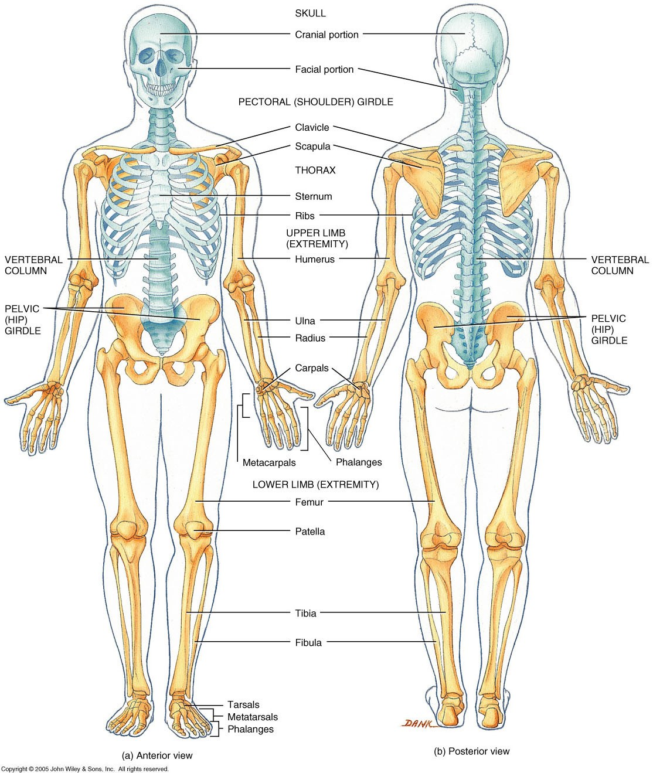
Divisions & Functions of the Skeleton
3
Axial
  Skull
  Vertebral column
  Thorax
Appendicular
  Upper limb
  Lower limb
Support
Protection
Movement
Calcium storage
Haematopoiesis

Slide 4
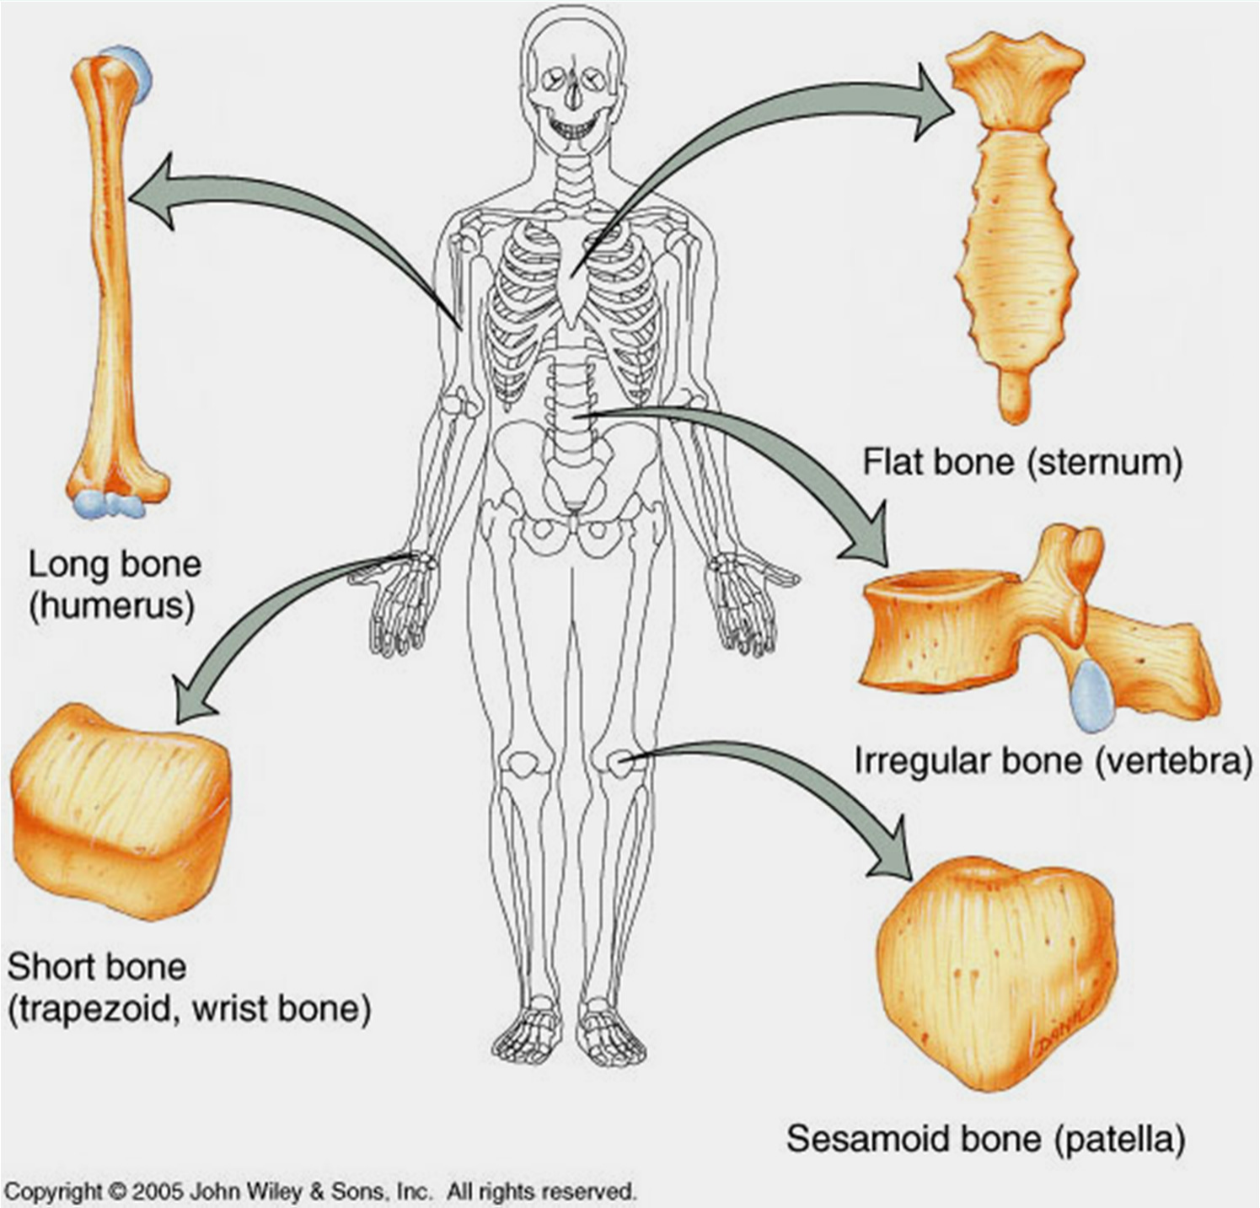
Types of Bones
Long
  humerus
Short
  carpal
Flat
  sternum
Irregular
  vertebrae
4

Slide 5
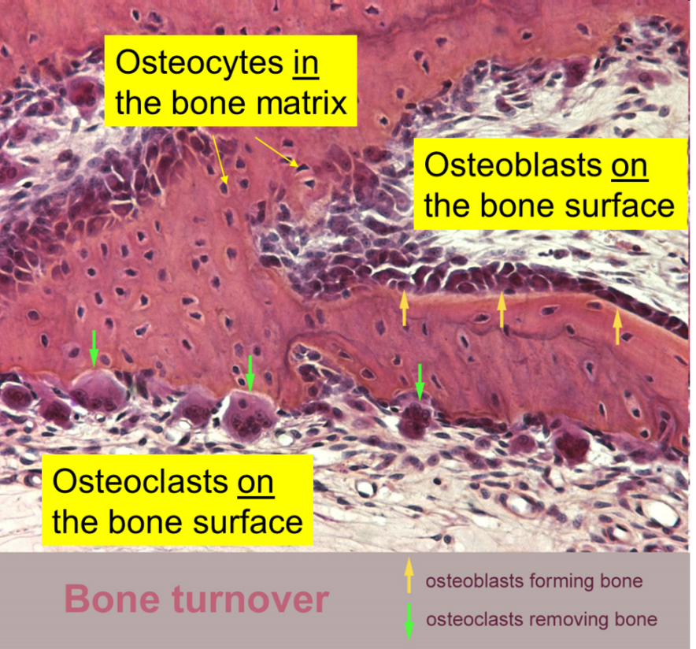
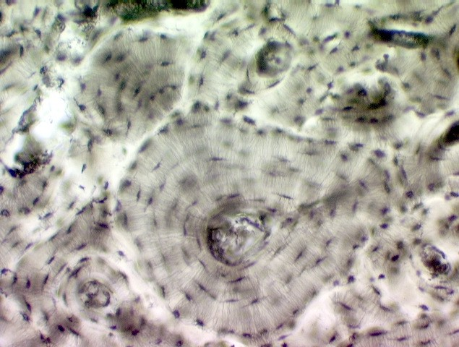
Bone Tissue
Bones tissue consists of ;
cells,
fibers and
extracellular matrix (ECM) made up of type one collagen
The combination of hard mineral and flexible collagen makes bone harder than cartilage without being brittle

Slide 6
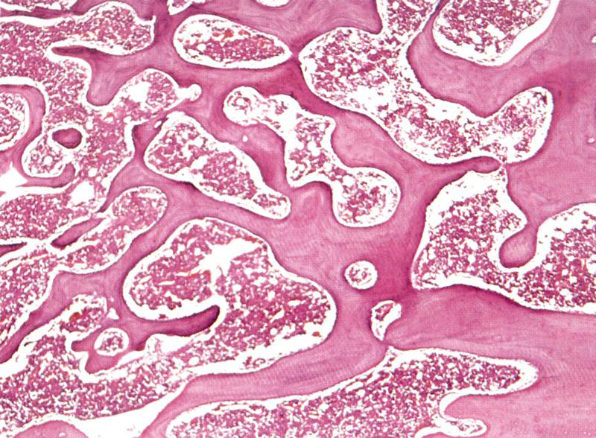
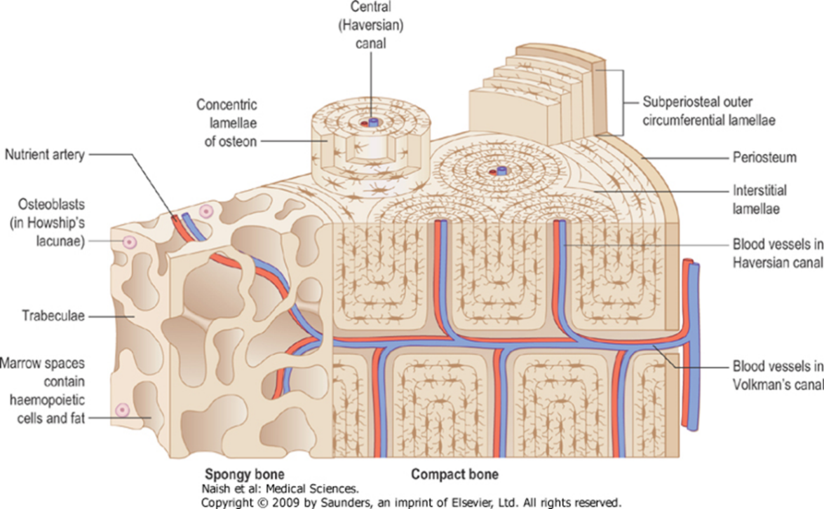
Structural types of bones
Cortical (Compact) Bone:
- with a dense outer layer- the cortex
- This structure resists bending
Spongy (Cancellous or trabecular) Bone
- Tissue is located beneath the compact bone and consists of a meshwork of bony bars (Trabeculae) with many interconnecting spaces filled with bone marrow.

Slide 7
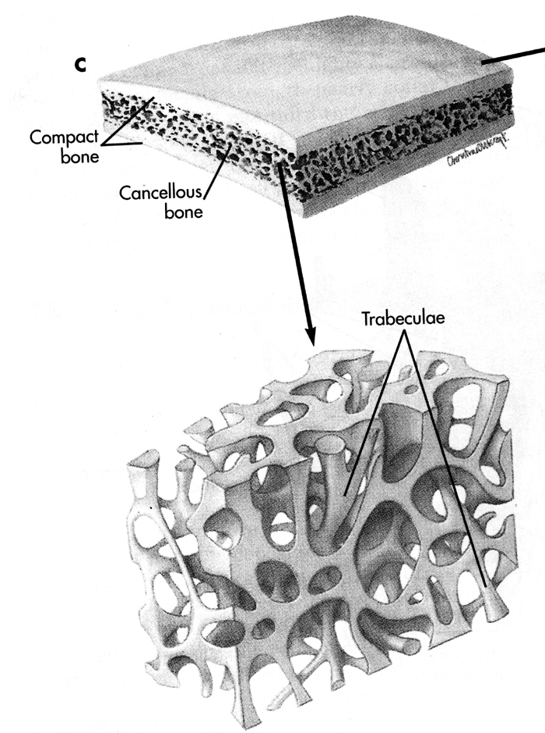
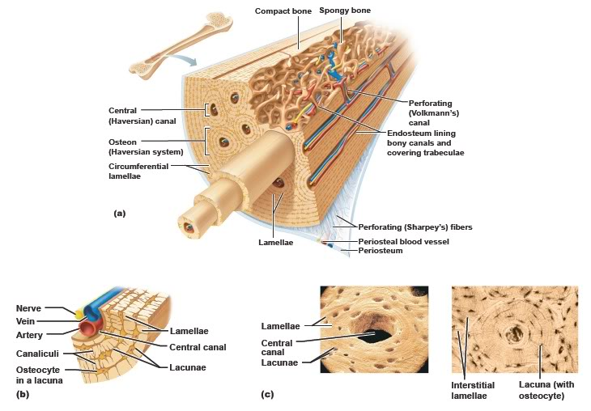
Structure of Long Bones
5
Compact bone, Spongy bone

Slide 8
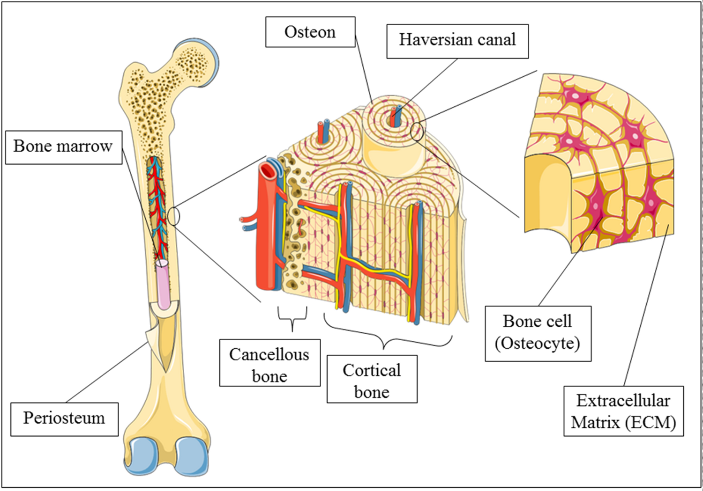
Compact bone ( Lamellar Bone)
forms the outer ‘cortical’ shell of most bones- eg. the dense walls of the shaft of long bones
It is organised into bony columns called osteons with central Haversian canals which convey blood to the surrounding osteocytes

Slide 9
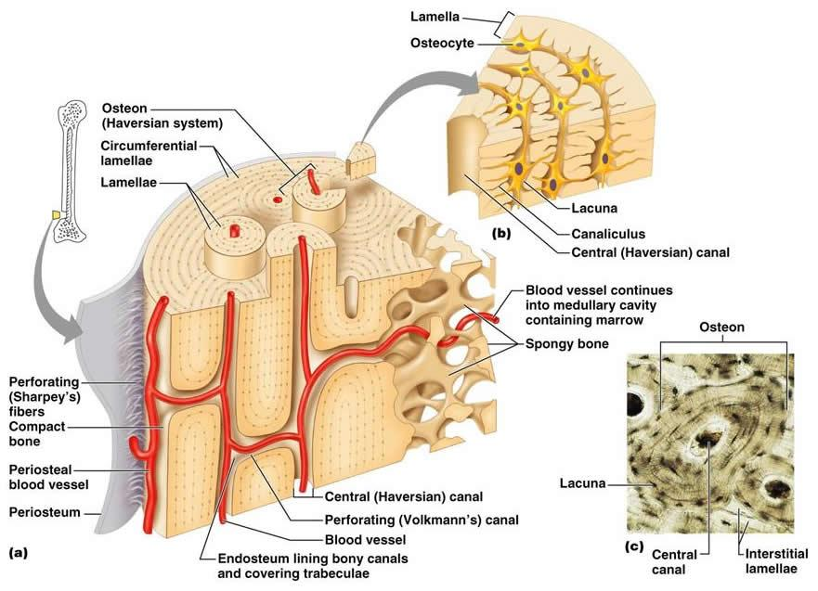
Compact Bone

Slide 10
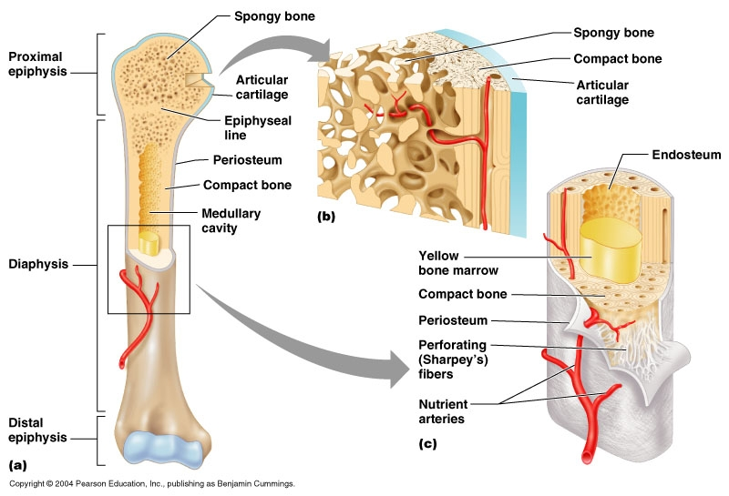
Trabecular, Cancellous (spongy) bone
Bone organised in beams or spicules along lines of stress - strong but lightweight
no osteons; blood supply is obtained from outer
surfaces-- spaces between trabeculae are filled
with bone marrow
found in central ‘medullary’ portions of
most bones. (Long bones have a central
marrow cavity surrounded by the
trabecular portion)

Slide 11
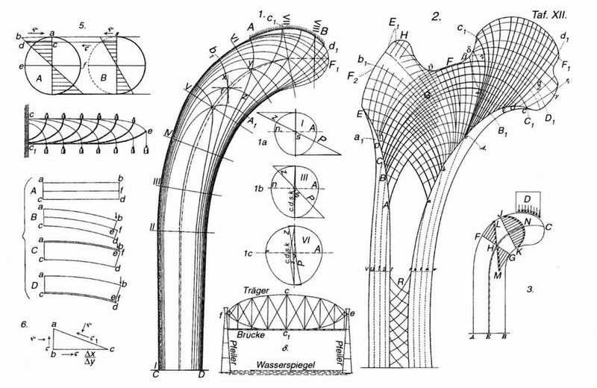
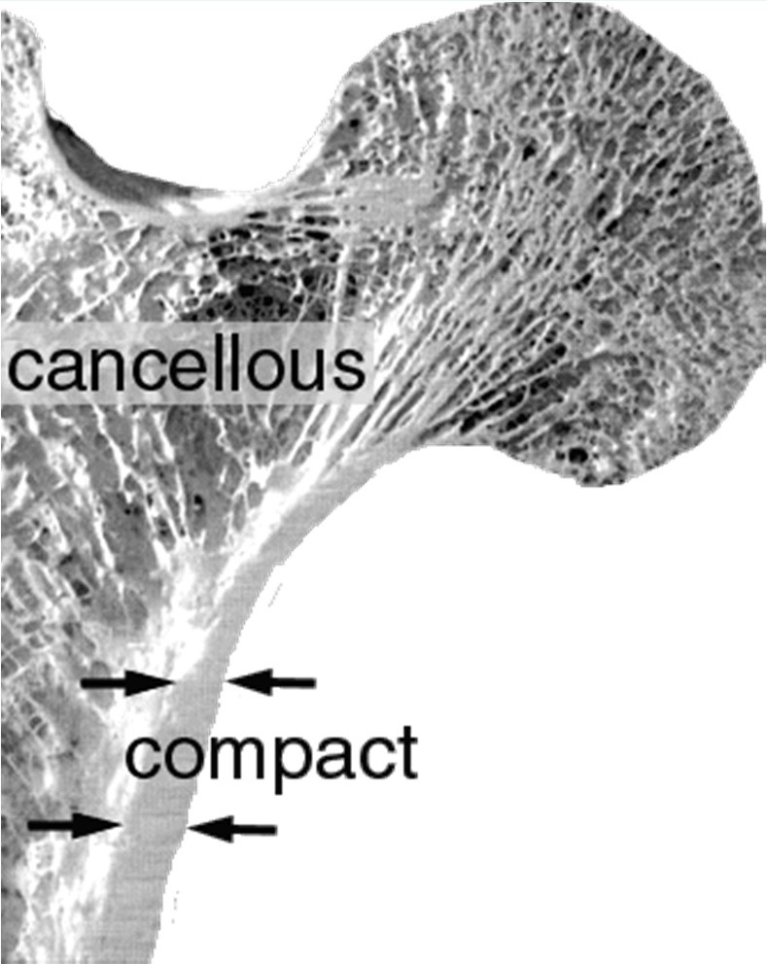
Wolf’s Law
Stress trajectories in a cane design (left) compared with trabeculae in a femur (right)
This comparison led Wolff to formulate his famous law on bone adaptation:
“Bone in a healthy person or animal will adapt to the loads it is placed under” or in a more modern version:
“Bone changes its external shape and internal (spongy) architecture in response to stresses acting on it”

Slide 12
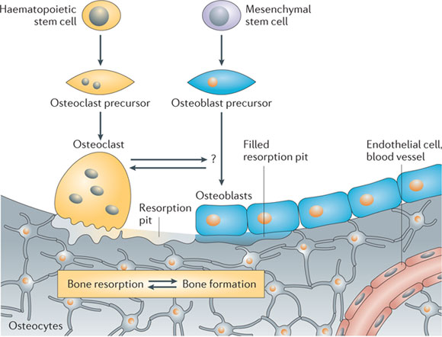
Bone Cells
Osteocytes-
Maintain bone, mechanosensors
Osteoblasts-
Secrete osteoid,
form bone
Osteoclasts-
resorb bone

Slide 13
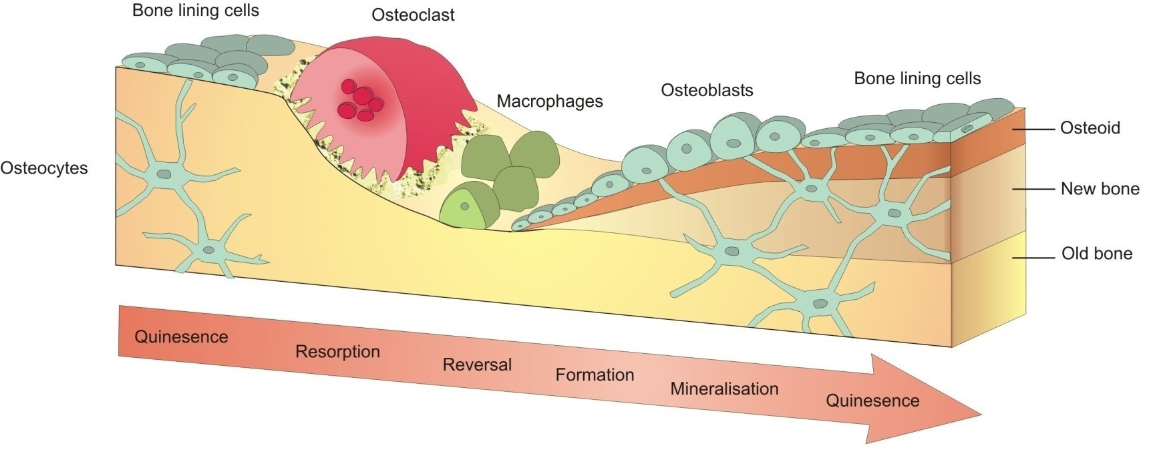
Bone Modelling and Remodelling
Osteoclasts break down bone tissue by removing its mineralized matrix and resolving the organic bone
Osteoblasts deposit a collagen (flexible) matrix but they also release calcium, magnesium and phosphate ions, which chemically combine and harden within the matrix into the mineral hydroxyapatite
Calcium and phosphate ions are released into the blood stream
Osteoclasts and osteoblasts are crucial for the control of the amount of bone tissue and blood calcium level and their activity is under strong hormonal control (Vitamin D)

Slide 14
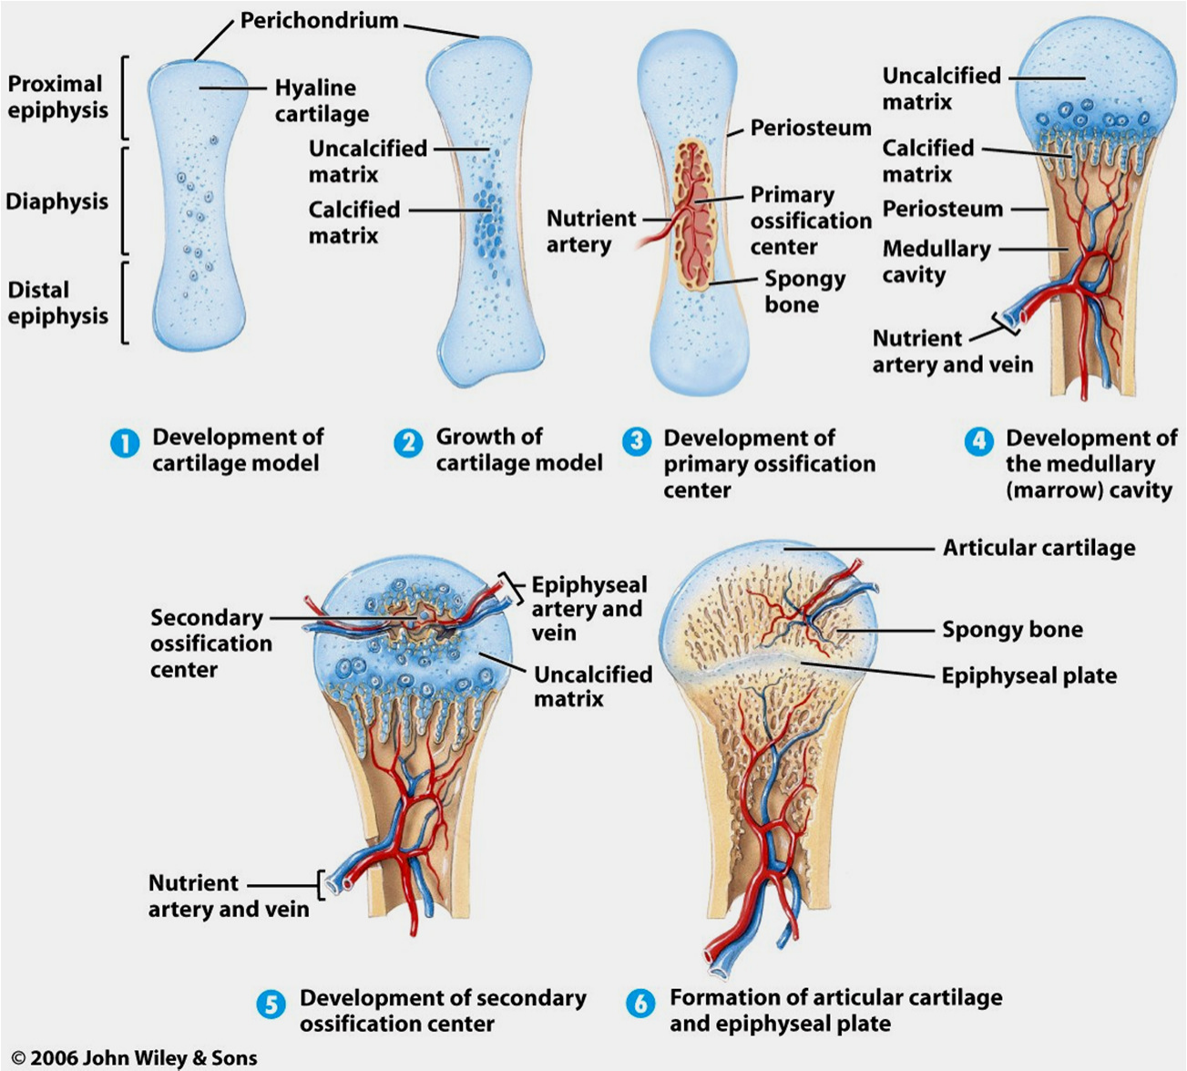
Endochondral Ossification
1: Cartilage model
3: Invasion of blood vessels, primary center of ossification
5: Secondary center of ossification in epiphyses
6: Epiphyseal plate, articular cartilage

Slide 15
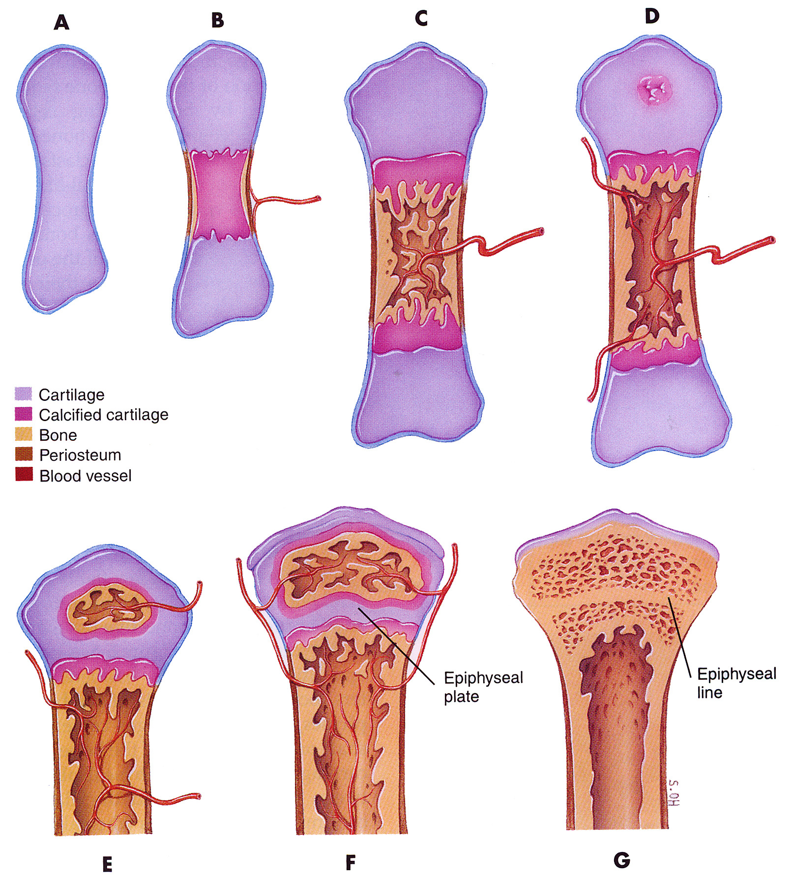
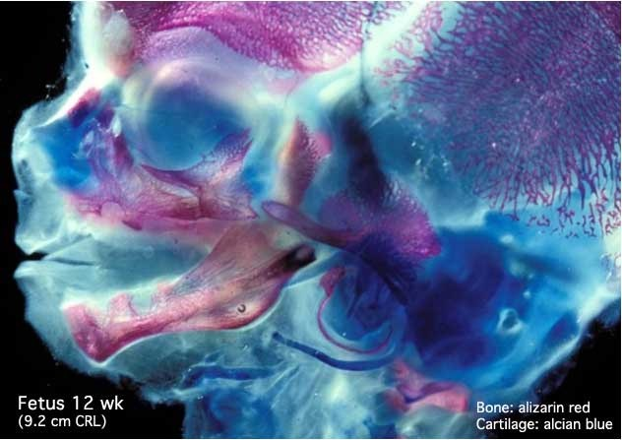
Endochondral and Intramembranous Ossification
Endochondral (most bones)
A: cartilage model
B: invasion of blood vessels, primary centre of ossification
D: secondary centre of ossification in epiphyses
F: epiphyseal plate, articular cartilage
Intramembranous (bone fracture healing, skull bone development)
No cartilage model present
Formation of bone spicules which fuse to trabeculae in membranes
Bone growth continues at the surface of trabeculae resulting in woven bone
Woven bone is later replaced by lamellar bone
10

Slide 16
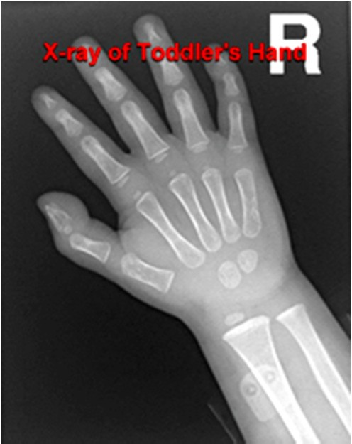
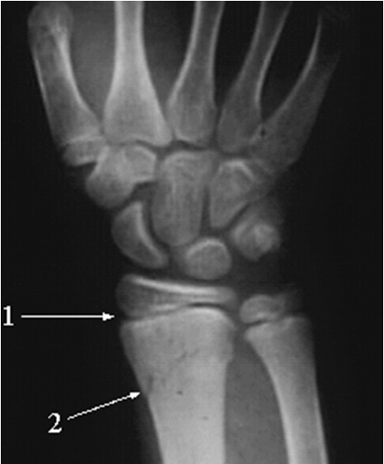
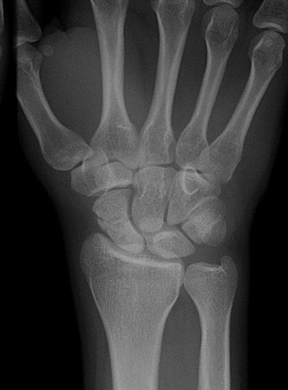
Ossification of Bones in Wrist and Forearm
Age at which bones ossify is different for each bone
One can estimate age of a person by pattern of ossification present
A: Note incomplete ossification of carpal bones (wrist) in toddler B: Note growth plate in young individual (1) and fracture (2)
C: Carpal bones and growth plates fully ossified in adult
A B C

Slide 17
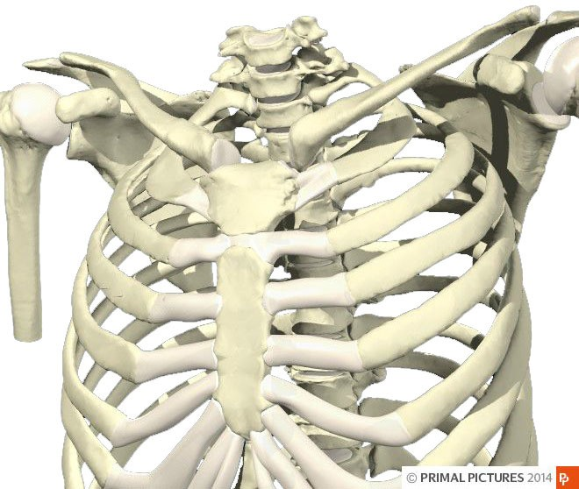
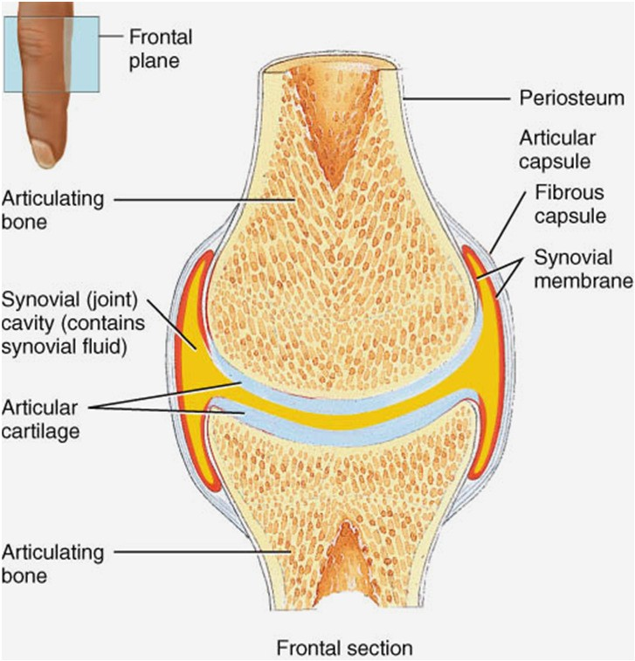
Joints - Structure
Cartilaginous joints
  Primary:
Temporary joint, connecting element = hyaline cartilage, e.g. between epiphyses and diaphyses of long bones, joint between ribs 2-7 and sternum
  Secondary:
Persisting joint, connecting element = fibrous cartilage, e.g. pubic symphysis, intervertebral discs, sterno-manubrial joint
Cartilaginous joint
Synovial joint
Synovial joints
  Fluid filled joint capsule
  Articular cartilage
  Most joints with a wide range of movement

Slide 18
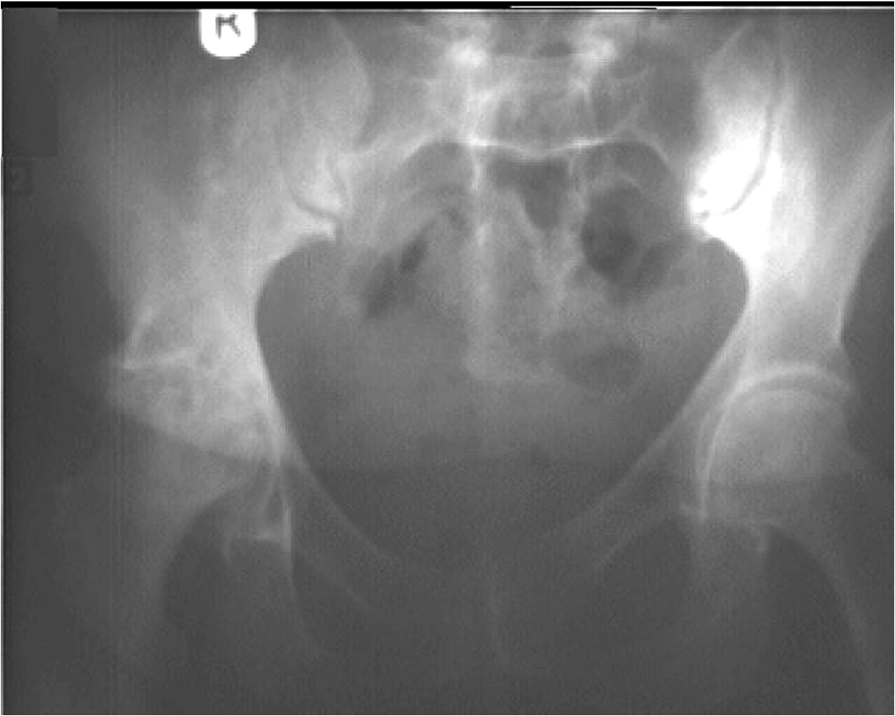
Joint Space
Joint space on Radiograph is articular cartilage
Loss of this joint space [R] indicates loss of cartilage
Osteoarthritis or rheumatoid arthritis

Slide 19
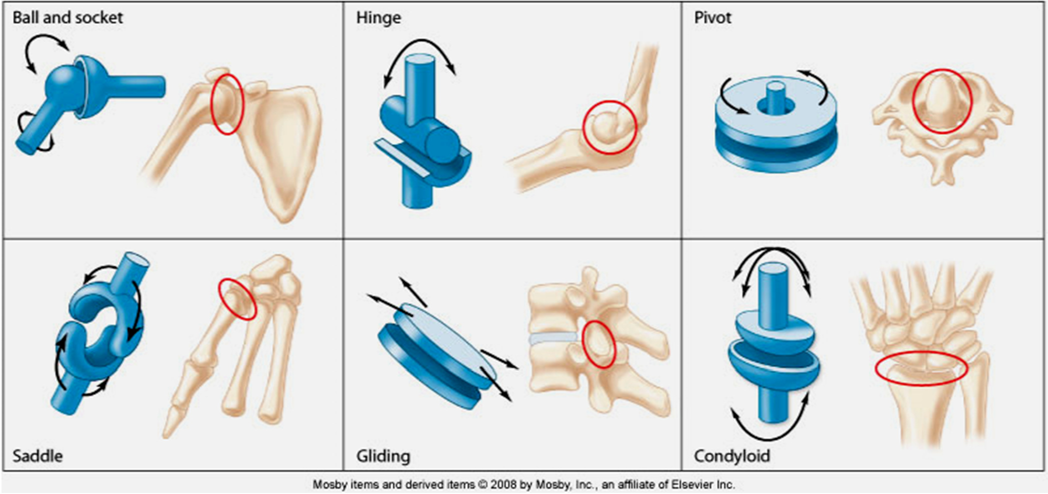
Joints - Movement, Degrees of Freedom (df)
Ball & socket (3 df) Saddle joint (3 df)
Hinge (1 df)
Gliding (2 df)
Pivot (1 df)
Condyloid (2 df)

Slide 20
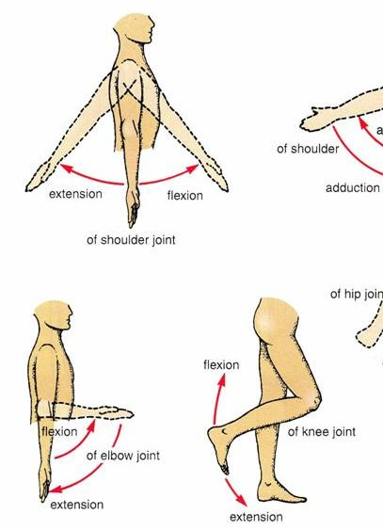
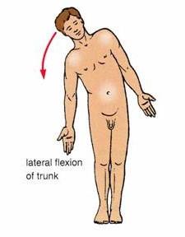
Motion – Flexion and Extension
Flexion and extension = joint angle decreasing and increasing – from a defined 0°line

Slide 21
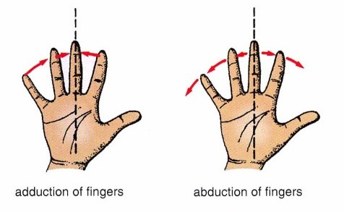
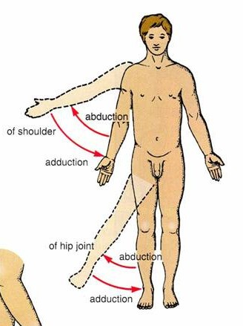
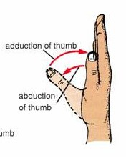
Motion – Adduction and Abduction
Adduction and abduction = joint angle decreases or increases in relation to the mid-sagittal plane (body or body parts)

Slide 22
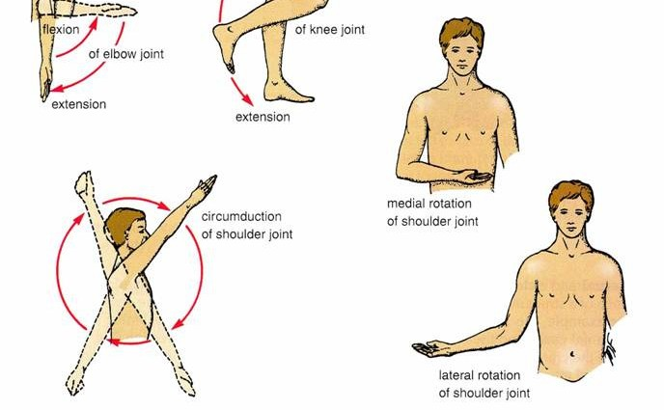
Motion - Circumduction
Circumduction = movement pattern made up of a combination of flexion, extension, abduction and adduction. It occurs in ball and socket joints mostly, e.g. seen in shoulder and hip joints

Slide 23
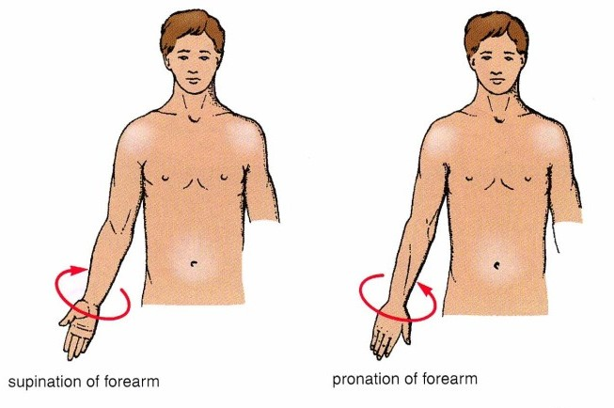
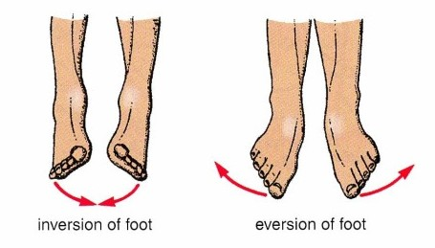
Motion – Supination and Pronation (or Inversion and Eversion)
Supination and pronation = rotational movements of the forearm (at the radio-ulnar joint) or foot (at the subtalar and talocrural joints)

Slide 24
Muscles, Tendons and Ligaments

Slide 25
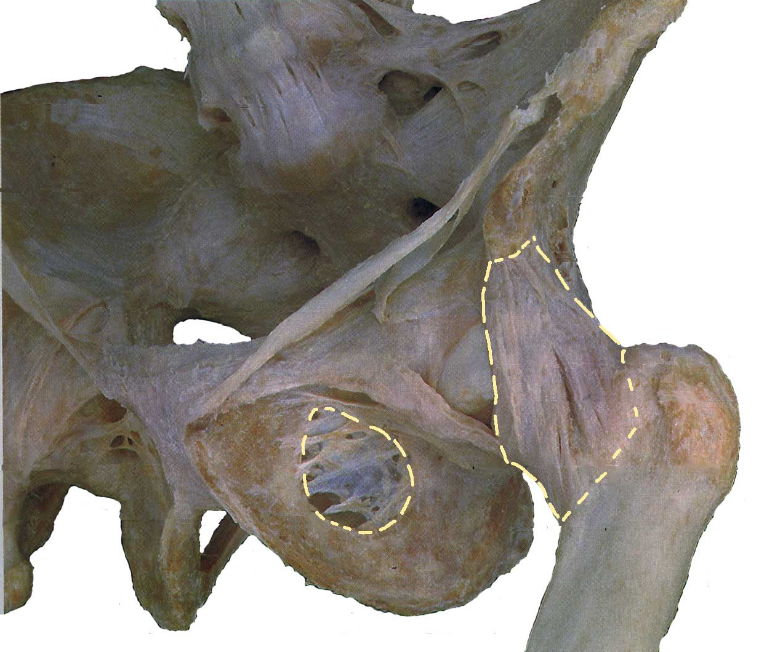
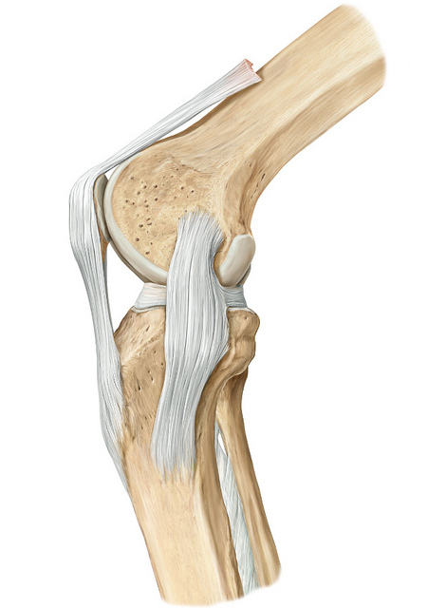
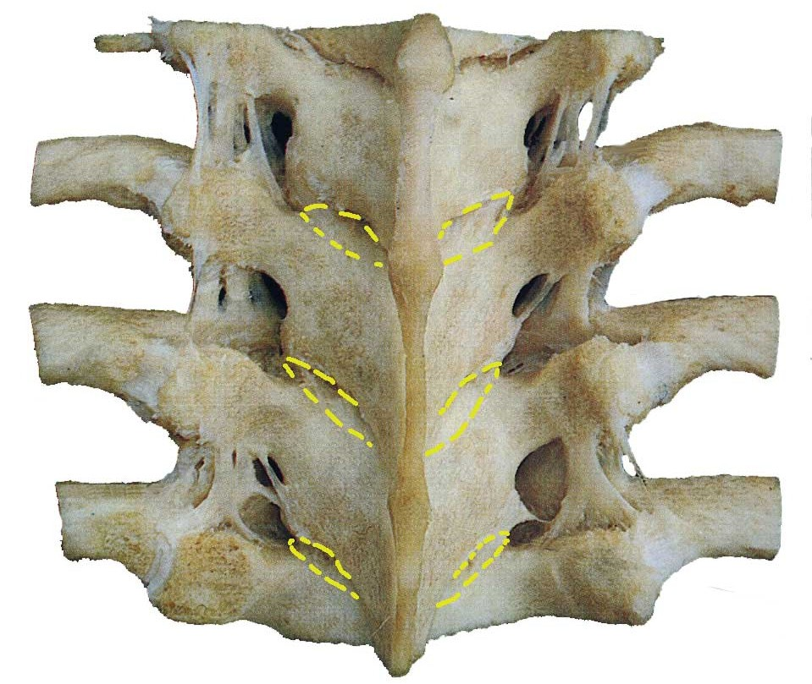
Ligaments
Connective tissue – often in the shape of a band uniting two structures (mostly bones)
Ligaments are often associated with joints where they help increase joint stability and regulate joint mobility
Fibrous ligaments (mostly collagen): prevent excessive motion in a joint
Elastic ligaments (mostly elastin): return to their original length after stretching
Rohen & Yokoshi 2006

Slide 26
Muscle
Muscle cells (muscle fibres) can contract
Enable body parts to move
Muscle cells convert chemical energy into mechanical energy
Important for body temperature homoeostasis

Slide 27
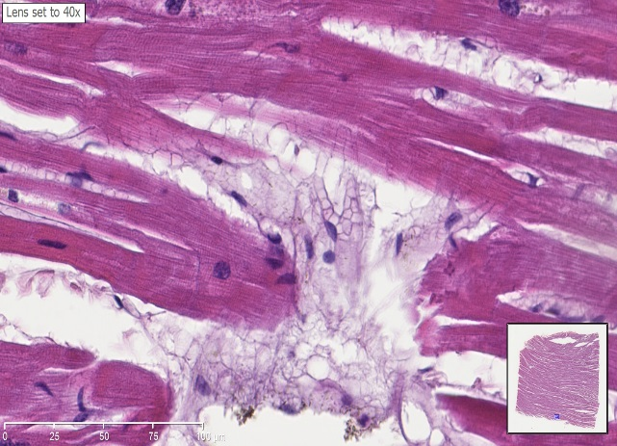
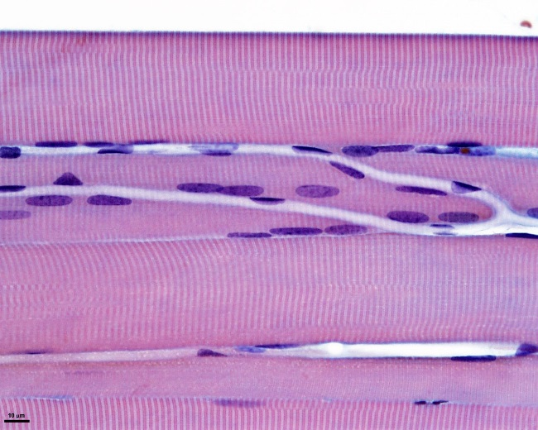
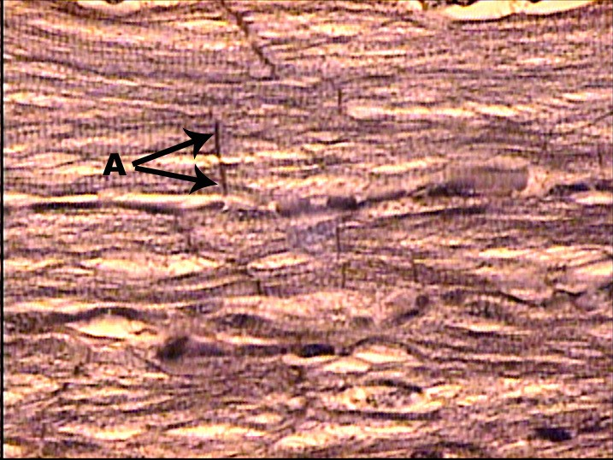
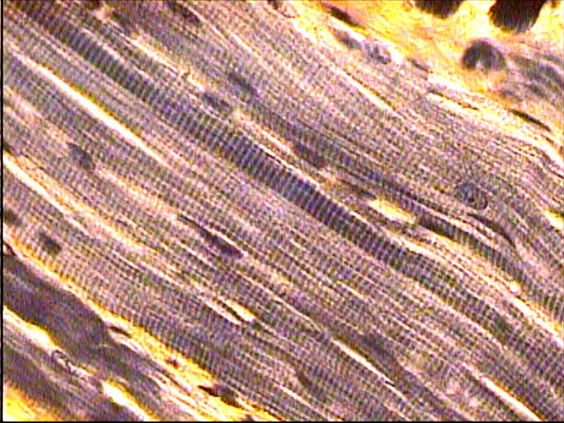
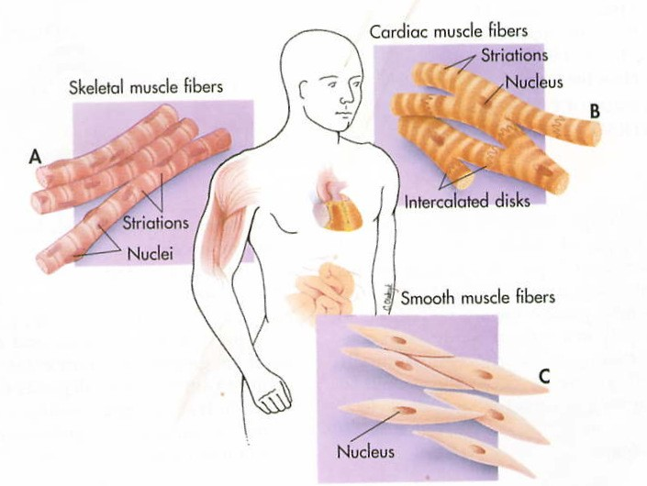
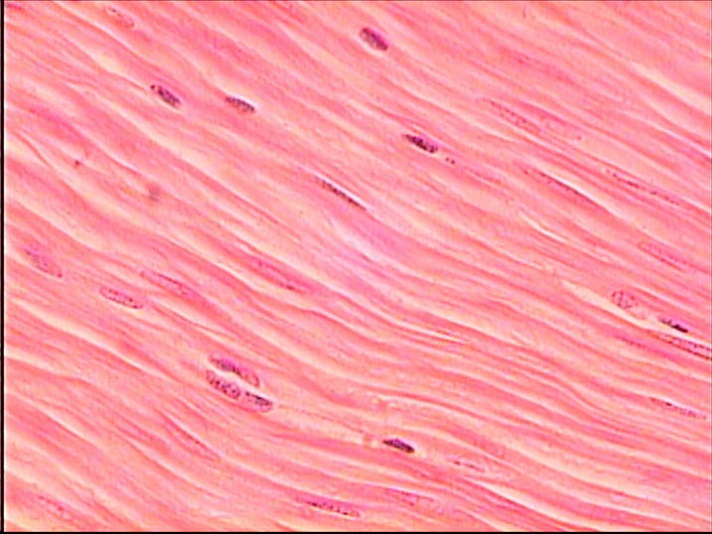
Muscle Tissue Types – Skeletal, Smooth and Cardiac
Striated cardiac muscle tissue
Striated skeletal muscle tissue
Smooth muscle tissue
Images at 400x magnification: http://www.gwc.maricopa.edu/class/bio201/Histology/HistoRev20a.htm

Slide 28
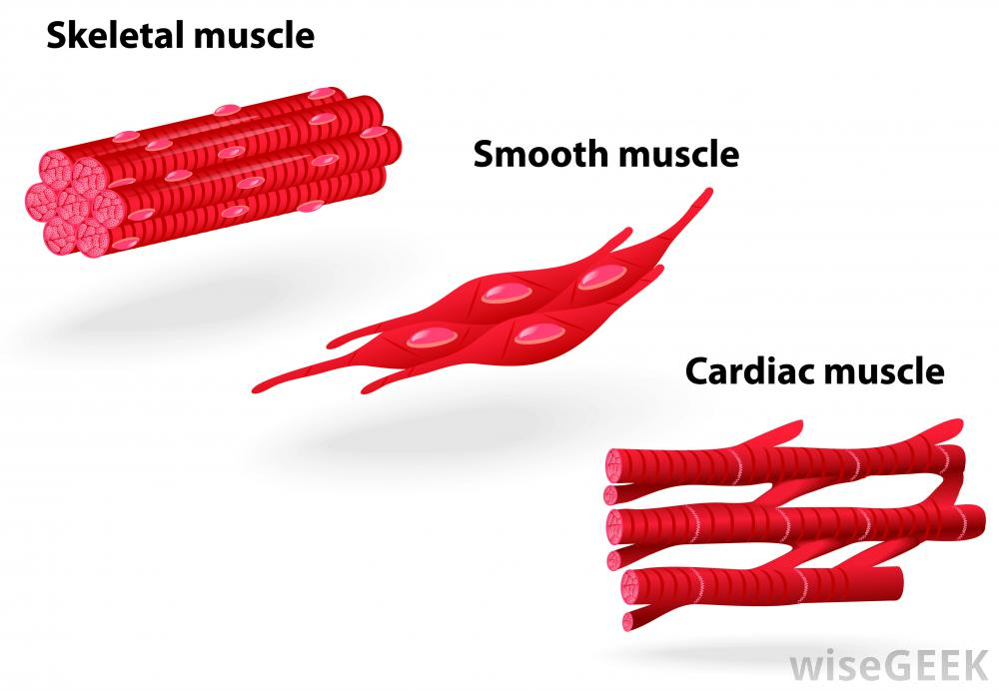
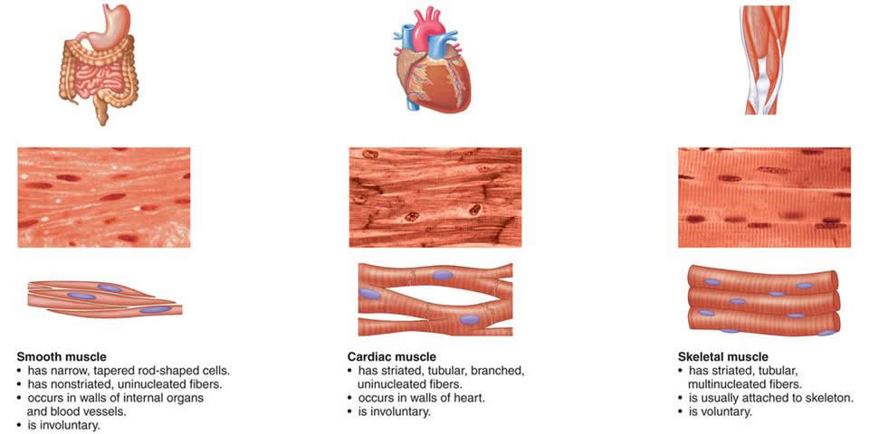
Characteristics of Different Kinds of Muscle Tissues
Characteristics of different kinds of muscle
Feature | Skeletal | Smooth | Cardiac
Location | Attached to bones | Inner organ walls | Heart
Cell shape Nucleus | Long, cylindrical Multiple, peripheral | Spindle Single central | Y-shaped Single central
Cell-cell | None | Gap junctions | Intercalated discs
Striation | Yes | No | Yes
Control | Voluntary | Involuntary | Involuntary
Spontaneous | No | Yes/no | Yes
Function | Body movement | Digestion, blood vessel size, urinary bladder etc. | Heart contraction
S
oo
m

Slide 29
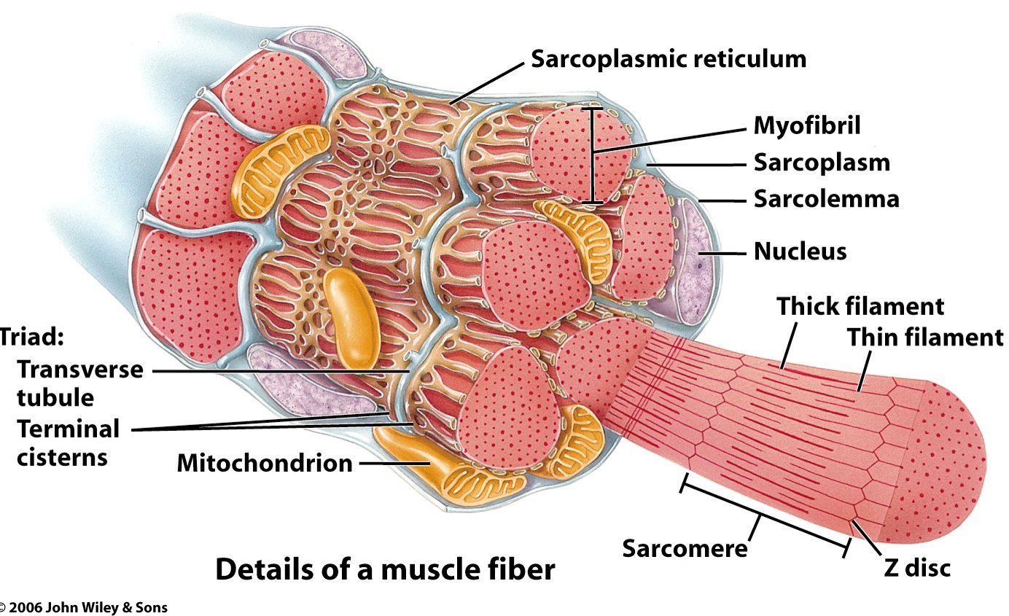
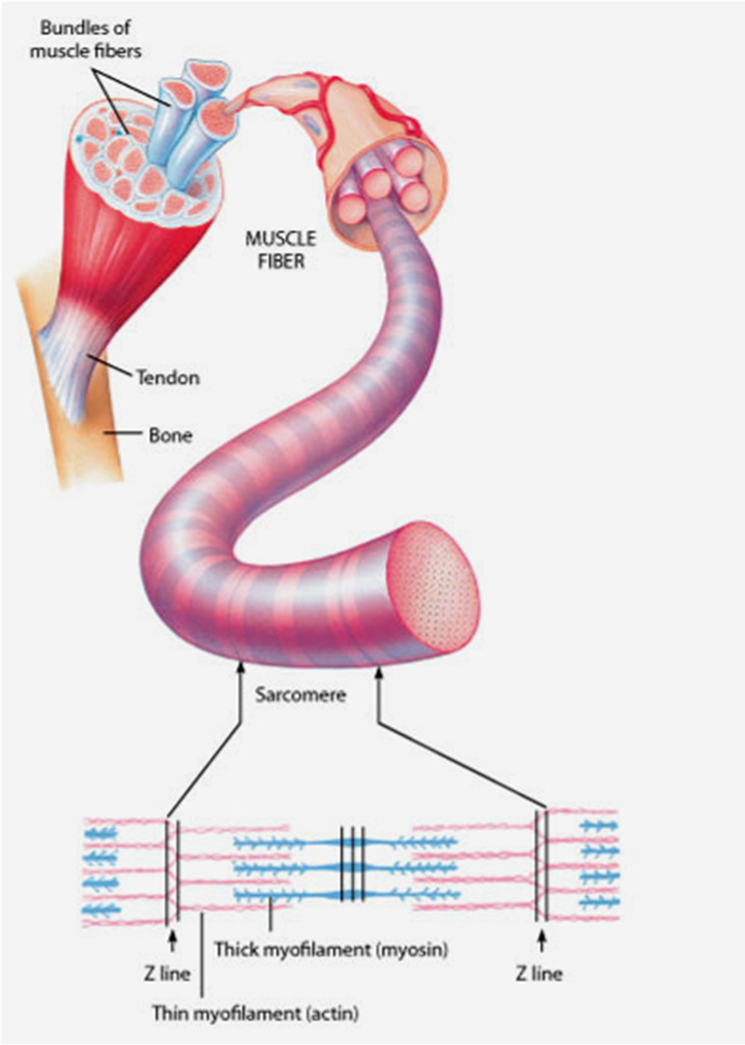
Muscle - Muscle fibres, Myofibrils and Sarcomeres
Note: A muscle fibre consists of 1 muscle cell – these cells can be rather long and large

Slide 30
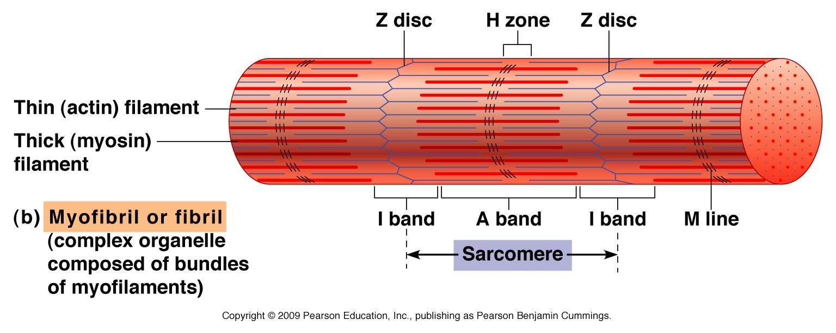
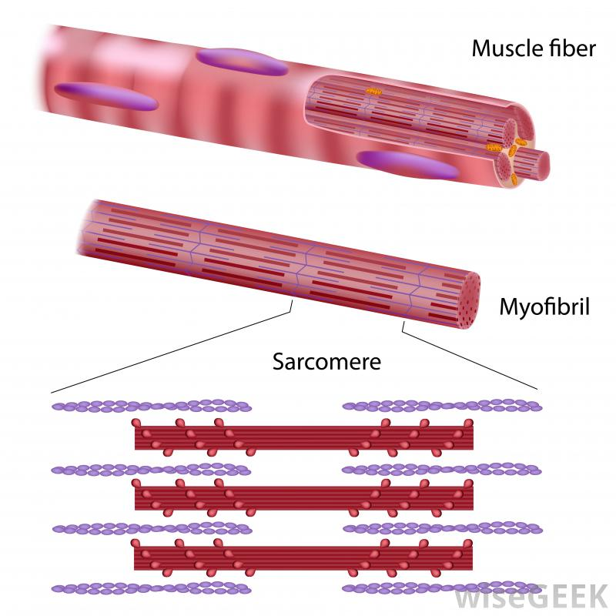
Sarcomere Structure
Actin(Thin) Filament
Myosin(Thick) Filament

Slide 31
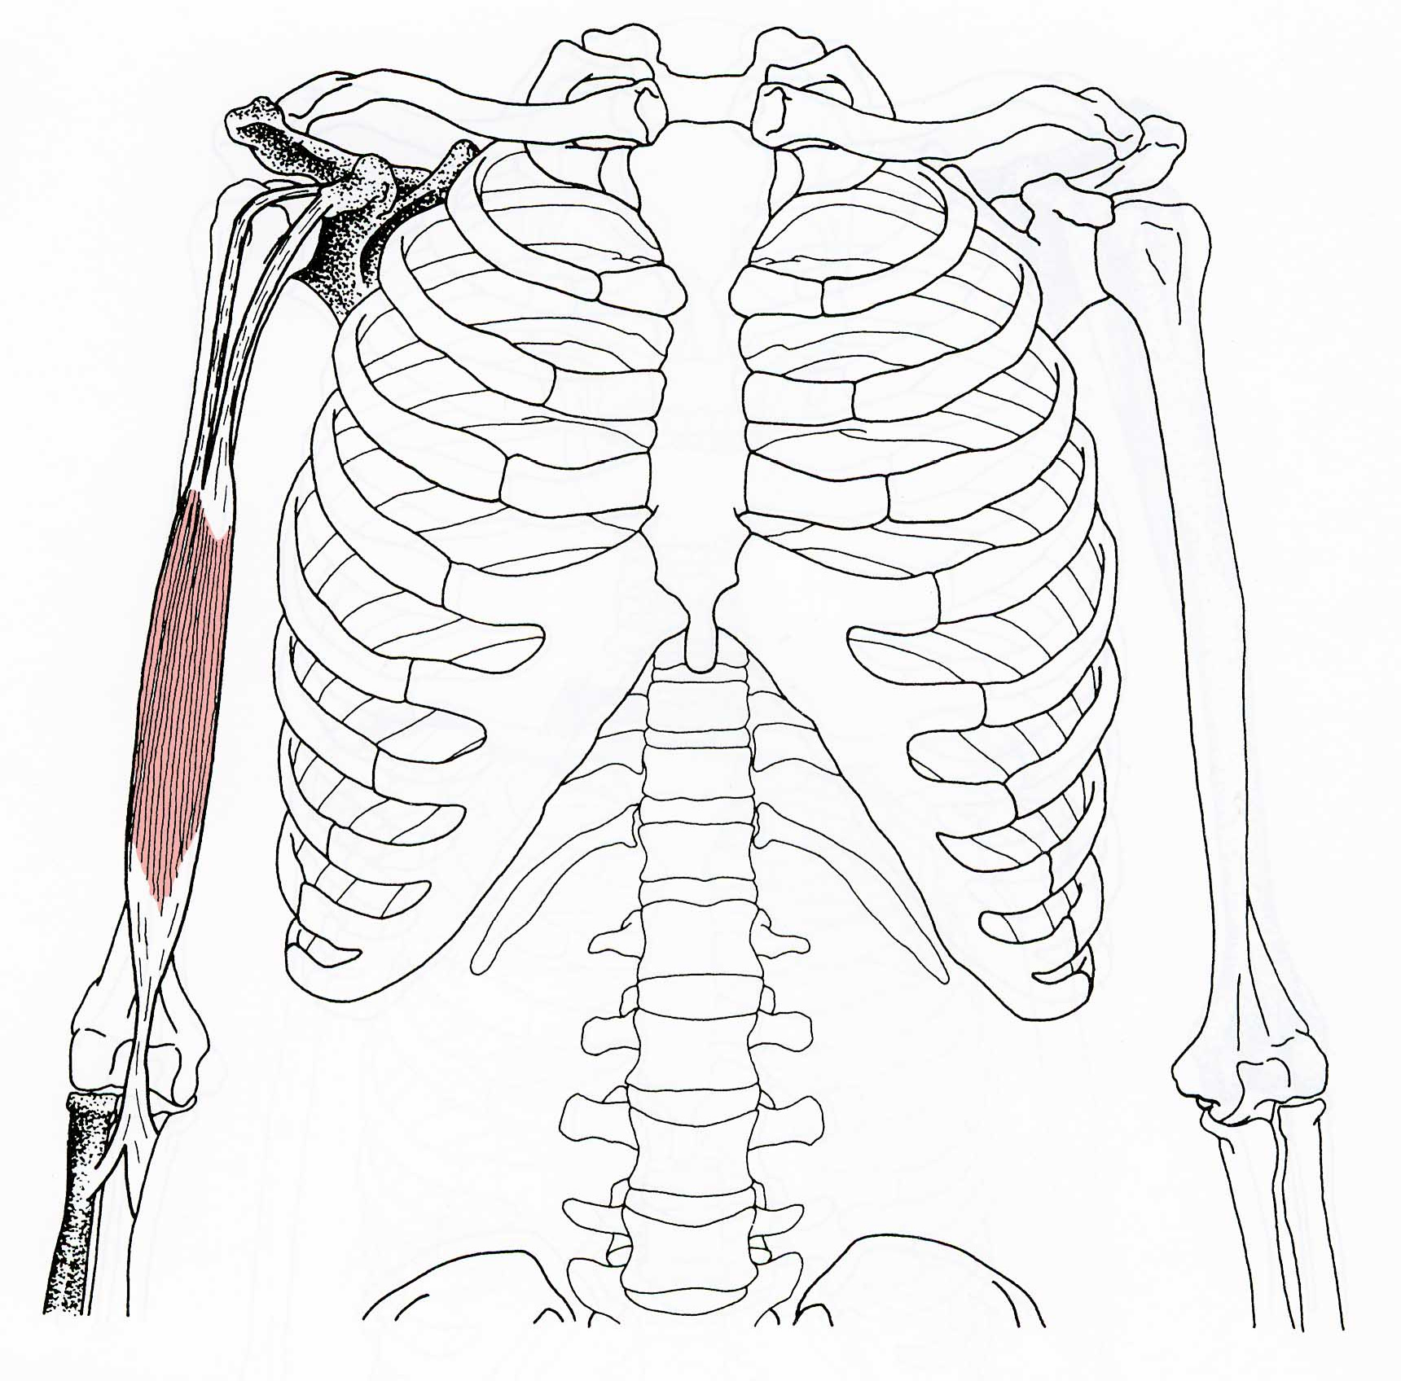
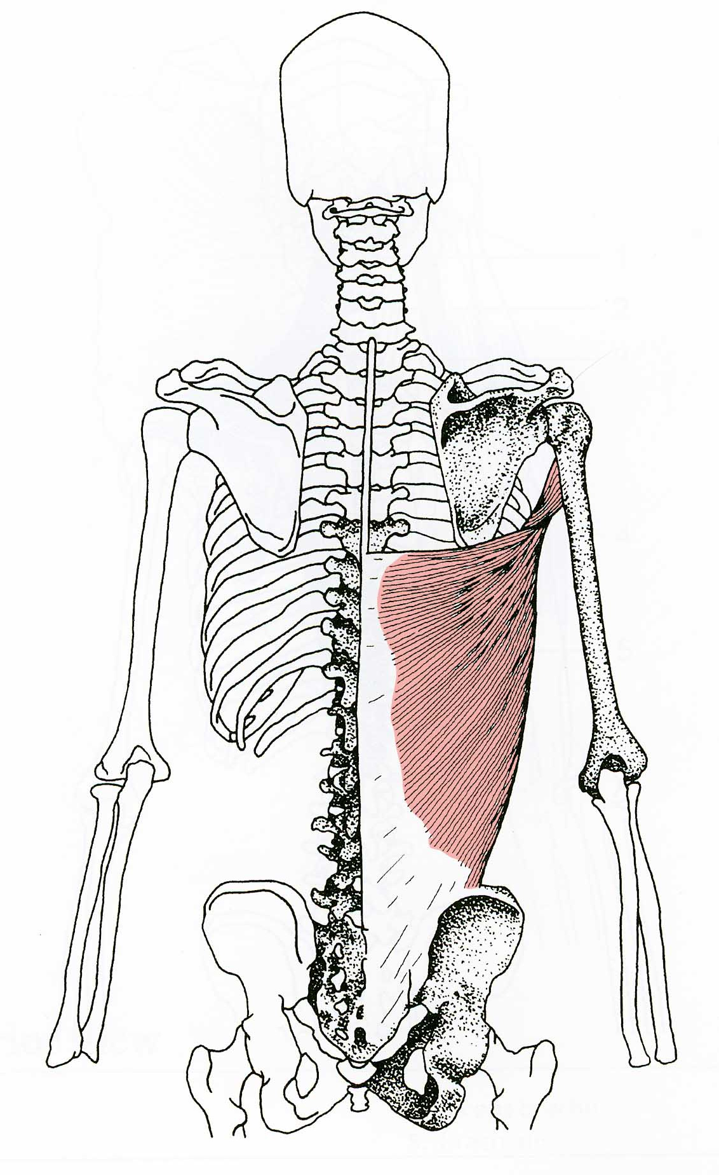
Muscle: Origin – Belly - Insertion
A skeletal muscle has two or more attachments. The attachment that moves the least is referred to as origin, the one that moves the most the insertion. The degree of mobility a the attachments might be reversed – origin and insertion are therefore interchangeable
The fleshy part of the muscle is referred to as its belly
Muscle attachments to bones, cartilage or ligaments are fibrous tissue cords called tendons
Flat muscles are sometimes attached by sheets of fibrous tissues called aponeuroses (i.e. sheet-like tendons)
Belly
Biceps
Belly
Latissimus dorsei

Slide 32



Muscle Shapes
Different numbers of bellies
Different numbers of heads/attachments
Spindle
2 headed
3 headed
4 headed
Different muscle fibre arrangements
Straps with tendinous and membranous intersections
Multiple tendons
Serrated
Bi- Uni- Inter- Flat pennate pennate tendinous
Ring-shaped

Slide 33





Dorsal and Ventral Muscle Groups
Fish
Reptile
Mammal
Dorsal muscle groups
Ventral muscle groups

Slide 34


Slide 35

Muscle Force Production at Sarcomere Level
Contraction and shortening of all sarcomeres causes the muscle to shorten while simultaneously generating force
The amount of force generated depends on the degree of overlap between the actin and myosin myofilaments (potential for interactions)
Maximum force is generated when the muscle is almost at resting length

Slide 36

Muscle Isotonic vs. Isometric Contractions
In an isotonic contraction, the length of the muscle is shortened and a force is generated at the musculo-tendinous junction, causing the muscle to shorten and the angle of the joint changes
During an isometric contraction, the muscle elongates while under tension due to an opposing force being greater than the force generated by the muscle. However, rather than working to pull a joint in the direction of the muscle contraction, the muscle acts to decelerate joint at the end of a movement or otherwise control the repositioning of a load

