Slide 1
Medical
Device Regulations and the need for a
Quality Management System - Part I
Julian Henty

Slide 2
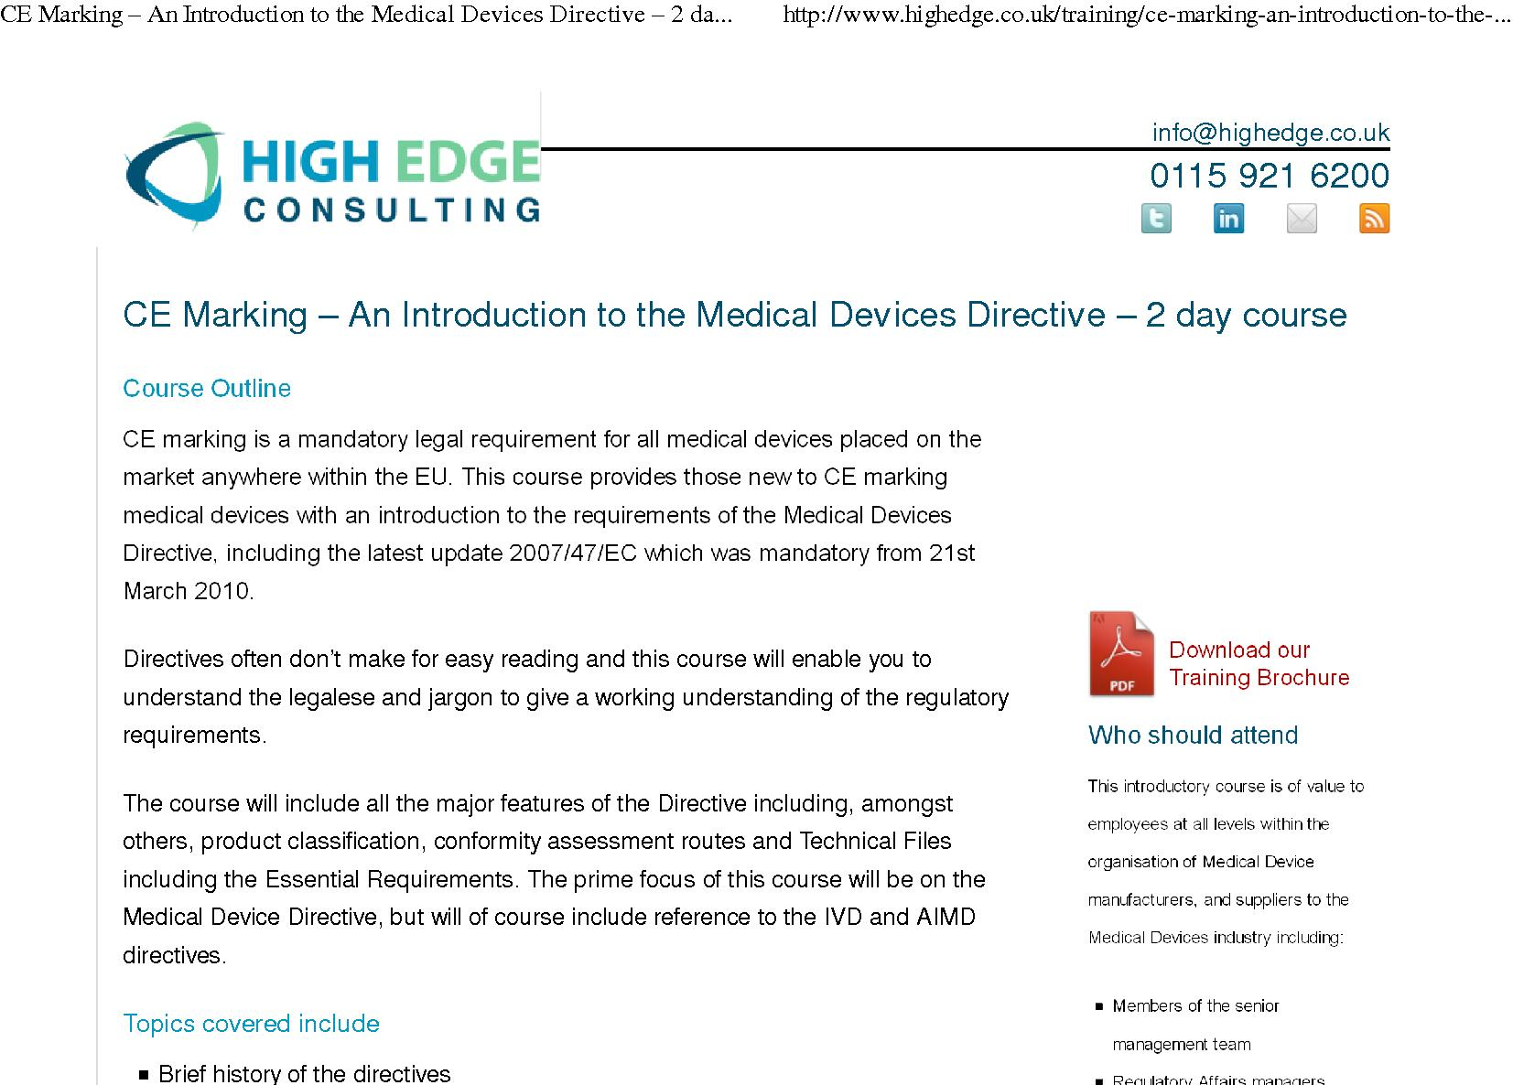
CE Marking Course
Notes:
Abbreviation of French phrase "Conformité Européene" which literally means "European Conformity” – from 1993
Medical Device Directive – intended to harmonise the existing laws (pre-1993) on medical devices in the EU.
Products conforming with the MD Directive must have a CE mark applied. Two day course about this!

Slide 3
EC Framework
EEC
  set up to facilitate trade between member states
De facto protectionism:
  Each country’s Health Ministry would require that medical devices had to comply to local regulations and safety requirements
  Included specific tests only done by their approved laboratories or clinical trials with a fee payable to the government
EEC/EC introduced directives to address this problem
  The ‘New Approach’
Notes:
*Was EEC (European Economic Community) to 1993, then European Commission
The UK is a member of the EC - main purpose of this organisation is to facilitate trade between the member states.
The member states are required to implement the EC directives by incorporating them into local legislation. We often hear how UK fully adopts everything coming out of Brussels when other member states are not perhaps as keen to make their laws correspond quite so closely.
By making sure that each state followed the same rules it was intended to remove barriers to trade that would otherwise prevent products being sold as widely as possible – this is good for trade. Also the populations in a particular state would not be disadvantaged because of local regulations which meant that it was harder for companies to access their particular market.
STANDARDISING

Slide 4
The Medical Device Directive
1993 - directive for medical devices named:
“Council Directive 93/42/EEC”
  known widely as the Medical Devices Directive, MDD
Key Points:
  High level of protection for patient, user and third parties
  Principles of: risk management/reduction, state of the art design, EMC, compliance with Harmonised standards
Comply by June 1998
Notes:
The directive governing medical devices came out in the EC Official Journal in 1993.
If you read it then you can see the angle it is coming from – particularly where it requires a ‘high level of protection for patient, user and third parties’.
– THINK OF A MEDICAL DEVICE THAT REQUIRES PROTECTION FOR PATIENT/USER
It also stresses risk management and risk reduction, use of ‘state of the art’ (design/technology/materials perhaps..), EMC (Electromagnetic Compatibility) and compliance with other standards.
Manufacturers were given 5 years to comply.

Slide 5

The Medical Device Directive
Notes:
European Commission medical device website
In it, there are links to the main directive,
- and also to other directives that cover the higher risk medical devices
e.g. active implantable and in-vitro diagnostics
Notice again where the legislation sits in the thinking of the EC – under Consumer Affairs

Slide 6
Case study
- Salibsury District Hospital
Notes:
Case study – Salisbury District Hospital
…………………………………………………………………………………

Slide 7
1996 - Salisbury Hospital
Started with paraplegic standing using modified Slendertone™ machines
developed a dropped foot stimulator and a clinical service was developing
Other stimulators also being
made in lesser numbers,
e.g. two channel
Began to supply other clinics
Health service changes were
encouraging “competition”
between hospitals
Notes:
Because Odstock (NHS) were short of money.................1996
our therapists asked us to help with some incomplete spinal patients – existing equipment was not up to the job
- and there were no devices on the market that would do what they wanted
- put an appeal in the local papers asking for discarded slimming machines
FES had a poor reputation among medics and therapists.

Slide 8
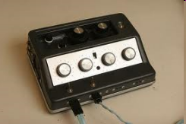
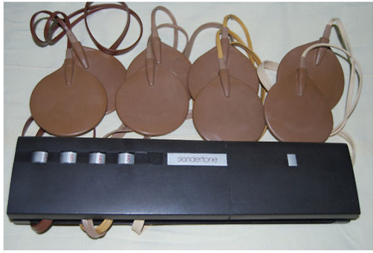
1996 - Salisbury Hospital
Notes:
Here are some examples of the devices made and used for training paraplegics to stand.
- Left are Slendertone machines, adjusted in order to reduce the stimulation frequency and increase the pulsewidth. - Brown pads are the electrodes and the other side of the pad is conductive rubber. A layer of wet sponge is used
between these pads and the skin, and all is held in place with elastic straps.
These machines predate CE marking and may not fall into the category of medical device anyway.
Man on the right has a closed loop standing system. Much more compact and with self adhesive electrodes. CE marking is looming….

Slide 9
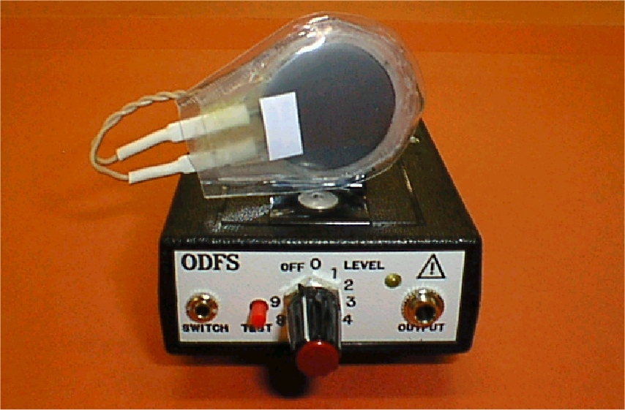
1996 - Salisbury Hospital
Odstock Drop Foot Stimulator (Orthosis)

Slide 10
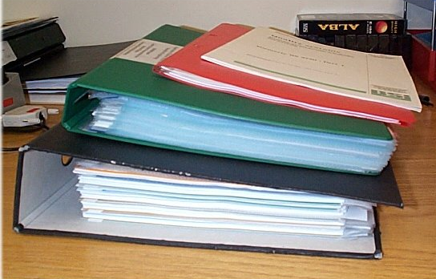
The MDD document
Notes:
The MDD is a thin document but must read a few time to understand the picture of what it is asking.
If we skip the legal stuff at the beginning, what does it actually say..?

Slide 11
What is a Medical Device?
Determine whether your device falls within the remit of the Directive
  i.e. is it a medical device?
  Check ‘scope’ of the directive – Article 1
(a) ‘medical device’ means any instrument, apparatus, appliance, software, material or other article, whether used alone or in combination, including the software intended by its manufacturer to be used specifically for diagnostic and/or therapeutic purposes and necessary for its proper application, intended by the manufacturer to be used for human beings for the purpose of:
— diagnosis, prevention, monitoring, treatment or alleviation of disease,
— diagnosis, monitoring, treatment, alleviation of or compensation for an injury or handicap,
— investigation, replacement or modification of the anatomy or of a physiological process,
— control of conception,
and which does not achieve its principal intended action in or on the human body by pharmacological, immunological or metabolic means, but which may be assisted in its function by such means;
Notes:
Article 1 is the first crucial part of the MDD. If you are designing a new product then you need to be aware of how it fits into this ‘scope’ this definition of what constitutes a medical device.
Even if you are sure that your device is a ‘medical device’, it is still worth looking at the wording here to establish on what basis you will be claiming that this is the case.
The MDD was revised in 2007 and one of the changes was to explicitly include ‘software’ as a medical device. So, a program on a PC which gives a diagnosis and/or monitoring of a disease will fall into the category of medical device and become subject to the requirements of this directive.
So, is a muscle stimulator a medical device..?

Slide 12
Is it a Medical Device?
What is your decision based on?
Notes:
Our Odstock Dropped foot stimulator, what does it do and does that make it a medical device?
Well, it is a neuromuscular stimulator which means it stimulates the nerve in order to get a muscle to contract. By placing an electrode over the common peroneal nerve just below the knee the act of stimulating the nerve actually gets two groups of muscle contractions. Hip flexion and ankle flexion. The stimulation stops when the ‘good’ leg comes off the ground – this is detected by a thin switch in the shoe.
In order to decide which bit of Article 1 applies, we should look at how it is intended to make a difference to the user. Article 1 again..

Slide 13
Article 1
(a) ‘medical device’ means any instrument, apparatus, appliance, software, material or other article, whether used alone or in combination, including the software intended by its manufacturer to be used specifically for diagnostic and/or therapeutic purposes and necessary for its proper application, intended by the manufacturer to be used for human beings for the purpose of:
— diagnosis, prevention, monitoring, treatment or alleviation of disease,
— diagnosis, monitoring, treatment, alleviation of or compensation for an injury or handicap,
— investigation, replacement or modification of the anatomy or of a physiological process,
— control of conception,
and which does not achieve its principal intended action in or on the human body by pharmacological, immunological or metabolic means, but which may be assisted in its function by such means;
Notes:
From a knowledge of our device we can pick out the appropriate terms in Article 1. So this is not just defining our device but it becomes a shortcut to justifying our device as a medical device.
By improving somebody’s walking, what are we doing? I would say that we are alleviating the effects of a disease and we are alleviating or compensating for a handicap. We are not really treating a disease – nobody is going to recover from a stroke because they have had treatment from a peripheral nerve stimulator but their quality of life can be improved though making their walking more normal.
Note also the phrase at the bottom, what is this designed to pick up?
- anything related to drugs.

Slide 14
It is a Medical Device
Because it ‘treats or alleviates a disease or handicap’
Notes:
We can now be sure that our device is a medical device and we can borrow some jargon from Article 1 to express this in a compact way.

Slide 15
Does the MDD really apply?
Many departments in Salisbury’s position – making small numbers or individual items thought they would somehow be exempt – perhaps if their items were ‘custom made’ or just supplied in their hospital.
So, MDD does apply,
even if you don’t put a CE mark on your device.
(d) ‘custom-made device’ means any device specifically made in accordance with a duly qualified medical practitioner's written prescription which gives, under his responsibility, specific design characteristics and is intended for the sole use of a particular patient. The above mentioned prescription may also be made out by any other person authorized by virtue of his professional qualifications to do so.
Mass-produced devices which need to be adapted to meet the specific requirements of the medical practitioner or any other professional user shall not be considered to be custom made devices;
Notes:
Article 1 – defining medical devices – goes on to cover custom made devices so the MDD will apply √
‘Adapted’ underlined as well, so we can think of products that the maker might say were just components and the clinician or technician putting them together in a patient specific way would become the manufacturer. This is covered - components are treated as a medical device. The supplier/maker etc is the manufacturer and takes liability as long as they are used as described in the instructions.

Slide 16
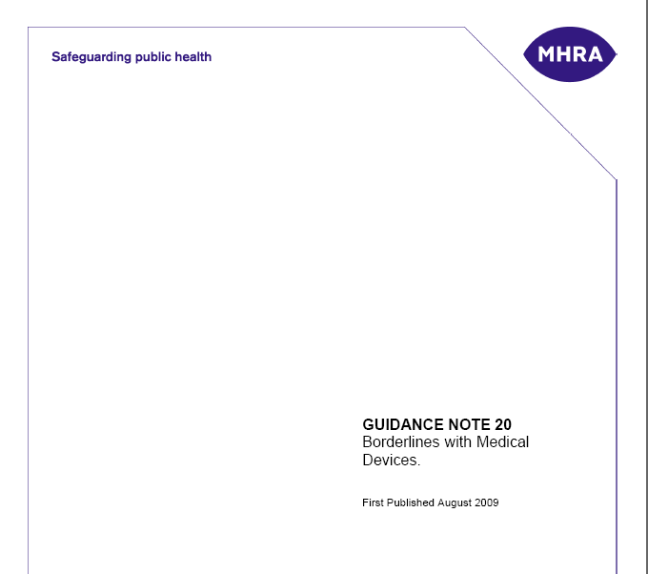
Additional Guidance - UK
The UK Medicines and Healthcare products regulatory agency (MHRA) have publications on their website. These are helpful in interpreting ‘grey areas’
http://www.mhra.gov.uk/Publications/Regulatoryguidance/Devices/index.htm
Notes:
National bodies have produced their own guidance. In the UK this is the MHRA. In EC jargon the MHRA is the UK Competent Authority, i.e. they are responsible for policing compliance with the MDD in the UK and for receiving and disseminating device alerts from other States Competent Authorities. The jargon for this is vigilance.
e.g. Bulletin 20

Slide 17
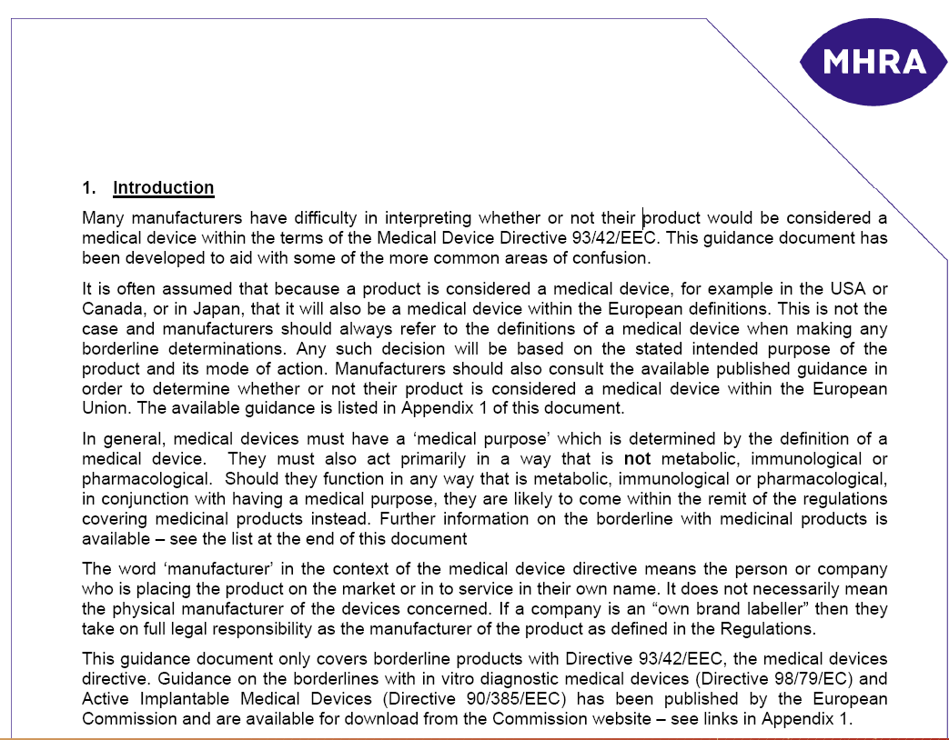
Notes:
If we just pick one bulletin as an example, Bulletin 20, intended to help with ‘grey areas’…
You don’t have to read very much of it to see that you should be going to the MDD anyway…

Slide 18
MHRA – Competent Authority
MHRA is responsible for ‘policing’ the MDD in the UK – vigilance
MHRA is the Competent Authority for the UK
  in EU jargon
Article 2
Placing on the market and putting into service
“Member States shall take all necessary steps to ensure that devices may be placed on the market and/or put into service only if they comply with the requirements laid down in this Directive when duly supplied and properly installed, maintained and used in accordance with their intended purpose.”
Notes:
If you encounter a medical device that you know or suspect is not compliant with the MDD
- despite having a CE mark - then the MHRA are the body that you would report this to.

Slide 19
What does the MDD require of you?
Article 3
Essential requirements
“The devices must meet the essential requirements set out in Annex I which apply to them, taking account of the intended purpose of the devices concerned.”
Notes:
There are a lot of “Essential Requirements”
so just a few of the opening paragraphs...

Slide 20
Articles and Annexes
Articles come first
and describe the application of the Directive
– may direct you to various Annexes
located at the end of the Directive
Annex I – Essential Requirements, applies to all Medical Devices – whether you CE mark them or not!

Slide 21
Essential Requirements: Annex 1
I. GENERAL REQUIREMENTS
1. The devices must be designed and manufactured in such a way that, when used under the conditions and for the purposes intended, they will not compromise the clinical condition or the safety of patients, or the safety and health of users or, where applicable, other persons, provided that any risks which may be associated with their intended use constitute acceptable risks when weighed against the benefits to the patient and are compatible with a high level of protection of health and safety.
This shall include:
— reducing, as far as possible, the risk of use error due to the ergonomic features of the device and the environment in which the device is intended to be used (design for patient safety), and
— consideration of the technical knowledge, experience, education and training and where applicable the medical and physical conditions of intended users (design for lay, professional, disabled or other users).
Notes:
What is stated here is pretty much what you would expect – nobody is likely to argue with these requirements.
Placing the emphasis on ergonomics first is not just random – investigations into adverse incidents shows that ergonomics play a key role, poor ergonomics contribute to user error. Need to think who the ‘user’ is going to be..
- 2nd indent – maybe more consideration should be paid to design for older users..

Slide 22
Essential Requirements: Annex 1
2. The solutions adopted by the manufacturer for the design and construction of the devices must conform to safety principles, taking account of the generally acknowledged state of the art.
In selecting the most appropriate solutions, the manufacturer must apply the following principles in the following order:
— eliminate or reduce risks as far as possible (inherently safe design and construction),
— where appropriate take adequate protection measures including alarms if necessary, in relation to risks that cannot be eliminated,
— inform users of the residual risks due to any shortcomings of the
protection measures adopted.
3. The devices must achieve the performances intended by the manufacturer and be designed, manufactured and packaged in such a way that they are suitable for one or more of the functions referred to in Article 1 (2) (a), as specified by the manufacturer.
Notes:
‘State of the art’.. i.e. a comparison with other things that are out there..
How do we inform users of the risks of use? Labelling, manuals and training..
Software..

Slide 23
Clinical evaluation - Annex X
Essential Requirement:-
“6a. Demonstration of conformity with the essential requirements must include a clinical evaluation in accordance with Annex X.”
Where you present evidence for the performance and safety of the device.
If it is a novel device it is likely that you will have to conduct a clinical trial. If the outcome of the trial is to be used for CE marking purposes then it will have to be registered with the Competent Authority (MHRA in UK)
Notes:
Clinical Evaluation is an important section of the Essential requirements.
- this is where you will present the evidence for the performance and safety of the device
- if it is a novel device it’s likely you will have to conduct a clinical trial
If the outcome of the trial is to be used for CE marking purposes, then it will have to be registered with the Competent Authority (MHRA in UK)

Slide 24
MDD Article 5
- Reference to standards
Member States shall presume compliance with the essential requirements referred to in Article 3 in respect of devices which are in conformity with the relevant national standards adopted pursuant to the harmonized standards the references of which have been publishes in the Official Journal of the European Communities; Member States shall publish the references of such national standards.
In other words – If there is a harmonised standard that the EC has adopted and you comply with the standard then you automatically comply with the Essential Requirements
Notes:
This is a long way of saying that:
- if there is a harmonised standard that the EC has adopted and you comply with the standard, then you
automatically comply with the Essential Requirements √

Slide 25
MDD Article 9 - Classification
Devices shall be divided into Classes I, IIa, IIb and III. In order to determine the class you have to run through the questions in Annex IX.
Annex IX asks lots of questions..
[p53 MDD]
Notes:
Skipped some interim clauses defining how the Commission and Member states should act in various circumstances – e.g. marketed devices not meeting the ER.
Devices shall be split into three classes based on their potential for doing harm. Class II is split into IIa and IIb
Class I – low risk (e.g bandage); chassis connected to earth (electrical) – minimal intervention by notified body
Class IIA – medium risk (e.g. surgical instruments); double insulated (electrical) – medium intervention
Class IIB – complex medium risk (e.g. electrodes used on a wound) – high intervention (more testing)
Class III – high risk (e.g. plasters with medicated wound pads) – high intervention
In order to determine the class you have to run through the questions in Annex IX

Slide 26
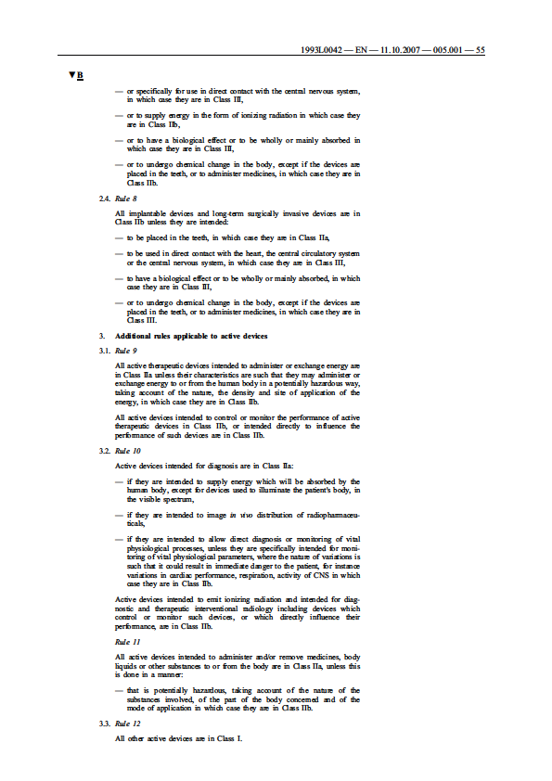
For a Muscle Stimulator, which Class?
Lets step through the rules and see..
  (Double click on picture right to see)
make sure you go all the way to the end
http://ec.europa.eu/health/medical-devices/files/meddev/2_4_1_rev_9_classification_en.pdf
Notes:
It is quite simple to use the Annex in the Directive in most cases – make sure you go all the way to the end
- Muscle stimulator is Class IIa

Slide 27
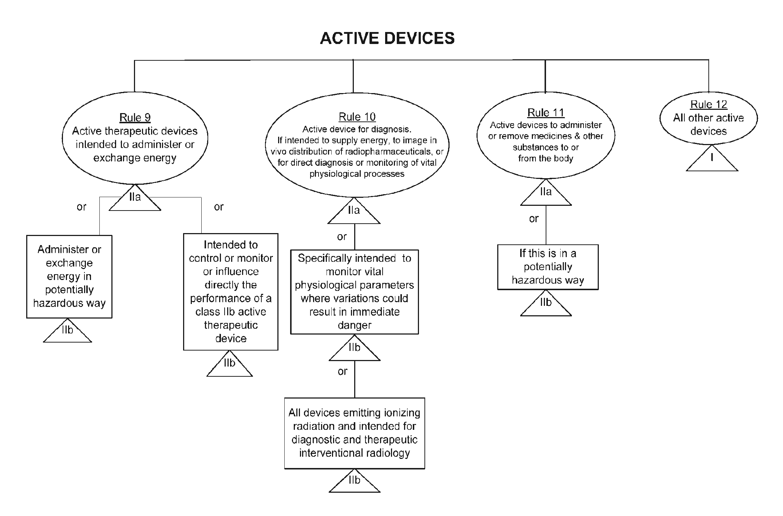
If just pick active devices..
Notes:
Rule 9 applies
Note – no Class III

Slide 28
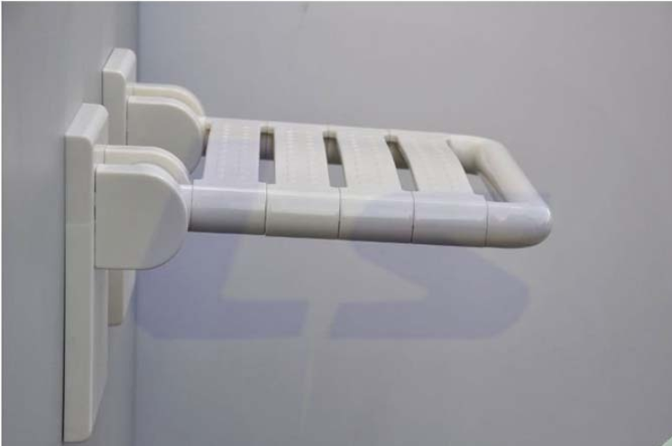
Revenge of the shower chair!
Notes:
If you ever doubt the usefulness of MHRA bulletins or device alert notices then this little diversion should make you think!
Warning for the squeamish!

Slide 29
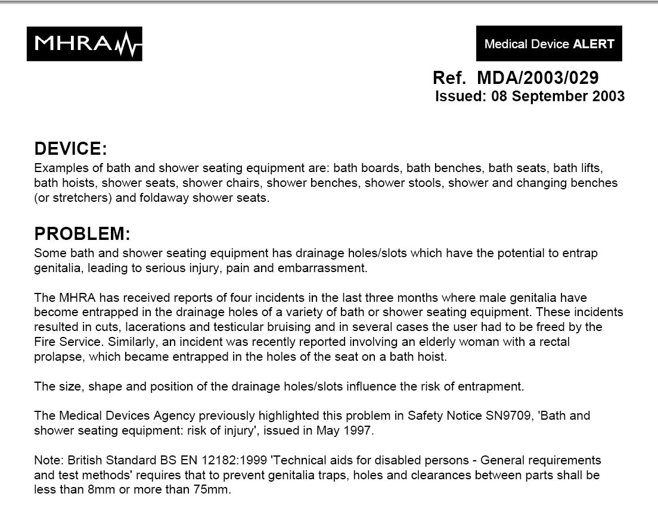
Notes:
Male genitalia trapped
Rectal prolapse – slipping down of rectum so that it protrudes through the anus
NOTE: size of drainage holes <8mm; <75mm

Slide 30
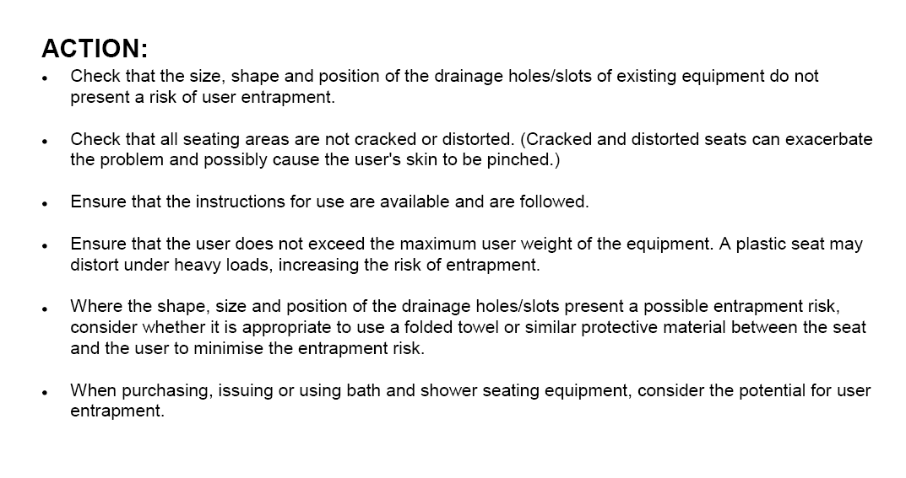
Notes:
3rd point: check instructions (elderly??)
User must not exceed maximum weight - population getting more and more overweight??

Slide 31
MDD Article 10
- Information on incidents
Adverse Incident reporting:
  if a device causes harm or something happened with the potential to cause harm then it can be reported to the MHRA by users, patients or manufacturers
Forms available on MHRA website - excuse for a diversion..
Notes:
Adverse Incident Reporting...

Slide 32
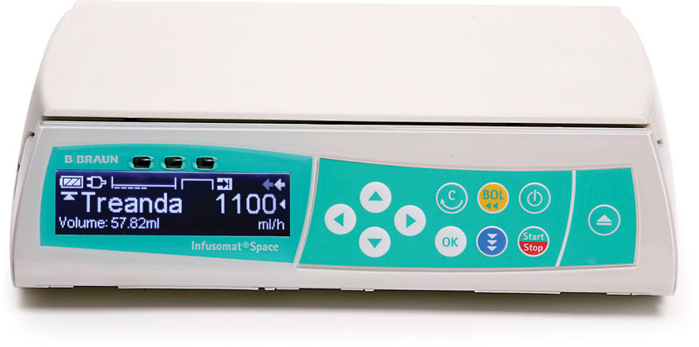
MDD Article 10
- Adverse Incident Reporting
Notes:
Adverse Incident Reporting – example of infusion pump
DEVICE LOGS.....

