Slide 1
From Particles To Electronic Trading
John Loizides (in spirit) and Simon Bevan

Slide 2
Introduction
For the first few slides we will aim to give you a feeling of what high frequency trading means and the arguments for and against it.
We will then move our focus towards describing market analysis and how this can be used for trading.
Finally we will describe the technology involved.

Slide 3
What is High Frequency Trading?
Trading can be split into two camps – market making (supplying liquidity to the market) and risk taking (trying to predict the direction of the market).
As a rule of thumb large banks are the market makers (MM) and hedge funds are the risk takers.
Traditionally MM was done by voice traders manually quoting markets or executing trades. Now it is driven by quants using mathematical models.
These mathematical models have proved amazingly successful and as a result the market is in the process of seismic shift towards electrification and high frequency trading.

Slide 4
The Trend

Slide 5
Arguments For High Frequency Trading
Computers interact with the market more strategically than humans – lower volatility
Smaller trade size
Price compression
Positive, additional liquidity – benefits all market participants
Streaming support – market making
Participation consistent even in less active markets

Slide 6
Arguments Against High Frequency Trading
Liquidity Mirage
Increase cost of ticket processing
Opportunistic strategies at the cost of real business
Market Makers come and go as they please
Last look enables cherry picking
Flashing
Manipulation is harder to police

Slide 7
Risk Taking
This can simply be described as placing a trade in the direction you think the market is going to move.
But why use computers:
    There is no computer that can beat the human brain for processing complex information, finding patterns and making decisions.
    But we can only process a few data sets at a time, at a limited speed, and for a limited time. We are also prone to emotions and selective memory.
    However a computer does not tire, can do a very large number of calculations in a very short time, has a perfect memory , and is emotionless.
Strategies can be very simple to very complex. In the next few slides we will construct a very simple strategy and briefly describe techniques people use.

Slide 8
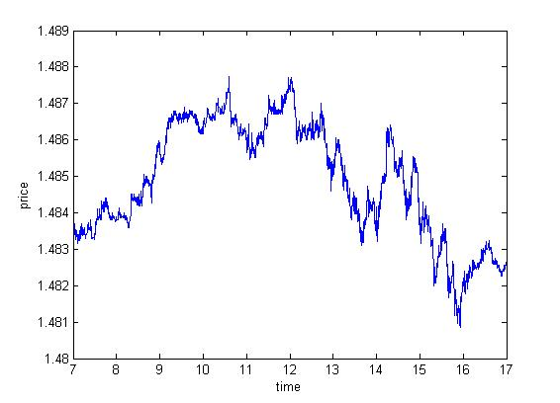
Constructing a Risk Taking Strategy
Consider the plot to the left. This is a time series for EUR from 2012. Maybe at the beginning of that day you came in economic data from Europe was bad so you decided to sell the EUR.
By the end of the day you would have a profit of 10 ticks.
Profit is good, but now consider the dots.
If we had traded at these points we would have made 200 ticks
The smaller time scale we look at the more potential ticks profit we can capture
But how do we identify when to place the trade. Let’s look at probably the most famous algo trading strategy – the simple moving average.

Slide 9
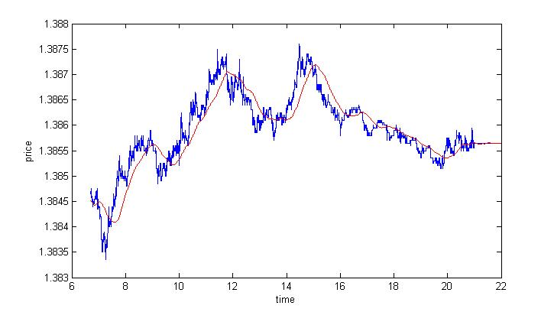
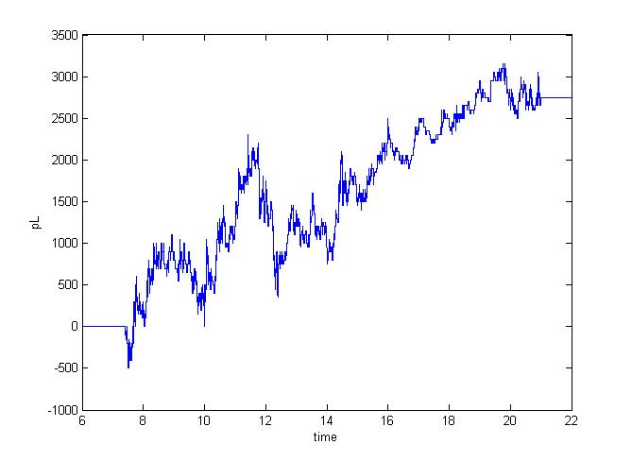
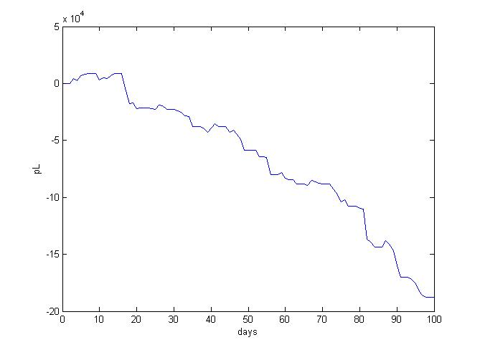
Simple Moving Average
The plot on the left shows a time series with a 10 minute moving average.
Now every time the time series goes above the line we buy the currency, when it goes below we sell.
Easy!
Sadly I cheated. I just picked a day that works as an example.
The plot on the left shows the cumulative profit over 100 days.
And that doesn’t include costs of trading.

Slide 10
Quiz
In the previous slide I showed an example of using a 10 minute window, but why 10? Why not 9, 11, 1, or 30? Each will give different trading signals and hence profit.
What we find is that the parameter that gives the maximum profit moves around on a daily basis.
So the question I ask you to think about for the remainder of the presentation, and there will be Citi prizes up for grabs, is how do we select the best parameter(s) to trade?
What happens when we have more than 1 parameter?

Slide 11
High Frequency Strategies
For those with a keen eye you could see the example on the previous slide was only trading on the hour scale. Not particularly high frequency. What is generally meant by high frequency is trading on the mille second scale.
Although the previous strategy (and others similar) can be scaled down, high frequency trading also opens up a whole host of new strategies based on market micro structure.
These include:
    Latency Arbitrage - Observing market moves and dealing on prices before market makers have a chance to update pricing
    Systematic response to economic data releases
    Cash futures - Capturing the value of arbitrage opportunities between spot and futures markets
    Imbalance - Trade decisions are based on relative amounts on the bid and offer
    Queue Priority - Utilizing the structure of an market’s order book optimize order placement within a market
    Market Correlation - Trading generated by correlated price moves between currency pairs between other liquid markets
    Market Specific Knowledge - Use of knowledge of flows/players in the market to dictate positioning

Slide 12
Market Making
As a market maker our clients expect us to always be showing a price that we will buy (bid) and sell (offer) the currency at.
To do this we look take the bid and offer from all reliable market sources, create where we think the mid point we is, and add our own spread to this mid.
If the market didn’t move, and our clients had an unbiased view we would expect to make money from the spread we show. i.e. we buy a currency from a client at a rate of 1 and then sell it to another client at a rate 2, making a profit of 1.
However the market does move and we need technology that allows us to adapt to these changes and alter our price instantaneously (more on this later).
Also clients are biased and have views, and as a result we can quickly build up risk and be exposed to market moves.
So as a market maker we need to be increasingly smart in what price we show and how we manage the risk

Slide 13
Market Making - Pricing
There is no such thing as the correct market mid. It is a subjective value to where people are willing to buy and sell.
In constructing the mid we have to consider the source, consider the whole order book from each source, and make sure that the data we are receiving looks correct.
We then have to add a very dynamic spread that we think correctly reflects the market conditions.
Similarly we have to make very dynamic decisions on what liquidity we are willing to show,
From these decisions we can then create an order book.
Once we have an order book we then need to make decisions on how to regenerate liquidity once it has been taken from us.
Finally as different clients have different requirements this process is repeated for many pricing streams.

Slide 14
Market Making - Hedging
This topic alone could take up a whole seminar.
Market makers want as little exposure to the market as possible, and as a result do not want to build up risk.
There are two ways we can do this, take the risk and trade with the market in other direction (costs as we have to cross the spread) or reduce/increase our bid/offer on the side we want to decrease our risk (no cost).
We therefore have to make decisions on when to skew our spread and when to hedge in the market.
We then have to make a decision on how to hedge
    At what price do we want to hedge at
    Where do we want to hedge
    How do we trade in the market
    Do we want look at our whole portfolio or just the single currency

Slide 15
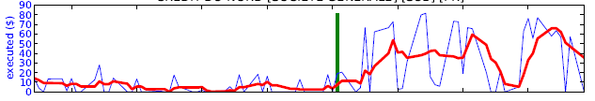
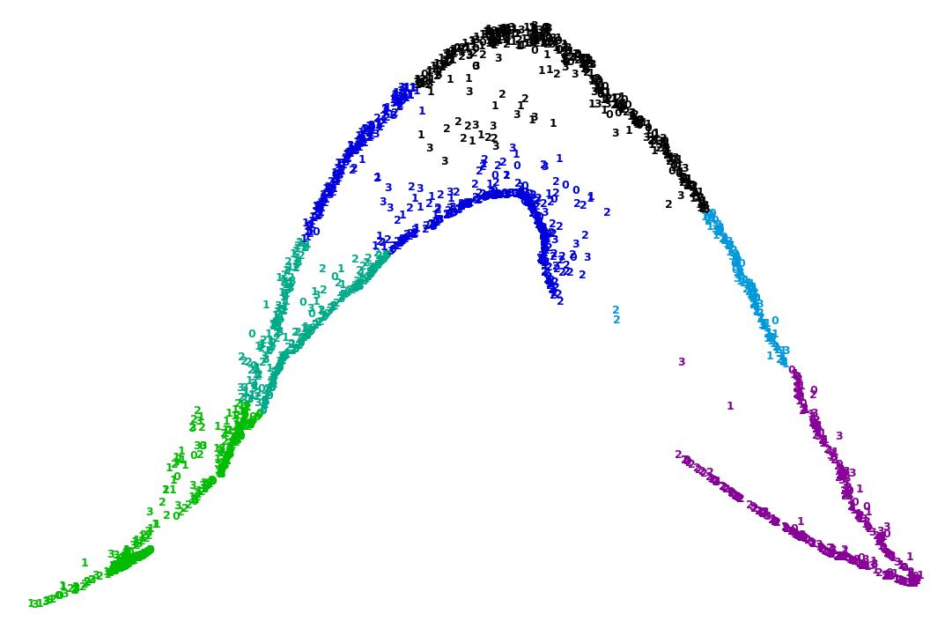
Trendy Tech Industry/Big Data Techniques
A/B testing. Tighten a clients price and perform statistical analysis on the results to decide the best price to show clients.
Dimensionality reduction looking at what are the main drivers in the market or a clients trading behaviour
Machine learning techniques – neural networks, decision trees, clustering, network theory (I would like to see if we can use game theory) to analyse client behaviour
Amazon style predictive engines, people who did this trade also did this.

Slide 16
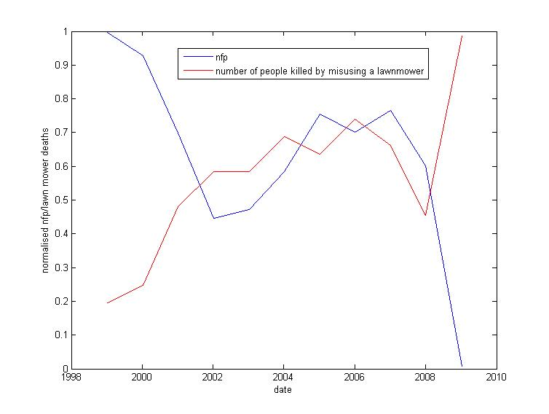
Statistics
How do we test the robustness of a strategy. Has it been over fitted, how confident are we when if it loses money, how do we decide what a successful is strategy, correlation.
We can also use statistics for risk taking strategies
Given clients trades how likely is that they just got lucky or are they picking us off.
Can we predict a clients behaviour from past behaviour.
80% inverse correlation

Slide 17
Data
We trade in 3 regions – EMEA (Europe/Africa), NAM (North America), APAC (Asia/Pacific)
Each region has it’s own exchanges, offering products unique to the region and products that are traded in all regions.
Also each exchange has it’s own rules, for example the frequency they update, they way they match trades, or the rules for how long and how many trades we have to show on the venue.
So let’s look our top 3 venues, EBS, Reuters, and CME. In order they update every 100ms, 250ms, in real time.
Now it also takes 35ms for a signal to get from NAM to EMEA, 95 ms to get from EMEA to APAC and 95 to get from EMEA to APAC.
We are therefore presented with a big technology/data analysis problem of how to aggregate the prices from different exchanges in different regions to get an actual market.
We then need to analyse this data, make pricing and trading decisions, then get back to the exchange as quickly as possible.

Slide 18
Technology
Examples of projects:
    Market connection/aggregation – quick, stable
    Trading systems – quick, adaptable, robust
    Back testing system – intuitive, quick
    Data visualisation – intuitive
    Risk management – stable, reliable
  Data
    We collect about 2TB a day
    Needs to be easily accessed and analysed – specialised databases
    We can analyse 7 billion records in 50 seconds
  We have 552 cores, 8TB ram, 120TB of disk across 23 servers
  FPGAs/GPUs for fixed tasks
  No standard on language used, personally I use Java and Python

Slide 19
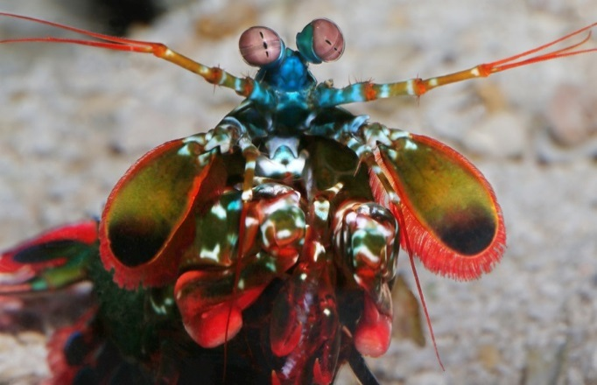
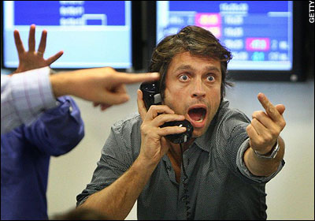
So how have we used our PhD’s?
  On a desk of 15, there are 3 PhD particle physicists – there’s a reason
    Practical problem solving skills. From theory, to research, to solution (you’d be amazed how rare this skill is)
    Experience with large data set analysis
    Technology skills, be that software or hardware
    High performance computing
  Some personal examples
    Signal processing – PhD looked for shrimp clicks, now I look for human signals
    Matrix algebra – PhD correlating hydrophone signals, now correlating markets
    Machine learning – PhD (trying to) classify neutrinos, now classify clients
=

Slide 20
Quiz Ideas

Slide 21
Conclusion
We have seen how the markets are becoming increasingly electronic and high frequency
And as this happens the more and more quants (and in my opinion particle physicists) will dominate the banking landscape, be that on the buy side or the sell side
Banks are quick to adapt to new technology and are always looking to improve their business
Day to day work in a bank/hedge fund really isn’t that different from that in physics
Although the end result is very different!

