Slide 1
Problems in Particle Detection, 1930-1950
New Ways to Talk about the History of Physics
William Thomas
Centre for the History of
Science, Technology and Medicine
Imperial College London

Slide 2
The Quality of Experiment
What makes a good experiment?
How do we describe the skill of a skilful experimental physicist?
Notes:
Historical accounts are usually quite vague about these issues; not something that shows up much in physics education; suspect there is a half-articulated understanding of this among experimenters

Slide 3
The Quality of Experiment
What makes a good experiment?
How do we describe the skill of a skilful experimental physicist?
Focus on
Precision and reliability of the experimental apparatus
Ingenuity (but also rigour) of experiment design
Ingenuity (but also rigour) in experiment interpretation
Interrelation of experimental capability with theoretical needs

Slide 4
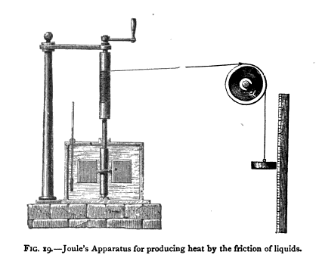
“Tacit Knowledge”

Slide 5
Particle physics
1930-1950: a period of great experimental instability

Slide 6
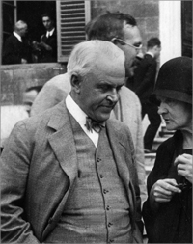
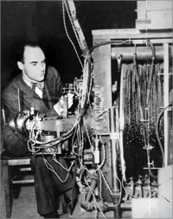
Measuring Cosmic Ray Energies (c1930)
Robert Millikan (1868-1953)
Known for “oil drop” experiment on electron mass
Controversy over origins and nature of cosmic rays
Carl Anderson (1905-1991)
Postdoctoral researcher

Slide 7
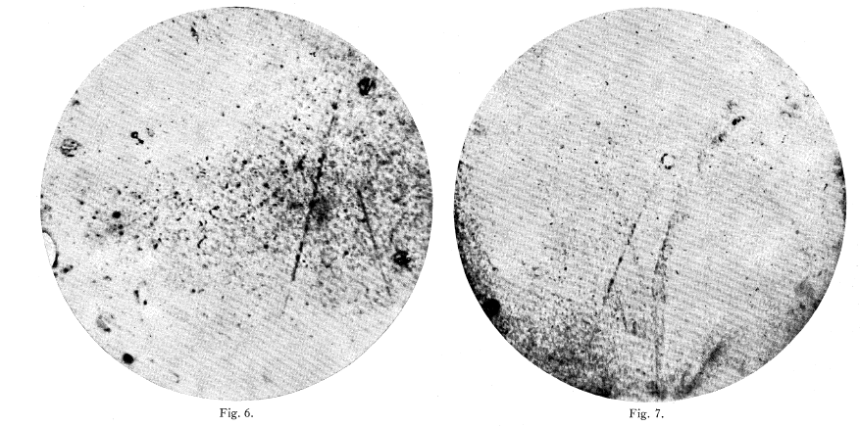
Using Cloud Chambers
The task: identify a particle and measure its energy.
Notes:
12,000 gauss; momentum by curvature; velocity by ionization (provided charge is known); derive mass, and thus energy

Slide 8
Inferential strategies
Identifying particles through assumptions and argument

Slide 9
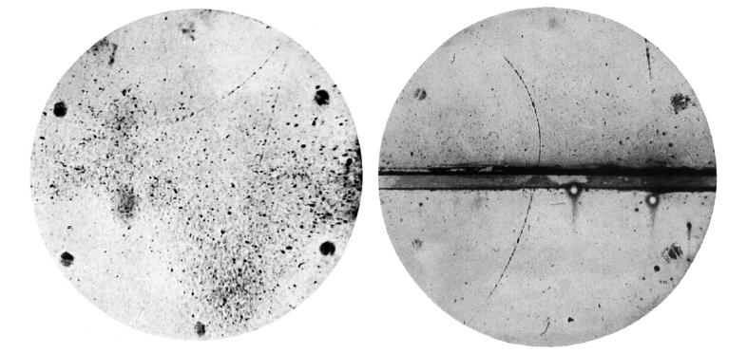
Using Cloud Chambers
How do you discover something when your interpretive strategies militate against discovery?
Notes:
Assume known particle; identify by direction of curvature, plus rough measurement of range and ionization, and direction of travel (usually down); derive energy based on curvature and known mass

Slide 10
aggregation
Conclusions through accumulation of results

Slide 11
Blackett and Occhialini
Blackett (right): “In order to make [the Geiger counter] work you had to spit on the wire on some Friday in Lent.”
Notes:
However, it is not easy to agree with Anderson and Kunze that the positively curved tracks are mainly due to protons. For, as already mentioned, it, is a striking feature of our photographs that the great majority of the tracks have almost the same specific ionization. Now Kunze finds that the mean energy of the protons (for this he assumes the positively curved particles to be) is about 4 x 108 volts. Protons of this energy … ionize not very differently from electrons…... But if such fast protons are present, then there must also be some slower ones present, for the stream of descending particles must certainly be fairly heterogeneous at the bottom of the atmosphere, whatever it may be at the top, and these slower tracks will ionize more strongly and so produce noticeably denser tracks. Four tracks have been found showing the character of proton…, but in no case are they to be classified with the main group of downward moving particles, but rather with some local nuclear disintegration process. Further, all the single tracks which do show marked positive curvature have nearly the same specific ionization as the undeflected ones, so are either negative electrons going up, or positive electrons coming down. By a positive electron is meant a particle with unit positive electronic charge and, with a mass very much less than that of a proton. So the conclusion seems justified that the main beam of downward moving particles consists chiefly of positive and negative electrons. Some protons are probably also present.

Slide 12
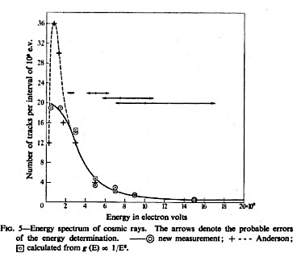
Aggregation of Measurements

Slide 13
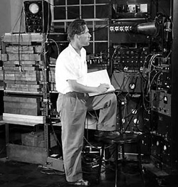
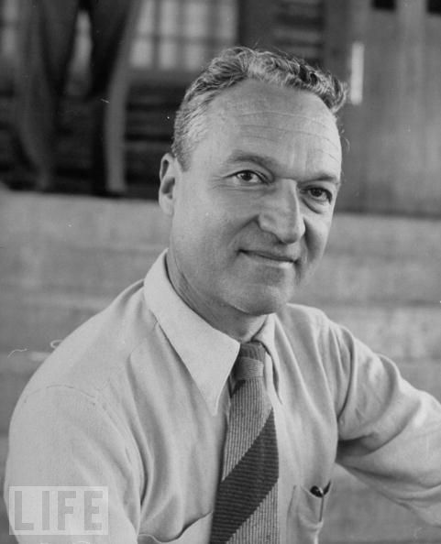
The Italian masters of counter experiments
Above: Oreste Piccioni
Right: Bruno Rossi
(1905-1993)
Notes:
Franco Rasetti, Gilberto Bernardini, Ettore Pancini

Slide 14
Nuclear physics
Narrowing range of possible interpretations in terms of the physically possible
Notes:
Inside and outside the apparatus

Slide 15
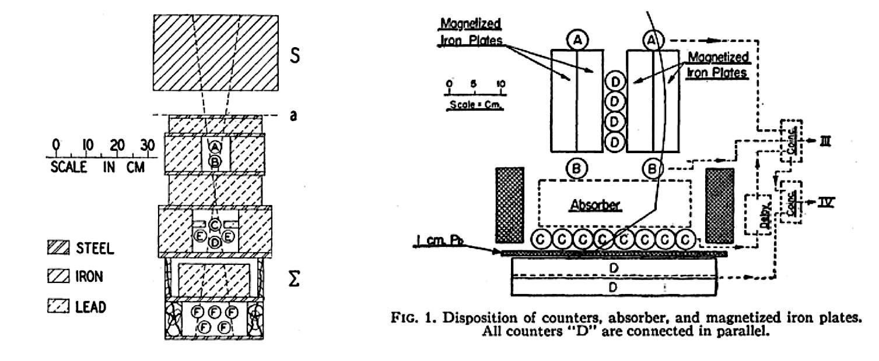
Opaque interactions

Slide 16
The pion discovery
Deft strategy use in the midst of confusion
Notes:
1) Variable-mass meson

Slide 17
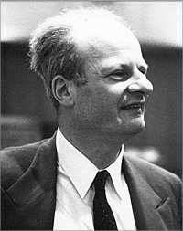
How do you know when you’ve made a discovery?
Hans Bethe: “This brings us to a more philosophical point: All known fundamental particles have a definite rest mass. To discover a particle for which this is not the case would be a tremendous deviation from previous experience. For this reason the most unambiguous and accurate experimental evidence would have to be obtained before a non-unique rest mass could be accepted.”
Notes:
“It is obviously very easy to explain each new experiment by a new assumption, and this was done in the last few years in the case of the meson mass: It is much more difficult to explain all experiments by a minimum of assumptions, which is the way in which physics has progressed in the past. The burden of proof lies always with the discoverer of a new phenomenon, and must in this case lie with the advocates of the variable rest mass of the meson.”

Slide 18
How do you know when you’ve made a discovery?
Hans Bethe: “It is obviously very easy to explain each new experiment by a new assumption, and this was done in the last few years in the case of the meson mass: It is much more difficult to explain all experiments by a minimum of assumptions, which is the way in which physics has progressed in the past. The burden of proof lies always with the discoverer of a new phenomenon, and must in this case lie with the advocates of the variable rest mass of the meson.”

Slide 19
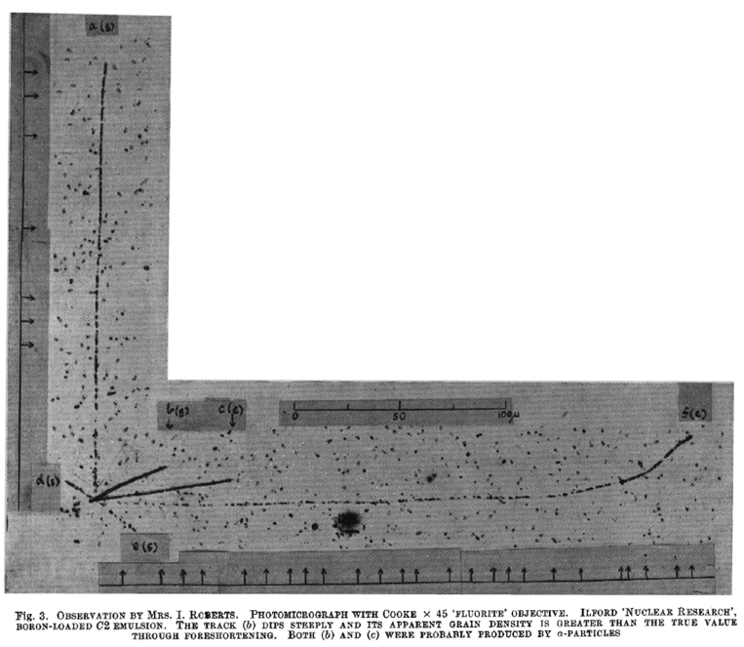
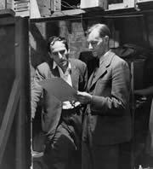
Nuclear interactions in emulsions

Slide 20
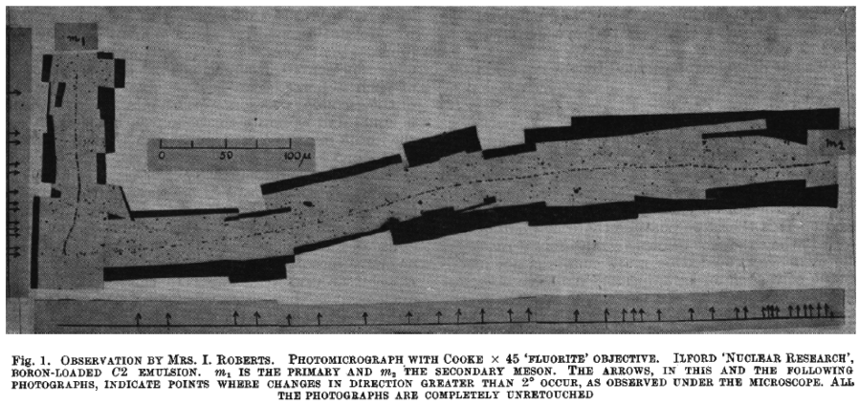
Nuclear interaction or spontaneous decay?

Slide 21
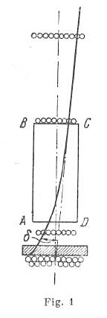
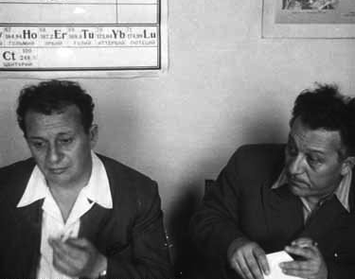
The “Varytron”
Artëm Alikhanian and
Abraham Alikhanov

Slide 22
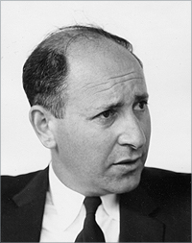
Marshak’s “Two Meson” Theory
“The Russians were constantly finding lots of intermediate mass particles… Alikhanian and his group—but they had small numbers of particles with all kinds of masses. Maybe some of the heavier mesons are pions but they had many more than are known even now. It was pretty poor stuff. But in the case of the Bristol work, these were nuclear emulsion events, and they looked very good, although they made a very serious mistake in the estimate of the mass of the heavier meson.”
Notes:
“less convincing”

Slide 23
New strategies
Decay mode analysis and accelerator-based experiments in an age of discovery

Slide 24
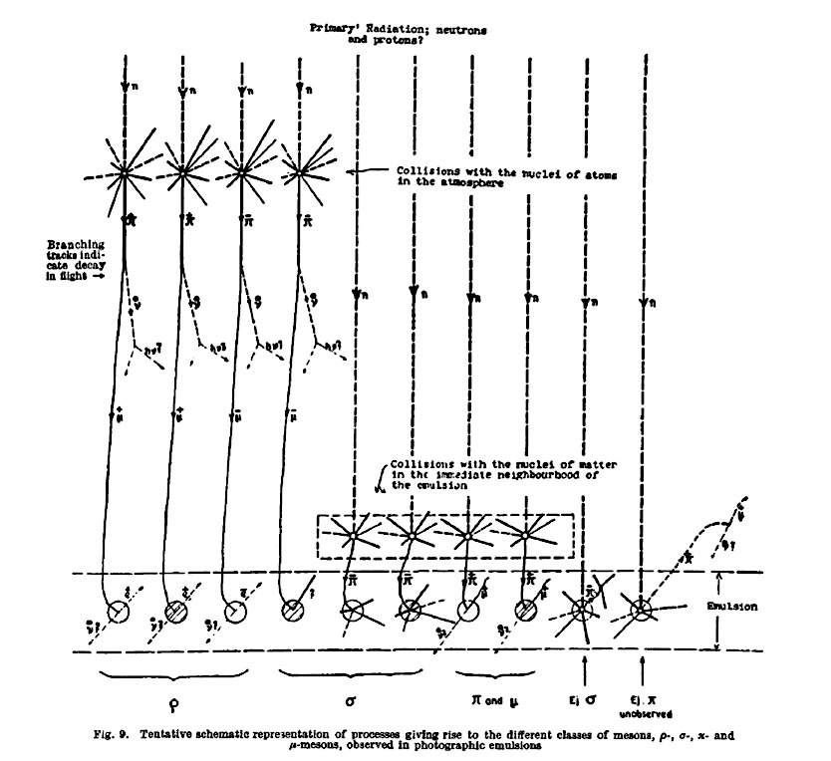
Notes:
1948

Slide 25
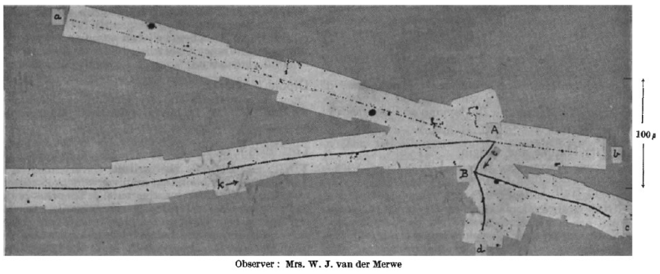
Decay mode analysis and discovery
Notes:
1948

Slide 26
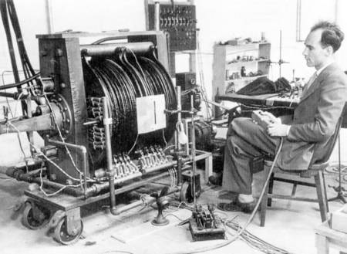
High-precision detection

Slide 27
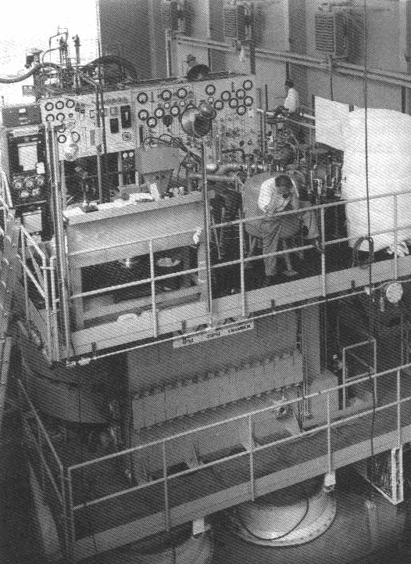
High-precision detection

Slide 28
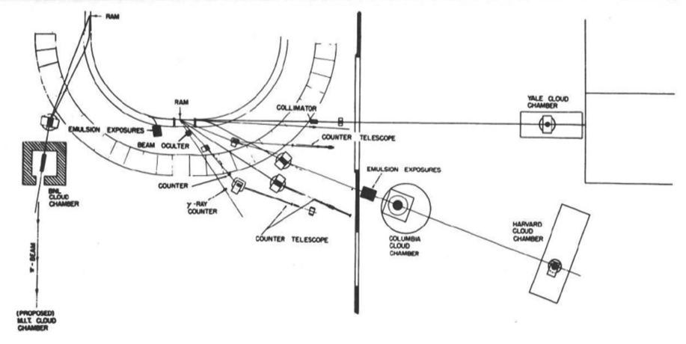
Known experimental parameters

Slide 29
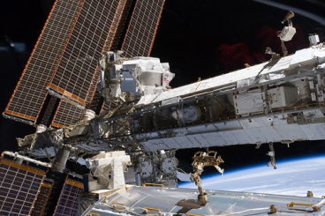
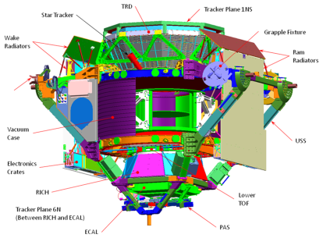
Measuring Cosmic Ray Energies (2013)

