Slide 1
Standard Model physics at the LHC
  Jonathan Butterworth
  University College London
  Seminar
  11/1/2013

Slide 2

The LHC gave us a new landscape to explore…

Slide 3
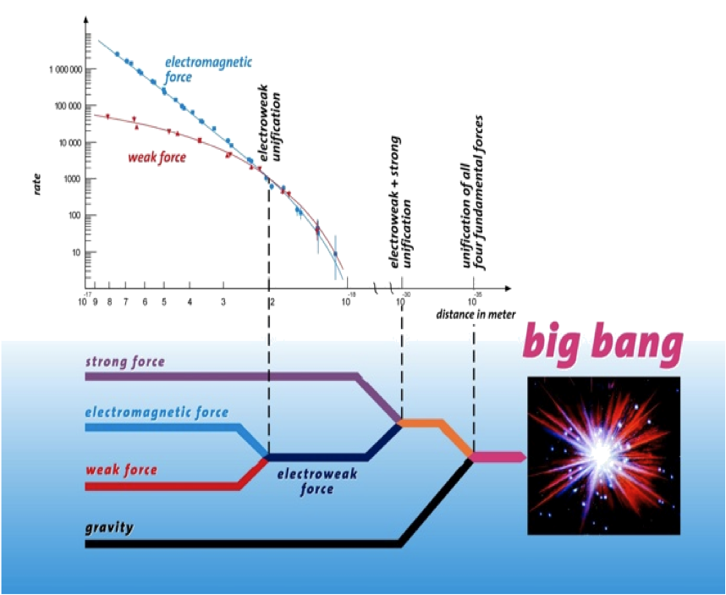
A new landscape…
Notes:
First in-depth study of physics above the EWSB scale

Slide 4

No low-hanging fruit

Slide 5
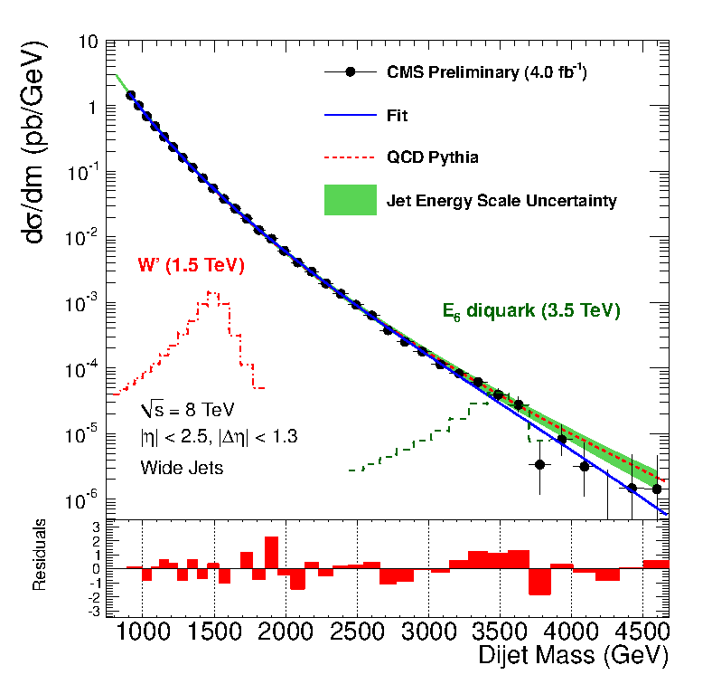
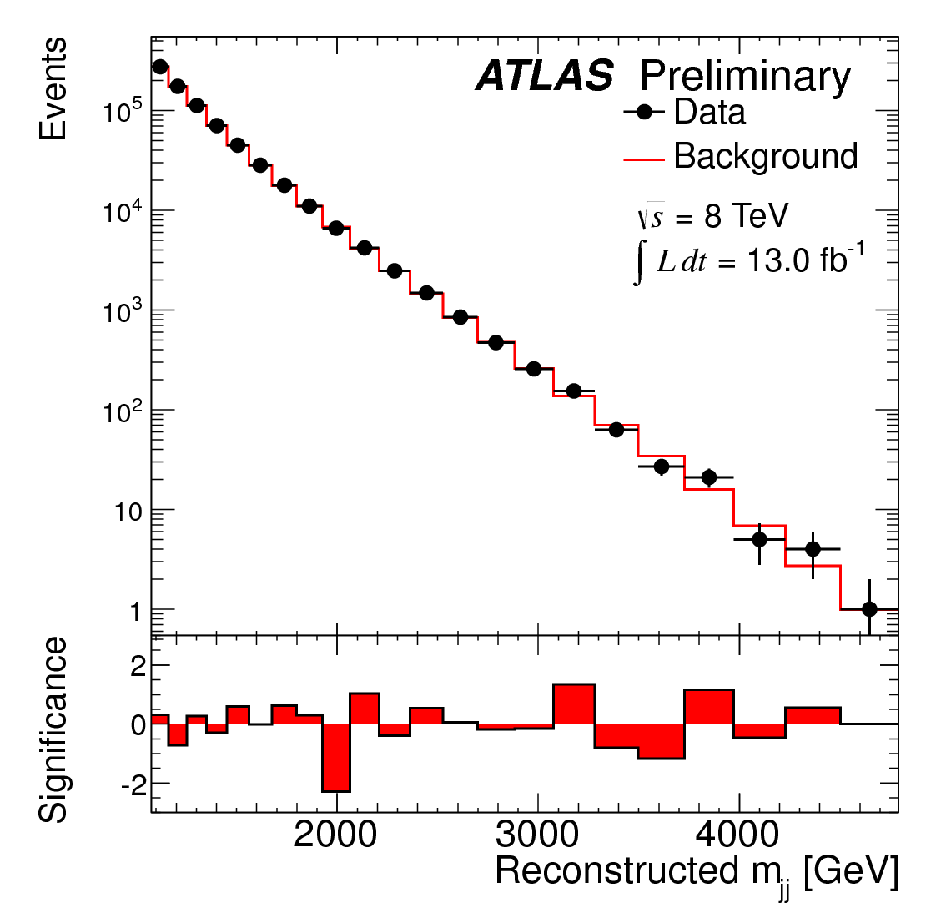
Looking for bumps…
… didn’t work so far (except for one!)

Slide 6

Jet physics at hadron colliders

Slide 7
Jet physics at hadron colliders
High energy hadron colliders are “quark/gluon” colliders
Highest cross-section hard-scattering process is gluon exchange, leading to high transverse momentum quarks or gluons
First probe of physics at the kinematical/statistical limit

Slide 8
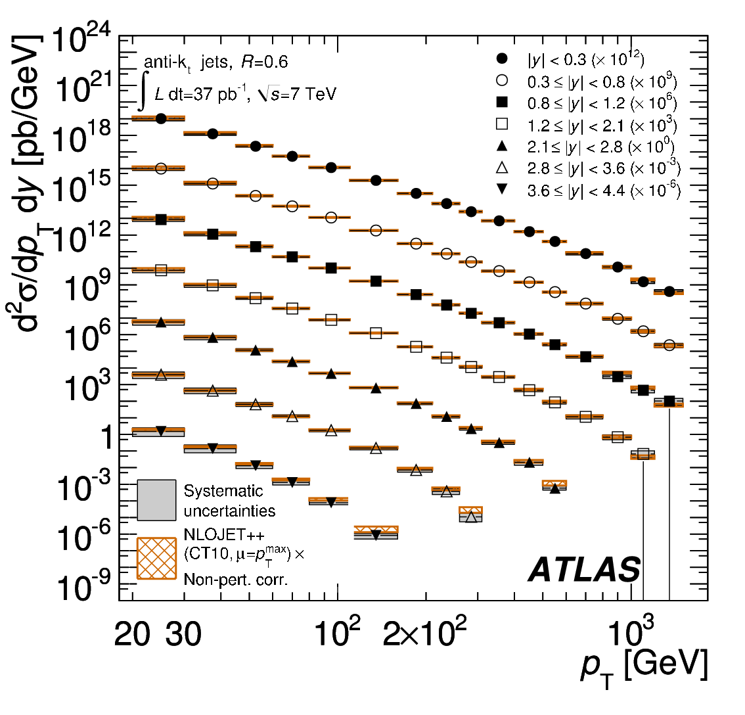
Jets at the highest scales
And measure stuff
Highest transverse momentum jets; at the TeV scale
  arXiv:1009.5908 (EPJC),arXiv:1112.6297 (PRD)

Slide 9
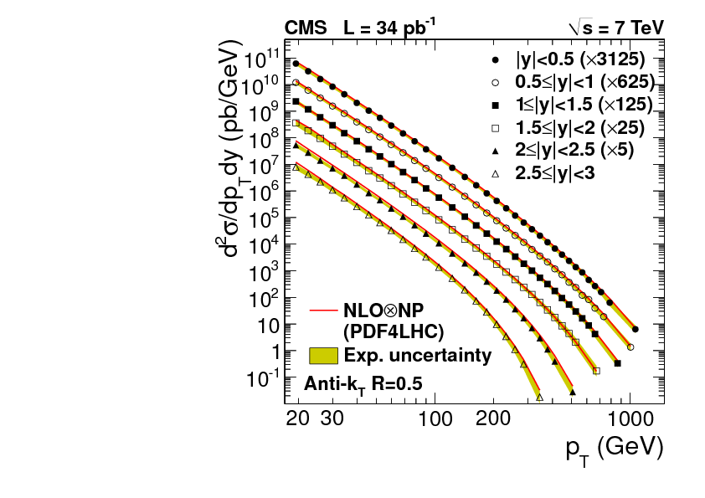
Jets at the highest scales
Highest transverse momentum jets; at the TeV scale
  arXiv:1009.5908 (EPJC),arXiv:1112.6297 (PRD)
  arXiv:1106.0208 (PRL)

Slide 10
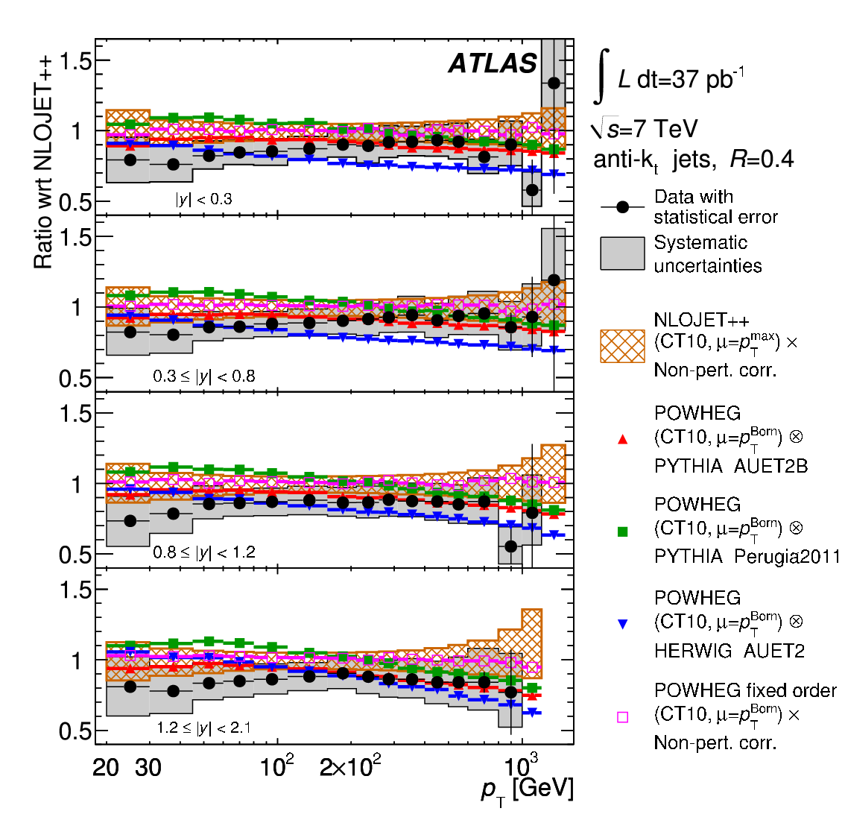
Jets at the highest scales
Highest transverse momentum jets; at the TeV scale
  arXiv:1009.5908 (EPJC),arXiv:1112.6297 (PRD)
  arXiv:1106.0208 (PRL)
General agreement with NLO QCD calculations (after soft corrections)
Significant spread in “NLO” predictions. ME/PS matching? MC tune (UE)? PDFs?

Slide 11
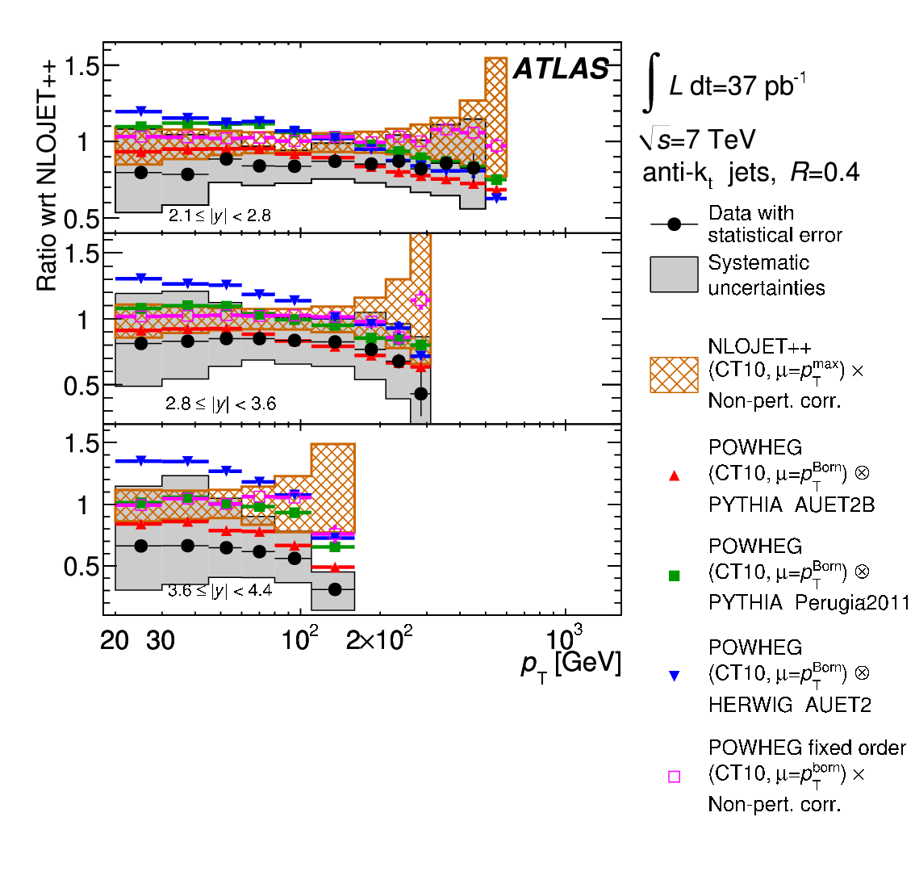
Jets at the highest scales
Highest transverse momentum jets; at the TeV scale
  arXiv:1009.5908 (EPJC),arXiv:1112.6297 (PRD)
  arXiv:1106.0208 (PRL)
General agreement with NLO QCD calculations (after soft corrections)
Significant spread in “NLO” predictions. ME/PS matching? MC tune (UE)? PDFs?

Slide 12
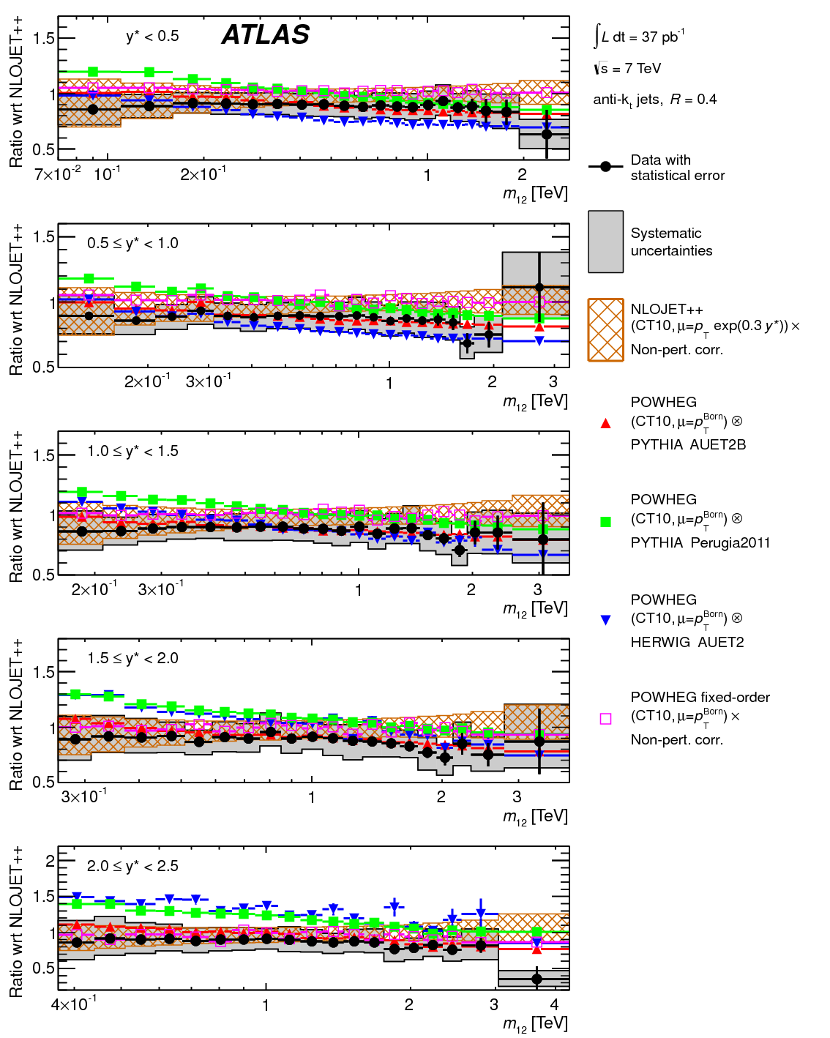
Jets at the highest scales
Highest mass dijet pairs
  arXiv:1009.5908 (EPJC),arXiv:1112.6297 (PRD)
  arXiv:1104.1693 (PLB)
General agreement with NLO QCD calculations (after soft corrections)
Significant spread in “NLO” predictions. ME/PS matching? MC tune (UE)? PDFs?

Slide 13
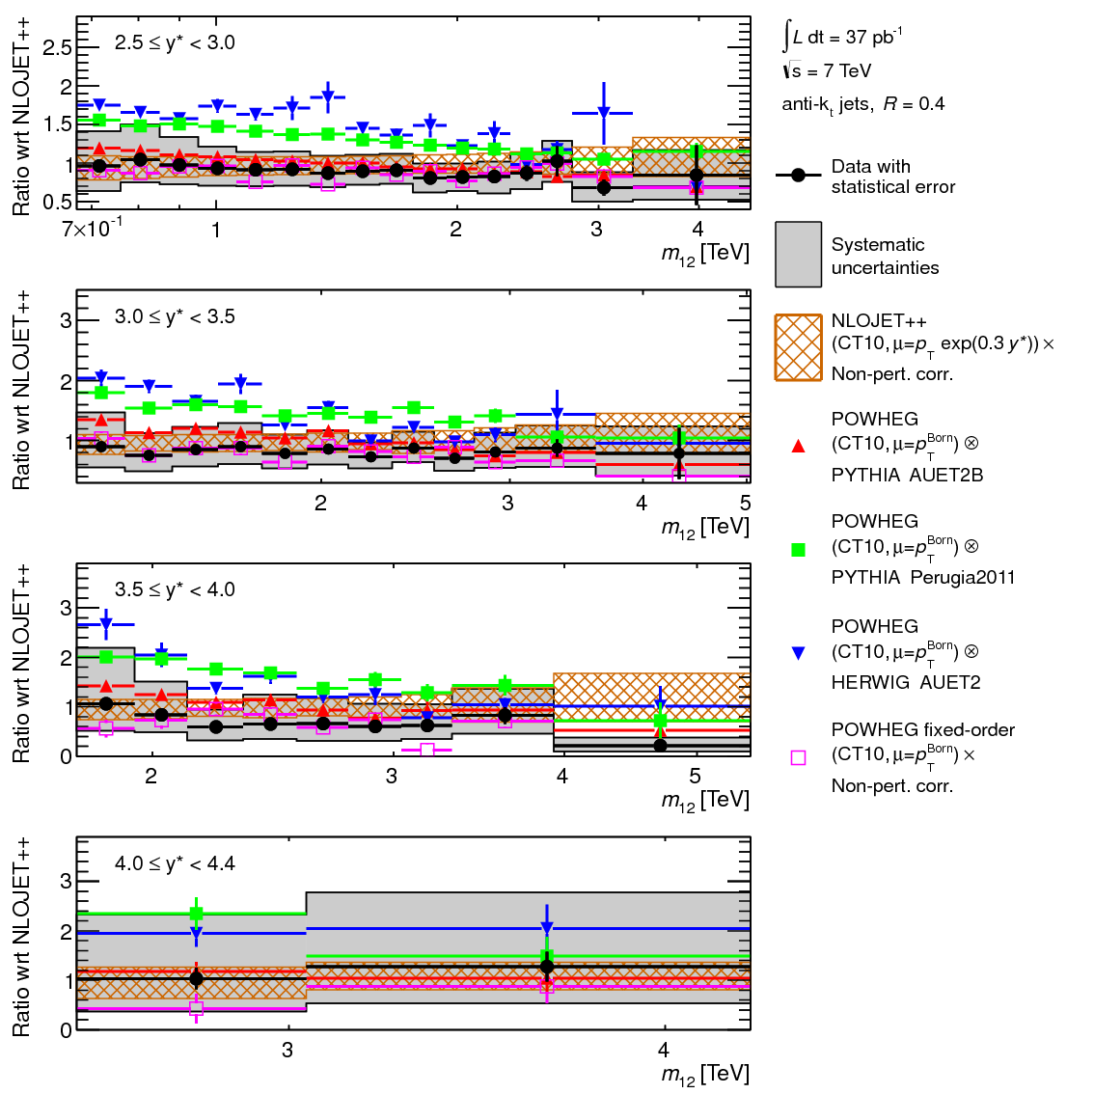
Jets at the highest scales
Highest mass dijet pairs
  arXiv:1009.5908 (EPJC),arXiv:1112.6297 (PRD)
  arXiv:1104.1693 (PLB)
General agreement with NLO QCD calculations (after soft corrections)
ATLAS
Significant spread in “NLO” predictions. ME/PS matching? MC tune (UE)? PDFs?

Slide 14
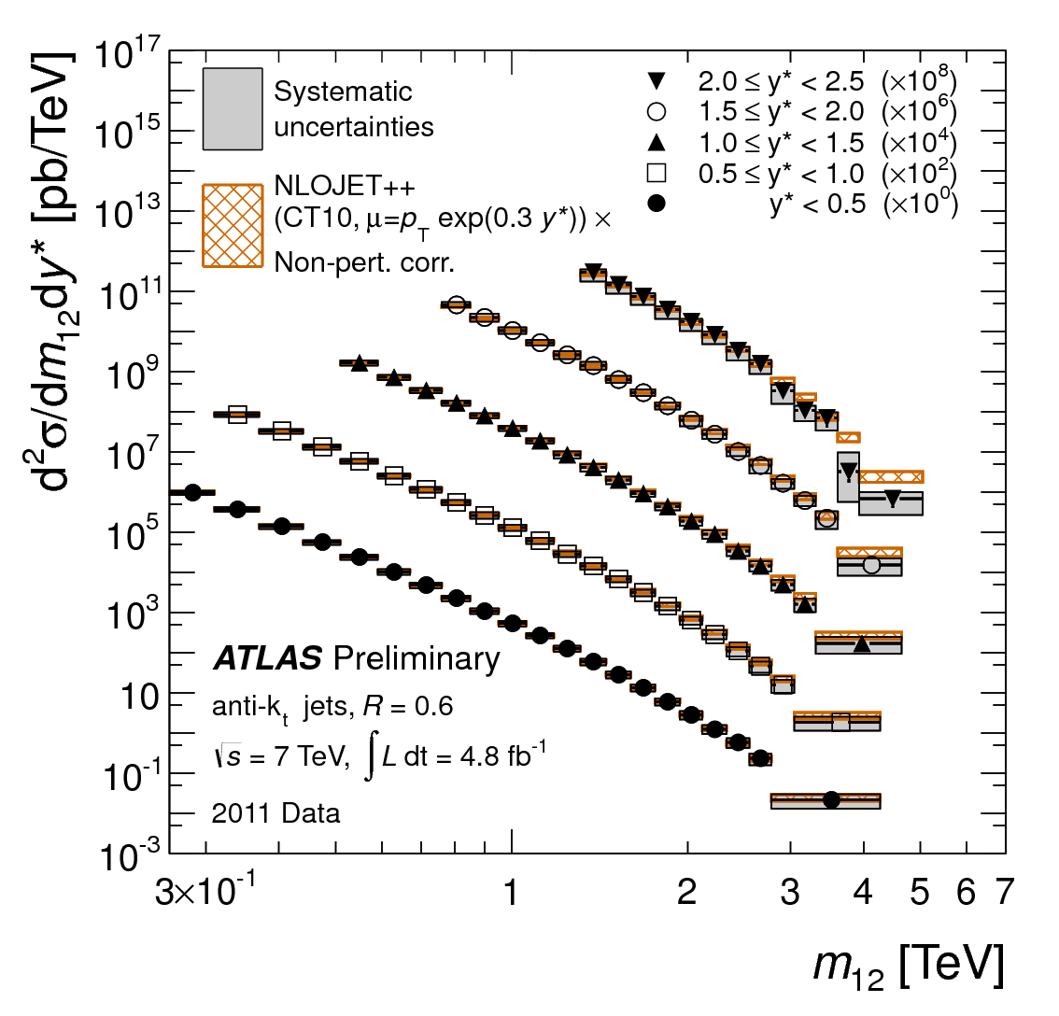
Jets at the highest scales
Highest mass dijet pairs
  arXiv:1009.5908 (EPJC),arXiv:1112.6297 (PRD), ATLAS-CONF-2012-021
  arXiv:1104.1693 (PLB)
Agreement with NLO QCD calculations (fixed order shown, after soft corrections)

Slide 15
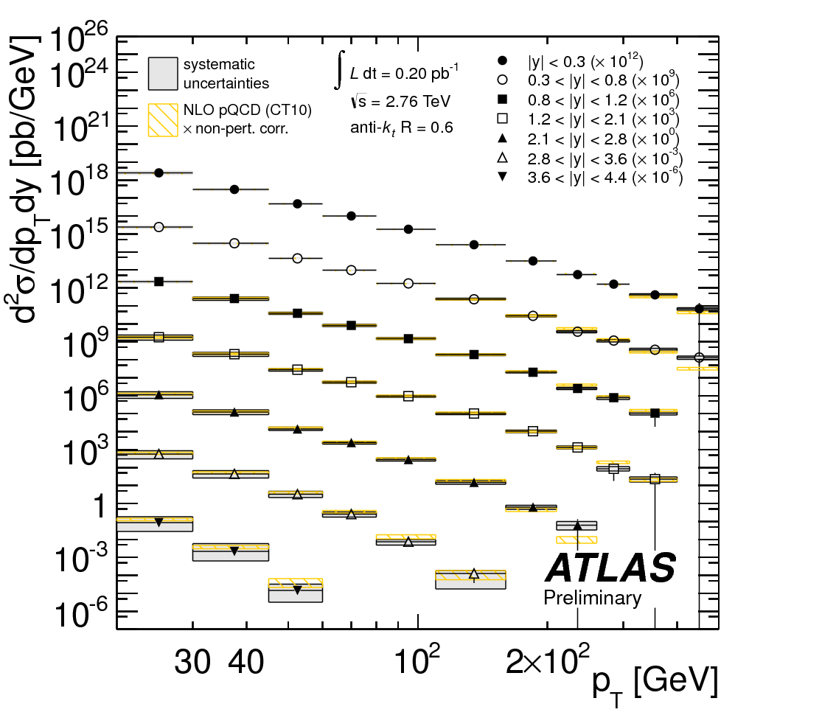
Jets as a probe of the proton
Use 2.76 TeV CM data to measure cross sections.
ATLAS-CONF-2012-128

Slide 16
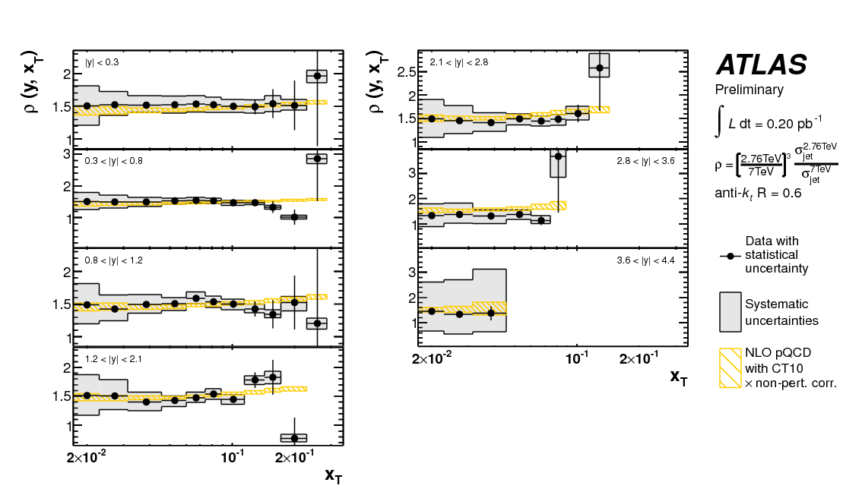
Jets as a probe of the proton
Use 2.76 TeV CM data to measure cross sections.
Ratios;
  in x_{T}, many theory uncertainties ~cancel (same x, different Q²)
ATLAS-CONF-2012-128

Slide 17
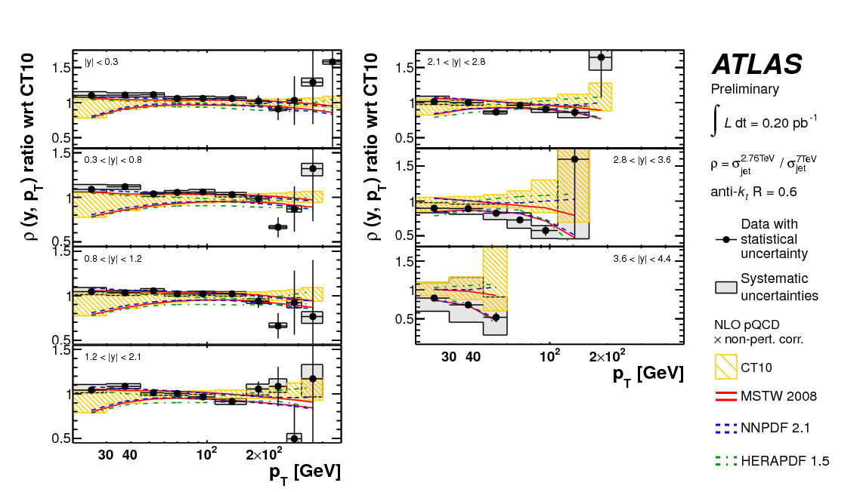
Jets as a probe of the proton
Use 2.76 TeV CM data to measure cross sections.
Ratios;
  in x_{T}, many theory uncertainties ~cancel (same x, different Q²)
  In p_{T}, jet energy scale ~cancels (dominant experimental uncertainty)
ATLAS-CONF-2012-128

Slide 18
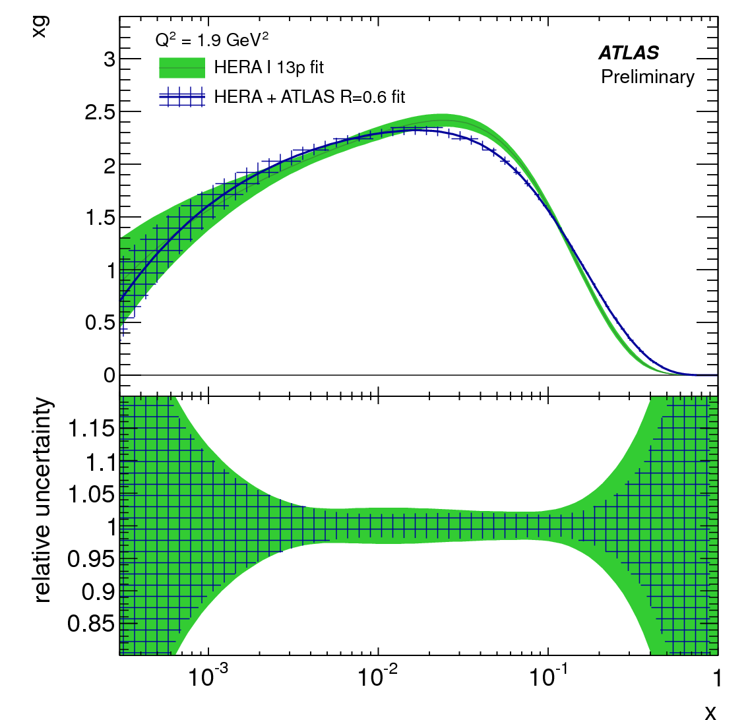
Jets as a probe of the proton
Illustrative fit to HERA and ATLAS data
Valence quarks heavily constrained by HERA
High x gluon and sea quarks modified by addition of ATLAS data
ATLAS-CONF-2012-128

Slide 19
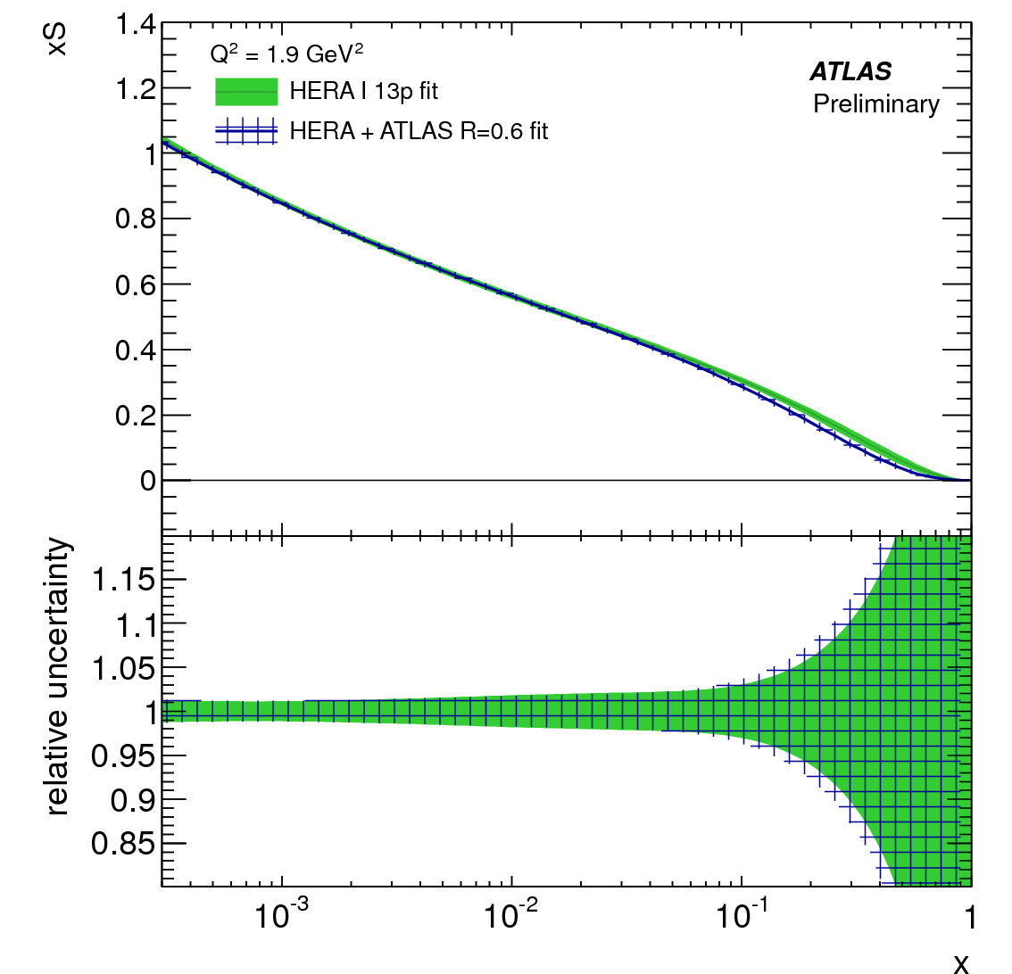
Jets as a probe of the proton
Illustrative fit to HERA and ATLAS data
Valence quarks heavily constrained by HERA
High x gluon and sea quarks modified by addition of ATLAS data
ATLAS-CONF-2012-128ç

Slide 20
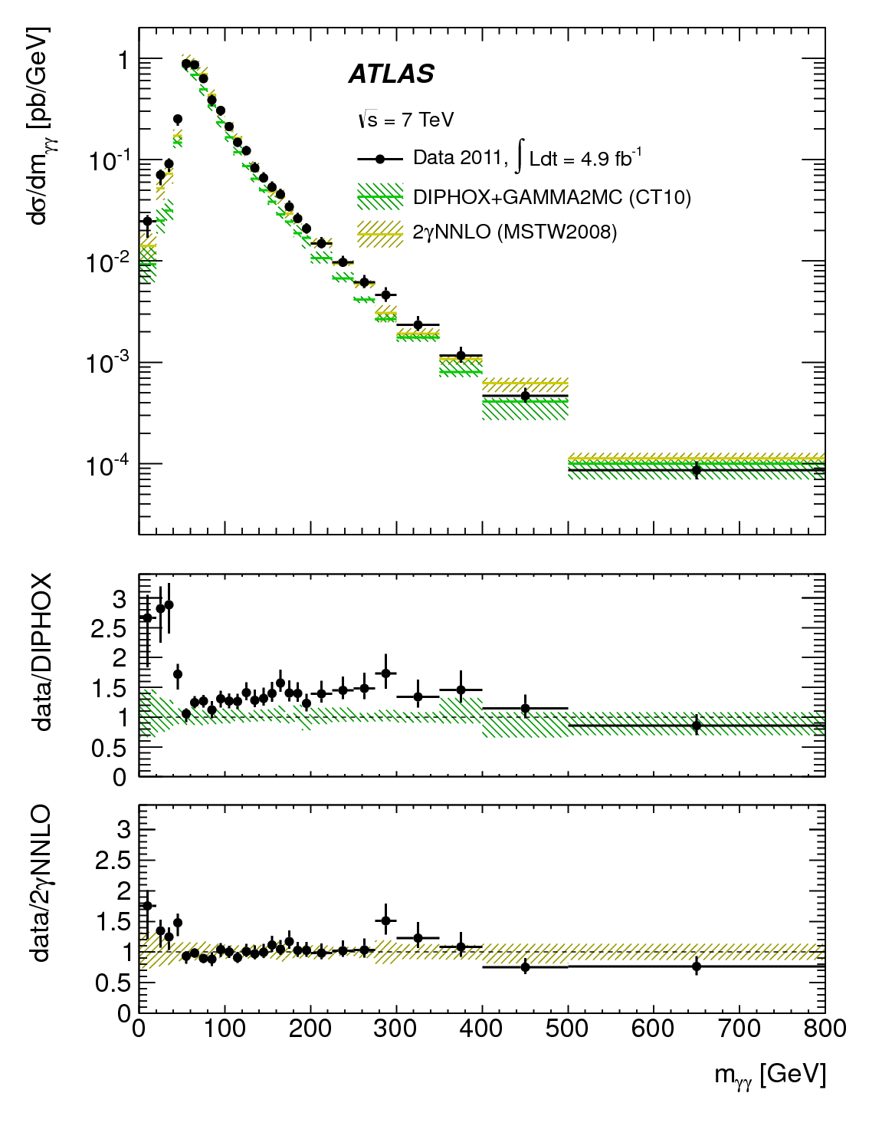
Photons
Similar physics, complementary systematics to jet studies
Key background for Higgs
  arXiv:1211.1913
  arXiv:1210.5033

Slide 21
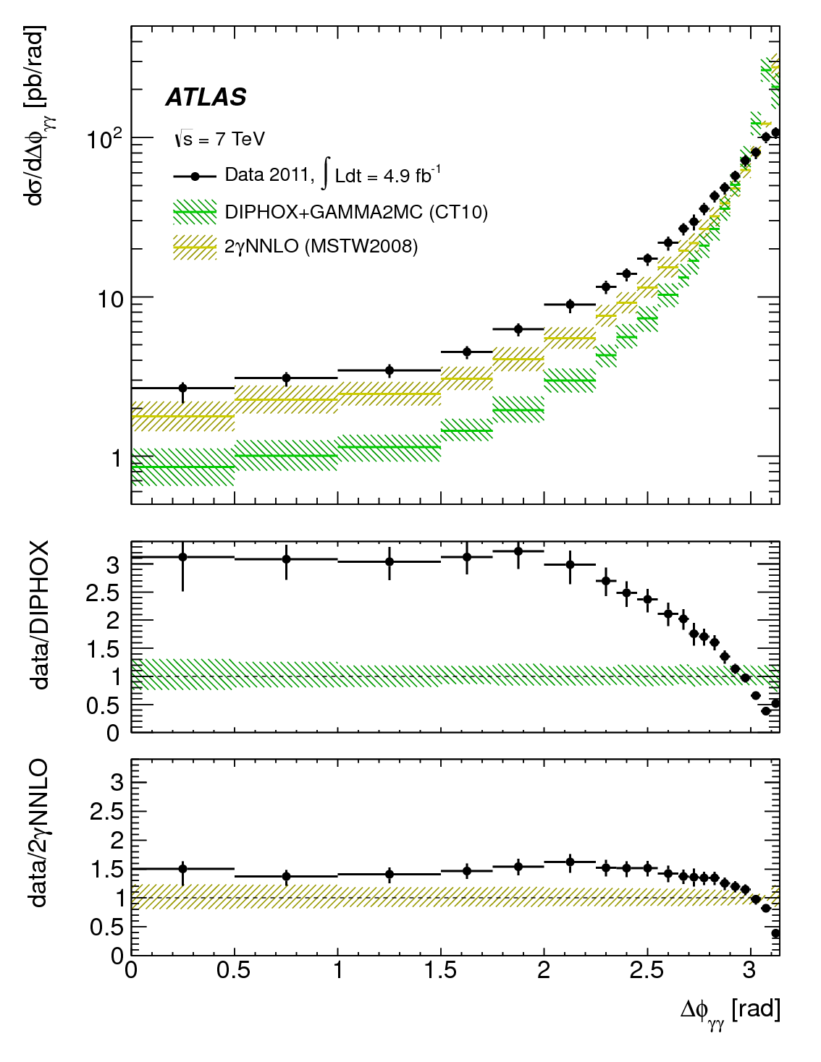
Photons
Similar physics, complementary systematics to jet studies
Key background for Higgs
Diphoton + jet measurements badly needed!
  arXiv:1211.1913
  arXiv:1210.5033

Slide 22
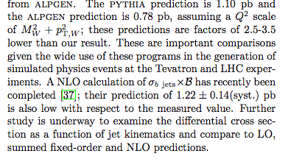
Bosons and jets
W+b
  Key channel for credibility of QCD at EWSB scale
  Important background for WH
  Discrepancy between CDF data & theory

Slide 23
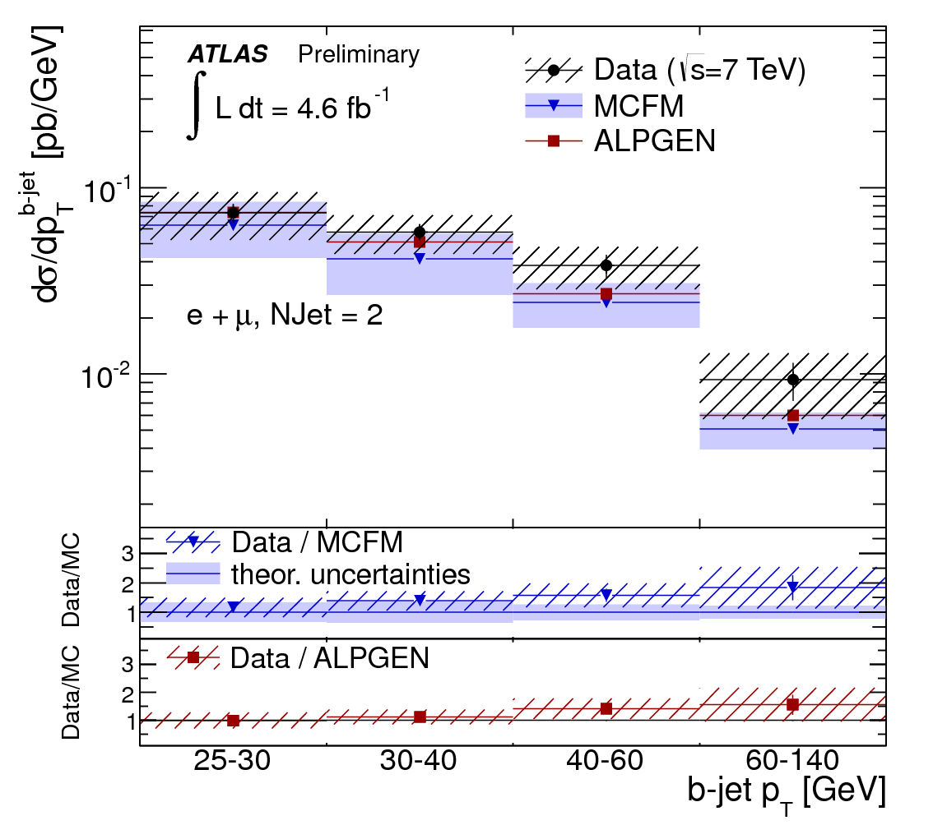
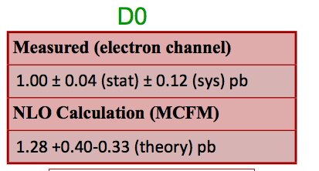
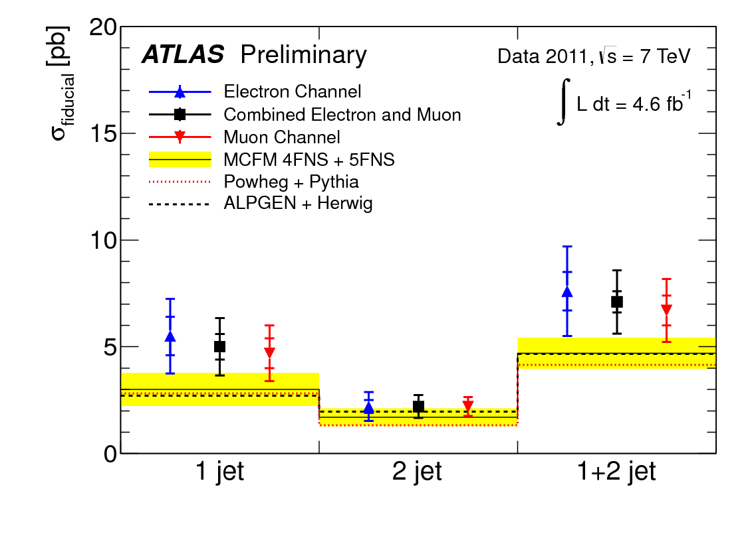
Bosons and jets
W+b
  Key channel for credibility of QCD at EWSB scale
  Important background for WH

Slide 24
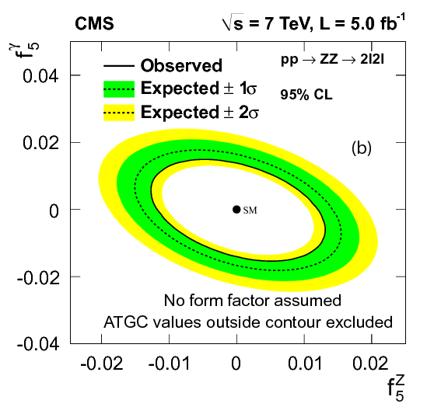
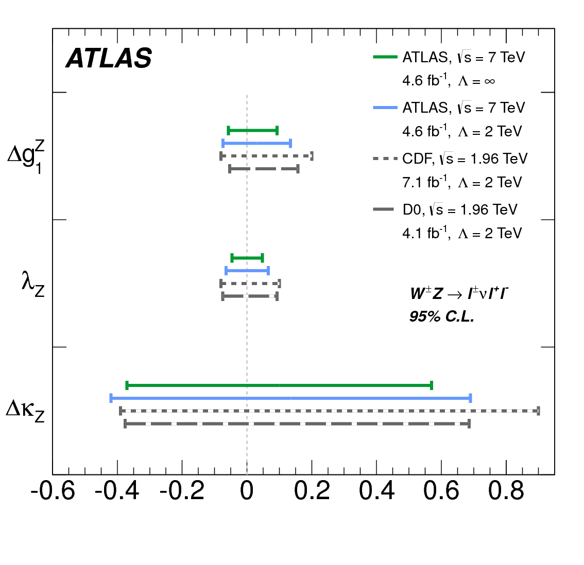
Dibosons
Continue to probe for anomalous couplings

Slide 25
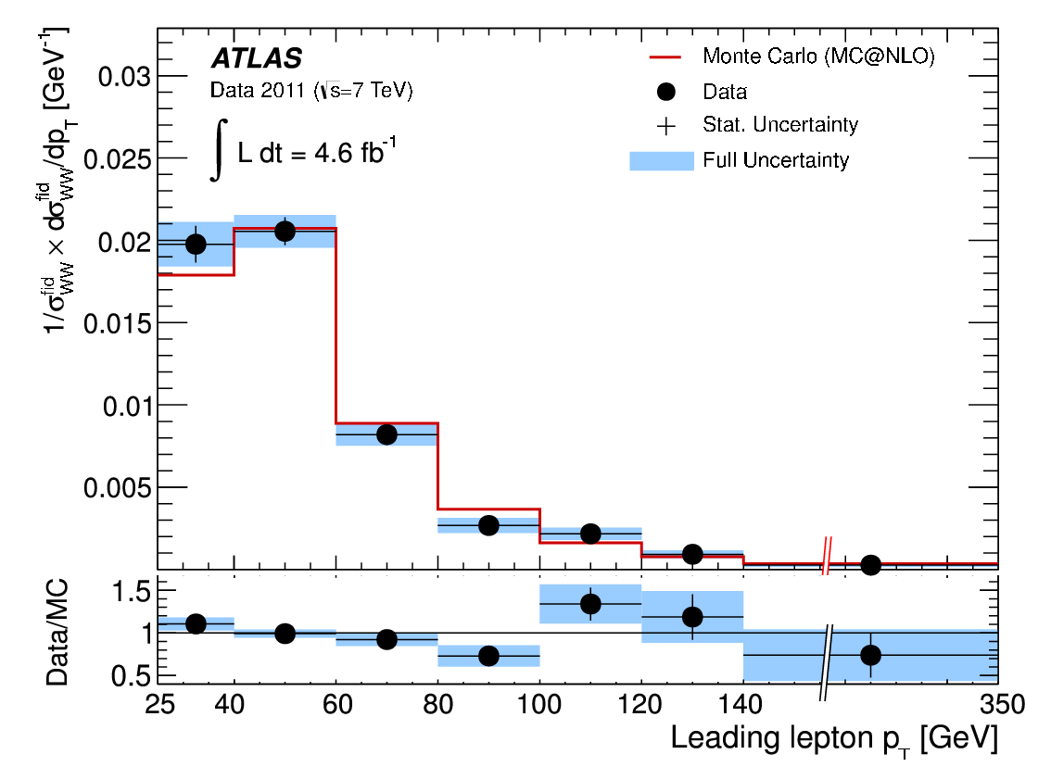
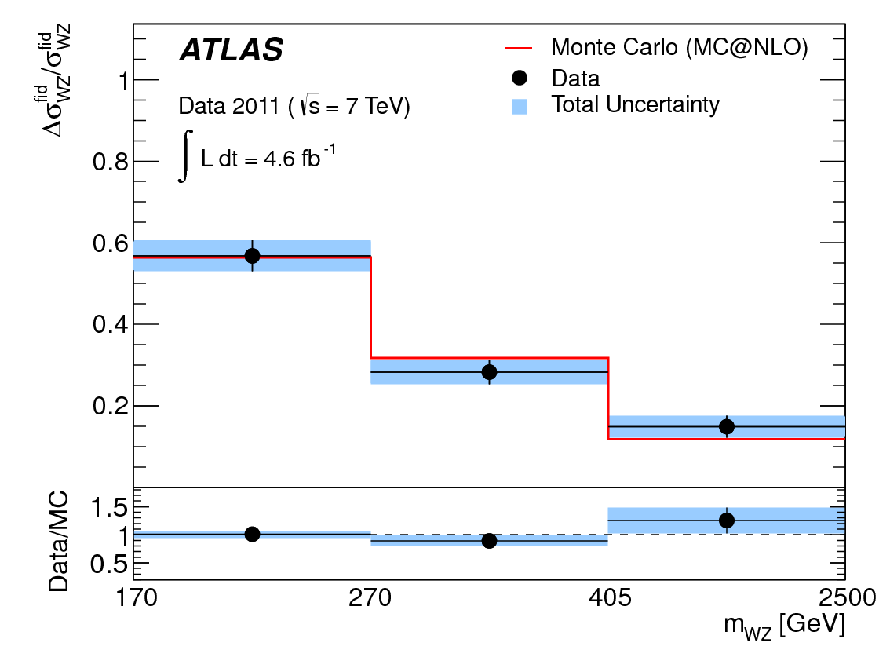
Dibosons
Continue to probe for anomalous couplings
Measure the kinematics

Slide 26
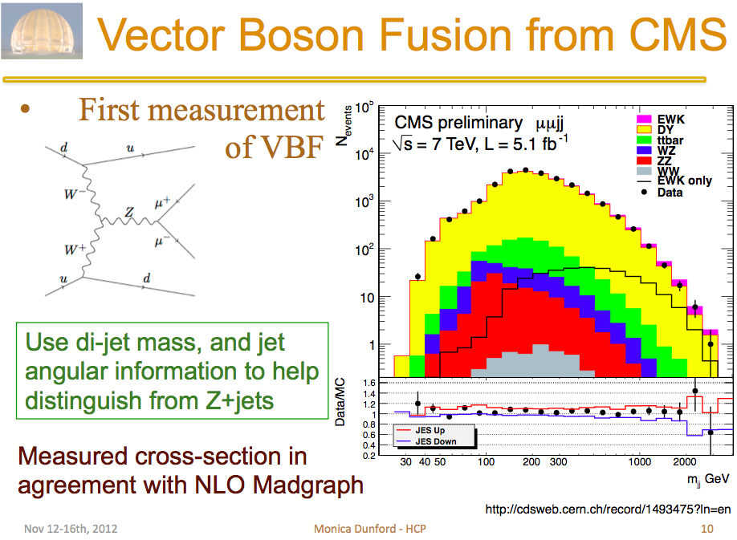
Vector boson fusion/scattering?

Slide 27
Dijets with veto
Select two jet separated by a large rapidity interval
ATLAS-CONF-2011-038

Slide 28
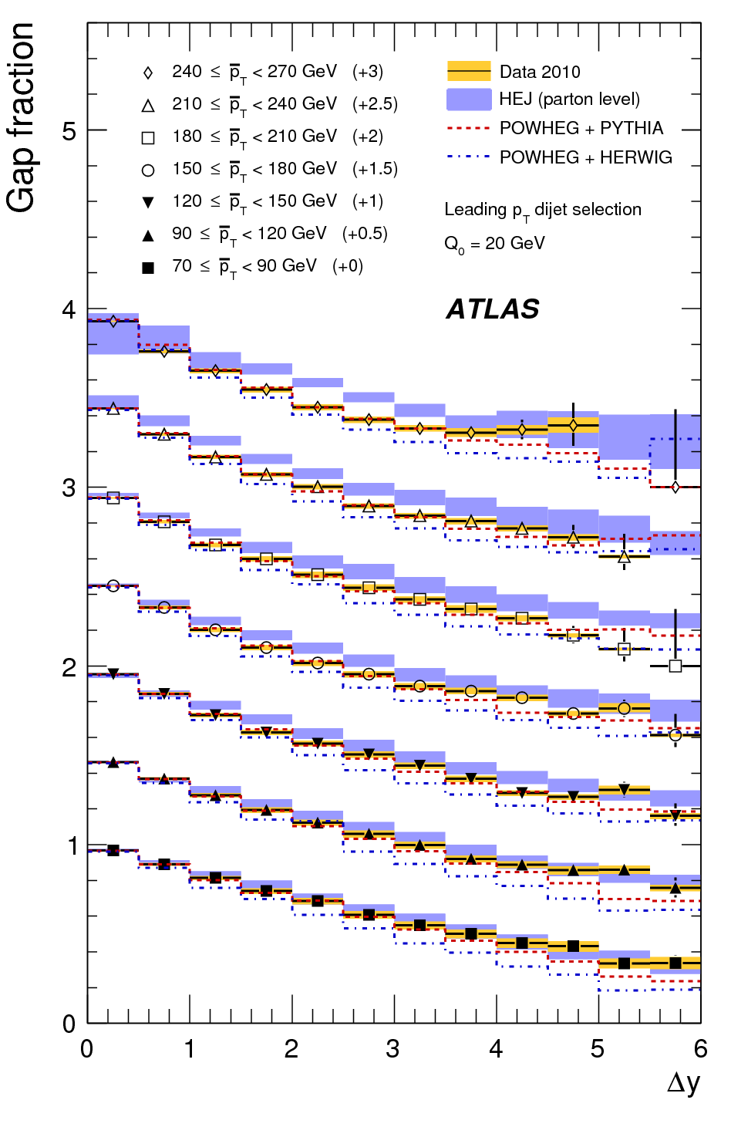
Dijets with veto
Gap fraction falls with Δy
Fairly well described by POWHEG with PYTHIA or HERWIG shower/UE
HEJ doing somewhat better at high p_{T}?
arXiv:1107.1641
ATLAS-CONF-2011-038

Slide 29
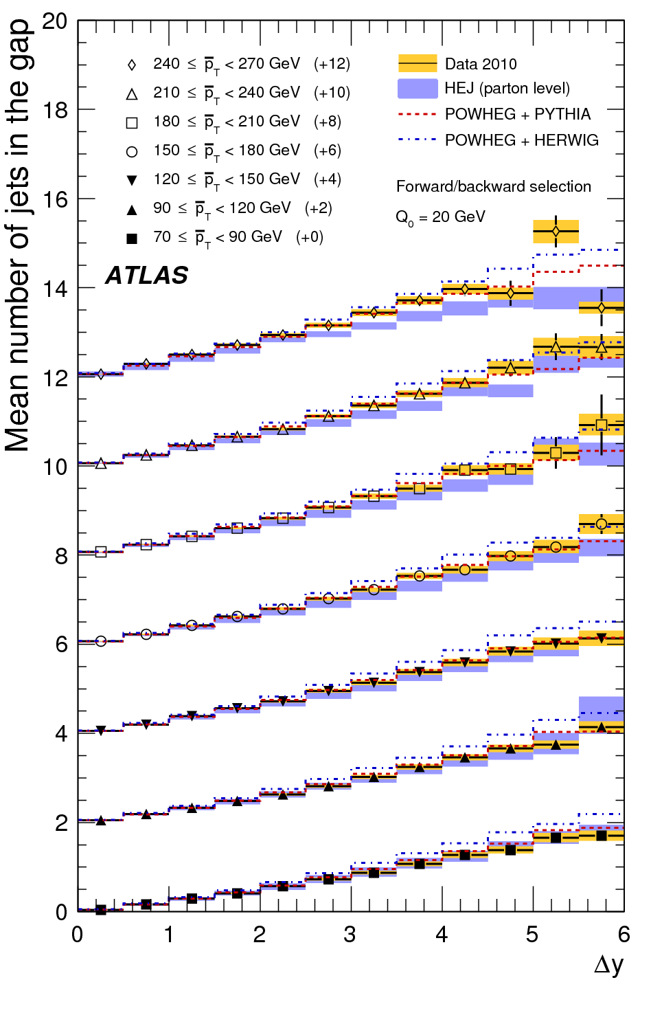
Dijets with veto
However, number of events in gaps not well modelled by HEJ at high p_{T} – much better with NLO + standard parton shower?
Under active development… Powerful test of the approximations, and key to understanding “tag” and “veto” jets in e.g. Higgs or Diboson events
arXiv:1107.1641

Slide 30
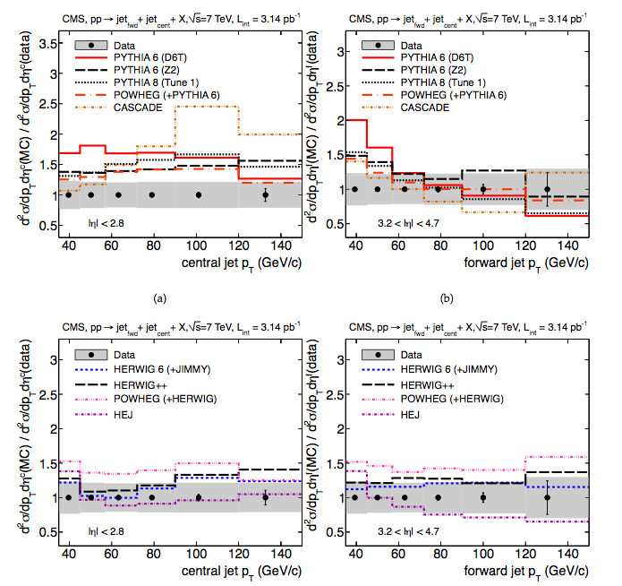
Forward/forward vs central/forward dijets
Herwig variants (angular-order parton showers?) describing shape well.
Problems for some Pythia variants
arXiv:1202.0704

Slide 31
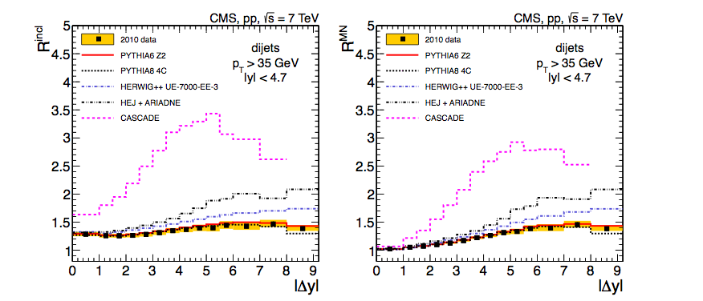
Forward/central vs central/central dijets
Ratio of “all jet pairs” to “exclusive jet pairs”
Disfavours non-DGLAP dynamics?
arXiv:1204.0696

Slide 32
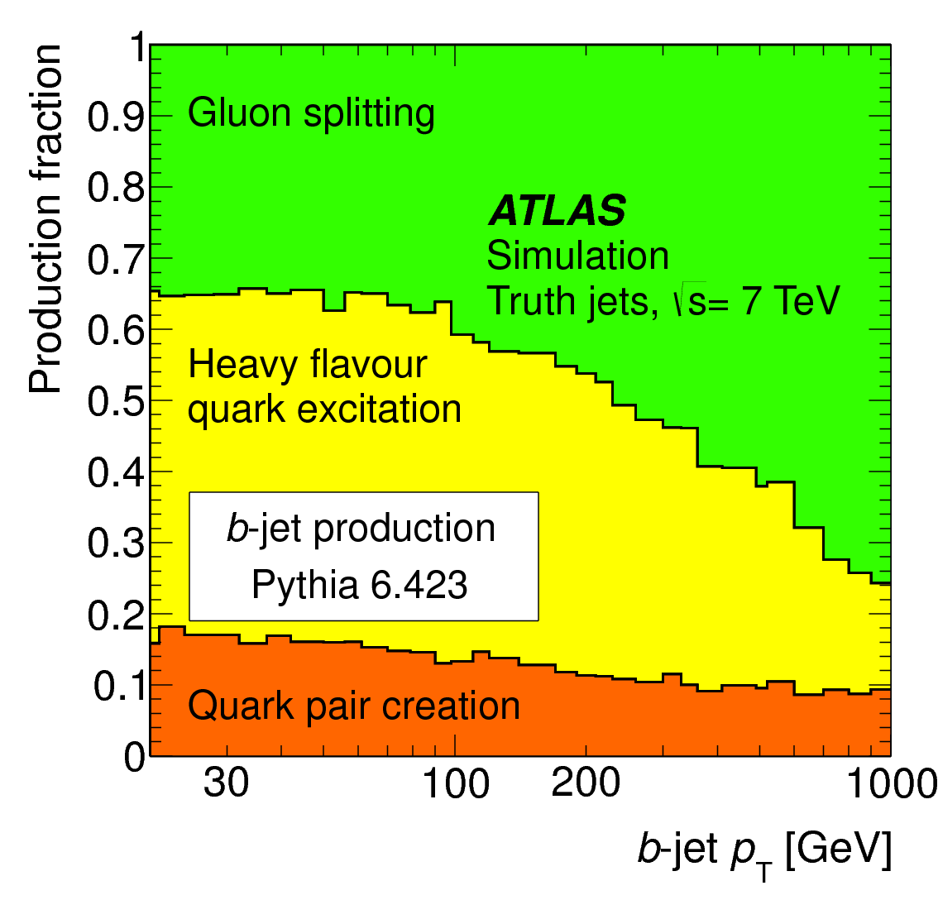
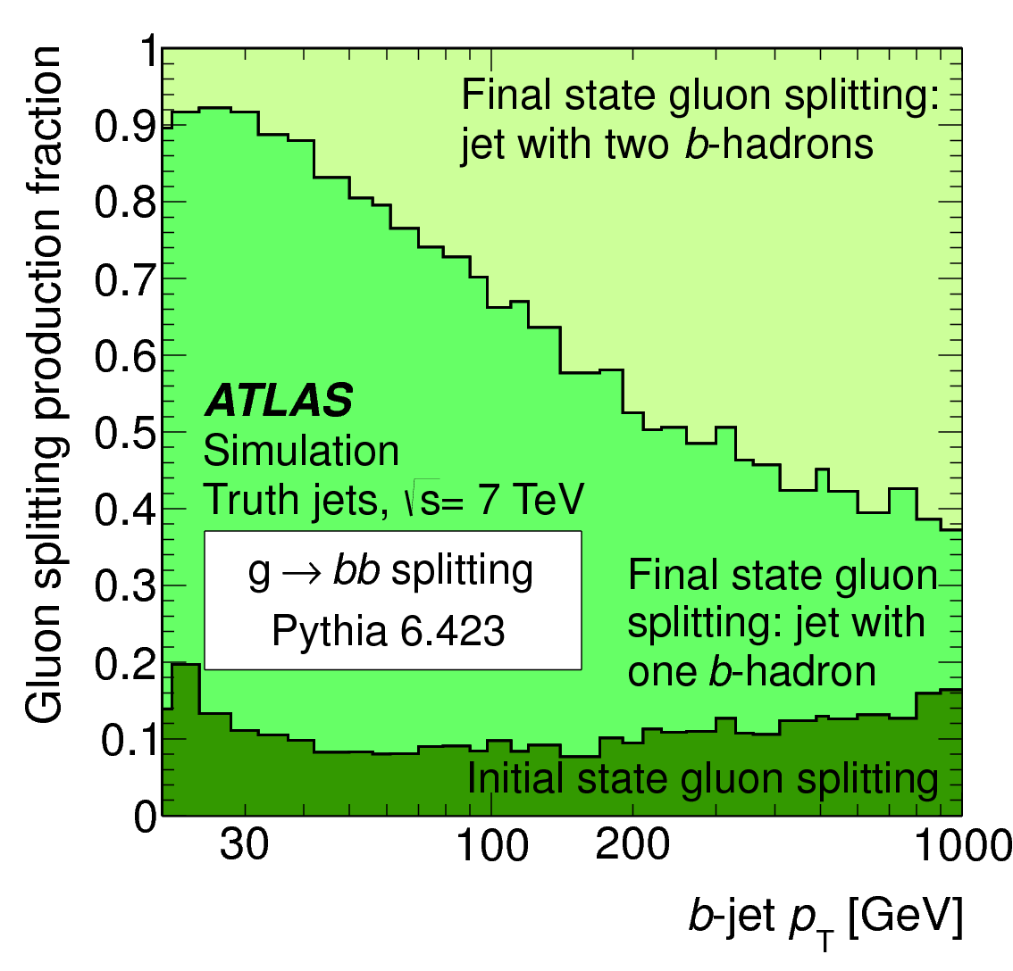
Jets as a probe of QCD dynamics
Bottom &/or charm production introduces another hard (or “semi-hard”) scale. How well is this understood?
arXiv:1210.0441

Slide 33
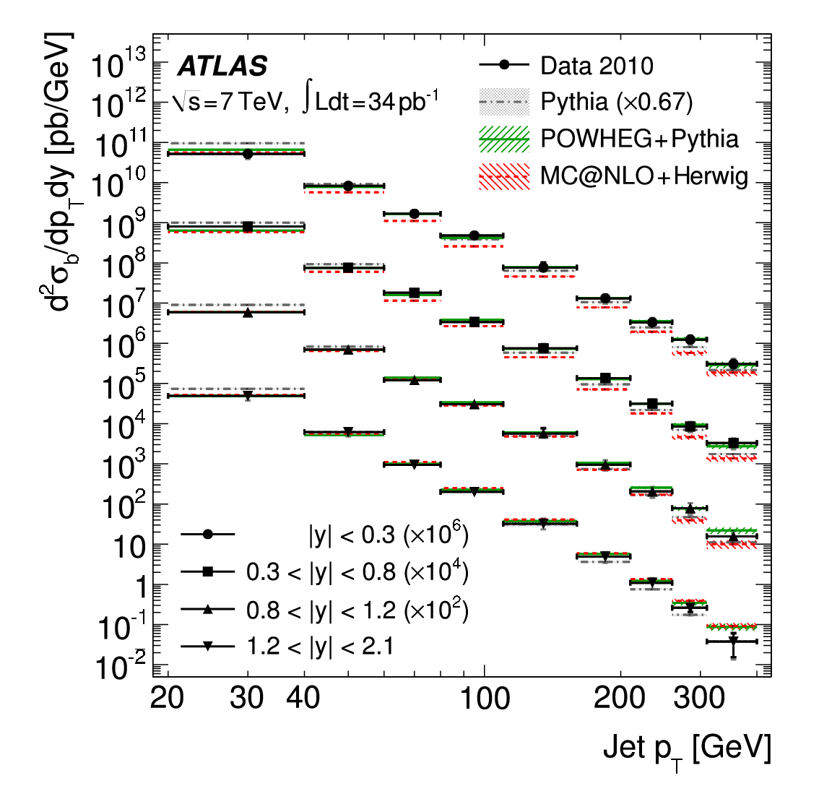
Jets as a probe of QCD dynamics
B jet (and dijet) cross sections compared to NLO QCD
arXiv:1109.6833 arXiv:1202.4617

Slide 34
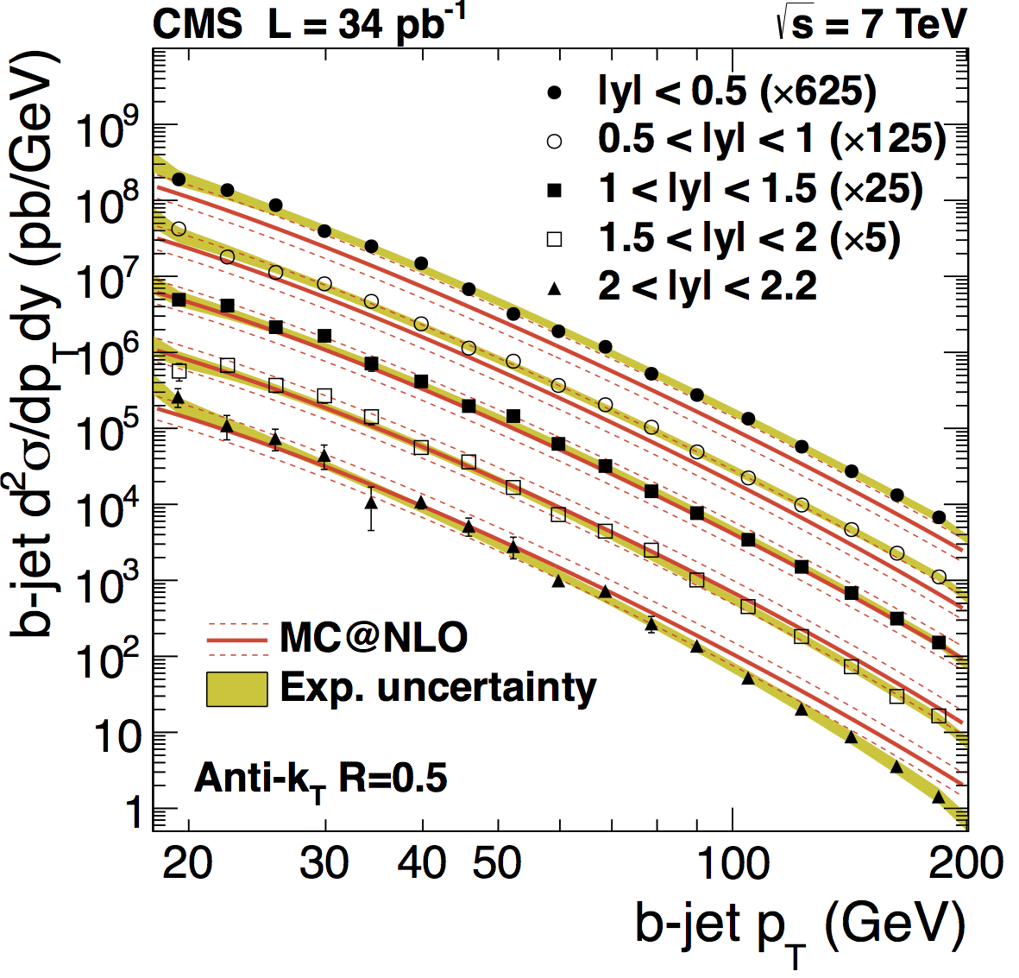
Jets as a probe of QCD dynamics
B jet (and dijet) cross sections compared to NLO QCD
arXiv:1109.6833 arXiv:1202.4617

Slide 35
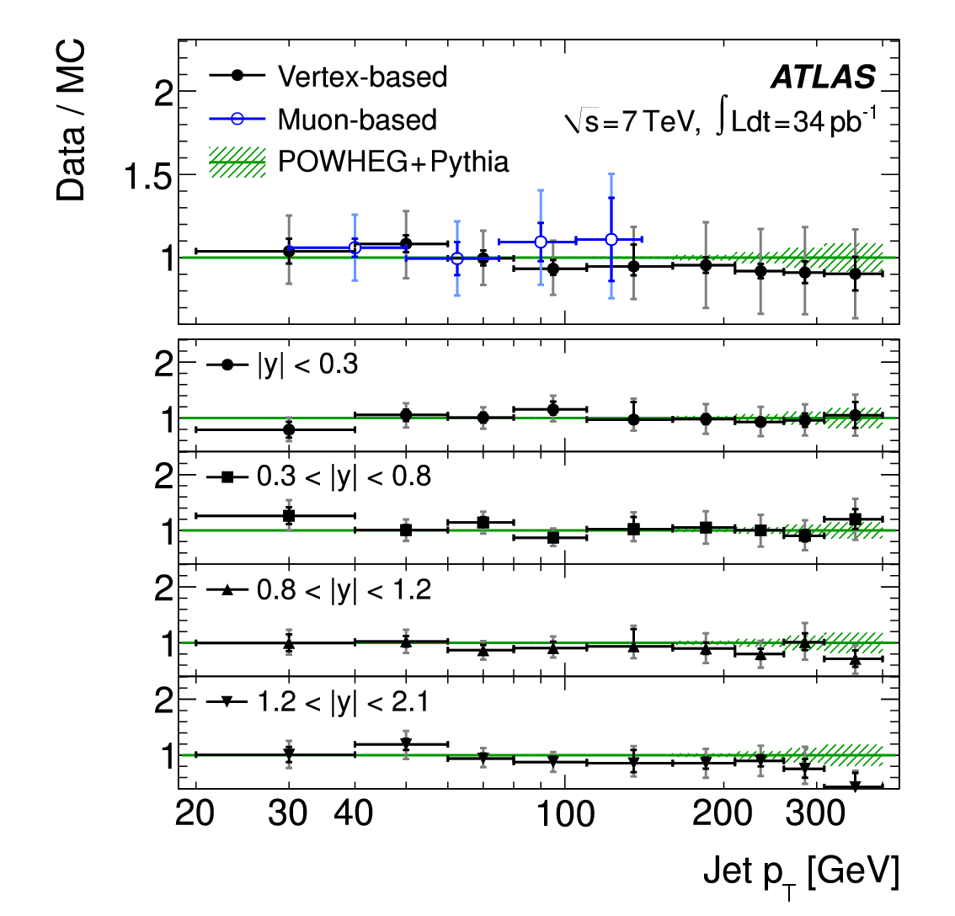
Jets as a probe of QCD dynamics
B jet (and dijet) cross sections compared to NLO QCD
arXiv:1109.6833 arXiv:1202.4617

Slide 36
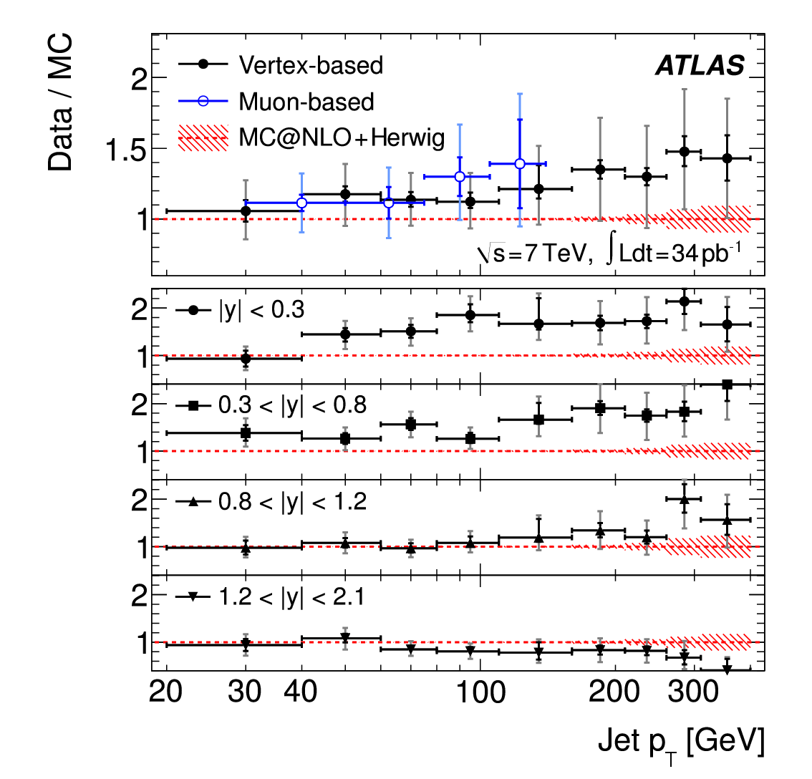
Jets as a probe of QCD dynamics
Good agreement with POWHEG, poorer with MC@NLO (seen by both ATLAS & CMS)
arXiv:1109.6833 arXiv:1202.4617

Slide 37
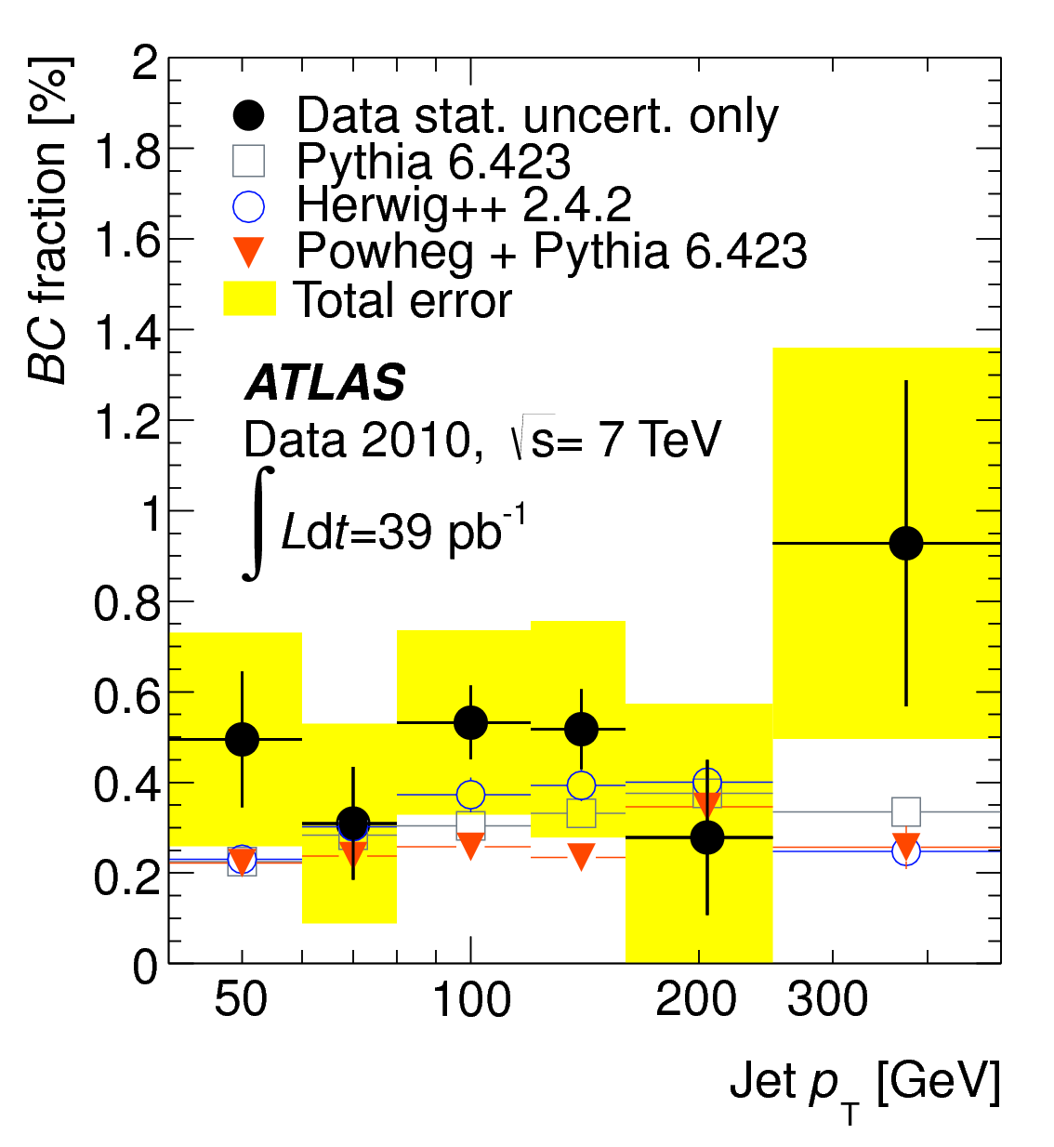
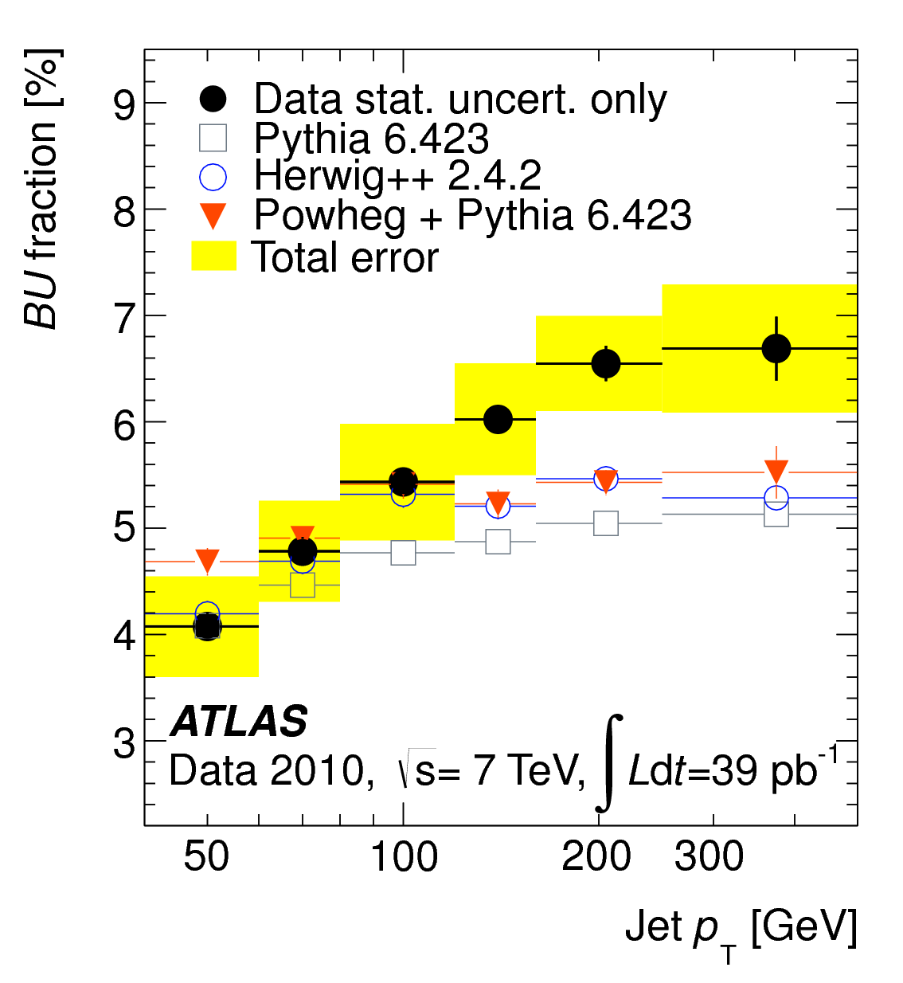
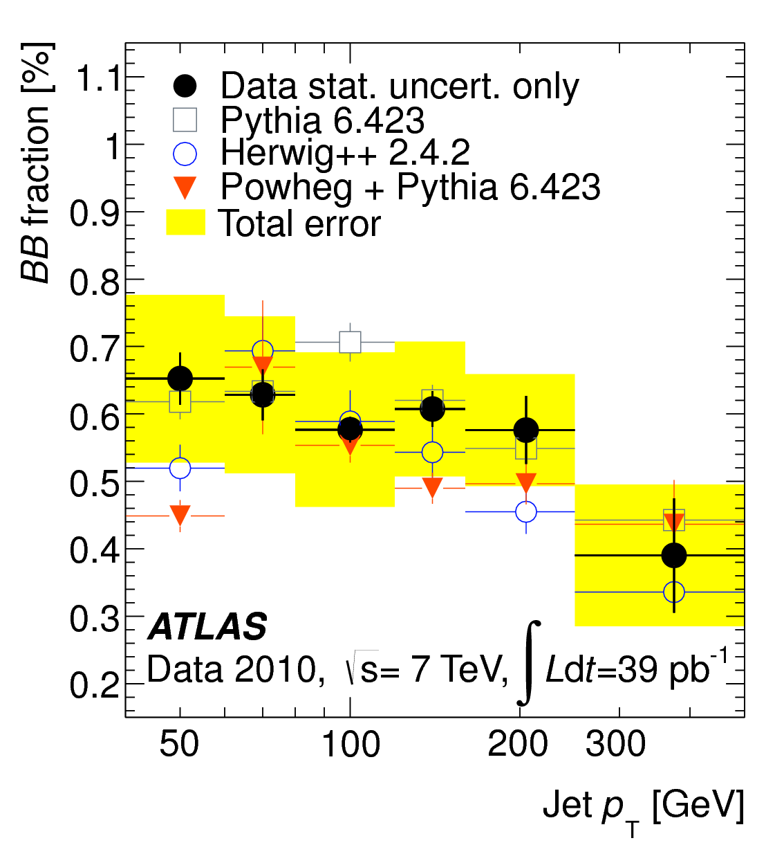
Jets as a probe of QCD dynamics
Use properties of displaced decay vertices to distinguish light, c and b jets in dijet events
arXiv:1210.0441

Slide 38
Jet properties
Final stage of jet structure is “soft” non-perturbative QCD.
  Formation of hadrons from gluons, 100 MeV energy scales (Λ_{QCD})
Vast phase space between quark-gluon scatter (100’s GeV, few TeV) and Λ_{QCD}
Most of jet substructure can be analysed perturbatively
EWSB scale (~100 GeV) lies in this region
  Jets may contain objects with EW-scale mass (W,Z,H,t,?)

Slide 39
Tagging and “Grooming” of jets
Splitting & filtering: Unclustering last stages (in C/A algorithm), throw away softer or more distant partner, recluster with smaller R
  JMB, Davison, Rubin, Salam, PRL 100, 242001 (2008). Kaplan, Rehermann, Schwartz, Tweedie, PRL 101, 142001 (2008). JMB, J Ellis, Raklev, Salam, PRL 103, 241803 (2009).
Variable R parameter
  Krohn, Thaler, Wang, JHEP 0906:059,2009.
“Pruning” or “Trimming”: Remove soft splittings in (re)clustering
  S. Ellis, Vermilion, Walsh, PRD 80, 051501 (2009); Krohn, Thaler, Wang, arXiv:0912.1342 [hep-ph].

Slide 40
Tagging and “Grooming” of jets
Distinctive jets shapes (see previous results)
  JMB, Davison, Rubin, Salam, PRL 100, 242001 (2008). Kaplan, Rehermann, Schwartz, Tweedie, PRL 101, 142001 (2008). JMB, J Ellis, Raklev, Salam, PRL 103, 241803 (2009).
N-subjettiness; evaluate how much a jet’s internal structure resemble N subjets.
  Thaler, Van Tilberg, JHEP 1103 (2011)
k_{T} splitting scale: look for a scale which is not in a “strongly ordered” sequence
  Seymour, Z.Phys. C62 (1994) 127-138 JMB, Cox, Forshaw, PRD 65; 096014 (2002).

Slide 41
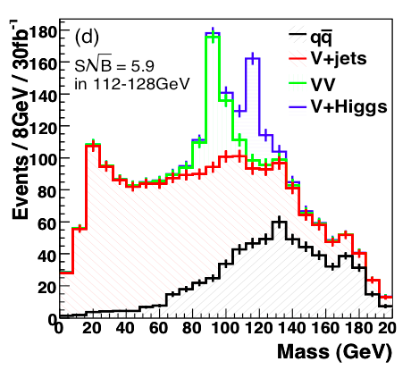
In the Higgs to bb hunt…
Note excellent Z peak for calibration
~6 σ; H->bb measurement

Slide 42
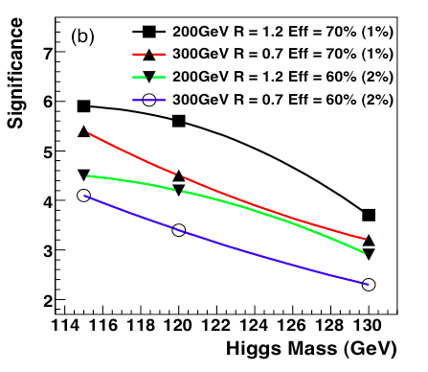
In the Higgs to bb hunt…
Reasonably good up to about 130 GeV.
Benefits of “boost” already seen in current results
But 8 TeV and 125 GeV not ideal, and benefit of subjet analysis not so large
Will be more important at 13 TeV

Slide 43
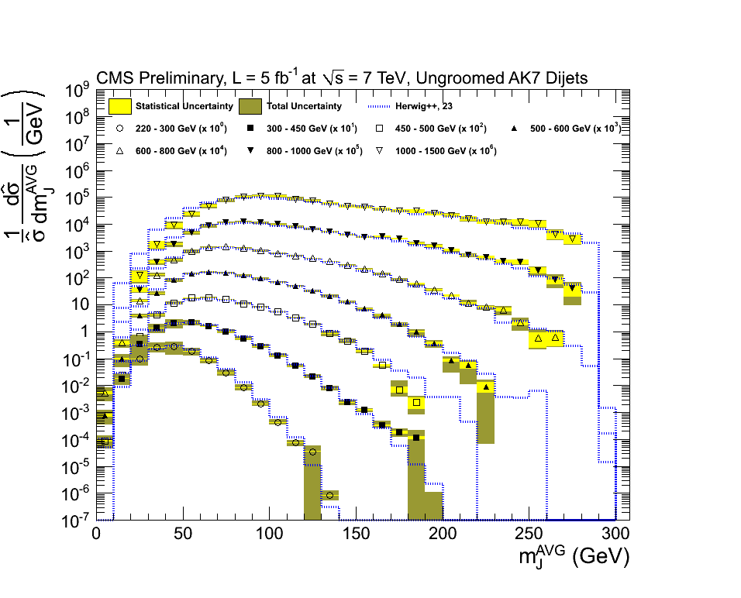
Do we really understand the QCD?
Ungroomed
  CMS-PAS-SMP-12-011
  arXiv:1106.5952

Slide 44
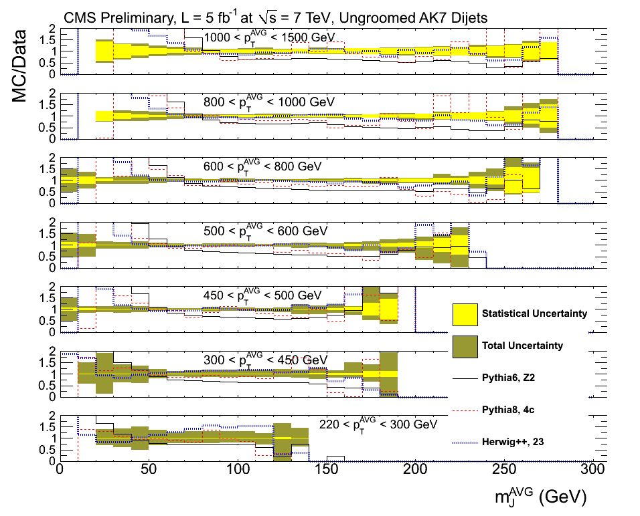
Jet mass
Ungroomed
  CMS-PAS-SMP-12-011

Slide 45
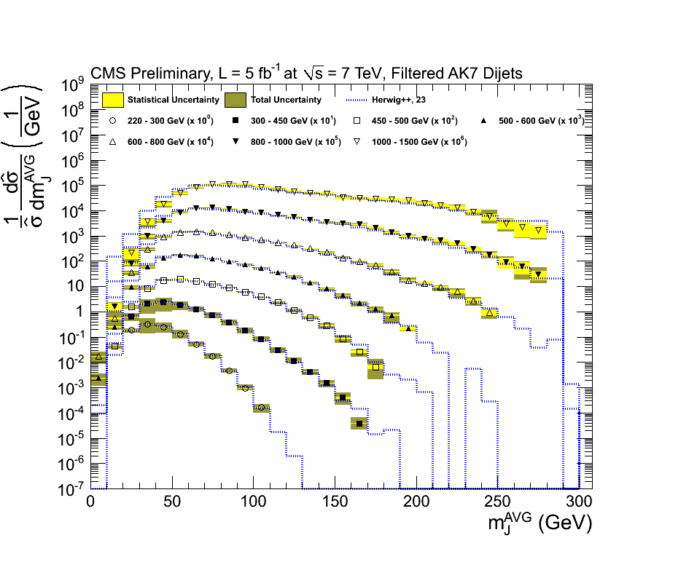
Jet mass
Ungroomed Groomed (filtered)
  CMS-PAS-SMP-12-011

Slide 46
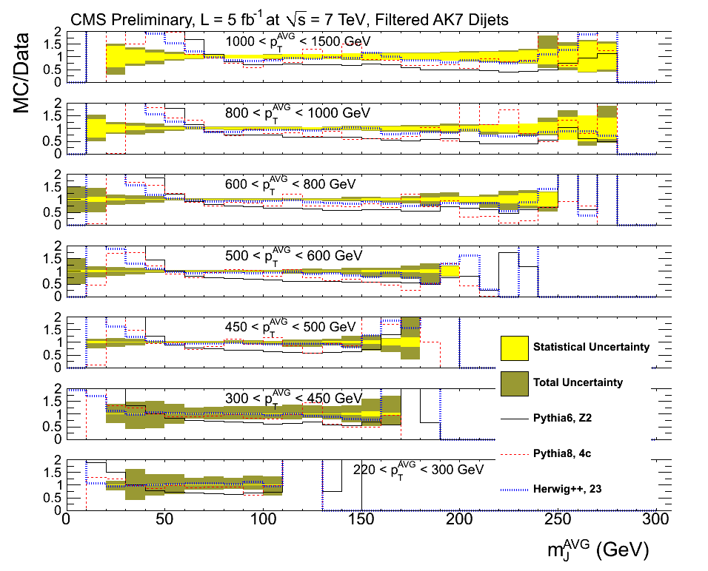
Jet mass
Ungroomed Groomed (filtered)
  CMS-PAS-SMP-12-011

Slide 47
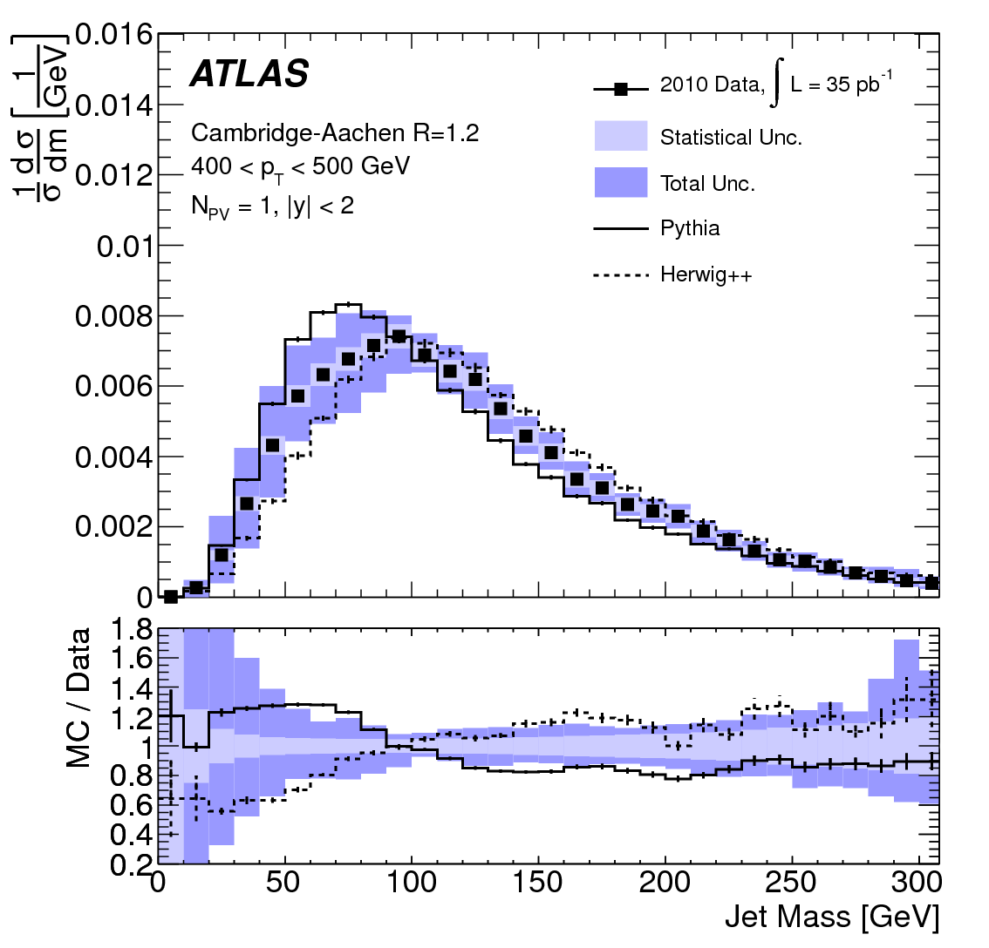
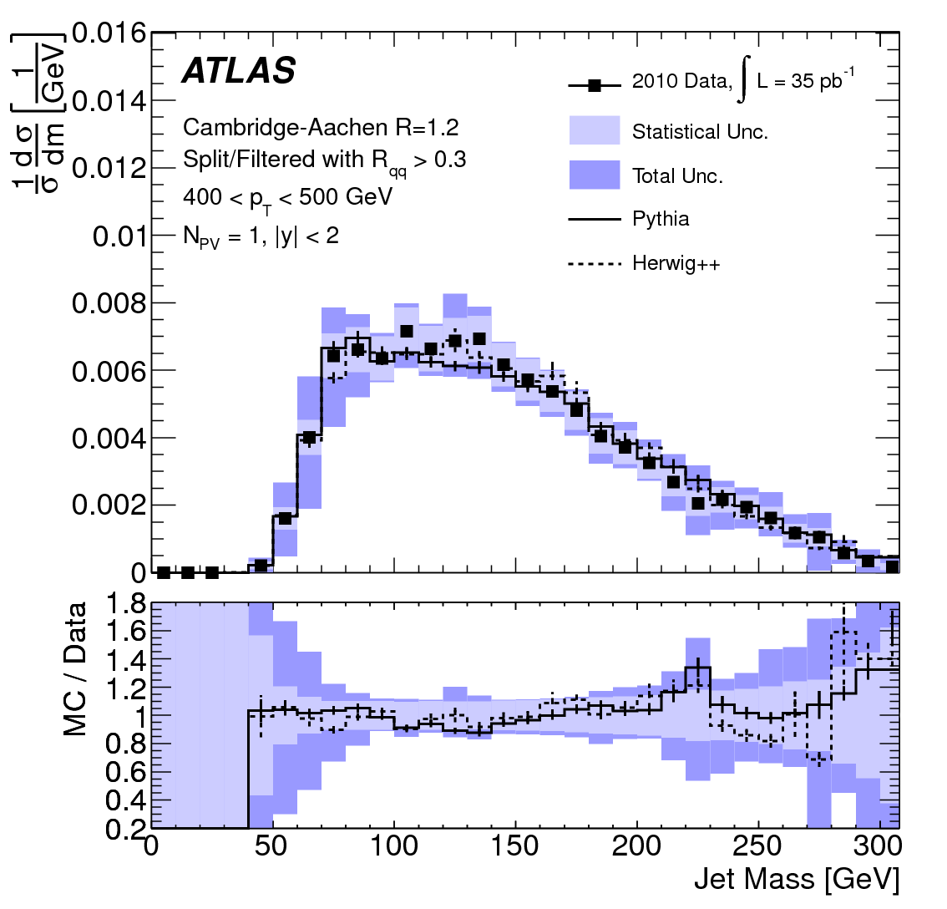
Jet grooming and subjets
arXiv:1203.4606

Slide 48
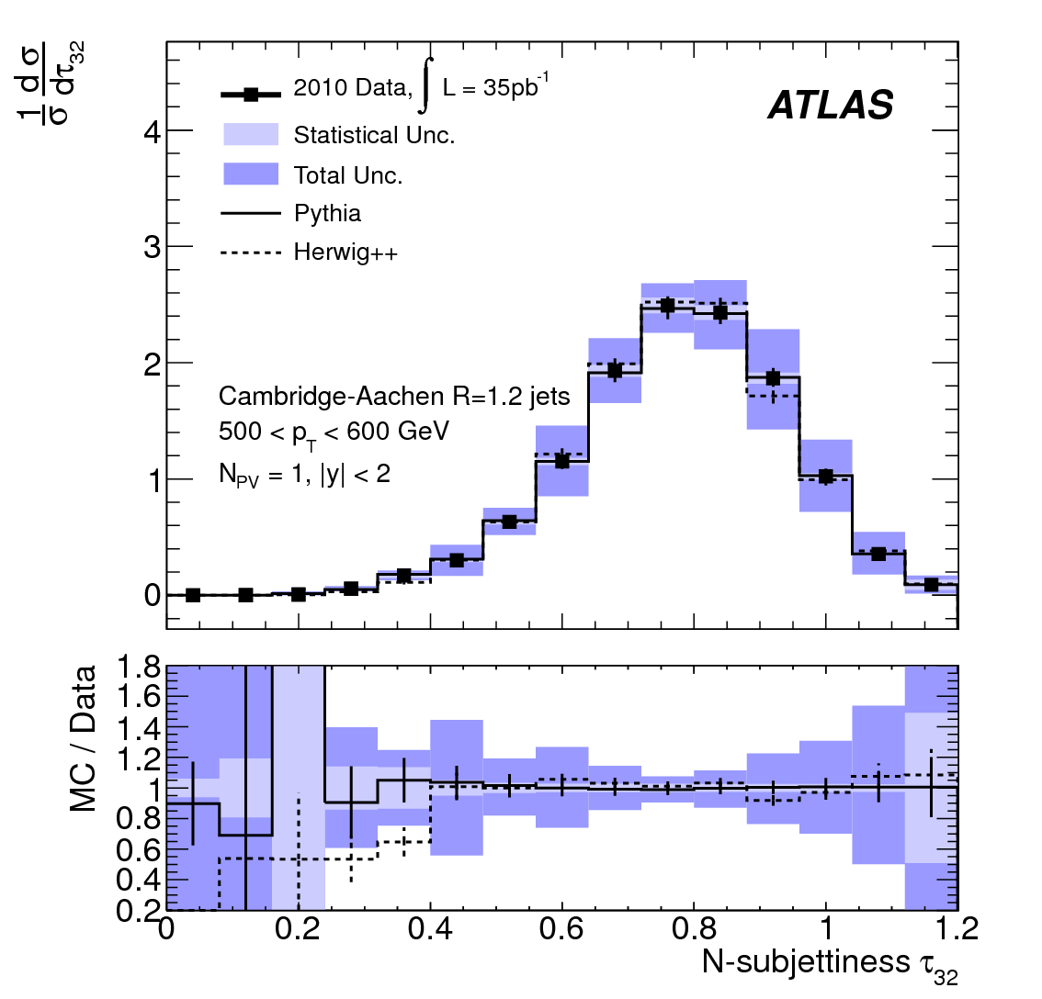
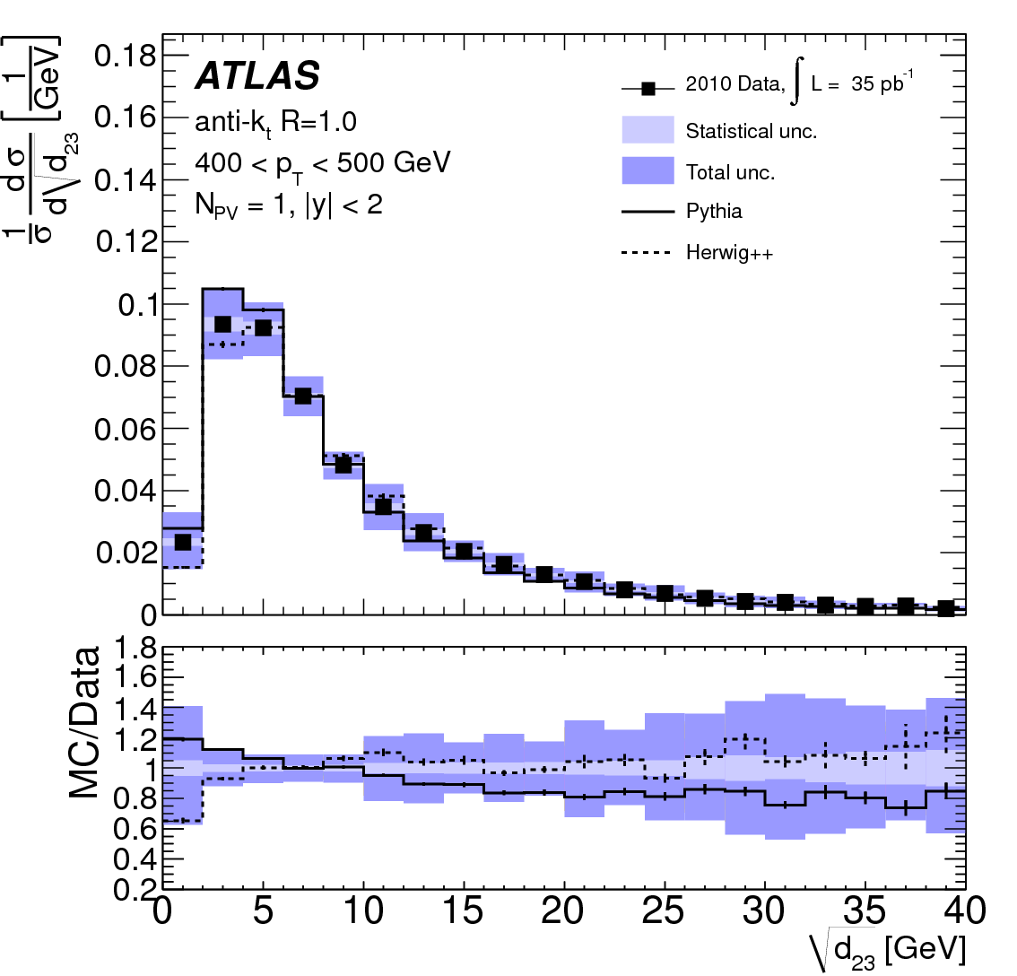
Jet grooming and subjets
k_{T} scale, N-subjettiness
arXiv:1203.4606

Slide 49
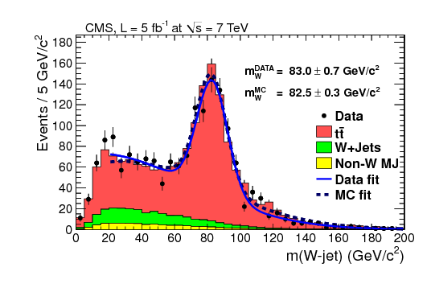

In use in searches (boosted top, boosted W)

Slide 50
And finally… what do we actually measure?
Difference between “efficiency corrections” or “unfolding”, and “acceptance corrections”.
  The first two generally mean correction for detector effects which no one but the experimentalists can do.
  The third means extrapolating into kinematic regions which have not been measured at all
Beware of the third, especially as we go to higher energies…

Slide 51

Unfold

Slide 52

Increase acceptance

Slide 53
Increase acceptance

Slide 54
Extrapolate

Slide 55
Extrapolate

Slide 56
But how reliably?

Slide 58
And finally… what do we actually measure?
Defining a region in which acceptance is ~100%,

Slide 59


Slide 61
For example… WW cross section
ATLAS WW cross section (to e, μ), 7 TeV
  efficiency/detector corrections to obtain fiducial cross section, 0.4-0.7
  acceptance (phase space) , 0.07-0.16
That missing 90% is stuff we don’t measure
The efficiency/detector efficiency won’t change much at 13 TeV
The acceptance may well drop further
Garbage in, garbage out.

Slide 62
For example… Top cross section
Current measurements extrapolate to 4π, 4 TeV>p_{T}>0
Often not even possible to extract the acceptance from the papers (convoluted with efficiencies and migrations)
Means for some, non-trivially-different, regions of phase space, we are just buying the theory
Will be even more of a problem at higher beam energies.
(see LHC Top Working group discussions, e.g. talk by Will Bell, 19/7/2012 )

Slide 63
For example… Higgs
As we continue extracting properties, being clear what we actually measure becomes increaingly important
Fiducial “Higgs” cross sections…

Slide 64


Slide 65
Summary and Conclusions
We have done much precision surveying at 7/8 TeV
  Soft QCD (not covered here) including diffraction
  Hard QCD, Photons, Jets, vector bosons, top..
  Dibosons
Understanding the SM above the EWSB scale
  Extracting info on PDFs, TGCs
  Latest (NLO/matched etc) calculation/simulations are in general required, and do quite well.
Higgs discovery potentially extends the region of validity of the SM a long way

Slide 66
Future prospects…
In the next run we will get significant new areas to explore
  There is no guarantee of obvious new states
  We may be lucky
But we have to do the survey properly; does the Standard Model really work above the electroweak symmetry breaking scale?
  What exactly do we measure?
  (Final states, including irreducible backgrounds?

Slide 67
End

