Slide 1
The DAVE Card Status
SCT has developed a new ATLAS trigger card
“The card that no-one knew they needed, but now do”
Introduction
Concept & Motivation
Functionality Overview
Production Status
ATLAS orders

Slide 2
What is it?
6U VME Digital Atlas Vme Electronics (DAVE) card (acronym reflects a certain sense of humour by our engineers)
Design, production and firmware by UCL and Cambridge
Maurice Goodrick, Rick Shaw (Cambridge)
Matt Warren, Martin Postranecky (UCL)
Support and encouragement from ATLAS
Strong support and ideas from Thilo Pauly, Carolina Gabaldone
User case suggestions from Iskander Ibragimov, Bruce Barnett, Andrej Gorisek

Slide 3
Concept & Motivation
NIM Crate – SCT USA15
We long wanted to eliminate use of a NIM crate in USA15 which provides our trigger for standalone physics runs
Contains veto logic (prevent BCR/L1A clash) which drifts
Need to go downstairs to adjust trigger rate
Non-realistic conditions
Trigger
L1A to LTP
Pulse Generator
VETO
Orbit (BCR)
Delay
Stretch
First thoughts were replace this simple logic in a VME card
Concept quickly grew to add more generic features
Significant enhancement to adopt ATLAS CTP functionality to exactly duplicate running conditions, whilst incorporating much generic functionality, has turned the card in a hugely powerful and flexible logic card, potentially useful to all ATLAS subsystems as well as for non-ATLAS use

Slide 4
Trigger path:
8
Veto
ExtTrigger
SHP
8
L
U
T
8
8
1
1
PS
MSK
OR
Gate
L1Aout
Internal
4
TriggerOut
ECR:
ECRout
Veto:
VME
ECRsel
ECRin
period
ECRsel
1+1ms
BUSY
Veto
L1Aout
SD
OR
Internal Triggers:
L1Ain
2
CD
RND
2
Fixed Freq
6?
Internal
BG
4
BC/ORBIT:
Playback
BCout
VCXO
DELAY25
QPLL?
BCin
internal
ORBout
ORBin
DAVE card: examples of CTP Functionality

Slide 5
Interesting use-cases
Trigger generator for LTP (via LEMO)
no busy gating, feed-forward of deadtime to LTP
Standalone trigger generator without LTP
busy gating
ECR generator
VETO generator
L1A (or other signal) sequence analyser
Sequence playback
Eg capture and replay trigger sequences that causes susbsystem busy etc
BC/ORBIT source, fine-delay (dt=0.5-1ns) for timing scans
Generic delay line
Generic counter facility
a few counters
per-bunch counters?
Generic logic unit
Programmable “NIM crate”

Slide 6
ATLAS-SCT “DAVE-1” Programmable VME Module M.Goodrick, D.Robinson, R.Shaw @ University of Cambridge, Cavendish Lab M.Postranecky, M.Warren @ UCL
3x LEDs
3
32
40-pin DIL BREAK-OUT HEADER
12x LEDs
3
SHIFT
REG.
2
2
All POWER and GND rails
3
VME BASE ADDRESS
3
FPGA & PROM
3
FPGA spec: Xilinx Spartan 3E 1600 (SC3S1600E)
SW
Buffers
VME
J2
SW
CLKIN0
CLKIN1
NIM
ECL
2
2
MPX
PLL
IN0
NIM
TTL
CLKIN select
20x LEMO-00
IN2
8
8
CLK Master DELAY
IN4
40/80MHz select
4
4
Buffers
VME
J1
4x Slave DELAYS
IN6
4
CLKOUT0
CLKOUT1
NIM
ECL
:2
2
2
7
X-TAL
80.15733MHz
7
2x LEDs
OUT0
NIM
TTL
16
Data
4Mbx18
SRAM
Address
All POWER Monitor
OUT2
8
8
8
FUSE
22
+5V
7
OUT4
2
+3V3 +2V5 +1V8 +1V2 -5V -2V
OUT6
8
16-pin AUX. CONNECTOR
16 ( incl. 4x 2V5 diff. LVDS )
16
6x DC-DC
MOD. RECORD
6
8
SW
J-TAG
SW
FUSES
HEX SELECT
SHIFT
REG.
4
SERIAL NO.
EXT. +5V IN
8
SW
USB
24
SW
MP-UCL, 21 February 2011

Slide 7
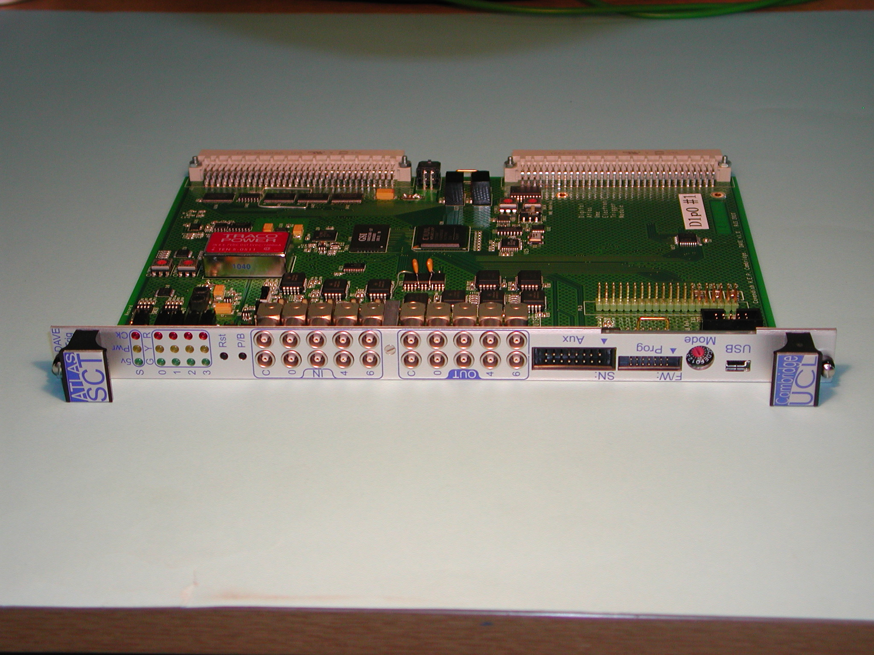
DAVE card – first prototype

Slide 8
DAVE card Firmware Blocks
Internal Sig Gen
Randomiser
Fixed Freq
BCR/BCID
ECR/ECRID
Sequencer
Output
Enable
Map
BCR Gen
ECR Gen
LEMO In
Input
Enable
Sync
Delay
Busy Gen
LEMO Out
8
8
CTP-like Trigger Module
AND/OR matrix
Dead-time
Mask/ Gate
4
Sink RAM
Fine Delay*
63x.5ns
VME/USB Interface
Not on FPGA
using CERN Delay25 chip
Firmware mainly by Matt, USB by Maurice, testing by Rick
CTP blocks originally by Stefan Haas.
Higher level software to be provided by Thilo Pauly & Dave Robinson

Slide 9
Production Schedule
3 prototypes already built
Some minor design iterations pending
Corrections made by wire-tack
Firmware already well underway and some basic functionality demonstrated
USB functionality still pending
Next design iterations by ~March
First modules for testing by ~June

Slide 10
ATLAS Orders
SCT (3)
TRT (2)
Pixels (2)
BCM (2)
ATLAS central trigger (3)
Strong interest by L1Calo and Lar
…others are likely

Slide 11
Summary - Key Points
Communication by VME OR USB
In vme crate or on desktop with power supply
Exact CTP functionality
Random trigger, simple and complex deadtime, ECR, BCR etc to give exact same conditions in standalone as experienced in combined runs
Trigger sequence playback
64M word SRAM gives us up to 52 seconds history of trigger playback for 75kHz L1 rate (eg on interrupt by system BUSY)
Powerful generic functionality
Available by ~summer – see them in TTC crates in USA15!

