Slide 1

Quantum Technologies for Neutrino Mass
20 members (and growing)
QTNM-CCFE Video-call
To say “Hi”
Update each other on status of QTNM/H3AT
Set up a framework for cooperation with an eye on next phase – Tritium neutrino experiment at Culham
Goals:
Ruben Saakyan (UCL)
24-Sep-2021

Slide 2
Agenda
Welcome and Introductions
Updates from QTNM
Updates from Culham/H3AT
Discussion of future developments
Scientific and technical forum at regular meetings
AOB

Slide 3
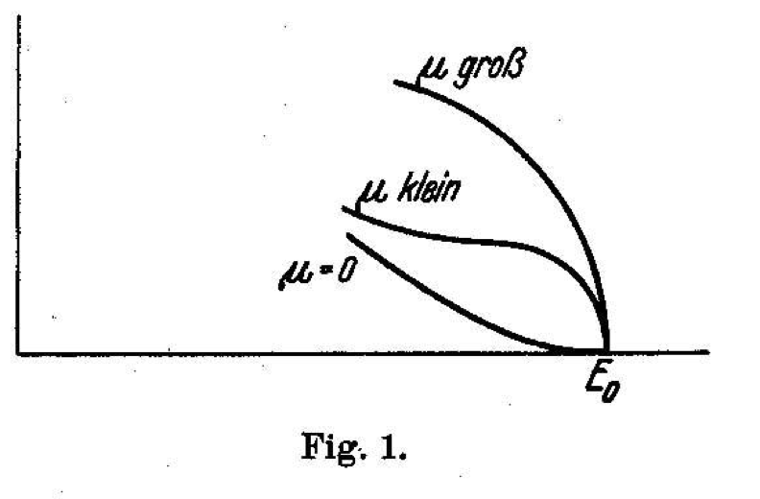
Neutrino oscillations
m_{v} ≠ 0
Window to New Physics
Absolute mass not known
complementarity of cosmological observations and laboratory measurements
Model independent measurement: electron spectrum near end-point of 𝝱-decay
E. Fermi, Z. Phys. 88 (1934) 161
Old idea!
Current upper limit, < 0.8 eV (KATRIN)
Lower bound (from 𝜈-oscillations) > 0.009 eV (!)
Requires a ”quantum leap” in technology

Slide 4


Cyclotron Radiation Emission Spectroscopy (CRES)
Monreal and Formaggio, Phys. Rev. D 80 (2009)
Challenges:
Atomic tritium
Sub fW power
< 1ppm resolution
B-field uniformity
…
$$B=1T, Q_{β}=18.6 keV$$
$$f=27 GHz$$
Goal: To build on recent investment in quantum sensors to assess feasibility of an experiment capable of a positive neutrino mass measurement from ³H 𝞫-decay using CRES technology.

Slide 5

QTNM is funded for 3 years under the UKRI QTFP Programme
The aim is to build CRES Demonstration Apparatus, CRESDA, based on Deuterium-atoms but “Tritium-ready”
Project start date: 1-Feb-2021
CRESDA
D/T atomic source
D/T atoms cooling and confinement
D/T atoms as quantum sensors for 3D B-field uniformity mapping at ≤ 0.1ppm
Quantum-limited systems for microwave radiation detection
Trap simulations, CRES signal modelling, Sensitivity and scale-up studies

Slide 6
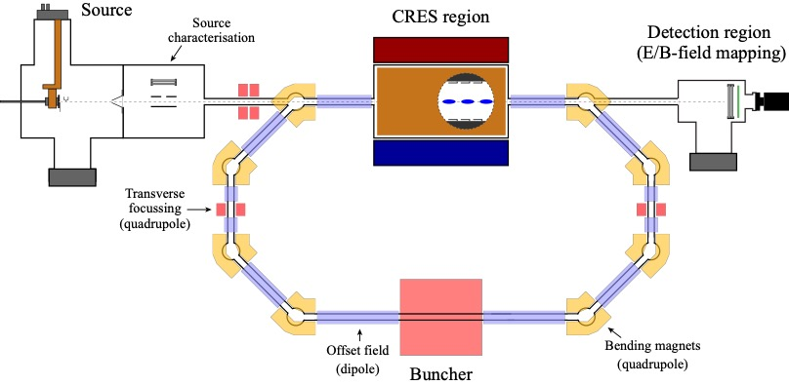
CRESDA Conceptual Design
CRES Magnet Assembly (CMA)

Slide 7
CMA – Microwave Receiver concept
Source of (10-20 keV electrons to simulate Tritium β-decay

Slide 8
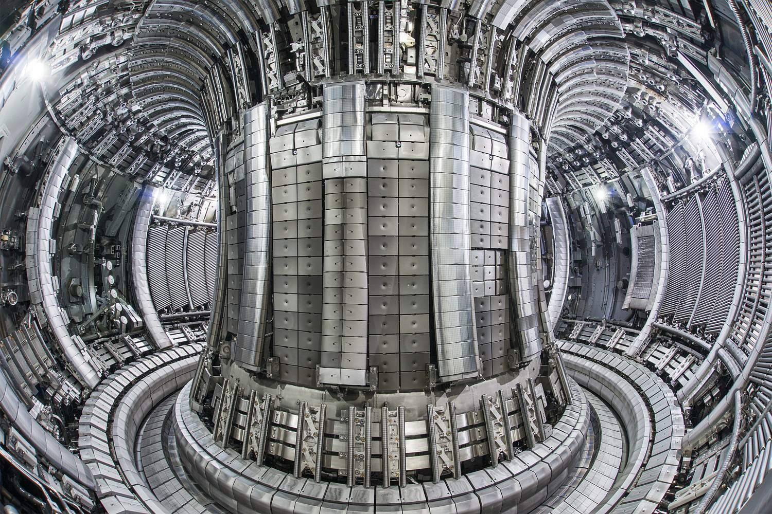
QTNM Future Outlook
A (VERY) tentative timeline
Current project: 2021-2024
  Technology demonstration with Deuterium which is Tritium ready
Next step. 2025-2029
  Moving CRESDA to a Tritium facility for Tritium phase demonstration
  O(eV) sensitivity
”Ultimate” international project > 2029
  Consolidate technological breakthroughs (QTNM, Project-8, …) to build and operate a detector with a phased sensitivity: 100 meV ⇨ 50 meV ⇨ 10 meV plus sterile neutrino programme

Slide 9
EXTRA

Slide 10
QTNM-Culham Forum
Suggest to establish regular meetings (monthly, bi-monthly?) to discuss scientific and technical aspects of *Trutium* experiment
  Both initial step, i.e. CRESDA@Culham, and “final experiment”@Culham
Example questions include:
  Are materials planned for use in CMA, storage ring, atom source, tritium compatible?
  Can radiation hardness of CRESDA materials/components be a problem?
  EM-noise and stray B-field environment at Culham side
  Interface between atom source and Tritium “line”
  Tritium exhaust/recirculation
  Experimental space requirements for CRESDA and “final experiment”
  Many-many more …

Slide 11
Current CRESDA footprint (very approximate, for guidance only)
Ceiling, ideally ≳ 3m
CRES region in CRESDA ~ 1L c.f. CRES region for “ultimate experiment” ~ 10-100 m³
Space for lasers, dilution fridge, room temp electronics, DAQ etc
5m
1.5m
2.5m
8m

