Slide 1
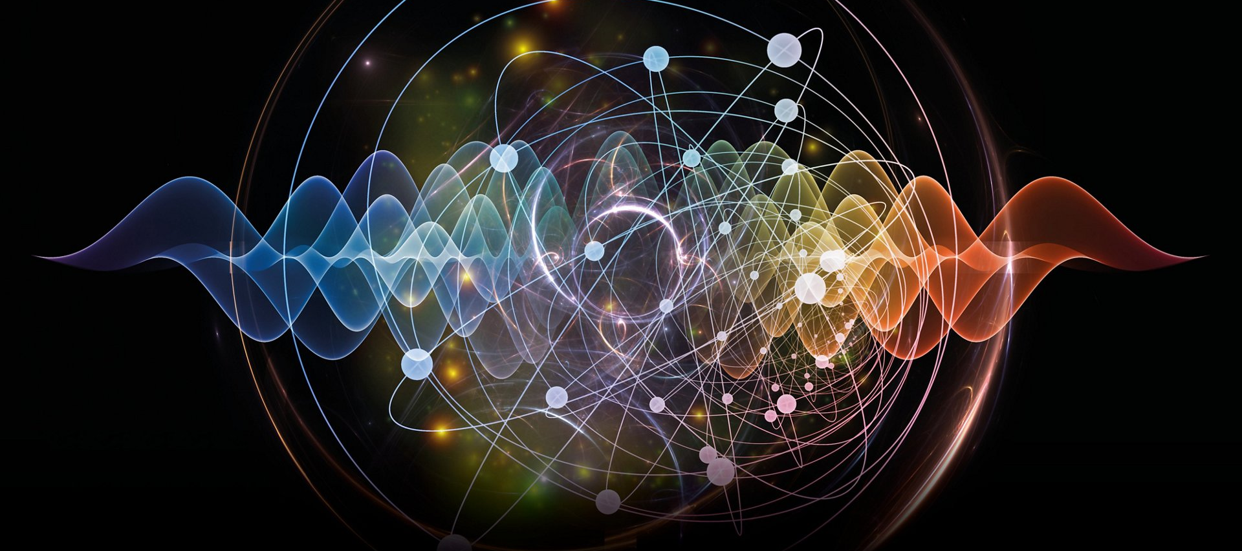
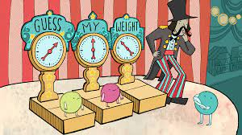
Quantum Technologies for Neutrino Mass
Ryan Nichol (for QTNM collaboration)

Slide 2
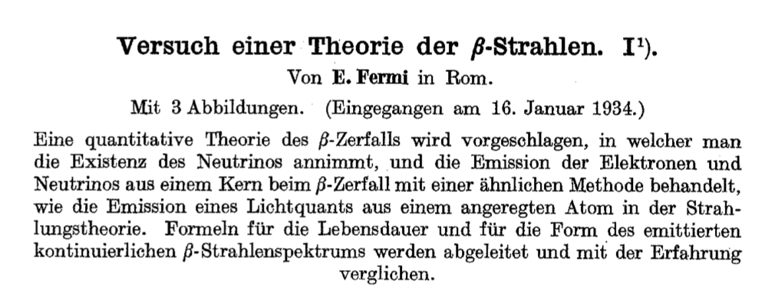
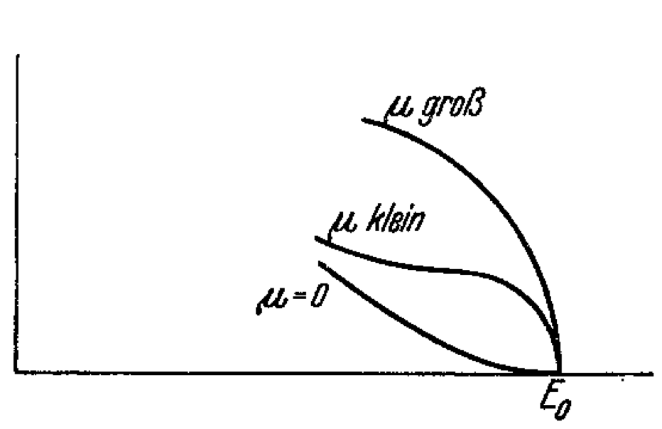
Neutrino mass history
In 1930 Wolfgang Pauli postulated a neutral particle carried away some of the energy in beta decays
In the 1930’s Enrico Fermi:
  Named the neutrino
  Wrote his theory of beta-decay
    He considered the effect of neutrino mass on the beta decay spectrum
    Concluded hat neutrinos were so much lighter than electrons that they could be safely considered massless

Slide 3
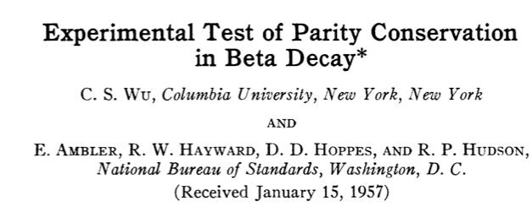
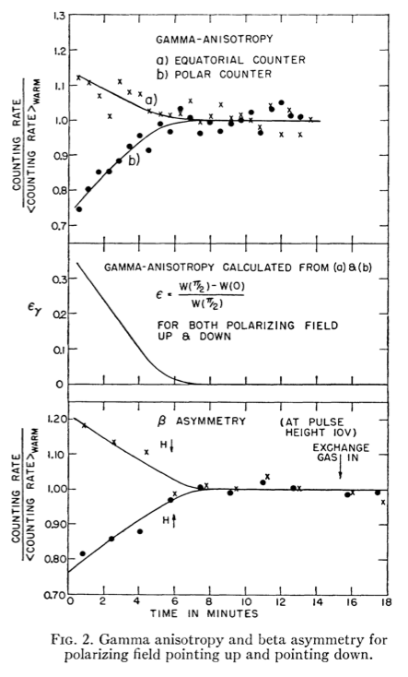
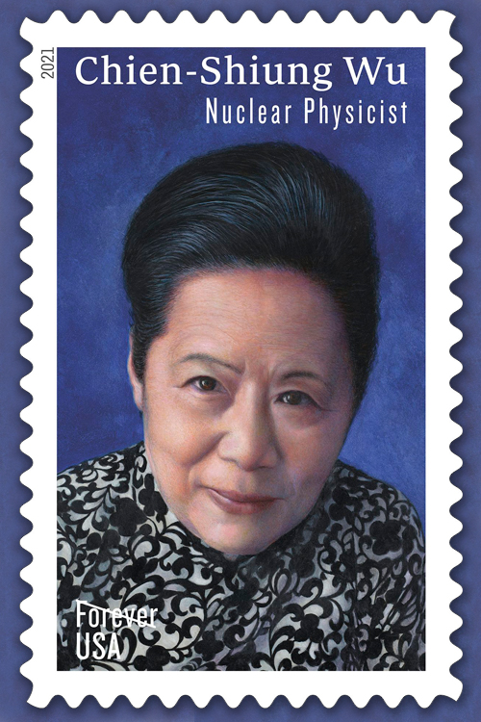
Neutrino mass history
In the 1950’s Lee and Yang came to the surprising conclusion that there was no evidence for parity conservation (or violation) in weak interactions
Then Chien Su Wu performed the experiment that showed parity was not conserved in the beta decay of Cobalt-60
  This provided further evidence for the massless neutrino
In the original formulation of the Standard Model of Particle Physics, neutrinos were explicitly massless particles like the photon

Slide 4
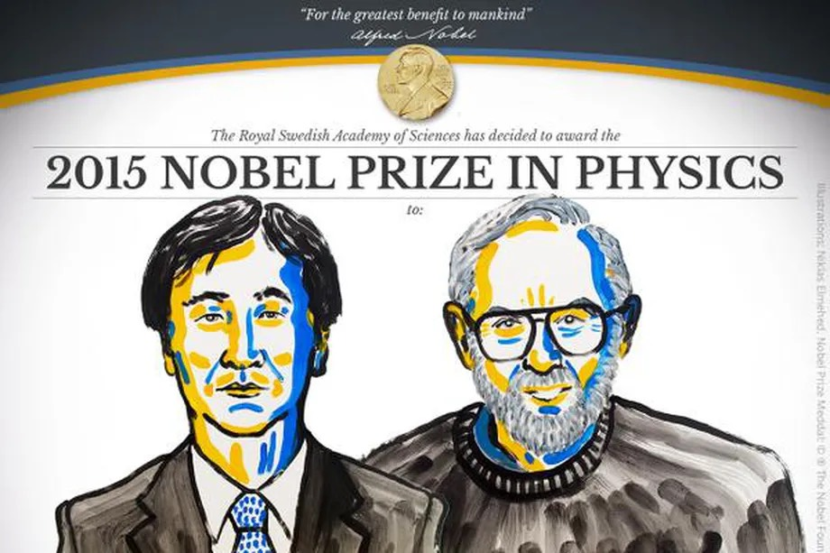
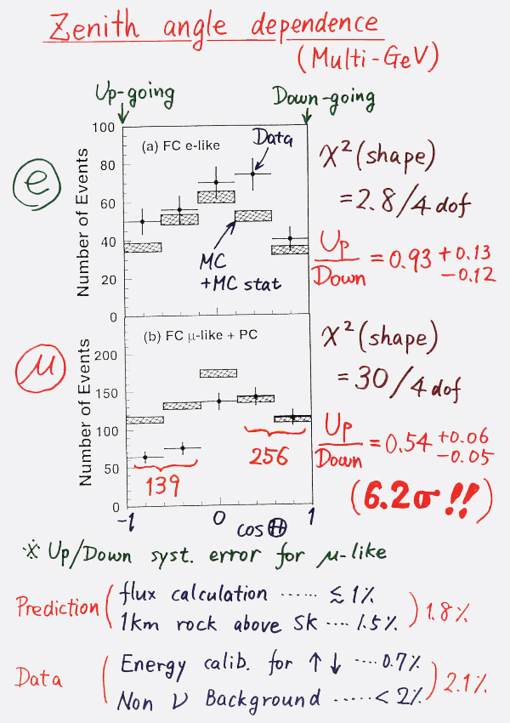
Do neutrinos have mass?
In 1998 & 2001 Super-Kamiokande and SNO showed that neutrinos undergo flavour oscillations
This implied that neutrinos must have mass!
“The Nobel Prize in Physics 2015 was awarded jointly to Takaaki Kajita and Arthur B. McDonald "for the discovery of neutrino oscillations, which shows that neutrinos have mass.”
But oscillation experiments are only sensitive to mass differences not absolute mass

Slide 5
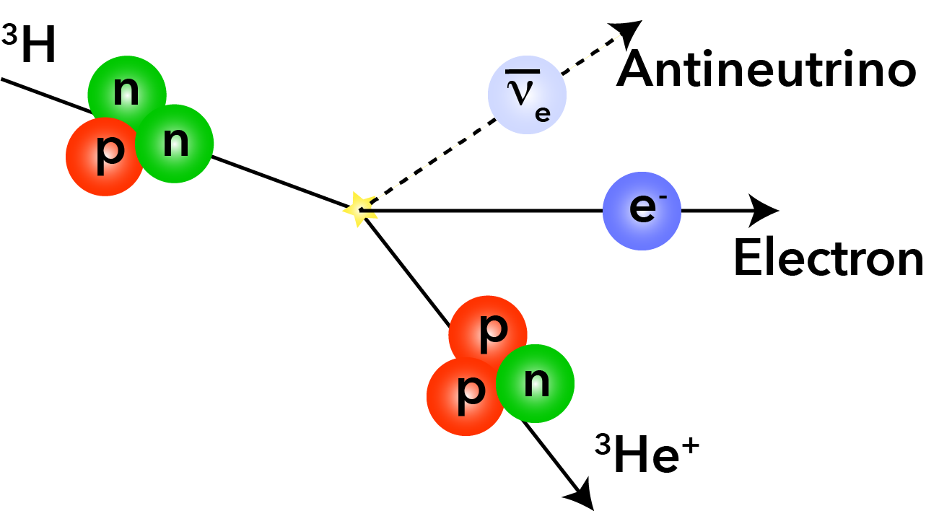
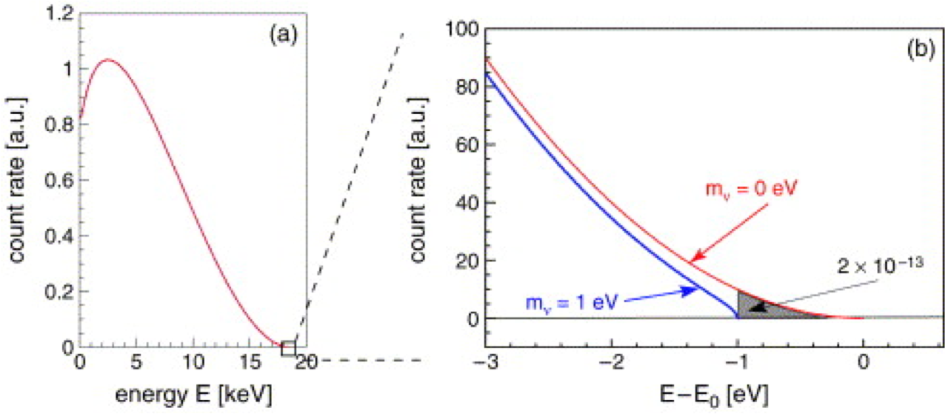
Tritium Experiments
Tritium is one of the best isotopes for searching for the effects of neutrino mass on the beta-decay electron spectrum
Key characteristics
  End point = 18.5898(12) keV
  Half-life = 12.3 years

Slide 6
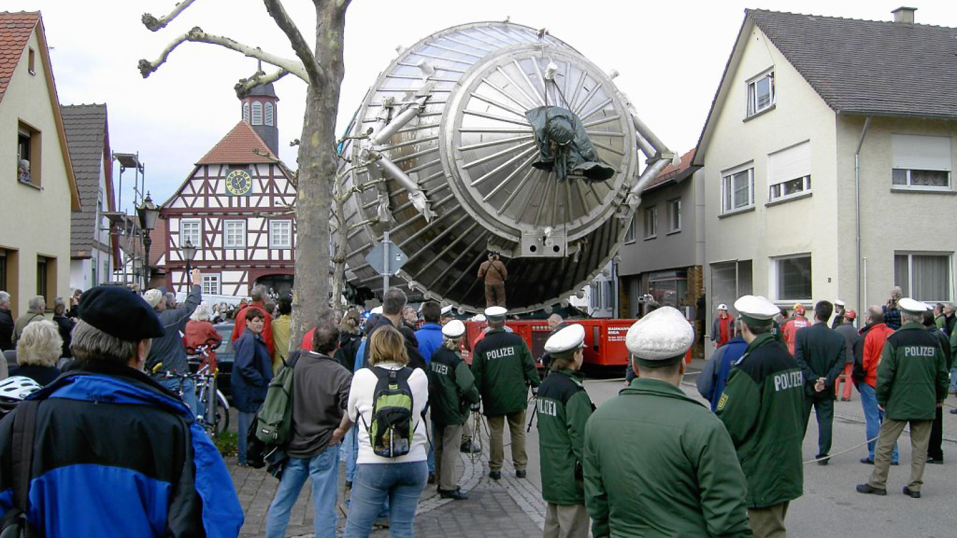
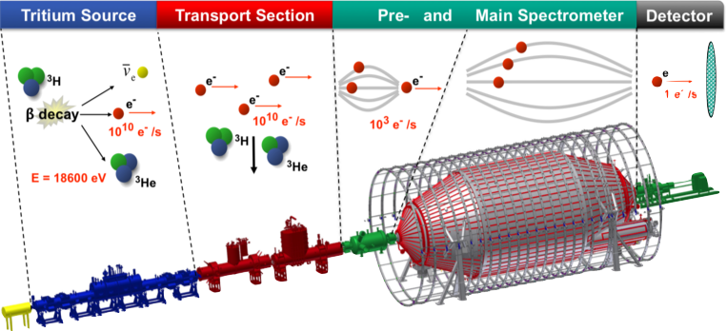
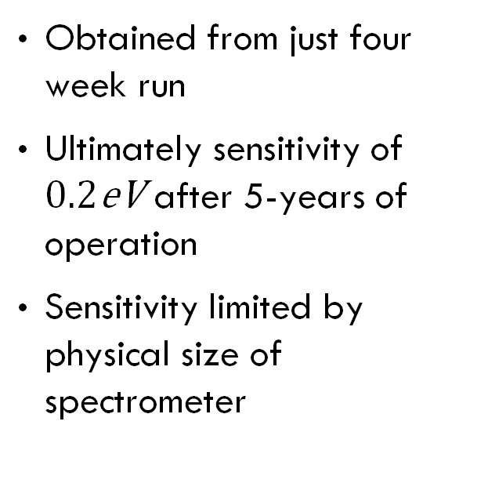
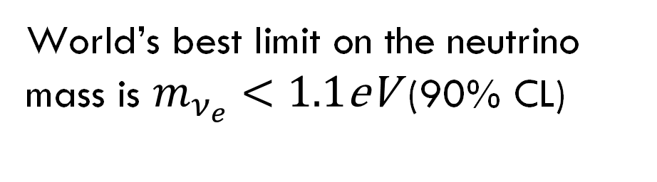
KATRIN
World’s best limit on the neutrino mass is $m_{ν_{e}}<1.1\text{eV}$ (90% CL)
Obtained from just four week run
Ultimately sensitivity of $0.2\text{eV}$ after 5-years of operation
Sensitivity limited by physical size of spectrometer

Slide 7
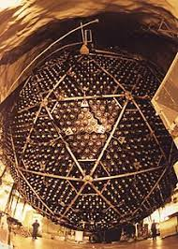
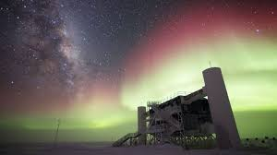
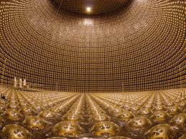
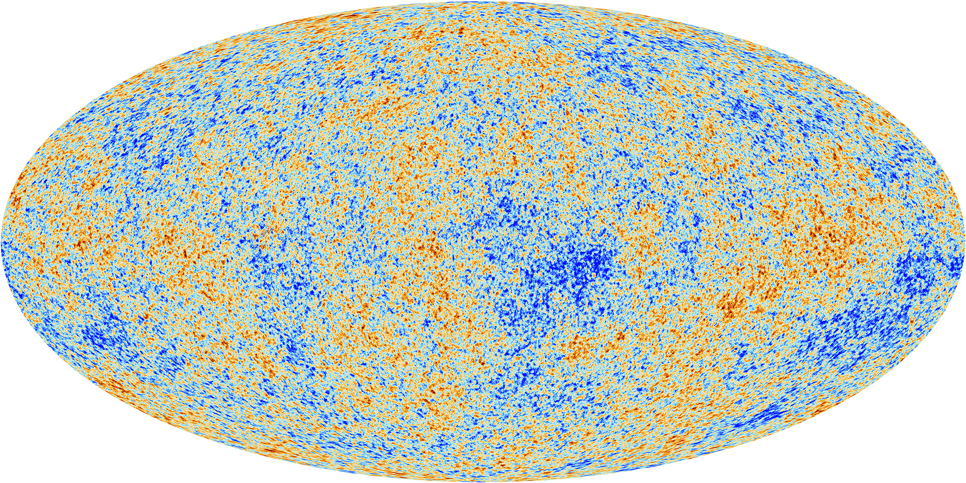
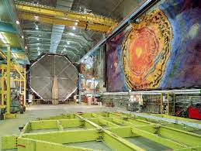
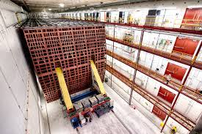
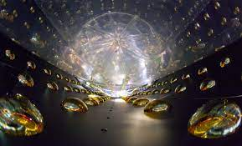
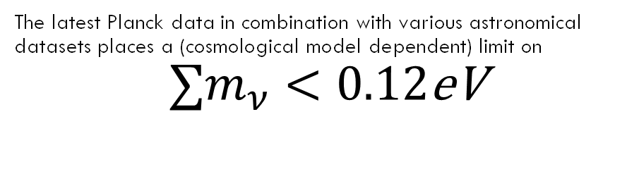
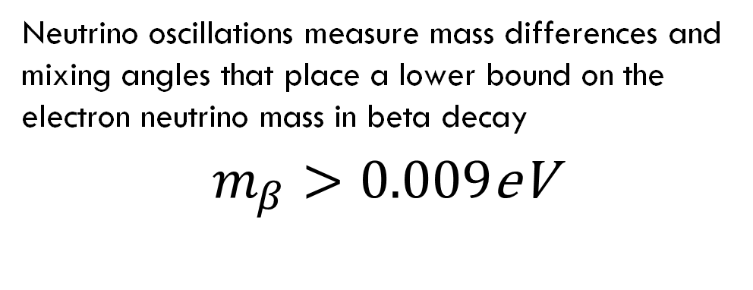
Neutrino mass targets
Neutrino oscillations measure mass differences and mixing angles that place a lower bound on the electron neutrino mass in beta decay
$m_{β}>0.009\text{eV}$
The latest Planck data in combination with various astronomical datasets places a (cosmological model dependent) limit on
$$∑m_{ν}<0.12\text{eV}$$
Can we build an experiment with more than two orders of magnitude more sensitivity than Katrin?

Slide 8
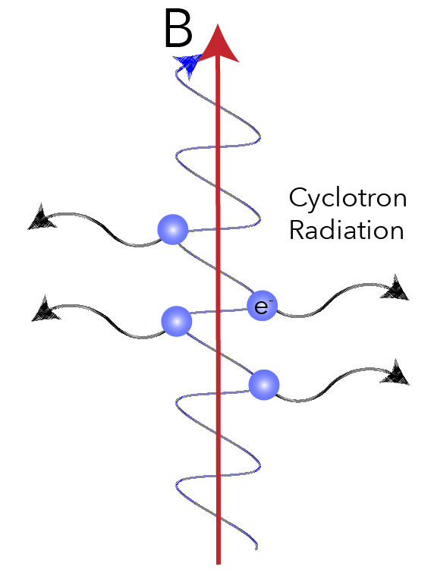
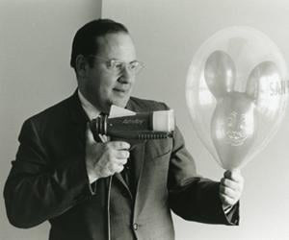
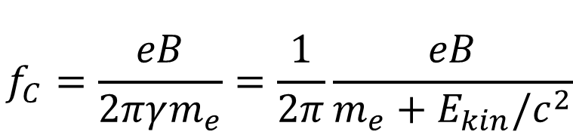
Cyclotron Radiation Emission Spectroscopy
“Never measure anything but frequency!”
Cyclotron Radiation Emission Spectroscopy
Monreal and Formaggio, Phys. Rev. D 80 (2009)
Measure single electron energy via frequency of cyclotron radiation
Arthur Schawlow
The frequency of emitted radiation is:
$$f_{C}=\frac{eB}{2πγm_{e}}=\frac{1}{2π}\frac{eB}{m_{e}+E_{kin}/c^{2}}$$
For $E_{kin}=18.6\text{keV}$ and $B=1\text{T}$ then $f_{C}≈27\text{GHz}$

Slide 9
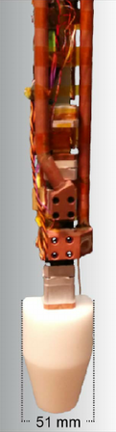
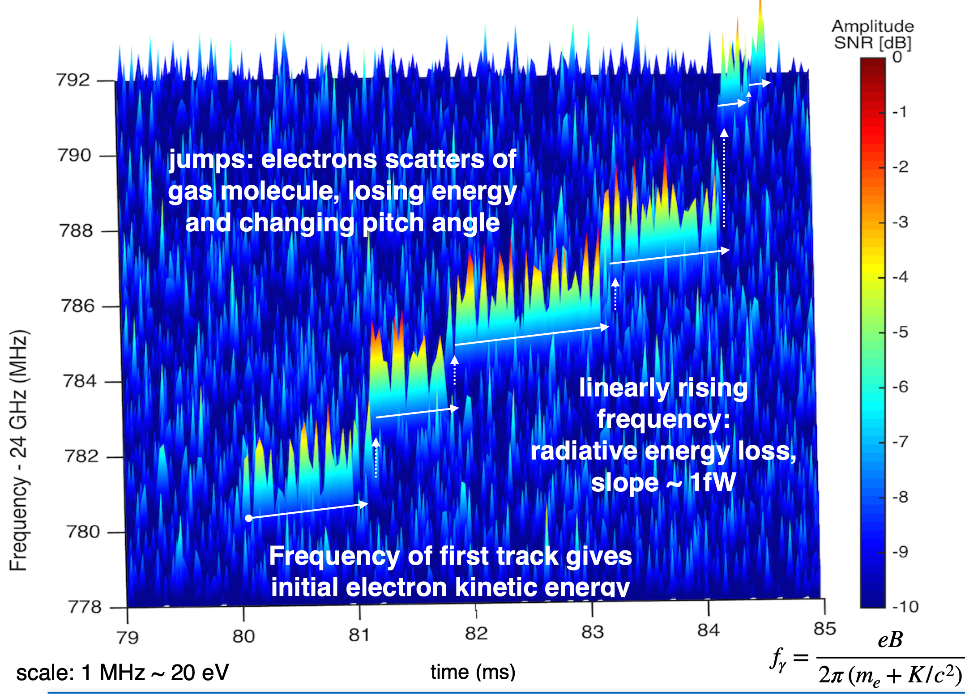
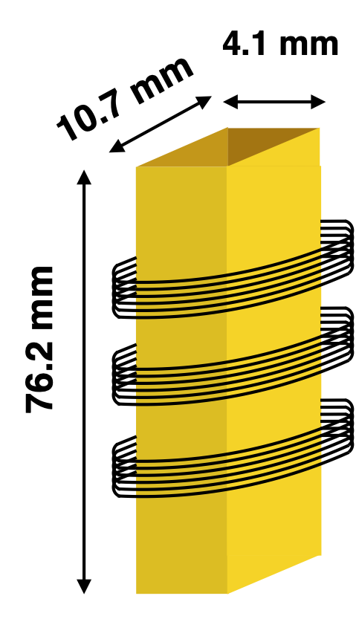
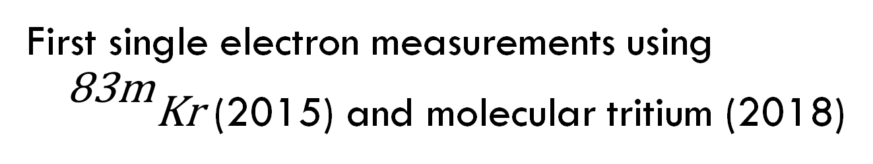
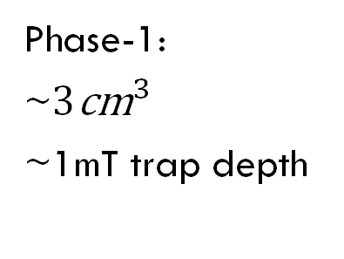
Project 8
First single electron measurements using ${}^{\text{83}\text{m}}\text{Kr}$ (2015) and molecular tritium (2018)
Phase-1:
~$3{\text{cm}}^{3}$
~1mT trap depth

Slide 10
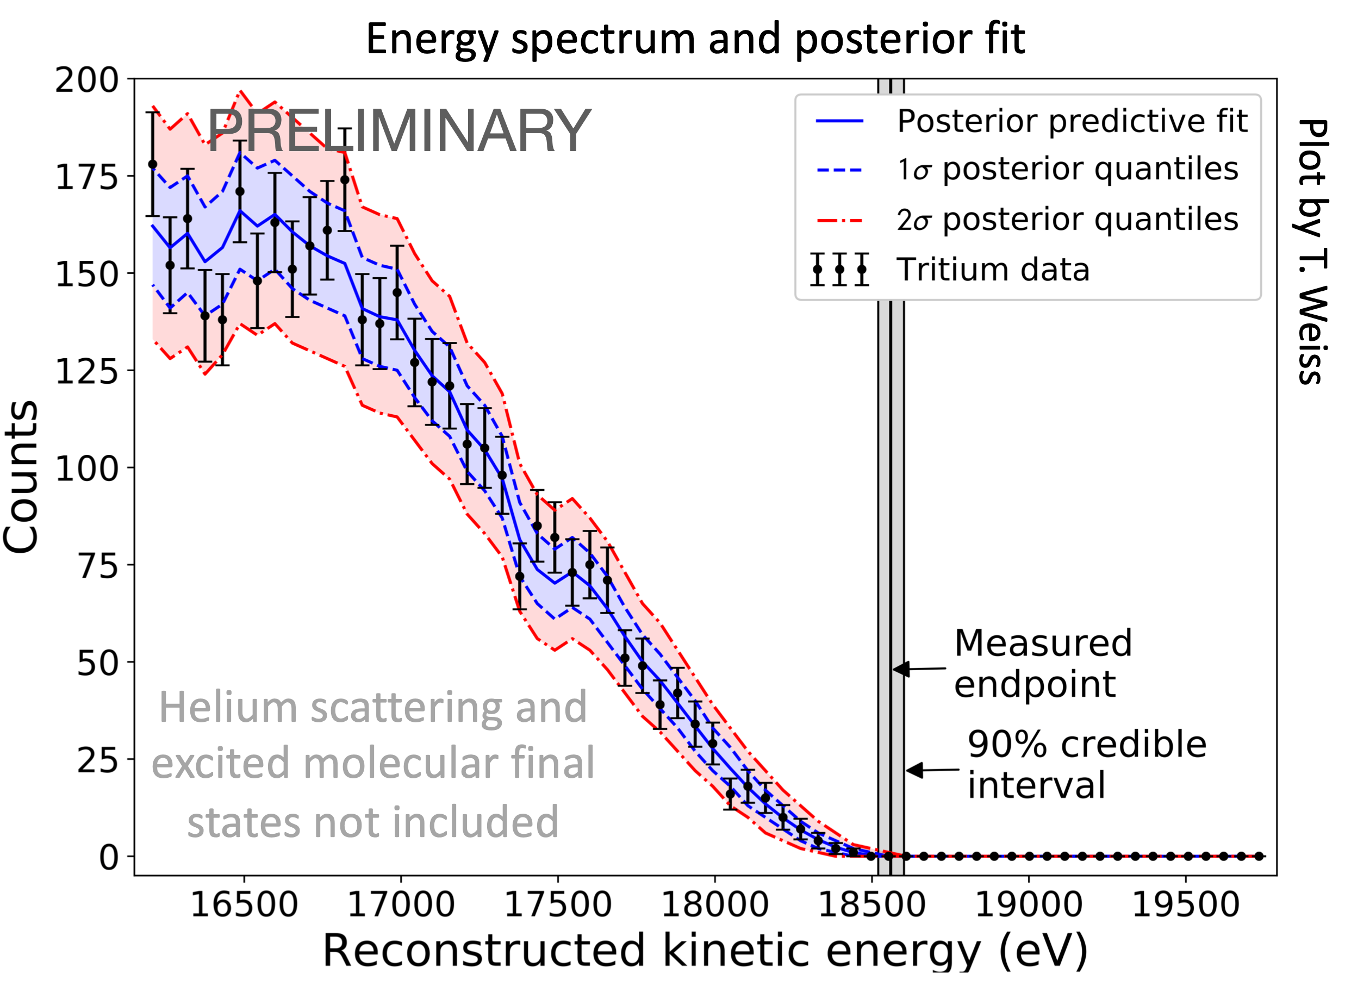
Project 8 Tritium Spectrum
First tritium spectrum measured by Project-8 using effective trap size of 1mm³
3770 events measured over 82 days of operation
Great proof of principle

Slide 11
How to scale up the CRES technology?
Advantages
Challenges
Source is transparent to microwave radiation
No need to transport electron to detector, minimise losses
Exquisite precision from frequency measurement
Can measure differential spectrum not just integral spectrum
Ultimate precision needs atomic not molecular tritium
Need to trap and observe ~10²⁰ Tritium-atoms
Emitted power sub-fW, need spectrometry with <1ppm resolution
Need magnetometry with <1ppm resolution

Slide 12
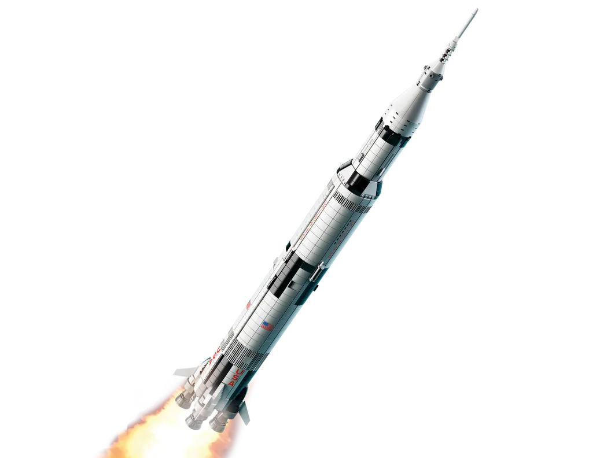
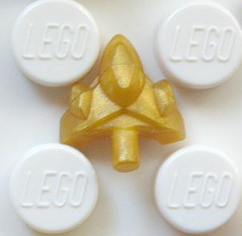
Quantum Technologies for Neutrino Mass
New UK collaboration to use CRES technique to measure neutrino mass
Current CRES:
  ~1mm³ trap
  3770 electron events
  Trap inside waveguide
  Single channel
  Molecular tritium
Future CRES:
  ~1000cm³
  >10¹⁴ electrons
  Trap viewed by antennas
  Multi-channel
  Atomic tritium

Slide 13
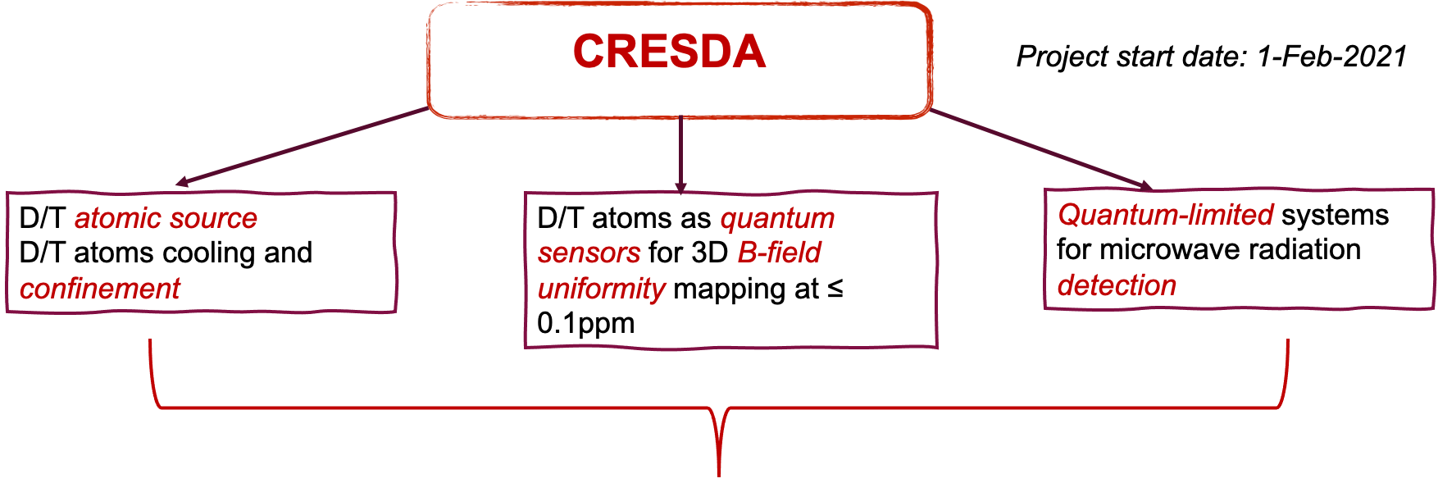
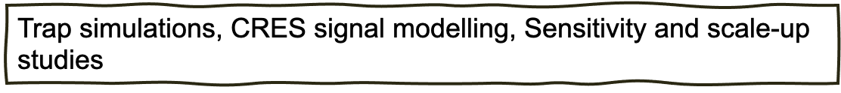
Cyclotron Radiation Emission Spectroscopy Demonstrator Apparatus (CRESDA)

Slide 14
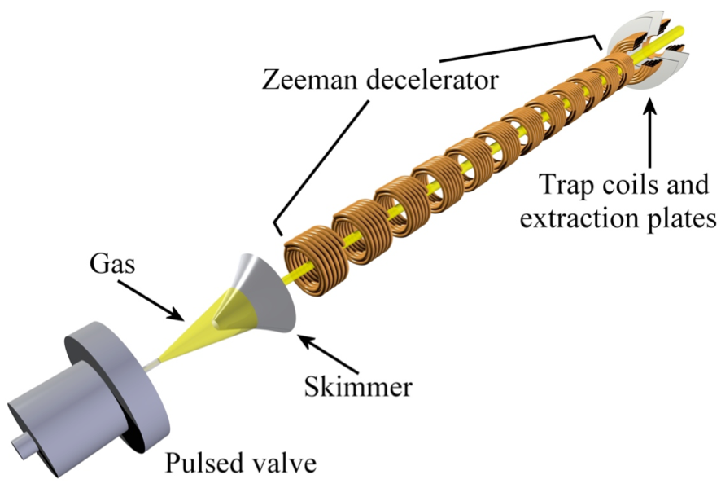
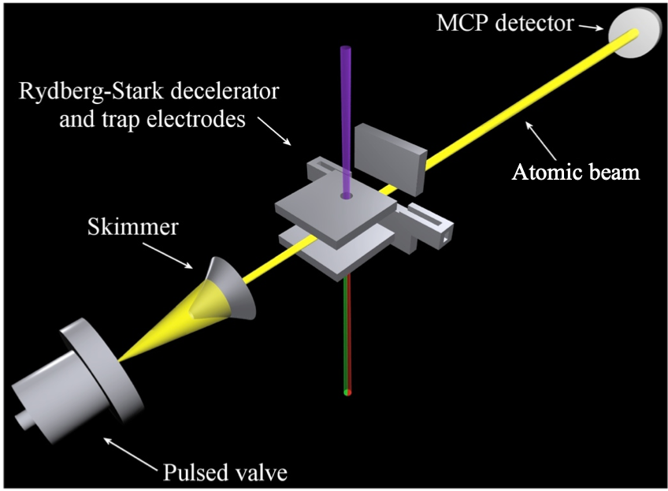
Atomic source and confinement
Challenge is decelerating the supersonic atoms
Zeeman Deceleration
Rydberg-Stark Deceleration
Hogan, Motsch and Merkt, Phys. Chem. Chem. Phys. 13, 18705 (2011)

Slide 15
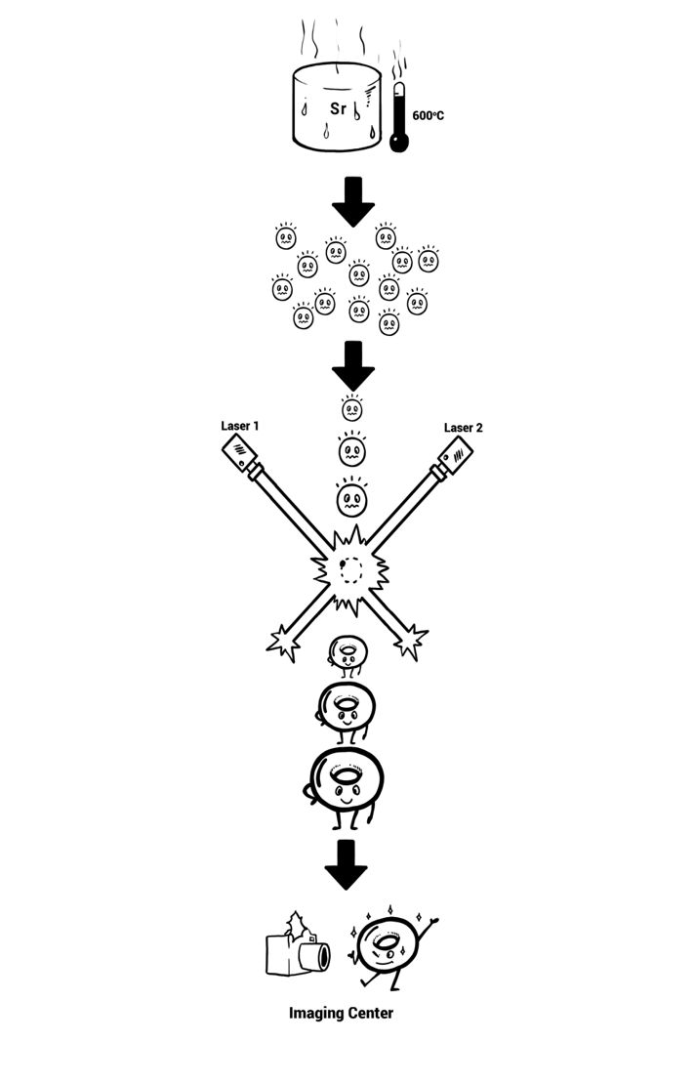
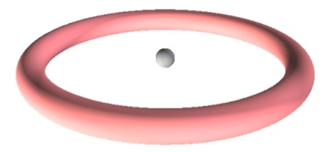
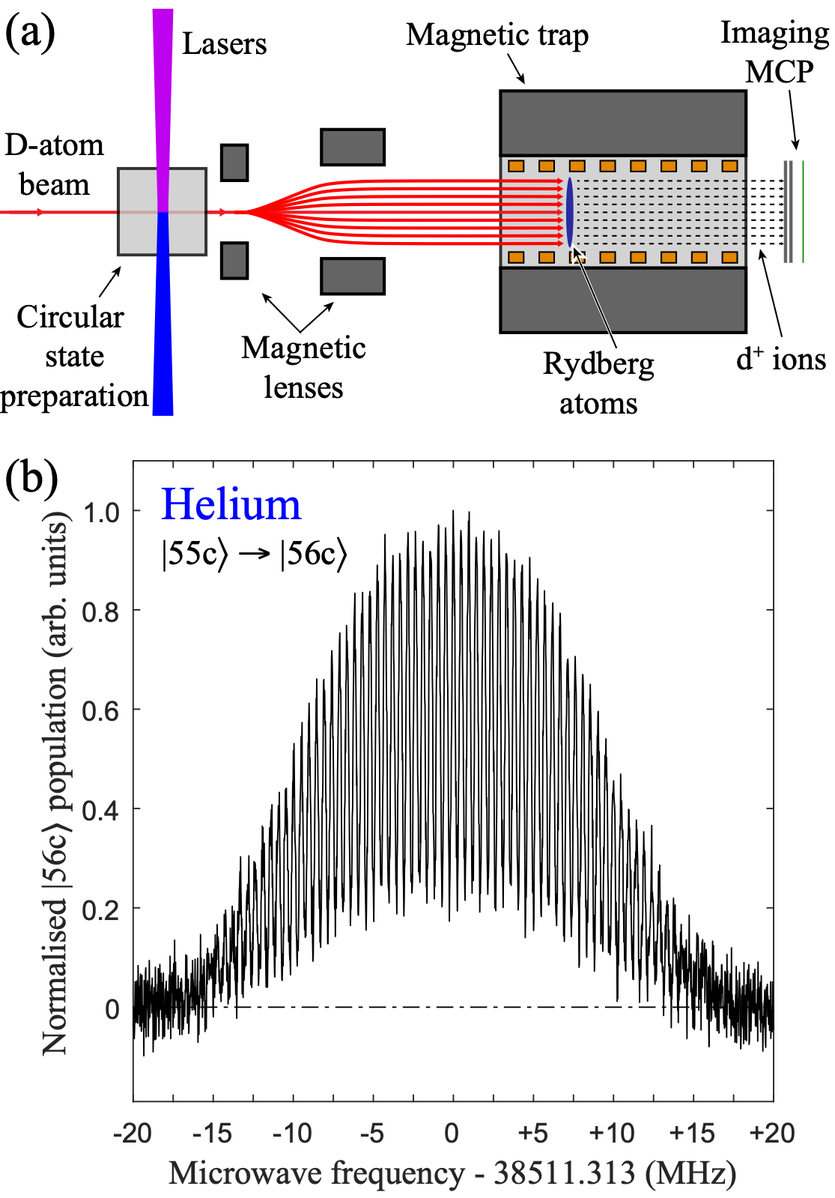
Rydberg atom magnetometry
Circular Rydberg states can be used to measure magnetic (and electric) fields
We can use the deuterium/tritium atoms to map the magnetic field in the trap region to the sub-ppm level required
From A. Muni

Slide 16

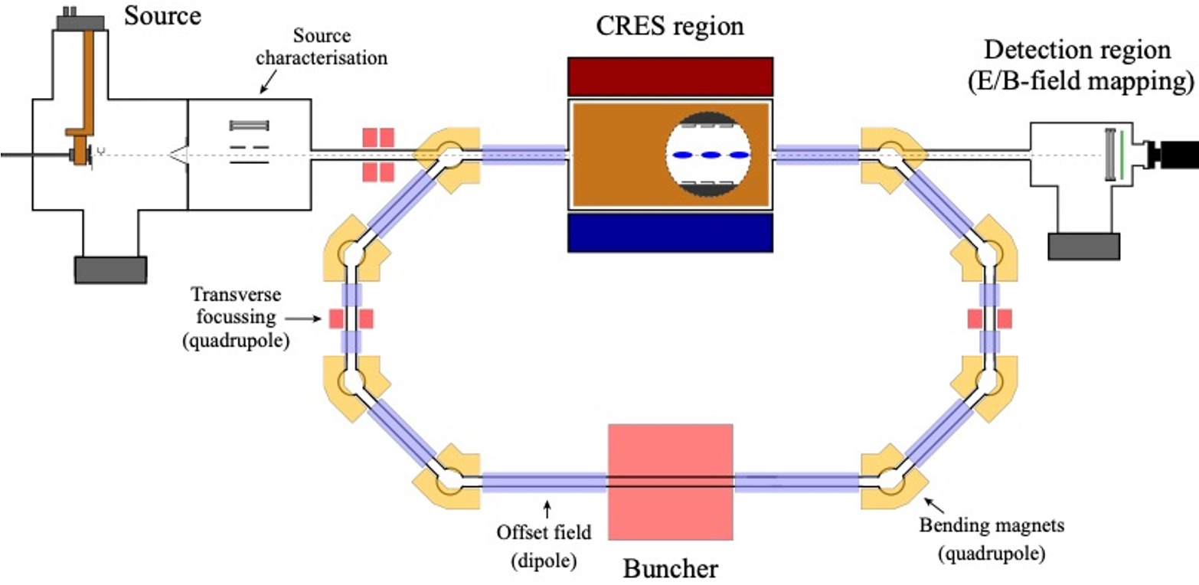
Storage Ring

Slide 17
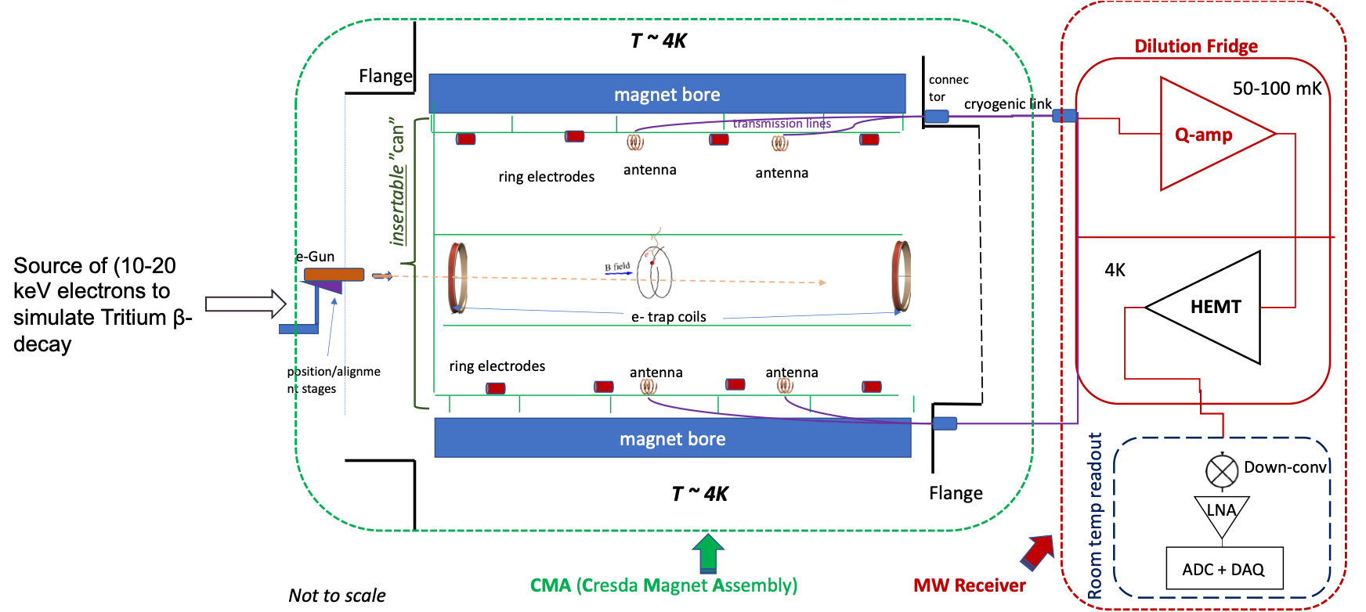
CRES Magnet Assembly

Slide 18
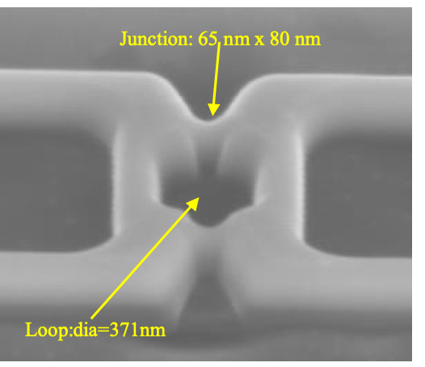
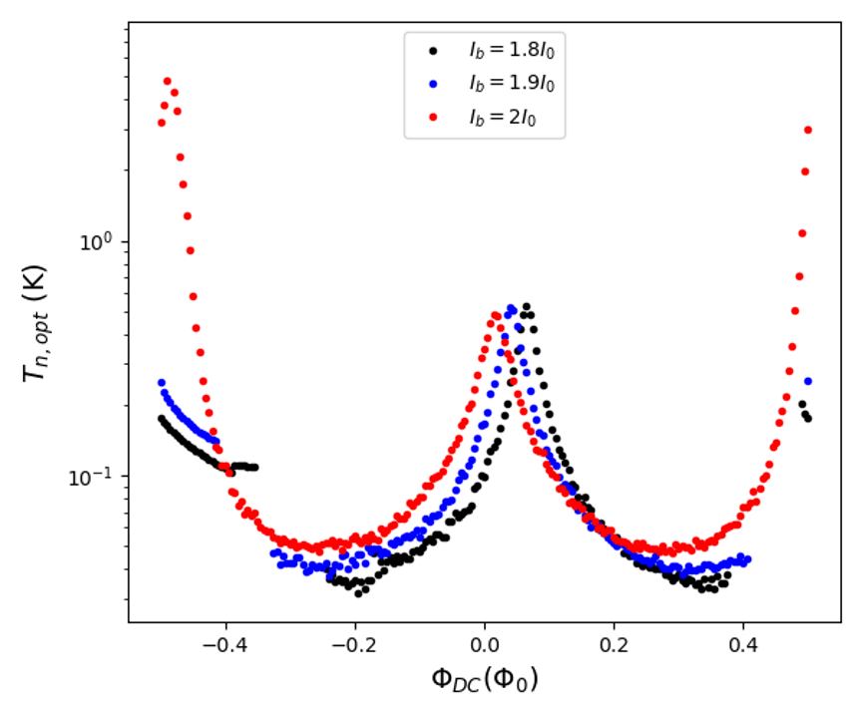
Quantum Preamplifier
The collaboration are pursuing two quantum-limited preamplifier technology possibilities:
Josephson Travelling Wave Parametric pre-Amplifier (JTWPA)
Superconducting Low-Inductance Undulatory Galvanometer (SLUG)
R. Nichol, QTNM, SPIE.Photonex, Glasgow 2021

Slide 19
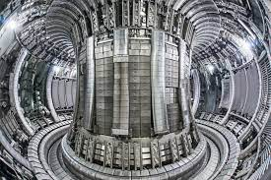
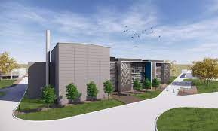
Future Tritium Stage
Already collaborating with the Culham Centre for Fusion Energy to ensure that CRESDA is tritium ready
Current QTNM 2021-2024 CRESDA @ UCL
2025: next stage CRESDA @ tritium facility
2029: ultimate neutrino mass experiment

Slide 20
Summary
Cyclotron radiation emission spectroscopy is an exciting new technique for measuring single electron energy at unprecedented precision
UK QTNM collaboration is building on existing UK expertise in atomic cooling, trapping, magnetometry and quantum amplifiers
Possibility of hosting the ultimate neutrino mass experiment in the UK

