Slide 1
Neutrinos, neutrons
and
Nuclear Arms Control
Ruben Saakyan
University College London
UK-China Verification Dialogue Workshop
29-30 October 2014

Slide 2
Outline
(Anti)Neutrinos at a glance
Anti-Neutrinos from reactors and their detection
NPT, IAEA and anti-neutrinos
Neutron detection and search for “dark matter”
International collaborations and role of China

Slide 3
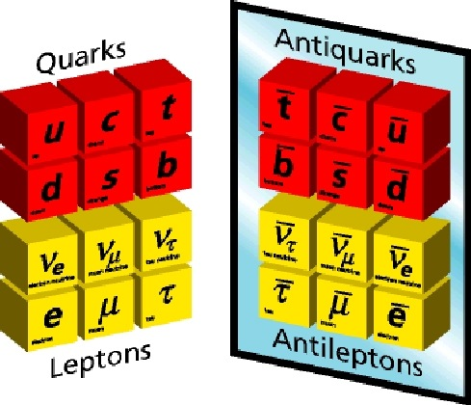
Neutrinos
Second most abundant (known) particle in Universe (after photon)
Recently discovered to have tiny but non-zero mass
May hold key to “New Physics”,
  why we leave in world dominated by matter (almost no anti-matter)
Extremely hard to detect (electrically neutral — only weak interactions)
Neutrino flux at Earth (mostly from the sun):
6.5 x 10¹⁰ particles/cm²/sec

Slide 4
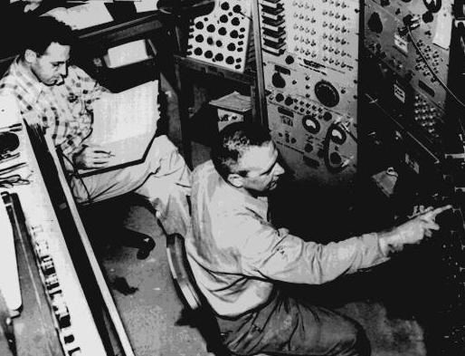
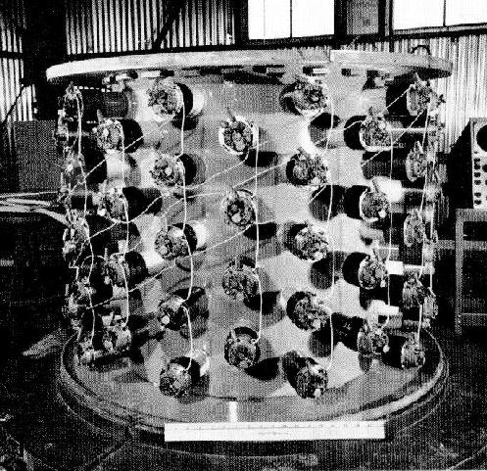
Neutrino Detection
Interact only via weak interactions
Mean free path at 1 MeV is ~ 10⁶ km !
Need very intense flux and very large detectors
Reactor produces antineutrino flux ~ 10¹⁷m⁻²s⁻¹
First observation in 1956 in a nuclear reactor
F. Reines (Nobel prize 1995):
“… the most tiny quantity of reality ever imagined by a human being”
This reaction was used in 1956 observation
Still main reaction used to detect reactor (anti)-neutrinos

Slide 5
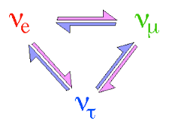
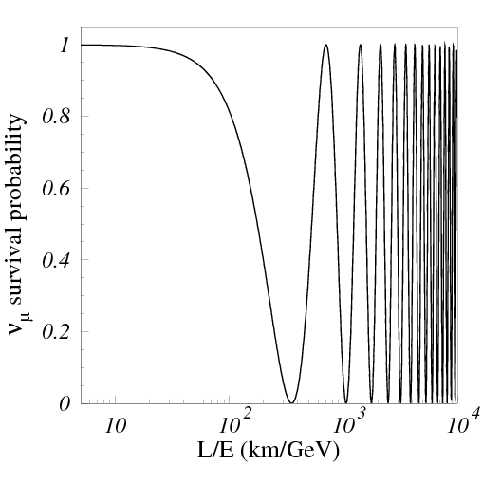
Neutrino Oscillations and role of reactors.
Observation of neutrino oscillations (1998-2002) and subsequent measurements of oscillation parameters — one of the biggest discoveries in particle physics
Complementary to Higgs boson and other physics pursued at LHC
Latest “big thing” (2012) — discovery of “θ13 mixing angle” —- came from reactor neutrinos
Perhaps our best hope for “New Physics”
One of the hottest topics in particle physics — lots of development and investment, truly international effort
oscillations ⇒ non-zero neutrino mass

Slide 6
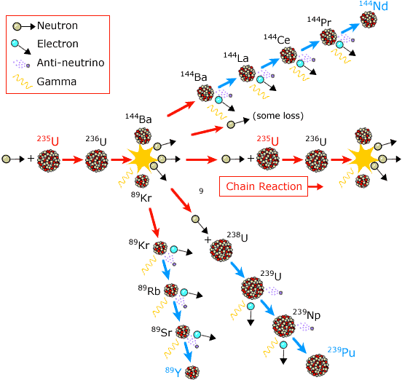
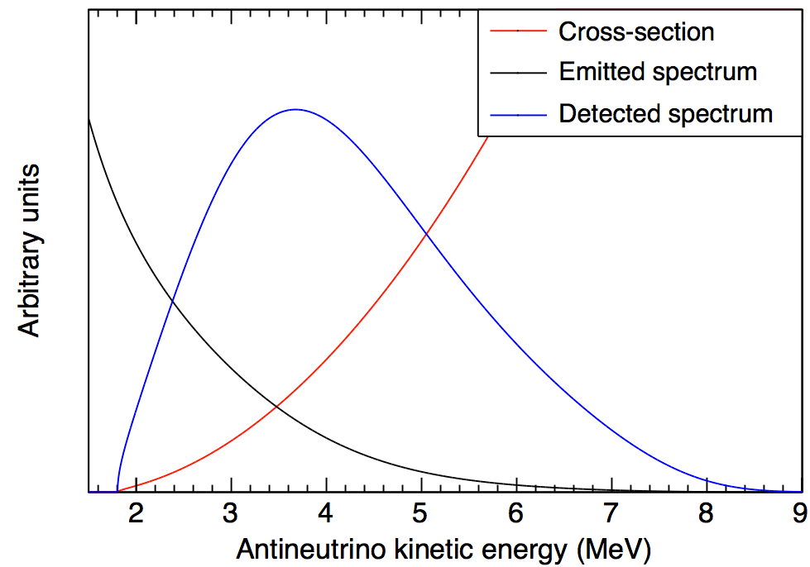
Antineutrino from nuclear reactor
~6 anti-ν’s per fission
1 GW reactor produces ~1.5 x 10²⁰ anti-ν’s/sec
Detection possible despite small cross section
Impossible to shield!

Slide 7
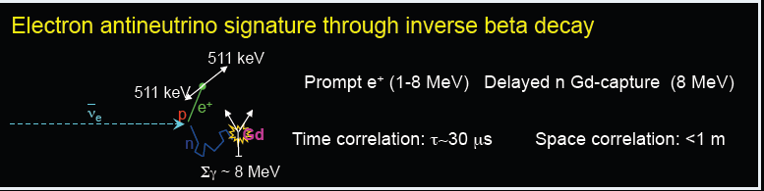
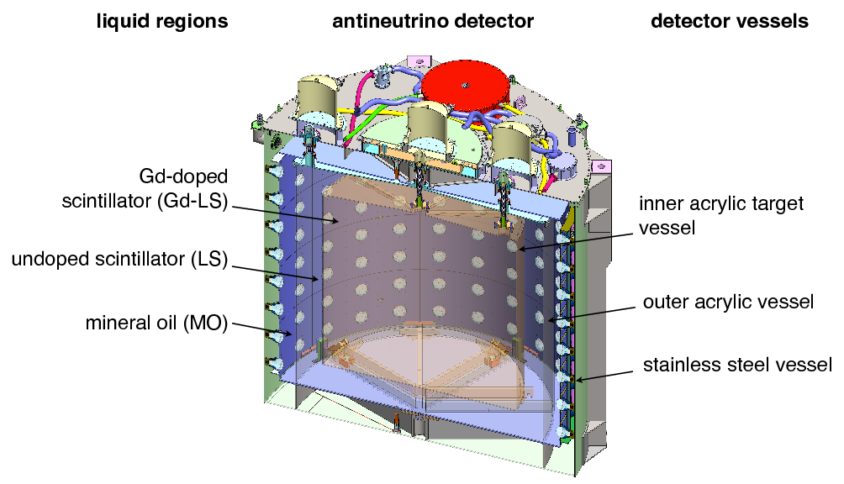

Antineutrino Detectors
A lot of detector development, liquid and plastic scintillators, water Cerenkov dopants to increase neutron cross-section (Gd, Cd etc), photodetectors
Understanding of backgrounds, improved modelling
Cost reduction for Mton detectors — remote reactor monitoring (focus on water Cerenkov detectors)
1,000-10,000 events per day, 1-10% precision
of number of anti-ν’s —> # fissions —> fuel consumption
Energy spectra of anti-ν’s are different for U and Pu

Slide 8
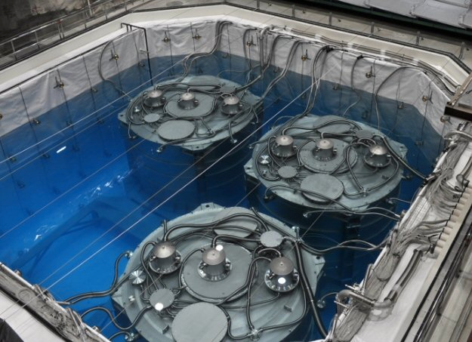
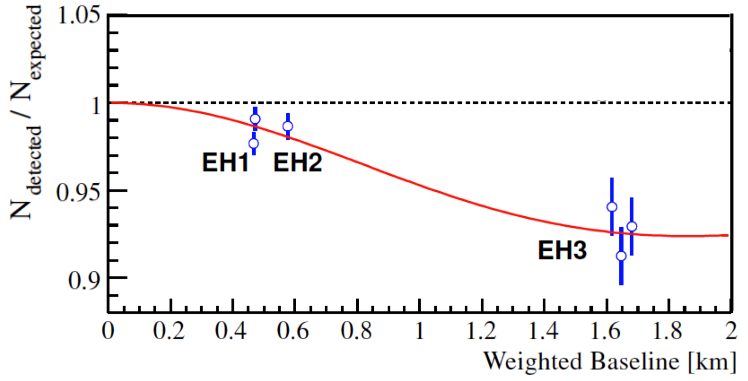
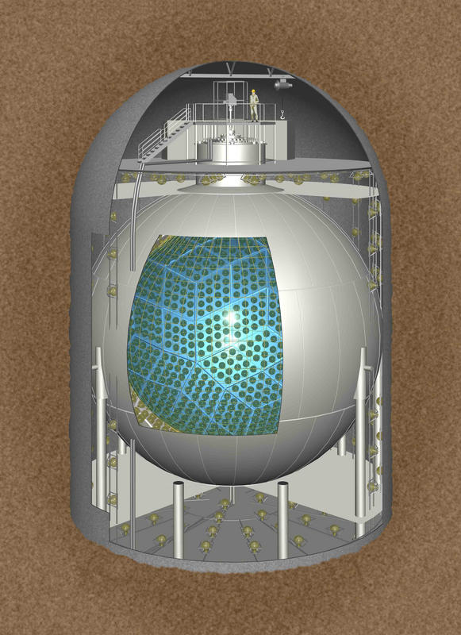
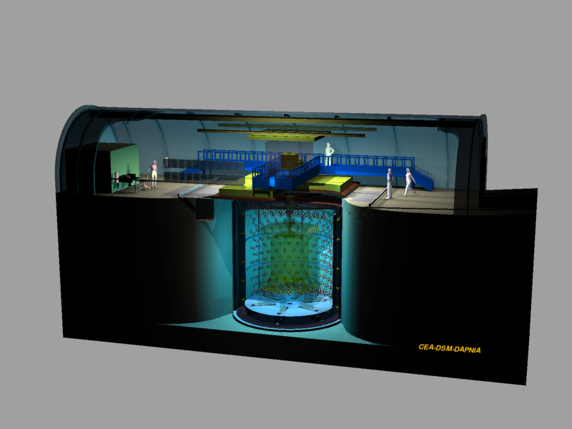
Truly international effort with China playing a key role
First θ13 measurement in Day Bay reactor in China
Future plans:
JUNO, 20kT scintillator detector
Other reactor neutrino experiments:
Double Chooz in France,
RENO in Korea, KamLAND in Japan

Slide 9
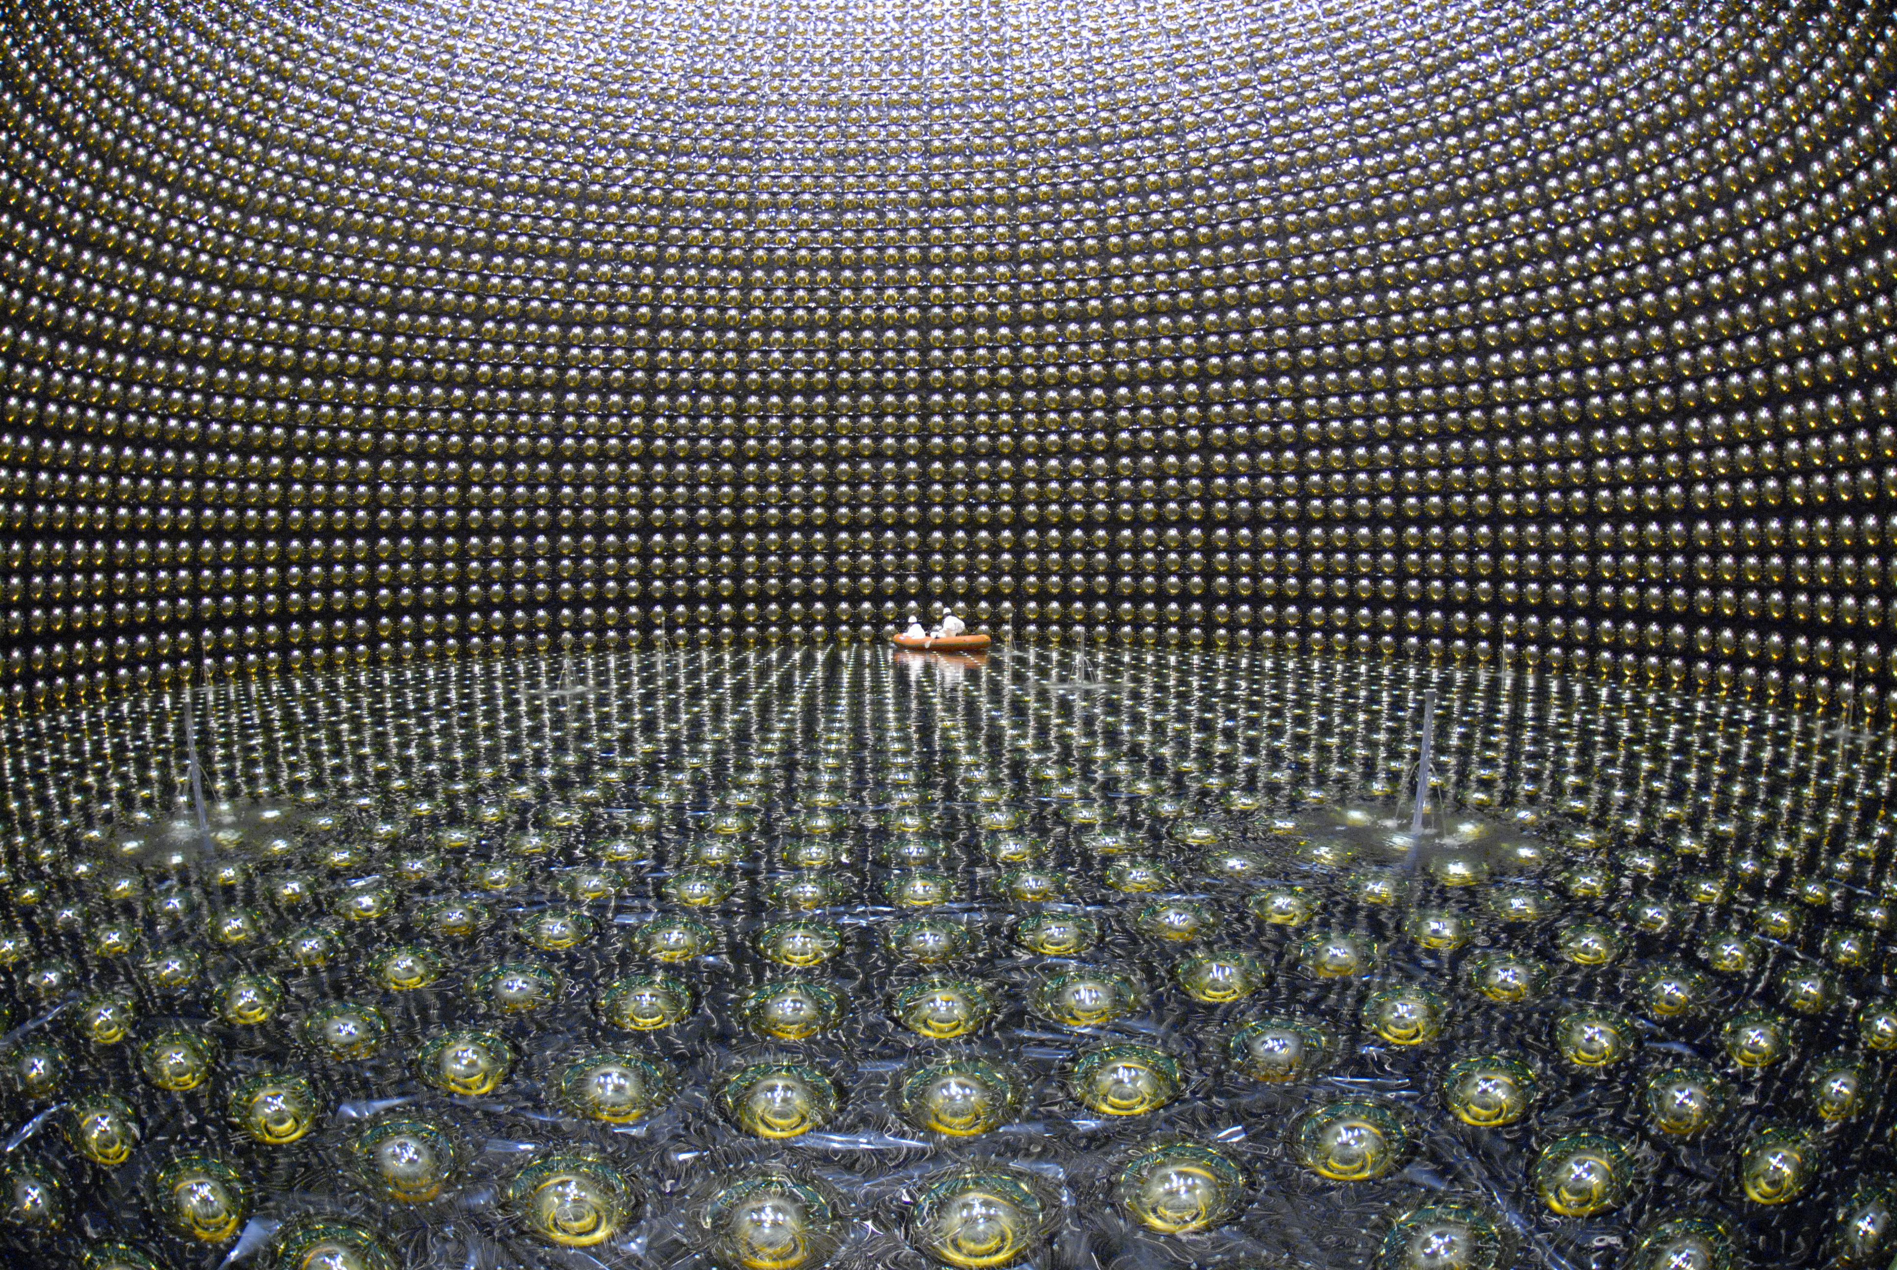
Development of very large cost effective detectors based on success of SuperKamiokande (Japan)

Slide 10
Can antineutrinos help with nuclear arms control?

Slide 11
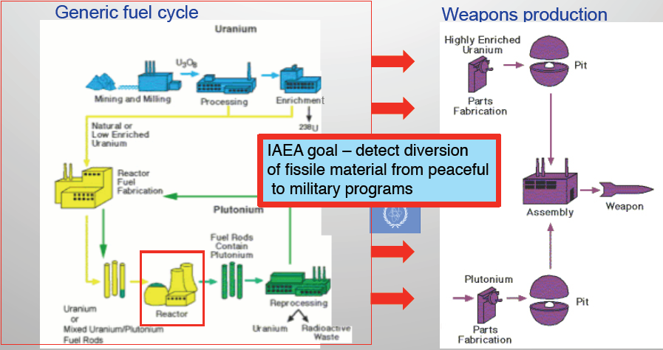
The IAEA “Safeguards” Regime monitors the flow of fissile material through the nuclear fuel cycle in 170 countries
Goal of antineutrino measurements — track fissile inventories in operating nuclear reactors

Slide 12
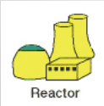
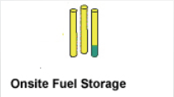
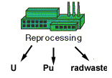

IAEA monitors ~220 reactors worldwide but never directly measures in-core fissile content
Check input/output declarations
Item accountancy
Containment and Surveillance
“Gross defect” detection
Item accountancy
Containment and Surveillance
Check declarations
Item accountancy
Concerns:
Operators report Fuel Burnup and Power History
No direct Pu Inventory (unless and until fuel is reprocessed)

Slide 13

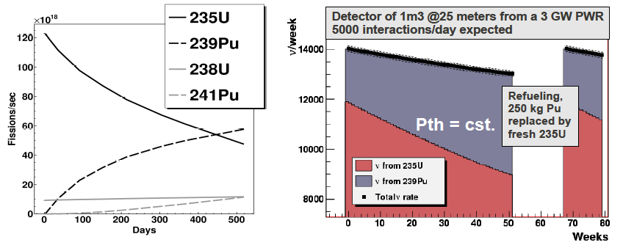
Antineutrino from nuclear reactor
As reactor fuel burns, the composition changes —> Burnup
Antineutrino flux and energy spectrum change with time and composition
Any sudden change in core composition causes change in antineutrino rate/spectrum —> can be detected

Slide 14
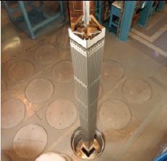
IAEA particular interest — Pu disposition
A long-sought goal of managing Pu that has been declared surplus to military needs.
Purpose: convert it to a form that is much harder to recover for use in a weapon
Currently preferred method: manufacture MOX fuel (Pu/U) and irradiate it in a reactor — “Spent Fuel Standard”, SFS
Verifying SFS requires knowledge of fuel burnup for each assembly
Burnup measures energy extracted from fuel (or number of fissions that have occurred)
Burnup is strongly correlated with
  Total neutron irradiation history
  Fission product concentrations
  Transmutation of heavy elements
  Total antineutrino flux

Slide 15
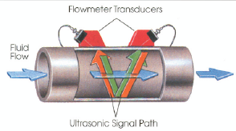
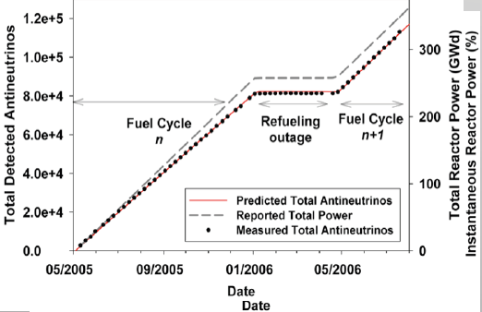
Burnup monitoring
“Conventional” burnup monitoring — thermo-hydraulic power monitor
measure temperature difference and flow rate to infer power
relatively intrusive (connection to sensitive plant systems)
vulnerable to spoofing
Alternative: measure integral antineutrino rate as a measure of fuel exposure
Advantages:
Non-intrusive, no connection to plant systems
Statistical precision
Self-calibrating
Highly tamper resistant, difficult to spoof
“Continuity of knowledge”
Currently two-type of reactors under evaluation
Westinghouse PWR with partial MOX loading (common in US)
Fast breeder BN-600 with partial and full MOX loading (Russian)

Slide 16
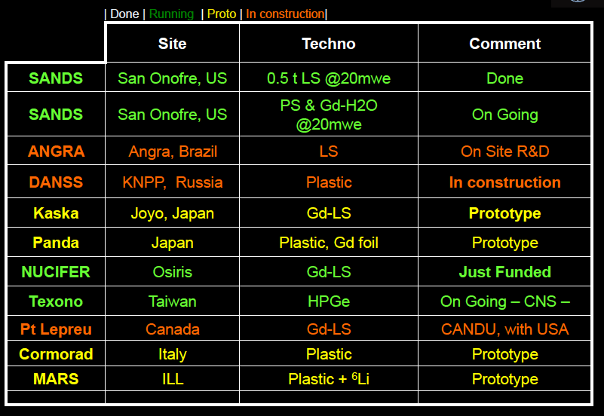
Reactor monitoring with antineutrinos — an emerging field
Slide by T. Lasserre, Applied Antineutrino Physics Conference, October 2012
Results from a pioneer SONGS experiment were reviewed at IAEA Novel Technologies meeting in Oct’08 and found to demonstrate the potential for the approach.

Slide 17
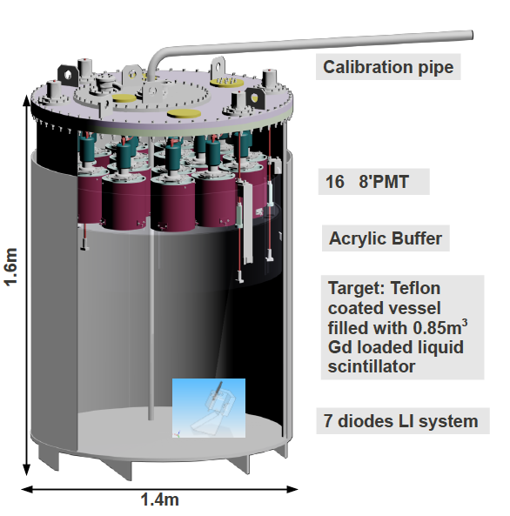
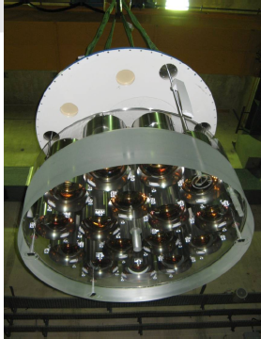
Example: NUCIFER Experiment
Deployment at a research reactor — Saclay Osiris (France)
Detector at 7m from 70MW core
~700 anti-ν events/day expected
Funded, built, taking data

Slide 18
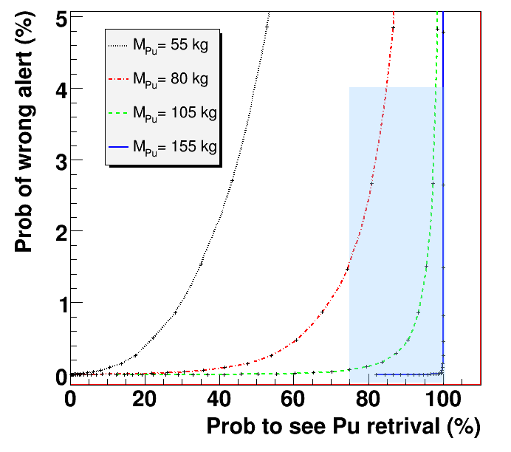
NUCIFER Sensitivity to illicit Pu Retrievals
from nuclear reactor core

Slide 19
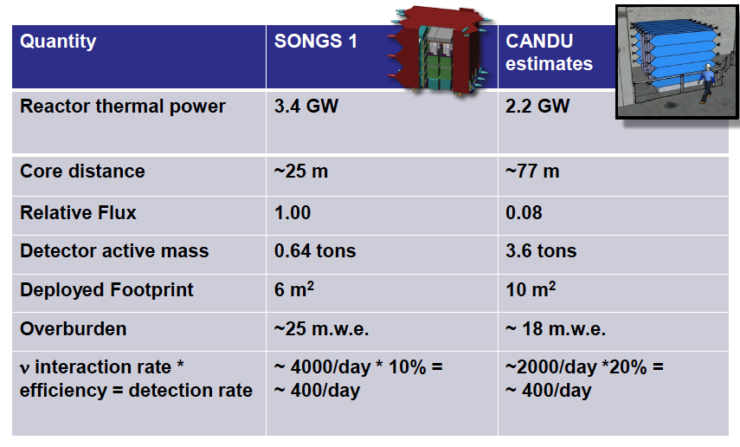
More examples

Slide 20
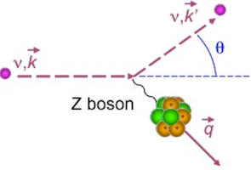
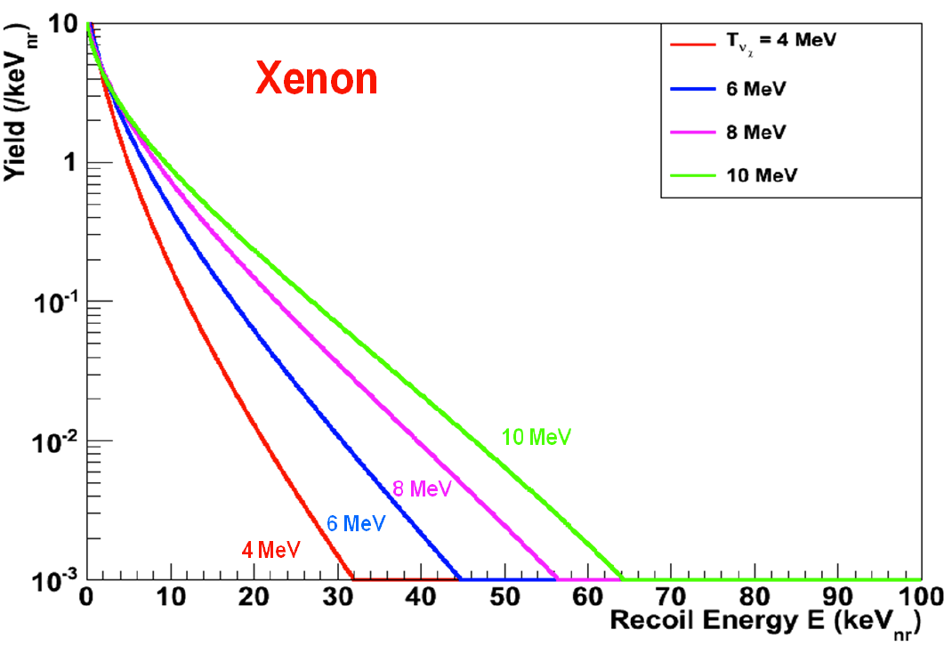
Other developments: Coherent Neutrino Scattering
Neutrino elastic scattering from a nucleus as a whole
Relevant for ν’s of ~ MeV range (good match for reactor anti-ν’s)
A “Standard Model”process that yet to be observed
Main challenge: tiny energies from nuclear recall —> —> very low thresholds (~1 keV)
International R&D effort and competition to observe CS for the first time
Important reward: cross section (probability of interaction) is ~10 higher than “conventional” ν-interaction — much smaller detectors can be used
ionisation caused by nuclear recoil is measured
Detector R&D, synergies with dark matter detection
focus on ultra-low thresholds
Broad Energy Germanium detectors (BEGe)
Low temperature bolometers
Liquid and gaseous noble gas detectors (e.g. LAr, HPAr, LXe, HPXe)

Slide 21
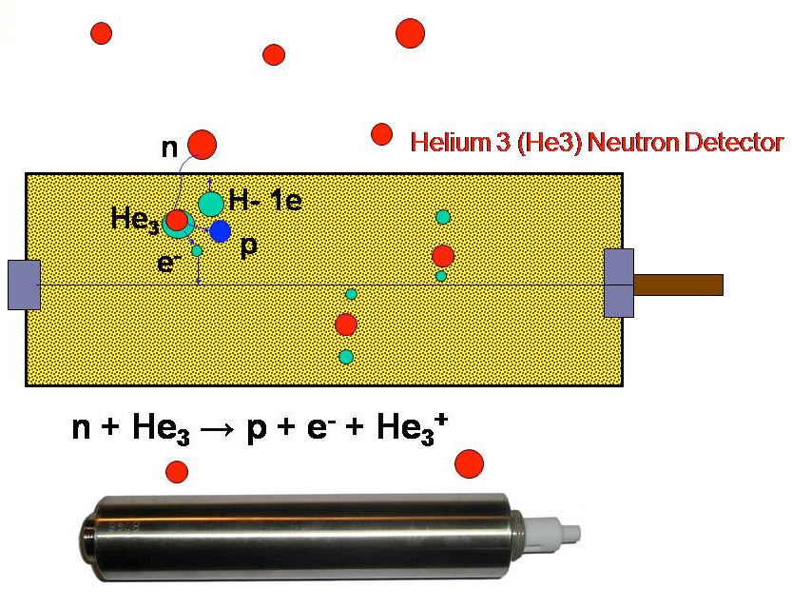
Neutron detection of SNM and it issues
Non-sensitive to isotope composition but provides clear signature of WGPu and HEU(90%)
Relatively straightforward for WGPu but not for HEU
  ~60,000 n/sec per kg WGPu
  ~1 n/sec per kg HEU
Neutron time signatures “multiplicity”
Shortage of He3, other techniques needed
Gamma background must be tackled
Can fundamental research help?
Instruments for direct detection of dark matter — most sensitive neutron detectors

Slide 22
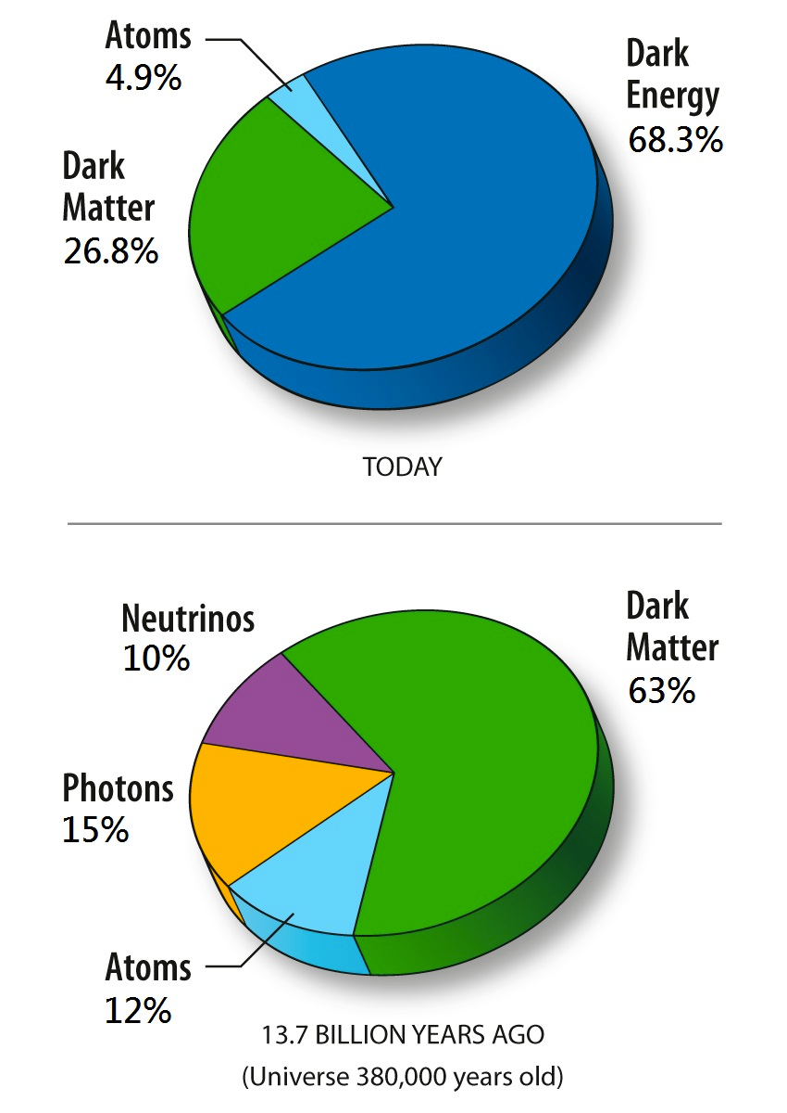
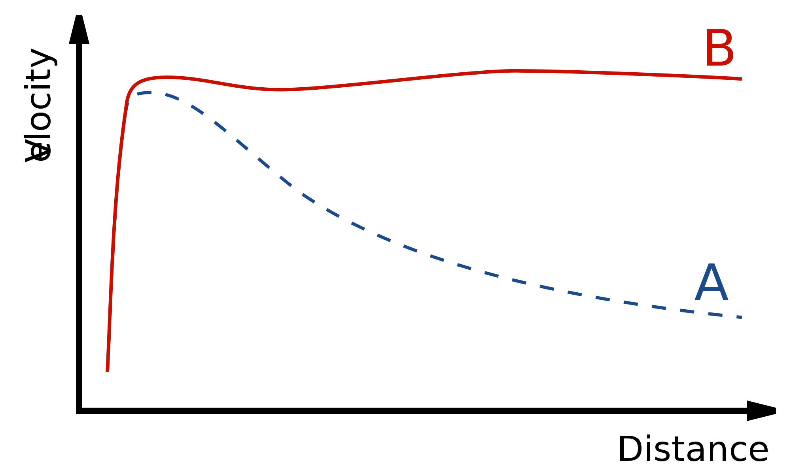
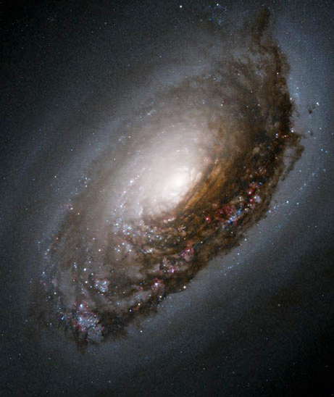
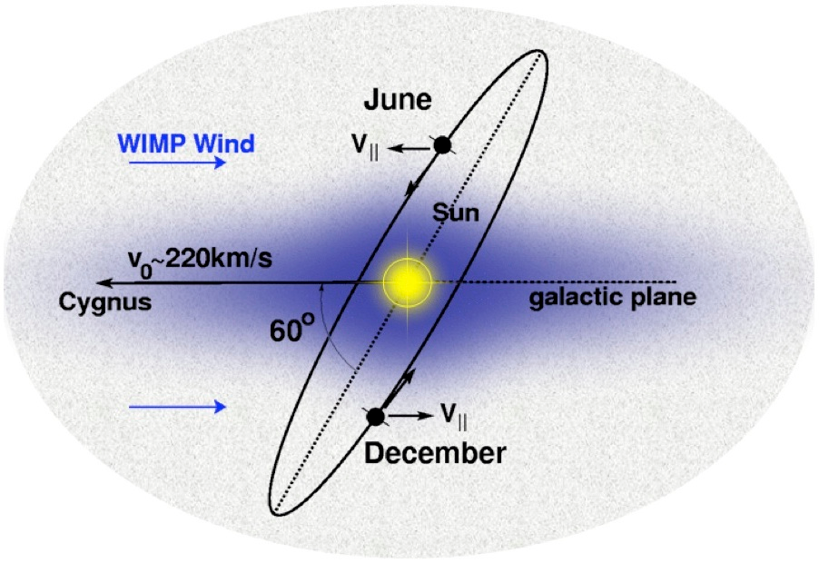
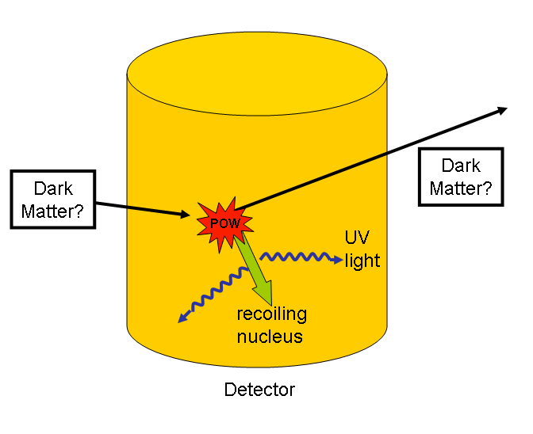
Dark Matter — we know it is there.
We don’t know what is made of.
observed
predicted
Leading candidate: Weakly Interacting Massive Particle — WIMP
Dark Matter direct detection:

Slide 23
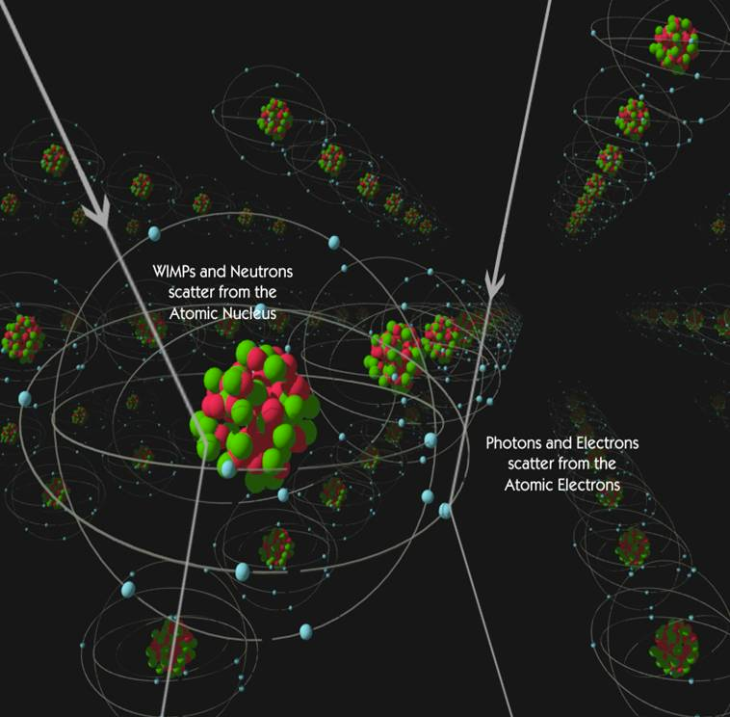
Direct Dark Matter Detection
WIMP interactions with matter are identical to neutron’s
  At issue: remove gamma background
State-of-the-art dark matter instruments — most sensitive neutron detectors

Slide 24
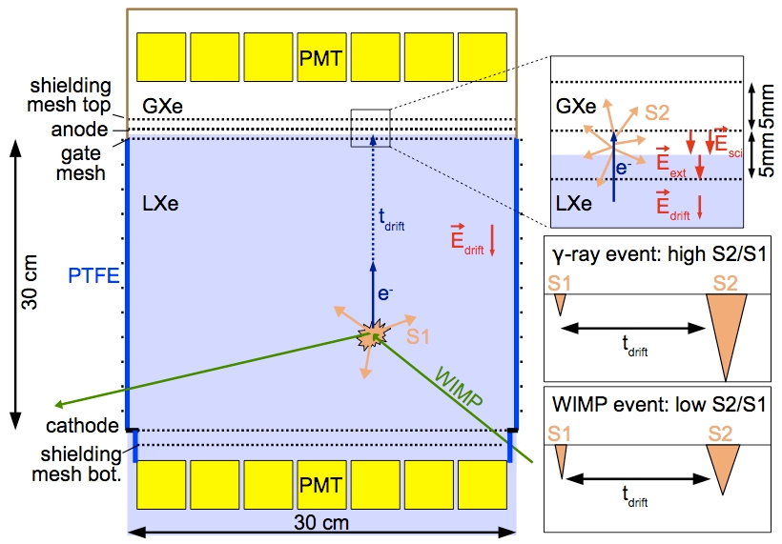
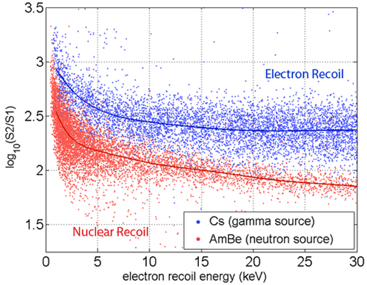
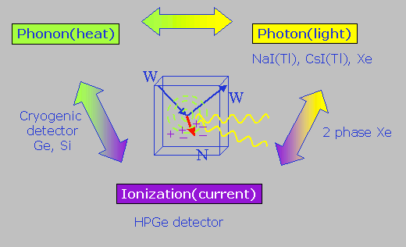
Dark Matter LXe detector
A highly competitive (and collaborative!) field
Many different technologies
  LAr and LXe
  Gaseous detectors
  Semi-conductors
  Bolometers
  Scintillators and scintillating bolometers
Unexplored opportunity for SNM detection

Slide 25
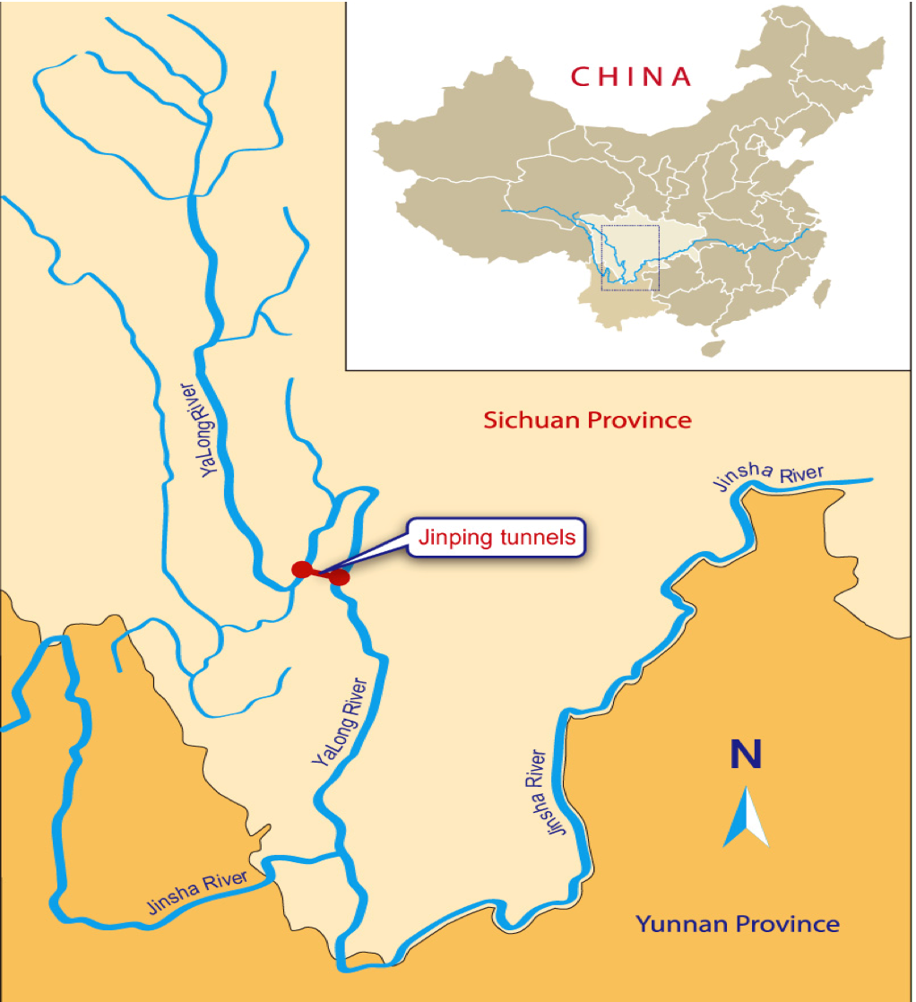
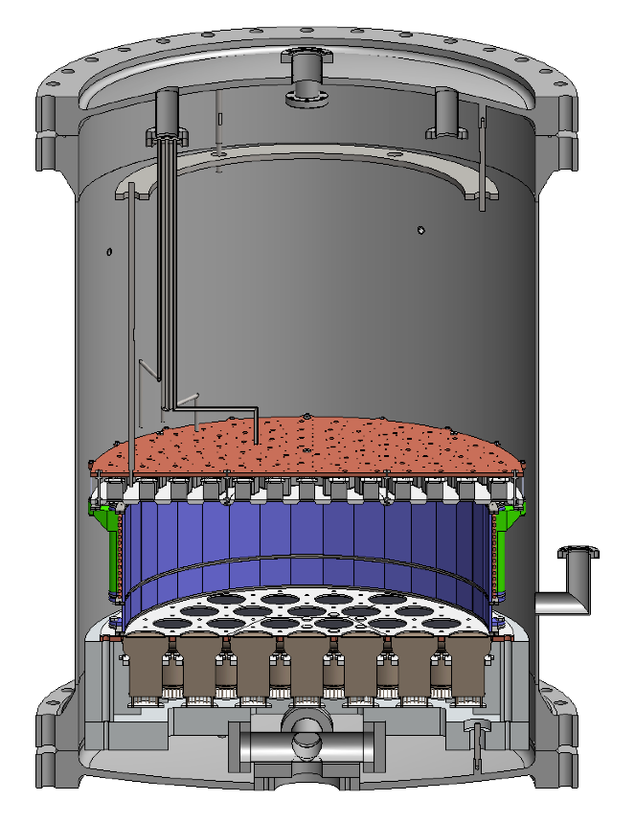
PandaX — A direct dark matter detection
experiment in China
Two-phase LXe position sensitive detector
1 ton of LXe
CJPL Underground Laboratory
Sichuan province

Slide 26
Concluding Remarks
Antineutrino detectors have unique abilities to non-intrusively monitor reactor operational status, power and fissile content in real-time;
Several detectors, built specifically for safeguard applications, have demonstrated robustness of this technique at operating power reactors. Several more are planned;
Implementation in safeguards regime can be aided by further input from IAEA on the needs at specific reactors;
Promising technological breakthroughs are possible leading to more compact detectors and/or ability to detect less powerful reactors at a greater distance;
Novel technologies developed for direct dark matter detection can increase sensitivity and reliability of SNM detection;
Increased international cooperation in particle physics in the last ~25 years have led to profound fundamental discoveries and enhanced detector capabilities which can be used in arms control;
China has played an increasingly important role in both fundamental research (neutrino physics, dark matter) and instrumentation development;
Closer cooperation between Fundamental Research and Arms Control communities is important in addressing verification challenges;

Slide 27
BACKUP

Slide 28
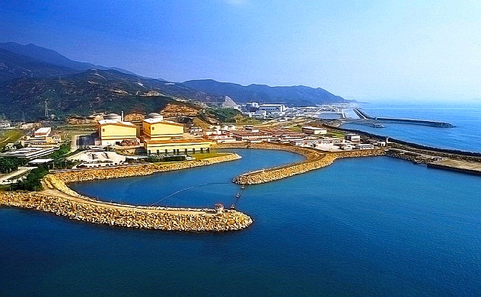
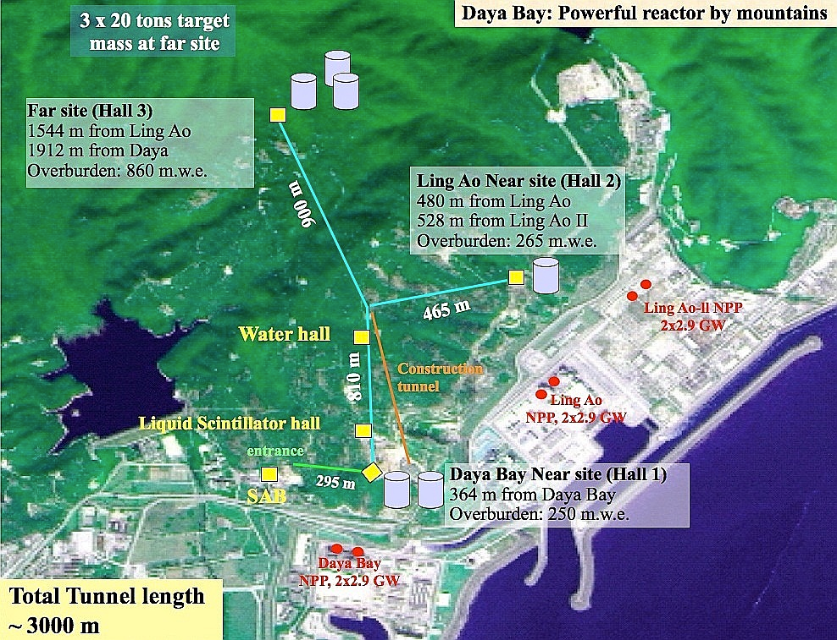
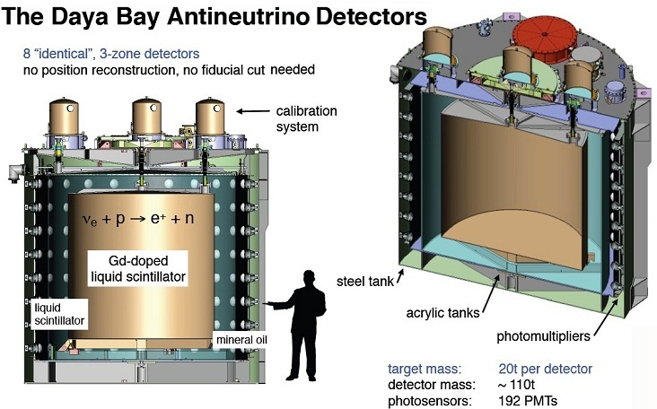
Daya Bay nuclear power complex (Guangdong, China)
At 2.9 GW per reactor, the complex produces ~3x10²¹ anti-ν’s per sec

Slide 29
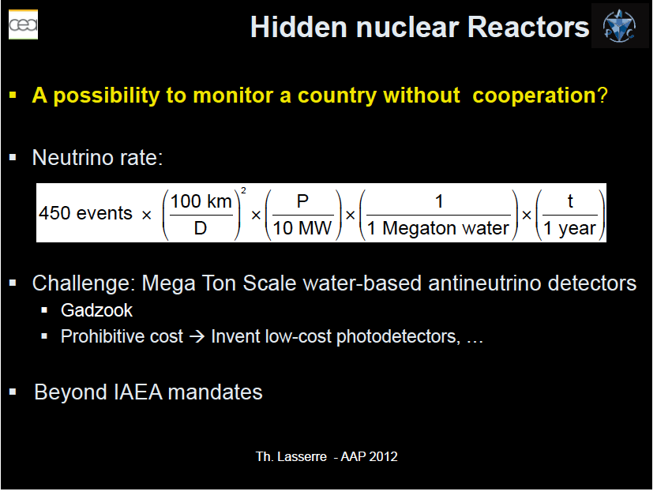

Slide 30
