Slide 1

Quantum Technologies for Neutrino Mass
17 members (and growing)
Determination of Neutrino Mass with Quantum Technologies
A collaboration of particle, atomic and solid state physicists, electronics engineers and quantum sensor experts
PPTAP Workshop
Cyberspace
3 June 2021
Ruben Saakyan (UCL)

Slide 2
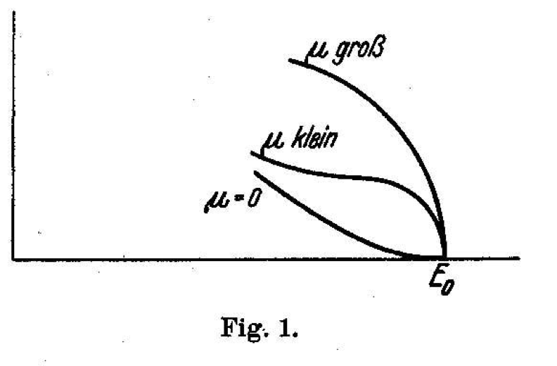
Neutrino oscillations
m_{v} ≠ 0
Window to New Physics
Absolute mass not known
complementarity of cosmological observations and laboratory measurements
Model independent measurement: electron spectrum near end-point of 𝝱-decay
E. Fermi, Z. Phys. 88 (1934) 161
Old idea!
Current upper limit, < 0.8 eV (KATRIN)
Lower bound (from 𝜈-oscillations) > 0.009 eV (!)
Requires a ”quantum leap” in technology

Slide 3
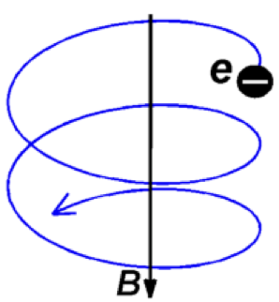
Challenges:
Atomic tritium
Sub fW power
< 1ppm resolution
Cyclotron Radiation Emission Spectroscopy (CRES)
Goal: To build on recent investment in quantum sensors to assess feasibility of an experiment capable of a positive neutrino mass measurement from ³H 𝞫-decay using CRES technology.

Slide 4

QTNM is funded for 3 years under the UKRI QTFP Programme
The aim is to build CRES Demonstration Apparatus, CRESDA, based on Deuterium-atoms but “Tritium-ready”
CRESDA
D/T atomic source
D/T atoms cooling and confinement
D/T atoms as quantum sensors for 3D B-field uniformity mapping at ≤ 0.1ppm
Quantum-limited systems for microwave radiation detection
Trap simulations, CRES signal modelling, Sensitivity and scale-up studies

Slide 5
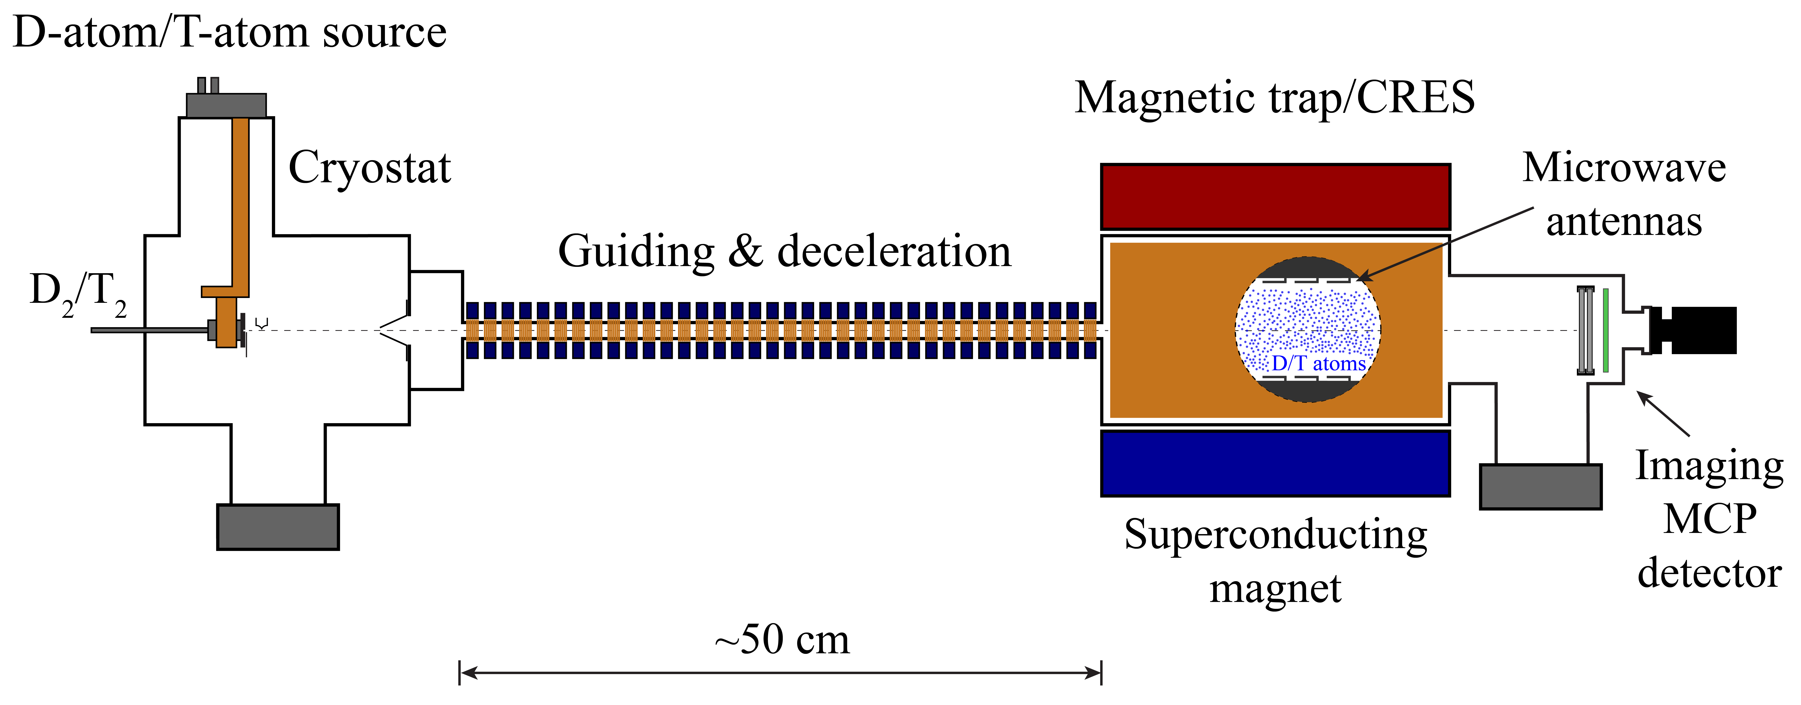
CRESDA. Atomic Source and Atom Confinement.
Extensive characterisation of confined atoms (density, velocity distributions…)
B-field mapping with ≤ 0.1ppm using D/T-atoms as quantum sensors
D₂/T₂ background characterisation
A number of designs under consideration
1L CRES region with 𝝆~10¹²-10¹⁴ cm⁻³.
Initially operate with D-atoms, tritium ready.

Slide 6
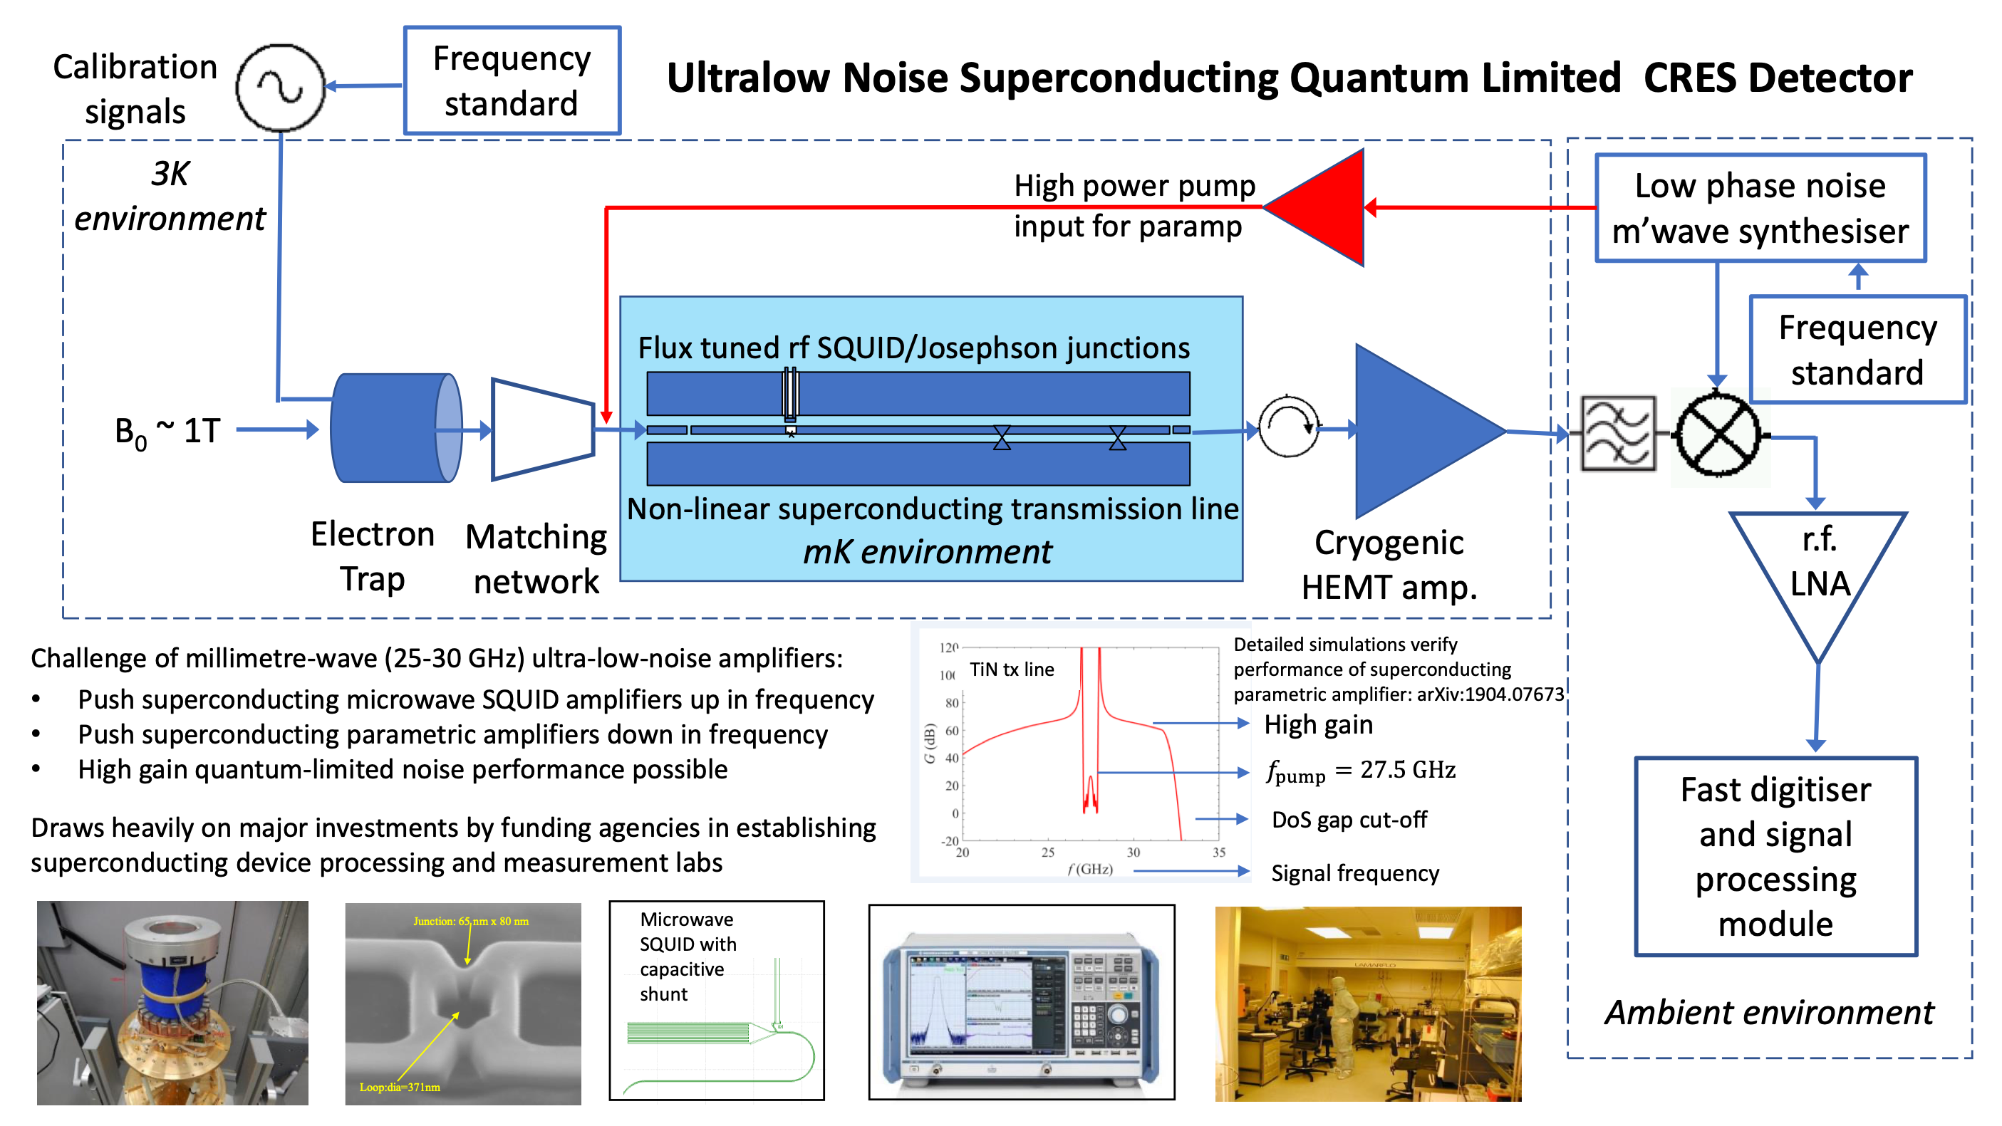
CRESDA. Quantum MW-Spectrometer.
MW signal
Antennas
SQUID or JTWPA preamp
HEMT amp

Slide 7
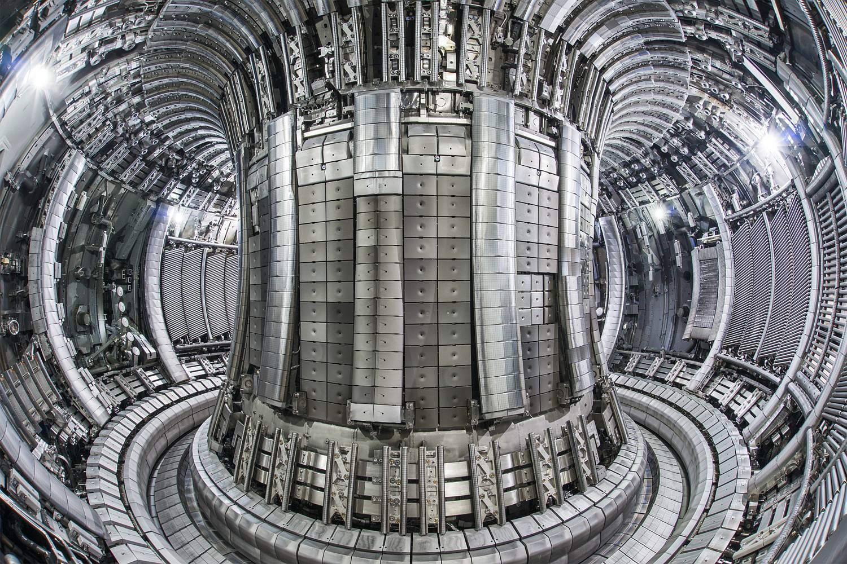
QTNM Future Outlook
A (VERY) tentative timeline
Current project: 2021-2024
  Technology demonstration with Deuterium which is Tritium ready
Next step. 2025-2029
  Moving CRESDA to a Tritium facility (strong engagement with Culham)
  Tritium phase demonstration
  O(eV) sensitivity
”Ultimate” international project > 2029
  Consolidate technological breakthroughs (QTNM, Project-8, …) to build and operate a detector with a phased sensitivity: 100 meV ⇨ 50 meV ⇨ 10 meV plus sterile neutrino programme

