Slide 1
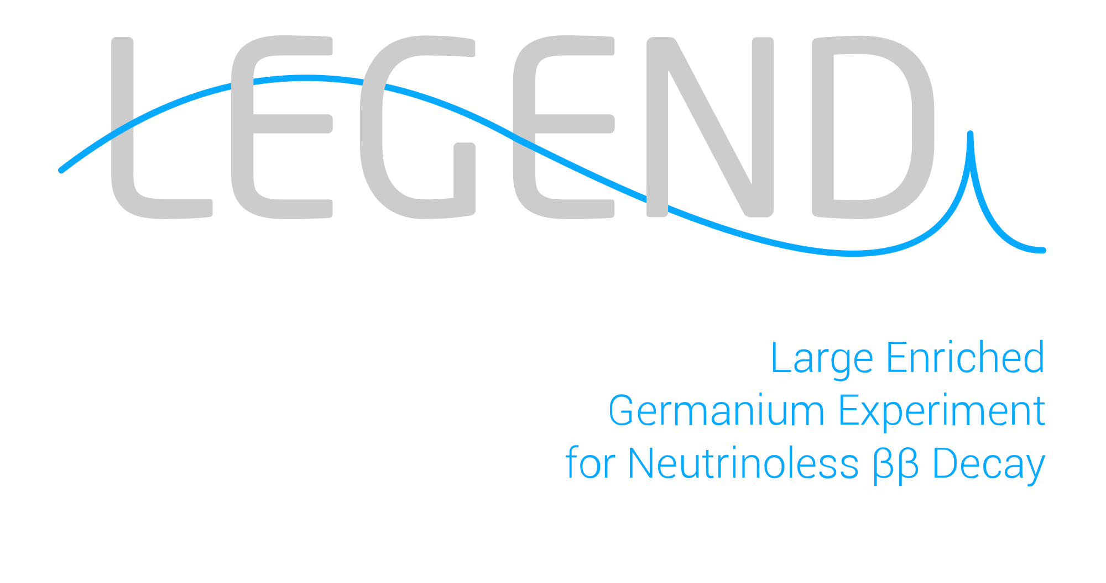
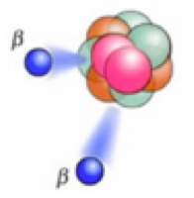
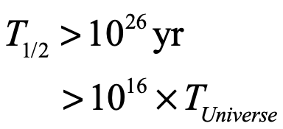
Project:
LEGEND
Supervisor: Ruben Saakyan
Big Questions of Modern Particle Physics
Preponderance of Matter
Origin of Neutrino masses
Lepton Number Violation
Neutrinoless Double Beta Decay
0𝞶𝞫𝞫
Experimental Signature
B=2
L=0
B=2
L=2
Matter
Creation!
E_{e1} + E_{e2} = Q_{ββ}

Slide 2
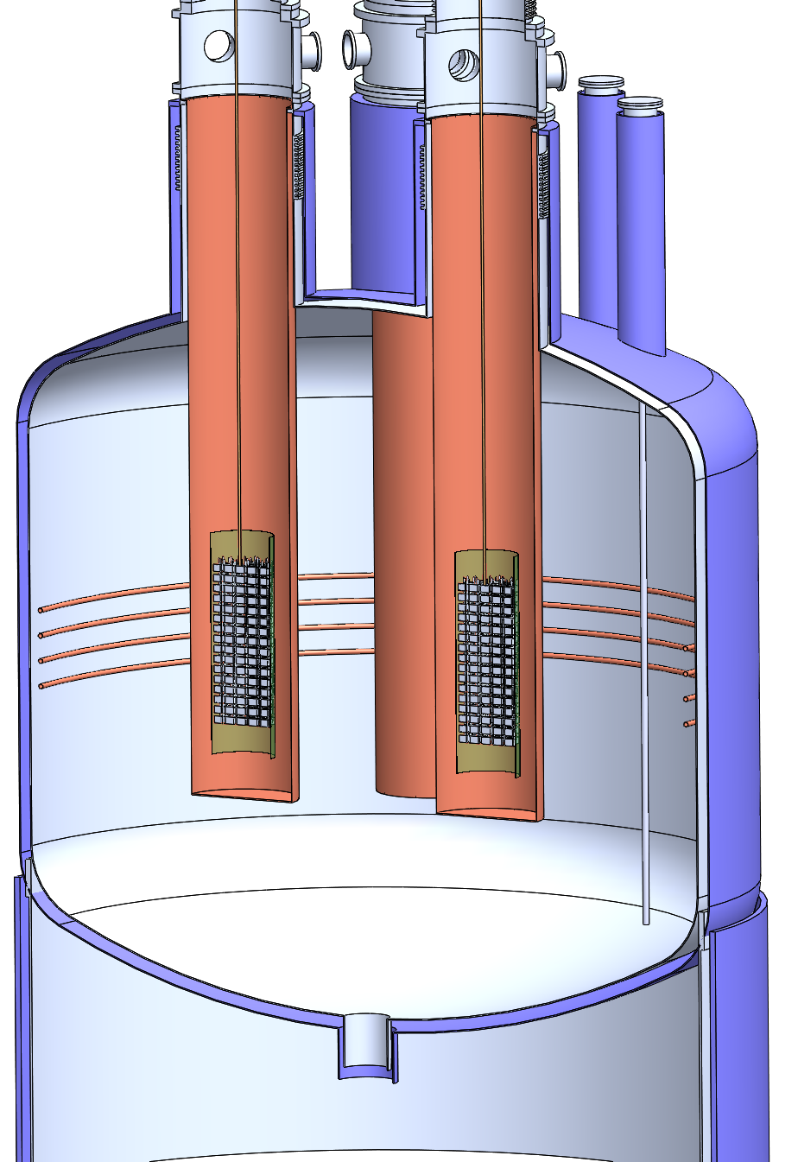

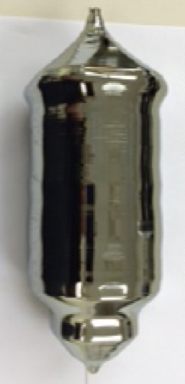


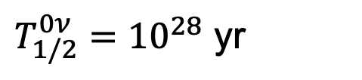
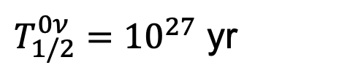
Enriched HP⁷⁶Ge detectors in Liquid Argon
a discovery-oriented approach due to unique energy resolution and recent breakthroughs in detector technology
Phased Approach
PhD project will involve:
LEGEND-200 (200kg of ⁷⁶Ge) at Gran Sasso
L200 Data Analysis
Focus on 0𝞶𝞫𝞫 and ⁴²Ar background
Ultra-low background technology development
L1000 Detector R&D
Commissioning 2021. Physics data taking starts autumn 2021.
Run for 5-7 years for 3𝞂 discovery at
$T_{1/2}^{0ν}={10}^{27}$ yr
LEGEND-1000 (1000kg of ⁷⁶Ge). Location TBD.
R&D and Design ongoing. Funding decision in 2022.
Happy to talk further, Tue-Wed, 23/24 Feb 16:30 – 17:30
10 t yr exposure for 3𝞂 discovery at
$T_{1/2}^{0ν}={10}^{28}$ yr
Zoom link

