Slide 1
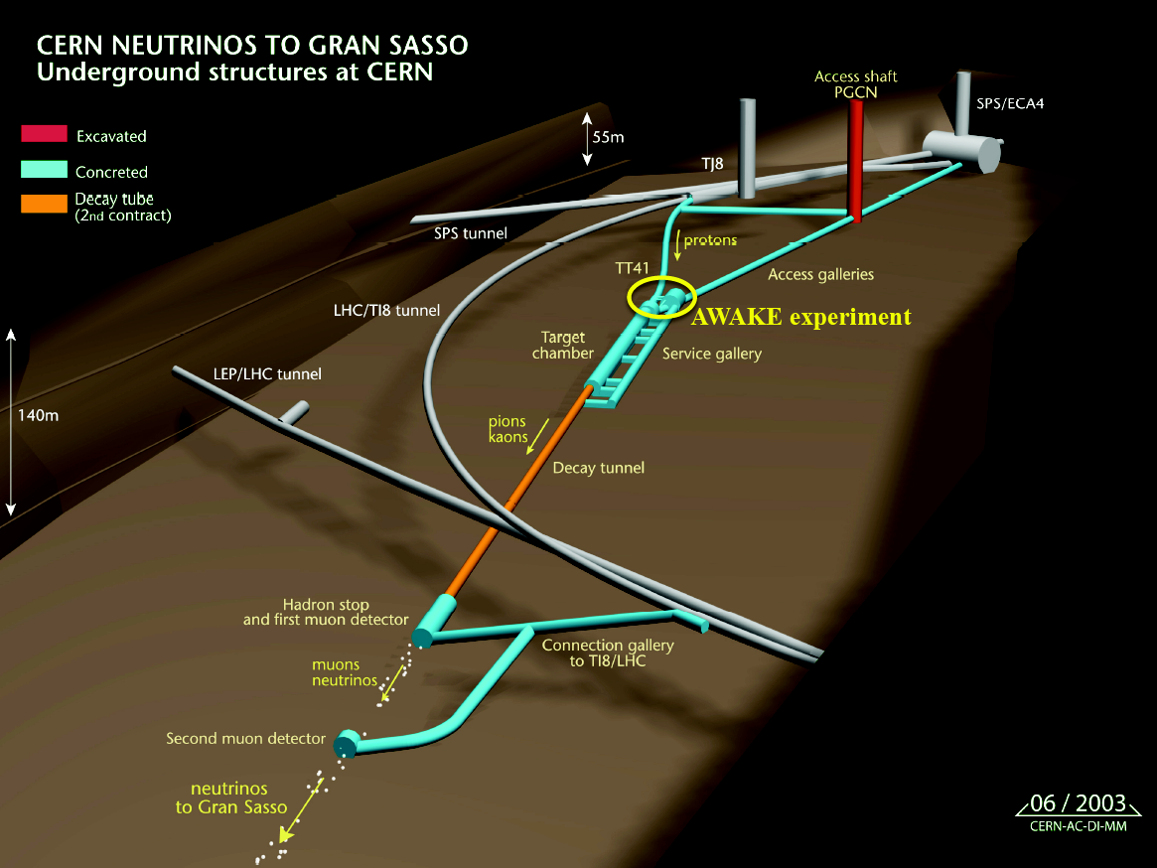
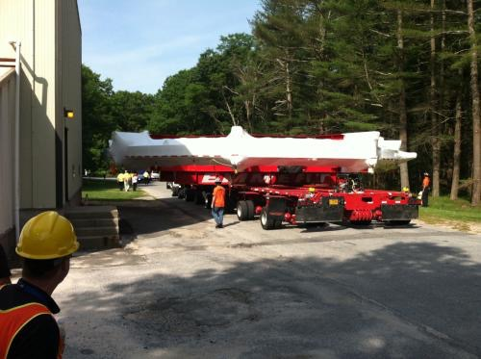
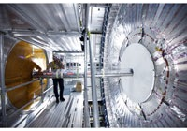
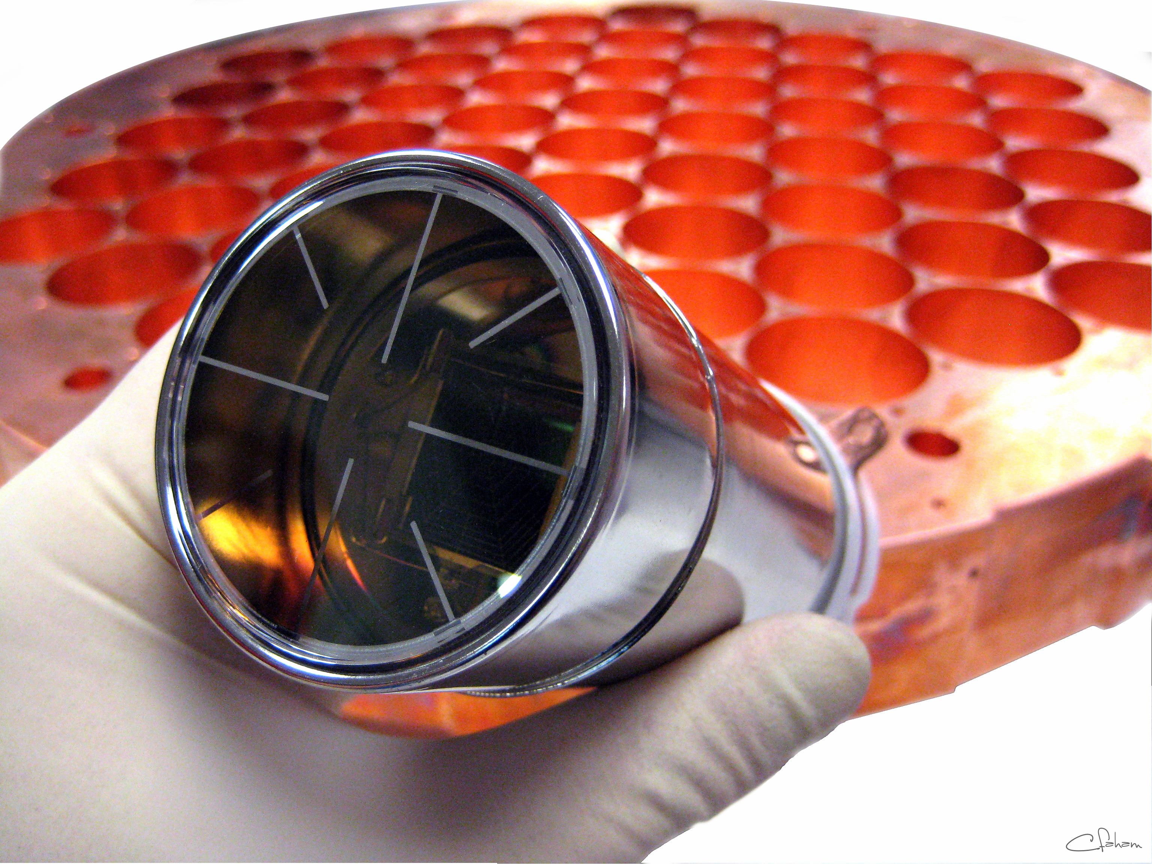
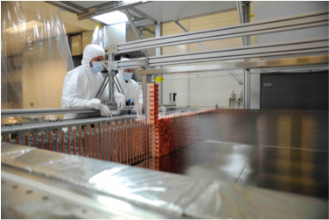
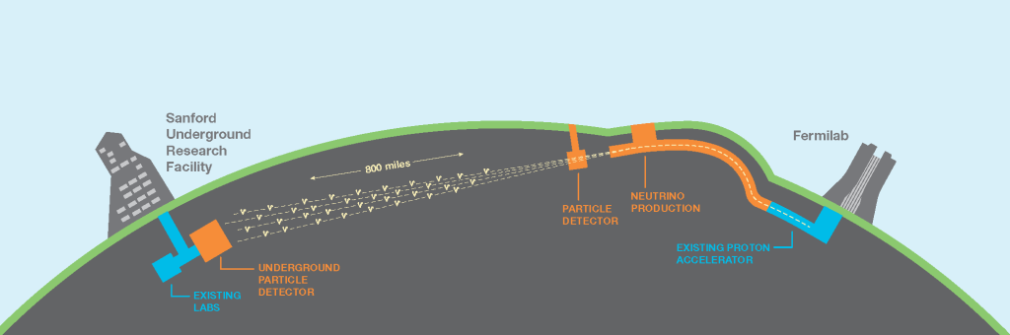
HEP — High Energy Physics (aka Particle Physics)
One of the largest groups in the country:
  50 academics, research and technical staff, ~40 PhD students (and counting!)
2 International Spokespersons, 1 Deputy Spokesperson, 4 UK PIs
Engineers providing critically important support for our physics programme
Close collaboration with other departments: MSSL, Med. Physics

Slide 2
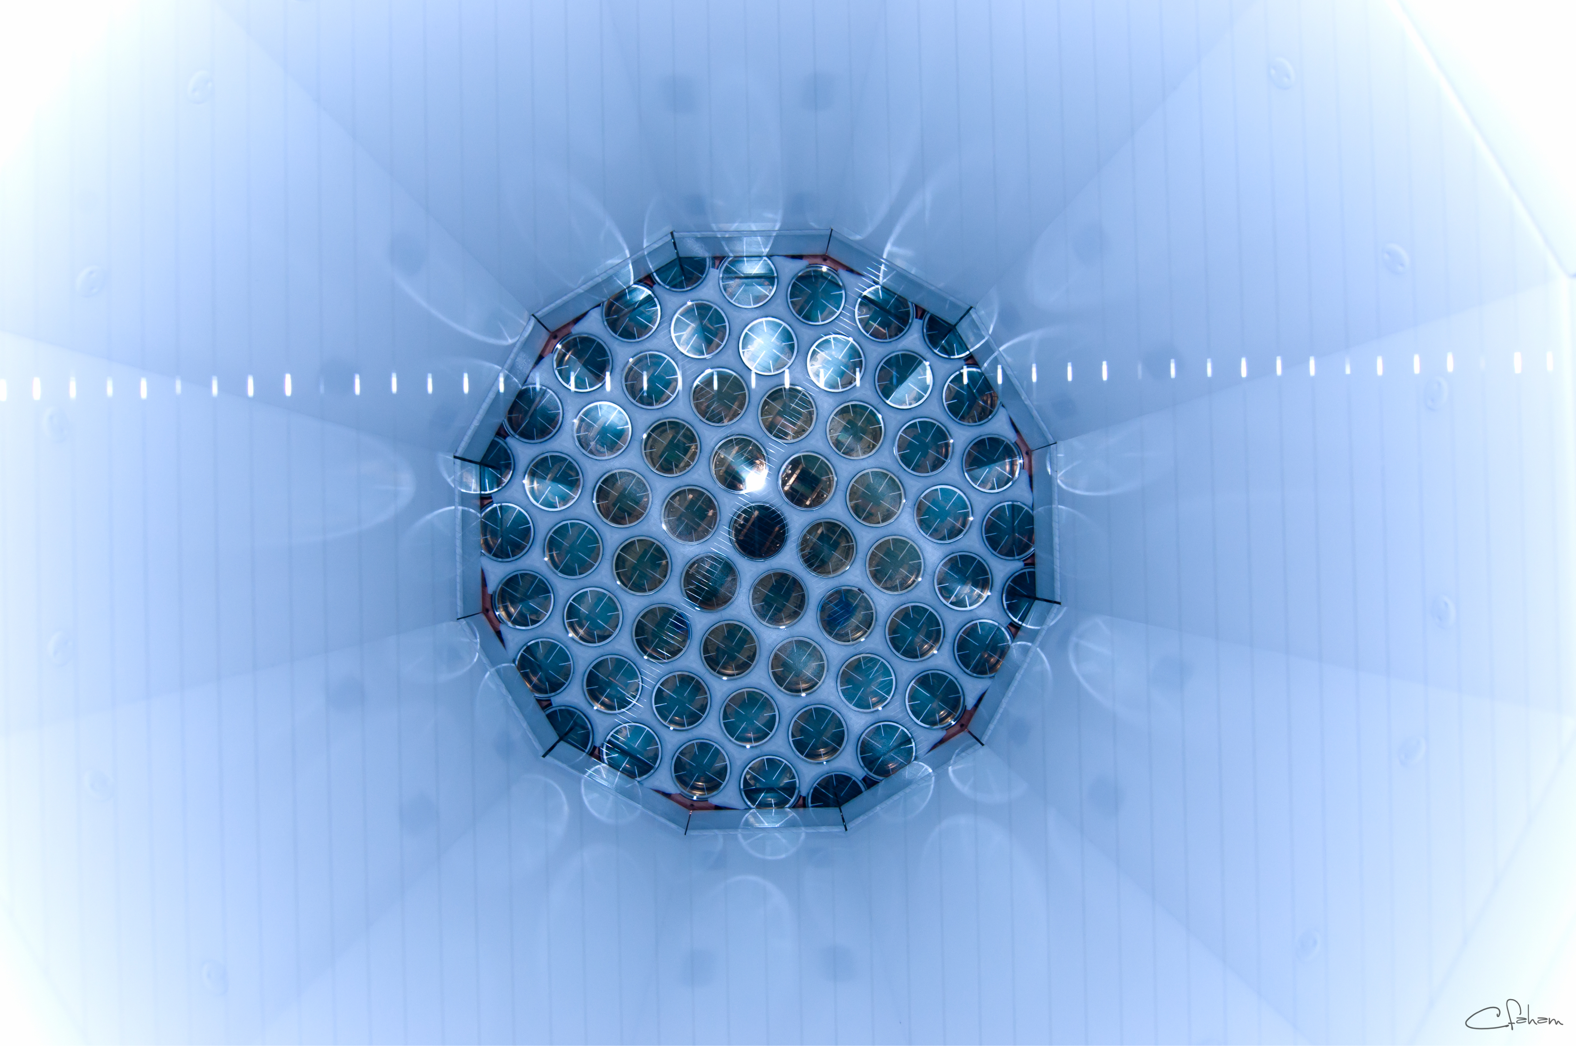
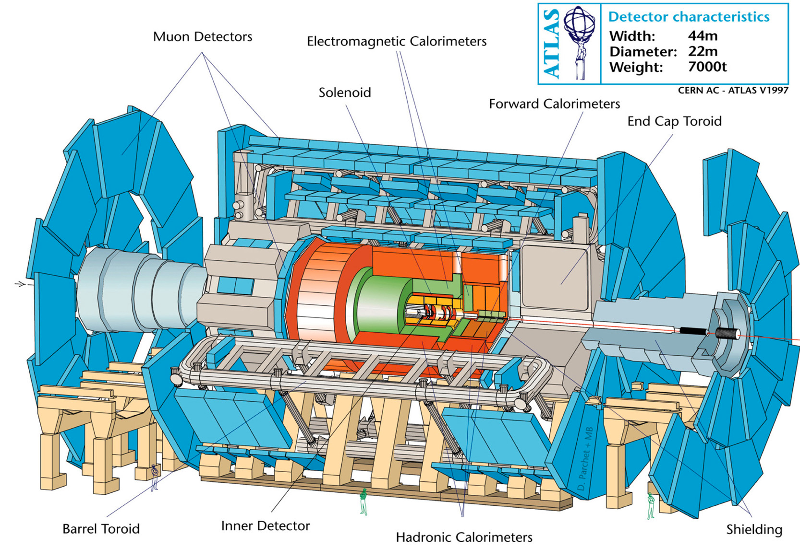
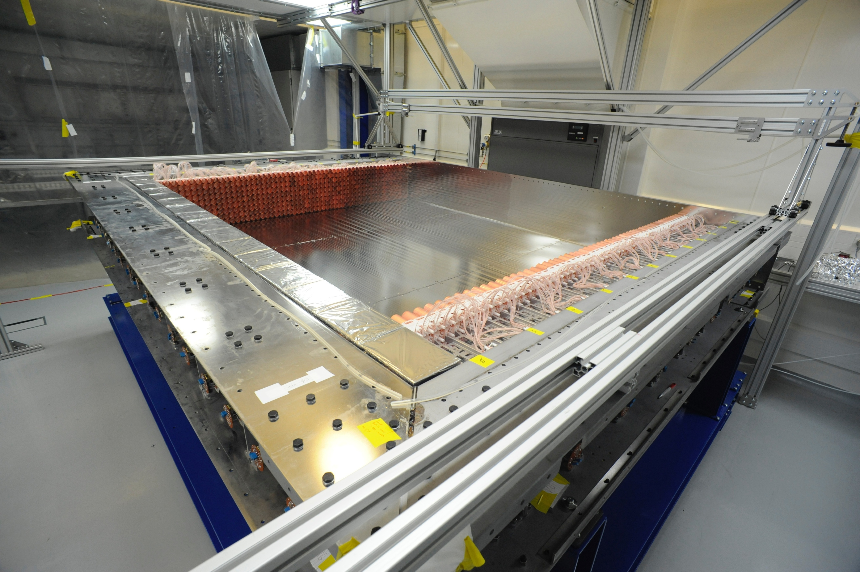
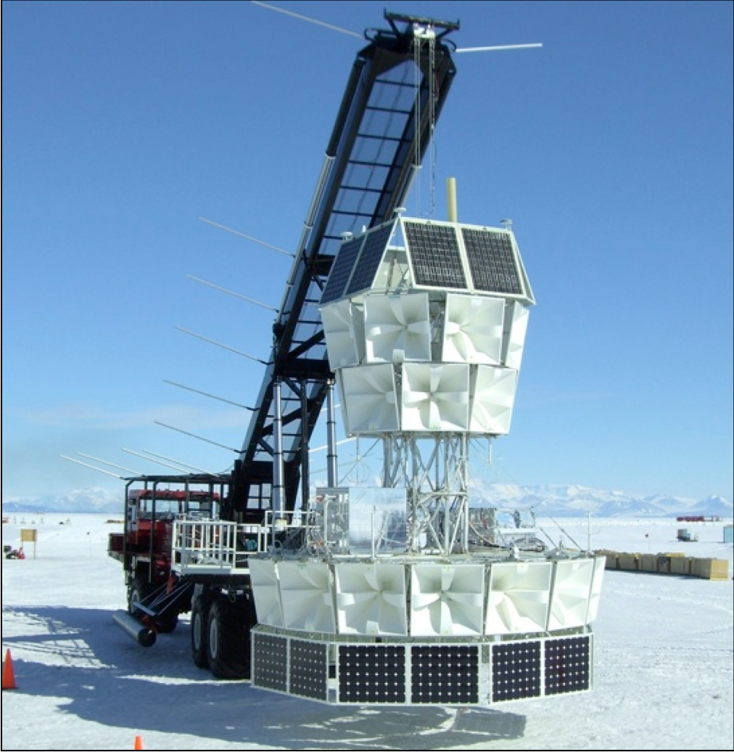
HEP Research
http://www.hep.ucl.ac.uk/
Energy Frontier with ATLAS at LHC
Neutrino Oscillations with NOVA, DUNE and CHIPS (MINOS legacy!)
Neutrinoless Double Beta Decay with SuperNEMO
Muon Physics: Magnetic moment (FNAL g-2); Charged Lepton Flavour violation (Mu2e, Mu3e)
Direct detection of dark matter with LZ experiment
Ultra High Energy neutrinos at South Pole (ANITA/ARA)
Theoretical studies of strong interactions, QCD, and physics beyond the standard model
Novel accelerator technologies, AWAKE
Novel DAQ (Data Acquisition) approaches inside and outside of particle physics
Developing novel instrumentation for future experiments and their applications in proton cancer therapy and muon tomography
Weak Measurements in Quantum Mechanics
Data Science for HEP, industry and medicine

