Slide 1
ABC130 reception tests
Bruce Gallop et al

Slide 2
Test setup
HSIO (the tried and tested DAQ board)
Generates/receives
LVDS fast signals
CMOS levels
Driver board
FPGA with persistent program
Can change signals as well
Small (fast to program)
Translate levels from LVDS to SLVS used by chip
Single chip card
Passive components + ABC130

Slide 3
Diced chips

Slide 4
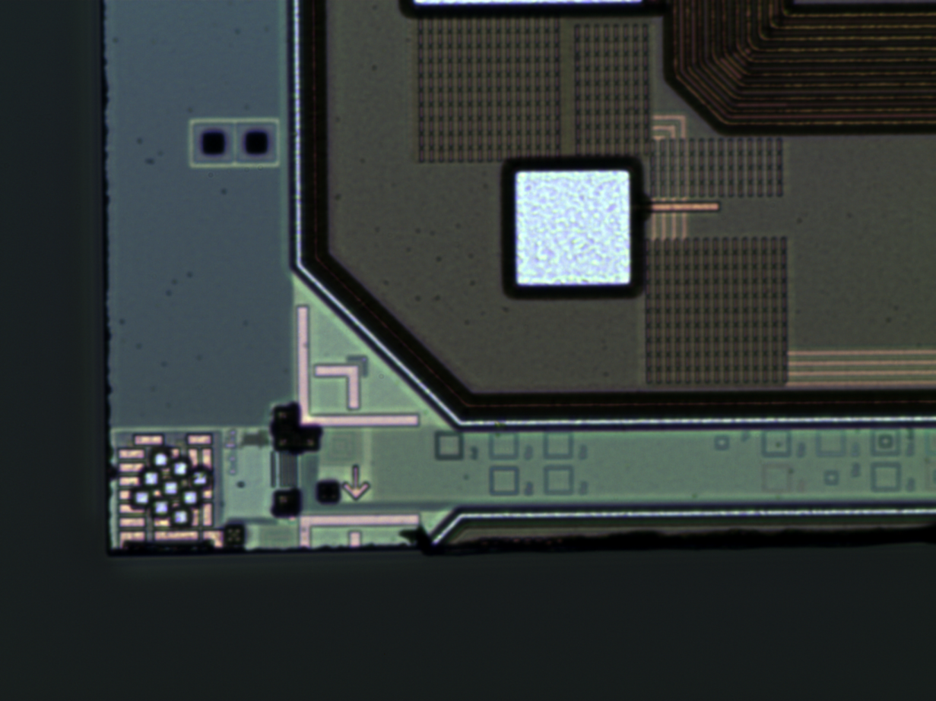
Dicing detail
Dicing not quite as
expected
Optimised for
TDC chip yield
To detriment of ABC130
Was another ABC130

Slide 5
One chip on a test board

Slide 6
Driver board

Slide 7
Driver + single chip board at RAL

Slide 8
Successes
Turn power on
See currents (changes with clocks etc)
Regulated voltage
Send commands to chip
Correct de-multiplexing from L0
Set registers
The preamp current – Changes current draw (30-38mA)
Direction bit – Changes from 0 to X
Drive currents – Changes voltage swing
Regulator voltage control
Responds only when addressed by correct ID

Slide 9
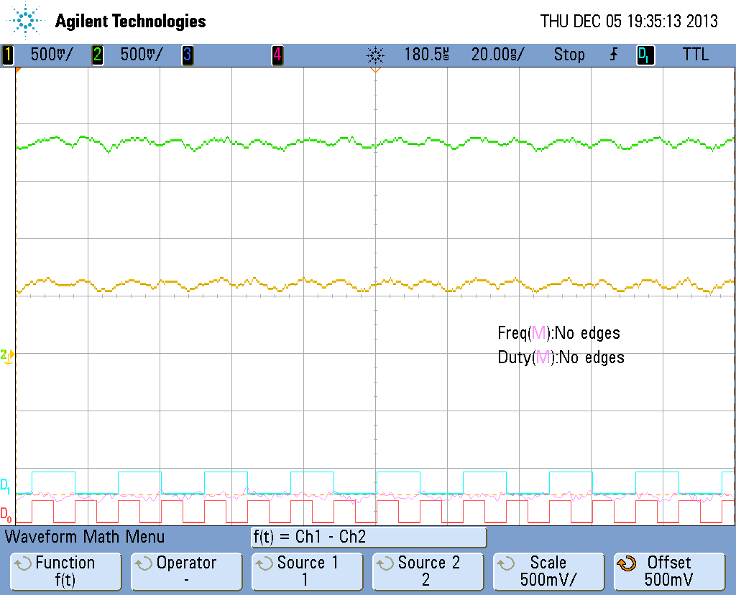
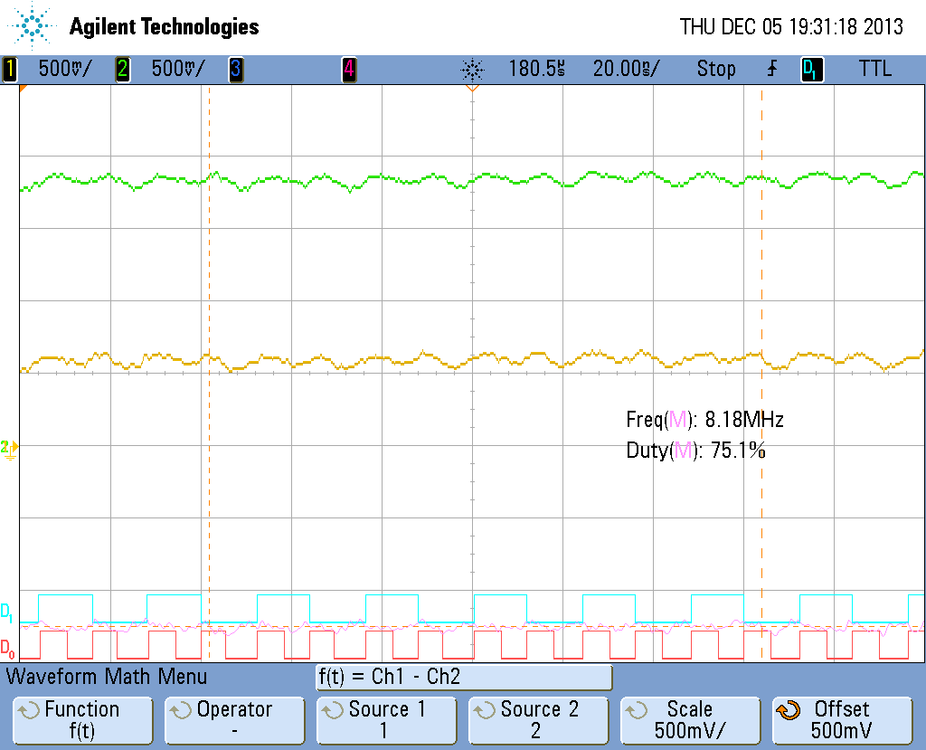
Powering
Offset from gnd for SLVS signals
Regulator output voltages
VDDD
VDDA
GND
GND

Slide 10
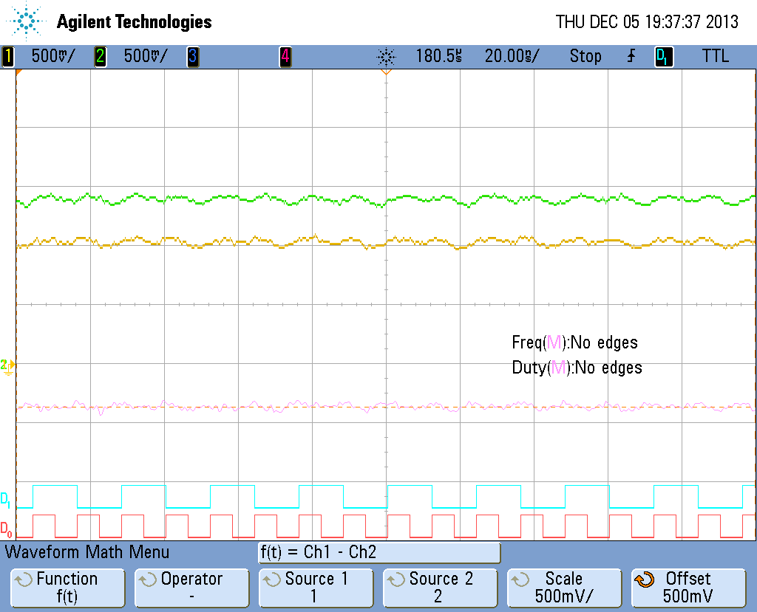
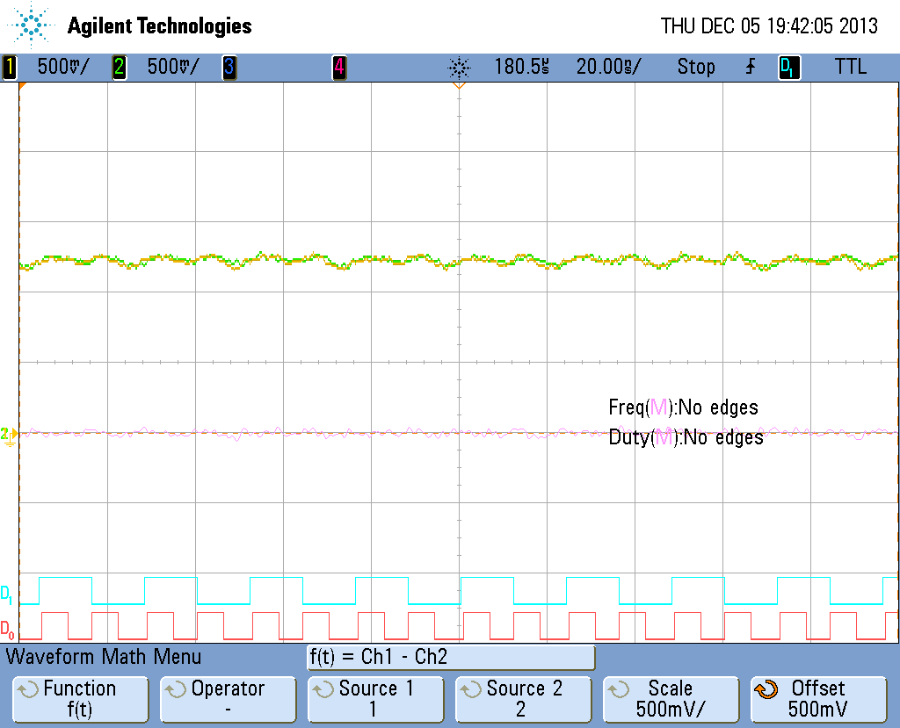
Bidirectional signals
Left, with dir = 0
XOFF
DATA
“0”
Not driven

Slide 11
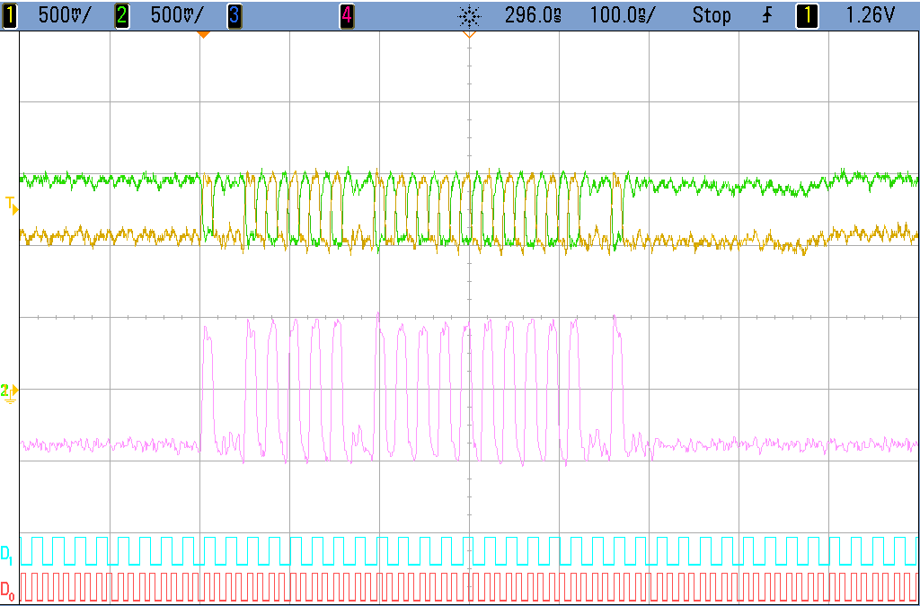
Send command
Multiplex L0 and COM (40 into 80)
Read register 0x20
Header Type HCC ABC Reg Read
1 0 1 1 1 1 1 0 1 1 1 1 1 1 1 1 1 1 0 1 0 0 0 0 0 0

Slide 12
Unfortunately…
We don’t see data on the data line
Seems to be driving a constant 0

Slide 13
What we’ve tried
Turn on clocks
Turn on regulators
Send command to turn on output FIFOs
Without which no data is expected
Send command which generates data
Read register (two varieties)
R3
L1
Data from neighbour
Each have different FIFOs

Slide 14
Multiplexer
Write Reg 0x7 = 0x4010
(Preamp)
0 = 26mV
4 = 31
8 = 36
12 = 41
16 = 46
20 = 51
24 = 56
28 = 61
31 = 65
<- With scope
Redo with DVM
0 = 56
31 = 96

Slide 15
Other channels
Channel 6: 678mV VCS (nominal 900)
Channel 7: 751mV VCD (nominal 600)
Channel 8: 756mV VCSP (nominal 600)
Channel 9: 309mV VBASE (nominal 500)
Channel 10: 279mV VB (nominal 450)
Channel 11: 37mV VBG (nominal 592)
Oops, testres is wrong

Slide 16
Fix band gap voltage
Disconnect testres from driver board
6: 678
7: 748mV
8: 753
9: 309
10: 280
11: 620mV

Slide 17
Scan Test data
Set scan enable
Bit pattern comes out of SDO
Longer pattern on BC chain (as expected)
Data clock scan chain (at least the part with 1s in it) is short enough that it’s easy to see changes directly on the scope
Can also capture on on HSIO
Things that have an effect
Read out (L1, R3, reg), all change same bit
Data direction
XOFF

