Slide 1
ABCN 130 nm Discussion
Overview of the list of activities toward a first version of ABCN in 130nm
Slides for specific domains (in black) :
Front-End
RAM design
Data and Command format
DCDC implementation
The way to progress (milestones etc…)

Slide 2
ABCN 130 nm Discussion
End 2010
Mid 2011
End 2011
Mid 2012
Obtain Protos
FE design
DC/DC and SP
SEU Logic
RAM SEU
test
TESTS
Protos
results
FE specs
Data format specs
Obtain
RAM block
DESIGN
ABCN full verilog code
Submission

Slide 3
ABCN 130 nm Design Tasks
Element | Work 1 | Institute/person | Time period | Condition
FE redesign | Redesign | Jan | Q2 2011 | According to specs
FE Bias/DAC & layout | Bias/DAC & layout | Jan + ? | Q3 2011
RAM blocks | RAM generator | CERN/ME | Q3 2011
RAM blocks | test |  | Q3 2011 | SEU test
RAM control | Verilog code | Francis | Q3 2011
Command Decoder | Verilog code | Francis | Q3 2011
Data Compression Logic | Verilog code | Daniel/Geneva | Q3 2011
Readout Logic | Verilog code |  | Q4 2011
Verilog code | Verilog code |  | Q1 2012 | + 3 months min

Slide 4
ABCN 130 nm Design Tasks
Element | Work 1 | Institute/person | Time period | Condition
I/O parameters | Spice simulation + bidirectional design | Mitch/PENN
Readout data format | Specification | Strips readout group | End March 2011 | Include L0/L1 preview Y Freeze at Oxford AUW
CD data format | Specification | Strips readout group | End March 2011 | Include L0/L1 preview Y Freeze at Oxford AUW
All digital | P&R | Krakow/CERN | 1st semester 2012 | Krzysztof + ?
Final chip | layout assembly | Krakow/CERN | 1st semester 2012 | Krzysztof + ?

Slide 5
ABCN 130 nm : Module Controller Chip
Element | Work 1 | Institute/person | Time period | Condition
MCC | Verilog model |  |  | To check with the ABCN data format definition
MCC | Specification/Design | PENN |  | Compatibility to GBT

Slide 6
ABCN 130 nm :
130nm Front-end (J. Kaplon)
Gain 100mV/fC
Linear range 4fC (saturation at 6fC)
Peaking time 22ns
Current consumption of the front end channel; Iinput+80uA (Iinput = 100-160uA)
Power consumption (1.2V supply); 220 – 290uW / channel

Slide 7
ABCN 130 nm :
130nm Front-end (J. Kaplon)
Channel 22um x 700um
Chip width;
channels; 256 x 22um = 5.6mm
bias + decoupling; 500um
Pads; 600um
DACs + bandgap; 500um?
Total; 7.2mm → two questions to module:
Is it OK?
How much we can increase (if necessary) this number?

Slide 8
ABCN 130 nm :
130nm Front-end (Barrel layout proposal, UK, Geneva, KEK)
Max width 7.5 mm
Would like only FE on top edge
Data, clock, command on sides
Maximizing spacing between pairs, no redunancy
Ground, power and chip ID on bottom
FE bonds only (4 rows of 64)
Token and Data (2 pairs)
Token and Data (2 pairs)
BCO, L1, Com, Clk, Reset (5 pairs)
Ground, Power, Chip ID
7.5 mm

Slide 9
ABCN 130 nm :
130nm Front-end (Barrel layout proposal, UK, Geneva, KEK)
Would like FE bond pads to take full width of ASIC
Ground pads if needed below FE connections
Ground pads would have to bond to the side, use same pad shape as for BE
Would like ~50x200 μm pads with 100 μm spacing between rows
200 μm
100 μm
1100 μm
Ground (if needed)

Slide 10
ABCN 130 nm : RAM
RAM cell (2.2x2.5um²) and RAM generator design work is currently started in PH/ME (C. Paillard + student, not specific to ATLAS)
Best case availability : Summer 2011, 256x256 block
1st version does not include ECC (ECC may be needed for long latency time as in L0/L1 architecture)
Support from experiments welcome for TID/SEU radiation tests (Summer 2011) Availability best case : Summer 2011
We will build regular contacts with PH/ME to understand specifications and progress, tests to be carried on

Slide 11
ABCN 130 nm : Digital Functions
Covers HDL description for RAM control, DCL, Readout
(Missing) one person for building the code for the new readout part
(Missing) one person for building the code for the L0/L1 inclusion
Specifications of readout and commands formats should be completed soon → should include L0/L1 format requirements
Aim is to have a complete chip verilog description Q1 2012
Data format specifications should be frozen at end of March 2011 (AUW)

Slide 12
ABCN 130 nm : Digital Functions
Header
Data
Header
Data
Header
Data
N Fixed size data packet
1 chip
Next chip
No need of Data concat. Btw. chips | No Constraint btw.chips
Multiply nbe of headers | Occupies BW

Slide 13
ABCN 130 nm : Digital Functions
Trigger command with L0/L1 capability
L0₁
L0₂
R3₁
R3₂
L1₁
L0ID₁
L1₂
L0ID₂
Fixed Latency
Geographical ID
No fixed Latency
Time ID
0.4-1MHz rate
40-100KHz rate
Data content with L0/L1 capability
Ty
pe
L0ID
Event
ERC
L0 or L1 or Control Data or DCS Data

Slide 14
ABCN 130 nm : Digital Functions
Additional time estimated for L0/L1 : + 3 months at best (depending on complexity and availability of RAM generator)
R3 latency (3us ?)
L1 latency and Event Buffer
Missing resource
Pipeline
L1 buffer (AddressableMemory)
WA
RA
WA
RA
PE
DCL
SER
BC
L0
R3
WAcalc
RAcalc
L0
Mem
W
R
@BC : WA=WA+1
@L0: RA=WA-Nlat
L0ID
L1
Match
RR
R
ROL
L0ID
Mem
L0
W
Missing resource
L0ID gen

Slide 15
ABCN 130 nm : Module Controller
The verilog code of the MC (FPGA, ASIC) should be build at the same time as the readout code is written for ABCN130 to verify data transmission compatibility
Also the compatibility with the GBT E-link has to be defined and verified (clock in & clock out frequencies, etc …)

Slide 16
Decisions Procedure
Specifications for Front-End (detector segmentation & hybrid experts) : Target AUW 2011.
Specification for CD and Data Format : Strips Architecture working group. Target AUW 2011.

Slide 17
Milestones
End 2010
Mid 2011
End 2011
Mid 2012
Obtain Protos
FE design
DC/DC and SP
SEU Logic
RAM SEU
test
TESTS
Protos
results
FE specs
Data format specs
Obtain
RAM block
DESIGN
ABCN full verilog code
Submission

Slide 18
Resources Issue
Missing resources :
One digital designer for the readout part of ABCN 130
One digital designer for the L0/L1 implementation
One part time effort for MCC specifications fixing

Slide 19
Backup Slides

Slide 20
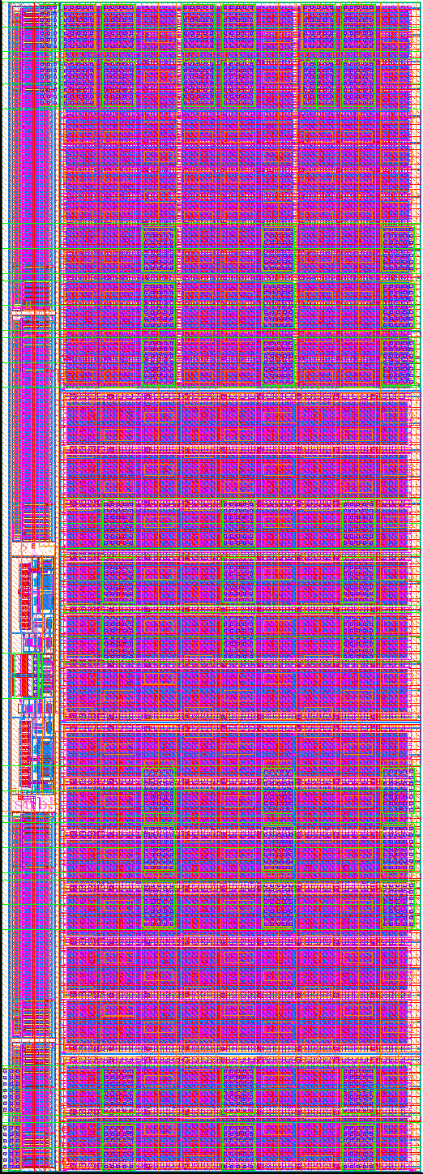
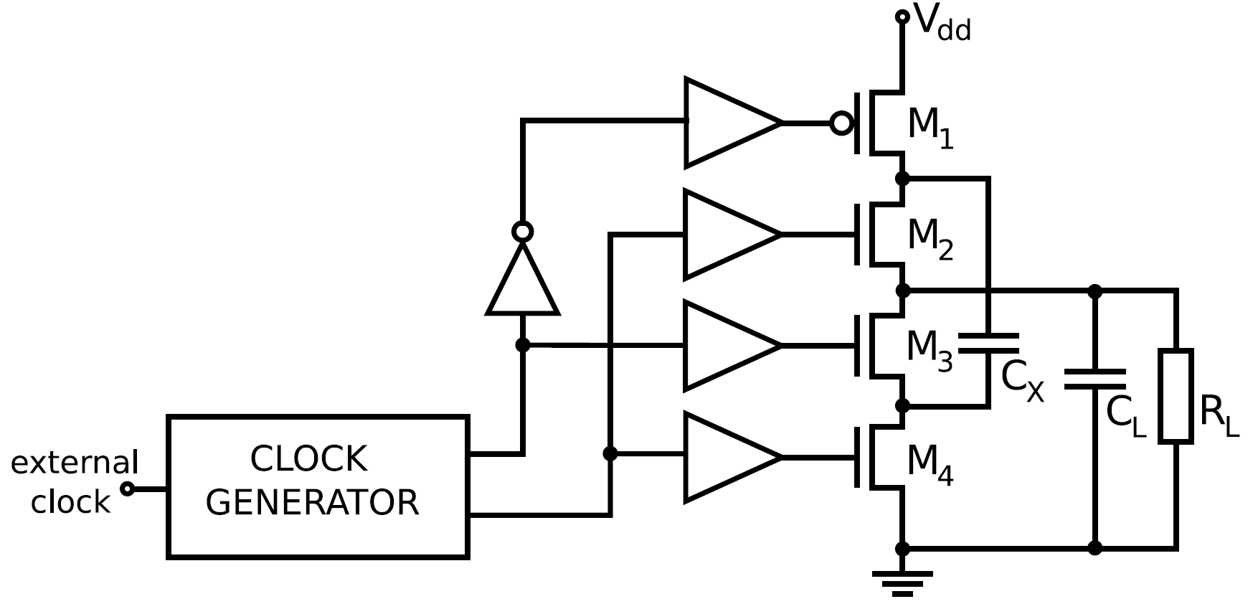
ABCN 130 nm : Where we are
M1 Buffer
M1 (PFET)
28.2mm / 0.24μm
V_{DD} = 1.9 V
V_{OUT} = 926 mV
I_{OUT} = 60 mA
C_{X} = 1000 nF
C_{L} = 200 nF
f = 1 MHz
Power
Efficiency
= 97%
(including all circuitry)
M2 Buffer
M2 (NFET)
18.0mm / 0.30μm
Clock Gen
M3 (NFET)
18.0mm / 0.30μm
M3 Buffer
Step-up converter design
M. Bochenek
M4 Buffer
M4 (NFET)
6.0mm / 0.30μm

Slide 21
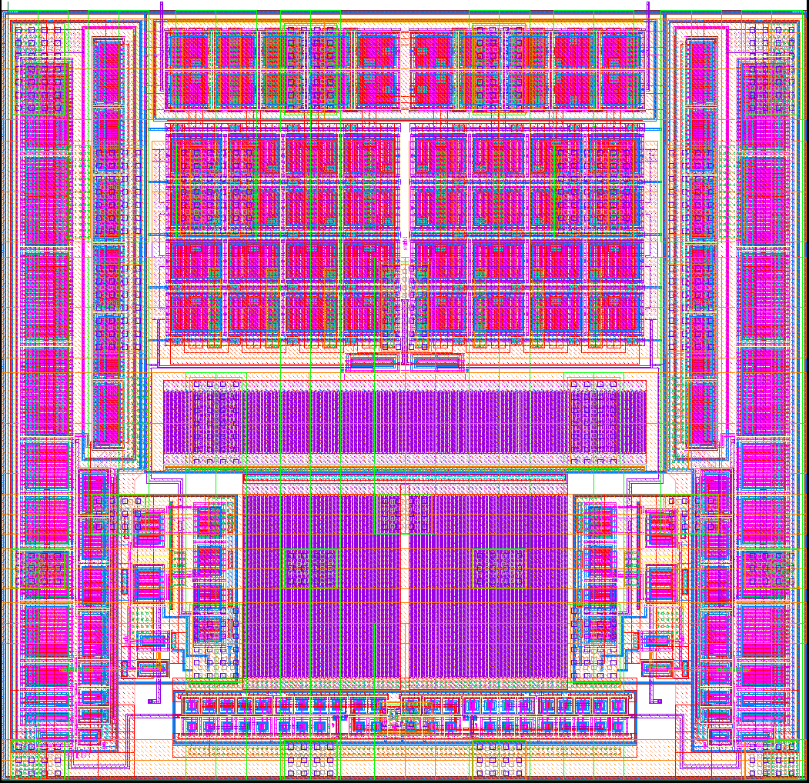
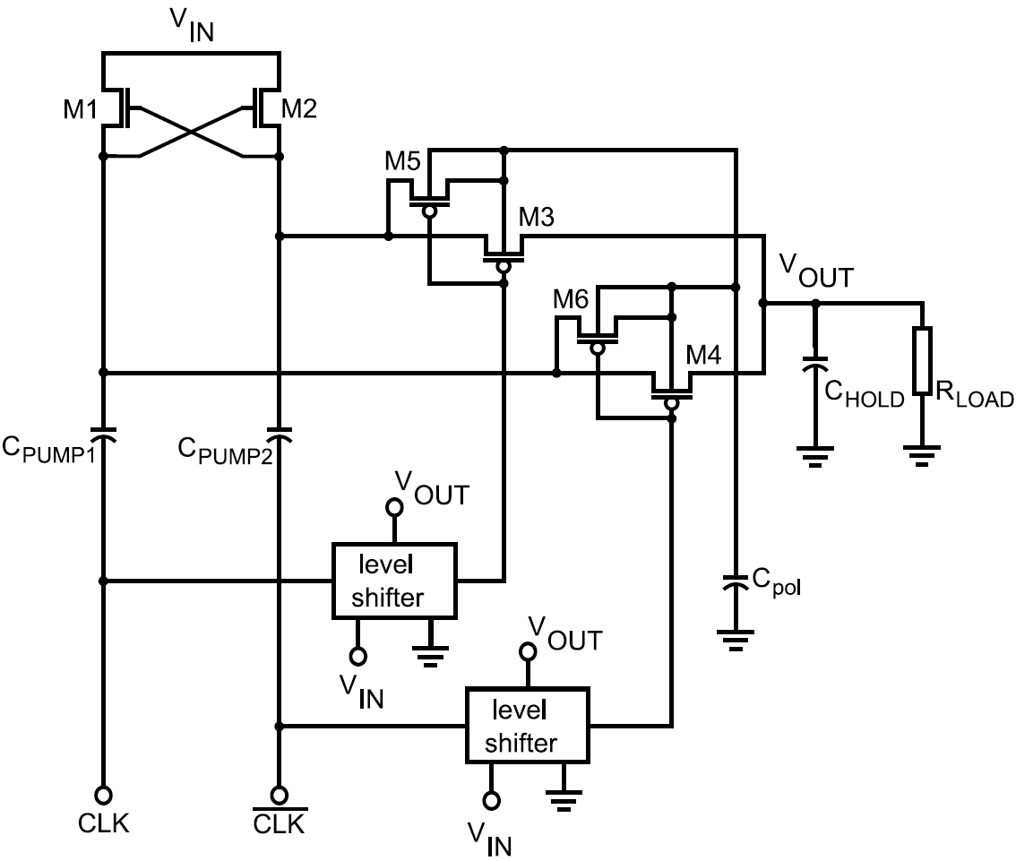
ABCN 130 nm : Where we are
V_{DD} = 0.9 V C_{PUMP} = 470 nF
V_{OUT} = 1.55 V C_{LOAD} = 470 nF
I_{OUT} = 32 mA f = 500 kHz
M1 (NFET)
980μm / 0.24μm
M2 (NFET)
980μm / 0.24μm
M4 (PFET)
2000μm / 0.24μm
M3 (PFET)
2000μm / 0.24μm
Power
Efficiency
= 85%
(including all circuitry)
Buffer 1
Buffer 2
Level
Shifter
Level
Shifter
Clock Generator
Total area = 0.04 mm²
(200 x 190 μm²)
Step-up converter design
M. Bochenek
21

Slide 22
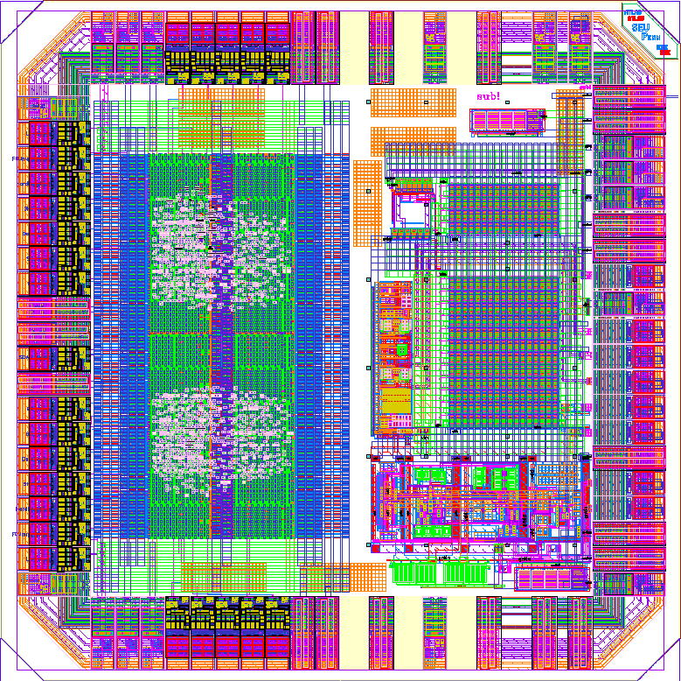
ABCN 130 nm : Where we are (status)
SEU Logic test
RTL exists
Fast Command
decoder
xx-SEU (4 bits, static)
Serial Register
Slow Command
decoder
yy-REGSEU (7 bits, one clk)
yy-SEU (7 bits, static)
Serial Out
SEU Logic part
(F. Anghinolfi,
K. Swientek)
SPP Elements
(M. Newcomer,
N. Dressnandt)

Slide 23
ABCN 130 nm Discussion
Techno: stick to 130nm
256 channels, one sided
Analogue : test of the front-end to be done as soon as it is back (December)
L0: could be skipped for first 130nm version
Radiation hardness: should be implemented
Memory: need to find a good memory block. The one from IBM is not rad hard. Mitch to discuss with a US company. Effort started at CERN PH/ME.
Switched capacitor DC-DC: it should be possible to use the block (prototype block expected in December for tests)
Serial power : elements (shunt transistor) should be implemented
Readout data format: fixed length to be implemented as it is the simplest and that with the new luminosity target it's very likely to be good enough

Slide 24
ABCN-130 : number of channels
256
4.0mm
7.7mm
FE pads
4 rows
1mm x 10.0mm
ABCN 25
Size (same scale)
10.0mm
(7.2mm min)
7.5mm
256 FE channels
Width : 0.7mm
Height : 10.0mm
(7.2 mm min)
22um pitch
Max digital
area
2mm x 10.0mm

Slide 25
Lite ABCN-130 Powering
WE SHOULD ALLOW OPERATION WITH DIGITAL VOLTAGE RANGE FROM 1.5V TO 0.9V (for Lite, incl. on hybrids)
This is justified by :
The SEU cross section is strongly depending on the VDD of registers
The standard cells characterisations are valid from … to … (not know now)
Power consumption optimization vs. other parameters (frequency, voltage margin, digital noise, total dose)
WE SHOULD EVALUATE HOW THIS CONSTRAINT IS AFFECTING THE SERIAL OR DC/DC POWER DISTRIBUTION developments during the prototype phase

Slide 26
256 channel ABCN-130 Powering (Low VDDD)
2.4V
DC-DC
DC/DC
1.2V Analogue (45mA)
1.8V
DC/DC
0.9V Digital (102mA)
1.2V
Analogue (45mA)
Serial
Power 1
Shunt
LDO
0.9V Digital (102mA)
0.9V
Digital (102mA)
Serial
Power 2
Shunt
DC/DC
1.2V Analogue (45mA)

Slide 27
256 channel ABCN-130 Powering (Std VDDD)
2.4V
DC-DC
DC/DC
1.2V Analogue (45mA)
DC/DC
1.2V Digital (102mA)
1.2V
1.2V Digital (102mA)
Serial
Power
Shunt
1.2V Analogue (45mA)
Even in the case of “one source” for analogue and digital, remains the issue of using LDO for analogue power quality

Slide 28
ABCN-130 Data Transmission
Basically 2 mechanisms were under discussion :
Data packets built with data from adjacent chips (data concatenation constraints as for ABCD)
Independent Data packets (per chip, each packet contains its full identifiers) (impact on BW, compatibility with track trigger data, …)
Assumption : due to reduced BW requirement (to be proven) the last schema becomes preferable

Slide 29
ABCN-130 Data Transmission
Data packets built with data from adjacent chips :
With Token (as ABCN now) : timing constraint, workable in 130nm
Xon/Xoff : no token timing constraint, one FIFO and some add. Logic in each chip
tk
FEI
FEI
data
WE
FEI
FEI
data
There are 2 variants, one does not requires WE at each chip (see backup slide)

Slide 30
ABCN-130 Data Transmission
We may use a simple Xon/Xoff mechanism in case of independent data packets (not dependancy on exact chip to chip timing)
The track trigger readout priority is also in favor of the “short” independent data packets method

Slide 31
ABCN-130 REDUNDANCY
In ABCN-25 the redundancy has resulted in :
Adoption of a Bidirectional data flow from chip-to chip (affects only the I/O circuits, very little impact on logic) that I believe we should maintain (free to transmit data either side of a chip to its neighbour or MC)
Dual clock and COM inputs
The main impact is for hybrid design (carry dual clock and COM lines along hybrid)

Slide 32
Schedule
Full description of the (Lite) chip(s) mid of 2011
Floorplan and layout for submission in period in period Q1-Q2 2012
Schedule subject to commitments, should be assessed soon, (also in conjunction with the MC design ?)

Slide 33
Schedule
Now
May 2010
Mid 2011
Mid 2012
FE design
DC/DC and
Regulators
SEU structures
I/Os, DCS ?
Partial HDL code
(ABCN, MC ?)
Submission
(ABCN, MC ?)
RAM block
Test results

Slide 34
Cost estimate and resources
Cost
The projected MPW submission cost is around 30KUSD (3KUSD/mm2)
One Engineering run in 130nm is 405KUSD (2 wafers) + 3.6KUSD/wafer
Resources (manpower)
We should assess them (organisation/institutes) :
Seeking young people
List tasks and distribute
Select appropriate software tools
Organize a dedicated seminar ? (Organization of design team, incl. MCC?)

Slide 35
ABCN 130nm Open Issues
1. Define precisely design resources for 2 next years
Organize a dedicated seminar ? (Specifications, organization of design team, list of tasks)
2. On design elements :
Clarify implementation of blocks for powering
CRITICAL → RAM block development (1 year time frame)
Agreement on readout schema
Simultaneous development of MCC (with interface to GBT) ?
Rad & SEU tolerance

