Slide 1


BCM FPGA Firmware v4 Code/Design Review
Aleš Svetek
J. Stefan Institute, Ljubljana
CERN, 2011-05-05

Slide 2
Agenda
BCM FPGA Main Tasks
Upgrade v3 ➔ v4
BCM FPGA Data Flow
BCM FPGA Firmware v4 Design
FPGA Resource Utilization
Design Status

Slide 3
BCM FPGA main tasks
DAQ of sensor data at 2.56 GHz (64 samples at 390 ps for each BC)
Beam Monitor ➔ Controls Interlocks Beam User (CIBU) , Detector Safety System (DSS) and Post-Mortem Buffer
Luminosity Monitor
TDAQ ROD functionality
CTP triggers
Detector Control System (DCS)

Slide 4
BCM FPGA Firmware Upgrade
On-board (system) MGT synchronization support
Adapt to channel remapping
(8 LG channels ➔ Beam_Abort_ROD)
(8 HG channels ➔ Lumi_ROD)
Redesign Basic Beam Abort Algorithm
Redesign CTP trigger outputs
Integrate Test Vector “play back”
Gb Ethernet (TCP, UDP) – faster Post-Mortem buffer download
Prepare only 1 FPGA firmware, final operation defined by SW

Slide 5
BCM FPGA Data Flow

Slide 6
Why utilize PowerPC 405?
Support GbE UDP and TCP/IP communication
Execute the MGT calibration algorithms
Generate and load MGT test vectors
Startup Built-in Self Test(BIST), DDR and DDR2 RAM
Provide additional debug information

Slide 7
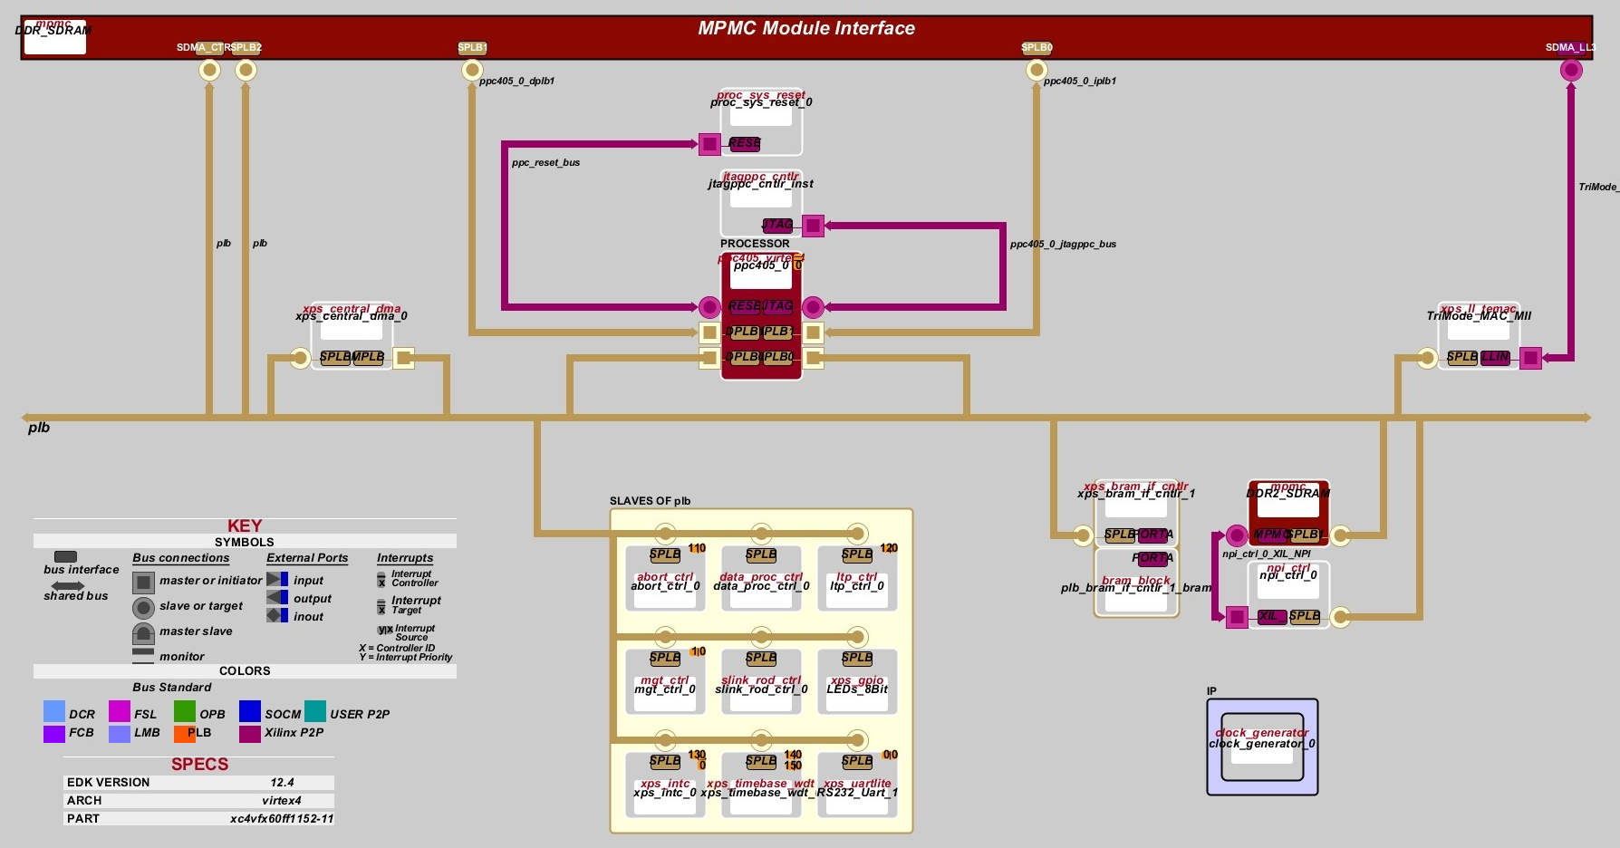
Processor System Architecture
CDC and sync!

Slide 8
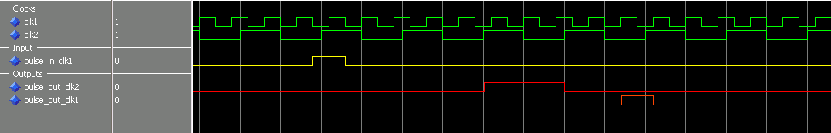
Clock Domain Crossing and Sync.
Edge detector
2-stage synchronizer
Pulse_sync_1_way
Pulse_sync_2_way
(FIFOs)
Pulse_sync_1_way
Datapath sync.

Slide 9
Processor Support Modules
Reset generator (reset sequencing of PPC405, PLB Bus, Peripherals)
Clock generator (1x 300 MHz, 2x 100 MHz, 2x 200 MHz, 1x 50 MHz)
JTAG controller
Interrupt controller (intc)
UART/RS-232
Watchdog timer

Slide 10
Gb Ethernet Communication
Available well-known socket communication APIs
Post-Mortem buffer dump
Startup parameter configuration from OKS
DCS slow control
Syslog daemon channel
Command-line/Telnet interface to PPC (used to read/write to any register, parameter reconfiguration, diagnostics)

Slide 11
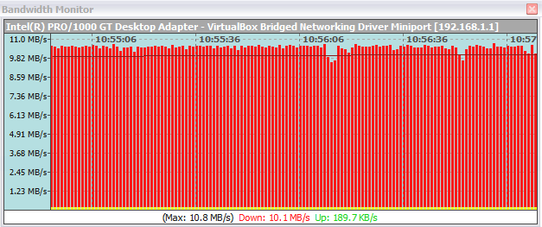
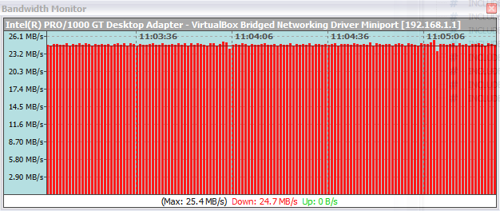
Gb Ethernet throughput (LWIP)
Benchmark: iperf application for measuring maximum TCP and UDP bandwidth performance
Using MTU 1500 (Maximum Transmission Unit)
Using open-source LWIP (Lightweight IP) stack:
sustained throughput (BCM FPGA ➔ PC)
11 MB/s via TCP 25 MB/s via UDP

Slide 12
Gb Ethernet throughput (Treck Inc.)
Commercial TCP/IP stack solution
Using the same FPGA hardware:
MTU 1500 ➔ 27 MB/s (213 Mbps) via TCP
MTU 9000 ➔ 115 MB/s (922 Mbps) via TCP
Price: 20.000 €
Source: Xilinx Application Note XAPP1043: Measuring Treck TCP/IP Performance
Using the XPS LocalLink TEMAC in an Embedded Processor System

Slide 13
BCM FPGA Data Flow

Slide 14
MGT Interface

Slide 15
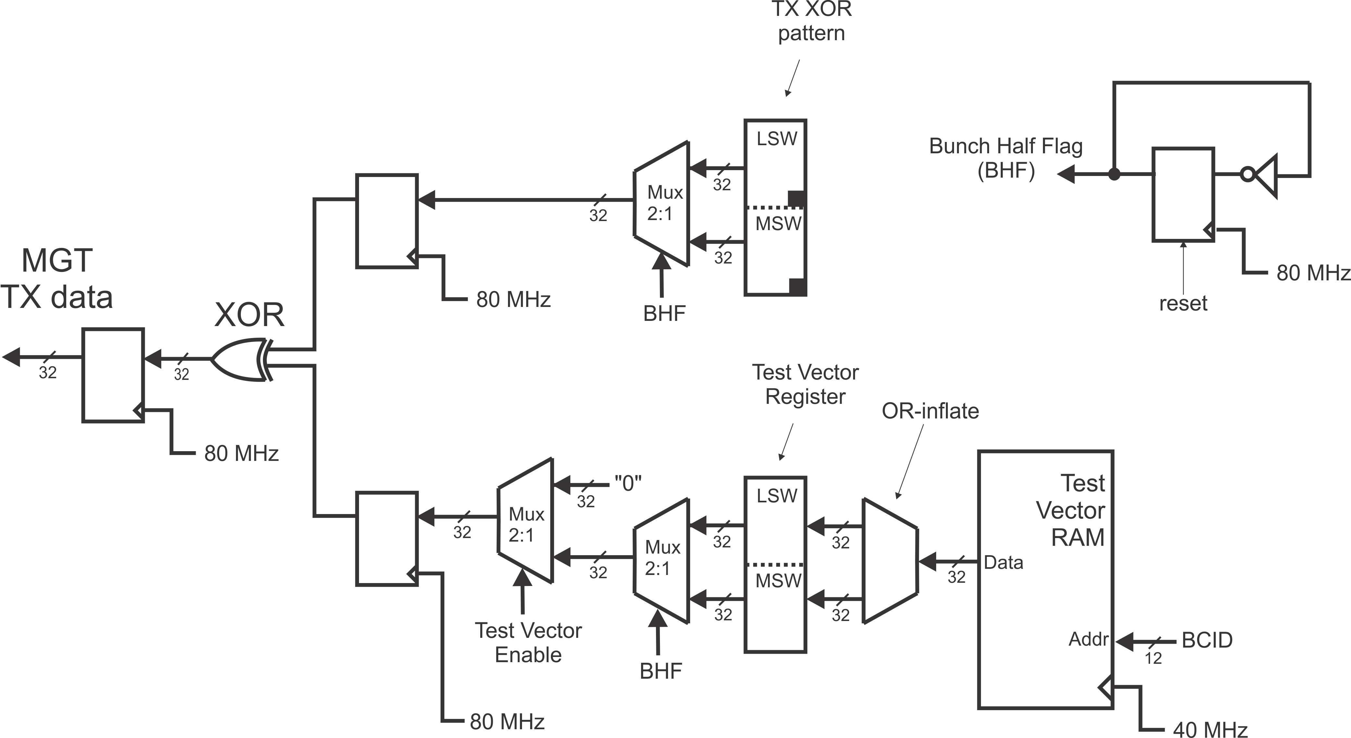
MGT Transmit Path

Slide 16
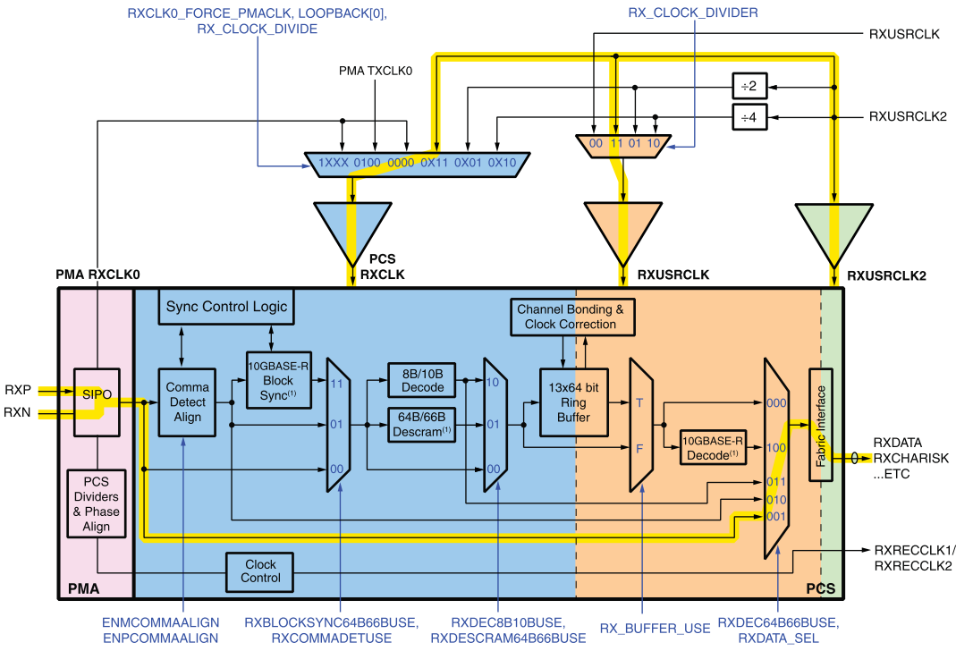
MGT RX Operating Mode

Slide 17
MGT Receive Path

Slide 18
BCM FPGA Data Flow

Slide 19
NPI Controller
Separate 256 MB of DDR2 RAM in 2x128 MB buffers
Simultaneous read/write ➔ MPMC
Maximum write speed on 1 MPMC port: 1600 MB/s
Actual data: 2560 MB/s ➔ reduce the amount of recorded data,reduce resolution from 390 to 780 ps

Slide 20
NPI Data Path

Slide 21
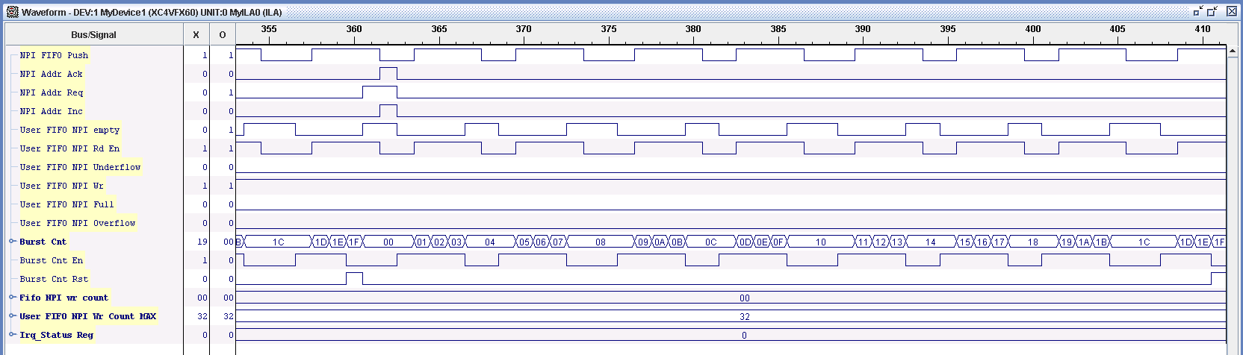
NPI Signaling (FIFO empty)

Slide 22
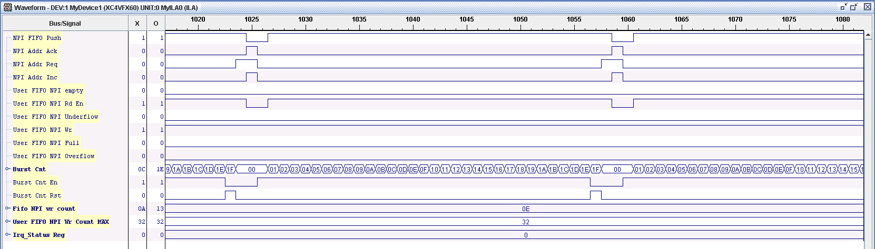
NPI Signaling (FIFO not empty)

Slide 23
BCM FPGA Data Flow

Slide 24
Data Processing
Based on pulse reconstruction on 64-bit data
Reconstruct max. 2 pulses in one BC sample
Count number of pulses (hits)
Each pulse encoded in:
6-bit rising edge position
5-bit pulse width
Calculate collisions, background events and lumi conditions by applying time-windows
Provide 176-bit data stream to TDAQ
(8 ch × 2 pulses × (6-bit + 5-bit) )

Slide 25
Pulse Reconstruction 1/2
Calculate rising (RE) and falling(FE) edges in a sample
Search for first bit set (“1”) from forward (FWD) and reverse (REV) direction on RE and FE ➔
Pulse 1: position = FWD_RE
width = FWD_FE – FWD_RE
Pulse 2: position = REV_RE
width = REV_FE – REV_RE
Examples follow

Slide 26
Pulse Reconstruction 2/2

Slide 27
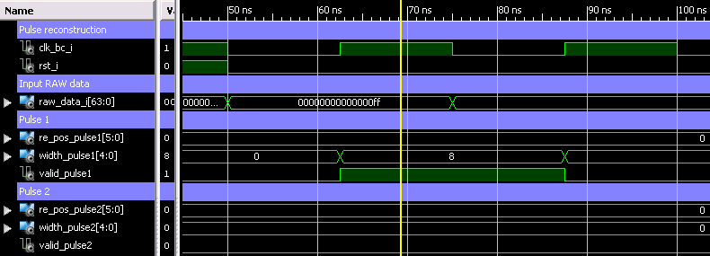
Pulse Reconstruction Simulation

Slide 28
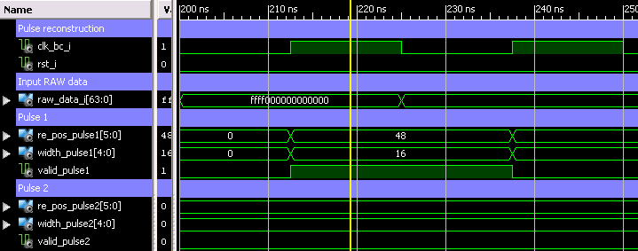
Pulse Reconstruction Simulation

Slide 29
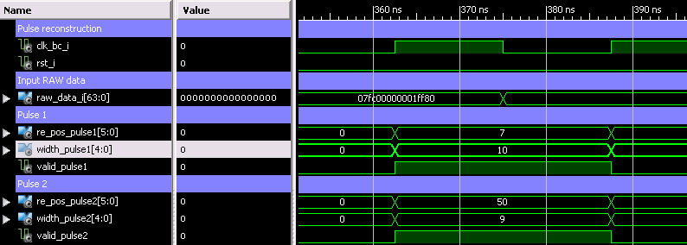
Pulse Reconstruction Simulation

Slide 30
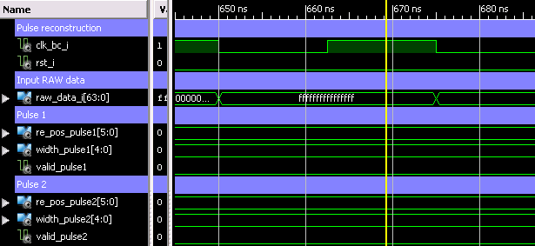
Pulse Reconstruction Simulation

Slide 31
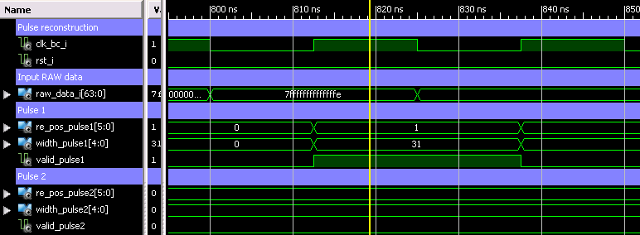
Pulse Reconstruction Simulation

Slide 32
BCM FPGA Data Flow

Slide 33
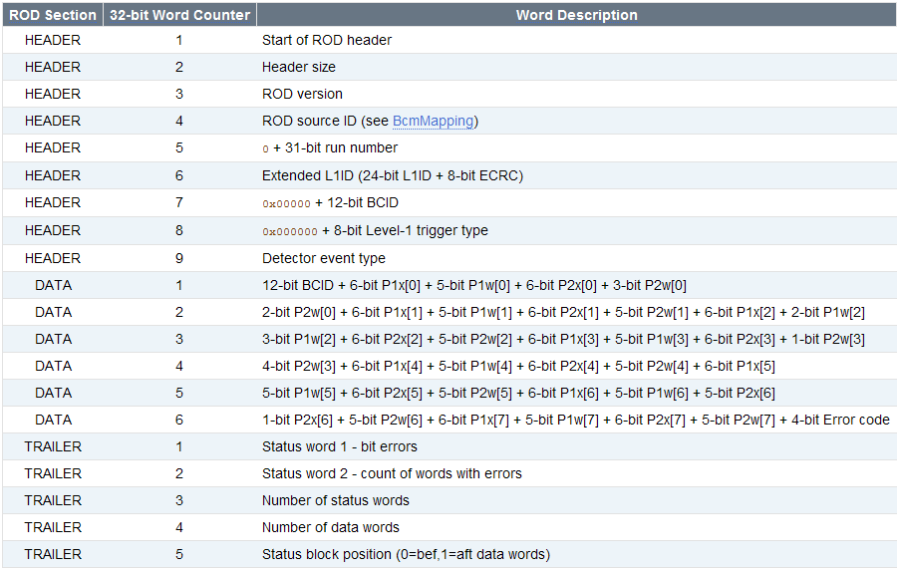
BCM SLINK/ROD Data Format
P{1,2}{x,w}[n] refers to pulse 1/2 position/width for channel n.
12-bit BCID
+ 176-bit of data
+ 4-bit error code
per BC
https://twiki.cern.ch/twiki/bin/view/Atlas/BcmRod

Slide 34
SLINK ROD Controller

Slide 35
BCM FPGA Data Flow

Slide 36
Abort Logic
Search for background pattern
The same pulse reconstruction logic, but
32-bit data @ 80 MHz
cond3_sideX = at least 3 out of 4 valid
pulses at side X
Basic Abort:
If (cond3_sideA AND cond3_sideC_dly ) OR
(cond3_sideC AND cond3_sideA_dly )))
BA = ACTIVE
Else
BA = NOT ACTIVE

Slide 37
Additional Abort Algorithms
Basic Beam Abort (desribed on previous slide)
X-of-Y : takes into account last Y Basic Abort results and demands that at least X of them will fire before it issues an abort condition.
Forgetting Factor (Leaky bucket) Extension of Basic Abort algorithm. It provides a more dynamic behaviour by "forgetting« past results as they get older.

Slide 38
BCM FPGA Data Flow

Slide 39
LTP Controller
L1ID bookkeeping with ECR load support
BCID bookkeeping
Post-Mortem delay
Regenerate 40 MHz (BC) and 80 MHz from 320 MHz (or use 40 MHz available on the new Personality Modules)
LTP interface, proper latching of LTP signals (L1A, ECR, Orbit, Trigger Type)

Slide 40
40/80 MHz BC Clock Scheme

Slide 41
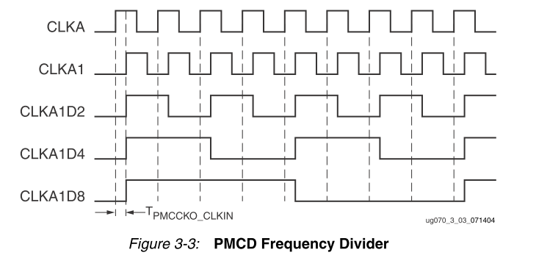
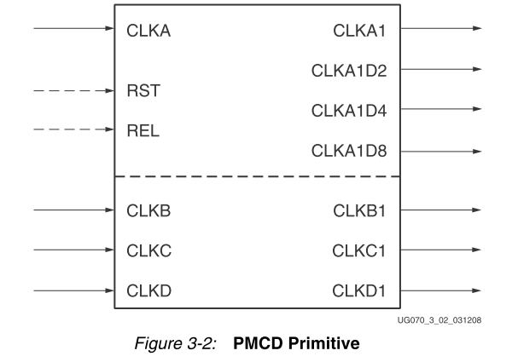
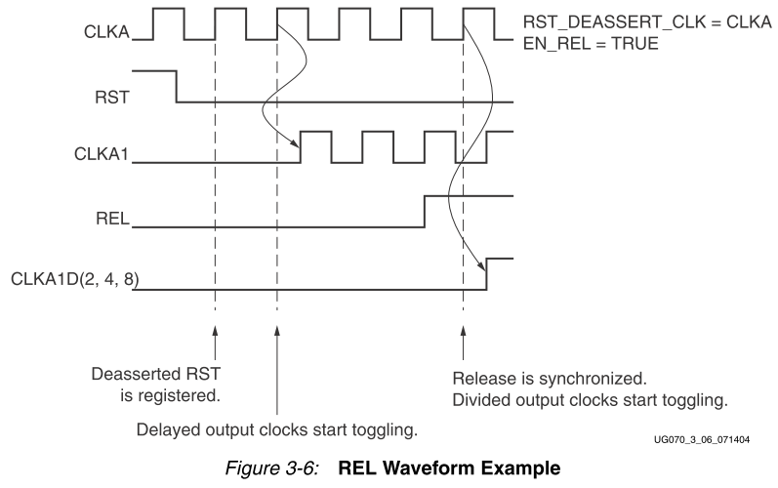
Xilinx Phase-Matched Clock Divider

Slide 42
Orbit Signal Aligning

Slide 43
Device Utilization Summary
Logic Utilization | Used | Available | Utilization
Number of Slice Flip Flops | 20,797 | 50,560 | 41%
Number of 4 input LUTs | 28,465 | 50,560 | 56%
Number of occupied Slices | 21,611 | 25,280 | 85%
Number of bonded IPADs | 24 | 80 | 30%
Number of bonded OPADs | 18 | 32 | 56%
Number of bonded IOBs | 222 | 576 | 38%
Number of BUFG/BUFGCTRLs | 14 | 32 | 43%
Number of FIFO16/RAMB16s | 137 | 232 | 59%
Number of DCM_ADVs | 4 | 12 | 33%
Number of PMCDs | 1 | 8 | 12%
Number of PPC405_ADVs | 2 | 2 | 100%
Number of EMACs | 1 | 2 | 50%
Number of BUFRs | 1 | 32 | 3%
Number of JTAGPPCs | 1 | 1 | 100%
Number of IDELAYCTRLs | 10 | 20 | 50%
Number of GT11s | 10 | 16 | 62%
Number of GT11CLKs | 2 | 8 | 25%
Number of RPM macros | 72
Average Fanout of Non-Clock Nets | 3.23

Slide 44
Module Resource Utilization Breakdown
XPS Synthesis Summary Report * | Flip Flops Used | LUTs Used
proc_system | 21715 | 30401
ddr_sdram_wrapper | 5620 | 6400
ddr2_sdram_wrapper | 3857 | 3104
trimode_mac_mii_wrapper | 3712 | 3206
mgt_ctrl_0_wrapper | 3405 | 3073
abort_ctrl_0_wrapper | 1392 | 2626
data_proc_ctrl_0_wrapper | 899 | 5976
npi_ctrl_0_wrapper | 711 | 1177
slink_rod_ctrl_0_wrapper | 700 | 1073
ltp_ctrl_0_wrapper | 655 | 603
xps_central_dma_0_wrapper | 566 | 1005
ppc405_0_wrapper | 381 | 409
xps_intc_0_wrapper | 283 | 274
xps_bram_if_cntlr_1_wrapper | 229 | 184
plb_wrapper | 180 | 1034
xps_timebase_wdt_0_wrapper | 169 | 224
rs232_uart_1_wrapper | 148 | 143
leds_8bit_wrapper | 128 | 97
proc_sys_reset_0_wrapper | 69 | 54
* XPS Synthesis Summary produces approximate report, but it is still relevant to determine relative size of the modules.

Slide 45
Resource Optimization Strategies
Optimization will be applied if necessary
Trade Ethernet speed for FPGA resources
Processor System Architecture Redesign
More than 20% of resources can be saved by:
- reducing DDR 64 MB MPMC to one port
- excluding DMA controller
- excluding Ethernet Checksum HW offloading
Matter of 10 minutes

Slide 46
Resource optimization: From this…

Slide 47
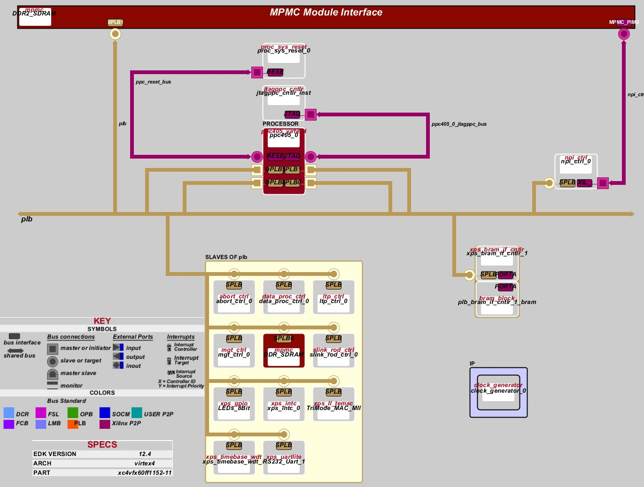
Resource optimization: …to this.

Slide 48
Current Design Status
Completed
- MGT DAQ
- MGT Test Vectors
- Gb Ethernet
- PPC development application
To-do
- Finalize SLINK/ROD controller
- LTP interface and BC clock
- Finalize PPC application
- Slight modification of pulse reconstruction

Slide 49
Thank you!

