Slide 1
Updated Results and Images from the First Complete Stavelet
Peter, Ashley, Bruce, Matt
13/10/2010

Slide 2
The Stavelet

Slide 3
Stavelet Detail: EoS

Slide 4
Stavelet Detail: PPB Side

Slide 5
Stavelet Detail: BCC Side

Slide 6
Summary
Today’s HSIO firmware update means we can now run all hybrids at the same time
The system was stable through a complete trim study
Hybrids SP at 5A, 150V detector bias
Gain and noise results, after trimming are shown overleaf
Note that, within a hybrid, the channel mask applied to each column is an OR of the bad channels of both columns.
This is an analysis bug, and will be corrected tomorrow...

Slide 7
Stavelet GAIN
After Trimming, reading all hybrids simultaneously.
Anomalous Cal Line

Slide 8
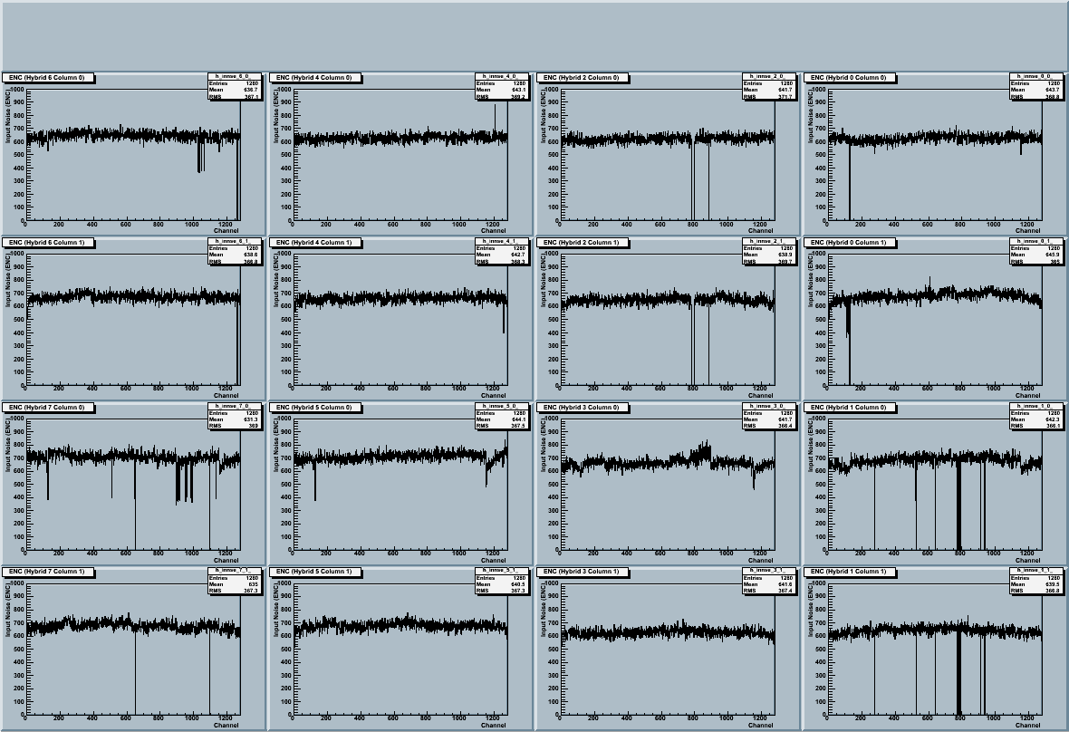
Stavelet ENC
After Trimming, reading all hybrids simultaneously.

